Slide 1
Discussion group 1: Reduction techniques—concepts and application
Case collection for small group discussion
Please note: There may not be enough time to discuss all cases in this document. Depending on the duration of the discussion session, the Course Chair needs to select an adequate number of cases. As a rule of thumb, allow for 15-20 minutes discussion time for every case.
Course chairs can also prepare their own cases.
AO Trauma Advanced Principles Course

Slide 2
Table of contents
Case 1: Reduction—distal humeral fracture
Case 2: Reduction—subtrochanteric femoral fracture
Case 3: Reduction—femoral shaft fracture
Case 4: Reduction—distal femoral fracture (articular simple, methaphyseal multifragmentary)
Case 5: Reduction—closed distal tibial fracture
Case 6: Reduction —extraarticular closed distal tibial and fibular fractures

Slide 3
Reduction—distal humeral fracture
Case for small group discussion
AO Trauma Advanced Principles Course

Slide 4
51-year-old woman
Fall from the stairs on a panic attack
Painful right elbow, dominant hand
Isolated closed injury, neurovascular status intact

Slide 5
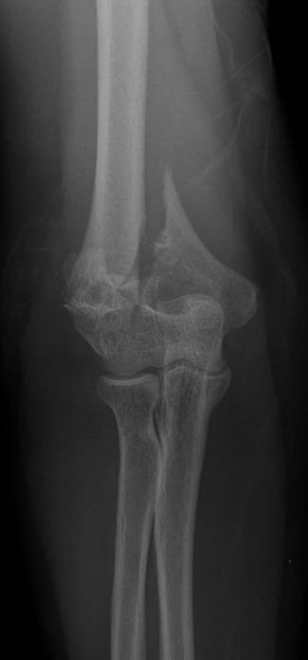
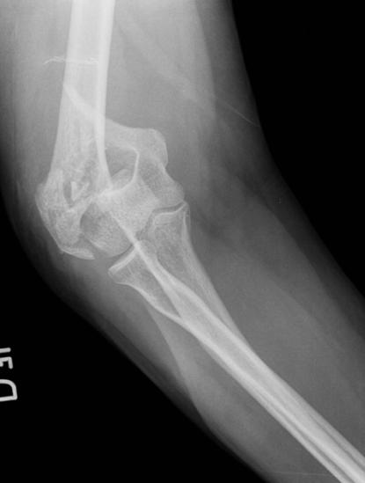
Day 0
Notes:
2013.01.03
Discussion points:
Diagnosis and fracture classification
Discuss surgical approach and reduction techniques as well as sequence of reduction
Discuss fixation options

Slide 6
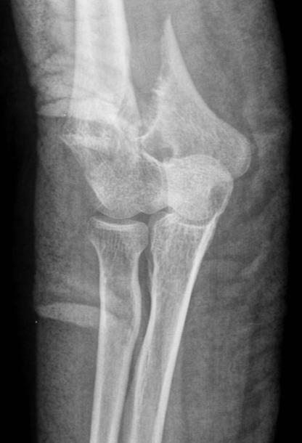
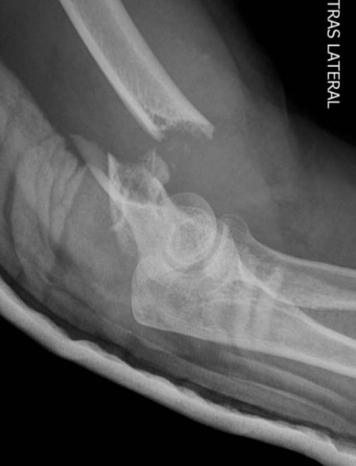
Day 0
Notes:
2013.01.03

Slide 7
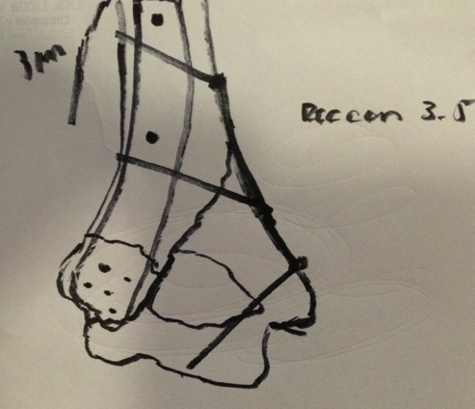
Preoperative plan
Lateral decubitus
Posterior approach, para tricipital.
Be aware of ulnar nerve on medial side and radial nerve proximally on lateral side
Reduce medial column first
Provisional fixation with K-wires 1.6 mm
Contour a six-hole 3.5 mm reconstruction plate
Fix the plate with a proximal screw, antiglide plate
Lag screw through the fourth hole
3.5 mm screw on distal hole of the plate
Reduce lateral side with K-wires 1.6 mm
Lateral decubitus
Fix lateral side with an extraarticular distal humerus LCP four holes proximal
Fix the plate proximally with two 3.5 mm regular screws
Fix distal part with four locking head screws
Irrigation and debridement, close SC and skin
Notes:
2013.01.03

Slide 8
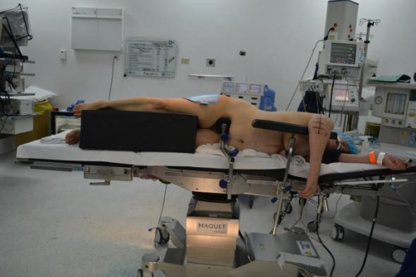
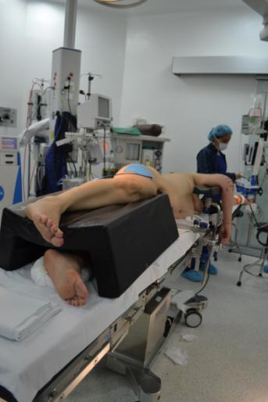
Day 0
Notes:
2013.01.03
Discuss patient positioning.

Slide 9
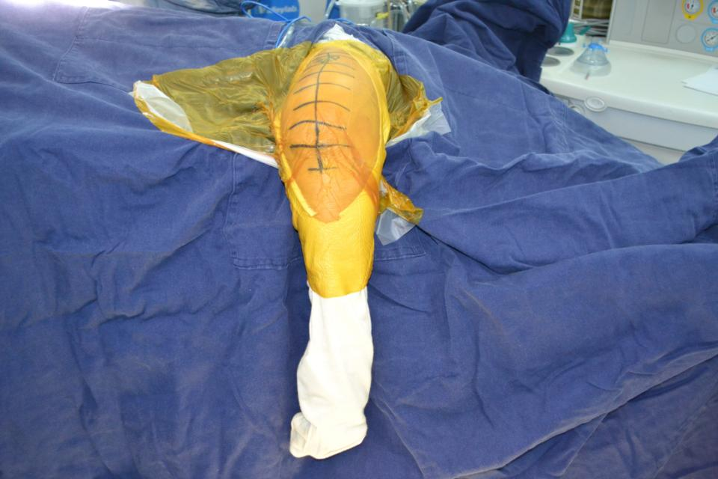
Notes:
2013.01.03

Slide 10
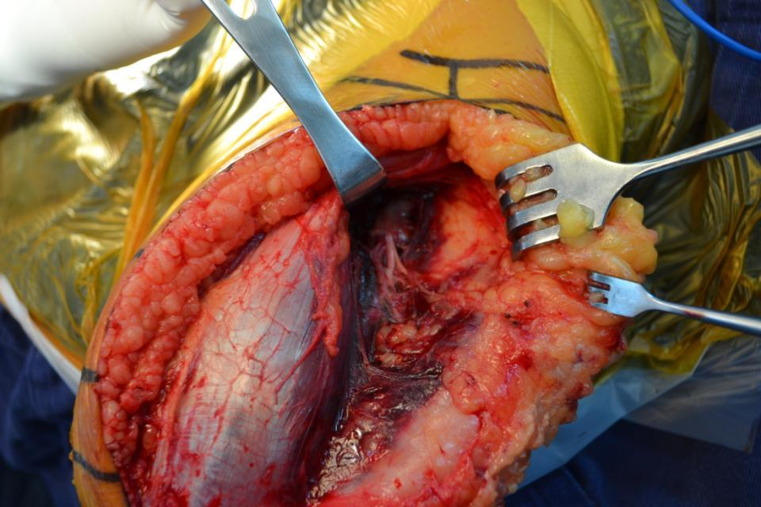
Lower lateral brachial cutaneous nerve
Notes:
2013.01.03
Lateral paratriciptal approach. Identify the lower lateral brachial cutaneous nerve and follow it to find the radial nerve.

Slide 11
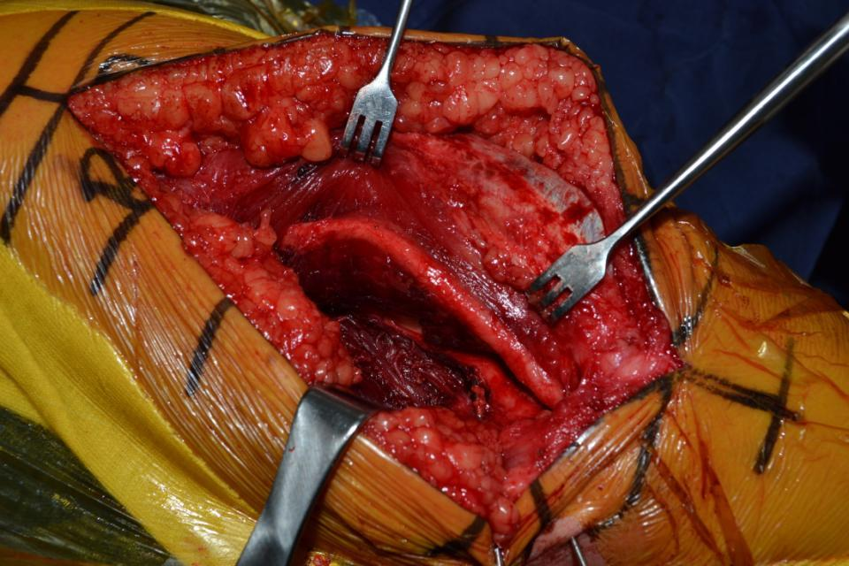
Ulnar nerve
Notes:
2013.01.03
Medial side and identification of ulnar nerve.

Slide 12
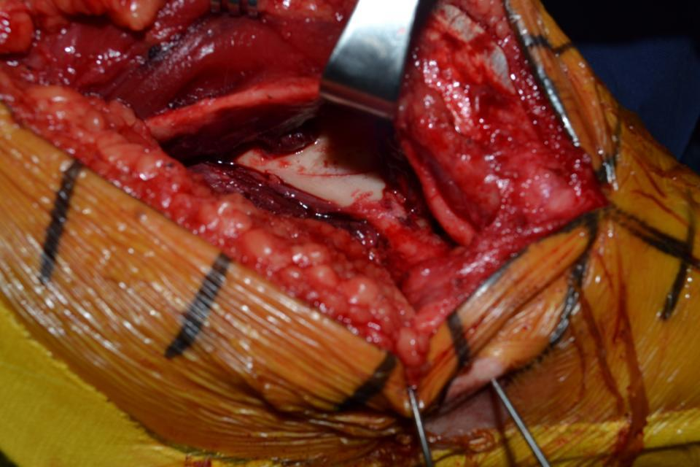
Notes:
2013.01.03
Reduction of medial side and provisional fixation with k wires. Start on medial side first because this is a simple fracture and extra articular. Once reduced fixation is with a medial plate (reconstruction plate).

Slide 13
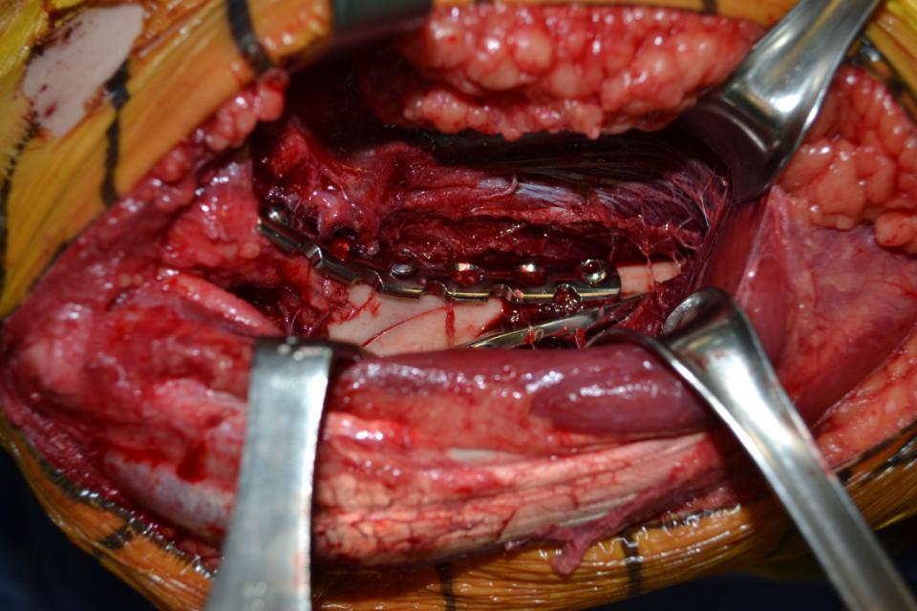
Notes:
2013.01.03
Medial side after fixation.

Slide 14
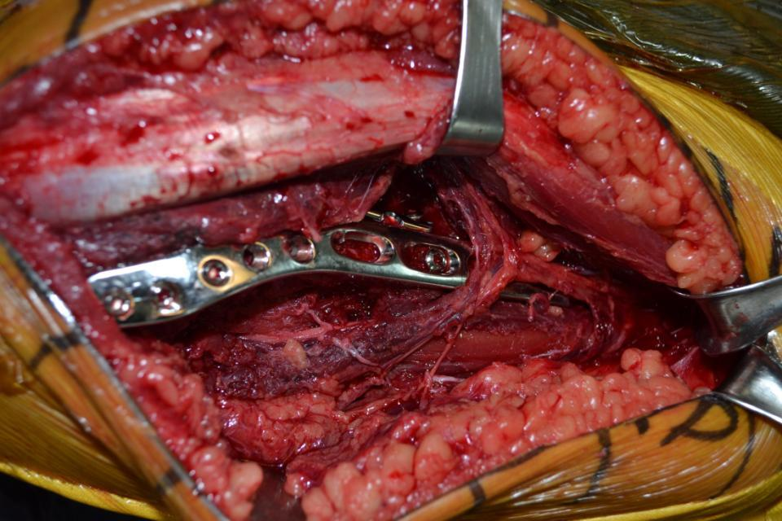
Radial nerve
Notes:
Once the medial side is reduced, reduce and fix the lateral side using an extra articular distal humerus plate with distal locking head screws.

Slide 15
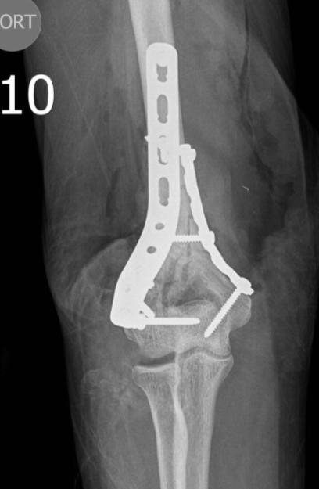
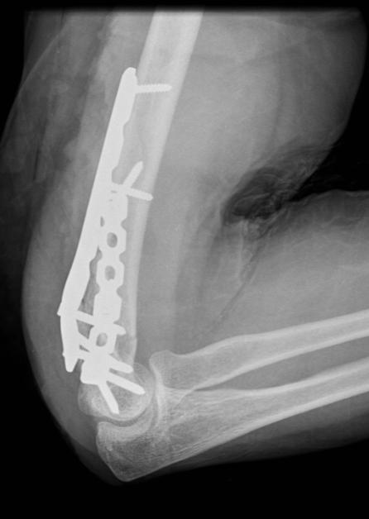
Notes:
Final result

Slide 16
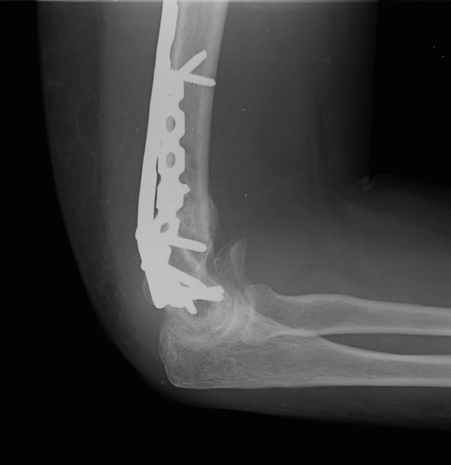
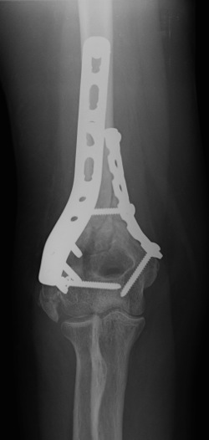
4 months
Notes:
2013.05.08: Follow-up x-rays at 4 months.

Slide 17
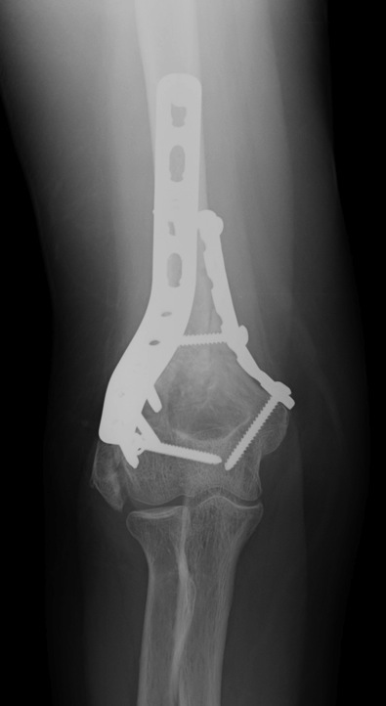
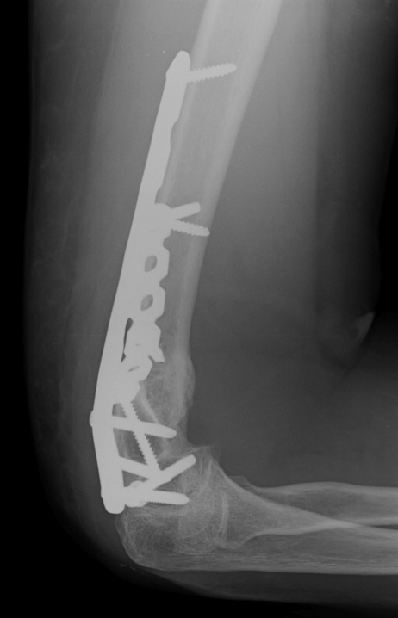
5 months
Notes:
2013.06.12: Follow-up x-rays at 5 months.

Slide 18
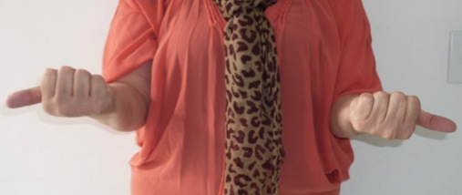
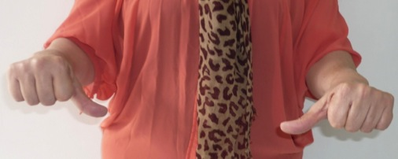
5 months
Notes:
2013.06.12: Clinical result at 5-month follow-up.
Ask participants what they have learned out of this case.

Slide 19
Reduction—subtrochanteric femoral fracture
Case for small group discussion
AO Trauma Advanced Principles Course

Slide 20
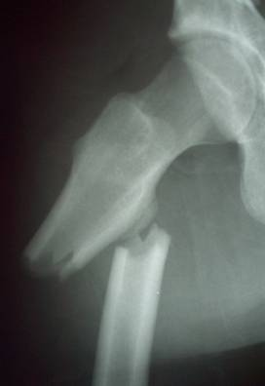
22-year-old man, motorbike accident
Isolated subtrochanteric fracture
Closed injury
Neurovascular status ok
Notes:
Discussion points:
Will the fracture reduce easily? Deforming forces?
Fracture table or regular table?
Close vs open reduction?

Slide 21
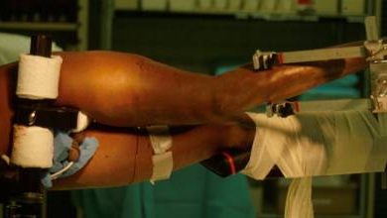
If using a fracture table: supine vs lateral ?
Advantages and disadvantages of each setup ? Potential problems ?
Notes:
Discussion points:
If using a fracture table: supine vs lateral?
Discuss advantages and disadvantages of each setup, potential problems (neurological injuries, malrotation, deformity)
How do you assess your reduction: rotation and angulations
Tips and tricks of setup

Slide 22
If using a regular table: positioning and setup ?
Advantages and disadvantages of using a regular table ? Potential problems ?
Notes:
Discussion points:
If using a regular table: setup?
Discuss advantages and disadvantages using a regular table, potential problems (malrotation, deformity)

Slide 23
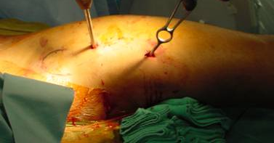
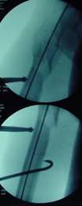
How to assess reduction (rotation and angulation) ?
How to make sure the reduction instruments do not interfere with the fixation ?
Is the choice of the reduction method implant-dependent ?
Notes:
Discussion points:
How do you assess the reduction: rotation and angulation?
How do you make sure the reduction instruments (distractor, external fixator, etc) do not interfere with the fixation techniques?
Is the choice of the reduction method implant-dependent?
Tips and tricks of reduction techniques

Slide 24
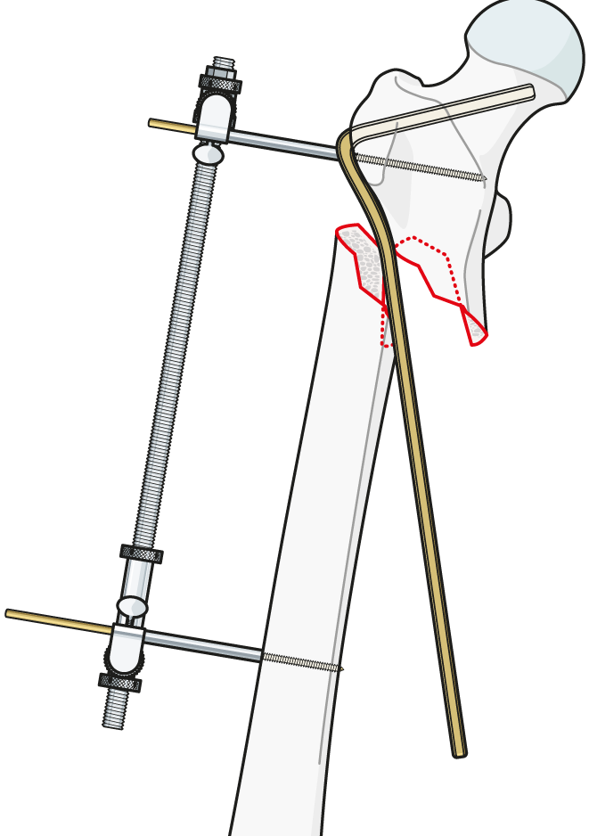
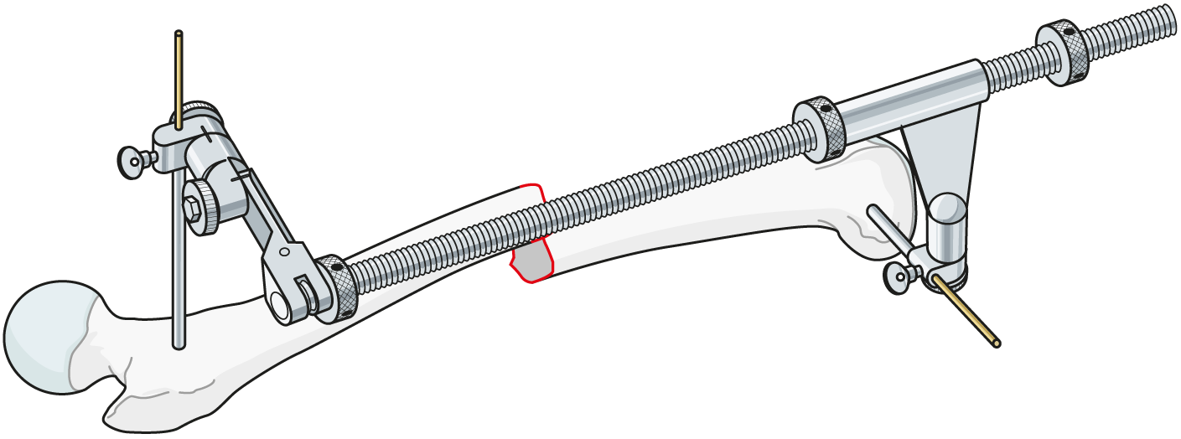
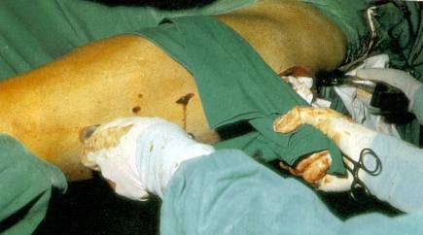
Notes:
Discussion points:
Tips and tricks of reduction techniques

Slide 25
Summary
Reduction can be difficult on a fracture table with the patient in supine position.
Different implants can be used to fix this fracture, and their choice affects the reduction techniques.
Use of the implant as a reduction aid is possible (nail or plate).
Use of other adjuncts can be beneficial in these injuries: external fixation, ball spike, percutaneous clamps, bone hooks.
Notes:
Moderator should ask participants to summarize what else they have learned from this case.

Slide 26
Reduction—femoral shaft fracture
Case for small group discussion:
Reduction techniques
AO Trauma Advanced Principles Course
Notes:
Rodrigo Pesantez, CO

Slide 27
61-year-old woman
Fall from standing height
Immediate pain on her left thigh
Previous medical history of osteoporosis treated with Fosamax® for the last 7 years
No pain on her hip and was independent on activities of daily living
Isolated closed injury, neurovascular status intact

Slide 28
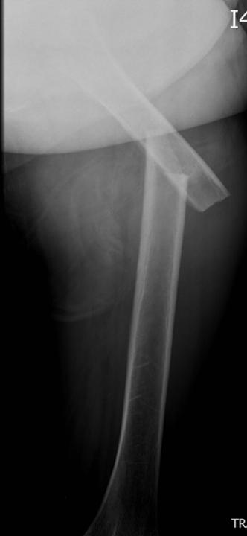
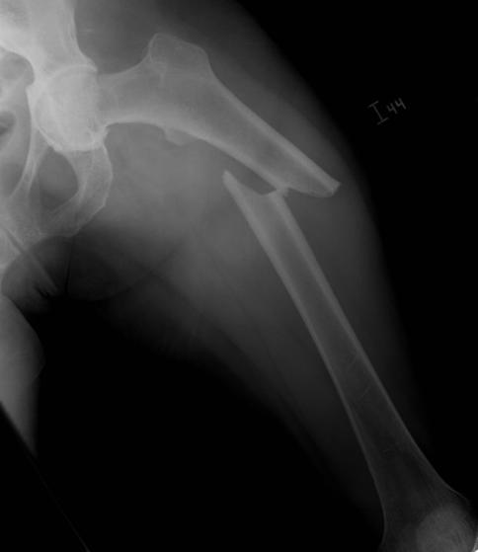
Day 0
Notes:
2013.02.14
Discussion points:
Describe injury and fracture pattern
Previous history of osteoporosis treatment with Fosamax, discuss atypical femoral shaft fractures
Discuss influence of hip arthrosis and decision making in treatment and patient positioning
Discuss treatment options: nailing (antegrade or retrograde) and plating

Slide 29
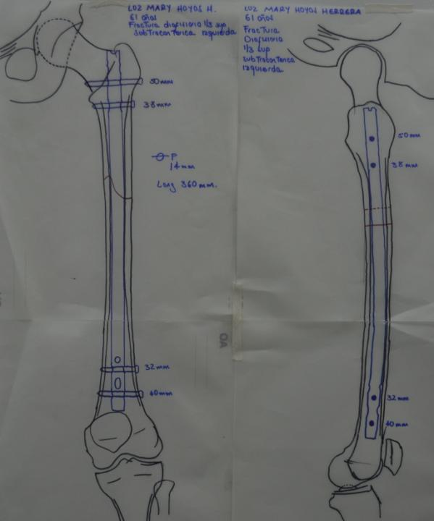
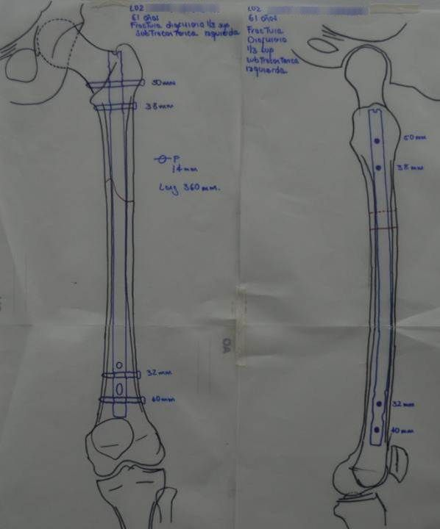
Day 0
Notes:
2013.02.14
Preoperative planning with a reamed nail, piriformis entry point

Slide 30
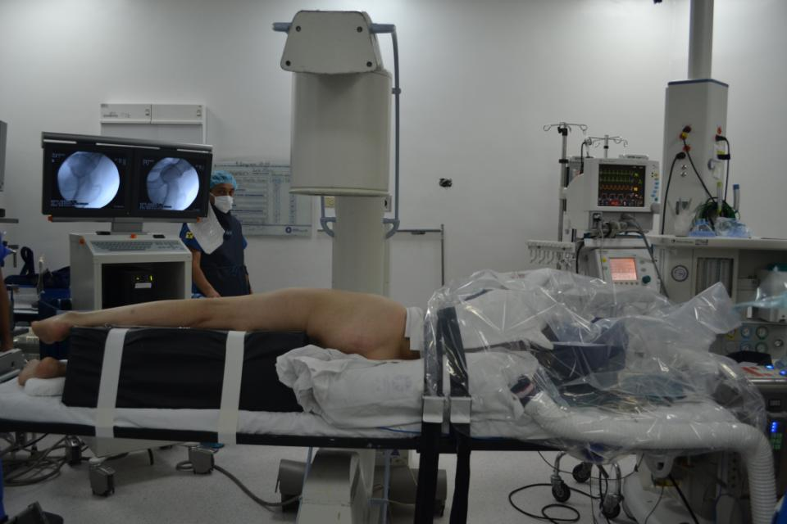
Day 1
Notes:
2013.02.15
Discuss different positions for IM nailing: supine on a regular radiolucent table, supine on a fracture table, lateral position on a regular or a fracture table.

Slide 31
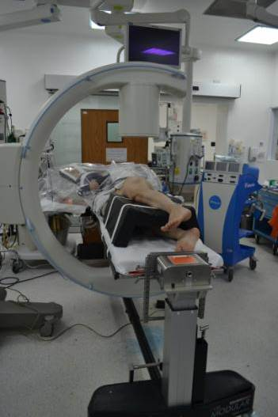
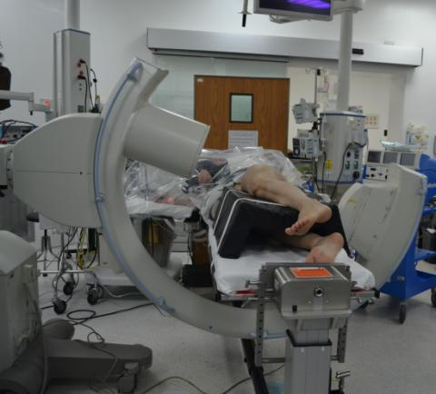
Day 1
Notes:
2013.02.15
Discuss patient positioning and how to position the C-arm in order to get adequate AP and lateral views of the whole femur from hip to knee.

Slide 32
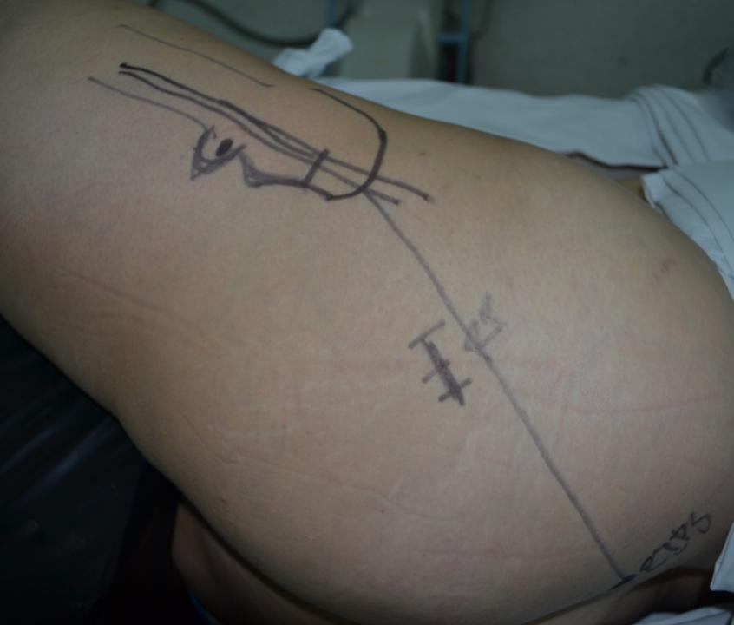
Day 1
Notes:
2013.02.15
Entry point for percutaneous nailing and anatomical landmarks (greater trochanter and posterior superior iliac spine (PSIS)).

Slide 33
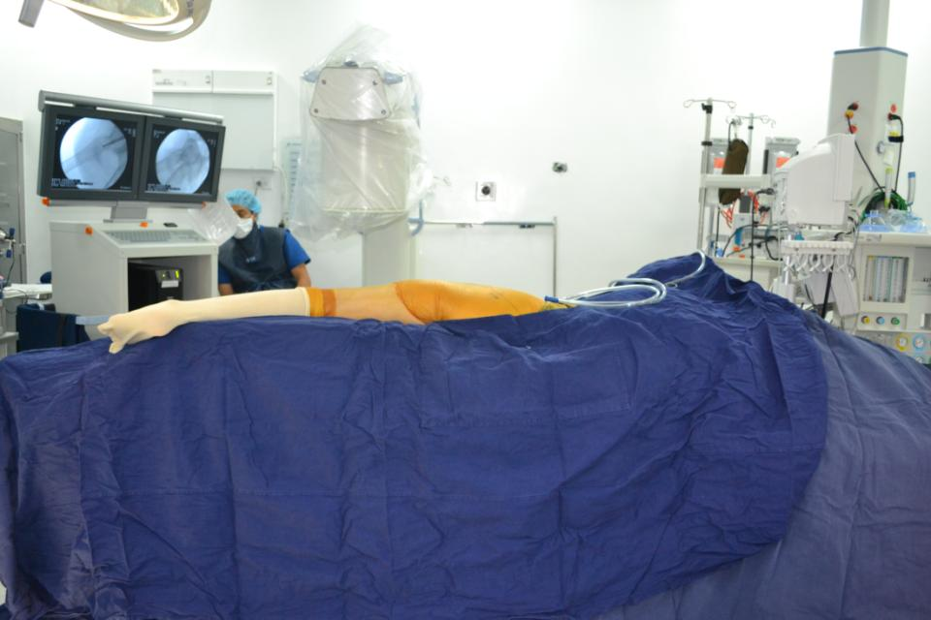
Day 1
Notes:
2013.02.15
Final prepping and draping and C-arm position as well as screens position for surgery.

Slide 34
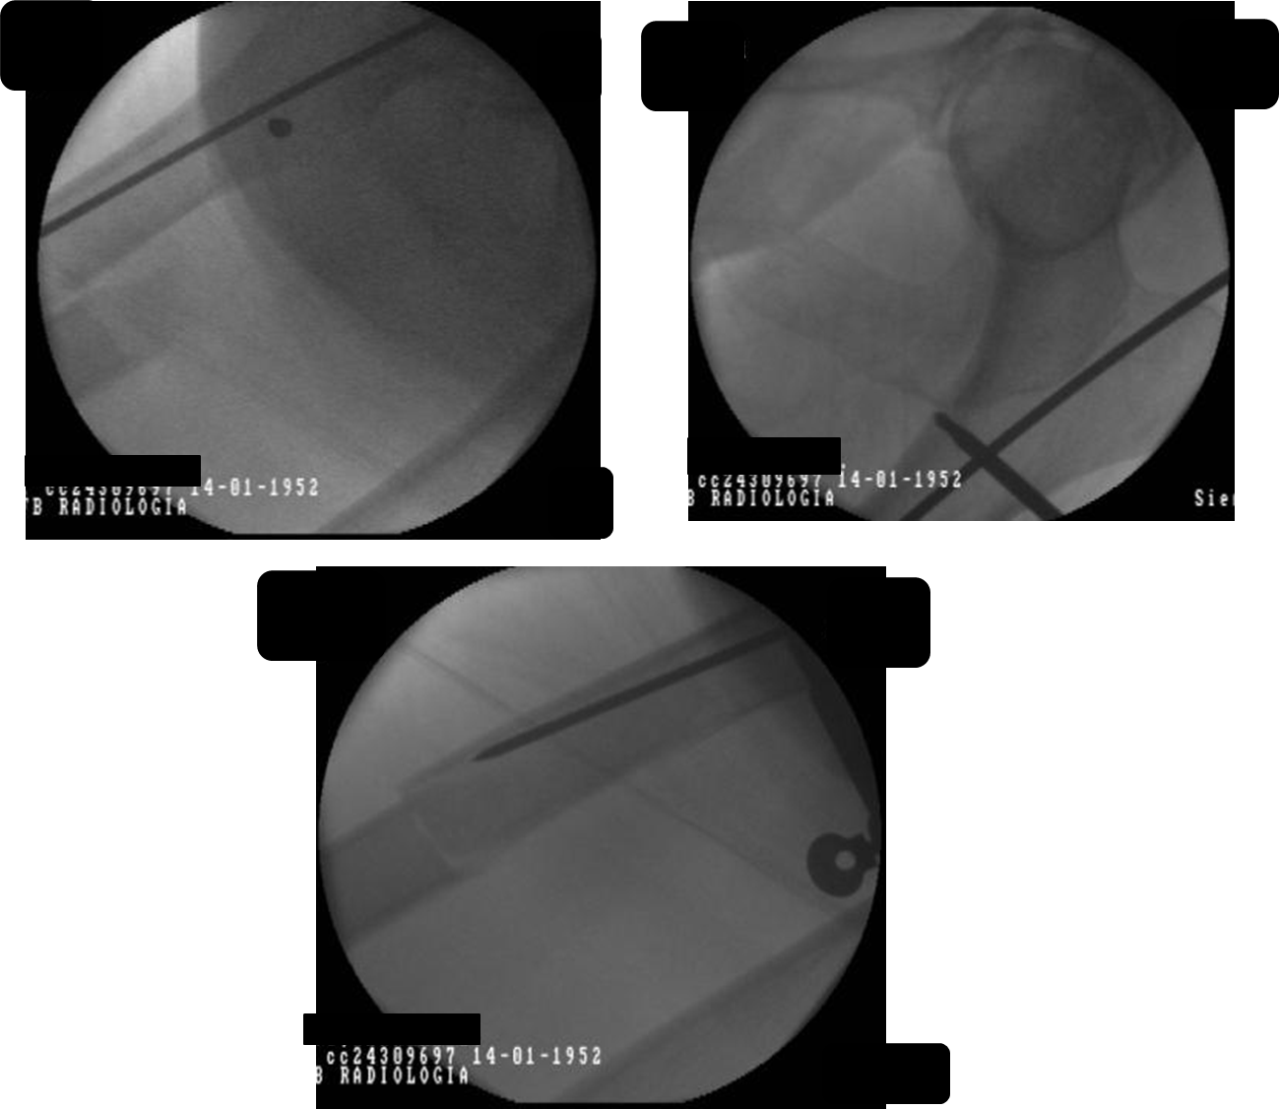
Day 1
Notes:
2013.02.15
Discuss reduction techniques: in this particular case we use the femoral distractor (discuss where to put the Schanz screws and the distractor)?
Discuss entry point and Schanz screw position in order not to interfere with guide and reaming and nailing

Slide 35
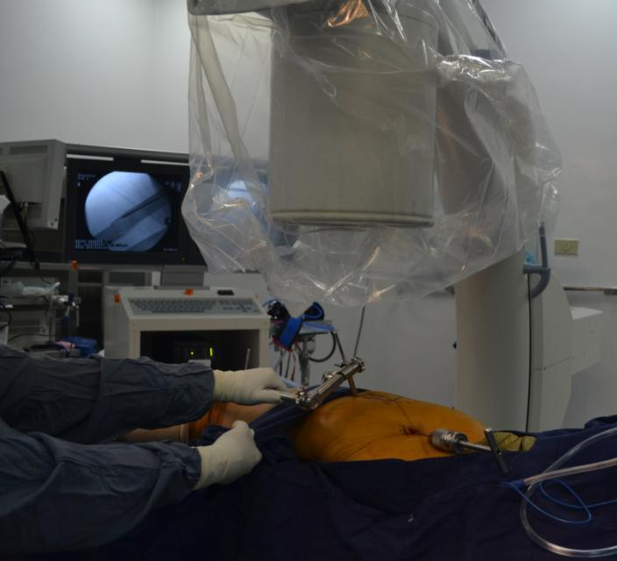
Day 1
Notes:
2013.02.15
Image showing distractor position and nail entry point.

Slide 36
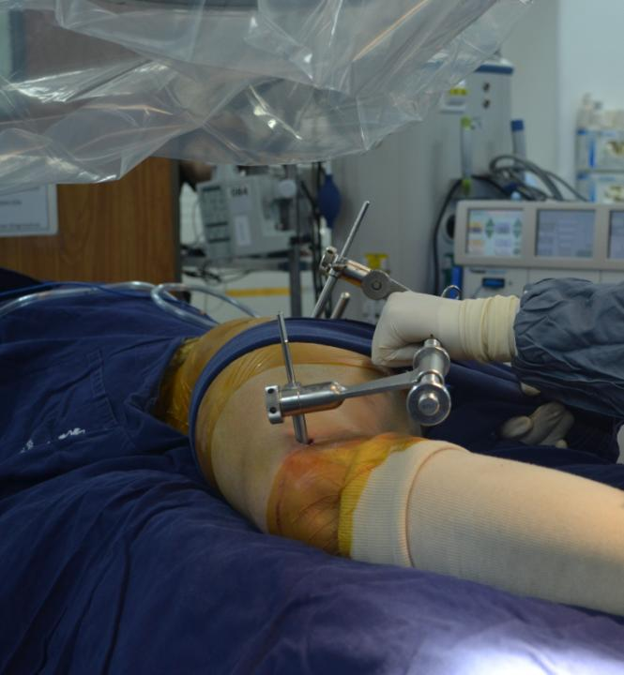
Day 1
Notes:
2013.02.15
Image showing distractor position. Discuss use of a towel to reduce anterior displacement of proximal fragment

Slide 37
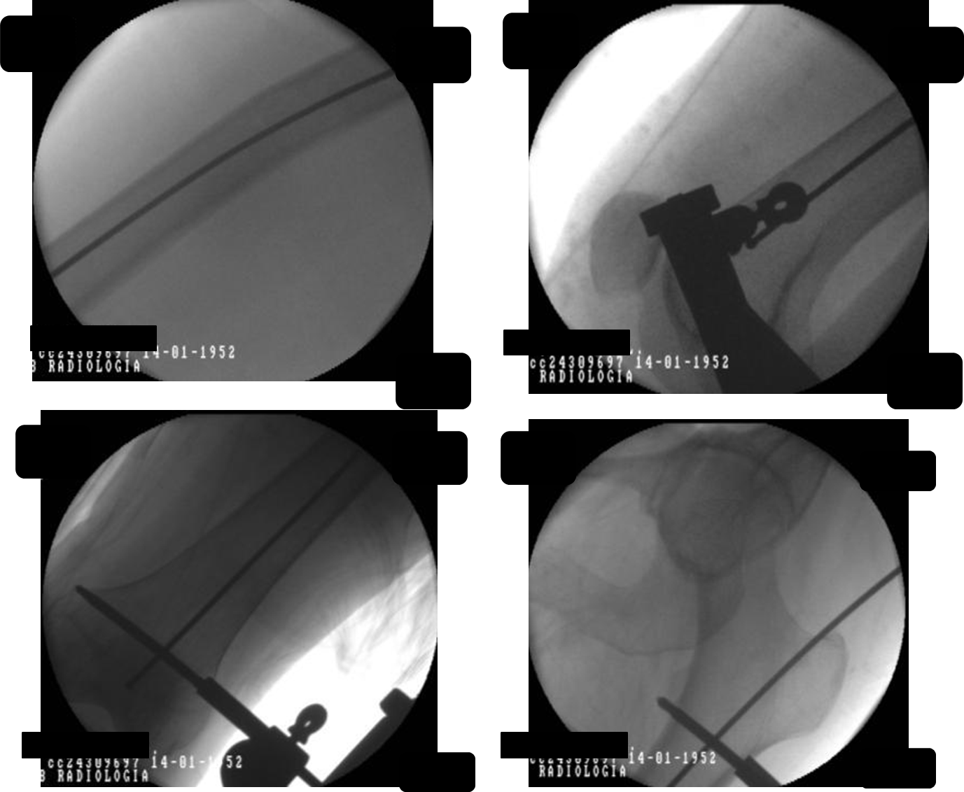
Day 1
Notes:
2013.02.15
Discuss sequence of reduction and reaming.
Discuss guide position in center of distal femur in AP and lateral as well as proximal position.

Slide 38
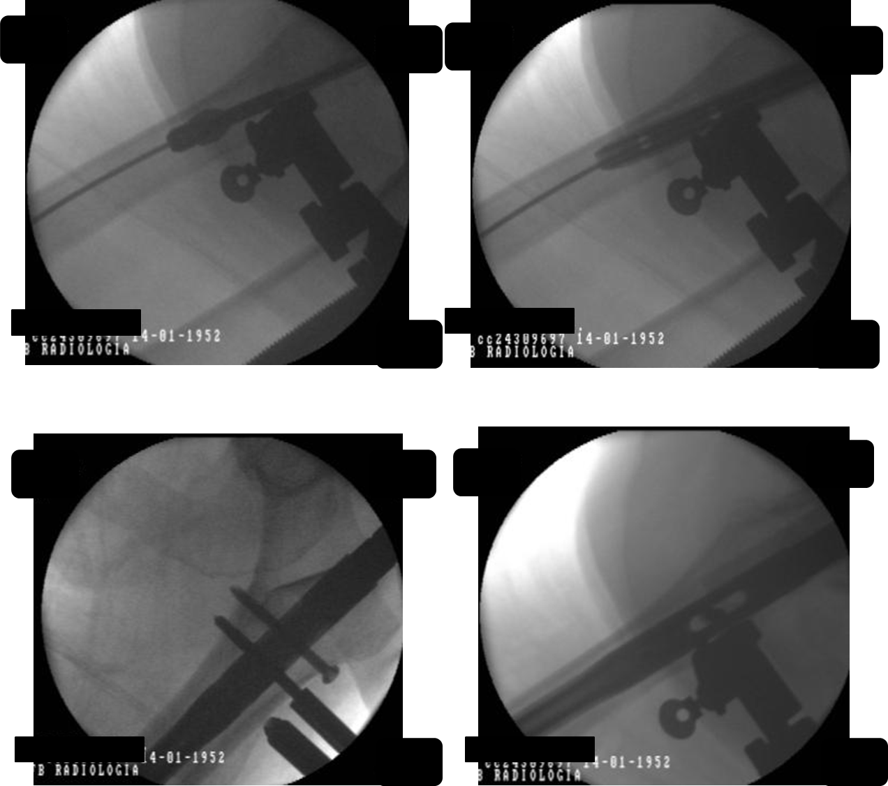
Day 1
Notes:
2013.02.15
Reaming and nailing, it shows that if you plan the correct position of Schanz screws carefully they can stay there during the whole procedure

Slide 39
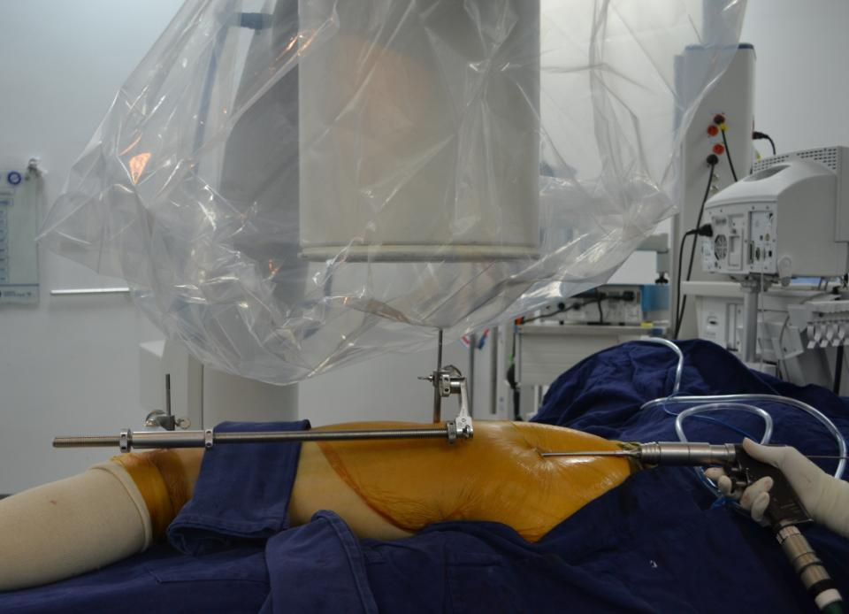
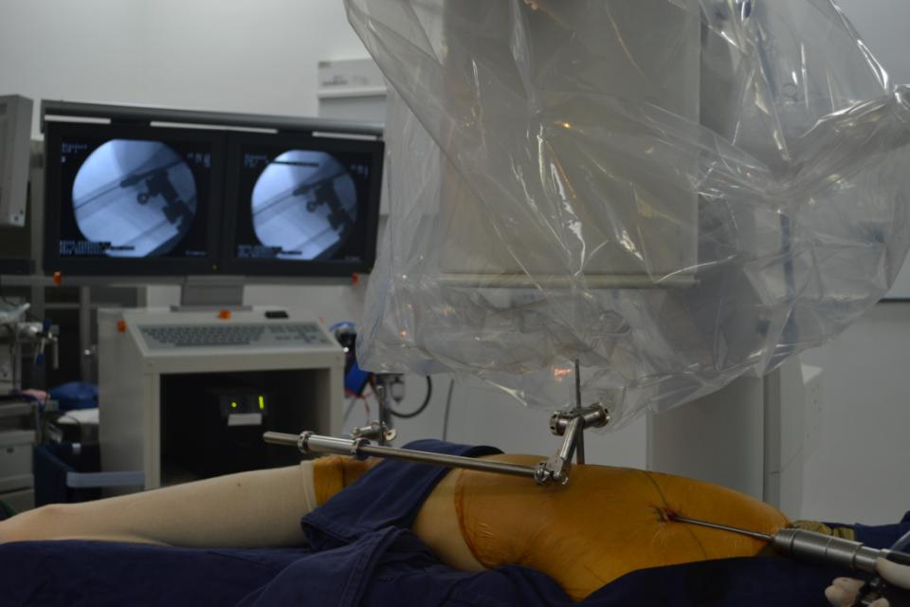
Day 1
Notes:
2013.02.15
Reaming with the distractor in place.

Slide 40
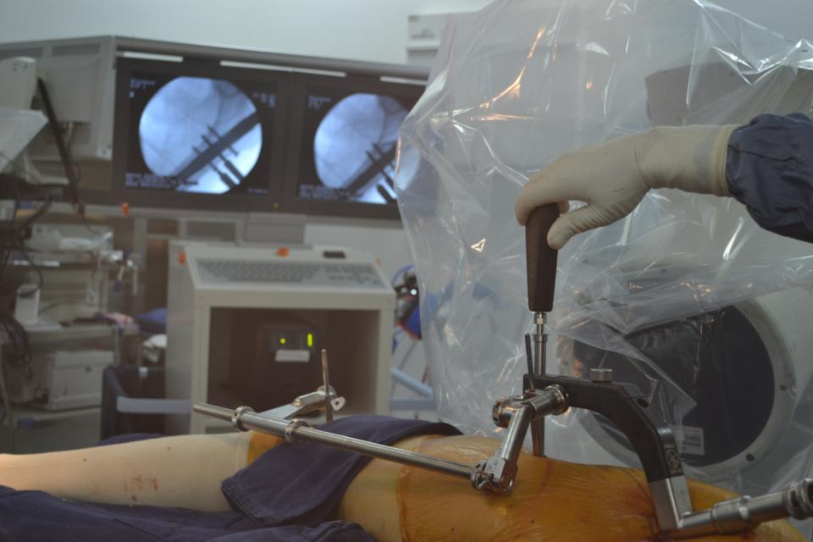
Day 1
Notes:
2013.02.15
Locking the nail proximally with the distractor in place.

Slide 41
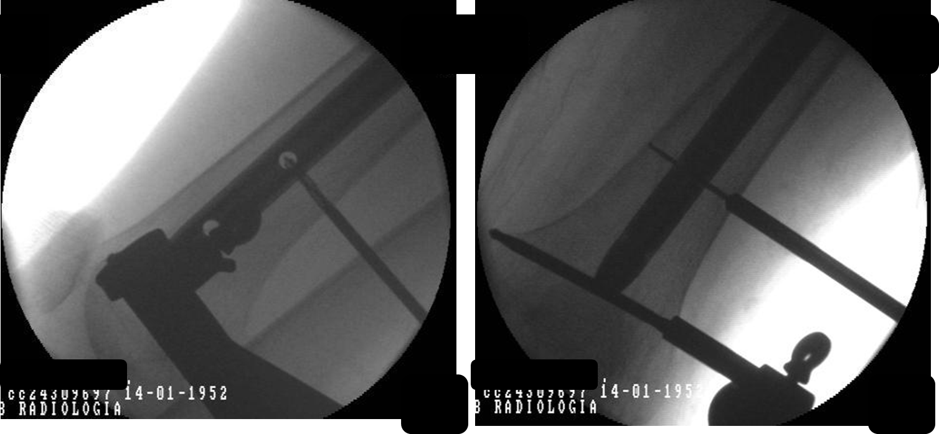
Day 1
Notes:
2013.02.15
Distal locking after use of distractor to compress the fracture.

Slide 42
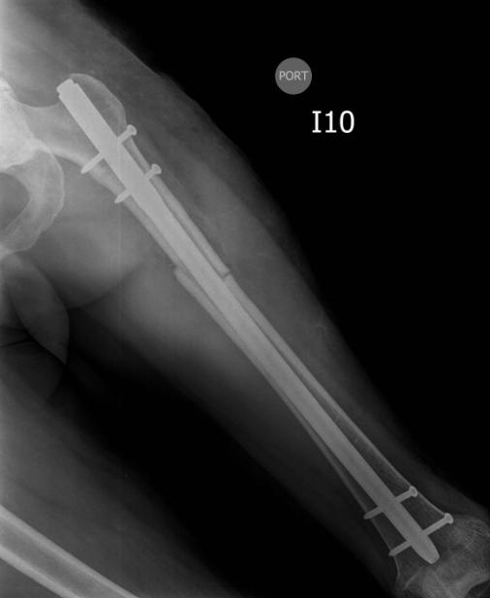
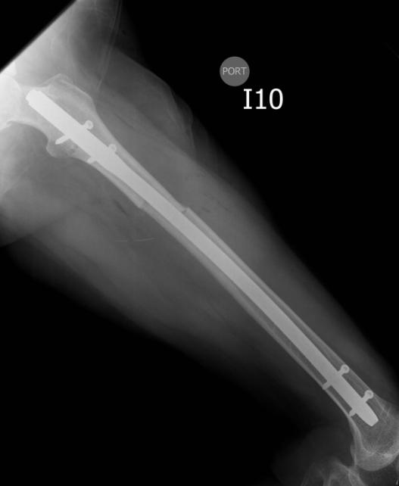
Postoperative X-rays
Day 1
Notes:
2013.02.15
Postoperative x-rays.

Slide 43
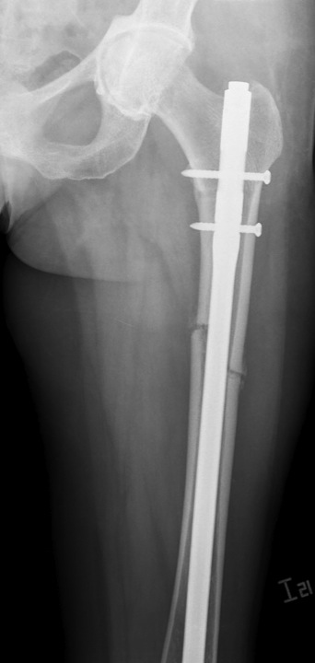
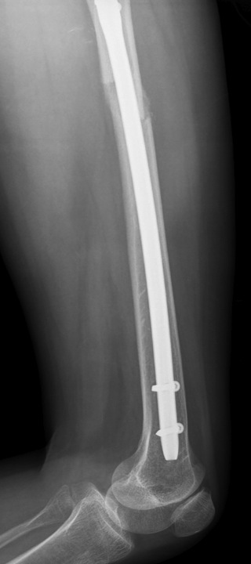
2 months
Notes:
2013.04.04
2 months after surgery: The patient was using crutches on her right hand and was independent on activities of daily living.

Slide 44
3 months
Notes:
2013.05.17
3 months after surgery: No crutches, patient is independent on activities of daily living, no pain on her thigh, full weight bearing.

Slide 45
Summary
Appreciate importance of preoperative planning
Choose the right setup for the implant used
In proximal and distal third fractures of the femur it is important to obtain reduction before fixation
In midshaft femur fracture the nail can be used to reduce the fracture
Notes:
Moderator should ask participants to summarize what else they have learned from this case.

Slide 46
Reduction—articular simple, metaphyseal multifragmentary fracture
Case for small group discussion
AO Trauma Advanced Principles Course

Slide 47
31-year-old male soldier, motorcycle accident
Open fracture, 33-C2
Articular simple, metaphyseal multifragmentary
Notes:
Discussion points:
Is any other information needed: traction views/CT scans?
After irrigation and debridement what are the next steps?
What kind of reduction is needed for the articular injury and for the metaphyseal injury?
What are the tips and tricks to aid in achieving and maintaining reduction?

Slide 48
2
1
2cc
1
Notes:
Discussion points:
What are the problems of reduction in this injury?
What are the deforming forces acting on the distal fragment?

Slide 49
Reduction
Articular component
Metadiaphyseal component
What reduction is needed for each component and how can it be achieved ?
Notes:
Discussion points:
Differentiate between reduction needed for articular component (anatomical) and reduction needed for metadiaphyseal component (functional).
How can reduction be achieved for each component of the fracture?
Discuss reduction needed for metadiaphyseal component to achieve normal function .

Slide 50
Notes:
Discussion points:
Discuss how a bump can aid in reducing the fracture.
Notes for moderator:
Example of a bump under the distal femur to correct the recurvatum of the distal femur.

Slide 51
Notes:
Discussion points:
Which table should be used? Radiolucent table vs fracture table.
Discuss patient positioning.
How to aid reduction?
Discuss knee flexion over the end of the table vs bump under the knee.

Slide 52
How to achieve correct length—distractor or external fixator ?
Where should pins be positioned?
How do you control recurvatum?
Notes:
Discussion points:
How to achieve correct length—distractor or external fixator?
Where should pins be positioned?
How do you control recurvatum? Discuss the use of a Schanz pin in the distal fragment as a joystick vs bump under knee.

Slide 53
Advantages and disadvantages of using the distractor ?
Notes:
Discussion points:
Discuss the advantages and disadvantages of using the distractor.
Discuss the use of the implant as a reduction tool.

Slide 54
Advantages and disadvantages of using the external fixator?
Notes:
Discussion points:
Discuss the advantages and disadvantages of using the external fixator.
Discuss the use of a Schanz screw as a joystick for correcting the recurvatum of the distal fragment.

Slide 55
Summary
Emergency debridement is mandatory.
Articular fractures should be reduced anatomically and directly.
Complex meta/diaphyseal components should be reduced indirectly in order to restore length, alignment, and rotation.
Maintain and control the reduction during implant application for successful function.
Notes:
Moderator should ask participants to summarize what else they have learned from this case.

Slide 56
Reduction—closed distal tibial fracture
Case for small group discussion
AO Trauma Advanced Principles Course

Slide 57
55-year-old man, banker, falls off roof while fixing his TV antenna
Closed distal tibial injury
Good pulses
Normal sensation
No other injuries
Notes:
Discussion points:
What is the importance of the timing of fixation in bone and soft-tissue injuries: temporary vs definitive?
What are the priorities in this kind of injuries: soft tissues!
What is the value of bridging external fixation?
When should definitive fixation be performed: wrinkle sign?

Slide 58
Notes:
Discussion points:
What is the value of percutaneous fixation of the articular surface.
Discuss the technique of applying a bridging external fixator on the ankle and where to put the pins, clamps, and bars.
How long can you keep the fixator on before definitive fixation, and what are the advantages and disadvantages of this technique?

Slide 59
Notes:
Discussion points:
Discuss the soft-tissue injury: wrinkle sign.
Which reduction technique should be used: open vs closed, direct vs indirect.
Discuss keeping the external fixator vs the femoral distractor.
What are the tips and tricks of reduction techniques using percutaneous clamps, distraction, joysticks?

Slide 60
Notes:
Discussion points:
Discuss the definitive fixation used to treat this fracture.
What type of bone healing has been achieved?
What is the rehabilitation protocol for this patient?

Slide 61
Summary
Fracture dislocation requires stable immobilization after reduction.
Skeletal traction can be used for a short period.
External fixators allow distraction with ligamentotaxis.
Initial reduction should be as good as possible to allow for definitive minimally invasive fixation.
Notes:
Moderator should ask participants to summarize what else they have learned from this case.

Slide 62
Reduction—extraarticular closed distal tibial and fibular fractures
Case for small group discussion
AO Trauma Advanced Principles Course

Slide 63
25-year-old woman with a high-energy, closed distal tibial and fibular fracture
Reduction of Weber C fibular fracture as first step
Fibula remains short despite traction
Notes:
Discussion points:
Which reduction technique should be used: push-pull technique or reduction using a femoral distractor?

Slide 64
Notes:
Discussion points:
Discuss reduction techniques: push-pull technique or the use of a femoral distractor.
Which fracture should be treated first?
How can the fibula be aligned and how can reduction of the tibia be maintained?
How can implants aid in reduction?

Slide 65
Summary
It is important to restore the length of the fibula and correct alignment in distal tibial fractures.
The push-pull screw technique can be used to help gain length.
Notes:
Moderator should ask participants to summarize what else they have learned from this case.

