Slide 1
Reduction—articular simple, metaphyseal multifragmentary fracture
Case for small group discussion
AO Trauma Advanced Principles Course

Slide 2
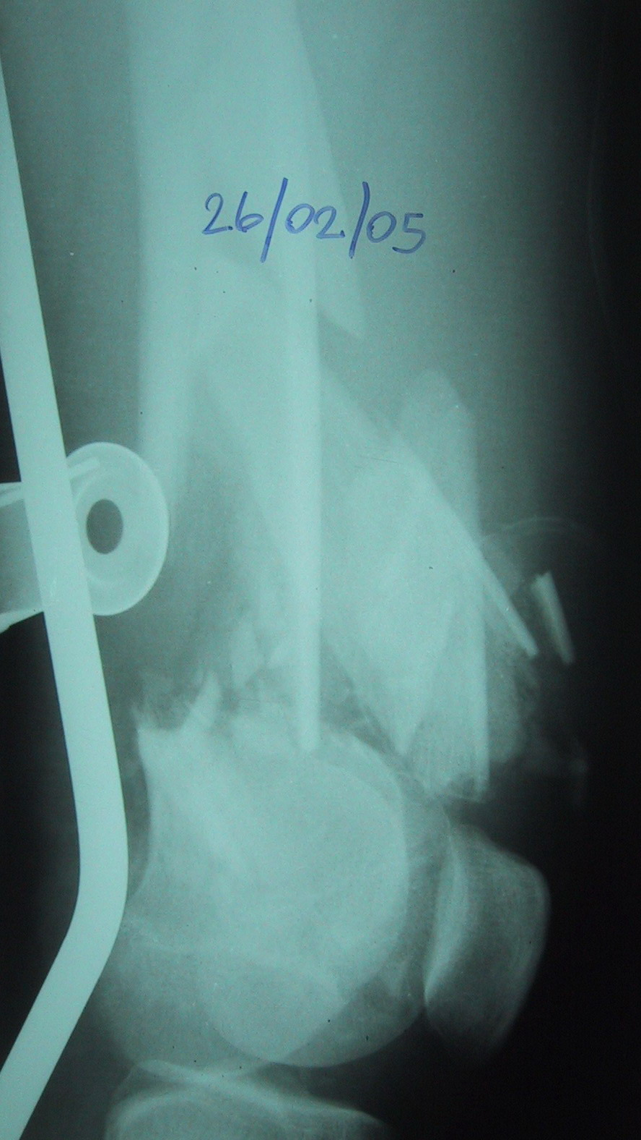
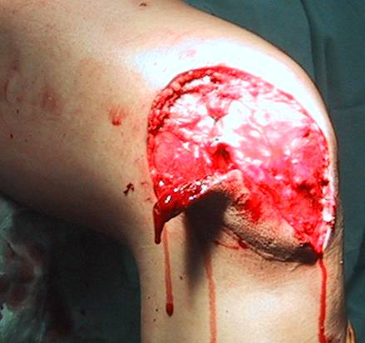
31-year-old male soldier, motorcycle accident
Open fracture, 33-C2
Articular simple, metaphyseal multifragmentary
Notes:
Discussion points:
Is any other information needed: traction views/CT scans?
After irrigation and debridement what are the next steps?
What kind of reduction is needed for the articular injury and for the metaphyseal injury?
What are the tips and tricks to aid in achieving and maintaining reduction?

Slide 3
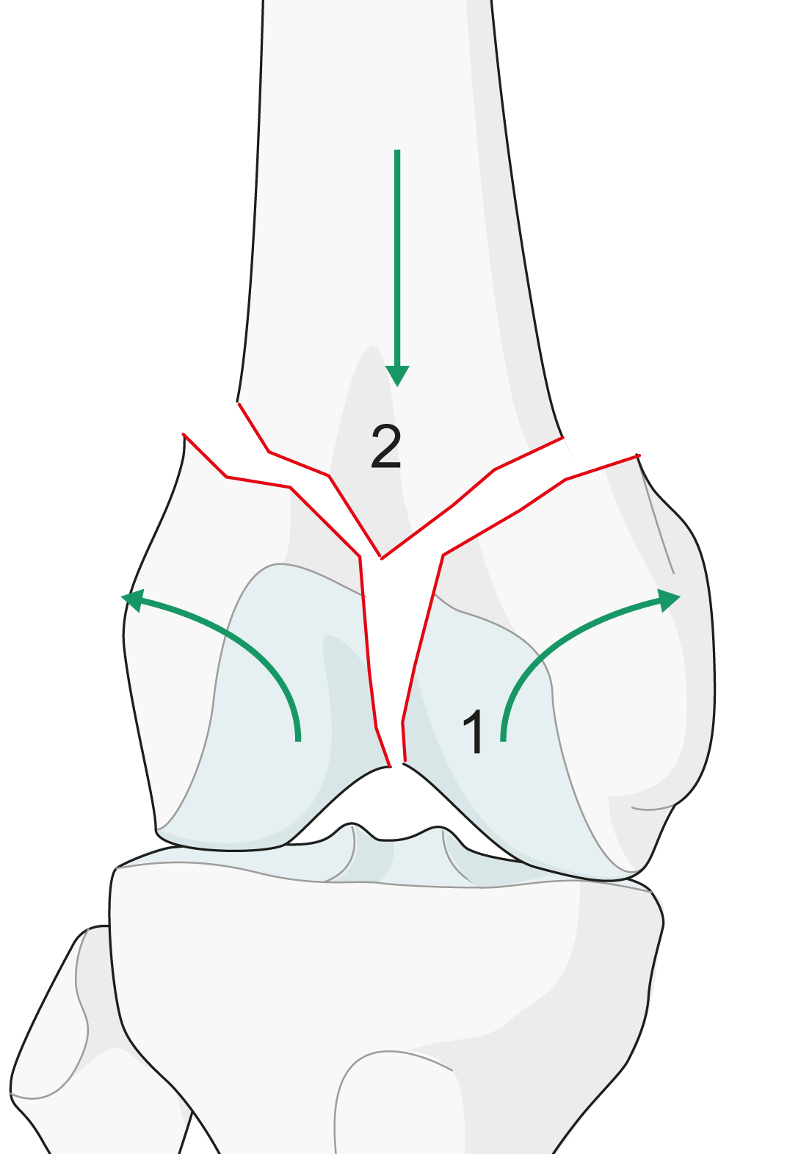
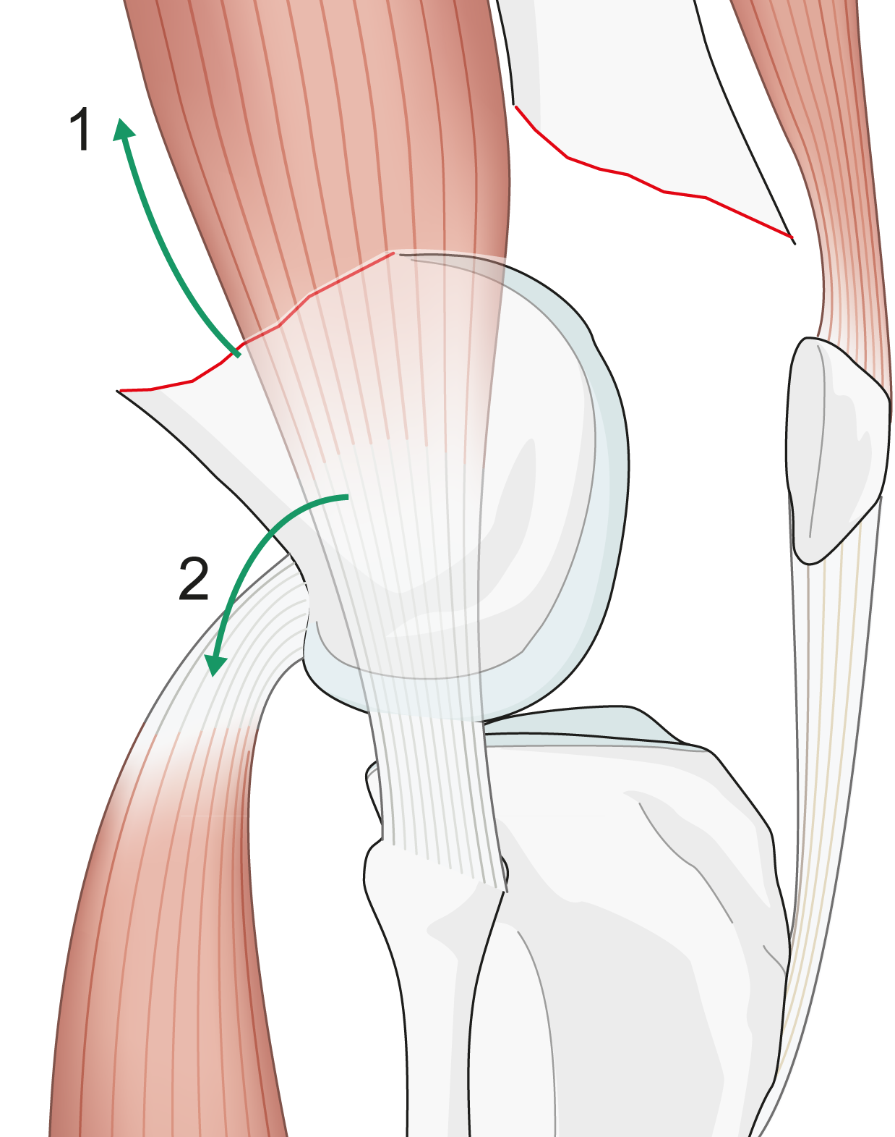
2
1
2cc
1
Notes:
Discussion points:
What are the problems of reduction in this injury?
What are the deforming forces acting on the distal fragment?

Slide 4
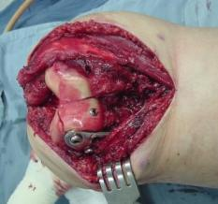
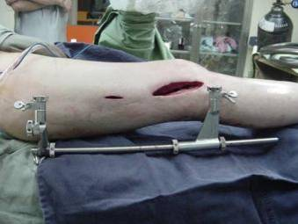
Reduction
Articular component
Metadiaphyseal component
What reduction is needed for each component and how can it be achieved ?
Notes:
Discussion points:
Differentiate between reduction needed for articular component (anatomical) and reduction needed for metadiaphyseal component (functional).
How can reduction be achieved for each component of the fracture?
Discuss reduction needed for metadiaphyseal component to achieve normal function .

Slide 5
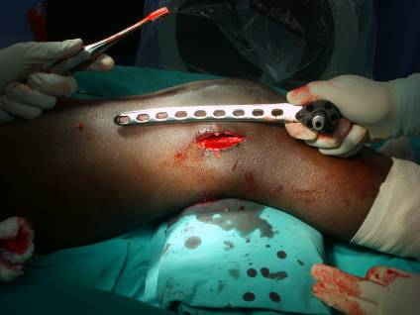
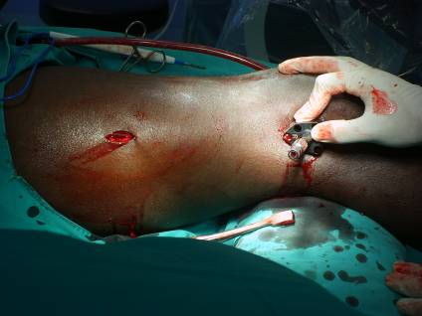
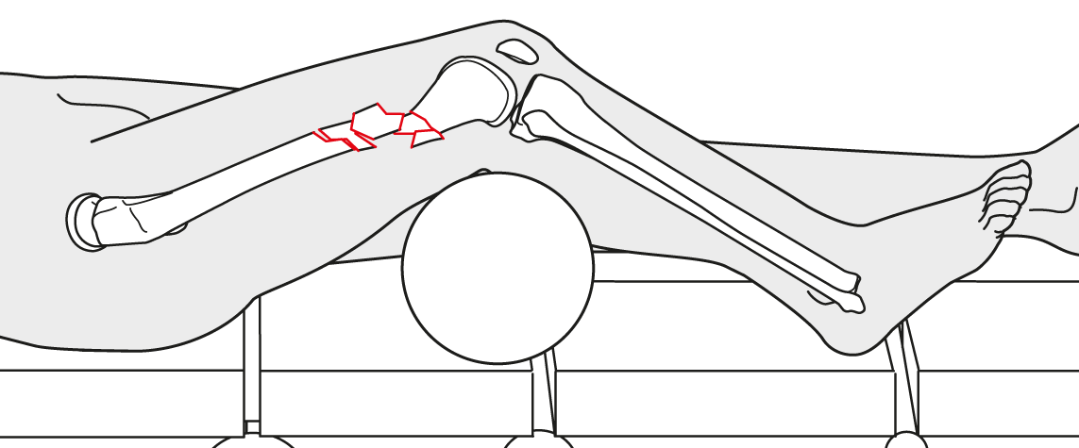
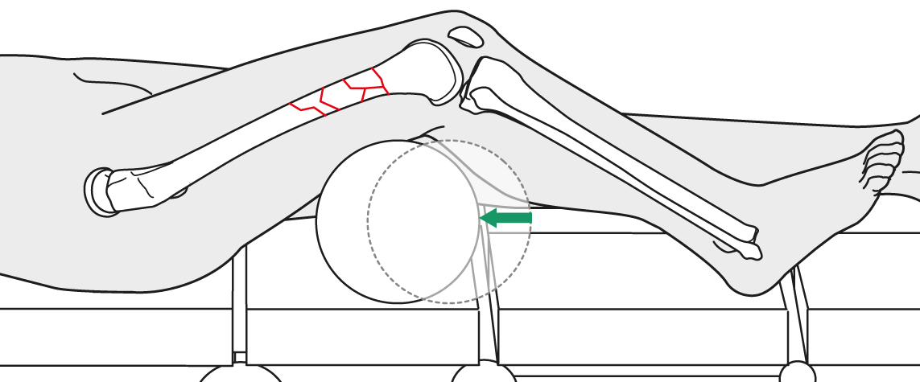
Notes:
Discussion points:
Discuss how a bump can aid in reducing the fracture.
Notes for moderator:
Example of a bump under the distal femur to correct the recurvatum of the distal femur.

Slide 6
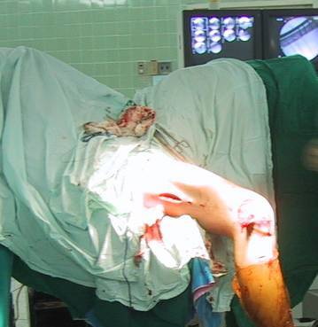
Notes:
Discussion points:
Which table should be used? Radiolucent table vs fracture table.
Discuss patient positioning.
How to aid reduction?
Discuss knee flexion over the end of the table vs bump under the knee.

Slide 7
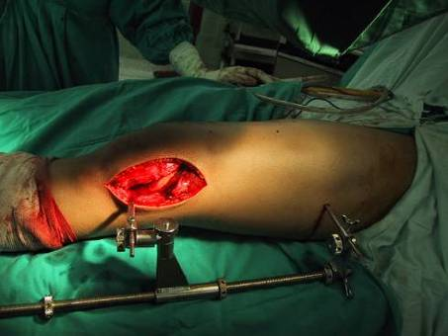
How to achieve correct length—distractor or external fixator ?
Where should pins be positioned?
How do you control recurvatum?
Notes:
Discussion points:
How to achieve correct length—distractor or external fixator?
Where should pins be positioned?
How do you control recurvatum? Discuss the use of a Schanz pin in the distal fragment as a joystick vs bump under knee.

Slide 8
Advantages and disadvantages of using the distractor ?
Notes:
Discussion points:
Discuss the advantages and disadvantages of using the distractor.
Discuss the use of the implant as a reduction tool.

Slide 9
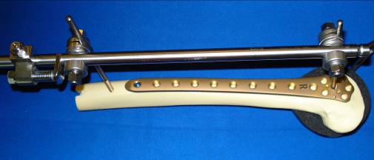
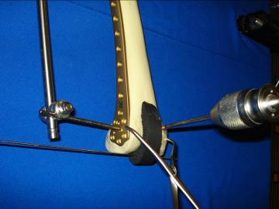
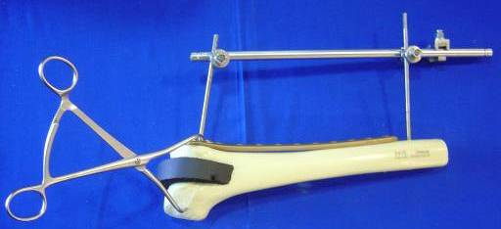
Advantages and disadvantages of using the external fixator?
Notes:
Discussion points:
Discuss the advantages and disadvantages of using the external fixator.
Discuss the use of a Schanz screw as a joystick for correcting the recurvatum of the distal fragment.

Slide 10
Summary
Emergency debridement is mandatory.
Articular fractures should be reduced anatomically and directly.
Complex meta/diaphyseal components should be reduced indirectly in order to restore length, alignment, and rotation.
Maintain and control the reduction during implant application for successful function.
Notes:
Moderator should ask participants to summarize what else they have learned from this case.

