Slide 1
Femoral shaft malunion
Case for small group discussion: Decision making in difficult fracture problems and polytrauma patients
AO Trauma Advanced Principles Course

Slide 2
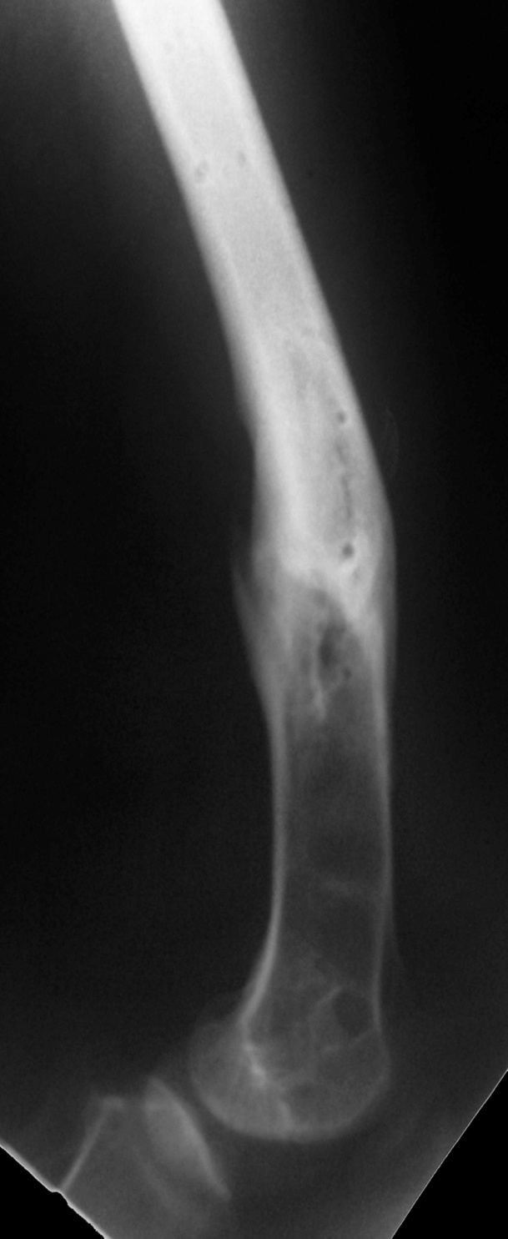
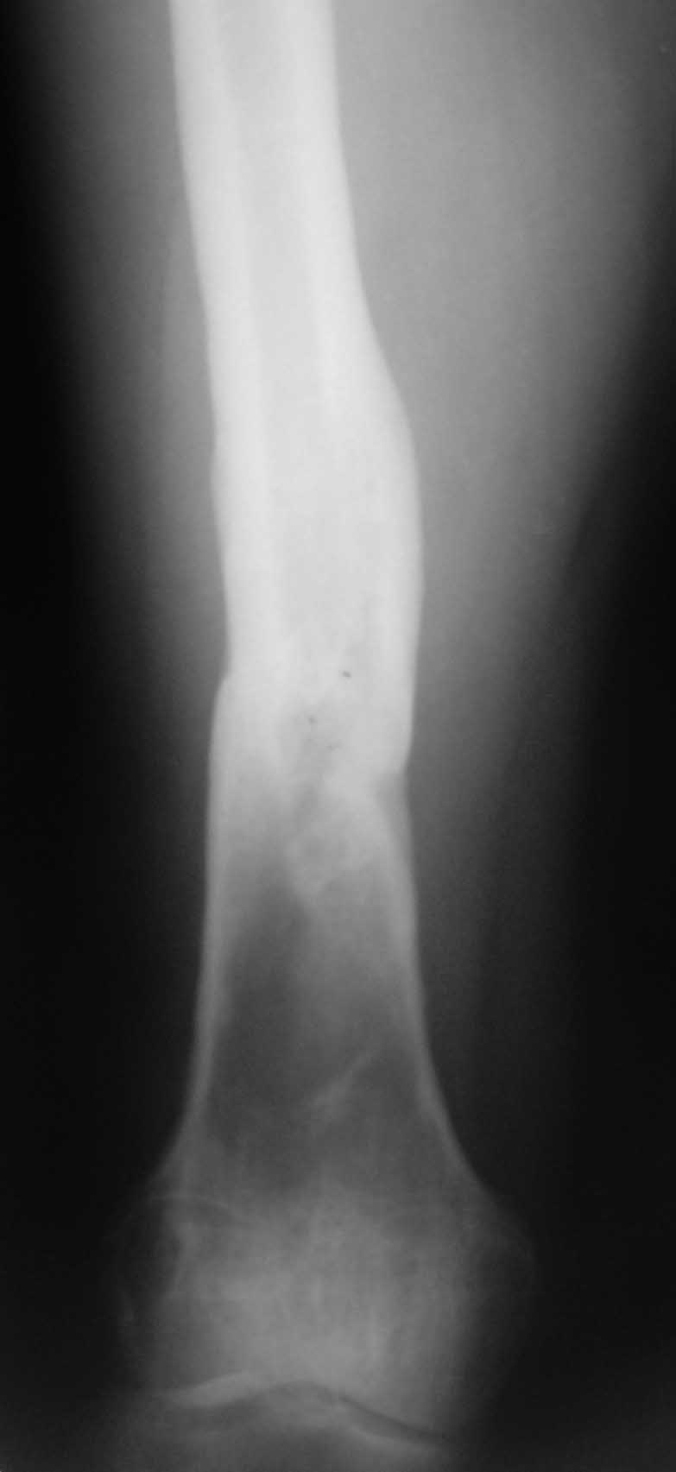
43-year-old man
Femoral shaft fracture
4 years earlier: DCS
Now:
Can’t extend knee
Quads weakness
Soft tissues good
No evidence of infection
Can‘t work
Claim settled!

Slide 3
RTA 4 years earlier: DCS
now:
Can’t extend knee
Quads weakness
Soft tissues good
No evidence of infection
Can‘t work
Claim settled!
How to treat this deformity?
Type of osteotomy?
How would you fix the osteotomy?

Slide 4
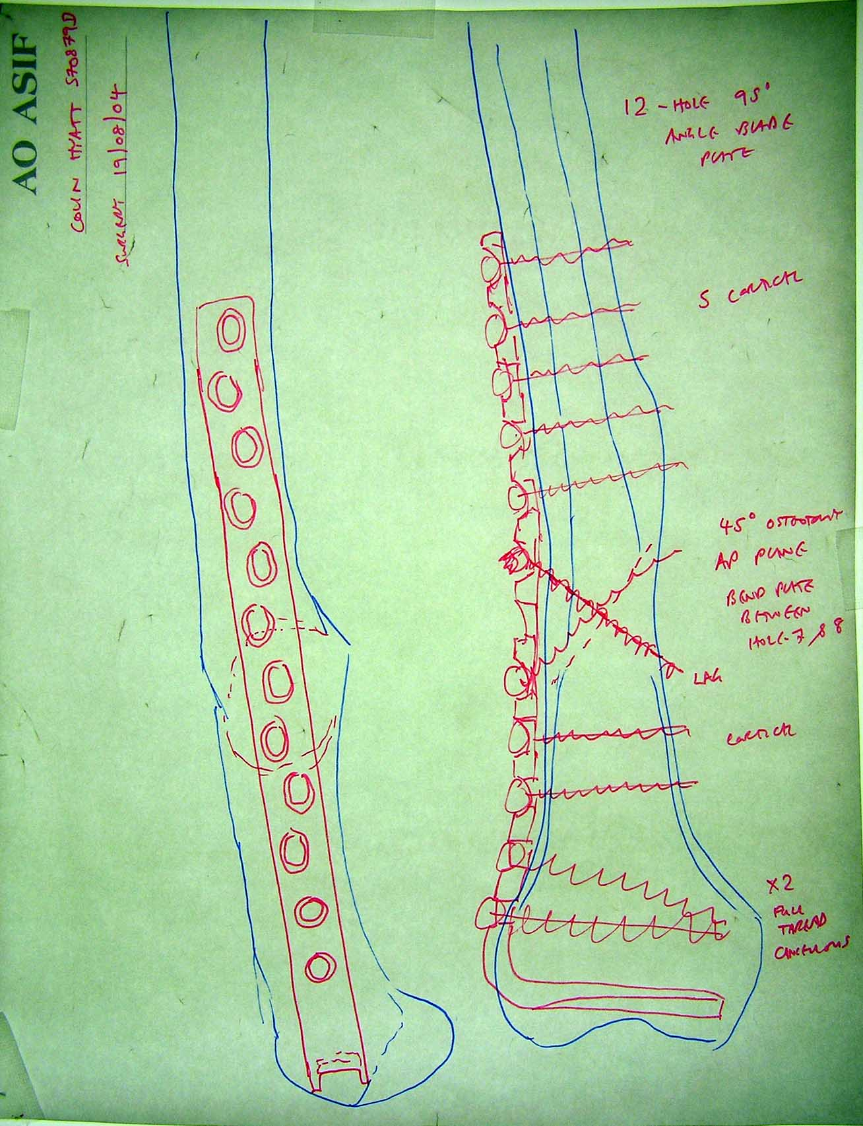
Preoperative plan

Slide 5
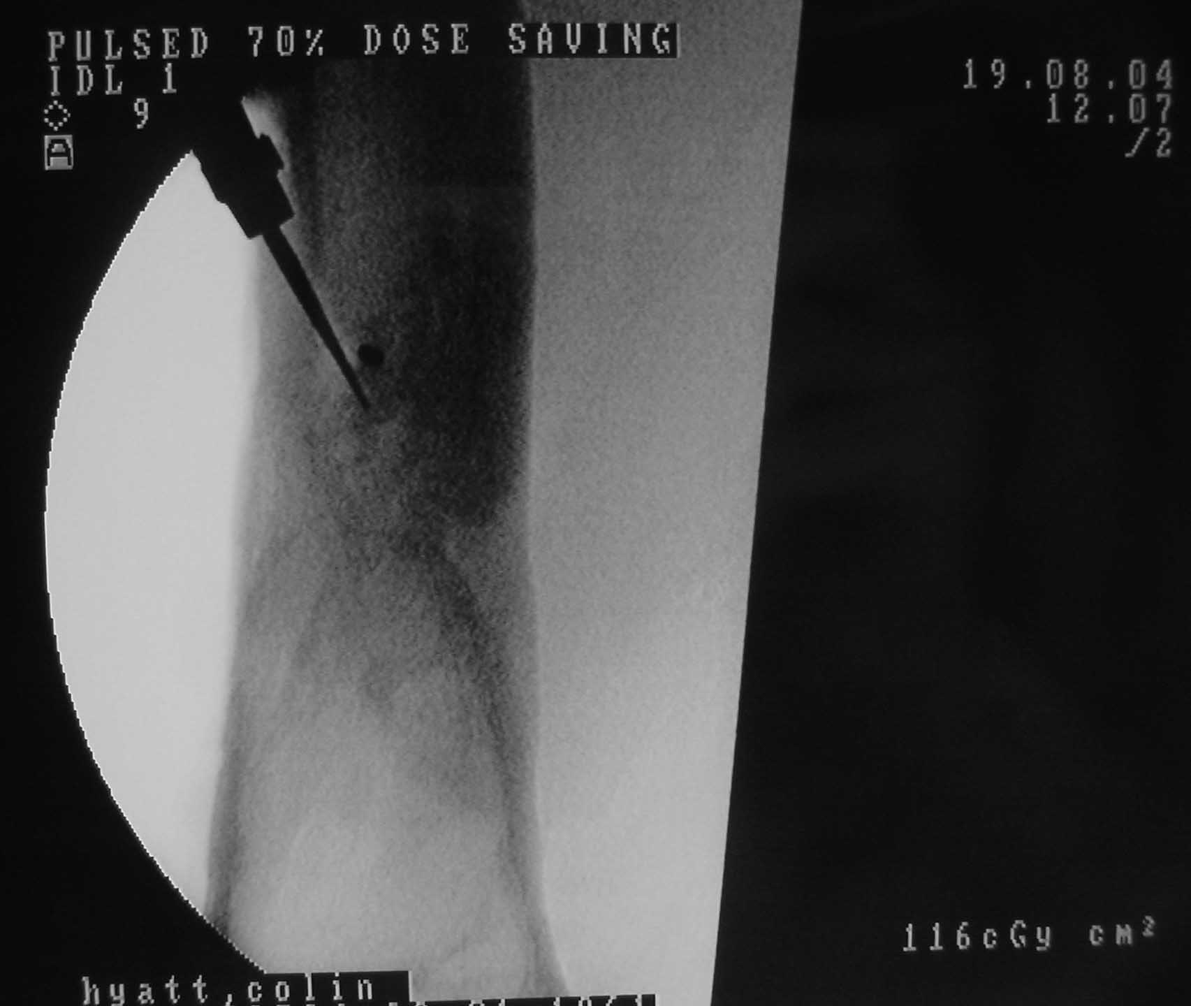
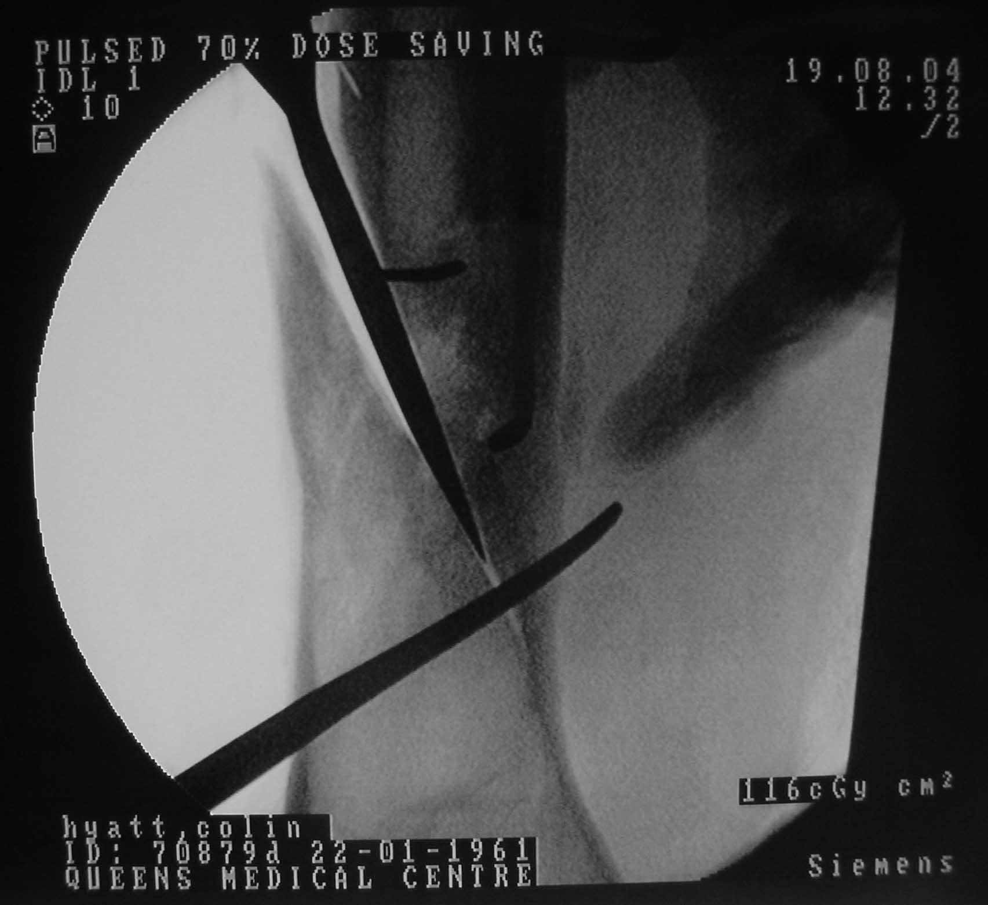
Single plane osteotomy

Slide 6
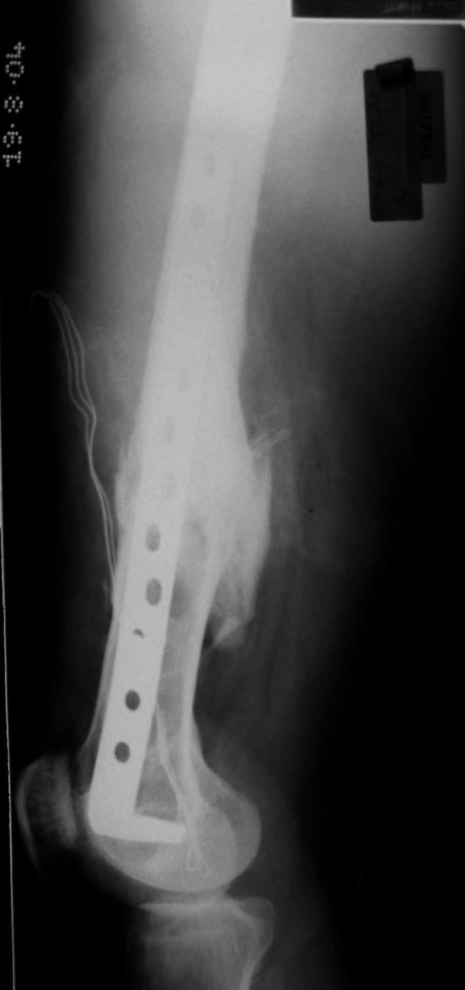
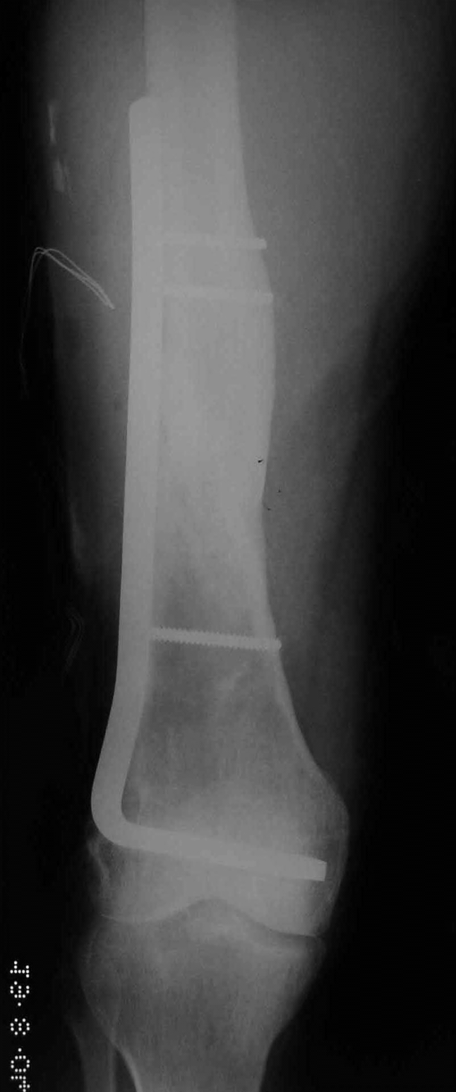
Deformity corrected
95º blade plate
Intraoperative x-ray
What principles need to be applied?

Slide 7
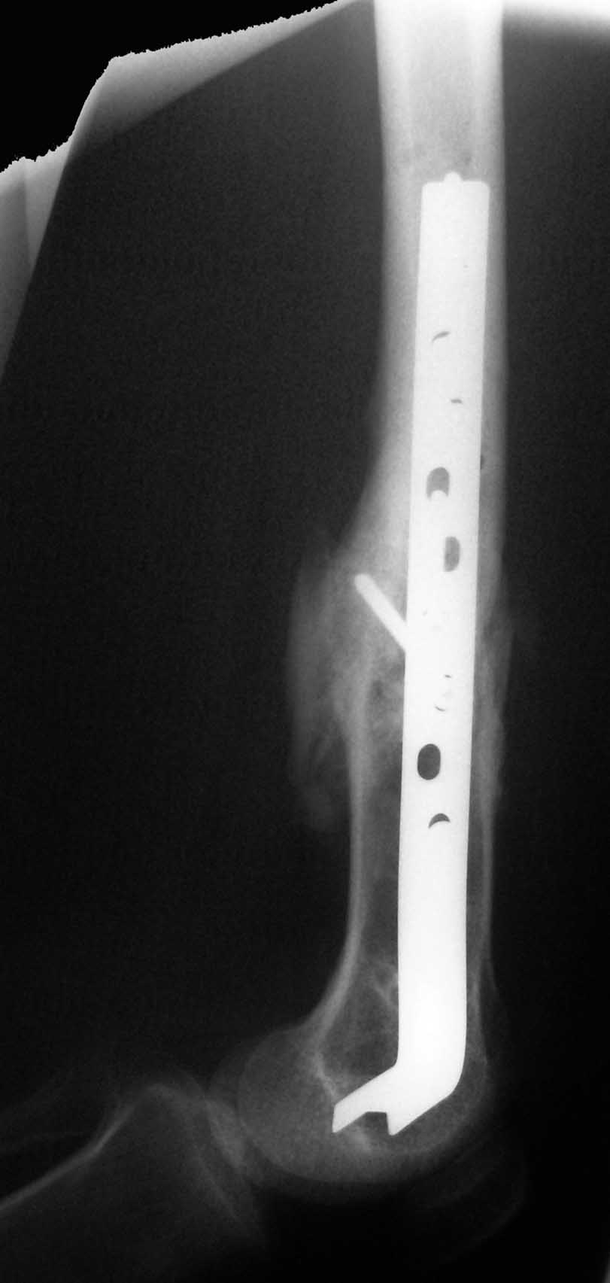
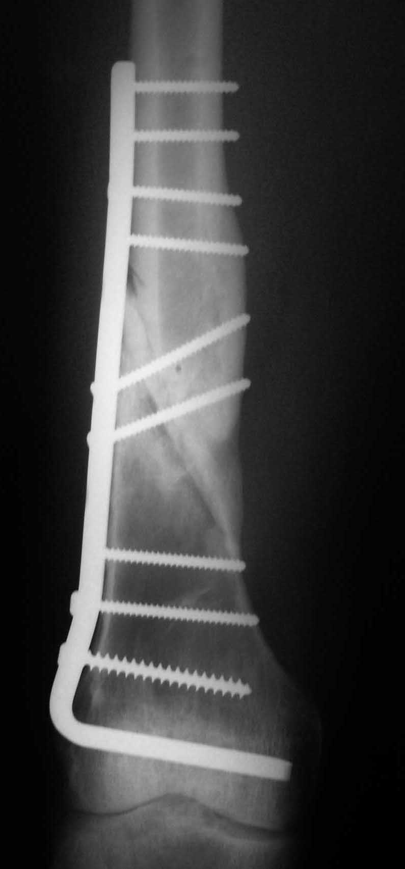
8 weeks: started to bear weight
Returned to work at 6 months
Principles
Absolute stability always needed

Slide 8
Summary
Function of the patient affects results of bone healing.
Correction of malunion is directed towards improving function and preventing delayed complication.
Principles of fracture fixation apply to correction of post traumatic deformities.
Notes:
Moderator should ask participants to summarize what else they have learned from this case.

