Slide 1
Lower limb trauma
Case for small group discussion: Decision making in difficult fracture problems and polytrauma patients
AO Trauma Advanced Principles Course

Slide 2
35-year-old woman, motorcycle accident
Isolated right lower limb trauma
ABC’s – ok
No other injuries

Slide 3
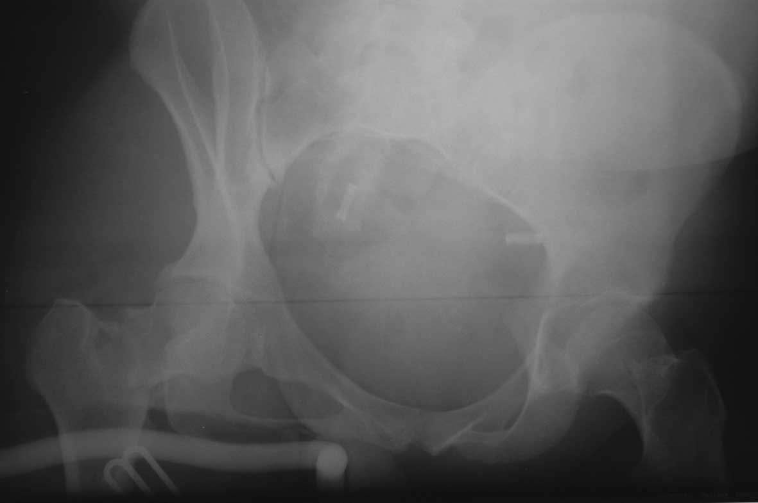

Slide 4
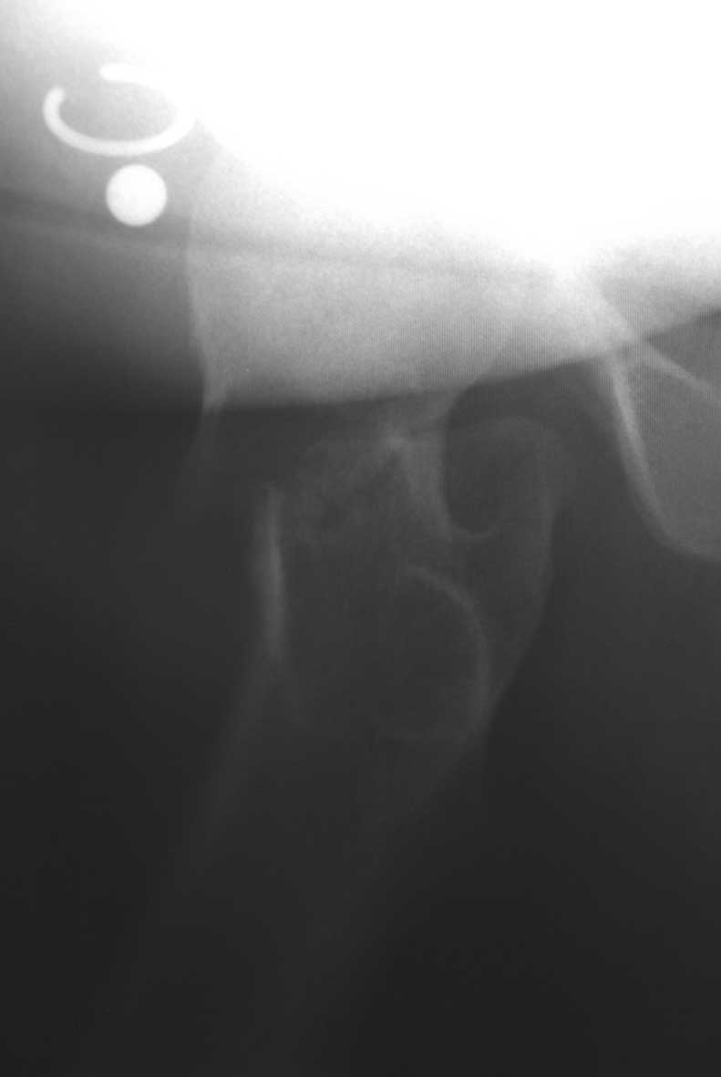

Slide 5
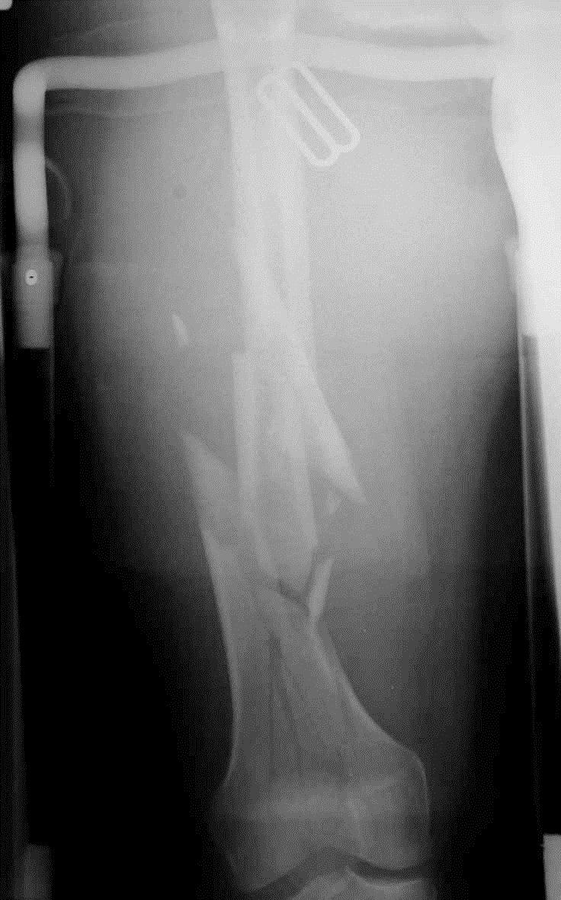
Closed fracture
Neurovascular status normal
No compartment syndrome

Slide 6
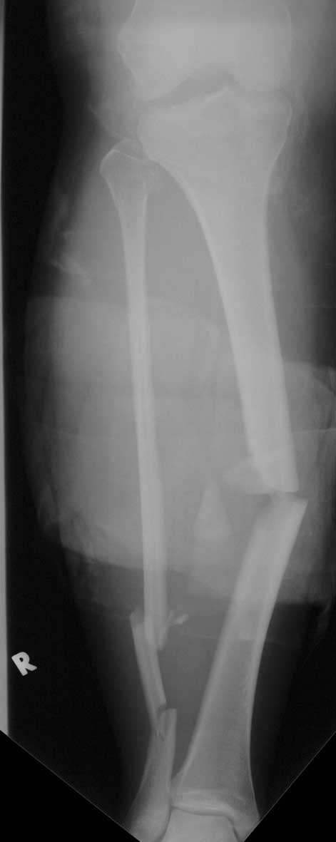
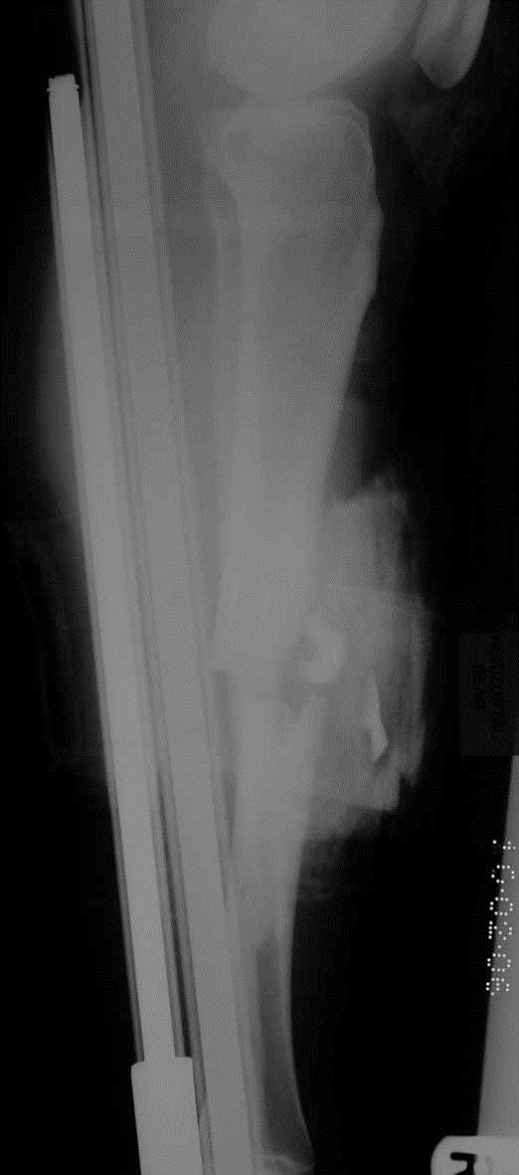
Open fracture IIIa
Neurovascular status normal
No compartment syndrome
Foot/ankle - normal

Slide 7
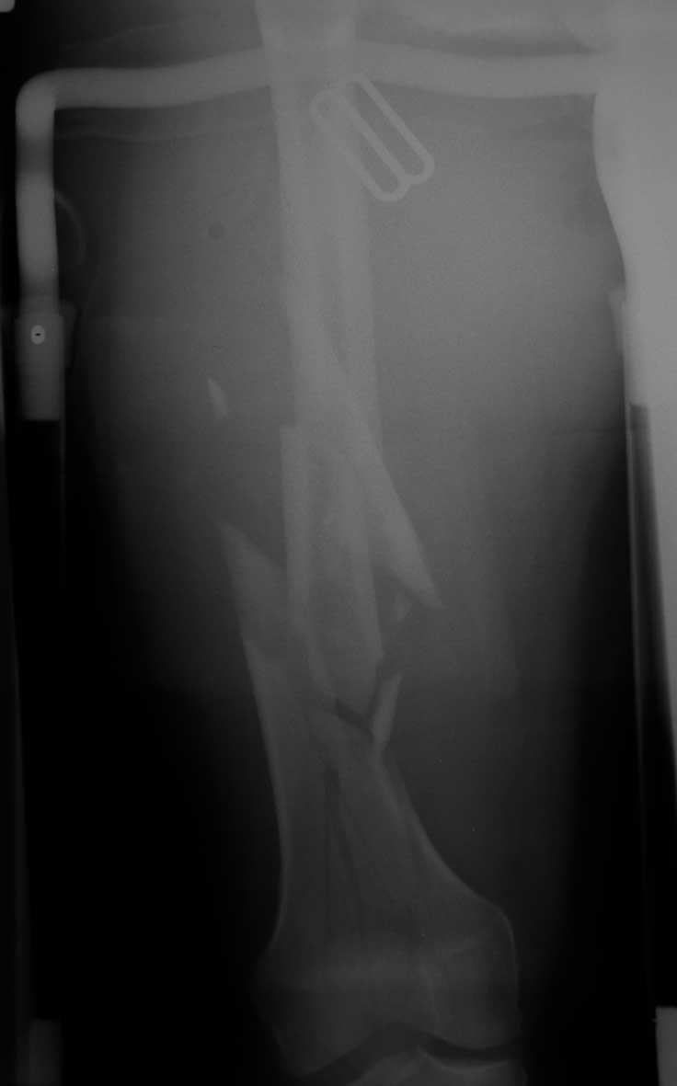
Displaced intracapsular
femoral neck fracture
Closed complex segmental
femoral shaft fracture
Closed simple articular
supracondylar fracture
Open (IIIa) bending wedge
tibial shaft fracture
Notes:
Discuss priorities in management. Which injury to manage first?

Slide 8
Displaced intracapsular
femoral neck fracture
3
1
B
3
Closed complex segmental
femoral shaft fracture
3
2
C
3
Closed simple articular
supracondylar fracture
3
3
C
1
Open (IIIa) bending wedge
tibial shaft fracture
4
2
B
3
Notes:
Discuss priorities in management. Which injury to manage first?

Slide 9
Displaced intracapsular
femoral neck fracture
31-B3
Closed complex segmental
femoral shaft fracture
32-C3
Closed simple articular
supracondylar fracture
33-C1
Open (IIIa) bending wedge
tibial shaft fracture
42-B3
(Local) damage control or early total care?
Which injury to manage first?
Notes:
Discuss priorities in management. Which injury to manage first?

Slide 10
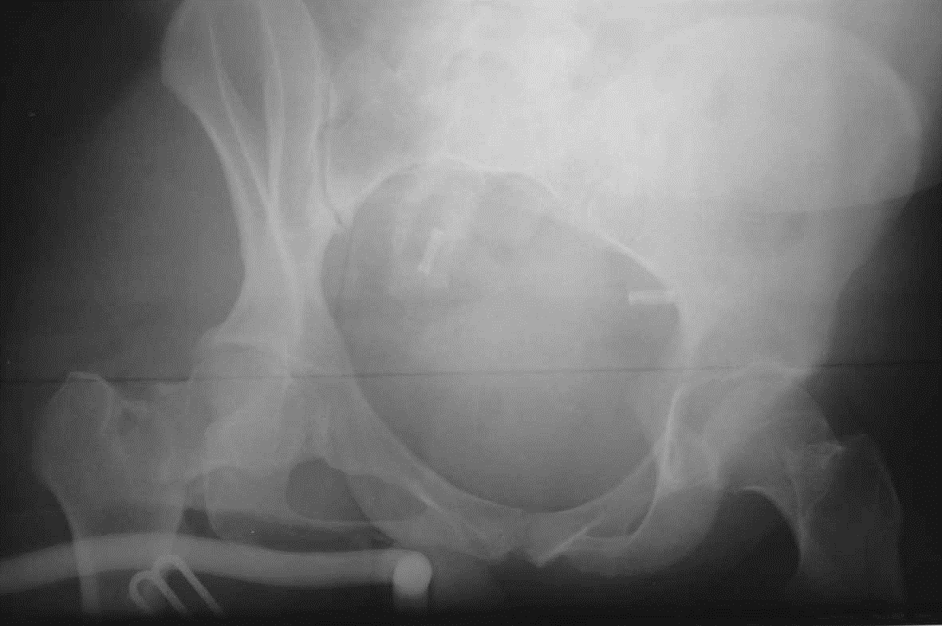
How would you
manage this fracture?

Slide 11
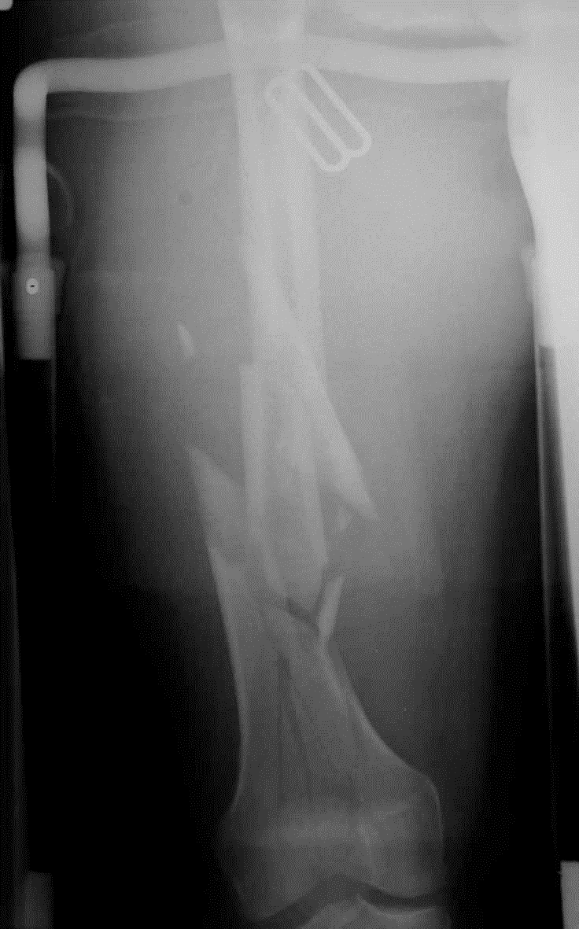
How would you
manage this fracture?

Slide 12
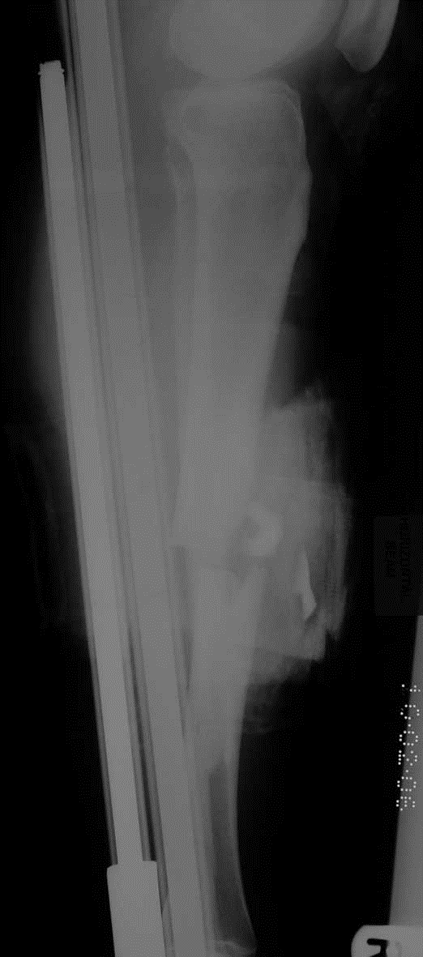
How would you
manage this fracture?

Slide 13
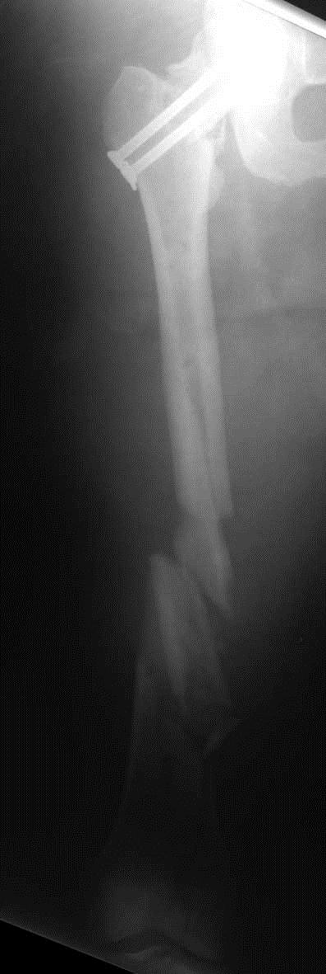
Emergency surgery
- Wound debridement
Percutaneous screw fixation femoral neck
Joint-bridging external fixator
proximal femur distal tibia
Transferred to tertiary trauma unit next day

Slide 14
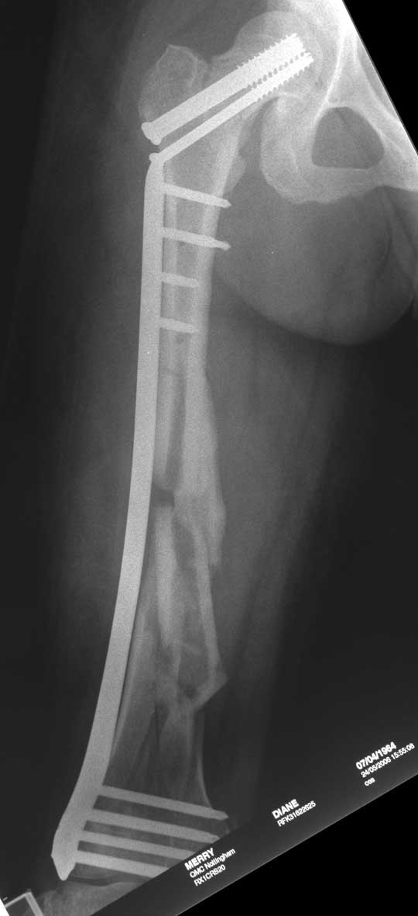
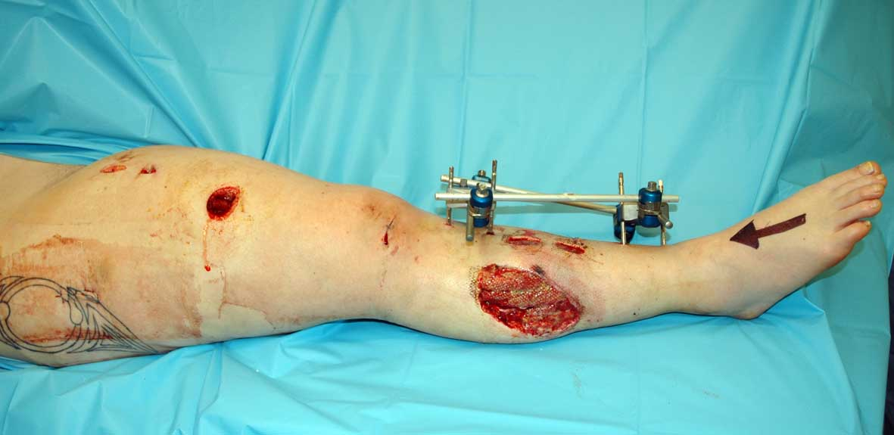
Definitive surgery at 48hrs
Wounds re-debrided
Femoral external fixator removed
ORIF femoral neck
Bridge plating of femur shaft (LISS)
Tibial external fixator removed
Reamed, locked IM nail (tibia)
Skin grafts at 96 hours

Slide 15
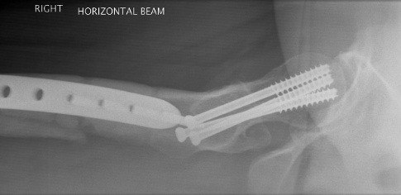
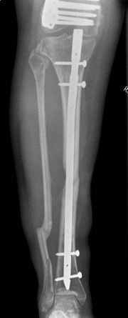
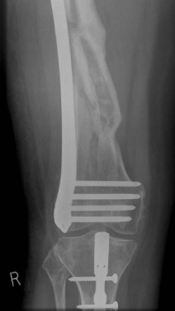
12 months

Slide 16
Summary
Reamed IM nailing—gold standard in femoral shaft fractures
Plates excellent for proximal and distal femoral fractures
Retrograde IM nailing an option for extraarticular and simple articular fractures
Periprosthetic fractures require careful attention to and understanding of the type of injury
Notes:
16
Moderator should ask participants to summarize what else they have learned from this case.

