Slide 1
Humeral shaft nonunion
Case for small group discussion: Decision making in difficult fracture problems and polytrauma patients
AO Trauma Advanced Principles Course
Notes:
Michael J. Raschke, DE

Slide 2
Case description
30-year-old man
MVA
Fracture of the humeral shaft AO 12-A3
Subtotal amputation forefoot
Fractured tibial plateau
Fractured ankle
Notes:
Additional case information:
Date of accident: 08.12.2009
Case history: car accident
Diagnosis: fracture of the humeral shaft AO 12-A3 right side, acetabulum fracture right side, subtotal amputation of the distal phalanx D3, D4 right side, fracture of the tibial plateau right side, fracture of the upper ankle left side, head laceration
Surgical treatment (08.12.2009): primary stabilization of the fracture using 4.5 LC-DCP (6 hole)

Slide 3
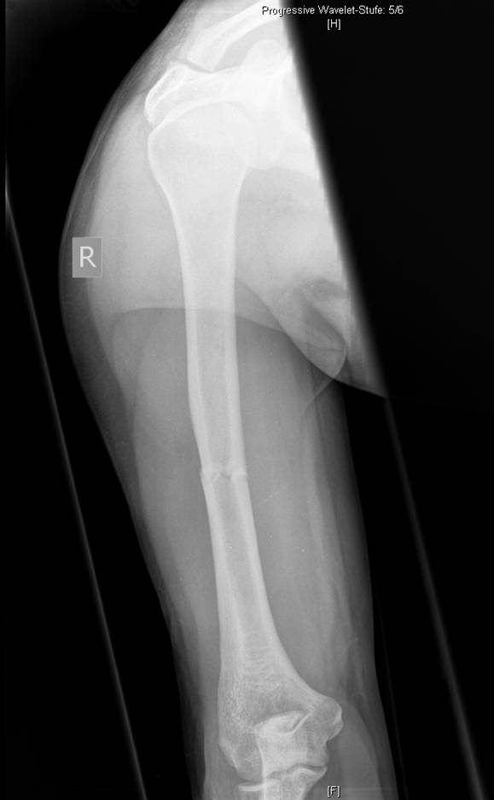
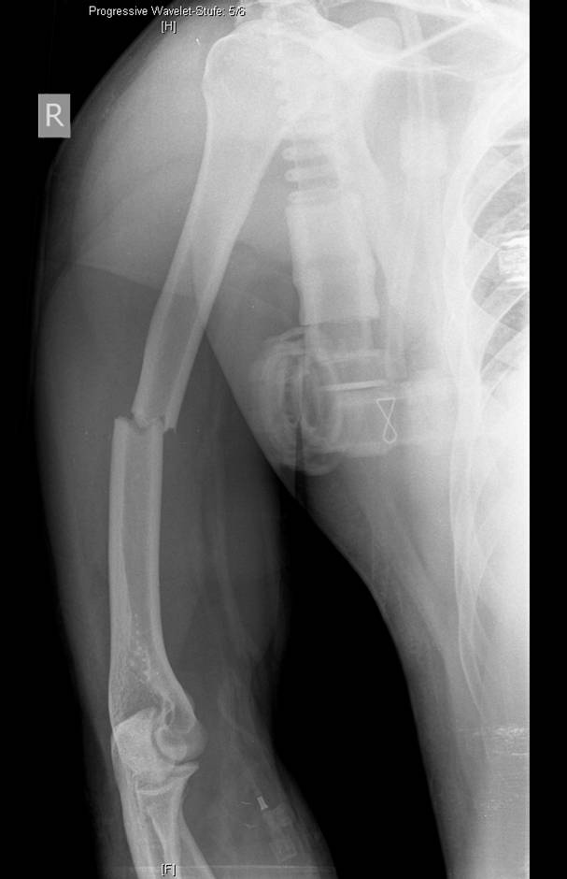
Midshaft transverse fracture of the humeral shaft AO 12-A3
Normal neurological status
Notes:
Discuss fixation options

Slide 4
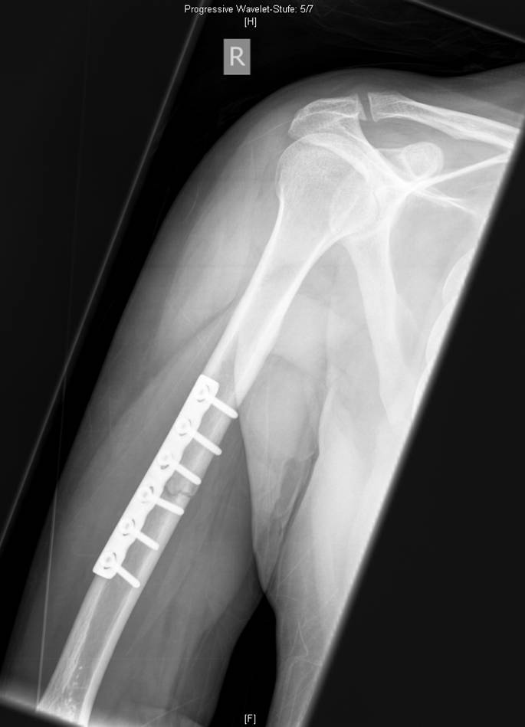
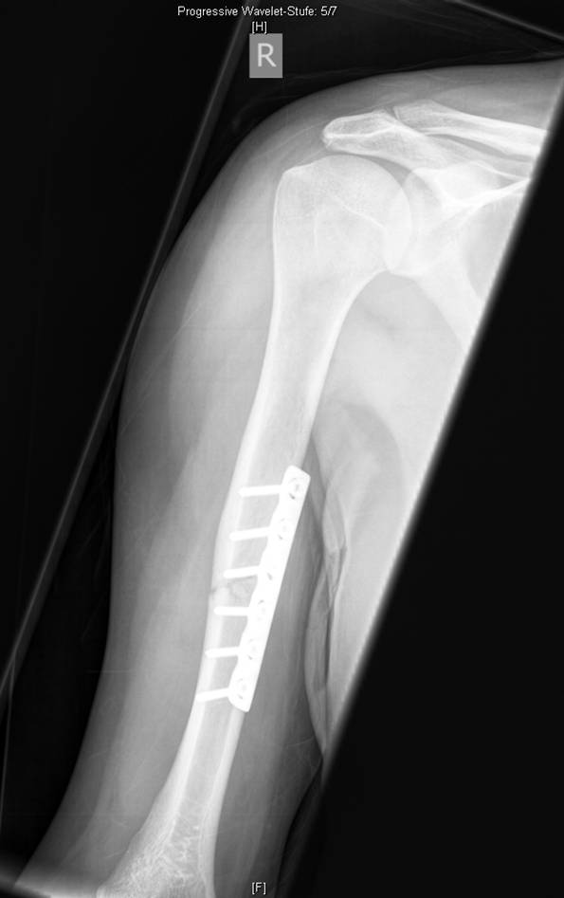
Day 0: plate fixation using 4.5 LC-DCP
Notes:
Discussion points:
Compression techniques
Expected fracture healing

Slide 5
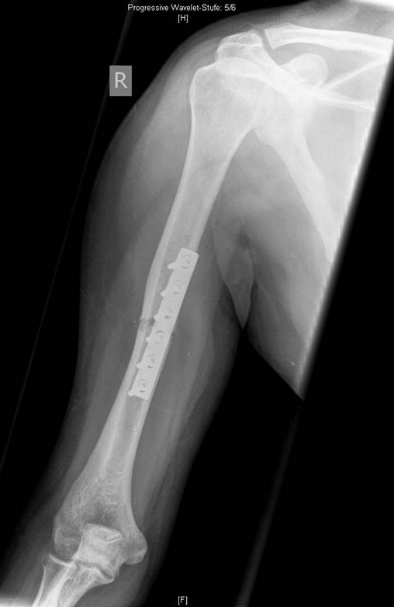
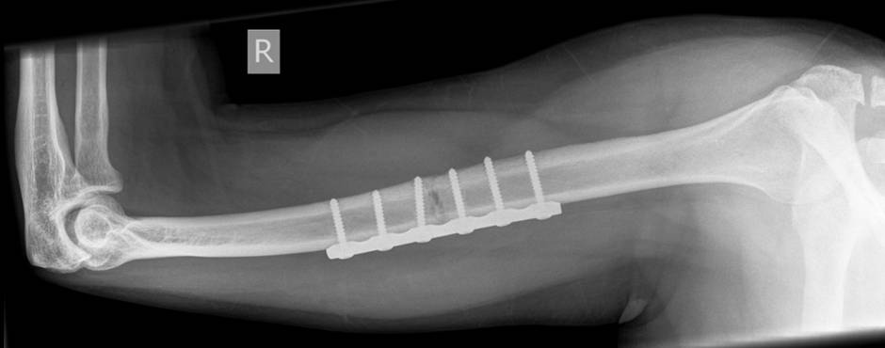
6-week follow-up
Healing?

Slide 6
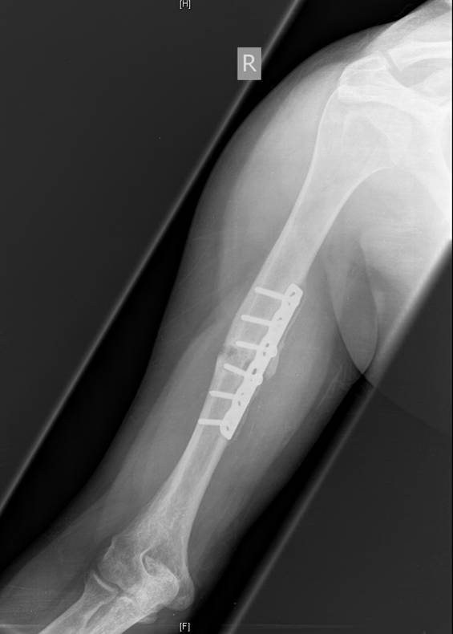
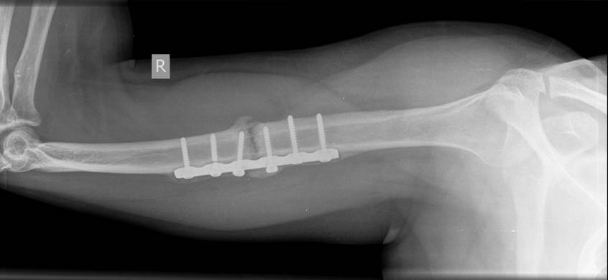
6-month follow-up:
Pain with motion
Nonunion
Notes:
Discussion points:
What went wrong?
Type of nonunion
Mechanical and biological requirements
Additional case information:
Patient was treated in the rehabilitation center after initial operation. Returned to our department of trauma 6 months after primary stabilization. Recommendation to revision of the right arm at this time.

Slide 7
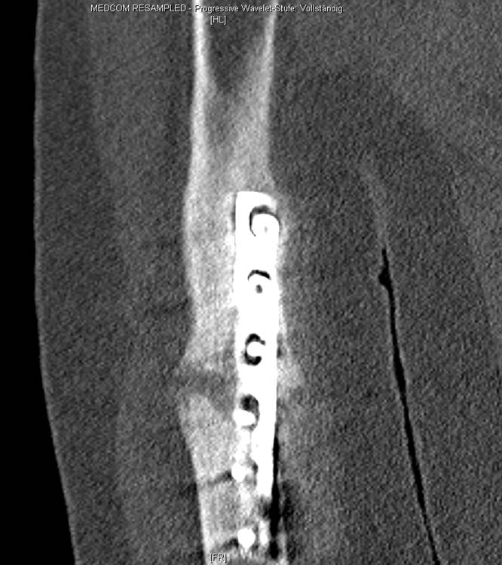
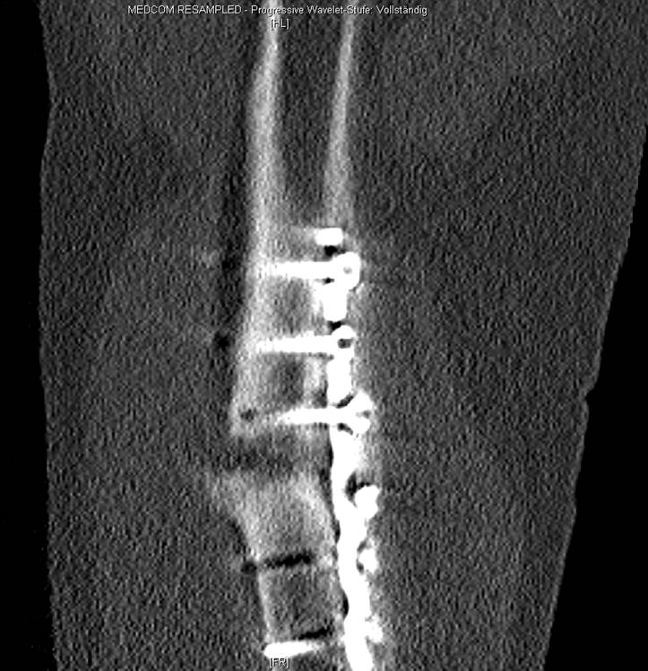
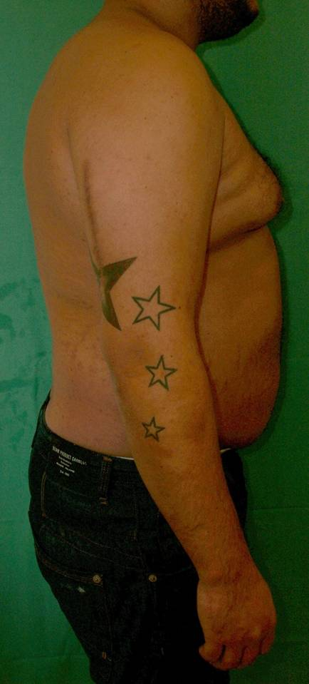
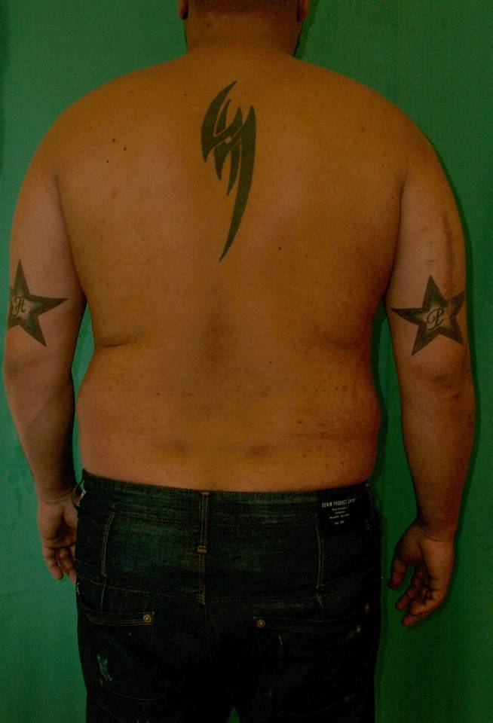
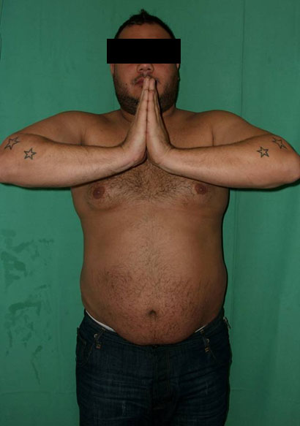
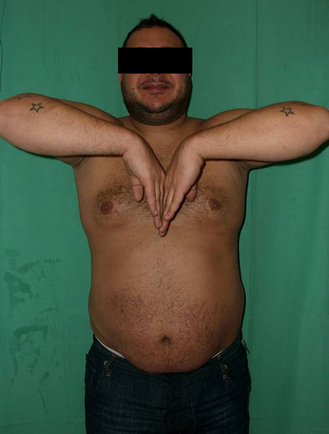
Normal function despite nonunion

Slide 8
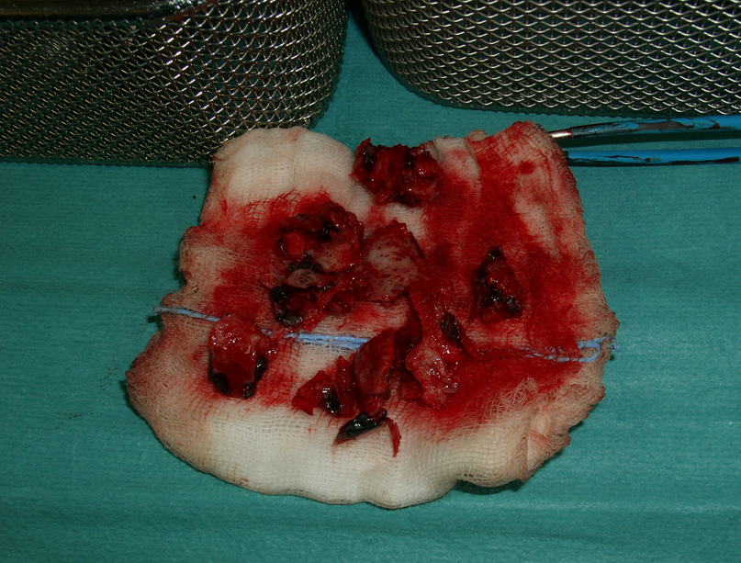
Nonunion humeral shaft
Notes:
Discussion points:
Removal of nonunion material
Perfusion of nonunions

Slide 9
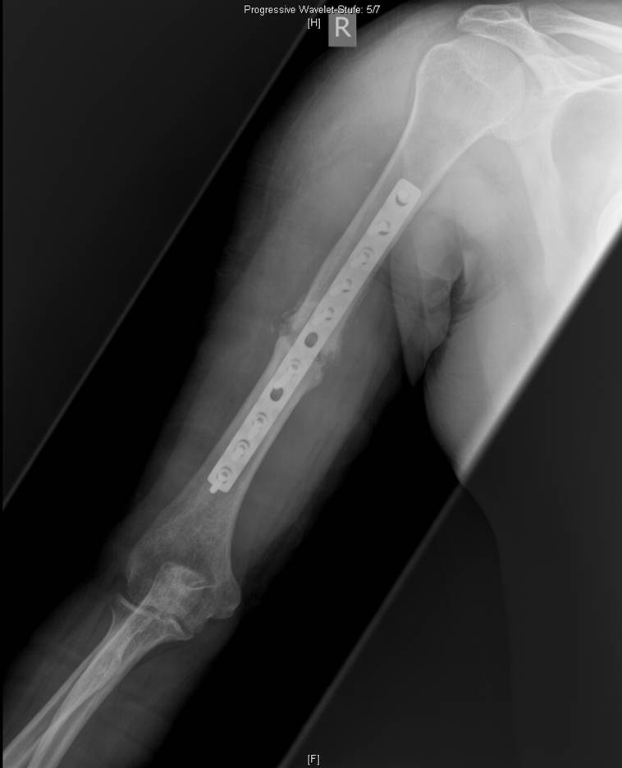
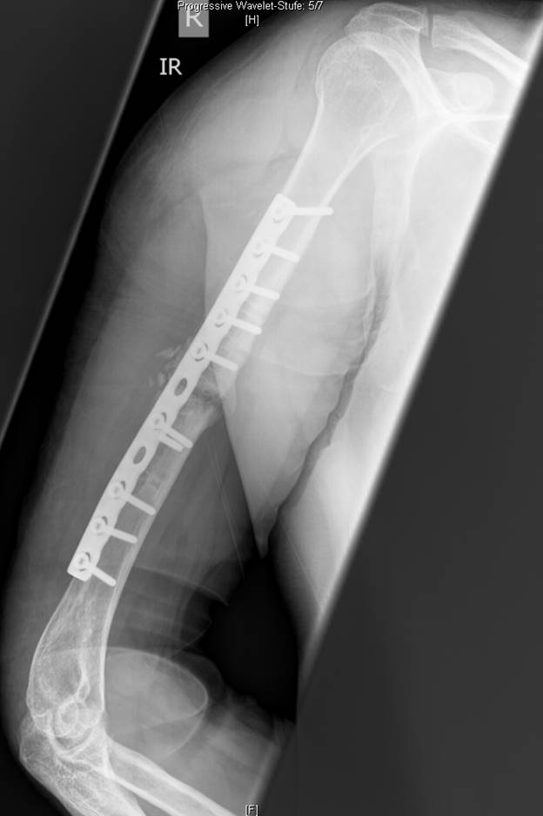
Day 1 postrevision using long LC-DCP, bone graft
Notes:
Discussion points:
Rationale of long plate
Plate function
Screw function
Alternative techniques
Absolute stability, axial compression
Absolute stability, axial compression plus bone graft

Slide 10
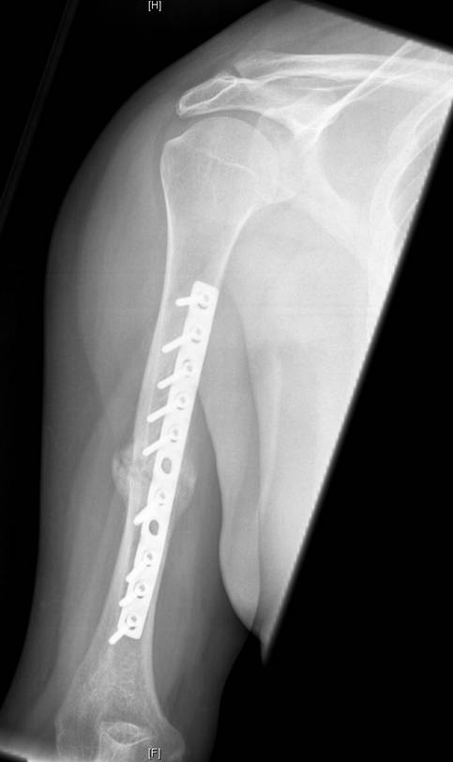
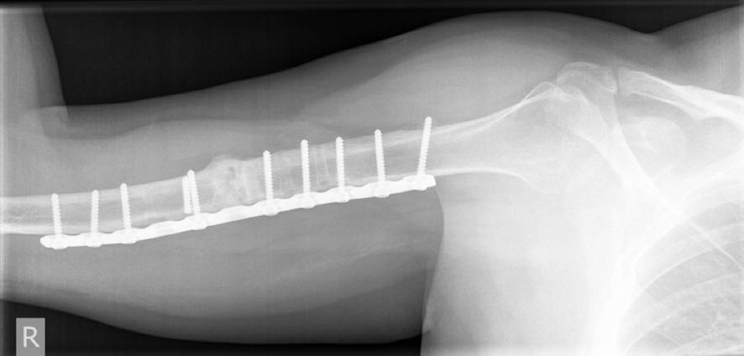
3 months postrevision

Slide 11
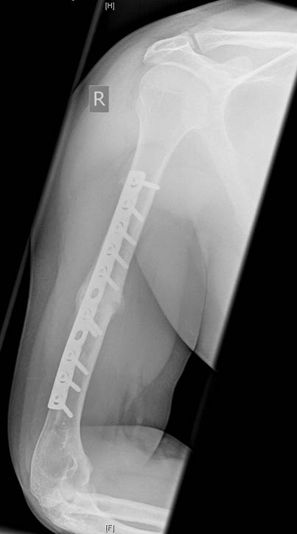
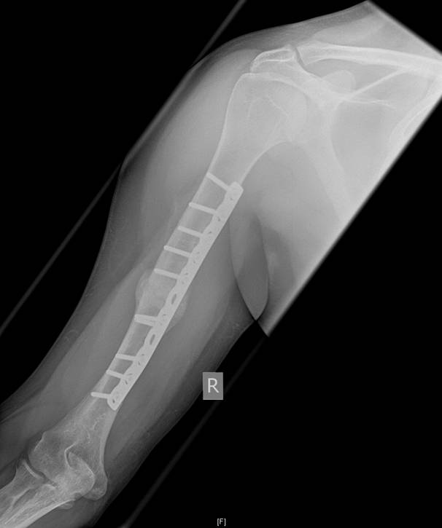
1 year post trauma, 6 months postrevision:
Full function
Notes:
Additional case information:
Patient feels fine
Consolidation 4/4 cortices
If this had failed, what would be the most likely reason for failure? (comment on plate position/plate hole)

Slide 12
Take-home message
Transverse fractures despite anatomical reduction require absolutely stable fixation. If absolute stability is not achieved, there is a risk for nonunion.
Removing nonunion connective tissue requires biological substitutes.
Plate fixation must adhere to principles of relative or absolute stability.
Notes:
Moderator should ask participants to summarize what else they have learned from this case.

