Slide 1
Principles of surgical approaches
AO Trauma Basic Principles Course
Notes:
Revised: August 2018
Reviewer: Piet de Boer

Slide 2
Learning objectives
Plan your surgical approach
Fracture anatomy
Stability required
Imaging available
Surgical experience
Realize the need to preserve soft tissues
Know the safe zones
Notes:
Emphasize that you cannot teach surgical approaches in a lecture. Performing surgery is a practical skill. Understanding the principles behind surgical approaches will facilitate surgery but there is no substitute for observing surgery and dissecting anatomical specimens.

Slide 3
Surgical approaches in trauma surgery
What types of surgical approaches exist?
What are the characteristics of a surgical approach?
What are the critical features of each type of approach?
How should fracture type and desired stability affect the approach used to treat an individual fracture?

Slide 4
What types of surgical approaches exist?
Percutaneous
Minimally invasive
Open

Slide 5
How to plan your surgical approach
Patient positioning
Landmarks and incision
Internervous planes
Layered dissection—usually superficial and deep
Dangers
Extending incision
Notes:
This way of describing a surgical approach reflects the sequence of steps needed to perform the approach.
Lecturers should emphasize the importance of correct patient positioning and how it is the responsibility of the surgeon to ensure this.

Slide 6
Internervous plane
Plane between two muscles that are supplied by different nerves
You cannot damage the nerve supply of either muscle if you stay within this plane
You can make your incision as long as you like as long as you stay between the two muscles
Notes:
The internervous plane is the key to safe dissection in open surgery. Most participants will not be familiar with the term so take time to explain it.

Slide 7
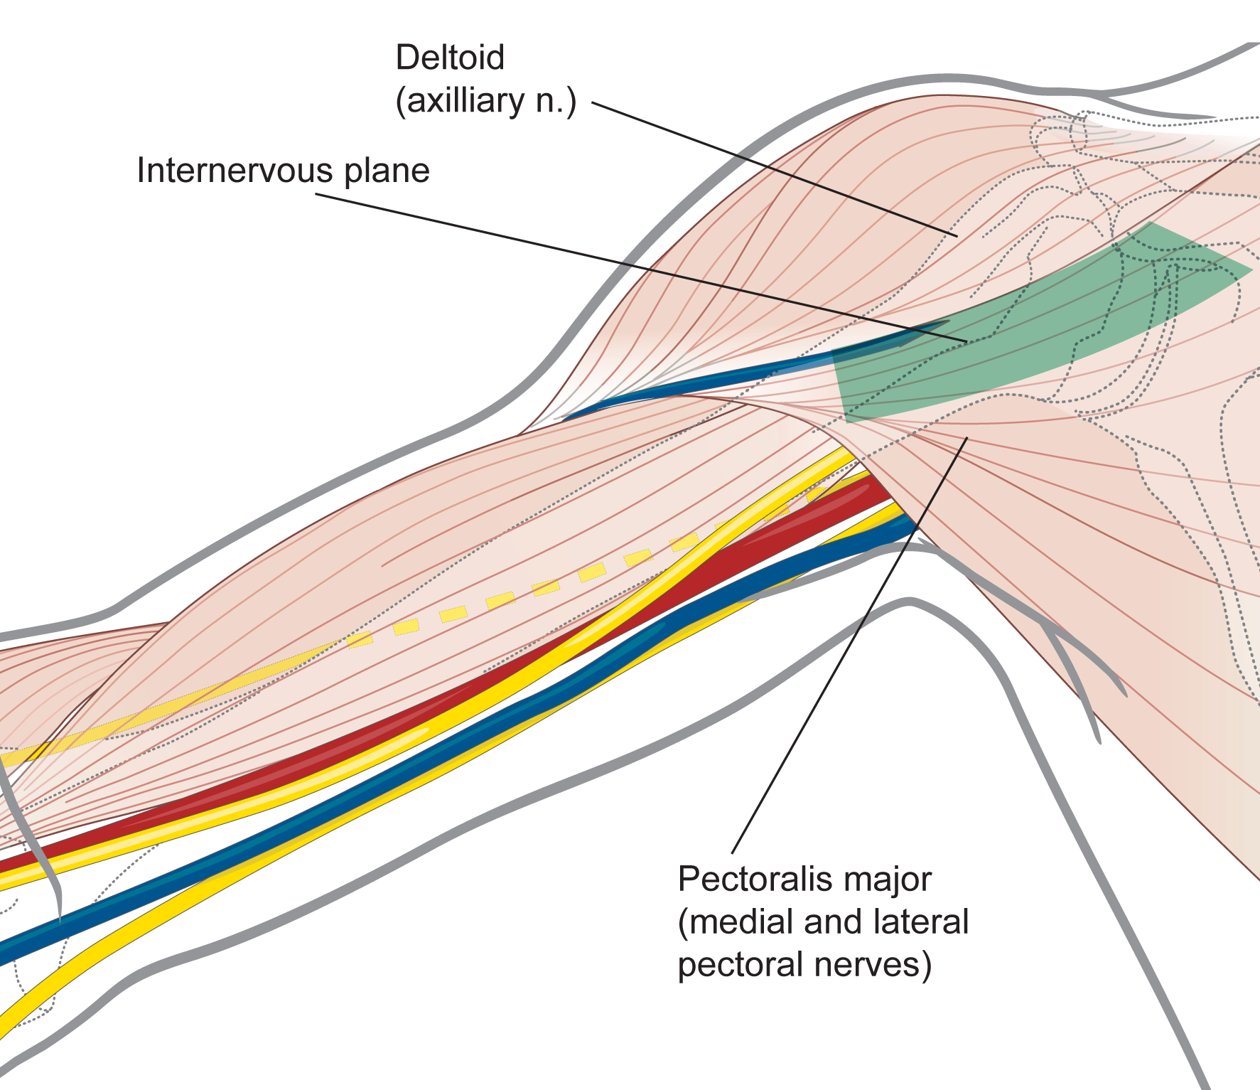
Internervous plane—approach to proximal humerus and shoulder
Notes:
The internervous plane used in the anterior approach to the shoulder and proximal humerus lies between the deltoid muscle supplied by the axillary nerve and the pectoralis major muscle supplied by the medial and lateral pectoral nerves.

Slide 8
Percutaneous approaches—critical features
Fracture | Must be reduced or be reducible without open surgery
Landmarks | Palpation of bony landmarks is not sufficiently accurate Imaging before incision is therefore mandatory, usually with image intensifier
Internervous plane | Not critical but beware of vital anatomical structures
Superficial and deep dissection | Not carried out
Dangers | Damage to vital structures
Surgical extension | Never possible
Notes:
Spell check?

Slide 9
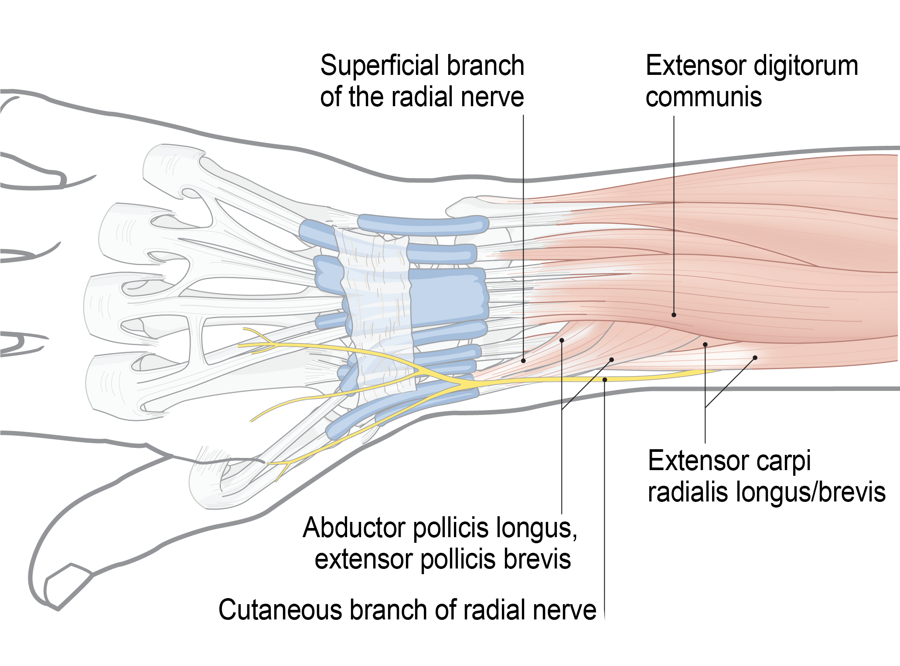
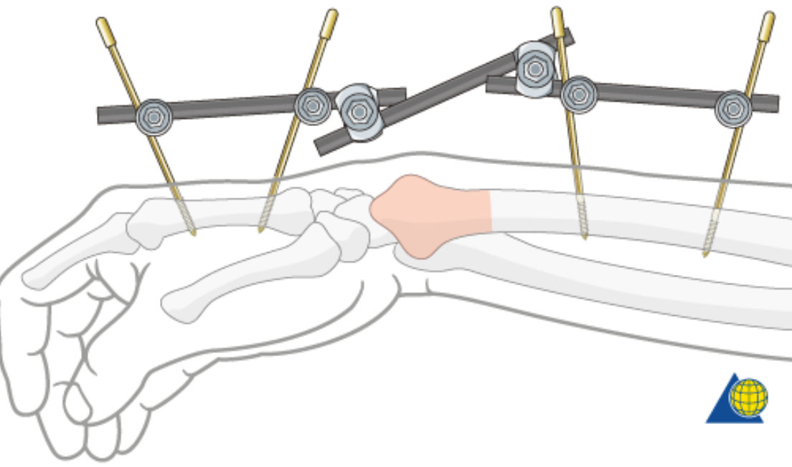
Percutaneous approaches—dangers
External fixator pins inserted in the distal radius may hit superficial radial nerve
Notes:
The external fixator shown does not cross the joint and is only suitable for type A fractures.

Slide 10
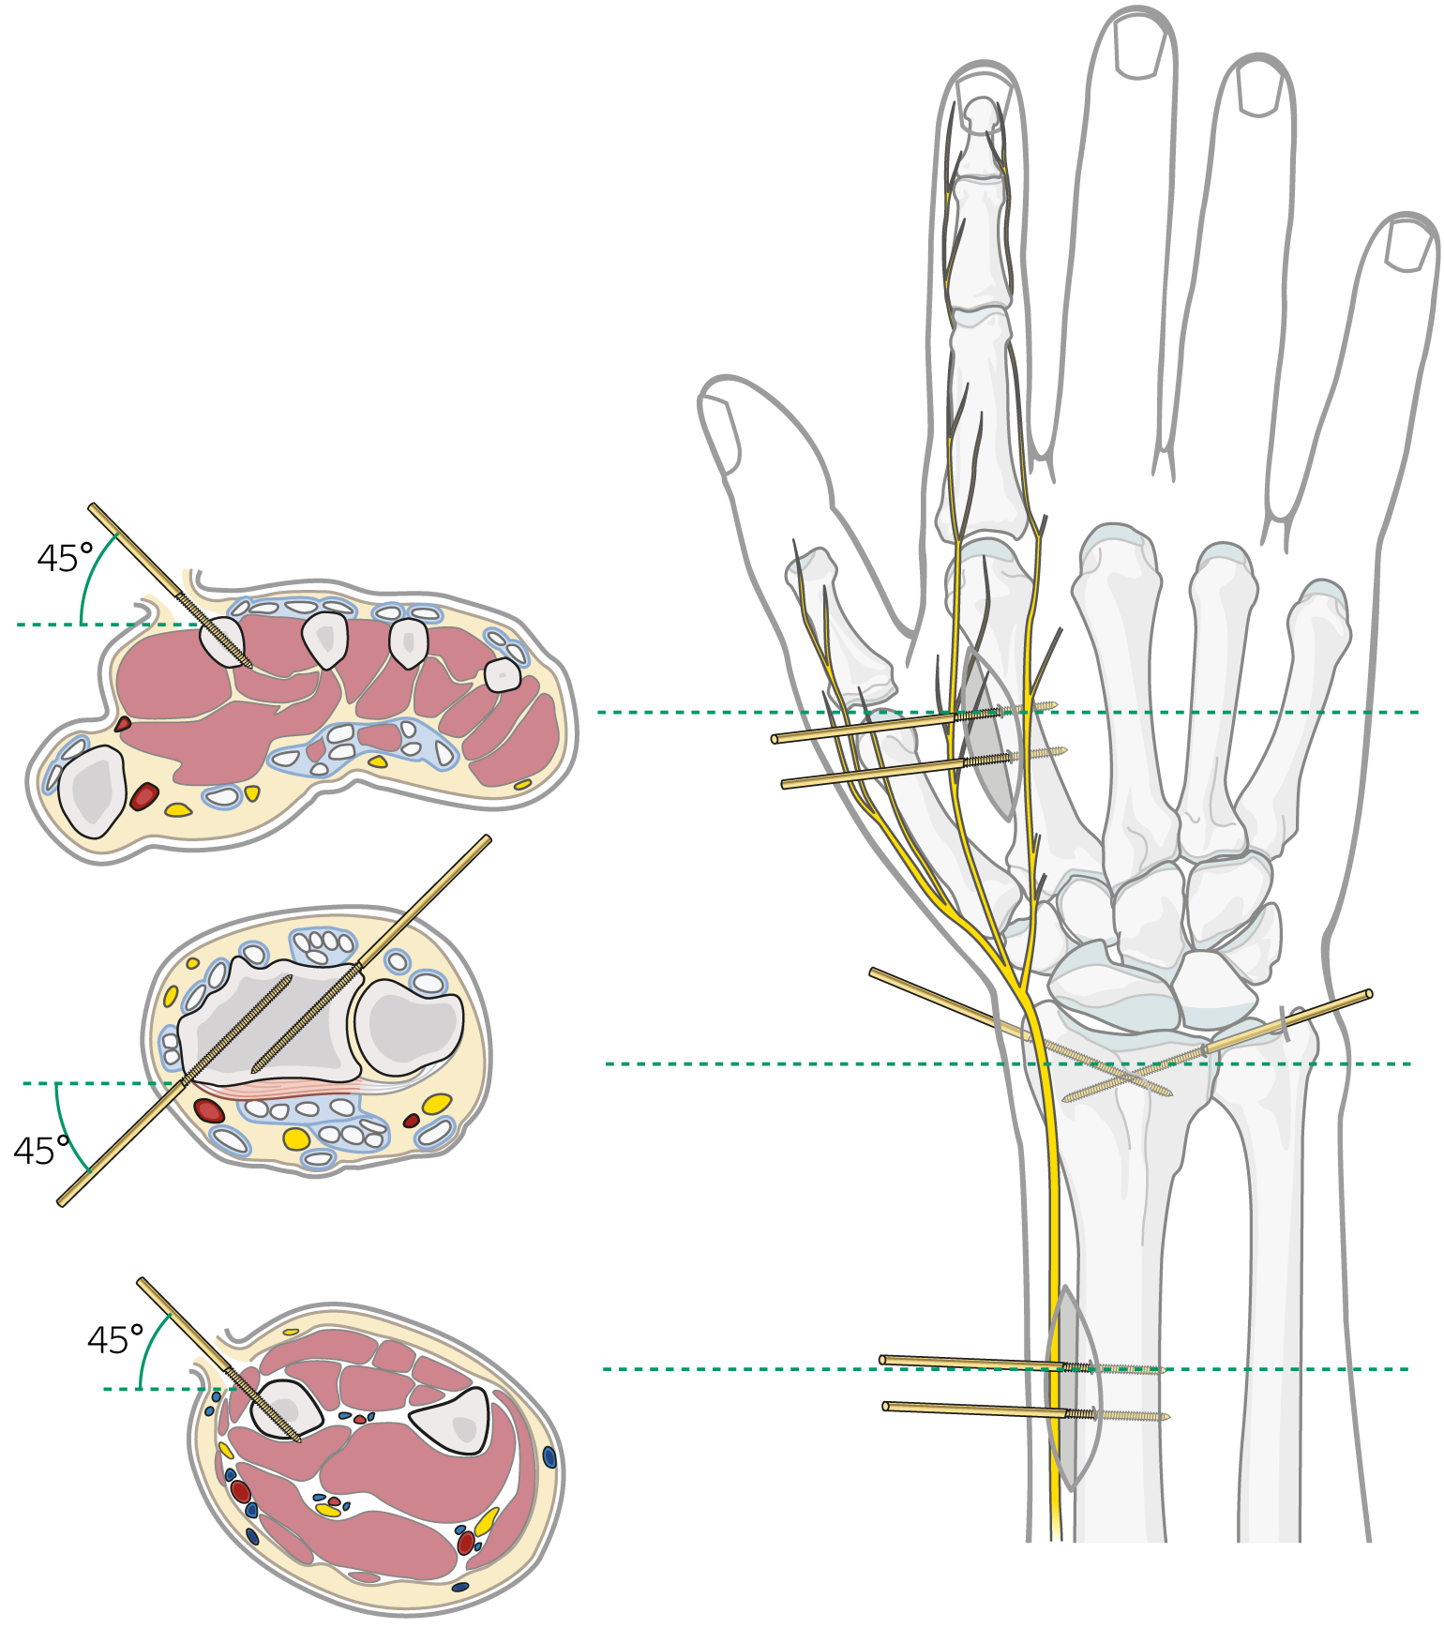
Percutaneous approach to distal radius—no safe stab incisions
Always make a mini surgical approach and look for the nerve

Slide 11
Percutaneous approaches—dangers
What is this?
This is a targeting
device for hitting
the radial nerve
Notes:
The most proximal of the two distal locking bolts will be within 1 cm of the radial nerve. Therefore AP locking bolts are preferred.

Slide 12
Minimally invasive surgical approaches—critical features
Fracture | Must be reduced or reducible without direct access to the fracture
Landmarks and incision | Palpation is not accurate enough Image guidance is mandatory
Internervous plane | Used in windows technique
Superficial and deep dissection | Can either be onto a subcutaneous surface or via a window of an open approach
Dangers | Damage to vital structures in the unexposed zone
Surgical extension | Usually not possible

Slide 13
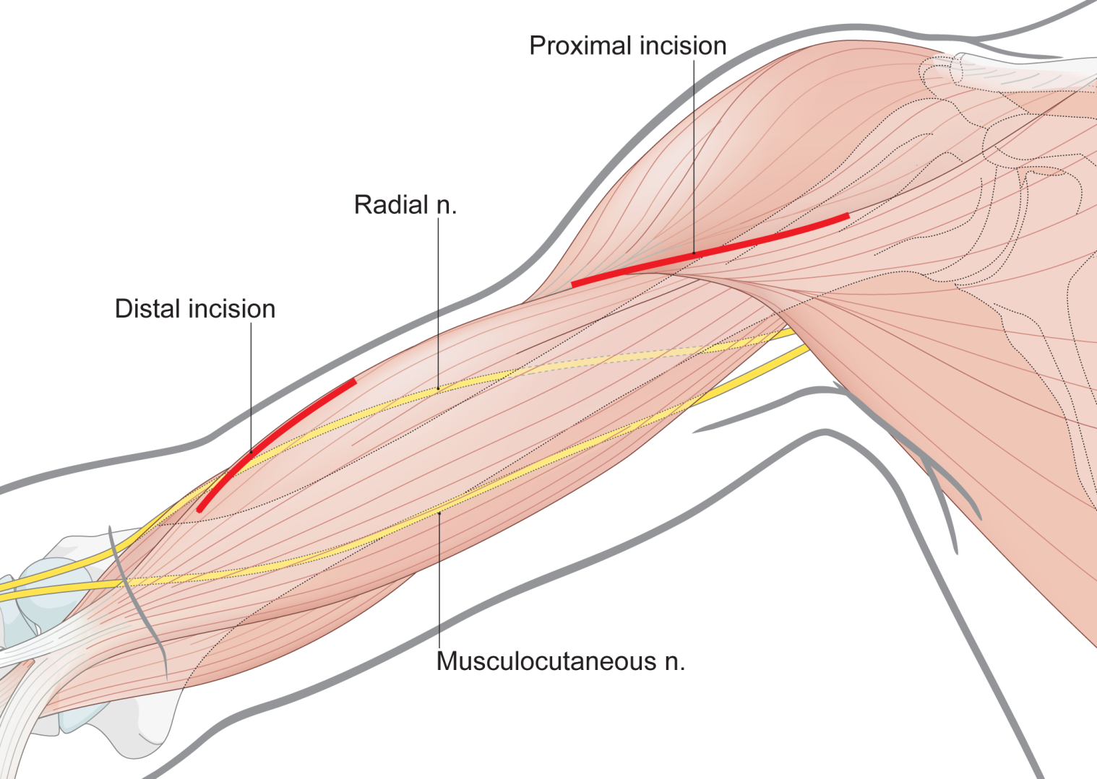
Minimally invasive anterior approach to humerus—skin incisions
Notes:
The upper skin incision is part of the anterior approach to the shoulder. The lower skin incision is part of the anterolateral approach to the humerus.

Slide 14
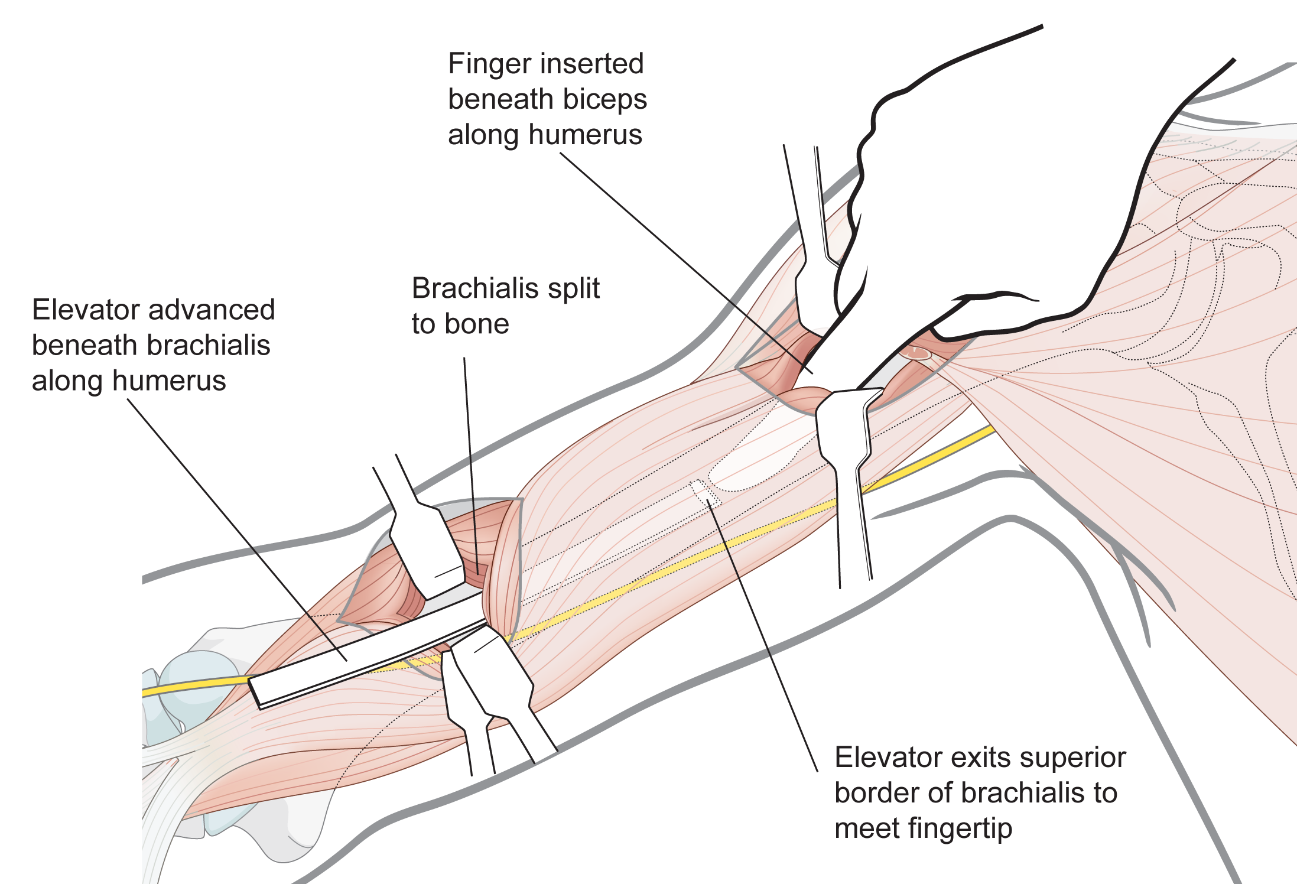
Minimally invasive anterior approach to humerus—connecting the two windows
Notes:
Proximally develop the internervous plane between the pectoralis major supplied by the medial and lateral pectoral nerves and the deltoid supplied by the axillary nerve. Distally identify the plane between the biceps brachii and the brachialis muscles.
Distally retract the biceps brachii and then split the brachialis muscle to approach the anterior surface of the humerus. This is an internervous plane because the brachailis muscle receives a dual nerve supply. On the medial side the nerve supply is from the musculocutaneous nerve and the radial nerve supplies the lateral side.

Slide 15
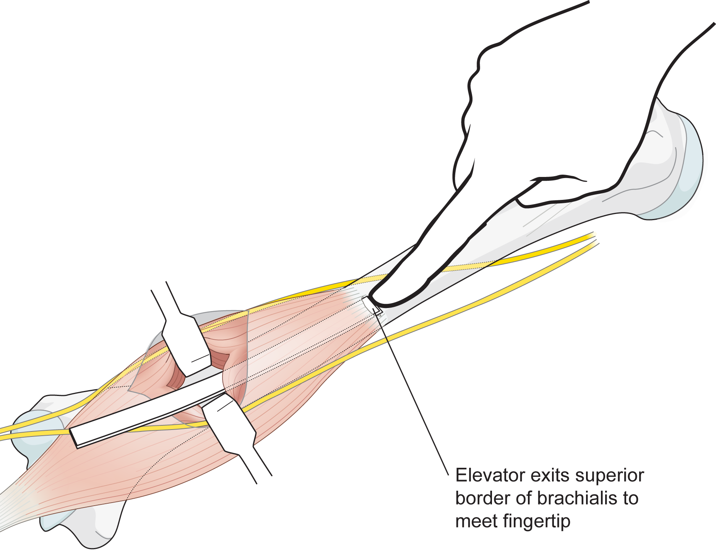
Minimally invasive anterior approach to humerus—developing the deep plane
Notes:
Develop a plane on the anterior surface of the humerus using blunt dissection.

Slide 16
Open surgical approach—critical features
Fracture | Need not be reduced or be reducible by closed methods
Landmarks and incision | Bony landmarks are sufficiently accurate for incisions to be made Image intensifier is not necessary but is useful to localize the approach accurately
Internervous plane | Essential if the approach is to be safe
Superficial and deep dissection | Gentle, atraumatic, and avoid fierce retraction
Dangers | Fracture trauma may distort normal anatomy
Surgical extension | Usually possible and safe

Slide 17
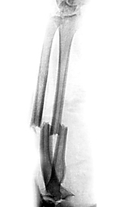
Plating of forearm
Absolute stability
Open reduction
Anatomical reduction
Notes:
Forearm plating is probably the best indication for an open surgical approach because anatomical reduction is usually required to achieve absolute stability

Slide 18
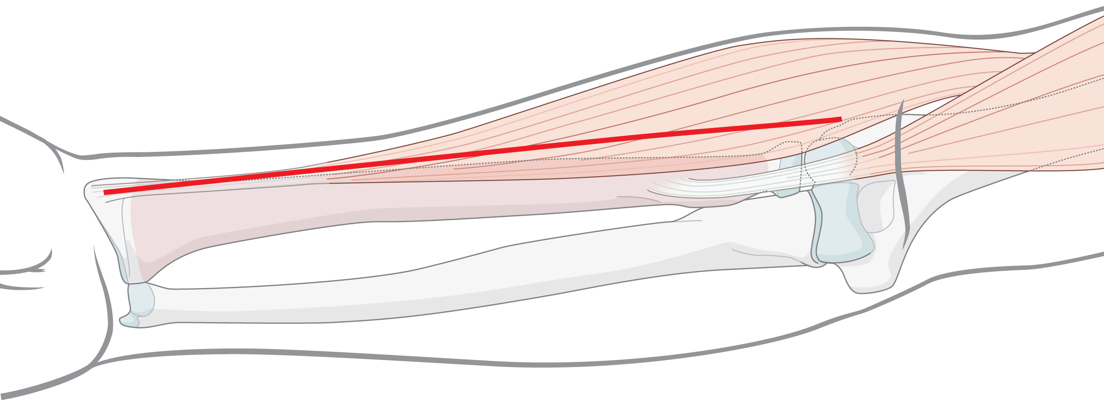
Open surgical approaches—landmarks
Styloid process of radius
Midline of elbow crease
Notes:
The skin incision runs from the styloid process of the radius to the midline at the elbow joint crease. You will normally only require a small part of this incision.

Slide 19
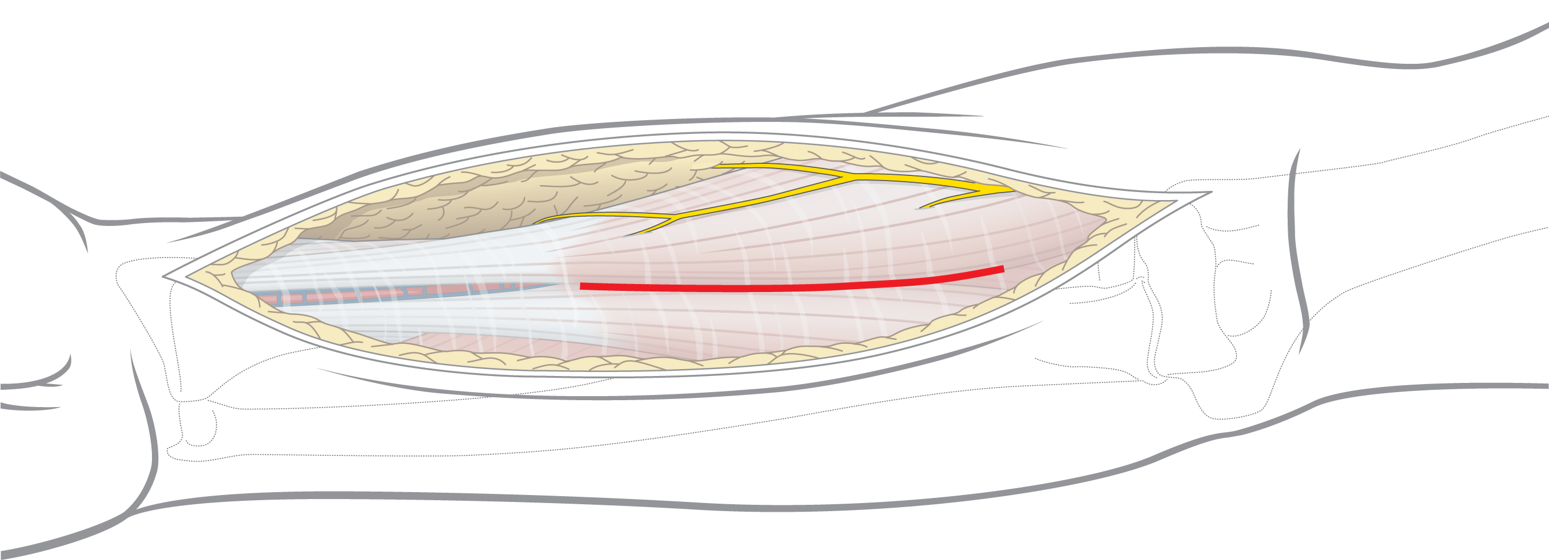
Open surgical approaches—internervous plane
Brachioradialis
Flexor carpi radialis
Notes:
Indentify the plane between the flexor carpi radialis and the brachioradialis. Proximally this plane is more medial than you think.

Slide 20
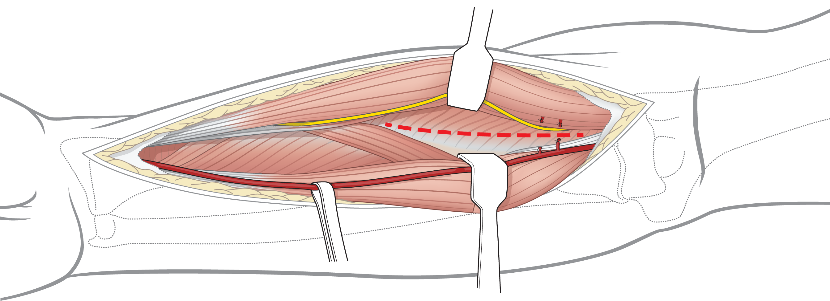
Open surgical approaches—deep surgical dissection
Insertion of supinator
Superficial radial nerve
Radial artery
Recurrent radial artery - divided
Notes:
Develop a plane separating the brachioradialis from the flexor carpi radialis to reveal the underlying supinator muscle. To do this you will need to divide numerous branches of the radial artery which run into the substance of brachioradialis. Observe the superficial radial nerve.

Slide 21
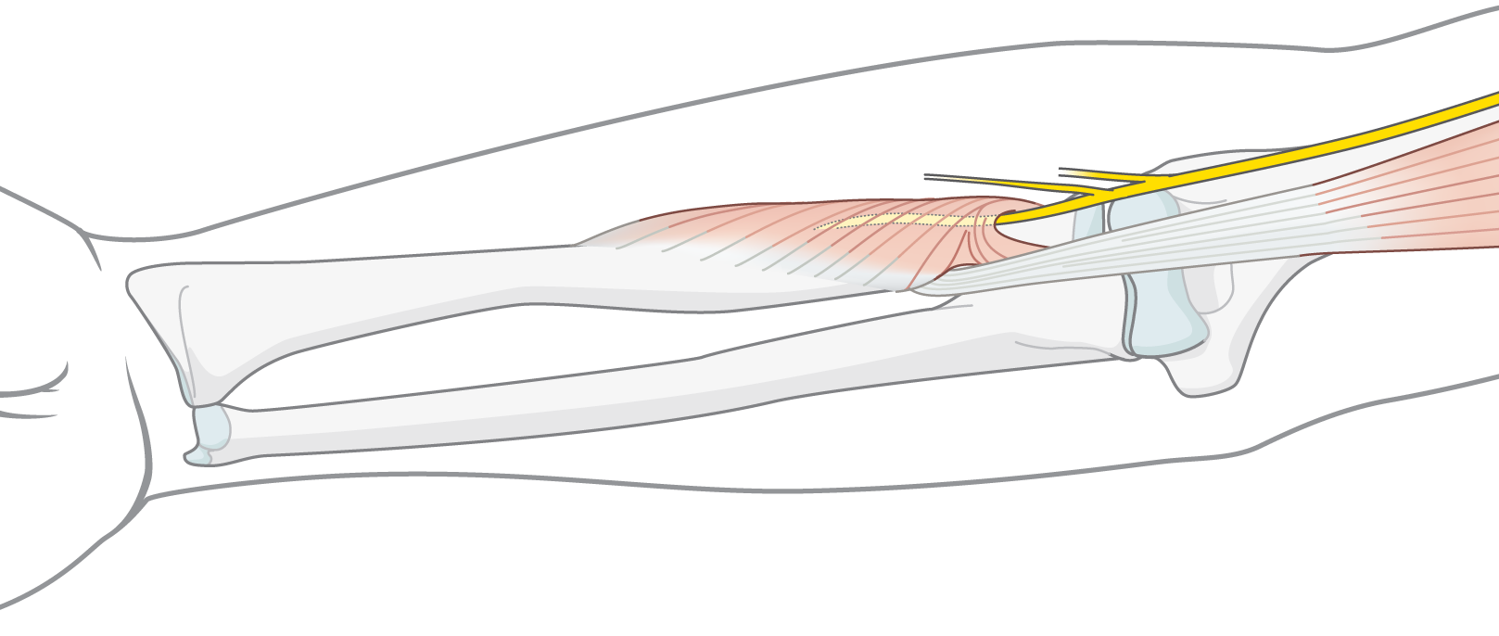
Dangers—how to avoid the posterior interosseous nerve
Posterior interosseous nerve
Incision of insertion of supinator
Fully supinate the forearm to take the posterior
interosseous nerve away from the surgical field
Notes:
Fully supinate the forearm to take the posterior interosseous nerve away from the plane of dissection. Trace the biceps tendon down to its bursa. Identify the origin of the supinator muscle and detach the muscle from the bone. Do not put retractors around the radius to avoid compression of the posterior interosseous nerve.

Slide 22
Dangers—how to avoid the posterior interosseous nerve
Detach the insertion of supinator
Don’t cut through the muscle

Slide 23
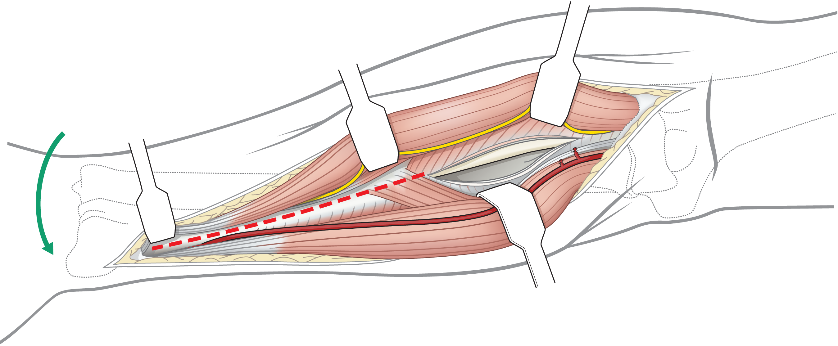
Open surgical approaches—deep surgical dissection
Insertion of pronator teres
Fully pronate the forearm to expose the insertion of pronator teres
Notes:
To achieve access more distally detach the insertion of pronator teres.

Slide 24
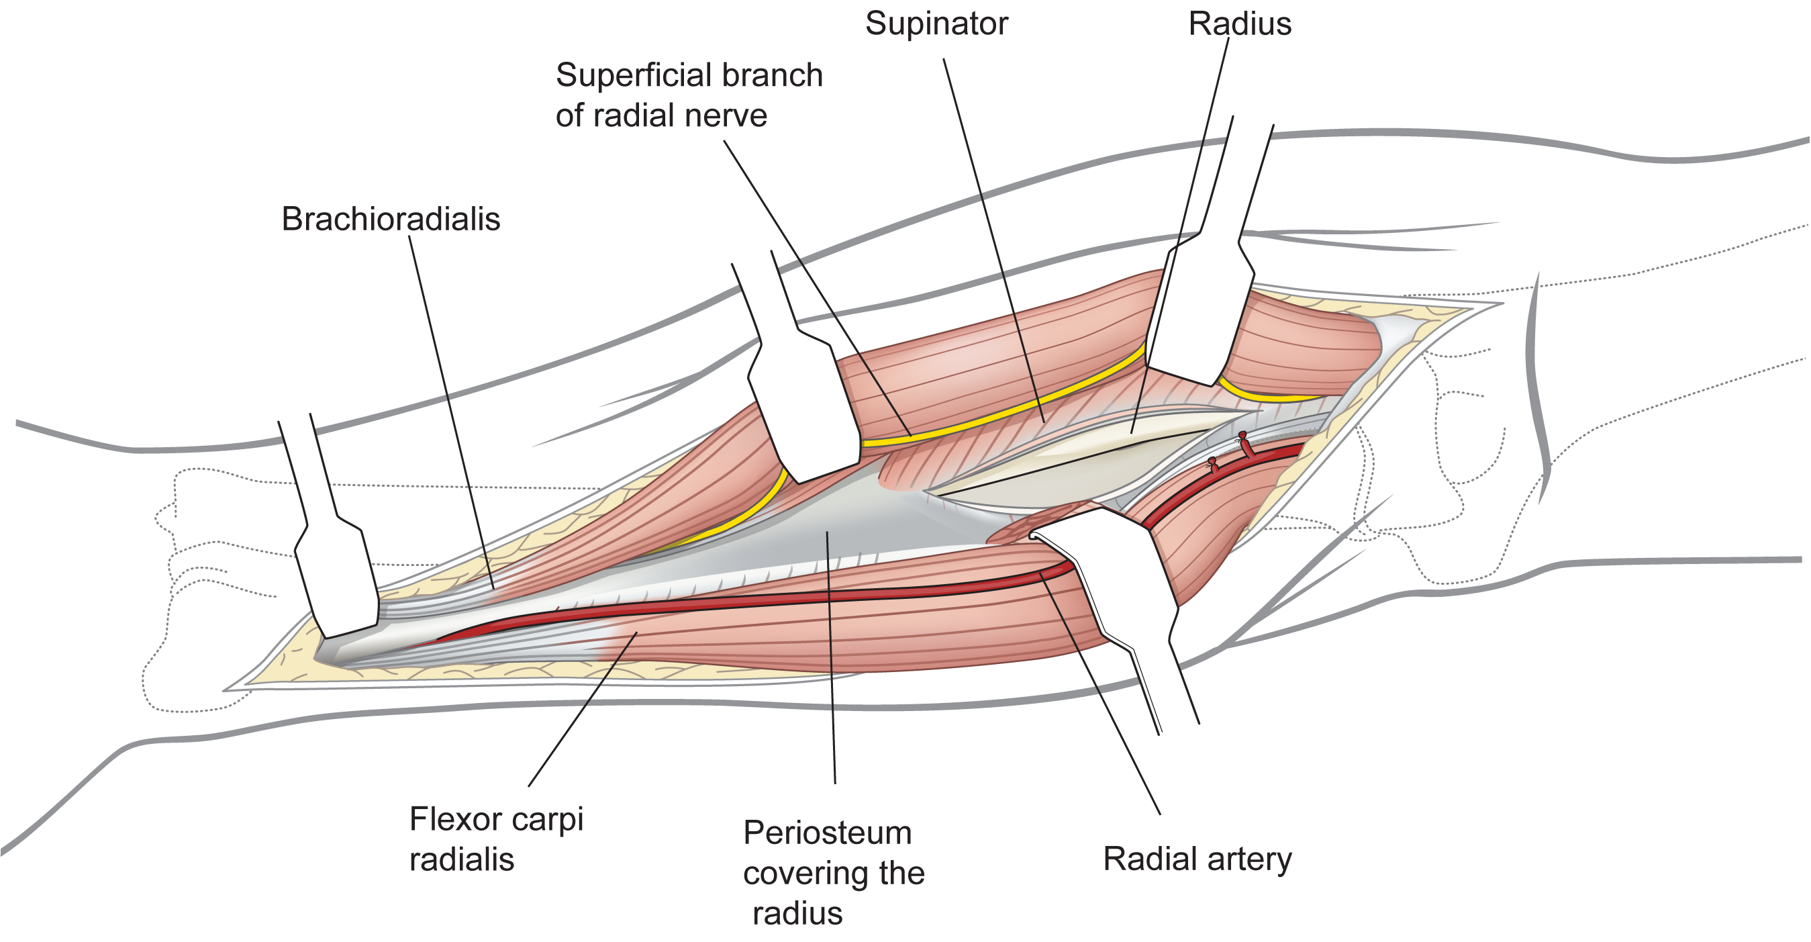
Open surgical approaches—the bone
Notes:
More distally, divide the pronator quadratus.

Slide 25
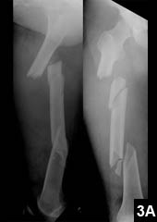
How do you plan your surgical approach?
Do I require anatomical reduction?
No—minimally invasive approaches are indicated

Slide 26
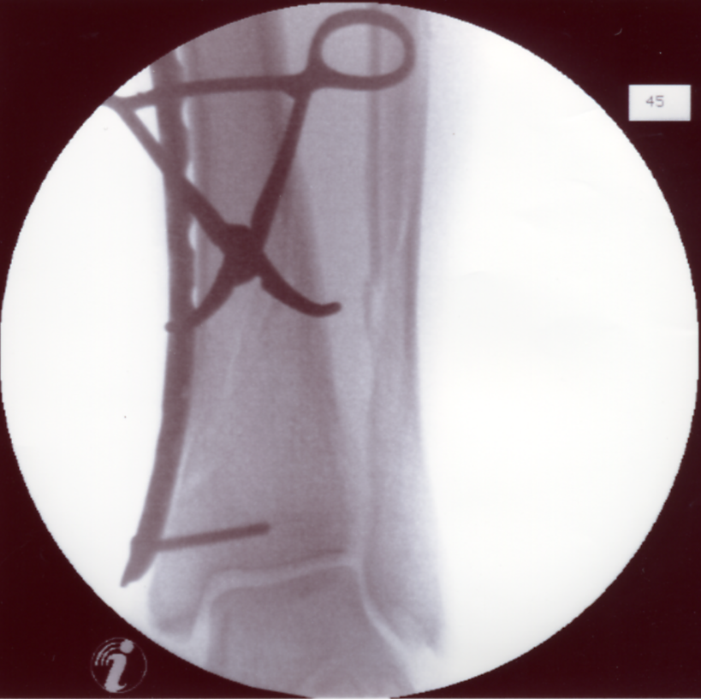
How do you plan your surgical approach?
Do I require anatomical reduction?
Yes—but can I achieve it by closed means?
Yes—minimally invasive surgery is possible in expert hands

Slide 27
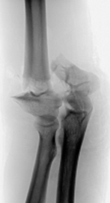
How do you plan your surgical approach?
Do I require anatomical reduction?
Yes—but can I achieve it by closed means?
No—formal open approach is necessary

Slide 28
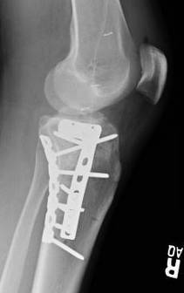
How do you plan your surgical approach?
Do I require absolute stability?
Yes—go for formal open approach techniques unless you are an expert with great imaging and special equipment or the fracture is very simple
No—minimally invasive approaches are indicated

Slide 29
How do you plan your surgical approach?
Type A:
More likely to require anatomical reduction to achieve absolute stability
Therefore, more likely to use an open approach
Type C:
Very unlikely to require anatomical reduction
Relative stability usually desirable
Therefore, more likely to use minimally invasive approach

Slide 30
Surgical approaches in trauma surgery
What types of surgical approaches exist?
What are the characteristics of a surgical approach?
What are the critical features of each type of approach?
How should fracture type affect the approach used to treat an individual fracture?

Slide 31
Take-home messages
There are three types of surgical approaches:
Percutaneous
Minimally invasive
Open
All types of surgical approach require detailed knowledge of anatomy
Choice of approach depends on fracture anatomy, soft-tissue conditions, and surgeon experience
Surgical approach must always be part of the preoperative plan

