Slide 1
AO/OTA Fracture and Dislocation Classification 2018—Review
AO Trauma Basic Principles Course

Slide 2
Learning objectives
Recognize the need and purpose of a fracture classification system
Describe the fracture and dislocation classification system and its clinical importance for decision-making and preoperative planning
Outline the structure of this classification for long-bone fractures
Name the bone segments and use their numerical code
List types, groups, subgroups, qualifiers, and universal modifiers
Properly classify long-bone fractures

Slide 3
Introduction
Fracture description based on terminology from the Müller Comprehensive Classification of Long Bone Fractures
Provides standard terminology for consistent communication between colleagues
Has an alphanumerical code for each injury or fracture:
Allows for data storage
Allows for recall for research and clinical use

Slide 4
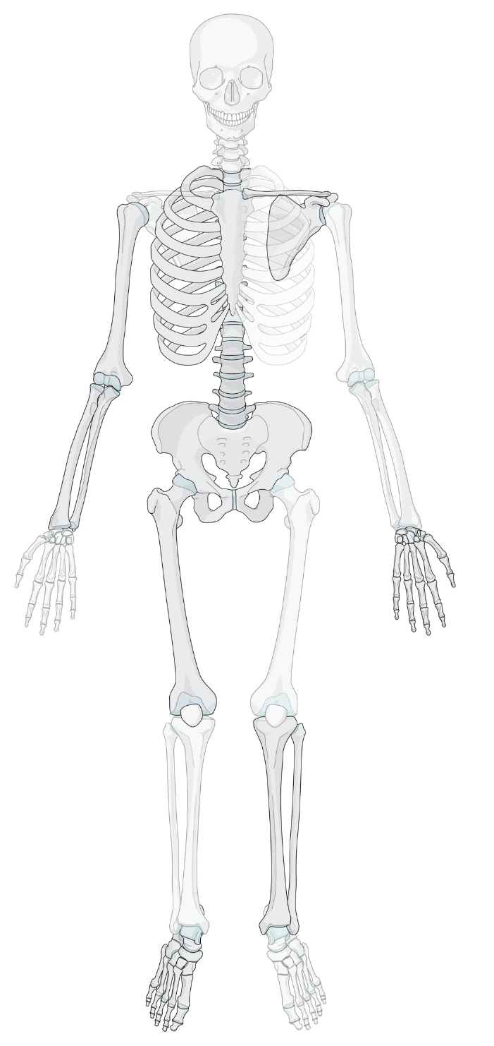
Location—bone
Humerus 1
Radius 2R/Ulna 2U
Femur 3
Tibia 4/Fibula 4F
Malleolar segment 44
1
2R
2U
4F
4
44
Notes:
The humerus is allocated bone code 1, the forearm bones are now coded separately so the radius is 2R and the ulna is 2U, the femur 3, and tibia (now coded separately from the fibula) is 4. The bone code for fibula is 4F. The malleolar segment remains 44.

Slide 5
Location—bone and segment
Proximal end segment 1
Diaphyseal segment 2
Distal end segment 3
Exception—31
Defined as above a line at the inferior aspect of the lesser trochanter
Bone
Segment
Type
Group
Subgroup
Location
Morphology
Notes:
The clear distinction between the segments must be defined.
The metaphyseal segments are demarcated by a square, the dimensions of which correspond to the maximum width of the metaphysis. This creates two end segments: the proximal end segment is given the number 1 and the distal end segment is given the number 3.
The diaphyseal segment 2 is the bone between the two end segments.

Slide 6
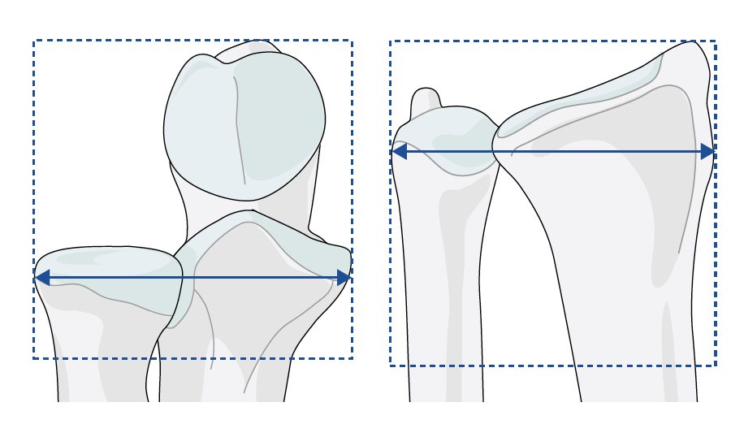
End segment determination
The end segment is determined by a square whose sides are
equal to the widest part of the epiphysis of the involved bone
Notes:
The end segment determination remains the same using the square defined by the widest distance of the metaphyseal epiphyseal block. For two-bone systems the individual bones are classified separately but the end segment determination remains as previously using both bones together.

Slide 7
Morphology—type, group, and subgroup
Description of the fracture
Type | A | B | C
Type + Group | A1 A2 A3 | B1 B2 B3 | C1 C2 C3
Type + Group + Subgroup | A1.1, A1.2, A1.3 A2.1, A2.2, A2.3 A3.1, A3.2, A3.3 | B1.1, B1.2, B1.3 B2.1, B2.2, B2.3 B3.1, B3.2, B3.3 | C1.1, C1.2, C1.3 C2.1, C2.2, C2.3 C3.1, C3.2, C3.3
Bone
Segment
Type
Group
Subgroup
Location
Morphology
Notes:
The morphology of the fracture is expressed by dividing fracture patterns into 3 types (A, B, and C), and then further subdividing into three groups (1, 2, and 3), and then three subgroups (.1, .2, and .3).
Each subdivision increases the precision of categorization.

Slide 8
Severity and complexity
The morphology of the fracture is presented in the types (an upper case letter), groups (number), and subgroups (number)
The progression from A to C denotes increasing fracture morphology complexity and difficulty of management, as does the numerical coding
The 2018 revision has further defined the morphology by the use of universal modifiers and fracture-specific qualifiers

Slide 9
Morphology—diaphyseal types
Morphology—diaphyseal types
Simple A
12
2R2
2U2
32
42
4F2
12
2R2
2U2
32
4F2
42
Wedge B
42
Multifragmentary C
Bone
Segment
Type
Group
Subgroup
Location
Morphology
Notes:
Diaphyseal fractures are divided into types according to the complexity of the fracture pattern.
Simple, Type A, is a single plane fracture.
Wedge, Type B, is a fracture with a separate wedge, but with contact between the two main fragments after reduction.
Multifragmentary, Type C, is a fracture with no contact between the two main fragments after reduction and the fractured portion is removed.

Slide 10
Morphology—diaphyseal types
Morphology—diaphyseal types
Simple A
32
Wedge B
Multifragmentary C
Bone
Segment
Type
Group
Subgroup
Location
Morphology
Notes:
Diaphyseal fractures are divided into types according to the complexity of the fracture pattern.
Simple, Type A, is a single plane fracture.
Wedge, Type B, is a fracture with a separate wedge, but with contact between the two main fragments after reduction.
Multifragmentary, Type C, is a fracture with no contact between the two main fragments after reduction and the fractured portion is removed.

Slide 11
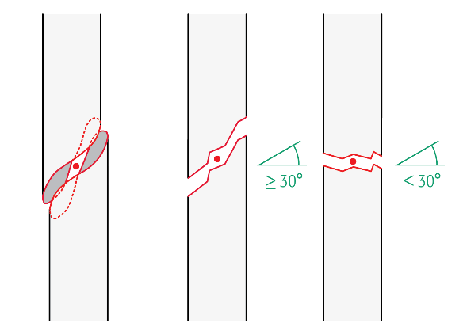
Morphology—diaphyseal groups
Bone
Segment
Type
Group
Subgroup
2U
2R
12-
32-
4F
42-
Location
Morphology
Spiral Oblique Transverse
Intact
Fragmentary
Intact Fragmentary
A1
A2
A3
B2
B3
C2
C3
Notes:
The diaphyseal types are each further subdivided into three diaphyseal groups.
A are simple fractures with one fracture line:
A1 is a spiral single plane fracture.
A2 is a single plane oblique fracture angled more than 30° from the transverse axis of the bone.
A3 is a single plane oblique fracture angled less than 30° from the transverse axis of the bone.
B fractures are wedge fractures so that after reduction the proximal and distal fragments will have contact allowing for the determination of length and alignment:
B2 is an intact wedge fracture (wedge is one piece).
B3 is a fragmentary wedge fracture (wedge is in more than one piece).
C are multifragmentary fractures meaning that after reduction if the fractured fragment or fragments are removed there will be no contact between the proximal and distal main fragments:
C2 is an intact segmental fracture.
C3 is an fragmentary segmental.

Slide 12
Morphology—diaphyseal groups
Spiral Oblique Transverse
Intact
Fragmentary
Intact Fragmentary
A1
A2
A3
B2
B3
C2
C3
Bone
Segment
Type
Group
Subgroup
Location
Morphology
Notes:
The diaphyseal types are each further subdivided into three diaphyseal groups.
A are simple fractures with one fracture line:
A1 is a spiral single plane fracture.
A2 is a single plane oblique fracture angled more than 30° from the transverse axis of the bone.
A3 is a single plane oblique fracture angled less than 30° from the transverse axis of the bone.
B fractures are wedge fractures so that after reduction the proximal and distal fragments will have contact allowing for the determination of length and alignment:
B2 is an intact wedge fracture (wedge is one piece).
B3 is a fragmentary wedge fracture (wedge is in more than one piece).
C are multifragmentary fractures meaning that after reduction if the fractured fragment or fragments are removed there will be no contact between the proximal and distal main fragments:
C2 is an intact segmental fracture.
C3 is an fragmentary segmental.

Slide 13
Morphology—end segment types
Extraarticular fracture
Does not enter the joint—type A
A
Partial articular fracture
Part of the joint remains in continuity with the diaphysis—type B
B
Complete articular fracture
No part of the joint remains in continuity with the diaphysis—type C
C
Bone
Segment
Type
Group
Subgroup
Location
Morphology
Notes:
End segment (metaphyseal) types are:
Extraarticular, type A, no joint involvement
Partial articular, type B, a portion of the joint surface remains in continuity with the diaphysis
Complete articular, type C, none of the joint surface remains in continuity with the diaphysis

Slide 14
Exception: 11 Humerus, proximal types
Bone
Segment
Type
Group
Subgroup
Location
Morphology
Notes:
The proximal humeral types are defined as:
11A Extraarticular, unifocal, 2-part fracture
11B Extraarticular, bifocal, 3-part fracture. This is not an intraartiuclar fracture.
11C Articular or 4-part fractures
Also note that the Neer classification has been integrated into the description.

Slide 15
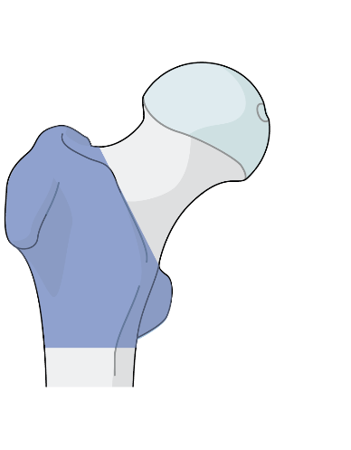
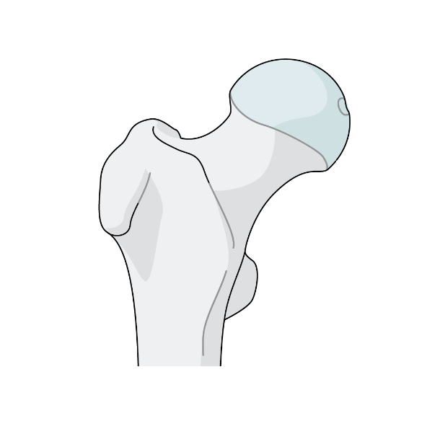
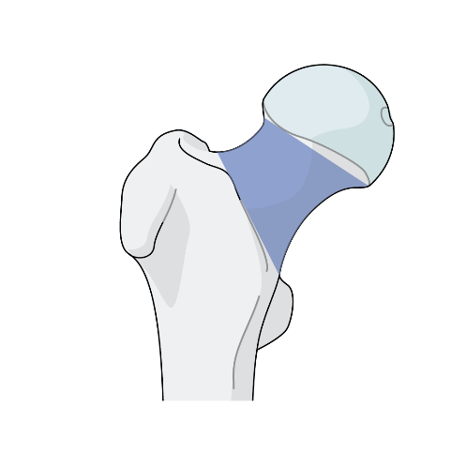
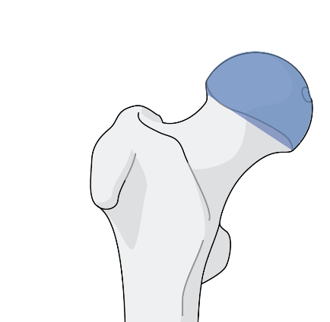
Exception: 31 Femur, proximal end segment types
A
Trochanteric area fracture
31
B
Neck fracture
Bone
Segment
Type
Group
Subgroup
C
Location
Morphology
Head fracture
Notes:
The proximal femoral end segment is not determined by the Rule of Squares but is defined as being above a line perpendicular to the femoral shaft located at the inferior margin of the lesser trochanter. The proximal femoral end segment types are defined as:
Trochanteric region fracture 31A
Femoral neck fracture 31B
Femoral head fracture 31C

Slide 16
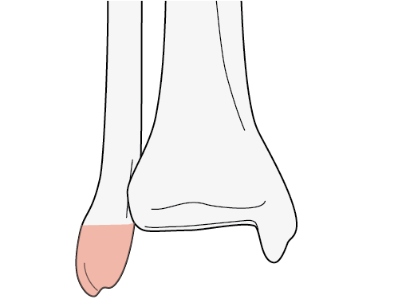
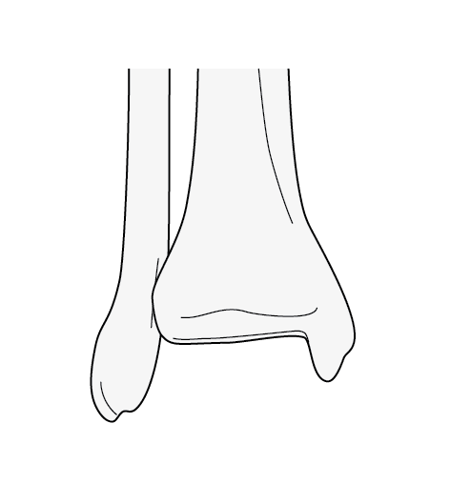
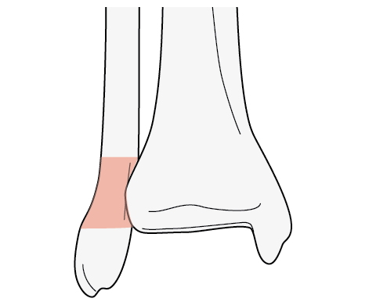
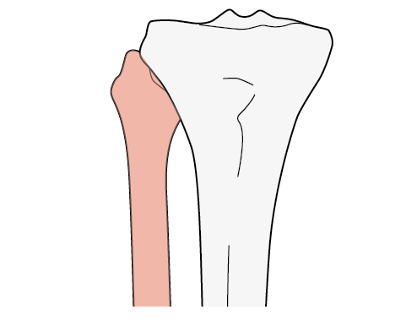
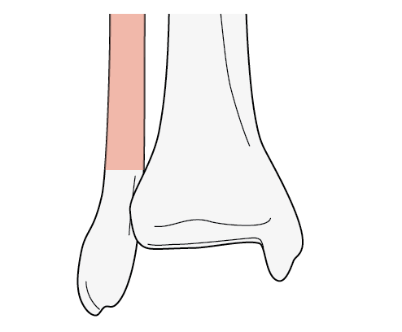
44 Malleolar types
A
44
B
Bone
Segment
Type
Group
Subgroup
C
Location
Morphology
Notes:
In the malleolar segment, the types are defined as:
Infrasyndesmotic lateral lesion 44A
Transyndesmotic lateral lesion 44B
Suprasyndesmotic lateral lesion 44C

Slide 17
Universal modifiers
Many qualifications were similar for many fractures
Combinations of injuries, eg, fracture dislocation, are difficult to classify consistently
Additional modifiers were requested
As a consequence:
A list of modifiers common to all fractures has been created
They may be applied as deemed necessary by the user
Modifiers are added at the end of the code in square brackets [ ]
Multiple modifiers can be used separated by a comma, eg, [2, 5a, 9]

Slide 18
Qualifications
Descriptive terms of fracture morphology or location—fracture specific
Example:
a Proximal third b Middle third c Distal third
These are qualifications and are listed with the specific fracture
Optional—applied to the fracture code as lower case letter within round brackets ( )
Multiple qualifications can be applied, eg, (a, b)

Slide 19
Universal modifiers
Combinations of injuries, eg, fracture dislocation, are difficult to classify
As a consequence:
A list of modifiers common to all fractures has been created
Modifiers are added at the end of the code in square brackets [ ]
Multiple modifiers can be used separated by a comma, eg, [2, 5a, 9]

Slide 20
Qualifications
Descriptive terms of fracture morphology or location—fracture specific
These are qualifications and are listed with the specific fracture
Optional—applied to the fracture code as lower case letter within round brackets ( )
Multiple qualifications can be applied, eg, (a, b)

Slide 21
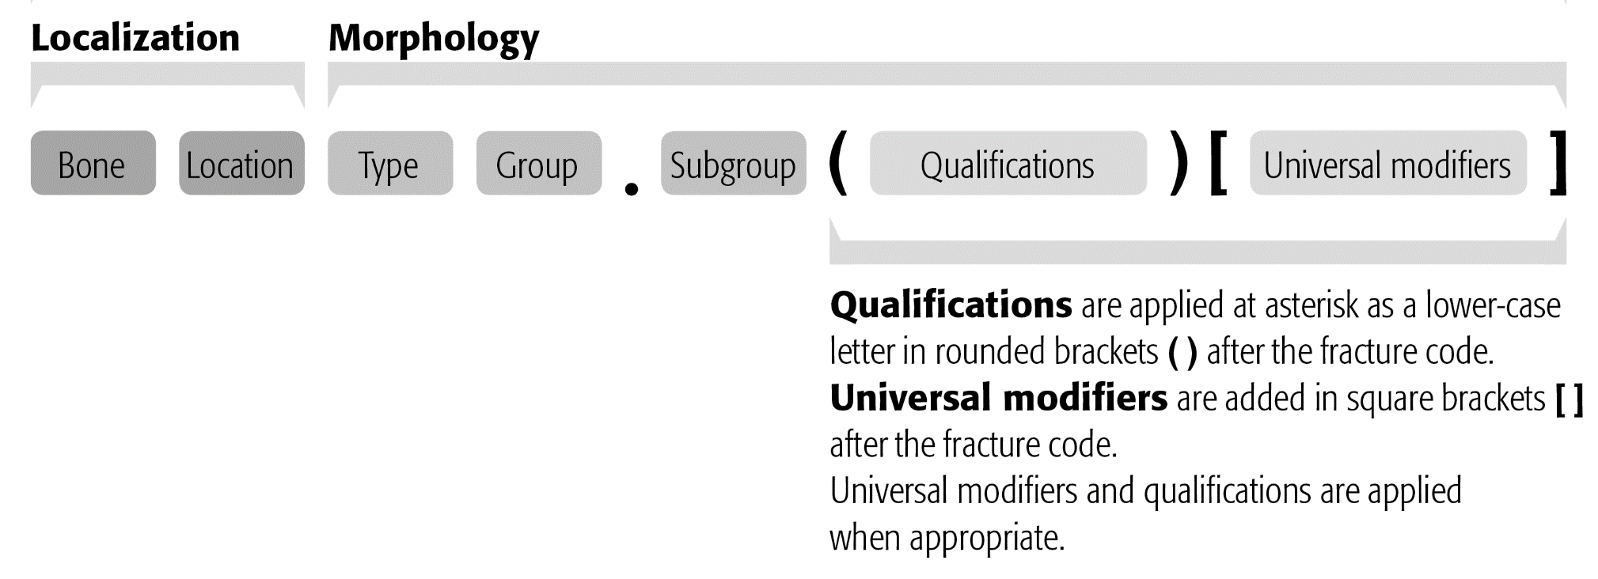
Alphanumerical code
Hyphen dropped due to potential error in data entry
Qualifications and/or universal modifiers can be added optionally (in any order at code end as identified by the brackets when searching)

Slide 22
Qualifications—example
Humerus, proximal end segment, articular or 4-part fracture, valgus impacted 11C1.1
To indicate both tuberosities are fractured, add qualification: for both tuberosities = (p)
Final code: Humerus, proximal end segment, articular or 4-part fracture, valgus impacted, and both tuberosities fractured = 11C1.1(p)

Slide 23
Combining qualifications and universal modifiers—example
Humerus, proximal end segment, articular or 4-part fracture, valgus impacted, and both tuberosities fractured 11C1.1(p)
To add anterior dislocation, use the universal modifier: with an anterior dislocation = [5a]
Final code: Humerus, proximal end segment, articular or 4-part fracture, valgus impacted, and both tuberosities fractured = 11C1.1(p)[5a]

Slide 24
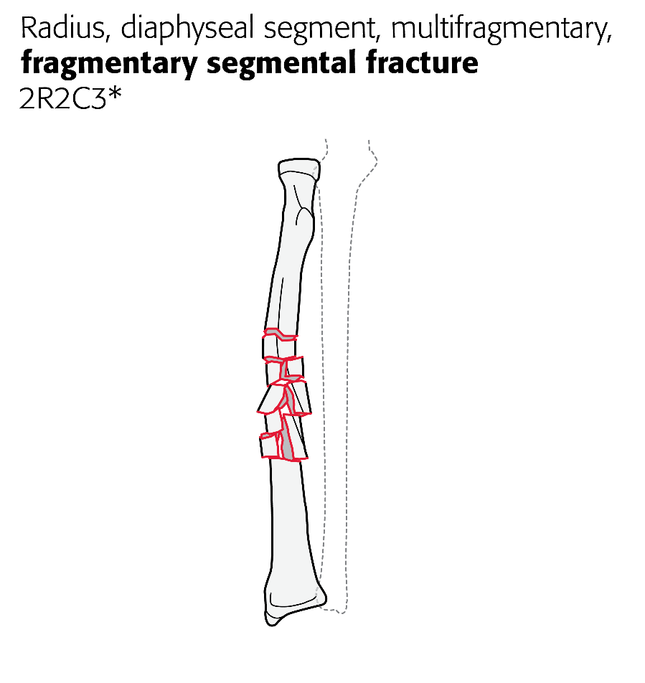
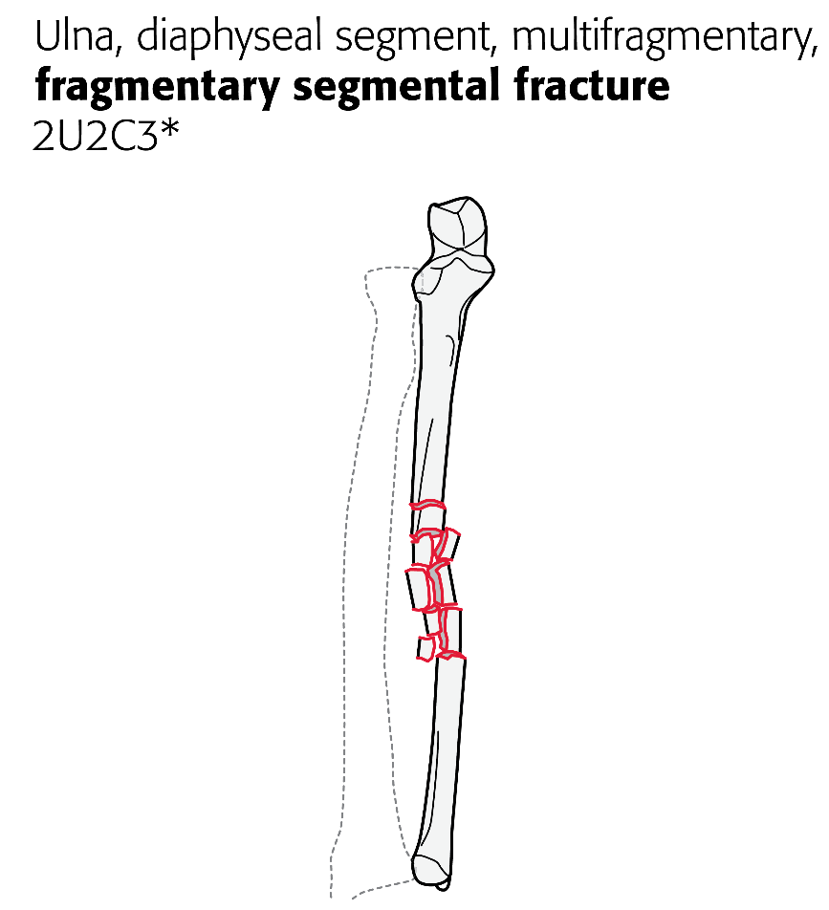
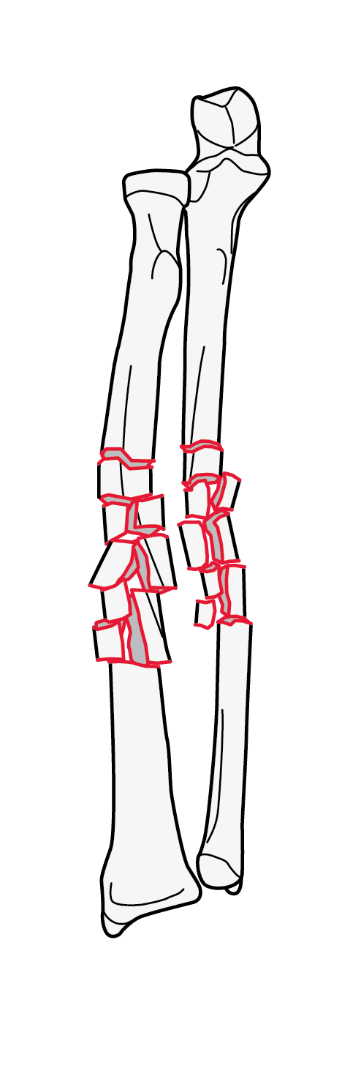
Radius (2R) and ulna (2U)—both-bone fractures coded separately
Notes:
By separating the coding of each bone, it is easier and more accurate to describe and code fractures of the radius and ulna. The radius is 2R and the ulna is 2U. Following this, the location as to segment is added and then the type, group, and subgroups as well as universal modifiers and qualifiers are added.
This an animated slide to show the two codes.

Slide 25
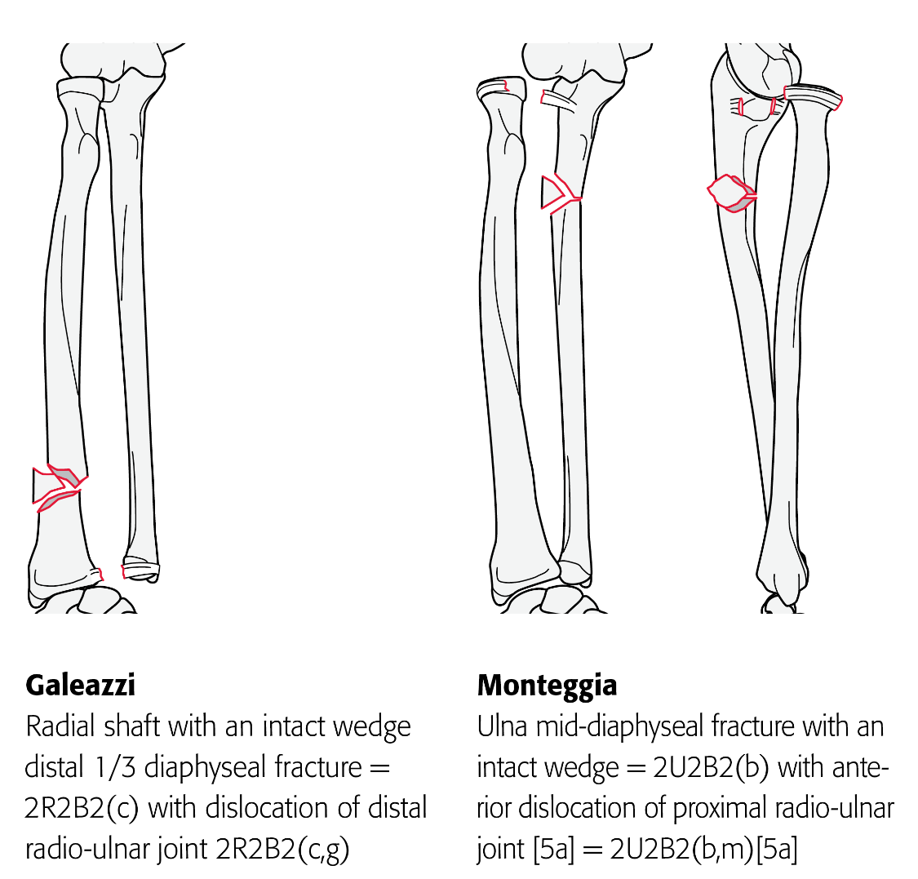
Galeazzi and Monteggia fractures
These are coded using the qualifications (g) and (m):
Dislocation direction added from universal modifier list

Slide 26
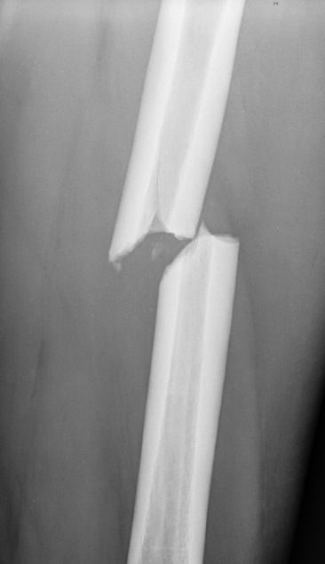
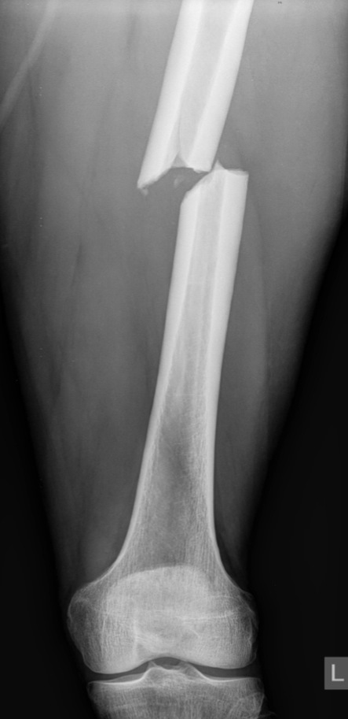
Location and morphology
Femur, diaphyseal
Simple, transverse
Mid diaphysis
32A3
Qualifiers for diaphyseal fractures for location: a Proximal third b Middle third c Distal third
32A3(b)
Notes:
Ask participants to categorize this fracture.
This is animated to allow the description and coding by the participant to proceed in steps.

Slide 27
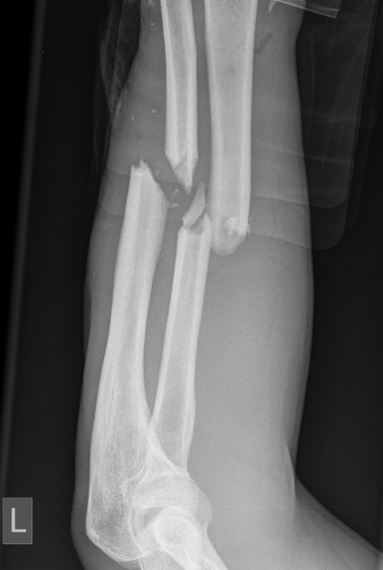
Location and morphology
Radius, diaphyseal
Wedge, intact, middle
2R2B2(b)
Qualifiers for diaphyseal fractures for location: a Proximal third b Middle third c Distal third
Ulna, diaphyseal
Simple
Oblique, middle
2U2A2(b)
Notes:
Ask participants to categorize this fracture.
This is animated to allow the description and coding by the participant to proceed in steps.

Slide 28
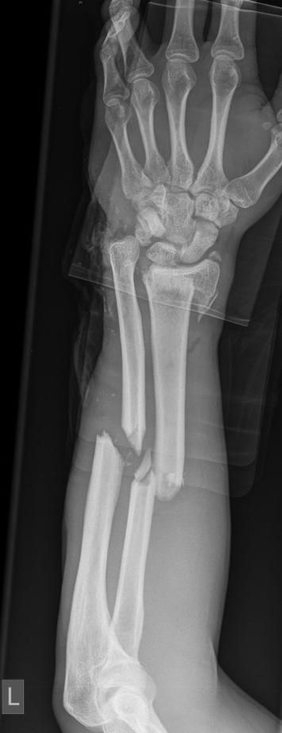
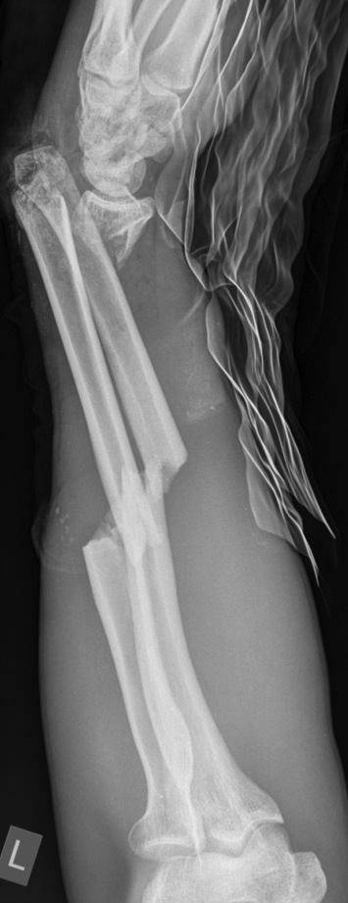
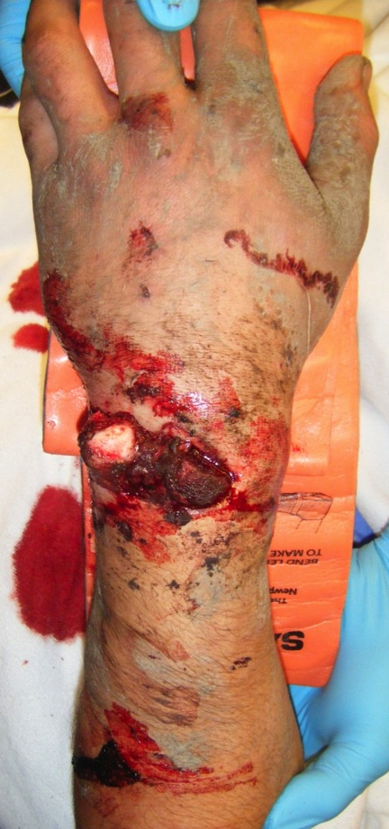
Location and morphology
Notes:
Ask participants to categorize this fracture.
This is animated to allow the description and coding by the participant to proceed in steps.

Slide 29
Location and morphology
Radius, distal end segment, extraarticular
Simple metaphyseal
Dorsal displacement
2R3A2.2
Radius, diaphyseal wedge intact, middle
2R2B2(b)
Ulna, diaphyseal simple oblique, middle
2U2B2(b)
Notes:
Ask participants to categorize this fracture.
This is animated to allow the description and coding by the participant to proceed in steps.

Slide 30
Notes:
The new OTA Open Fracture Classification has been added to the compendium. This classification has been validated and is more reproducible than the prior open fracture classifications.

Slide 31
Open fractures
OTA Fracture Classification
Edges approximate
No appreciable muscle loss or damage
No vessel disruption
No contamination
No bone loss
Gustilo-Anderson
Type IIIA
Notes:
Ask participants to categorize this fracture.
The OTA Open Fracture Classification is now part of the revised compendium. It may be discussed here.
This is animated to allow the description and coding by the participant to proceed in steps.

Slide 32
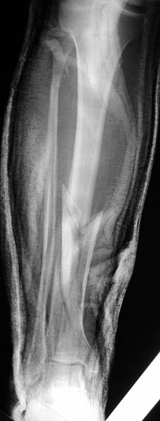
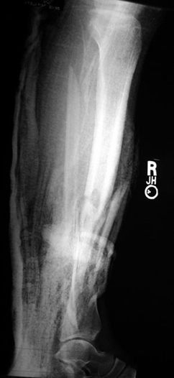
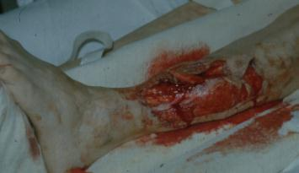
Describe this injury
Notes:
This is animated to allow the description and coding by the participant to proceed in steps

Slide 33
Fractures
Tibia, diaphyseal, wedge, fragmentary, distal
42B3(c)
Fibula, diaphyseal, simple, oblique proximal
4F2A2(a)
Notes:
This is animated to allow the description and coding by the participant to proceed in steps.

Slide 34
Open injury
OTA Open Fracture Classification
Laceration associated with degloving
Dead muscle with loss of function
No vessel injury
Surface contamination
Dead bone fragment, but
Main fragment contact
Gustilo-Anderson
Type IIIA
AO Open Fracture Classification
IO4 MT2 NV1
Notes:
Although 42.B3.2 IO4 MT2 NV1 would seem an obscure categorization of the injury illustrated here, such alphanumerical coding is necessary.

Slide 35
Take-home message
The 2018 Classification Compendium is a streamlined, concise,
and clinically relevant tool for coding fractures and dislocations

Slide 36
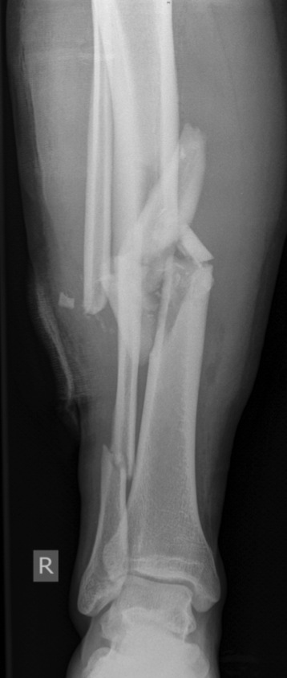
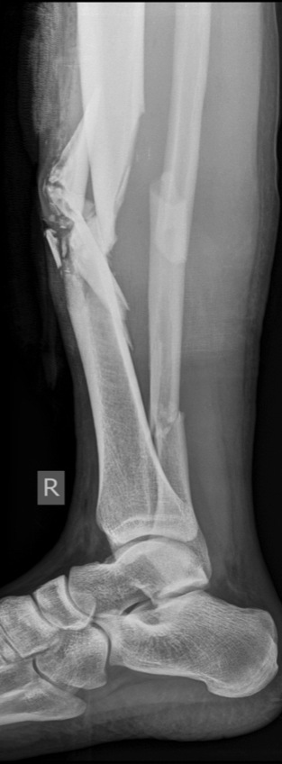
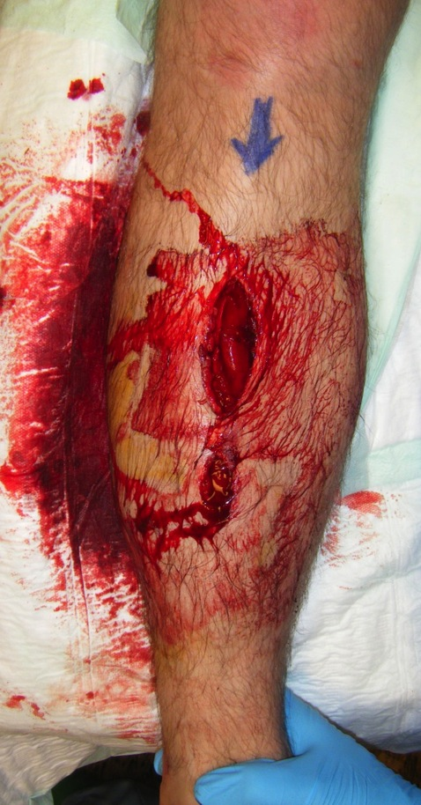
31-year-old man, motorcycle collision

Slide 37
31-year-old man, motorcycle collision
Tibia, diaphyseal
Wedge, fragmentary
Middle
42B3(b)
Fibula, diaphyseal
Multifragmentary
Intact
4F2C2

Slide 38
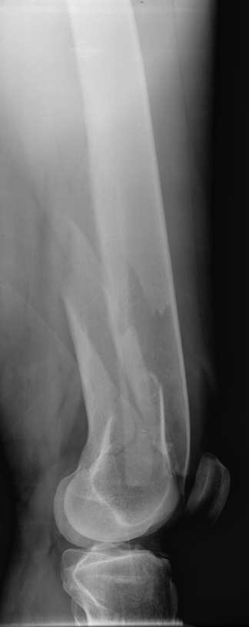
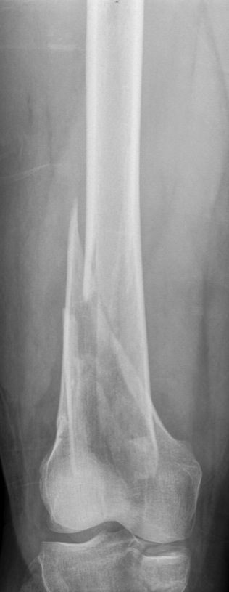
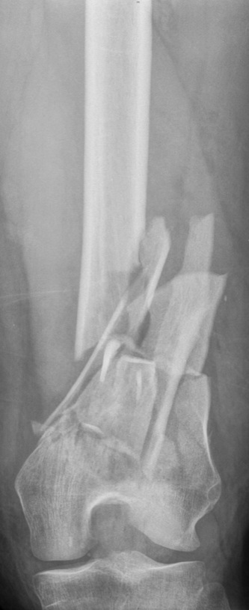
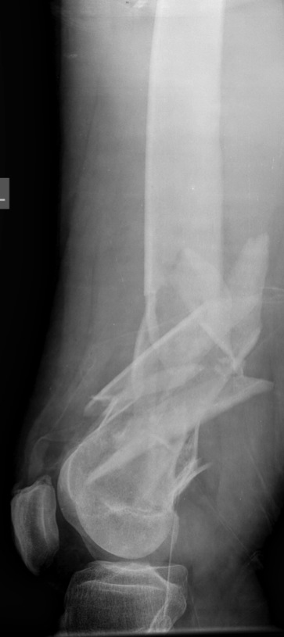
Right femur Left femur

Slide 39
Right femur
Femur, distal end segment
Wedge or multifragmentary
Fragmented wedge
Lateral
33A3.2(f)

Slide 40
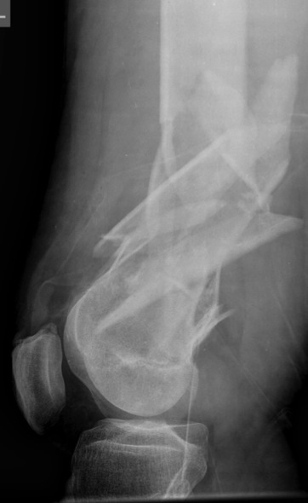
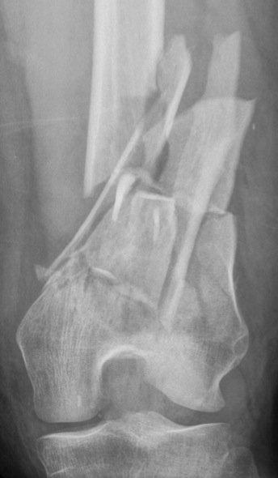
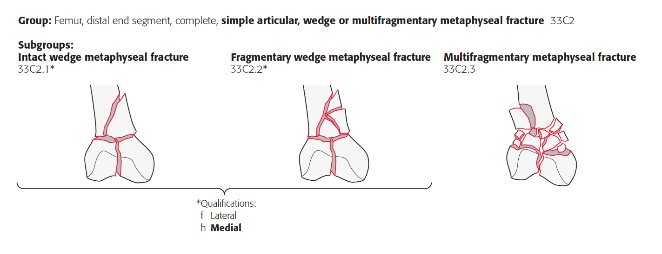
Left femur
Femur, distal end segment
Complete articular
Simple articular
Multifragmentary metaphyseal
33C2.3

Slide 41
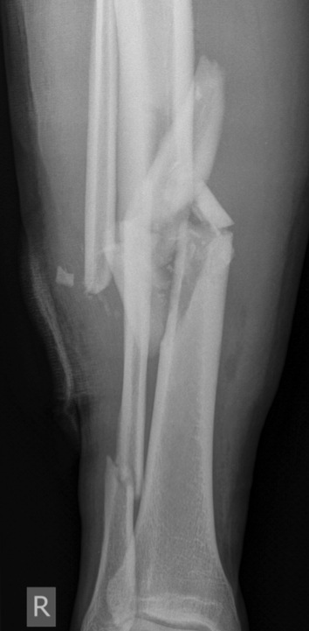
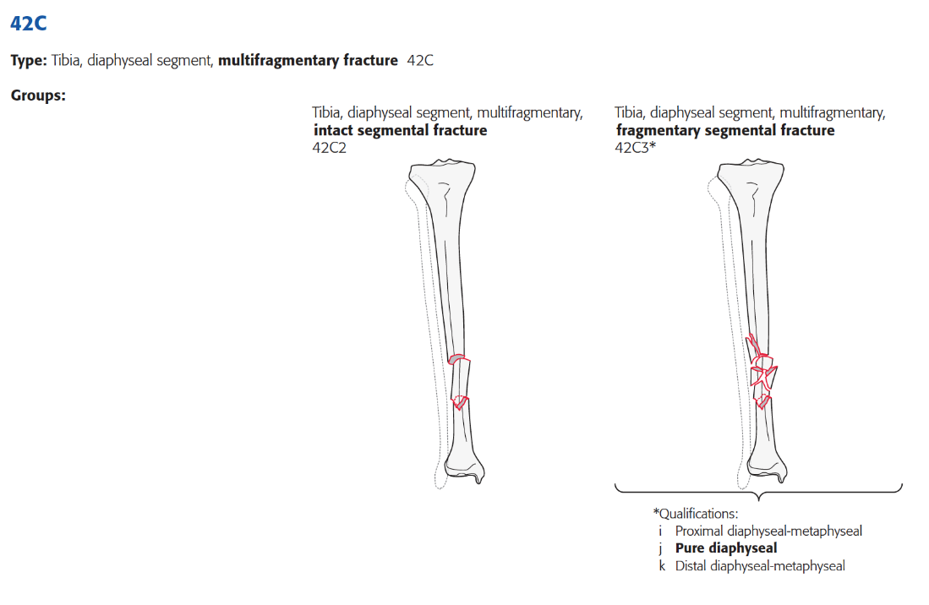
Tibia
Tibia, diaphyseal segment
Multifragmentary, fragmentary segment
Pure diaphyseal
42C3(j)

