Slide 1
The use of plates in fracture fixation
AO Trauma Basic Principles Course
Notes:
Creation date: 2019
Author: Hatem Said

Slide 2
Learning objectives
Comprehend the different functions of plates in fracture fixation
Demonstrate plate features that enable these functions
Discuss how to use plates for absolute and relative stability
State the indications for locking plates

Slide 3
Plates in fracture fixation
Compression plate
Protection plate
Buttress plate
Tension band plate
Bridging plate
Absolute stability
Relative stability

Slide 4
Compression plating
Dynamic compression principle (DCP)
Plate over-bending
Tensioning device
……provides absolute stability – direct bone healing (no callus)

Slide 5
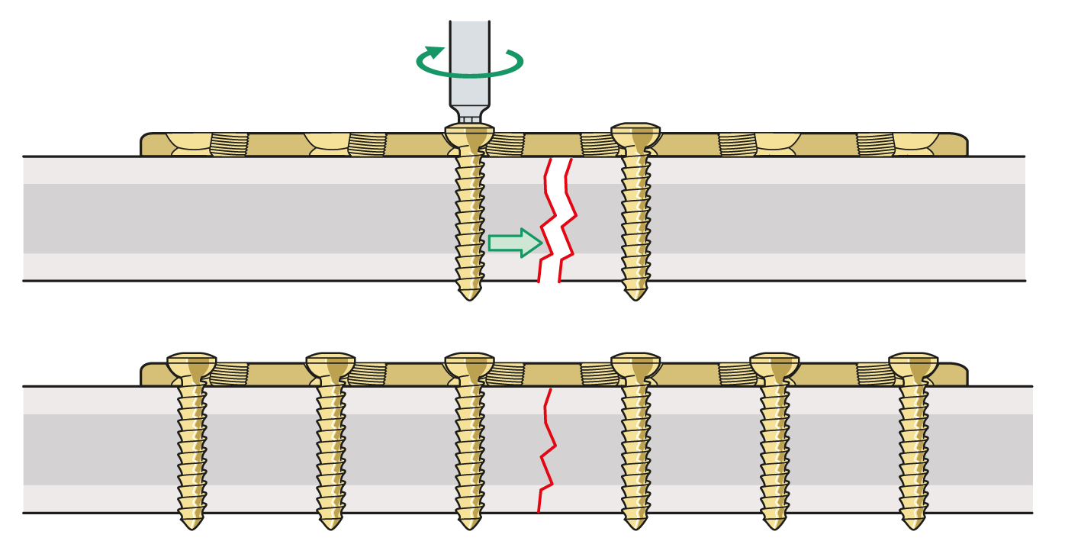
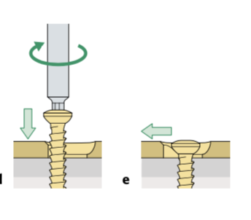
Compression by DCP
Eccentrically placed screw – away from the fracture site
Screw tightening leads to fracture compression

Slide 6
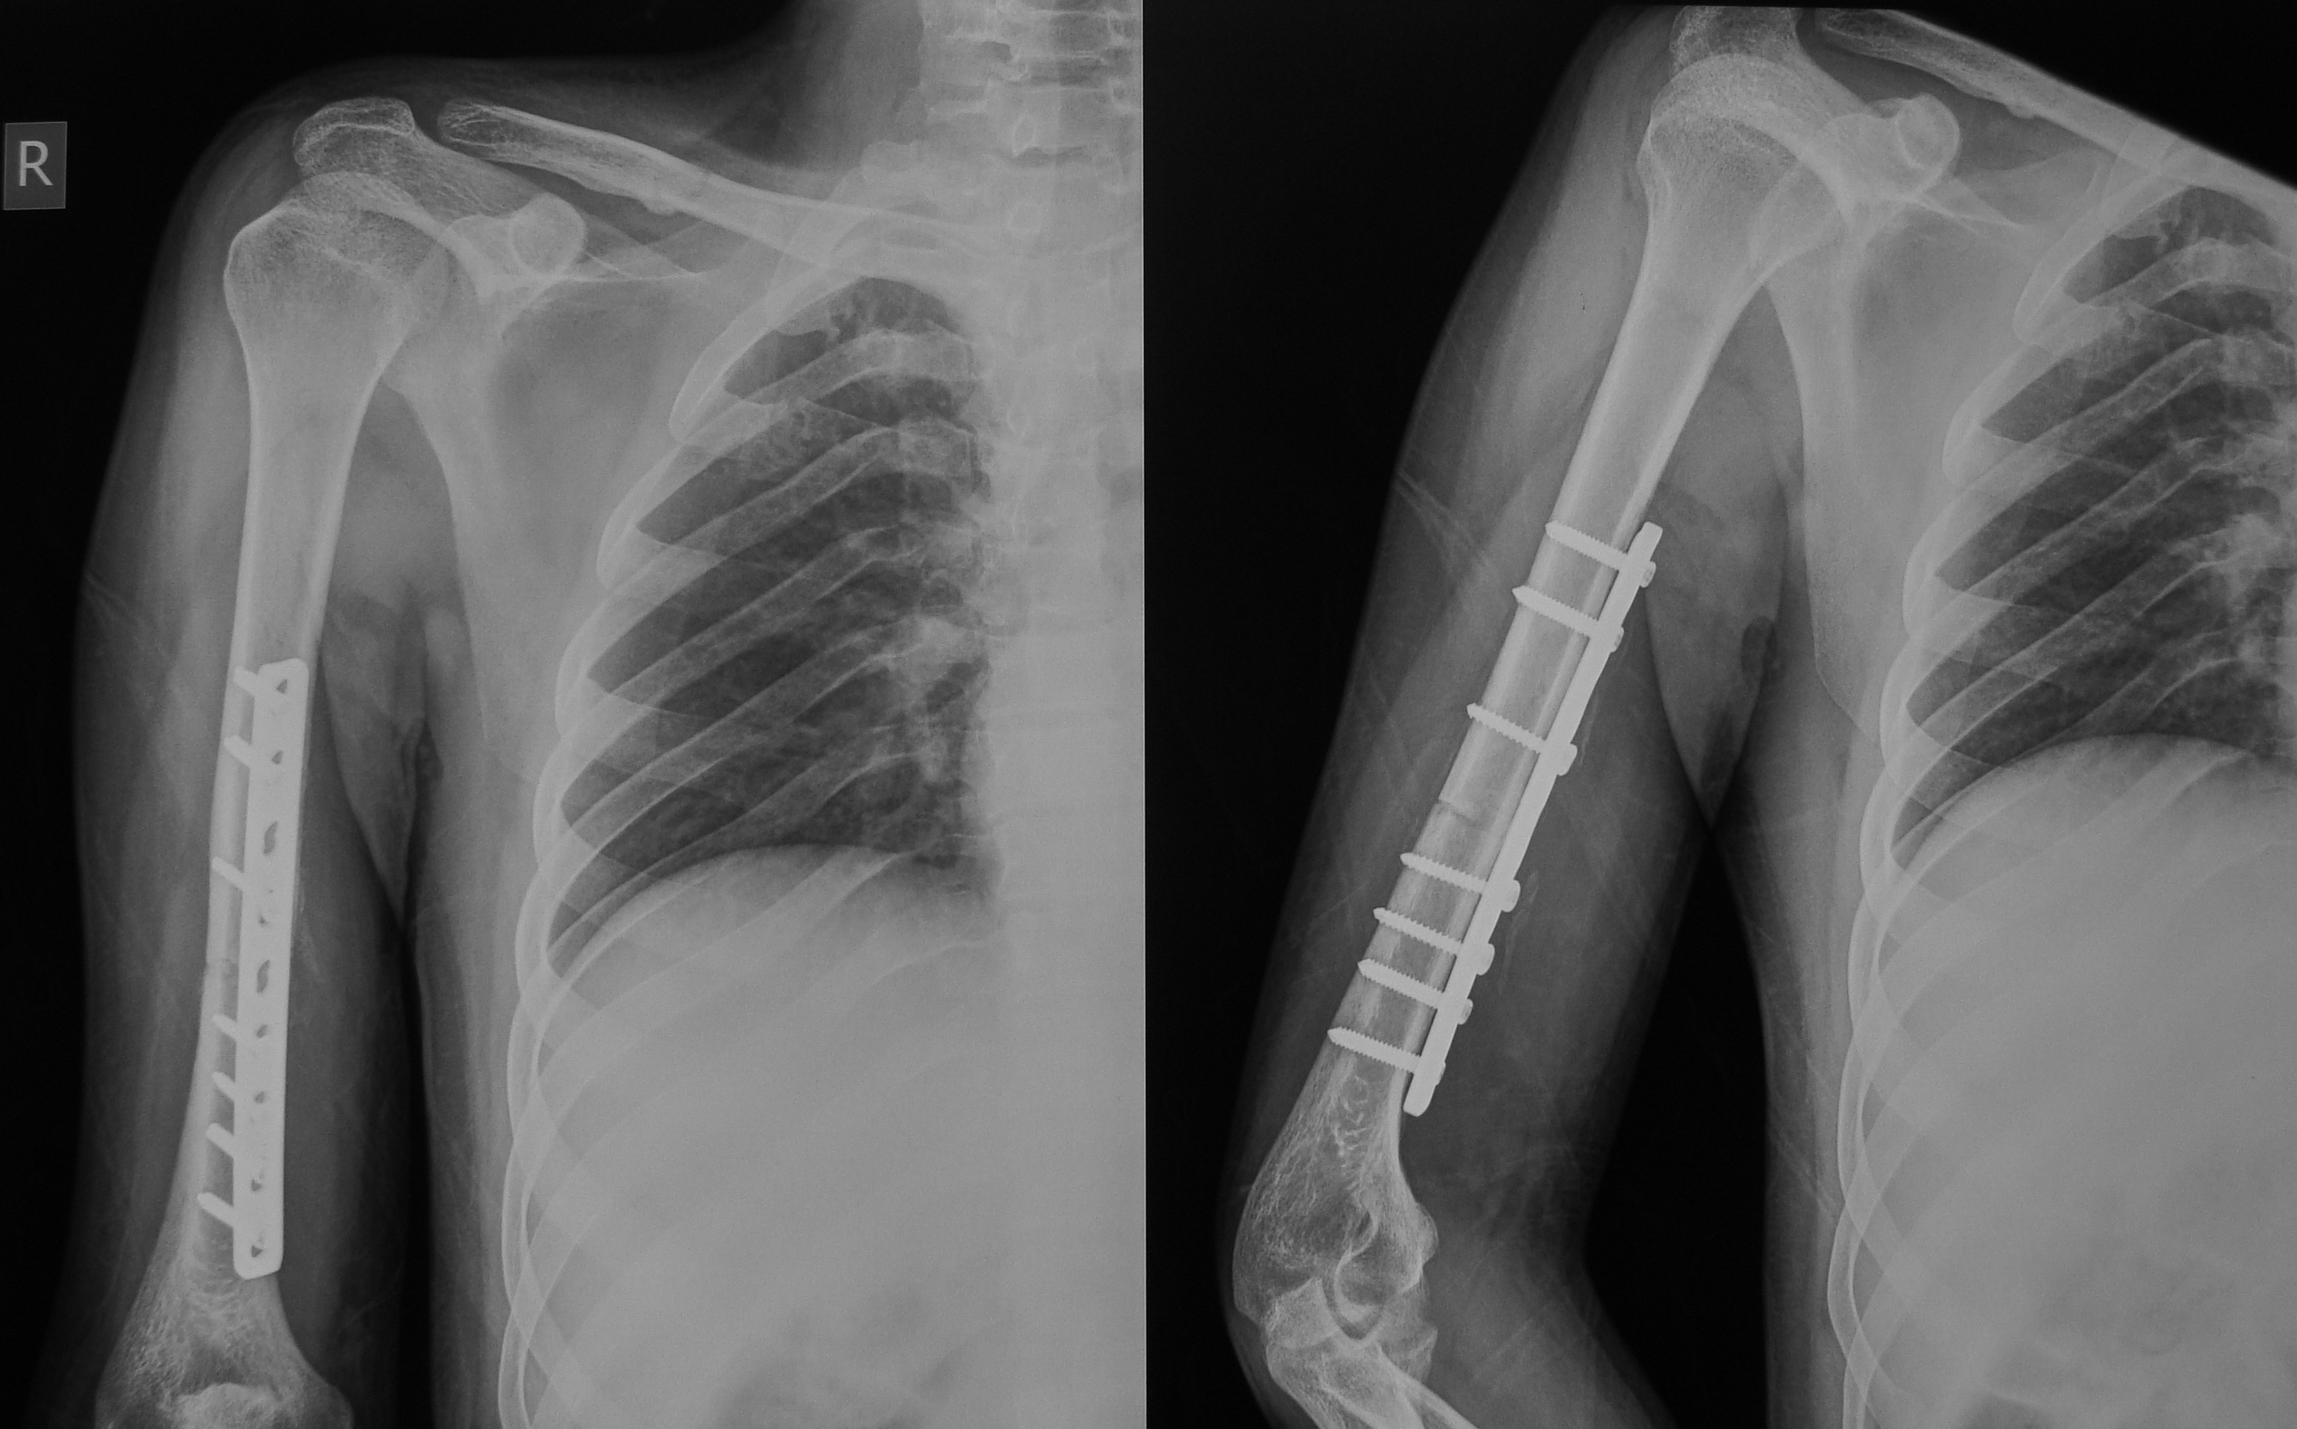
Absolute stability: compression by DCP
Transverse fracture
Notes:
Case by Hatem Said.

Slide 7
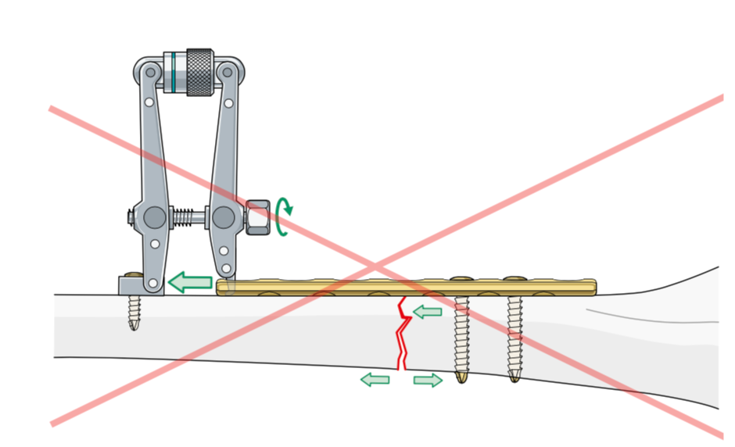
Compression by plate over-bending
Compress by tension device or eccentric screws
Tension of straight plate on straight bone – opens opposite cortex

Slide 8
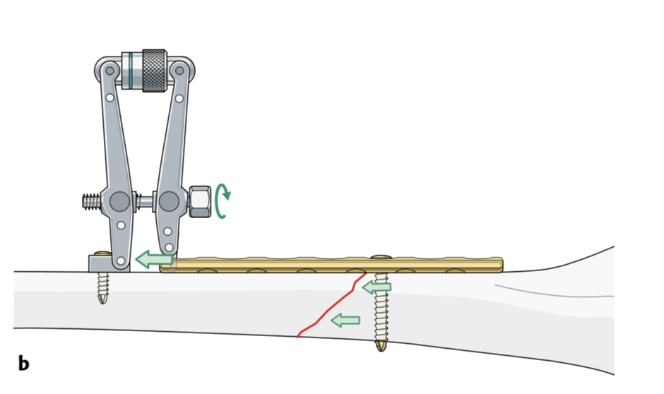
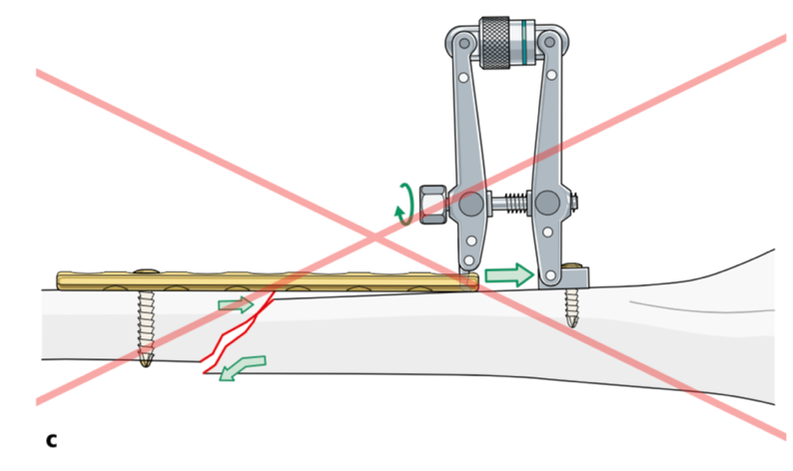
Compression by tension device
Compress into the axilla of the fracture

Slide 9
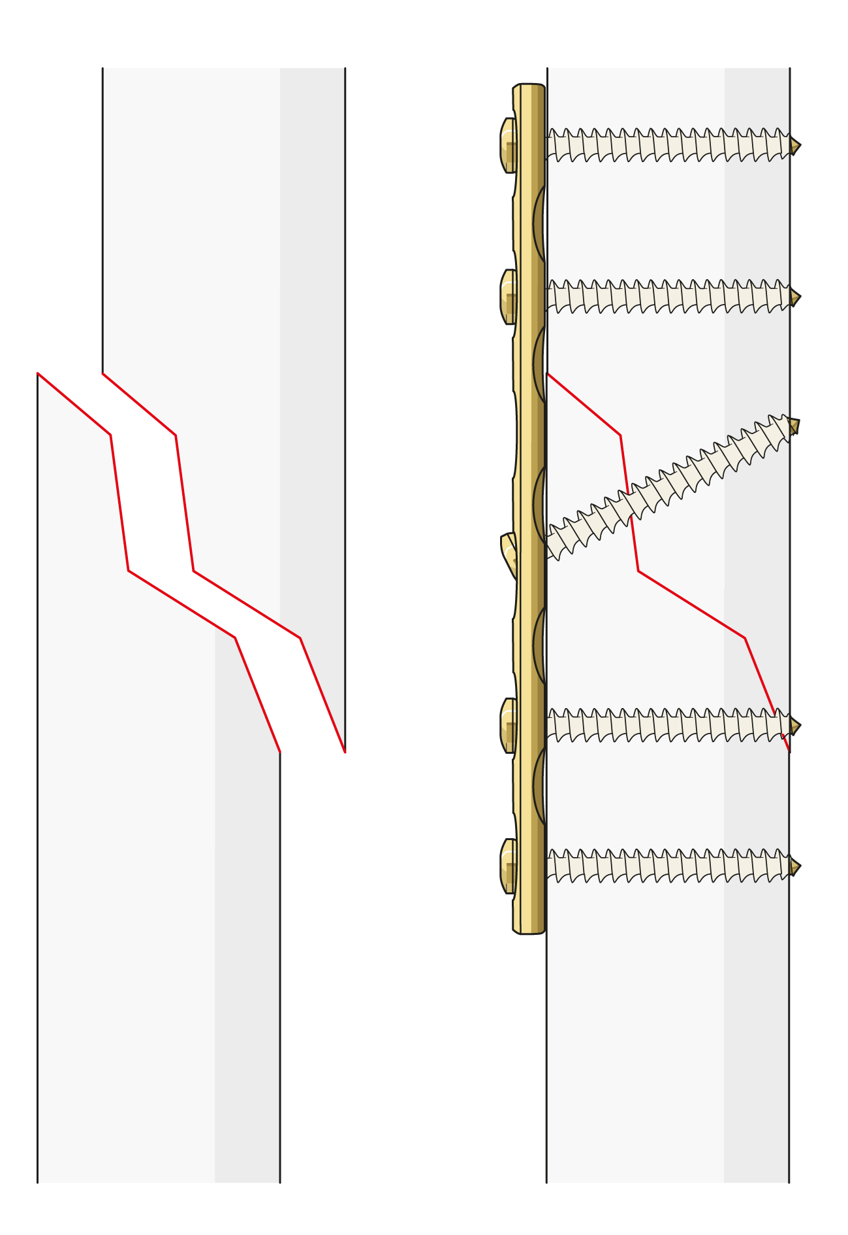
Protection plate: (neutralization)
Protects interfragmentary lag screw
Resists torsion, bending, and shear forces
Absolute stability – direct bone healing

Slide 10
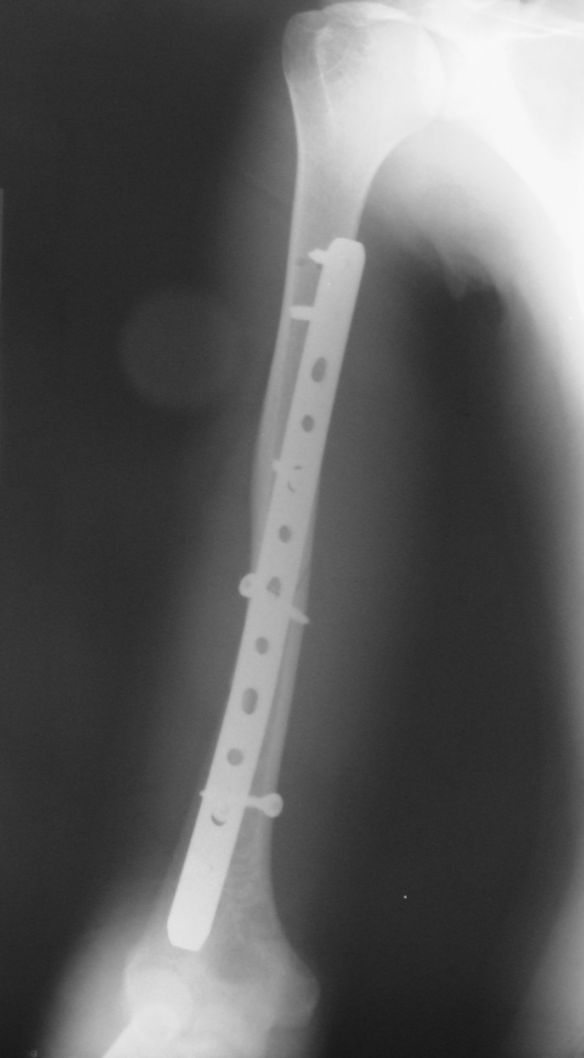
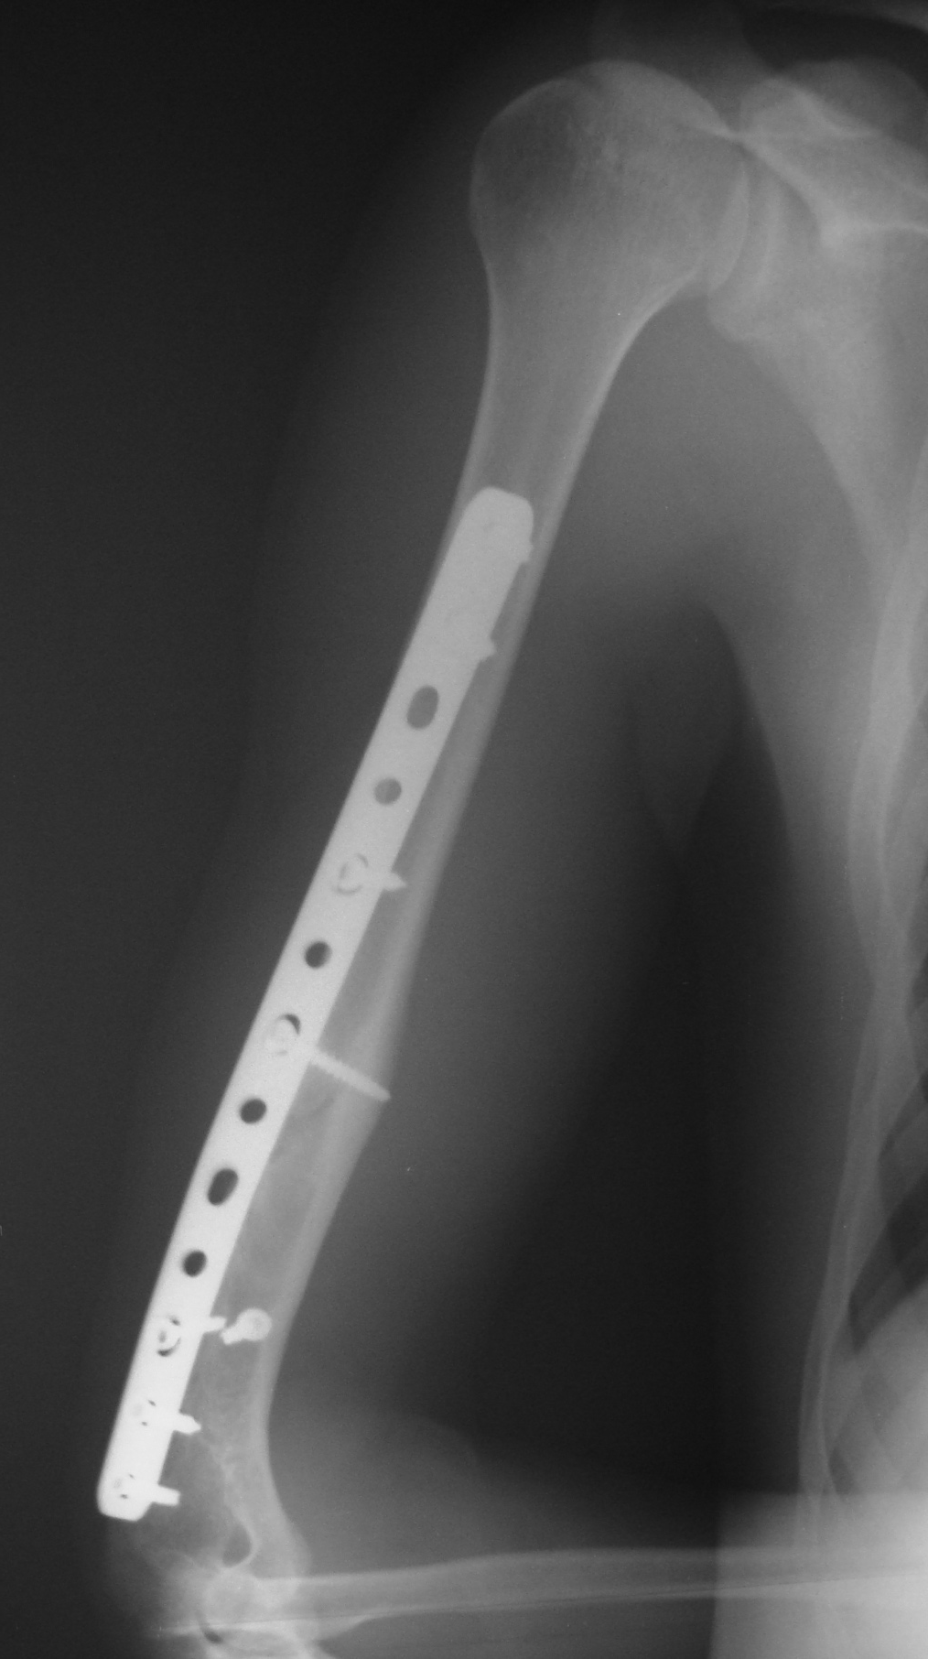
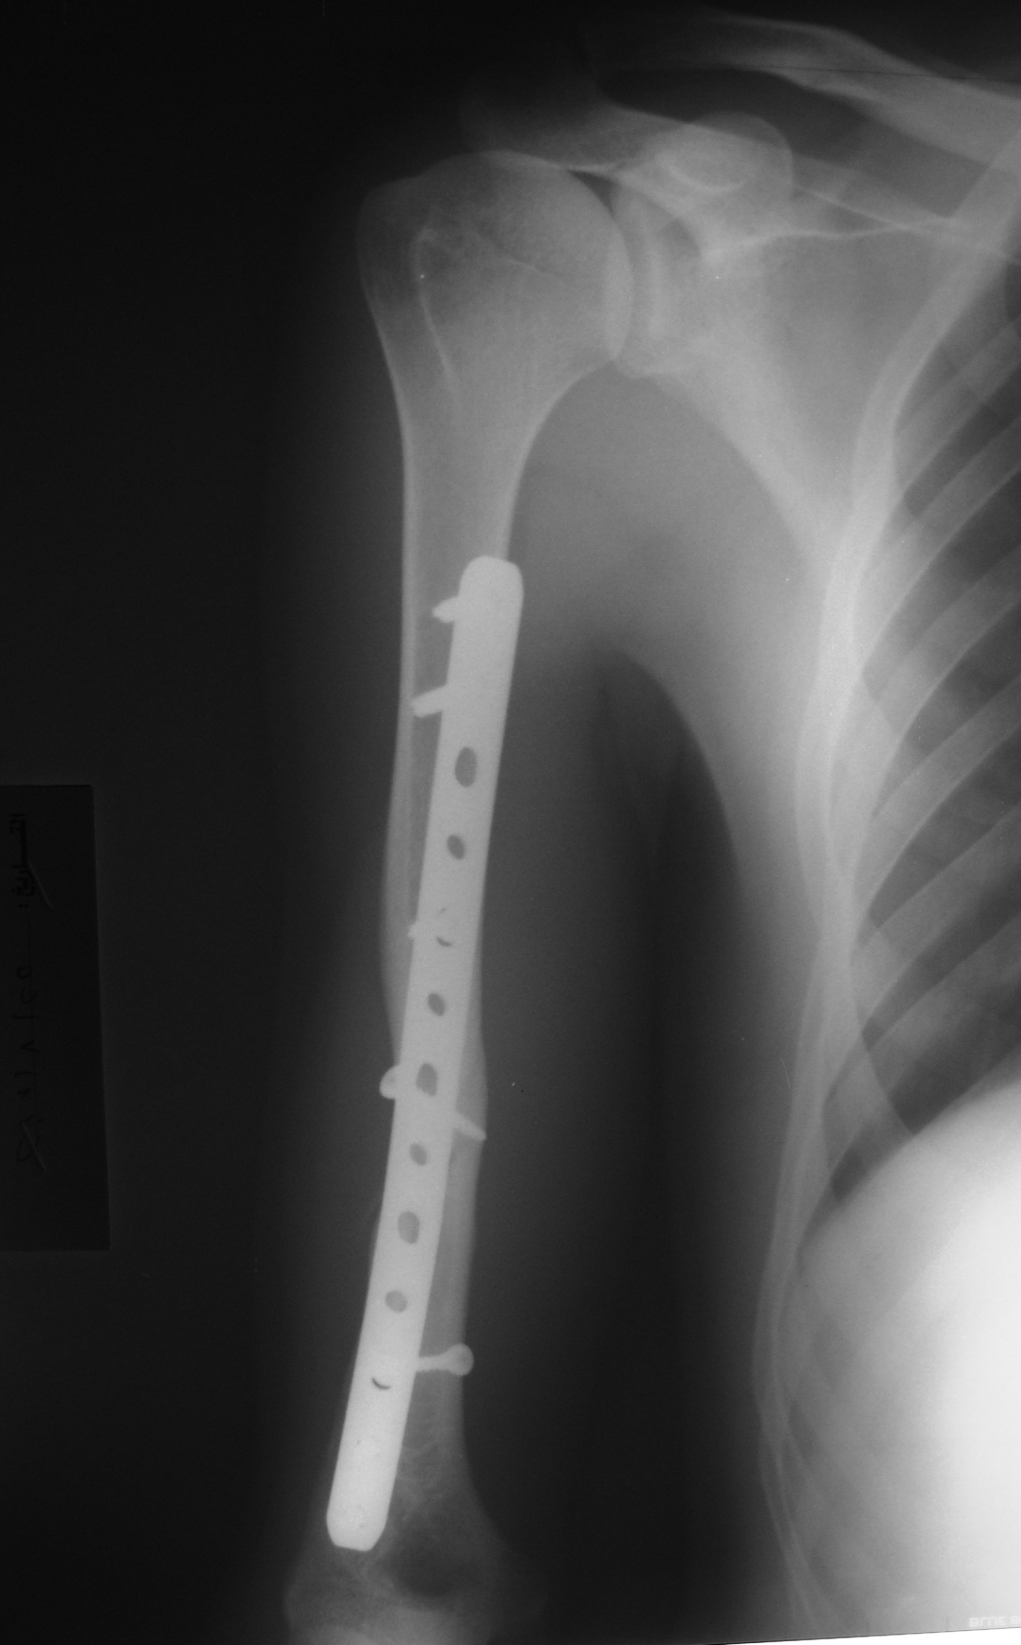
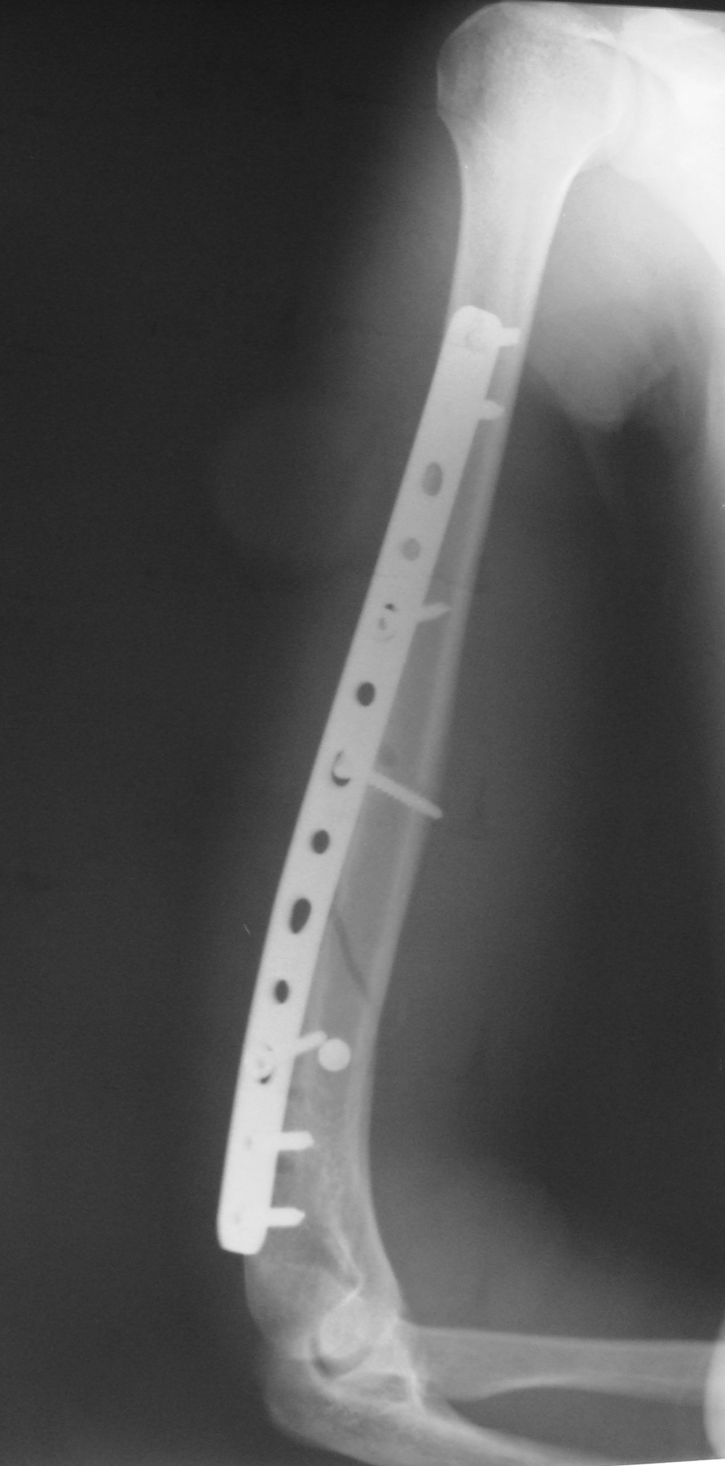
Protection plate
Lag screws
Notes:
Case by H Said

Slide 11
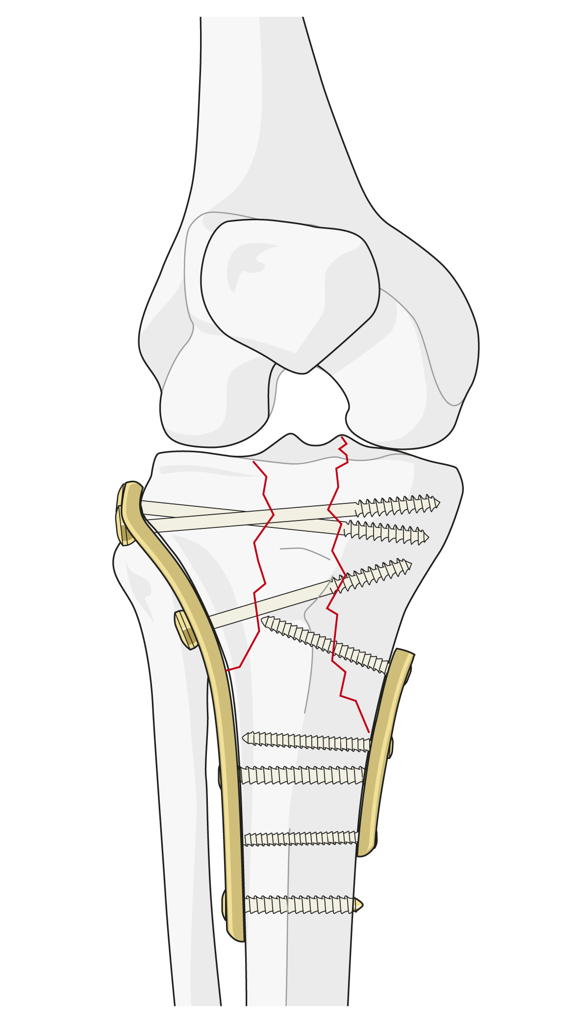
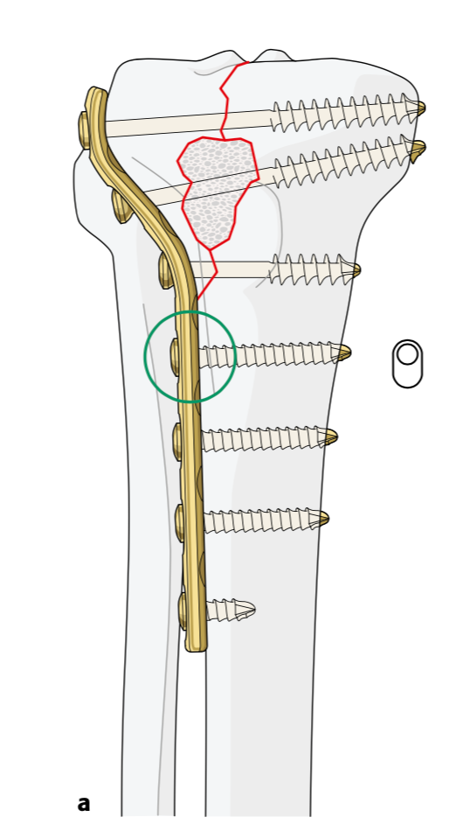
Buttress plate
Resists axial shear load by applying opposing force
In areas where bone is not supported by the shaft, eg, condyles
Distal femur
Tibial plateau
Ankle

Slide 12
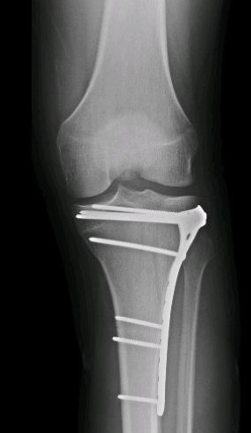
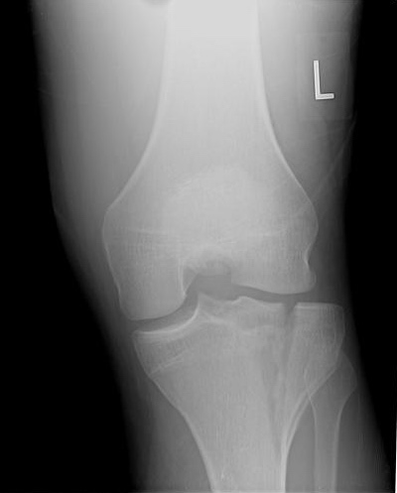
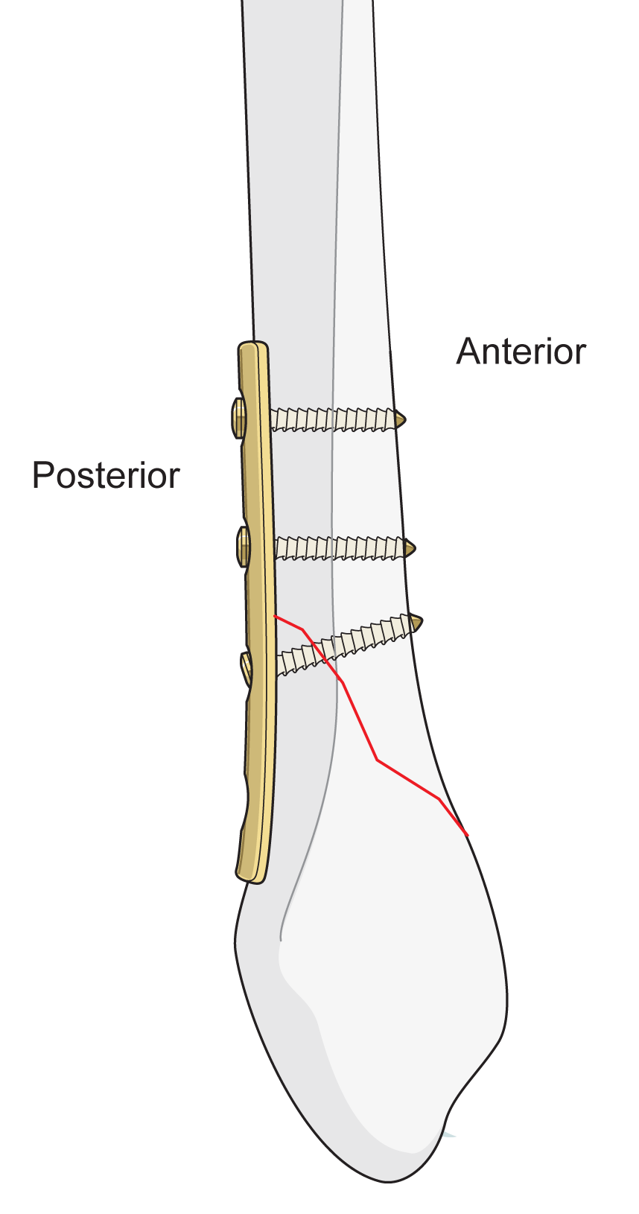
Buttress plate
Notes:
Change case from Adv

Slide 13
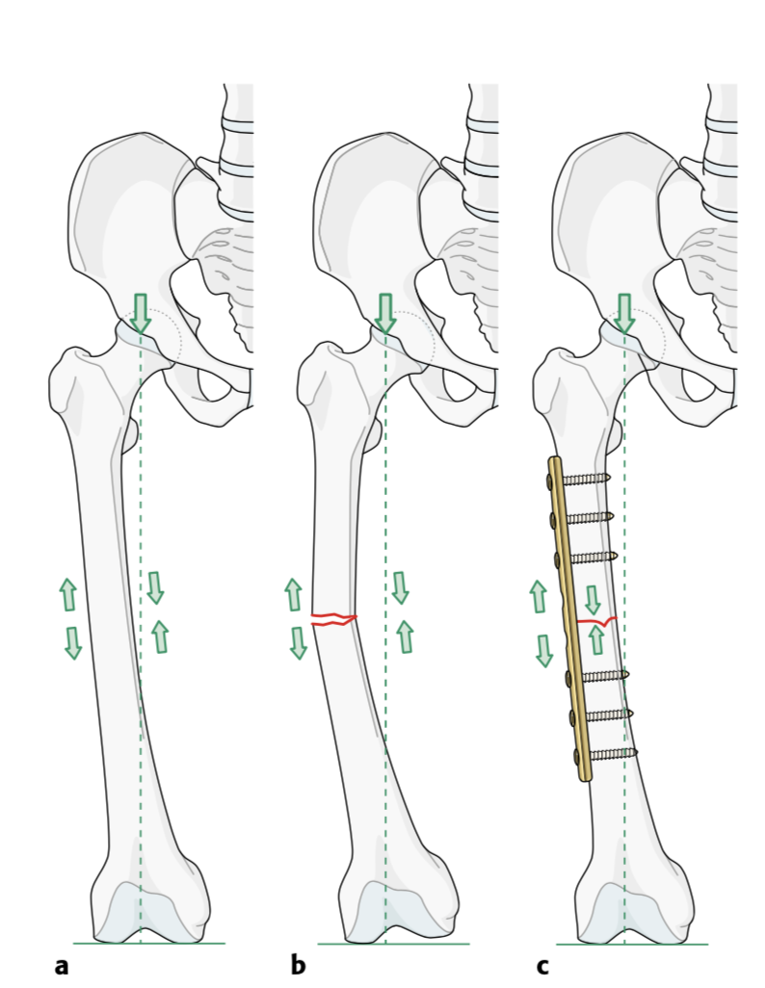
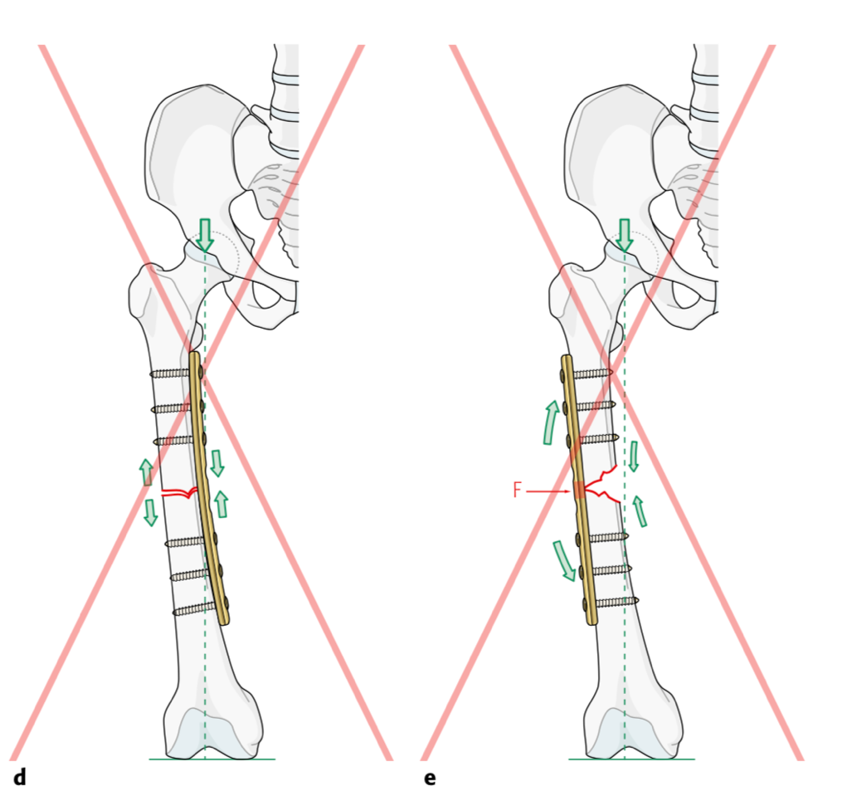
Tension plate: converting tension to compression
Curved bone: eccentric loading
Plate on tension (convex) side
Intact opposite cortex

Slide 14
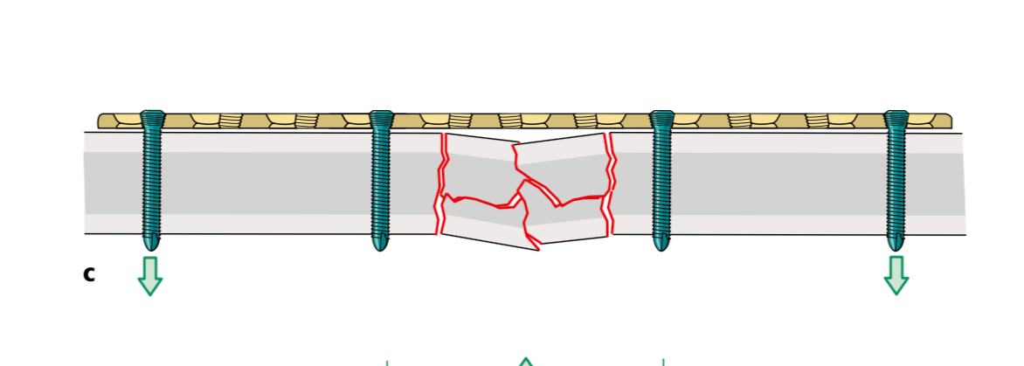
Bridging plate
Multifragmentary fractures
Bridge the fracture site: restore length, rotation, and angulation
Relative stability – healing by callus

Slide 15
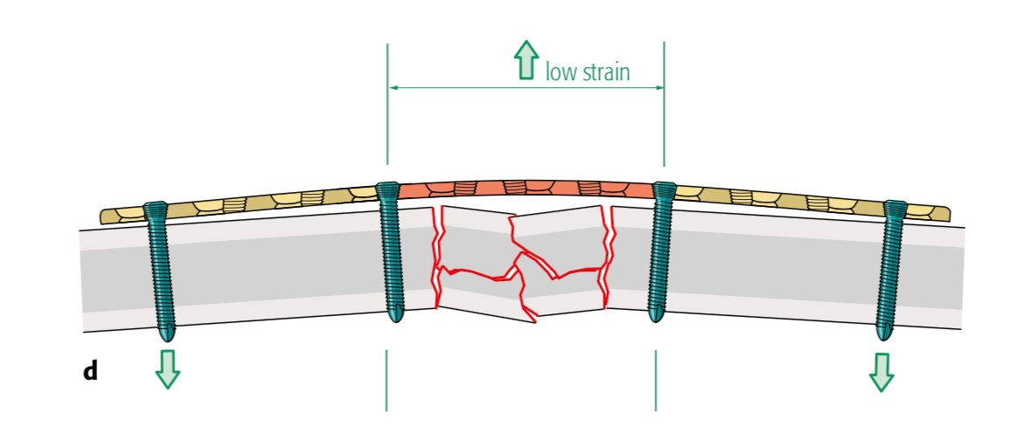
Bridging plate: tips
Long plates: three times the length of the fracture
Increase level arm
Decrease load on distal screws
No screws in fracture area

Slide 16
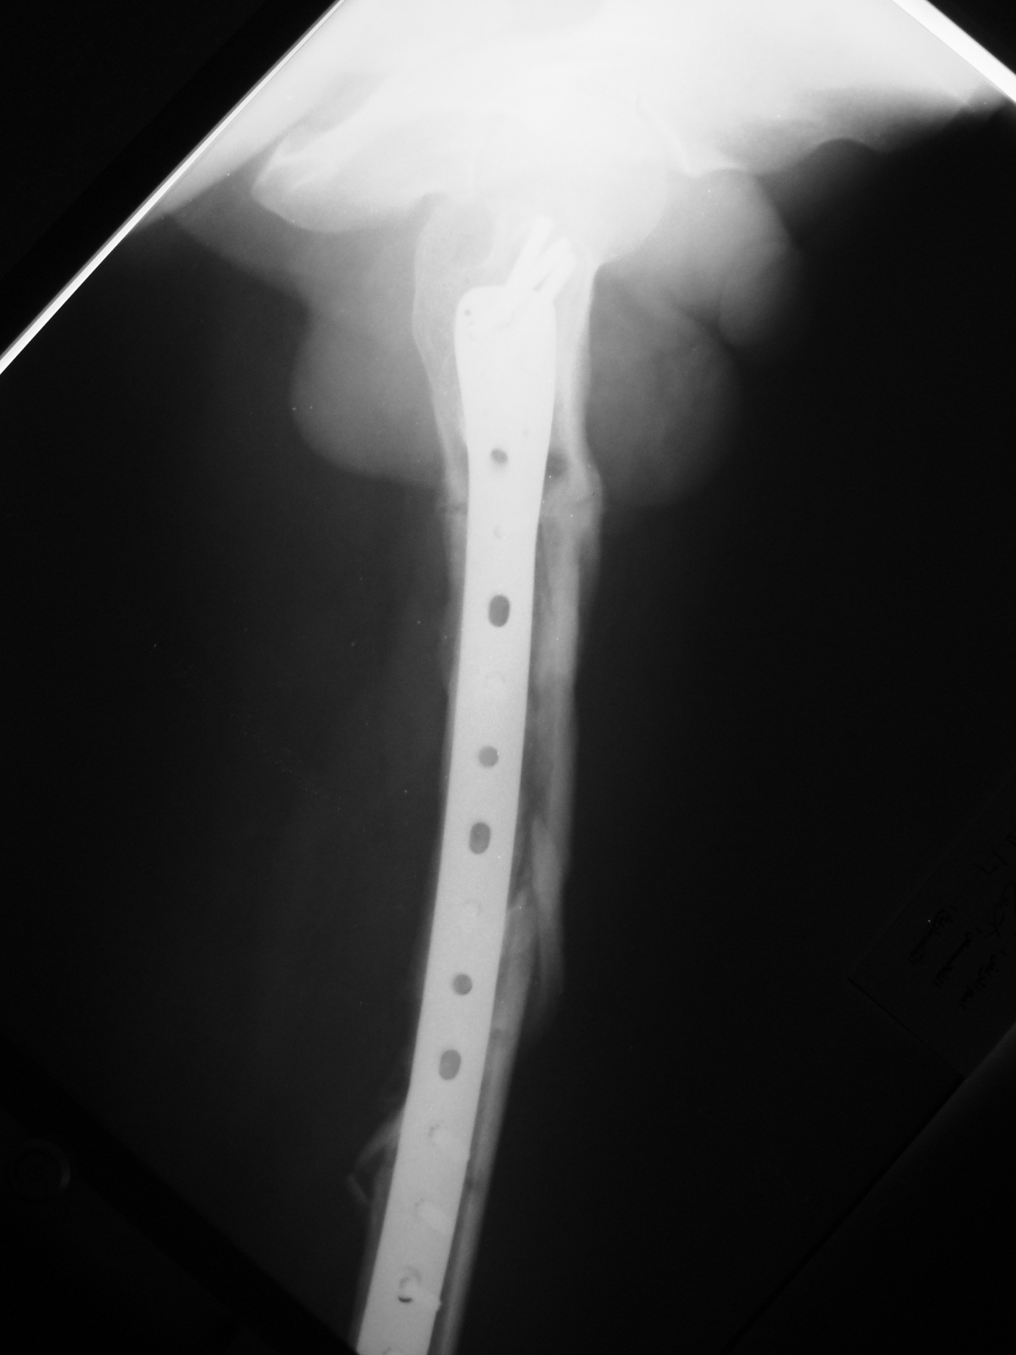
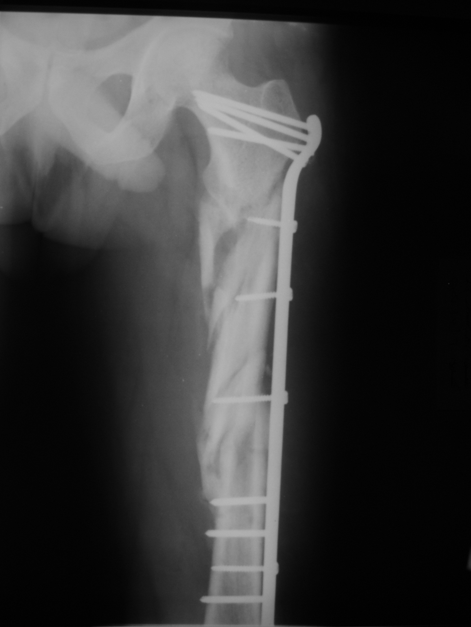
Relative stability
Callus
Callus
Notes:
Case by H Said.

Slide 17
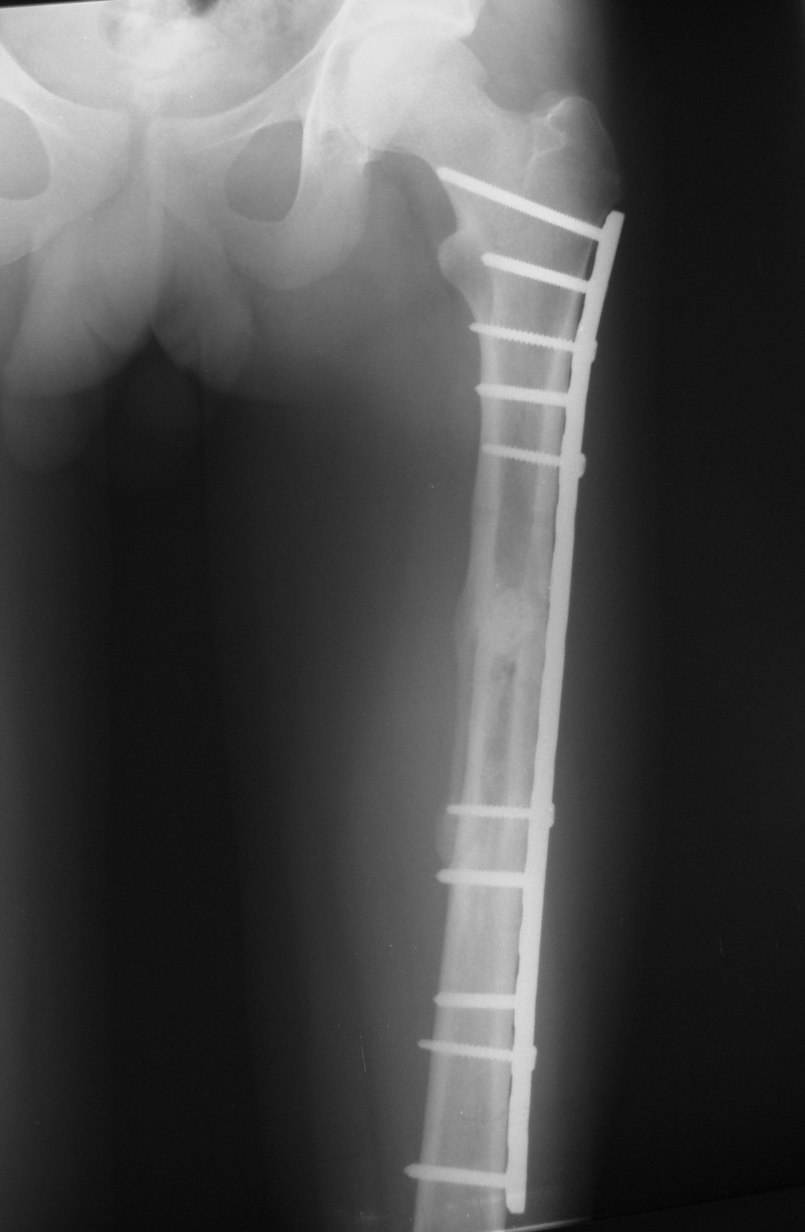
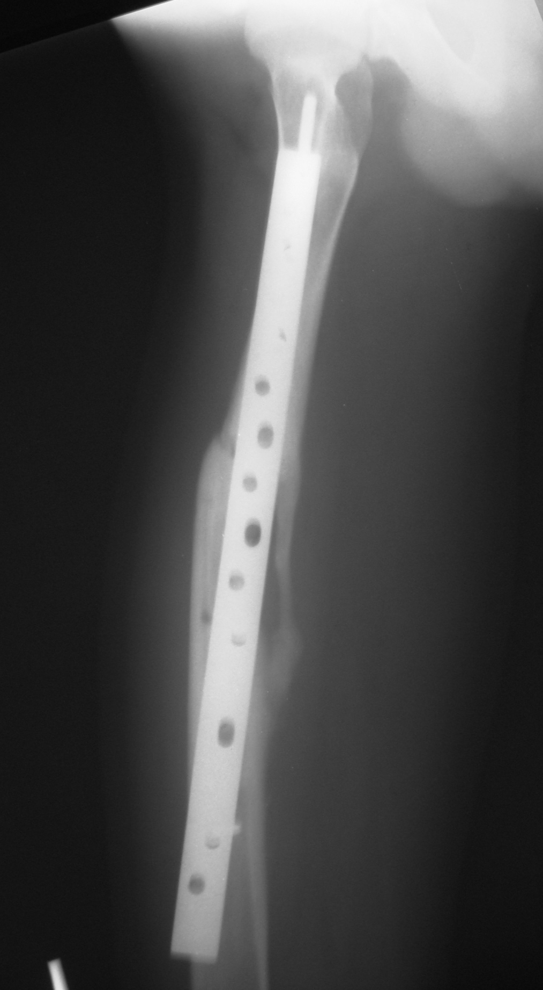
Relative stability
Callus
Notes:
Case By H Said: Replating femur after metal failure. Bridge plating.

Slide 18
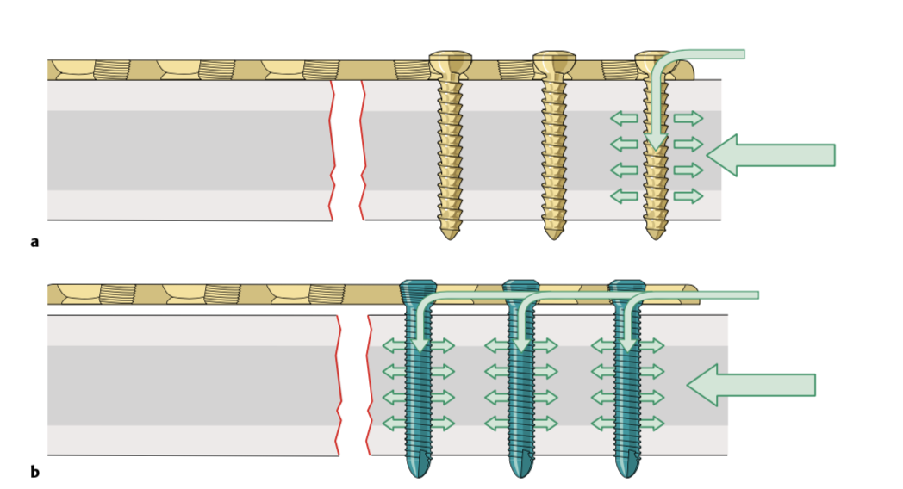
Locking plates
Can be used as a regular plate to perform the same functions
Can be used as an internal fixator without compressing the periosteum
Locking plate/screws: biomechanical advantage
Load distribution along the whole construct
Higher forces required for failure
Notes:
Can be used as a regular plate to perform the same functions: compression, protection, buttress, bridging.

Slide 19
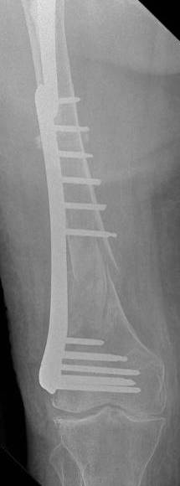
Locking plates: indications
Photos
Osteoporotic bone
Elderly patients
Nonunions
Short segment of bone (not enough screws) eg, condyles
MIPO
Notes:
Can be used as a regular plate to perform the same functions: compression, protection, buttress, bridging.
MIPO can be an Indication if fewer screws are planned, and a smaller incision.

Slide 20
Locking plates: tips
Locking screws: cannot be used for reduction
“Reduce before locking”
Locking screws: not lag screws
But can maintain compression produced by other means
Osteoporotic bone:
Relative stability instead of absolute stability
No lag screws
Notes:
Can be used as a regular plate to perform the same functions: compression, protection, buttress, bridging.
MIPO can be in Indication if fewer screws are planned, and a smaller incision.

Slide 21
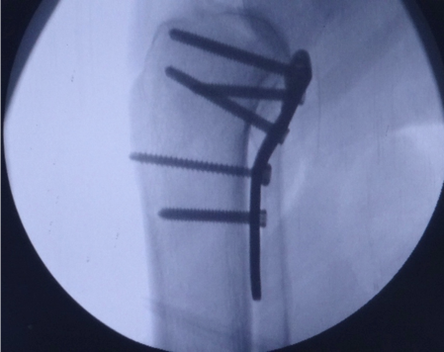
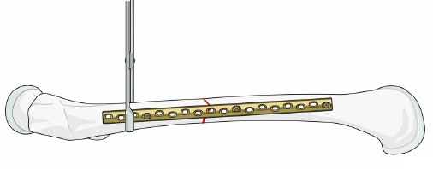
Plates as a reduction tool
Helps in fracture reduction
Depends on fixing the plate on one side
Then tightening the screws to push the fragment (buttress plates)
Or using reduction tools on the opposite side (shaft plates)
Works with nonlocking screws only

Slide 22
Take-home messages
Plates have different functions in fracture fixation depending on their application method
They can produce absolute or relative stability
Locking plates have specific indications
Plates can be used as a reduction tool

