Slide 1
Emergency management of pelvic fractures—a critical skill that can save lives
AO Trauma Basic Principles Course
Notes:
Published: July 2013
Revised: 2018
Reviewer: Friedrich Baumgaertel

Slide 2
Learning objectives
Identify and describe the mechanism of injury for pelvic fractures
Describe the initial treatments to save the life of the patient
Outline the use of pelvic binding and external fixation to stabilize fractures
Communicate effectively with trauma surgeons and other specialist team for comprehensive management
Notes:
Teaching points:
Focus on pattern recognition on x-rays, describe how to use binders and sheets appropriately.

Slide 3
Pelvic trauma
High-velocity pelvic trauma means massive bleeding of pelvic soft tissues and fracture surfaces
Motor vehicle accidents
Crush injuries
Falls from a height

Slide 4
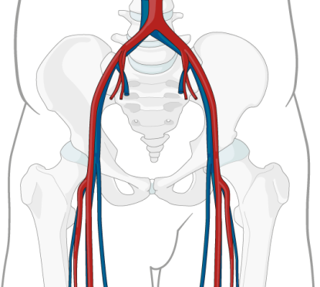
Pelvic trauma
Soft-tissue damage and hemorrhaging
10% of bleeding is arterial
30% are fracture surfaces
60–70% are venous
External rotation and vertical shear
Notes:
Forces acting on pelvic contents cause soft tissue damage and hemorrhaging.
External rotation and vertical shear cause most cases of complex pelvic injury.

Slide 5
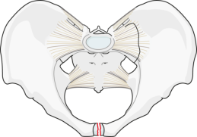
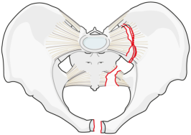
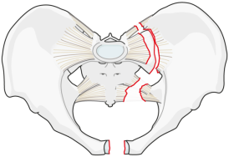
Ligaments as ring stabilizers
Symphyseal tear has little influence on ring stability
As forces increase, posterior ligaments disrupt and
rotational instability occurs
Maximum force causes complete ligament disruption
and rotational plus vertical instability

Slide 6
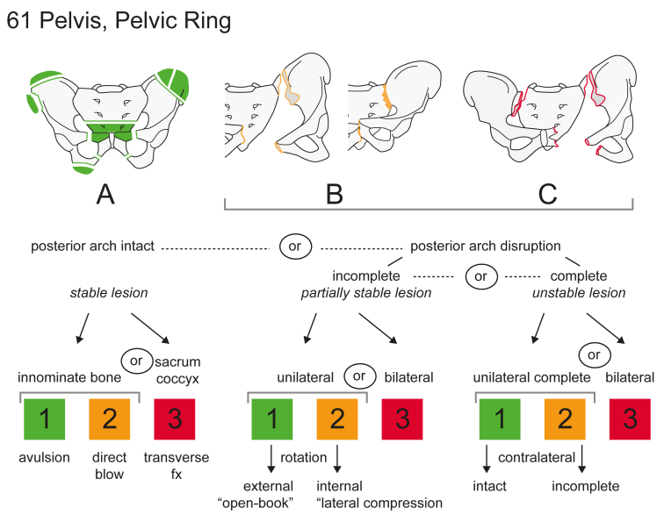

Slide 7
Rotation

Slide 8
Rotation

Slide 9
Vertical shear

Slide 10
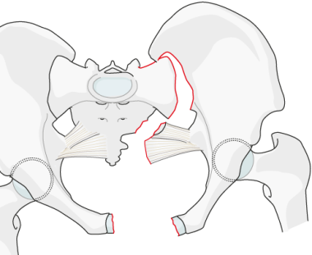
B1 “open book“
Massive intrapelvic bleeding

Slide 11
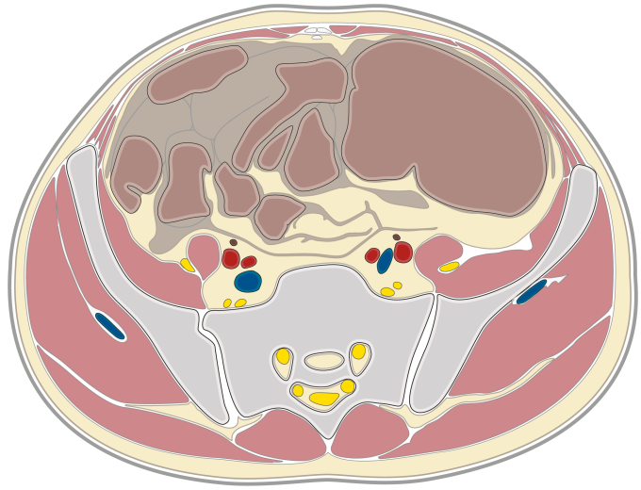
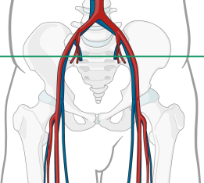
Area of severe bleeding
Retroperitoneum

Slide 12
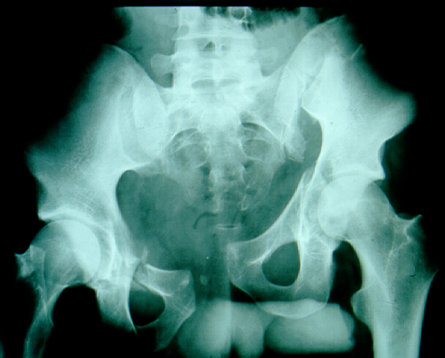
C3 bilateral
Right pelvis externally rotated
Left pelvis vertically and posteriorly displaced

Slide 13
Morel-Lavallé (1948)

Slide 14
Area of severe bleeding
Retroperitoneum plus gluteal compartment

Slide 15
Assessment of severity
Expect pelvic injury in 3–8% of all fractures and 25–30% of polytrauma cases
8–15% mortality overall
In complex pelvic injury, 20% mortality
In open pelvic injury, up to 50% mortality

Slide 16
Principles of management
Assess severity of injury:
Symptoms of shock
Symptoms of bleeding
Stabilize pelvis
Stop bleeding

Slide 17
Factors influencing outcome
Timing of treatment (golden hour of shock)
Efficiency of management protocol
Stability achieved by treatment
Reduction of pelvic volume
Ease of application of device
Safety of device
Availability

Slide 18
Prehospital management
Circumferential pelvic antishock sheeting
Can be very effective
Complications with the skin can occur
Notes:
References:
Routt ML Jr, Falicov A, Woodhouse E, et al. Circumferential pelvic antishock sheeting: a temporary resuscitation aid. J Orthop Trauma. 2006 Jan;20(1 Suppl):S3–S6.
Simpson T, Krieg JC, Heuer F, et al. Stabilization of pelvic ring disruptions with a circumferential sheet. J Trauma. 2002 Jan;52(1):158–161.
Schaller TM, Sims S, Maxian T. Skin breakdown following circumferential pelvic antishock sheeting: a case report. J Orthop Trauma. 2005 Oct;19(9):661–665.

Slide 19
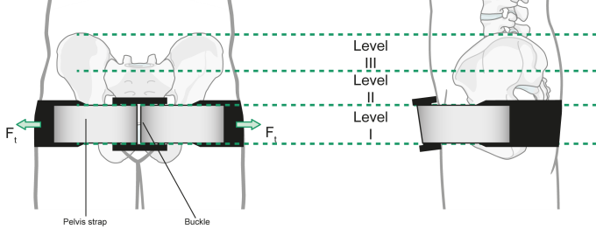
Prehospital management—binder
Strap
Can be very effective
Restricted to B1 type fractures
„
Notes:
References:
Bottlang M, Simpson T, Sigg J et al. Noninvasive reduction of open-book pelvic fractures by circumferential compression. J Orthop Trauma. 2002 Jul;16(6):367–373.

Slide 20
Prehospital management—binder
Binder
Can be very effective
Restricted to B1 type fractures
„

Slide 21
Pelvic immobilization belt (PIB)
Circumferential compression with three inflatable chambers
Two gluteal chambers, one half-size suprapubic chamber

Slide 22
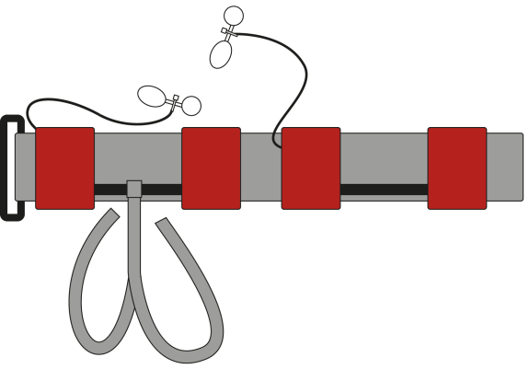
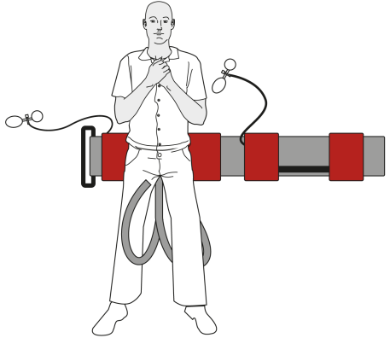
Pelvic immobilization belt (PIB)
Gluteal chambers
Suprapubic chamber

Slide 23
Pelvic immobilization belt (PIB)
Normal soft-tissue distribution
Three-point compression

Slide 24
Pelvic immobilization belt (PIB)—principles
Circumferential compression
Inflating chambers reduces volume within pelvis
Bony pelvis reduces without anterior ring collapse
Posterior chambers compress gluteal compartments preventing bleeding
Anterior chamber compresses soft tissues against convexity of lumbosacral spine, producing a tamponade within the pelvis

Slide 25
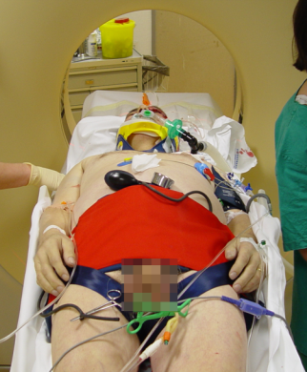
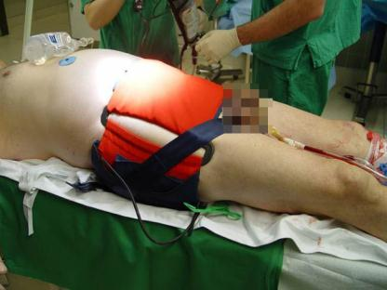
Pelvic immobilization belt (PIB)
70-year-old
Motor vehicle accident
Unstable pelvis
Emergency PIB application
Principle: pelvic volume is decreased

Slide 26
Pelvic immobilization belt (PIB)
Grossly unstable pelvis with PIB applied
Significant blood pressure increase
Emergency management
Notes:
26

Slide 27
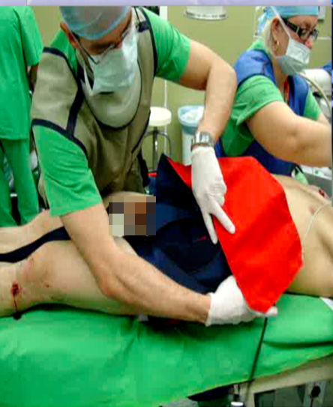
Pelvic immobilization belt (PIB)
PIB removal causes significant blood pressure drop
BP 58/38 approximately after 1 minute

Slide 28
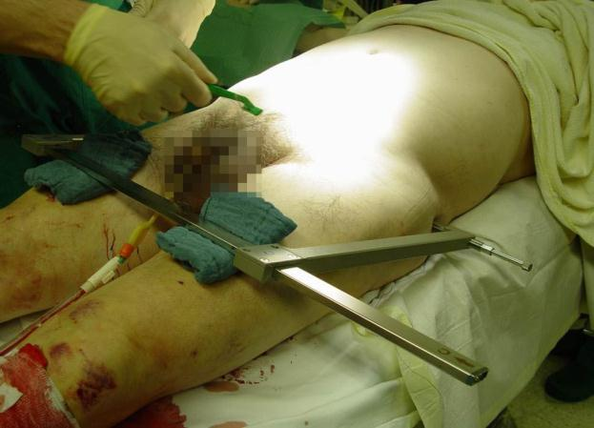
Pelvic immobilization belt (PIB)
Application of pelvic clamp is next

Slide 29
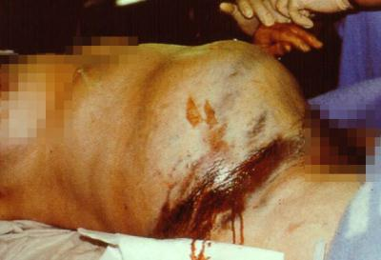
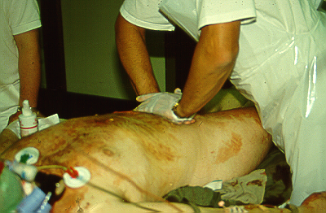
Emergency department assessment
Pelvic asymmetry
Leg-length discrepancy
Malalignment of lower extremity
Lower abdominal swelling
Pelvic instability
Rotational
Vertical

Slide 30
Emergency department assessment
Hematoma
Perineal
Scrotal
Labial
Bleeding from orifices
Anus
Urethra
Rectal exam

Slide 31
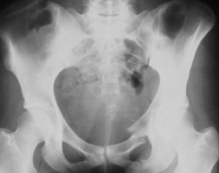
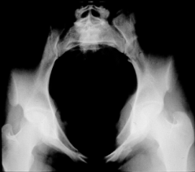
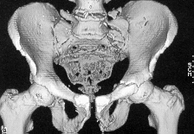
Acute emergency department assessment radiology
AP pelvis
Inlet view and outlet view
3-D CT
Retro-cystogram
2-D CT

Slide 32
Emergency department management
PIB or other binder, sheet
Pelvic clamp
External fixator

Slide 33
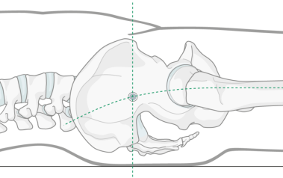
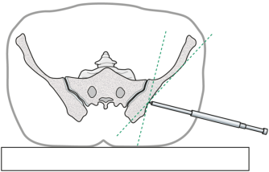
Emergency management—pelvic clamp
Indication: posterior instability presenting with significant hemorrhaging
Technique: lower extremity traction plus internal rotation, sterile percutaneous spikes
Complications: malposition of the spike and too much compression

Slide 34
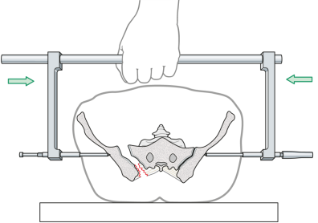
Emergency management—pelvic clamp
Principle:
compression of posterior pelvic ring

Slide 35
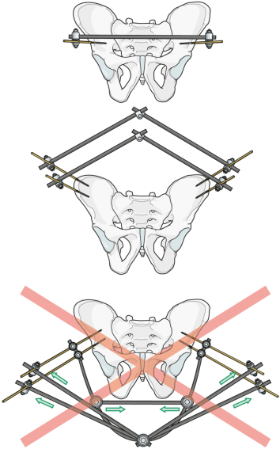
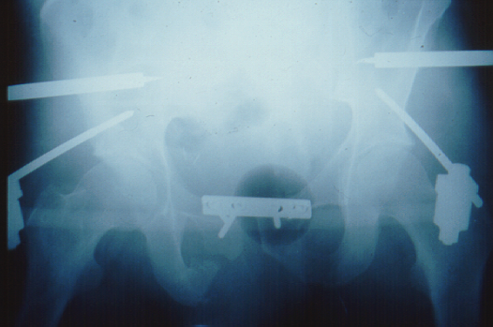
Emergency management—pelvic clamp
ER
OR
External fixation plus
anterior ORIF of
iliac crest or supraacetabulum

Slide 36
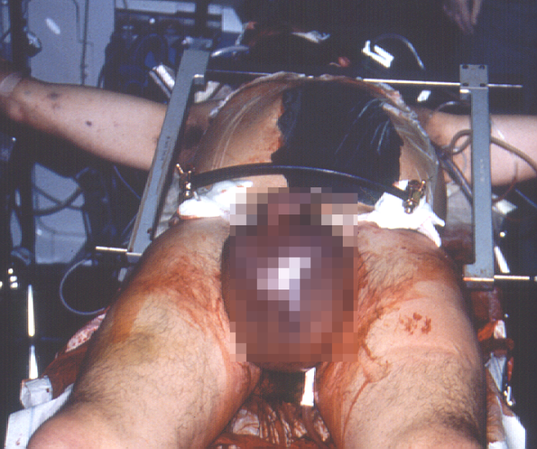
Emergency management—pelvic clamp

Slide 37
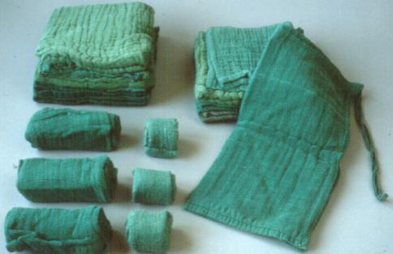
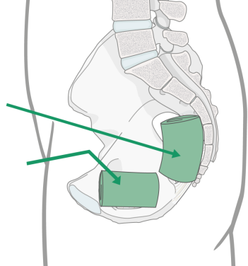
Operating room procedure only—retroperitoneal packing
Ultimate procedure to stop exsanguination

Slide 38
Operating room procedure only—retroperitoneal packing
No self-tamponade
Try to avoid laparotomy
Circumvent peritoneum
Evacuate hematoma
Pack, then combine with fixation
Second look within 24 hours

Slide 39
Angiography and embolization
Preferred treatment in some institutions
Arterial bleeding in about 10% of cases
Indicated as adjunct treatment
Indicated as secondary intervention
Interventional radiologist required at all times

Slide 40
Intensive care
Anterior external fixation
Posterior pelvic clamp
?
Primary or secondary embolization
Retro-peritoneal packing
Evacuation of hematoma
ORIF
Binder

Slide 41
Example of pelvic treatment algorithm in the golden hour
Obvious pelvic instability → ATLS
unstable ← → stable → AP pelvis, contrast CT
Pack pelvic clamp anterior ORIF or ExFix
stable unstable angio/embol
PIB/Binder
planned surgery
Second look, definitive ORIF or planned Sx
staged ORIF ant/post

Slide 42
Take-home messages
Pelvic reduction and stabilization in the early posttraumatic phase provide the most effective means of controlling venous hemorrhage
Fracture reduction aligns bleeding fracture surfaces
Stabilization facilitates clot formation by reducing fracture site motion
Bleeding is retarded by compression

