Slide 1
Complex malleolar fractures
AO Trauma Advanced Principles Course
Notes:
Published: August 2013
Reviewer: Stefan Rammelt, Mandeep Dhillon
Reviewed: 2018

Slide 2
Learning objectives
Classify complex malleolar fractures and develop a treatment plan
Recognize typical concomitant soft-tissue injury
Apply reduction principles and choose appropriate implants for fixation
Explore key outcome publications
Notes:
Teaching points:
Soft-tissue problems produced by complex malleolar fractures may be the main factor influencing outcome. Diagnosing and treating underlying cartilage lesions are as important as achieving congruity.

Slide 3
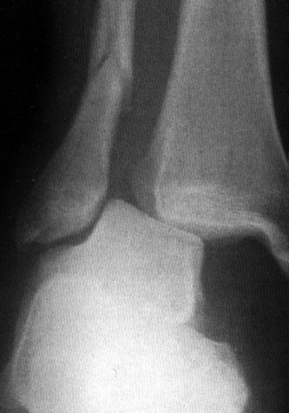
Malleolar fractures
Indirect forces
Shearing and tensile through talus
Plafond intact

Slide 4
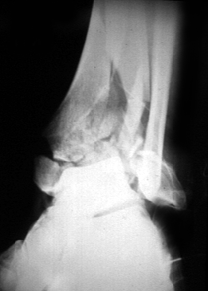
Pilon fractures
Direct (impaction) forces
Plafond fractured
Prognostically significant

Slide 5
Malleolar fractures
Most common lower extremity fractures
Significant changes in management since 1970s
Controversies remain
Complications still occur

Slide 6
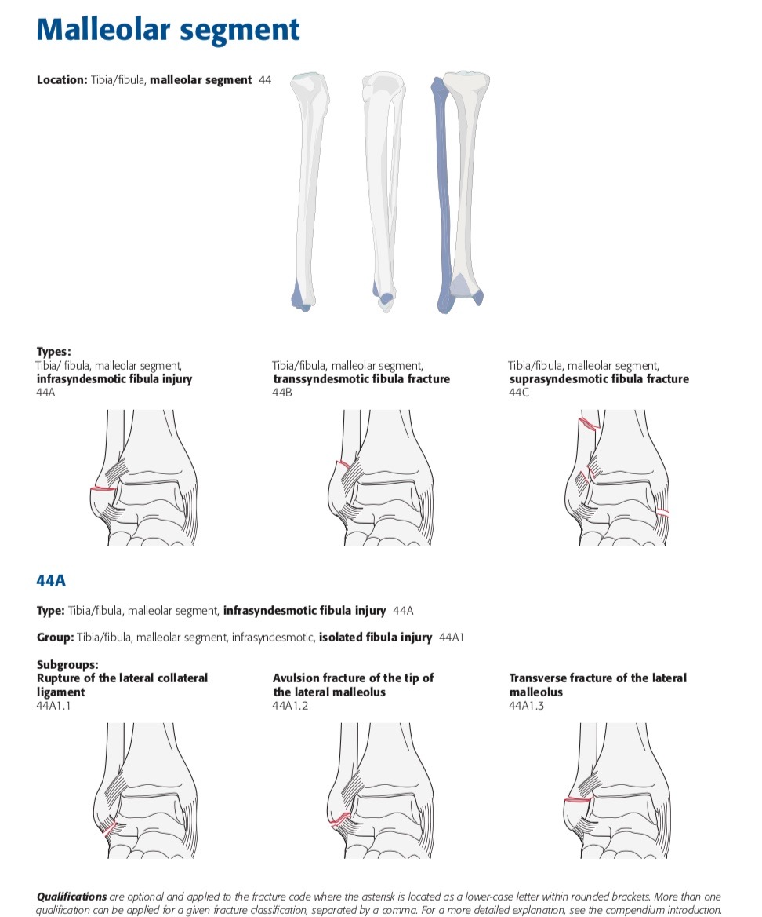

Slide 7
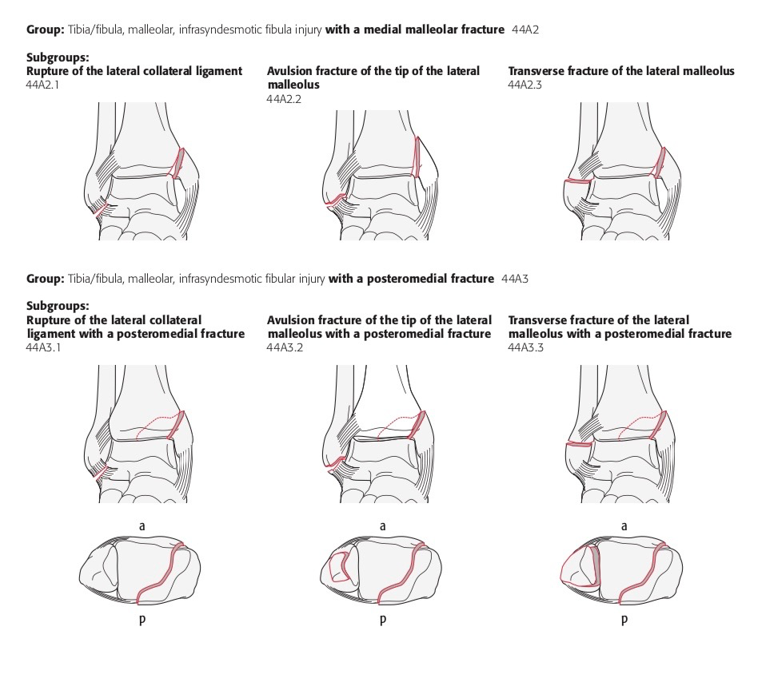
44A2
Infrasyndesmotic fibula with medial malleolar fracture
44A3
Infrasyndesmotic fibula with posteromedial fracture

Slide 8
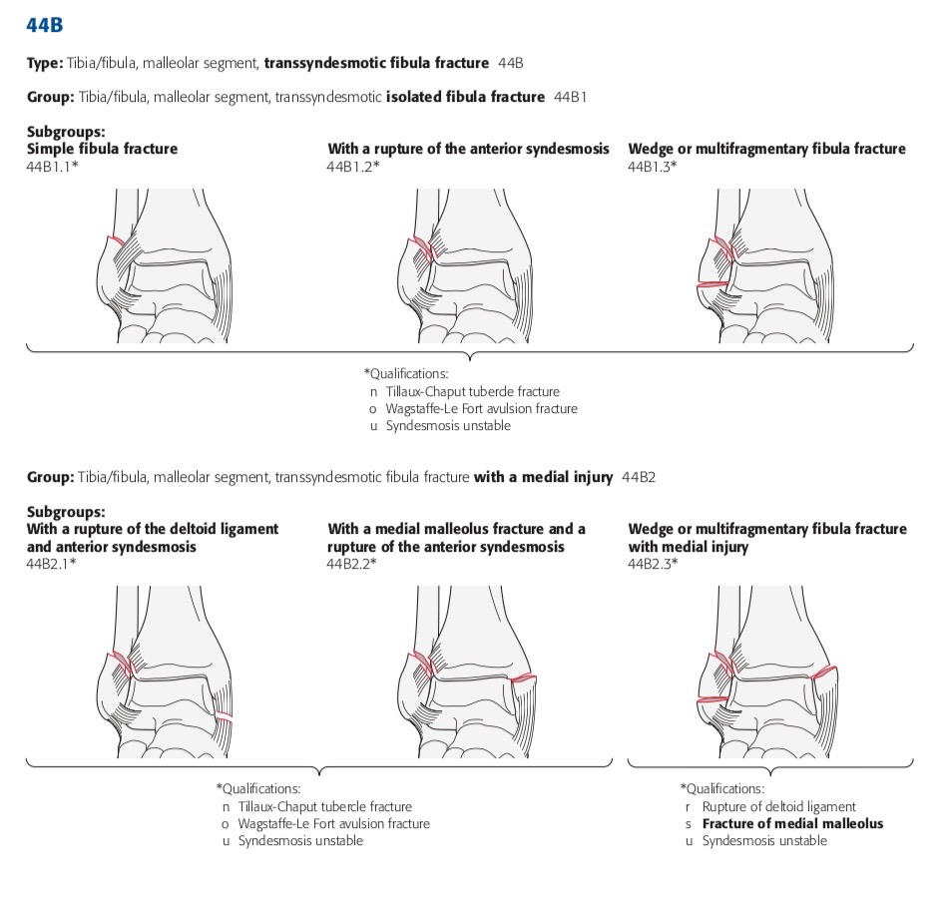
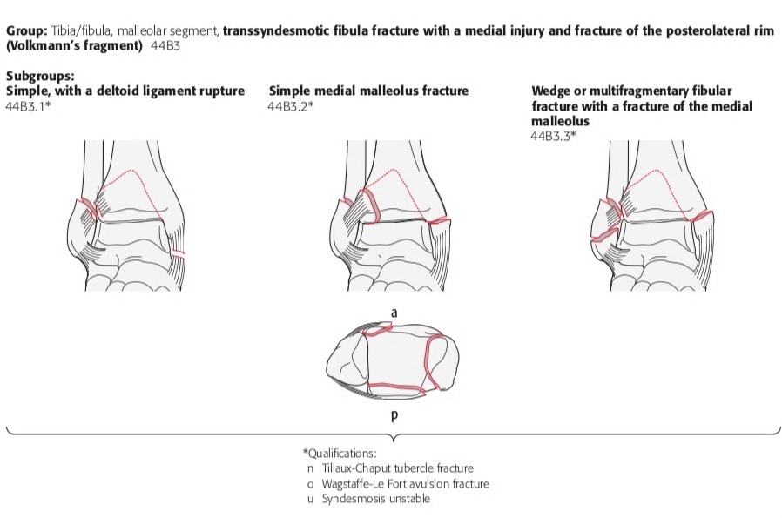
44B Transsyndesmotic fracture

Slide 9
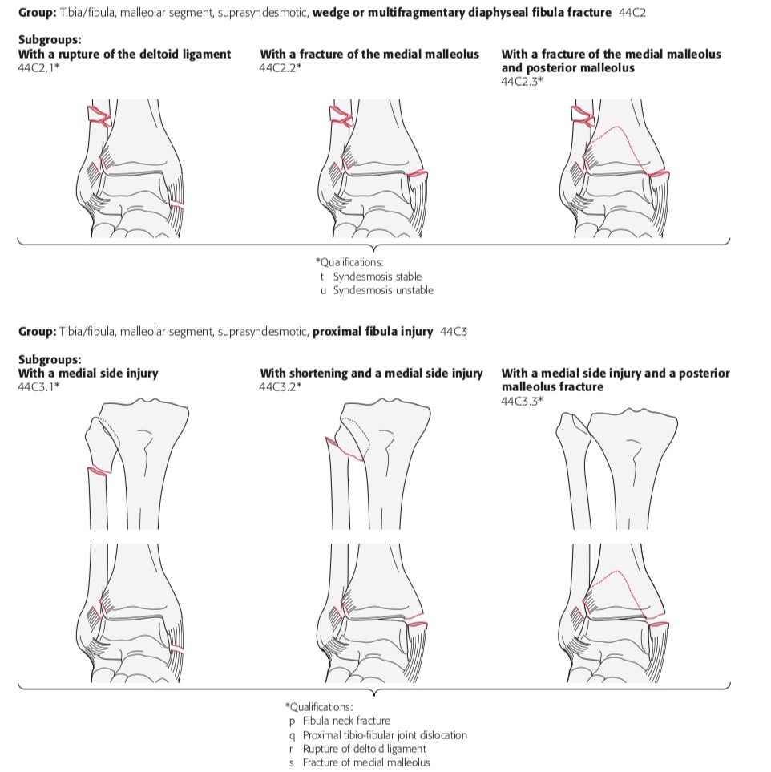
44C Suprasyndesmotic fibula injury

Slide 10
Do all ankle fractures do well?
Minimum of 10 years of follow-ups
36% moderate or severe arthrosis
Notes:
References:
Day GA, Swanson CE, Hulcombe BG. Operative treatment of ankle fractures: a minimum ten-year follow-up. Foot Ankle Int. 2001 Feb;22(2):102-6.

Slide 11
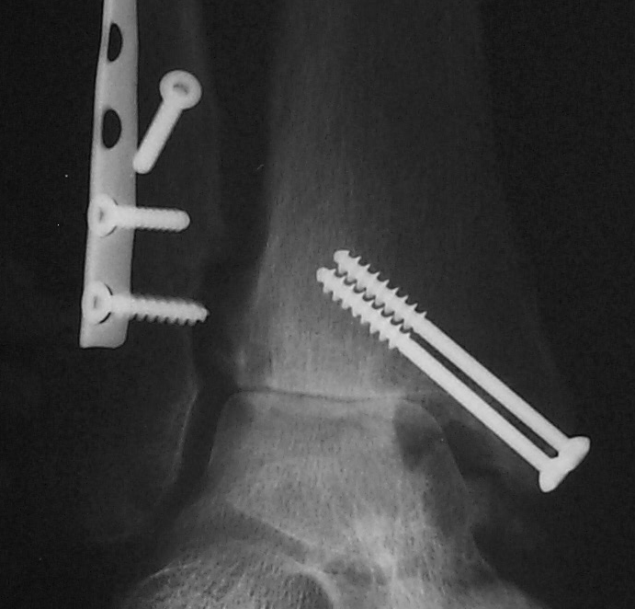
What are we doing wrong?

Slide 12
Changing trends
Length of the fibula and rotation are important
Early range of movement
Anatomical reduction
Notes:
One of the advantages of stable internal fixation over casting once wounds are stable, is the ability to allow early ROM of the ankle joint preventing postoperative arthrofibrosis and allowing an earlier return to work and activity. Less calf atrophy and lower rate of DVT are also advantages. However, the risk for postoperative wound complications is greater.
Both shortening and rotation of the fibula (often occurring together) are associated with lateral talar shift and posttraumatic ankle arthritis. Both are indications for operative treatment of an ankle fracture and should be corrected at the time of surgery. Early ankle arthritis in which shortening and/ or rotation are present should be addressed with fibular osteotomies to restore normal joint mechanics.
References:
Thomas G, Whalley H, Modi C. Early mobilization of operatively fixed ankle fractures: a systematic review. Foot Ankle Int. 2009 Jul;30(7):666-74.
Vioreanu M, Dudeney S, Hurson B, et al. Early mobilization in a removable cast compared with immobilization in a cast after operative treatment of ankle fractures: a prospective randomized study. Foot Ankle Int. 2007 Jan;28(1):13-9.

Slide 13
Importance of the fibula
Length of the fibula is critical
Proximal migration (shortening)
Lateral talar displacement
Inaccurate reduction of distal tibia/fibula joint
Ankle incongruity—arthrosis
Notes:
References:
Yablon IG, Heller FG, Shouse L. The key role of the lateral malleolus in displaced fractures of the ankle. J Bone Joint Surg Am. 1977 Mar;59(2):169-73.

Slide 14
Importance of early range of movement
Is your fixation stable?
Do you trust your patient?
Why not move early?

Slide 15
Importance of anatomical reduction
Intraarticular fractures
No different to any other joint
Secondary arthrosis related to quality of reduction
1 mm talar displacement—reduction of tibiotalar contact surface by 46%
Notes:
References:
Ramsey PL, Hamilton W. Changes in tibiotalar area of contact caused by lateral talar shift. J Bone Joint Surg Am. 1976 Apr;58(3):356-7.

Slide 16
Early management
Reduce dislocation immediately
Beware threatened skin, especially medially
Splint without delay
Immediate or delayed open reduction internal fixation (ORIF)
Always fix unstable injuries

Slide 17
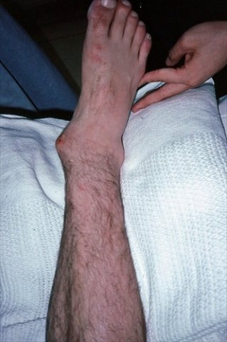
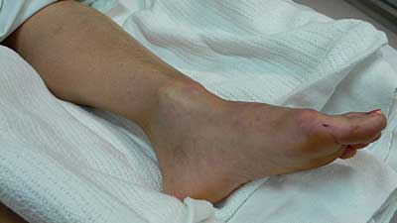
Early management
Threatened skin

Slide 18
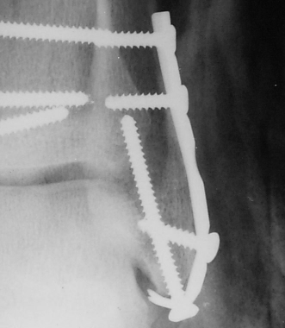
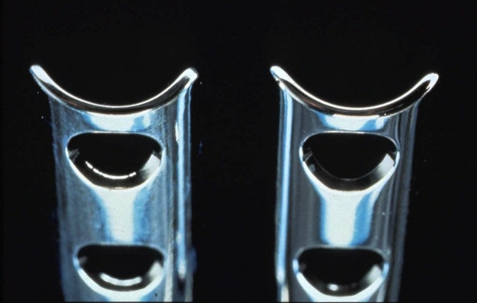
Weber A—fibula fixation
“Hook” plate
Modified 1/3 tubular plate
Good distal fixation
Suitable for low fractures

Slide 19
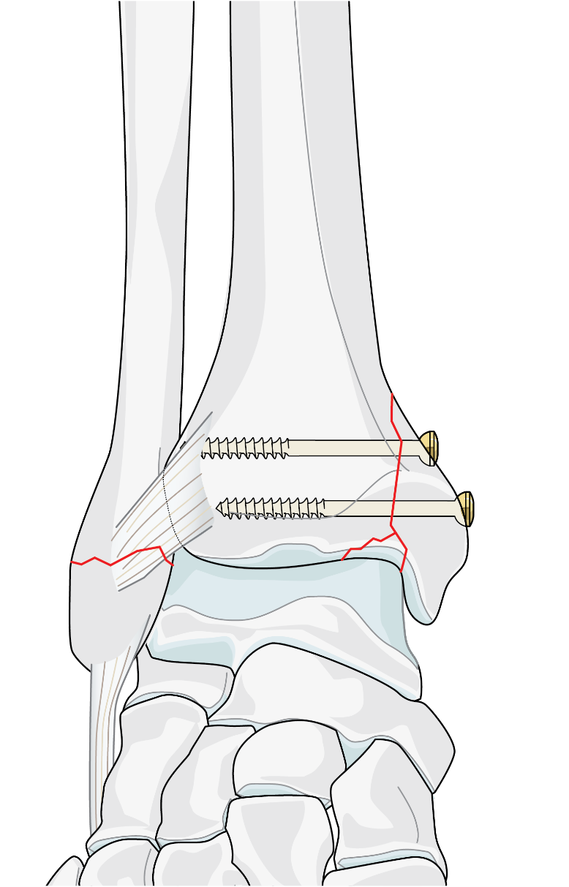
Weber A—medial malleolar fixation
Vertical shear injury
Always inspect joint
Restore and bone graft marginal impaction
Screws perpendicular to fracture plane
NOT from tip—malreduction
Buttress plate adds stability (antiglide)
3.5 screws better than “malleolar”

Slide 20
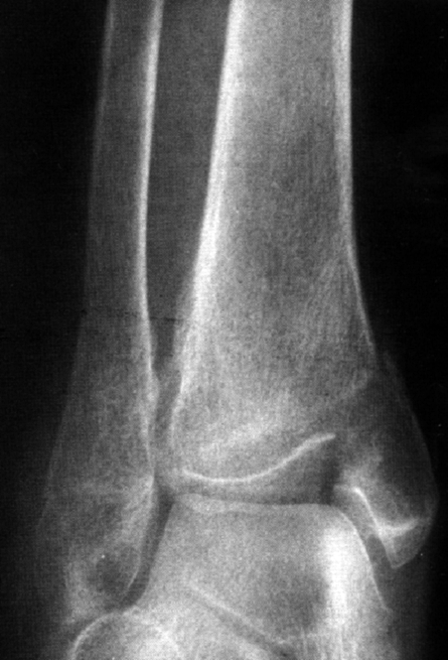
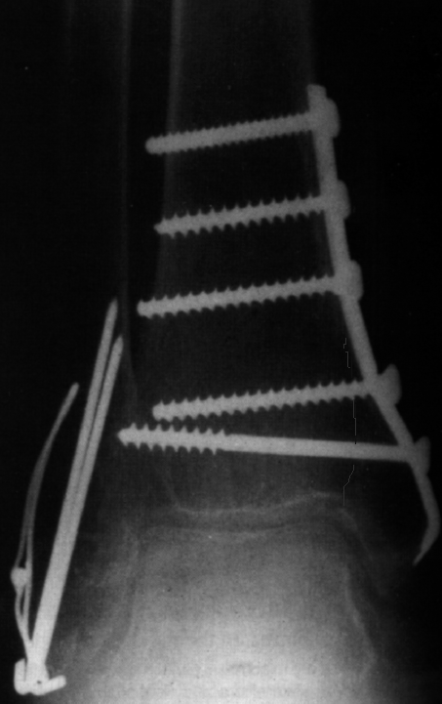

Slide 21
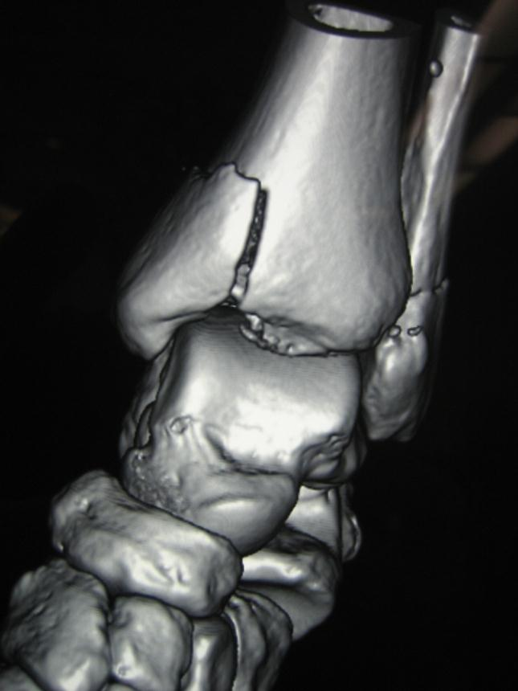
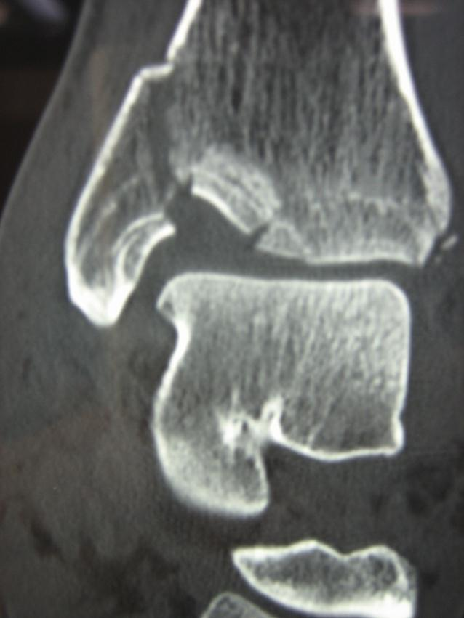
Marginal impaction

Slide 22
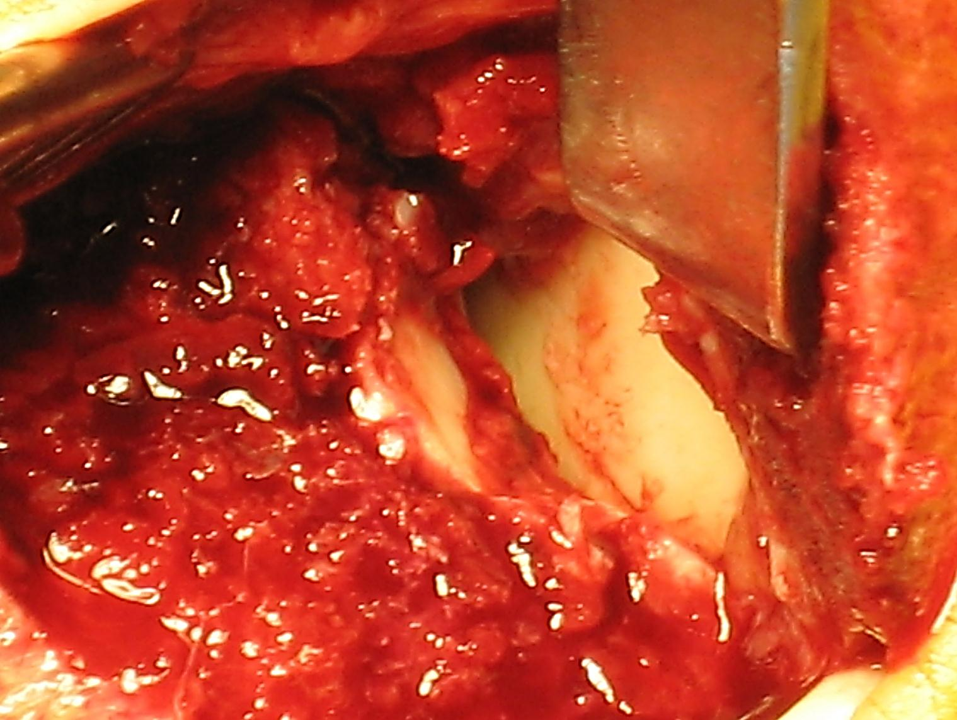
Marginal impaction
Notes:
Marginal impaction medial tibial plafond

Slide 23
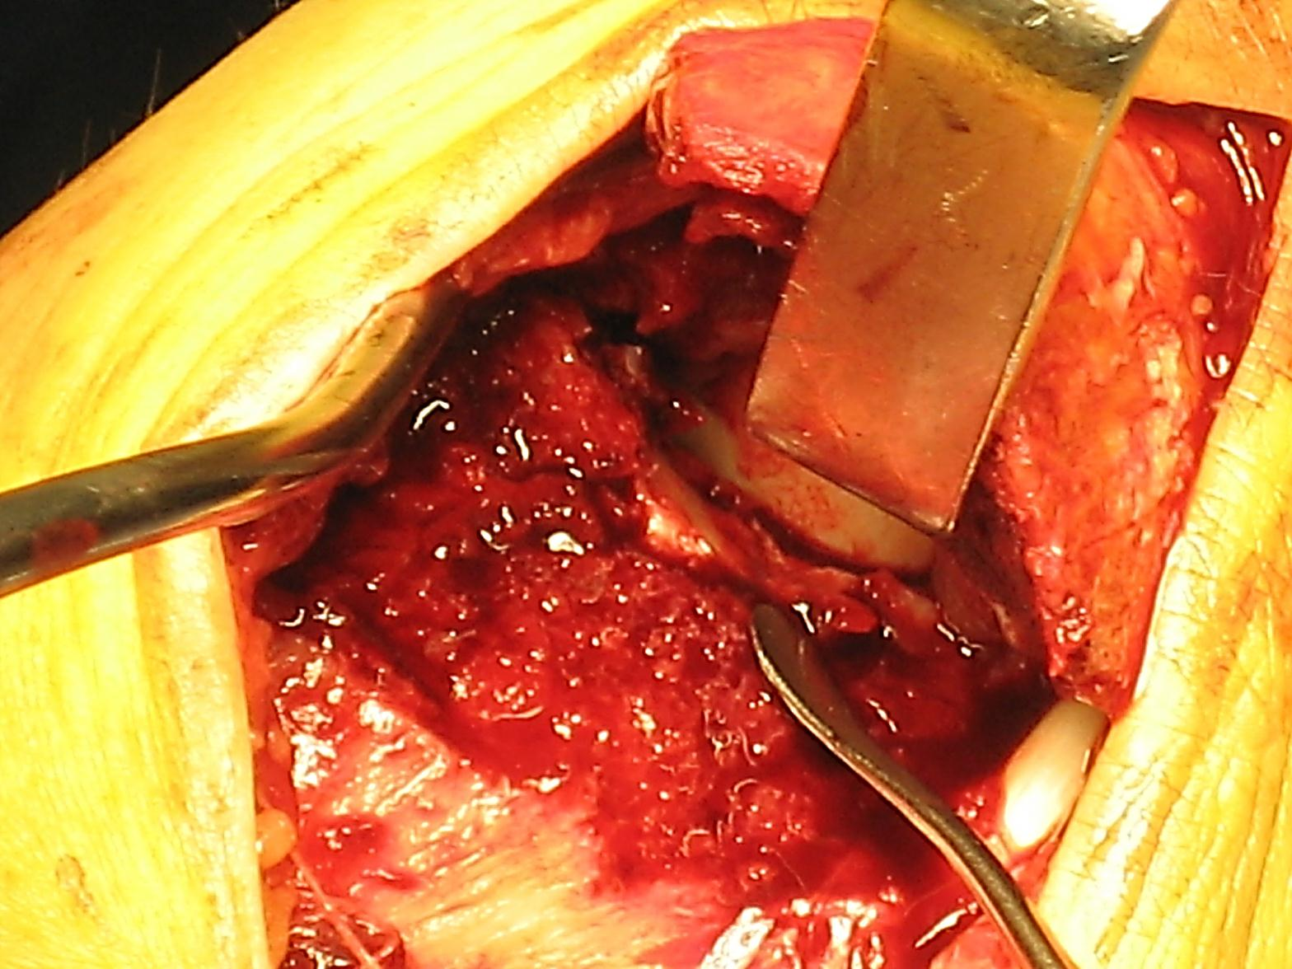
Marginal impaction
Notes:
Use of a freer elevator to restore the subchondral surface following marginal impaction of the medial tibial plafond

Slide 24
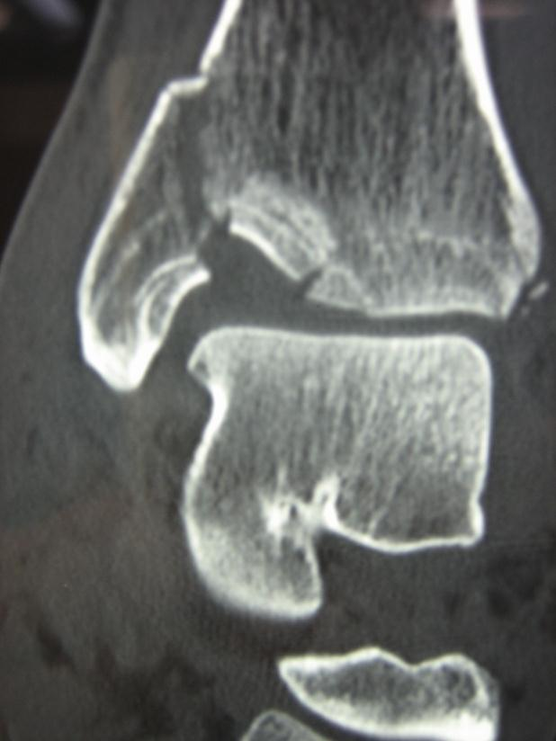
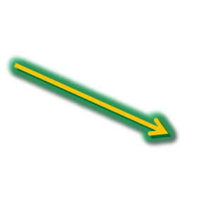
Vertical medial malleolar fracture
Notes:
CT scan shows medial (green arrow) and proximal displacement (red arrow) of the medial malleolar fracture fragment; impaction of the medial tibial plafond is also evident.

Slide 25
Management—Weber B
60–80% of ankle fractures
Be careful with superficial peroneal nerve (SPN)
Fibular fixation posterior or lateral?
Begin ORIF with fibula
Medial malleolar fixation—two 40 mm cancellous 4.0 screws

Slide 26
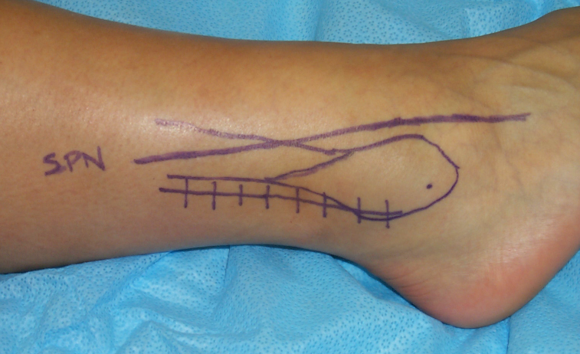
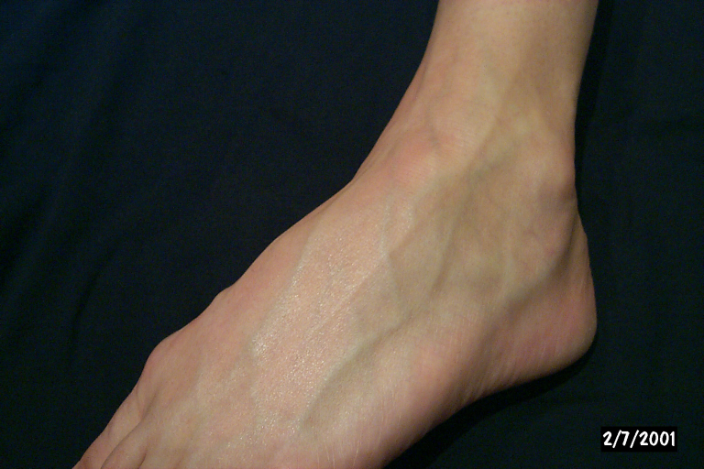
Superficial peroneal nerve
Injury to SPN common
Variable course
It may be lower than you think!
Posterolateral incision

Slide 27
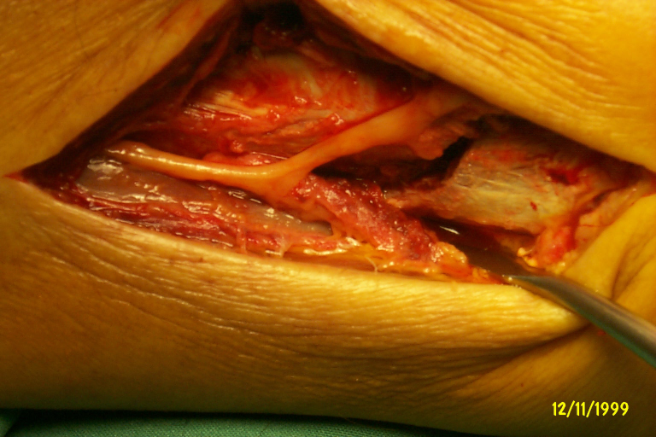
SPN over low Weber B fracture

Slide 28
Weber B—posterior fibular fixation
Posterolateral plate
Not subcutaneous
Biomechanically sound—antiglide
Lag screw(s) through the plate
No anterior stripping
Joint penetration less likely
Distal bicortical fixation

Slide 29
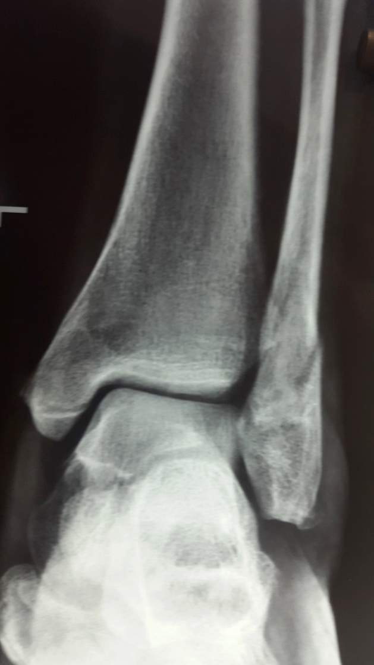
Weber B—when to fix?
Literature suggests: B-type fracture with no medial injury: ORIF = nonoperative
Surgery is NOT superior; maybe associated with more complications
Mittal R, Harris IA, Adie S, Naylor JM; CROSSBAT Study Group. Surgery for Type B Ankle Fracture Treatment: a Combined Randomised and Observational Study (CROSSBAT). BMJ Open. 2017 Mar 27;7(3)

Slide 30
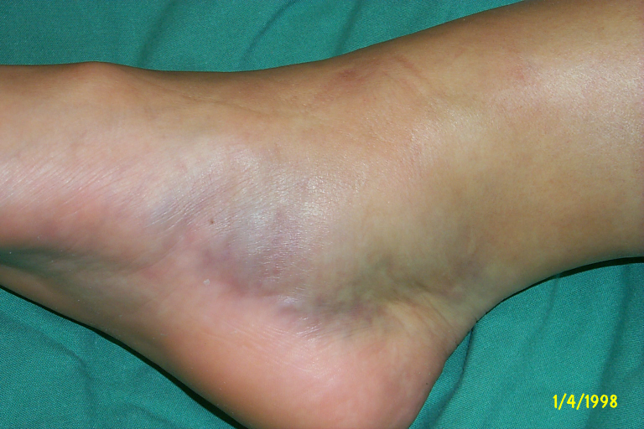
Weber B—when to fix?
But many need ORIF
Significant instability
Significant medial or deltoid ligament injury and instability
Displaced medial malleolar fracture
Talar shift on x-ray
Toth MJ, Yoon RS, Liporace FA, Koval KJ.: What's new in ankle fractures.
Injury. 2017 Oct;48(10):2035-2041.

Slide 31
Management—Weber C
Syndesmosis disrupted
Syndesmotic injury ligamentous or bony
Fibula—restoration of length critical
Fibular fracture may be high
Be careful with SPN
Accurate reduction and fixation of syndesmosis is paramount
Medial malleolar fixation—as for Weber B

Slide 32
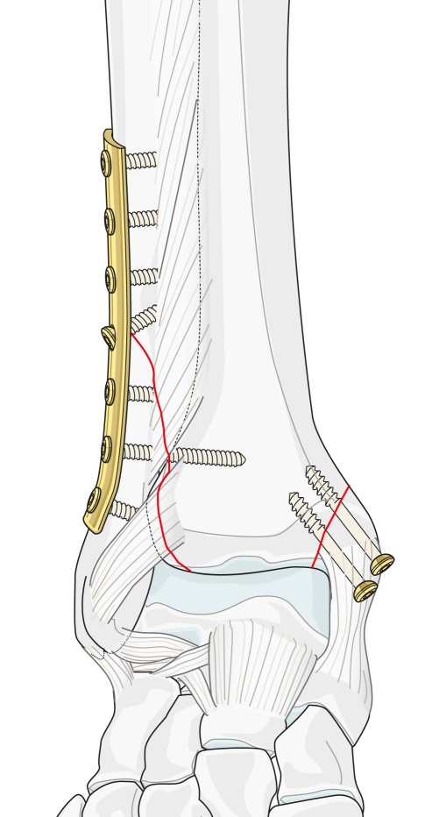
Weber C—fibular fixation
Low fractures—anatomical reduction
High fractures (maisonneuve)
Fibular fixation not necessary if length is OK

Slide 33
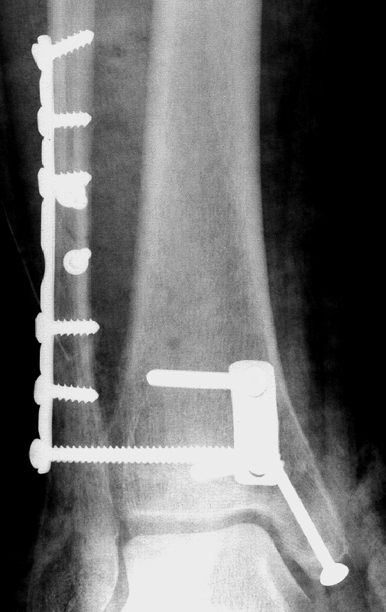
Weber C—syndesmotic fixation
No lag screw—position
Reduce prior to insertion
3 or 4 cortices
3.5 or 4.0 cortical
Posterolateral to anteromedial
2–3 cm above ankle—parallel
Removal at 12 weeks or more

Slide 34
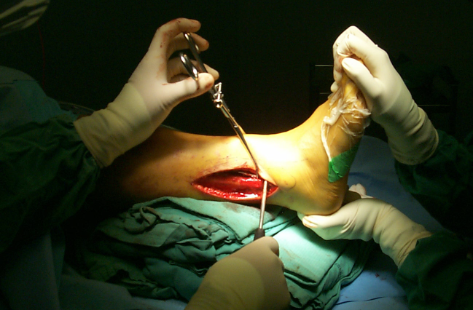
Syndesmotic reduction

Slide 35
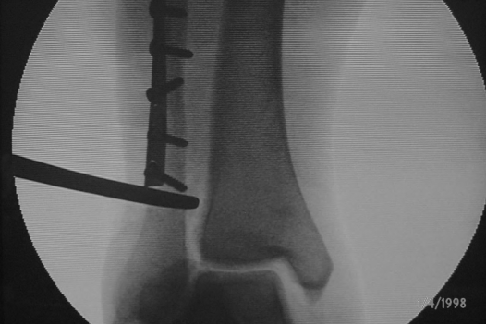
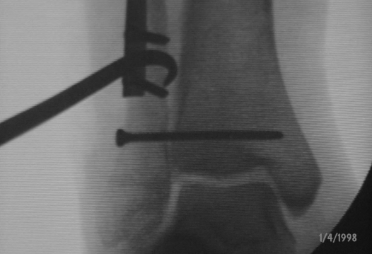
Weber C—syndesmosis controversies
When is fixation necessary?
Best method—screw fixation or direct ligament repair?
Type of screw fixation?
Time to screw removal (syndesmosis healing)?
Time to weight bearing?
Notes:
Suggest answers to these question especially the best method and type of screw.

Slide 36
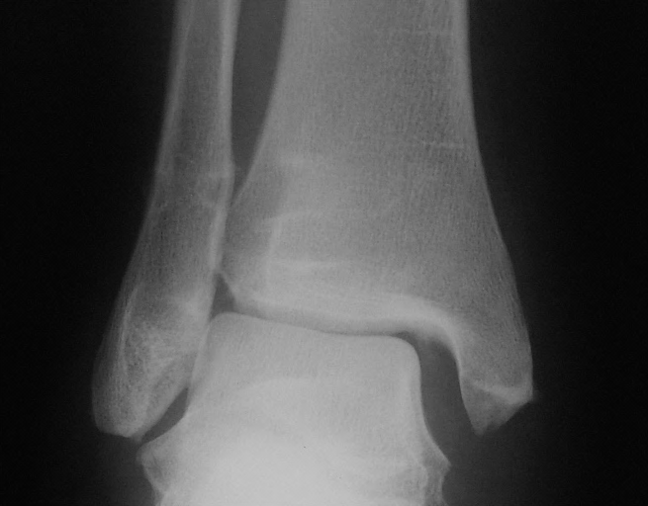
Screw removal?

Slide 37
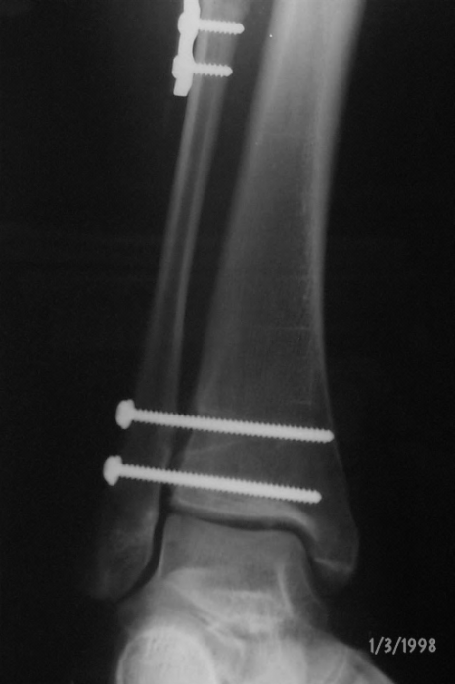
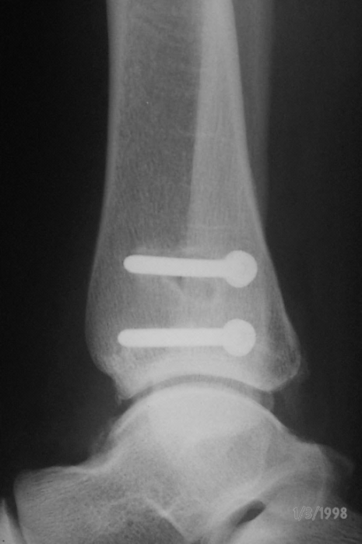
Revision syndesmosis stabilization

Slide 38
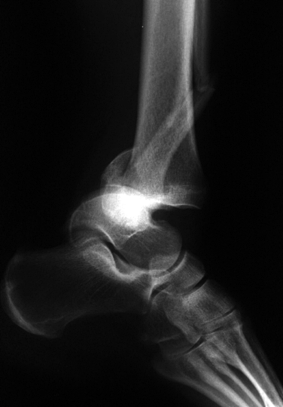
Management—posterior tibial lip
Not true “malleolus”
Usually attached to posteroinferior tibiofibular ligament (PITFL)
Reduction with ORIF of fibula
Most authors—less than 20% ORIF
Approach PM or PL
AP or PA lag screws or posterior antiglide plate

Slide 39
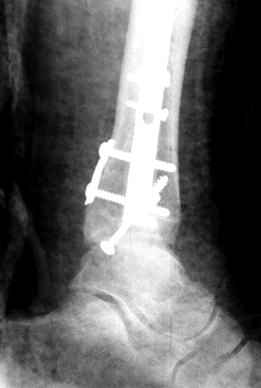

Slide 40
Osteoporotic fractures
Treat as if “normal”
Allow the implants to do the work
Aim: prevent progressive deformity and arthrosis
Better than arthrodesis
If fibula is osteoporotic and difficult to fix
Pass screws into tibia for added fixation and stability
Antiglide plate

Slide 41
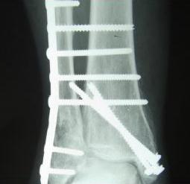
Osteoporotic fractures—fibula pro-tibia technique

Slide 42
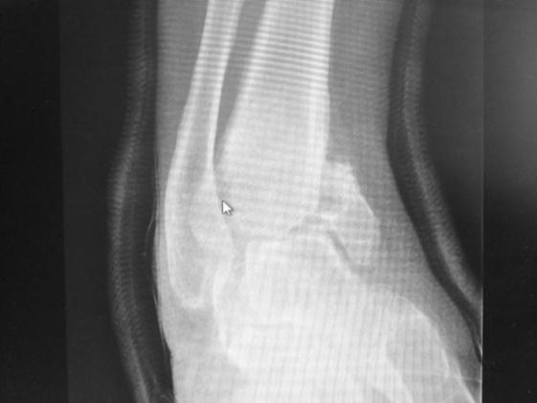
Neuropathic ankle fractures
Need more aggressive treatment
Double nonweight bearing
Double fixation
Double immobilization
Careful attention to soft tissues

Slide 43
Take-home messages
Not all ankle fractures are straightforward
Recognize more complex injuries
Apply sound fixation principles
Length of the fibula and rotation are critical
Restore anatomy
Recognize high-risk patients

