Slide 1
To all presenters:
This presentation is a definitive guide to the principles of acetabular fracture management
Please select only the slides relevant to your lecture and that will fit within your allocated time slot
Slides which are not needed may be hidden (right click, hide slide)

Slide 2
Principles of acetabular fracture management
AO Trauma Advanced Principles Course
Notes:
Reviewer: Wa’el Taha
Reviewed: 2018

Slide 3
Learning objectives
Perform an assessment of acetabular fractures
Outline the anatomy of the acetabulum
Interpret x-rays and CT scans of acetabular fractures
Describe different fracture patterns
Describe principles of management
Avoid potential complications
Notes:
Teaching points:
Focus on x-rays and CT scans, fracture classification (Letournel) and decision-making process. Highlight that these fractures should be treated by experts and that there are specific AOT courses (pelvis and acetabulum) to learn more about these injuries.

Slide 4
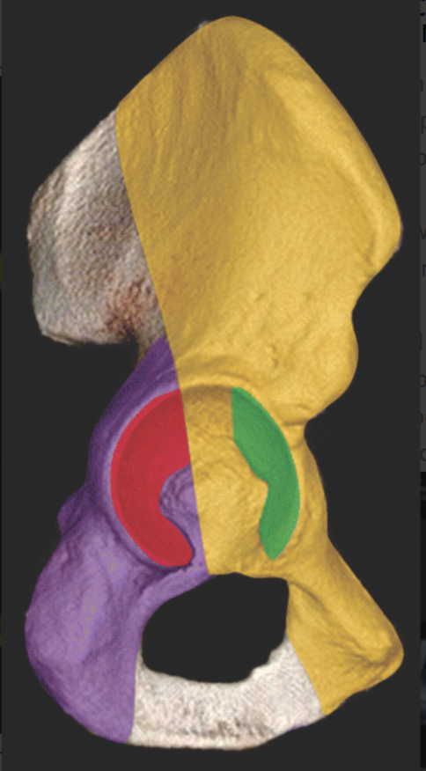
Acetabular anatomy
Anterior column
Posterior wall
Anterior wall
Posterior column
Notes:
The anterior wall makes part of the anterior column, and the posterior wall makes part of the posterior column

Slide 5
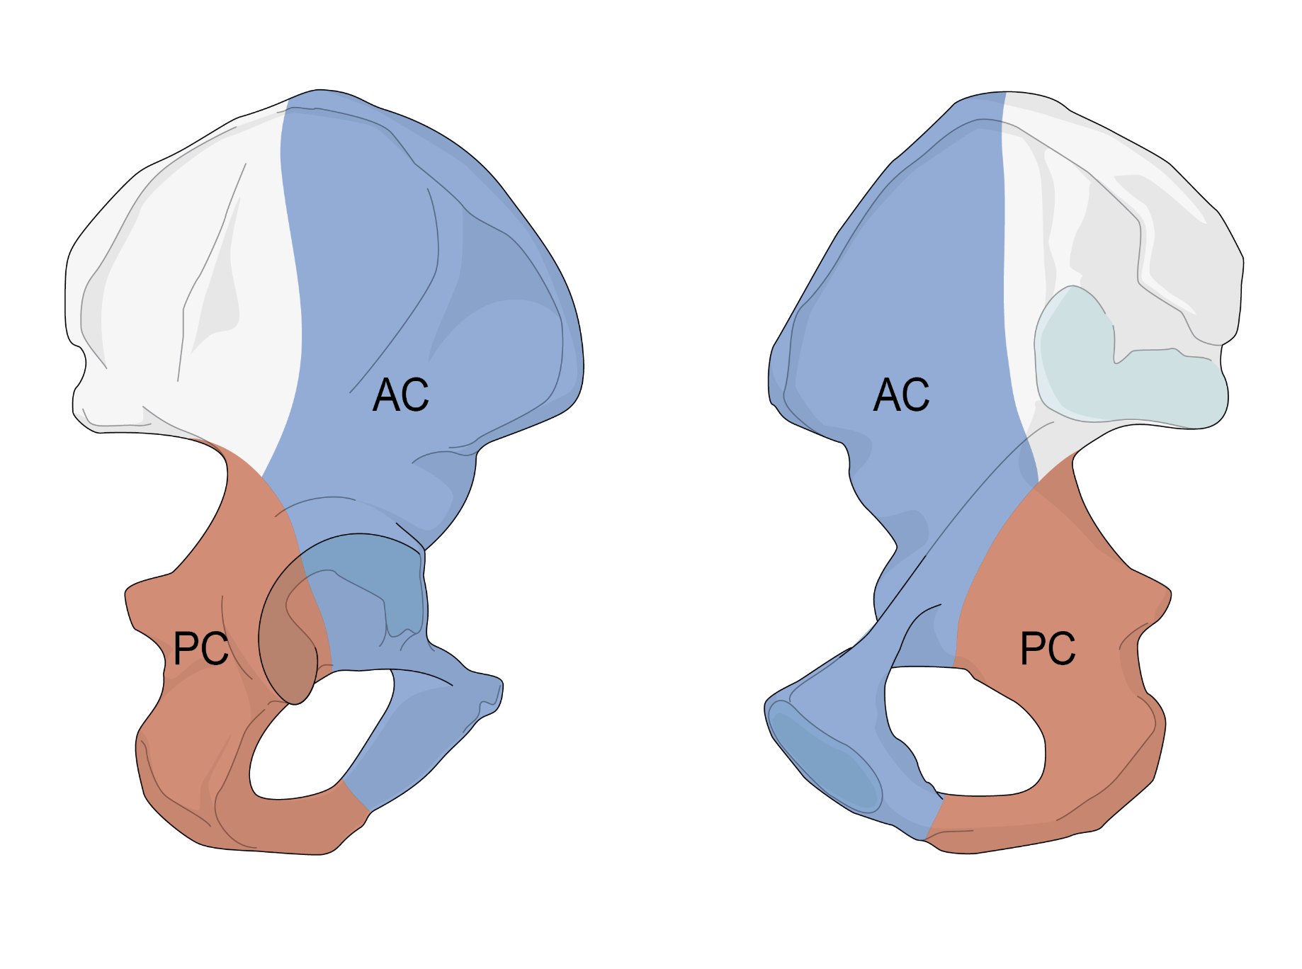
Notes:
A is the acetabulum from the lateral outside view, B is the from the medial inside view

Slide 6
Radiological evaluation
X-rays:
  AP view
  Judet views: iliac oblique and obturator oblique
CT scan
Notes:
Although 3D CTs can be of great help in making and planning the surgery, a thorough understanding of the oblique views is essential as these views are used intraoperatively to assess reduction and fixation

Slide 7
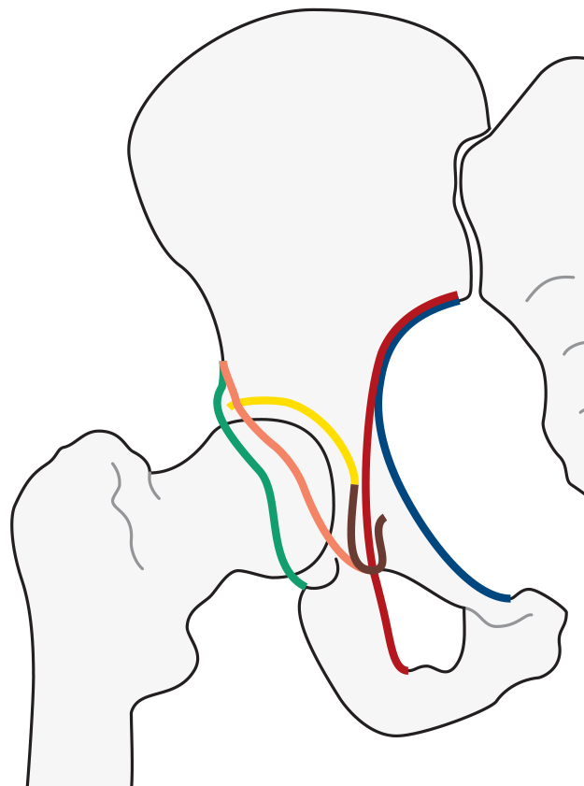
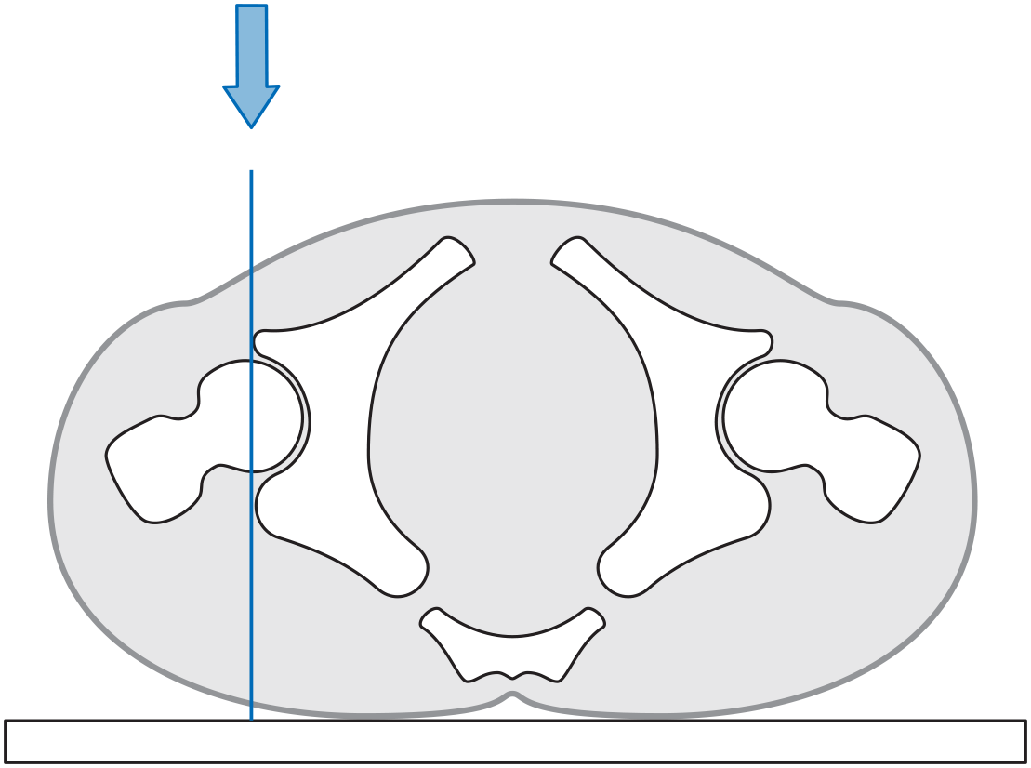
AP view
Notes:
There are six lines which indicated the different borders of the acetabulum, these should be assessed on all the acetabular views in order to make a correct diagnosis.

Slide 8
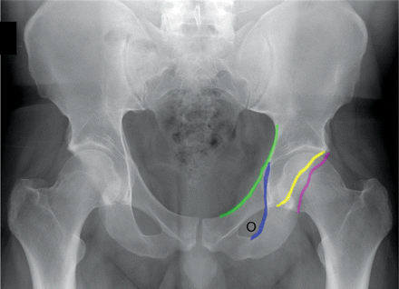
1
5
4
6
3
2
Notes:
The iliio pectineal line indicated the border of the anterior column
The ilioischial line indicated the border of the posterior column
The lip of the anterior wall
The lip of the posterior wall
The dome of the acetabulum
The tear drop which indicated the medial wall of the acetabulum

Slide 9
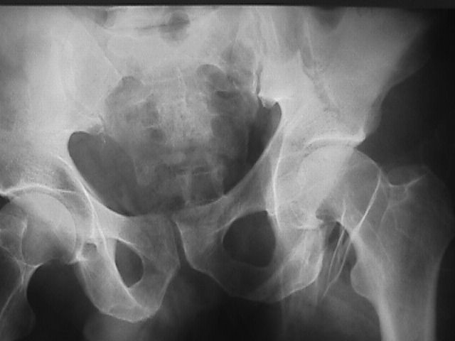
AP view

Slide 10
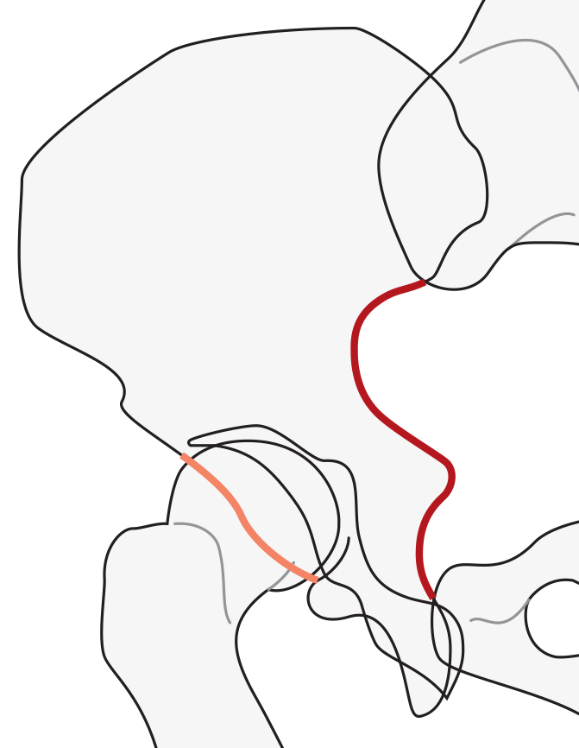
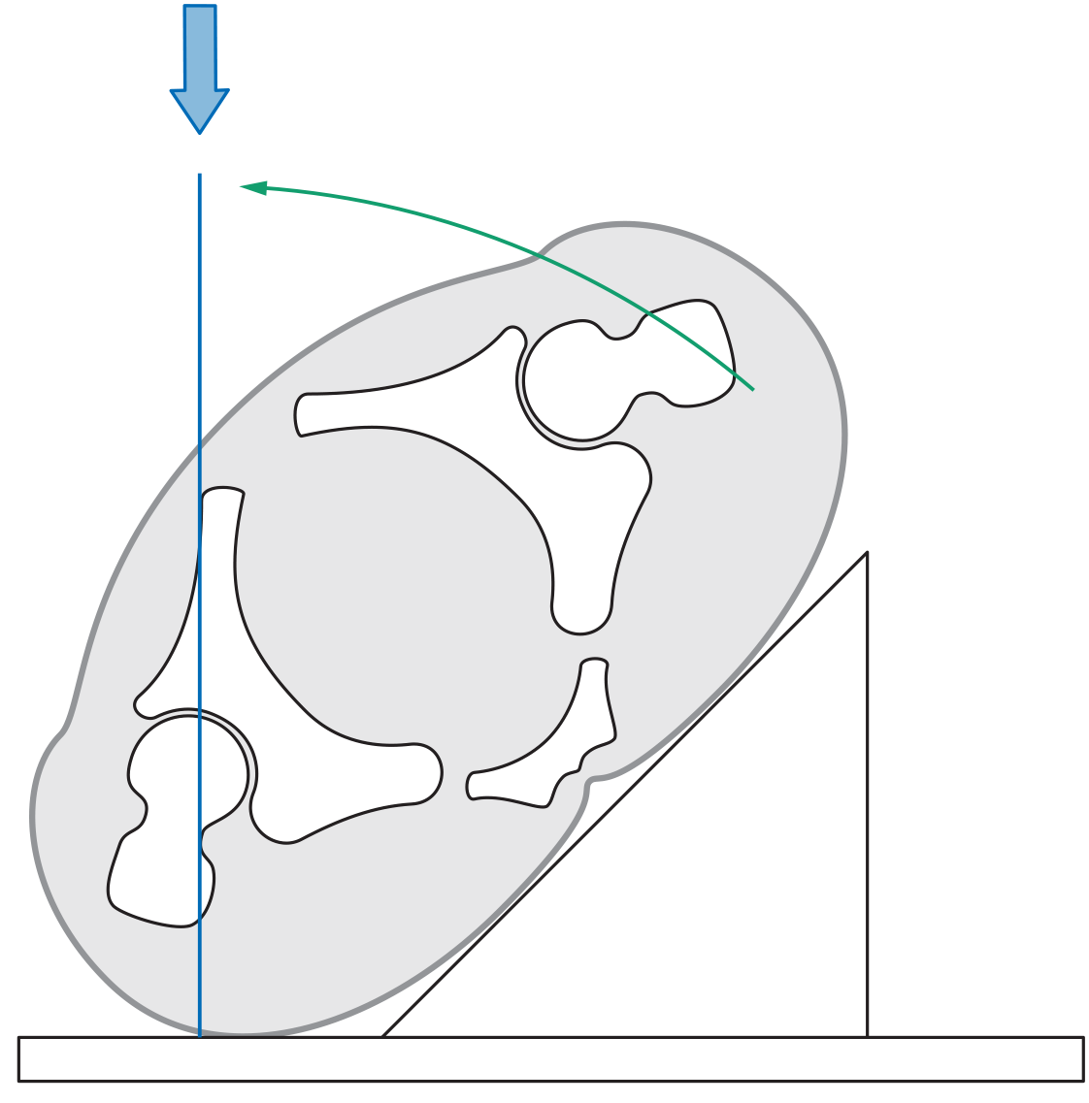
Iliac oblique view
Notes:
The iliac oblique view is best for assessing the posterior column and the anterior wall.

Slide 11
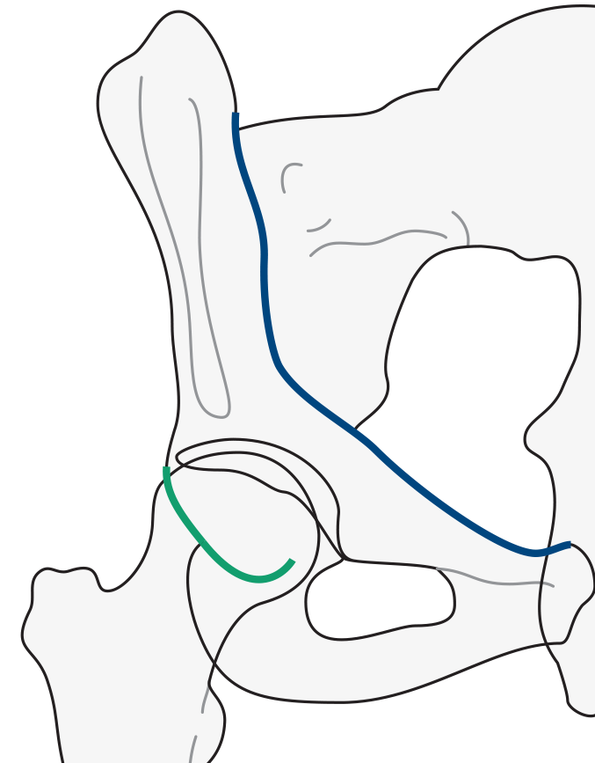
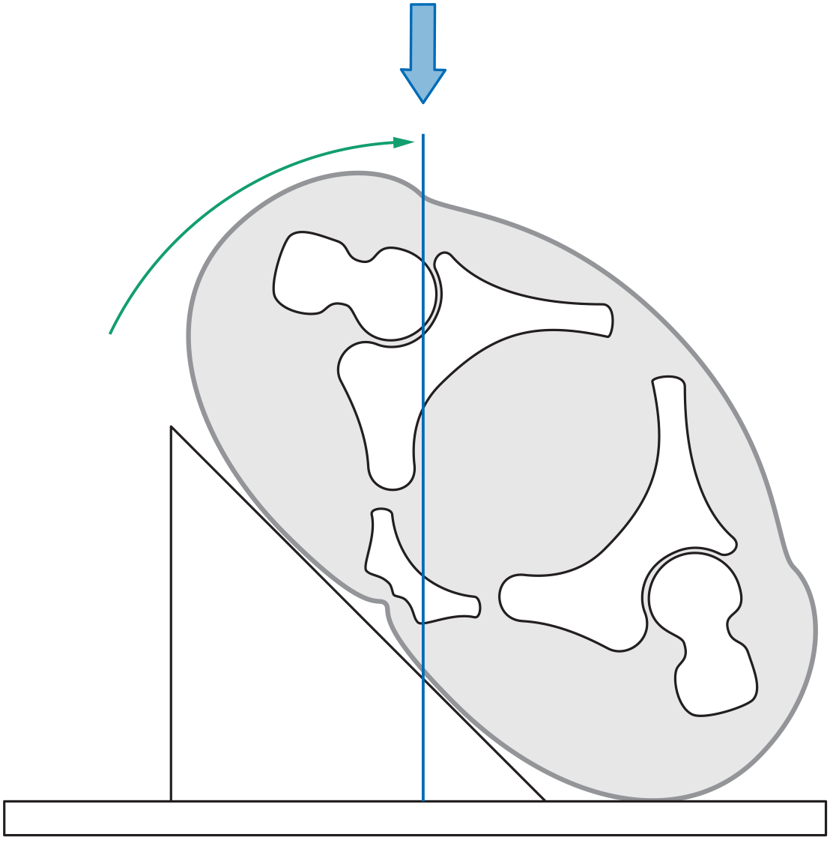
Obturator oblique view
Notes:
The obturator oblique view is best for assessing the anterior column and the posterior wall.

Slide 12
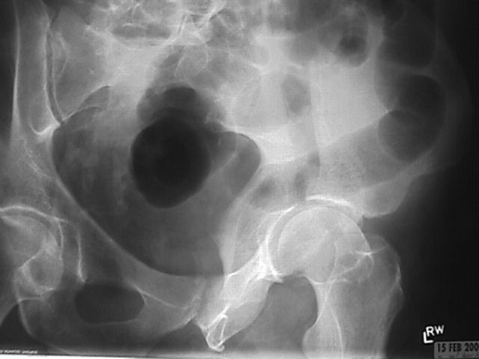
Iliac oblique view

Slide 13
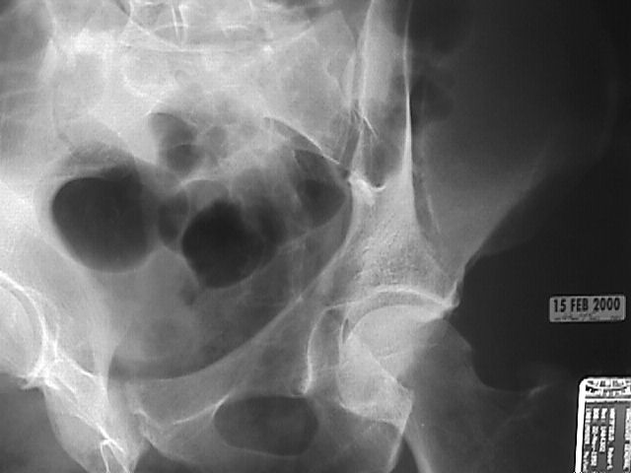
Obturator oblique view

Slide 14
CT scan
Intraarticular fragments
Femoral head fractures
Size of posterior wall fragment
Involvement of sacroiliac joint
Notes:
The CT scan is essential to detect these points.

Slide 15
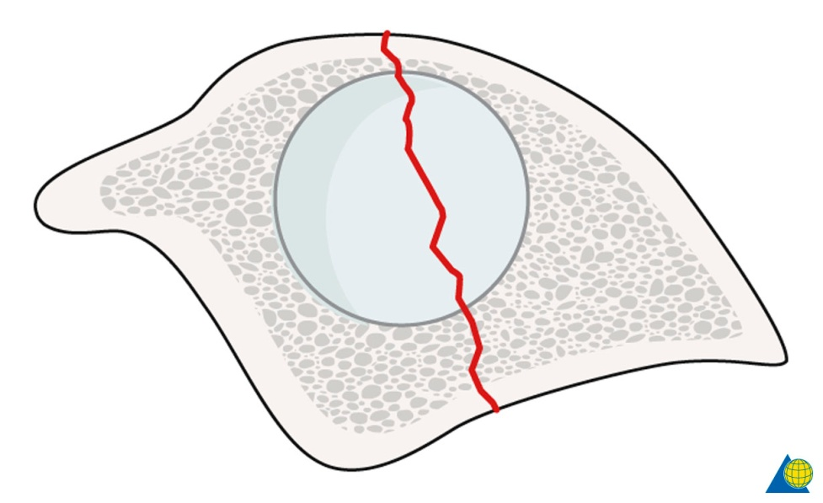
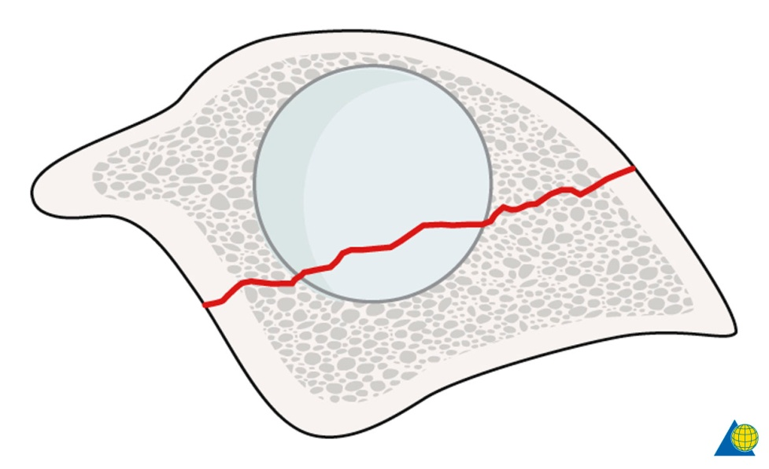
CT axial cuts
Fracture line orientation
Notes:
A vertical line on the axial cuts of the CT scan indicate a transverse fracture or its variants, where a transverse line on the axial views indicated a both column fracture orientation.

Slide 16
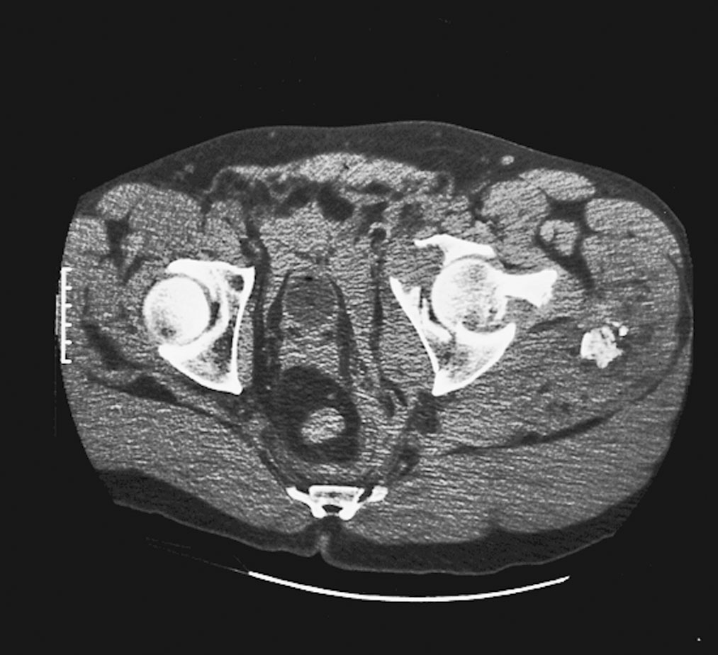
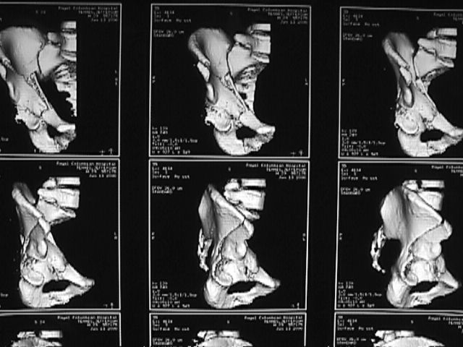
CT scan

Slide 17
Classification
Letournel classification
  Simple fractures:
      One fracture line
  Complex fractures

Slide 18
Letournel and Judet classification
Divides fractures into
Simple fractures, ie, one fracture line
Complex fractures, ie, more than one fracture line

Slide 19
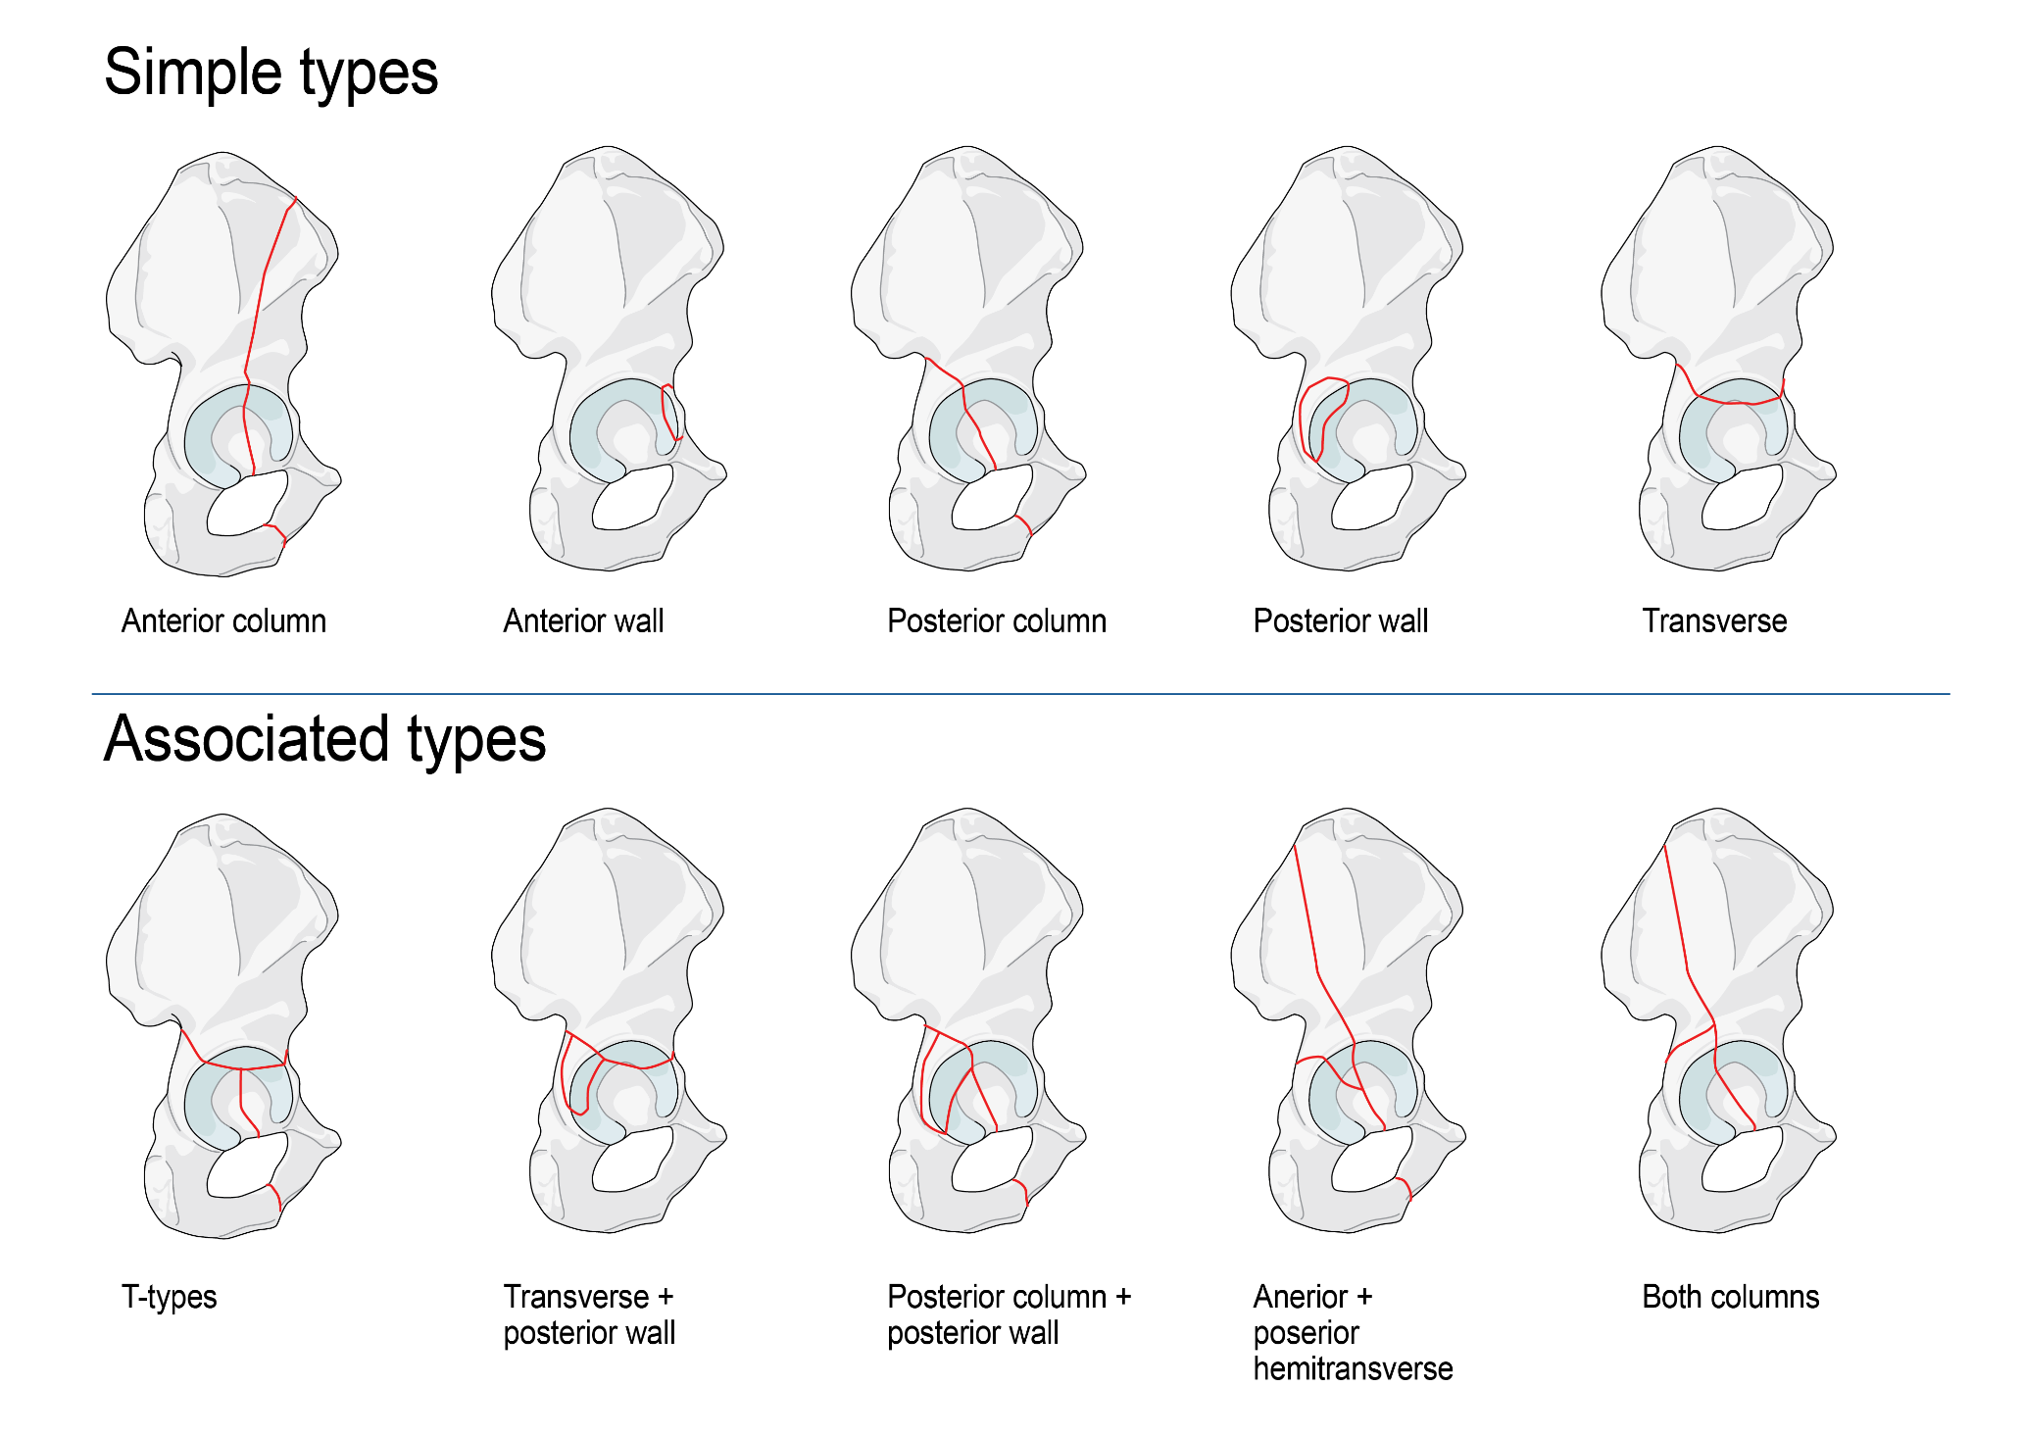

Slide 20
Simple fractures
Single line

Slide 21
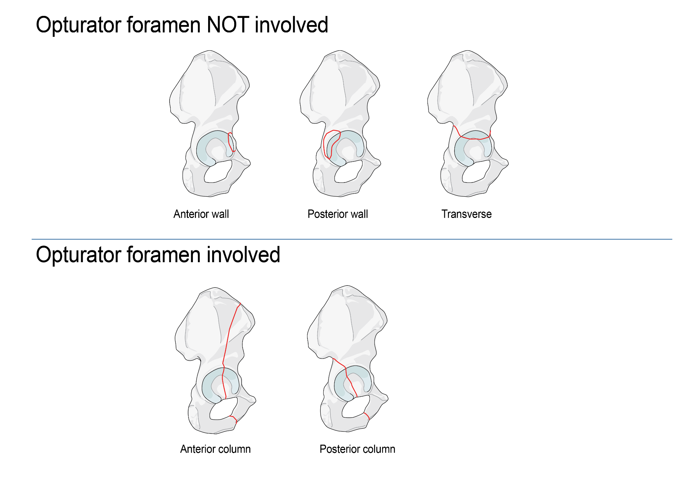

Slide 22
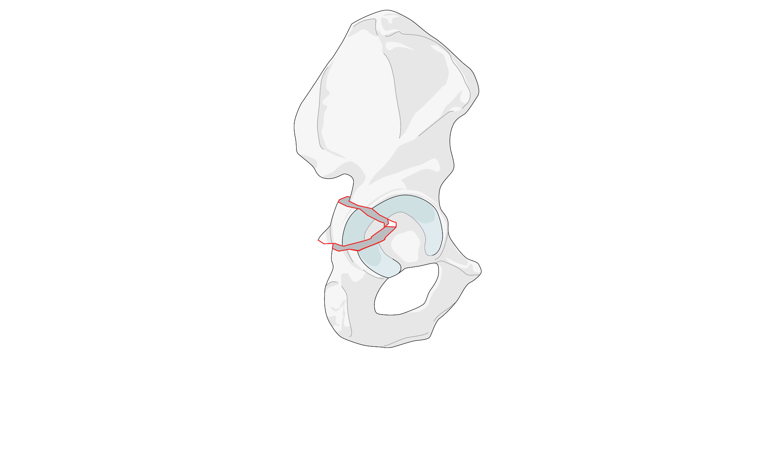
Posterior wall

Slide 23
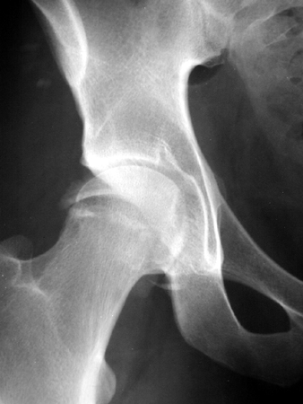
AP view

Slide 24
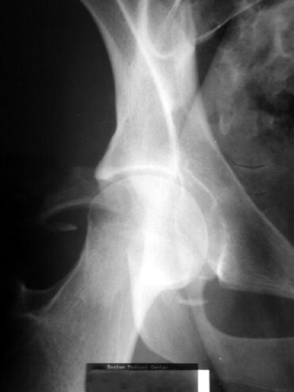
Obturator oblique view

Slide 25
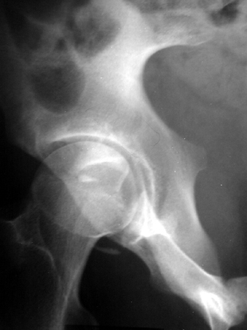
Iliac oblique view

Slide 26
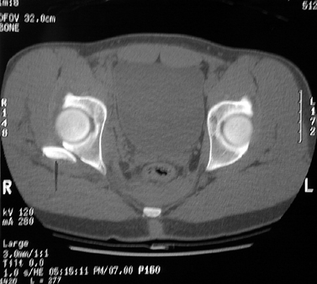
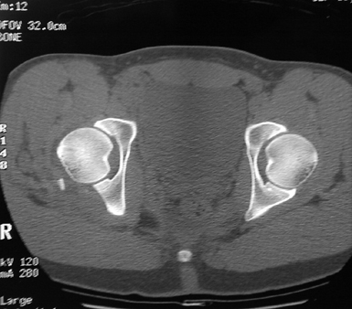

Slide 27
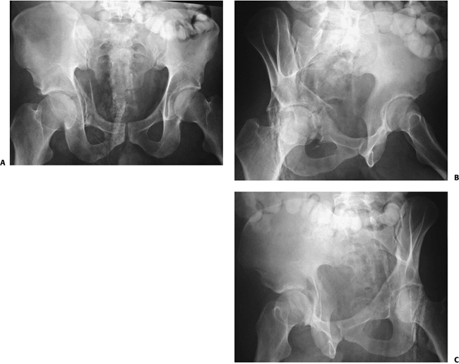
Anterior wall fracture

Slide 28
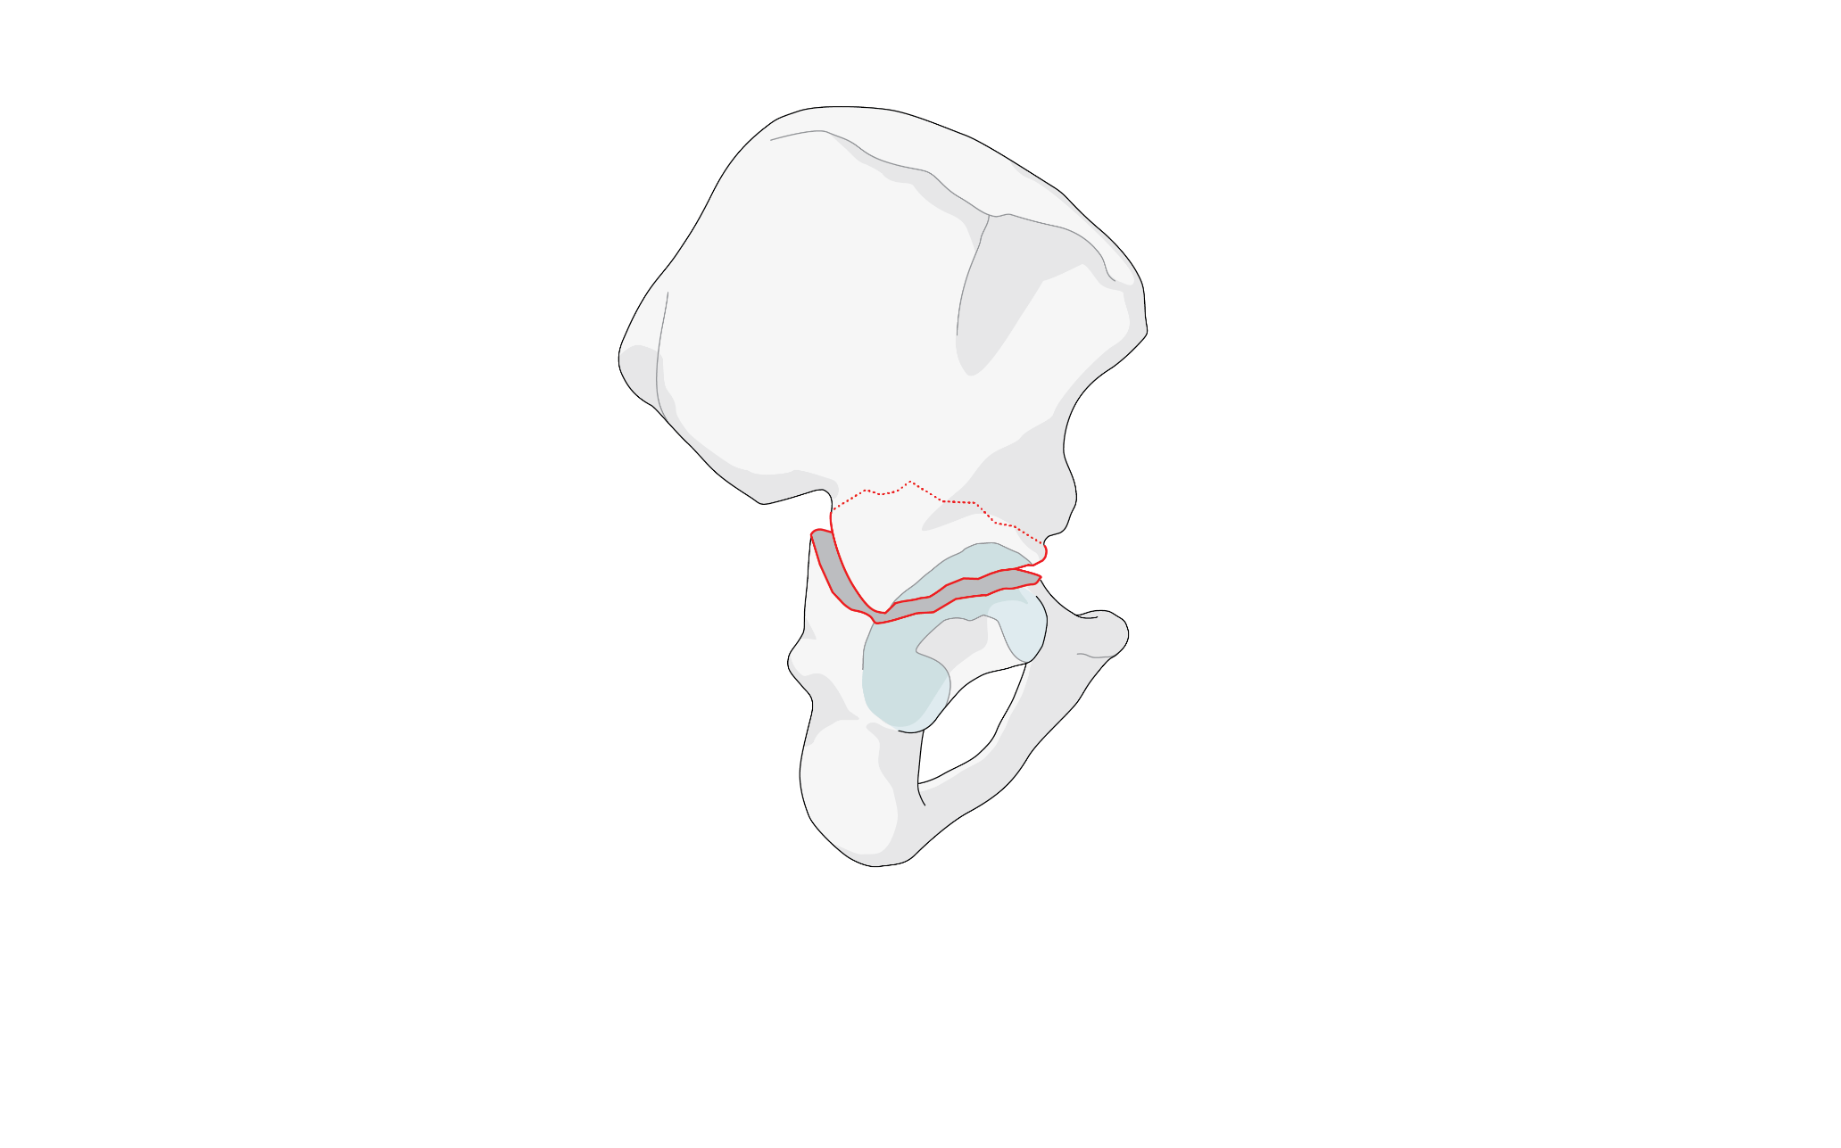
Transverse
Durkee, N. J. et al. Am. J. Roentgenol. 2006;187:915-925

Slide 29
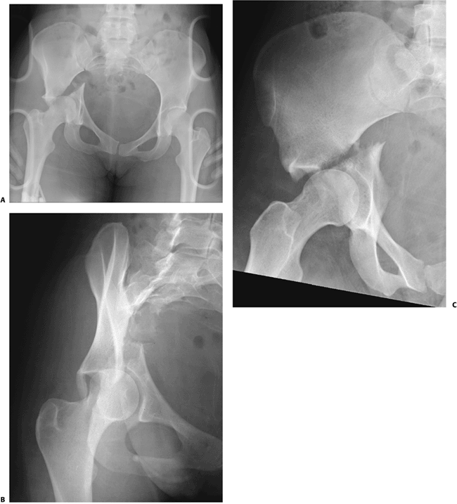

Slide 30
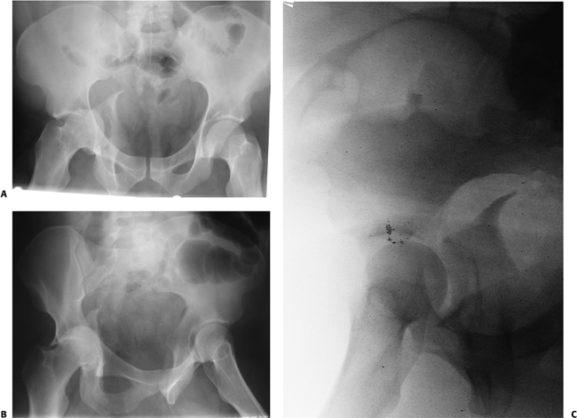
Posterior column

Slide 31
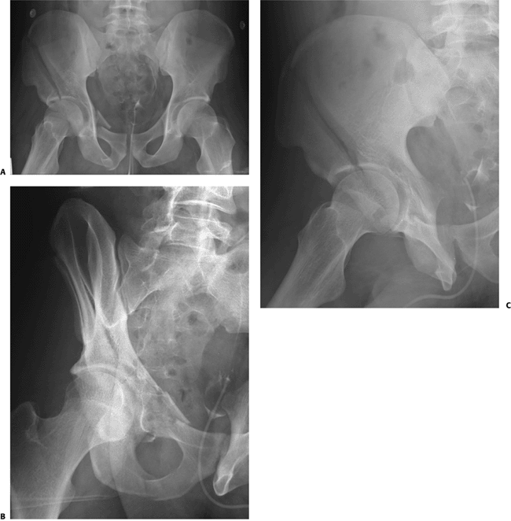
Anterior column

Slide 32
Complex (associated) fractures
More than one fracture line

Slide 33
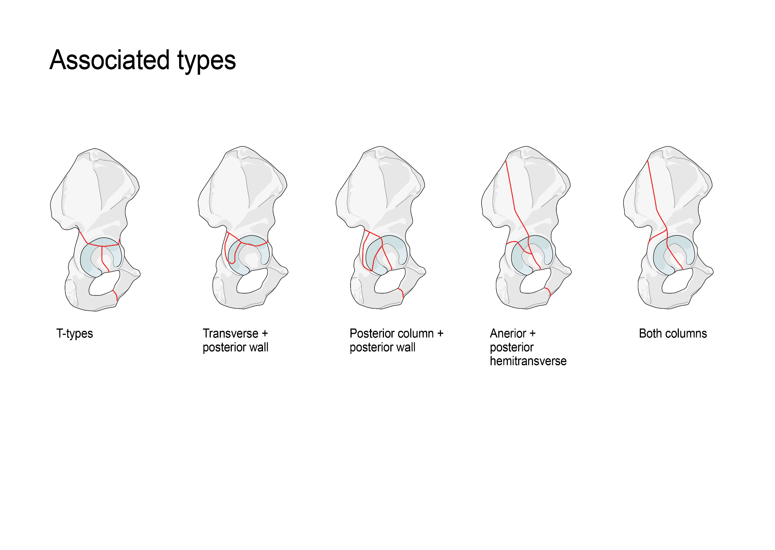
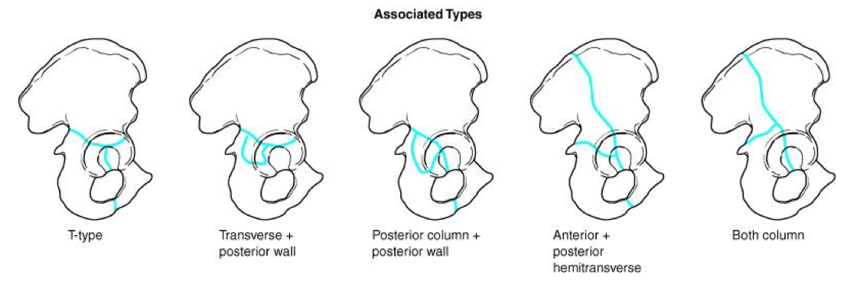

Slide 35
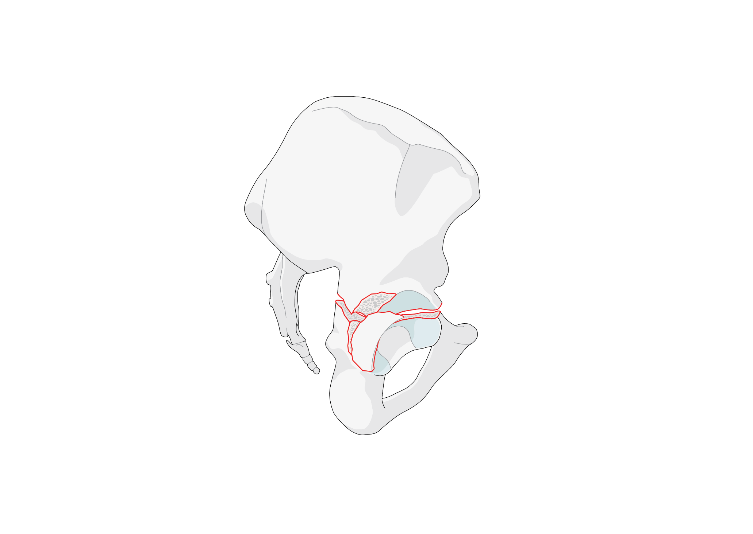
Posterior wall and transverse

Slide 36
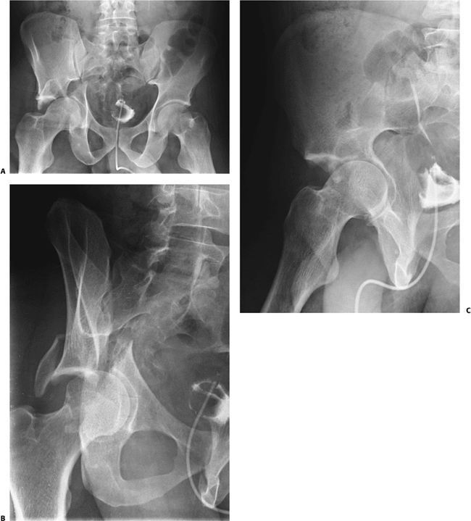
Posterior wall and transverse

Slide 37
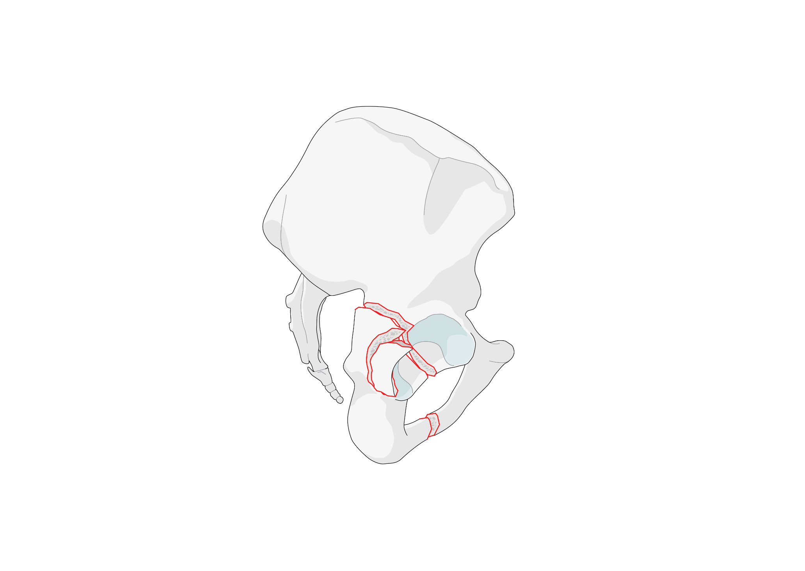
Posterior wall and column

Slide 38
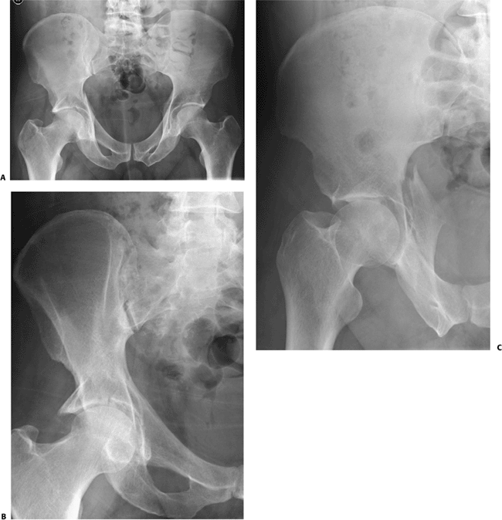
Posterior wall and column

Slide 39
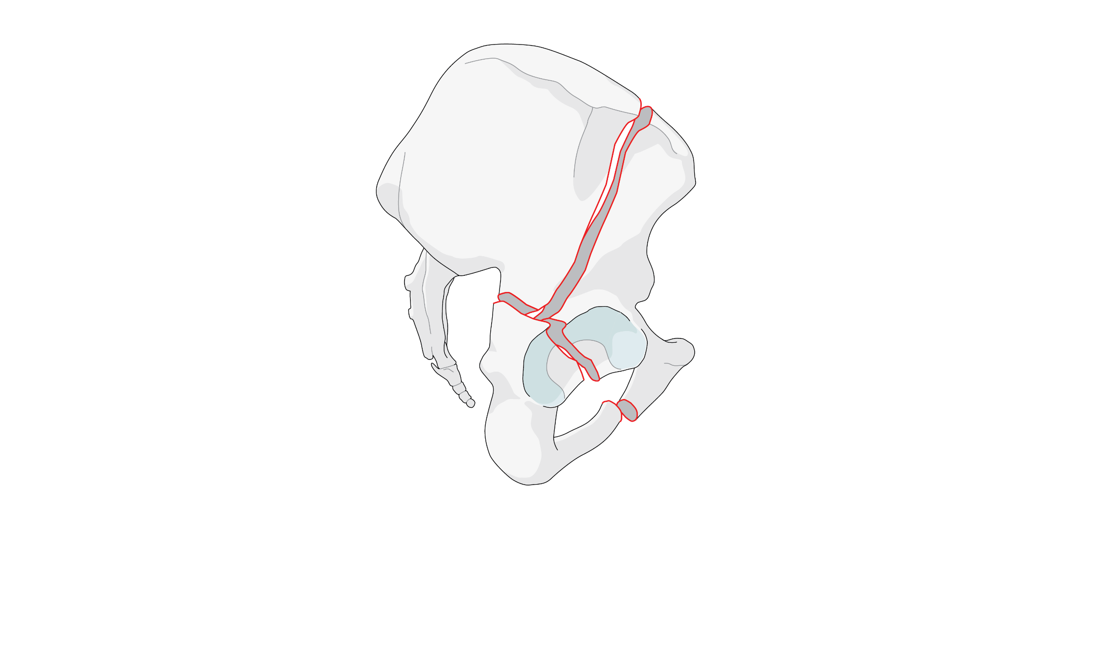
Anterior column and posterior hemitransverse

Slide 40
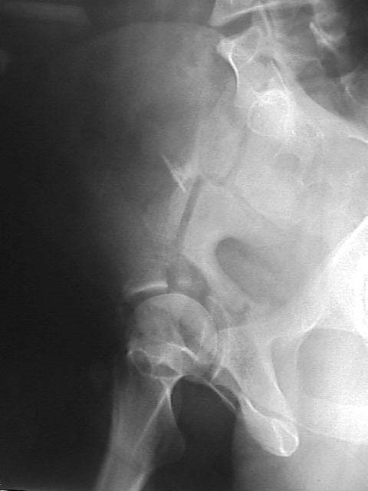
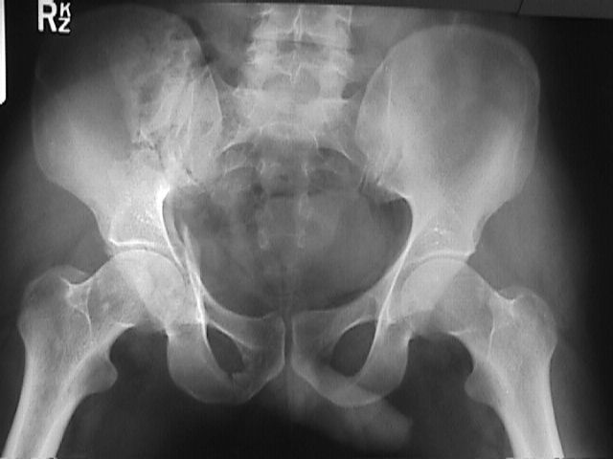
Anterior and posterior hemitransverse

Slide 41

Both column

Slide 42
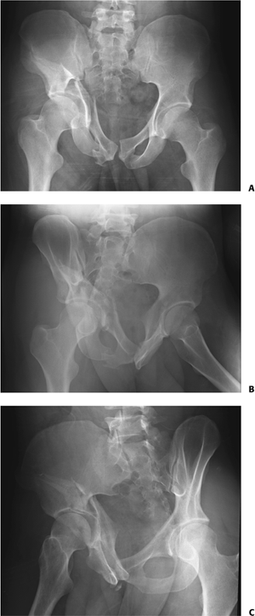

Slide 43
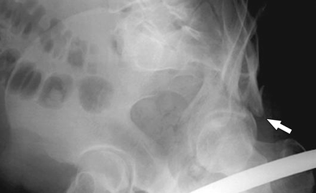
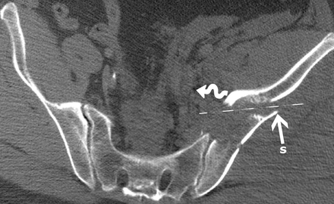
Both column fracture
Spur sign

Slide 44
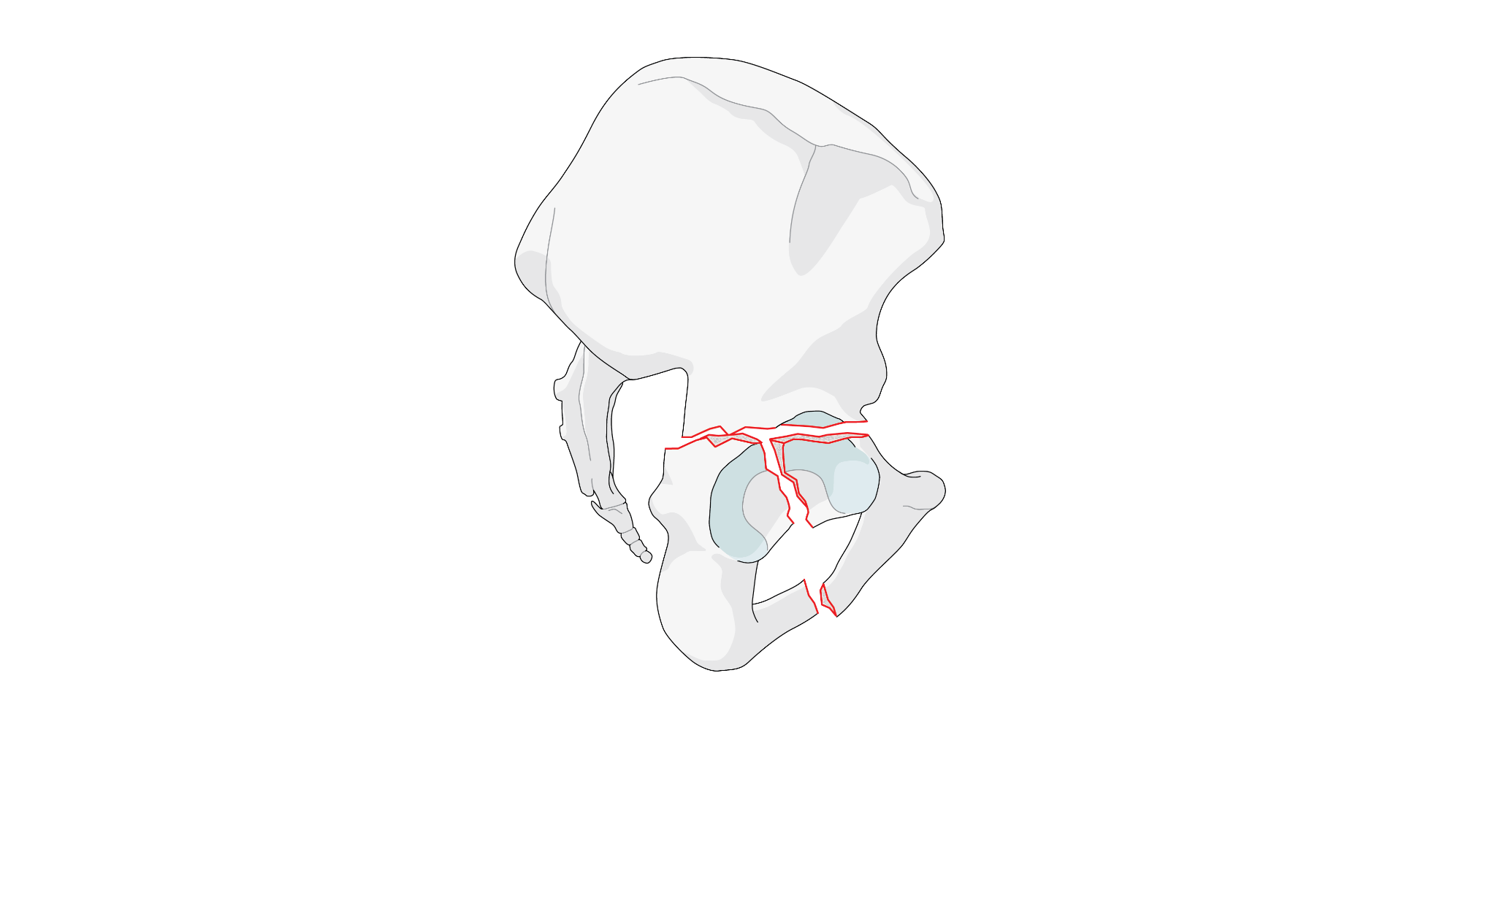
T-shape fracture
Durkee, N. J. et al. Am. J. Roentgenol. 2006;187:915-925

Slide 45
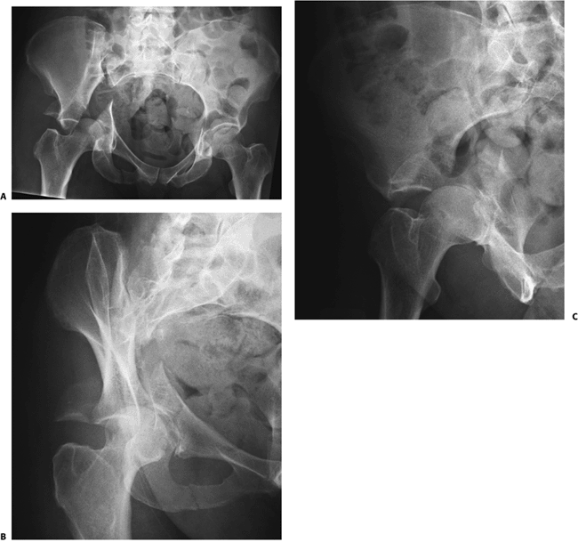

Slide 46
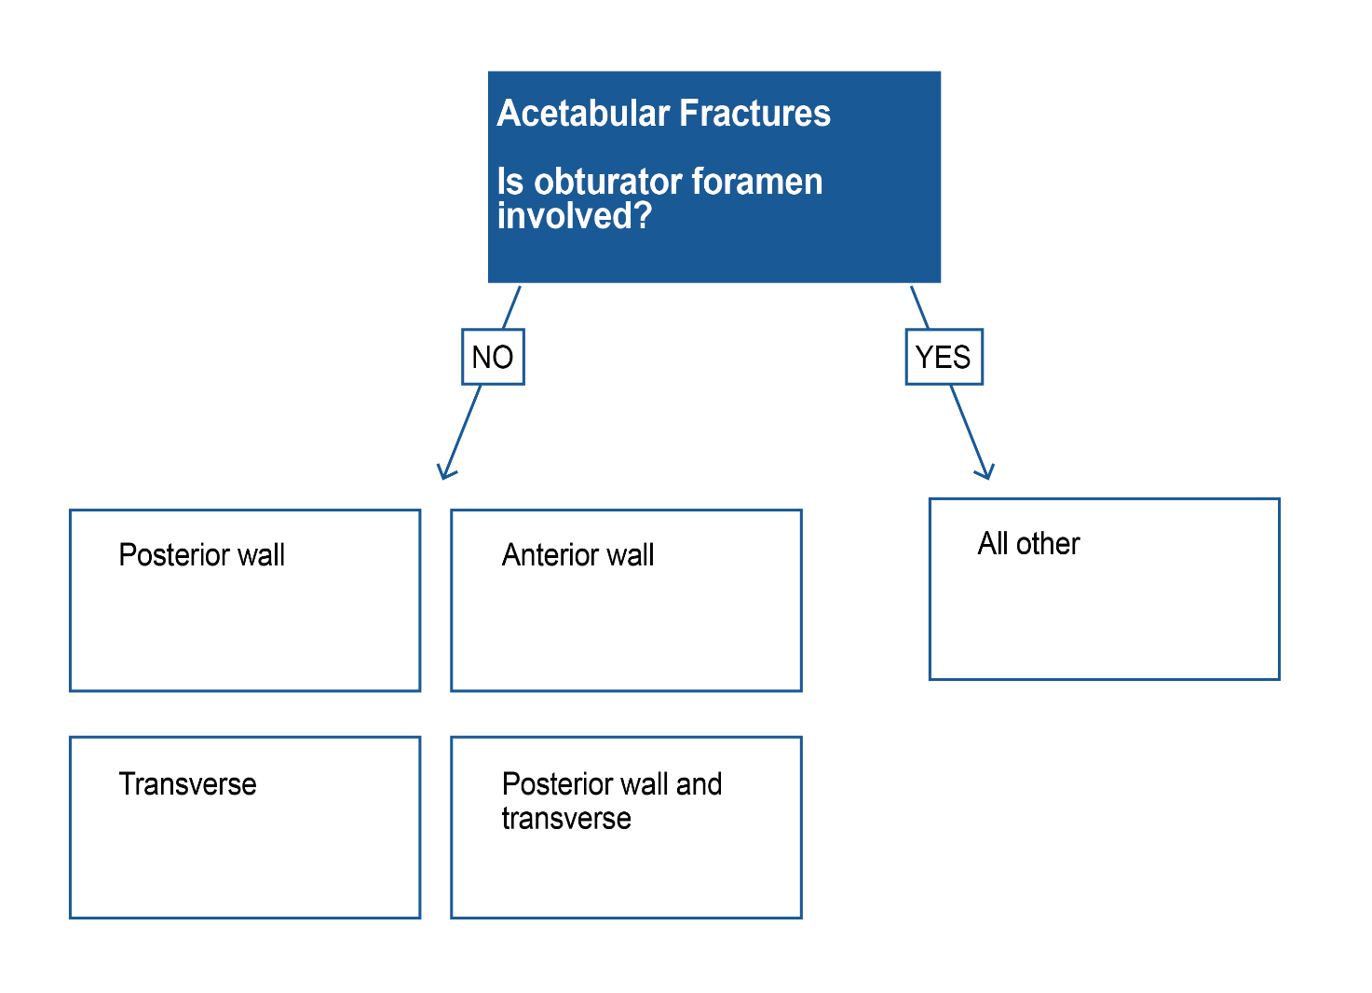

Slide 47
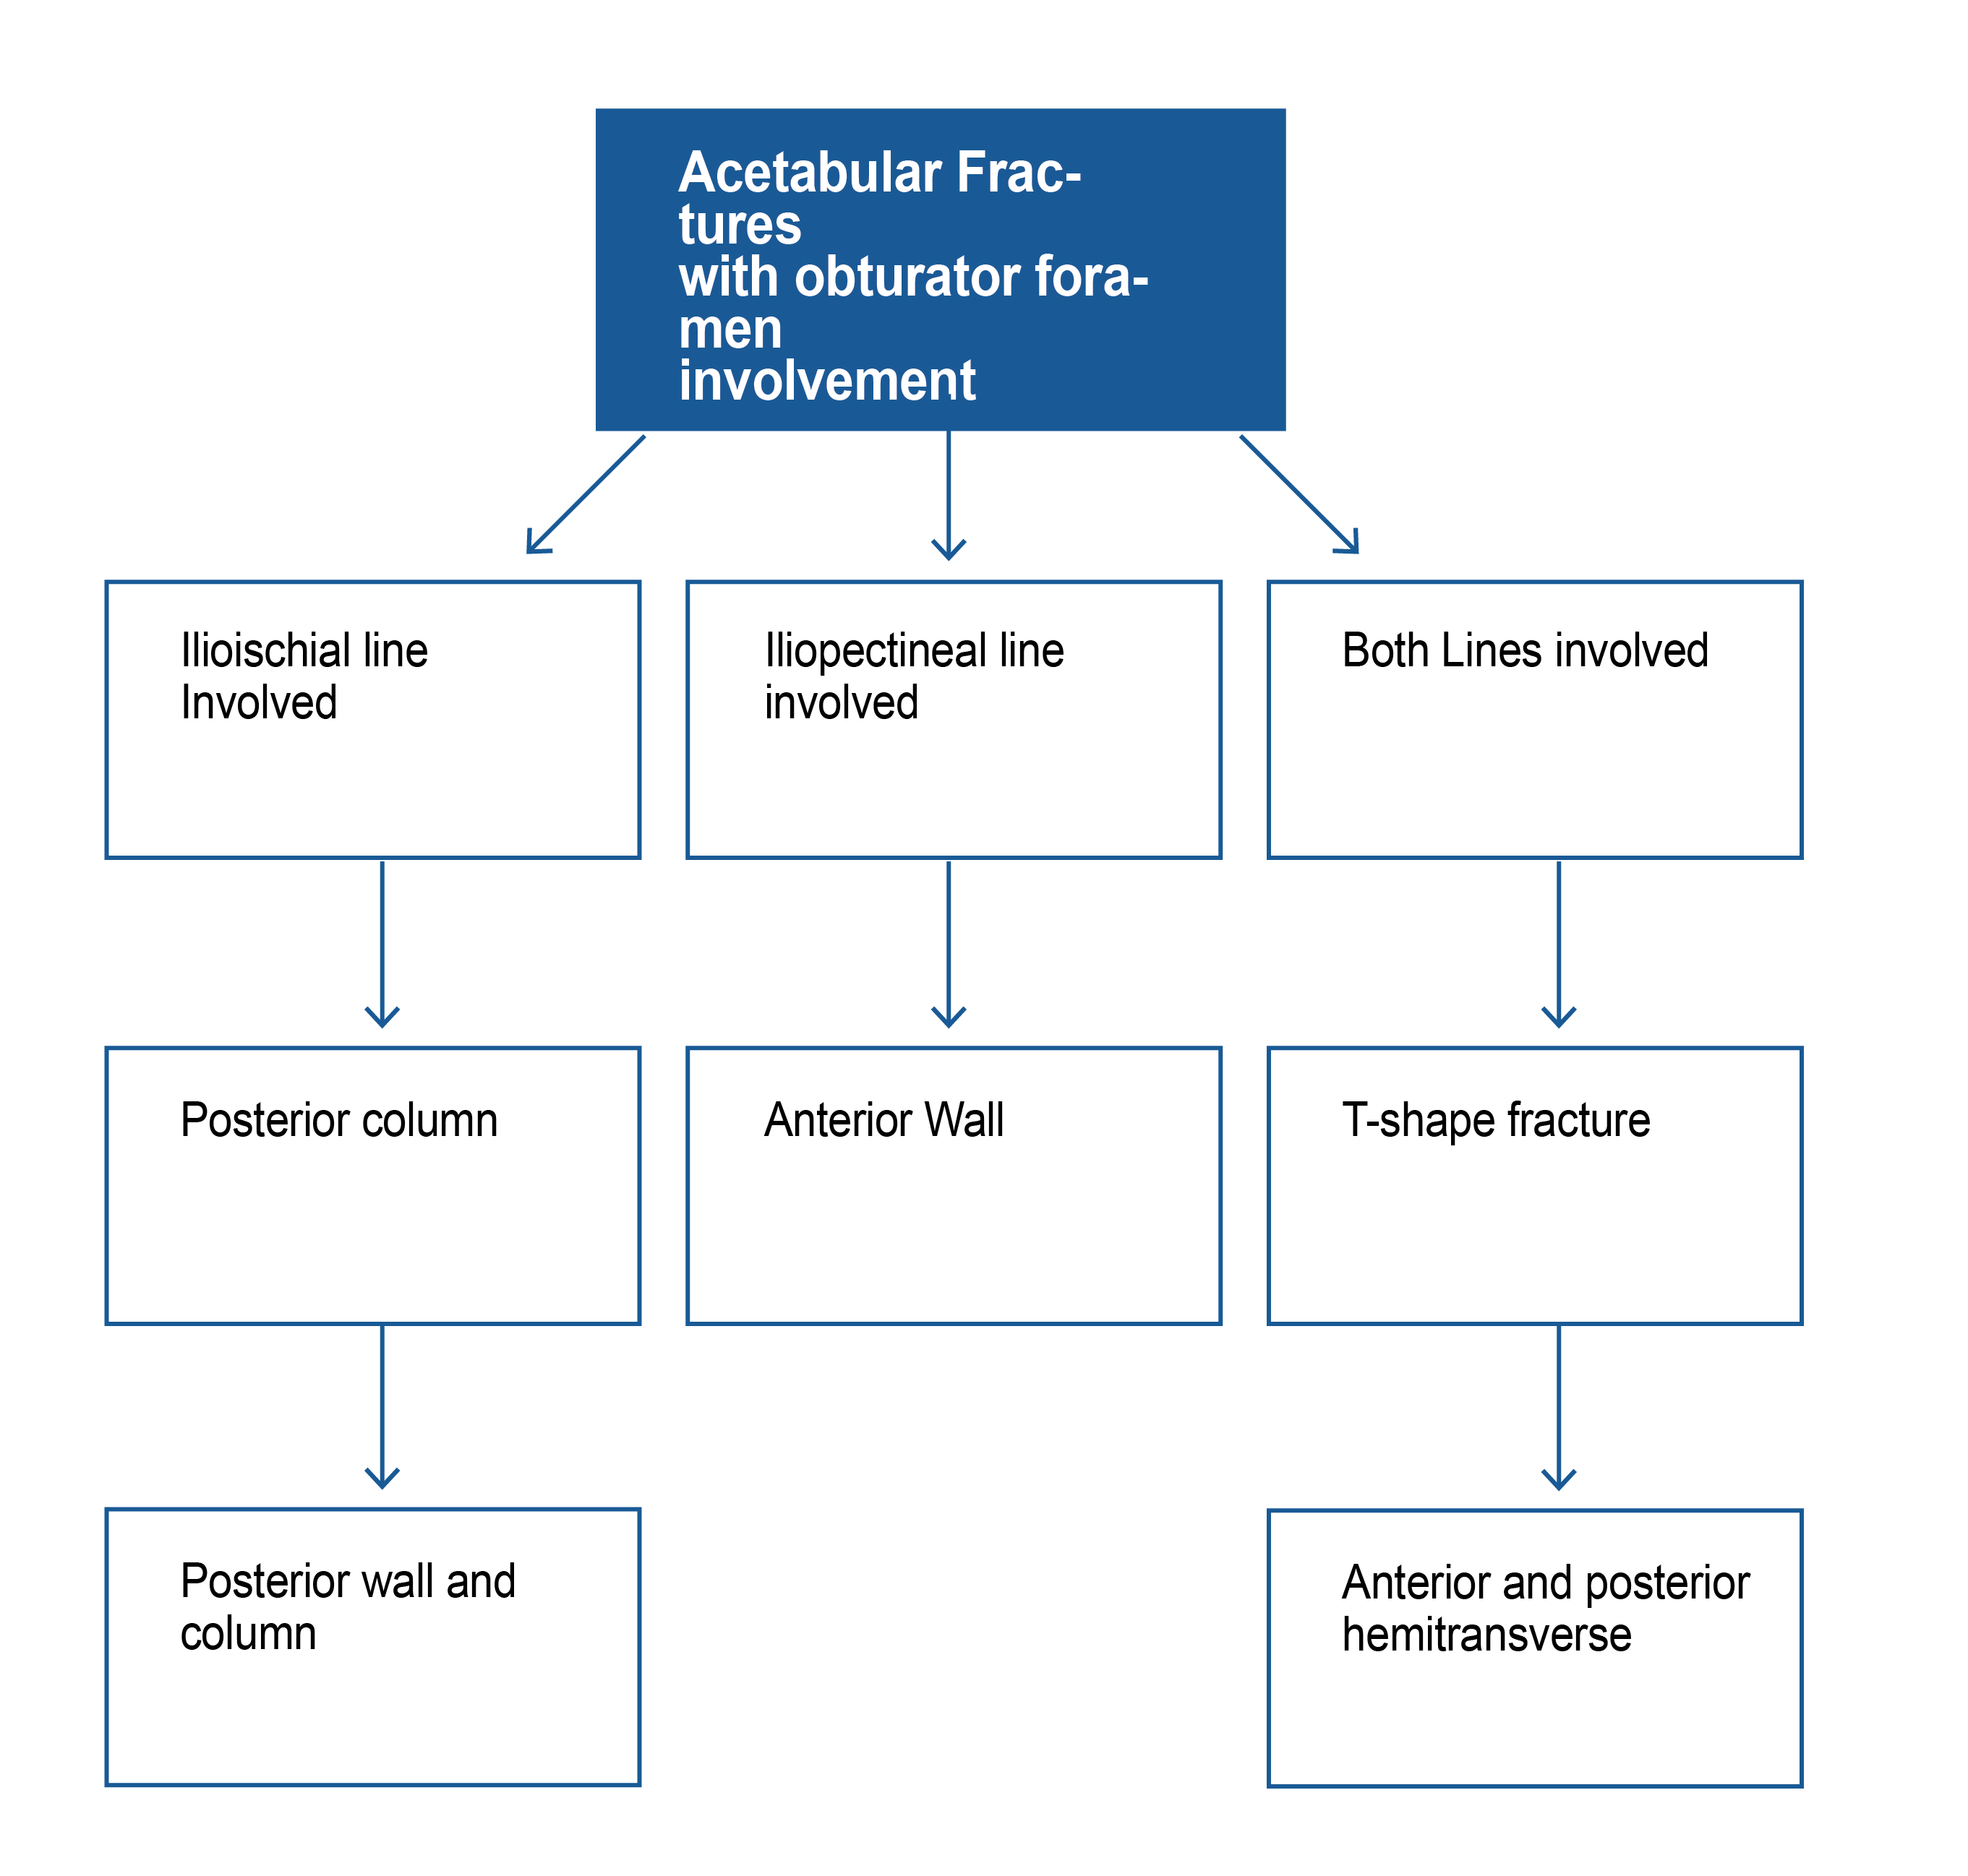
Acetabular fractures with obturator foramen involvement

Slide 48
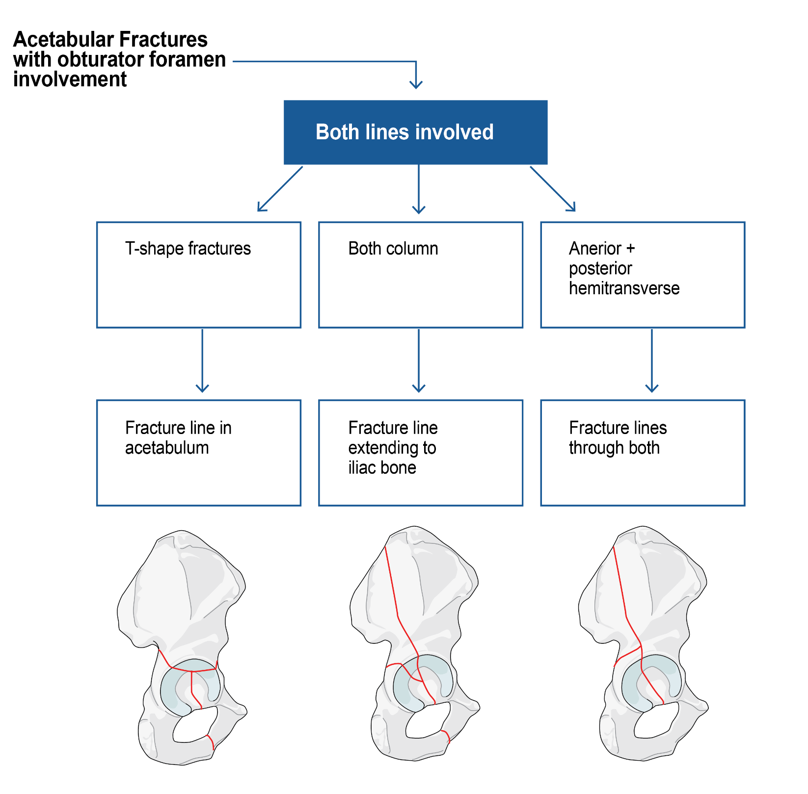

Slide 49
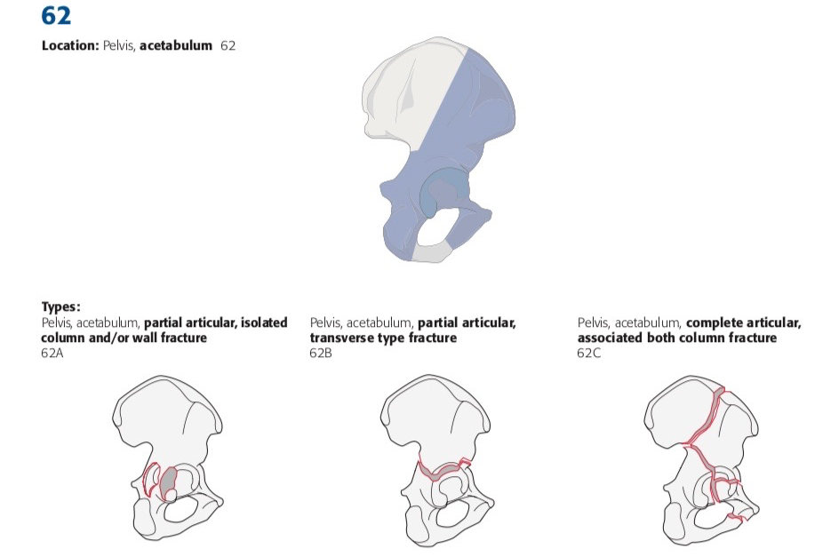
AO/OTA classification

Slide 50
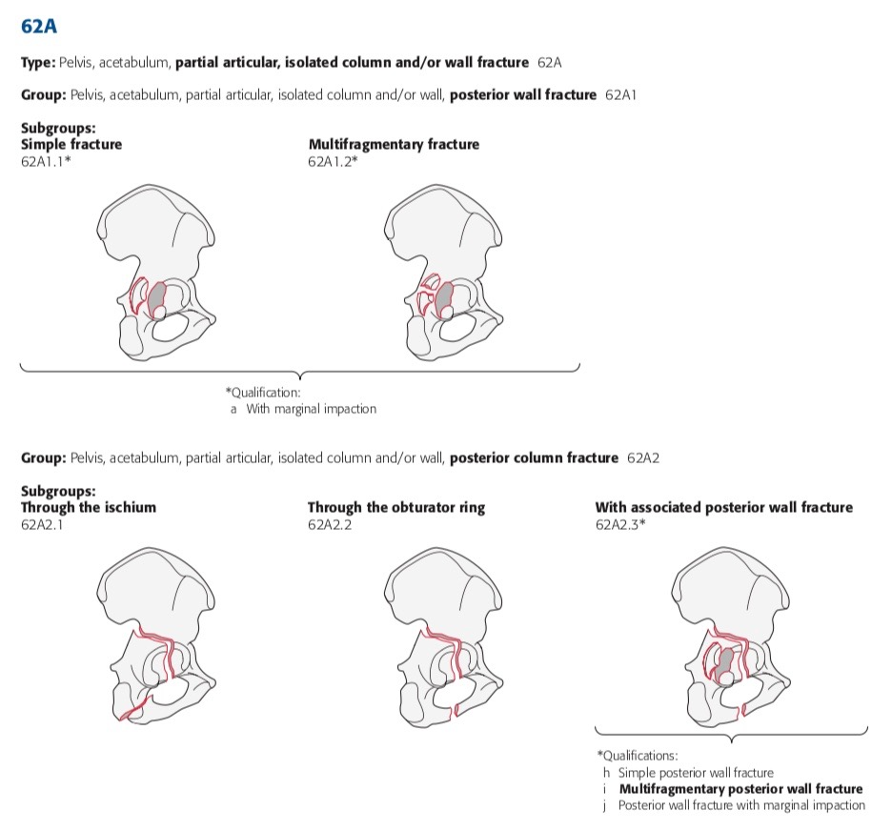
62A Partial articular
62A2 Posterior column fracture

Slide 51
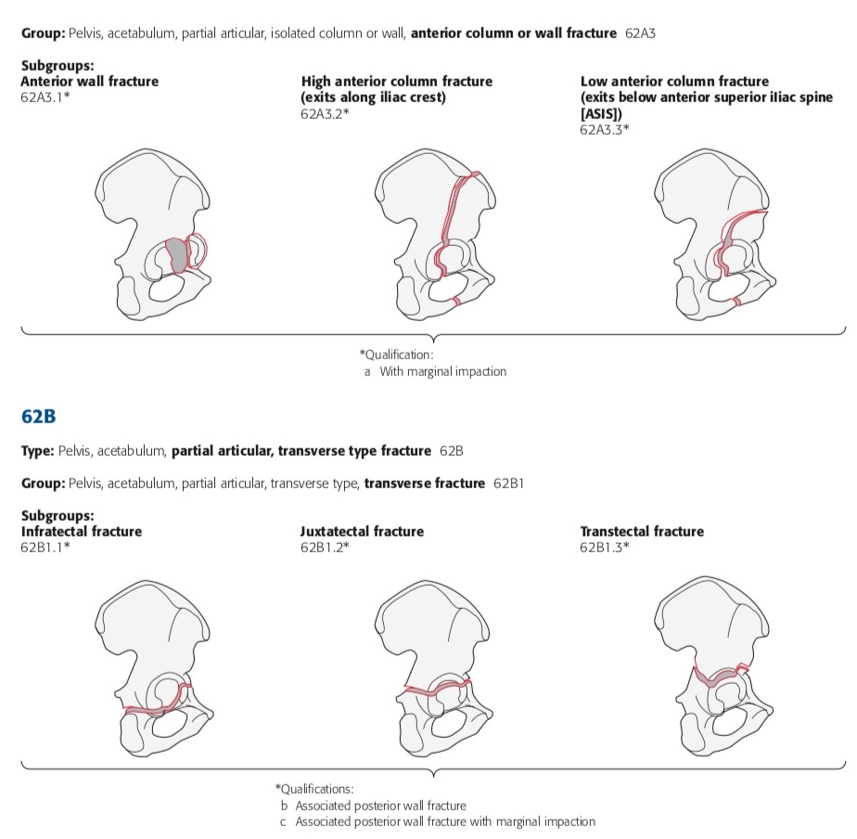
62A3
Anterior column or wall fractures
62B1
Partial articular, transverse, transverse type fracture

Slide 52
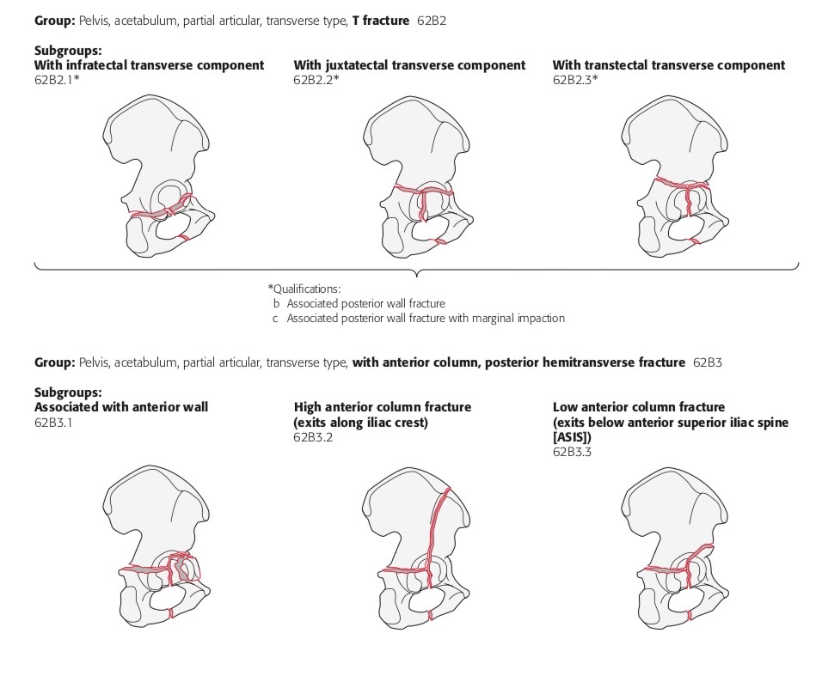
62B2 Tranverse type
T-fracture
62B3
Transverse type
anterior column, with posterior hemitransverse

Slide 53


Slide 54
Management
Displaced acetabular fracture = intraarticular fracture
      Anatomical reduction
      Stable internal fixation
      Early motion

Slide 55
Management
Goal of surgical treatment
    Decrease risk of arthrosis
    Maximize hip function
    Minimize risk of complications

Slide 56
Management
Main indication for surgery
      Hip instability
      Joint incongruity
      Intraarticular loose bodies

Slide 57
Hip instability
Subjective impression
Dynamic stress views
Stress testing under fluoroscopy
Precise amount of stress unknown

Slide 58

Roof arc angle
Notes:
This should be measure on all three views, AP and two oblique views

Slide 59
“More of the posterior column than the anterior column may be necessary for stability.”
Vrahas et al (J Bone Joint Surg. 81:966–974)
Notes:
References:
Vrahas MS, Widding KK, Thomas KA. The effects of simulated transverse, anterior column, and posterior column fractures of the acetabulum on the stability of the hip joint. J Bone Joint Surg Am. 1999 Jul;81(7):966–974.

Slide 60
Indications for nonsurgical management
Displacement < 2 mm
Fracture below weight-bearing area
Stable hip
Both-column fracture with secondary congruency
Advanced medical problems

Slide 61




Secondary congruency
Notes:
As evident on the obturator oblique view, the joint congruency is maintained since all the fragments have displaced to the same degree, resulting in secondary congruency.

Slide 62
Surgical approach
Fracture type | Recommended approach | Indicator
Transverse | K-L Ilioinguinal | Major displacement of posterior column Major displacement of anterior column
Transverse and posterior wall | K-L Extended | Fractures more than 3 weeks
T-shaped | K-L Ilioinguinal Extended or front/back | Most patients Minimal posterior displacement Wide separation of column
Anterior column and posterior hemitransverse | Ilioinguinal Extended or front/back | Most patients Fracture > 3 weeks
Both column | Ilioinguinal Extended | Most patients Posterior column comminuted Fracture > 3 weeks Extending to sacroiliac joint

Slide 63
Outcome
Clinical indicators
Radiological indicators
Pain
Range of motion
Gait
Excellent: normal
Good: minimal sclerosis, joint narrowing < 1 mm
Fair: moderate sclerosis, loss of 50% joint space
Poor: advanced changes

Slide 64
Surgical approach
Anatomical reduction: < 2 mm displacement
Imperfect reduction: 2–3 mm displacement
Poor reduction: > 3 mm displacement

Slide 65
Surgical approach
Experienced surgeon
  Good to excellent results in 75% of cases treated in the first 3 weeks

Slide 66
Surgical approach
Less experienced surgeons
  Rate drops to 50%

Slide 67
Surgical approach
Delayed surgical treatment beyond 3 weeks have poor results

Slide 68
Take-home messages
Intraarticular fracture: anatomical reduction and stable fixation
Surgery indicated for unstable and incongruent hips
Outcome dependent on surgeon’s experience and time of presentation

