Slide 1
Periprosthetic fractures
AO Trauma Advanced Principles Course
Notes:
Published: September 2013
Author: Michael Schütz
Reviewed: 2019
Reviewer: Bishoy Youssef

Slide 2
Learning objectives
Indicate the incidence of these fractures
Outline relevant classification systems for femoral periprosthetic fractures
Evaluate application of modern biological techniques
Analyze current evidence for surgical management
Explore key outcome publications

Slide 3
Periprosthetic femoral fractures
Incidence—primary
  Intraoperative cemented: 3%, uncemented: 0.23%
  Postoperative
Incidence—revision
  Intraoperative cemented: 6%, uncemented: 19%
  Postoperative rate no difference
Notes:
1. Abdel MP, Watts CD, Houdek MT, Lewallen DG and Berry DJ. Epidemiology of periprosthetic fracture of the femur in 32644 primary total hip arthroplasties. BJJ Vol 98-B No 4 2016
2. Abdel MP, Houdek MT, Watts CD, Lewallen DG and Berry DJ. Epidemiology of periprosthetic femoral fractures in 5417 revision total hip arthroplasties. BJJ Vol 98-B No 4 2016

Slide 4
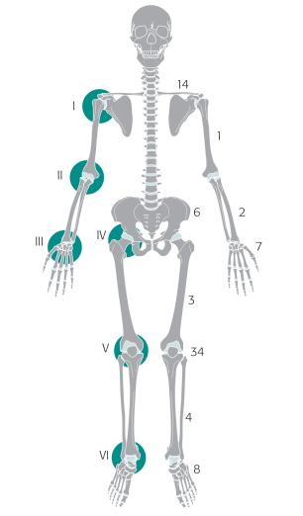
Diagnosis and classification
“Unified” or “comprehensive” classification system* for all periprosthetic fractures
Joints:
I Shoulder
II Elbow
III Wrist
IV Hip
V Knee
VI Ankle
Bones:
According to
AO/OTA Classification
Types:
A-E
“Vancouver”
*Duncan, Haddad, Perka, Schütz 2012

Slide 5
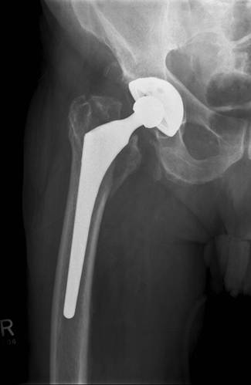
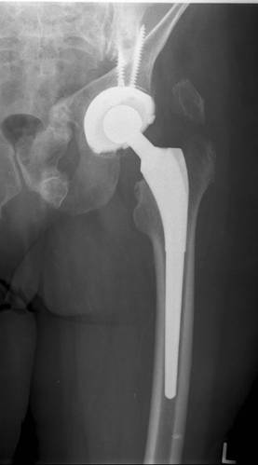
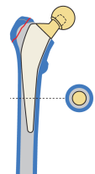
Comprehensive Classification System (CCS)
IV.3-A

Slide 6
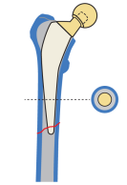
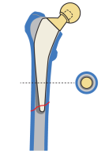
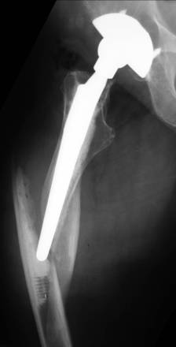
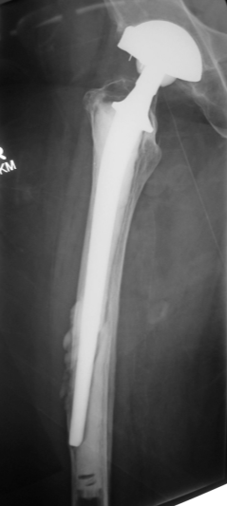
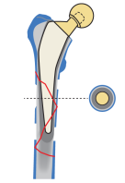
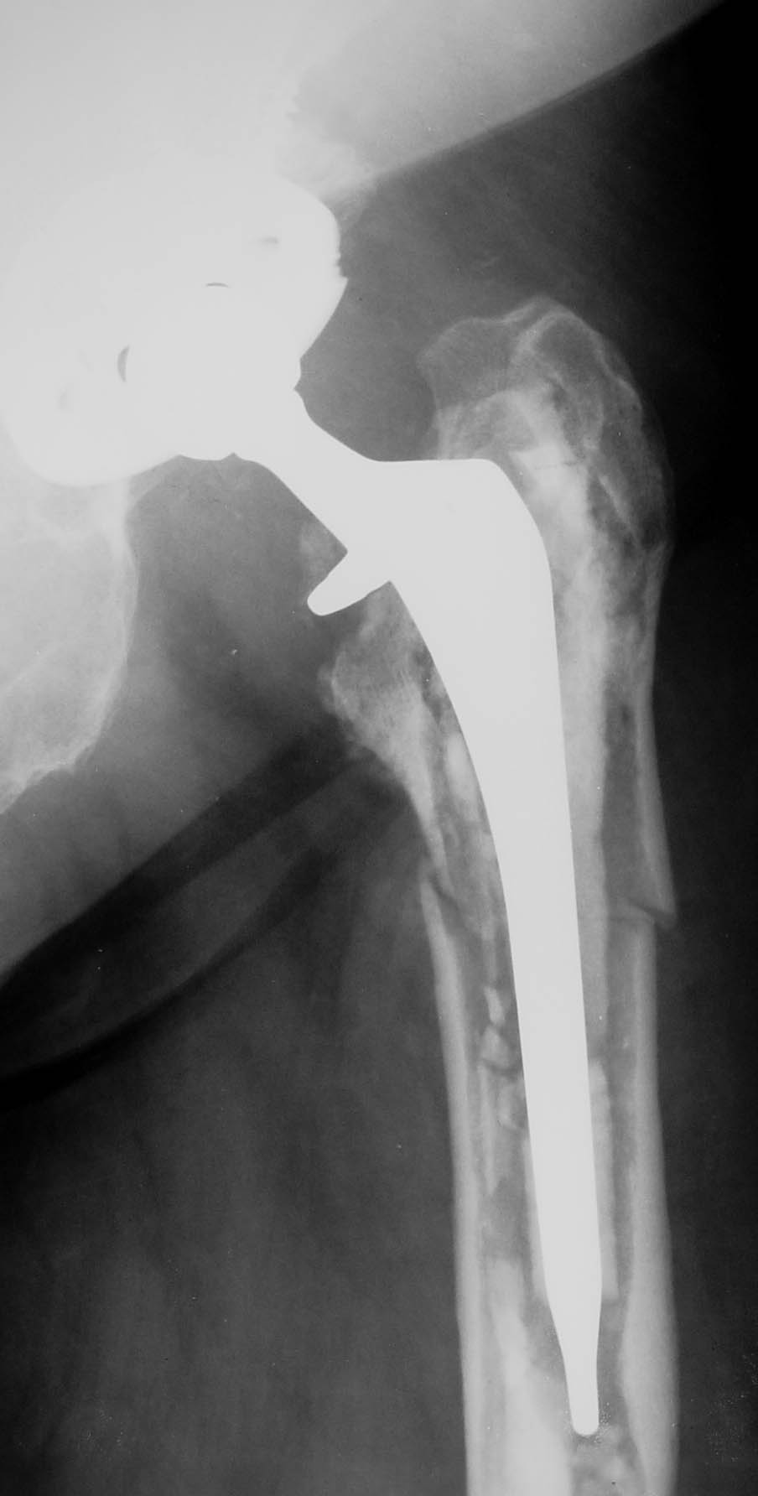
Comprehensive Classification System (CCS)
IV.3- B1
IV.3- B2
IV.3- B3
Prosthesis
loose, but
good bone
Prosthesis loose,
poor bone
Well fixed
prosthesis

Slide 7
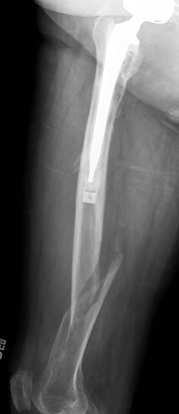
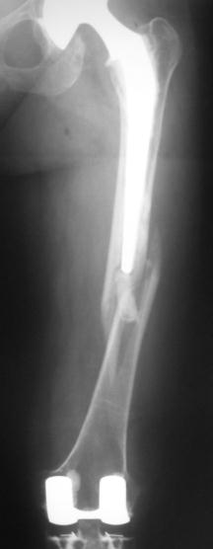
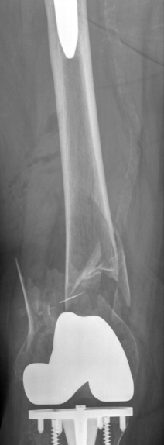
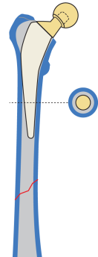
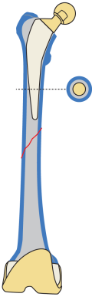
Comprehensive Classification System (CCS)
IV.3- C:
distant to THA
IV.3- D: intercalary
close to THA
IV.3- D: intercalary
close to TKA

Slide 8
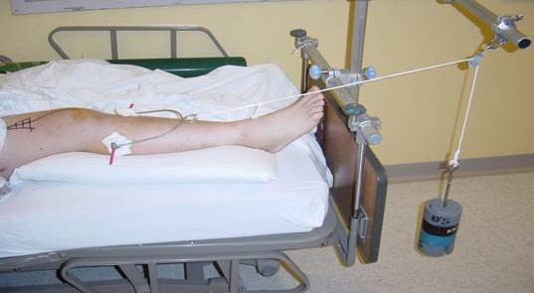
General management principles
Early mobility—avoid traction and bed rest
Minimize surgical trauma
Compromise if necessary
Notes:
General principles for periprosthetic fractures are the same for any femoral fracture. Early mobilization, avoid traction and bed rest, and minimize surgical trauma. Mobilize the patient.

Slide 9
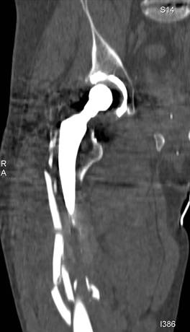
General management principles
If the stem is loose, revise the stem
    If isthmus is intact, tapered fluted stem
    If isthmic fit can be achieved, distally locked porous/HA coated stem or long cemented stem
The proximal tube of bone must be reconstructed around the implant to prevent stem fracture
Notes:
If the implant is loose, remove the implant, stabilize the fracture with an intramedullary device, and finally reconstruct the fracture. If the stem is stable, proceed with extramedullary fixation with relative stability.

Slide 10
General management principles
Consider supplemental fixation
    Lateral locked plate spanning the length of the femur.
    Strut grafts
    Not necessary for the majority of cases where isthmus is intact and a good distal fix can be achieved
Consider acetabular revision
    Polyethylene is worn
    Preoperative symptoms of loosening
    Infection
    High risk of dislocation
Notes:
Extramedullary fixation is generally plate fixation which can be augmented with strut grafts. Relative stability is needed. Minimally invasive principles should be adhered to. Long plates with proximal screws and cable fixation.

Slide 11
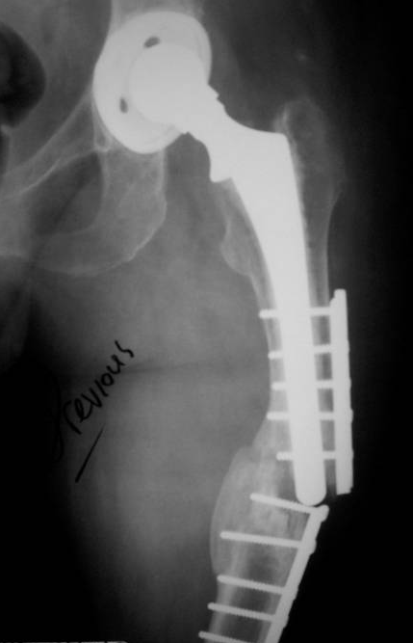
Failed rigid fixation
Biomechanical principles
Attempted absolute stability
Stress concentration at tip of prosthesis led to failure
Notes:
An attempt at rigid fixation that failed because of stress concentration at the tip of the prosthesis.

Slide 12
Preoperative plan: option 1
Relative stability
Create a long construct, trochanter to condyle avoiding stress concentration
Lateral locking plate
Notes:
The better option would have been to use relative stability with a lateral tension band plate with a possible medial strut graft.

Slide 13
Preoperative plan: option 2
Revision to a modular tapered, fluted stem
Aiming to achieve distal isthmic fixation with the stem
Reconstitution of the femoral tube proximally
+/- lateral plate

Slide 14
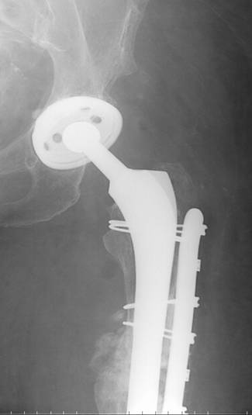
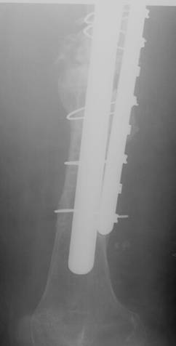
Option 2

Slide 15
General management principles
Preserve total hip replacement longevity
Change scratched head
Change worn poly
Dual mobility/constrained options if dislocation is a risk
Know what components you need before surgery!
Notes:
General principles are to preserve the longevity of the implant. Exchange worn poly, when indicated.

Slide 16
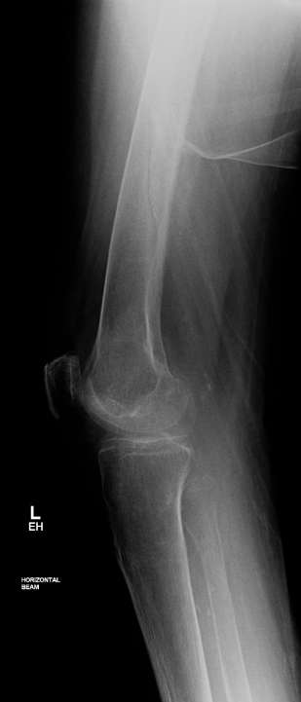
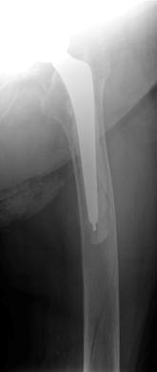
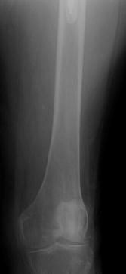
101-year-old patient
Type B1 fracture
Lives in a nursing home
Uses walking frame
ASA III

Slide 17
Goal of treatment
Early mobilization out of bed
Stable fixation
Principles of fixation
Long implants bridging the femur
Proximal fixation options: VA screws, cables
Open reduction techniques when fractures will not reduce closed
Consider screws or cerclage wires to hold the reduction prior to plate application
Notes:
Highlight the principle on the application of fixation as a very important principle.

Slide 18
Strongest
Locking screws
Locking attachment plates
Cables
Wires
Weakest

Slide 19
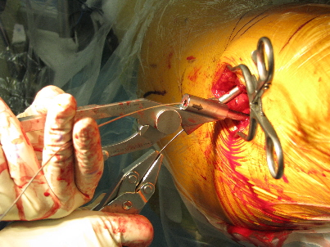

Slide 20
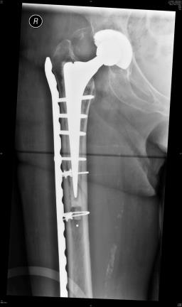
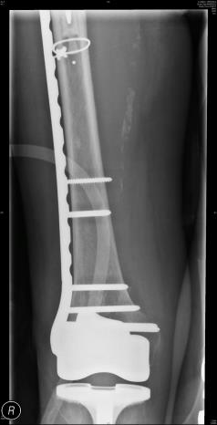

Slide 21
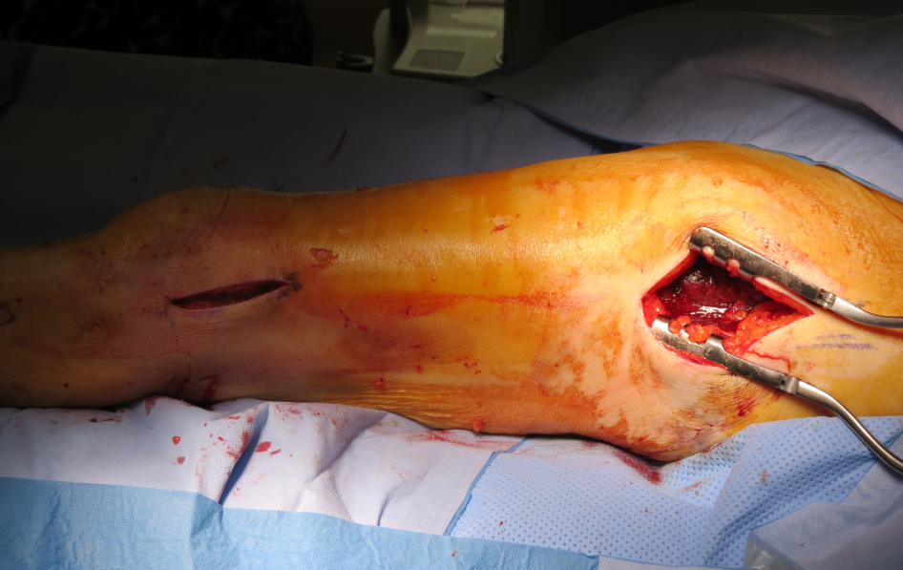
Distal approach to insert plate
Proximal open approach to position plate and apply supplementary fixation options

Slide 22
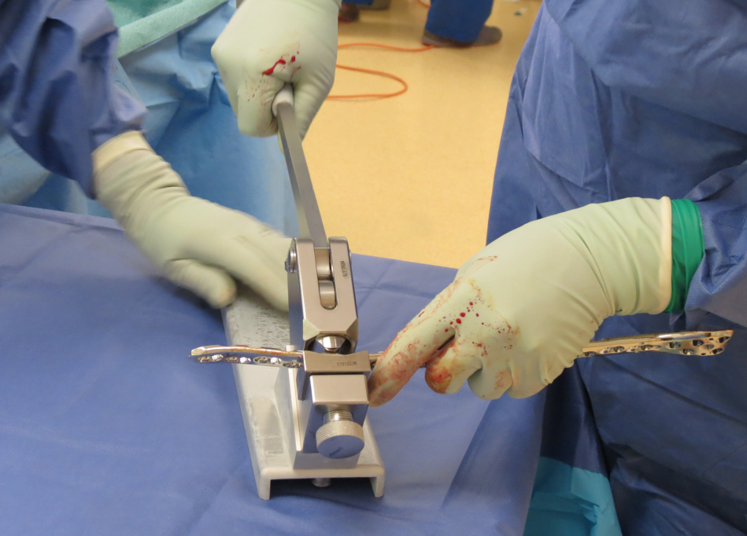
Precontoured plates sometimes need adjustment to the situation and anatomy

Slide 23
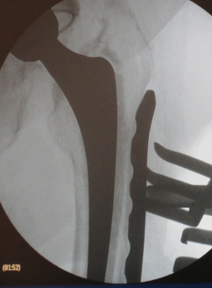
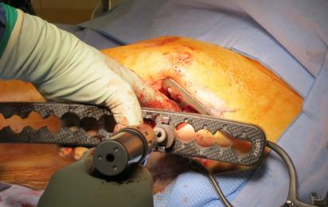
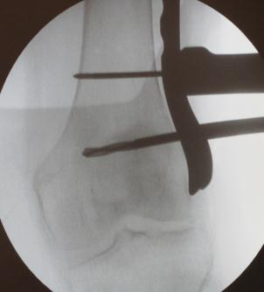
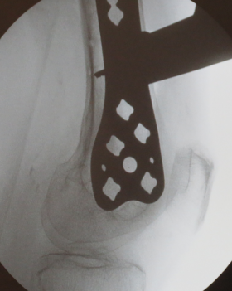
Select the right length of plate
Position plate

Slide 24
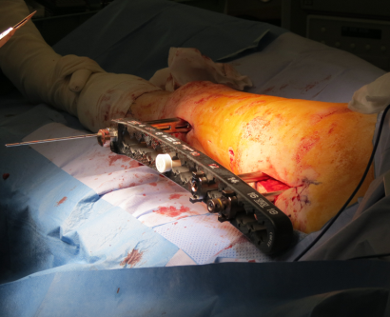
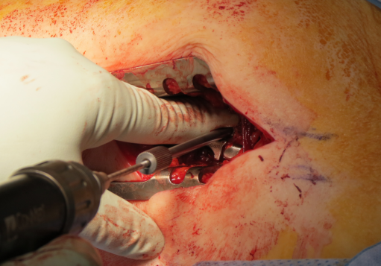
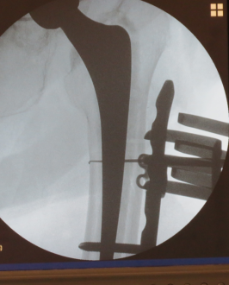

Slide 25
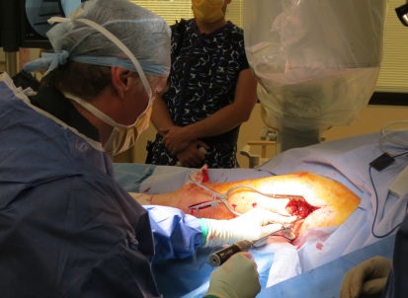
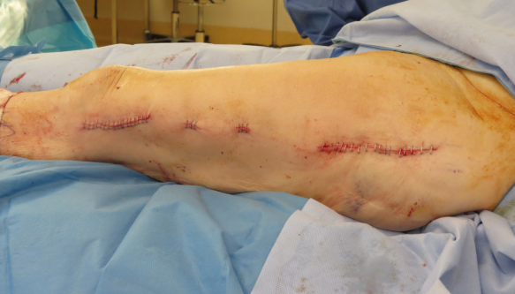

Slide 26
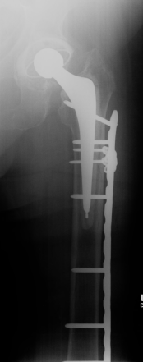
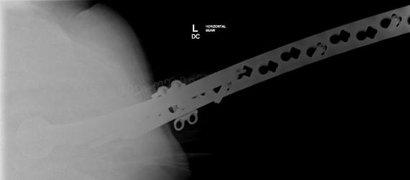
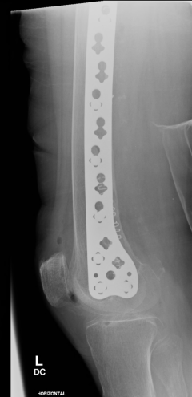
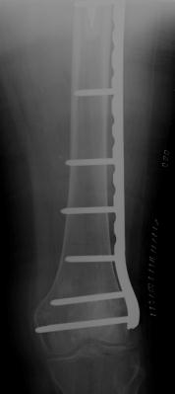

Slide 27
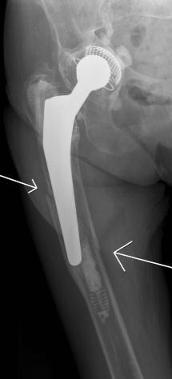
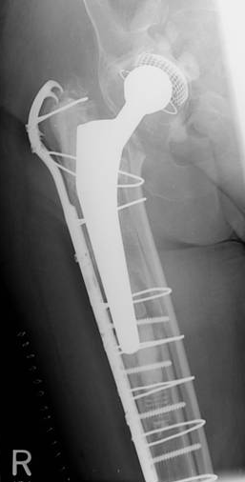
91-year-old patient
Type B2 fracture
Lives with retired daughter
Wheelchair bound
ASA IV

Slide 28
Preoperative plan?
Keep patient alive, maintain ability to transfer, minimize surgery, and keep implant
Relative stability
Lateral plate (lateral) + strut (medial or anterior)
Immediate mobility
Notes:
With the proper indications, remove the loose implant. For a patient such as this 91-year-old wheelchair-bound patient, plate fixation and medial strut was used to obtain the ability to transfer.

Slide 29
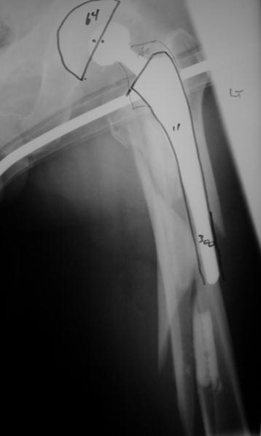
Type B2—preoperative plan
Relative stability
Intramedullary fixation (new stem)
Supplemental extramedullary fixation
  Lateral plate
  Medial/anterior strut
Notes:
In this type B2 fracture the preoperative plan would proceed with removal of the loose implant, reconstruction of the femoral canal, and intramedullary fixation using a long-stem prosthesis.

Slide 30

Technique
Option 1:
Reconstruct tube around new implant
Option 2:
Place new implant into
reconstructed tube
Option 2 shown

Slide 31
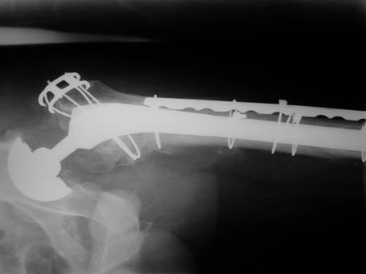
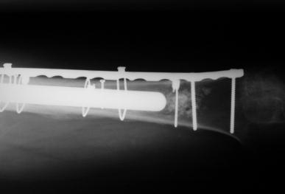
Option 2: fixing the tube first

Slide 32
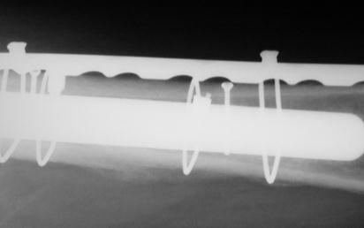
Reconstituting the tube first: intracortical screws
Not reported
Avoid excessive stripping
    AO reduction “towel clips” only—no lobster claws, etc
2 mm screws
    Drill through with 1.1 mm first, then over drill
Notes:
Reconstruction of the tube first, can be done with bone holding clamps. Avoid soft-tissue stripping. Use 2 mm screws as small holding devices.

Slide 33
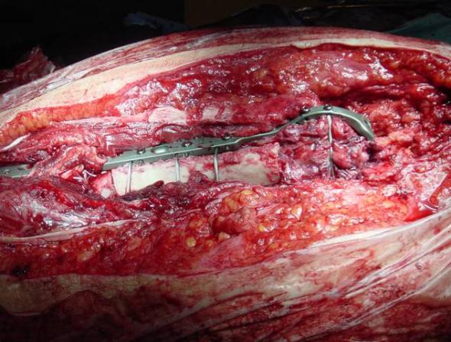
Reconstituting the tube
Lateral plate (or strut)
Proximal cerclage wires
Distal screws if possible
Cortical strut
(Medial or anterior)
Shaped with burr to fit
Bone graft around edges

Slide 34
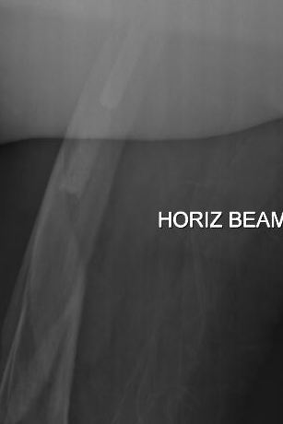
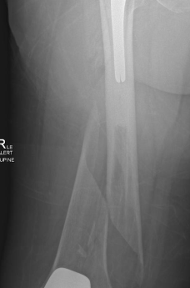


Type C: fix the fracture
Osteoporotic bone
    IM fixation
    Fixed-angle device
    Locking plates
    DCS
    Blade plate
Poor biology (age, illness)
    Minimize stripping
    Consider augmentation with strut

Slide 35



Open reduction of fracture with cerclage fixation
Positioning and fixation of plate

Slide 36





Slide 37


IV.3-D: intercalary close to THA
Use of cerclage wire
    Either to facilitate reduction
    Or improve fixation around the femur

Slide 38
Take-home messages
Consider patient factors
Balance early mobility against the effects of major surgery
Decision making influenced by stability of prosthesis!
Notes:
Consider patient factors. Balance early mobilization against major surgery. Change loose stems to long intramedullary prosthesis.

Slide 39
Take-home messages
If prosthesis is stable, then fixation of fracture (mostly extramedullary implants)
  If possible, bridge the whole bone with the fixation
  Consider medial or anterior strut
If prosthesis is loose, change loose stem: long IM fixation
  Fix tube first or wrap around new implant (burr needed)
  Augment with extramedullary fixation
  Revision longevity: change scratched head and worn poly in virtually all cases
Notes:
Consider patient factors. Balance early mobilization against major surgery. Loose stems change to long intramedullary prosthesis. Lateral plate with medial strut grafting where indicated for stable implants. Use of long plates and relative stability.

