Slide 1
Deep vein thrombosis (DVT) prophylaxis
AO Trauma Advanced Principles Course
Notes:
Published: September 2013
Reviewed: 2018
Reviewer: Richard Buckley

Slide 2
Learning objectives
Identify the incidence of DVT/pulmonary embolism (PE) in orthopedic trauma patients left untreated
Evaluate data for pharmacological DVT prophylaxis/prevention
Assess incidence of bleeding complications
List contraindications to pharmacological prophylaxis
Explore key recent outcome publications
Notes:
Teaching points:
Give participants practical algorithms for preventing, identifying, and treating thromboembolic complications.

Slide 3
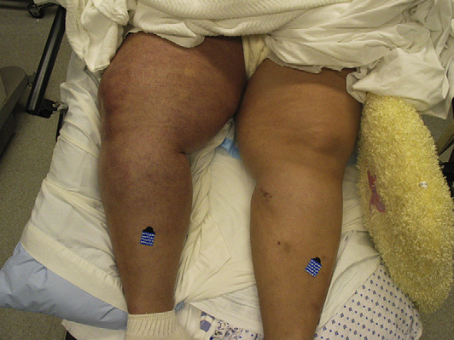
Consequences of not trying to prevent DVT or pulmonary embolism (PE)
For the patient
Mortality—PE is the third most common cause of death for trauma patients after the first 24 hours
Prevalence of DVT in trauma patients > 50%
Morbidity: 22% of trauma patients will suffer PE
Postthrombotic syndrome
Notes:
It makes sense to try to prevent venous thromboembolic (VTE) disease.

Slide 4
Consequences of not trying to prevent DVT or PE
For the system
Increased resources to diagnose and treat
Prolonged hospital stay
Delayed rehabilitation
Medical/legal ramifications
Notes:
VTE is costly and causes sudden death.

Slide 5
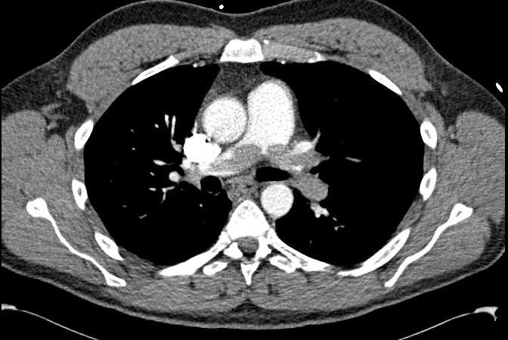
Goal of care
Prevent:
Acute
Symptomatic DVT/PE
Fatal PE
Chronic
Postthrombotic syndrome
Recurrent venous thromboembolism (VTE)
Notes:
A fatal saddle embolus is identified here in this CT.

Slide 6
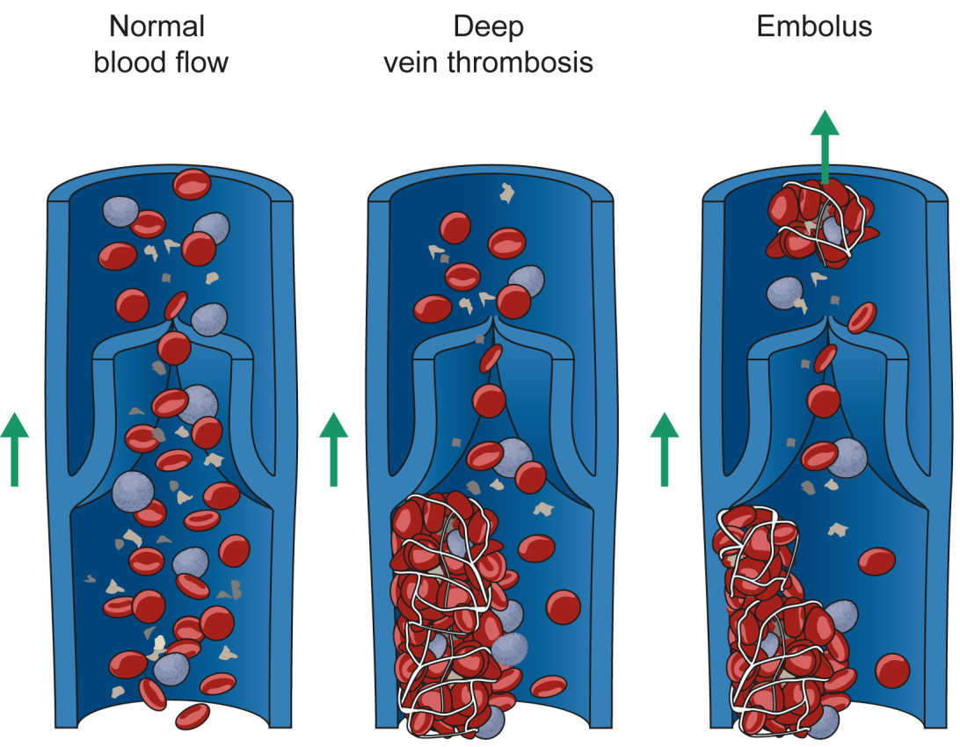
Rationale for prophylaxis of venous thromboembolism (VTE)
Prevalence of VTE in trauma patients > 50%
Clinically silent nature of VTE
No easy way of proving who has a clot or how to prevent one from progressing
“Chasing a ghost”
Notes:
VTE is silent and it is like trying to prove that there is a ghost in the room.
However, if it can be prevented, then it can decrease morbidity and mortality.

Slide 7
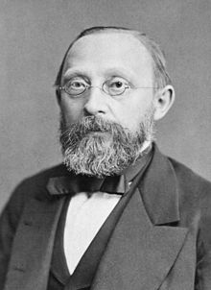
Virchow’s Triad (1856)—wise physician
Venous stasis – (caused by pain, immobility)
Intimal injury – (local fracture or soft tissue injury)
Hypercoagulability – (endothelial tissue injury)
Rudolf Virchow
1821-1902
German physician, pathologist

Slide 8
Epidemiology—study group had no treatment Sunnybrook VTE detection study (1994)
 | Number of patients | DVT | Prophylaxis of DVT
All patients | 349 | 58% | 18%
Major injuries
Face/chest/abdomen | 129 | 50% | 15%
Head | 91 | 54% | 20%
Spine | 66 | 62% | 27%
Lower extremity fractures | 182 | 69% | 24%
Geerts W et al. NEJM 331: 1601-06 1994
Notes:
Cohort of 716 patients, 349 with adequate venographic studies.
No prophylaxis
Bilateral venography
3 fatal PE
Reference:
Geerts WH, Code KI, Jay RM, et al (1994) A prospective study of venous thromboembolism after major trauma. N Engl J Med; 331(24):1601–1606.

Slide 9
Epidemiology—Sunnybrook VTE detection study
Fracture | Number of patients | DVT | Prophylaxis DVT
Pelvis | 100 | 61% | 29%
Femur | 74 | 80% | 20%
Tibia | 86 | 77% | 22%
Patella | 19 | 79% | 32%
Ankle | 34 | 74% | 15%
Geerts W et al. NEJM 331: 1601-06 1994
Notes:
The Sunnybrook study shows a significant decrease in DVT when the polytrauma patient is treated with low molecular weight heparin, for all fractures involving the lower extremity and pelvis.
Reference:
Geerts WH, Code KI, Jay RM, et al (1994) A prospective study of venous thromboembolism after major trauma. N Engl J Med; 331(24):1601–1606.

Slide 10
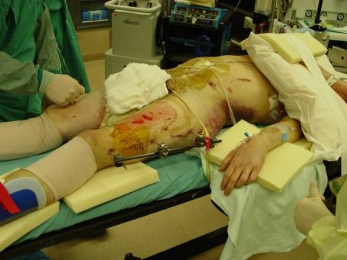
Risk factors—polytrauma
Spinal cord injury
Lower extremity, pelvic, spinal fractures
Head trauma
Femoral venous line, repair
Surgery
Age
Immobility (> 3 days)
Scolaro J, et al., Venous thromboembolism in orthopaedic trauma. J Am Acad Orthop Surg. 2015 Jan;23(1):1–6.
Notes:
Nearly 100% with spinal cord injury
ISS not predictive: specific injury more important than the overall trauma score.
Reference: Scolaro JA, Taylor RM, Wigner NA. Venous thromboembolism in orthopaedic trauma. J Am Acad Orthop Surg. 2015 Jan;23(1):1–6.

Slide 11
Risk factors—polytrauma
Spinal cord injury
Age, ability to mobilize, obesity
Ventilated
Head injury
Displaced pelvic fracture
Femoral shaft
Tibial plateau
Genetics, chronic disease
Isolated ankles
Notes:
Many factors play a role in the incidence of a clot and the chance of it progressing. Injury proximity, amount of trauma or ability to mobilize are very important when it comes to developing a clot.

Slide 12
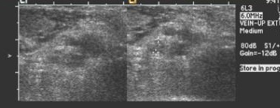
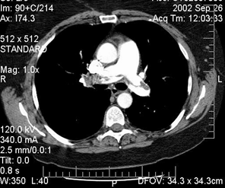
Surveillance
Expensive
Inability to perform proximal ultrasound > 25% trauma patients
Methods have limited reliability
Not been shown to reduce incidence of VTE and fatal PE
Bates SM, et al. Diagnosis of DVT: AntithromboticTherapy and Prevention of Thrombosis,
9th ed: American College of Chest Physicians Evidence-Based ClinicalPractice Guidelines. Chest. 2012 Feb;141(2 Suppl):e351S–418S.
Notes:
Ultrasound and other studies are useful for detecting a clot but are not useful for preventing a clot.

Slide 13
When to start prophylaxis
High
Low
Notes:
Bleeding risk decreases quickly in the first 24 hours after injury while the risk of thrombosis probably does not increase until 2–3 days, leaving a window of opportunity to use effective prophylaxis

Slide 14
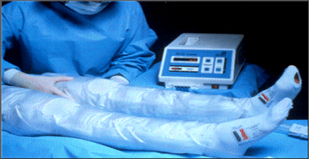
Prophylaxis
Chemical
Unfractionated heparin
Low-molecular-weight heparin (LMWH)
Warfarin
Mechanical
Intermittent pneumatic compression
Venous foot pump
Graduated compression stocking
Inferior vena cava filter (IVC)
Kahn S. et al. Compression stockings to prevent post-thrombotic syndrome: a randomised placebo-controlled trial. Lancet. 2014 Mar;383(9920):880–888.
Notes:
Commonly used methods for prophylaxis for DVT include use of unfractionated heparin, low-molecular-weight heparin or Coumadin.
Mechanical modalities include intermittent pneumatic compression, venous foot pumps, graduated compression stockings, and IVC filters.

Slide 15
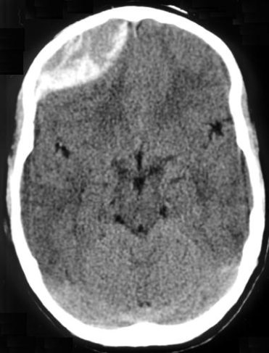
Contraindications for chemical prophylaxis
Active bleeding or risk of bleeding
Intracranial bleed
Spinal injury
Abdominal organ injury
Coagulophathy
INR > 1.5
aPTT > 40 seconds
< 50,000 platelets
History of heparin induced thrombocytopenia
May use fondaparinux

Slide 16
Best evidence for VTE treatment and decision making
Notes:
The CHEST guidelines provide an up-to-date reference as to what is best evidence in all of the areas of DVT and PE prevention.
Evidence is graded with Level 1A being the best and Level 4 being the least good.

Slide 17
CHEST Guidelines 2012, 9th edition
It is recommended that every hospital develop a formal strategy that addresses the prevention of VTE (Grade 1A)
Use of aspirin alone is not recommended as thromboprophylaxis for any patient group (Grade 1A)
It is recommended that mechanical methods of thromboprophylaxis be used primarily for patients at high bleeding risk (Grade 1A)
Possibly as an adjunct to anticoagulant thromboprophylaxis (Grade 2A)
Notes:
A VTE protocol should be in place in your hospital.
Aspirin is no longer of any use alone for prophylaxis.
Where chemical prophylaxis cannot be used, then mechanical means are reasonable.
They may also work adjunctively with chemical means.

Slide 18
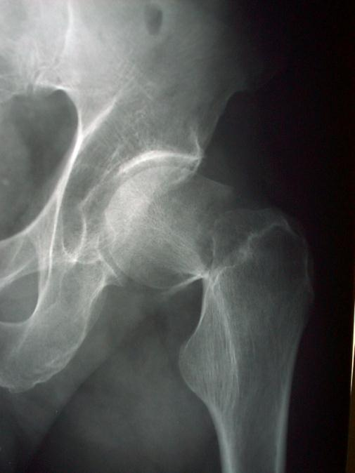
CHEST Guidelines 2012, 9th edition
Hip fracture surgery (HFS)— recommended routine use of:
Fondaparinux (Grade 1A)
LMWH (Grade 1B)
Vit. K antagonist (target INR, 2.5; range, 2.0 to 3.0) (Grade 1B)
Low-dose unfractionated heparin (LDUH) (Grade 1B)
Notes:
For hip fracture surgery, low-molecular-weight heparins are the best and aspirin is not recommended.
LMWHs should be started as early as possible to be preventative.

Slide 19
CHEST Guidelines 2012, 9th edition
For patients undergoing HFS, use of aspirin alone is not recommended
For patients undergoing HFS for whom surgery is likely to be delayed, it is recommended that thromboprophylaxis with LMWH or LDUH be initiated during the time between hospital admission and surgery (Grade 1C)
Notes:
For hip fracture surgery, low-molecular-weight heparins are the best and aspirin is not recommended.
LMWHs should be started as early as possible to be preventative.

Slide 20
CHEST Guidelines 2012, 9th edition
For patients undergoing HFS, it is recommended that thromboprophylaxis be extended beyond 10 days and up to 35 days after surgery (Grade 1A)
The recommended options for extended thromboprophylaxis in HFS include:
Fondaparinux (Grade 1A)
LMWH (Grade 1C)
Vit. K antagonist (Grade 1C)
Notes:
Thromboprohylaxis should be considered incomplete until it extends for a month or more after a hip fracture as the patient mobilizes.
Fondaparinux is the best and LMWH and warfarin are ok for extended periods.

Slide 21
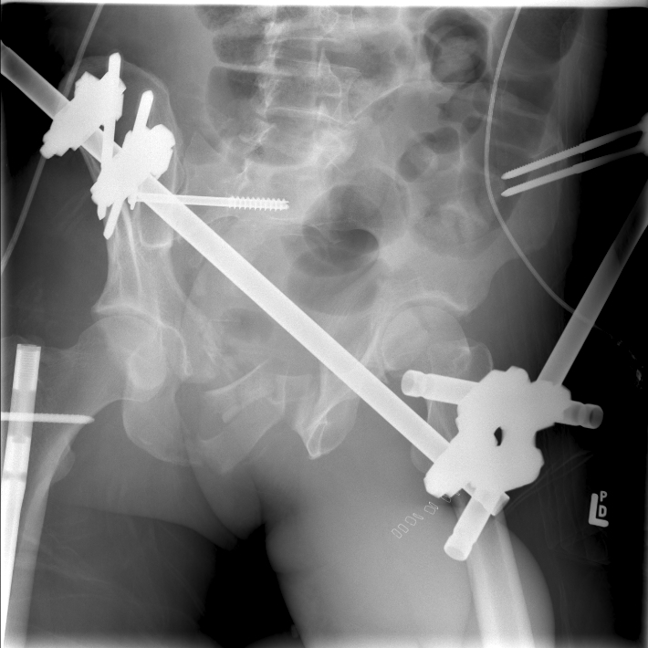
CHEST Guidelines 2012, 9th edition
It is recommended that all major trauma and all spinal cord injury patients receive thromboprophylaxis (Grade 1A)
For asymptomatic patients following major orthopedic surgery, the routine use of Doppler ultrasound screening before hospital discharge (Grade 1A) is not recommended
Falck-Ytter Y, et al., Prevention of VTE in orthopedic surgery patients: Antithrombotic Therapy and Prevention of Thrombosis. 9th ed. American College of Chest Physicians Evidence-Based Clinical Practice Guidelines. Chest. 2012;141(2 Suppl):e278S–325S.
Notes:
All major trauma patients should be treated.
Screening with Doppler ultrasound is not useful if they are not symptomatic.

Slide 22
CHEST Guidelines 2012, 9th edition
For patients with isolated lower extremity injuries distal to the knee, it is recommended that clinicians not routinely use thromboprophylaxis (Grade 2A)
For major trauma patients, in the absence of a major contraindication, it is recommended that clinicians use LMWH thromboprophylaxis starting as soon as it is considered safe to do so (Grade 1A)
Selby R et al. A double-blind, randomized controlled trial of the prevention of clinically
important venous thromboembolism after isolated lower leg fractures. J Orthop Trauma. 2015 May;29(5):224–230.
Notes:
For isolated injuries of single limb below the knees, evidence is present that prophylaxis is not needed.
For polytrauma patients, prophylaxis should start as soon as possible.

Slide 23
IVC filters
When chemical prophylaxis is contraindicated in high risk patients (eg. pelvic, acetabular fractures)
Bleeding risk
Multiple surgeries
Clot already present in proximal vasculature
Recommendation is to remove filter (CHEST Guidelines 2012)
Should not be used for prophylaxis alone
Expensive and no RCTs showing efficacy
Notes:
IVC filters are to be used when surgery must be performed and there is no other way to prophylaxis a patient who is a risk or already suffered a PE. They are temporary though and not to be left in.

Slide 24
The future
Better screening tools
Oral route for anticoagulation medication
One drug/one dose for (almost) all patients at risk
Relatively inexpensive
Used routinely for duration of risk
Notes:
The future should be bright for this terrible complication as VTE disease is a devastating complication of trauma.
One dose of one drug that is cheap should be possible.

Slide 25
Take-home messages
DVT risk and PE in trauma is high, especially with proximal injuries and polytrauma
Every institute should establish up-to-date guidelines/protocols and quality assurance
LMWH is safe and effective
Mechanical prophylaxis is less effective but may be useful in combination with chemical prophylaxis and EARLY MOBILIZATION
Prophylaxis should be continued for up to 6 weeks after injury
References provided in this lecture with new CHEST guidelines to be published shortly

