Slide 1
Treatment of metaphyseal and diaphyseal nonunions
AO Trauma Advanced Principles Course
Notes:
Published: October 2013
Author: David Elliott
Reviewer: KC Park
Reviewed: 2019

Slide 2
Learning objectives
Define an established nonunion
Recognize and define factors that lead to nonunion
Outline the contribution of mechanical and biological factors
Discuss appropriate strategies for intervention
Evaluate the role of bone graft and chemical bone growth stimulation in nonunion treatment
Notes:
Teaching points:
Focus on the principles of nonunion management.

Slide 3
Definition of nonunion
When the treating doctor believes that the fracture will not heal without further intervention

Slide 4
Requirements for bone healing
Hypothetical bone healing organ derived from fracture hematoma and migrating pluripotential stem cells
Appropriate mechanical environment
Notes:
Postulating the existence of a temporary bone healing organ allows us to explain the variation in fracture healing.

Slide 5
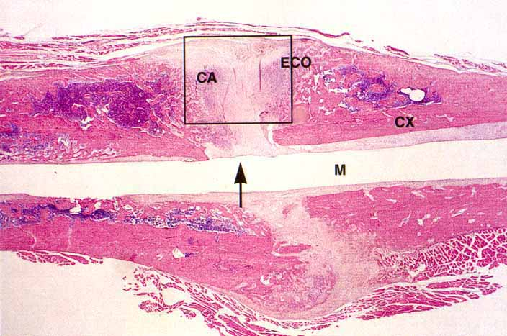
Bone healing organ
Notes:
Cross section of a rat femur through a healing fracture.

Slide 6
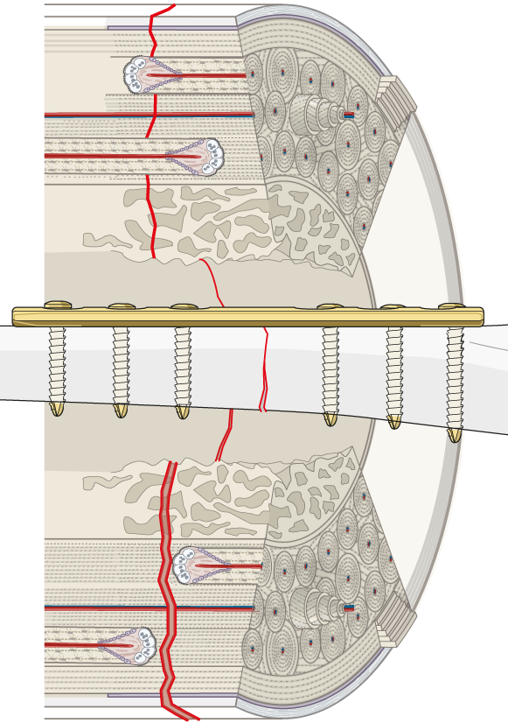
Fracture healing
Contact healing
Primary bone healing with osteonal reconstruction is not really healing
It is the bone going about its usual business of remodelling
Gap healing

Slide 7
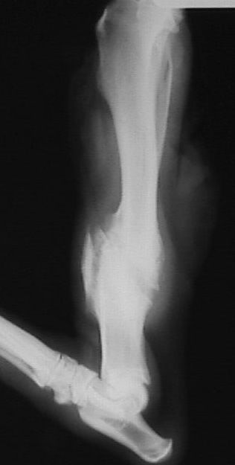
Secondary (indirect) bone healing
True healing process driven by an inflammatory response to injury
Classically described in four stages
Inflammation
Soft callus
Hard callus
Remodelling

Slide 8
Bone healing organ
Formation adversely affected by
Open fracture
High energy (soft-tissue disruption)
Subcutaneous bone, intraarticular bone
Surgery?
Notes:
The bone healing organ (BHO) theory explains why these sorts of fractures are slower to heal.

Slide 9
Bone healing organ
Performance adversely affected by
Presence of carbon dioxide (smoking)
Poor blood supply (microvascular)
Infection
High-strain environment (instability)
Notes:
The BHO theory explains why some patients’ fractures are slow to heal. However, the most important determinant of the performance of the BHO is the mechanical environment.

Slide 10
Bone healing organ
Type of tissue formed is dependent on the mechanical environment
Interfragmentary Strain Theory of fracture healing—Stephan Perren (1975)

Slide 11
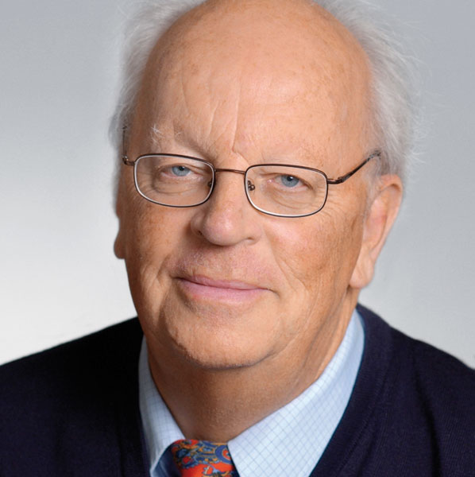
Interfragmentary Strain Theory by Stephan Perren
Strain: ε = ΔL/L (measured in %)
A tissue cannot be formed by the bone healing organ if the interfragmentary strain is greater than the yield tolerance of the tissue concerned

Slide 12
Yield tolerances
Bone = 2%
Cartilage = 10%
Granulation tissue = 100%

Slide 13
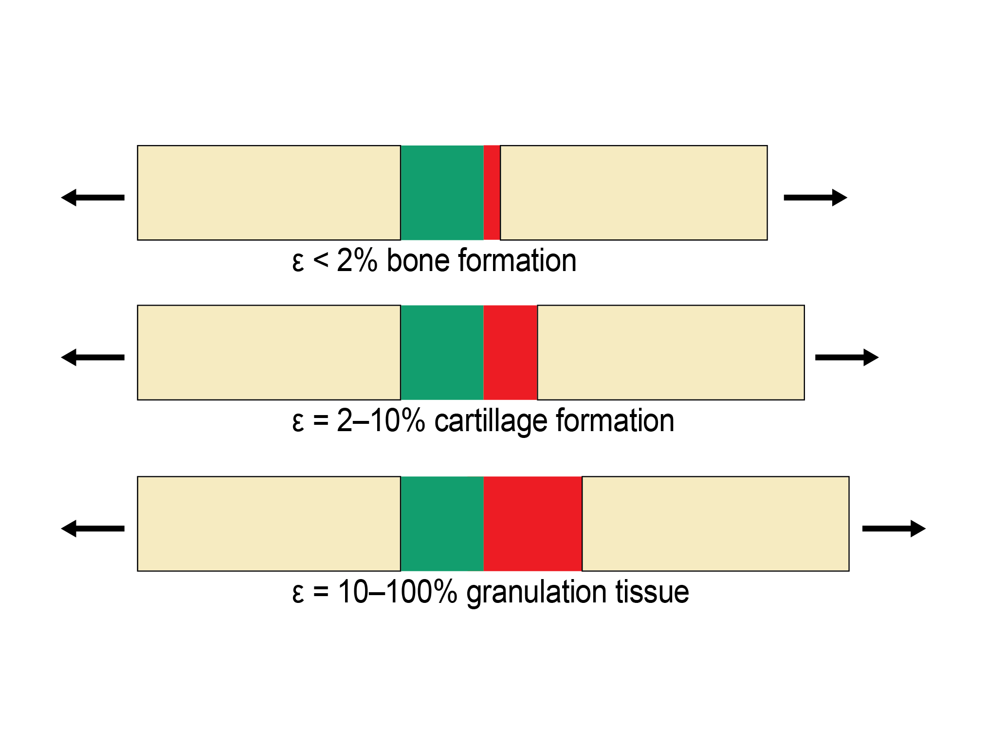

Slide 14
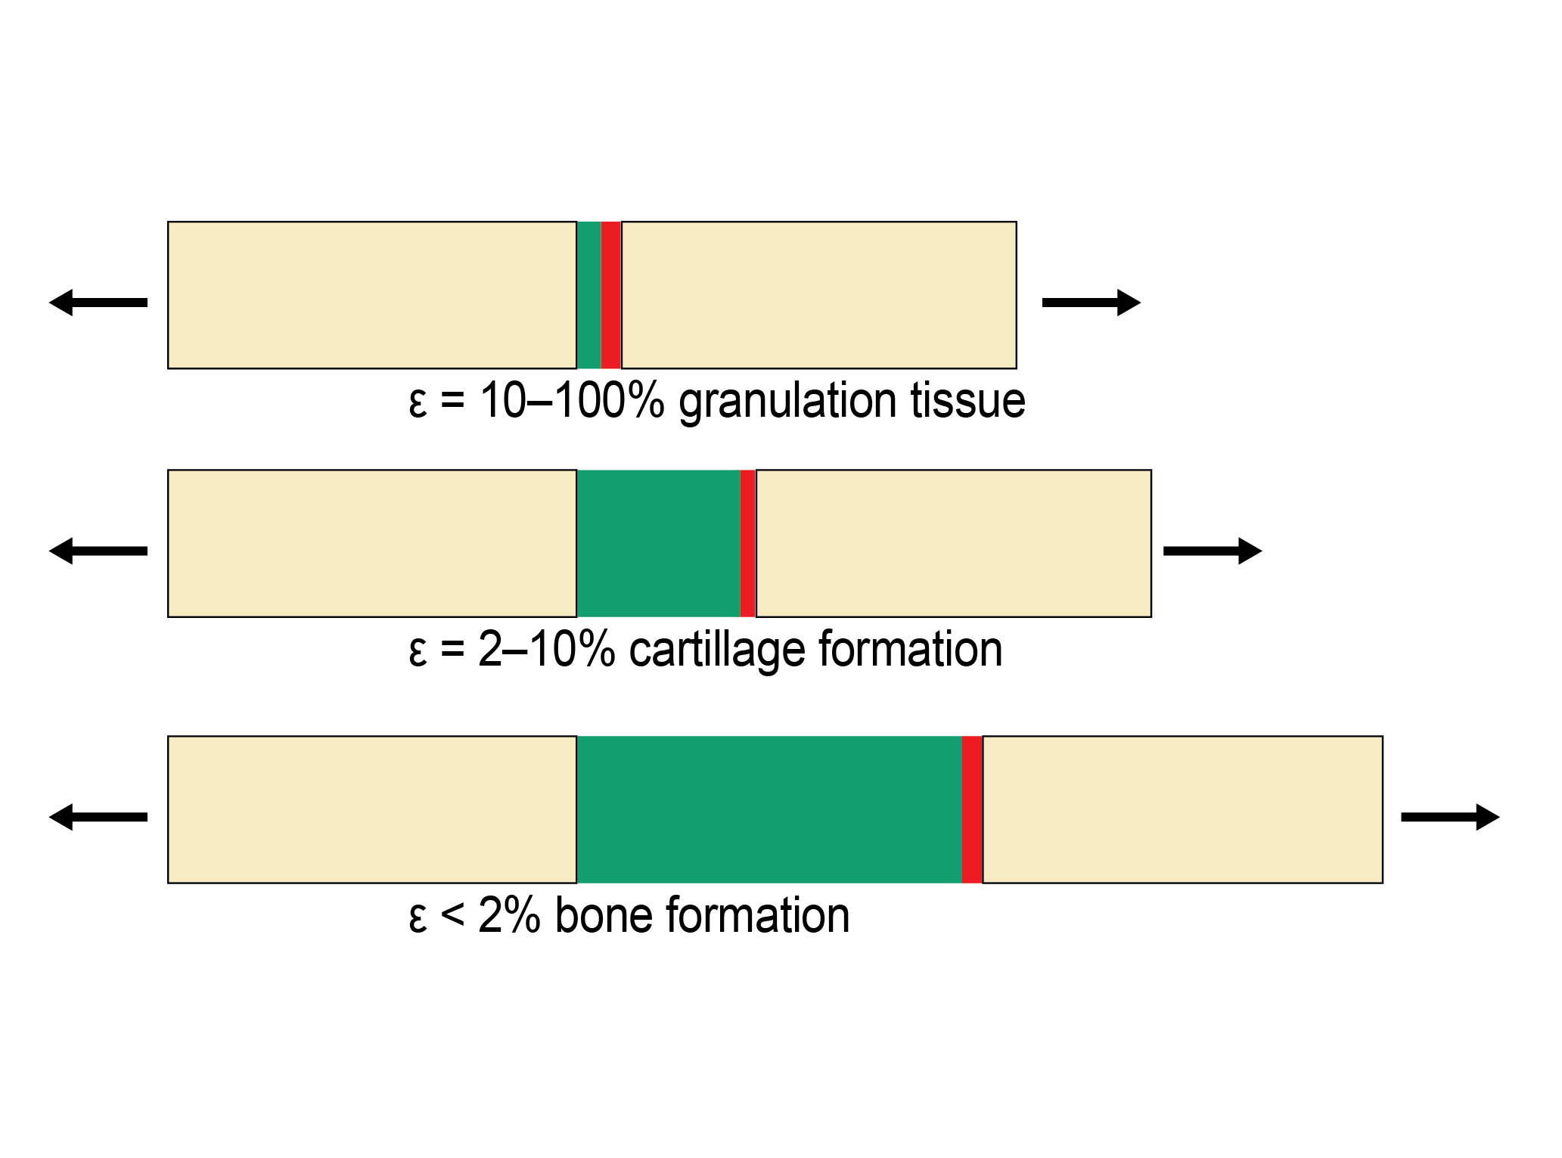

Slide 15
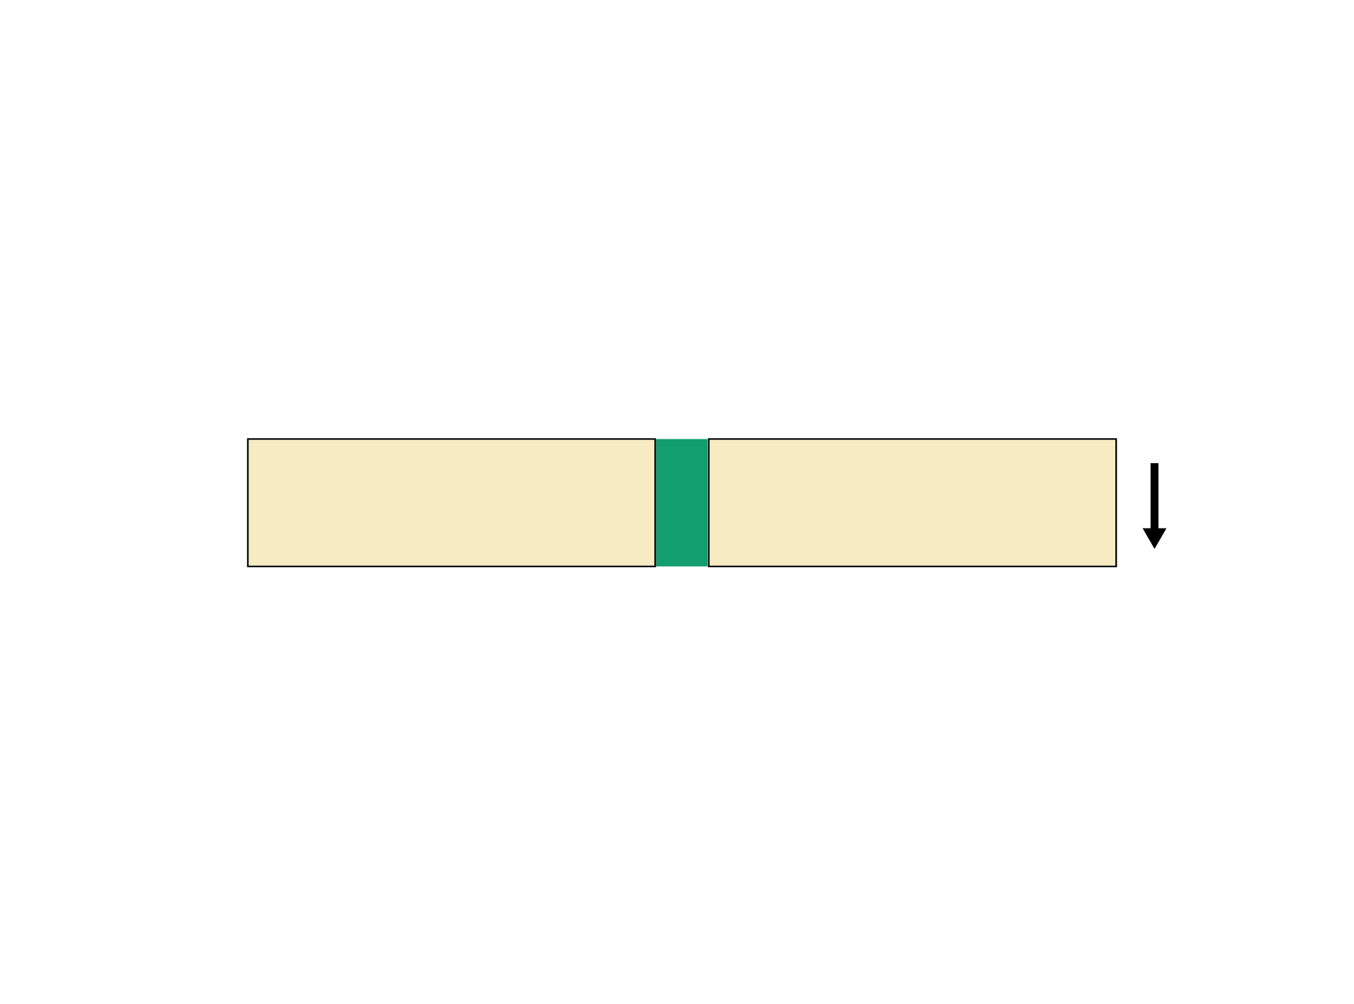
Angular displacement (bending)
Notes:
The mechanical environment in a fracture is much more complicated than pure longitudinal distraction.

Slide 16
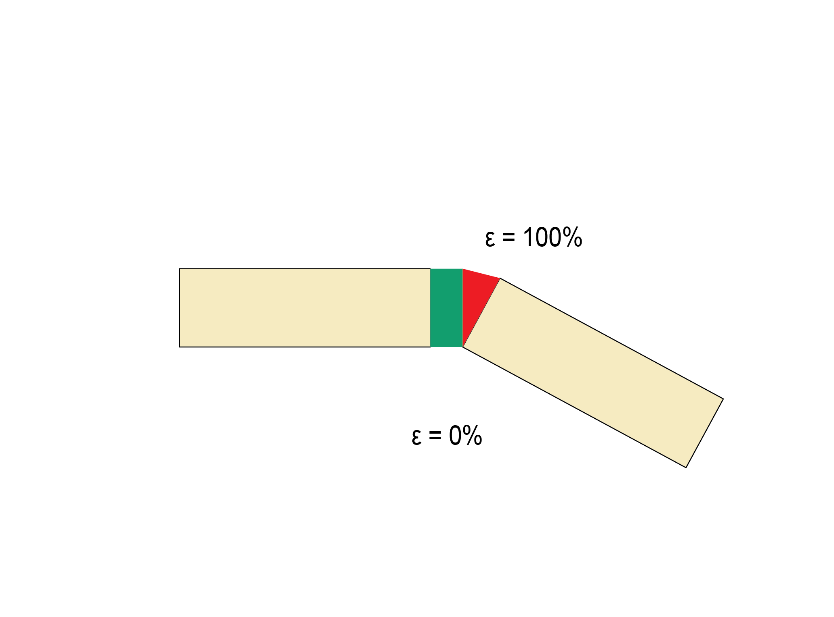
Angular displacement (bending)
ε = 100%
ε = 0%
Notes:
Angular displacement causes great variation of strain across the fracture gap.

Slide 17
Octahedral strain
Notes:
The actual situation is even more complex as there are 4 degrees of freedom.

Slide 18
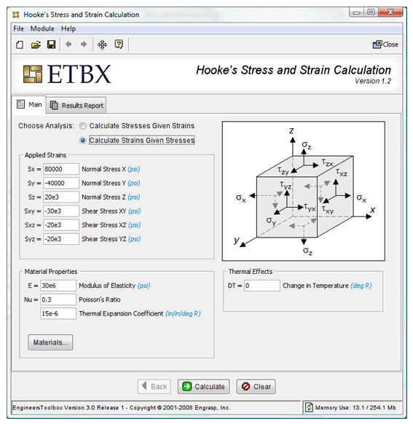
Notes:
App for calculating strain.

Slide 19
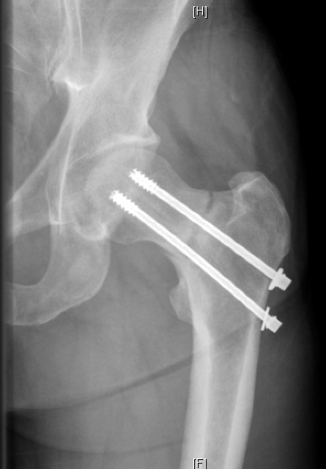
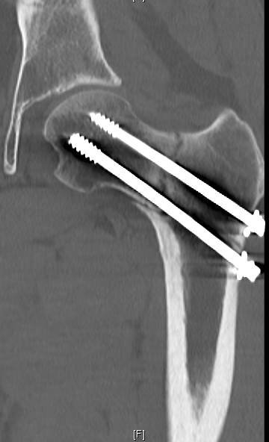
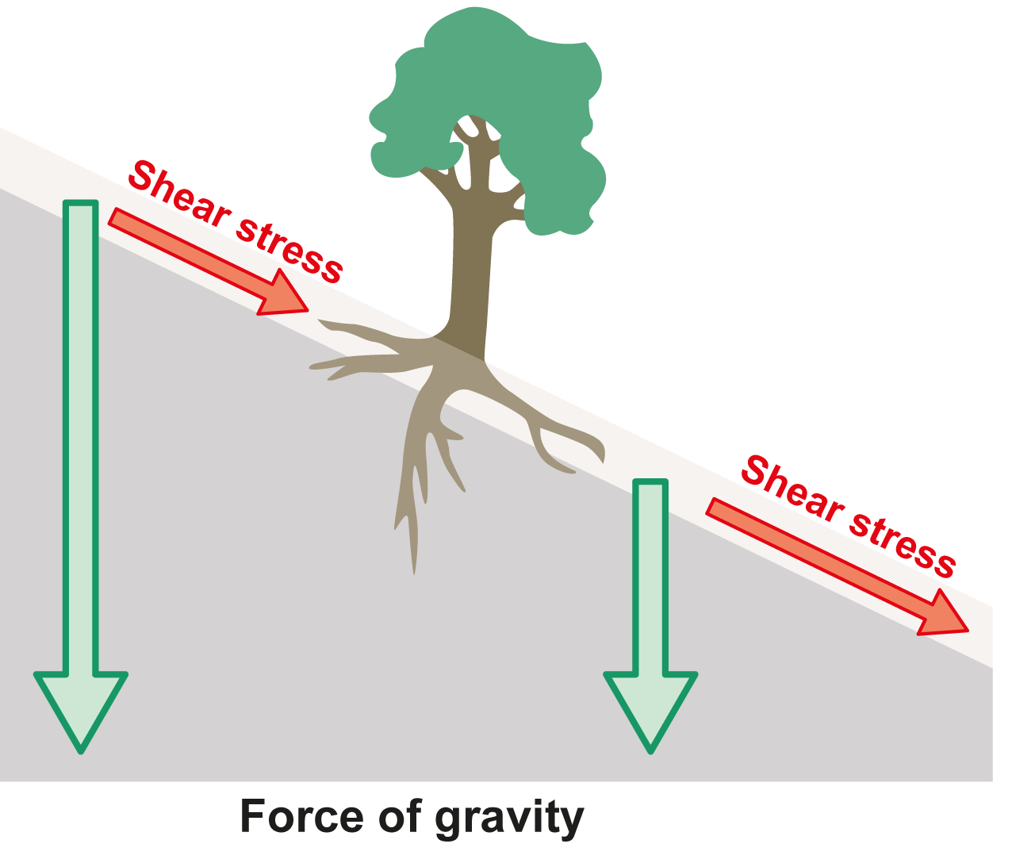
Shear is bad!
Notes:
Shear will always create very high strain because the fracture gap is small so even tiny movements will result in high strain.

Slide 20
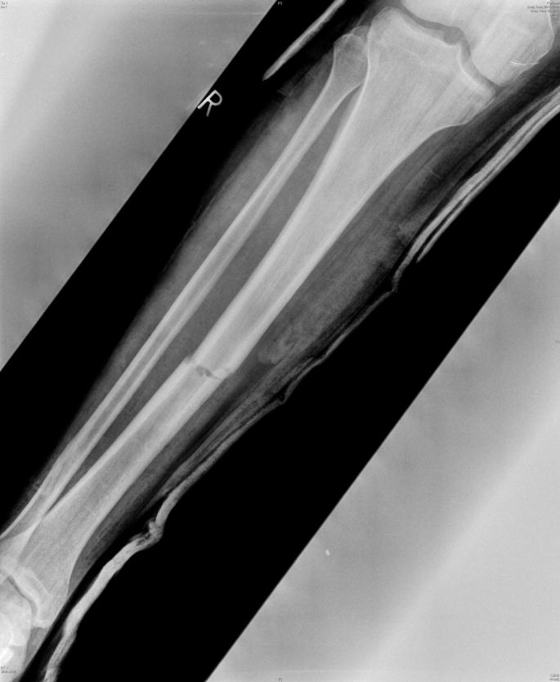
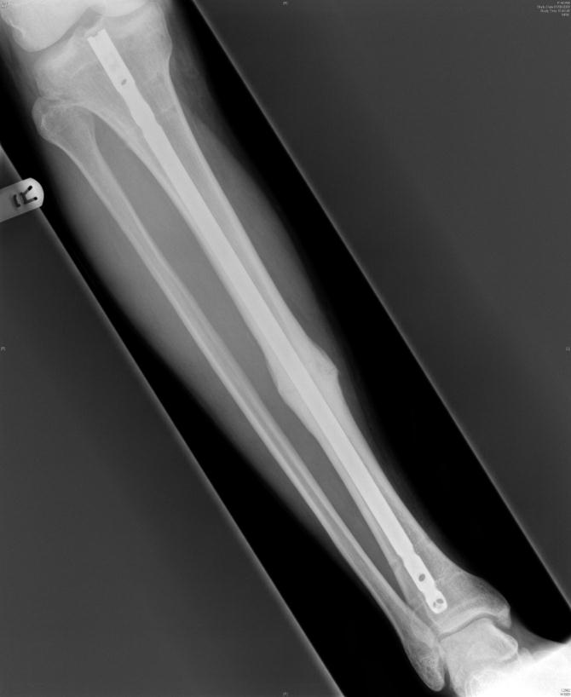
On-axis fixation
Symmetrical strain
Circumferential callus formation

Slide 21
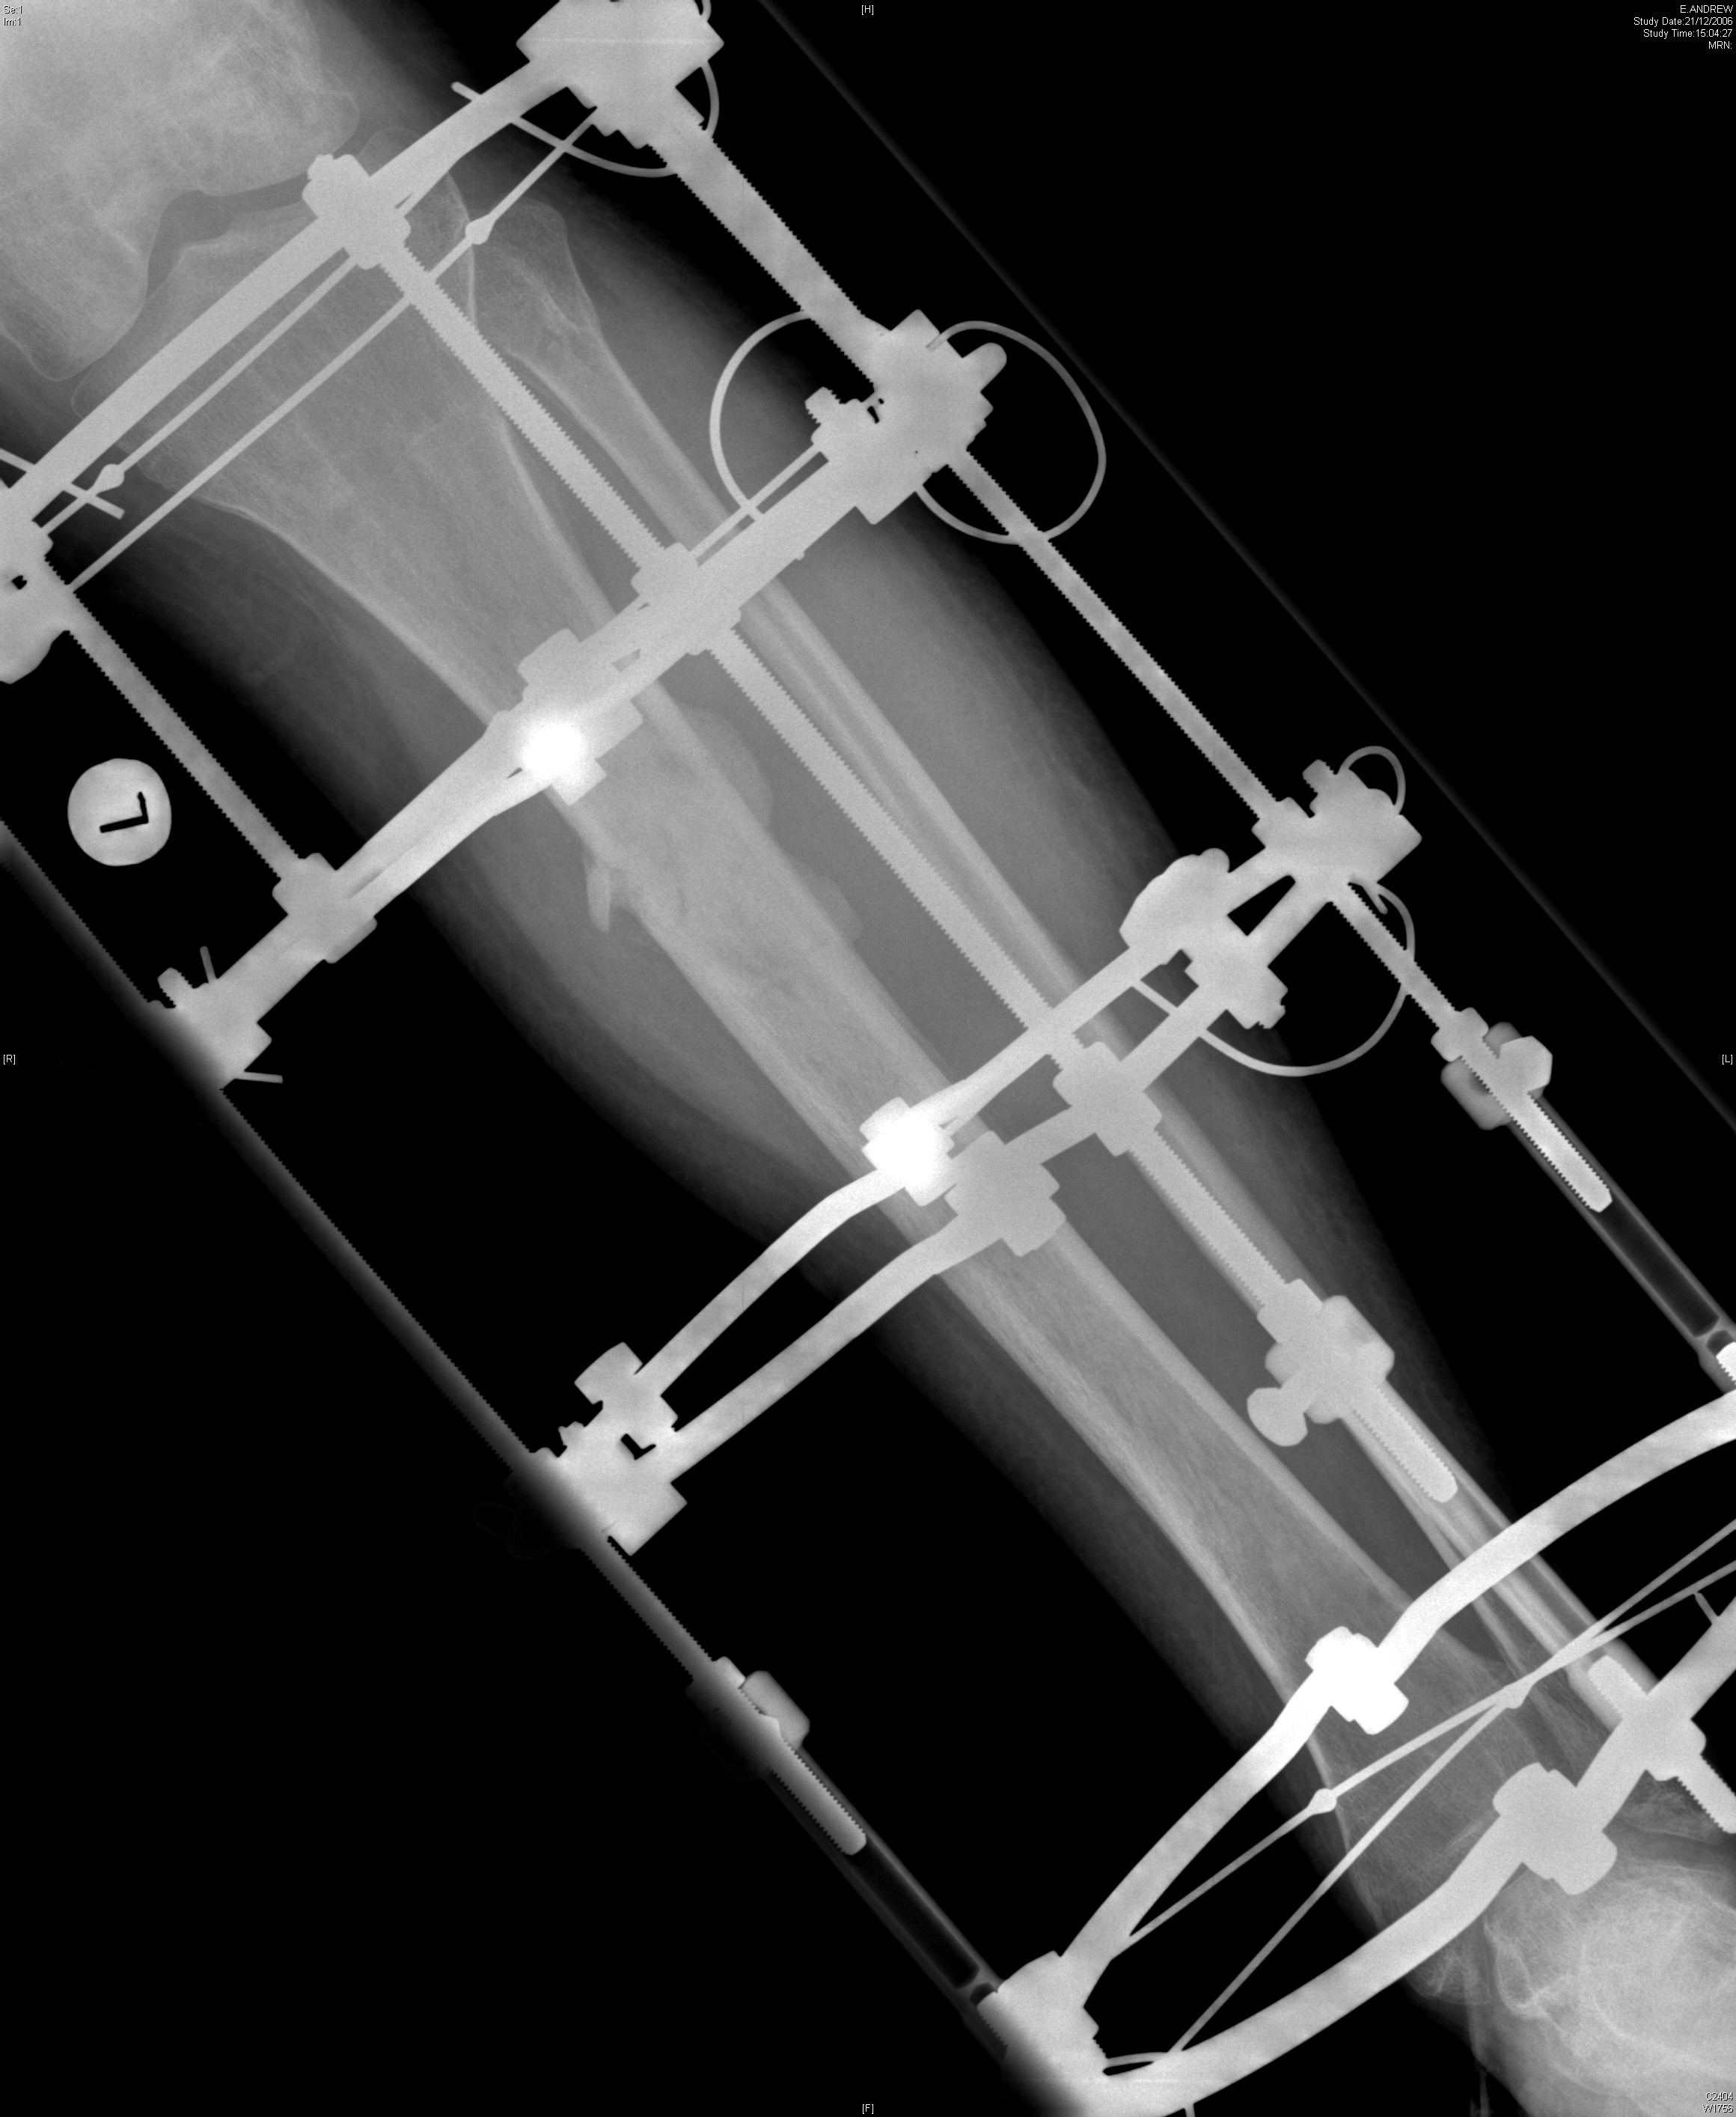
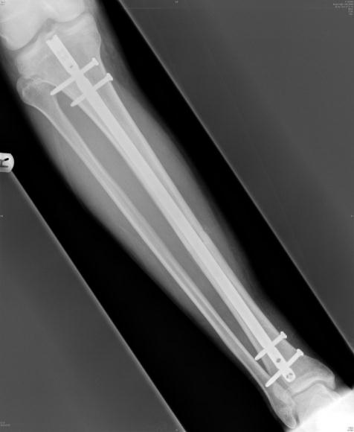
On-axis fixation
Notes:
A circular frame, fine wire fixator is mechanically analogous to a locked IM nail.

Slide 22
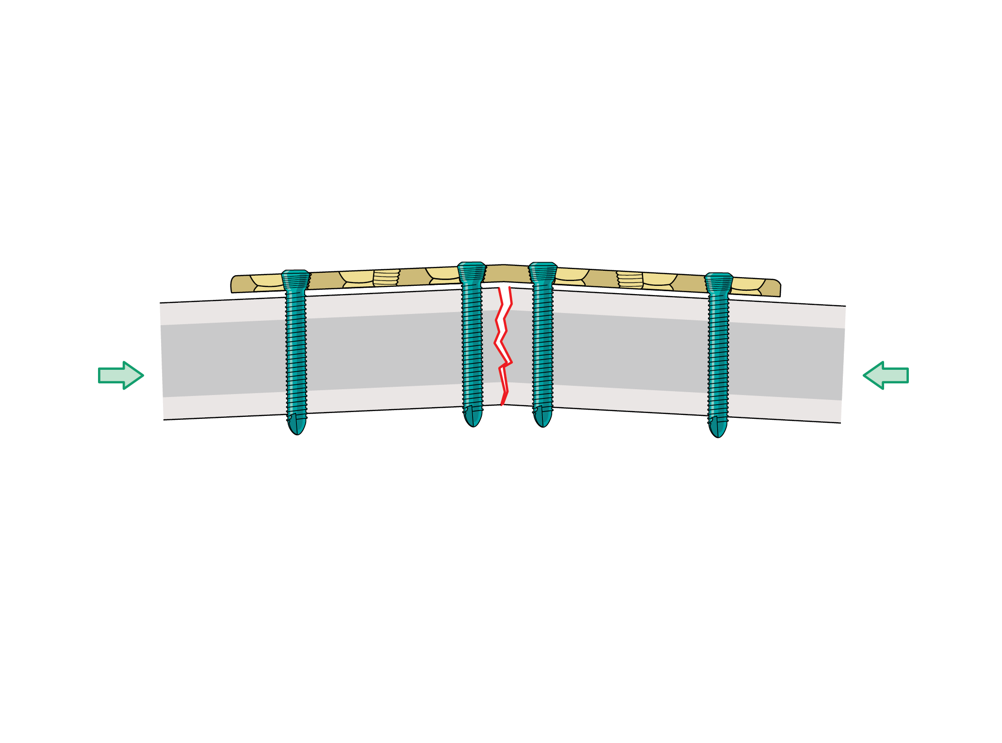
Off-axis fixation
Asymmetrical strain
Asymmetrical healing
Notes:
If the fixation device is not on the mechanical axis of the bone, loading will create a bending force resulting in asymmetric strain—small movement close to the plate, larger movement at far cortex.

Slide 23
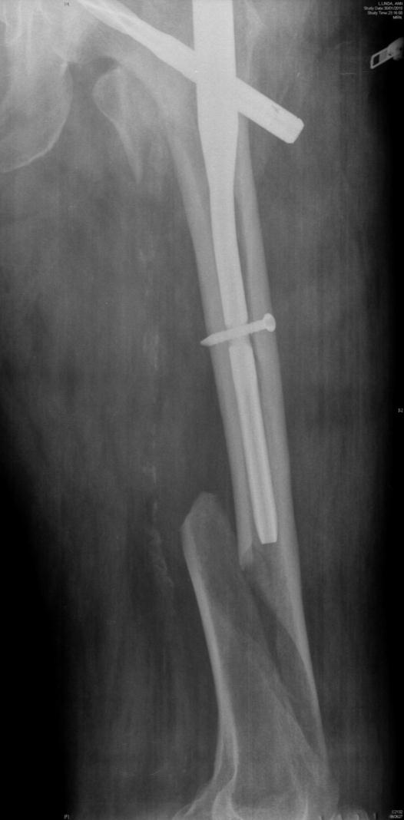
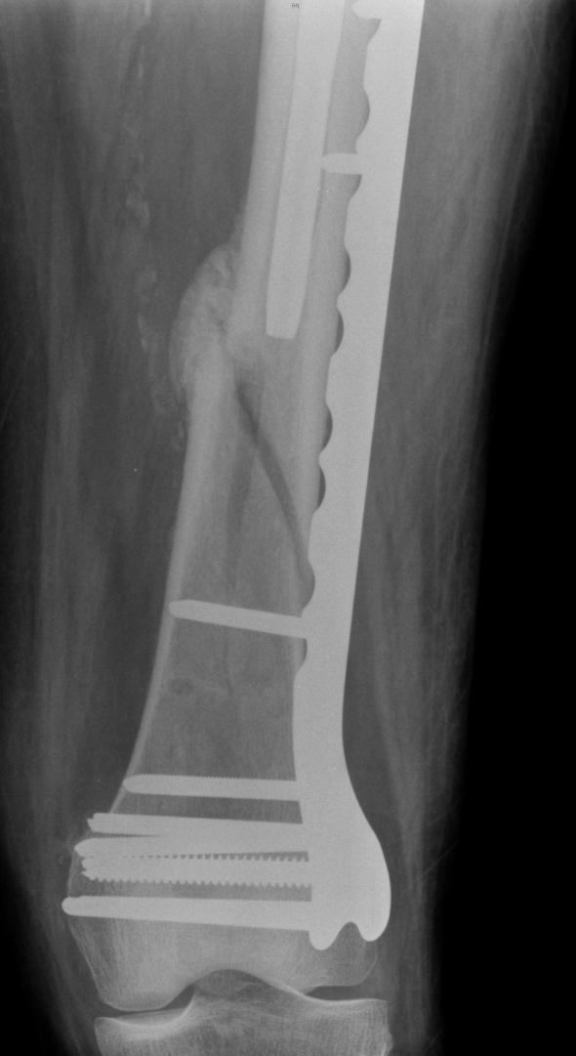
Off-axis fixation
Asymmetrical strain
Asymmetrical healing
Notes:
This clinical example demonstrates the common finding of rapid healing at the far cortex. This means that the strain environment is favorable further away from the plate.

Slide 24
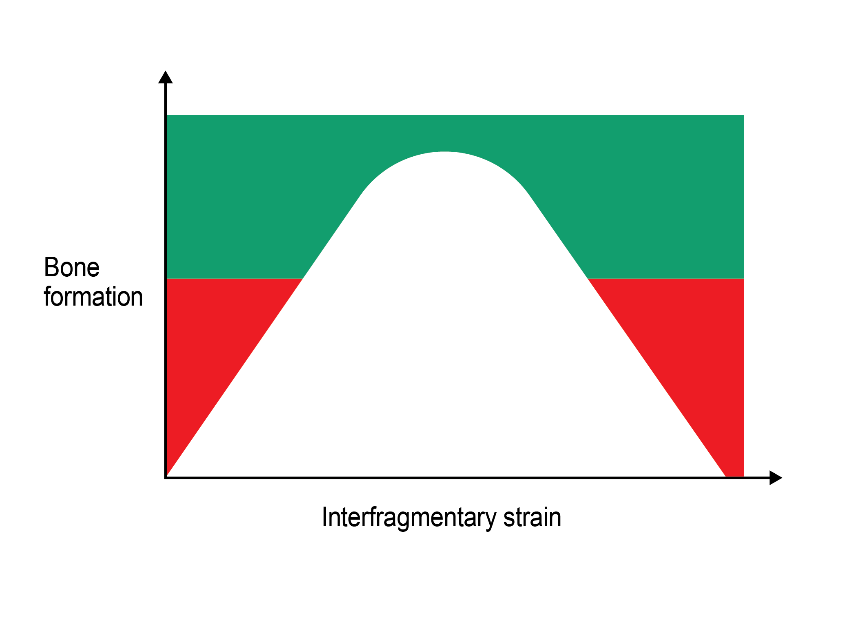
Notes:
These observations, as well as the well-known phenomenon of bone resorption on stress shielding, lead to the postulation of this graph. With no strain bone is resorbed (red area). Within certain levels of strain, bone is formed and there must be a level at which bone formation is maximum (green). As strain increases, the yield point of bone is passed and further bone formation cannot occur. At high levels of strain, bone resorption is observed, eg, synovial pseudarthroses. The shape of the curve and the values of the axes will be different for all fractures in all bones.

Slide 25
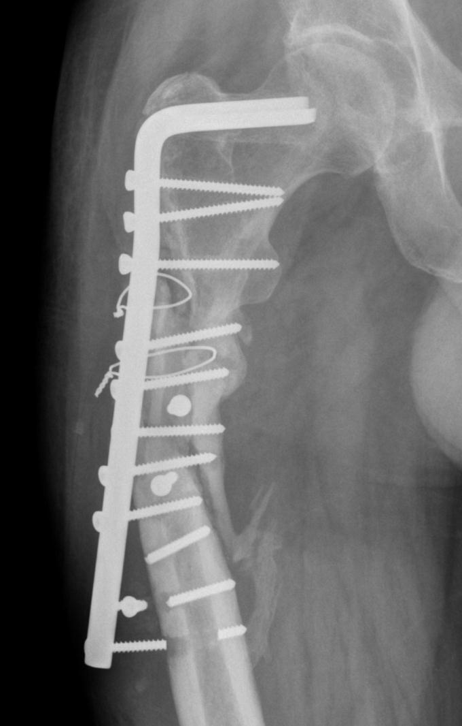
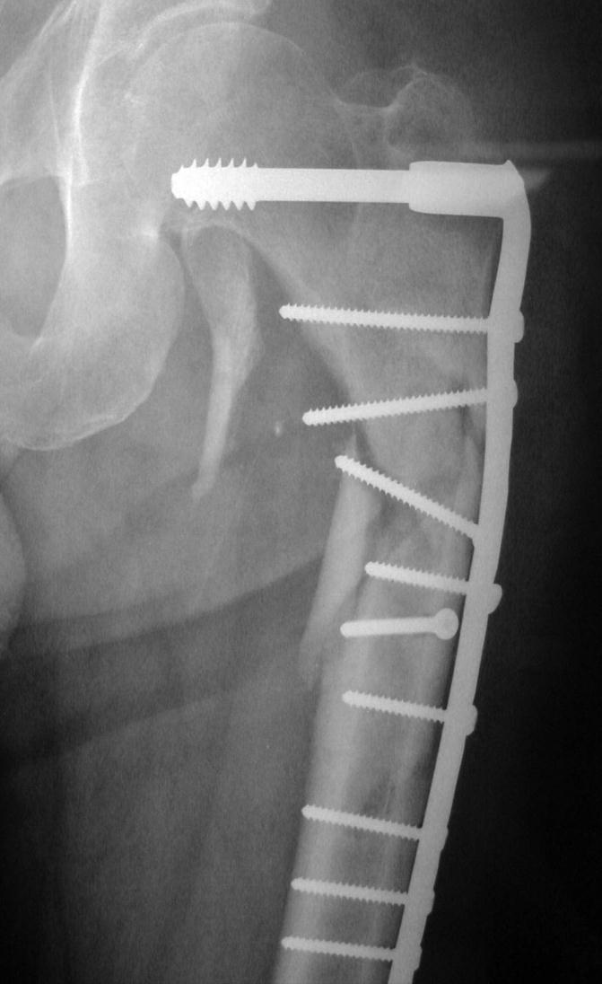
Nonunion radiology

Slide 26
Nonunion radiology
Bone is relatively radio-opaque due to the presence of calcium atoms in crystalline hydroxyapatite [Ca₅(PO₄)₃(OH)]
Calcification of callus cannot occur until the interfragmentary strain falls below the yield tolerance of healing bone
Radio-opaque callus is a radiological indicator of stability

Slide 27
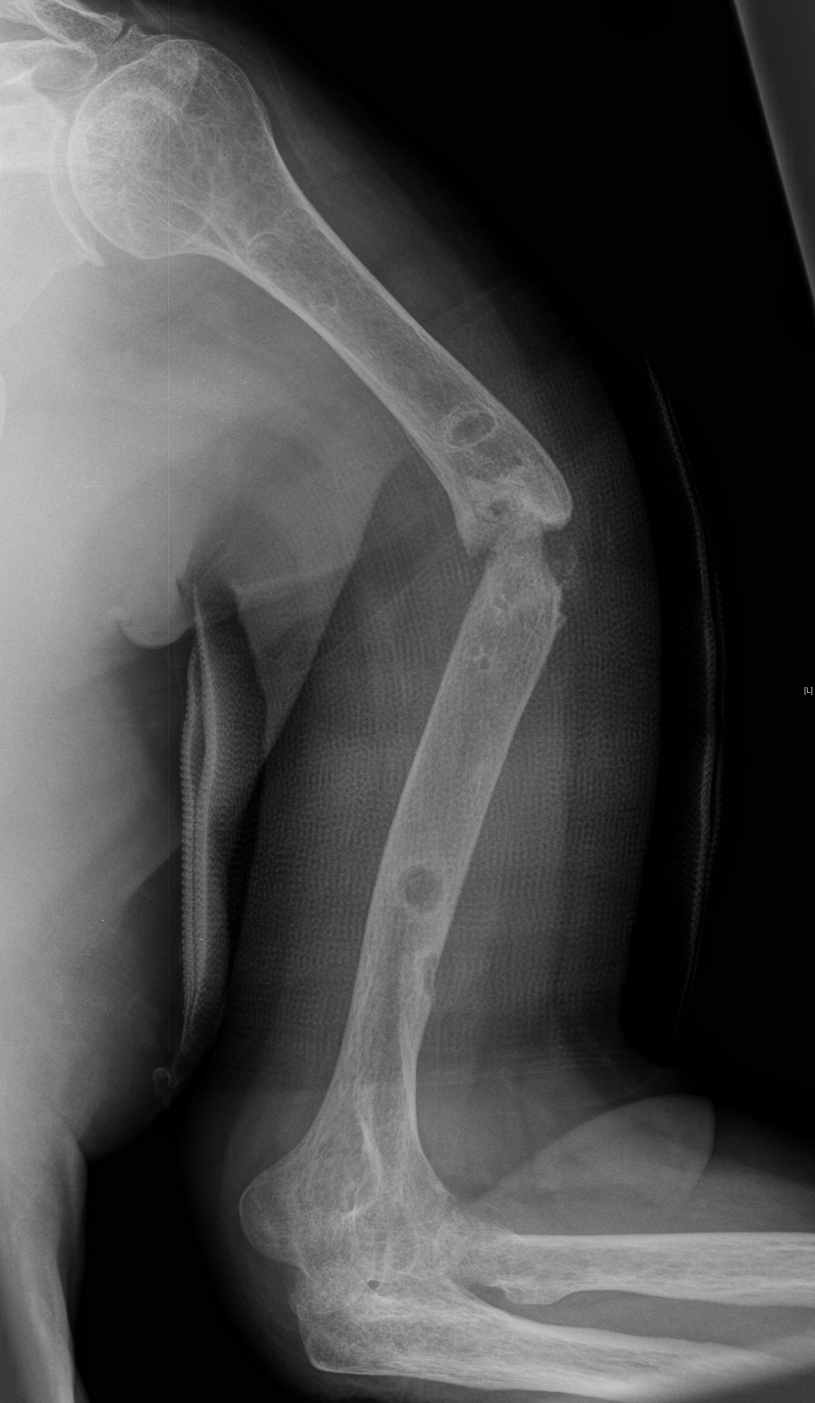
Notes:
The bone ends in these two humeral nonunions are equally vascular. The left image shows a completely mobile nonunion which must form a synovial pseudarthrosis. The other image shows a nonunion that is sufficiently stable for some calcified callus to have formed.
Experienced surgeons will recognize that the bone ends will be viable in both cases and the, so-called, “atrophic” nonunion is merely a radiological feature of instability.

Slide 28
Nonunion treatment
Restore alignment
Stabilize
Durable implant
Equalize strain across the fracture

Slide 29
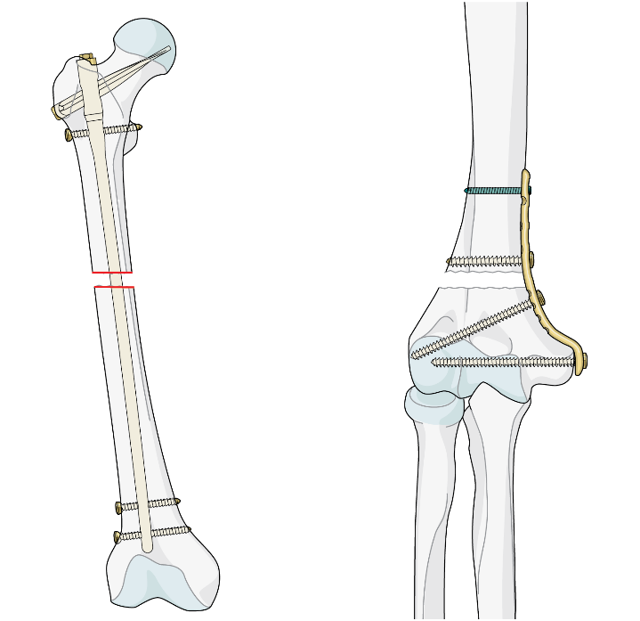
Stability
Essential to achieve low interfragmentary strain in order to permit bone formation
Default options
Reamed IM nail for lower limb diaphyseal nonunion
Compression plates for upper limb and metaphysis

Slide 30
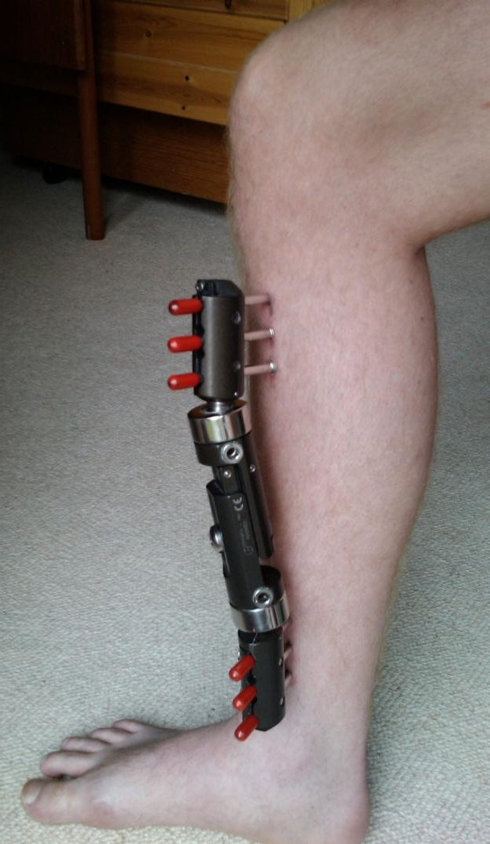
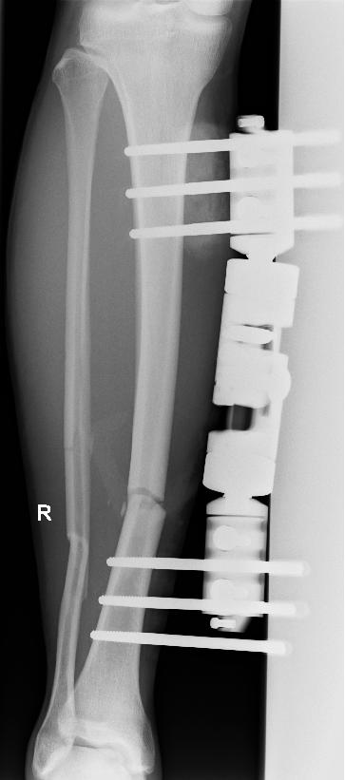
Notes:
Tibial nonunion was very common during the era of these over-stiff monolateral fixators. Treatment was simple—remove the fixator and nail the tibia.

Slide 31
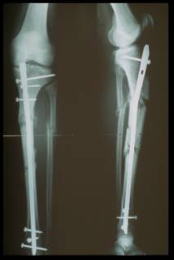
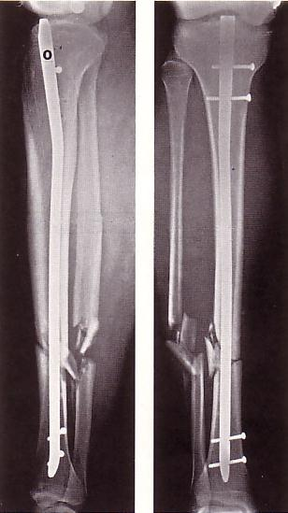
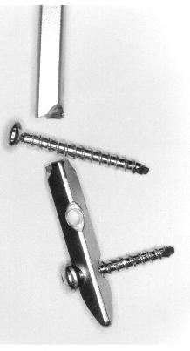
Notes:
The age of unreamed tibial nails also provided plenty of work for the nonunion surgeon. These devices were not designed to be used as load bearing implants and if they were, they broke!

Slide 32
Durability
Notes:
Most tibial diaphyseal nonunions now arise as a result of poor choice of implant. The surgeon chose a plate because he believed that nailing would not be possible due to a previous tibial shaft fracture.

Slide 33
Notes:
Of course nailing is always possible if you have the right tools.

Slide 34
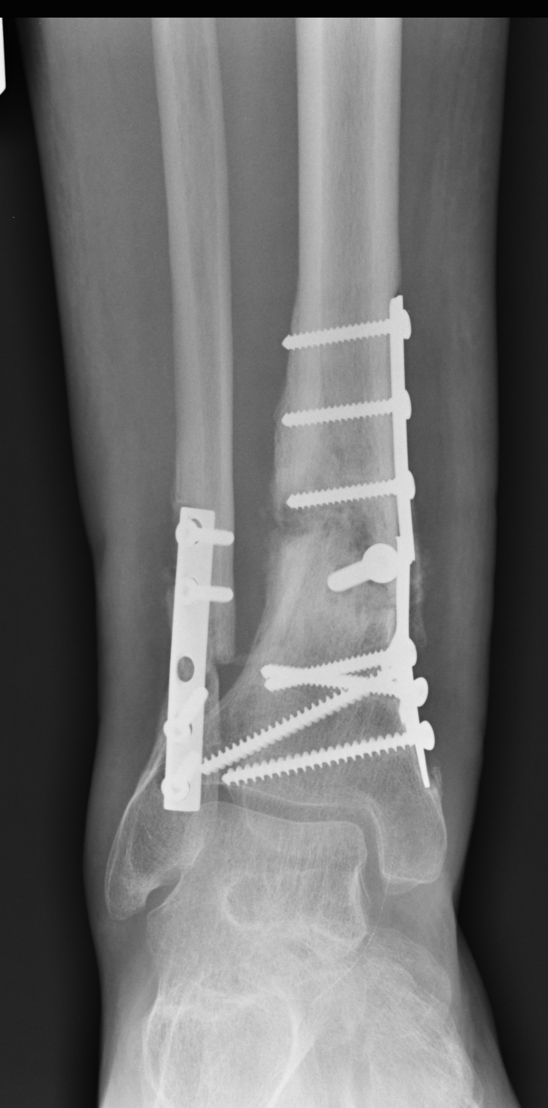
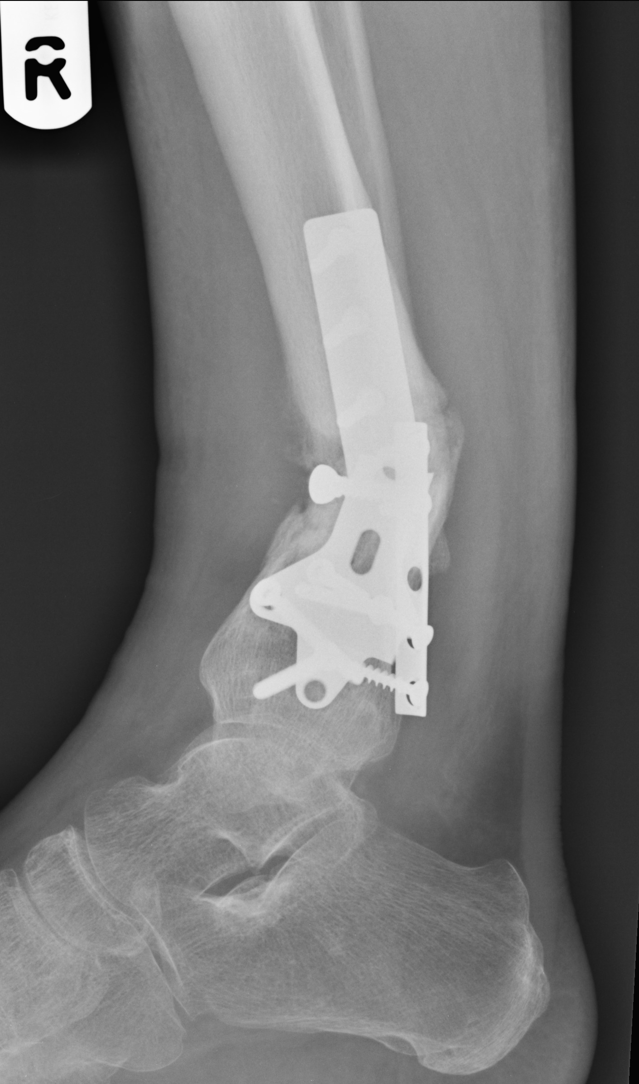
Notes:
In recent times, nonunions seem to be more common at the metaphyseal/diaphyseal junction.
Surgeons often choose plates because of the belief that nailing is difficult and ineffective in this zone. The asymmetric strain across a simple fracture pattern generated by off axis fixation with a low-strength plate means this sort of fixation frequently fails.

Slide 35
Notes:
Solution is to restore alignment and hold with on-axis fixation.
In this case, percutaneous hardware extraction, closed controlled osteoclasis, and reamed IM nailing with multiaxial locking screws distally.

Slide 36
Notes:
The subtrochanteric region of the femur is a common source of nonunion because it is not possible to place a fixation device along the load bearing axis. There will always be a bending force on the implant and asymmetric strain across the fracture.
In this case the surgeon blamed the plate failure on the manufacturing process and chose to replace it with an identical implant from “a different batch”.

Slide 37
Notes:
The result was entirely predictable.

Slide 38
Notes:
A recent trend is the use of periprosthetic techniques to fix acute fractures. However, without the stabilizing effect of an implant, this fixation is hopelessly inadequate.

Slide 39
Notes:
Even though the bone was devascularized by circumferential stripping, rapid healing occurred after IM nailing.

Slide 40
Stability
Notes:
With a simple transverse fracture, nonunion may occur if the implant does not confer sufficient stability to reduce the interfragmentary strain down to bone forming levels.
Nontensioned implants, such as locking plates or this IM nail, may result in a high strain fixation especially if the gap is small.

Slide 41
Notes:
Adding a tensioned implant, with no other adjuncts, results in healing.

Slide 42
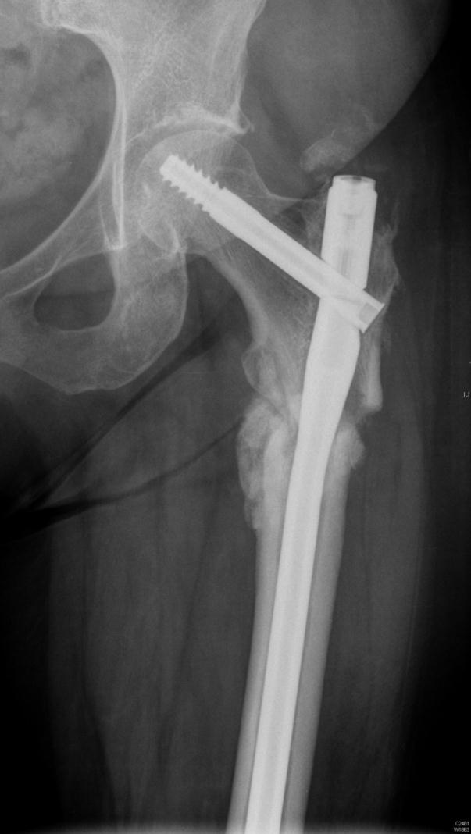
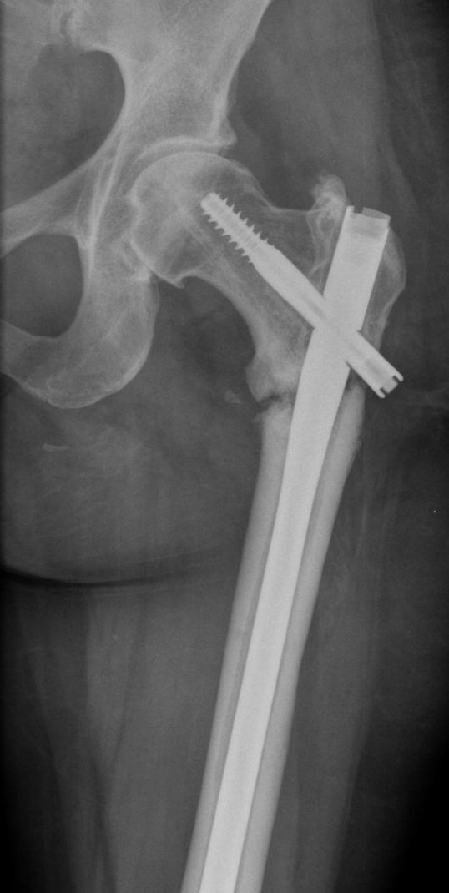
Notes:
Two similar subtrochanteric nonunions.

Slide 43
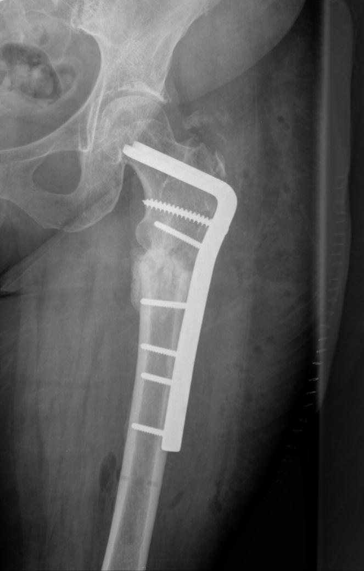
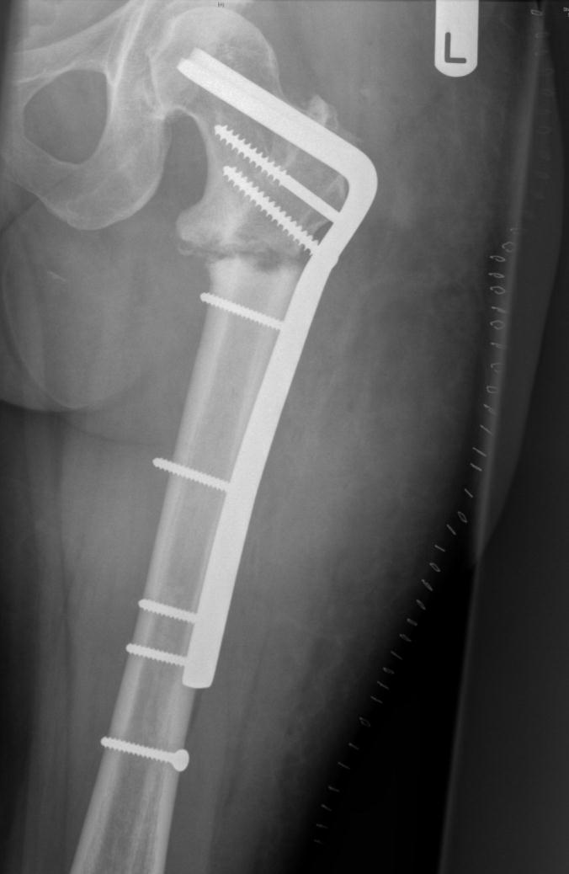
Notes:
Immediate postoperative images after correcting varus and stabilizing with a highly tensioned implant.

Slide 44
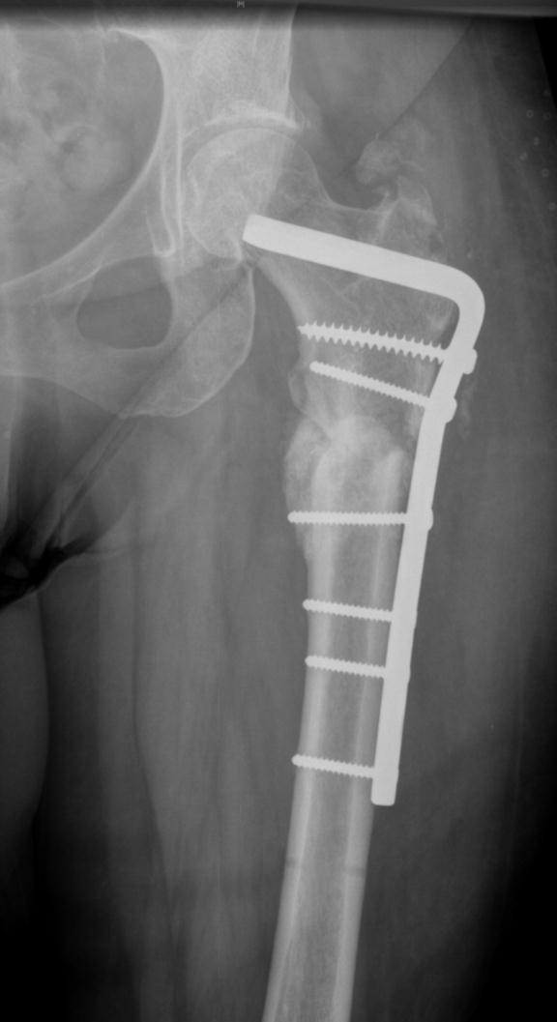
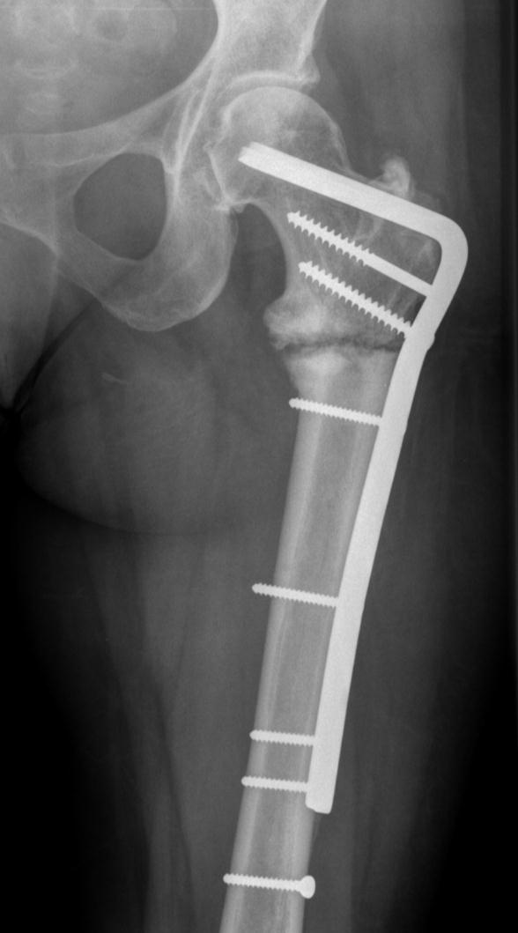
Notes:
At 6 months, one has healed and the other has not.

Slide 45
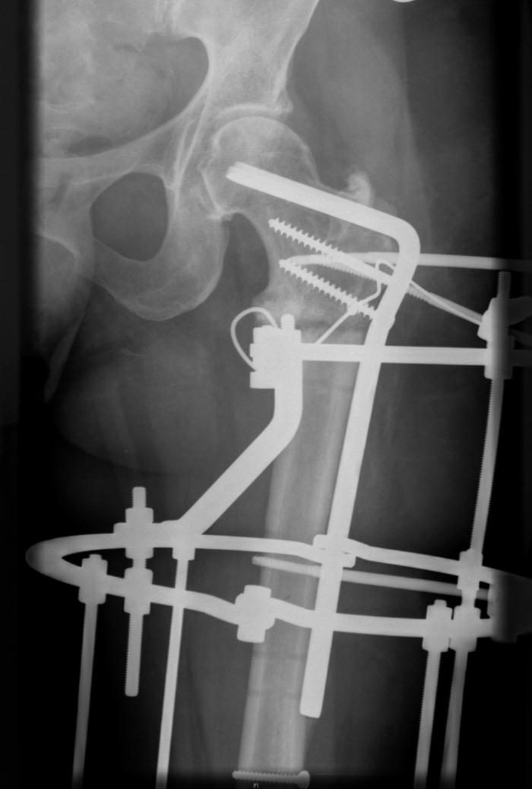
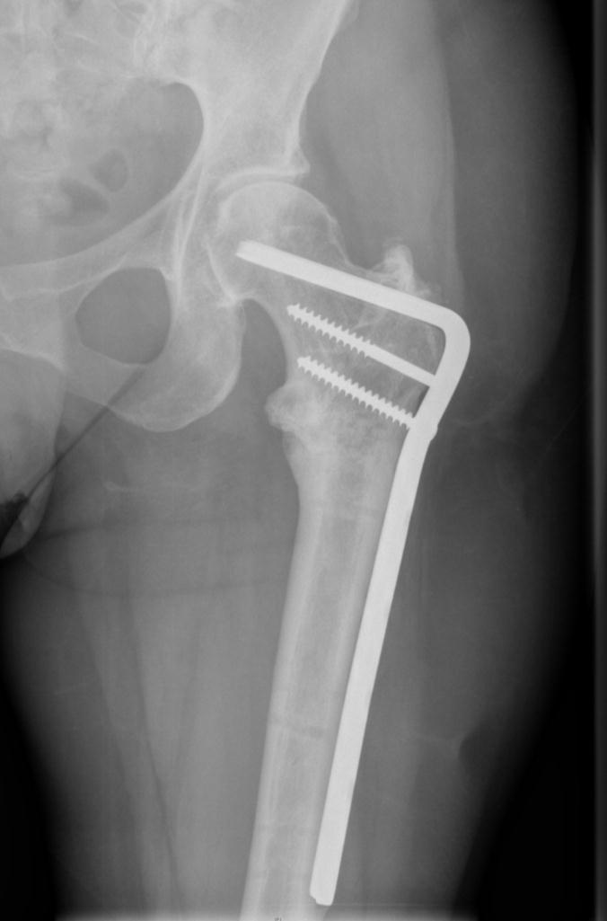
Notes:
Further stability is achieved by applying a circular frame with maximum tension (look at bend on half pins). Union with no further adjuncts.

Slide 46
What is the role of cancellous autograft?
Harvesting stimulates the bone healing organ (osteotomy)
Humoral factors
Placing the graft around the nonunion site may result in the formation of a fresh bone healing organ (decortication)
Notes:
Many surgeons no longer use cancellous bone grafting in the treatment of nonunion. There is lack of evidence that grafting promotes healing and there is considerable donor site morbidity.
Surgeons treating nonunion should be encouraged to research the considerable amount of literature written on the subject and come to their own conclusions. There is no absolute proof of the value of grafting but the act of approaching the nonunion and debriding by decortication may be sufficient stimulus without adding graft.

Slide 47
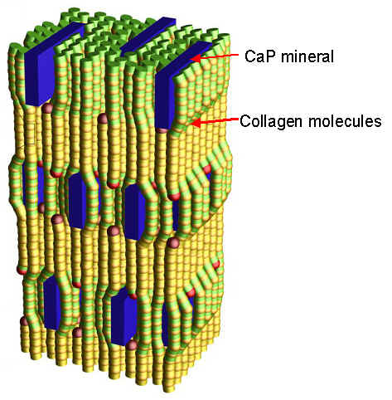
Chemical bone growth stimulation

Slide 48
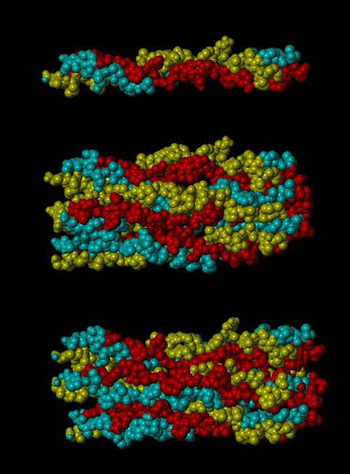
Notes:
The structure of the organic matrix and the crystalline components of human bone are well known. These are the collagen fibrils composed of multiple strands of collagen molecules.

Slide 49
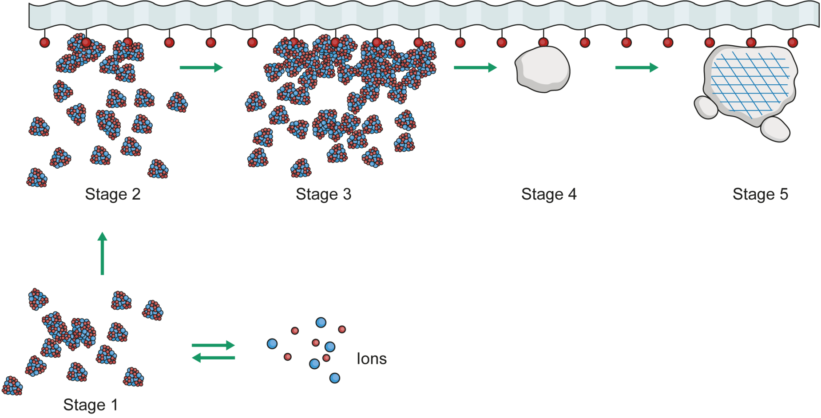
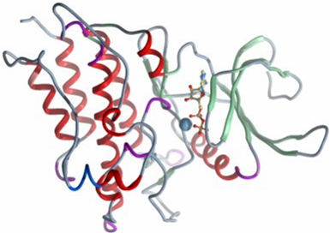
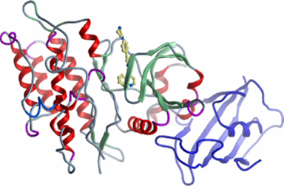
Notes:
The steps in the mineralization of collagen are also understood but how these processes are modulated by bone morphogenic proteins is unknown. It must be possible to influence this process chemically but there is no current evidence that we have been able to successfully do this in humans.

Slide 50
Chemical bone growth stimulation
The Treatment of Complex, Recalcitrant Long-Bone Nonunion with a Human Recombinant Bone Morphogenic Protein: Results of a Prospective Pilot Study
McKee M, Schemitsch E, Wild L, Waddell JP
Purpose: We sought to determine the safety and efficacy of a human recombinant osteogenic protein (rhBMP-7) in the treatment of recalcitrant human long-bone nonunion.
Methods: In a prospective pilot study, we identified 15 patients with complex, recalcitrant long-bone nonunion whose previous treatment was unsuccessful. There were nine men and six women with a mean age of 52.8 years (range, 38 to 76). The involved bones included five tibiae, four clavicles, four humerii, and two femora. All patients had radiographic nonunion, and had had a mean of 2.8 prior unsuccessful operative procedures (range, 0 to 6). Eleven patients had received prior autogenous bone grafting in an attempt to promote union.
All patients underwent removal of any previously implanted hardware, debridement of the nonunion, correction of deformity, stable internal fixation, and addition of the rhBMP-7 compound to the nonunion defect.
Results: The mean follow-up was 22 months (range, 6 to 52), and no patient was lost to follow-up. The nonunion of 13 patients healed at a mean of 11 weeks postoperatively, and all demonstrated abundant bone formation. The tibia of one patient developed a recurrence of deep infection and required below-knee amputation. One patient with a segmental clavicular defect had delayed radiographic union at the 6-month follow-up but had progressive bone formation, was clinically stable, and declined further intervention. Technically, the rhBMP-7 bone substitute was easy to handle and simple to apply, and there were no adverse clinical events related to its use. Patient satisfaction was high.
Conclusions: The bone substitute was technically feasible to use, was not associated with any adverse events, and promoted union in 13 of 15 (87%) patients with refractory long-bone nonunion that had not responded to conventional bone grafting. As part of a standard protocol, this bone graft substitute appears to be safe and effective in providing sufficient biological stimulation for bony union to occur in this difficult-to-treat patient population. Its use eliminates the requirement for autogenous grafting.
Notes:
Many papers have been written on chemical stimulation of bone healing but most are flawed by the multiple treatments carried out and the heterogeneity of the samples.

Slide 51
Chemical bone growth stimulation
All patients underwent:
Removal of any previously implanted hardware
Debridement of the nonunion
Correction of deformity
Stable internal fixation
Addition of the rhBMP-7 compound to the nonunion defect
Notes:
Many papers have been written on chemical stimulation of bone healing but most are flawed by the multiple treatments carried out and the heterogeneity of the samples.

Slide 52
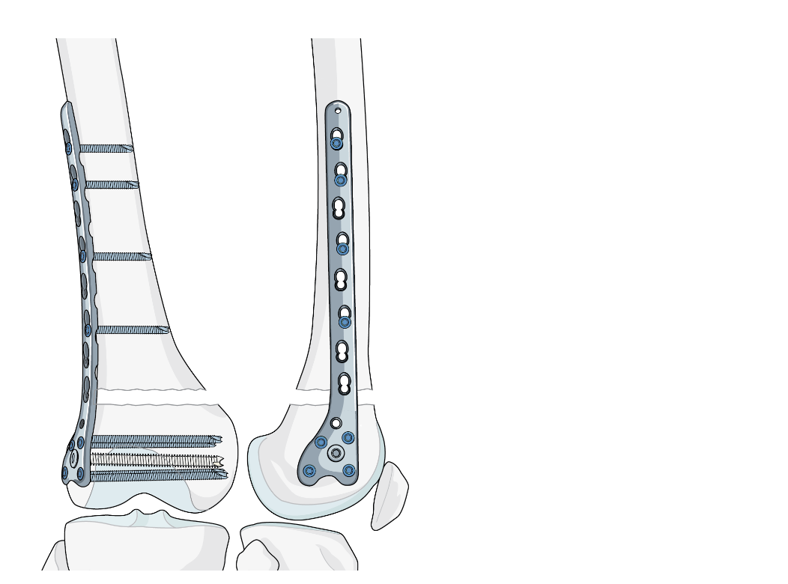
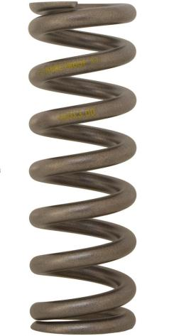
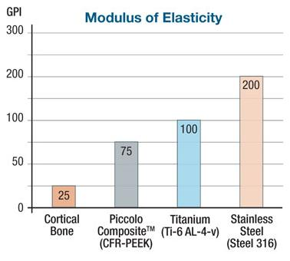
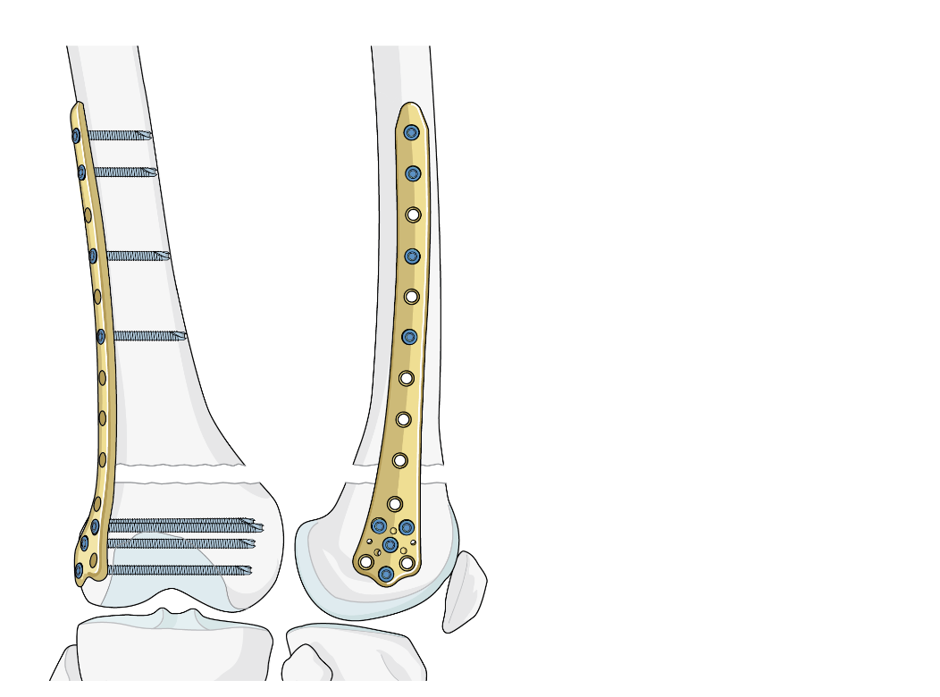
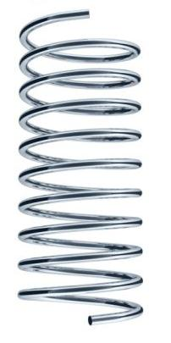
Hardware
Notes:
Regarding the mechanical properties of implants, stainless steel can be visualized as a stronger and stiffer spring than titanium.

Slide 53
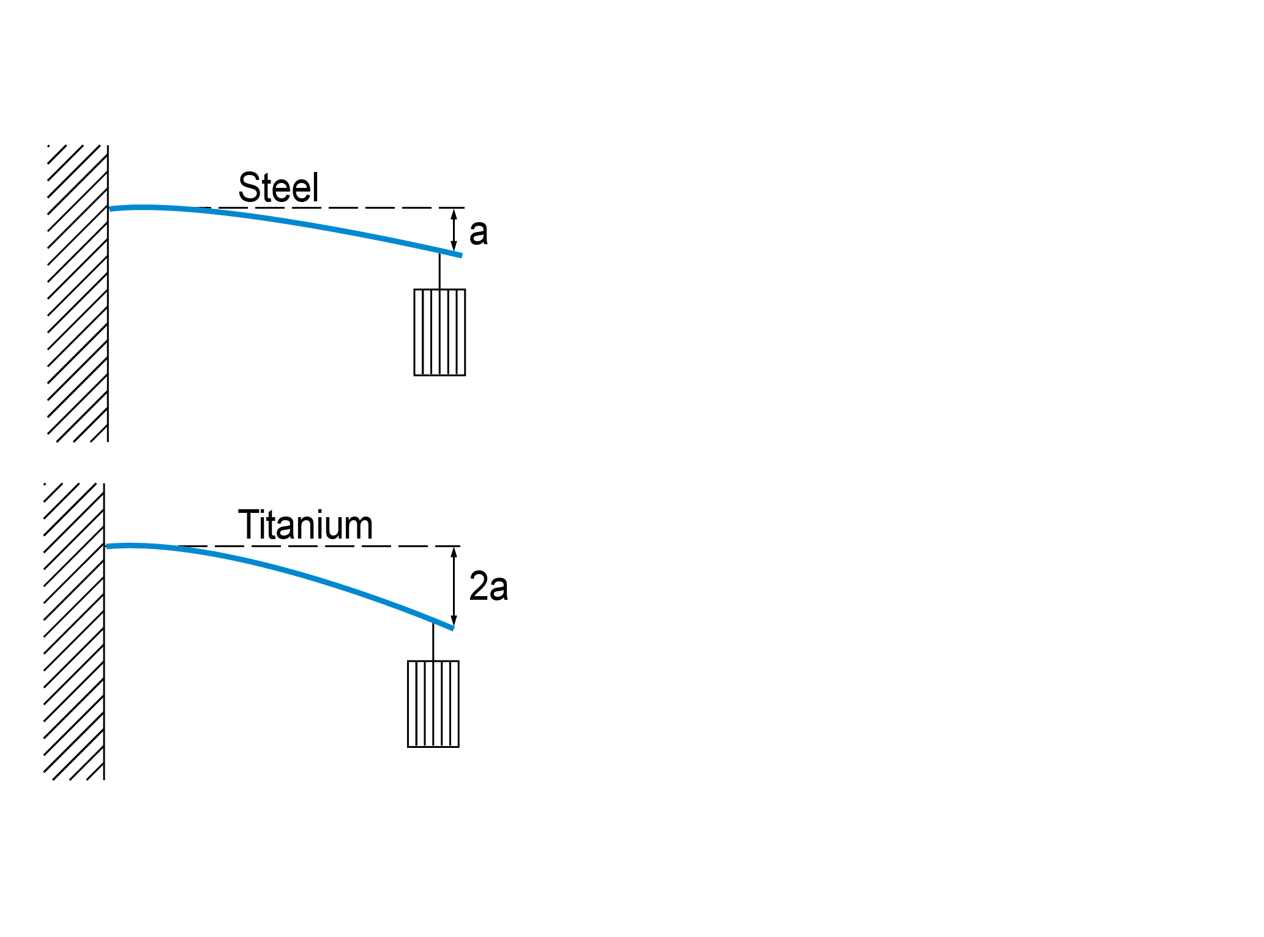
Hardware
Notes:
This means that twice as much energy can be stored in a steel implant by the same deformation. If maximum tension is required to stabilize a nonunion, then stainless steel is a better choice.
The stiffness of stainless steel plates may be the reason for delayed healing in certain fracture patterns after locking plate fixation.

Slide 54
Experimental research
Notes:
We desperately need to put some values on the bone forming graph. Can this be done with experimental research?

Slide 55
Experimental research
Nonunion model must be in a mature animal with mass and bone dimensions comparable with humans
Time consuming and very expensive
Morality?
Relevance of animal models in bone healing research?
Notes:
The paper below cast doubts as to the relevance of animal models in bone healing research. It looks like the only way we will have to answer these questions in the future is to collaborate in multicenter trials.
References:
Reichert JC, Saifzadeh S, Wullschleger ME, et al. The challenge of establishing preclinical models for segmental bone defect research. Biomaterials. 2009 Apr;30(12):2149-63.

Slide 56
Take-home messages
Mechanical environment is the most important factor in fracture healing
An “atrophic” nonunion is not avascular—it is unstable
Treatment aims = alignment + stability
There is doubt about the value of cancellous autografting alone
Clinical research desperately needed

