Slide 1
Management of diaphyseal fractures Principles of reduction and fixation
AO Trauma Basic Principles Course
Notes:
Acknowledgements:
Cleber AJ, Paccola BR
Author: Kevin Smith
Published: 2018

Slide 2
Learning objectives
Describe the importance of injury mechanism – high vs low energy
To match mode of fixation and implant to fracture pattern
Describe the roles of direct/indirect reduction in diaphyseal fractures
Describe the importance of strain theory in fixation
Understand the concept of the working length of plates and IM nails
Notes:
Teaching points:
Integrate principles of humeral, tibial, and femoral diaphyseal fracture management in this lecture.
Discuss the biological requirements of a diaphyseal fracture; the need for axial, rotational, and angular alignment; mention IM nailing as generic option with and without reaming.
This must not be a specific implant related lecture.

Slide 3
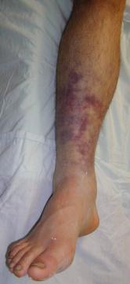
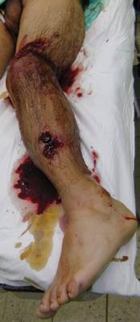
Higher energy injury = worse soft-tissue injury
Notes:
There is a direct relationship between the energy that causes the fracture, soft tissue, and radiographic representation. The condition of the soft tissue is crucial to defining the time of surgery and the fixation. On the other hand the general patient condition must be kept in mind. First save lives, then save limbs.

Slide 4
Diaphyseal fractures
Simple fractures require anatomical reduction/compression
Direct reduction and absolute stability
Multifragmentary fractures require length/rotation/alignment
Indirect reduction and relative stability
Select appropriate reduction technique
Select appropriate method of fixation
Apply while minimizing further softetissue injury

Slide 5
Soft tissues
Soft-tissue injury
Determined by mechanism
Determines outcome of fracture
Determines the initial managemnt plan
Determines the timing of definitive fixation

Slide 6
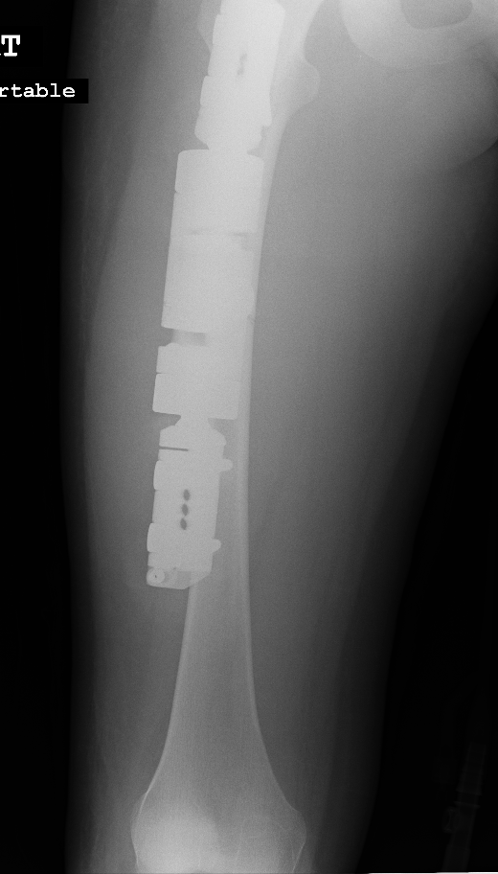
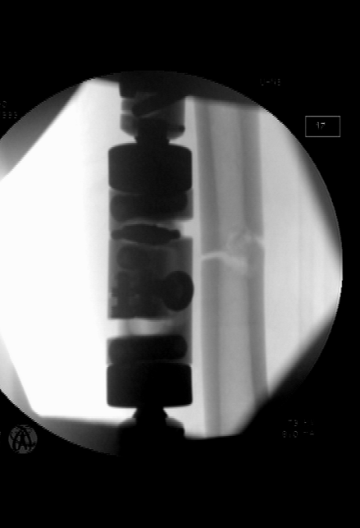
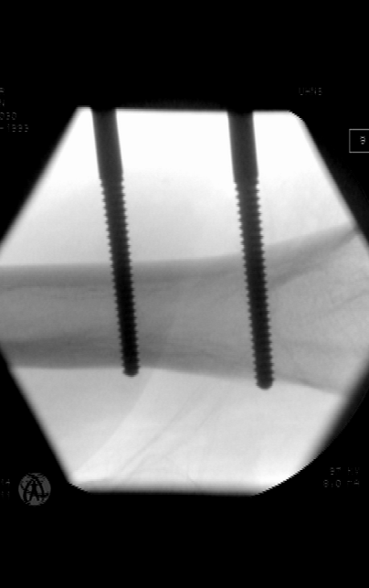
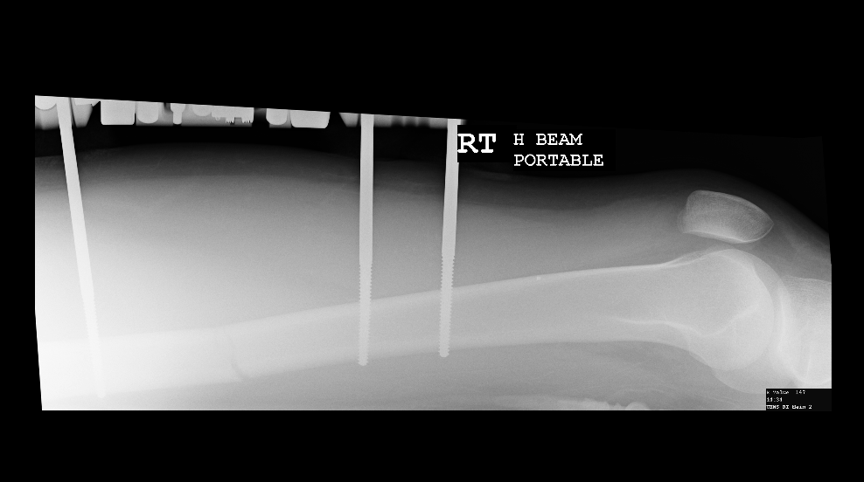
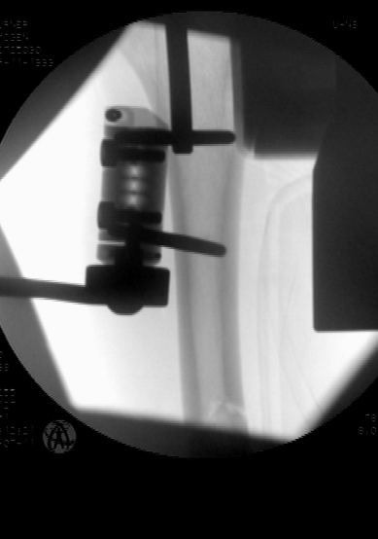
Soft tissues
If soft tissues are too bad
If patient is too sick
Temporize with external fixation

Slide 7
Diaphyseal fractures
Generally, length, alignment and rotation
Indirect reduction
Relative stability
Secondary healing
Callus

Slide 8
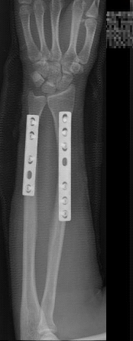
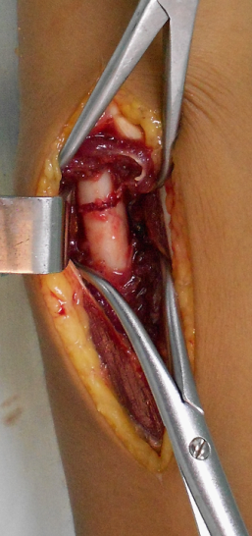
Diaphyseal fractures—exceptions
Radius and ulna
Foream is a “two-bone joint”
Malunion will compromise prono-supination
Anatomical reduction
Direct reduction techniques
Rigid fixation
Early movement

Slide 9
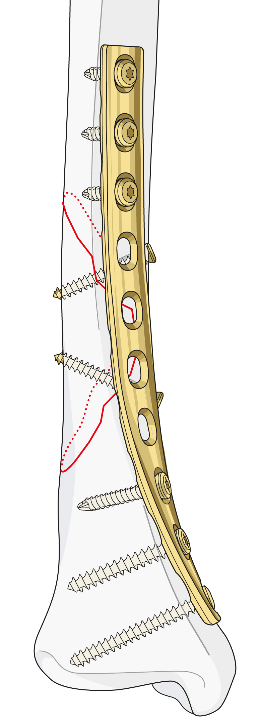
Diaphyseal fractures—exceptions
Simple fractures A B
Soft tissues in good condition
Direct anatomical reduction
Preserve vascularity
But....... could nail or bridge plate

Slide 10
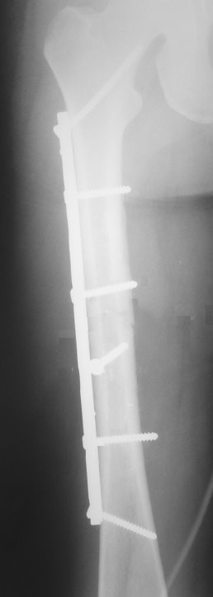
Compression plating
- must prebend!
Lag screw plus neutralization plate
Notes:
Simple fracture patterns are best reduced anatomically and fixed with absolute stability using a combination of lag screws and protection plate.
Axial compression can also be generated with the LC-DCP. Prebending of the plate is necessary to obtain an even distribution of the compressive force.
A protection plate is a plate that reduces the load placed upon the interfragmentary screw fixation, protecting it from failure.
In meta-/epiphyseal split fractures, lag screw fixation often needs to be combined with a buttress plate to protect these screws from shearing forces. A lag screw correctly inserted in good bone generates forces up to 3,000 N. Since the same effect cannot be brought about by certain methods, lag screws should be used whenever the fracture pattern permits.

Slide 11
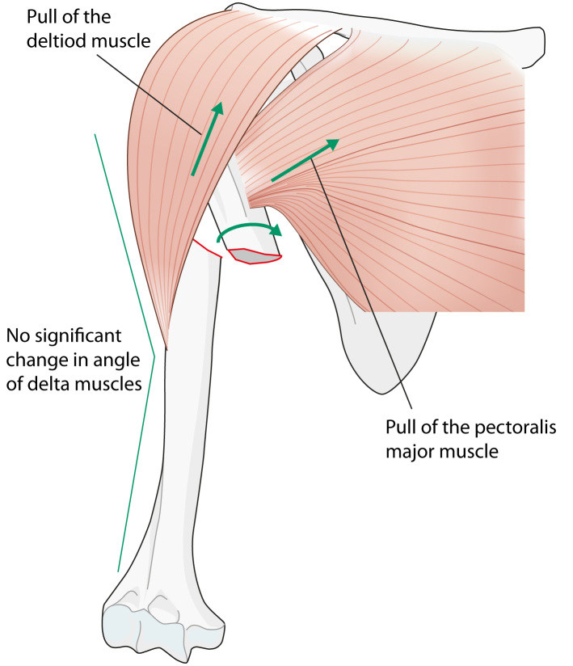
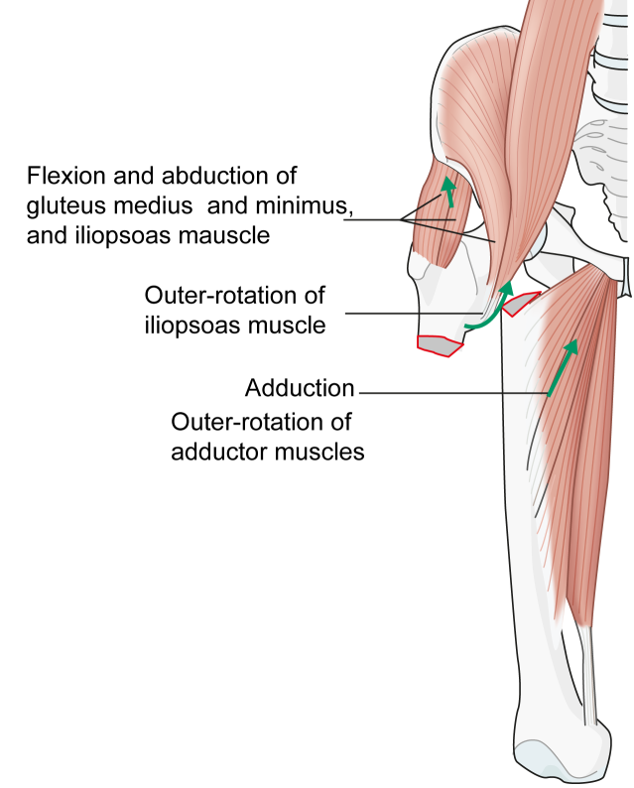
Diaphyseal fractures—reduction techniques
Displacement occurs secondary to muscle pull
Reduction techniques should overcome/reverse this pull

Slide 12
Basic fracture management—distraction
Stabilizes
Provides pain relief
Protects soft tissues
Gives approximate fracture reduction
Skin traction
Thomas splint
Assess neurovascular status before AND after traction

Slide 13
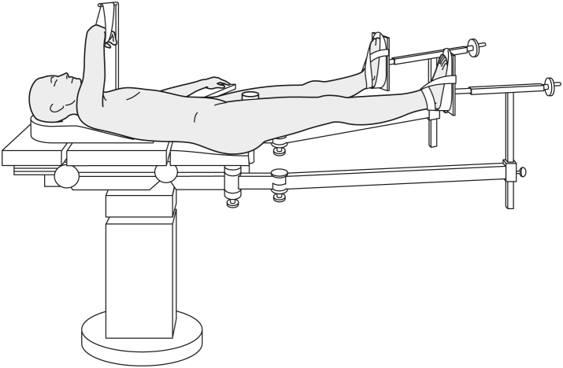
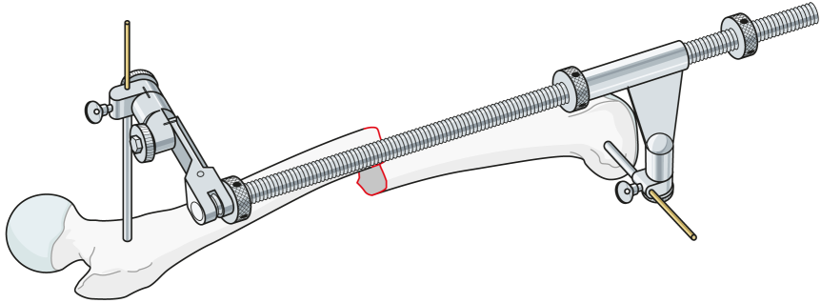
Diaphyseal fractures—reduction techniques
Distraction
Traction table
Distraction device
Uses soft tissues to reduce fracture
Muscle, skin, ligaments
Regains length and rotation
Improve reduction with direct manipulation

Slide 14
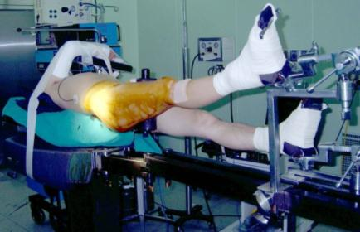
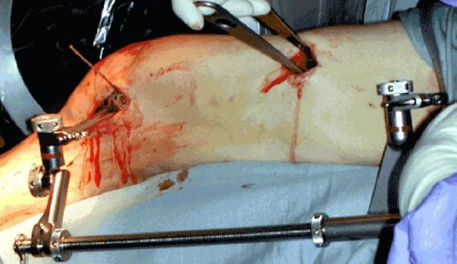
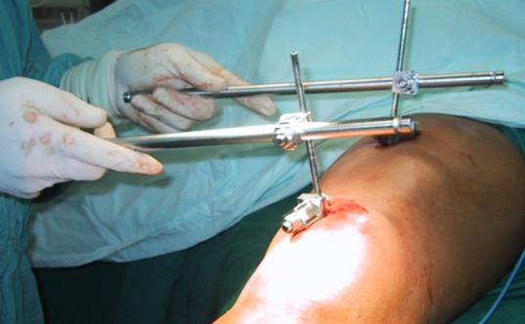
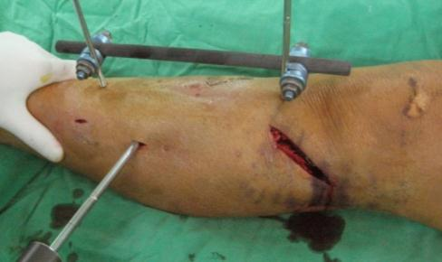
Diaphyseal fractures—reduction techniques

Slide 15
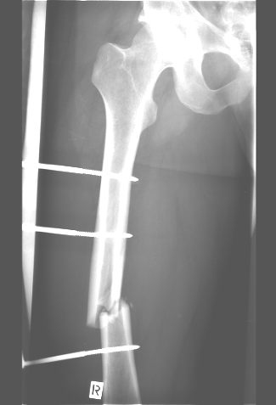
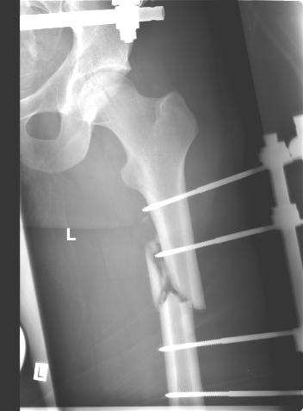
Diaphyseal fractures—reduction techniques
Assess rotation
Radiologically
Cortical thickness
should match
No
Yes

Slide 16
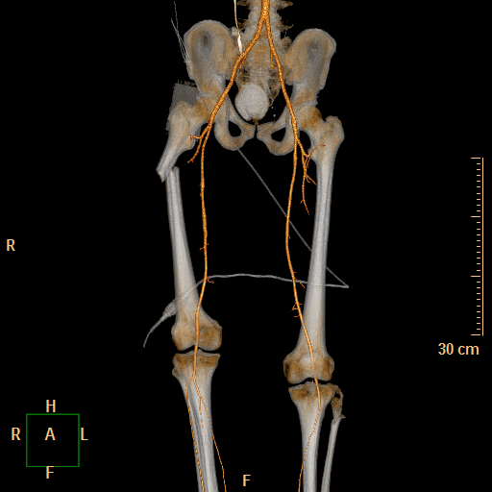
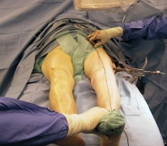
Diaphyseal fractures—reduction
Assess alignment
Clinically
Radiologically with diathermy lead

Slide 17
Diaphyseal fractures—fixation
Generally relative stability techniques
Intramedullary nail
Bridge plating – minimally invasive plate osteosynthesis
External fixation

Slide 18
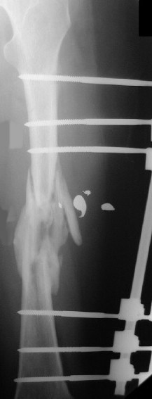

Slide 19
Diaphyseal fractures—fixation
Concept of “working length”
Length of bone/fracture unsupported by implant
= Working length

Slide 20
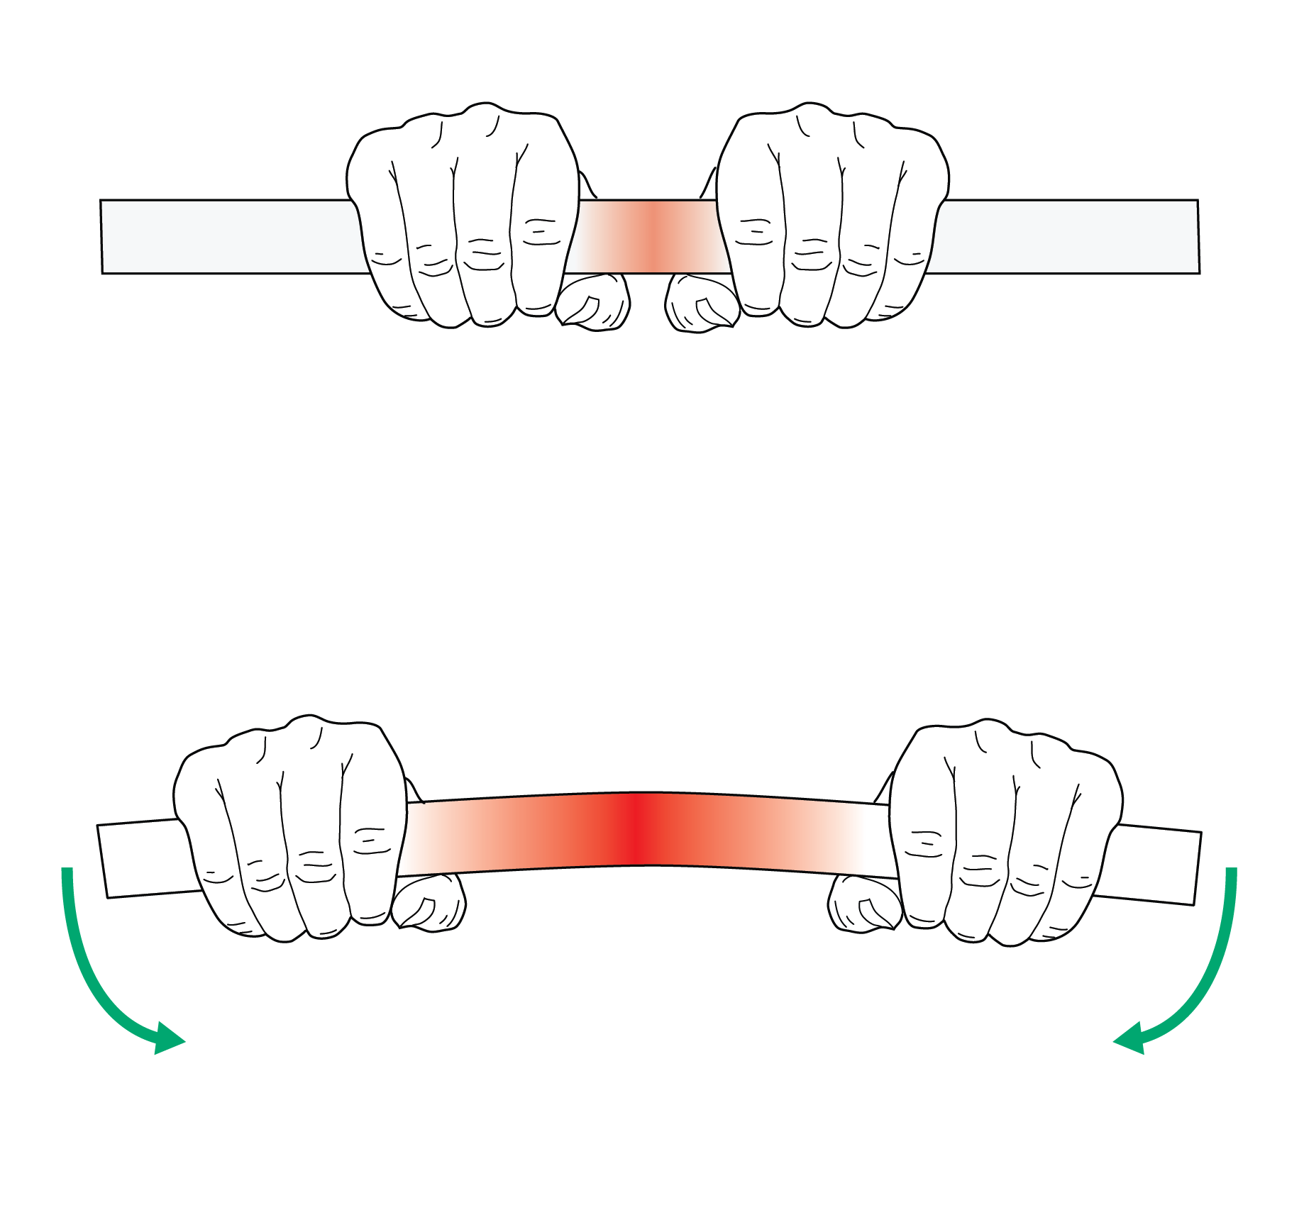
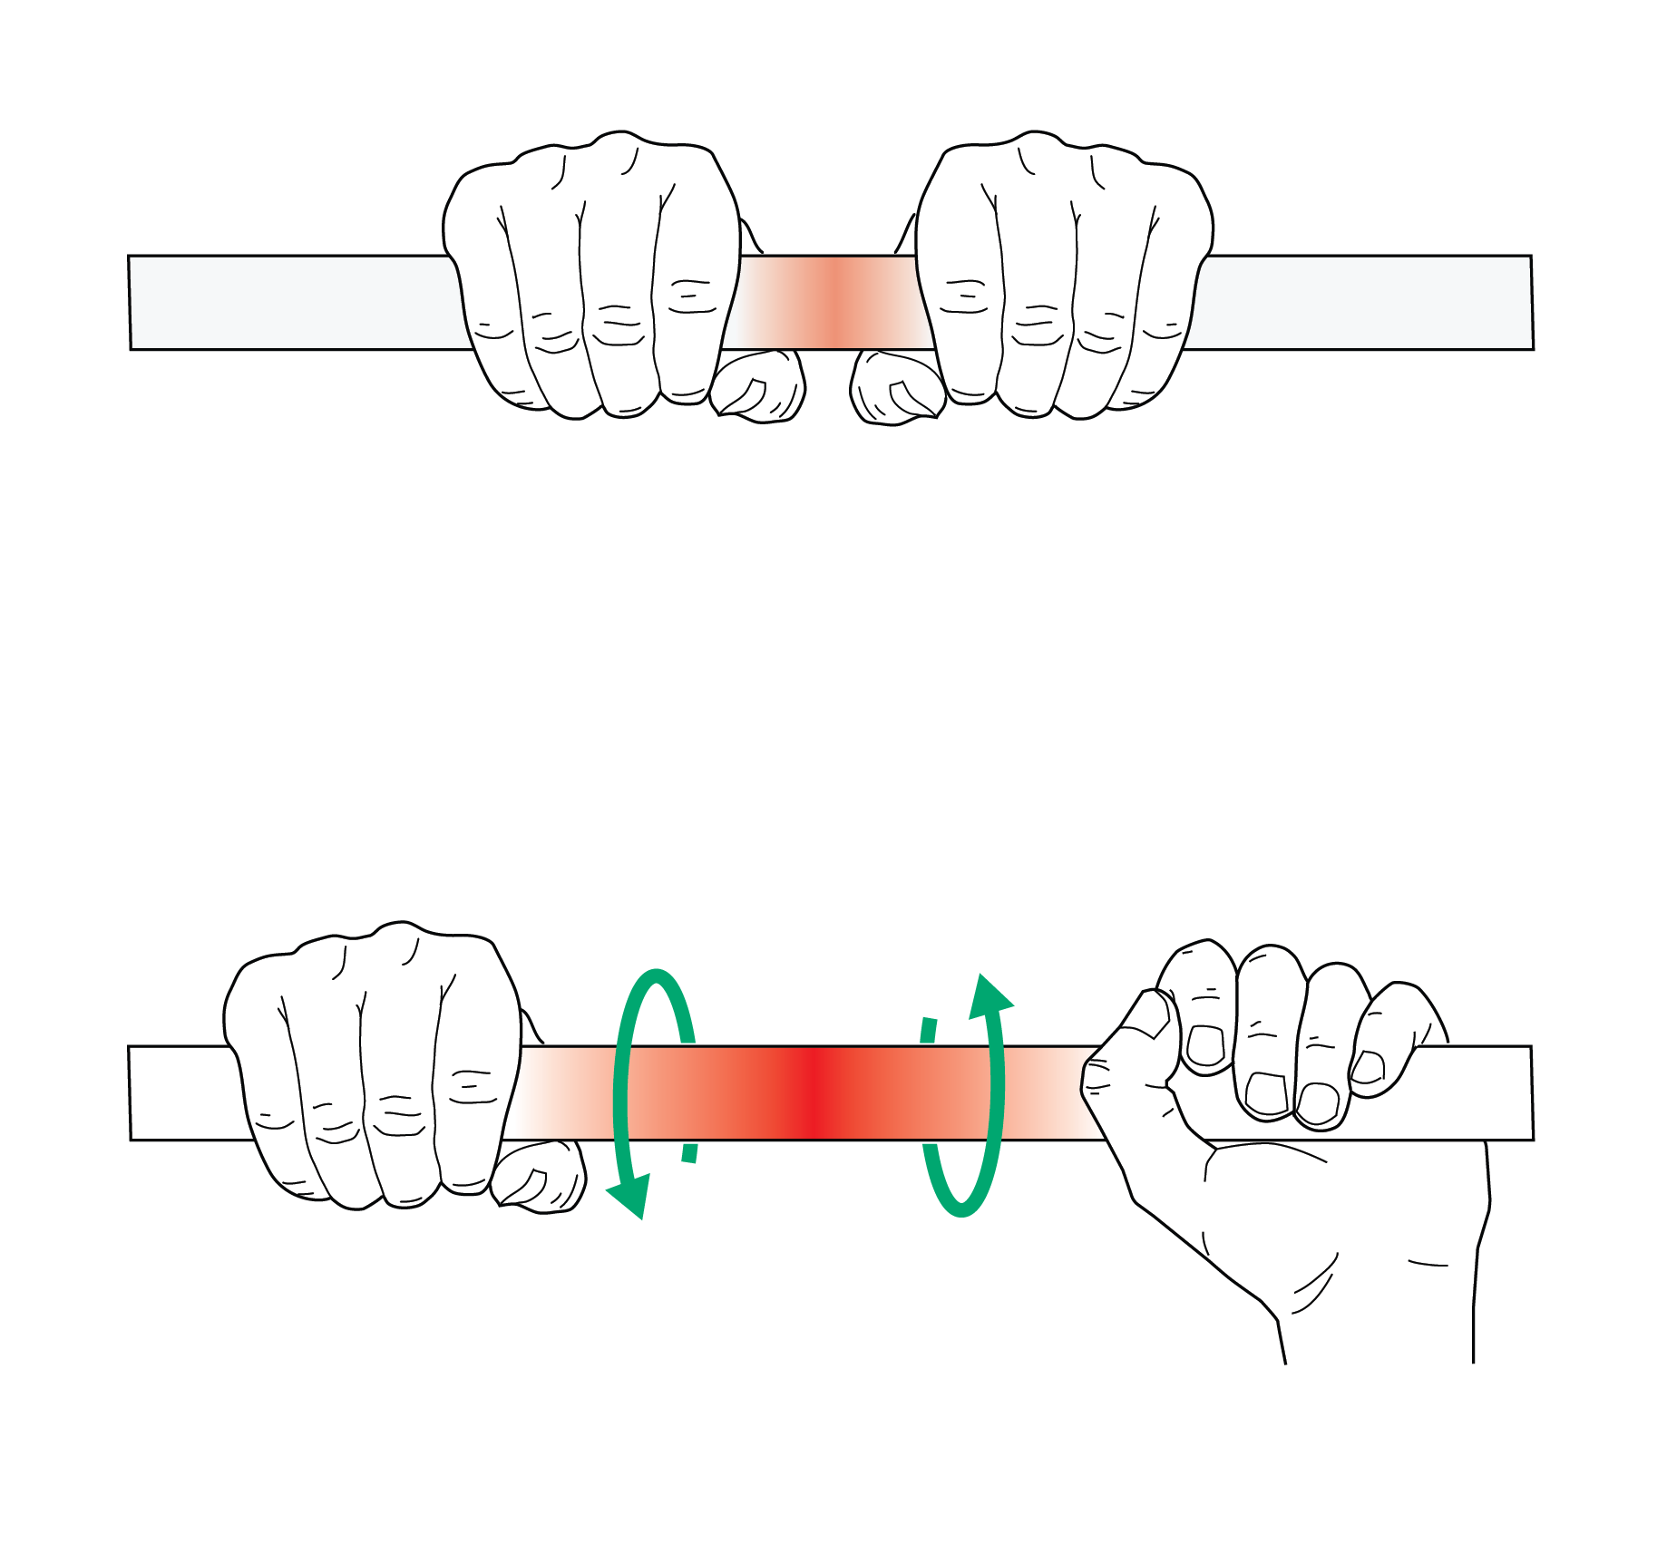
Diaphyseal fractures—working length
Bending stiffness is inversely related to working length squared
Torsional stiffness is inversely related to the working length

Slide 21
Implant—working length
Allows controlled motion at fracture site
Minimizes risk of stress concentration in implant
Reduces risk of implant failure
Minimizes risk of hypertrophic nonunion

Slide 22
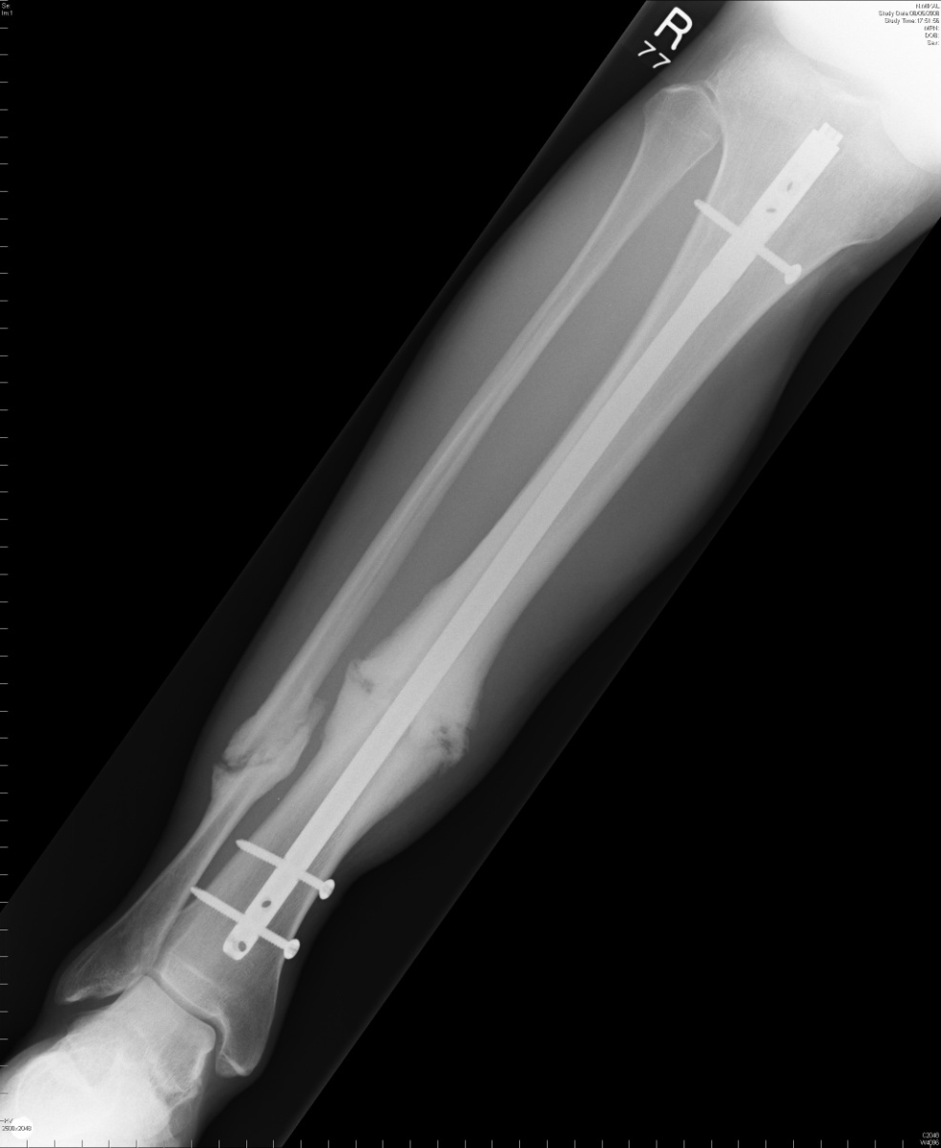
Implant—working length
Narrow nail
Long working length
Simple fracture
High strain at fracture
Nonunion

Slide 23
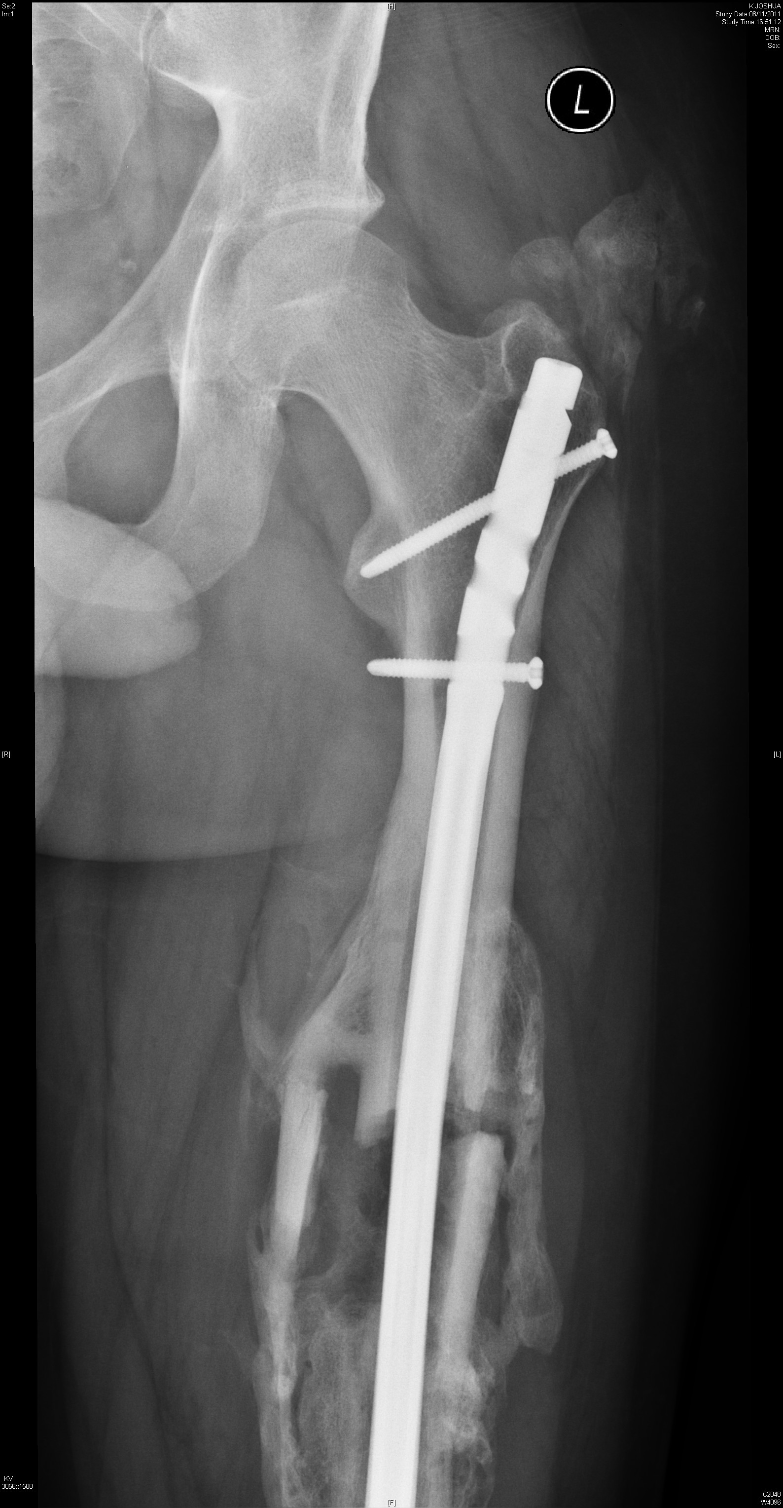
Implant—working length
Multifragmentary fracture
Long working length
Better strain environment
Abundant callus
Fracture union

Slide 24
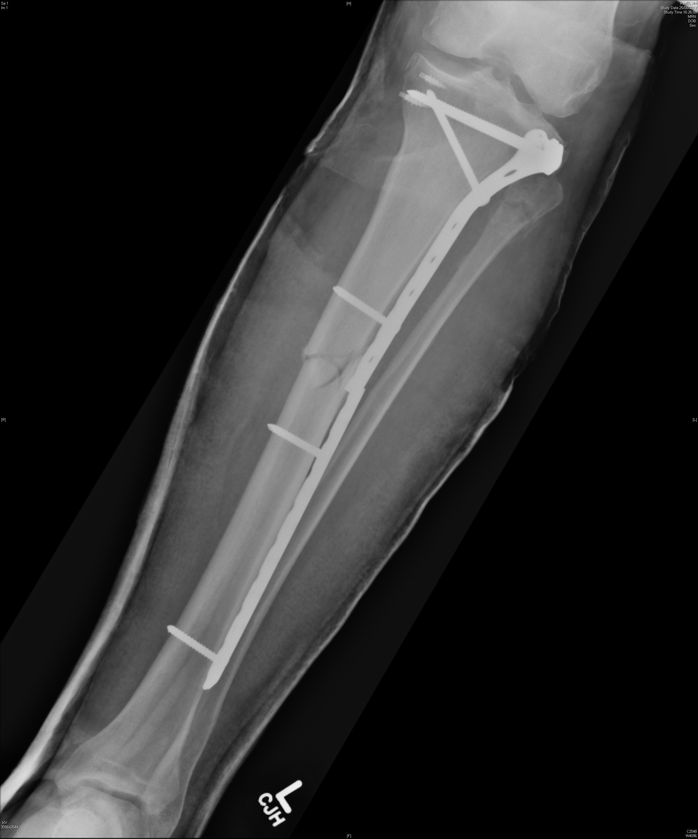
Implant—working length
Simple fracture
Short working length
High strain at fracture
Stress concentration
Implant failure

Slide 25
Diaphyseal fractures—fixation
Advantages of intramedullary nailing
Biomechanically better in osteopenia
Preserves periosteal blood supply
Early weight bearing which promotes healing
Prevents disuse osteoporosis
Easier removal of implant
Less chance of refracture after implant removal

Slide 26
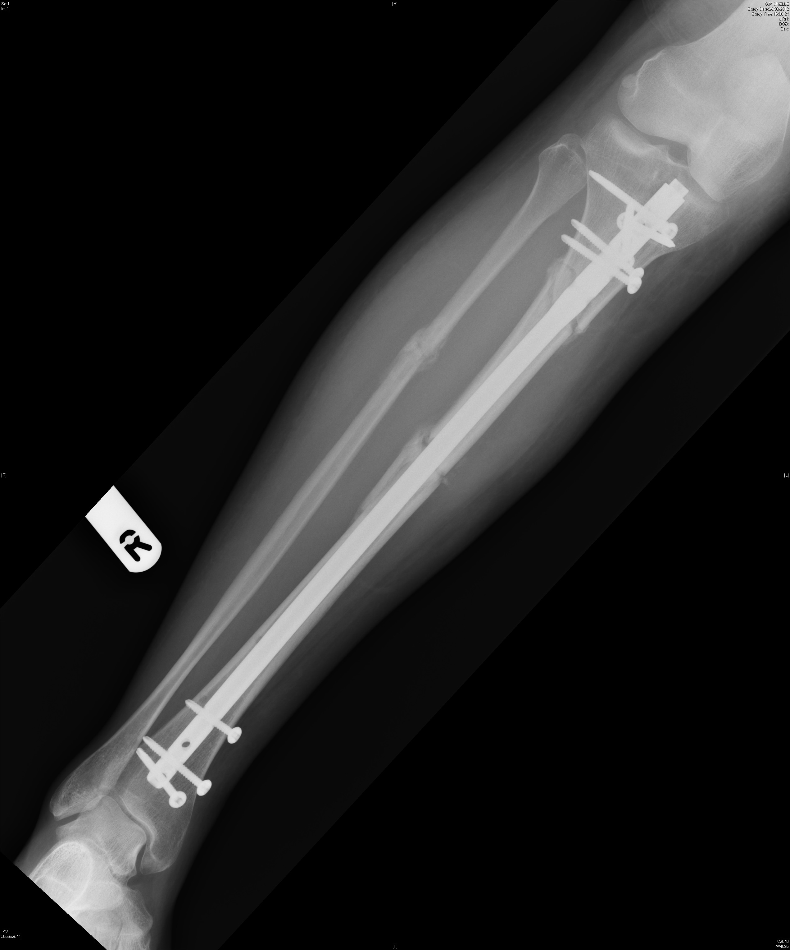

Slide 27
Diaphyseal fractures—fixation
Advantages of plates and screws
Less damage to endosteal circulation
Useful if metaphyseal/articular extension of fracture
Indirect reduction available in MIPPO technique
Can achieve both absolute/relative stability as required

Slide 28
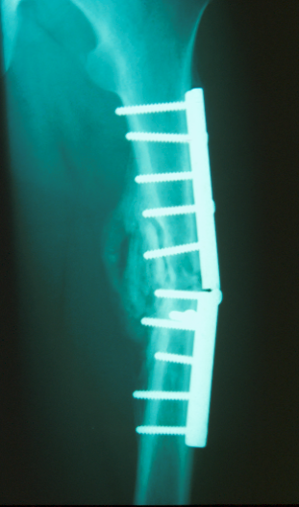
Plate—working length!!!!

Slide 29
Diaphyseal fractures—fixation
Postoperative management
Muscle rehabilitation
Active range of motion exercise/CPM
Early weight bearing as tolerated
Avoid prolonged nonweight-bearing
Prevent osteopenia, muscle wasting, cartilage atrophy

Slide 30
Take-home messages
Assessment of injured soft tissues and fracture classification
Indications for operative treatment
Difference between functional and anatomical reduction
Absolute and relative stability
Choice of implants determines strain environment
Avoid high strain in simple fractures

