Slide 1
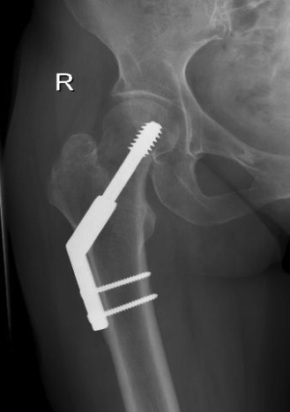
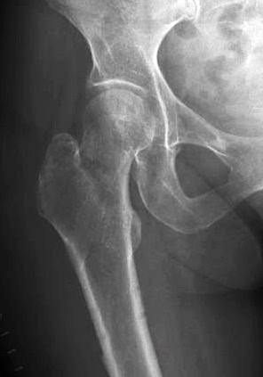
Implant removal
Why, when and how?
AO Trauma Basic Principles Course
Notes:
Published: October 2013
Reviewed: 2019
Reviewers: Dagmar Vos, NL., Geoff Richards, CH., James Kellam, USA.
Many optional slides have been provided at the end for presenters to use at their discretion. With these optional slides, this lecture can be presented as an Advanced Principles Course lecture.

Slide 2
Learning outcomes
Summarize the indications for implant removal
Understand when to remove implants
Describe the different removal techniques
Notes:
Teaching points:
Focus on the importance of appropriate planning of these surgical procedures.

Slide 3
In general
No evidence based guidelines
Indication not well defined
Many different policies
Implant removal starts at implantation

Slide 4
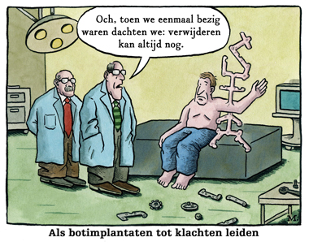
Effects of implant removal
During the surgery,
we finally decided that
future removal
is still an option
After fracture healing the implant no longer has a function
What might we expect from removal?
Pain relief?
Functional improvement?
Reduce swelling?
Solve problems of daily living?
If bone implants result in complaints

Slide 5
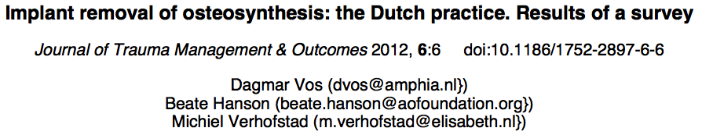
Indications
Indications are very heterogeneous
89% of Dutch surgeons agreed that
implant removal is useful
for pain or functional deficits
But is that true?

Slide 6
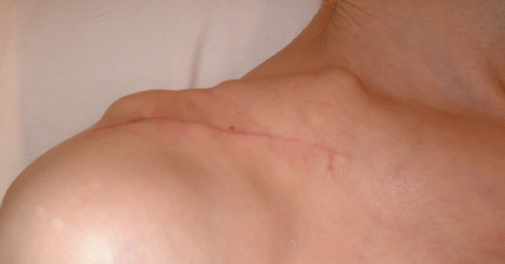
Indications
Patient related – clear expected benefit
Pain
  Difficult indication
  Best result if very specific and localized to the implant
Soft tissue compromise
  Bulky implants in subcutaneous areas

Slide 7
Indications
Patient related – much less clear benefit
  Loss of strength or joint motion
  Paraesthesia
  Problems in daily living (insurance, work)
  Request: “I just want to get it out”
Make sure the fracture has healed!!

Slide 8
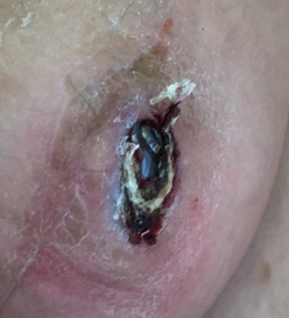
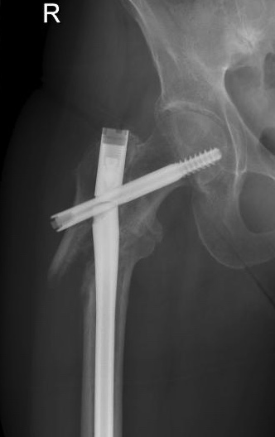
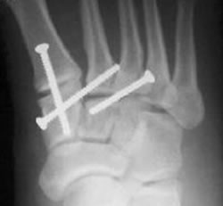
Indications
Implant related – clear benefit
  Perforating material
  Implant failure
  Joint bridging material

Slide 9
Indications
Potential long term problems – clear benefit
  Stress riser
  Intraarticular implants
  Expected joint prosthesis
  Combined with other surgery

Slide 10
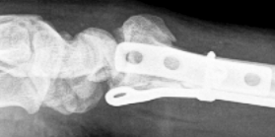
Indications
Implant related – less clear benefit
  Interference with a joint
  Infected material

Slide 11
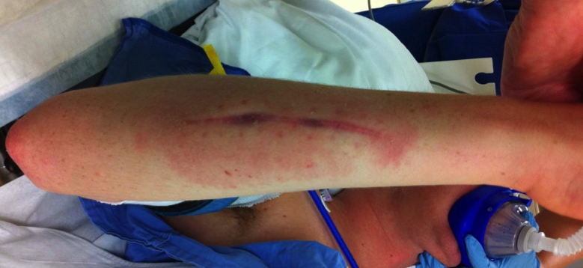
Indications
Potential long term problems – much less clear benefit
  Risk corrosion, infection, allergies, hypersensitivity
    Theoretical risks
    Literature: lack of proof

Slide 12
Indications
Potential long term problems – much less clear benefit
  In children (growth)
    Common practice
    Hardly any evidence
372 expert paediatric specialist opinions in USA
41% remove all, 36% sometimes, 22% never
More experienced surgeons advise to remove more
Loder et al, J Pediatr Orthop 2006, Orthopaedic Implants in Children: Survey Results regarding routine removal by the pediatric and nonpediatric specialists.

Slide 13
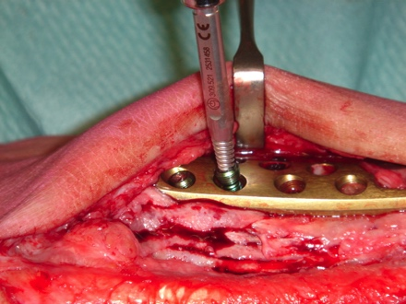
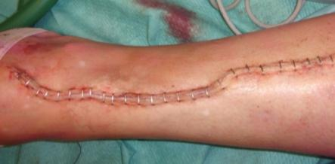
Concerns with removal
Patient related
Another operation
New period of rehabilitation
A larger and more unpleasant scar
Complaints may not disappear
Complications with temporary or permanent effects
Notes:
Courtesy Dagmar Vos, NL

Slide 14
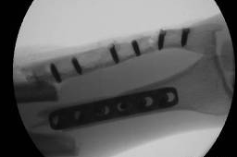
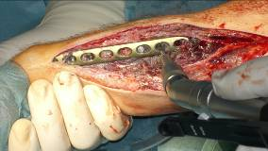
Concerns with removal
Surgeon related
Minimal invasive in ➔ maximal invasive out
OR time & costs
Modern materials can be difficult to remove
Intra/postoperative complications
Surgeon frustration or failure to accomplish resulting in:
  Broken implants and retrieval equipment
  Prolonged surgical times
Notes:
Courtesy Nikolaus Schwarz, Austria

Slide 15
Timing of removal
In case of elective surgery:
  Plate removal: cortex
    ≥ 24 months in adults (medullary canal restored)
    ≥ 6 months in children (< 18 years old)
  Plate removal: cancellous bone, metaphysis
    ≥ 6 months
  IM nail removal
    ≥ 12–24 months in adults
    ≥ 6–12 months in children
  Make sure the fracture has healed!
Notes:
It is obvious that the bone must be healed prior to implant removal.
For plates it takes about 2 years before the cortex beneath the plate is remodelled enough to prevent refracturing. For a nail the time is usually about a year. For cancellous metaphyseal bone the time is as early as 6 weeks but it is better to wait 3 months.
One guideline for cortical bone to know, when the healing has matured, is the development of a medullary canal across the fracture site. Pediatric removal may be earlier while in the osteoporotic bone it may be advised to wait longer and be aware of the potential for a stress fracture at a screw site.

Slide 16
Results
In children, general removal is advised - safe procedure
Minor complication rate ± 10%
Refracture risk 1%
In adults in the upper extremity at an advised time of removal ≥ 8 months
Overall complication rate 22%
Low risk of refracture
Good clinical outcome
In adults in the lower extremity at an advised time of removal ≥ 12 months
Overall complication rate = 37% (especially nail removal)
Low risk of refracture
Good clinical outcome
≥ 95%

Slide 17
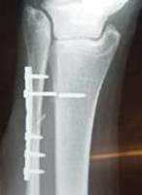
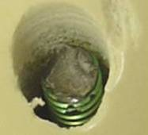
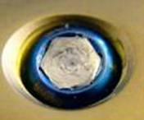
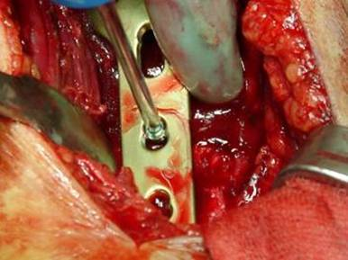
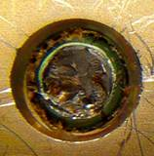
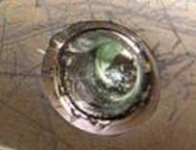
Preparation for surgery
Preoperative planning is essential!!
Be prepared: expect the unexpected

Slide 18
Preparation for surgery
Know what has happened—history
  Infection, stripped screws
Know the implant—type, manufacturer
Know the limb—incisions, scarring, flap pedicles ski grafts, sinuses
Make sure the fracture has healed—CT if in doubt
  Examination under anesthesia in OR
Positioning of the patient

Slide 19
Preparation for surgery
General preparations
Planning for removal starts when treating the initial fracture
Have your OR sets complete
Have your instruments in perfect shape
Know and check your instruments regularly!
Know what you have or not!

Slide 20
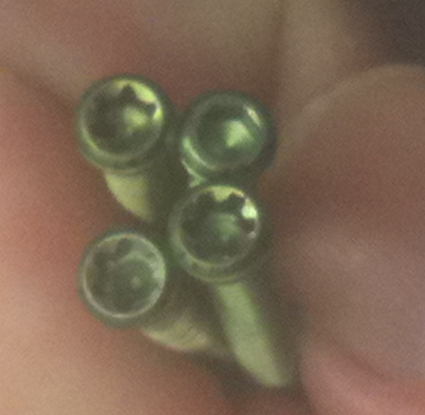
Preparation for surgery
Problems you need to plan for
Larger incisions
Failure to remove
Breakage
Risk of complications
No relief of complaints
Be prepared: expect the unexpected

Slide 21
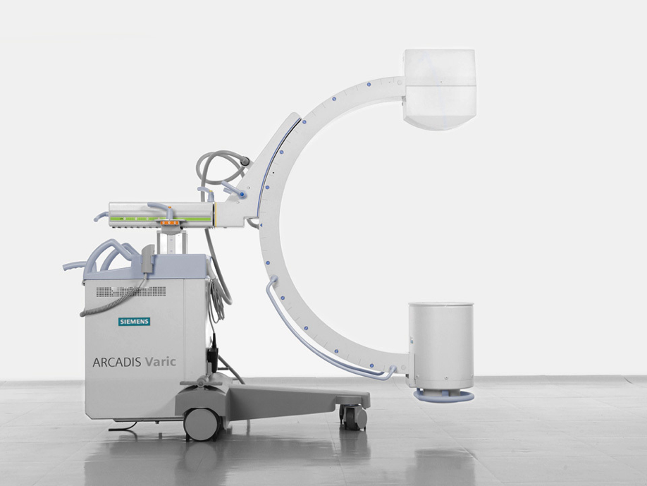
Preparation for surgery
Always have fluoroscopy

Slide 22
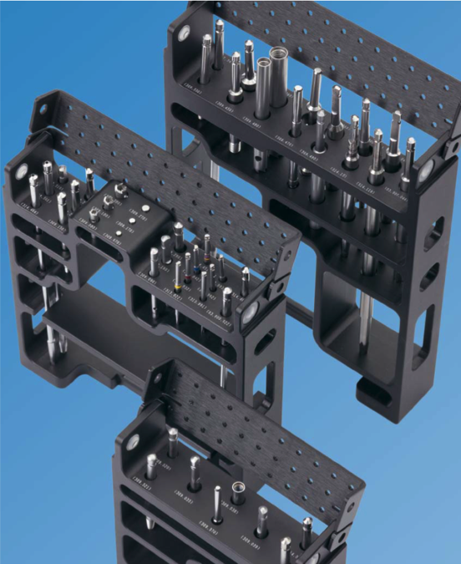

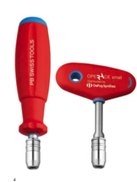
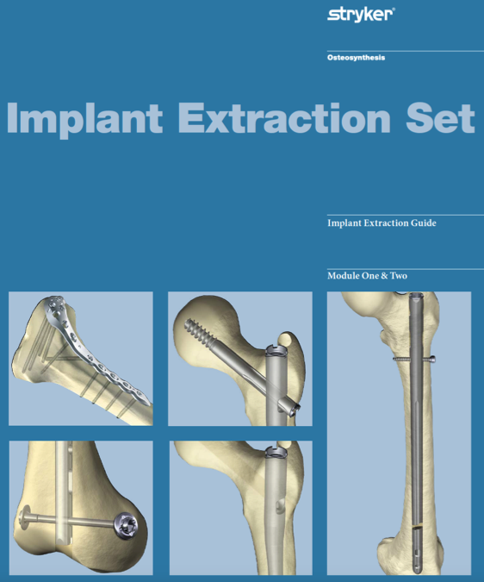

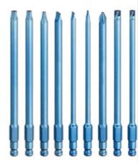
Preparation for surgery
Know the generic removal sets

Slide 23
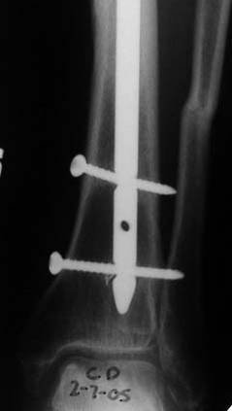
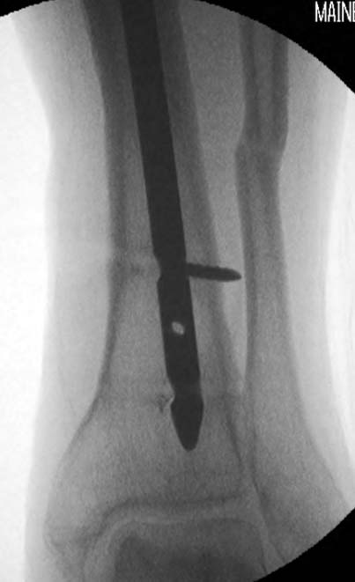
Preparation for surgery
Expect the unexpected !!
Notes:
Careful inspection of the proximal screw will reveal that it is broken.

Slide 24
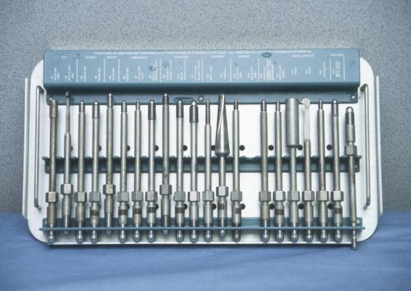
Specific problems: IM nails
Take time to clear out the insertion site
Do not strip the threads
Attach implant-specific insertion bolt
Universal sets are available
Notes:
Nails may be removed with an open incision or percutaneously. Bone over-growth over the nail end will usually need an open procedure to get rid of the bone.

Slide 25
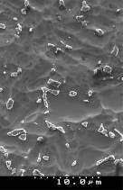
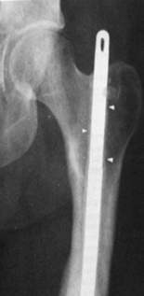
Specific problems: IM nails
Difficult to remove IM nails, especially in young, due to bone overgrowth
Increased operative time with TAN nails (~30%)
Increased blood loss during surgery (~14%)
Longer hospital stay with TAN nails (~20%)
Wound infection (12–40%) and nerve damage (2–29%)

Slide 26
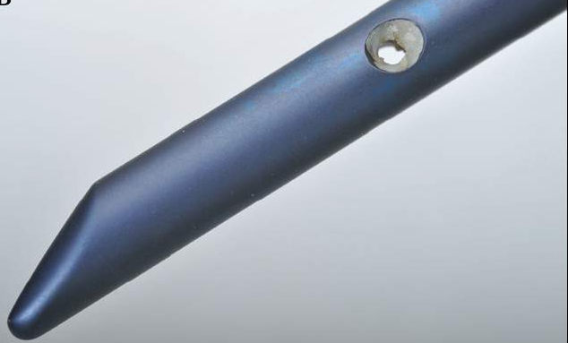
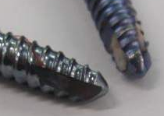
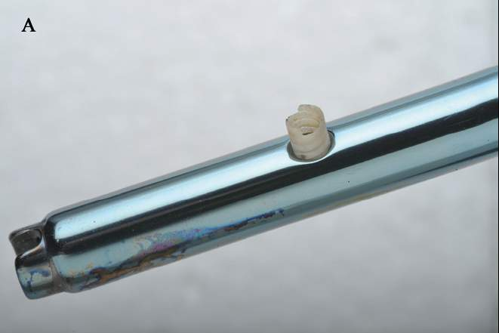
Specific problems: IM nails
Bone overgrowth – osseointegration – rough surface
Bone overgrowth – no osseointegration – polished surface
An in vivo evaluation of surface polishing of TAN intermedullary nails for ease of removal.
Hayes JS, Vos DI, Hahn J, Pearce SG, Richards RG. Eur Cell Mater. 2009 21;18:15-26.
Notes:
26

Slide 27
Screw and plate removal
Screw is removed when torque on screw head > resistance pitch-bone interface
Usually easy but
Always be ready for a problem
Especially with Ti and Ti alloy (TAN)
Notes:
The removal of screws and plates is generally straightforward and can even be done percutaneously unless there is bone overgrowth. It is best to advance the screw a quarter to half turn to break up the soft tissue or bone in-growth before extracting. Always make sure that the screw driver is firmly seated in the screw head to avoid stripping.

Slide 28
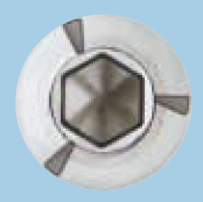

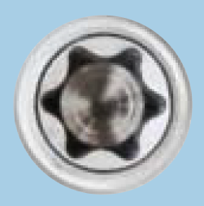
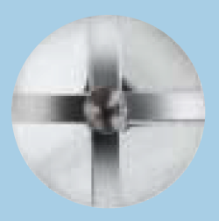
Screw removal: factors
Drive recess type
Hexagonal
Stardrive
Cruciform

Slide 29
Screw removal: factors
Drive recess type
Core diameter

Slide 30
Screw removal: factors
Drive recess type
Core diameter
Total pitch surface

Slide 31
Screw removal: factors
Drive recess type
Core diameter
Total pitch surface
Metal roughness
  Bone ingrowth

Slide 32
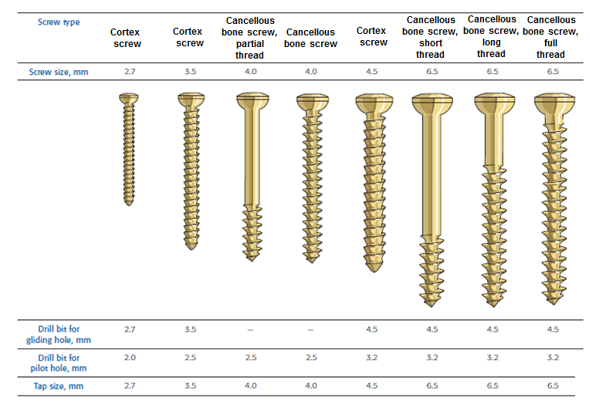
Screw removal: factors
Drive recess type
Core diameter
Total pitch surface
Metal roughness
Density of bone

Slide 33
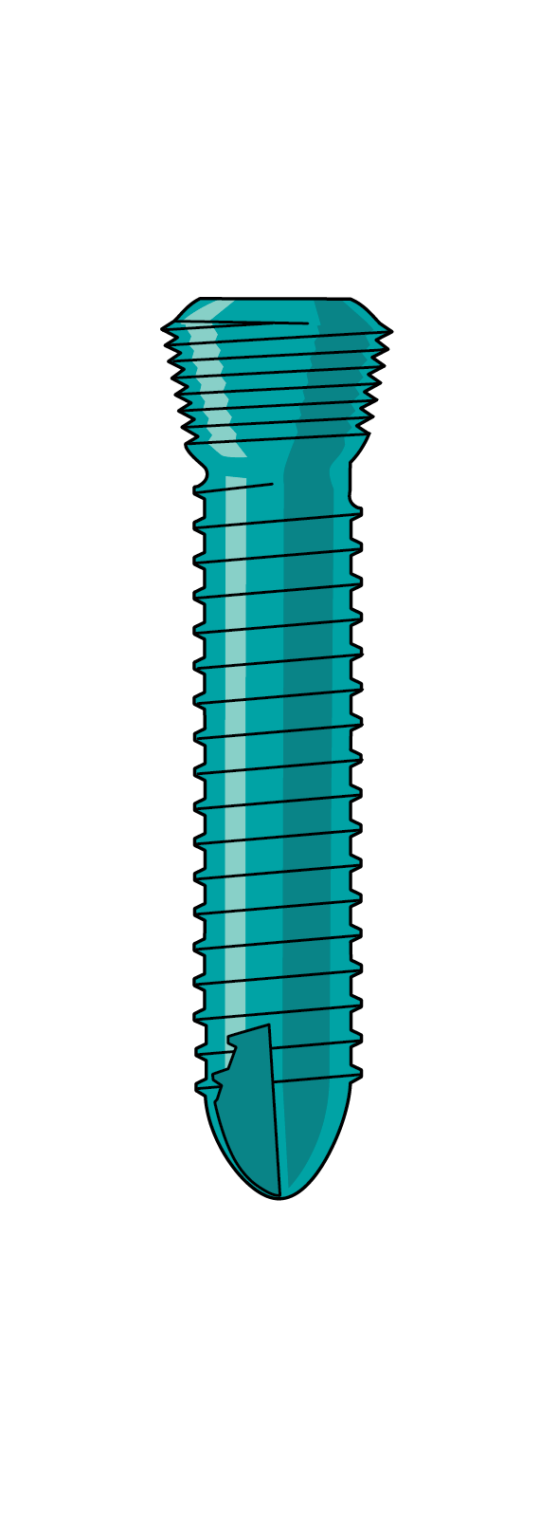
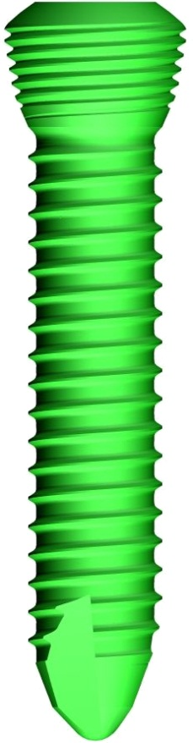
Screw removal: factors
Drive recess type
Core diameter
Total pitch surface
Metal roughness
Density of bone
Resistance plate-screw head—locking screws

Slide 34
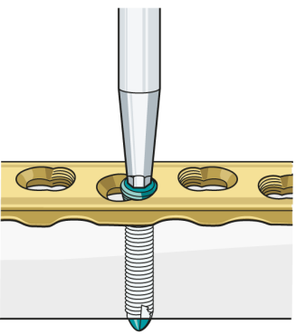
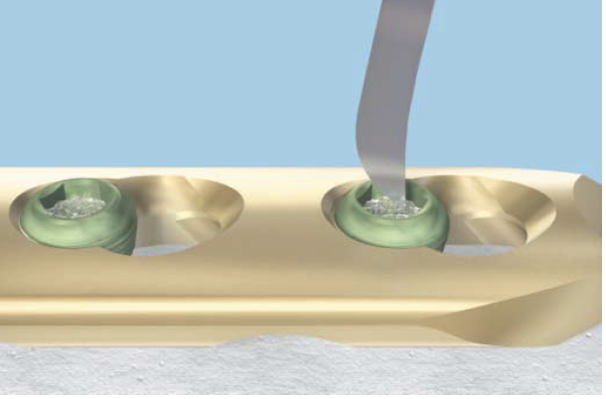
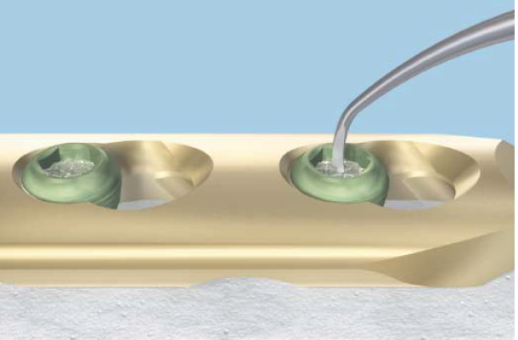
Screw removal techniques
Assure that the screw head recess is clear of all tissue
      Soft tissue
      Bone

Slide 35
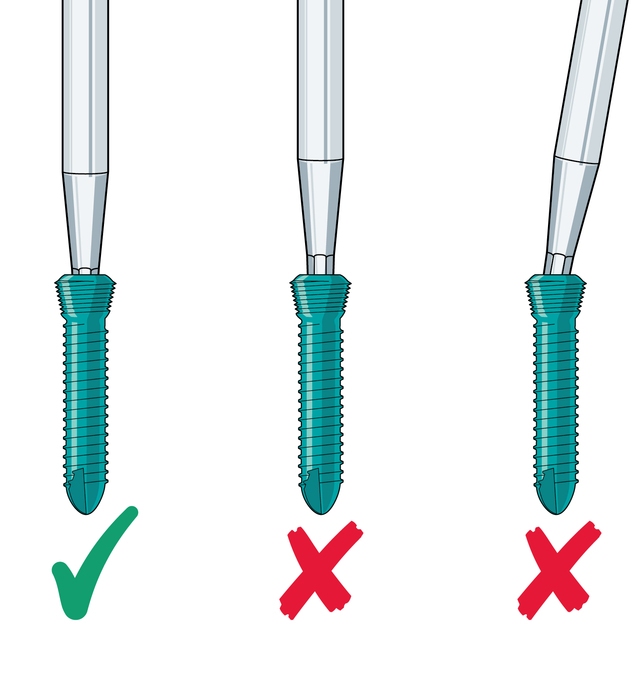

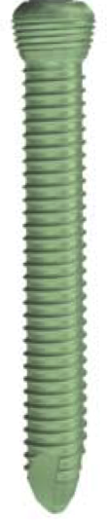
Screw removal techniques
Need maximum force to start screw turning
The screw driver
  Must be exactly in line to the screw
  Fully engaged in the drive recess
Failure deforms the drive recess
  Resulting in a lower applied maximum force
☑
☒
☒

Slide 36
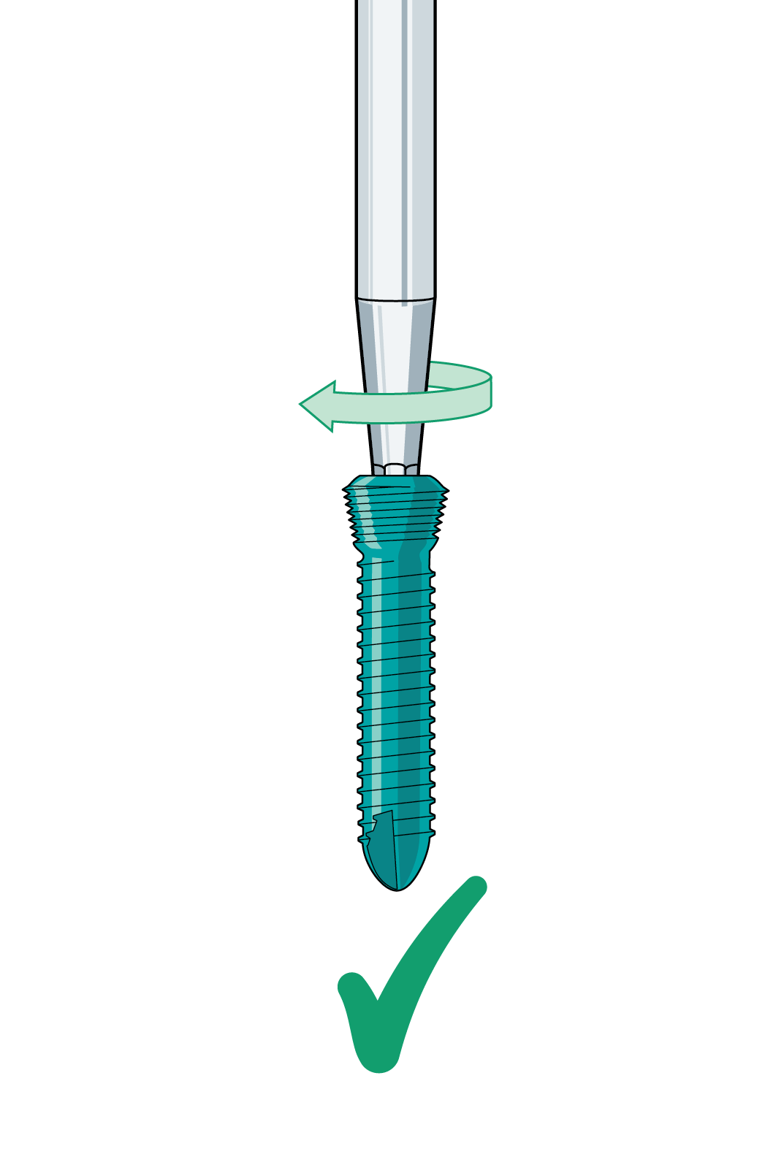
Screw removal techniques
Start with a small clockwise turn to get the screw driver firmly settled…
☑

Slide 37

Screw removal techniques
…and then counterclockwise!...
☑

Slide 38
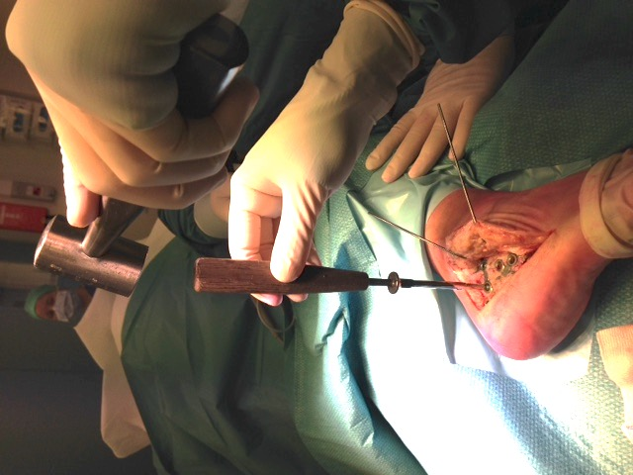
Screw removal techniques
or use a hammer with gentle blows to seat screwdriver

Slide 39
Pitfalls
Stripping screw head, ‘cold-welding’
Damage of the screw hole

Slide 40


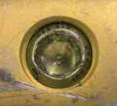
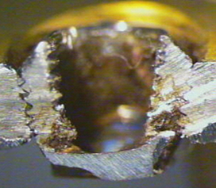
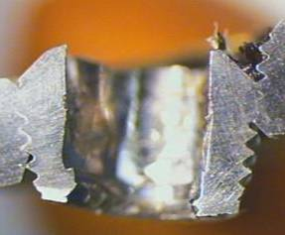

Pitfalls
Removal of jammed locking screws is difficult

Slide 41
Damaged recess—“cold weld”
“Galling’ is mechanical and increases the force needed to turn the screw in the recess

Slide 42

Damaged recess—“cold weld”
Welding is a chemical process related to heating which results in melting separate particles into one

Slide 43





Screws with damaged recess—removal
Use the “Easy Out” special devices
Conical extraction screw cuts thread in recess and works counterclockwise to allow removal once threaded into recess
Use largest diameter
Notes:
If the screw strips or was stripped on insertion the easy out device is helpful. This device is sized to correspond to the various crew heads and cuts into the screw head recess. It is inserted in a counterclockwise fashion so that when set into screw head recess will allow the crew to be screwed out.

Slide 44




Screws with damaged recess—removal
In case of LCP
Use empty part of combihole to drill an additional canal in bone (same size as thread diameter)
Use blunt instrument to drive screw into empty drill hole
Pry plate off bone as threads have no purchase
1
2
3

Slide 45


Broken shaft?
A screw shaft can be left in the bone, unless…
Interacts with surrounding tissues to decrease function
Improve diagnostics (MRI)
Is infected
Obstructs new metal works
Is destroying a structure

Slide 46




Screw shaft removal
Step 1: using a gouge to open the cortex 5–8 mm
Step 2: screw removal by turning counterclockwise with pliers

Slide 47

Screw shaft removal
Step 1: use hollow reamer to “expose” the screw threads
Step 2: attach special extraction bolt and remove (counterclockwise)

Slide 48
Screw shaft removal
Step 3: open cortex with countersink if possible (clockwise)
Step 4: use hollow reamer to “expose” the screw threads (clockwise)

Slide 49


Screws with damaged recess—removal
In case the extraction screw doesn’t work
Use a high speed steel (HSS) drill bit (2.5, 3.5, 4.8 mm) or a carbide drill bit (4, 6 mm) to drill out the head
Uncouples screw head from plate
Need a lot of drill bits
HSS drills
Carbide drills
Dull quickly
Single use only!
Notes:
49

Slide 50



Stripped screws
Recess rounded and deformed
Drill recess to deepen
Apply conical extraction bolt
Remove

Slide 51


Stripped screws
Drill the screw head off
  Protect soft tissues
  Irrigate
  Collect debris
Remove the plate

Slide 52


Stripped screws
Using gouge expose the screw
Get the screw using the pliers

Slide 53


Screws with damaged recess—removal
Make sure drill bit is larger enough to remove screw
Must drill the complete screw head out
The screw comes out - good
The conical screw fractures…
Notes:
53

Slide 54





Screws with damaged recess—removal
Be aware of metal debris
Use damp towels or sponges around the area to hold debris
Bone wax will also
hold metal debris
Cool the bit and aspirate the metal particles!
Notes:
54

Slide 55


Screws with damaged recess—removal
Diamond saws Midas Rex, Anspach drills and saws
Cut into plate holes

Slide 56


Galled/stripped screws
High-speed burr
Split the plate
Cut the plate and use it to turn the screw out with pliers

Slide 57


But be aware of
Damage to the soft tissue and bone…

Slide 58
Postoperative care
Screw holes
  Human absorptiometry data leads to a recommendation of return of strength in 4 months
Allow return to work when incision is healed for all except heavy laborers
Recommend against high stress activities for 3 to 4 months

Slide 59
Take-home messages
Indications for hardware removal based on risk/benefit of retention vs removal
Understand specific anatomical locations, implants, and patient demands
Try to decrease complications with careful preparation
Implant removal starts at implantation

Slide 60

…and remember…
“Attempts at hardware removal often result in broken implants and retrieval equipment, prolonged surgical times, and frustrated, humbled surgeons”
James Kellam

Slide 61
Optional slides

Slide 62
Science
Surfaces - osseousintegration

Slide 63


Bone overgrowth – osseointegration – rough surface
An in vivo evaluation of surface polishing of TAN intermedullary nails for ease of removal.
Hayes JS, Vos DI, Hahn J, Pearce SG, Richards RG. Eur Cell Mater. 2009 21;18:15-26.
Notes:
63

Slide 64



Bone overgrowth—no osseointegration—polished surface
An in vivo evaluation of surface polishing of TAN intermedullary nails for ease of removal.
Hayes JS, Vos DI, Hahn J, Pearce SG, Richards RG. Eur Cell Mater. 2009 21;18:15-26.
Notes:
64

Slide 65







Soft-tissue reaction
Titanium
(cpTi)
(micro-rough)
Steel
(smooth)
Steel
(micro-rough)
Notes:
Images here show plates within a rabbit model for 12 weeks without a fracture and soft tissue reaction.
Titanium (cpTi) has good soft-tissue adhesion to the surface, which is well vascularized and loose.
The smooth steel has a liquid filled capsule, which is very dense and poorly vascularised. There is no contact to the surface (the liquid filled space is not a problem in an aseptic condition, but can cause a problem if bacteria is found within since the body’s defence system can not get to that space). In the case of where a tendon would slide above the surface, the smooth surface would prevent adhesion and allow gliding.
The micro-rough steel has adhesion of the smooth tissue to the surface (though the dark blue line shows an inflammation to the ceramics remaining on the surface after roughening of the steel). Therefore microtopographical control of the soft-tissue adhesion is shown.

Slide 66




Soft-tissue reaction—titanium (Ti) surfaces
cpTi S
cpTi P
Implant
Parallel connective tissue
Artifact
Parallel connective tissue
Artifact
Implant
Loose connective tissue
Liquid filled void
Fascia
Fat cells
Loose connective tissue
Muscle
Fascia
Muscle
Notes:
cpTi S—commercially pure titanium, standard micro-rough (as sold by Synthes in 2010)
cpTi P—commercially pure titanium, paste polished experimental surface with virtually no micro-roughness. Similar to surface of standard electro-polished stainless steel (sold by Synthes in 2010)
Soft tissue-implant adhesion is often required for implant integration into the body; however, in some situations, the tissue is required to glide freely over an implant. In the case of distal radial fracture treatment, current literature describes how titanium and its alloys tend to lead to more intra-tendon inflammatory reactions compared with stainless steel. This leads to tendon-implant adhesion and damage possibly causing limited palmar flexion and even tendon rupture.
In the study referenced below, we analyzed the effect of different surface polishings of titanium on soft-tissue reactions in vivo, with the aim to prevent direct soft-tissue adhesion. Using a nonfracture model, to allow for study of the soft tissue-implant surface interactions only, six surface variants of the same plate design were implanted onto the tibia of 24 New Zealand white rabbits and left in situ for 12 weeks. Results indicate that paste polished commercially pure titanium had the least soft-tissue adhesion, with the concomitant development of a soft-tissue capsule.
Surface topography did not appear to influence the thickness of the connective tissue surrounding the plate. Therefore, suitable surface polishing could be applied to plates for clinical use, where free gliding of tissues is required. This would prevent several of the soft-tissue complications and need for removal of polished hand implants.
During fracture healing osteogenic cells, as a well as a variety of other cell populations involved in fracture healing, will migrate to the fracture site via a fibrin meshwork that forms during clot formation. However, concomitant with cell migration is the retraction of the hematoma. Therefore, the ability of a biomaterial surface to retain fibrin attachment during this retraction phase is crucial in determining if migrating cells will reach the device. It is suggested that the complexity of a micro-rough surface provides a three dimensional topography so that fibrin remains sufficiently attached to the implant to withstand retraction, allowing for cell migration, whereas fibrin attached to a smooth surface could not withstand this retraction.
References:
Hayes JS, Welton JL, Wieling R, Richards RG. In vivo evaluation of defined polished titanium surfaces to prevent soft tissue adhesion. J Biomed Mater Res Part B 2012:100B:611–617.

Slide 67



Effect of surface on screw removal
Mean peak removal torque—rib
Mean peak removal torque—tibia
6 weeks 12 weeks 18 weeks
6 weeks 12 weeks 18 weeks
Polishing significantly reduces the torque required for screw removal in both cancellous and cortical bone
Notes:
The functional demands on internal fixator (IF) devices have changed over the years especially in light of the increased occurrence of these procedures in children. Thus a device is not only required to allow for fracture healing to occur by providing stability and anatomical re-alignment, but in a large percentage of patients it must also allow for its safe and habitual retrieval. However, this is where one of orthopedics biggest clinical challenges lies. Removal of an IF device can be complicated despite generally being considered as a ‘routine’ procedure. One of the main culprits of these complications has been identified as the occurrence of excessive bony on- and in-growth of a device. Indeed in children alone approximately 13% of complications encountered during scheduled IF removal are related to the occurrence of excessive bony over-growth on the device. When bone grows up through and between the “dead” empty spaces of a device, such as into a screw head or between the thread of a screw and a plate, the surgeon faces the risk of inducing a variety of iatrogenic consequences such as debris contamination, implant breakage, re-fracture, nerve damage, and excessive blood loss, to name a few.
Given that the biological process of fracture healing cannot be mediated in terms of controlling extraosseous formation, focus has turned to controlling the type and extent of tissue interaction with a device. To this end, we and others have identified the microtopography of a metal implant surface as being a major determinant in the type and extent of tissue interaction with the implant. An additional consideration involves the distinct tissue response elicited by surface microtopographical changes depending on anatomical site of implantation. For instance, in hand applications the irritation of overlying free gliding tendons in contact with the plate is also of concern and we have shown that differences in material type and microtopography can govern tissue adhesion to help remedy these issues. We look to offer orthopedic surgeons a choice regarding the material type and surface to be used in IF procedures not only depending on the desired function of an implant, but also based on the desired end result depending on whether a device is to be removed or retained.
Difficulty in removing implants used in trauma patients can be a complication, and increased bone-implant adhesion likely is a major contributing factor. In vitro studies have shown that surface morphology of implant materials has the ability to influence cellular responses, with polished surfaces decreasing the potential for mineralization. This study examined the effect of polishing commercially pure titanium (cpTi) and the titanium alloy TAN on the removal torque and percentage bone–implant contact in cortical and cancellous bone of sheep. Polishing had a significant effect on both removal torque and percentage bone–implant contact, with the polished implants demonstrating a lower removal torque in both cortical and cancellous bone. Polished cpTi and stainless steel were similar in terms of surface roughness and removal torque. However, polished TAN, which was not as smooth as polished cpTi, did not show the same low level for reducing removal torque. Improved polishing of TAN should reduce the removal torque further. The results of the study show that polishing is promising in improving the ease of implant removal after fracture fixation and repair.
Pearce AI, Pearce SG, Schwieger K, Milz S, Schneider E, Archer CW, Richards RG. Effect Of Surface Topography On Removal Of Cortical Bone Screws In A Novel Sheep Model. J Orthop Res 26:1377–1383, 2008.

Slide 68




Biological reaction to bone—Ti and titanium aluminum niobium alloy (TAN)
cpTi
cpTi
Direct
osseointegration
TAN
cpTi
cpTi
Notes:
In trauma surgery the most common materials used for fracture fixation devices are:
Electropolished stainless steel (EPSS) (ISO 5832-1)
Commercially pure titanium (cpTi) (ISO 5832-2), (as used for IF plates and screws)
Titanium (6%) aluminium (7%) and niobium alloy (TAN) (ISO 5832-11) (as used for locking screws, intramedullary nails, and a few anatomical plates [not in hand surgery])
Each metal has specific mechanical properties that determine their use, but their surface properties which affect the surrounding biology also need to be considered. Metals that may behave extremely well mechanically and biologically for fracture fixation in one anatomical area may cause biological problems in another.

Slide 69




Biological reaction to bone—electropolished stainless steel (EPSS)
Fibro-osseointegration
No issues with stability!
Notes:
In trauma surgery the most common materials used for fracture fixation devices are:
Electropolished stainless steel (EPSS) (ISO 5832-1)
Commercially pure titanium (cpTi) (ISO 5832-2), (as used for IF plates and screws)
Titanium (6%) aluminium (7%) and niobium alloy (TAN) (ISO 5832-11) (as used for locking screws, intramedullary nails, and a few anatomical plates [not in hand surgery])
Each metal has specific mechanical properties that determine their use, but their surface properties which affect the surrounding biology also need to be considered. Metals that may behave extremely well mechanically and biologically for fracture fixation in one anatomical area may cause biological problems in another.
Current internal fracture fixation devices are fabricated for clinics with a “standard” micro-rough surface and no cpTi or titanium alloy currently reaches the smoothness attained by EPSS (0. 1μm). The morphology of these surfaces also differs dramatically between material types, and current clinically available cpTi, and TAN surfaces have a roughness average of approximately 1μm. Consequently, osseointegration and extraosseous formation is enhanced under these conditions although this response is exaggerated depending also on surface morphology.

Slide 70


Molecular-level events at implant surface
Oxygen
Metal ions
Metal / oxide ion diffusion
Ca⁺
Metal
Oxide
Biological ion incorporation
P
Protein adsorption
(serum: 2000 proteins~ trace to mg/ml)
Protein conformational
changes
Titanium
Cell-surface engagement through adsorbed protein layer
Cells never see a bare materials surface
Notes:
All proteins in the serum will bind to surfaces, some more than others. Different surfaces select different proteins more than others.
Medical device surfaces are widely recognized as critical determinants of the host’s biological response and ultimate implant performance. Surfaces are intrinsically reactive, actively and constantly seeking to minimize their reactivity through continuous processes of adsorption, restructuring, and chemical reactions that constantly change these surface properties. The surrounding host tissues and fluids are part of this surface environment. Deliberate modifications are made to medical device surfaces to:
Benefit host tissue acute and chronic responses
Reduce wound site inflammation
Promote or prevent device-tissue integration
Reduce infection risk
All implant surfaces react continuously with their surroundings to influence the host biological response: ambient species (water, atmospheric adsorbates and particulates) prior to implantation; then with biological milieu upon implantation (salts, amino acids, small molecules, macromolecules like proteins, lipids, oligosaccharides); and finally various host cells (that never touch a bare implant surface, but the adsorbed layers). Hence, implant surfaces are complex to understand and control before and after implantation.
Surface modification methods for medical devices
To better facilitate control of medical device surface reactions, eliminate undesired reactions (ie, corrosion, infection, coagulation, fibrosis, atrophic defects, bone integration or adhesion of free gliding soft tissues, eg, tendons), and also promote desired surface reactions upon implantation within host tissue (ie, acute phase inflammatory balance and control, recruitment of pro-healing cells, device-tissue integration), surface modifications are deliberately made to medical devices. Typical types of surface modifications include:
Roughening or smoothing
Coating with permanent overcoat materials (ie, to improve tribology, anti-corrosion, anti-thrombotic potential, cellular surface reactions, or deliver drugs)
Coating with resorbable materials (ie, those meant to deliver bioactive agents locally then degrade away), chemically grafted polymers or drugs (ultrathin layers used to resist adsorption of proteins, coagulants and pathogens)
Deliberate introduction of engineered topography with designed texture and porosity
References:
Richards RG, Moriarty TF, Miclau T, et al. Advances in Biomaterials and Surface Technologies. Journal of Orthopaedic Trauma, 2012 Dec;26(12):703-7. doi: 10.1097/BOT.0b013e31826e37a2.

Slide 71
Molecular-level events at implant surface
Molecular events controlled by surface
Chemistry—determines types of intermolecular forces, governing interaction with proteins
Hydrophobicity—surfaces bind more albumin (prevents cell adhesion)
Heterogeneity—surface nonuniformity domains interact differently with proteins
Potential—influences ion distribution and interaction with proteins (dependent upon topography/chemistry)
Topography—greater texture exposes discontinuities for interaction with proteins

Slide 72


From hand problem to research-based solution
1 in 6 fractures are distal radial fractures
Tendons in contact with the implant may incur a cellular reaction, tendon adhesions, limited palmar flexion, and even rupture
Tendon damage and rupture are more common with Ti and Ti alloy implants compared to steel
Why?
Courtesy DL Fernandez
Notes:
References:
Sinicropi SM, Su BW, Raia FJ, et al. The effects of implant composition on extensor tenosynovitis in a canine distal radius fracture model. J Hand Surg Am. 2005 Mar;30(2):300-7.

Slide 73





Implant removal—scientific background
Standard cpTi
Paste-polished cpTi
Standard polished steel
Notes:
Difficulties in removing temporary fracture fixation devices due to excessive bony on-growth results in extended surgical time leading to excessive blood loss, debris contamination, and potentially refracture. Commercially available locking plates and screws are manufactured for clinics with a micro-rough surface, which contributes to the excessive bony on-growth reported. We have applied polishing technology to cpTi locking compression plates (LCP) and TAN plates and screws to assess if it can alleviate problems with strong bony overgrowth.
Samples were implanted for 6, 12, and 18 months in a bilateral sheep tibia nonfracture model and assessed for screw removal torque, percentage of bone contact and tissue-material response. Both electropolishing (p=0.001) and paste polishing (p=0.010) of TAN screws significantly reduced the mean torque required for removal compared to their micro-rough counterparts. This was accompanied by a trend for a lower percentage of bone contact for polished screws.
This difference in bone contact was significant for paste-polished TAN screws (p<0.001) but not electropolished TAN screws (p=0.066). Ex vivo, soft tissue removal was much easier (approximately 5 minutes) for polished constructs, which was difficult and at least four times longer for standard micro-rough constructs. We suggest that polishing of locked plate/screw systems will improve ease of removal and reduce implant related removal complications encountered due to excessive strong bony on-growth while maintaining biocompatibility and implant stability.
References:
Hayes JS, Seidenglanz U, Pearce AI, Pearce SG, Archer CW, Richards RG. Surface Polishing Positively Influences Ease of Plate and Screw Removal. Eur Cell Mater. 2010 19: 117-126.

Slide 74


Biological reaction to bone—TAN
IM nail, 12-month implantation
0.758μm
Notes:
Fractures of the tibial and femoral diaphysis are commonly repaired by IM nailing. Currently IM nails are available as EPSS or TAN. TAN IM nails were introduced to clinics due to the demand for low stiffness and high fatigue strength to prevent implant failure, as well as providing superior biocompatibility compared to EPSS. Therefore, in our second in vivo model, IM nails fabricated from standard micro-rough TAN and paste-polished TAN were implanted in a bilateral, nonfracture sheep model for 12 months. Standard micro-rough TAN nails were compared to EPSS IM nails in a control group. Results indicated that surface polishing of TAN IM nails significantly reduced the pull out force required for extraction compared to standard micro-rough TAN IM nails. Histologically, standard IM nails had direct bone contact while paste-polished TAN nails induced a thin fibrous tissue interface between the nail and the bone. Our results showed that surface polishing of IM nails and interlocking screws will greatly help the surgeon and this technology should also pass onto nailing with TAN wires within the hand.
Histological observations from this study challenge the overall assumption that direct bony integration is required for implant stability. Indeed considering the lack of published data describing direct osseointegration for stainless steel implants this concept does not come as any great surprise. In fact we and others have published data that distinctly show that stainless steel implants support a thin fibrous shell between bone and the device (Albrektsson & Hansson, 1986). Furthermore despite this distinct lack of direct osseointegration for steel vast quantities of stainless steel implants are sold annually without a significantly higher number of failure rates compared to titanium. Throughout the 12-month implantation period no problems of instability were noted supporting the hypothesis that direct bony integration is not absolutely necessary for implant stability however this would have to be assessed in a fracture model to more accurately confirm this notion.
References:
Hayes JS, Vos DI, Hahn J, Pearce SG, Richards RG. An in vivo evaluation of surface polishing of TAN intramedullary nails for ease of removal. European cells & materials 01/2009; 18:15-26.

Slide 75


Biological reaction to bone —TAN (polished)
IM nail, 12-month implantation
0.18μm
Notes:
Fractures of the tibial and femoral diaphysis are commonly repaired by IM nailing. Currently IM nails are available as EPSS or TAN. TAN IM nails were introduced to clinics due to the demand for low stiffness and high fatigue strength to prevent implant failure, as well as providing superior biocompatibility compared to EPSS. Therefore, in our second in vivo model, IM nails fabricated from standard micro-rough TAN and paste-polished TAN were implanted in a bilateral, nonfracture sheep model for 12 months. Standard micro-rough TAN nails were compared to EPSS IM nails in a control group. Results indicated that surface polishing of TAN IM nails significantly reduced the pull out force required for extraction compared to standard micro-rough TAN IM nails. Histologically, standard IM nails had direct bone contact while paste-polished TAN nails induced a thin fibrous tissue interface between the nail and the bone. Our results showed that surface polishing of IM nails and interlocking screws will greatly help the surgeon and this technology should also pass onto nailing with TAN wires within the hand.
Histological observations from this study challenge the overall assumption that direct bony integration is required for implant stability. Indeed considering the lack of published data describing direct osseointegration for stainless steel implants this concept does not come as any great surprise. In fact we and others have published data that distinctly show that stainless steel implants support a thin fibrous shell between bone and the device (Albrektsson & Hansson, 1986). Furthermore despite this distinct lack of direct osseointegration for steel vast quantities of stainless steel implants are sold annually without a significantly higher number of failure rates compared to titanium. Throughout the 12-month implantation period no problems of instability were noted supporting the hypothesis that direct bony integration is not absolutely necessary for implant stability however this would have to be assessed in a fracture model to more accurately confirm this notion.
References:
Hayes JS, Vos DI, Hahn J, Pearce SG, Richards RG. An in vivo evaluation of surface polishing of TAN intramedullary nails for ease of removal. European cells & materials 01/2009; 18:15-26.

Slide 76



Biological reaction to bone—steel
IM nail, 12-month implantation
Notes:
Fractures of the tibial and femoral diaphysis are commonly repaired by IM nailing. Currently IM nails are available as EPSS or TAN. TAN IM nails were introduced to clinics due to the demand for low stiffness and high fatigue strength to prevent implant failure, as well as providing superior biocompatibility compared to EPSS. Therefore, in our second in vivo model, IM nails fabricated from standard micro-rough TAN and paste-polished TAN were implanted in a bilateral, nonfracture sheep model for 12 months. Standard micro-rough TAN nails were compared to EPSS IM nails in a control group. Results indicated that surface polishing of TAN IM nails significantly reduced the pull out force required for extraction compared to standard micro-rough TAN IM nails. Histologically, standard IM nails had direct bone contact while paste-polished TAN nails induced a thin fibrous tissue interface between the nail and the bone. Our results showed that surface polishing of IM nails and interlocking screws will greatly help the surgeon and this technology should also pass onto nailing with TAN wires within the hand.
Histological observations from this study challenge the overall assumption that direct bony integration is required for implant stability. Indeed considering the lack of published data describing direct osseointegration for stainless steel implants this concept does not come as any great surprise. In fact we and others have published data that distinctly show that stainless steel implants support a thin fibrous shell between bone and the device (Albrektsson & Hansson, 1986). Furthermore despite this distinct lack of direct osseointegration for steel vast quantities of stainless steel implants are sold annually without a significantly higher number of failure rates compared to titanium. Throughout the 12-month implantation period no problems of instability were noted supporting the hypothesis that direct bony integration is not absolutely necessary for implant stability however this would have to be assessed in a fracture model to more accurately confirm this notion.
References:
Hayes JS, Vos DI, Hahn J, Pearce SG, Richards RG. An in vivo evaluation of surface polishing of TAN intramedullary nails for ease of removal. European cells & materials 01/2009; 18:15-26.

Slide 77


Surfaces…what do cells see?

Slide 78

Surfaces…what do cells see?—rough and smooth topography (micro-range)

Slide 79


Surface microtopography and osteoblast cell shape
0.758μm
0.18μm
NS NE
Notes:
Interestingly, this effect of polishing does not appear to be purely mechanical. Our in vitro assessment of the same implant materials showed that surface polishing significantly reduces the rate of differentiation, maturation, and mineralization of rat calvarial osteoblasts compared to clinical standard micro-rough materials.
The osteoinductive and conductive capabilities of cpTi and its alloys is well documented, as is their ability to provide long-term stability for permanent implantable devices. Fracture fixation in pediatric and trauma patients generally requires transient fixation after which the implant becomes redundant and requires removal. Removal can be complicated due to excessive bony over-growth which is encouraged by the standard micro-rough implant surface. We have shown in vivo that removal related morbidity can be significantly reduced with surface polishing, a technique which reduces the micro-roughness of clinically available materials. However, tissue integration at the bone-implant interface requires activation of key regulatory pathways which influences osteoblastic differentiation and maturation therefore we do not believe this effect to be purely mechanical. To elucidate potential mechanisms by which surface polishing exerts its effect on bone regeneration this study assessed in vitro the effect of surface polishing cpTi on cell growth, morphology, and on the regulation of core binding factor 1, osterix, collagen I, alkaline phosphatase, bone sialoprotein and osteocalcin for primary rat calvarial osteoblasts. Results indicate that polishing differentially influences osteoblast differentiation in a surface dependent manner and that these changes are potentially linked to surface dependent morphology, but not to differences in cell proliferation.
References:
Hayes JS, Kahn IM, Archer CW, Richards RG The role of surface microtopography in the modulation of osteoblast differentiation. European cells & materials 2010 Jul 21;20:98-108.

Slide 80






Infection rates—surfaces
LCP Type | n | Rate of infection (%) | ID ₅₀ (CFU)
Polished TAN | 22 | 45 | 7.1 x 10⁶
Standard TAN | 21 | 38 | 6.3 x 10⁶
Standard Ti | 19 | 42 | 3.9 x 10⁶
EPSS | 22 | 54 | 3.2 x 10⁶
Polished Ti | 20 | 50 | 2.7 x 10⁶
In a stable locking internal fixation plate system no large differences were found between materials (cpTi, TAN, EPSS) or surface roughness for infection susceptibility in vivo (without fracture or major tissue trauma)
Notes:
References:
Moriarty TF, Debefve L, Boure et al. Influence of material and microtopography on the development of local infection in vivo: experimental investigation in rabbits.
Int J Artif Organs. 2009 Sep;32(9):663-70.

Slide 81
Techniques and planning

Slide 82
Incisions
Try to use what went before
If inserted percutaneously, removal incisions generally bigger
Position of implant insertion may be different than removal
Expose the implant
Remember the tissue is SCARRED
  Hides NB structures—nerves, vessels
  Not pliable

Slide 83
Intramedullary nails: types
Slotted
Cannulated
Solid
All are locked

Slide 84


Interlocking screws
Strips easily
Pliers, rongeur, whatever it takes (jumbo cutter)
Special screw extraction attachments

Slide 85


Interlocking screws
Leave them long
Remove from the opposite side
Use stout K-wire or Steinmann pin to drive them out the other side

Slide 86


Slotted nails

Slide 87


Slotted nails
Hook inserted through both fragments
Attached to slap hammer
Need to know or test for size of hook to distal opening

Slide 88

Cannulated nails: broken
Get the proximal fragment to move
Clear the tip of bone

Slide 89



Cannulated nails: broken
Pass ball tip guide out the end of nail
Pass multiple wires to jam ball tip
T-handle on ball tip
Back both out together

Slide 90



Bent cannulated nail—thin wall
Apex identified on C-arm
Percutaneous advancement of triple trochar
Outside wall drilled
Manual manipulation
Routine removal
Apivatthakakul T, Chiewchantanakit S. Percutaneous removal of a bent intramedullary nail.
Injury. 2001 Nov;32(9):725-6.
Notes:
References:
Apivatthakakul T, Chiewchantanakit S. Percutaneous removal of a bent intramedullary nail. Injury. 2001 Nov;32(9):725-6.

Slide 91

Thick walled nails: bent
Too strong to bend
Open fracture site and cut nail with high-speed burr
Remove from distal, away from the fracture site and proximal either way

Slide 92

Be prepared!

Slide 93

Preparation
  X-rays
  C-arm
  Full instrument sets
  Osteotomes, gauges
  Curettes
  Pliers
  Multiple screw drivers
  Adequate incision
  High-speed metal burr
Notes:
Tool

Slide 94
Rules of implant removal
Nobody looks good taking out hardware
Warn patient about:
  Larger incisions
  Failure to get out
  Breakage
  No pain relief
  Complications

Slide 95



Solid nails
Notes:
This is a commercially available system to remove a broken solid nail. A reamer is used to ream the remaining distal fragment and then a special trephine opens the bone around the fragment. A device that will twist and grab the fragment is inserted and the fragment secured to it and then hammered out.

Slide 96



Notes:
Courtesy of Chris Vander Werken

Slide 97




Notes:
Courtesy of Chris Vander Werken
Professor Vander Werken of the Netherlands has developed this elegant and simple method of removing a broken fragment. A reamer is used to open the canal down to the fragment and then a larger locked nail with the distal tip removed leaving one open distal locking hole is passed over the fragment and the locking holes in the nail and fragment aligned with C-arm. A K-wire is passed through both holes and out the far cortex. Now the inserted nail is hammered out and the K Wire captures the fragment and removes it

Slide 98

Retrograde removal
Backup plan
Medial knee arthrotomy
Line up to hit end of nail
Create articular hole and use a broad blunt object to strike nail

Slide 99




Equipment

Slide 100
Special techniques

Slide 101

Locked plate with stripped screw(s)
Using a larger drill bit, another hole is drilled immediately adjacent to the screw through the nonlocking portion of the combination hole
Using an osteotome and a hammer, the plate is struck so as to move the stripped locking screw to the newly formed hole
Using an elevator, leverage force is then applied to the plate
The plate is then removed with the stripped screw attached

Slide 102


Cannulated devices
Use of a conical screw extraction device

Slide 103
Cancellous screw removal trick
Over-drill with hollow mill
  Head of the screw
  Cortex
  Cancellous bone around screw threads
Fully-threaded cancellous screws may be easier to find and extract

Slide 104

Removal of cannulated screws before THA
Buried heads difficult to find
Remove screws with visible heads first
Dislocation of hip

Slide 105

Removal of cannulated screws before THA
Removal of femoral head until screw tip found
Retrograde drilling out lateral cortex
Head easily found with minimal bone loss

Slide 106

Result

Slide 107
Surgery related complications
 | Literature | Prospective study (n=300)
 |  | Upper limb | Lower limb
Bleeding | 1-40% | 4% | 19%
Wound infection | 0-15% | 6% | 10%
Nerve injury | 1-30% | 6% | 7%
Refracture | 1-30% | 1% | 1%
Indications for implant removal after fracture healing. Vos DI, Verhofstad MHJ. Eur J Trauma Emerg Surg 2013; 39: 327-37
Clinical outcome of implant removal. Results of a prospective multicentre clinical cohort study. Vos DI et al.

Slide 108
Does removal help?
Not universally
Ankle—improvement with lateral hardware removal 50% of patients
Femoral nail—78% experienced improvement with removal
Deep pain relief is less reliable

Slide 109


Tibial nail
  Anterior knee pain in about 57%
  45% rate of complete relief of knee pain with removal
  35% partial relief
  20%, no relief
  3–17% of patients experienced increased knee pain in other studies
Notes:
References:
Keating JF, Orfaly R, O'Brien PJ. Knee pain after tibial nailing.
J Orthop Trauma. 1997 Jan;11(1):10-3.

Slide 110

Risk/benefit—forearm
Removal of plates from the adult forearm is quoted to have a higher incidence of complications than retention
  Retention: 4% plate fracture, loosening, infection
  Removal: 16% refracture at an average of 6 months
  One series of 29 cases of pediatric forearm plate removal had no cases of refracture
Notes:
References:
Mih AD, Cooney WP, Idler RS et al. Long-term follow-up of forearm bone diaphyseal plating.
Clin Orthop Relat Res. 1994 Feb;(299):256-8.

Slide 111

Risk/benefit—forearm
  Meta-analysis of 635 cases
  24% overall complication rate
  Iatrogenic nerve injury 11%
  Wound infection 6.8%
  Refracture 7.7%
  Refracture was associated with:
    4.5 plate removal
    Less than anatomical reduction
  Conclusion: can be done with acceptable risk
Notes:
References:
Evers JBJS Br 2003

Slide 112
Return to sport
13/15 professional rugby players returned to full participation with a variety of implants
Symptomatic patella tension band
Peri-implant fracture at both-bone forearm ORIF
Recommended allowing early return to competitive sports with retained implants because the minimal risk is offset by competitive and financial rewards
Notes:
References:
Evans NA, Evans RO. Playing with metal: fracture implants and contact sport.
Br J Sports Med. 1997 Dec;31(4):319-21.

Slide 113
No evidence for or against routine pediatric implant removal
Case series only describe results of implant removal
No longitudinal studies that follow retained implants
Overall 10% complication
Complications: fracture, infection, hematoma, wound problems, failure of removal

Slide 114
Femoral nail removal
60 IM nails removed
  34 asymptomatic
5 broken rods, one not known preoperatively
6 postoperative hematomas (10%)
  40% of the ones with HO developed hematoma
No refractures
Notes:
References:
Miller R, Renwick SE, DeCoster TA et al. Removal of intramedullary rods after femoral shaft fracture.
J Orthop Trauma. 1992;6(4):460-3.

Slide 115
Indications

Slide 116

Broken screw heads, what about the shaft?
A screw shaft can be left in the bone, unless…

Slide 117

Broken screw heads, what about the shaft?
A screw shaft can be left in the bone, unless…

Slide 118


Indications for removal
Implant issues
  Is the implant in the way?
  Did the implant fail?

Slide 119




Implant removal in children
Special consideration—growth
Generally accepted practice by pediatric orthopedic surgeons
  Uncomplicated healing
  Prevention of pain
  Prominence of implant
  Late infection
  Fracture from stress shielding
  Malignancy possibility
  Bone growth effects
  Potential future surgery/injury
Must be weighed against risks and costs

Slide 120
Location and type of implant and age of the patient influence decision-making
 | Pediatric | Non-pediatric
Hip screw in older child | Do not remove (78%) | Split
Pelvis fixation | Do not remove (87%) | Do not remove (82%)
Large hip implant in young child | Remove (72%) | Remove 73%
Large hip implant in older child | Split | Remove 59%
Upper extremity plate in older child | Do not remove (64%) | Do not remove (60%)
Femoral shaft implant in older child | Split | Split
Pediatric Specialist Evidence-Based Analysis J. Ped Orthop 2008

Slide 121
Fixation across joints
Concern regarding pain and hardware failure across joints
  Syndesmosis—overall no difference if the syndesmotic screw was left in place or removed (Hamid et al, JBJS 2009)
  Lisfranc—only removed symptomatic hardware in 28 of 48 patients (Kuo et al, JBJS 2000)
  Data to support whatever you want to do
Notes:
References:
Hamid N, Loeffler BJ, Braddy W et al. Outcome after fixation of ankle fractures with an injury to the syndesmosis: the effect of the syndesmosis screw.
J Bone Joint Surg Br. 2009 Aug;91(8):1069-73. doi: 10.1302/0301-620X.91B8.22430.
Kuo RS, Tejwani NC, Digiovanni CW et al. Outcome after open reduction and internal fixation of Lisfranc joint injuries.
J Bone Joint Surg Am. 2000 Nov;82-A(11):1609-18.

Slide 122



Risks of retained implants
Stress shielding
Periimplant fracture
  Stress riser
More difficult future surgery
Intraarticular implants

Slide 123

Risks of retained implants
Hypersensitivity—metal allergy
Corrosion
  Allergy
  Toxicity
  Carcinogenicity (only 30 reported cases)
  Mostly theoretical risks
Courtesy of D Vos

