Slide 1
Small group discussion Intertrochanteric fractures
AOTrauma Masters Course
Current Concepts—Lower Extremity I

Slide 2
Learning objectives
Gain understanding of reduction techniques
Understand common complications including malunion and nonunion and strategies to correct
Appreciate the importance of lateral wall integrity and dangers of reverse obliquity patterns

Slide 3
Complex intertrochanteric fracture Case 1

Slide 4
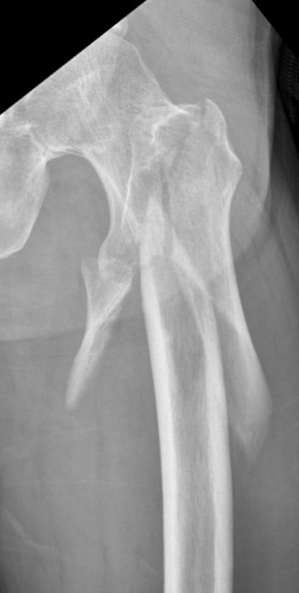
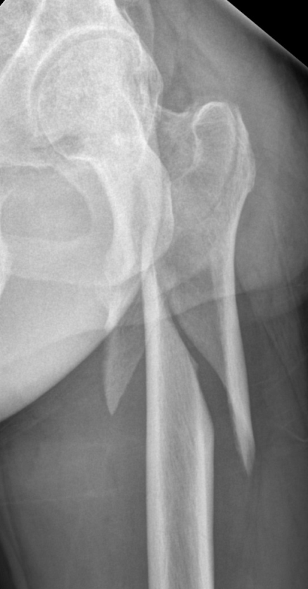
Case description
47-year-old man
Fall from a 4-meter height
Isolated injury
Neurovascular intact
Reduction techniques?
Choice of fixation?
Plating
Nailing
Day 0

Slide 5
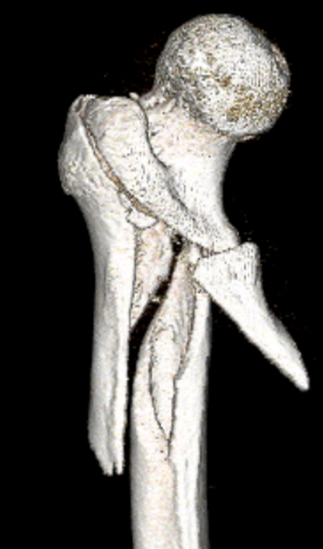
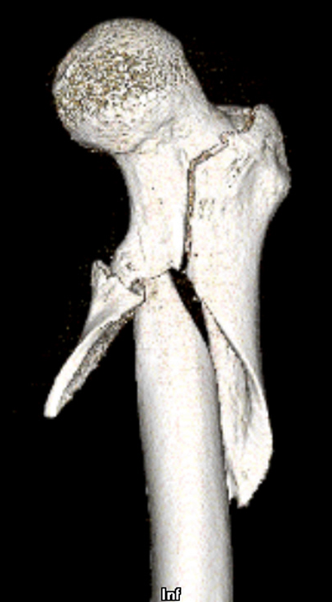
Computed tomographic scan taken at other hospital
Has the computed tomographic (CT) scan changed your plan?
Reduction techniques?
Choice of fixation?
Plating
Nailing

Slide 6
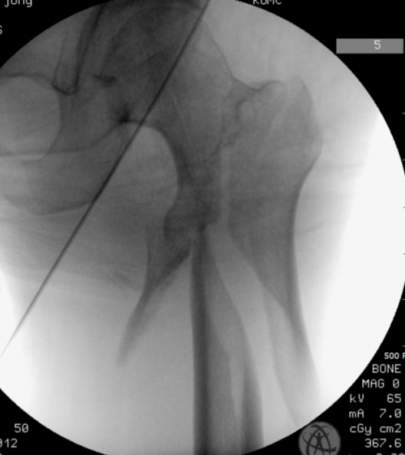
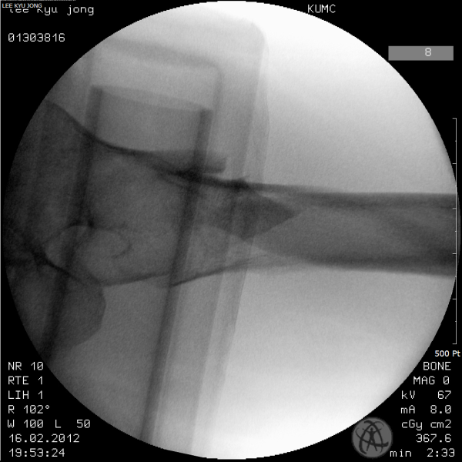
Operating room images on traction table
Reduction techniques?
Choice of fixation?
Plating
Nailing
Day 0

Slide 7
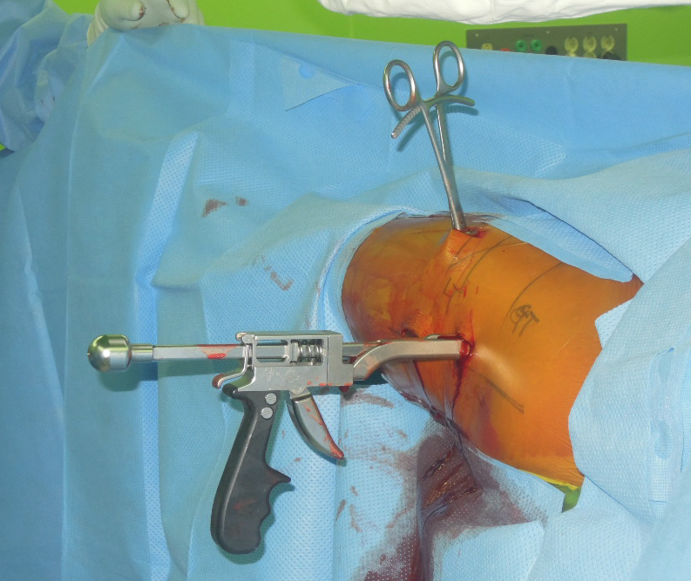
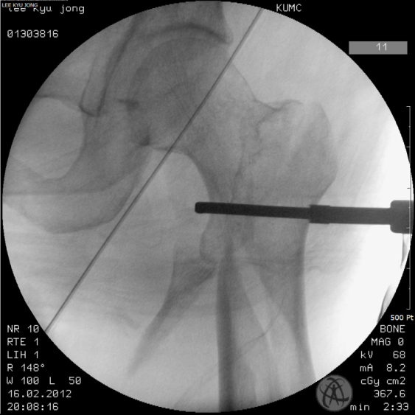
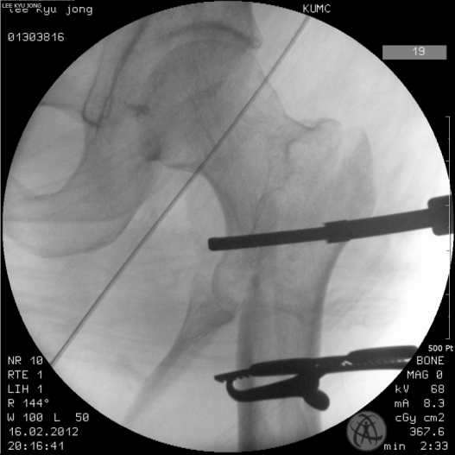
Percutaneous reduction
Collinear reduction clamp
Pointed reduction forceps

Slide 8
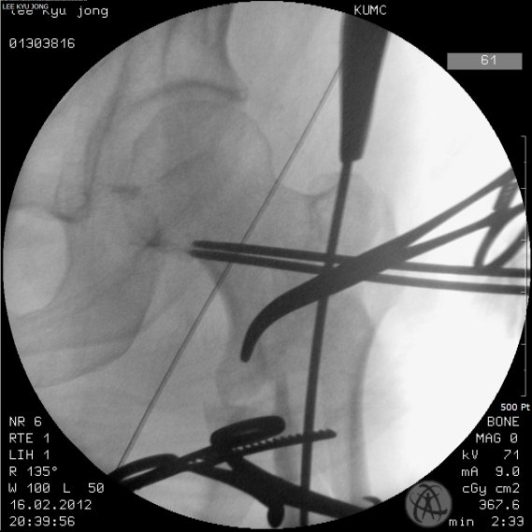
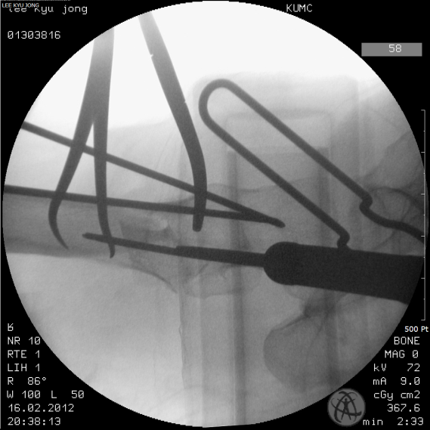
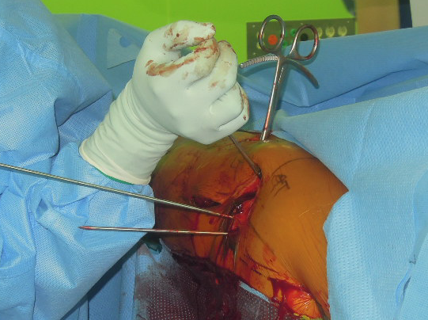
Temporary fixation with K-wires (white arrows)
Rotational control of the proximal fragment with a Kelly clamp (green arrows)

Slide 9
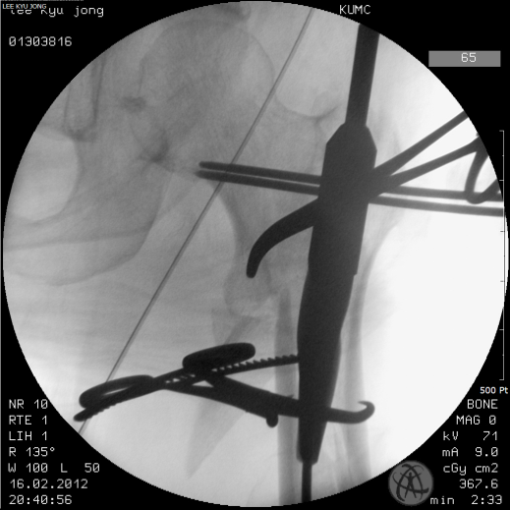
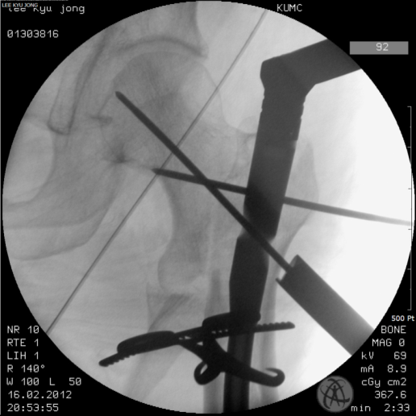
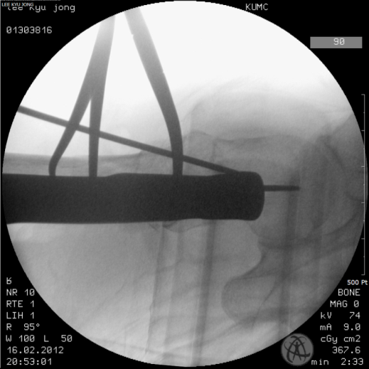
Nailing while reduction is maintained

Slide 10
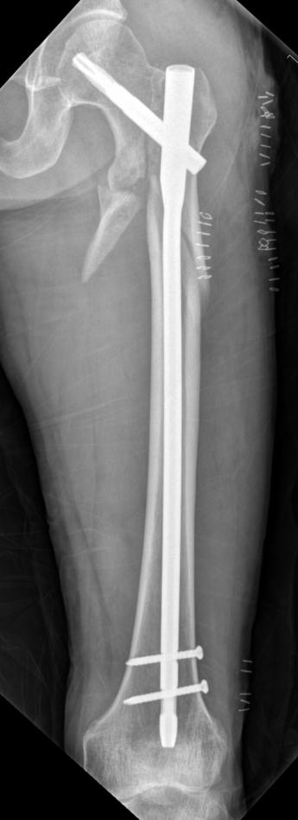
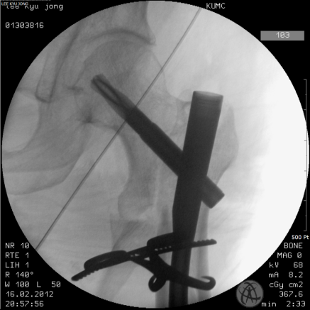
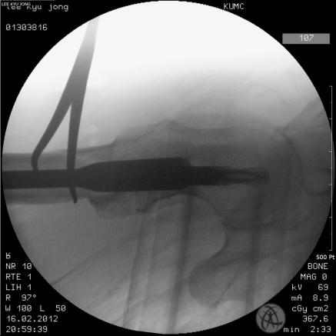
Postoperative imaging
Day 0

Slide 11
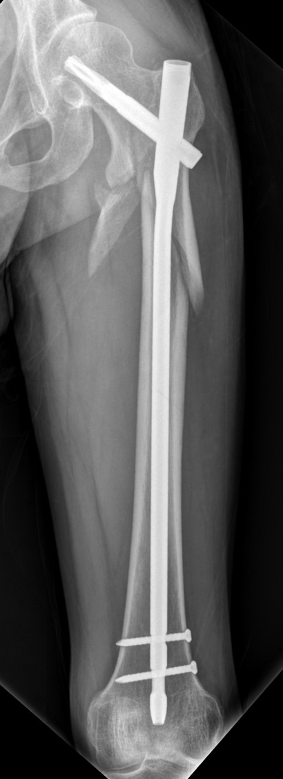
Postop
2 months
Day 60

Slide 12
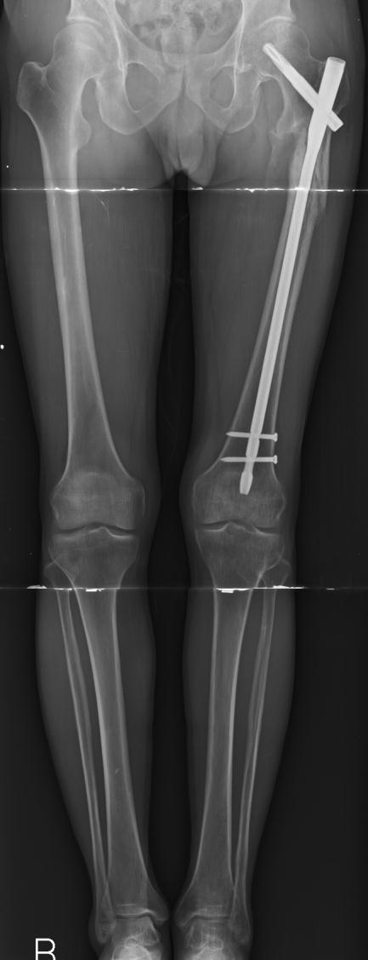
Postoperative imaging (at 8 months)
Day 260

Slide 13
Nonunited intertrochanteric femoral fracture complication Case 2
Eben Carroll, USA

Slide 14
Case description
“Left hip pain”
68-year-old man treated at outside hospital for left hip fracture
Transferred to our care for nonunion
Past medical history: hypertension, arthritis
Past surgical history: knee replacement

Slide 15
Injury film

Slide 16
Fixed at outside hospital

Slide 17
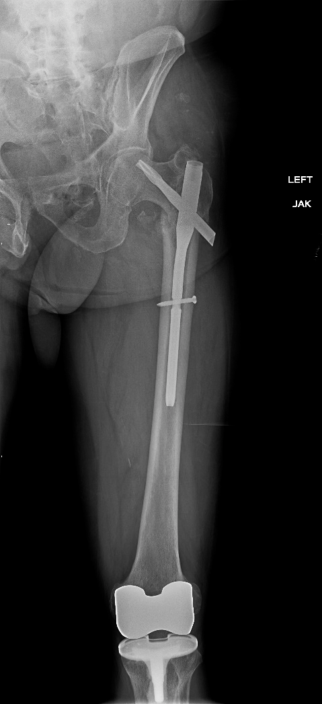
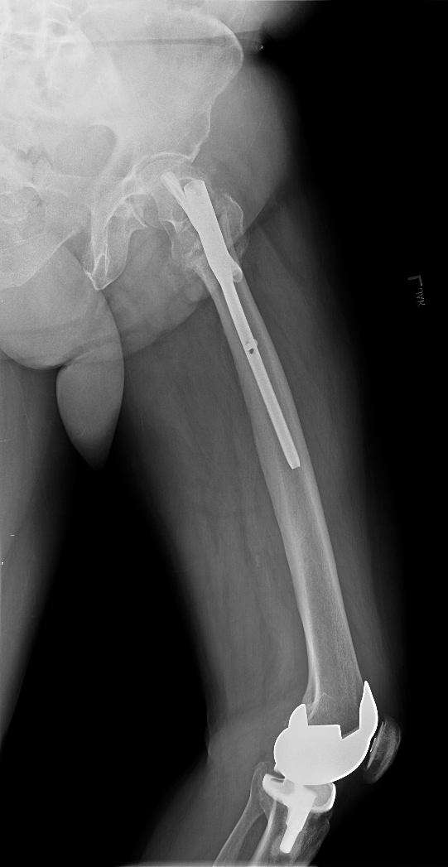

Slide 18
Fixed at outside hospital
What should be done with this?
Observe?
Revise?
How?

Slide 19
Preoperative plan

Slide 20
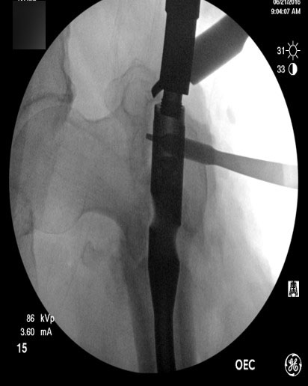

Slide 22
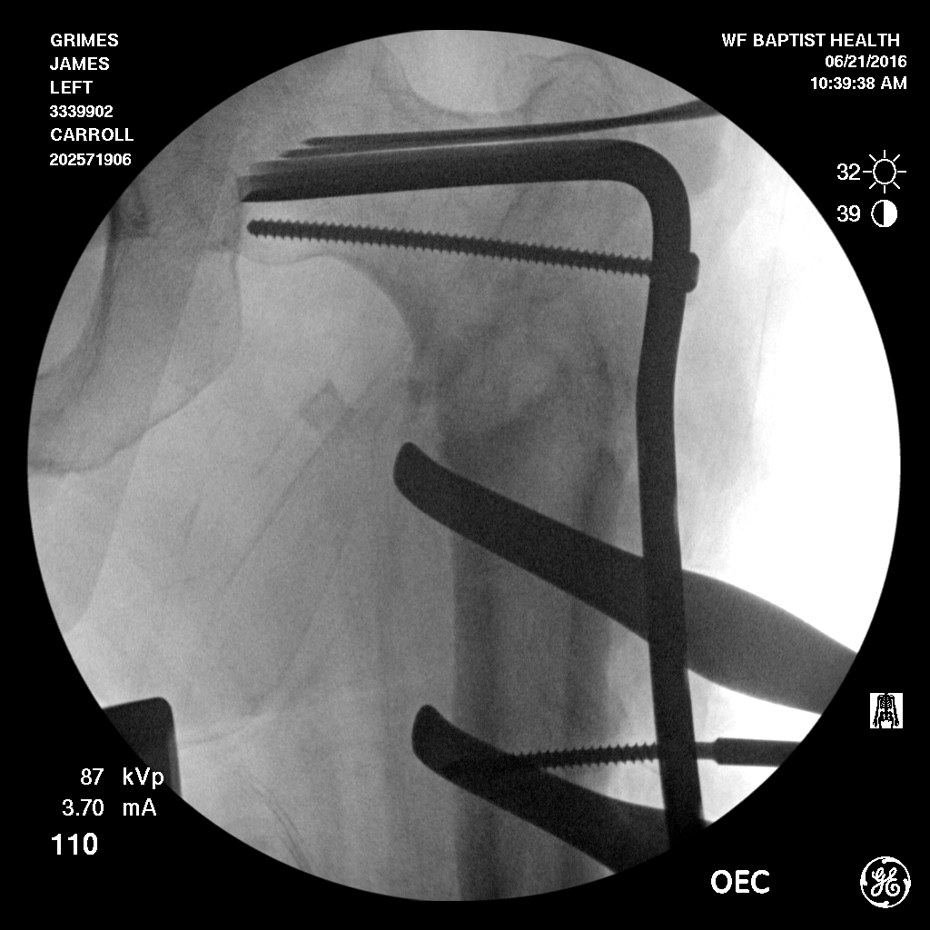

Slide 23
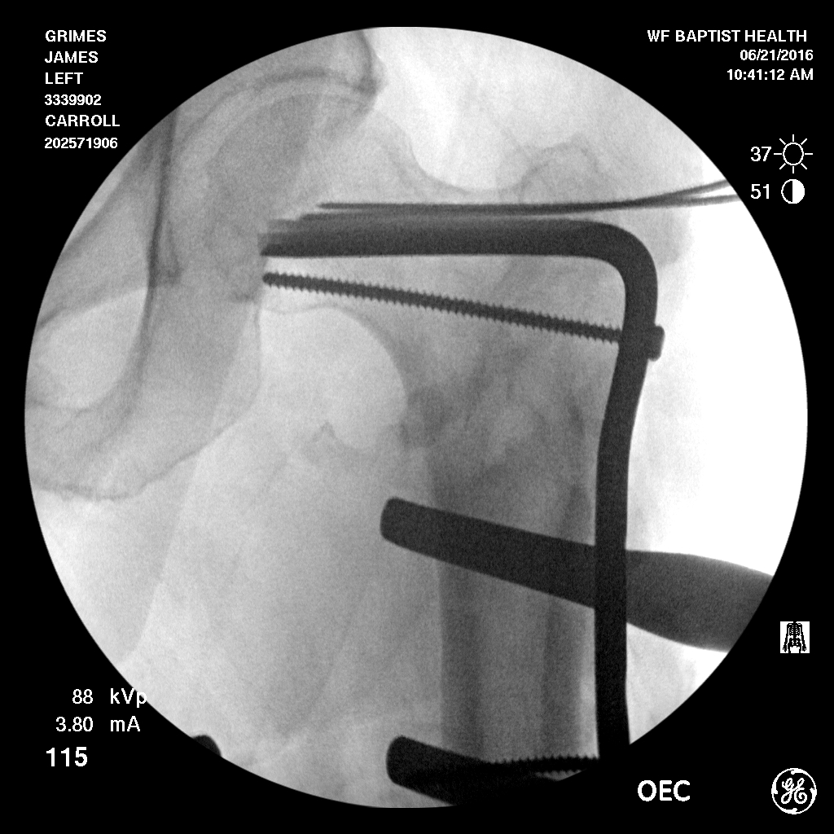

Slide 24
Correction with the plate alone, no osteotomy was made

Slide 25
At 1 year

Slide 26
At 1 year

Slide 27
High-energy intertrochanteric fracture Case 3

Slide 28
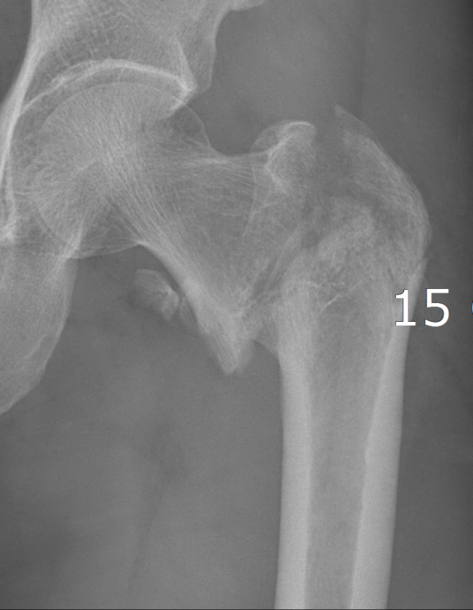
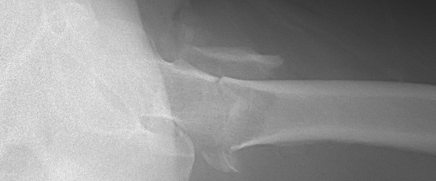
Case description
48-year-old man with isolated injury
Fall from a 3-meter height
Reduction?
Fixation options?
Dynamic hip screw
Nailing
Day 0

Slide 29
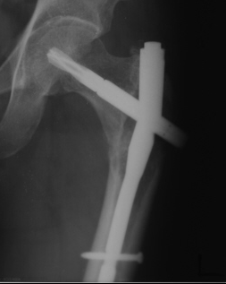
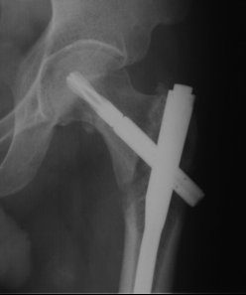
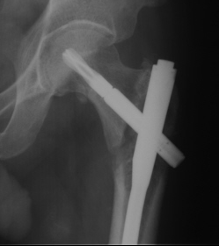
Open reduction and internal fixation, any thoughts?
Postoperative imaging
Lateral view not available
5 months
2 months 2 weeks
Notes:
Cause of failure: medial gap, good bone quality, abutment of proximal lateral aspect of the proximal fragment to the nail → failure of sliding → bending stress → failure

Slide 30
Cause of failure?
Medial gap, good bone quality, abutment of proximal lateral aspect of the proximal fragment to the nail → failure of sliding → bending stress → failure
Locking failure may have caused rotational instability
5 months
2 months
2 weeks

Slide 31
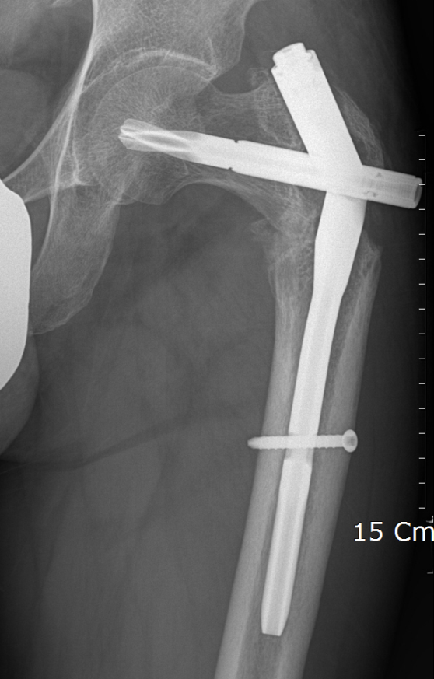
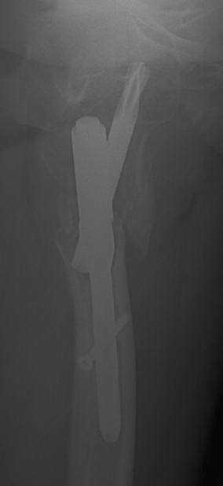
Your revision plan?
Correction of deformity
Fixation

Slide 32
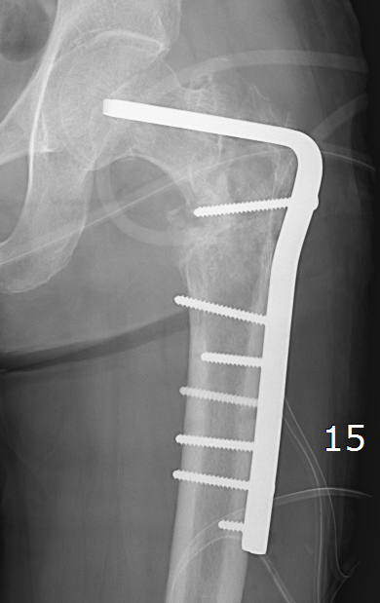
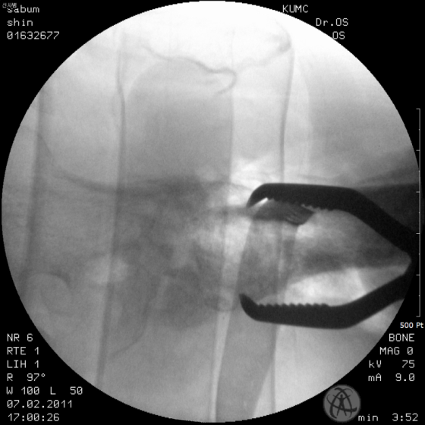
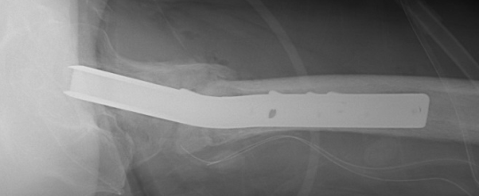
Revision with a 95º blade plate and autogenous bone graft
Second postoperative imaging
Month 13
Notes:
Varus persist, blade malposition, short working distance → high risk of failure

Slide 33
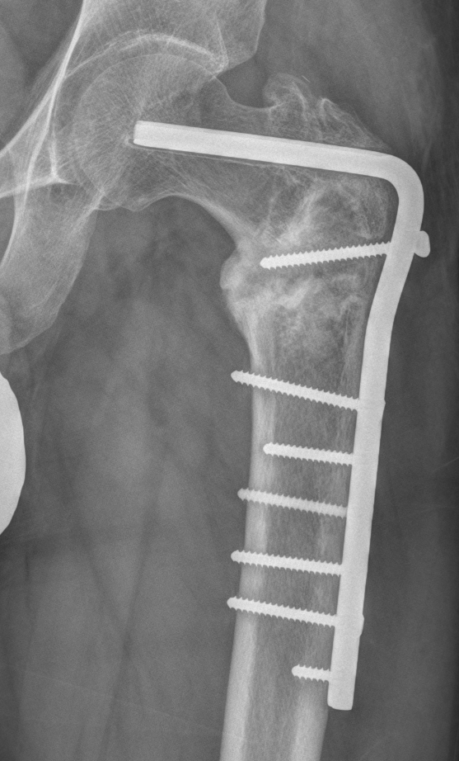
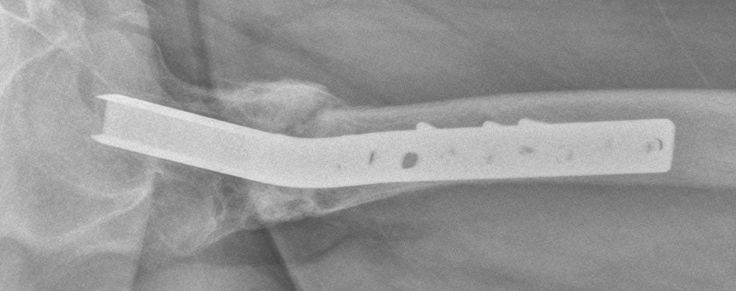
8 months after revision
Walks with a crutch, pain decreasing
What do you see?
What would you do?
Month 21

Slide 34
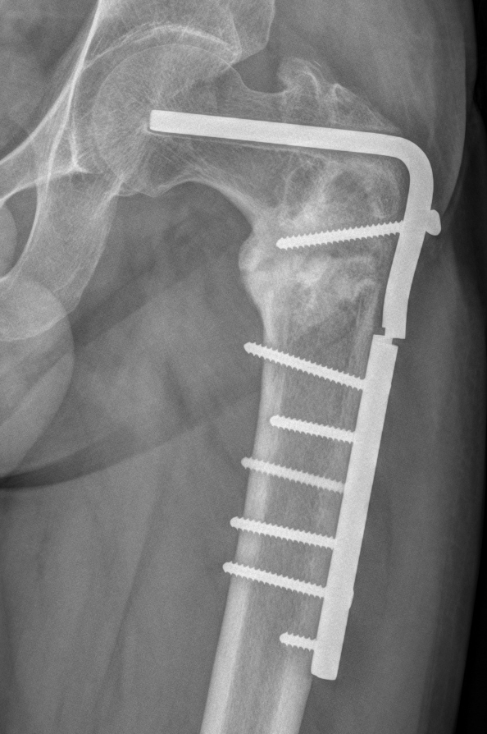
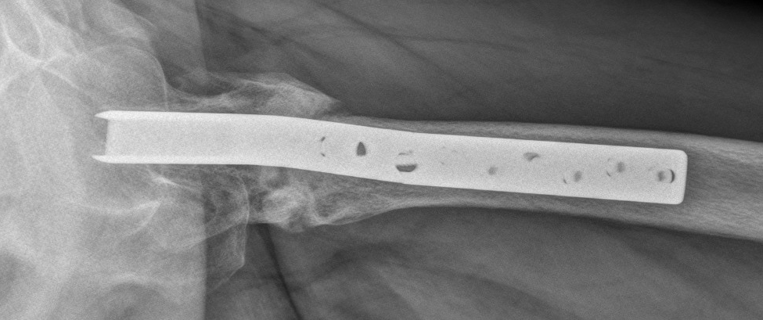
12 months after revision
Revision plan?
Month 25

Slide 35
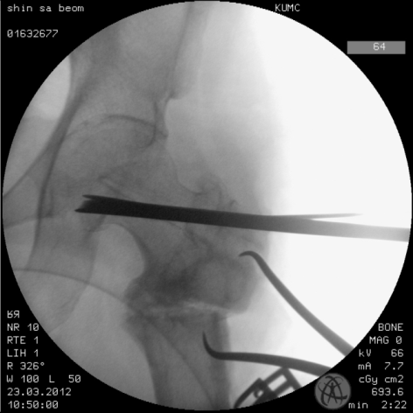
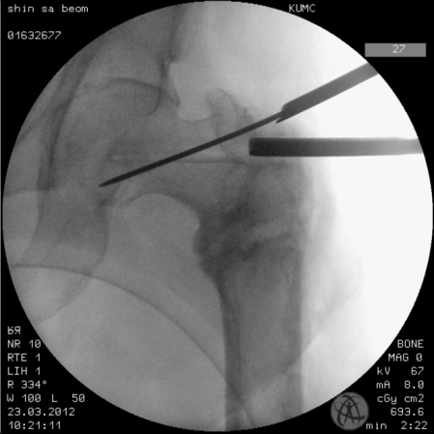
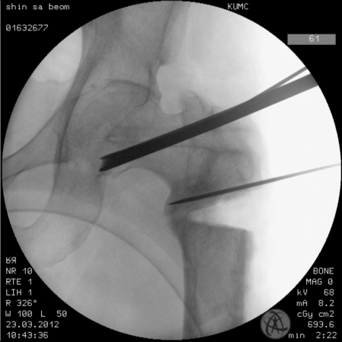
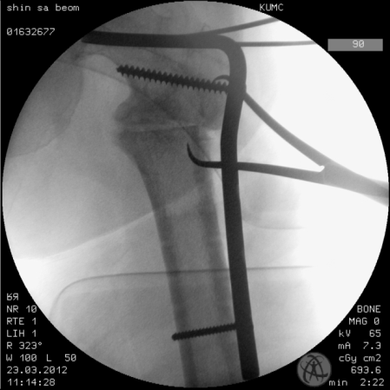
Second revision

Slide 36
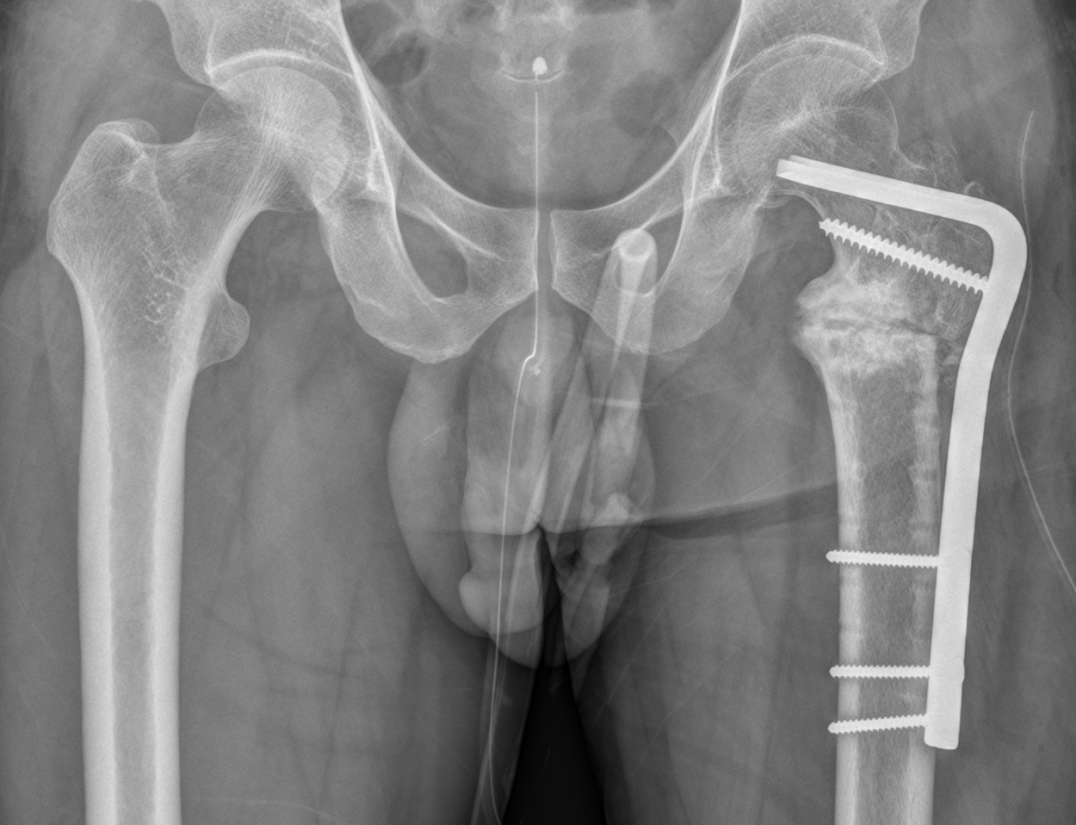
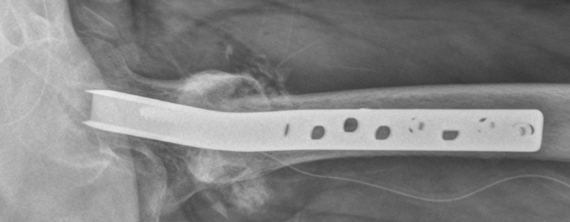
Second revision

Slide 37
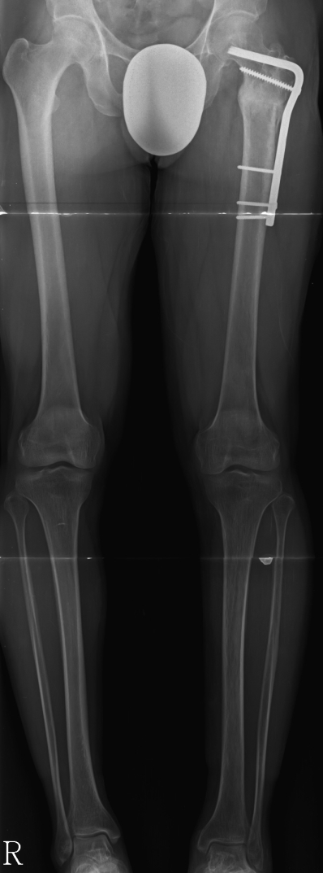
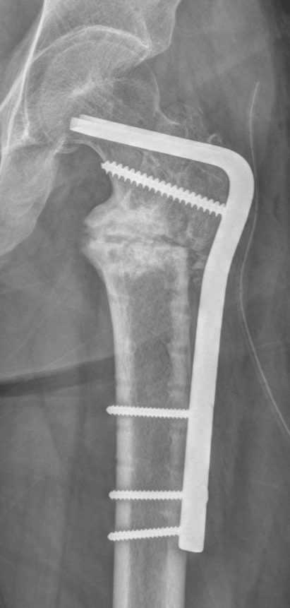
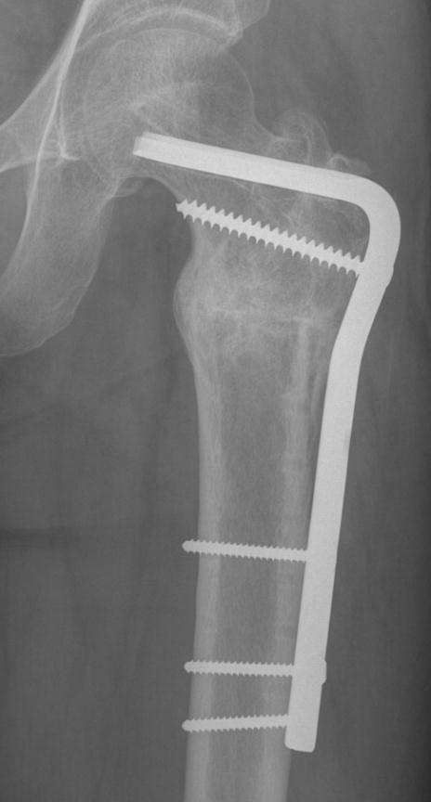
After second revision
Postoperative imaging
7 months
32 months
total

Slide 38
Take-home message (1)
Importance of restoring the medial cortical continuity
5 months
2 months
2 weeks

Slide 39
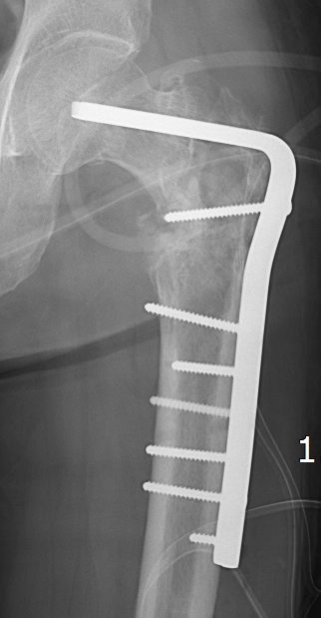
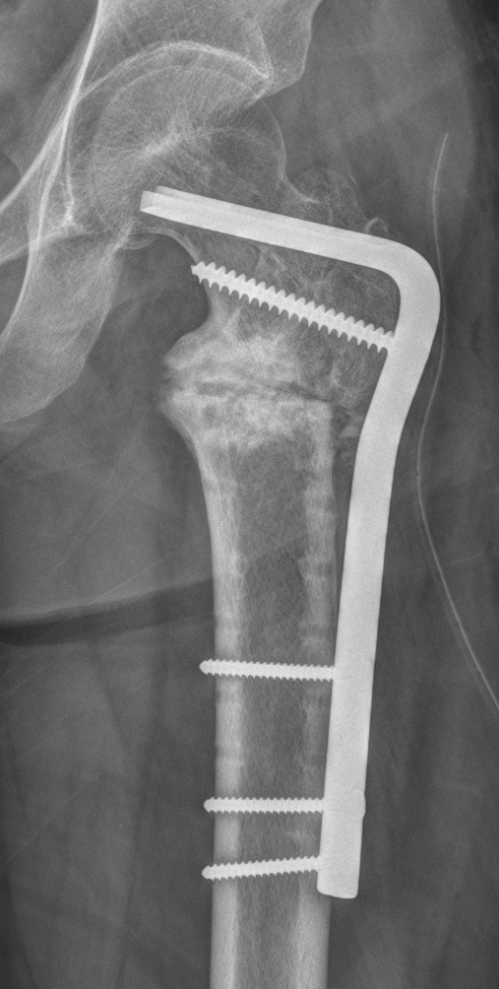
Take-home message (2)
Third postoperative imaging
Valgization
Proper working length
Correct positioning of BP
VS
Second postoperative imaging

Slide 40
Points of discussion
Varus moment arms will cause failure of any fixation in the proximal femur
Sliding must occur but not too much (stability must be achieved) for fear of having leg-length discrepancy
Early remedies need to be undertaken to avoid failure of fixation

Slide 41
Trochanteric fracture: Dynamic hip screw + lateral side plate Case 4
Felix Bonnaire, Germany

Slide 42
Case description
An 87-year-old woman
December 28, 2017

Slide 43
Notes:
Mühle Ursula

Slide 45
What happend?
What would you do?
Endoprosthesis?
Reosteosynthesis?

Slide 46
January 3, 2018
Remove implant
Bring in 4-hole dynamic hip screw
Push back head-neck fragment
Put on buttress plate

Slide 47
Four weeks later, full weight bearing
Notes:
Mühle, Ursula nach 4 Wochen

Slide 48
Intertrochanteric femoral fracture Case 5
Hobie Summers, USA

Slide 50
Issues with the transverse or reverse oblique intertrochanteric fracture?
Difficult to keep out of varus
Sliding hip screw device not indicated

Slide 53
Starting point more medial than previous case

Slide 56
At 5 months

Slide 57
Complex proximal femoral fracture Case 6
Hobie Summers, USA

Slide 58
Complex proximal component
Large medial fragment
Lateral side loadable?
Fixation options:
Plate – which plate?
Nail – which nail?

Slide 60
Appropriate plate placement on proximal fragment
Percutaneous plate application distally
Tension distally and load lateral fracture
Leave medial side alone

