Slide 1
Talar neck fractures and complications
AO Trauma Advanced Principles Course
Notes:
Published: August 2013
Reviewed: 2018
Reviewer: Stefan Rammelt

Slide 2
Learning objectives
Classify talar neck fractures and identify associated injuries
Describe the blood supply to the talus and its implications in treatment options and prognosis
Select a surgical approach appropriate to the fracture pattern
Evaluate fixation options
Identify complications (avascular necrosis, neurovascular injuries, malunion, infection)
Notes:
Teaching points:
Focus on fracture classification, decision making, and approach selection, as well as fixation options. Do not describe surgical techniques.

Slide 3
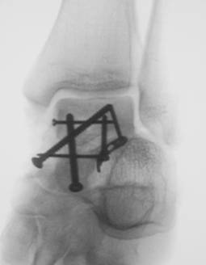
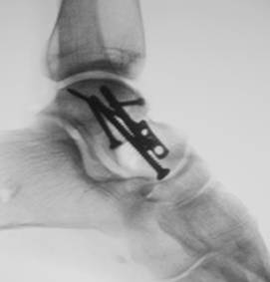
Anatomy
60−70% articular cartilage
No muscular attachments
Complex articulations
Neck deviation
Notes:
The talas is 60–70% articular cartilage and there are no muscle attachments.
Explain that the Canale view, as shown here, is best used to see the talar neck.

Slide 4
Blood supply
Extraosseus blood supply via three vessels
  Peroneal
  Anterior tibial
  Posterior tibial
Major blood supply to body is the artery of the tarsal canal
Deltoid and sinus tarsi vessels provide significant minor vascularity
Notes:
Extraosseous blood is supplied to the talus by three vessels: the peroneal, anterior tibial, and posterior tibial vessels.
The major blood supply to the body is through the artery of the tarsal canal. The deltoid and sinus tarsi vessels provide significant minor vascularity.

Slide 5
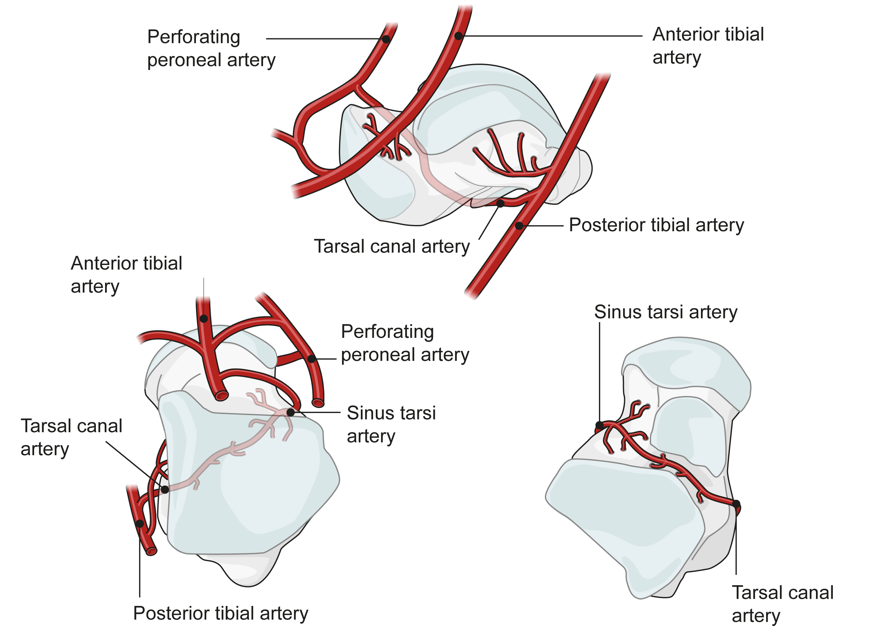
Blood supply
Notes:
Note the deltoid branches of the posterior tibial artery and the artery of the tarsal canal.
A posteromedial approach to the body of the talus would destroy its blood supply. Therefore, if the body has to be exposed, one utilizes an osteotomy of the medial malleolus.

Slide 6
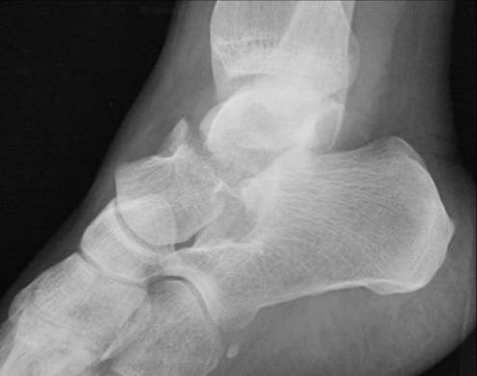
Mechanism
Shear force (not forced dorsiflexion)
Notes:
The mechanism of injury is an axial load with the ankle in dorsi flexion and shear force.

Slide 7
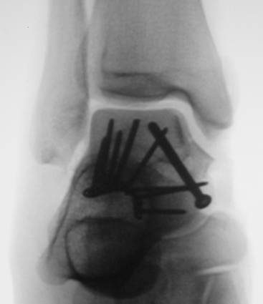
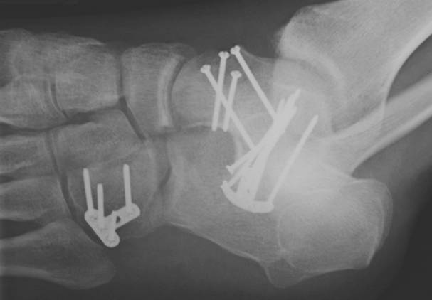
Fractures of the talus
Talar neck
Talar body
Talar head
Lateral process
Posteromedial
Extruded talus
Notes:
Fractures of the talus come in many varieties including: talar neck, talar body, talar head, lateral process, posterior medial fractures, and extruded talus.

Slide 8
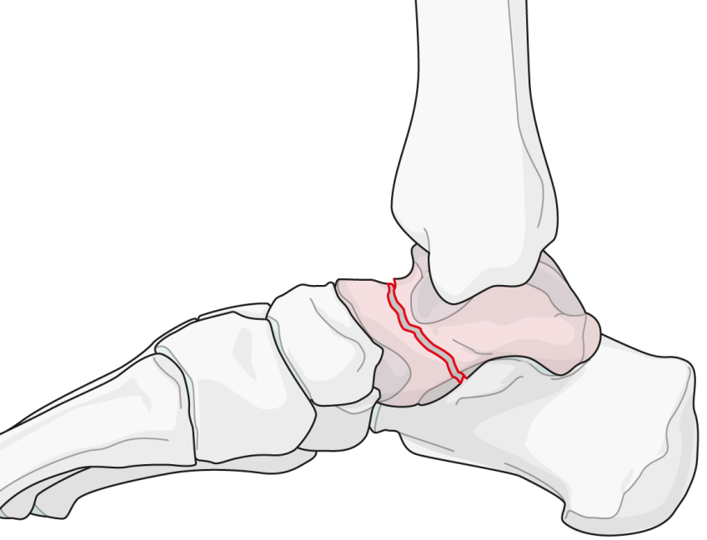
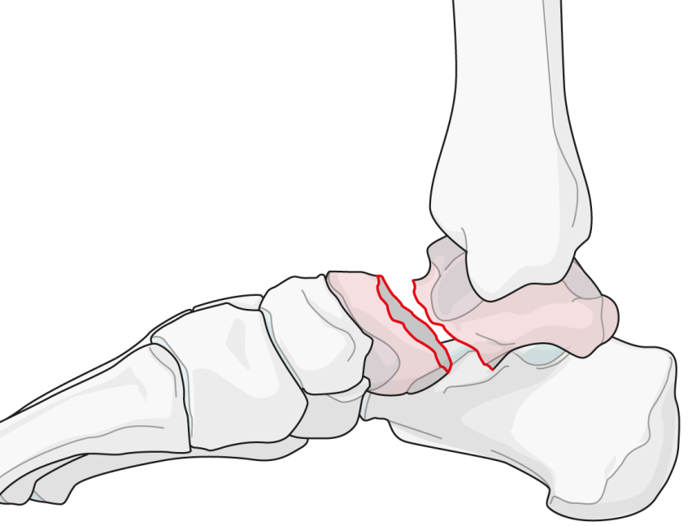
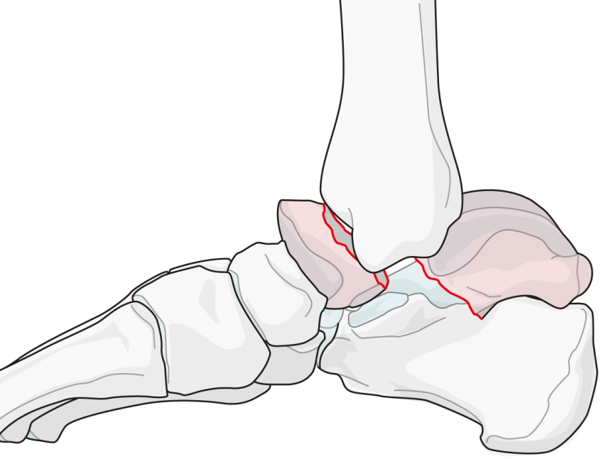
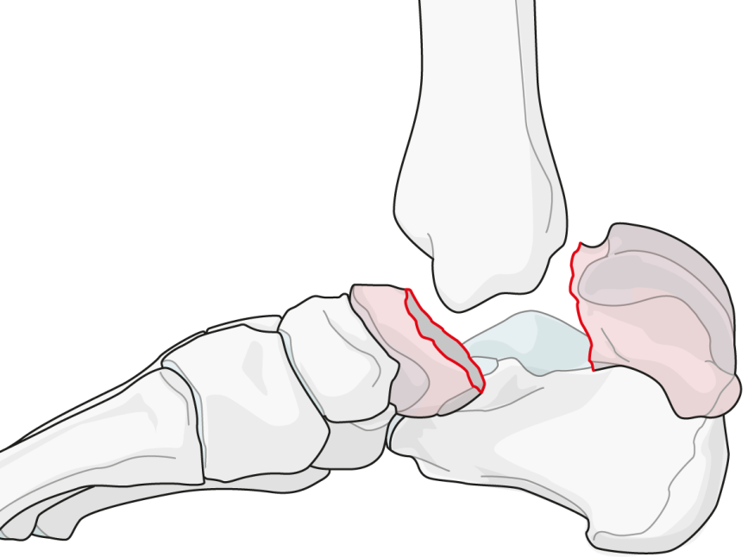
Talar neck fractures: Hawkins, AO/OTA Classification 81.2
Type I/81.2.A
Type II/81.2.B*
Type III/81.2.C*
Type IV/81.2.D*
*Qualification: a. Simple, b. Multifragmentary
Notes:
Classification of talar neck fractures by Hawkins:
Type I, an nondisplaced fracture of the talar neck
Type II, a displaced fracture of the talar neck with subluxation or dislocation of the subtalar joint
Type III, a displaced fracture of the talar neck with dislocation or subluxation of the talar body from both the tibiotalar and subtalar joints
Type IV, a displaced fracture of the talar with dislocation or subluxation of the talonavicular, tibiotalar, and subtalar joints

Slide 9
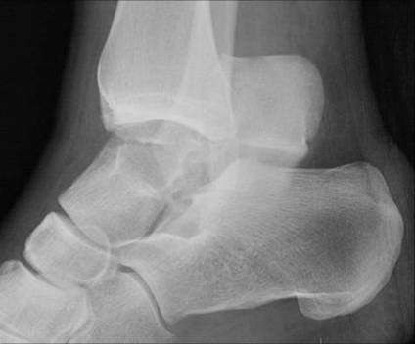
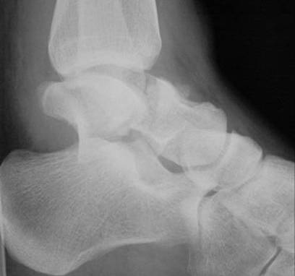
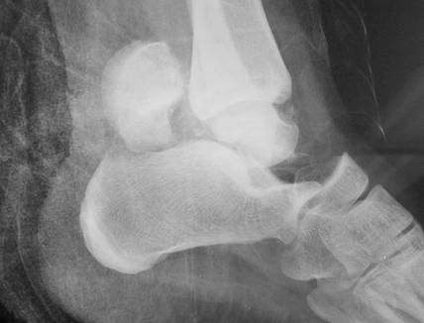
Notes:
These x-rays show an example of a type III fracture dislocation.

Slide 10
Talar emergencies?
Dislocated closed fractures
Open fractures
Closed fractures with soft tissue at risk
Neurovascular compromise
All talar neck fractures?
Notes:
Which fractures should be treated as emergencies?
A dislocation in a closed fracture should be reduced. This is almost always done open. Closed reduction can be attempted, but is very difficult.
Open fractures and closed fractures with soft tissue at risk of impingement with neurovascular compromise are all indications for emergency surgery.
There is a question as to whether all talar neck fractures are emergencies.

Slide 11
Talar emergencies?
Of 109 experts surveyed, 89 responded as follows:
  60% said waiting more than 8 hours is acceptable
  46% said waiting more than 24 hours is acceptable
Clinical studies show neither improved outcomes nor reduced rates of avascular necrosis after emergent definite fixation of all talar neck fractures
Notes:
A survey performed in 2005 indicated that 60% of the “experts” felt that it was acceptable to wait more than 8 hours before performing treatment, and 46% said it was acceptable to wait up to 24 hours.
References:
Patel R, Van Bergeyk A, Pinney S. Are displaced talar neck fractures surgical emergencies? A survey of orthopaedic trauma experts. Foot Ankle Int. 2005; 26(5):378–381.

Slide 12
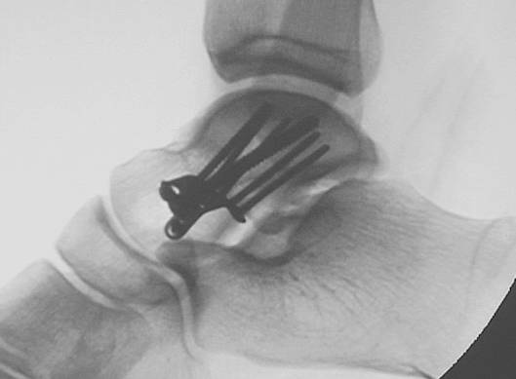
Goals of open reduction
Restoration of anatomy
Alignment of talar neck
Maximization of revascularization
Allow early ROM
Notes:
The goal of reduction is anatomical restoration, proper alignment of the talar neck, and prevention of any further vascular damage through stabilization of the fragments.

Slide 13
Approaches
Anteromedial
Anterolateral
Posterolateral
+/- malleolar osteotomy
+/- fibular osteotomy
Notes:
Approaches are anterior, medial, and anterolateral.
A posterolateral approach can be performed and a medial malleolar osteotomy or fibular osteotomy can be used for reduction and/or visualization of the fracture.

Slide 14
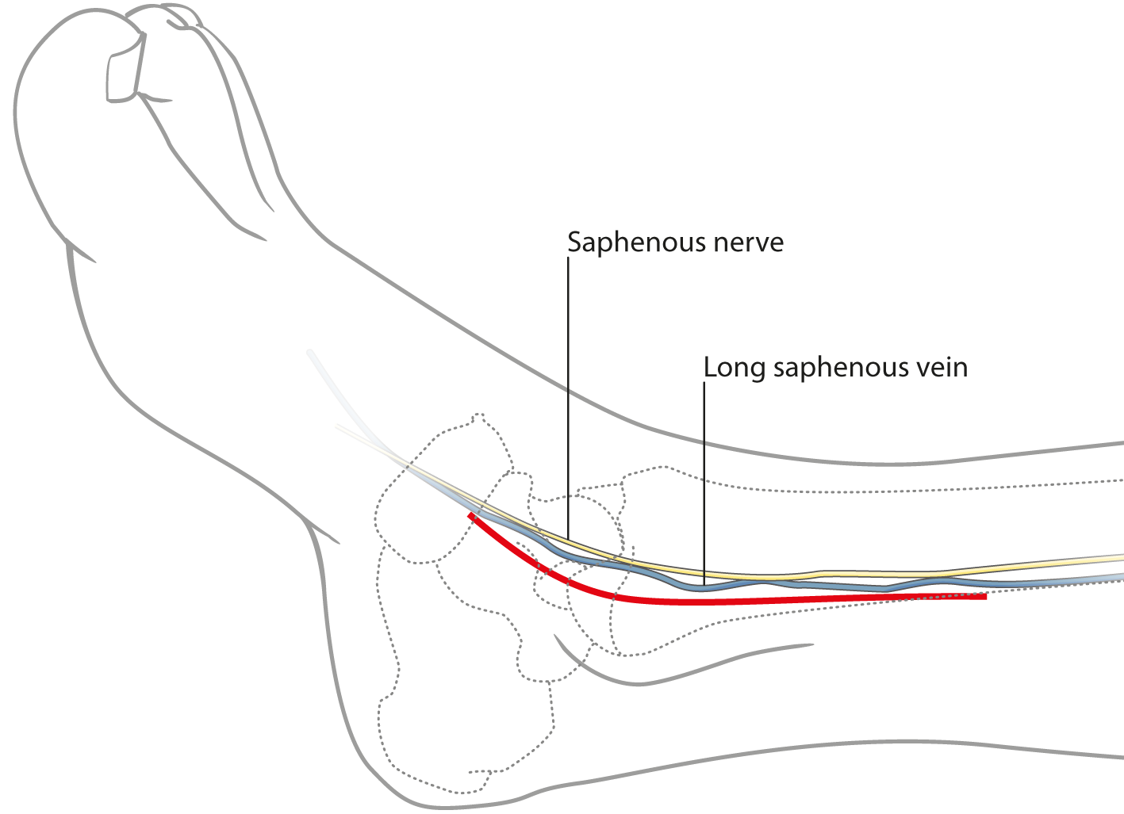
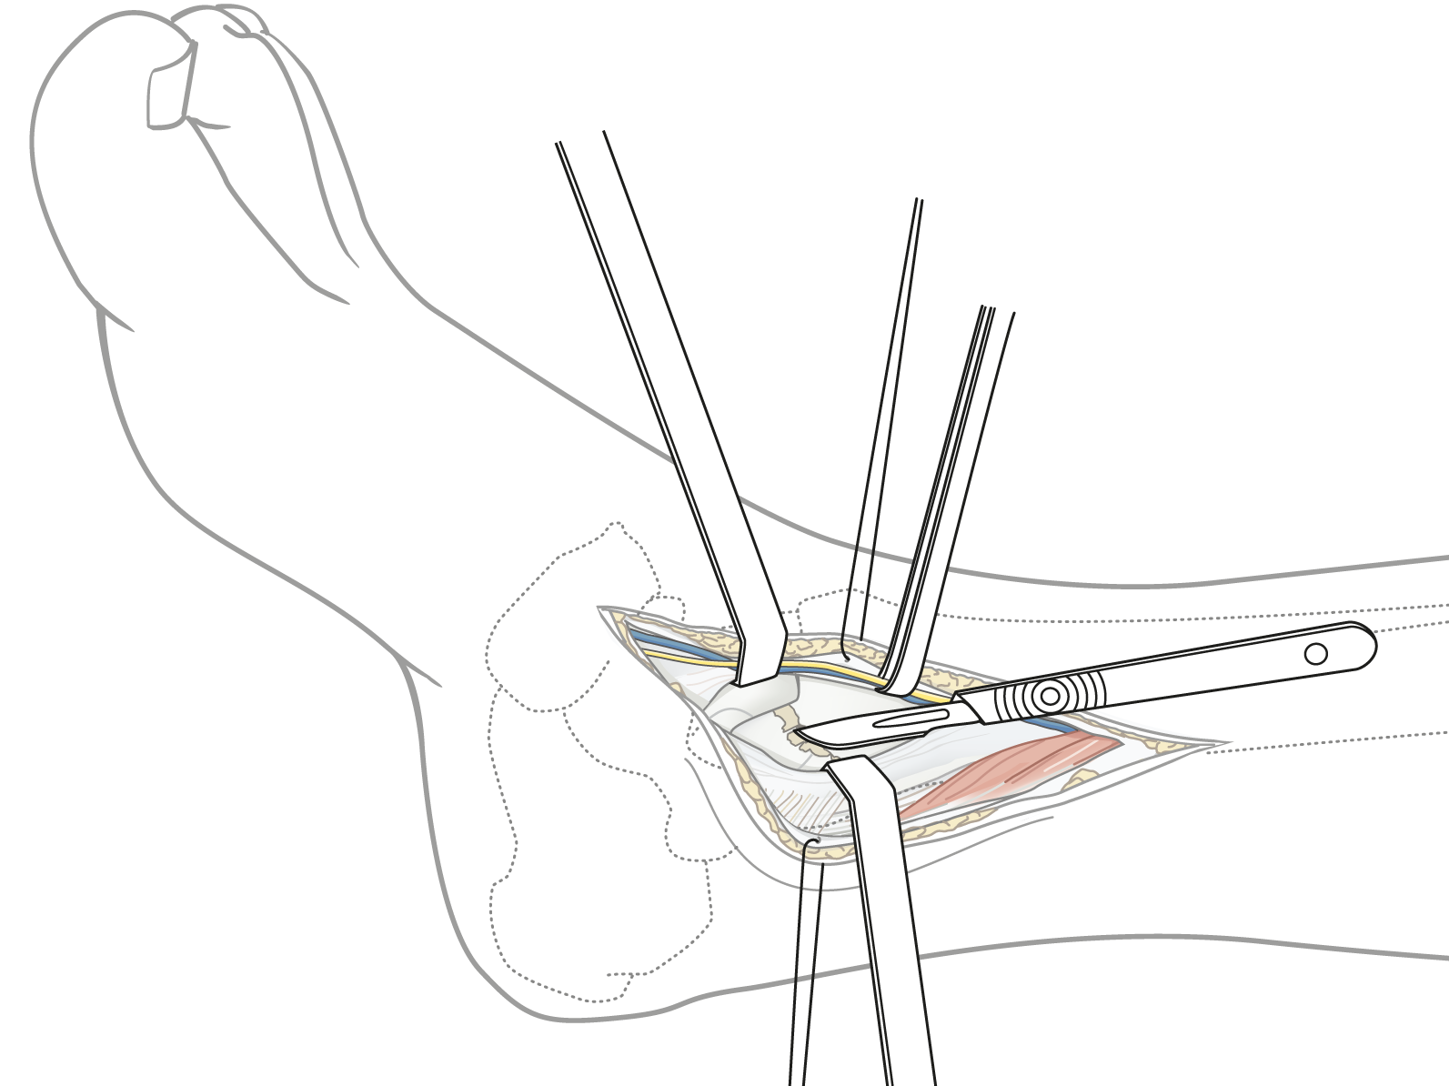
Medial approach
Notes:
The medial approach again seen in this diagram.
The incision is between the anterior and posterior tibialis tendons.

Slide 15
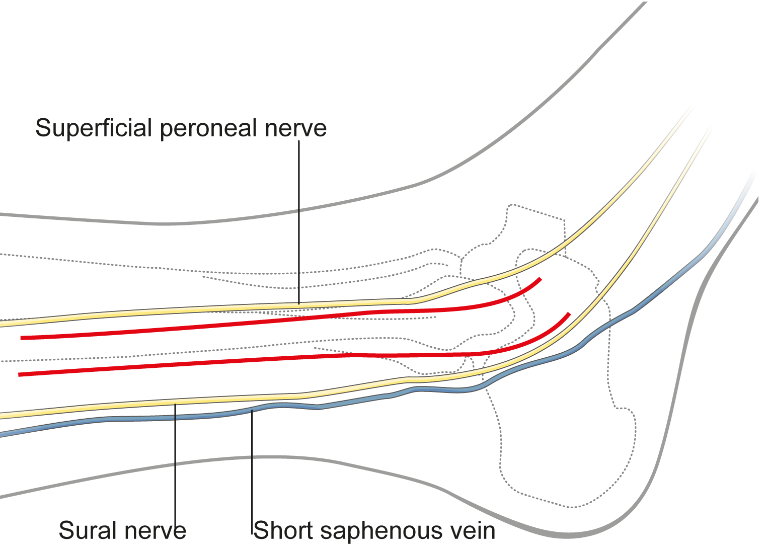
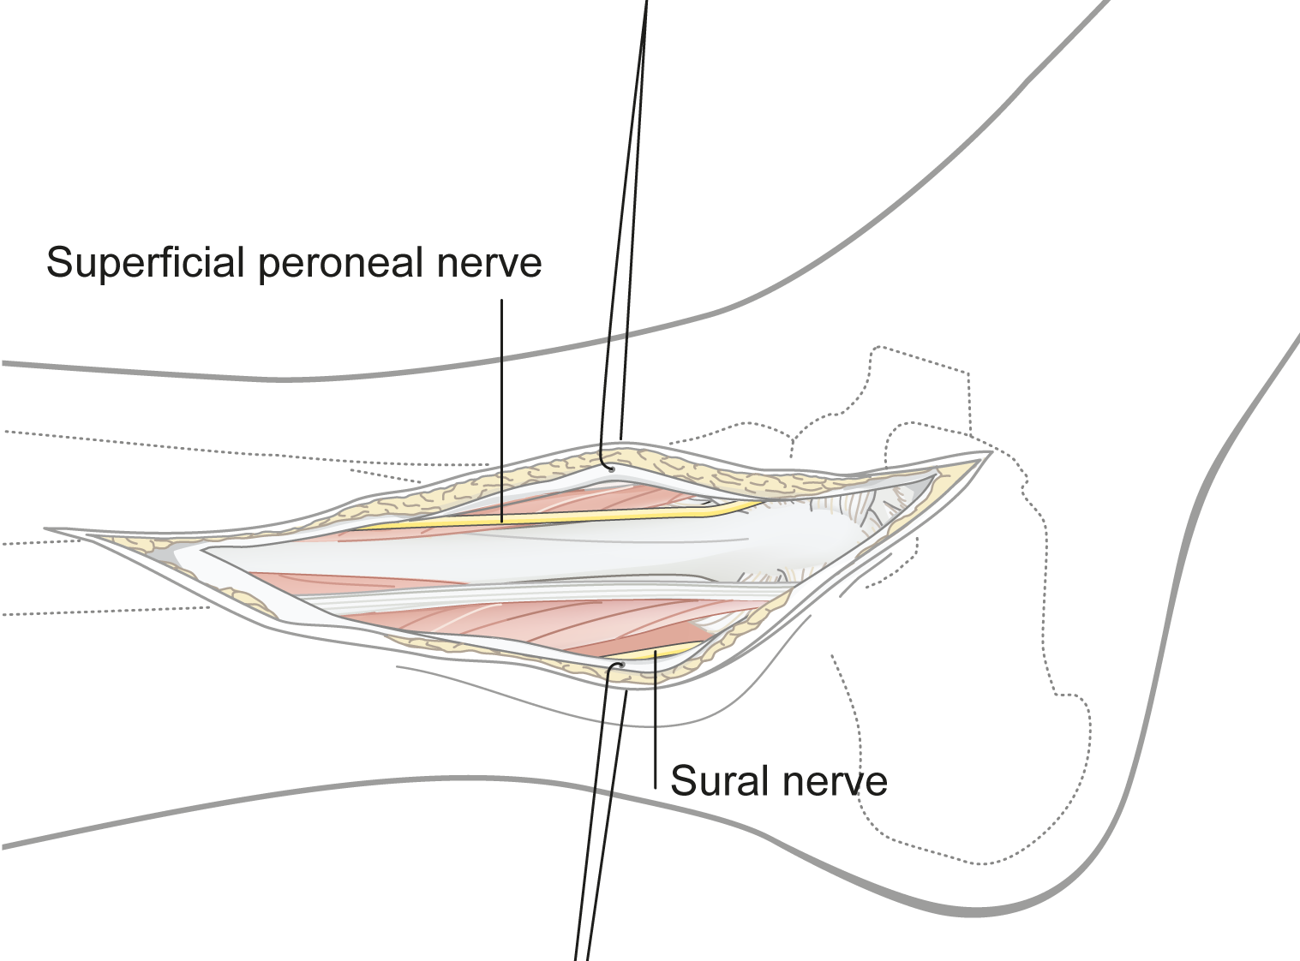
Lateral approach
Notes:
The lateral approach as seen in this diagram.
The incision is between the distal tibia and fibula, in line with the fourth ray.

Slide 16
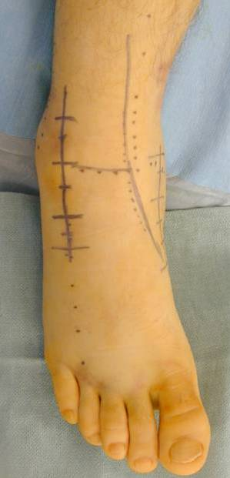
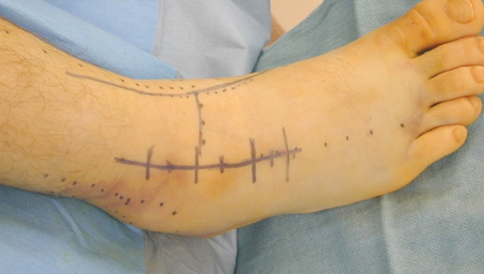
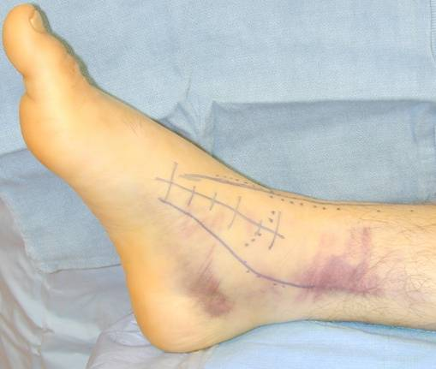
Anteromedial and anterolateral incisions
Notes:
The anteromedial and anterolateral incisions have been drawn on the foot. The center line is the anterior tibialis tendon.

Slide 17
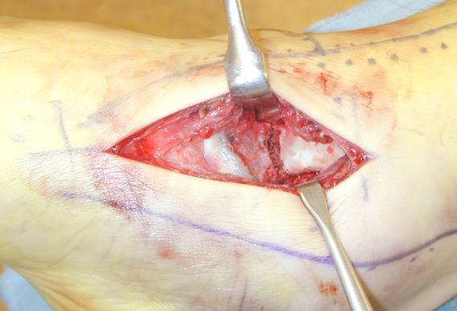
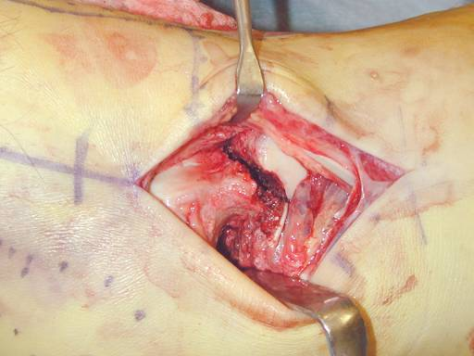
Minimal soft-tissue stripping
Medial
Lateral
Notes:
The visualization through the medial incision on the left and the lateral incision on the right. Medial and lateral views of the same incision are at right.
NOTE that minimal soft-tissue stripping is done. The use of two incisions allows for adequate access for reduction and fixation, without either incision using much stripping.

Slide 18
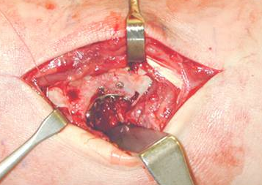
Surgical tactic
Consider dual exposures
Intraoperative distractor
Clean subtalar joint
Leave deltoid ligament intact
Span comminution (dorsomedial)
Avoid varus
Notes:
Dual incisions allow for better visualization without stripping during reduction and fixation of the fracture.
Depending on the comminution and impaction, it may be necessary to distract the joint.
It may be necessary to clean out the subtalar joint and the fracture site.
Be prepared to span the comminuted area with small plates to make sure that the talar is anatomically reduced.
References:
Daniels TR, Smith JW, Ross TI (1996) Varus malalignment of the talar neck. Its effect on the position of the foot and on subtalar motion. J Bone Joint Surg Am; 78(10):1559–1567.

Slide 19
Surgical tactic
Reduce the tension side first (lateral and plantar)
Fixation at nonarticular talus
Countersink screws at talar head
Notes:
Reduce the tension side first, which is almost always on the lateral side. This is typically the side with the more simple fracture, and less comminution.
Screws are placed through the nonarticular portion of the talus. The screw heads are countersunk when they are through articular cartilage.

Slide 20
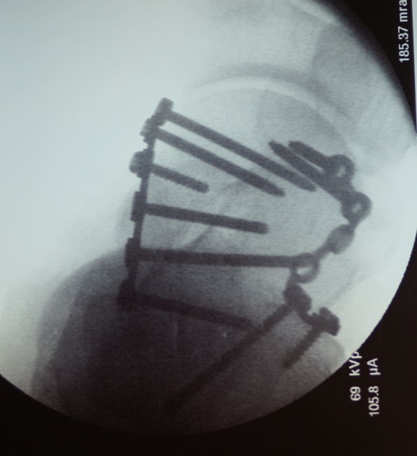
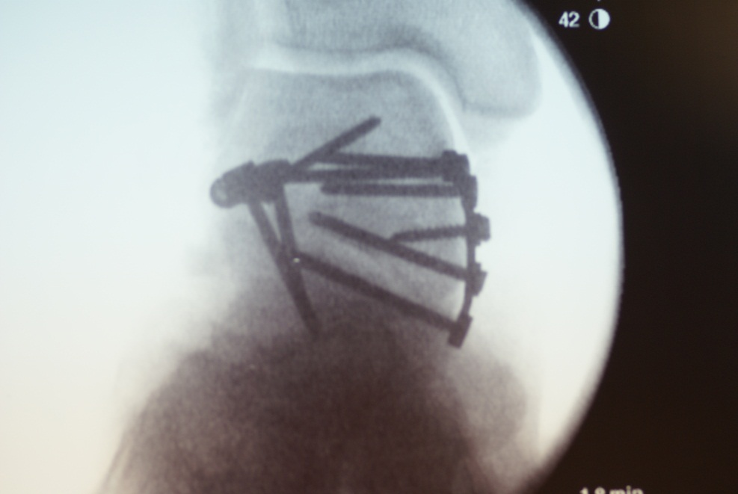
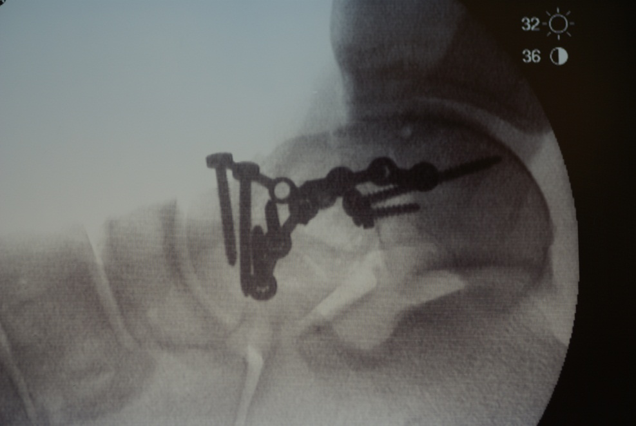
Plate fixation of talar neck fractures
Good results in 23 patients
Notes:
Postoperative x-rays of a talar neck fracture treated with screw fixation and a lateral plate to obtain length in the lateral side.
References:
Fleuriau Chateau PB, Brokaw DS, Jelen BA, et al. Plate fixation of talar neck fractures: preliminary review of a new technique in twenty-three patients. J Orthop Trauma. 2002; 16(4):213–219.

Slide 21
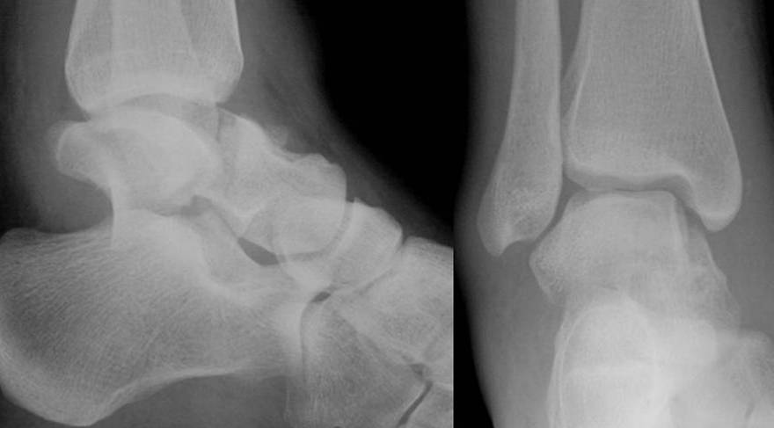
18-year-old woman, motor vehicle accident
Notes:
An 18-year-old woman with a displaced talar neck fracture.

Slide 22
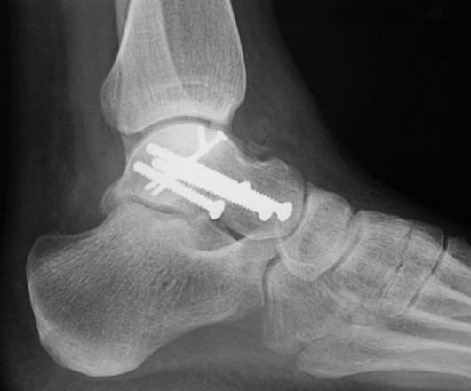
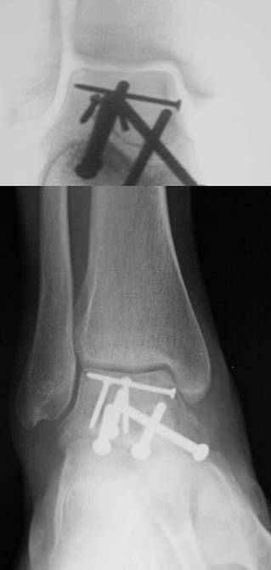
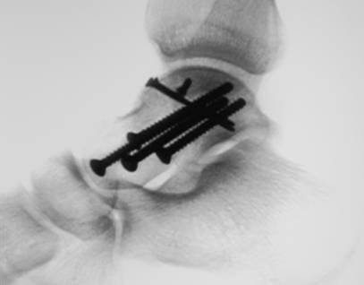
Notes:
Postoperative x-ray showing an anatomical reconstruction of the fracture as well as small fragment repositioning and screwing.

Slide 23
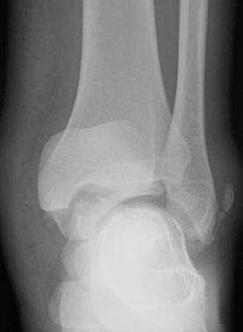
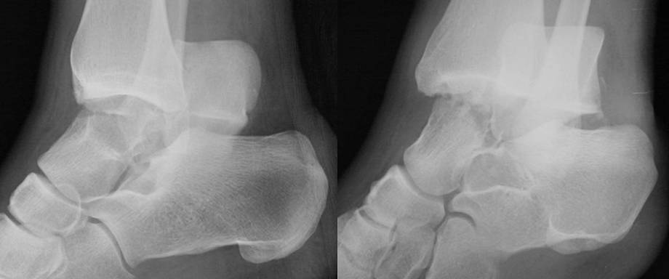
Notes:
A type III fracture dislocation.

Slide 24
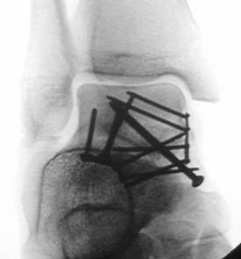
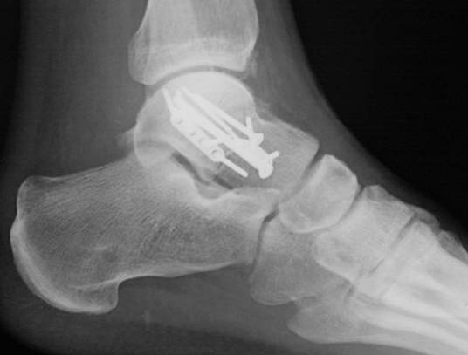
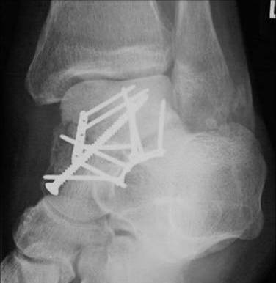
Notes:
Postoperative x-rays showing screw and plate fixation in an anatomical fashion.
The hardware will be specific to the fracture pattern, addressing the major fracture lines and fragments.

Slide 25
Osteonecrosis
49% with radiographic evidence
63% with collapse
37% without collapse
31% get avascular necrosis (AVN) with collapse
Hawkins II: 39% (9/23)
Hawkins III: 64% (9/14)
P = 0.18
Notes:
Osteonecrosis is common and the literature shows high percentages of fractures that do develop necrosis. However, not all osteonecrosis leads to collapse.
In the study below, 31% of fractures end up with avascular necrosis (AVN) with collapse and Hawkins type III fractures tended to have the highest rate of AVN.
References:
Vallier HA, Nork SE, Barei DP et al. Talar neck fractures: results and outcomes. J Bone Joint Surg Am. 2004 Aug;86-A(8):1616–1624.
Vallier et al JBJS 2004

Slide 26
Functional outcomes
In a study following 70 displaced talar neck fractures over 10 years:
26 (37%) required secondary surgical procedures
Secondary procedures increased with time
Good function if no complications (?)
Worse functional result with malalignment, subtalar arthritis
AVN low (9%)
Notes:
Sanders followed 70 fractures for 10 years. 37% required secondary surgical procedures. He only saw a 9% AVN rate which is quite low. He felt that worse function was with malalignment and subtalar arthritis. The most common malaligment involves varus of the talar neck.
References:
Sanders DW, Busam M, Hattwick E, et al. Functional outcomes following displaced talar neck fractures. J Orthop Trauma. 2004; 18(5):265–270.

Slide 27
Open reduction and stable fixation
In a study following 26 isolated, displaced talar neck and body fractures for a minimum of 4 years
Union in 88%; all closed and healed (time independent)
Subtalar arthritis universally observed
AVN in 50% overall, 86% in open fractures
Conclusion:
  Delay in treatment does not affect outcome
  Arthritis more common than AVN
  Open fractures problematic
Notes:
A study in JBJS in 2004, following open reduction and stable fixation of isolated talar neck and body fractures, followed for a minimum of 4 years. There was a good union rate, however, subtalar arthritis was universally observed.
In open fractures, there was a 50% AVN rate. The conclusion was that a delay in treatment did not affect outcome, and that arthritis was more common than AVN in open fractures and was problematic.
References:
Lindvall E, Haidukewych G, DiPasquale T, et al. Open reduction and stable fixation of isolated, displaced talar neck and body fractures. J Bone Joint Surg Am. 2004; 86-A(10):2229–2234.

Slide 28
Postoperative treatment—talar neck fractures
Active ankle and subtalar range of motion when wounds sealed
Nonweight bearing for 12 weeks
Plain x-ray evaluations
Weight bearing despite questionable vascularity
Notes:
Postoperative treatment involves initial casting, splinting, or Jones dressing, followed by suture removal at 2 weeks.
Active range of motion is possible with a stable reconstruction and nonweight bearing for 12 weeks.
Follow-up x-rays should be made to look for Hawkins sign, as evidence of the absence of AVN.

Slide 29
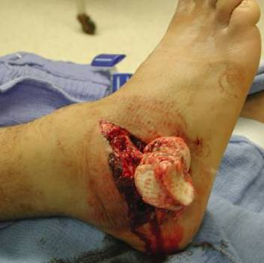
Take-home message
Accurate reduction is critical
Dual approaches
Avoid varus
Osteonecrosis does not equate to a poor result
Arthritis is common

