Slide 1
Minimally invasive osteosynthesis—minimizing surgical footprints
AO Trauma Advanced Principles Course
Notes:
Published: August 2013
Reviewed: 2018
Reviewer: Theerachai Apivatthakakul, TH

Slide 2
Learning objectives
Describe the principle and concept of minimally invasive treatment
Distinguish between conventional and minimally invasive fracture treatment
Explain pros and cons of conventional and minimally invasive treatment
Depict indications and tools for direct/indirect reduction
Describe implants used for minimally invasive osteosynthesis (MIO) (screw, plate, intramedullary (IM) nail, external fixator)

Slide 3
Minimally invasive osteosynthesis
Concept of biological fracture treatment
Reduce the iatrogenic trauma (surgical footprint) caused by surgery
Preserve blood supply to fracture fragments
Keep the proper environment for bone healing

Slide 4
Biological osteosynthesis
 | Conventional osteosynthesis | Biological osteosynthesis
N | 24 | 23
Bone graft | 10 | 0
Weight bearing (Mt) | 5.5 | 3.5
Delayed union/nonunion | 8 | 0
Infection | 5 | 0
Kinast et al (Clin Orthop Relat Res. 1989;(238):122–130)
Notes:
Reference:
Kinast C, Bolhofner BR, Mast JW, et al. Subtrochanteric fractures of the femur. Results of treatment with the 95 degrees condylar blade-plate. Clin Orthop Relat Res. 1989 Jan(238):122–130.

Slide 5
Definition—minimally invasive
Access to the bone through soft-tissue windows
Minimal trauma to the soft tissue and the bone by indirect reduction
Minimal additional trauma at the fracture site when direct reduction is necessary
Tools that leave “small footprints”

Slide 6
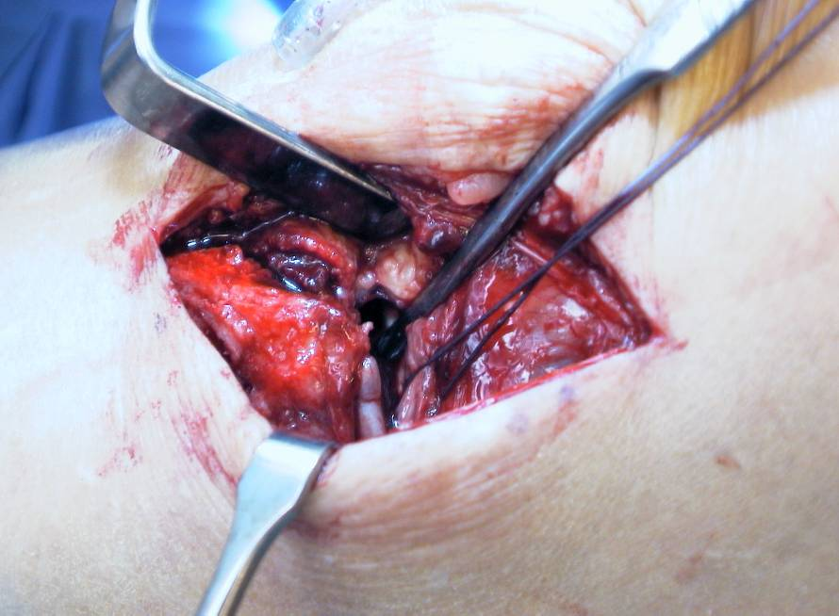
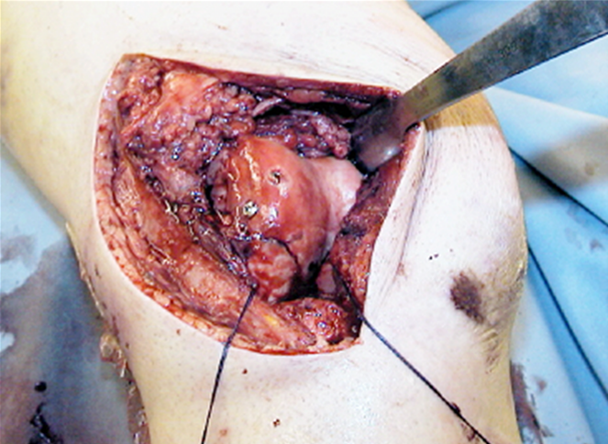
Minimally invasive osteosynthesis joint
Soft-tissue window:
Big enough to achieve anatomical reduction

Slide 7
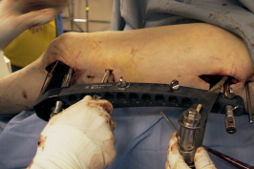
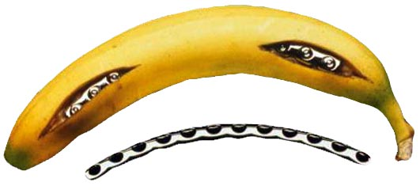
Minimally invasive osteosynthesis shaft
Soft-tissue window:
Away from the fracture site
Big enough to see or touch the plate and bone
Indirect reduction

Slide 8
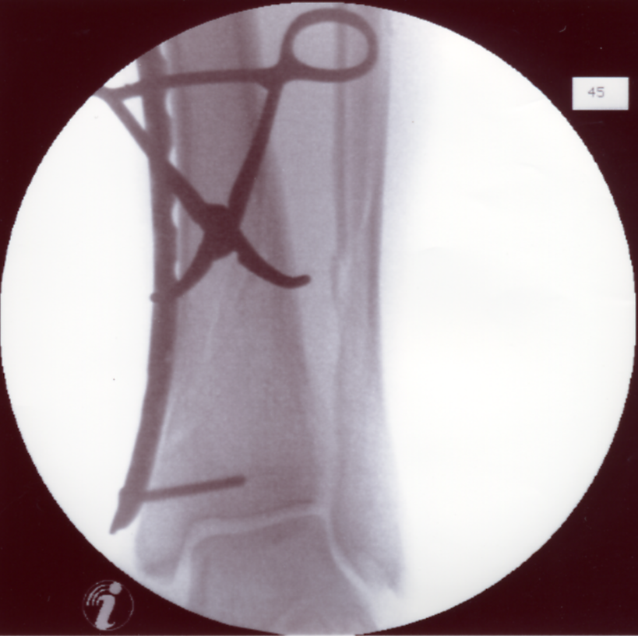
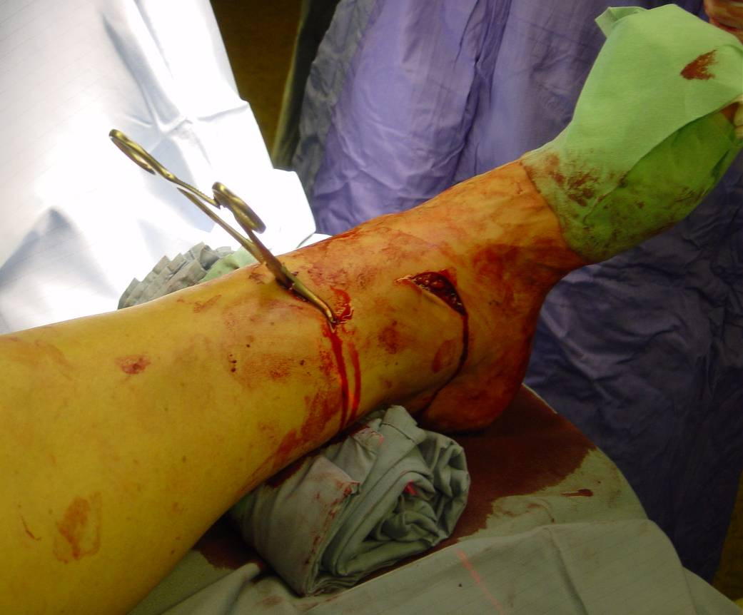
Minimally invasive osteosynthesis fracture site
Minimal additional trauma at the fracture site
Direct reduction

Slide 9
Indication for minimally invasive osteosynthesis
Some articular fractures:
Most displaced articular fractures still need open reduction internal fixation (ORIF)
Most metaphyseal fractures
Most diaphyseal fractures

Slide 10
Conventional ORIF versus MIO
Open reduction internal fixation:
Soft-tissue injures
Disrupts blood supply to fracture fragments
Delayed union
More anatomical alignment
Minimally invasive osteosynthesis:
Preserves soft tissue
Preserves viability of fracture fragments
Rapid healing
More malalignment

Slide 11
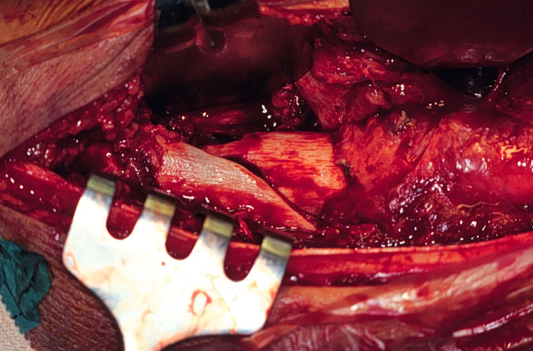
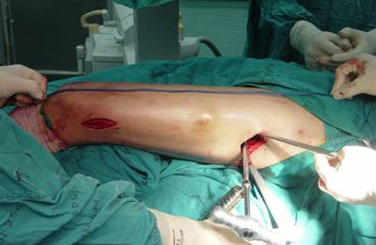
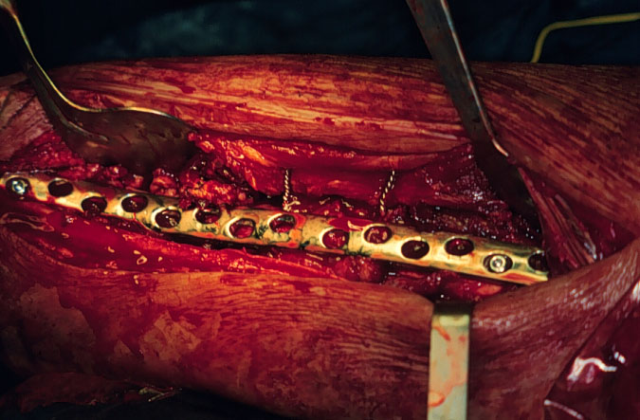
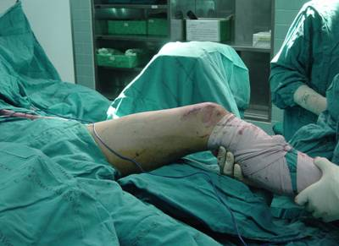
Conventional ORIF versus MIO

Slide 12
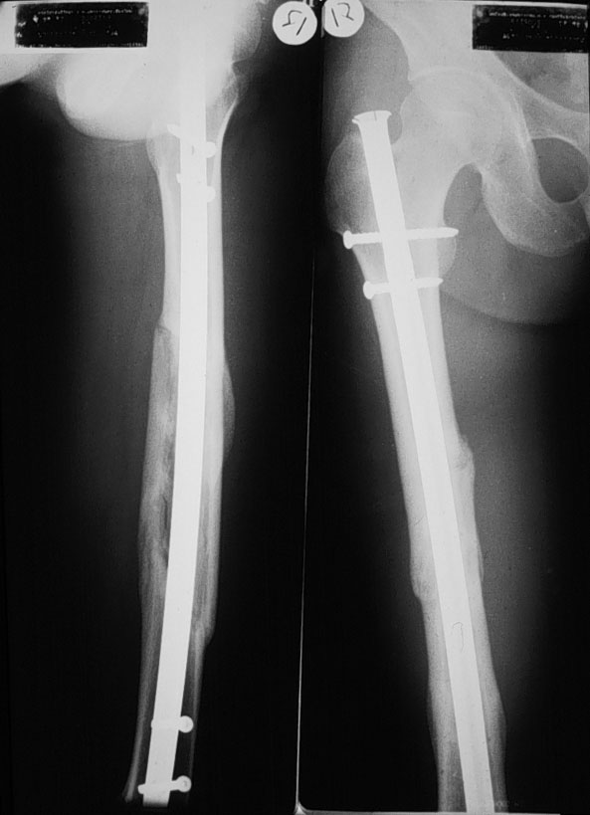
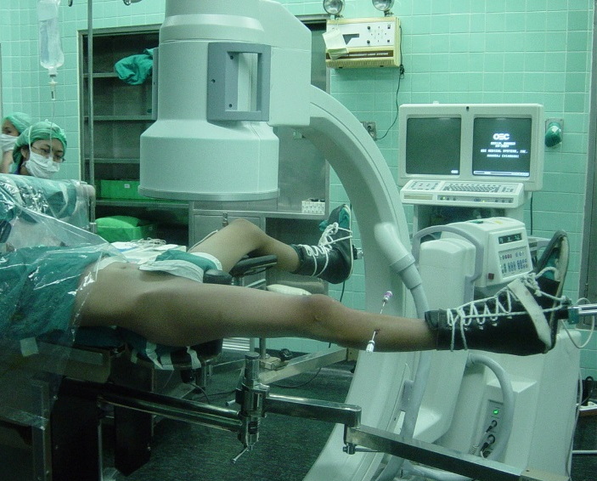
Conventional ORIF versus closed IM nailing

Slide 13
Minimally invasive osteosynthesis requires good planning—four “T”s
Timing—skin condition, difficult reduction in delayed case
Tools—reduction → MIO tools, fixation → stable implants
Teamwork—surgeons and operating room personnel (ORP)
Techniques and tactics
Notes:
If the fracture zone is not open, preoperative planning is important. The timing of surgery must be delayed until the soft tissue wrinkle appear, however if delayed, treatment may result in difficult closed reduction.
Some special reduction tools may require a stable implant.
Surgeons have to discuss with their team about preparing the right tools.

Slide 14
Minimally invasive osteosynthesis—definition of reduction
Indirect reduction:
Traction along axis of the limb
Direct force applied away from the fracture site
Soft tissue helps reduction (ligamentotaxis)
Direct reduction:
Direct force applied at the fracture site
Open or percutaneously

Slide 15
Indirect reduction—traction and manipulation
Manual traction
AO distractor
Fracture table
Reduction handle
External fixator

Slide 16
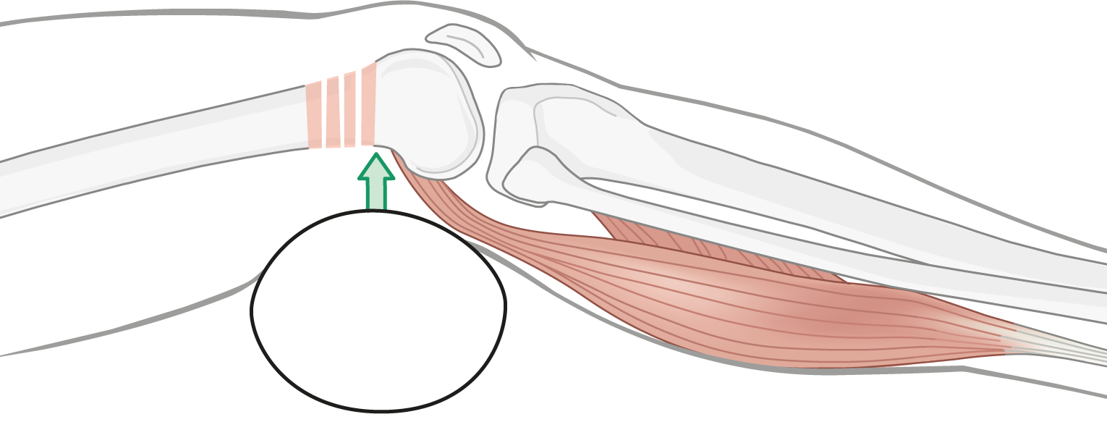
Tools for indirect reduction
Bolster, towel
Joystick
Plate
Screw and plate
Collinear clamp with plate
Direct force applied
away from the fracture site

Slide 17
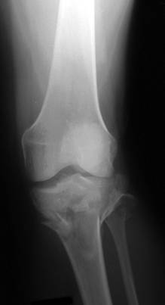
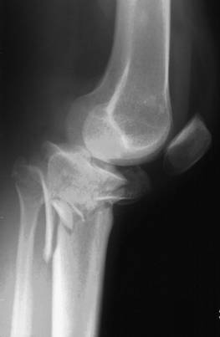
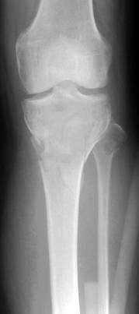
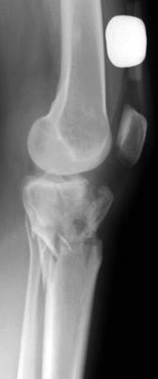
Traction—ligamentotaxis
Ligamentotaxis → reduction
Fragments that attach to soft tissue

Slide 18
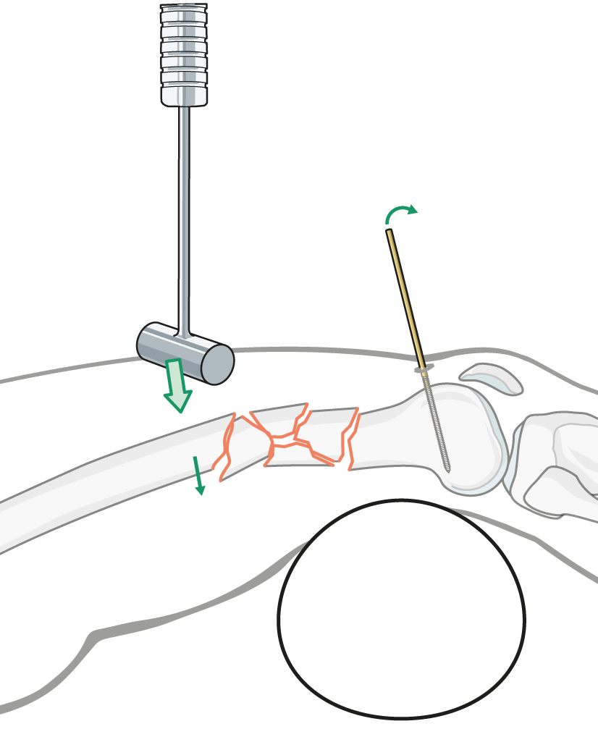
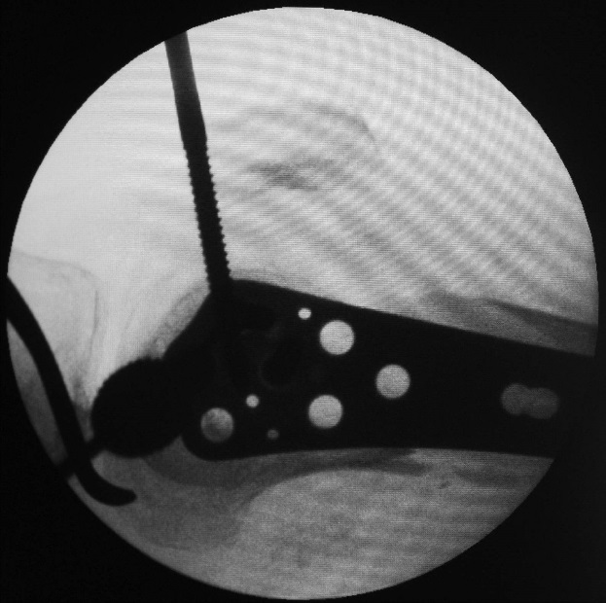
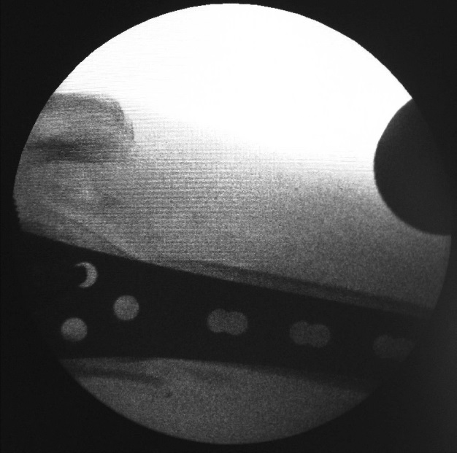
Bump—positioning and joystick
Hammer pushes the proximal fragment
Joystick controls the distal fragment

Slide 19
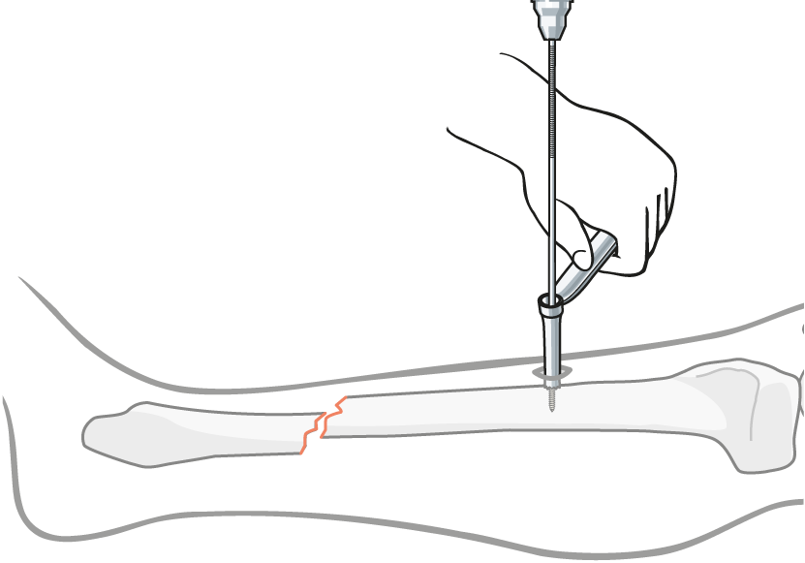
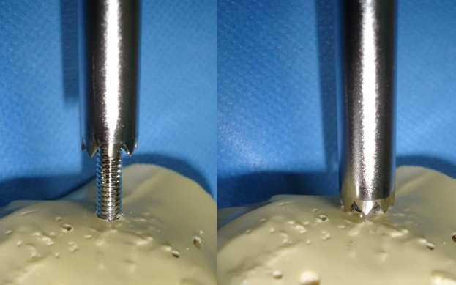
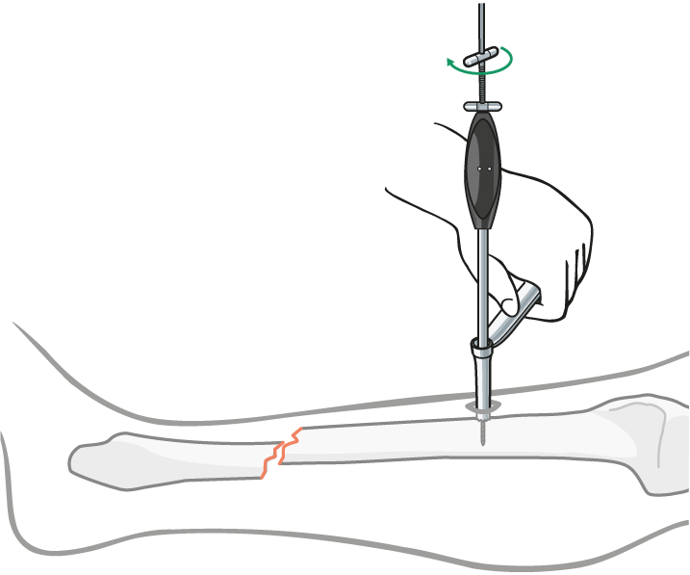
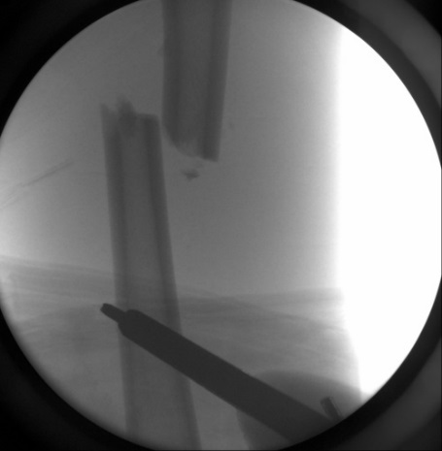
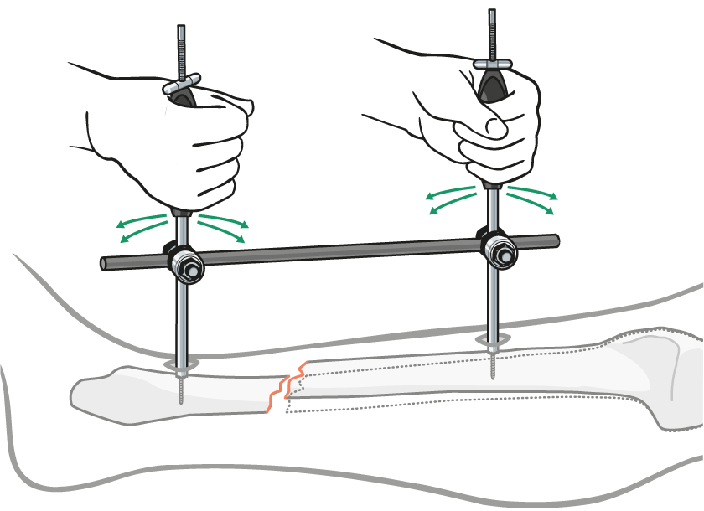
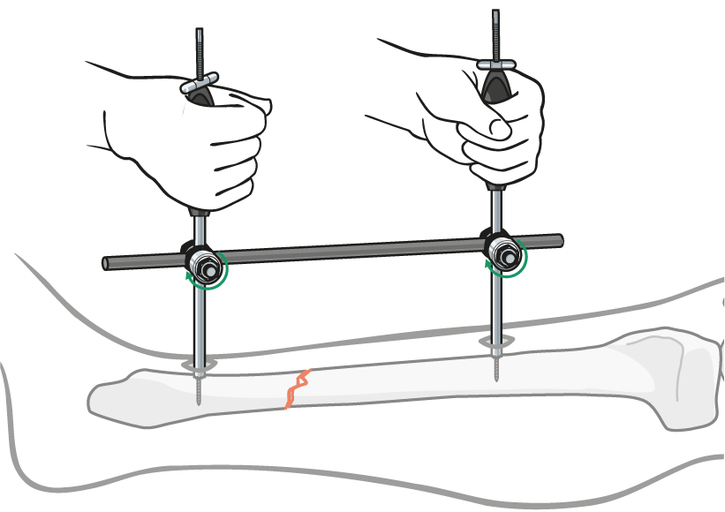
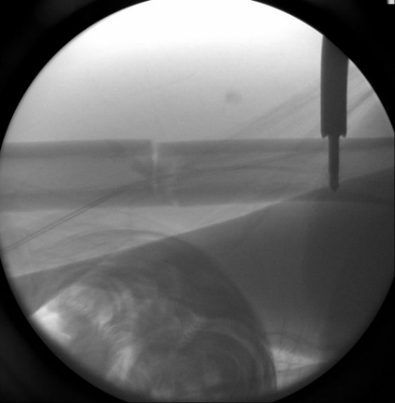
Reduction handle
Notes:
The reduction handle has a special sharp tip which, when compressed on the bone, will allow for three-dimensional control of the fracture movement.

Slide 20
External fixation

Slide 21
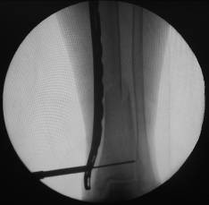
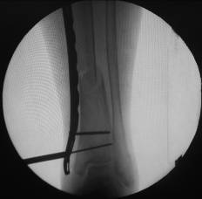
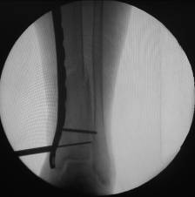
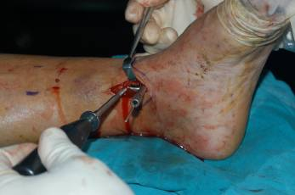
Screw and plate
Notes:
This assumes that the plate is well contoured. Note that this only works with conventional (nonlocked) implants.

Slide 22
Direct reduction
Anatomical reconstruction
Absolute stability by rigid fixation
Articular fractures
Simple metaphyseal fractures
Osteotomies and nonunions
Hazards:
Too wide of an exposure
Excessive periosteal stripping

Slide 23
Tools for direct reduction
Hohmann retractor
Screw (lag screw)
Collinear clamp
Pointed reduction clamp
Cerclage
Force applied directly
at the fracture site
Open or closed (MIPO)

Slide 24
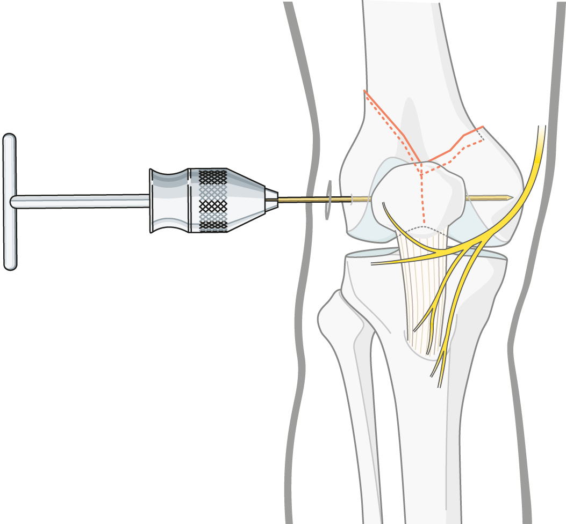
Joystick

Slide 25
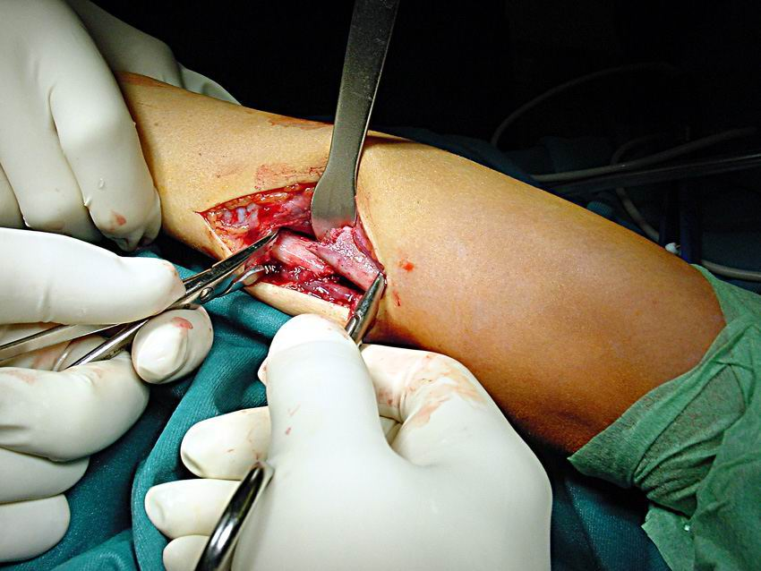
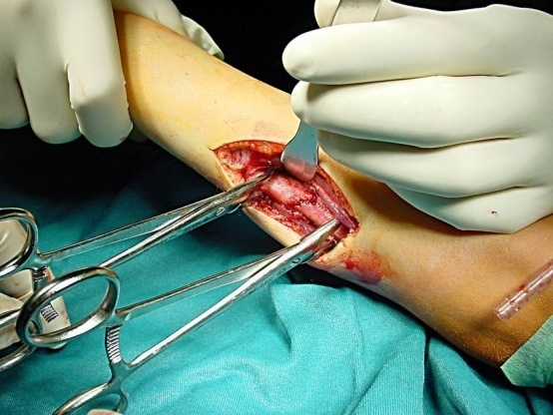
Pointed reduction forceps
Direct manual reduction with the pointed reduction forceps
Notes:
Direct manual reduction with the pointed reduction forceps. Each main fragment is held with a pointed reduction forceps. Lengthening is achieved by manual distraction while proper axial alignment can be controlled with the forceps.
Direct reduction with standard reduction forceps. One branch of the clamp is positioned on each main fragment. With some pressure and simultaneous rotation of the handles the bone is lengthened and the fragments are reduced.

Slide 26
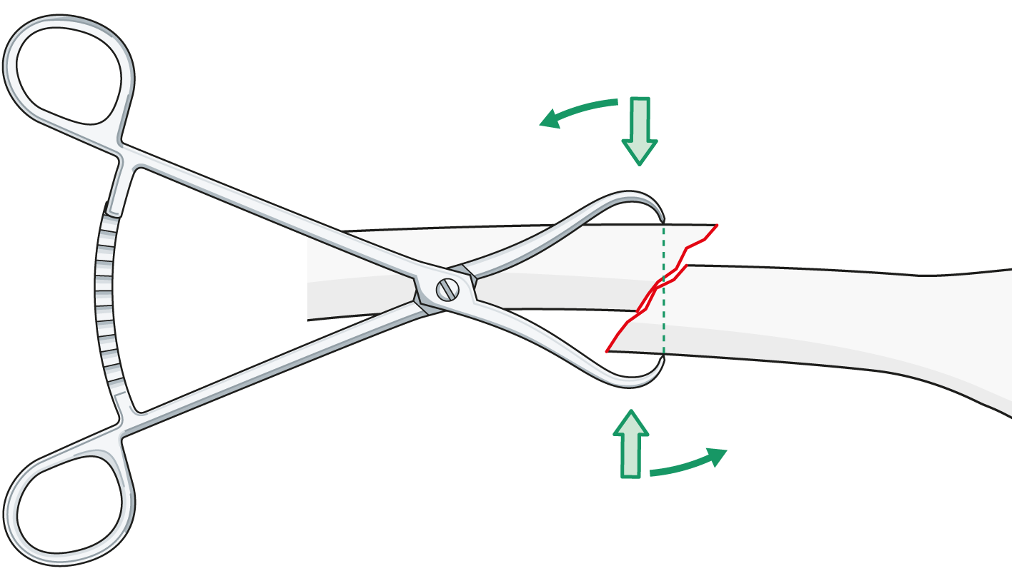
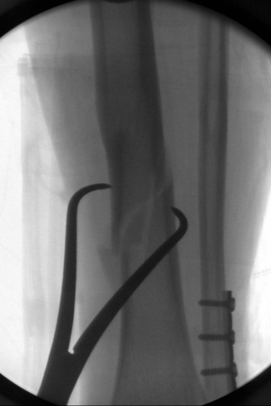
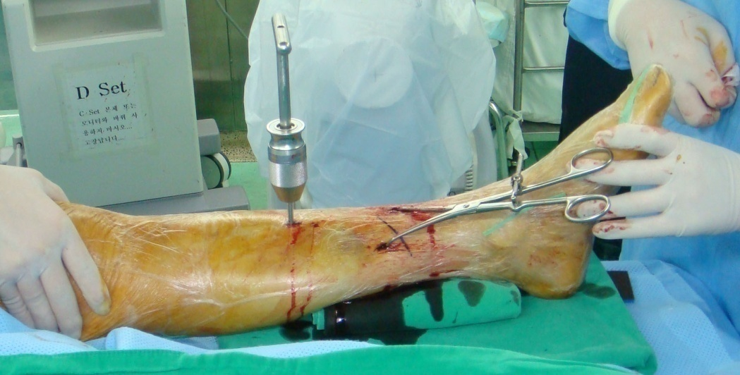
Reduction forceps
Per~Q approach

Slide 27
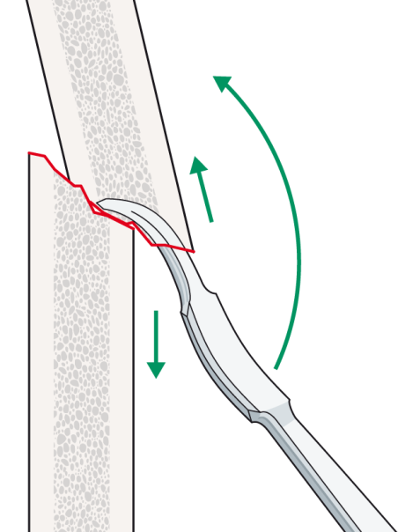
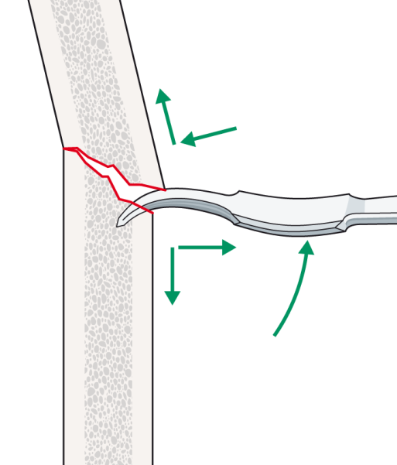
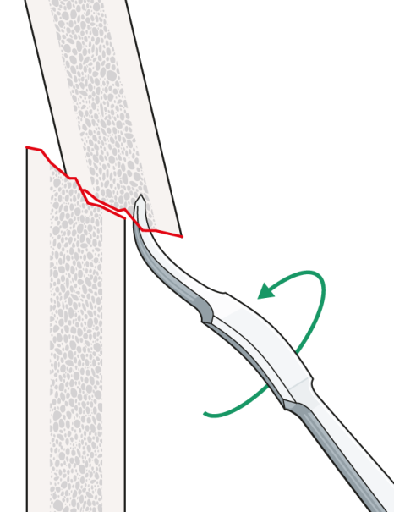
Hohmann retractor
Use as a lever or pusher
Reduction by turning and bending
Advantage: big force with little exposure
Hazards:
Additional fragmentation
Loss of reduction upon Hohmann removal

Slide 28
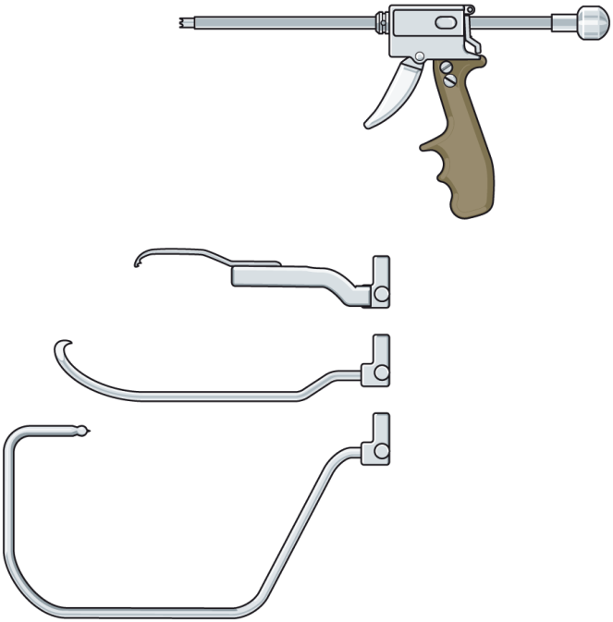
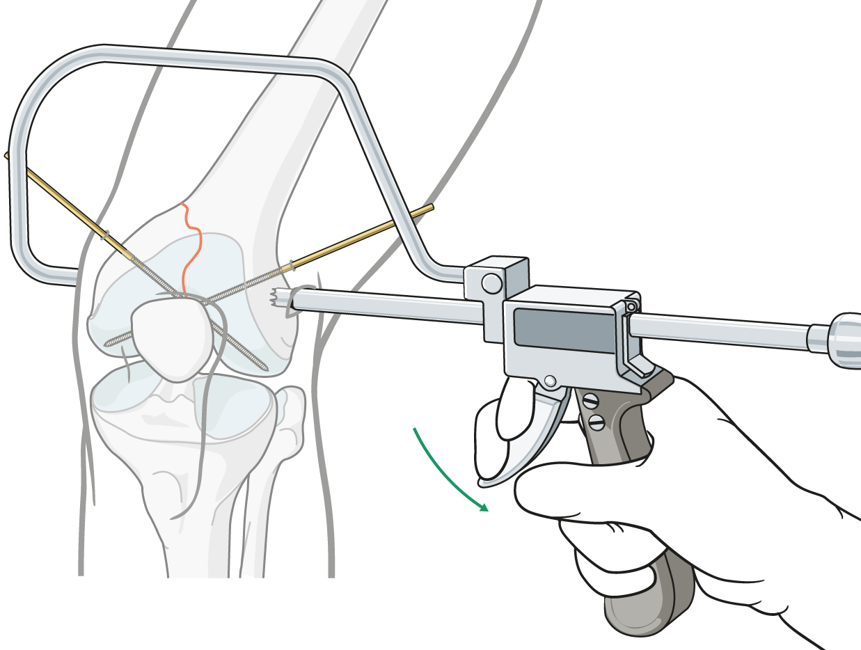
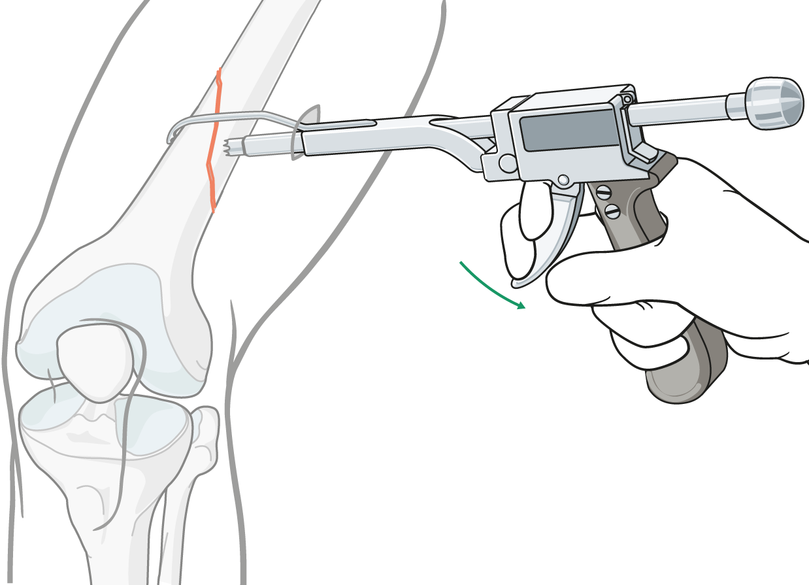
Collinear forceps
Collinear closing system with modular arms
Good for articular, oblique, and spiral fractures

Slide 29
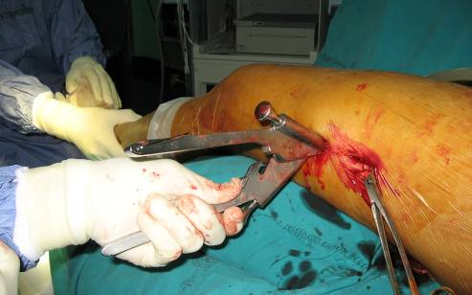
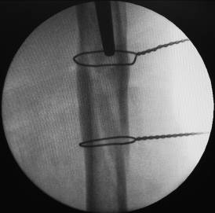
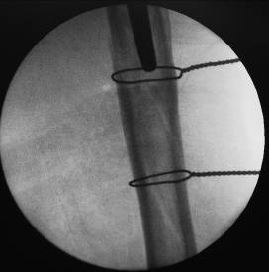
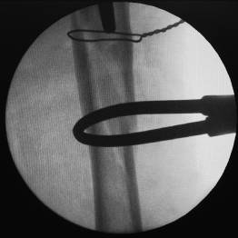
Cerclage wiring

Slide 30
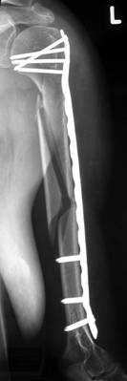
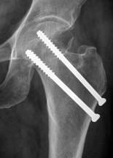
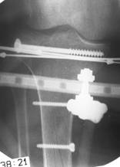
Implants for minimally invasive osteosynthesis
Screw
IM nail
Plate
External fixator
Notes:
Every implant can be applied using the MIO concept. Percutaneous screws for femoral neck, MIPO of the humeral shaft, closed nailing of the femur, or hybrid external fixator of the tibial plateau.
The red lines show the skin incisions and the fracture zones (in blue) are left undisturbed.

Slide 31
Advantages of minimally invasive osteosynthesis
Rapid and strong bone healing
Less infection
Decrease the need for bone graft
Less pain
Faster rehabilitation
Better cosmetic appearance

Slide 32
Disadvantages of minimally invasive osteosynthesis
Limited view
Increased C-arm time
Malunion
Pseudarthrosis through diastasis
Delayed union with flexible fixation in simple fractures

Slide 33
Take-home messages
Preoperative plan and case analysis are critical
Soft-tissue window: key is not length of incision
Be aware of danger zones!
Indirect or direct reduction as necessary
Reduction tools: minimal additional trauma
Basic principles of ORIF remain the same

