Slide 1
Discussion group 2 Proximal humeral fractures
AOTrauma Masters Course Upper Extremity Current Concepts

Slide 2
Case 1
37-year-old man
Pedestrian hit by a car
Concussion (brain computed tomographic (CT) scan negative)
Dominant extremity
Neurovascular OK

Slide 3
Three-dimensional CT reconstruction

Slide 4
3 weeks after surgery in another hospital

Slide 5
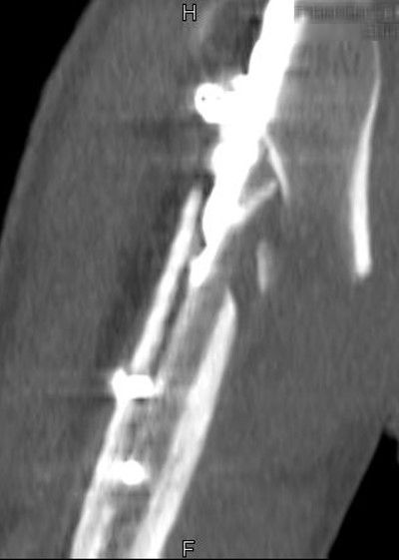
Three-dimensional CT reconstruction

Slide 6
Image intensification in operating room
What to do ?
Notes:
Stable malreduction !

Slide 7
What to do?
37-year-old man
Four weeks after initial surgery
Conservative
Plate OS
Nail OS
Other
Plan you surgery
Notes:
* Conservative ?
What we will expect healing and clinical outcome
* Surgery?
Plan your surgery
Deltoideopectoral vs. transdeltoideal approach
IM nail – same entry or new entry in humeral head
Plate – technique – absolute or relative stability ? Grafting ?

Slide 8
Reosteosynthesis: long PHILOS plate
Deltopectoral approach
Intramedullary nail removed
Humeral head reduction
Bridging plate osteosynthesis
Chronos in comminution area

Slide 9
3 months after surgery: long PHILOS plate

Slide 10
1 year after surgery

Slide 11
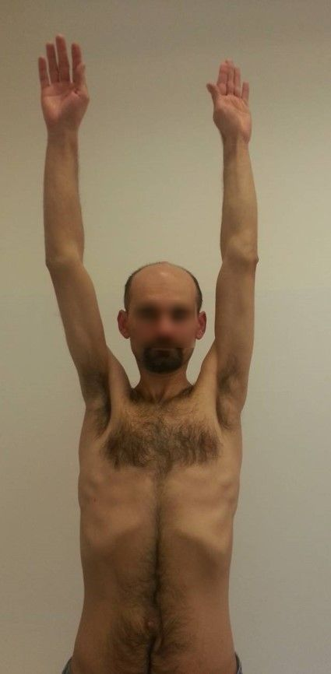
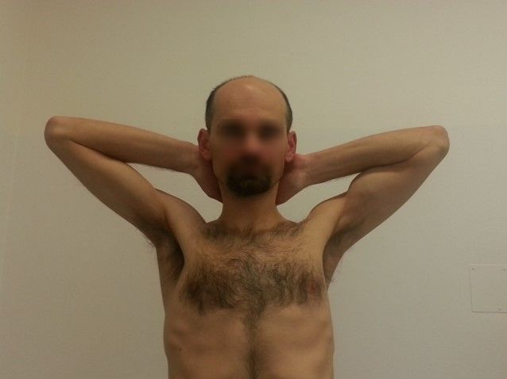
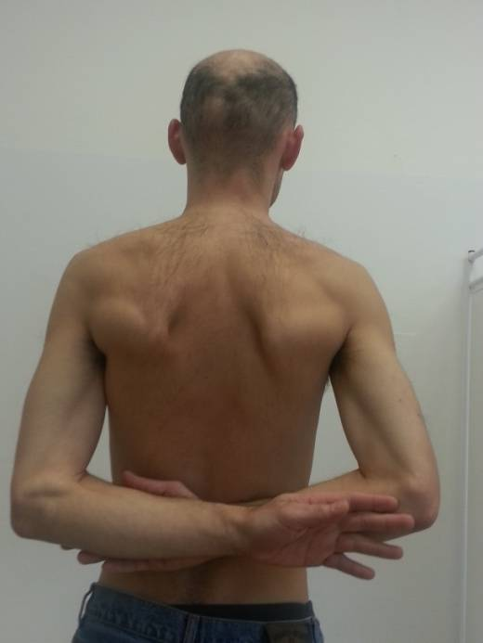
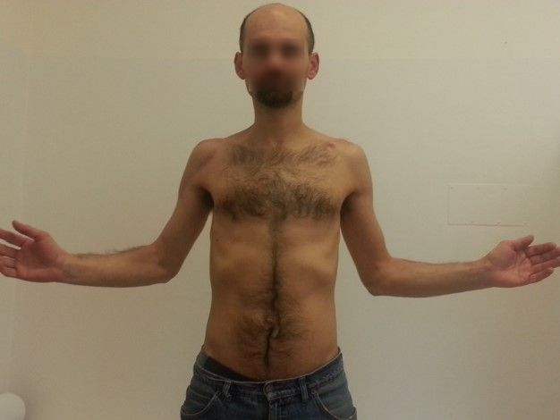
Functional results 1 year after surgery
rCMS 96 points

Slide 12
Take-home messages
Intramedullary nailing for proximal humeral fractures is a viable option
Like all nailing, it requires fracture reduction prior to nailing
Early revision after a malreduction open reduction and internal fixation gives the best chance for a good outcome
“Failed” nail often revised with a plate
Allows for direct reduction

Slide 13
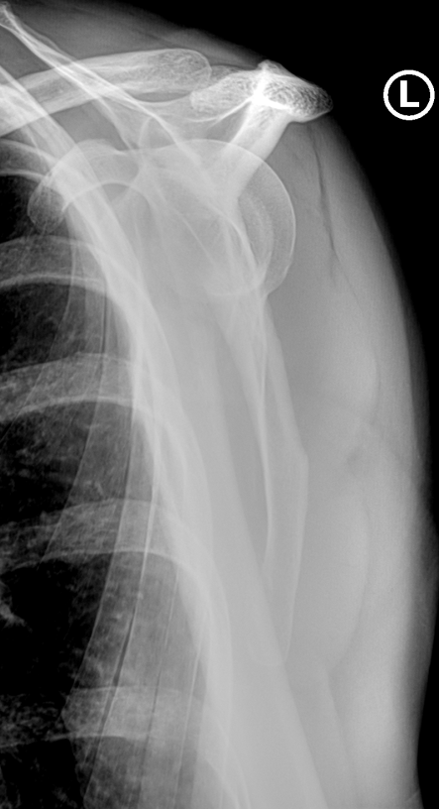
Case 1
59-year-old woman
Ski injury
Nondominant extremity
Neurovascular OK
Is this displaced?
Is this unstable?
Would you recommend surgery?

Slide 14
After surgery
Deltopectoral approach
5-hole PHILOS plate
Any red flags?
What would you expect?
Notes:
Deltoideopectoral approach
5hole Philos plate
Coment quality of reduction
Stability of osteosynthesis

Slide 15
6 weeks
3 months
After surgery
Progressive pain
Restricted movement

Slide 16
6 months after surgery
Persistent pain
Shoulder elevation only 45°
Notes:
What to do?

Slide 17
Two-dimensional reconstruction
What now?

Slide 18
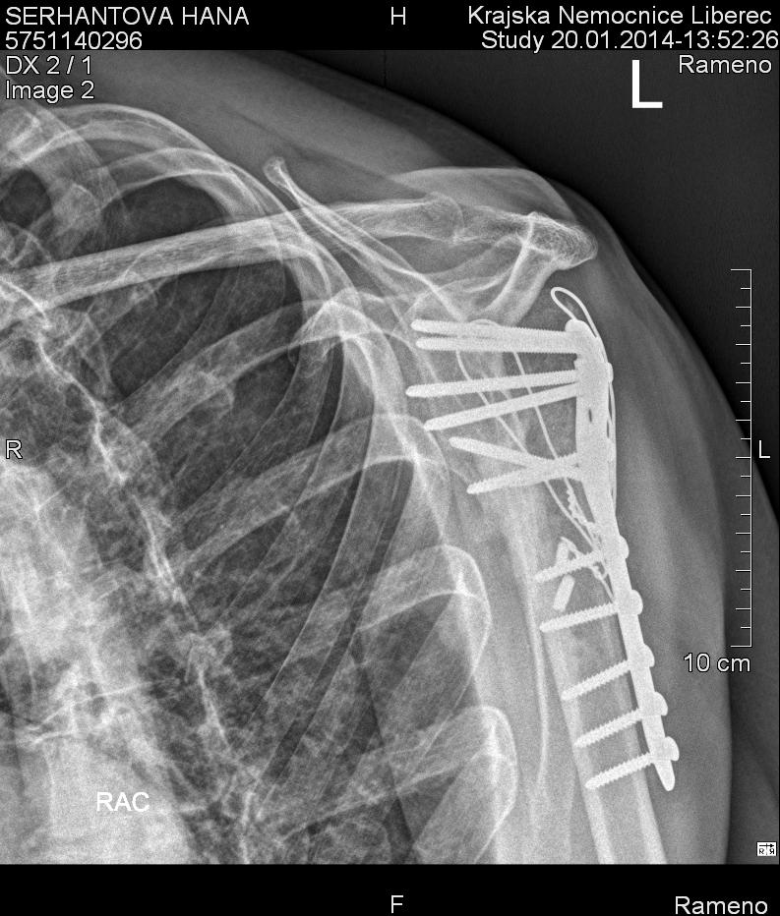
After reosteoysnthesis
Neutralization of rotator cuff forces
Lag screw
Cancellous bone grafting
Notes:
1. Deltoideopectoral approach
2. Cancellous bone grafting to hole in humeral head and around metaphyseal nonunion
3. Interfragmentary compression
4. Neutralization of rotator cuff forces

Slide 19
Six months after reosteosynthesis

Slide 20
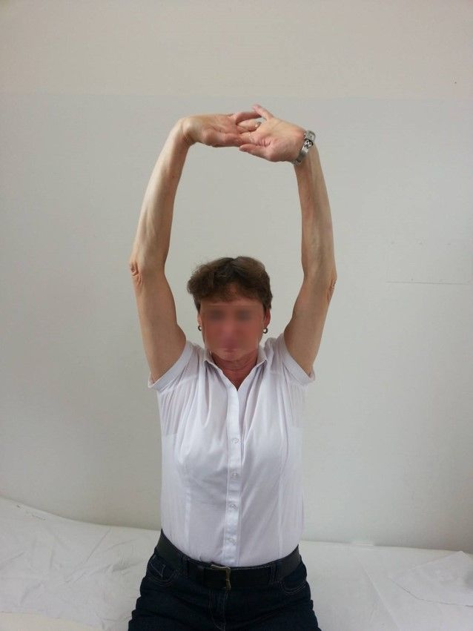
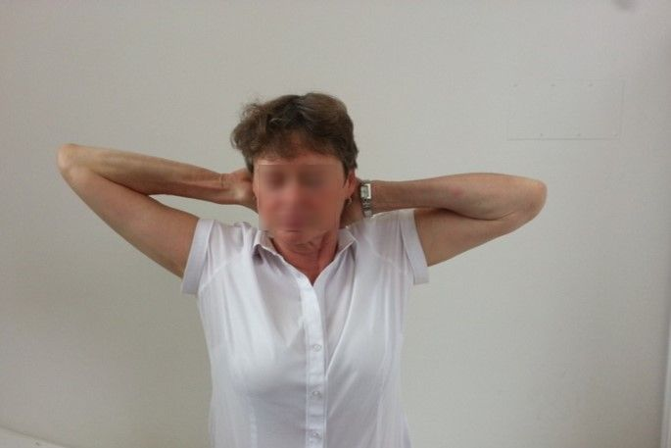
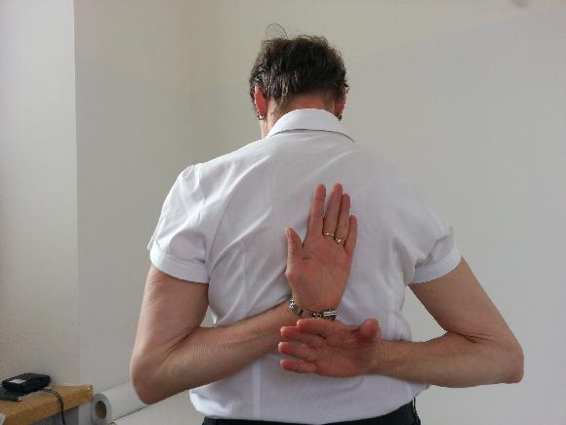
Functional results 1 year after surgery

Slide 21
Take-home messages
Open reduction and internal fixation with locked plate needs to be technically excellent or there is high rate of complications
Unsupported medial column very difficult to stabilize with locked plate alone
Consider fibular allograft in these situations

Slide 22
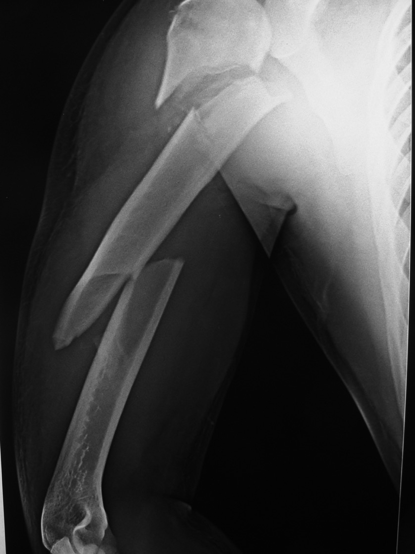
Case 3
29-year-old man
MCA 1 week
Working abroad, home by plane
Any concerns?
Plan?

Slide 23
Clinically
Swollen right upper limb
Weak movement of the elbow and hand
Radial pulse weak
Next steps?

Slide 24
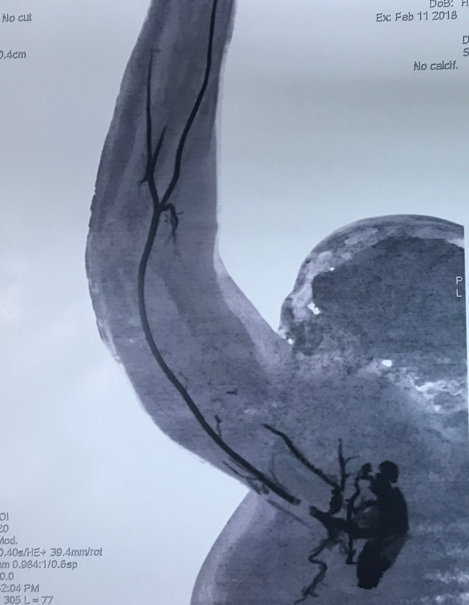
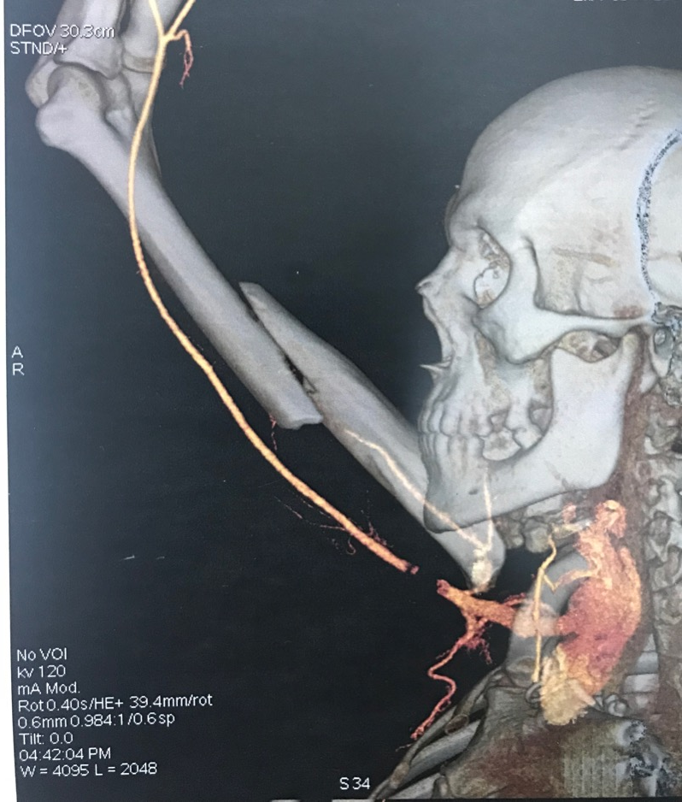
Computed tomographic angiography
Plan?
Sequence?

Slide 25
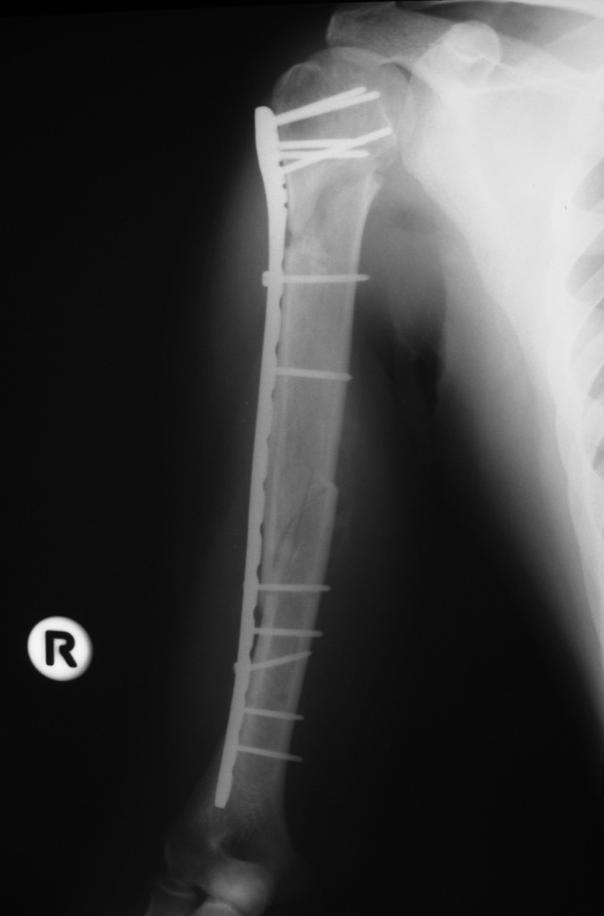
Open reduction and internal fixation long PHILOS plate and vascular graft
What type of approach/fixation?
Distal elbow and hand movements still weak at 6 weeks
Further investigations?

Slide 26
NCV
Demyelinating and axonal affection of all trunks of BP
Severely affecting the axillary nerve
How to proceed?

Slide 27
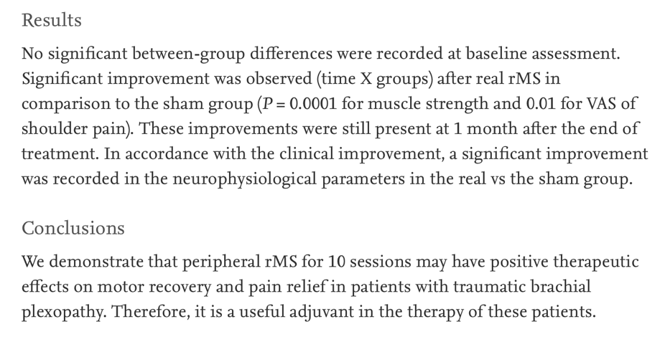
Peripheral magnetic stimulation
(Khedr et al. Neurophysiol Clin. 2012 Apr;42(3):111–118)
Notes:
Khedr EM, Ahmed MA, Alkady EA, et al. Therapeutic effects of peripheral magnetic stimulation on traumatic brachial plexopathy: clinical and neurophysiological study. Neurophysiol Clin. 2012 Apr;42(3):111-118.

Slide 28
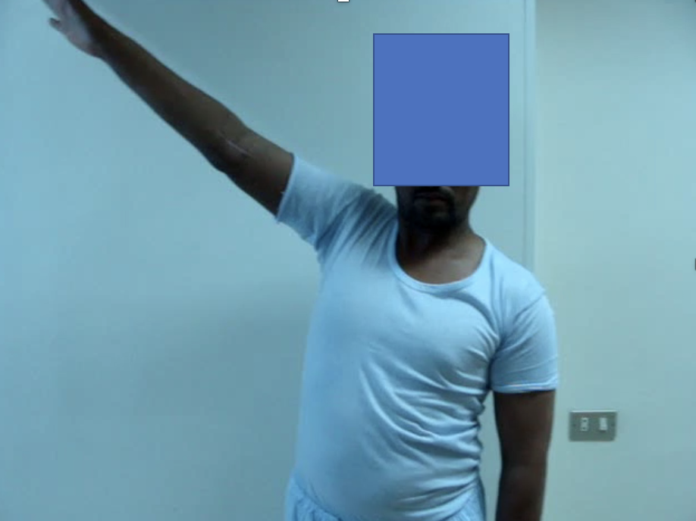
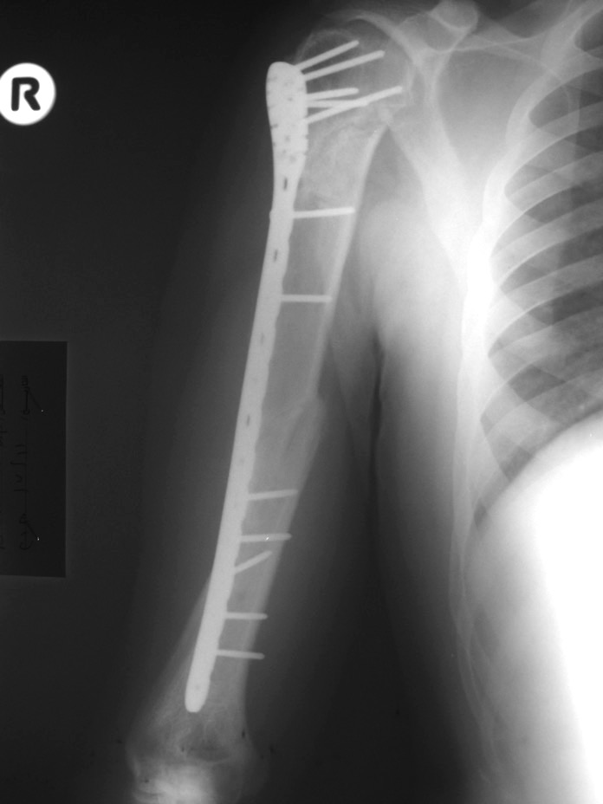
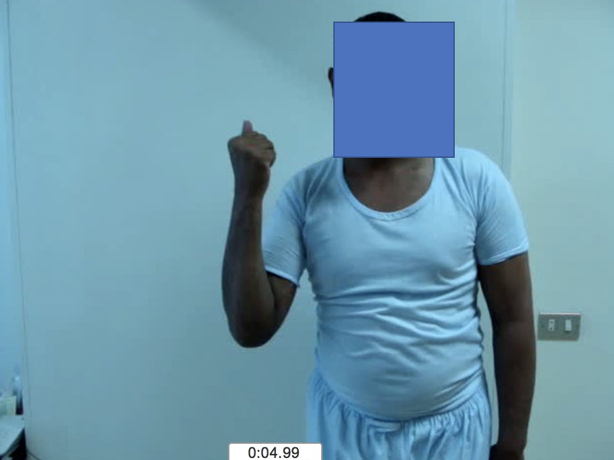
Follow-up at 8 months

Slide 29
Take-home messages
Be aware of vascular injury in medially displaced shaft fractures
High-energy UL trauma maybe associated with brachial plexus injury
Peripheral magnetic stimulation is a useful adjunct to assist in these injuries

Slide 30
Case 4
51-year-old woman
Fell three steps off a step stool
Right-hand dominant
No medical comorbidities
Isolated injury
What is the recommended treatment?
What is the expected outcome of nonoperative treatment?

Slide 31
Any criticisms?
Any red flags?

Slide 32
After 3 months, progressive pain
What could have been done differently?
What is the best treatment now?

Slide 35
Take-home messages
Evaluate locus point of failure
Shaft fixation failure uncommon in proximal humeral open reduction and internal fixation
Removing plate fixation from head not necessary, can impair subsequent fixation strength from bone loss

Slide 36
Case 5
47-year-old man
Nonsmoker
Right-hand dominant
Tripped and fell
What to do ?
Notes:
Stable malreduction !

Slide 38
At 2 months
Notes:
* Conservative ?
What we will expect healing and clinical outcome
* Surgery?
Plan your surgery
Deltoideopectoral vs. transdeltoideal approach
IM nail – same entry or new entry in humeral head
Plate – technique – absolute or relative stability ? Grafting ?

Slide 39
At 4 months
Notes:
* Conservative ?
What we will expect healing and clinical outcome
* Surgery?
Plan your surgery
Deltoideopectoral vs. transdeltoideal approach
IM nail – same entry or new entry in humeral head
Plate – technique – absolute or relative stability ? Grafting ?

Slide 40
What is the diagnosis?
What is the chance of success of continued nonoperative treatment?
What is the role of arthroplasty?
What is the surgical plan?
Notes:
* Conservative?
What we will expect healing and clinical outcome
* Surgery?
Plan your surgery
Deltoideopectoral vs. transdeltoideal approach
IM nail – same entry or new entry in humeral head
Plate – technique – absolute or relative stability ? Grafting ?

Slide 42
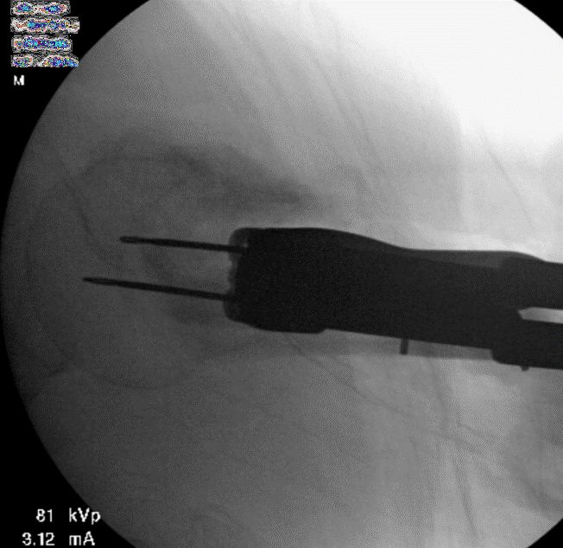

Slide 44
At 4.5 months postoperative

Slide 45
Take-home messages
“Corticalization” of humeral head after nonoperative treatment of a surgical neck fracture is a sign of impending nonunion
Open reduction and internal fixation with nonunion repair is a very predictable procedure
Fibular allograft provides excellent stability for healing

