Slide 1
Discussion group 3 Elbow injuries
AOTrauma Masters Course Current Concepts—Upper Extremity I

Slide 2
Case 1
51-year-old woman
Fell off a horse
Rib fractures
No neurological deficits
What to do ?
Notes:
Stable malreduction !

Slide 3
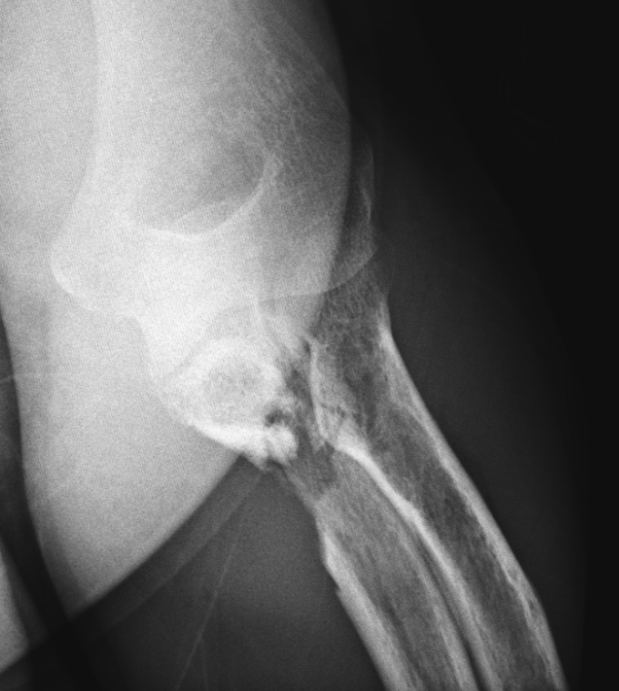
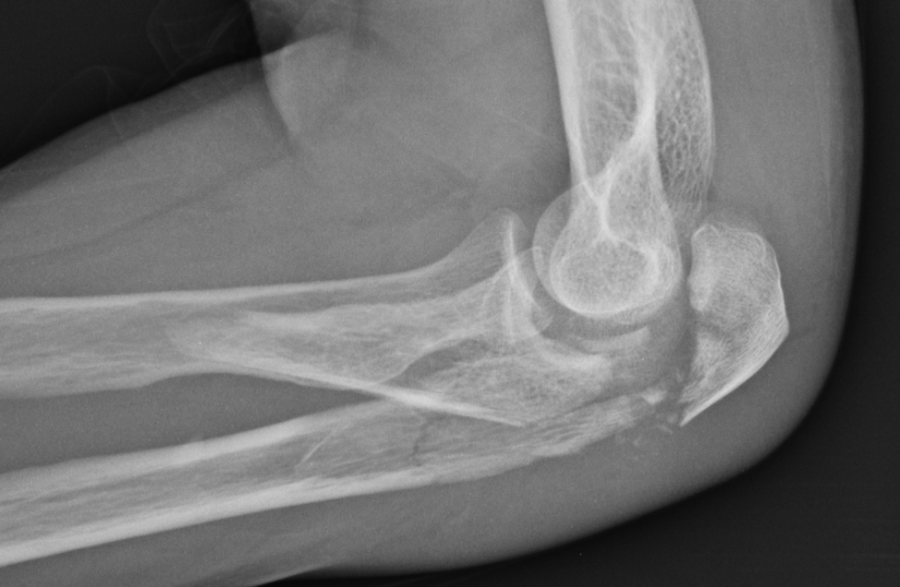

Slide 4
What is this injury pattern?
What are the dominant fragments?
Computed tomography (CT) necessary?
Positioning?
Surgical approach?
Reconstruction tactic?

Slide 5
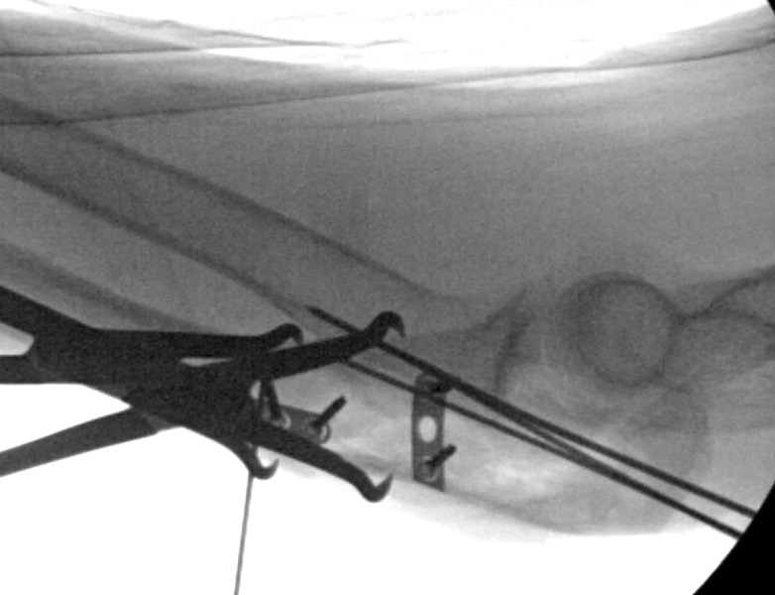

Slide 6
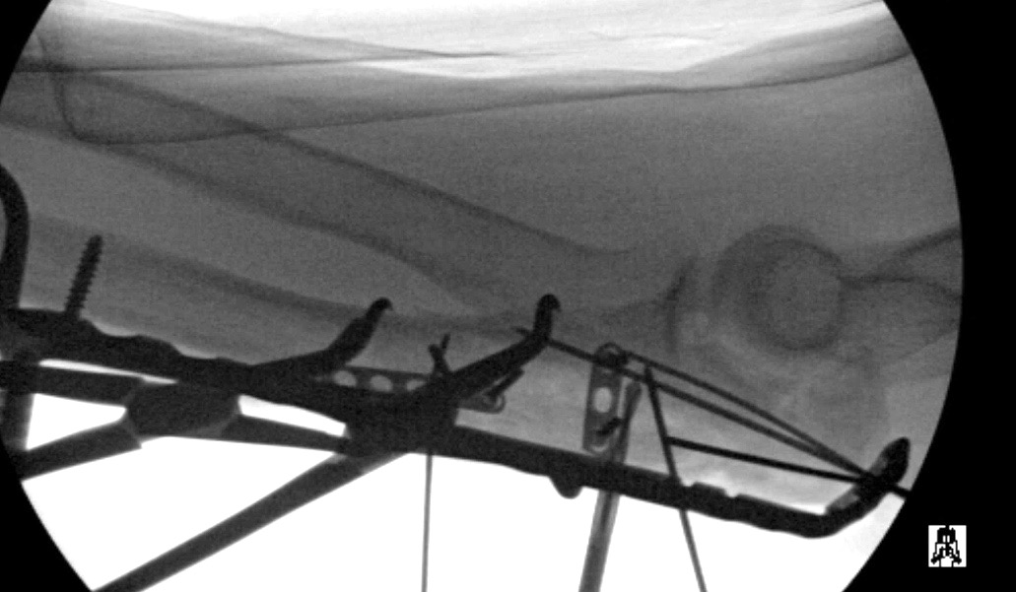

Slide 7
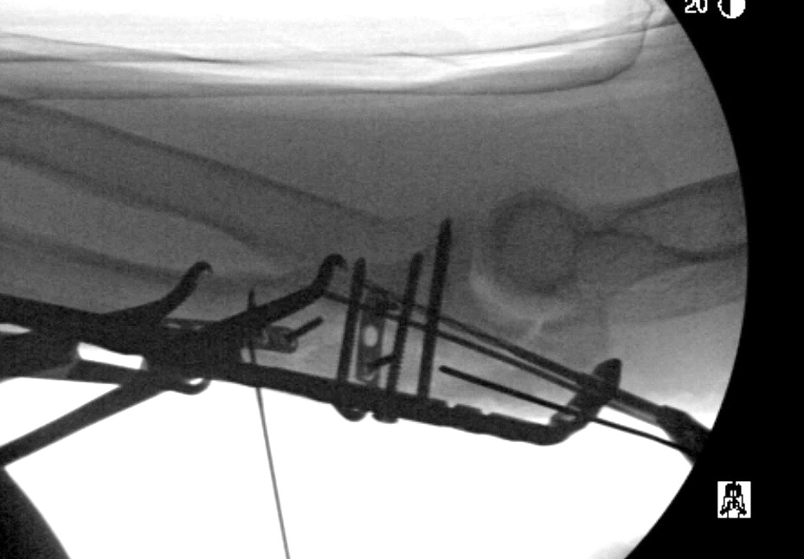

Slide 8
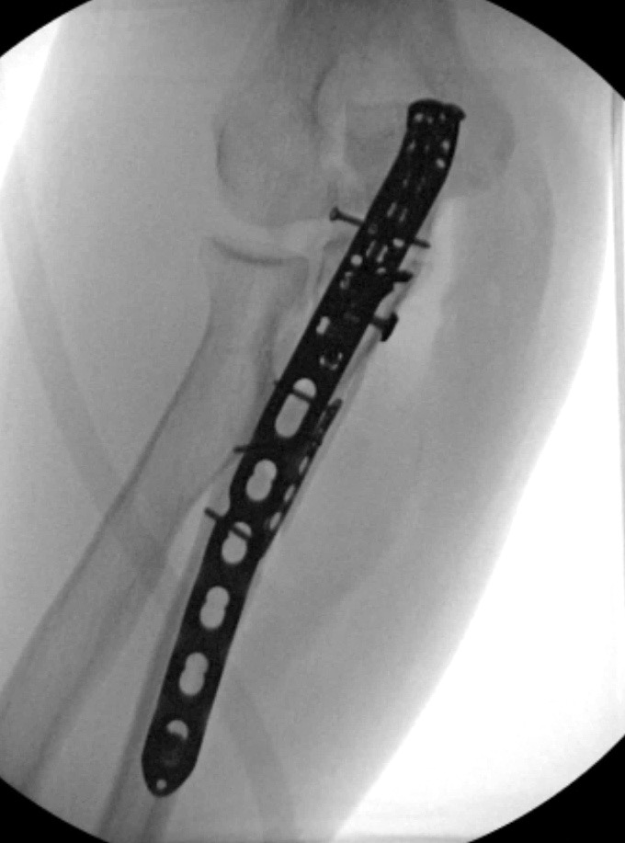
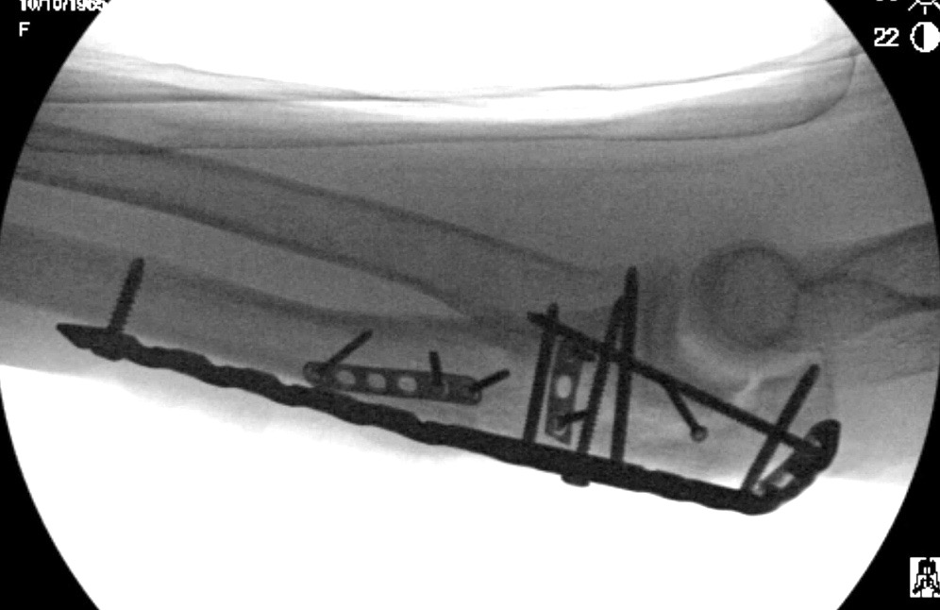

Slide 9
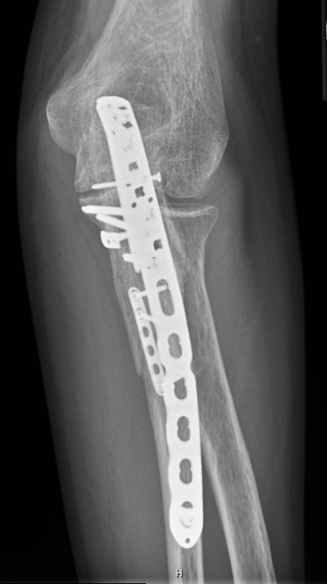
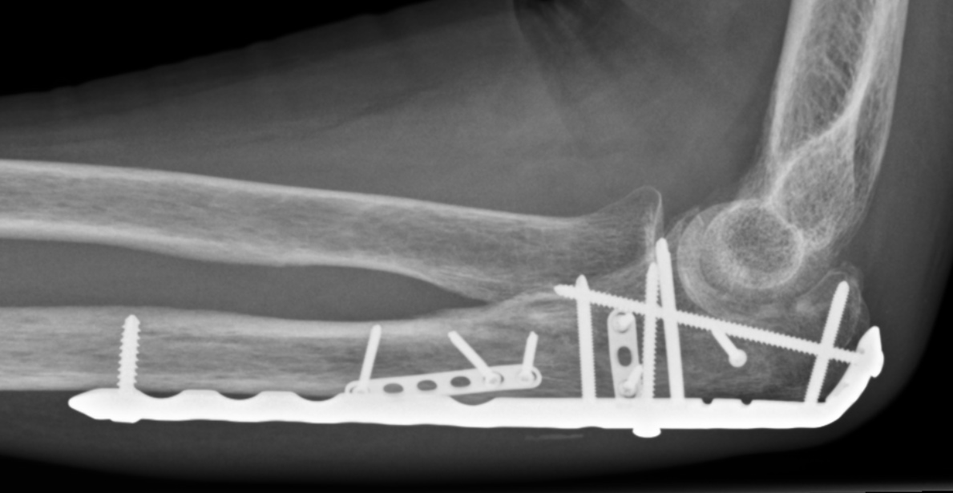
3 months postoperative, no pain, full range of motion

Slide 10
Take-home messages
Plan sequence carefully
Importance of reduction and fixation of large coronoid fragment
Minifragment plates for sidewall comminution useful
Fixation of small olecranon tip fragment
Long dorsal plate
Early motion

Slide 11
Case 2
57-year-old man
Motorcycle accident
Mild pulmonary contusions and three rib fractures
Closed elbow injury
What to do ?
Notes:
Stable malreduction !

Slide 12
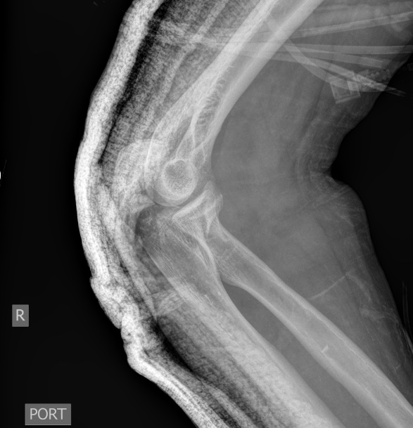
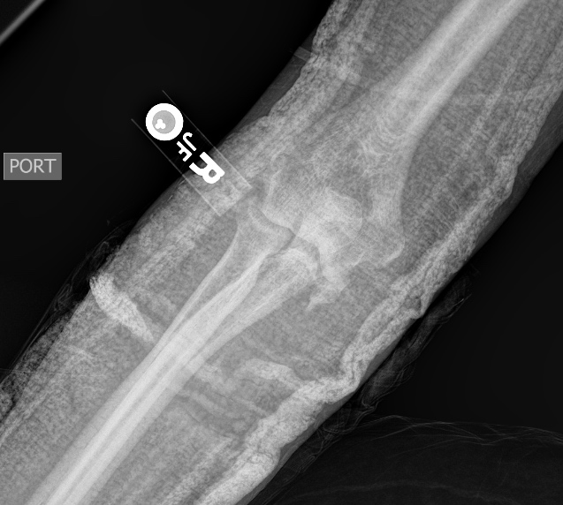

Slide 13
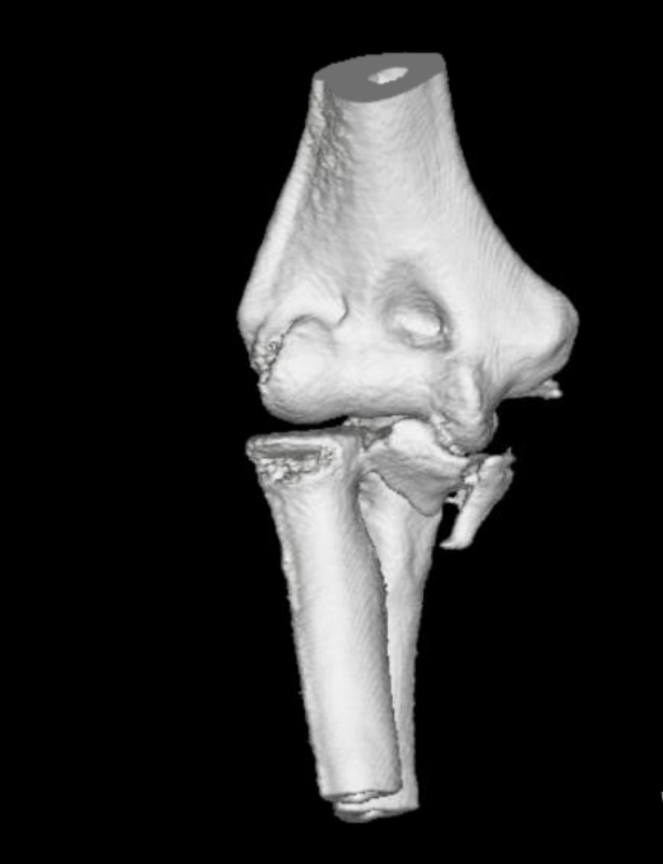
Describe injury
What are the critical components?
How to address the coronoid component?

Slide 14
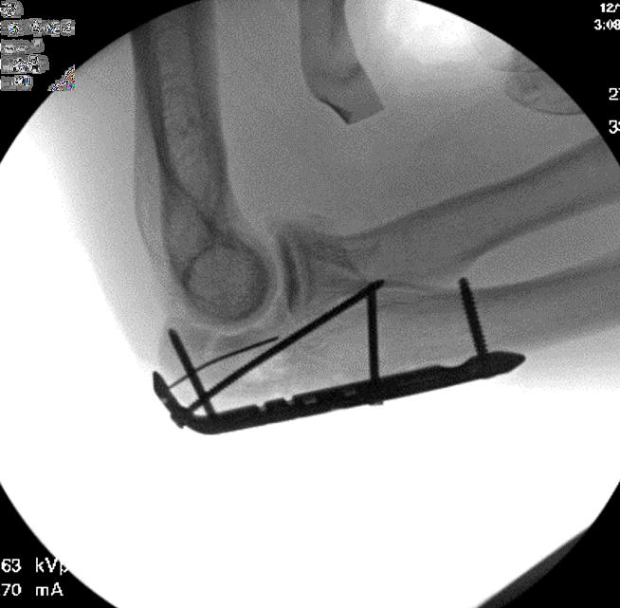

Slide 15
Olecranon fixed through posterior approach
Anteromedial coronoid fragment fixed with flexor carpi ulnaris (FCU) split
Anterior coronoid fragment fixed through direct anterior approach

Slide 16
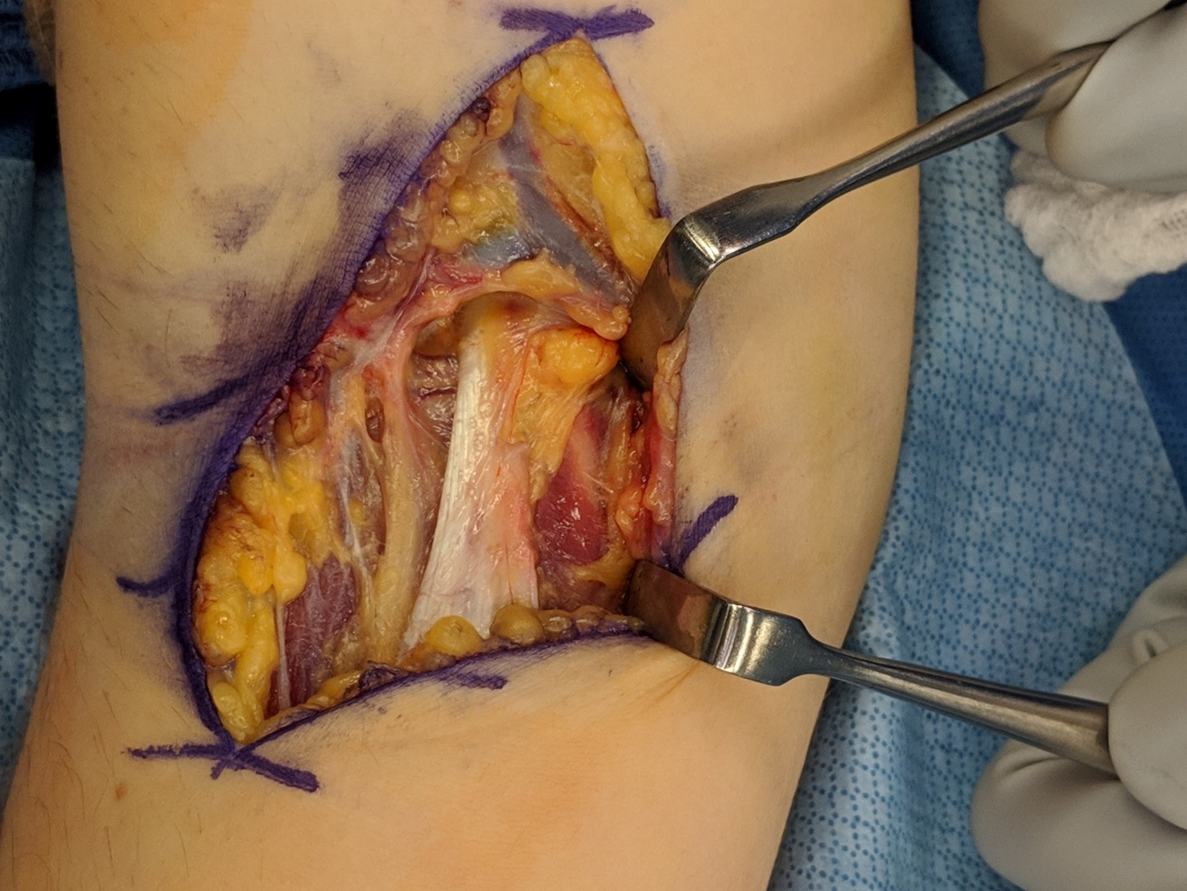

Slide 17
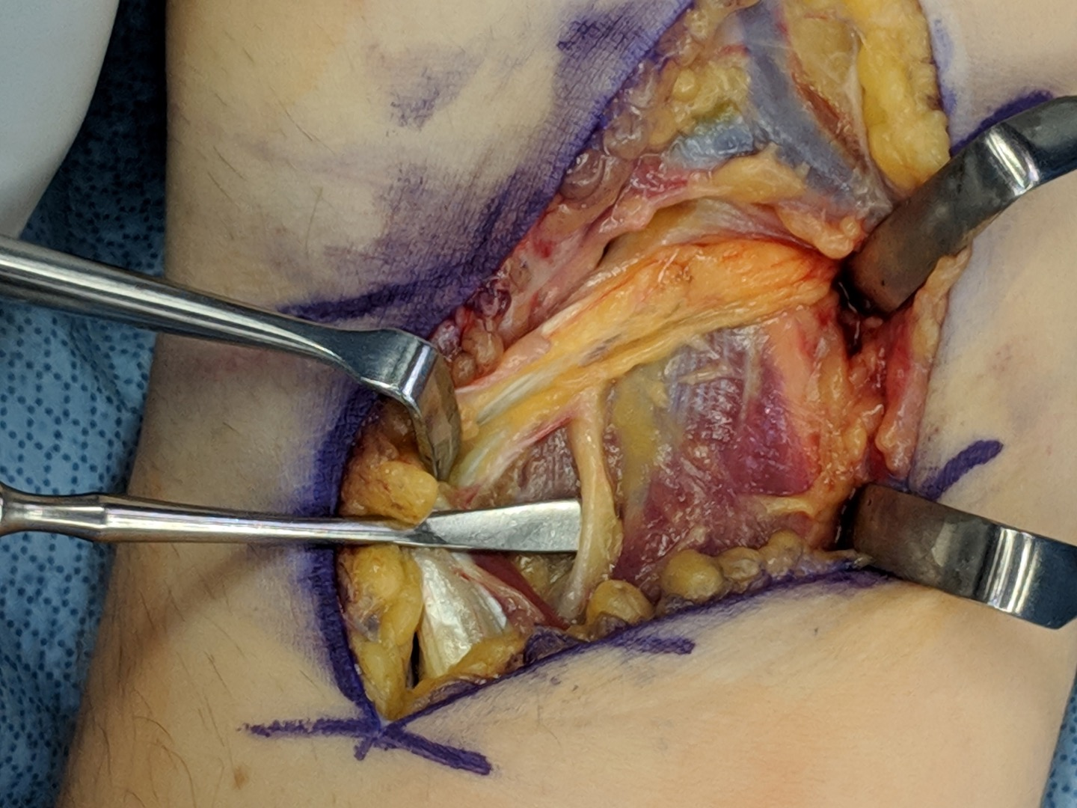
Retract biceps
Protect musculocutaneous nerve

Slide 18
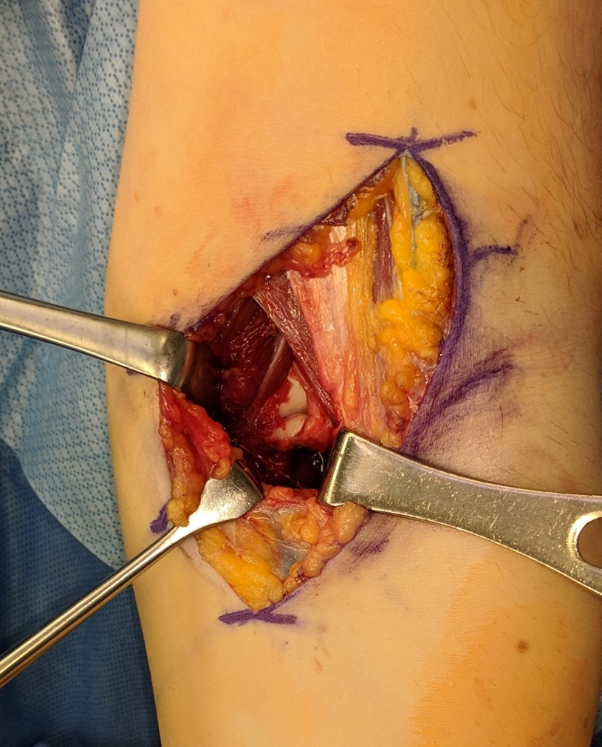
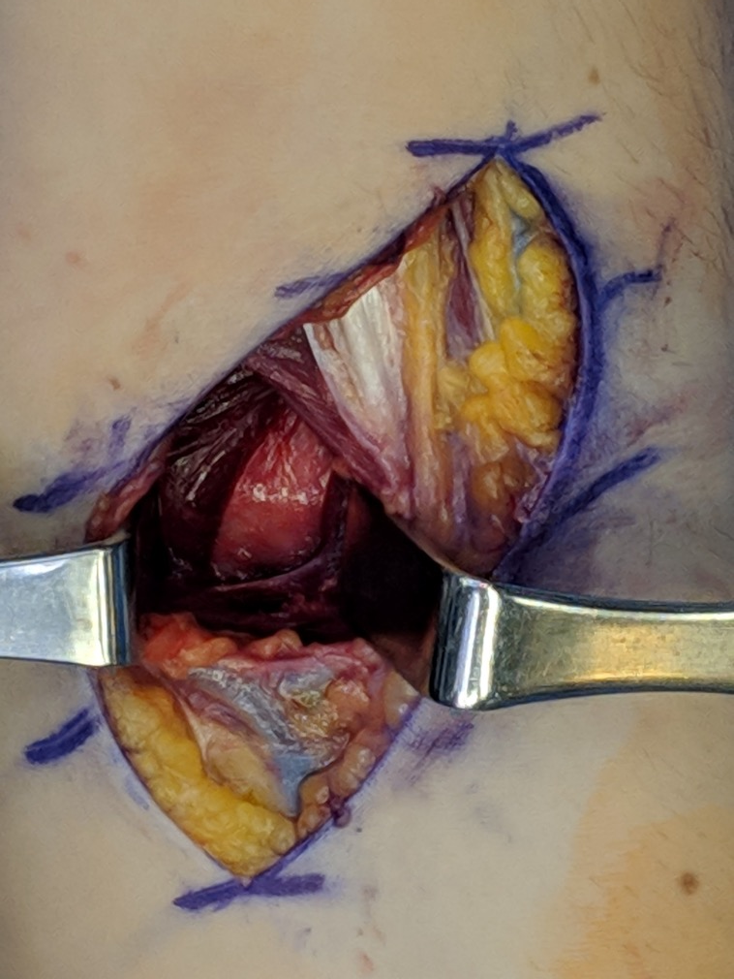
Retract brachialis
Incise capsule

Slide 19
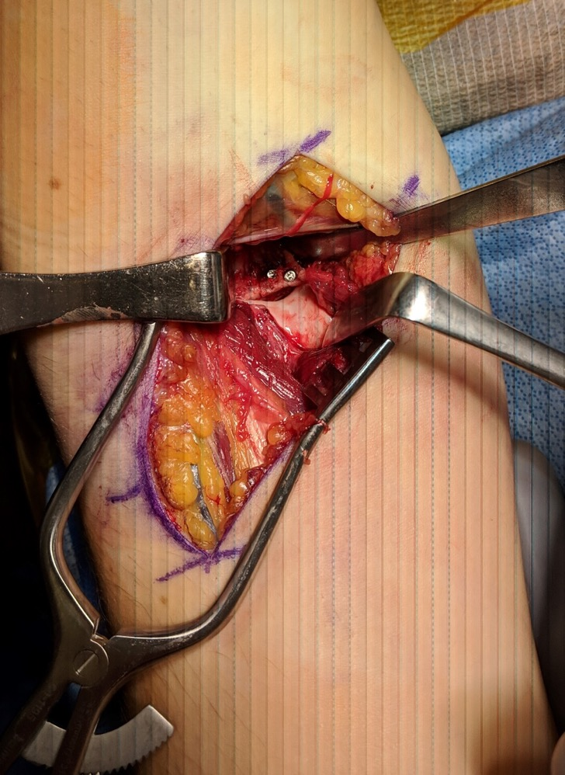
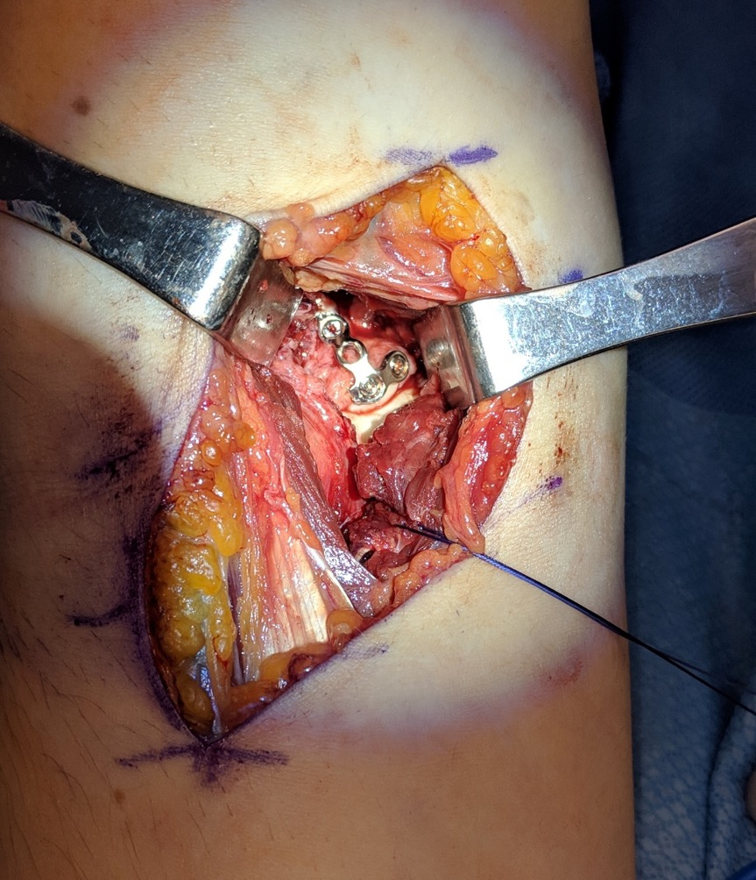
Direct anterior buttress plate on coronoid

Slide 20
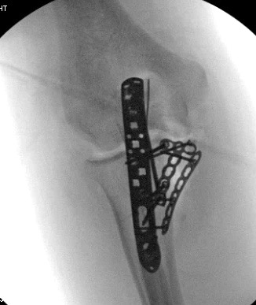
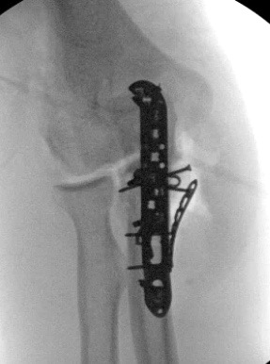
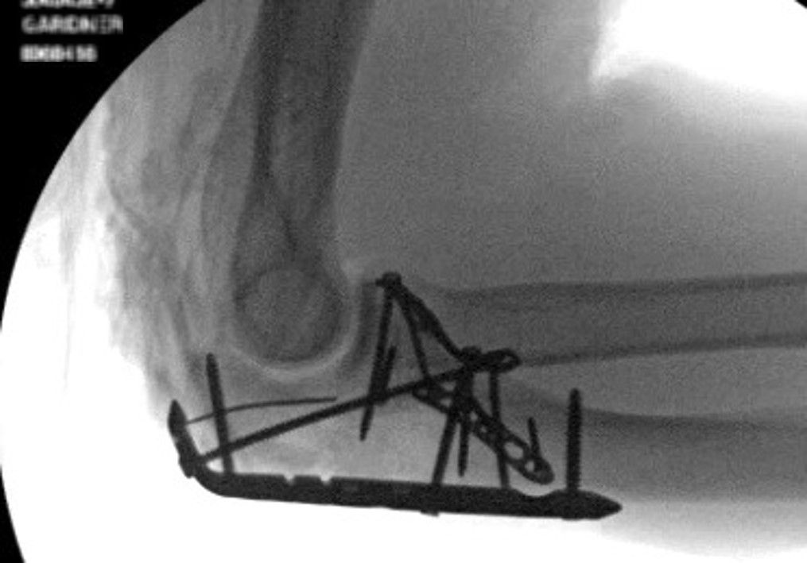

Slide 21
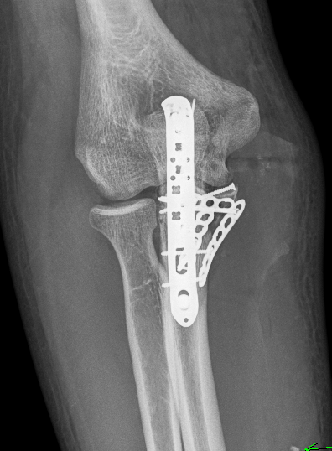
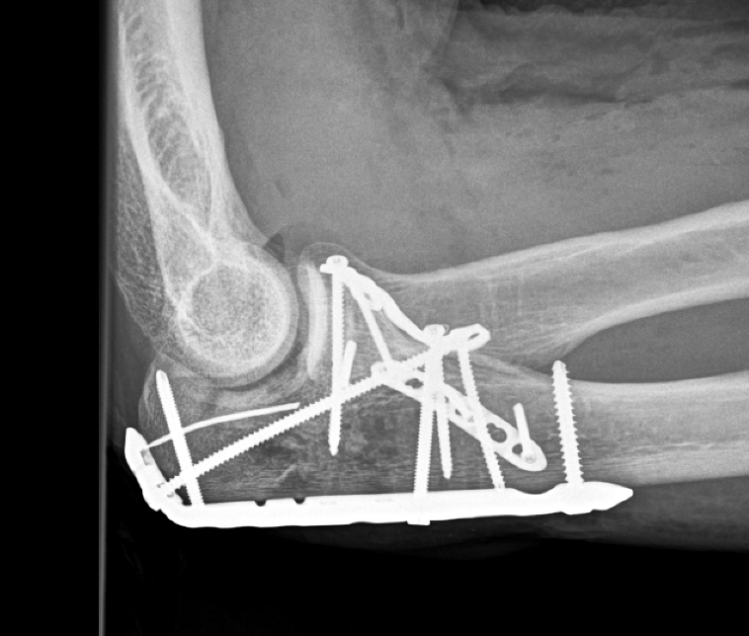
3 months, back to near full function

Slide 22
Take-home messages
Carefully identify all fracture fragments
Coronoid critical for elbow stability and articular congruity
Understand access from anteromedial (FCU split) approach and direct anterior approach
Early motion important

Slide 23
Case 3
69-year-old woman
Fell on left forearm about 8 months previously
Treated at outside hospital with open reduction and internal fixation (ORIF)
Continued pain
What to do ?
Notes:
Stable malreduction !

Slide 24
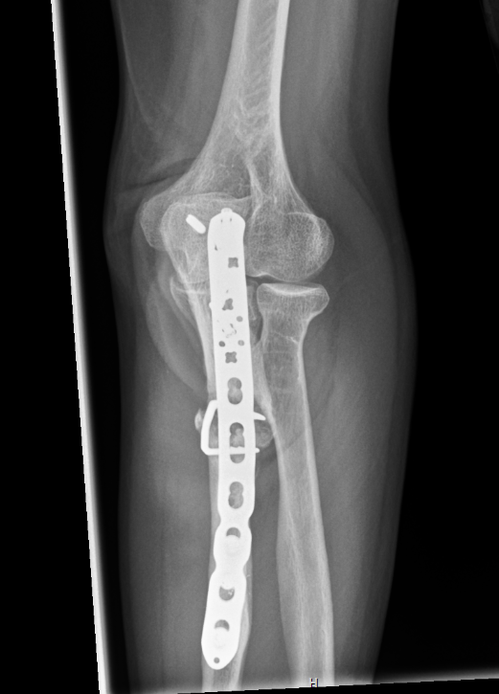
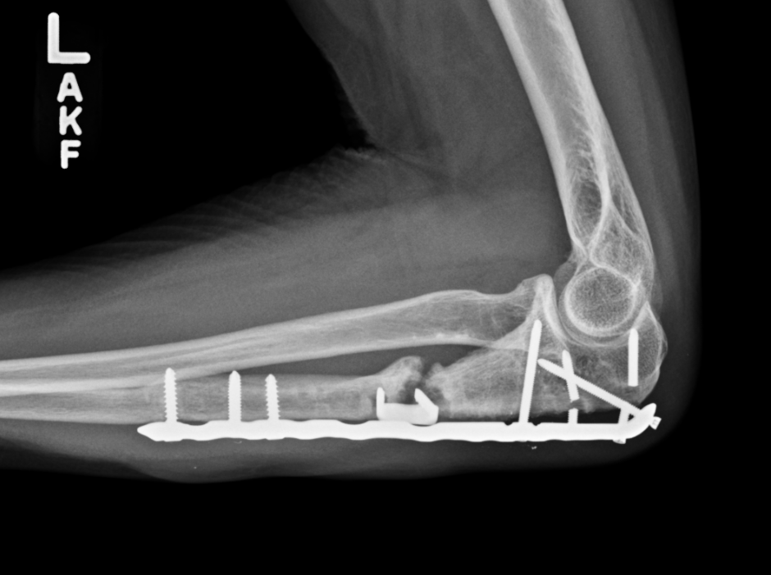

Slide 25
What is the diagnosis?
Any further workup?
Surgical plan?

Slide 26
Workup negative for infection
Plan:
Removal of hardware
Bone graft
Compression

Slide 27
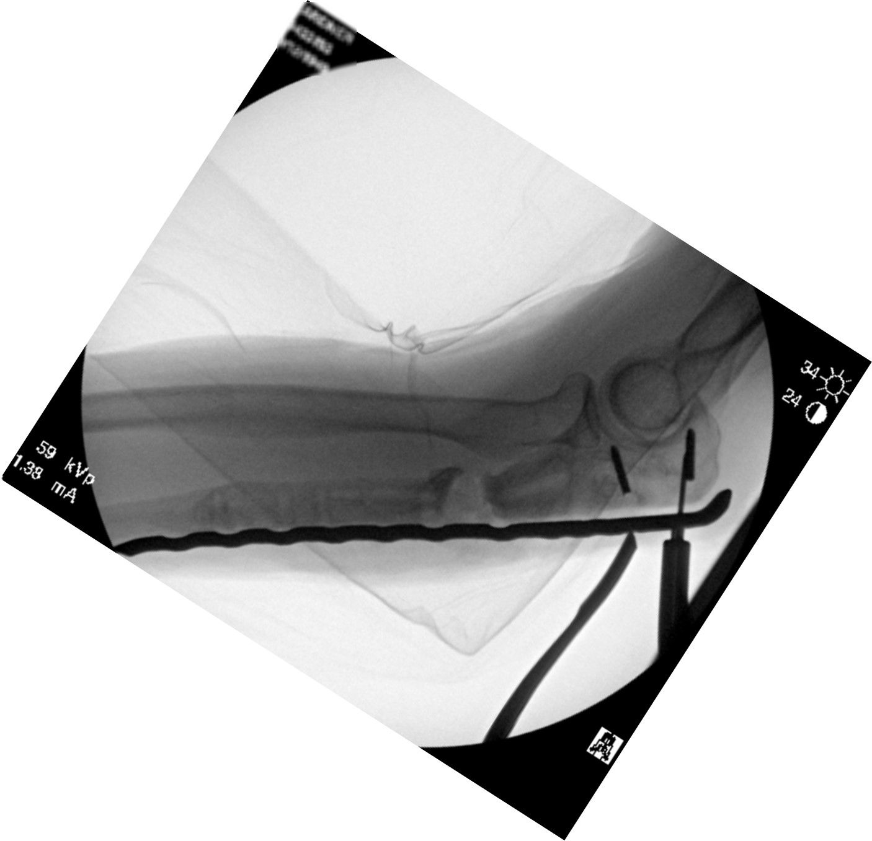

Slide 28
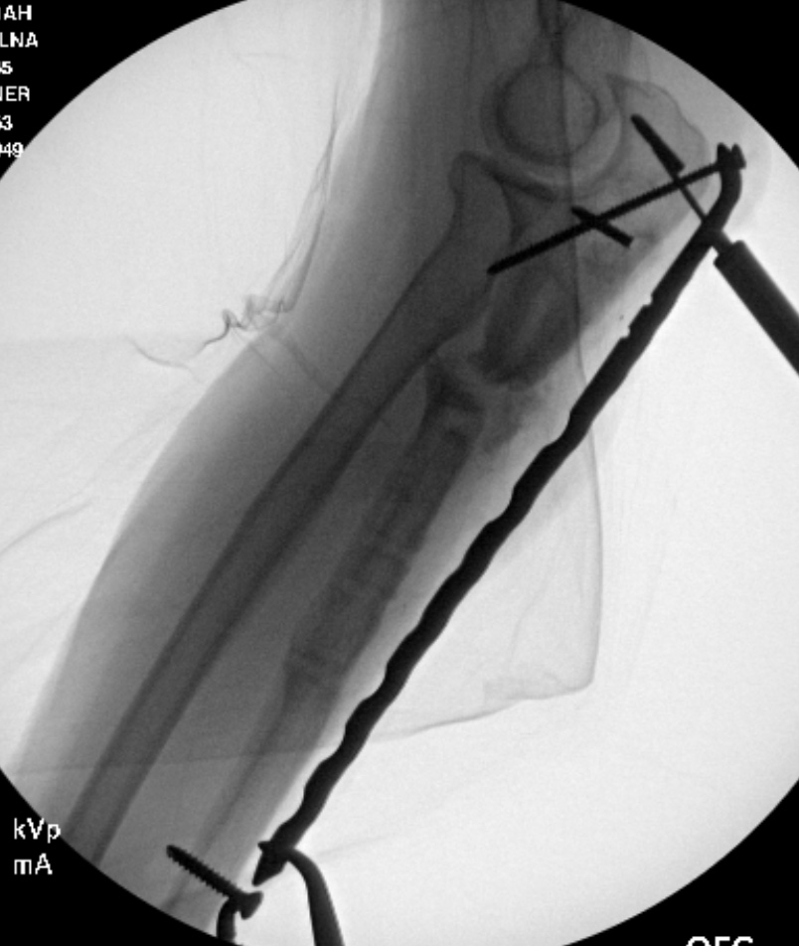

Slide 29
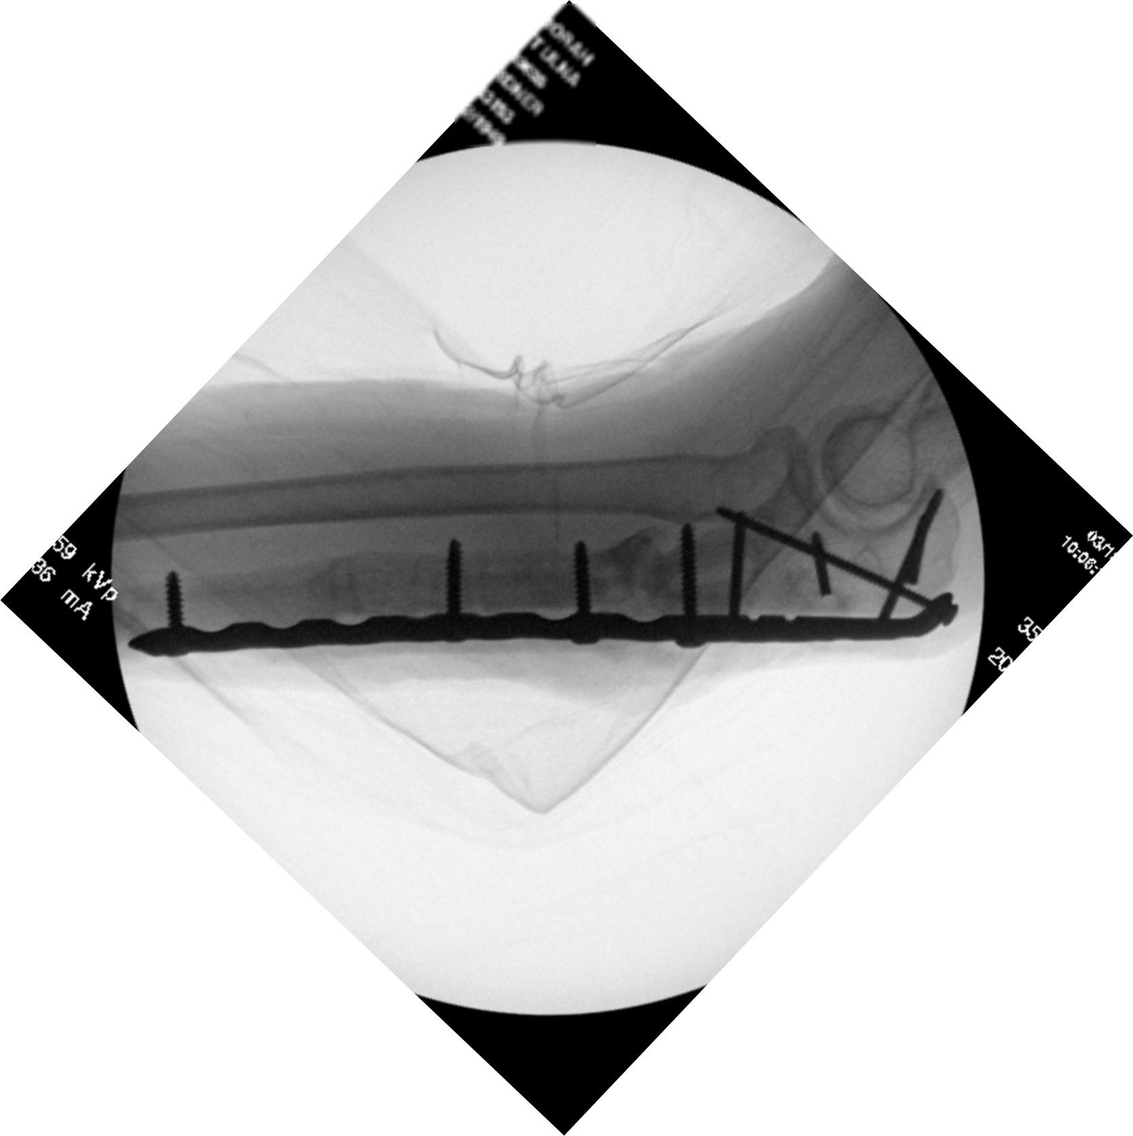
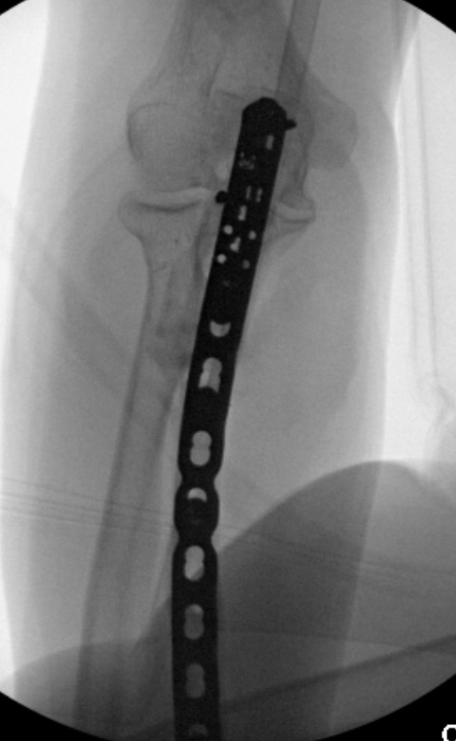

Slide 30
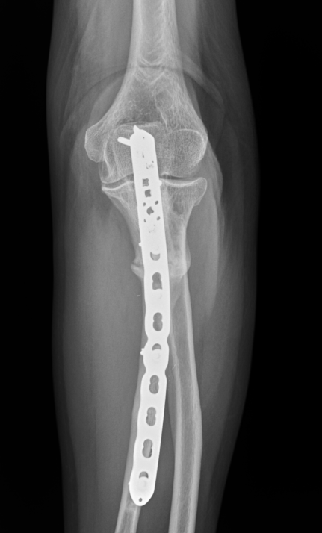
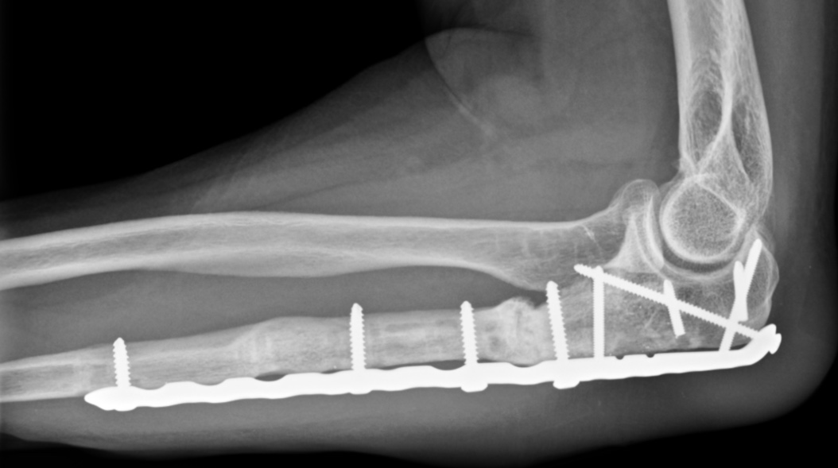
6 months postoperative, no pain

Slide 31
Take-home messages
Rule out infection in all nonunion
Revise with removal of all hardware, debridement
Compress all transverse nonunions as much as possible
Bone graft defects as necessary
Use long plates to maximize stability

Slide 32
Case 4
31-year-old man
Fell from a scooter
No other injuries
What to do ?
Notes:
Stable malreduction !

Slide 33
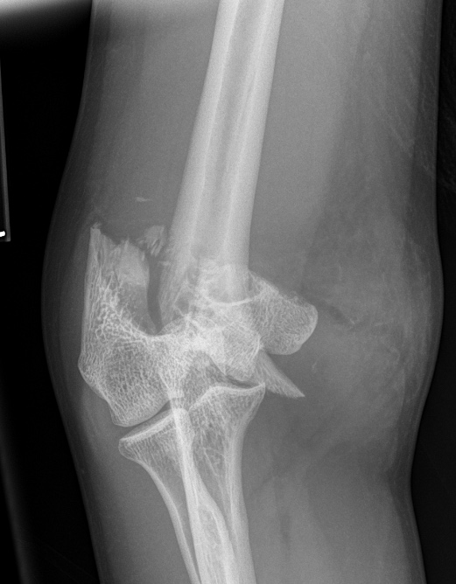
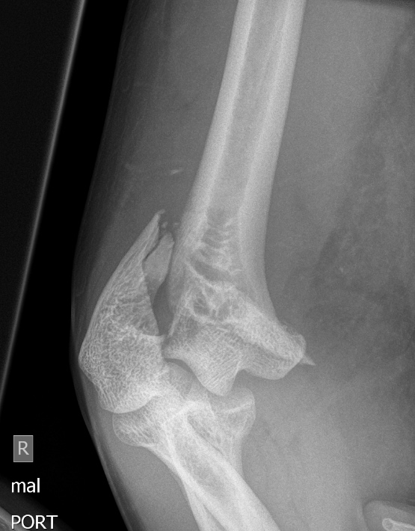

Slide 34
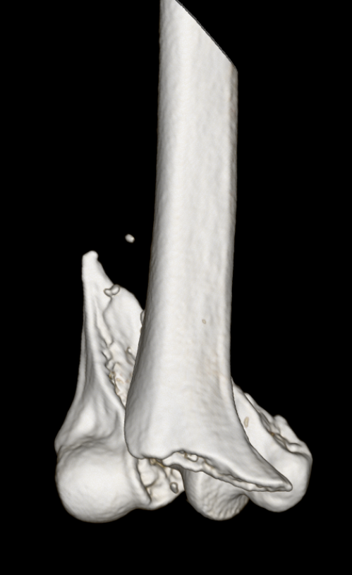
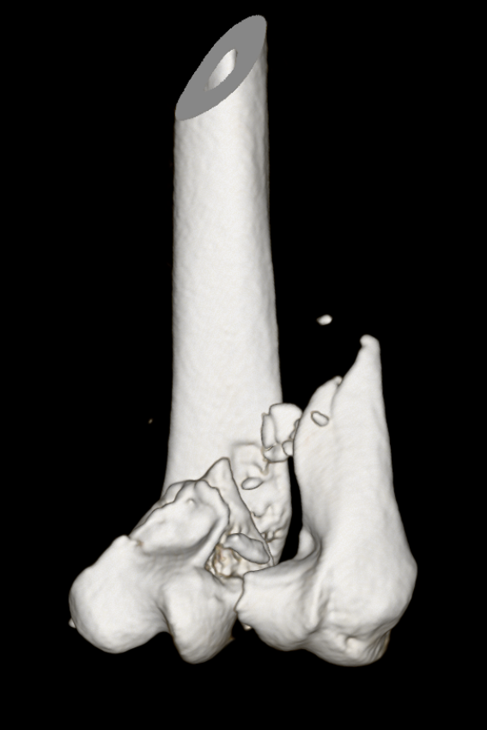
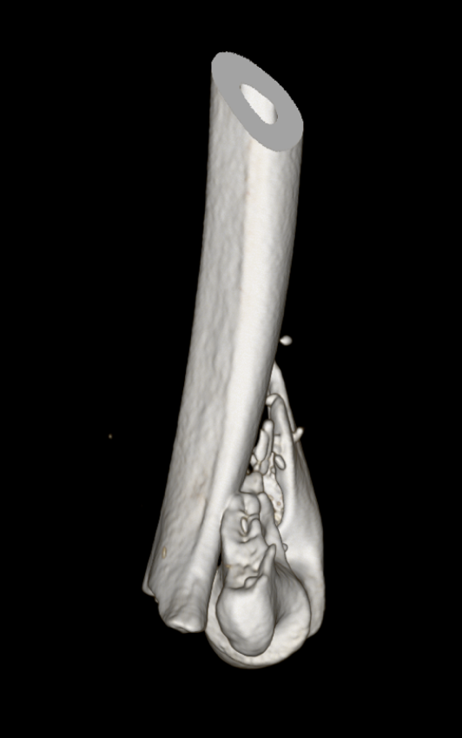
Notes:
* Conservative ?
What we will expect healing and clinical outcome
* Surgery?
Plan your surgery
Deltoideopectoral vs. transdeltoideal approach
IM nail – same entry or new entry in humeral head
Plate – technique – absolute or relative stability ? Grafting ?

Slide 35
What is the position?
What is the approach?
Do we need an olecranon osteotomy?
How should we handle the ulnar nerve?
What is the sequence of reconstruction?
What is the postoperative rehabilitation?

Slide 36
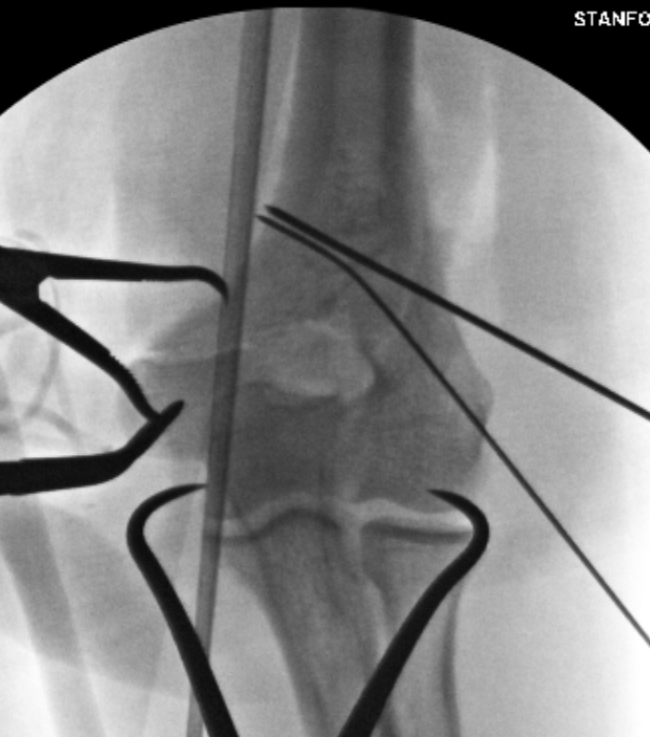
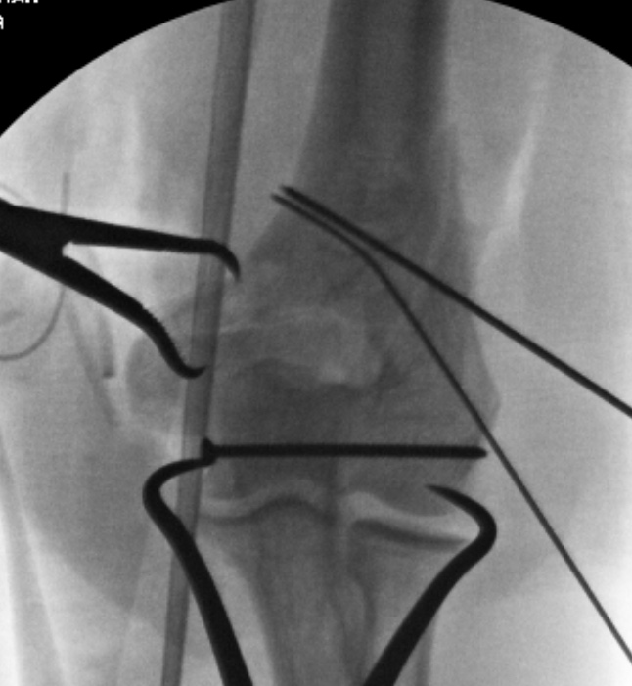

Slide 37
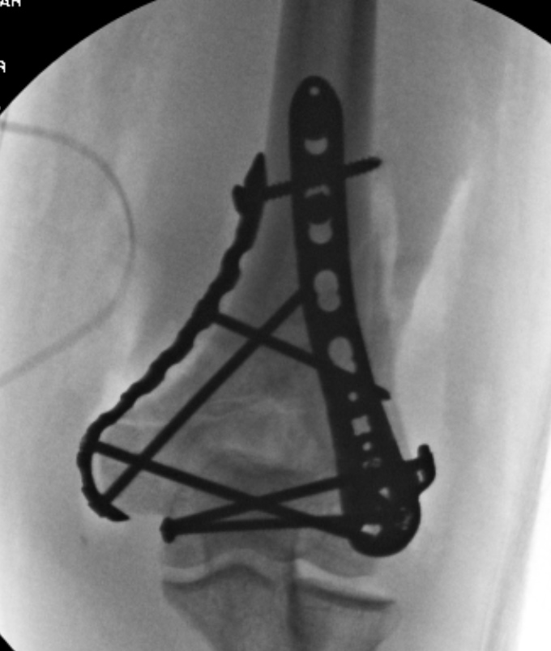
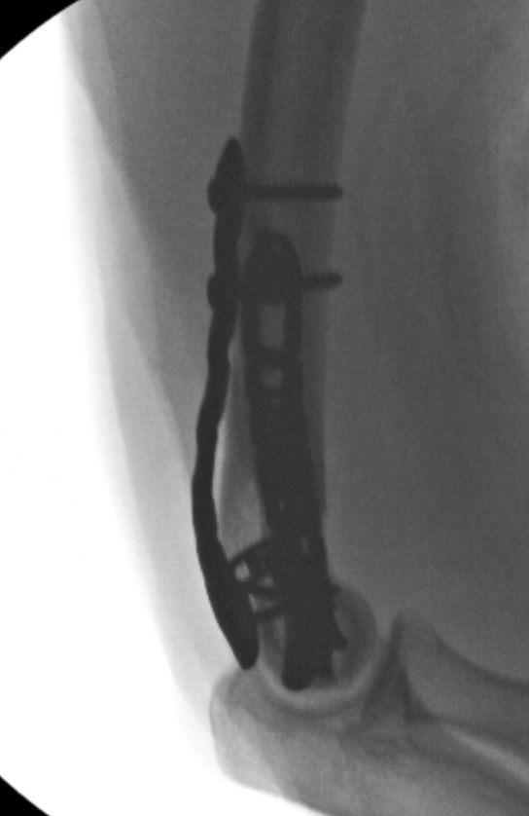

Slide 38
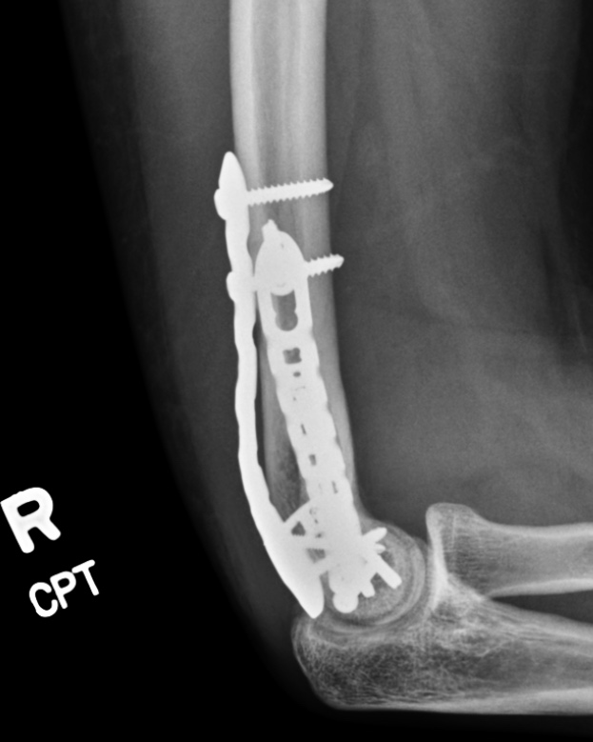
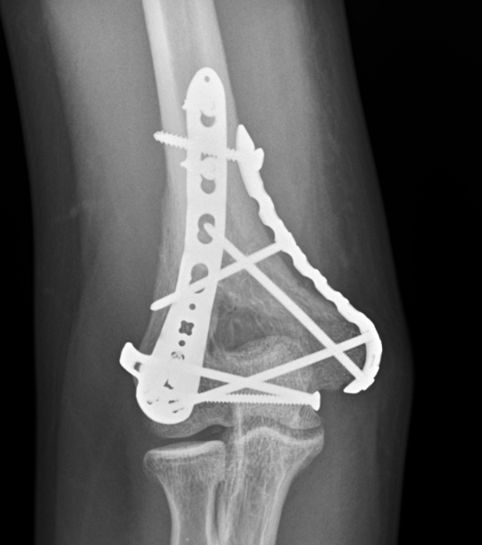
3.5 months postoperative

Slide 39
Take-home messages
Use traction views and computed tomography as needed to fully define fracture
Use simplest fracture lines as initial reads
Articular compression with independent lag screw
If articular surface has simple fracture line, don’t always need olecranon osteotomy
Pay close attention to (perfect) lateral image intensification view for sagittal plane alignment and implant positions
No splint and early motion

