Slide 1
Humeral shaft fracture
Reto Babst

Slide 2
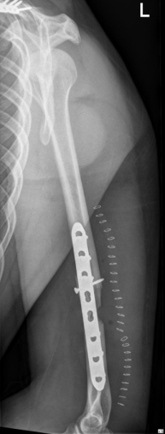
Case description
38-year-old man
Motorcycle crash
III° open humeral shaft fracture
Primary radial nerve palsy
Open reduction and internal fixation at another hospital
Presented 7 days after operation with increasing swelling and redness, fever
What next?

Slide 3
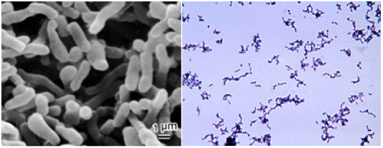
Microbiology Debridement lavage
Microbiology: Propionibacterium acnes in 1/4 bone biopsies
Plate in situ
Antibiotic therapy with amoxicillin
Rifampicin for 12 weeks
What next?

Slide 4
6 weeks after revision surgery
Partial recovery of nerve palsy
Patient starts minimal weight lifting
What next?

Slide 5
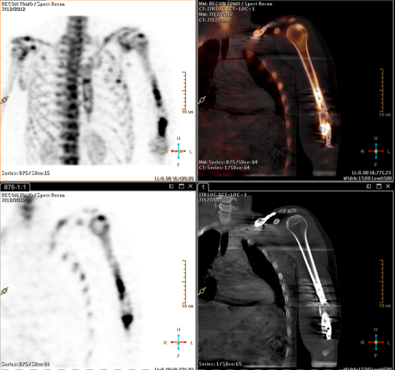
Additional diagnostics
SPECT CT
Tc-scintigraphy
What next?

Slide 6
What would you do for this case?

Slide 7
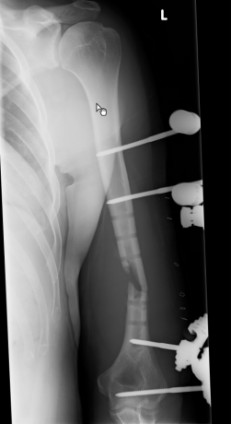
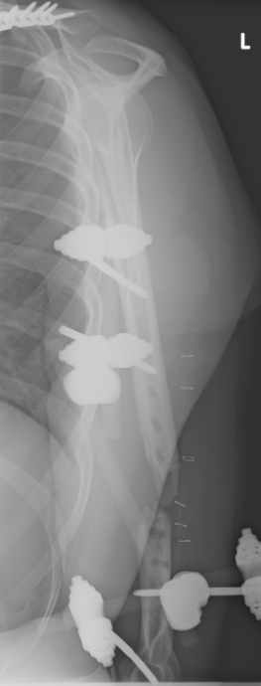
6 weeks after revision surgery
Plate removal
Debridement
External fixator
Approach?
Positioning?
What next?

Slide 8
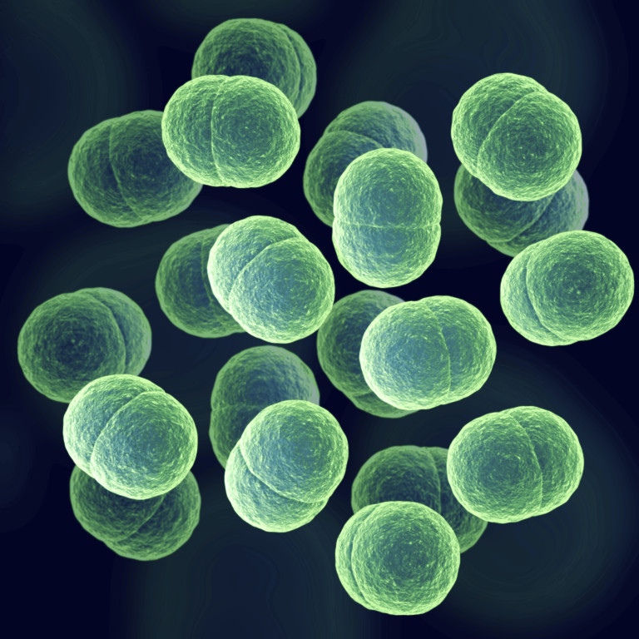
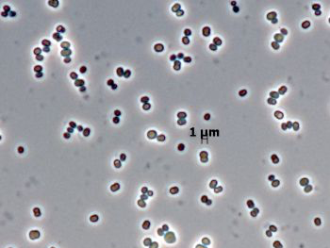
Microbiology
Staphylococcus epidermidis and hominis
Long-term antibiotic therapy with:
Clavulanic acid / amoxicillin and rifampicin

Slide 9
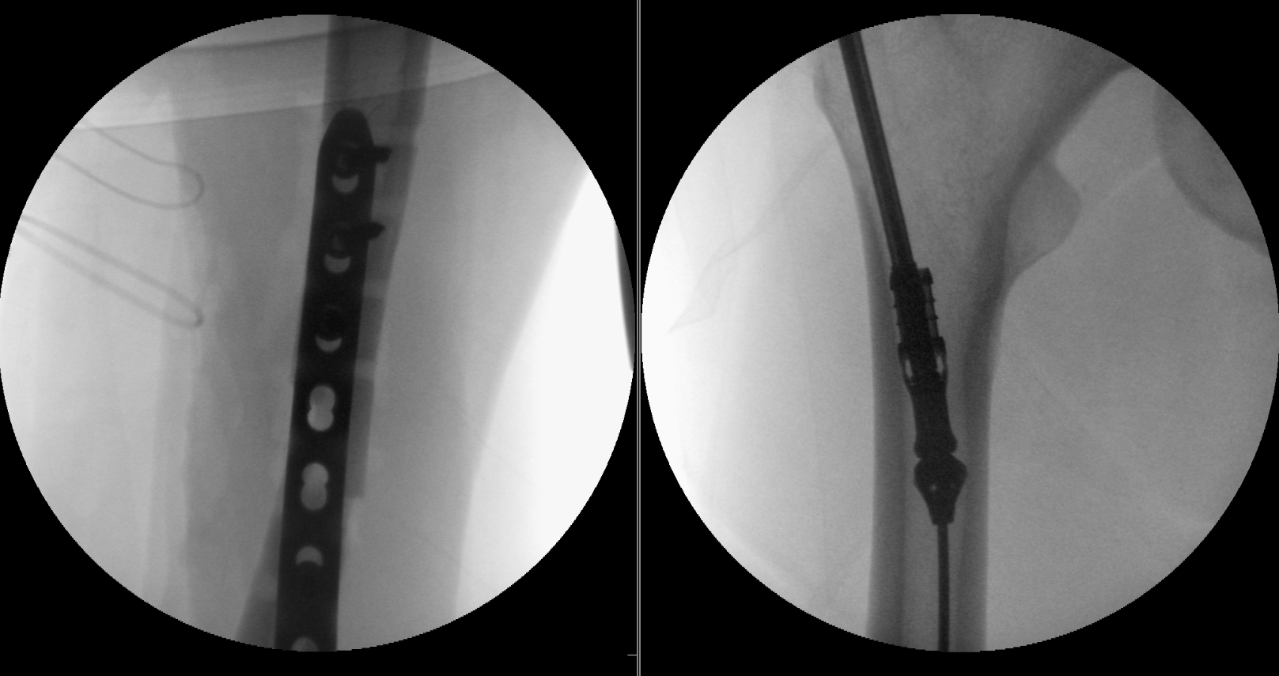
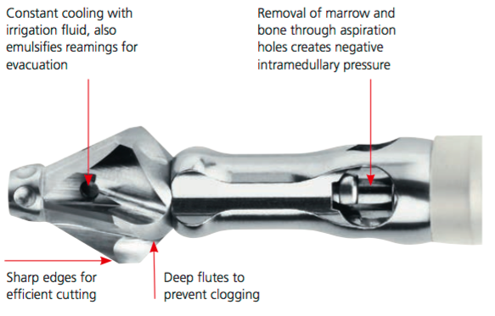
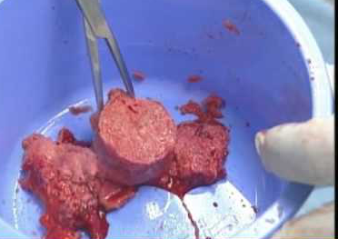
8 weeks later
Plate osteosynthesis
Bone graft harvesting by reamer / irrigator / aspirator system

Slide 10
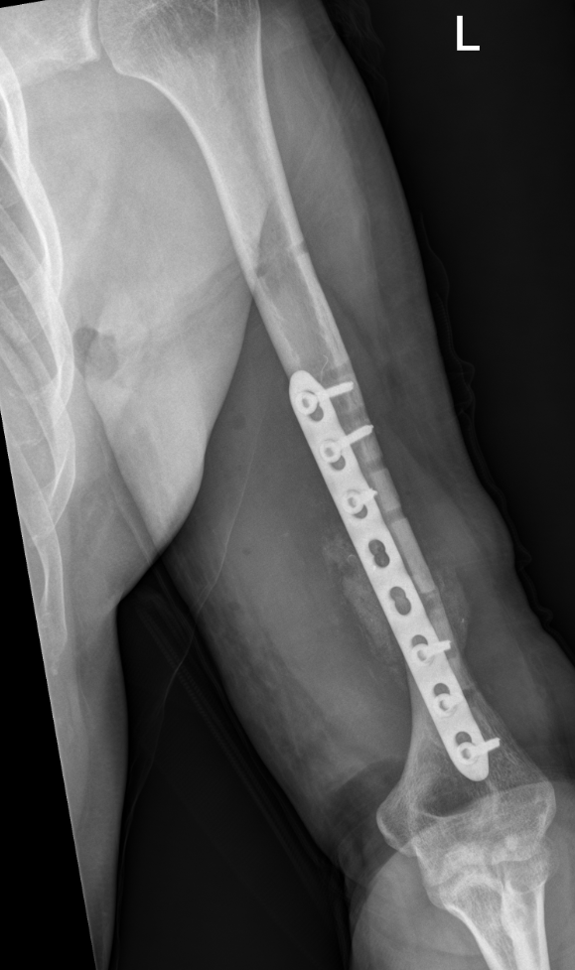
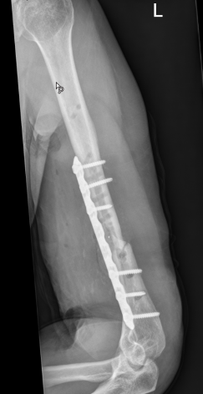
Postoperative x-rays
Antibiotics for 12 weeks
Happy?
Other solution?

Slide 11
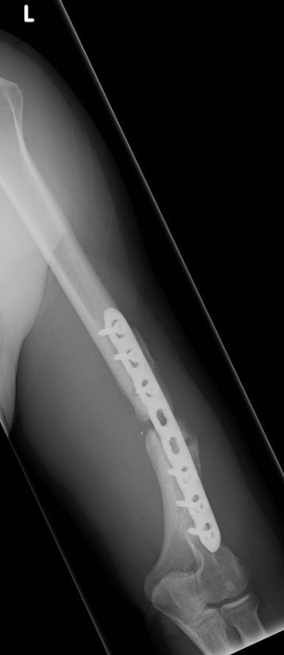
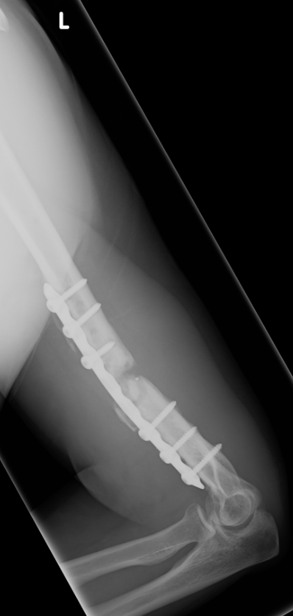
5 months after reosteosynthesis
Slight pain on exertion
No sign of infection
Does some exercise
What next?
Further diagnostics
Wait and see

Slide 12
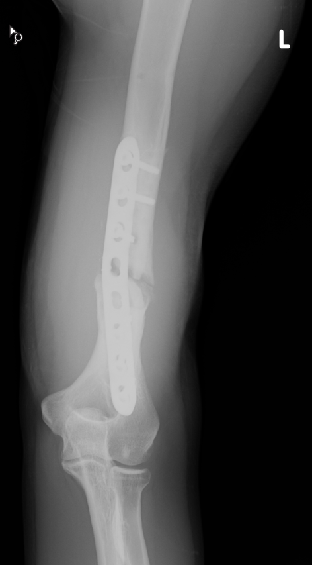
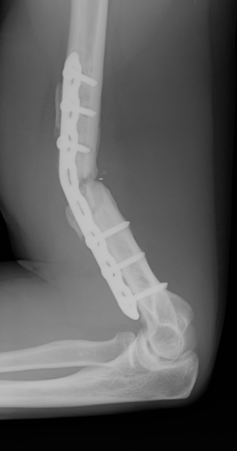
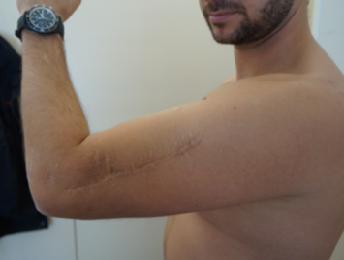
6 months
Fall with bike
What next?

Slide 13
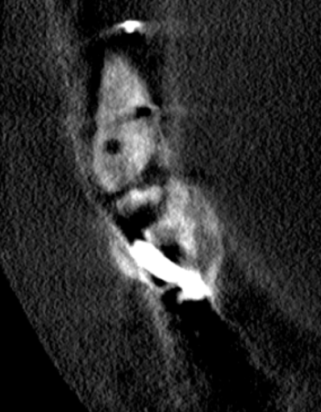
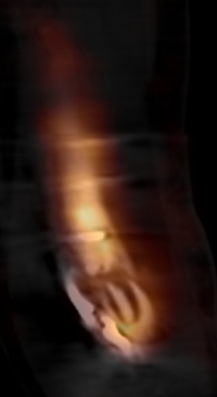
SPECT-CT

Slide 14
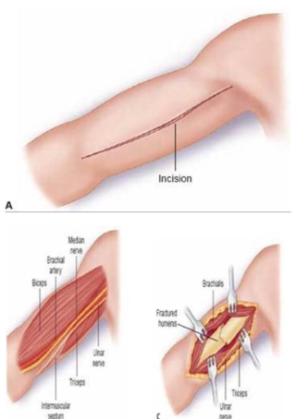
Rerevision surgery
Approach
Positioning
Jupiter. JBJS Am 1990
Notes:
Jupiter J. Complex non-union of the humeral diaphysis. Treatment with a medial approach, an anterior plate, and a vascularized fibular graft. J Bone Joint Surg Am. 1990 Jun;72(5):701-7.

Slide 15
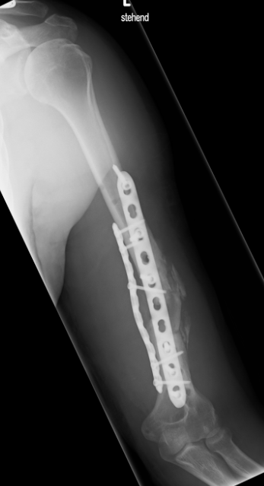
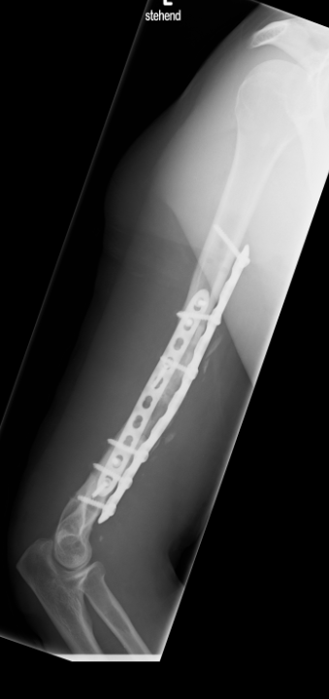

Slide 16
6 weeks 5 months

Slide 17
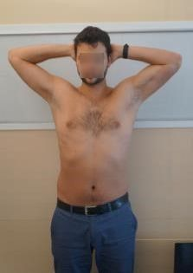
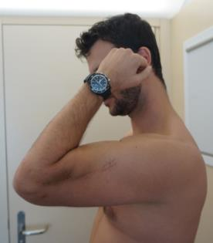
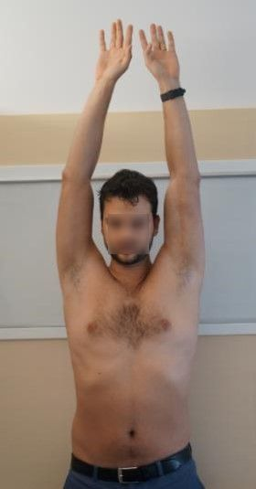
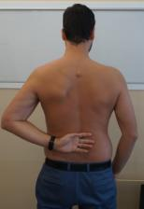
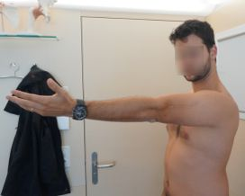
2 years
Full recovery of radial nerve

Slide 18
Take-home messages
Infected nonunion needs absolute stability (eg, double plating)
Bone graft
In difficult soft-tissue situations (scars and obesity) don’t forget the medial approach

