Slide 1
Mangled extremity management—limb salvage vs amputation
AO Trauma Advanced Principles Course
Notes:
We would like to thank:
Bob O’Toole
Andy Pollak
Author: Jason W Nascone, US

Slide 2
Learning objectives
Understand the patient and the injury
Understand the variables involved in the decision for salvage vs amputation
Analyze current evidence associated with limb salvage and amputation, ie, Lower Extremity Assessment Project (LEAP) studies
Discuss patient-derived outcomes
Identify factors that influence decision making including economical, social, and cultural differences
Notes:
Teaching points:
Focus on the results of LEAP studies and the importance of involving the patient and the family in the decision-making progress.

Slide 3
What do we know as an absolute in limb salvage?
The patient’s leg as they knew it is gone.
You probably know more of what the course of treatment entails than the patient.
They will not remember anything you discuss after you bring up the possibility of amputation.

Slide 4
Commonly asked questions...
“What would you do if you were me?”
“Can you save his leg?”

Slide 5
Components of decision making
Patient
Injury
Medical resources

Slide 6
Who is the patient
Work
Spouse/family/support
Recreation
Problems before the injury

Slide 7
Who did poorly in the L.E.A.P. study?
White Male 20–45-years-old
Poor:
38% No Insurance
25% Below Poverty Line
70% High School Grads
Alcohol drinkers:
2 times national average “heavy” drinkers
Personality differences:
More neurotic, less “agreeable”
MacKenzie et al (J Ortho Trauma. 2000;14:455–466)
Notes:
Reference:
MacKenzie EJ, Bosse MJ, Kellam JF, et al. Characterization of patients with high-energy lower extremity trauma. J Orthop Trauma. 2000 Sep–Oct;14(7):455–466.

Slide 8
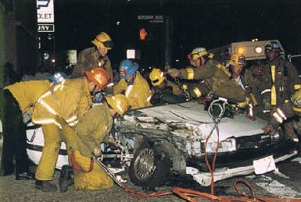
Injury variables: mechanism of injury

Slide 9
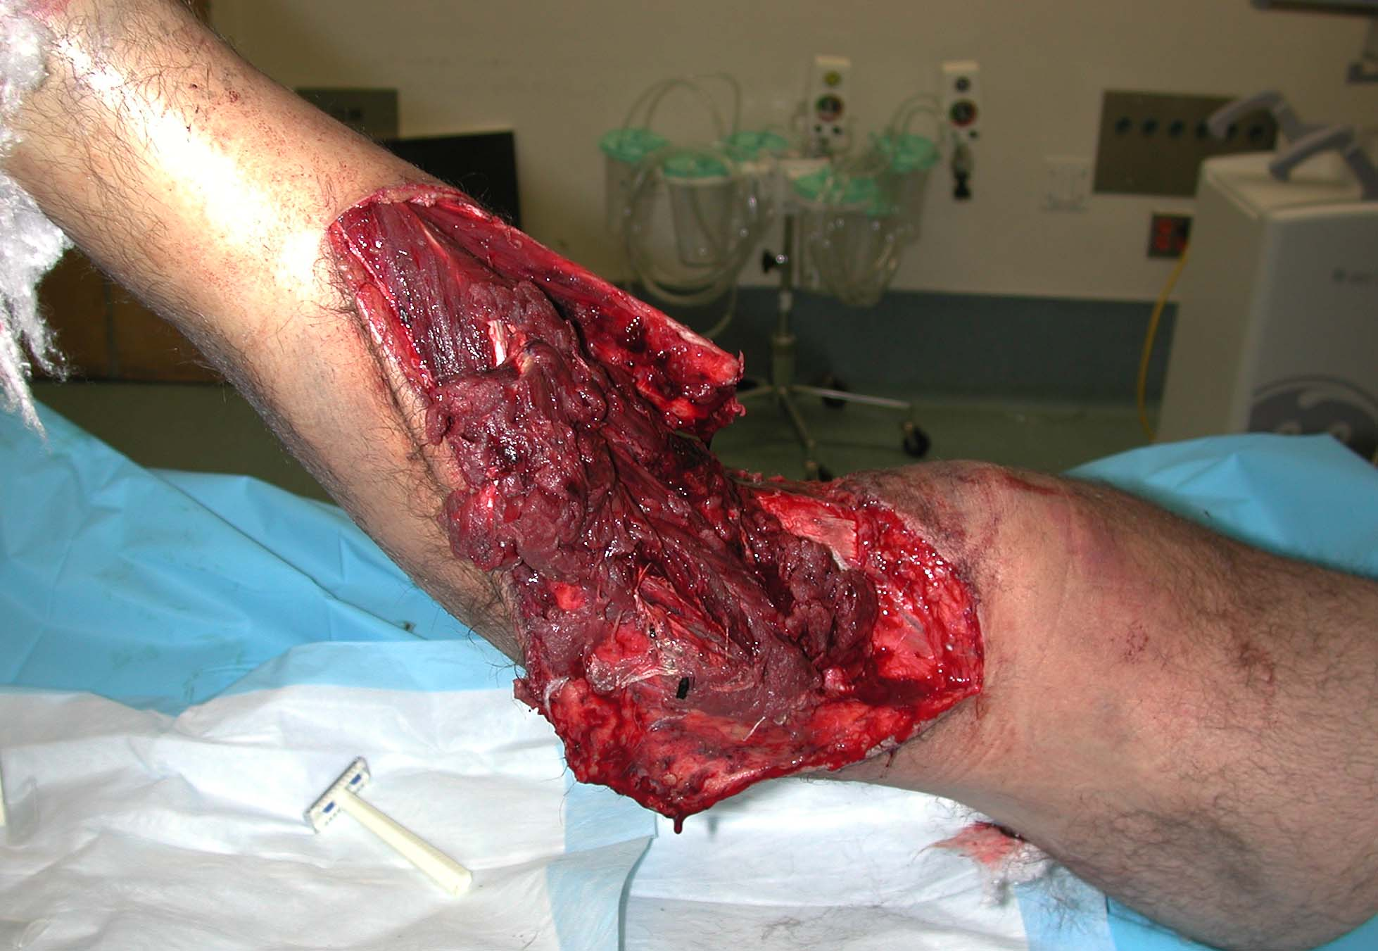
Injury severity

Slide 10
Injury inventory
What’s needed:
Skin
Muscle
Bone
Arteries
Nerves
Zone of injury

Slide 11
The injury
Can we solve the problem?
Bone | Yes (graft, transport...)
Skin | Yes (graft, flap...)
Blood Vessels | Yes (repair)
Muscle | No
Nerve | No (not well)

Slide 12
Medical resources
Trauma capabilities
Familiarity with salvage techniques
Plastic surgeon
Patience

Slide 13
Is it worth saving the limb?
“…futility of salvage”
“…disservice to patients“
“Saving a limb may ruin a life.”
Hansen (J Bone Joint Surg Am. 1987;69:799–800)
Notes:
Reference:
Hansen ST Jr. The type-IIIC tibial fracture. Salvage or amputation. J Bone Joint Surg Am. 1987 Jul;69(6):799–800.

Slide 14
Questions
Is outcome better after amputation or reconstruction?
Is there a limb salvage score to help decide?
No tibial nerve = no reconstruction?
What are the (financial) costs?
What drives patient satisfaction?

Slide 15
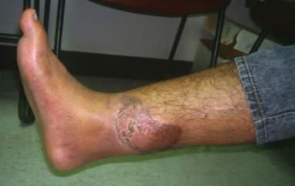
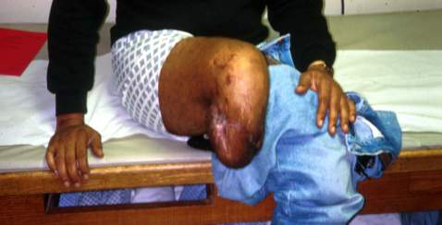
Answers: LEAP
Bosse (N Engl J Med. 2002;(24):1924–1931)
Notes:
Reference:
Bosse MJ, MacKenzie EJ, Kellam JF, et al. An analysis of outcomes of reconstruction or amputation after leg-threatening injuries. N Engl J Med. 2002 Dec 12;347(24):1924–1931.

Slide 16
Previous literature
Small retrospective analyses
Few measure disability/quality of life
Few examined influence of injured person and their environment
Conflicting results

Slide 17
LEAP study design
High-energy, limb-threatening lower extremity injuries
Prospective, observational
NIH funded—about $ 6 million
8 Level I trauma centers
601 patients

Slide 18
LEAP study design
Traumatic amputations
IIIB and IIIC open tibial fractures
Selected IIIA open tibial fractures
Vascular injuries
Major soft-tissue injuries
Severe foot injuries
Injuries where amputation is a serious consideration

Slide 19
The LEAP hypothesis:
Outcome after amputation would be better than outcome after reconstruction for HELET (High Energy Lower Extremity Trauma)
After controlling for patient characteristics

Slide 20
Sickness Impact Profile (SIP)
High numbers are bad
Population average ~ 2–3
> 10 = “severe” disability
Sensitive to wide range of health conditions and injuries
Notes:
The principle outcome measure is SIP. Multidimensional self-administered health profile 0–100. Secondary outcomes were status of the limb and complications need for rehospitalization.

Slide 21
Is outcome better after amputation or reconstruction?
LEAP results
 | Amputation | Reconstruction
SIP | 12.2 | 11.7
Return to work | 53% | 49%
(p > 0.05, 2 years postinjury)
Bosse et al (N Engl J Med. 2002;347:1924–1931)
Notes:
Reference:
Bosse MJ, MacKenzie EJ, Kellam JF, et al. An analysis of outcomes of reconstruction or amputation after leg-threatening injuries. N Engl J Med. 2002 Dec 12;347(24):1924–1931.

Slide 22
LEAP: results
Were the groups the same?
Amputations more severe injuries
Otherwise no differences

Slide 23
LEAP: results
Predictors of High SIP:
Rehospitalization
Low education
Poverty
No Health Insurance
Poor social support
Poor self efficacy
Smoking
Involvement with litigation

Slide 24
LEAP: results
Longer term?
Still no difference at 7 years
Both groups worsened
MacKenzie et al (J Bone Joint Surg Am. 2005;87:1801–1809)
Notes:
Reference:
MacKenzie EJ, Bosse MJ, Pollak AN, et al. Long-term persistence of disability following severe lower-limb trauma. Results of a seven-year follow-up. J Bone Joint Surg Am. 2005 Aug;87(8):1801–1809.

Slide 25
LEAP: results
No difference in SIP, but …
 | Amputation | Reconstruction
Rehospitalization | 34% | 48%
Osteomyelitis | 3% | 9%
More Surgery | 5% | 19%
Bosse et al (N Engl J Med. 2002;347:1924–1931)
Notes:
Reference:
Bosse MJ, MacKenzie EJ, Kellam JF, et al. An analysis of outcomes of reconstruction or amputation after leg-threatening injuries. N Engl J Med. 2002 Dec 12;347(24):1924–1931.

Slide 26
Is there a limb salvage score to help decide?
LEAP: results
Low index scores predicted limb salvage potential
High scores not accurate predictors of amputation
Did not support utility of lower extremity indicies to determine salvage vs amputation
Bosse et al (J Bone Joint Surg Am. 2001;83:3–14)
Notes:
Reference:
Bosse MJ, MacKenzie EJ, Kellam JF, et al. A prospective evaluation of the clinical utility of the lower-extremity injury-severity scores. J Bone Joint Surg Am. 2001 Jan;83-A(1):3–14.

Slide 27
No tibial nerve = no reconstruction?
601 LEAP patients
633 limbs
8 limbs excluded (bilateral)
101 insensate limbs
38 immediate amps
55 limbs salvaged at 24hrs
26 Amputations Group I
29 Salvaged Group II

Slide 28
LEAP: plantar sensation
Half regain normal sensation by 2 years
Not predictive of functional outcome
Not reliable… don’t use as amputation criteria!
Notes:
Reference:
Bosse MJ, McCarthy ML, Jones AL, et al. The insensate foot following severe lower extremity trauma: an indication for amputation? J Bone Joint Surg Am. 2005 Dec;87(12):2601–2608.

Slide 29
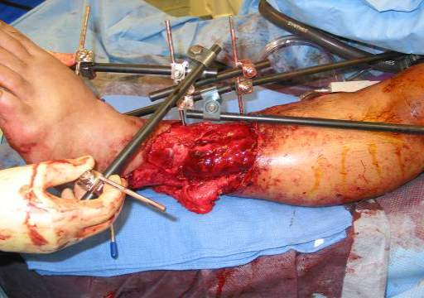
What are the (financial) costs?—LEAP: costs
Lifetime costs:
Salvage: | $ 163 000
Amputations: | $ 509 000
MacKenzie et al (J Bone Joint Surg Am. 2007;89:685–1692)
Notes:
Reference:
MacKenzie EJ, Jones AS, Bosse MJ, et al. Health-care costs associated with amputation or reconstruction of a limb-threatening injury. J Bone Joint Surg Am. 2007 Aug;89(8):1685–1692.

Slide 30
LEAP: patient satisfaction
Satisfaction driven by:
Function
Pain
Depression
Not driven by:
Injury
Treatment
Patient characteristics

Slide 31
LEAP: supports both sides
Amputation:
If outcome is the same, why go through the higher complications and longer treatment?
Reconstruction:
If outcome the same, wouldn’t you rather have your leg?
It is reversible

Slide 32
LEAP: limitations
Best we have
Treatment not randomized

Slide 33
Summary and take-home messages
Know LEAP:
2 and 7 years: SIP is the same (complications lower in amputation)
Limb Assessment Scores? | Do not use
Plantar Sensation? | Do not use
Cheaper? | Reconstruction

Slide 34
Summary and take-home messages
Outcomes poor (regardless of reduction)
Consider the whole patient
Difficult choice: shared decision making

