Slide 1
Orbital wall fractures
Notes:
Version 2 (December 12, 2018)
Faculty can add a clinical or imaging picture of Orbital wall fractures

Slide 2
Learning objectives
Describe the mechanism of injury for different types of orbital wall fractures
Recognize signs and symptoms of orbital wall fractures
Select appropriate imaging modalities and interpret the findings
Formulate principles of management

Slide 3
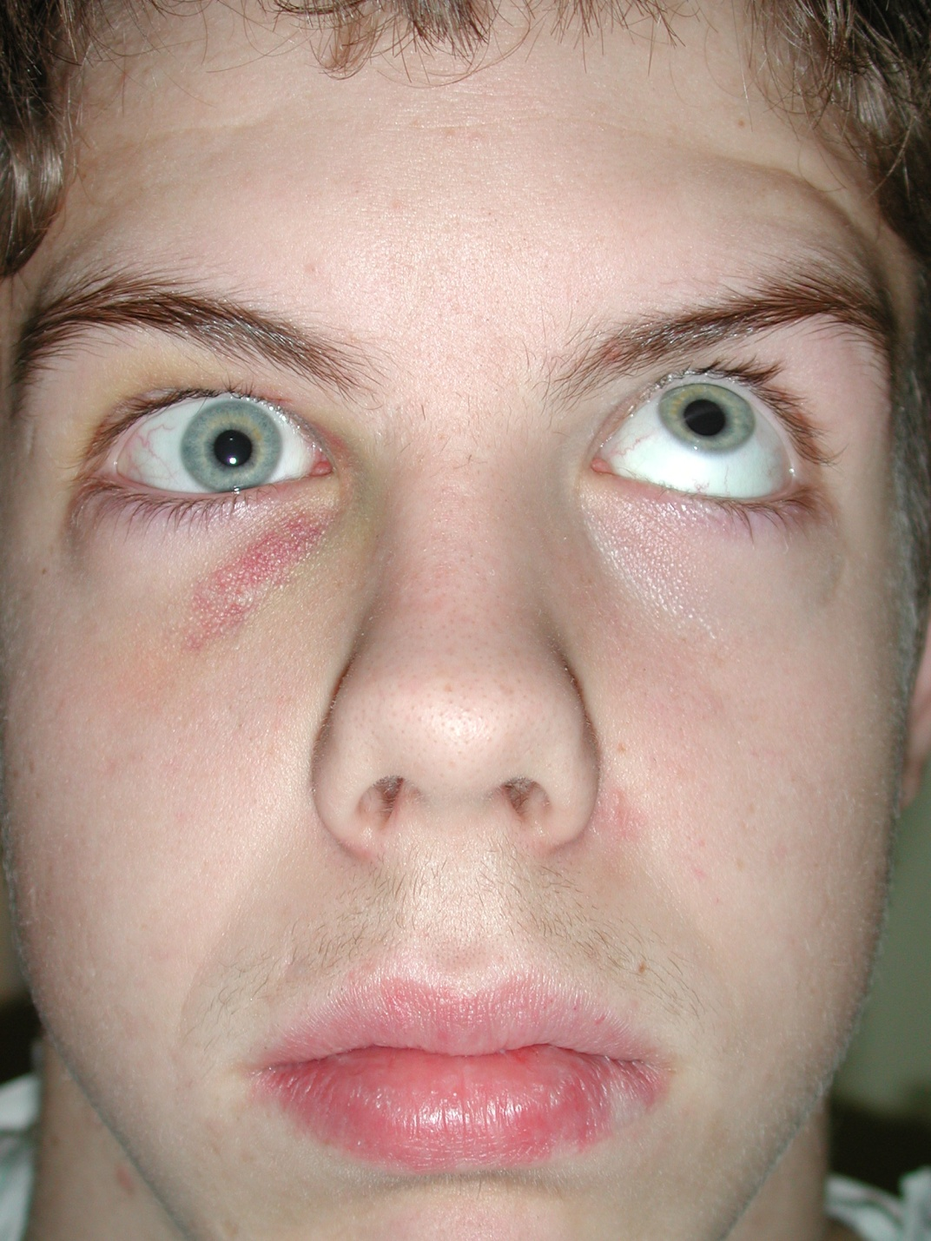
Clinical findings
Periorbital bruising
Conjunctival hemorrhage
Enophthalmos
Visual acuity changes
Extraocular motility restriction
Diplopia
Infraorbital paresthesia
Pain on eye motion
Notes:
Pain on eye motion is a more unusual finding and may imply entrapment
Functional
Structural

Slide 4
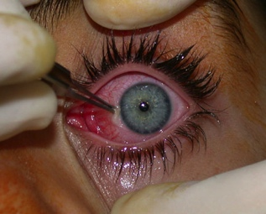
Diagnostic evaluation
CT scan
Ophthalmology consultation
Forced duction test
Notes:
Ophthalmology consultation:
Preoperative and postoperative
Up to 40% of patients have associated injury
Visual acuity, eye movements, orthoptic assessment and forced duction test
Forced duction test:
To assess preoperative entrapment and post-reconstruction mobility

Slide 5
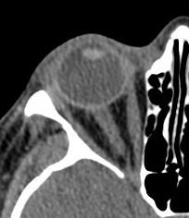
Diagnostic imaging—CT scan
Axial cuts identify:
Lateral and medial wall fractures
Medial and lateral rectus shape

Slide 6
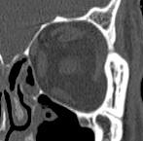
Diagnostic imaging—CT scan
Coronal cuts:
Floor and medial wall fractures
Measure floor fracture size
Inferior and medial rectus shape

Slide 7
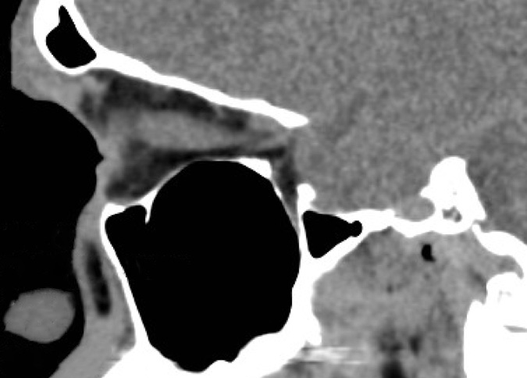
Diagnostic imaging—CT scan
Sagittal cuts:
Floor shape
Fracture extent
Fracture position
Inferior and superior rectus shape

Slide 8
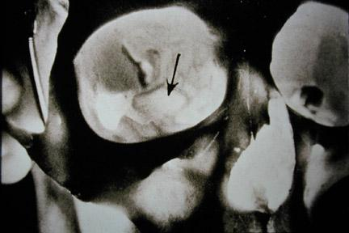
Orbital floor fractures
Isolated or associated with other midfacial fractures
Often medial to infraorbital nerve
Beware of “trap door” fractures
Posteromedial fractures associated with enophthalmos
Notes:
Note: a trapdoor fracture is an emergency situation

Slide 9
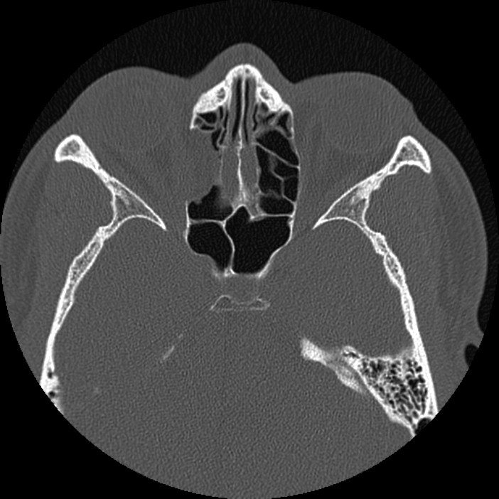
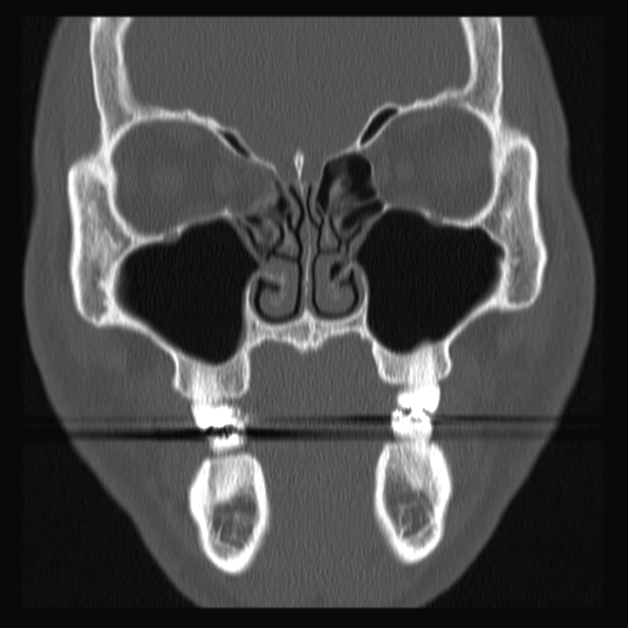
Medial wall fractures
Isolated fractures—easy to miss
Can result in diplopia and/or enophthalmos
Approaches—varied and none is easy
Optic nerve enters orbit medially
Notes:
Relative indications:
Multiple wall fractures
Distortion of medial rectus on CT scan
Entrapment, decreased range of motion
Late enophthalmos

Slide 10
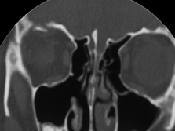
Orbital roof fractures
Rare/blow-in type fractures
Vertical dystopia
Proptosis, pulsating
Diplopia
Globe pressure—decompression

Slide 11
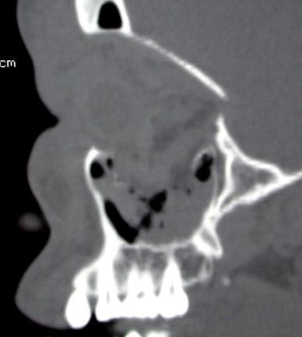
Indications for surgery
Evidence of entrapment
Vertical globe malposition
Enophthalmos
Size and location of fracture
Treatment of other associated fractures
Diplopia?
Notes:
Diplopia itself is not necessarily an indication for surgery.
The decision to operate is multifactorial ... patient’s symptoms, patient’s wishes, ability to monitor.
Best evidence suggests that both a large floor defect and periorbital fat herniation is required to develop significant enophthalmos.

Slide 12
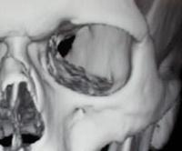
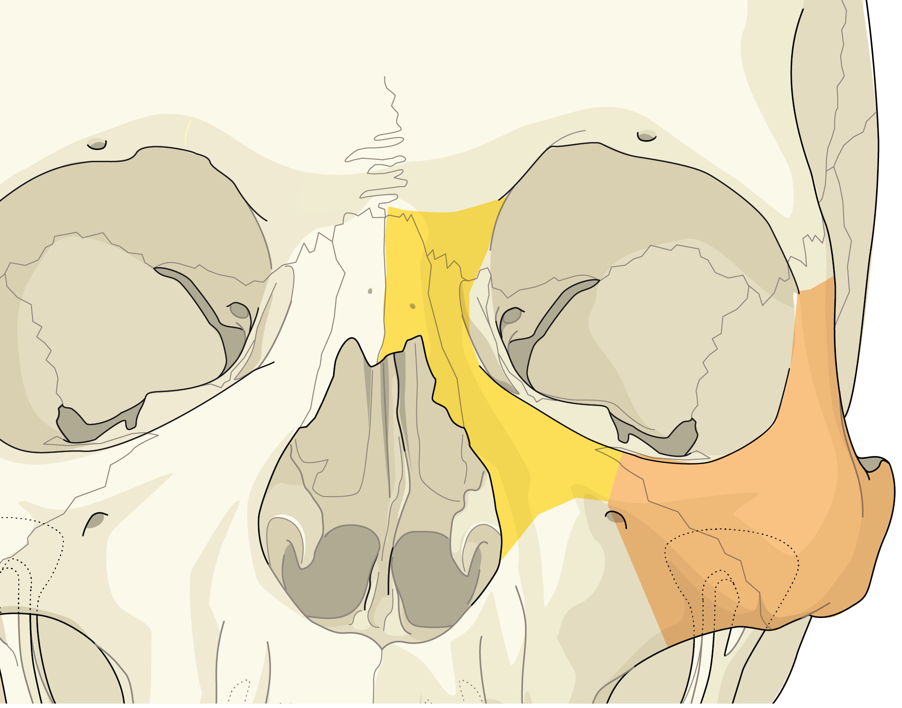
Principles of orbital fracture correction
Reduce and fix rim fractures first
Expose all edges of orbital wall defects
Place appropriate implant
Fixate implant if required
Notes:
Note: Orbital wall fractures are usually medial to infraorbital nerve
Note: Emphasize Hammer’s critical zone in posteromedial orbital floor

Slide 13
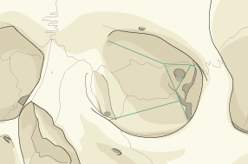
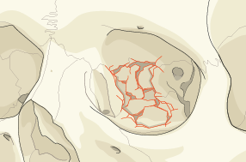
Critical zones (Hammer, 1994)
Transition between orbital floor and medial orbital wall
Repair of crucial importance
Normal orbit Fracture in critical zone

Slide 14
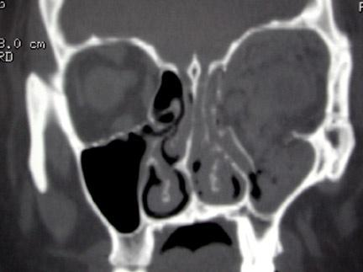
Orbital implants
Autograft
- Bone
- Cartilage
- Fascia
Alloplastic
- Porous polyethylene
- Bioresorbable
- Titanium mesh
- Patient-specific implants
Notes:
Emphasize the need for an intraoperative or postoperative CT to assess reduction and fixation.

Slide 15
Complications
Persistent diplopia
Enophthalmos:
- Must get to posterior ledge in floor fractures
Vertical dystopia
Scar/lid deformities
Mydriasis/blurry vision—CN III injury
Blindness
Paresthesia V
Notes:
Key message for faculty: Emphasize that the two most common complications are related to failure to correct the original deformity.

Slide 16
Take-home messages
Accurate diagnosis and planning
Reconstruct orbital rims before orbital walls
Implant appropriate to fracture
Accurate positioning of implant
Intraoperative or postoperative CT

