Slide 1
Infection control
Presenter‘s name Arial 24 pt
Meeting Arial 24 pt
Presenter‘s title Arial 20 pt
City, Month, Year Arial 20 pt
Notes:
This lecture is created and adapted by the AO Trauma ORP Educational Taskforce. It is to be used as outline for the discussion «Infection control» in the blended learning program for ORP.
S Althani and Pauline Johnston - Reviewed during ETF meeting July 2019

Slide 2
The outline of this discussion can only be used for the blended learning course for ORP!

Slide 3
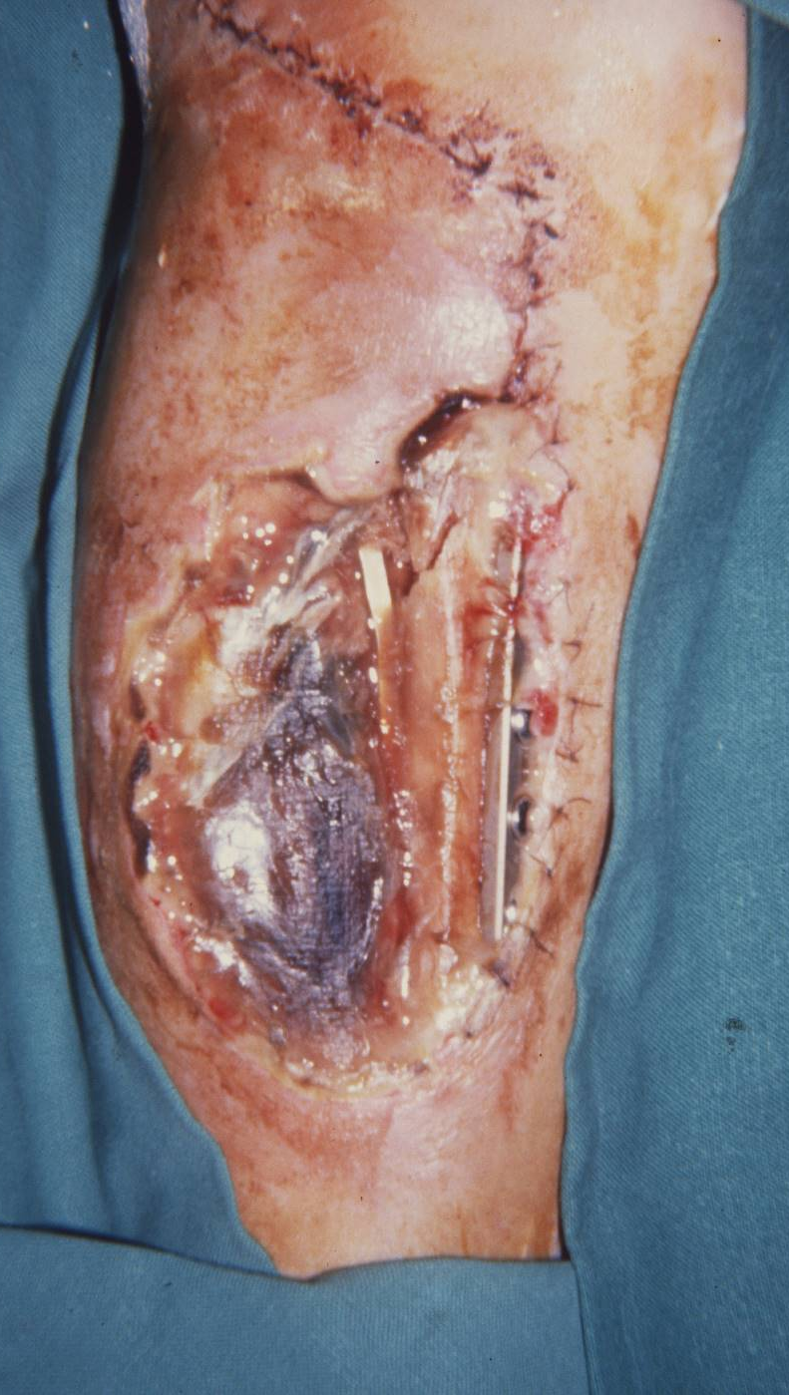
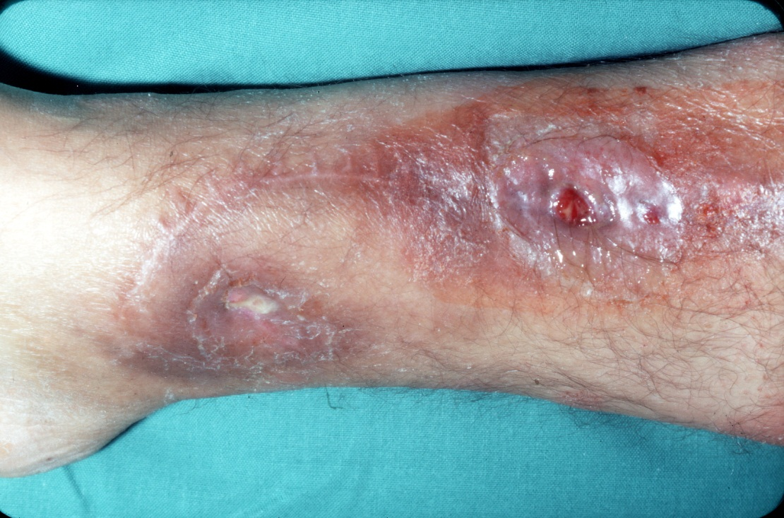

Slide 4
Learning outcomes
At the end of this discussion you will be able to:
Discuss why infection control in OR is important
Define SSI
Discuss how infection control planning is essential
Notes:
At the end of this lecture you will be able to:
Discuss why infection control in OR is important
Define SSI
Discuss how infection control planning is essential

Slide 5
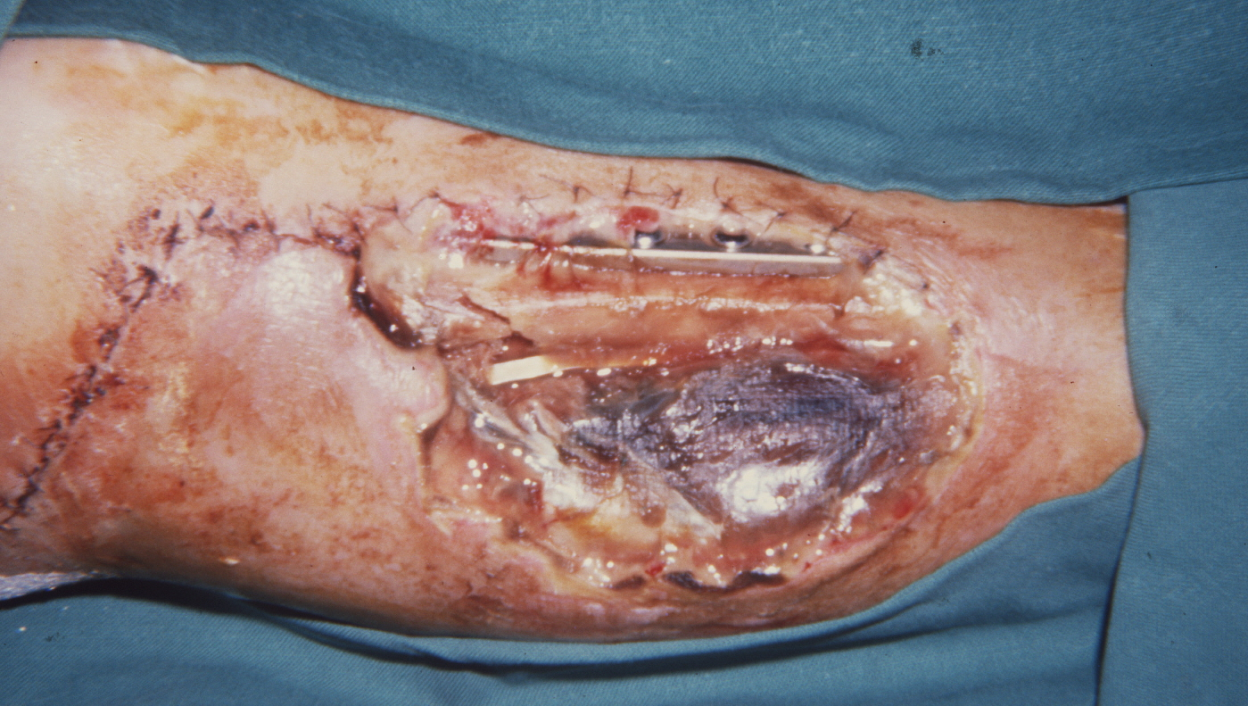
1. Infections in orthopedic trauma
Why is this so important in orthopedic trauma?
Notes:
Discuss with audience. The audience should come up with answers!

Slide 6
Definitions and examples of
An infection
A surgical site infection
Notes:
In the next slides you will discuss together with the audience the definitions of :
an infection
a hospital-acquired infection (HAI) also known as a healthcare-associated infection or in medical literature described as a nosocomial infection.
a surgical site infection.
The participants also come up with examples.

Slide 7
Infection
What is an infection?
Give examples.
Notes:
Discuss with audience. The audience should come up with the answers! The next slide can be used to complete the discussion.

Slide 8
Infection
Definition:
Invasion by and multiplication of pathogenic microorganisms
In body tissues or a part of the body
Produces injury and disease
Through a variety of cellular or toxic mechanisms
Examples:
Flu, cold
All type of wound infections, etc.
Notes:
An infection is an invasion by and multiplication of pathogenic microorganisms in body tissues or a part of the body which produces injury and disease through a variety of cellular or toxic mechanisms. Examples are flu, a cold, or wound infections.

Slide 9
Surgical site infection (SSI)
What is a surgical site infection?
Give examples.
Notes:
Discuss with audience. The audience should come up with the answers! The next slide can be used to complete the discussion.

Slide 10
Surgical site infection (SSI)
Definition
Microorganisms enter through the surgical skin incision
Examples
Entrance points of external fixator, infected surgical wound, etc.
Notes:
A surgical site infection is a hospital-acquired infection where the microorganisms enter the skin incision made in order to carry out the operation.
These infections can be developed at any time starting from two to three days after surgery until the wound has completely healed (usually two to three weeks after the operation).

Slide 11
Facts
1/3rd of hospital-acquired infections in surgical patients are SSI.
40–60 % of SSI are preventable
2–5% of operated patients will develop SSI
SSI increases length of stay in hospital by ~ 7 days
Notes:
Information for faculty:
Adapt the figures to your country if possible.
Show this slide only if you wish.
These are US statistics.

Slide 12
Sources
Exogenous:
Contamination of wound through bacteria from environment:
Surgical team
Operating room environment
Instruments, material
Endogenous:
Contamination of wound through the patient’s own bacterial skin flora
Notes:
There are two types of sources:
Exogenous sources (the first source) are less common in comparison to endogenous sources (the second source).

Slide 13
Sources
Exogenous:
Contamination of wound through bacteria from environment:
Surgical team
Operating room environment
Instruments, material
Endogenous:
Contamination of wound through the patient’s own bacterial skin flora
Notes:
During this discussion we will focus on the exogenous source, more specific care and maintenance of instruments and implants.
Discuss with audience care and maintenance of instruments and material and how their actions can influence the infection rate (positive/negative).

Slide 14
Consequences
Notes:
Discuss with audience. The audience should come up with the answers! The next slide can be used to complete the discussion.

Slide 15
Consequences
Discomfort and pain
Increased antibiotic usage
Prolonged hospitalization and readmission
Increased costs (Pt., government, Insurance…)
Increased mortality
Notes:
The consequences are:
Discomfort and pain
Increased antibiotic usage
Prolonged hospitalization and readmission
Increased costs
Increased mortality

Slide 16
Planning for infection control
Identify ORP person responsible for IC in each OR room.
Pt preparation including hair removal, skin disinfection, prophylactic Antibiotic, etc.)
Apply best practice for scrubbing, gowning, gloving and prepping and draping…
Proper handling and opening of instruments in OR
Maintain the surgical environment in the OR

Slide 17
Summary
Infection control in OR is important
SSI is preventable
Planning is essential in IC
Notes:
Ask participants to make their own summary as individual or in plenum.

