Slide 1
Preoperative planning―key to success
AO Trauma Advanced Principles Course
Notes:
Published: September 2013
Author: Paulo Barbosa, BR
Our great appreciation to Mathew Porteous for his contribution to this lecture.
From the many slides provided below, please select the appropriate number of slides that fits within your allotted time.

Slide 2
Learning objectives
Appraise the importance of preoperative planning
Describe how preoperative planning will improve surgical outcomes
Recognize that with preoperative planning a precise and more accurate reconstruction of the fracture is possible, and an improved surgical outcome expected
Recognize the potential pitfalls of not planning
Notes:
Teaching points:
Compare the surgeon to the pilot or SCUBA diver: “plan your flight – fly your plan”.

Slide 3
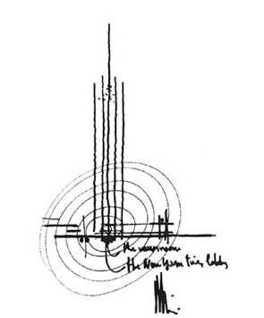
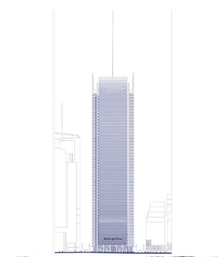
Planning is common in many areas...

Slide 4
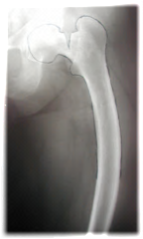
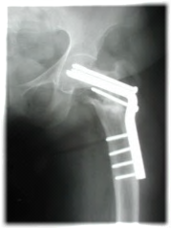
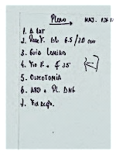
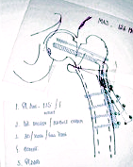
Importance
Plan the surgery that you are about to do
Before doing it!

Slide 5
Prior to surgery
Planning involves NOT ONLY choosing an implant or a technique
Time available
Pathology
Anatomy
Techniques
Best solution

Slide 6
Importance
Time devoted to preoperative planning is essential
Often determines the success or failure of the operation

Slide 7
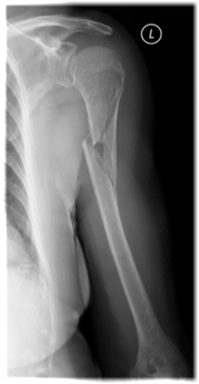
Example:
75-year-old woman
Fall from the stairs
Pain
Functional incapacity in the left shoulder
Neurovascular normal

Slide 8
Planning
Necessary information
Planning—tactic
Instruments and equipment
Execution

Slide 9
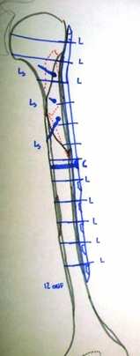
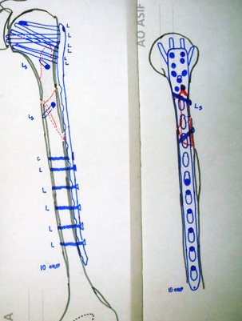
Preoperative planning

Slide 10
Preoperative planning
Materials:
PHILOS plate (long, 10–12 holes)
Small fragment set / 3.5
Reduction forceps
CAD power drill
Hand table
Tourniquet
Technique:
Deltopectoral approach (extended)
Reduce wedge fragment to distal fragment with 3.5 mm lag screw
Reduce distal and proximal fragment with 3.5 mm lag screw
Fix the 10-hole PHILOS plate laterally with K-wires
Image control
Fix plate with conventional 3.5 mm screw at hole #5
Fix the proximal and distal holes with LHS alternatively
Image control
Wound irrigation/closure

Slide 11
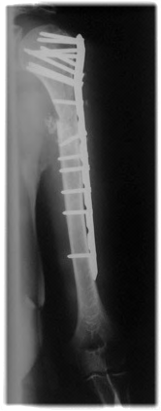
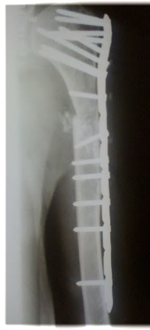
Execution

Slide 12
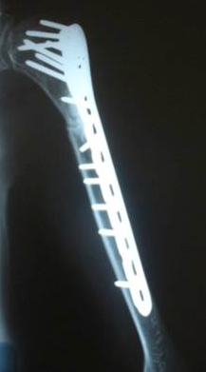


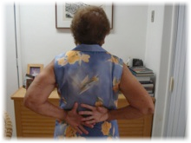
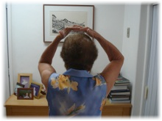
Result

Slide 13
How to plan?

Slide 14
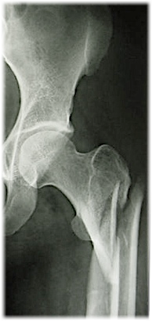
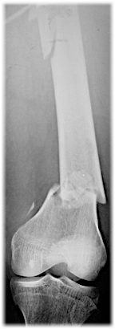
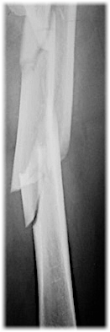
Make the correct diagnosis
History
Physical examination
Complementary information
Image diagnosis
  X-rays
  CT: 2-D, 3-D, and reconstruction
  MRI
  Others

Slide 15
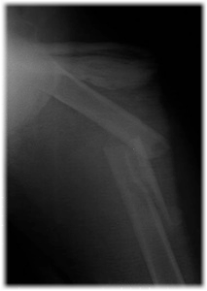
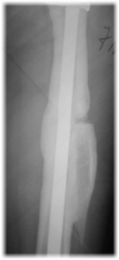
Identify the desired goal
Arthroplasty
Osteotomy
Nonunions
Fracture

Slide 16
Goals
Draw the expected result
Establish the surgical tactic
Save time and stress

Slide 17
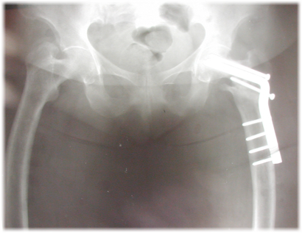
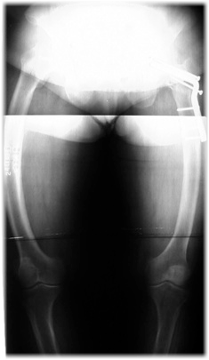
Draw the expected result
Allows evaluation of what we will do
Check the possibilities of success

Slide 18
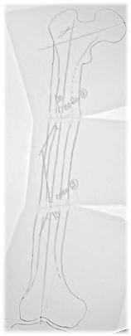
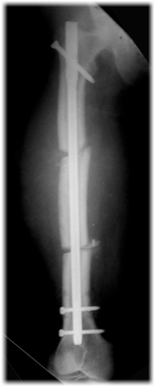
Draw the expected result
Notes:
Double osteotomy necessary.

Slide 19
Establish the surgical tactics
  Patient's position
  Surgical approach
  Reduction methods (direct/indirect)
  Implants and position
  Bone graft
  Anticipate solutions to difficulties

Slide 20
Save time and stress—before operating
We know what to do
We know how to do
We know what is necessary to do

Slide 21
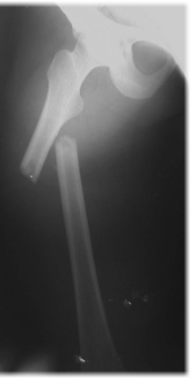
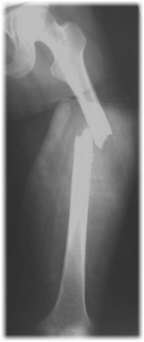
Save time and stress—example
What is the difference between these fractures?
8 mm
8 mm

Slide 22
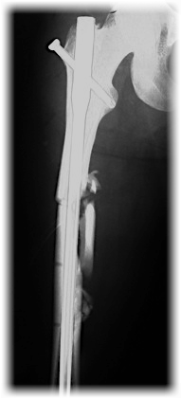
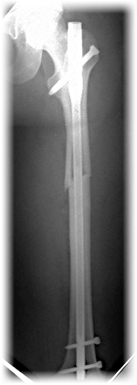
Save time and stress—anticipate problems
What is the difference between the treatment of these fractures?
8 mm
8 mm
Preoperative planning
Notes:
Diameter of canal was not appreciated in the case on the left! Good example of what can happen to a surgeon who does not plan!

Slide 23
Planning: methods
Using the fracture
Using the normal side
Using the anatomical axis

Slide 24

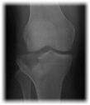
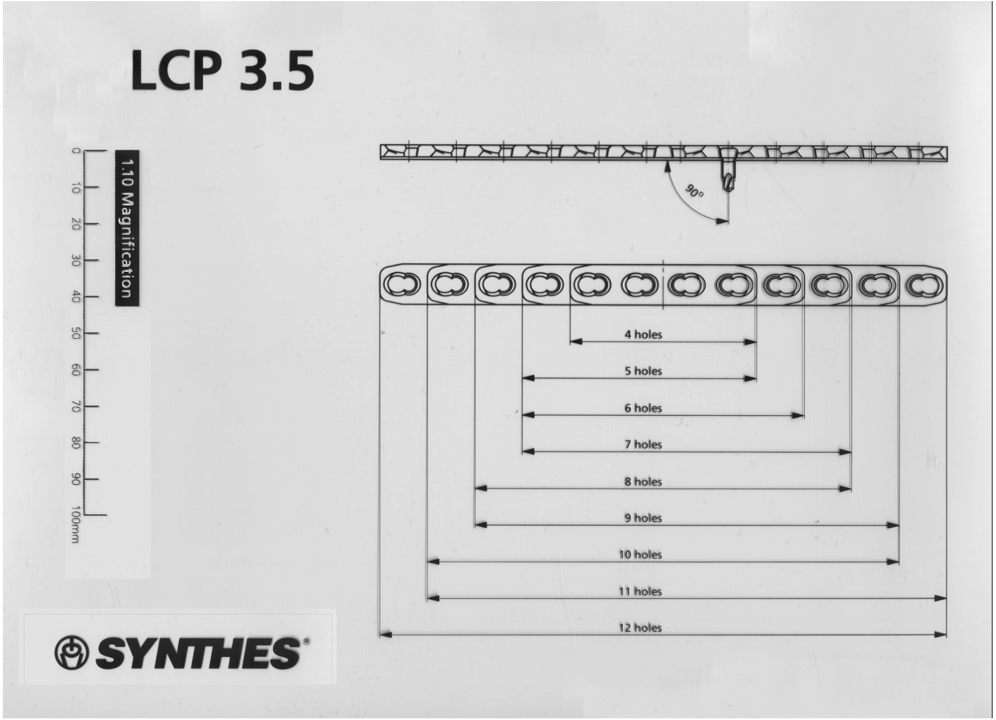
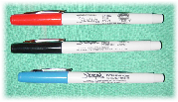
Necessary material
X-ray—lesion/normal
Tracing paper
Templates—implants
Color pens
Computer/software

Slide 25
Using the fracture
Draw individual fragments of the fracture
"Reduce" the fracture: drawing the fragments
Select the implants and put them over the "reduced" fracture
Establish the surgical tactic with the expected:
  Positioning
  Surgical approach
  Reduction methods
  Implants
  Fixation sequence, etc

Slide 26

Using the fracture
Fracture x-ray: diagnosis
Notes:
BB: replaced again

Slide 27
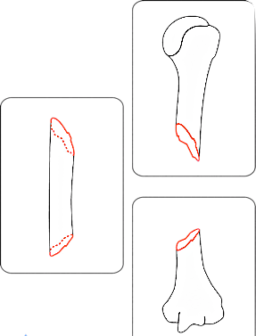
Using the fracture
Fracture x-ray: diagnosis
Draw fragments of the fracture
Notes:
BB: again

Slide 28
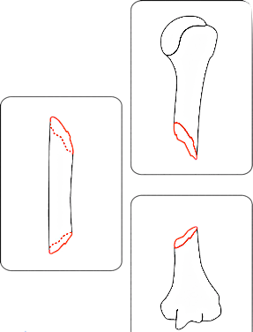
Color code
Bone = BLACK
Fracture = RED
Implants = BLUE

Slide 29
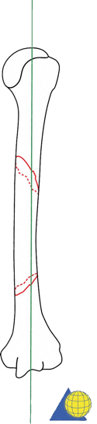
Using the fracture
Fracture x-ray: diagnosis
Draw fragments of the fracture
"Reduce" the fracture drawing
Notes:
BB: again

Slide 30
Using the fracture
Fracture x-ray: diagnosis
Draw fragments of the fracture
“Reduce” the fracture drawing
Select the implants and put them over the "reduced" fracture

Slide 31
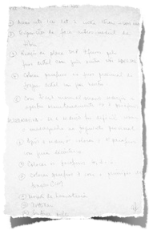
Using the fracture
Fracture x-ray: diagnosis
Draw fragments of the fracture
“Reduce” the fracture drawing
Select the implants and put them over the "reduced" fracture
Establish the tactic with the expected positioning, surgical approach, reduction methods, implants, fixation sequence, etc

Slide 32
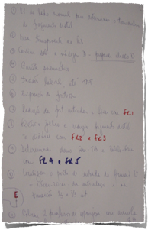
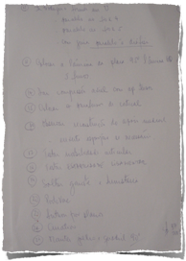
Step-by-step description

Slide 33
Using the normal side as a template—fractures/osteotomies
Draw the intact side and axis
Draw the deformity and evaluate:
  Angles, axis, and length
    Deformity = 3-D and x-ray = 2-D
      Deformity is usually greater than it looks
    Pay attention to rotation!
Place the implants: fracture/deformity corrected
Establish the surgical tactic with the expected positioning, surgical approach, reduction methods, implants, fixation sequence, etc
Notes:
This is an alternative example of preoperative planning – planning an osteotomy case, so not technically a trauma/fracture case and can potentially be omitted.
However, it does show use of the NORMAL side technique, as does the series of slides about using anatomical axis as a template.
All these are important for an advanced audience, and are not slides that the presenter will spend time on, but can flip through as an “animated series”.

Slide 34
Using the normal side
Draw the intact side and axis
Draw the fragments of the fracture
“Reduce” the fracture by drawing the fragments over the normal side
Insert implants: deformity/fracture corrected
Establish the surgical tactic with the expected positioning, surgical approach, reduction methods, implants, fixation sequence, etc

Slide 35

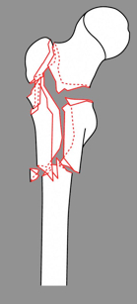

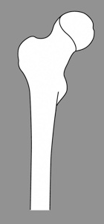



Using the normal side

Slide 36
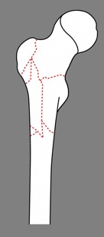

Choose implant
Angled plate 95º
Dynamic condylar screw (DCS)
Proximal femoral nail (PFN) long

Slide 37
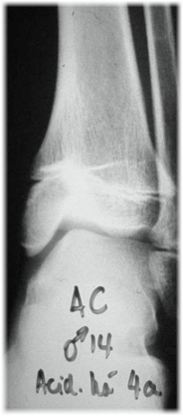
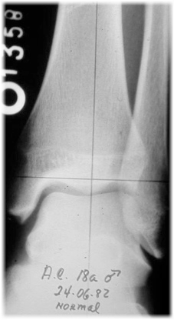
Using the normal side for deformity correction

Slide 38
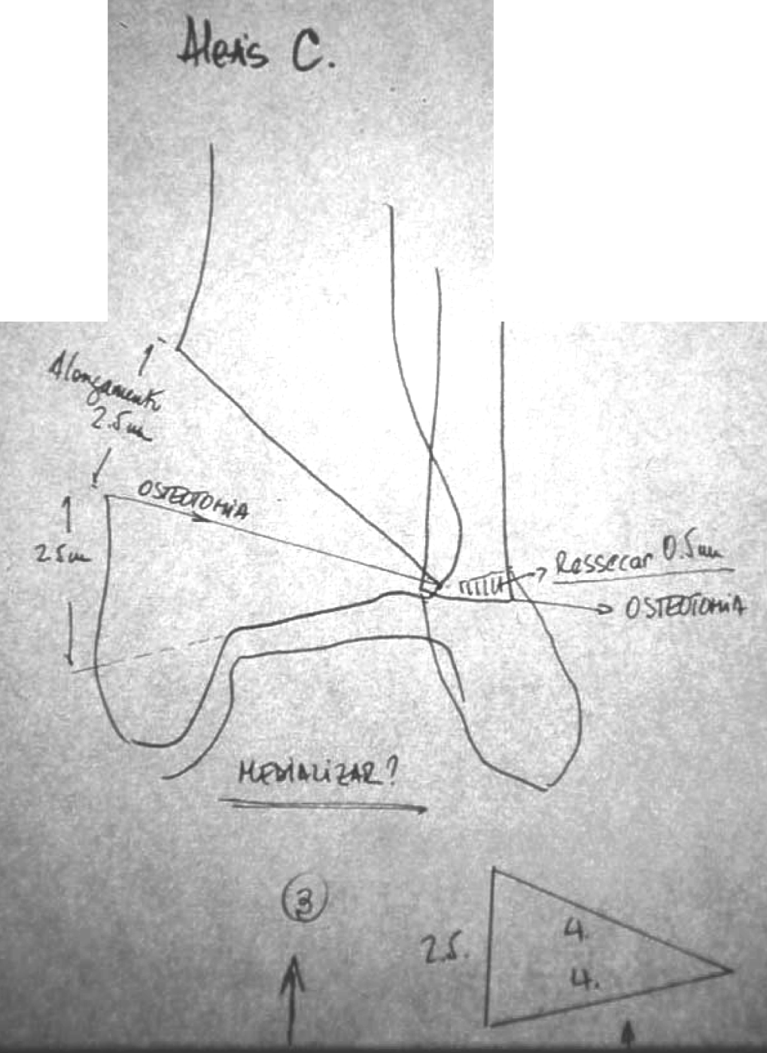
Using the normal side

Slide 39
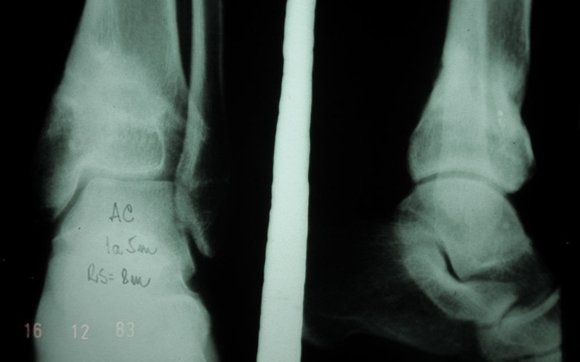
Using the normal side—results

Slide 40
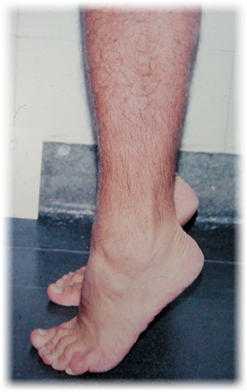
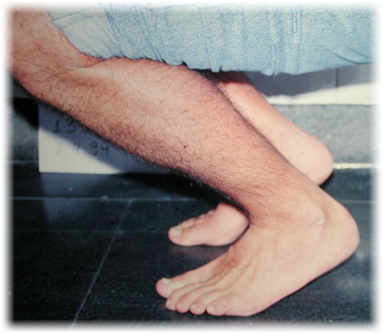
From the intact side

Slide 41
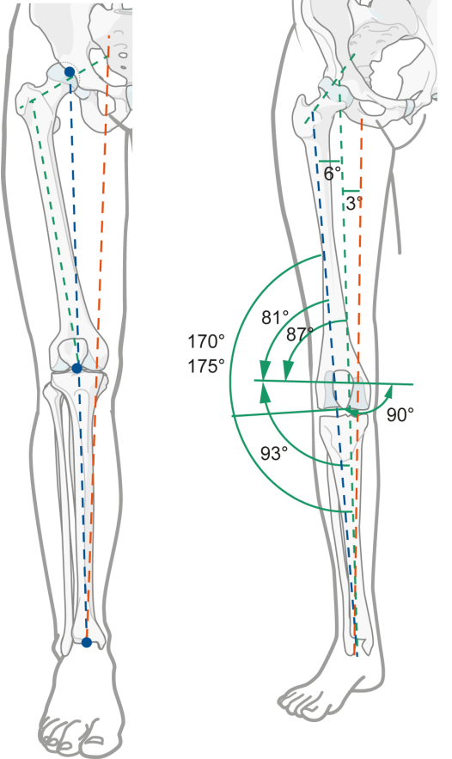
Using the anatomical axis

Slide 42

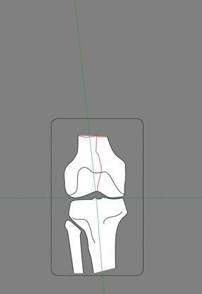
Using the anatomical axis

Slide 43
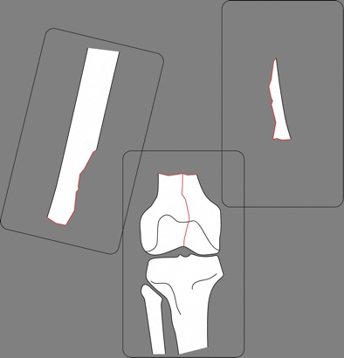
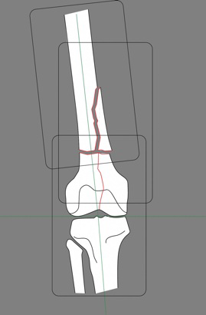
Using the anatomical axis

Slide 44
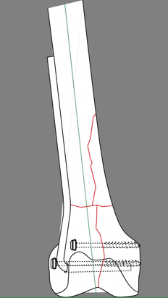
Define
Reduction method
Implant
Fixation sequence
Axial compression?
Traction screw?
Bone graft?

Slide 45
Computer-assisted planning
Material required:
Digital camera
Computer
Photoshop, or similar
TIME

Slide 46

Example
24-year-old man
Open tibial fracture
External fixator
Malunion

Slide 47
Deformity correction
Step 1
CORA

Slide 48
Deformity correction
Step 2
Plan osteotomy

Slide 49
Deformity correction
Step 3
Fibular ostectomy

Slide 50
Deformity correction
Step 4
Tibial osteotomy
Deformity correction

Slide 51
Deformity correction
Step 5
Consider implant:
  IM nail
  Blocking screws
Notes:
Note use of “blocking” screws

Slide 52
Deformity correction

Slide 53


Deformity correction—radiological result

Slide 54





Deformity correction—clinical result

Slide 55
Planning allows us to:
Understand the lesion and evaluate all possible solutions
Anticipate every step
Avoid improvisations

Slide 56
Planning allows us to:
Facilitate the procedure
  Ideal approach
  Best reduction method
  Choice of implants and instruments
  Save time and energy in operation
Achieve better results

Slide 57
Advanced planning modalities (helpful when available)
CT and 2D/3D CT reconstructions for articular approch planning
Digital planning software for osteotomies and acute fracture planning
3D printing

Slide 58
Take-home messages
Few surgeons have the intellectual capacity, enhanced by experience, to perform mental planning...
...most of us, common surgeons will benefit from preoperative planning...
A LOT!

