Slide 1
Hand Overview Management summary
Presenter’s name
AO Trauma Upper Extremity Event
Content prepared by AO Trauma Upper Extremity Education Taskforce
City, month year
Notes:
Developed by Ashraf Moharram and approved by the AO Trauma Upper Extremity Education Taskforce IPEs (March 2020)

Slide 2
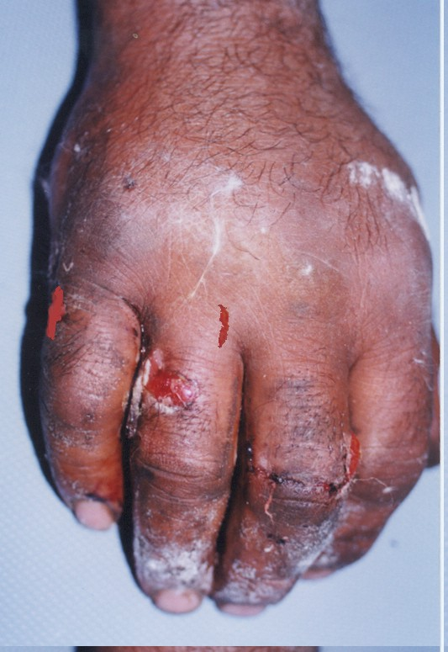
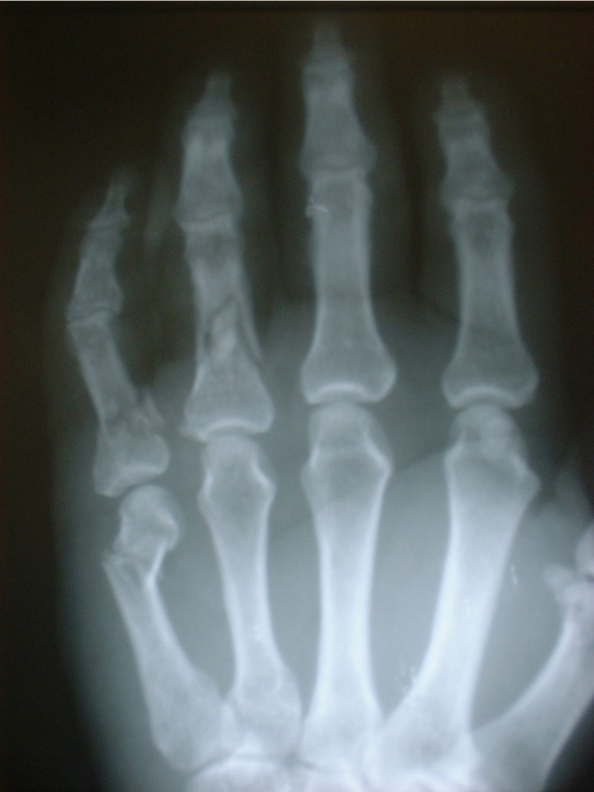
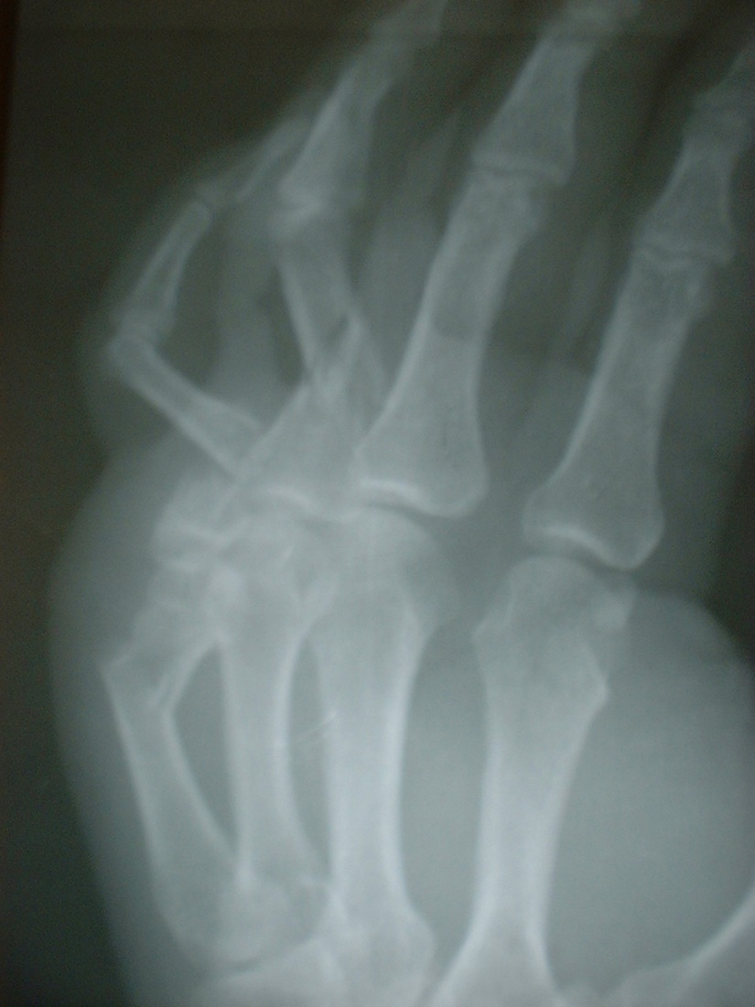
Case: how do we manage this today?
50-year-old man, tyre explosion injury to right dominant hand

Slide 3
Learning objectives
Describe how to investigate the problem
Classify the lesion
Relate injury patterns to indications and treatment
Decision making (including avoid complications)

Slide 4
The problem
Metacarpal and phalangeal fractures are most frequent of all skeletal injuries [10–20% of all trauma]
Majority can be treated nonoperatively
However, unstable fractures with shortening or rotational deformity will benefit from surgical intervention

Slide 5
Treatment approach
Stable fracture pattern, with no or acceptable deformity:
Splint for comfort and move
Unstable fracture and/or deformity:
Convert to stable and acceptable and move
Conversion by closed reduction +/- splint, closed reduction and internal fixation (CRIF) or open reduction and internal fixation (ORIF)
Cannot convert (eg, completely smashed open proximal interphalangeal joint):
Move or fuse

Slide 6
What is the problem?
What is stable/unstable?
What is an acceptable deformity?
What leads to loss of motion?

Slide 7
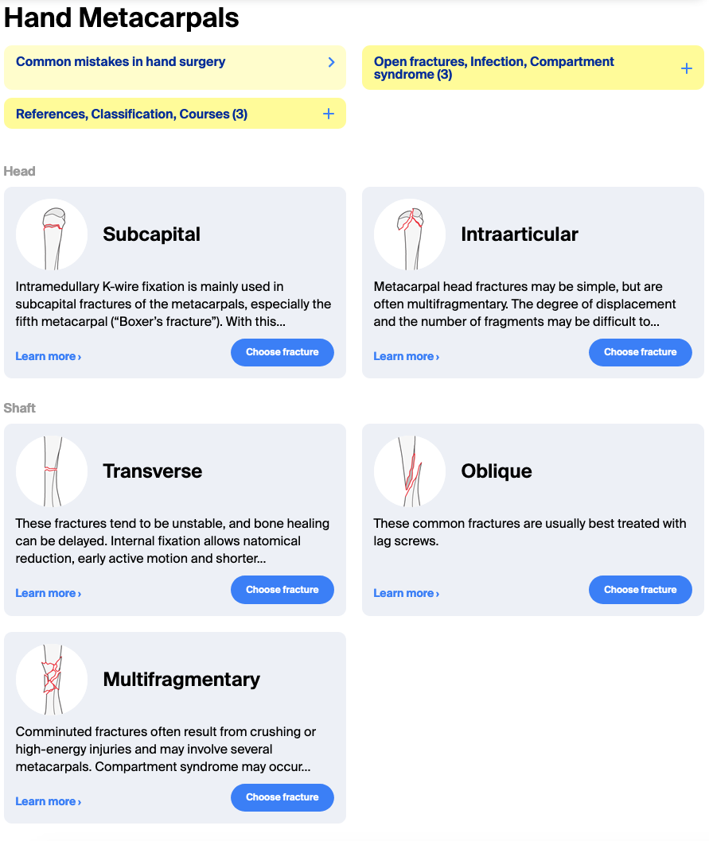
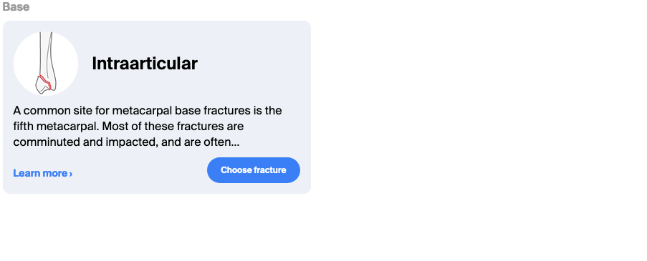
What is stable/unstable?
Single metacarpal fractures are usually stable
Multiple metacarpal fractures lose stability of adjacent metacarpal and are therefore at more risk (pattern or fracture configuration dependent)

Slide 8
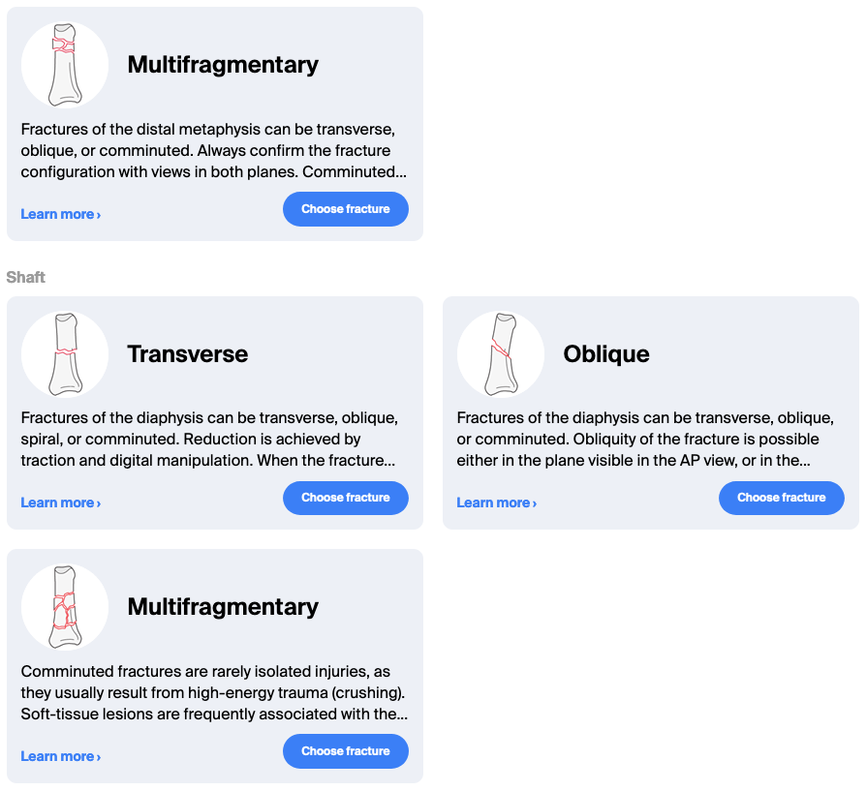
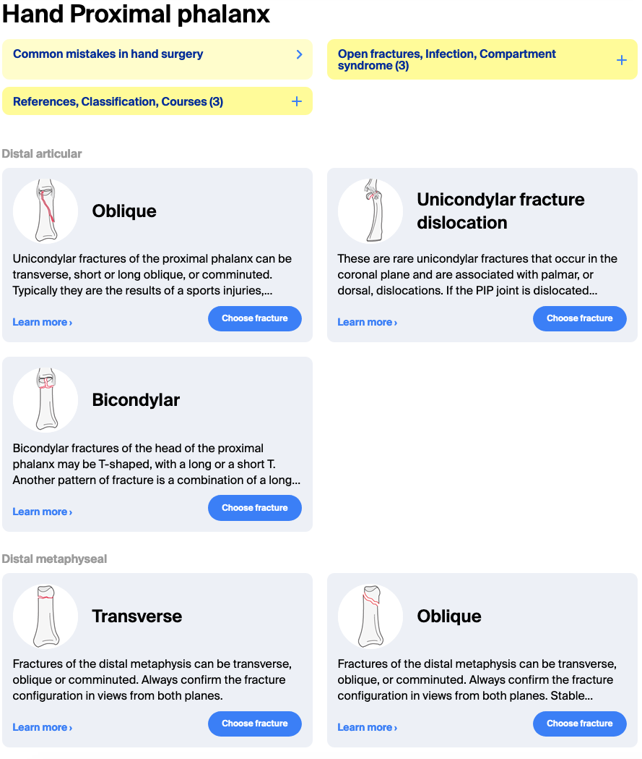
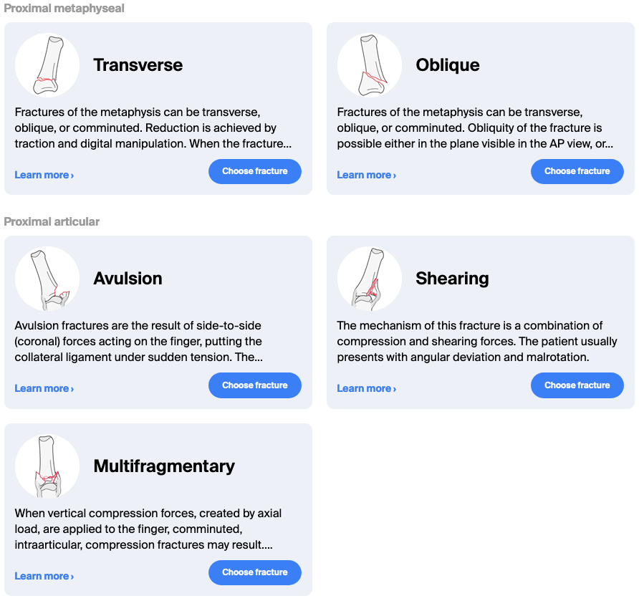
What is stable/unstable?
Phalyngeal fractures are more pattern dependent because they do not have an adjacent structure to support them.

Slide 9
What is acceptable alignment?
50% overlap
No rotation
10° angulation in sagittal or coronal plane
20° angulation in metaphysis
45° in 5th metacarpal neck
1 mm articular step
2 mm articular gap
Shortening 2 mm metacarpal 7° lag & pro phalanx 1 mm and 12° at PIP
Proximal phalanx angulation: 16, 27, 46 = 10, 24, 66, joint lag

Slide 10
Main aim of treatment
To establish fracture reduction and stabilization leading to early mobilization
Prevention of deformity
Reduce stiffness and tendon adhesion
Overall restoration of function

Slide 11
Management
Most fractures are managed nonoperatively
Splints, braces and casts

Slide 12
Indications for surgery
Irreducible fractures
Articular fractures
Subcapital fractures (phalangeal)
Malrotation (spiral and short oblique)
Unstable displaced fractures after reduction
Open fractures
Segmental bone loss
Polytrauma with hand fractures
Multiple hand or wrist fractures
Fractures with soft tissue injury (vessel, tendon, nerve, skin)

Slide 13
What options and tools do we have for this problem?
Closed reduction and plaster immobilization
Closed reduction and percutaneous pinning
ORIF
External fixation (CR\OR)

Slide 14
Small group discussion
Discuss the core and optional cases for the allocated time

Slide 15
Management summary
Learning objective
Manage using a structured approach

Slide 16
Methods of internal fixation
Plates [round hole, DCP and LCP] Absolute or relative stability
Tension bands Absolute stability
Interfragmentary screws Absolute stability
K-wire fixation Relative stability

Slide 17
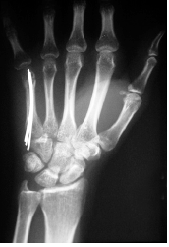
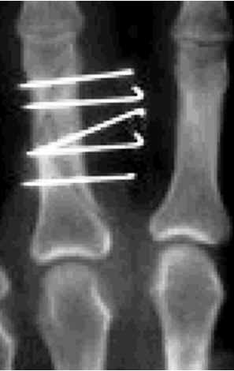
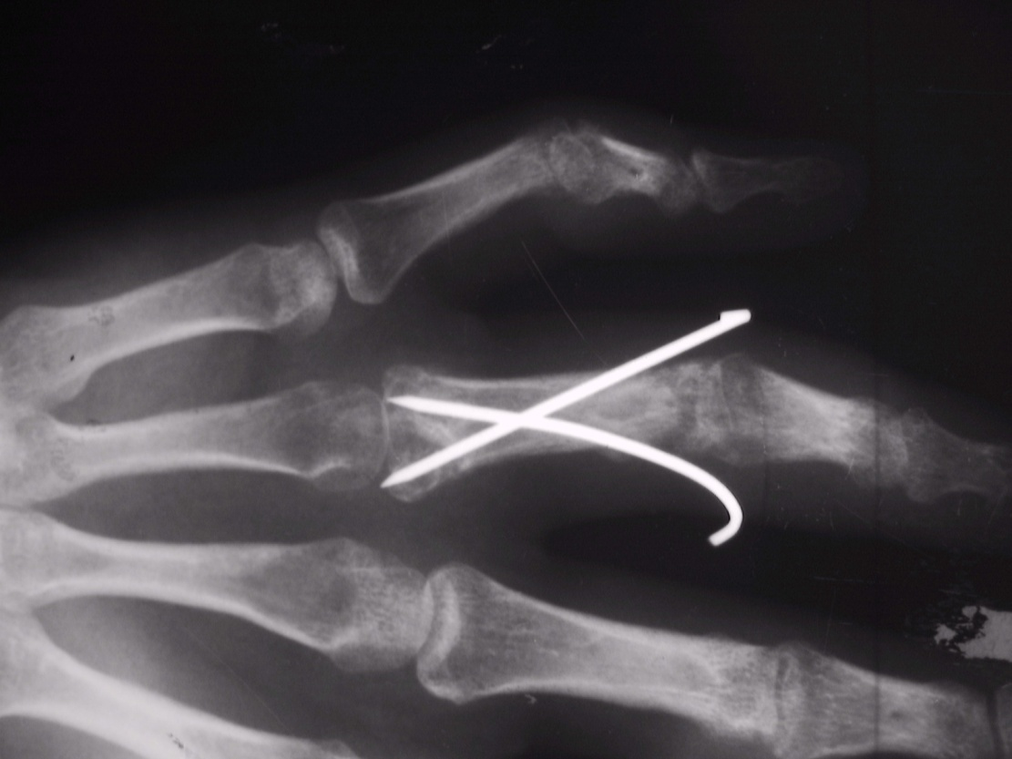
K-wires (avoiding crossing the joints)
Configuration
Crossed Parallel Intramedullary

Slide 18
K-wire fixation—aiming at relative stability
Pros:
Minimal metal
Minimally invasive
Cost effective
Cons:
Less fracture stability
May need plaster-of-Paris
Infection risk
Loss of range of motion (ROM)

Slide 19
ORIF
Pros:
Best fracture stability
No immobilization needed
Cons:
More metal
More invasive
Infection
Adhesions

Slide 20
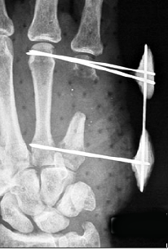
External fixation
Primarily indicated for severe fractures when anatomic reconstitution of the skeleton is not feasible:
Highly comminuted
Open fractures
With bone loss
Displaced, comminuted articular fractures; and
Fractures with injury or loss of soft-tissue structures
Usually temporary method of fixation
High complication rates

Slide 21
Decision making
Depends on:
Fracture-related factors
Soft tissue and associated injury factors
Surgeon and set-up factors
Patient-related factors
Most important: Avoid deformity and stiffness to restore ROM and function

Slide 22
50-year-old man, tyre-explosion injury to right dominant hand

Slide 23
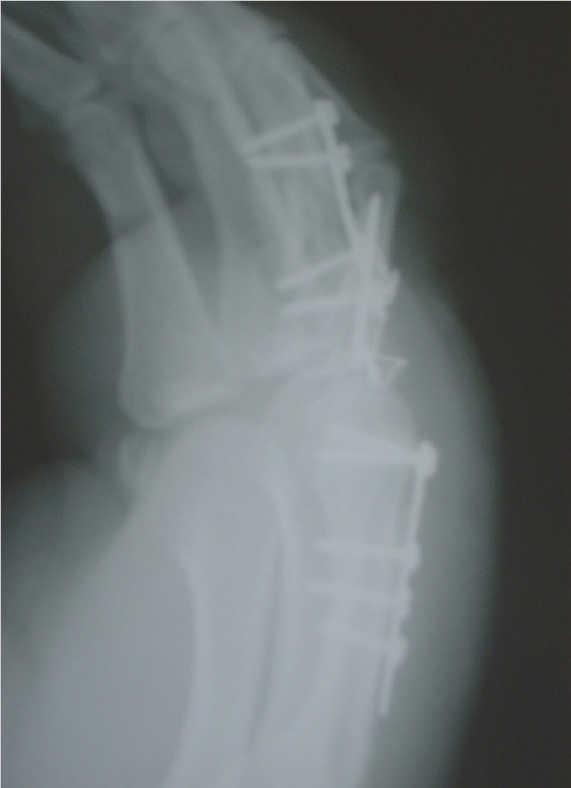
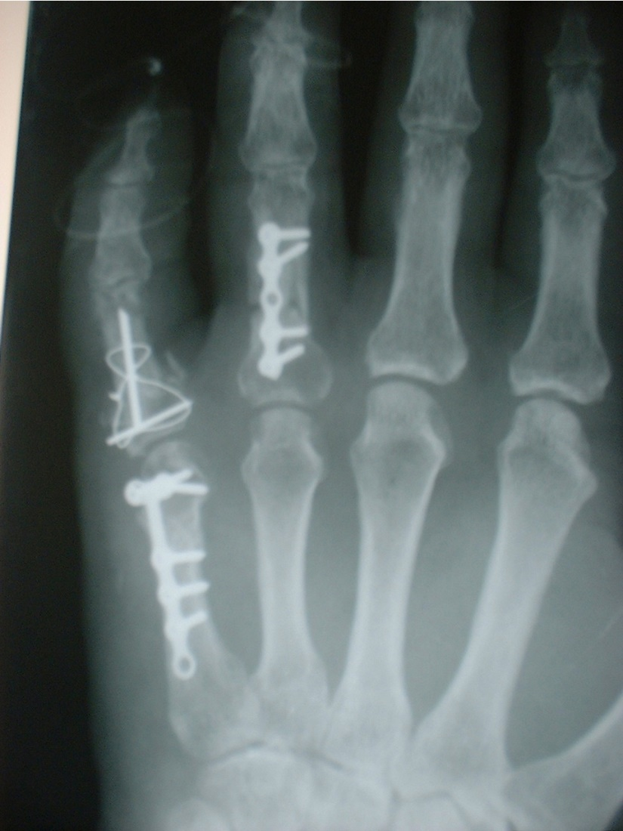
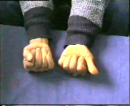
50-year-old man, tyre-explosion injury to right dominant hand

Slide 24
Take-home messages
Most frequent of all skeletal injuries
Majority can be treated nonoperatively
Decision making has many options
But most importantly aim at restoration of ROM and function

