Slide 1
Proximal ulna Overview Management summary
Presenter’s name
AO Trauma Upper Extremity Event
Content prepared by AO Trauma Upper Extremity Education Taskforce
City, month year
Notes:
Developed by Stefaan Nijs and approved by the AO Trauma Upper Extremity Education Taskforce IPEs (March 2020)

Slide 2
Case: how do we manage this today?

Slide 3
Learning objectives
Describe how to investigate the problem
Classify the lesion
Relate injury patterns to indications and treatment
Decision making (including avoid complications)

Slide 4
What is the problem?

Slide 5
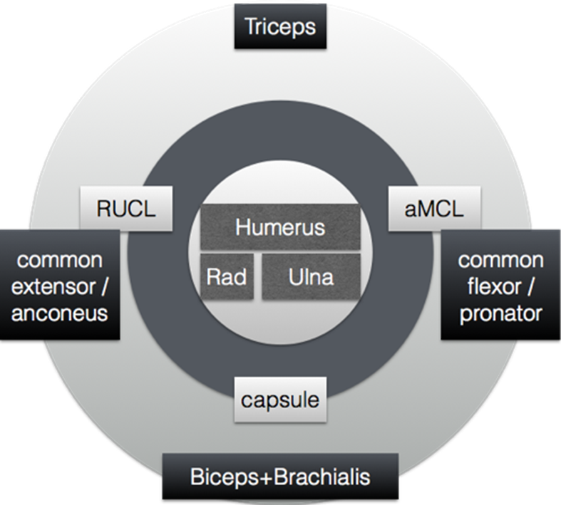
The elbow – the double guarded fortress
Abbreviations: radial ulnar collateral ligament (RUCL); anterior band of medial collateral ligament (aMCL)
Notes:
Bony and ligamentous structures and how they relate to

Slide 6
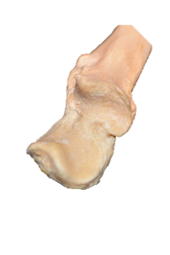
The elbow—the double-guarded fortress
Ulna

Slide 7
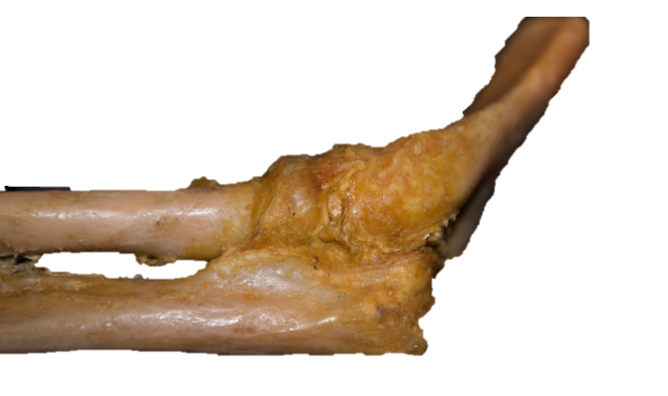
The elbow—the double-guarded fortress
Ulna

Slide 8
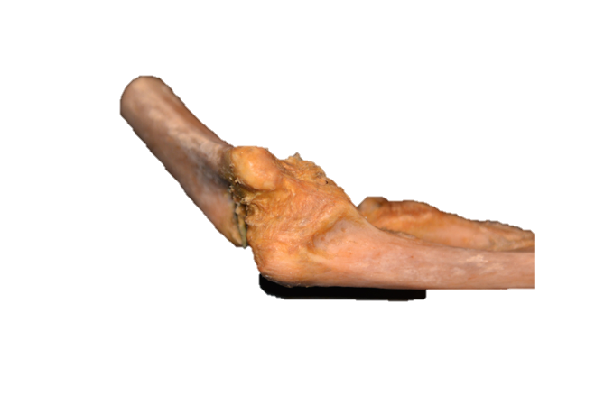
The elbow—the double-guarded fortress
Ulna

Slide 9
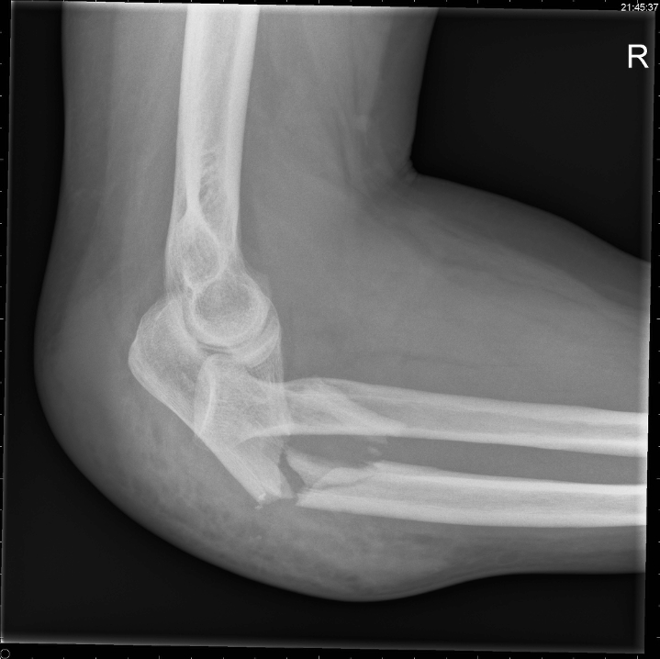
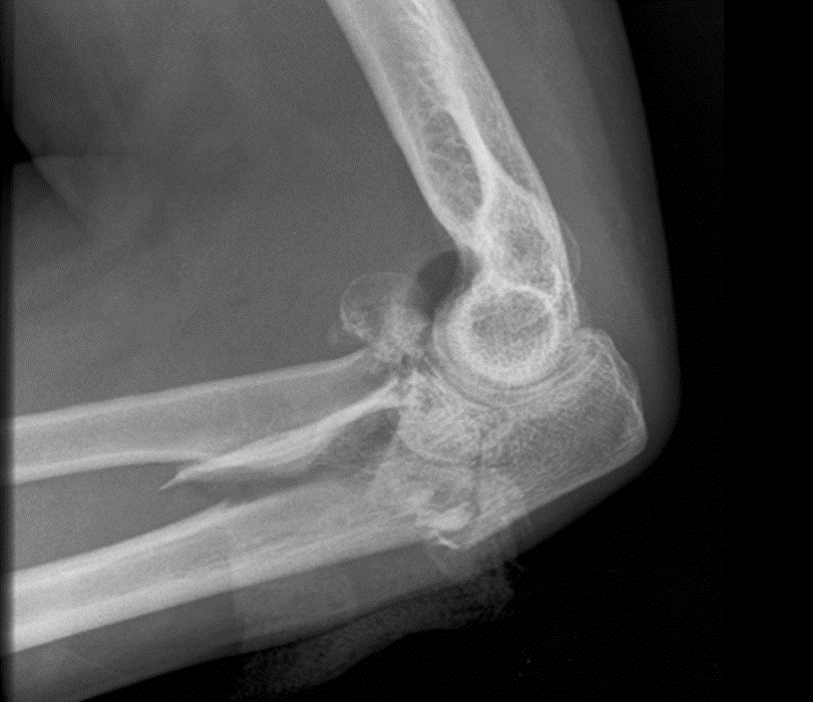
What is the problem?

Slide 10
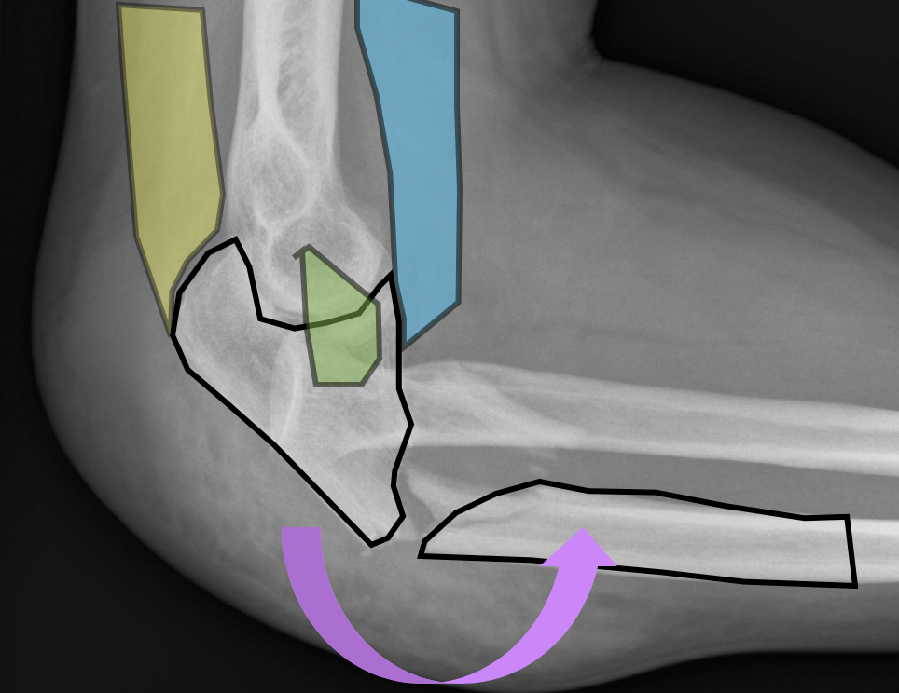
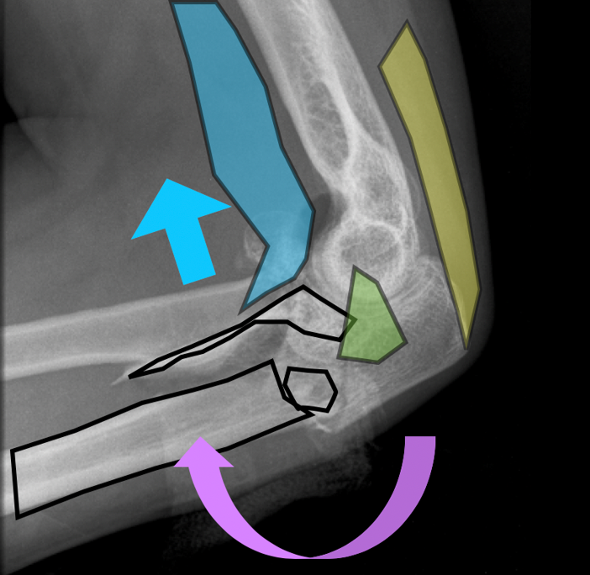
Bending

Slide 11
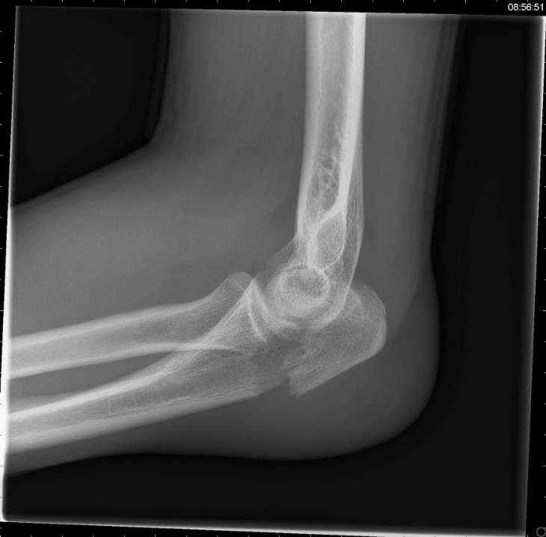
What is the problem?

Slide 12
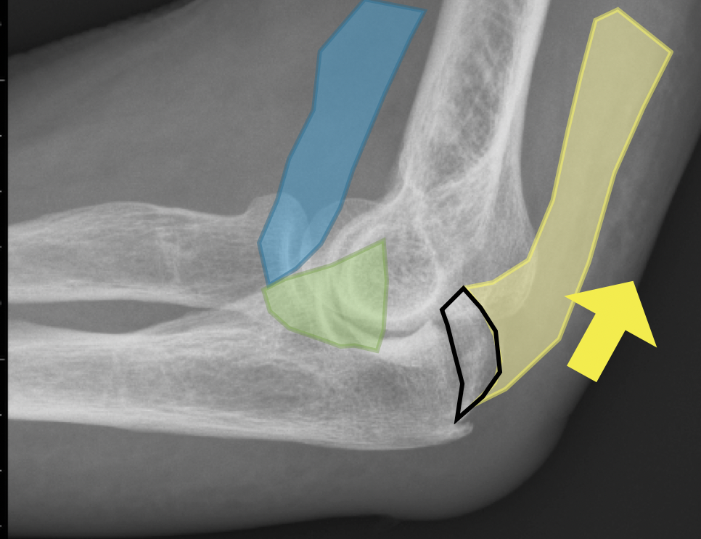
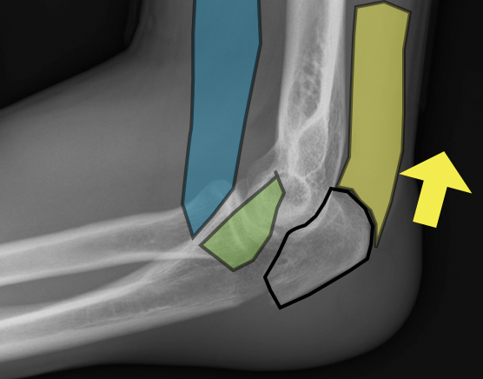
Avulsion

Slide 13
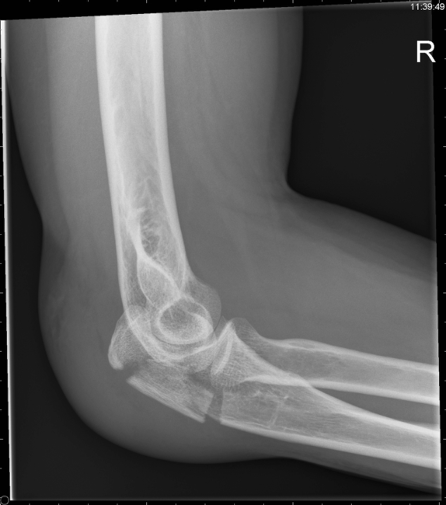
What is the problem?

Slide 14
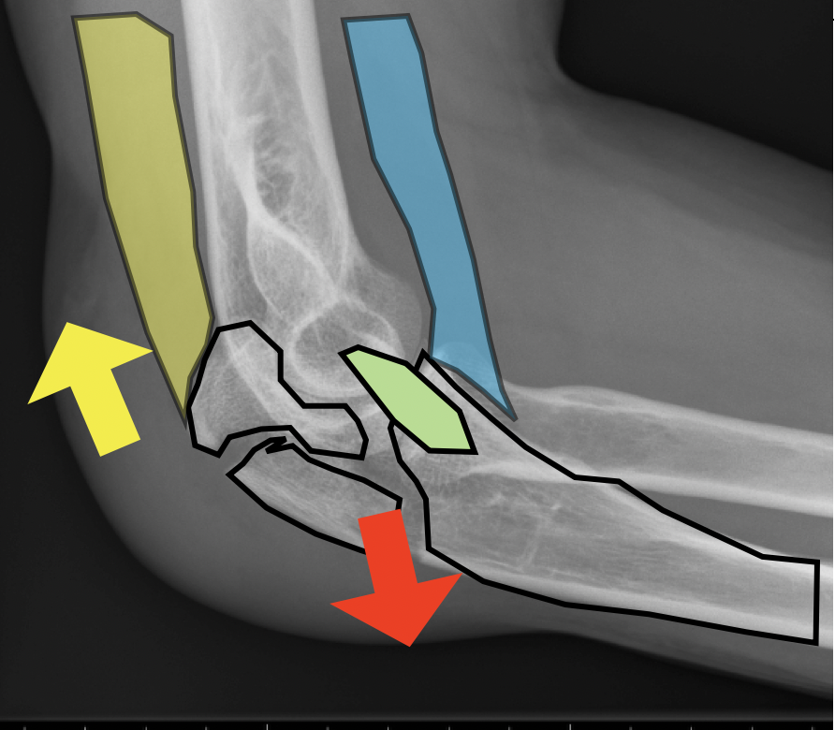
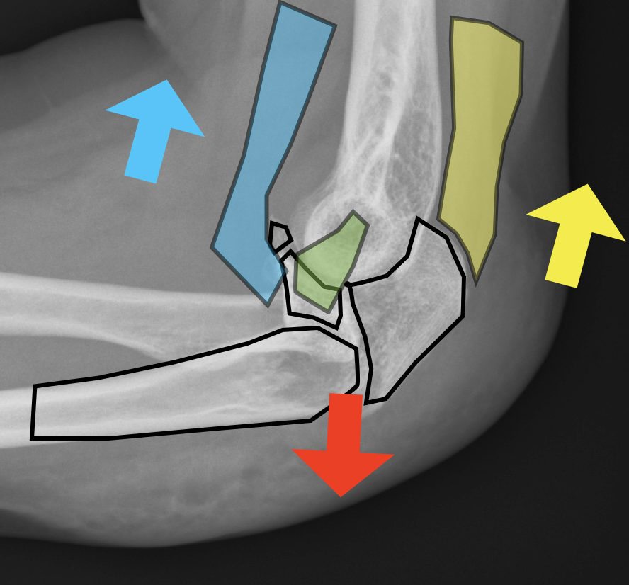
Protrusion/shear

Slide 15
CT scan add value to assess complex articular fractures

Slide 16
What options and tools do we have for this problem?

Slide 17
Bending

Slide 18
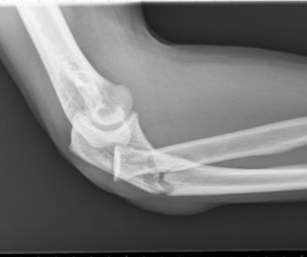
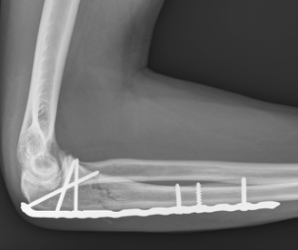
Strong enough to withstand bending force

Slide 19
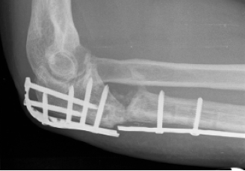
Consider an anterior defect
Strong enough to withstand bending force

Slide 20
Anatomic reduction ulna repositions radial head

Slide 21
Avulsion
Notes:
Note: make graphics look like ligaments – can remove green and blue here (NOT fragments)
Could add AP view too (make it all clear)

Slide 22
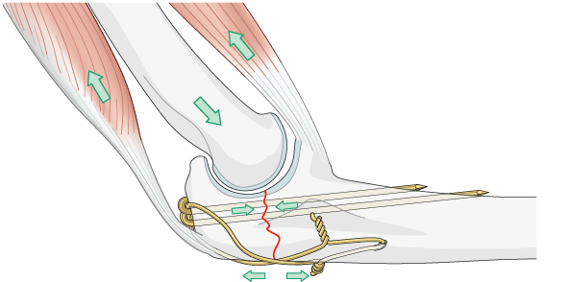
K-wires and cerclage
Static compression osteosynthesis (no dynamic component)
Dependent of good bone quality
Dependent of exact technique
High rate of implant removal needed

Slide 23
Plate and screw osteosynthesis
Static compression osteosynthesis (stronger compression)
Less dependent of bone quality
Small proximal fragment needs high proximal plate position—triceps handling

Slide 24
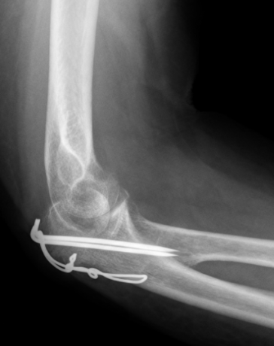
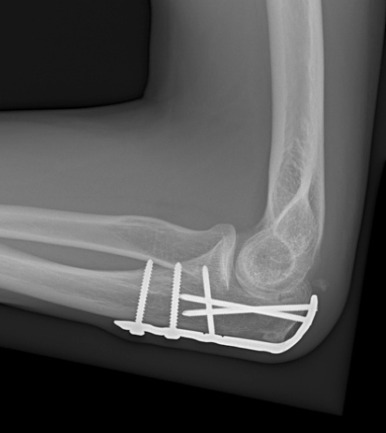

Slide 25
Protrusion/shear

Slide 26
Plate and screw osteosynthesis
Anatomic reconstruction joint surface
Coronoid process is key fragment
Think about ligamentous injuries
Use of additional plates/screws

Slide 27
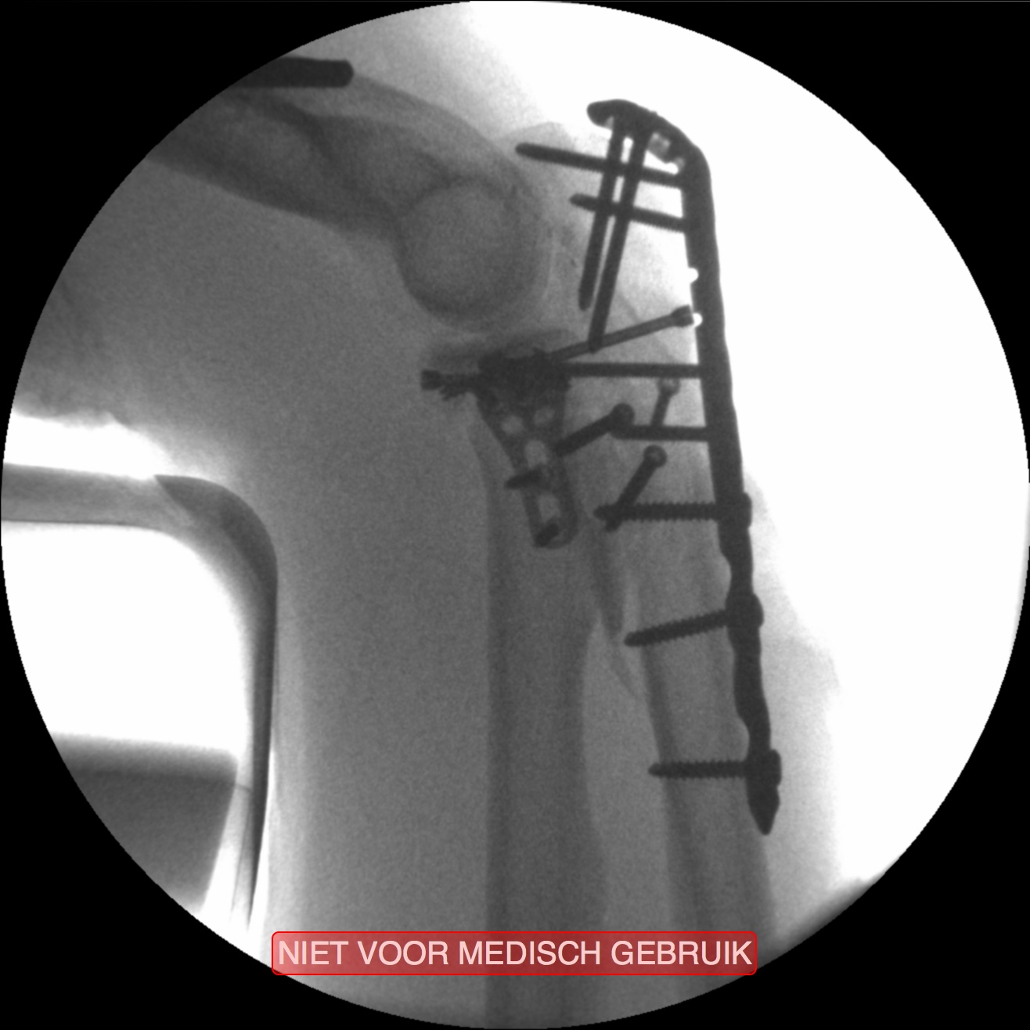
Headless compression screw fixing coronoid process
Plate fixing olecranon process
Independent lag screws reconstructing lateral wall and proximal radial distal joint
1
2
3

Slide 28
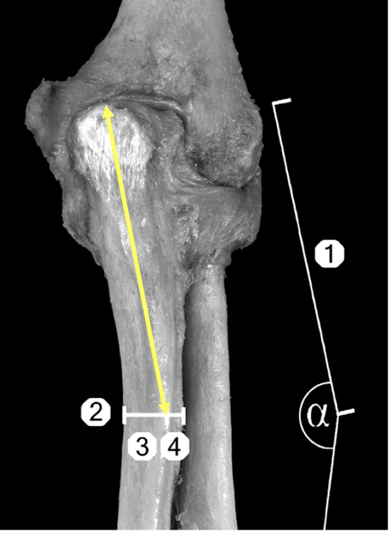
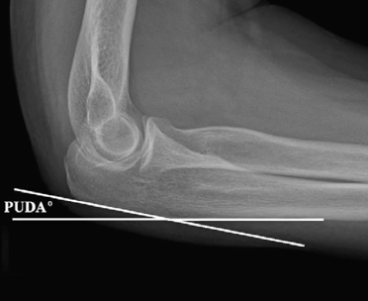
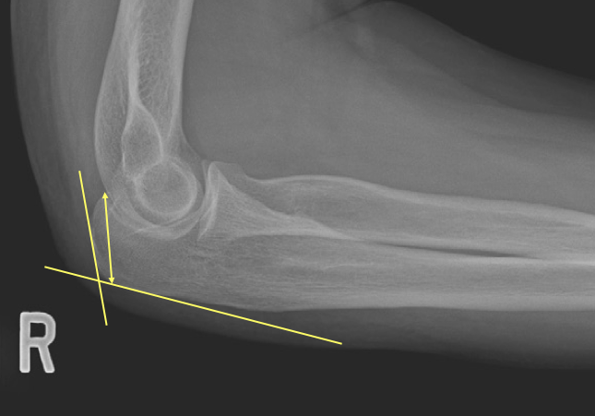
Pearl in plating: the variable bends of the proximal ulna
Varus angle
Proximal ulna diafysis angle (PUDA)
Hook angle
Notes:
Define 1 to 4 in varus angle
Contralateral x-rays for all fracture that will have a plate (to determine the PUDA angle)

Slide 29
Small group discussion
Discuss the core and optional cases for the allocated time

Slide 30
Management summary
Learning objective
Manage using a structured approach

Slide 31
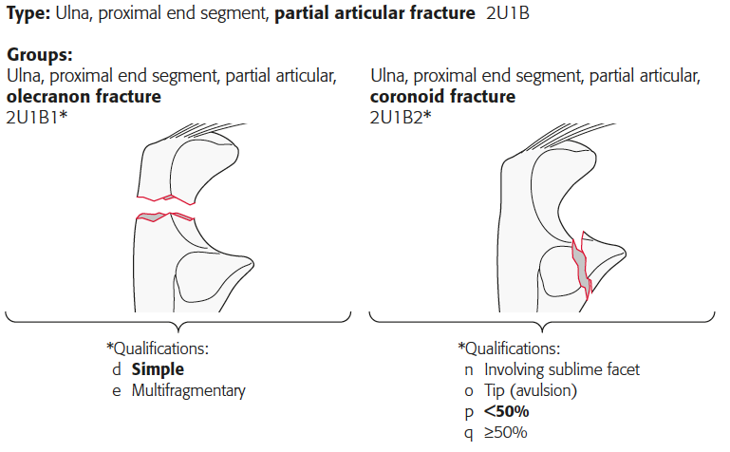
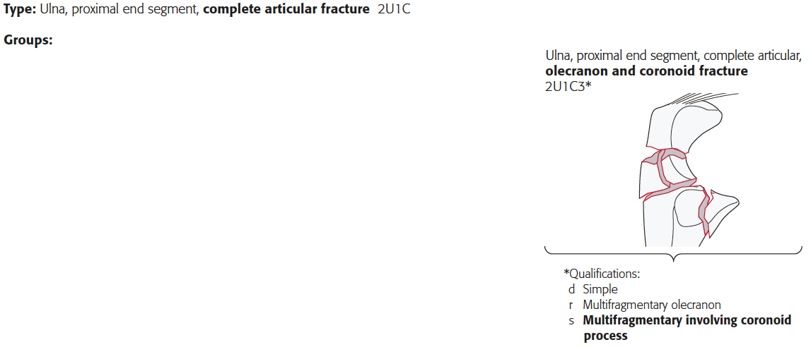
Algorithm

Slide 32
Algorithm
Plate and screw
Compression in simple fractures
Bridging in complex fractures
Strong enough plates
(Think about anterior defects)
Coronoid process is key fragment

Slide 33
Algorithm
Anatomical reconstruction joint surface
Compression osteosynthesis
K-wires and cerclage is option in good bone quality
Plate and screw osteosynthesis

Slide 34
Algorithm
Stable fixation of the coronoid process
Transosseous sutures
Screws
Butress plate
Special attention to the medial facet fragment

Slide 35
Algorithm
Anatomic reconstruction joint surface
Coronoid process is key fragment
Think about ligamentous injuries
Use of additional plates/screws

Slide 36
After treatment
Early functional rehabilitation: “plaster is disaster”
Active assisted exercises
All exercises within pain limits
In complex fractures consider heterotopic ossification (HO): prophylaxis
In the stiff elbow (even in case of HO), consider early arthrolysis (not mobilization under narcosis)

Slide 37
Take-home messages
Computed tomographic scan add values in complex articular fractures
Identification of the fracture pattern determines treatment:
Bending metaphyseal fractures
Partial articular avulsion fractures
Protrusion/shear (complex/complete) articular fractures
Contralateral x-rays determine if plate contouring is required

