Slide 1
Properties of x-rays—what are they?
Hatem Said, Simone Platzke

Slide 2
Learning outcomes
At the end of this lecture you will be able to:
Explain what x-rays are
Discuss the difference between x-rays and Image Intensifier (II)
Describe correct positioning of the II
Explain how to protect well against radiation
Notes:
At the end of this lecture you will be able to
Explain what x-rays are
Discuss the difference between x-rays and Image Intensifier (II)
Describe correct positioning of the II
Explain how to protect well against radiation

Slide 3
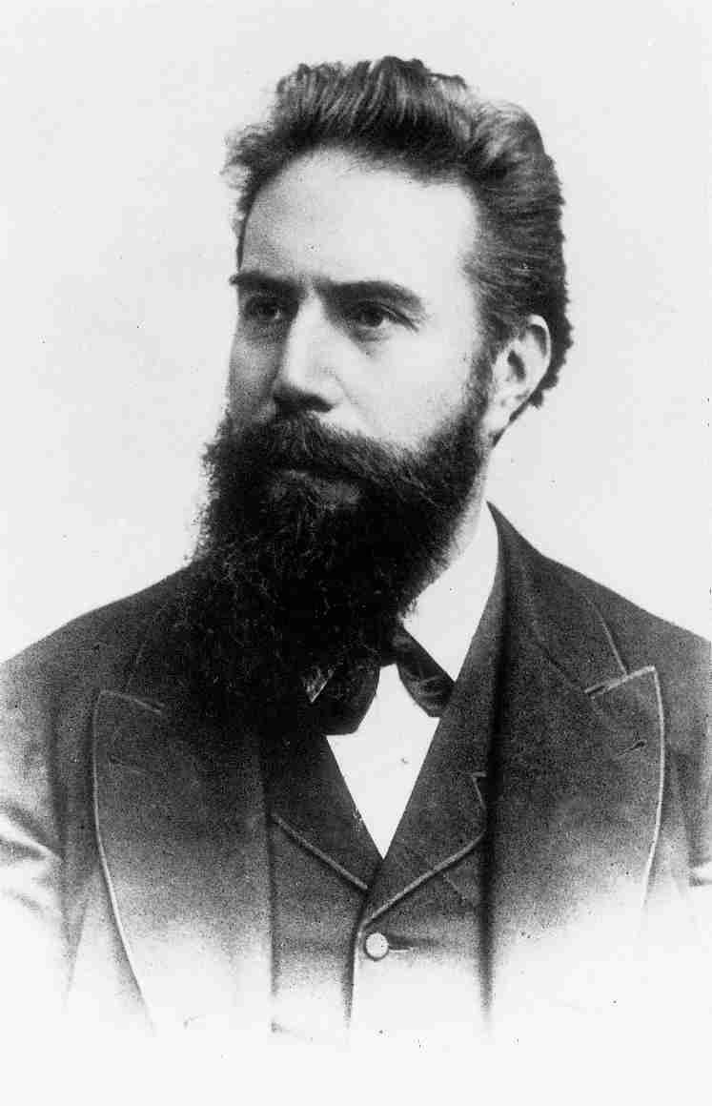
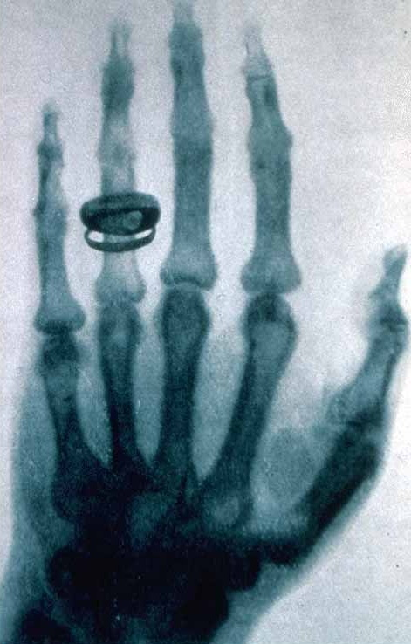
Wilhelm Röntgen (1845-1923)
1885: discovery of x-rays
“Röntgen rays”
First x-ray
Left hand of his wife
1901: Nobel Prize
Notes:
Wilhelm Röntgen, Professor of Physics in Würzburg, Bavaria, was the first person to discover the possibility of using electromagnetic radiation to create what we now know as the x-ray. Röntgen referred to the radiation as "X", to indicate that it was an unknown type of radiation.
The image on the slide is the first x-ray that Röntgen ever created. It is an image of his wife's left hand (incl. wedding ring).
The Nobel Prize in Physics 1901 was awarded to Wilhelm Conrad Röntgen "in recognition of the extraordinary services he has rendered by the discovery of the remarkable rays subsequently named after him".

Slide 4
What is an x-ray?
Short wave electromagnetic radiation
Production:
High voltage electricity in a vacuum
Hits tungsten target and produces x-rays
70,000 V
anode
cathode
X-rays
Notes:
X-rays are a form of invisible, high frequency electromagnetic radiation.
The wavelength of x rays is very small/short, energetic and with great penetrating power.
They are produced by accelerating electrons at a metal target in a special tube (cathode) and received by the anode.
Some of this energy is turned into X-radiation.
Image courtesy of Matthew Porteous and Christopher Colton
An x-ray is a picture of the shadows cast by objects, bones, etc.
The shadows are projected onto a film.
The film is developed similar to a photograph.
X-rays are used extensively in medical applications and have physical and biological factors.
Explanation:
Anode = The positively charged electrode by which the electrons leave a device.
Image courtesy: Matthew Porteous and Christopher L Colton.

Slide 5
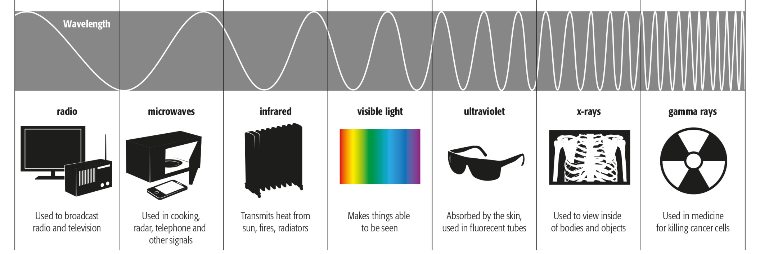
X-ray waves
Nonionizing
Ionizing
Notes:
There is:
Nonionizing radiation, such as microwaves, radio waves, ultraviolet, infrared, laser and ultrasound.
Ionizing radiation (capable of producing ions) such as α-rays, β-rays, γ-rays, and x-rays.
X-ray is electromagnetic radiation of extremely short wavelength and high frequency. Wavelengths ranges from 10⁻⁸ to 10⁻¹² meter and corresponding frequencies from 10¹⁶ to 10²⁰ hertz (Hz).

Slide 6
X-ray waves
Nonionizing
Ionizing
Short wavelength
High frequency
Ionizing: a process which causes biological damage
Notes:
Ionizing radiations interact with matter through excitation and ionization. The ionization process causes biological damage either by direct action or indirect action:
Direct action—acting directly by disrupting molecular bonds of sensitive cellular material (ie, DNA or cell membranes).
Indirect action—acting indirectly by first ionizing or exciting water molecules to disrupt molecular bonds. Most long-term effects of radiation are caused by indirect action.
Organs where cells divide rapidly are generally more sensitive to radiation damage (eg, bone marrow and epithelium of the intestine).

Slide 7
X-rays in medical application
Photographic film
developed
Lots of x-rays
Some x-rays
No x-rays
Notes:
X-rays are projected on photographic film and developed.

Slide 8
X-ray projection depends on…
Penetration of tissue volume
tissue depth
Notes:
X-ray image density depends on the tissue volume through which the rays pass.
More x-rays will penetrate when less tissue volume. The projection on the film will be darker.
Less x-rays will penetrate when more tissue volume. The projection on the film will be lighter.

Slide 9
X-ray projection depends on…
Penetration of tissue volume
Type of tissue/material
Soft
tissues
Air
Fluids
Bone
Metal
Notes:
Also the type (density) of the tissue, or material, will play a role.
Air (with lower density) will be projected black on the film, as more radiation penetrates.
Metal, which has a higher density, will be projected white, as more radiation will be blocked.
Bone will be projected grey. Also, the difference between the densities of cortical and cancellous bone can be seen on the film, since cortical bone has a higher density than cancellous bone.

Slide 10
Example: projection in open tibia fracture
Air
Air

Slide 11
Example: projection in open tibia fracture
Air
Soft
tissues

Slide 12
Example: projection in open tibia fracture
Air
Soft
tissues
Bone:
cortical
cancellous

Slide 13
Example: projection in open tibia fracture
Air
Soft
tissues
Bone:
cortical
cancellous
Metal

Slide 14
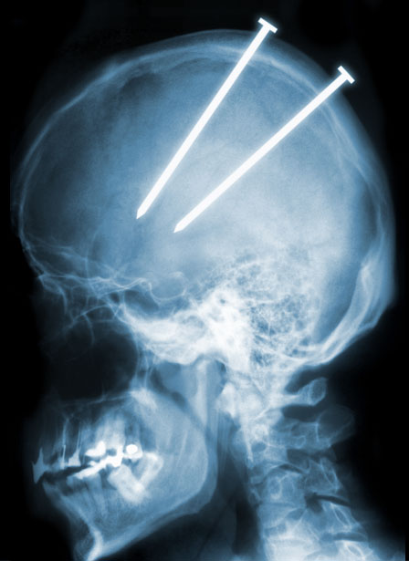
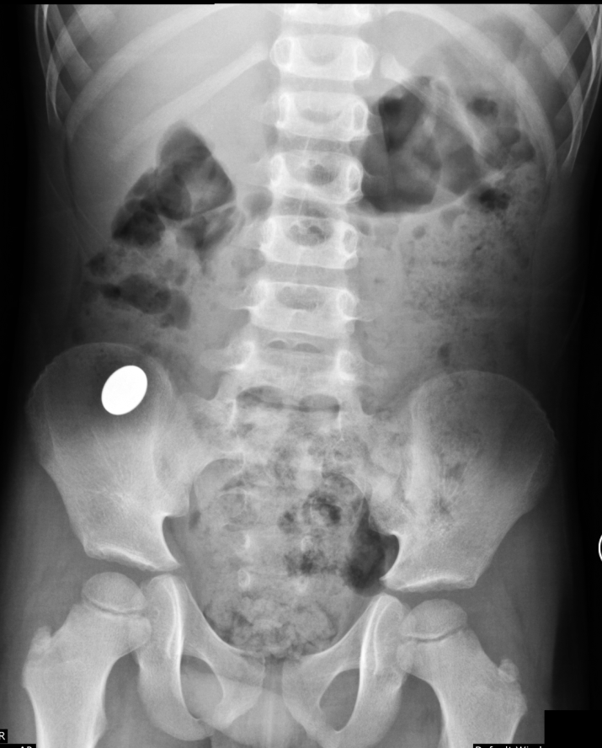
Radiopaque and radiolucent
Radiopaque:
X-rays are absorbed by a structure
Image appears light
Notes:
Radiopaque objects block radiation. They are opaque to radiation (see picture on slide; screws in head).
For example, if a child swallows a metal coin it will be visible on an x-ray because it is radiopaque and blocks the rays. The location of the coin can easily be identified.

Slide 15
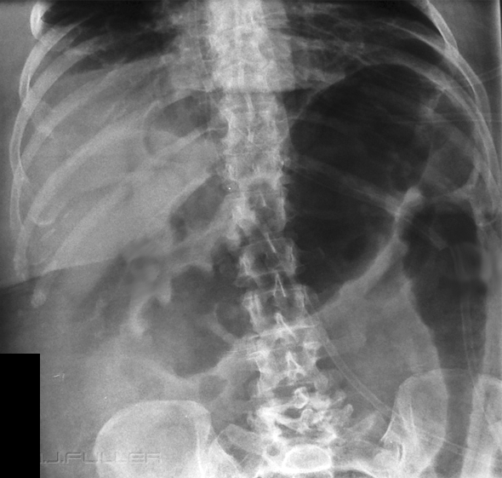
Radiopaque and radiolucent
Radiopaque:
X-rays are absorbed by a structure
Image appears light
Radiolucent:
X-rays pass through the material
Image appears dark
Ex. intestinal gas
Notes:
Radiolucent objects do not block radiation. For example, if a child swallows a plastic toy coin (radiolucent) it will not be visible on an X-ray film as the rays passed through it.
Intestinal gas is radiolucent and patterns of intestinal gas can lead to differential diagnoses.

Slide 16
Physical facts─units of measurement
Rem |  | Energy delivered by x radiation
Gray | 1 Gy=1 Joule/kg | Energy deposit in material Reflects the physical effect
Sievert | 1 Sv=1 Joule/kg | Reflects the biological effect
100 rem = 1 Gy = 1 Sv
100 millirem = 1 mGy = 1 mSv (=1000 µSv)
Notes:
The energy produced by x-radiation is measured in Rems.
Grey is the unit that represents the energy deposited in material (1 Gy=1 Joule/kg).
The energy deposited in biological material is expressed as a dose equivalent, called a Sievert and it reflects the biological effect of radiation (1Sv=1 Joule/kg).
The three units are related and are used depending on the location of its measurement.

Slide 17
Physical facts
Normal exposure
Cosmic rays in high-altitude flights: 0.001–0.01 mSv/hour
Natural background radiation: 0.01 mSv/day
Notes:
Everyone is exposed to a natural background radiation to a greater or lesser extent.
Examples of normal exposure are:
Cosmic rays during high altitude flights (ranges from 0.001 to 0.01 mSv/hour)
Natural background radiation that we receive daily (0.01 mSv/day)

Slide 18
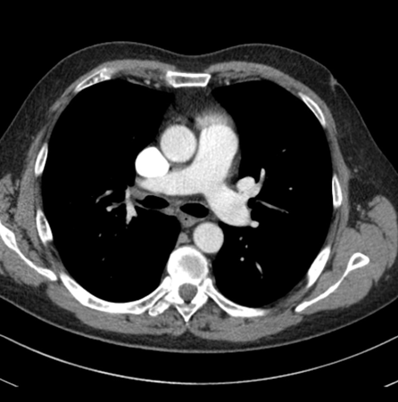
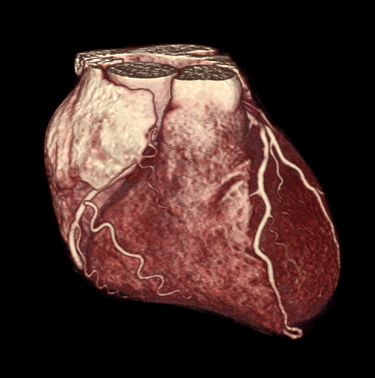
Physical facts
Type of scan | Radiation exposure in milli-Sievert
Chest x-ray | 0.1 mSv
CT scan head | 1.5 mSv
CT whole body | 9.9 mSv
Cardiac CT angiogram | 6.7–13 mSv
Notes:
The most important radiation exposure for patients usually takes place in the radiology department:
A chest x-ray is 0.1 milli-Sievert
A CT scan of the head is 1.5 milli-Sieverts
A CT of the entire body is 9.9 milli-Sieverts
Whereas, a cardiac CT angiogram has 6.7–13 milli-Sieverts

Slide 19
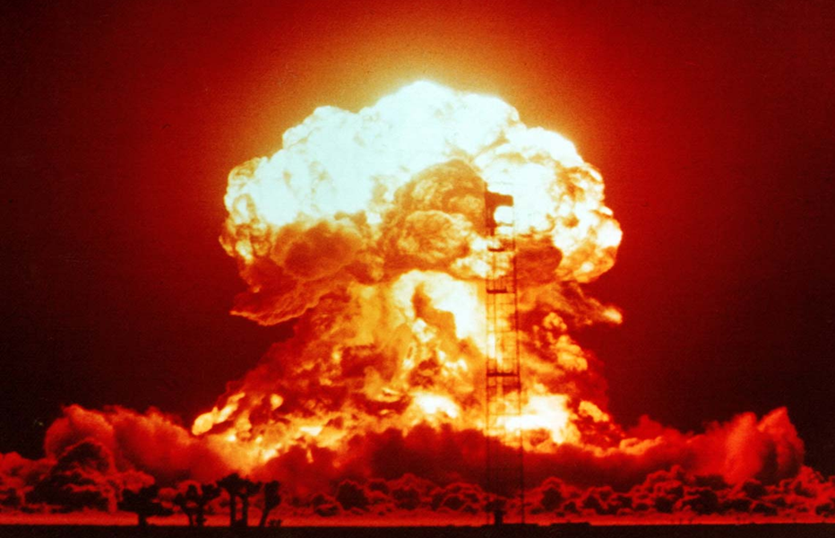
Physical facts
Accidental exposure
Radiation sickness: 500–1000 mSv
Radiation from nuclear bomb: 500–1000 mSv
Notes:
The dose of radiation required to produce radiation sickness is between 500 and 1000 mSv, which is equal to the amount to which the citizens of Hiroshima were exposed in 1945.

Slide 20
Biological facts─somatic effects
Determined by dose:
Early effect
Radiation sickness from 500–1000 mSv
Late effect
Leukemia, thyroid cancer, radiation cataract, osteosarcoma
Notes:
If an individual receives a dose greatly in excess of the threshold dose, the effects will occur in a relatively short period after the radiation (early effects radiation sickness from 500–1000 mSv). Late somatic effects include leukaemia, thyroid cancer or radiation cataracts.
However, if the dose is not greatly in excess of the threshold dose, many of the resulting effects will be of a temporary nature and reversion to normal conditions usually occurs.

Slide 21
Biological facts─stochastic (random) effects
Determined by cumulative dose
No threshold
Late effect:
Thyroid cancer
Leukemia
Notes:
Stochastic (random) effects of radiation are different. There is no safe threshold and damage is cumulative with multiple exposures to radiation. The late effects of this are thyroid cancer or leukemia.
Such effects may not manifest themselves until many years after the radiation exposure, e.g., survivors of the atomic bombs in Hiroshima and Nagasaki.

Slide 22
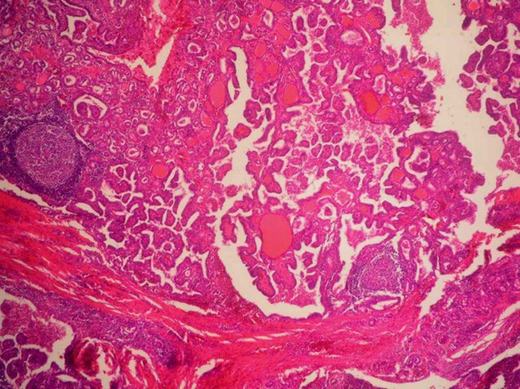
Biological facts─stochastic (random) effects
85% of papillary carcinoma is radiation-induced
Radiation dose to induce thyroid carcinoma = 100 mSv
Threshold value/year
Thyroid = 300 mSv
Hand = 500 mSv
Eye = 150 mSv
Notes:
Regarding thyroid cancer, 85% of papillary carcinoma of the thyroid are radiation induced. From literature is known that the carcinogenic dose of radiation to induce thyroid carcinoma is 100 mili-Sieverts.
The threshold value per year which should not be exceeded by surgeons, staff or patients is 300 milli-Sieverts for the thyroid gland, 150 milli-Sieverts for the eye, and 500 milli-Sieverts for the hand.

Slide 23
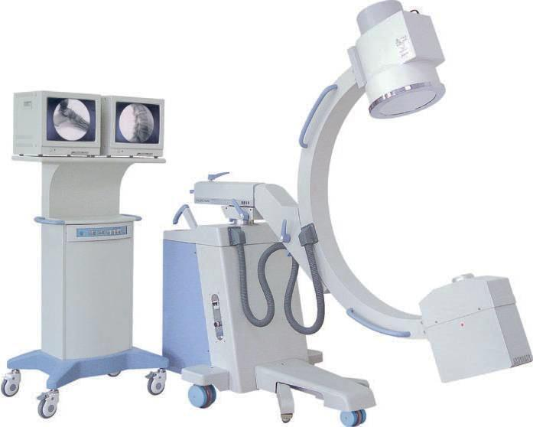
Image intensifier and x-ray film
Real-time imaging
C-arm image intensifier
Portable x-ray
Notes:
Image intensifier:
Direct visual procedure
Continuous live monitoring
Uses screen, monitor, and x-ray tube
Will be used in most orthopaedic fracture cases (IM Nails, ORIF)

Slide 24
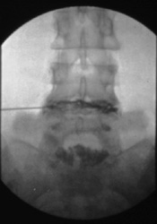
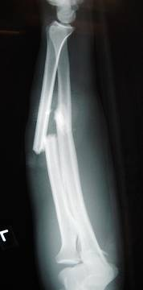
Image intensifier and x-ray film
Different interpretation of contrast
C-arm image intensifier
Portable x-ray
Bone dark
Bone white
Notes:
Radio density can be opposite to x-ray film. The bone is dark.

Slide 25
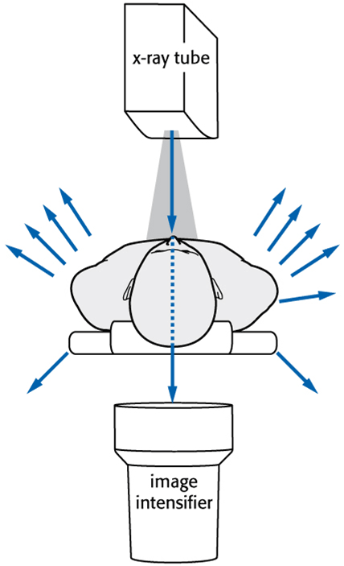
Absorption and scatter
Transmission, absorption, and scatter of ionizing radiation
≈ 80% absorbed by patient
≈ 10–20% scattered
≈ 2% transmitted to the image intensifier
Notes:
The radiation not absorbed by the patient is scattered. This scattered radiation can affect the team and surgeon.
In this example, the x-ray tube is emitting ionizing radiation, which is either reflected or absorbed by the patient. Just a fraction of the x-rays pass through the patient to the image intensifier.
Radiation scatter is mainly directed back towards the source, the x-ray tube.
For every thousand photons reaching the patient, 100–200 photons are scattered. Just 20 reach the image detector and the rest are absorbed by the patient. This is the radiation dose.

Slide 26
Absorption and scatter
Scattered radiation from the patient is the main source of radiation for the surgical team!
Notes:
It is this scattered radiation which can affect all who is present in the room during imaging.

Slide 27
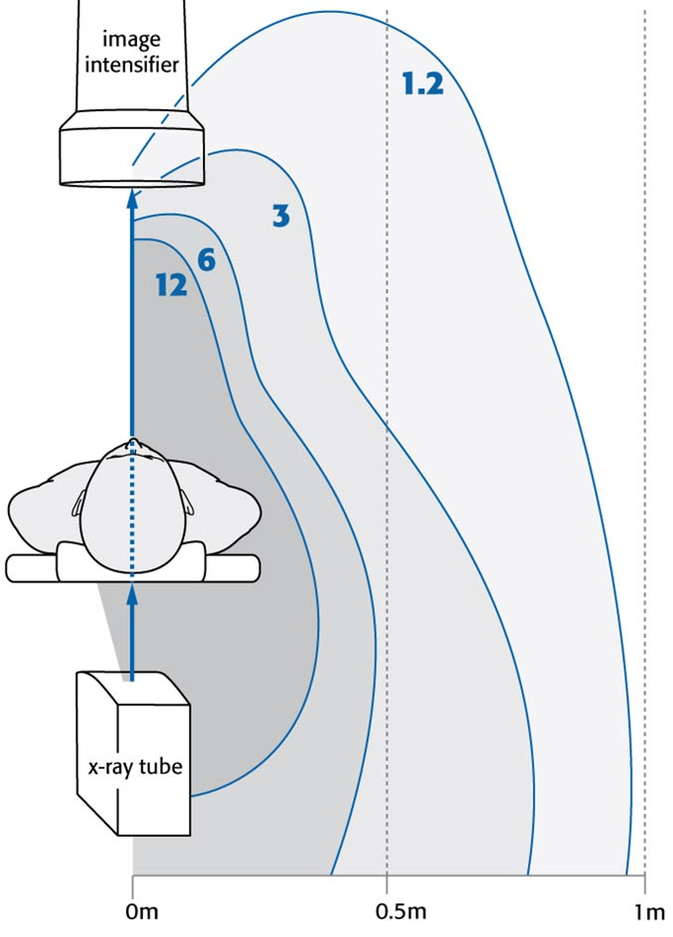
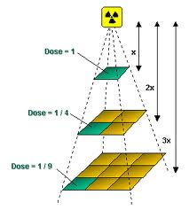
Dose rate around C-arm
Further away from patient:
Lower rate of scatter
Inverse Square Law applies
Notes:
If you measure the dose rate around a mobile C-arm you have scattered radiation as illustrated in this picture on the right.
The further away from the patient, the lower is the dose of scattered radiation.
If you stand further than 1 metre away, there would be less, or no, radiation. It is, therefore, very important to ensure that you stand at a safe distance from the patient, image intensifier and x-ray tube.
Inverse Square Law: Radiation decreases very rapidly with increasing distance from the source. Example: hold a flashlight a few centimetres from a white wall in a dark room and see the narrow beam of light hitting the wall. Then walk away from the wall with the flashlight still pointing on the wall and note how the beam of light gets wider and less intense as you move back.
So always keep at a safe distance of the image intensifier and the x-ray tube.

Slide 28
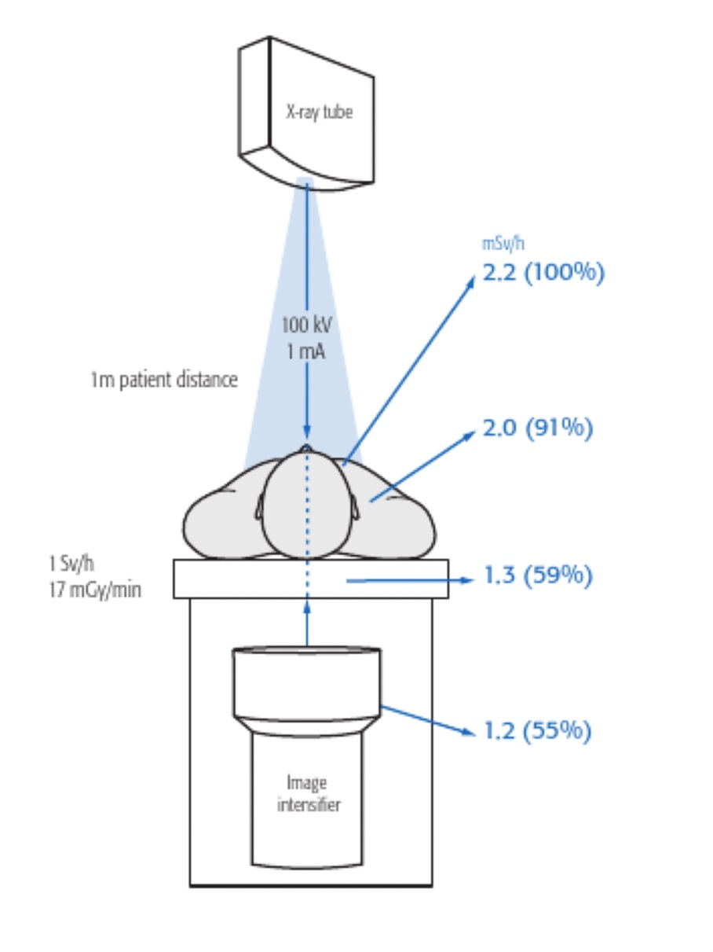
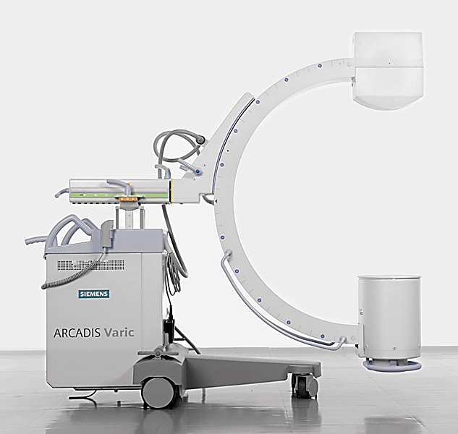
X-ray tube position
Notes:
It is important to know the effect of the x-ray tube positions.
When the x-ray tube is above the patient at 1 metre distance, your eyes receive a dose of 2.2 milli-Sieverts per hour.
Wear thyroid shields and eye protection to reduce high neck and facial exposure.

Slide 29
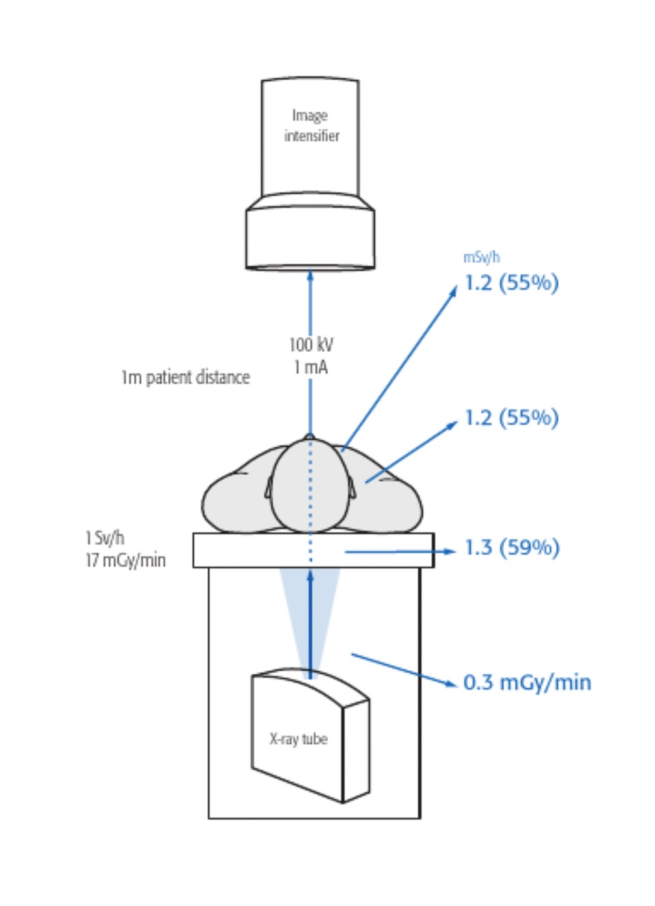
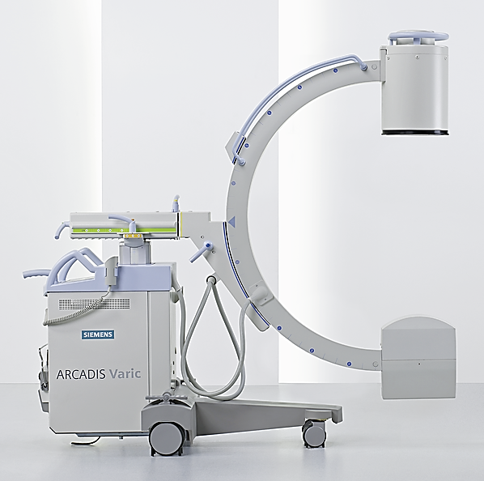
X-ray tube position
Notes:
When the C-arm is inverted and the x-ray tube is below the patient, you will be exposed to just 55% of the scattered radiation. Therefore, the x-ray tube position is of paramount importance.
As a rule, you should notice that positioning the x-ray tube below the OR table reduces high dose rates to the eyes.
The best configuration during surgery is with the intensifier above and the x-ray tube below. This will reduce the radiation dose to the team and the surgeon’s eyes by 3 times or more.

Slide 30
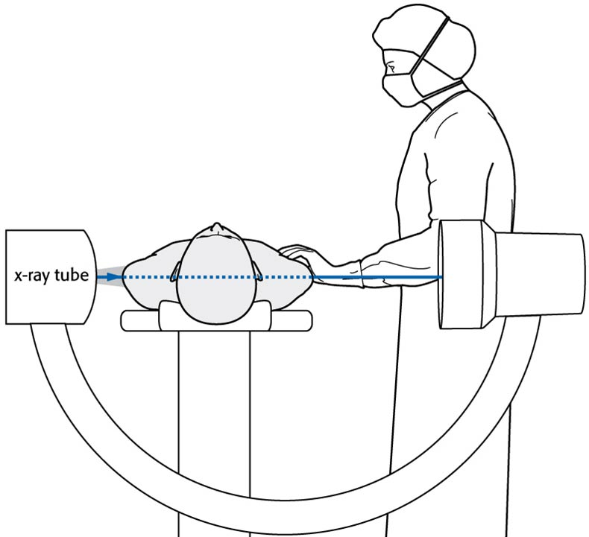
X-ray tube position
Scattered dose is higher at the x-ray tube side
Stand on the intensifier side
✗
✔
Notes:
If the surgeon stands on the x-ray tube side, thyroid exposure is 3 to 4 times higher than standing on the intensifier side.
The dose rates to the torso from the x-ray tube side are 0.53 milli-Sieverts per minute, whereas on the intensifier side it is just 0.02 milli-Sieverts per minute.
Standing on the intensifier side reduces the amount of general radiation exposure to one tenth.
When the surgeon performs a locking procedure he/she should stand close to the intensifier and ensure that the x-ray tube is not close to his/her hands.

Slide 31
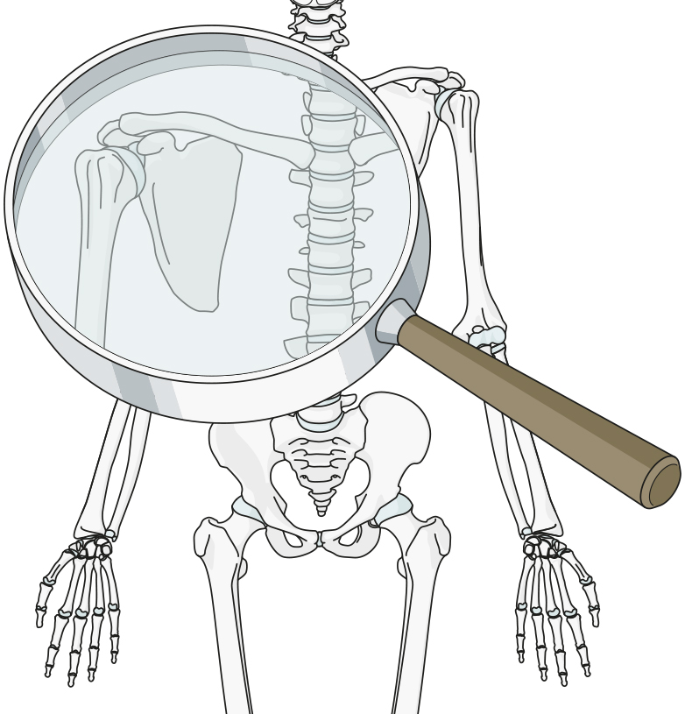
Factors affecting patient doses
Intensifier diameter
Relative patient entrance dose
32 cm (12 in)
Dose 1
22 cm (9 in)
Dose 1.5
16 cm (6 in)
Dose 2
11 cm (4.5 in)
Dose 3
A smaller II diameter can increase patient entrance dose.
Notes:
Another factor which increases scattered radiation to surgeons is the diameter of the intensifier.
The more you want to magnify your image the higher the relative patient entrance dose has to be.
Do not use too much magnification because you will then have to increase your patient entrance dose and will, as a result, increase scattered radiation risk.

Slide 32
Factors affecting patient and staff doses
Patient dose will increase if:
Distance of source to skin is short
Distance of patient to image intensifier is large
Notes:
Also important to know is that the patient dose will increase if the distance between the focus and the skin is short and the distance between the patient and the image intensifier is long.

Slide 33
Factors affecting patient and staff doses
Patient dose will increase if:
Distance of source to skin is short
Distance of patient to image intensifier is large
To reduce scatter:
Place patient close to image intensifier and far from x-ray tube
Notes:
The scatter is reduced by placing the patient close to the image intensifier and further away from the x-ray tube.

Slide 34
Protection─ALARA principle
“As Low As Reasonably Achievable”
Keep ALARA and apply:
Time
Distance
Shielding
Notes:
ALARA
The primary goals of radiation safety are to avoid any unnecessary radiation exposure and to keep all exposure As Low As is Reasonably Achievable . Three main ways to keep your doses ALARA: time, distance, and shielding.

Slide 35
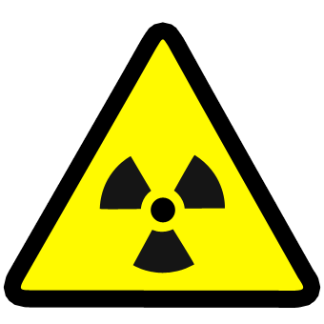
Reduce exposure
Do not enter the room, if not required
Consider C-arm position:
Positioning x-ray tube under the patient
Keep x-ray tube far away from patient
Keep image intensifier close to patient
Notes:
As summary it is important to repeat that the exposure can be reduced by
Not entering the room when not necessary
Considering the position and orientation of the C-arm

Slide 36
Reduce exposure
Reduce exposure to scatter radiation
Wear Personal Protective Equipment (PPE)
Keep distance
Keep hands out of beam
Notes:
As summary it is important to repeat that the exposure can be reduced by
Reducing the exposure to scatter radiation
Wearing personal protective equipment
Keeping distance
Keeping the hands out of the beam

Slide 37
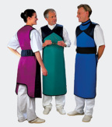
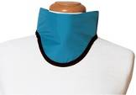
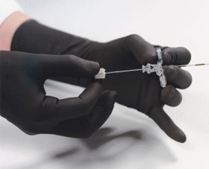
PPE─examples
Apron:
AP: decreased 16-fold
Lateral: decreased 4-fold
Thyroid protection:
85% of papillary carcinomata are radiation induced
Spectacles:
Radiation cataract
Gloves:
Hands have greatest exposure risk
Notes:
When you remember how many milli-Sieverts per hour you are exposed to when standing 50cm from the patient, you then see how important it is to protect your hands, eyes, thyroid and body.
Hand and glove protection is claimed to be from 60%-64% with 52–58 KV.
Goggles with 0.15 mm lead equivalent attenuate beam radiation by 70%.
A thyroid collar decreases the scattered radiation 2.5-fold further.
An apron in the AP, or in the lateral, position results in a decrease of 16-fold to 4-fold respectively.

Slide 38
Take-home messages
You will now be able to:
Explain what x-rays are
Discuss the difference between x-rays and II
Describe correct positioning of the II
Explain how to protect correctly against radiation

