Slide 1
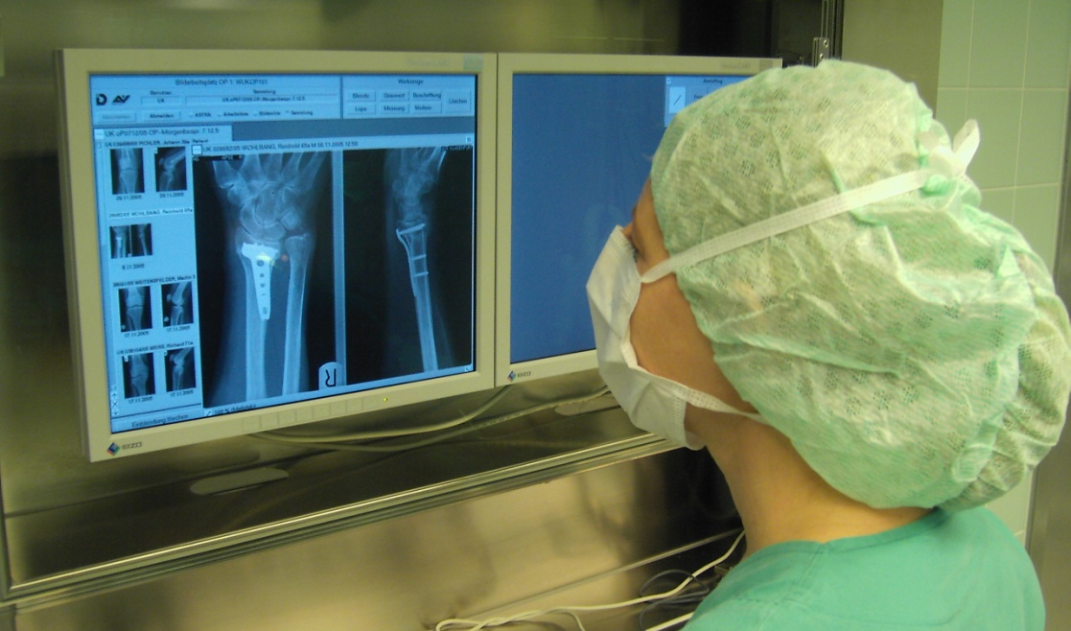
How to read x-rays
Nikolaus Schwarz
Thomas Rüedi
Matthew Porteous
Nicholas Lubega
Karl Heinz Frosch
Dominik Heim

Slide 2
Learning outcomes
At the end of this lecture you will be able to:
Read x-rays systematically
Describe fracture patterns
Interpret healing of fractures
Notes:
At the end of this lecture you will be able to:
Read x-rays systematically
Describe fracture patterns
Interpret healing of fractures

Slide 3
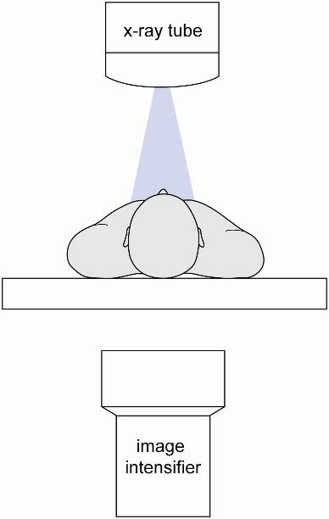
Physical facts of x-rays
Transmission, absorption, and scatter
of 1,000 photons reaching the patient:
~ 800 absorbed by patient
~100–200 scattered
~ 20 transmitted to image intensifier
Notes:
Radiation not absorbed by the patient is scattered. This scattered radiation can affect the team and surgeon.
In this example, the x-ray tube is emitting photons, which are either reflected or absorbed by the patient. Just a fraction of the x-rays pass through the patient to the image intensifier.
For every thousand photons reaching the patient, 100–200 photons are scattered. Just 20 reach the image detector. The rest are absorbed by the patient. This is the radiation dose.

Slide 4
X-ray projection depends on
Tissue volume penetrated
Type of tissue/material
Soft
tissues
Air
Fluids
Bone
Metal
Notes:
X-ray projection depends on the thickness of the tissue that is to be penetrated.
When there is no tissue to penetrate, the color of the picture will be black.
The greater the depth, the lighter the grey.
Air is projected as black
Soft tissues are grey
Fluids are a lighter grey
Bone is an even lighter grey
Metal is projected as white

Slide 5
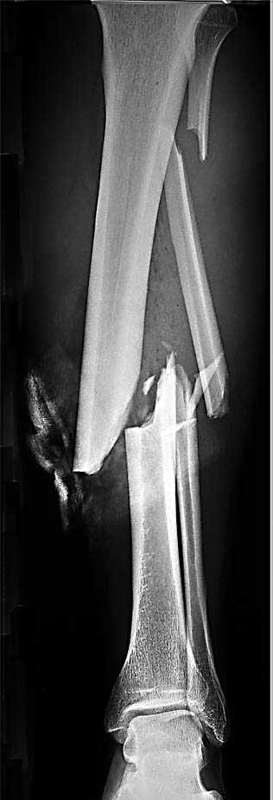
Projection in an open tibial fracture
Air

Slide 6
Projection in an open tibial fracture
Air
Soft
tissues

Slide 7
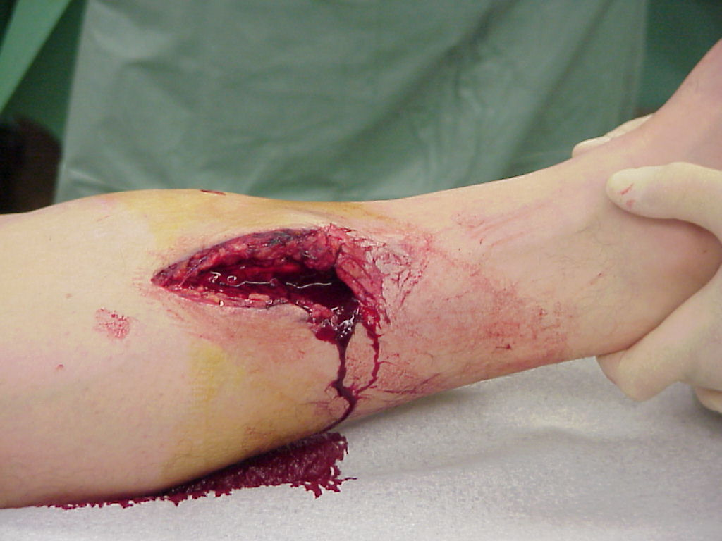
Projection in an open tibial fracture
Air
Soft
tissues

Slide 8
Projection in an open tibial fracture
Air
Soft
tissues
Bone:
cortical
cancellous

Slide 9
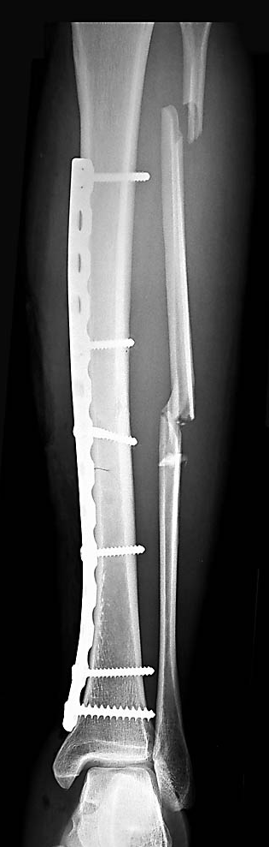
Projection in an open tibial fracture
Air
Soft
tissues
Bone:
cortical
cancellous
Metal

Slide 10
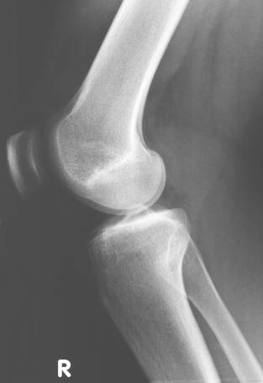
Systematic reading of x-rays
John Doe, 20.05.1970
Name and date of birth of patient
Side of extremity/body
Date of x-ray
01.05.2013
Notes:
Information found on the x-ray are:
Name and date of birth of the patient
Side of extremity/body
Date of x-ray

Slide 11
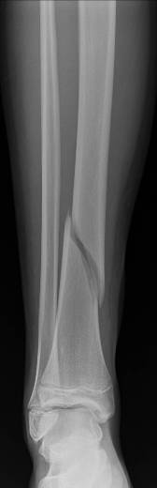
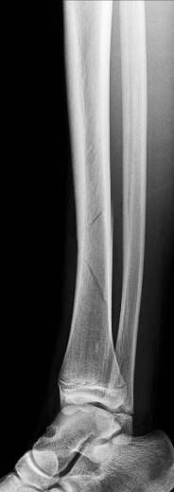
Systematic reading of x-rays
Two views
  AP
  Lateral
AP
Lateral
Notes:
Two views help to fully describe the fracture in both planes.
Animation: It is easy to miss a fracture with just one view.

Slide 12
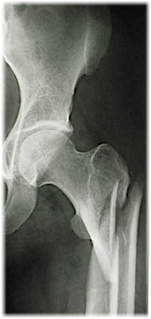
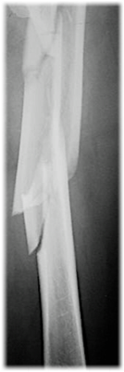
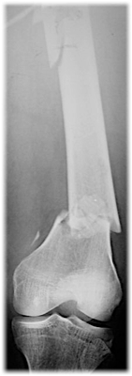
Systematic reading of x-rays
Two joints
  Adjacent
Notes:
X-rays of the two adjacent joints must be taken. Just a shaft view is not enough.
One of the two fractures could be missed in an x-ray not showing the entire bone.
Or, a joint injury could be missed with just one x-ray.
Both adjacent joints need to be seen.

Slide 13
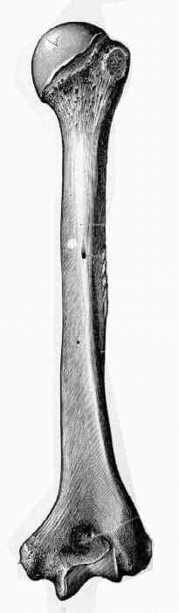
Systematic reading of x-rays
Identify bone
Identify fractured part of the bone
    Intraarticular fracture/ epiphysis
    Metaphyseal fracture
    Diaphyseal fracture
Notes:
Identify the bone.
Identify the fractured part of the bone.
Intraarticular fracture/epiphysis
Metaphyseal fracture
Diaphyseal fracture

Slide 14
Systematic reading of x-rays
Identify type of fracture
  Simple:
    Spiral
    Oblique
    Transverse
  Wedge:
    Butterfly segment
  Complex:
    Comminuted
Notes:
Identify the type of fracture.
Examples will follow for each fracture pattern.

Slide 15
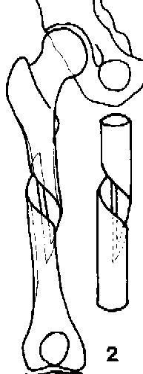
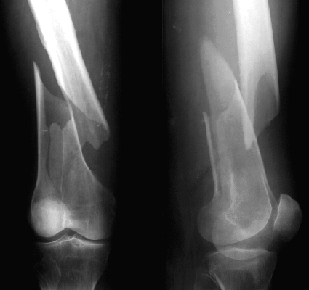
Example: Simple spiral fracture

Slide 16
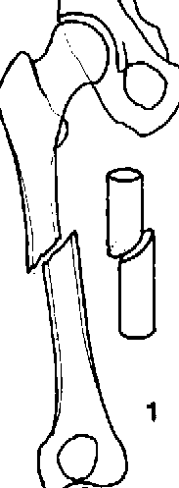
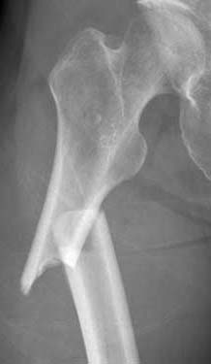
Example: Simple oblique fracture

Slide 17
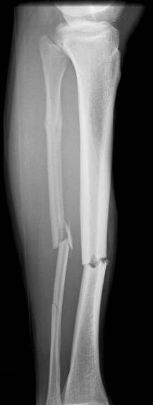
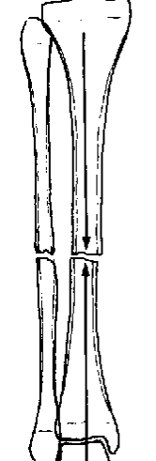
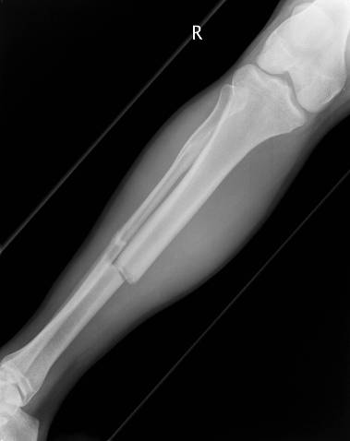
Example: Simple transverse fracture

Slide 18
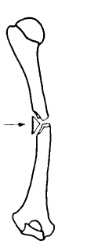
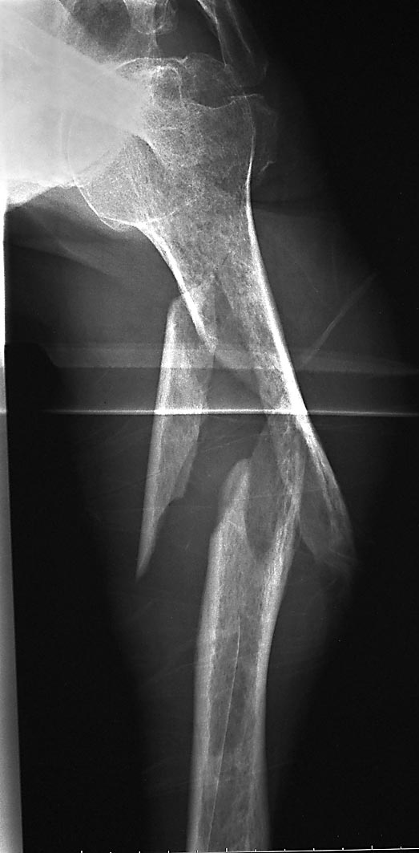
Example: Wedge fracture
Butterfly segment

Slide 19

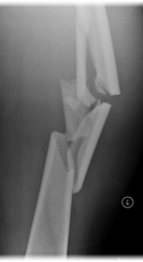
Example: Multifragmentary fracture (comminuted)
Multiple fragments

Slide 20
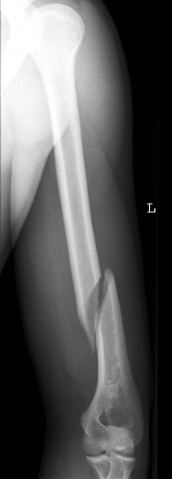
Which bone?
1. Femur
2. Tibia
3. Humerus

Slide 21

Which bone?
1. Femur
2. Tibia
3. Humerus

Slide 22
Which part of the bone?
1. Intraarticular fracture
2. Metaphyseal fracture
3. Diaphyseal fracture

Slide 23
Which part of the bone?
1. Intraarticular fracture
2. Metaphyseal fracture
3. Diaphyseal fracture

Slide 24
What is the fracture pattern?
1. Transverse
2. Spiral
3. Wedge

Slide 25
What is the fracture pattern?
1. Transverse
2. Spiral
3. Wedge

Slide 26
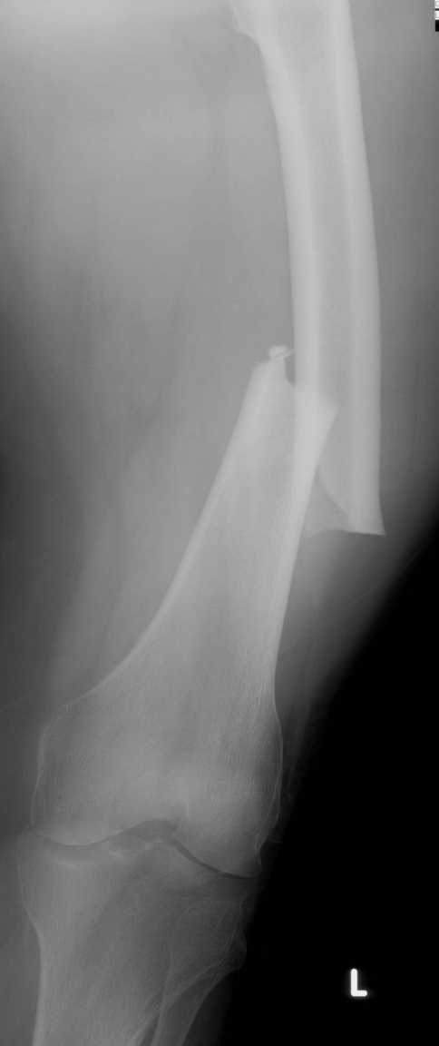
Systematic reading of x-rays
Describe the fracture displacement:
  Shortening
  Angulation
  Rotation
Notes:
The x-ray shows a short oblique fracture of the left femur with:
Medial dislocation
Shortening of at least 3 cm
Varus displacement

Slide 27
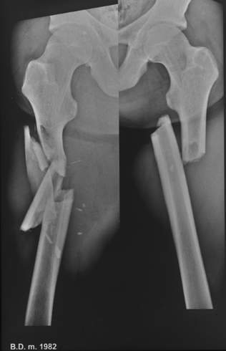
Systematic reading of x-rays
Describe the fracture displacement:
  Shortening
  Angulation
  Rotation
Usually
with
displacement
Medial
Notes:
Describe slide.

Slide 28
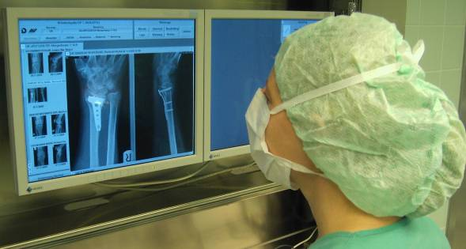
More about reading x-rays

Slide 29
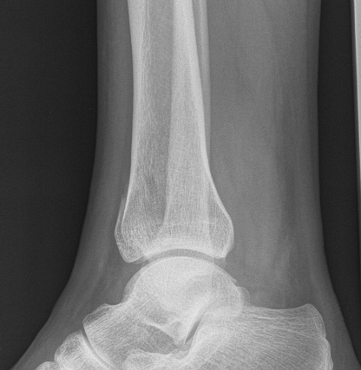
How to spot a difficult fracture?
Follow the cortex of the bone
Look for any defects
Notes:
29

Slide 30
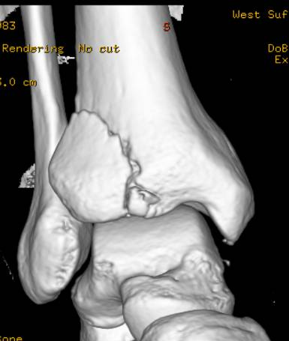
How to spot a difficult fracture?
Look for any defects
Get more information with a CT scan
Notes:
30

Slide 31
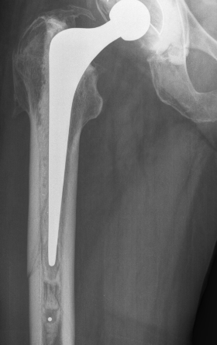
How to spot a difficult fracture?
Follow the cortex of the bone
Look for any defects

Slide 32
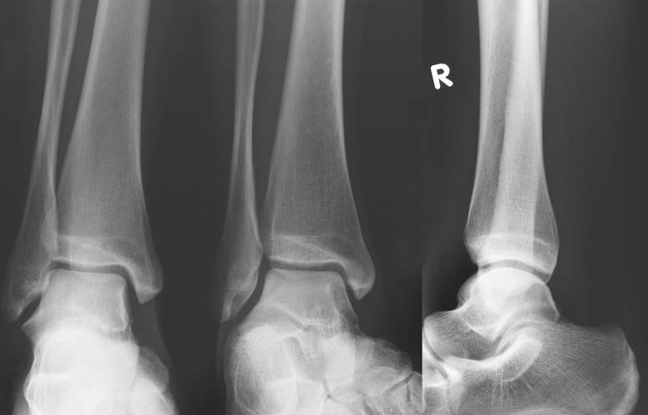
Articular fractures: normal aspect malleoli
L
Tibiofibular gap
Joint gap
AP
20°medial rotation
Lateral
Notes:
This is the normal aspect of a maleollar joint.
Tibiofibular gap is less than 6 mm.
Joint gap is of equal width.
Joint surfaces are parallel to each other.
Talus is in correct position.

Slide 33
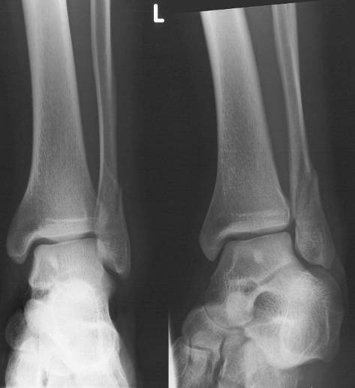
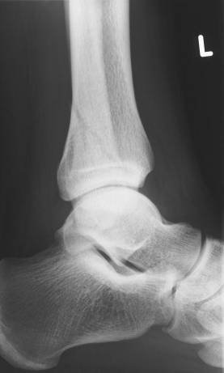
What about this case?
What about the joint gap?
What about the fibula?
AP
Medial rotation
Lateral
Notes:
This x-ray shows a shortened fibula.
The joint gap between the lateral ankle and talus is no longer parallel.
The fibula is rotated and fractured.

Slide 34
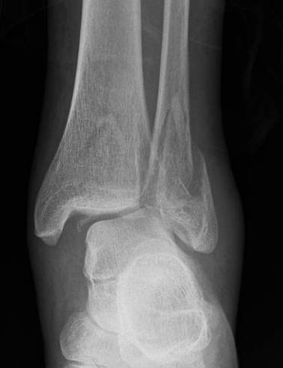
What about this case?
What about the joint gap?
What about the fibula?
Notes:
Fibula is shortened and rotated due to a dislocated fracture.
Talus is subluxated laterally.
Joint gap is no longer parallel and not of equal width.

Slide 35
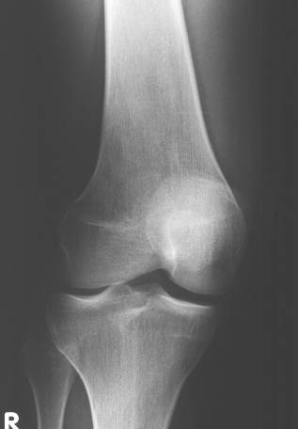
Articular fractures: normal aspect knee
Femur
Patella
Tibial plateau
Spine
Tibia
Fibula
Notes:
Here we see a normal knee joint.
There is no fracture or arthrosis.
The position of the tibia toward the femur is correct.
The position of the patella is correct (not too high, not too low).
The articular surface of the tibial plateau is intact and at the same level on both sides.

Slide 36
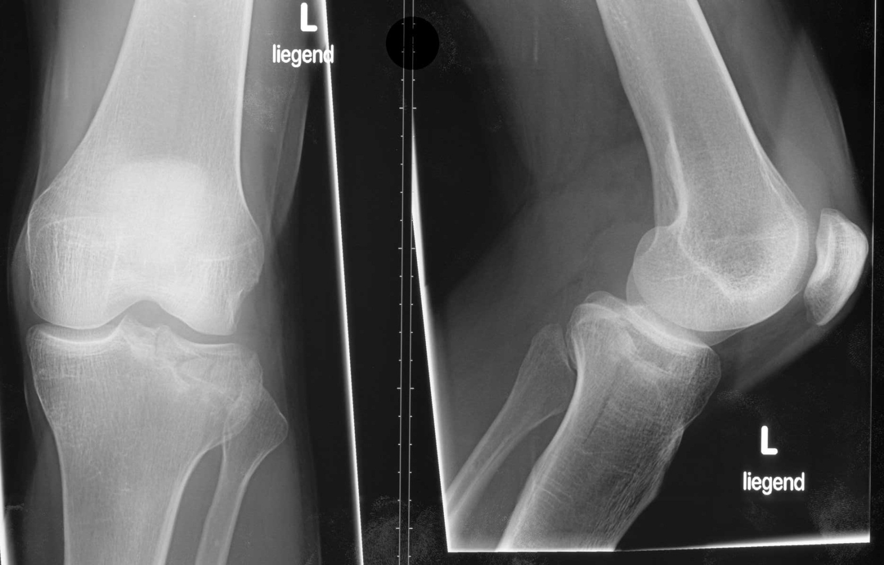
Can you describe this fracture?
35-year-old woman fell
while skiing
Notes:
If we compare the medial and the lateral tibial head, we see that:
There is an intact plateau medially.
There are fractures lines and hyperdense zones medially (ie, compression fractures of cancellous bone).
This is an indication for a CT scan to clearly visualize the whole fracture.

Slide 37
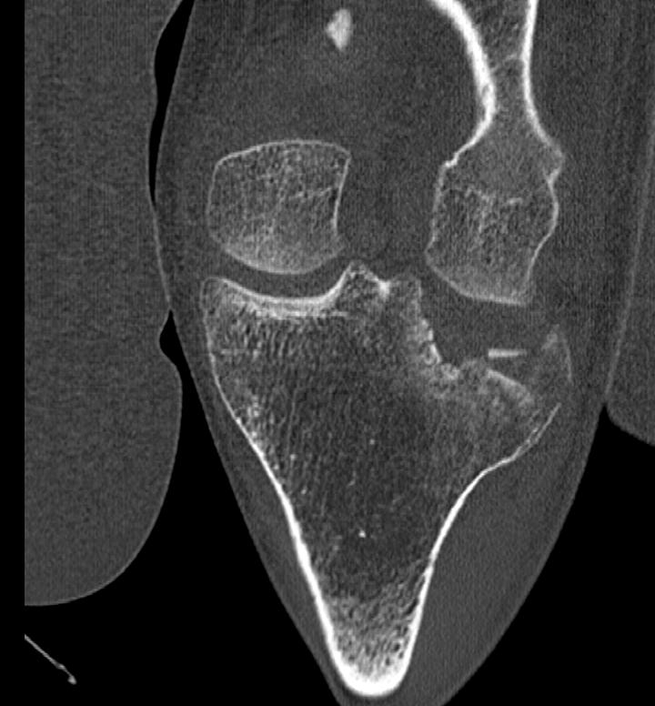
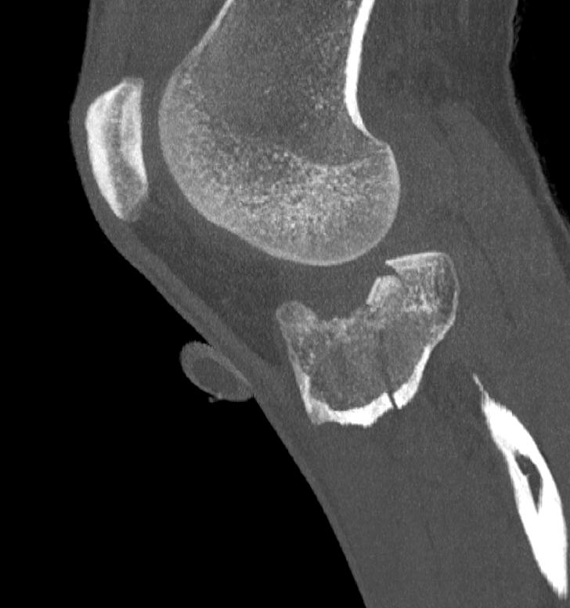
Get more information
CT scans

Slide 38
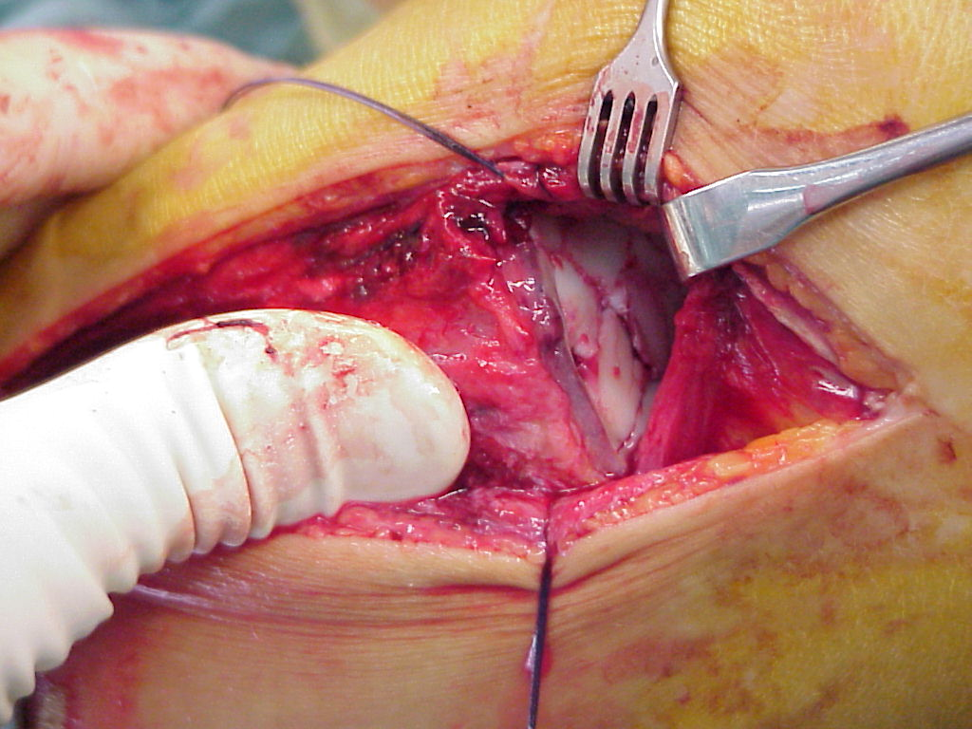
Intraoperative reduction of tibial plateau

Slide 39
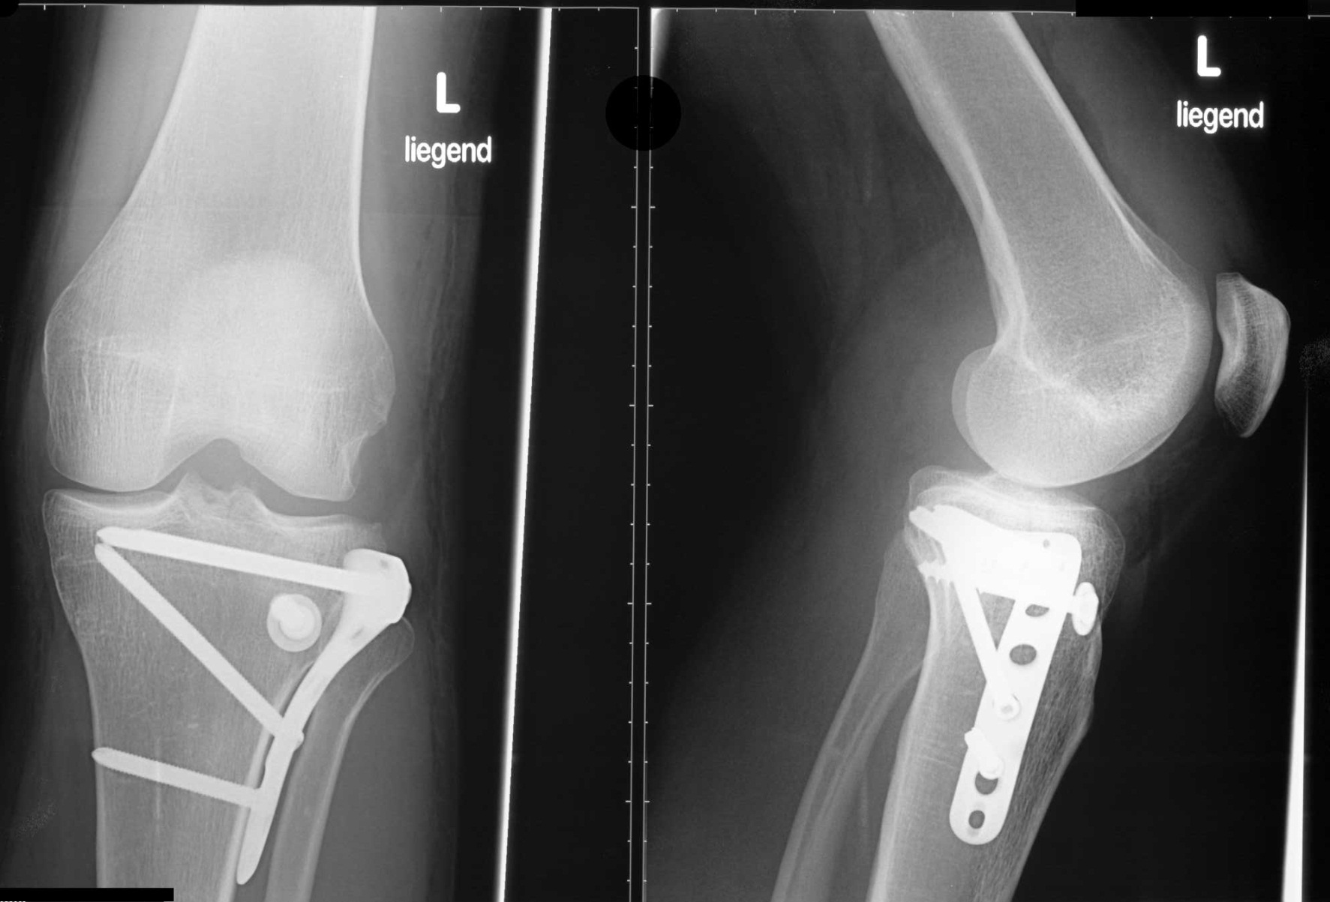
Surgical treatment
L-plate 4.5
Cancellous bone screw 6.5 (lag screw) with washer

Slide 40
Can you describe this fracture?
R
Notes:
Ask the audience.

Slide 41
Can you describe this fracture?
Right femoral fracture
Subtrochanteric fracture
Multifragmentary
R
Notes:
Repeat the answers.

Slide 42
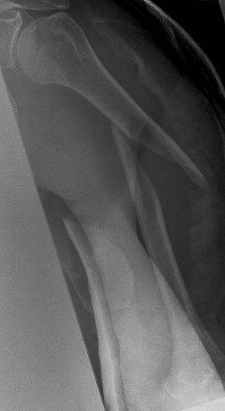
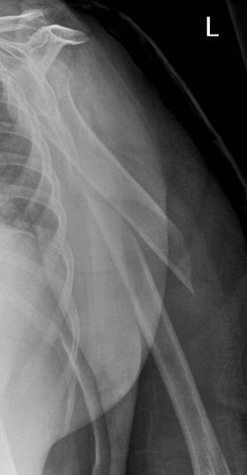
Can you describe this fracture?
Notes:
Ask the audience
Which bone?
Which segment?
Which fracture pattern? Which type of fracture?

Slide 43
Can you describe this fracture?
Humeral
Diaphyseal
Spiral
Notes:
Repeat or confirm the answers.

Slide 44
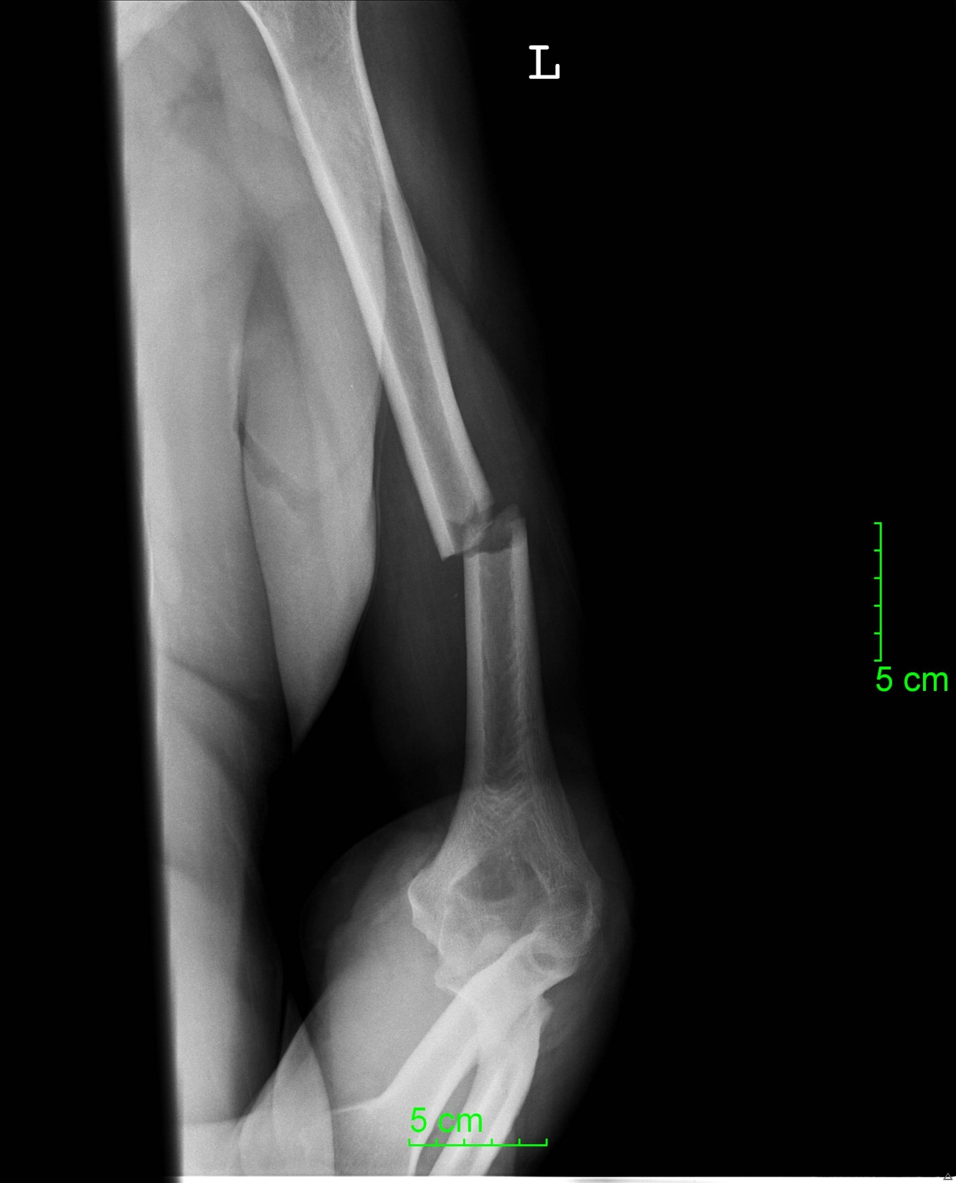
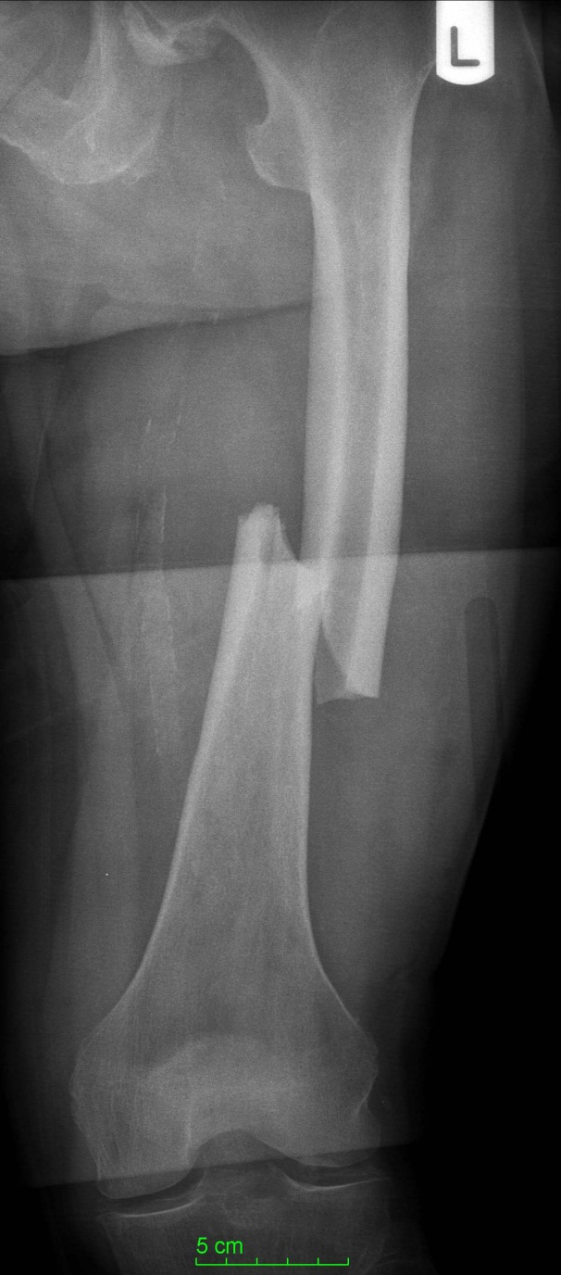
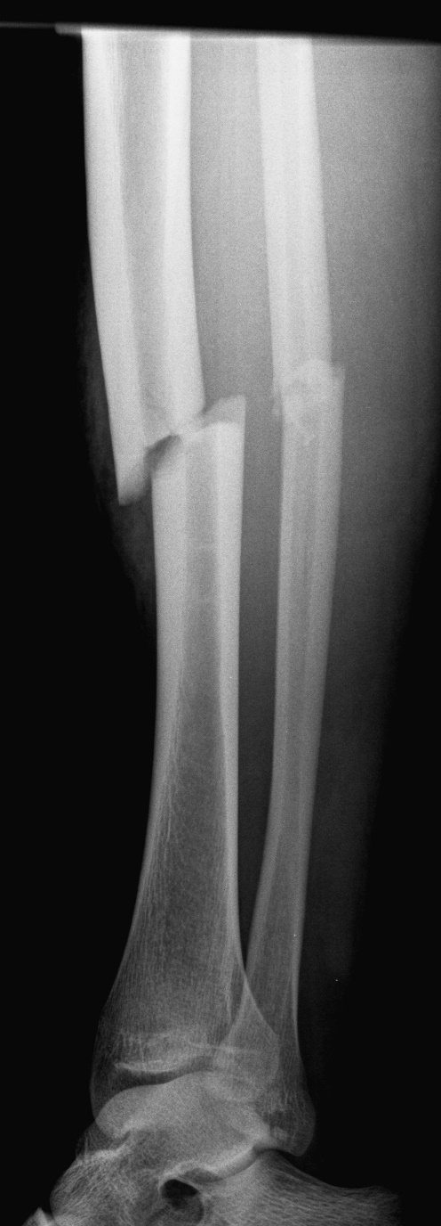
Which bone is it?
Notes:
Ask the audience.

Slide 45
Which bone is it?
Humerus Femur Tibia
Notes:
Ask the audience.

Slide 46
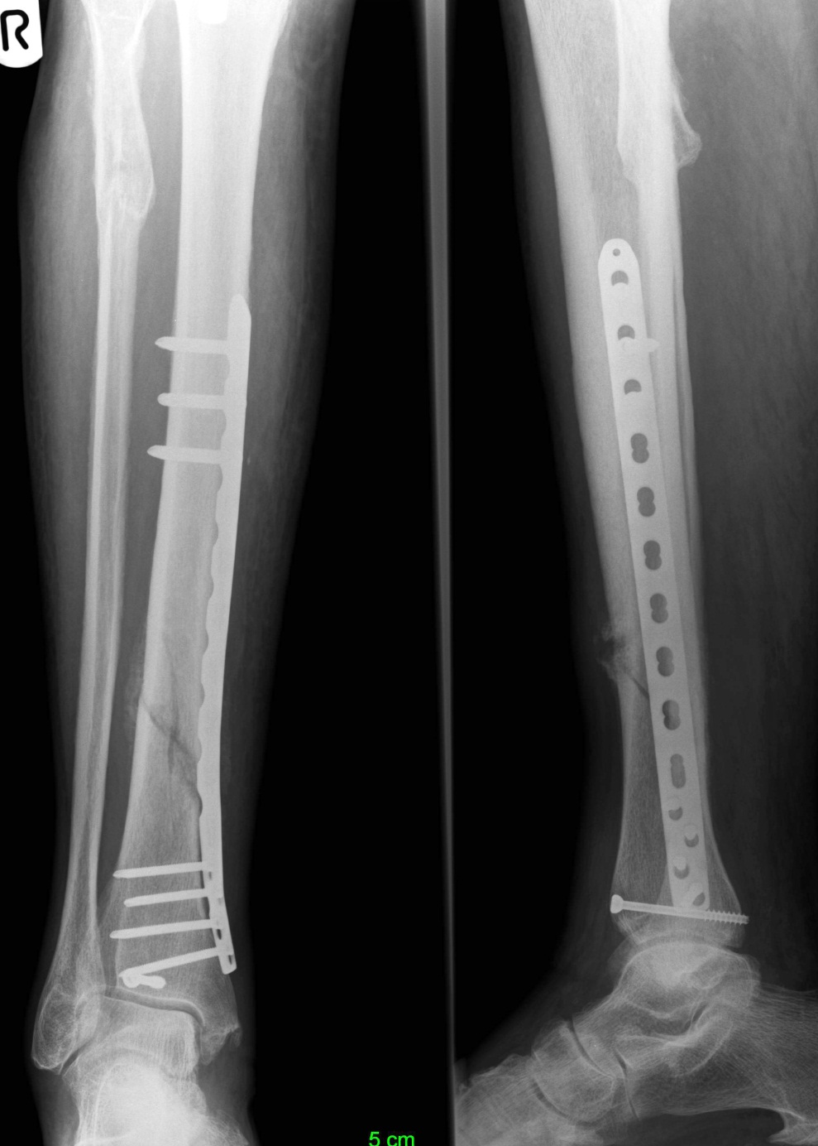
What do you see here?
8 weeks postoperatively
What would you tell the patient?
Notes:
This x-ray shows an osteosynthesis with plate and screws in a tibial fracture after 8 weeks.
The fracture is still visible, which is normal after only 8 weeks, without axial malalignment.
There is minimal callus formation on the lateral side.
There is no screw loosening. The osteosynthesis is stable.
Fracture healing is underway.

Slide 47
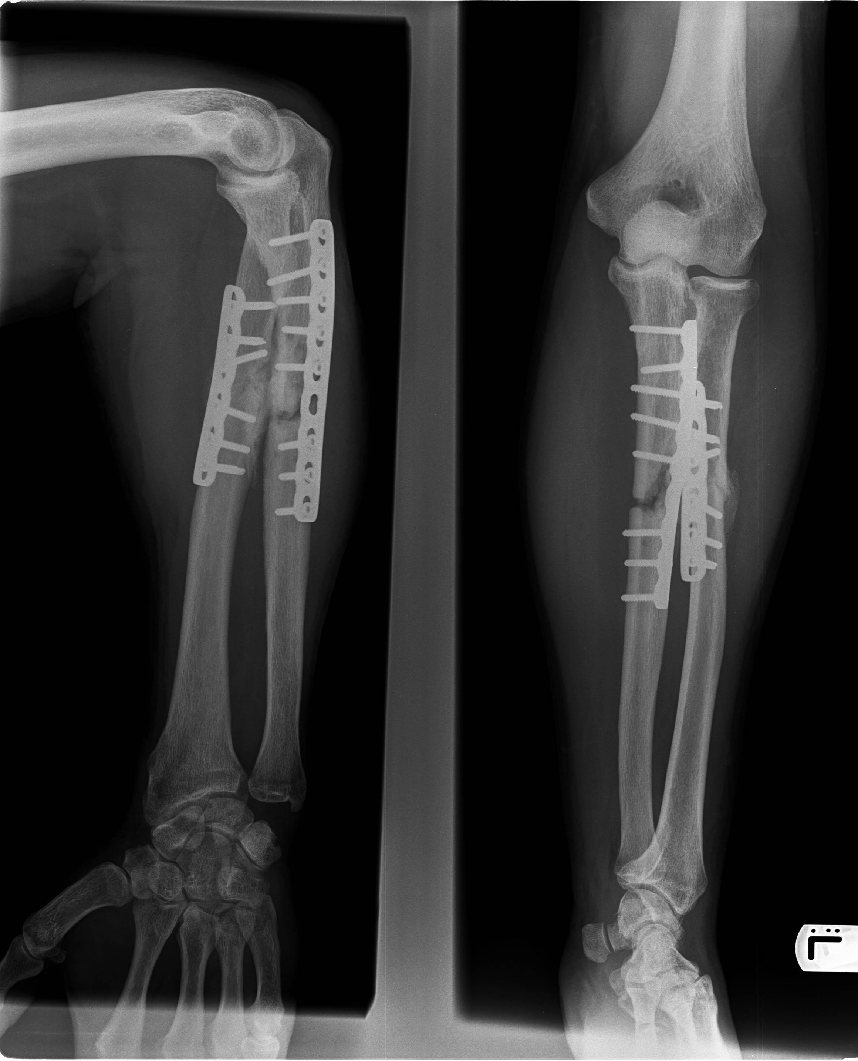
What do you see here?
8 months postoperatively
What about the radial fracture?
What about the ulnar fracture?
Radius
Ulna
Ulna
Radius
Notes:
The radial fracture is healing.
There is little callus on the radius.
The ulnar fracture is still open.
There is a large gap in the ulna without any visible callus formation yet. This is called atrophic pseudarthrosis.
There is no screw loosening. The plates are (still) stable.
After 8 months no further healing can be expected.
Reoperation of the ulna is indicated.

Slide 48
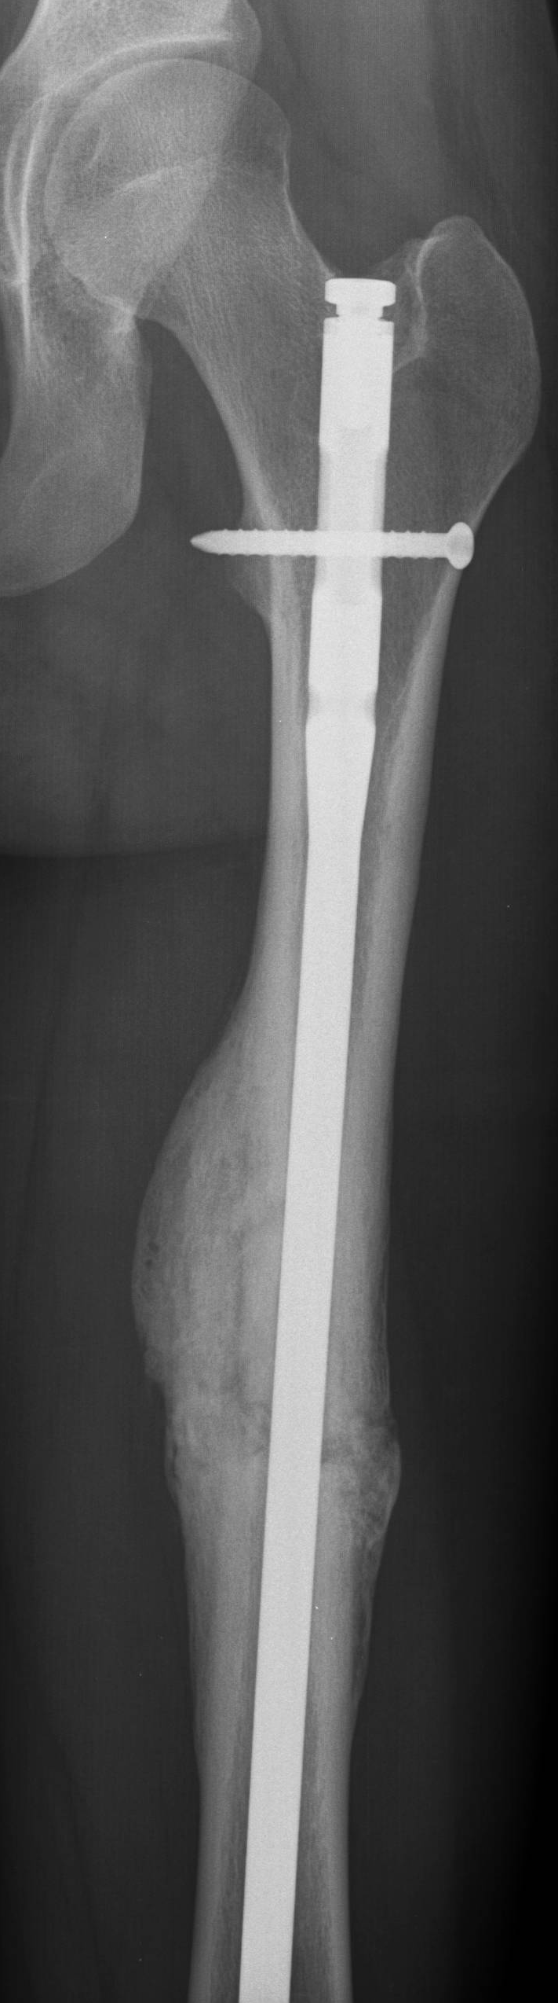
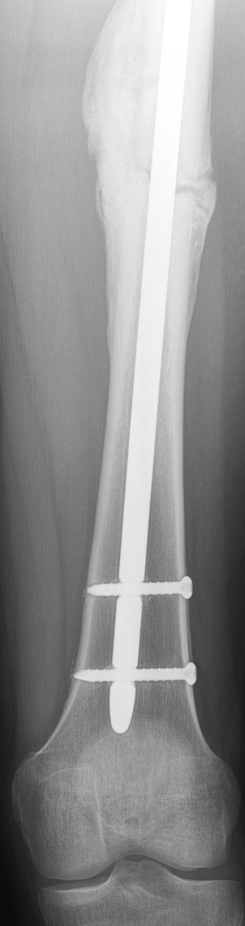
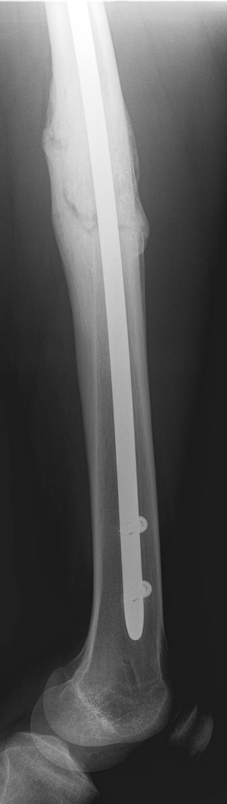
What do you see here?
3 months postoperatively
What would you recommend to
the patient?
Notes:
This fracture is stable and healing with callus formation.
Recommend doing a follow-up plus x-ray in 1 year.

Slide 49
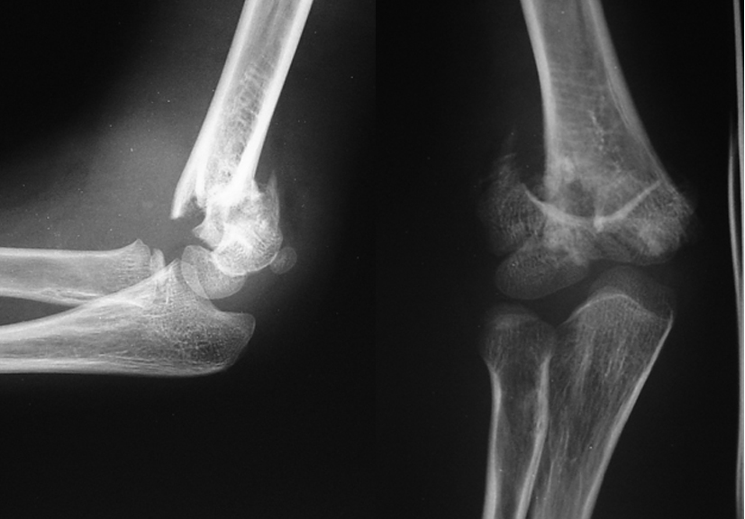
What do you see here?
How old is the patient?
What is your diagnosis?
Notes:
This is the x-ray of a child about 8 years of age with open epiphyseal lines.
The patient has a dislocated supracondylar fracture of the humerus.

Slide 50
Summary
You should now be able to:
Read x-rays systematically
Describe fracture patterns
Interpret healing of fractures
Notes:
After this lecture you should be able to:
Read x-rays systematically.
Describe fracture patterns.
Describe how a normal ankle and knee joint should look like.
Spot difficult fractures.
Read the “healing” of a fracture.

