Slide 1
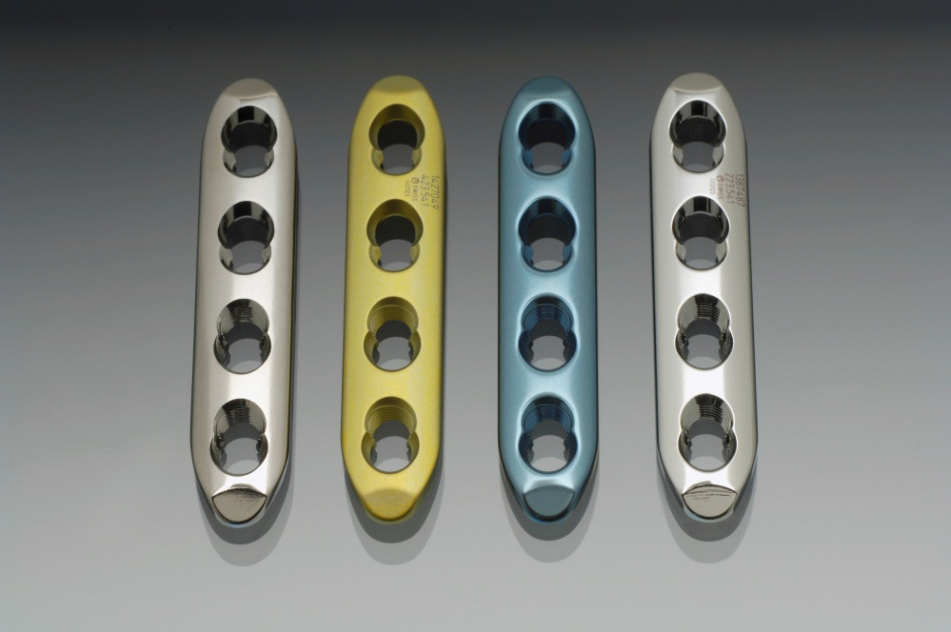
Implant materials in orthopedic trauma
David Eglin, Nicola Kildea

Slide 2
Learning outcomes
At the end of this lecture you will be able to:
List different implant materials used in traumatology
Discuss implant properties
Explain the use of specific materials for specific cases

Slide 3
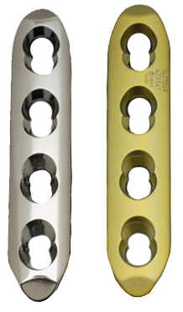
Implant materials in trauma
Functions of implants:
Providing stability
Restoring initial bone mechanics
Types of materials
Stainless steel (SS)
Titanium (Ti)
Titanium alloys (eg, TAN)
Ceramics
Degradable and nondegradable polymers
Notes:
Implants provide stability and restore initial bone mechanics.
The majority of implants consist of metal and metal alloys, such as:
Stainless steel (SS)
Titanium (Ti) and titanium alloys, eg, TAN which reads spelled-out Titanium-Aluminium-Niobium.
Sometimes ceramics, and biodegradable and nondegradable polymers are used.

Slide 4
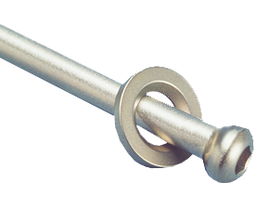
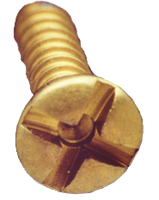
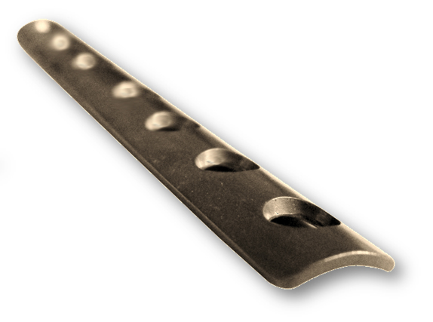
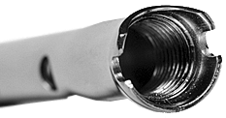
Examples of metal implants
Notes:
All implants (plates, screws, nails, etc.) are available in both stainless steel and titanium alloys.

Slide 5
1. Material properties
Strength and ductility
Notes:
Implants need to be strong and ductile.

Slide 6
Definitions
Strength | Ductility
The ability to resist applied forces without failure. | The ability to be stretched/shaped without breakage.
Notes:
Strength is the ability of a material to resist an applied force without failure.
Ductility is the ability of a material to be stretched/shaped without breakage.

Slide 7
Where to use which type of material?
Depending on:
Anatomical location
Required function
Notes:
The anatomical location and the required outcome dictate the type of material and device to be used.

Slide 8
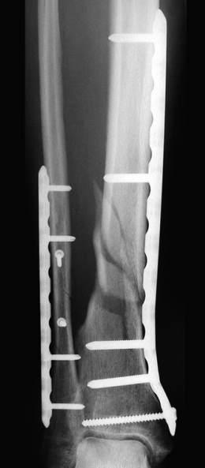
Strong implant materials
Are used for a large bone defect or a major fracture:
Stainless steel
Titanium alloys
Notes:
The resistance of an implant to repeated load may result in failure due to fatigue.
Titanium alloys are less strong than stainless steel.

Slide 9
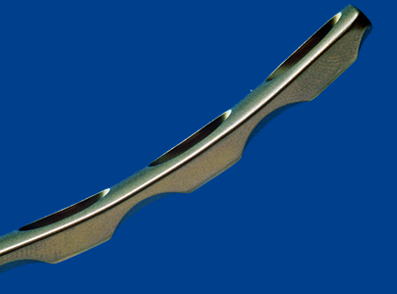
Ductile implant material
Is used when contouring is necessary
⇨ eg, titanium alloys
Contouring of titanium alloys implants is easier than stainless steel implants
Notes:
Titanium alloy implants are more ductile than stainless steel implants.
However, also the shape plays an important role in the ductility of an implant:
One third tubular, stainless steel plates are often bent according to the needs of specific ankle fractures, particularly in the medial malleolus region. These quite thin plates are ductile and good for bending. They are often used as neutralization plates protecting independent lag screws.
Reconstruction plates can be bend in two planes and are used for anatomical regions such as the symphysis, clavicle, etc.

Slide 10
2. Material properties
Strength and ductility
Biocompatibility
Notes:
Implants need to be biocompatible.

Slide 11
Biocompatibility
Is the degree to which implanted biomaterials result in tissue reaction
Highly biocompatible metals cause less negative tissue reaction
Biocompatible surgical materials include:
Stainless steel (SS)
Titanium (Ti)
Titanium-Aluminium-Niobium (TAN)
Notes:
Biocompatibility is the degree to which implanted biomaterials result in a tissue reaction.
Examples of biocompatible surgical materials are stainless steel, titanium, and titanium alloys.
The more biocompatible a metal, the less negative tissue reaction occurs. An example: Osseointegration may be wanted in one case but not in another. In the latter it would be a negative reaction.

Slide 12
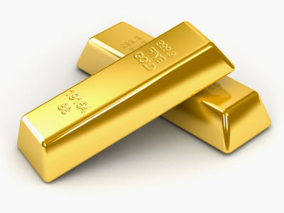
Biocompatibility
Most biocompatible metal in medical use:
Gold
But unsuitable for fracture fixation implants due to physical properties
Notes:
Gold is the most biocompatible of all metals, but it is far too soft and ductile – not to mention expensive – for use in surgical implants (except dental).
The biocompatibility of a metal for implants has to be weighed against its mechanical properties. This is always a compromise. There is no perfect metal for this purpose.

Slide 13
Biocompatibility─How does it work?
Implant
Determined mainly by the implant surface properties
The cell is strongly attached to a rough surface
The cell is loosely attached to a smooth surface
Metal
Metal oxide
passivation
layer
1
2
Notes:
When a metal implant comes in contact with biological tissue, the following occurs:
The implant is first covered with proteins from the body fluids, then cells may attach according to the implant surface properties.
A biocompatible implant will be tolerated by the body or a foreign body reaction will occur. For metals, this depends on the surface properties of the implant, such as surface chemistry and roughness. Proteins and cells interact differently on surfaces with different properties. (Note on surface roughness: Stainless steel has a smooth surface. Titanium and its alloys usually have a rough surface. The surface of Titanium and its alloys can be polished so that a smooth surface is created. This can be preferable in some cases eg, hand surgery, where it allows for free gliding of tendons over the plate.)
If the implant is biocompatible, the inflammation will decrease.

Slide 14
Biocompatibility─How does it work?
Implant
Determined mainly by the implant surface properties
Release of metal particles and ions causes:
Chronic inflammation
Toxic necrosis
Metal
Metal oxide
passivation
layer
Ni²⁺
Notes:
If the implant is not biocompatible:
A chronic inflammation can occur.
A possible consequence of chronic inflammation can be eg, a foreign body reaction.
In addition, nonbiocompatible surfaces (or damaged surfaces eg, with steel) may evolve to release ions which are potentially allergenic/toxic and also actual particles, which can be toxic. This is the corrosion process.

Slide 15
Tissue reactions
Material Properties | Tissue Reaction | Example of materials
Toxic | Tissue infection | Infected Implant
Inert | Tissue forms non-adherent capsule around the implant | Stainless Steel Titanium alloy implant with smooth surface
Bioactive | Tissue bonds to the implant | Titanium alloy implant with rough surface
Degradable | Tissue replaces the implant | Some calcium phosphate cements, polylactate screws, etc.
Notes:
Note: Surfaces of implants can be polished eg, titanium alloy plates. Polished surfaces, eg, of TAN plates, have the same surface properties as steel.

Slide 16
Where to use which type of material
Depending on:
Anatomical location
Required function
Degree of biocompatibility
Potential need for removal
Notes:
The choice of metallic device can also be dictated by the degree of biocompatibility and the need for removal.

Slide 17
Implant removal
Standard titanium implants (rough surface):
Have higher osseointegration than stainless steel implants (smooth surface)
In trauma surgery (where implant removal may be required):
Implants with lower osseointegration (smooth surfaces) are preferred
Notes:
Standard titanium implants refer to those implants which’s surface is not polished.
Polished Titanium and Titanium alloy implants do have a lower osseointegration and will therefore be easier to remove. This type of implant should mainly be used in children.
Standard titanium implants also have higher soft-tissue adhesion compared to standard stainless steel implants.
In areas such as hand surgery, tendons must always slide freely over the implant. Tissue adhesion must be avoided in these cases. This can be achieved through polishing the titanium.

Slide 18
3. Material properties
Strength and ductility
Biocompatibility
Corrosion
Notes:
Metals can corrode.

Slide 19
Corrosion
Is the deterioration of metals by chemical interaction with their environment.
Corrosion is a normal electrochemical process.
Notes:
Corrosion is the deterioration of metals by chemical interaction with their environment. It is a normal electrochemical process.

Slide 20
Corrosion─How does it work?
All metal implants have a protective oxide (passivation) layer.
Metal
Passivation layer
Notes:
Passivation is the formation of a metal oxide layer on the surface of the metal (implant). It is a normal and necessary process that protects the implant from corrosion and deterioration.

Slide 21
Corrosion─How does it work?
All metal implants have a protective oxide (passivation) layer.
Damage to the layer may induce corrosion.
Metal
Passivation layer
Notes:
Corrosion can be induced when this (protective) passivation layer is damaged.

Slide 22
Corrosion─How does it work?
All metal implants have a protective oxide (passivation) layer.
Damage to the layer may induce corrosion.
Fretting is the movement of metallic parts (eg, screw in plate) which damages the passivation layer.
Metal
Passivation layer
Notes:
Situations in which corrosion can occur:
Implant parts rub against each other and the oxide layer is thus mechanically reduced.
Two different metals have been combined in short distance to each other (galvanic corrosion).
There are multiple consequences of corrosion and it will influence the safety (eg, release of metal debris in tissue) and the reliability of the implants (eg, mechanical failure).

Slide 23
Note on the passivation layer
The passivation layer on a metal reforms within minutes when:
Oxygen is present
Exception: The passivation layer of steel does not reform!
Handle implants with care:
Avoid deep «scratches» on implant surfaces (steel) which could induce corrosion.
Notes:
Another important consideration to keep in mind when handling implants is to avoid deep «scratches» on implant surfaces, which could induce corrosion.

Slide 24
4. Material properties
Strength and ductility
Biocompatibility
Corrosion
Imaging

Slide 25
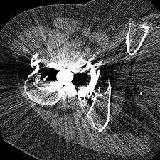
Imaging and metal implants
Stainless steel produces more imaging artifacts than titanium
Titanium is more MRI-compatible than stainless steel
Notes:
In trauma surgery, for patients with multiple injuries, who may require spinal fixation, it is preferable to use MRI compatible implants for all fractures, as the patient is likely to need MRI once stabilized. External fixators should be constructed such a way that they do not affect the MRI image quality.

Slide 26
 | Stainless steel | Titanium | Titanium alloys
Strength | +++ | + | ++
Ductility | + | ++ | +++
Implant Weight | +++ | + | +
Fretting | +++ | + | +
Imaging interference | +++ | ++ | ++
Potential allergenic | ++ | + | ++ (Ni,Cr,Co)
Biocompatibility | ++ | ++ | ++
Cost | + | +++ | +++
Notes:
This slide should be shown as overview only. Do not go into detail.

Slide 27
Questions
Notes:
Please use this slide, if required.

Slide 28
Function of implants
1. They slow down the healing process.
2. They reduce potential for infections in open fractures.
3. They restore the initial bone mechanics.
Notes:
Optional:
Insert these questions to check learning outcomes, if required.

Slide 29
Function of implants
1. They slow down the healing process.
2. They reduce potential for infections in open fractures.
3. They restore the initial bone mechanics.
Notes:
Optional:
Insert these questions to check learning outcomes, if required.

Slide 30
Why are titanium cannulated screws preferable in talus fractures?
1. They can be inserted faster.
2. Titanium screws create less artifacts on MRI.
3. They are not as tough as stainless steel.
Notes:
Optional:
Insert these questions to check learning outcomes, if required.

Slide 31
Why are titanium cannulated screws preferable in talus fractures?
1. They can be inserted faster.
2. Titanium screws create less artifacts on MRI.
3. They are not as tough as stainless steel.
Notes:
Optional:
Insert these questions to check learning outcomes, if required.

Slide 32
What causes implant corrosion?
1. Frequent sterilization of the implants
2. Removal of the passivation layer
3. Open fractures
Notes:
Optional:
Insert these questions to check learning outcomes, if required.

Slide 33
What causes implant corrosion?
1. Frequent sterilization of the implants
2. Removal of the passivation layer
3. Open fractures
Notes:
Optional:
Insert these questions to check learning outcomes, if required.

Slide 34
Summary
Implants provide stability, restore initial bone mechanics, and improve chances for good healing
Metals are strong, stiff, and ductile
The anatomical location and required function can dictate the choice of implant material
Biocompatibility of implant materials is important

