Slide 1
Osteosynthesis involving a joint
Thomas P Rüedi
Notes:
Editing
Isabel Van Rie
Susanne Bäuerle
Alan Norrish

Slide 2
Learning outcomes
At the end of this lecture you will:
Understand the pathophysiology of articular cartilage
Describe the need for anatomical reduction and rigid fixation in articular fractures
Discuss “staged surgery”
Notes:
At the end of this lecture you will be able to:
Outline the pathophysiology of articular cartilage
Describe the need for anatomical reduction and rigid fixation
Discuss “staged surgery”

Slide 3
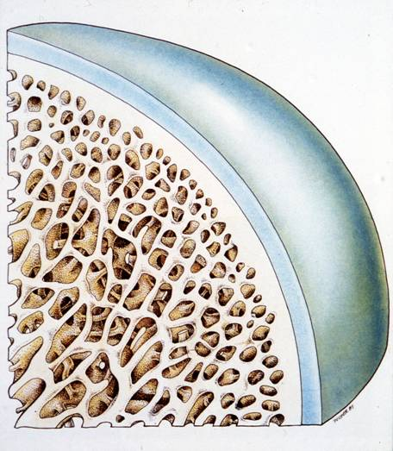
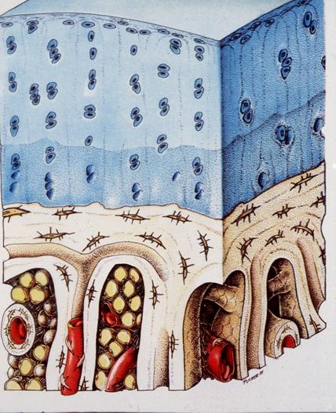
Articular cartilage—anatomy
Normal cartilage
Notes:
Articular cartilage and chondrocytes stay alive because they receive oxygen and nutrients by diffusion from joint fluids. This only works if there is both regular movement and physiological loading forces.

Slide 4
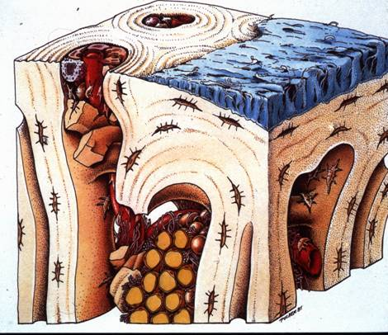
Articular cartilage—pathology
Arthrosis/arthritis
Notes:
To work properly, the articular cartilage must be very smooth. This minimizes friction. When a fracture occurs near to the cartilage, it can change this environment. Any changes in the axial alignment or step-offs in the articular surface may lead to rapid degenerative change in the joint, eg, posttraumatic arthrosis and arthritis.
Arthrosis: Degenerative cartilage
Arthritis: Inflammation of the joint

Slide 5
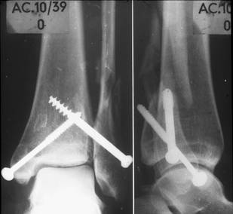
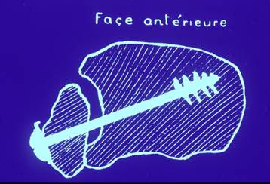
Historical introduction
1913, A Lambotte, Belgium:
Perfect anatomical reduction and stable fixation
Early motion
Transfixation screw in unreduced fibula
Case from the early AO days
Notes:
Over 100 years ago, Lambotte observed that only “perfect anatomical reduction and stable fixation” by screws combined with early motion allows to obtain a good functional outcome in articular fractures.
Lambotte described that a transfixation screw (between fibula and tibia) in an unreduced fibula must result in a severe osteoarthritis. The drawing and the x-rays show a clinical example of such a situation from the early days of AO.

Slide 6
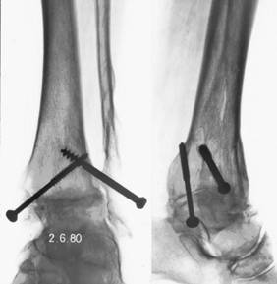
Historical introduction
1913, A Lambotte, Belgium:
Perfect anatomical reduction and stable fixation
Early motion
Transfixation screw in unreduced fibula
20 years later:
Osteoarthrosis
Joint fusion
Notes:
The same case 20 years later with severe posttraumatic osteoarthrosis resulting in spontaneous fusion (ankylosis).

Slide 7
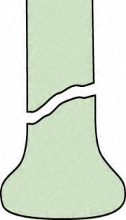
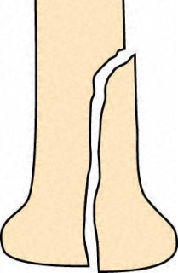
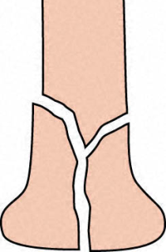
Classification—Types
A
Extra articular
B
Partial articular
C
Complete articular
Notes:
Classification of articular fractures:
Each bone segment, proximal and distal, is divided in three types of fractures:
A – Extra articular fracture
B – Partial articular fracture
C – Complete articular fracture
On the slide a distal femur (no. 31 in the AO Classification) is shown as an example.

Slide 8
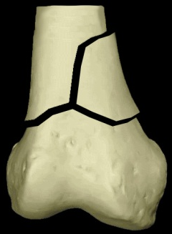
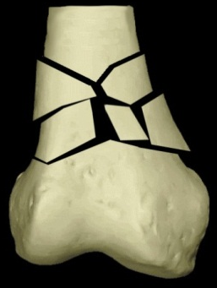
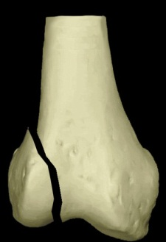
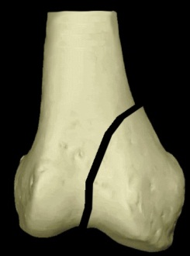
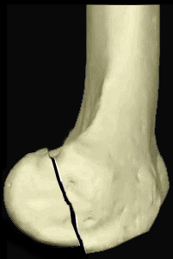
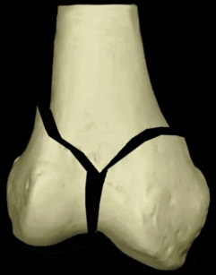
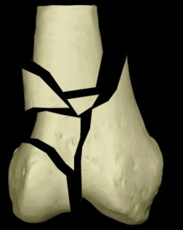
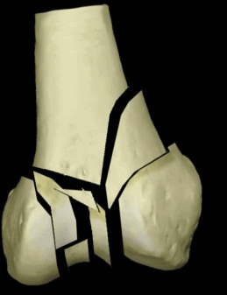
Classification—Subgroups
A
A1
A2
A3
Extra articular
B
B1
B2
B3
Partial articular
C
C1
C2
C3
Complete articular
Notes:
Each type is divided in three subgroups.

Slide 9
Classification—Subgroups
A
A1
A2
A3
Extra articular
Classifying the fracture:
Helps preoperative planning
Allows to make a prognosis
B
B1
B2
B3
Partial articular
C
C1
C2
C3
Complete articular
Notes:
Classifying the fracture helps preoperative planning.
A fractures have a better prognosis than B and C fractures. Type 1 fractures have a better prognosis than type 3 fractures.

Slide 10
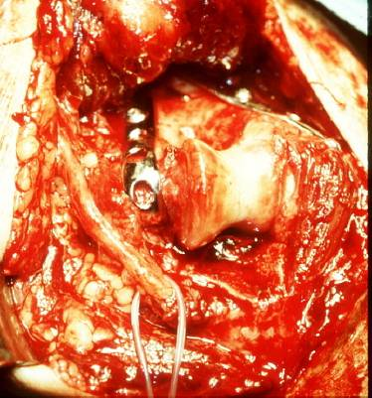
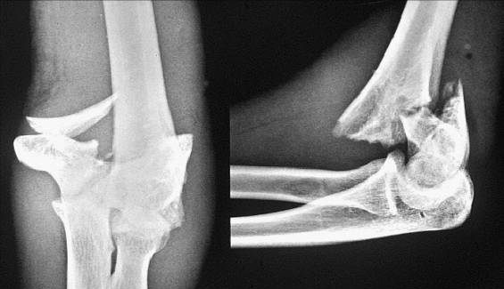
Reduction
Anatomical reduction of joint surface:
Mandatory
Requires good visualization (open incision):
Entire joint
Critical structures
Ulnar nerve
Notes:
Articular fractures must be reduced anatomically, which requires good visualization of the entire joint, including critical structures like eg, the ulnar nerve.

Slide 11
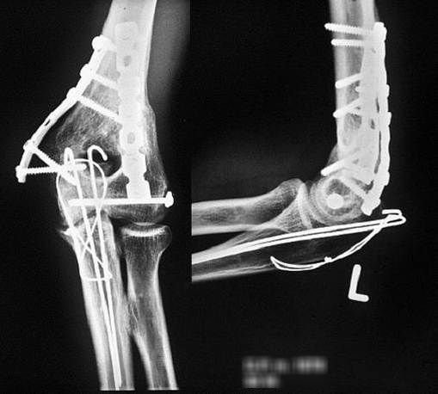
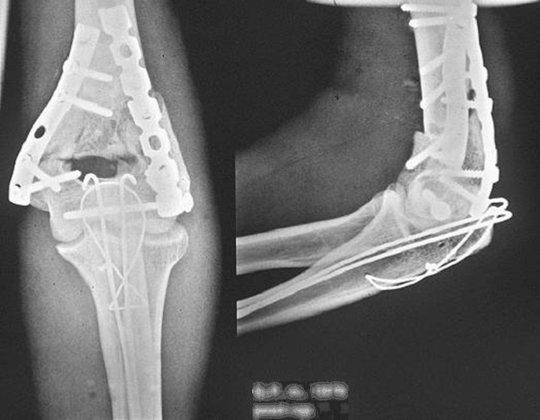
Fixation
Anatomical reconstruction
Rigid fixation:
Essential for early joint movement
Post-op
30 weeks post-op
Notes:
In displaced articular fractures anatomical reduction and reconstruction with rigid fixation is the treatment of choice. Early rehabilitation is important.

Slide 12
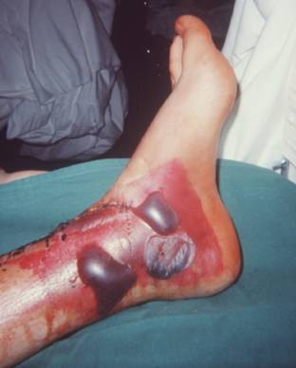
Complications of operative fracture treatment
Can result from:
Poor reduction of joint surface
Inadequate fixation
Wrong implant
Poor soft-tissue care
Wrong timing
Can be avoided:
With careful planning
Notes:
Complications of surgery can be a result of:
Poor reduction
Inadequate fixation
Wrong implant choice
Poor soft-tissue care
Wrong timing
Most complications can be avoided with careful planning.

Slide 13
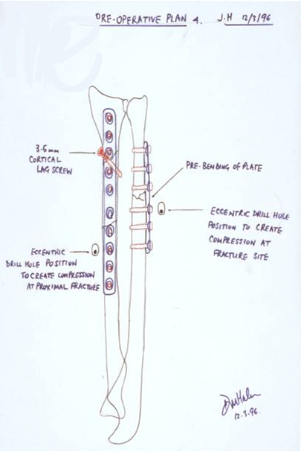
Preoperative planning
Assessment of fracture and soft tissue:
X-ray imaging, including CT
Classify fracture
Reduce fracture on paper
Discuss:
Procedure
Approach/incision
Patient positioning
Position of implants
Choice of instruments
Need for bone graft
Notes:
Preoperative planning involves
Correct assessment of fracture and soft-tissue parts
X-ray imaging, including CT: Traction views and CT scans (3D) are most instructive also in view of the planning of approaches.
Classification of the fracture
Reduction and drawing on paper
Discussion of the:
Procedure step-by-step
Approach
Position of patient
Choice of implant(s) and the position of the implant(s)
Choice of instruments
Need for bone graft

Slide 14
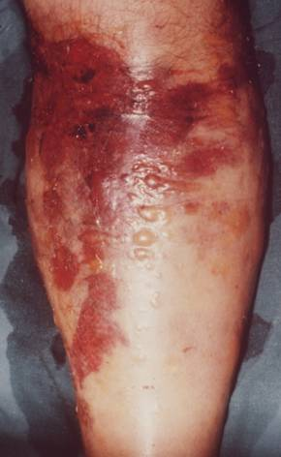
Timing of surgery
Very crucial
Vulnerable soft-tissue cover over the joints:
Thin subcutaneous fat
No muscles
Skin tension results in:
Ischemia
Necrosis
Blisters
Do not touch!
Notes:
The timing of surgery is always very crucial and important, certainly when the soft tissue is vulnerable. This is often the case when the layer of subcutaneous fat is thin and hardly no muscle structure is present.
Tension of the skin results in ischemia and later on in necrosis.
In case of doubt temporary stabilization of the fracture is chosen until the skin and soft tissue recovered. ORIF is done at a later stage.

Slide 15
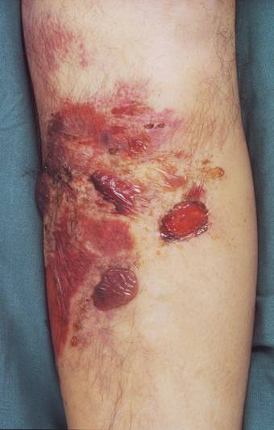
Timing of surgery
History of the injury:
Energy involved
Time span since accident
Swelling, skin tension, blisters, hematoma…
Open/closed injury:
Contamination
Neurovascular status
Compartment pressure
OK after 10 days!
Notes:
The timing of surgery depends on:
The history of the injury. What kind of energy was involved (high or low)? How long was the interval since the accident?
Swelling, skin tension, blisters, hematoma
The fracture. Is it open or closed? Is it contaminated? What is the neurovascular status?
Compartment pressure
Open and contaminated fractures, bad neurovascular status, and high compartment pressure are an indication for immediate surgery; temporary or definitive.
The longer the interval since the accident, the quicker the operation needs to be done, certainly in open and contaminated fractures.
Swelling, skin tension, and bad soft-tissue conditions are indications to delay definitive surgery and proceed to staged surgery (which will be explained later).

Slide 16
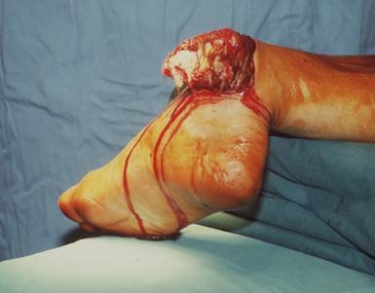
Timing of surgery
Based on soft-tissue conditions
Primary definitive surgery
Staged surgery
Delayed surgery
Notes:
There are three types of surgery: primary definitive surgery, secondary surgery, and staged surgery. Each one has advantages and draw backs. Most important in all cases are the soft tissues. This will define to which surgery the surgeon will proceed.

Slide 17
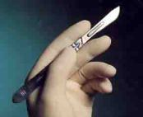
Primary definitive surgery
Unproblematic soft tissues
Simple, open articular fracture (1° and 2°)
Fractures with vascular injury
Prerequisites
Complete preoperative planning
Access to OR
Full equipment available
Experienced team of surgeons and nurses

Slide 18
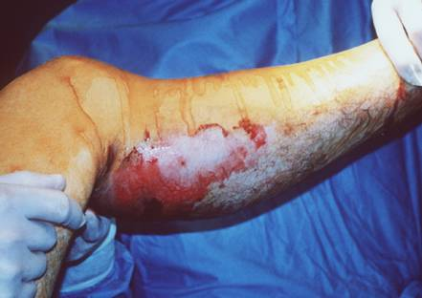
Motorbike accident—Case 1
30-year-old man
III° open proximal tibia fracture (41-C1)
Only a puncture wound
But poor pulses
Notes:
A young man sustained an open proximal tibia fracture (III C) after a motorbike accident.

Slide 19
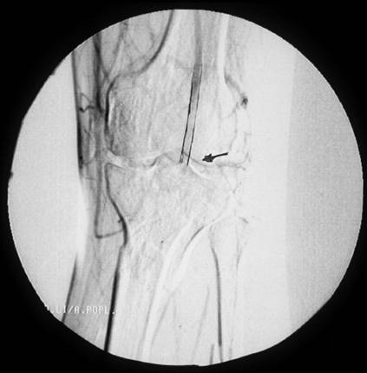
Motorbike accident—Case 1
30-year-old man
III° open proximal tibia fracture (41-C1)
Only puncture wound
But poor pulses
“On-table” angiography in operating room Injury of popliteal artery
Notes:
An angiography in the operating room was done to detect the status of the popliteal artery.

Slide 20
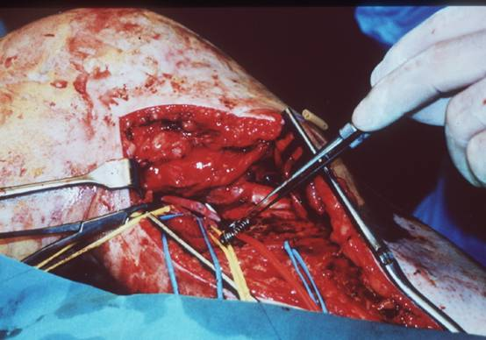
Motorbike accident—Case 1
Surgery
Medial approach to repair popliteal vessel
Notes:
The injury was approached through a medial incision. The popliteal vessels where repaired in a first step.

Slide 21
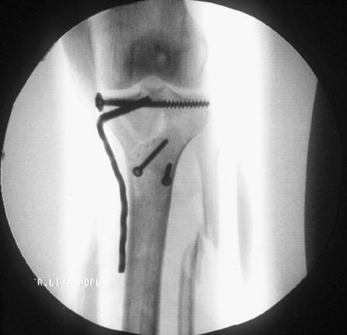
Motorbike accident—Case 1
Surgery
Medial approach to repair popliteal vessel
ORIF (Open Reduction Internal Fixation) with angled blade plate 3.5
Notes:
In a second step the fracture was reduced and fixed with a 3.5 mm angled blade plate.
Both interventions, the vascular repair and the osteosynthesis, were done by the same team. One and the same approach was used.

Slide 22
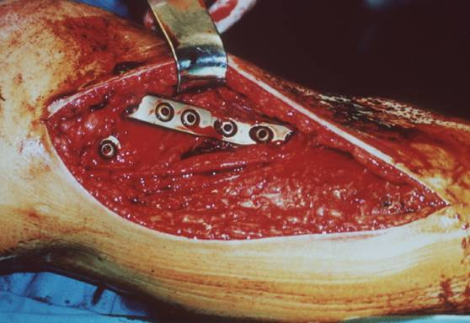
Motorbike accident—Case 1
Surgery
Medial approach to repair popliteal vessel
ORIF (Open Reduction Internal Fixation) with angled blade plate 3.5
Prophylactic release of compartments
Open articular fractures
are emergencies
Notes:
Because of the long duration of the ischemia the compartments were released prophylactically through several incisions.

Slide 23
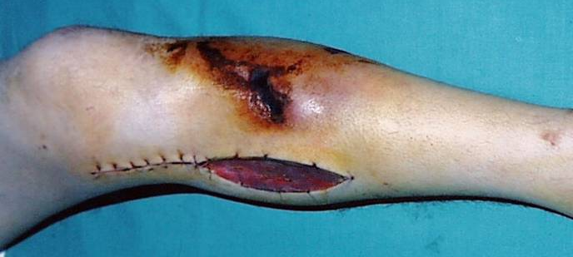
Motorbike accident—Case 1
Second look:
Debridement of skin necrosis over tibial tuberosity
Notes:
After 5 days, necrosis of the skin had to be removed at level of the tibial tuberosity.

Slide 24
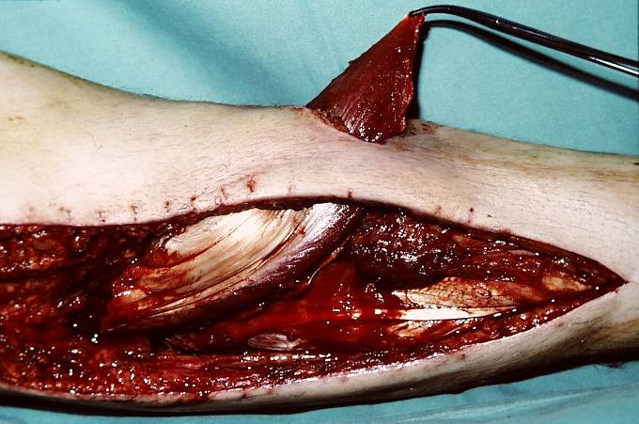
Motorbike accident—Case 1
Second look
Debridement of skin necrosis over tibial tuberosity
Cover of defect with gastrocnemius flap
Notes:
After 5 days, necrosis of the skin had to be removed at level of the tibial tuberosity.

Slide 25
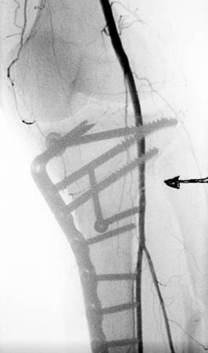
Motorbike accident—Case 1
Postoperative angiogram
To prove patency of popliteal artery
Notes:
A control angiogram was done to prove the patency of the popliteal artery.

Slide 26
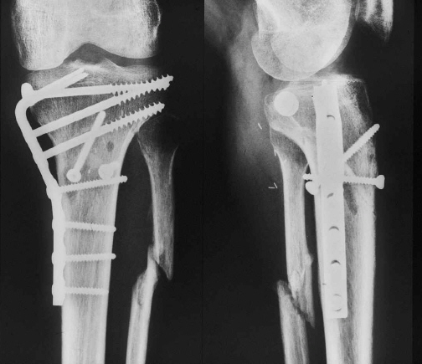
Motorbike accident—Case 1
13 weeks postoperative
No complications
Notes:
13 weeks later, there were no complications…

Slide 27
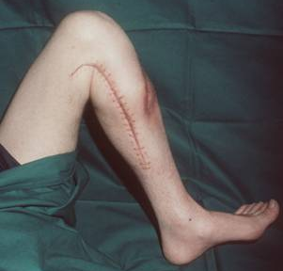
Motorbike accident—Case 1
13 weeks postoperative
No complications
Good function
Notes:
13 weeks later, there were no complications…

Slide 28
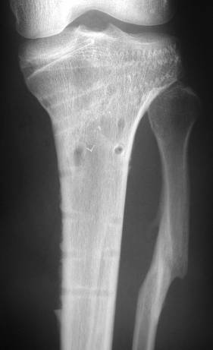
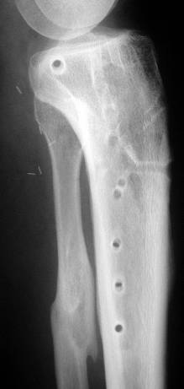
Motorbike accident—Case 1
1-year follow up
Implant removal
Well-healed bone
Congruent articular surfaces
Notes:
This is the result after 1 year, showing a well healed bone with congruent articular surfaces.

Slide 29
Staged surgery—advantages
Definitive treatment
Joint-bridging external fixation
Advantages:
Minimally invasive preliminary fixation
Protects soft tissues for better recovery
Reduction aid for definitive surgery
Patient remains “mobile”
For the “less experienced surgeon” at night
Notes:
Staged surgery or minimally invasive preliminary fixation is the preferred technique for complex articular fractures today. An example is a joint bridging external fixator.
The advantages are:
Protection of soft tissue
Reduction aid for definitive surgery
Patient remains “mobile”
For “less experienced” at night

Slide 30
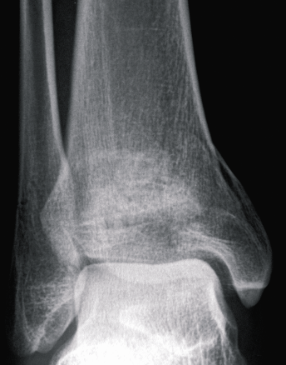
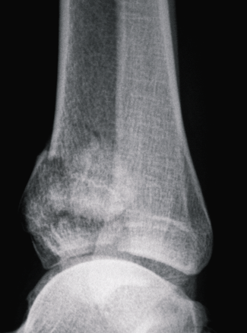
Skiing accident—Case 2
Anterior impaction of distal tibia (43-C fracture)
Notes:
This case from Dr Christoph Sommer (Switzerland) shows an anterior impaction of the distal tibia after a skiing accident.

Slide 31
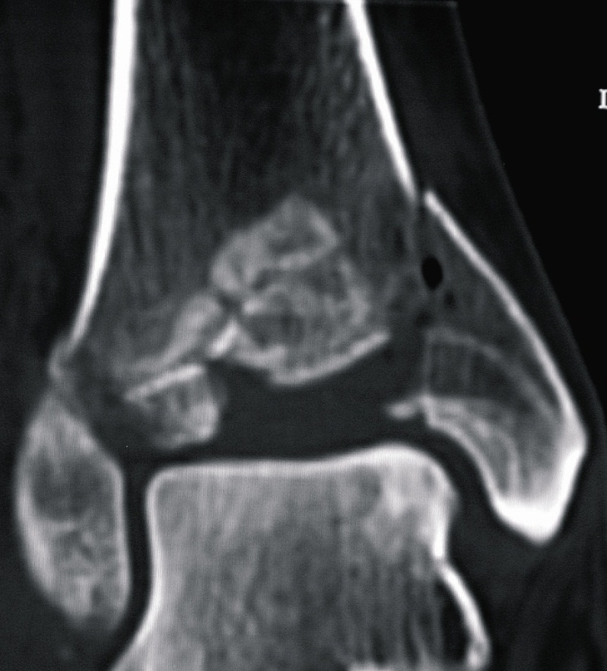
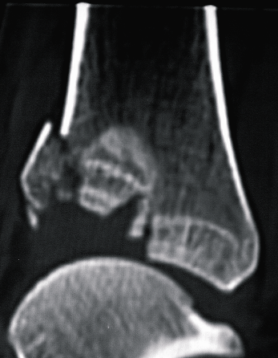
Skiing accident—Case 2
Anterior impaction of distal tibia (43-C fracture)
Absolute indication for surgery
Better evidenced by CT scan
Notes:
A CT scan shows that the case is an absolute indication for surgery.
Courtesy: C Sommer

Slide 32
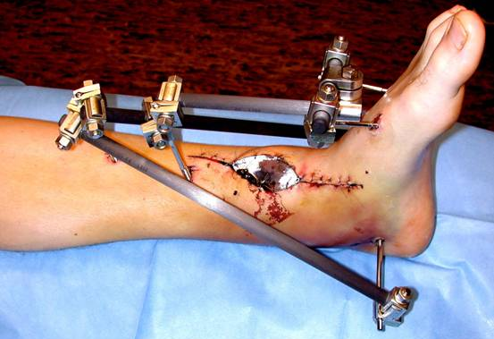
Skiing accident—Case 2
Staged surgery (1)
Temporary, “joint bridging” external fixation
For soft-tissue recovery
Notes:
In the first stage an external fixation has been installed to fix the fracture temporarily allowing the soft tissue to recover before definitive surgery.
Courtesy: C Sommer

Slide 33
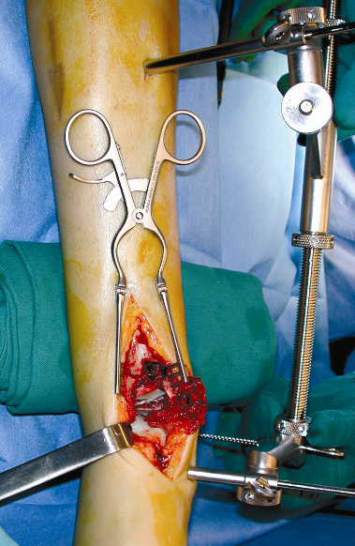
Skiing accident—Case 2
Staged surgery (2)
14 days later
Reconstruction of anterior impaction
Standard approach under distraction
Notes:
14 days later definitive surgery took place. A standard approach and distraction at the fracture site created space…
Courtesy: C Sommer

Slide 34
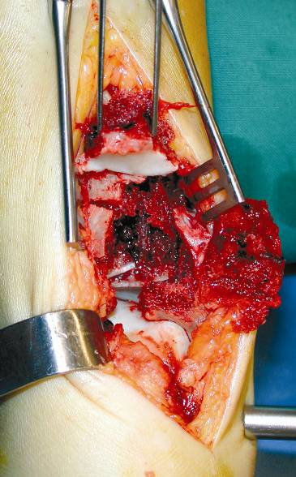
Skiing accident—Case 2
Staged surgery (2)
14 days later
Reconstruction of anterior impaction
Standard approach under distraction
Elevation of articular fragment with two K-wires
Notes:
…allowing to elevate the articular fragment with two K-wires.
Courtesy: C Sommer

Slide 35
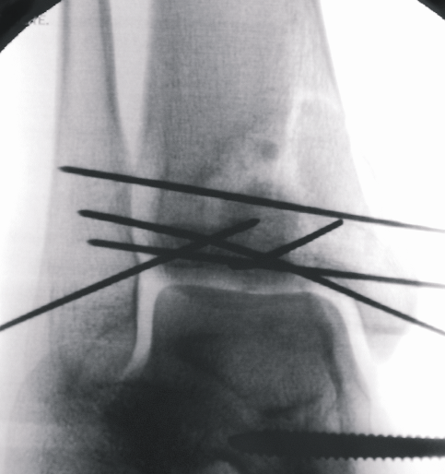
Skiing accident—Case 2
Staged surgery (2)
14 days later
Reconstruction of anterior impaction
Standard approach under distraction
Elevation of articular fragment with two K-wires
K-wire “cage”
Notes:
A K-wire cage is build as temporary fixation.
Courtesy: C Sommer

Slide 36
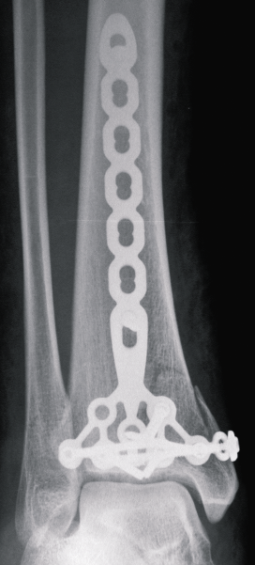
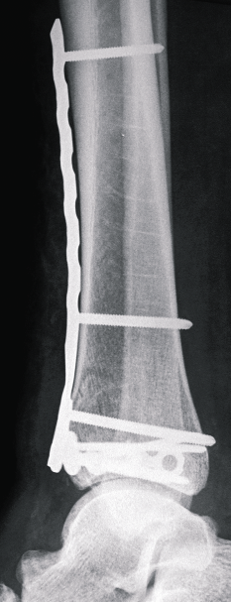
Skiing accident—Case 2
Staged surgery (2)
14 days later
Reconstruction of anterior impaction
Standard approach under distraction
Elevation of articular fragment with two K-wires
K-wire “cage”
Anterior buttress with LCP pilon plate
Notes:
A new pilon plate is used as anterior buttress.
Courtesy: C Sommer

Slide 37
Skiing accident—Case 2
8-month follow up:
No
Concomplicationsgruent joint
Good function
Notes:
8 months later, the patient has good functionality of the ankle and no complications.
Courtesy: C Sommer

Slide 38
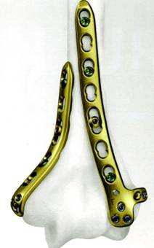
Choice of implant for articular fractures
Screws and plates are usually more adequate than intermedullary nails
1/3 tubular, LC-DCP, LCP
Preshaped plates
3.5 mm implants are best dimension
Proximal tibia
Pilon tibial
Distal humerus
…however special plates are no
guarantee for success!
Notes:
In most cases 3.5 mm implants are used. Screws and plates are more adequate than IM-nails.

Slide 39
Postoperative care
CPM (Continuous Passive Motion) for 5–6 days
No external splint
Immediate toe-touch (15 kg) weight bearing
6–8 weeks 30–40 kg weight bearing
Notes:
Postoperative care
If the patient is compliant, the postoperative care consists of:
Continuous passive motion (CPM) for 5–6 days
No external splint
Immediate toe-touch (15 kg) weight bearing
From 6–8 weeks partial weight bearing (30–40 kg)

Slide 40
Results after ORIF in articular fractures
Results:
70–80% good or excellent
10–15% moderate
5–10% poor
Decisive factors however are:
Anatomical reconstruction and rigid fixation
Experienced surgeon
Early rehabilitation
Notes:
The results after ORIF in articular fractures are in general good provided there is:
Anatomical reduction and rigid fixation
An experienced surgeon doing the surgery
Early rehabilitation
Results:
70–80% is good to excellent
10–15% is moderate
5% is bad

Slide 41
Results
Remember physiology of cartilage:
Damaged cartilage never „heals“ completely
Its repair „depends“ on early joint motion

Slide 42
Conclusion
Displaced articular fractures are absolute indications for surgery
Staged surgery is advisable in complex fractures
Correct timing and planning is crucial
Experienced surgical team is important
New locking plates may have advantages, but a good surgeon is more important
Early mobilization reduces cartilage damage
Injured cartilage never heals completely
Notes:
Conclusion
Displaced articular fractures are an absolute indication for surgery provided there is anatomical reconstruction and rigid fixation.
Staged surgery is advisable in complex fractures.
Correct timing and planning are crucial:
Good imaging and classification are important
Choice of approach(es)
Choice of reduction
Choice of implants and instruments
Choice of bone grafts or substitutes
New locking plates may have advantages but a good surgeon is more important
Injured cartilage never heals completely, but early mobilization is mandatory to reduce cartilage damage.

Slide 43
Questions
Notes:
Optional
Insert questions to check learning.

Slide 44
Displaced articular fractures are an indication for surgery providing…
1. Anatomical reconstruction and rigid
fixation
2. Anatomical reconstruction and relative
fixation
3. Reconstruction of length and axis and
rigid fixation
Notes:
Optional
Insert questions to check learning.

Slide 45
Displaced articular fractures are an indication for surgery providing…
1. Anatomical reconstruction and rigid
fixation
2. Anatomical reconstruction and relative
fixation
3. Reconstruction of length and axis and
rigid fixation
Notes:
Optional
Insert questions to check learning.

Slide 46
Advantages of staged surgery, eg, external fixator are…
1. Recovery of soft tissue
2. “Early” mobilization of patient
3. Use as reduction aid
Notes:
Optional
Insert questions to check learning.

Slide 47
Advantages of staged surgery, eg, external fixator are…
1. Recovery of soft tissue
2. “Early” mobilization of patient
3. Use as reduction aid
Notes:
Optional
Insert questions to check learning.

Slide 48
Cartilage
1. Can heal completely
2. Heals only partially
3. Does not heal
Notes:
Optional
Insert questions to check learning.

Slide 49
Cartilage
1. Can heal completely
2. Heals only partially
3. Does not heal
Notes:
Optional
Insert questions to check learning.

Slide 50
Summary
You should now be able to:
Outline the pathophysiology of articular cartilage
Describe the need for anatomical reduction and rigid fixation in articular fractures
Discuss “staged surgery”
Notes:
You should now be able to:
Outline the pathophysiology of articular cartilage
Describe the need for anatomical reduction and rigid fixation in articular fractures
Discuss “staged surgery”

