Slide 1
Reduction techniques
Rodrigo Pesantez, Myriam Sanchez

Slide 2
Learning outcomes
Define reduction and its types
Understand the degrees of displacement of fractures
Describe the reduction methods and the tools used
Notes:
At the end of this lecture you will be able to:
Define reduction and its types.
Understand the degrees of displacement of fractures.
Describe the reduction methods and the tools used.

Slide 3
What is reduction?
Realignment of a displaced fracture
Returning the affected part of the body to its normal position
Notes:
Reduction is the action of restoring a dislocation or fracture by returning the affected part of the body to its normal position.

Slide 4
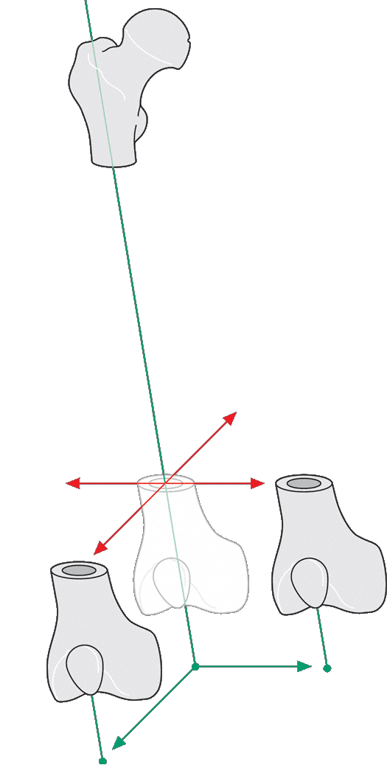
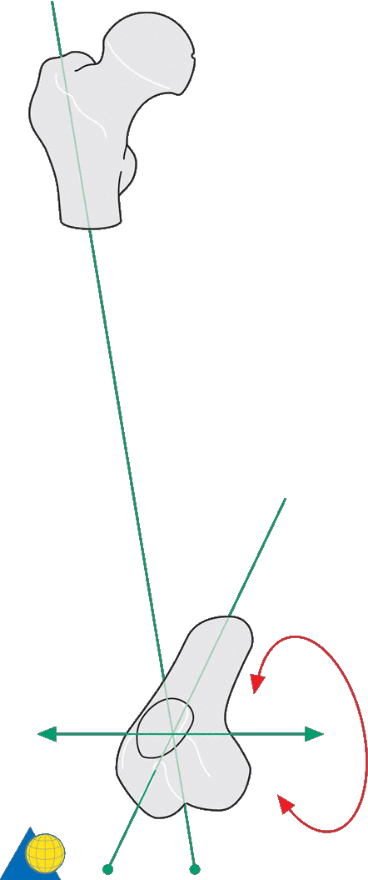
Types of displacement
1
2
1
2
3
Translational
Rotational
Notes:
There are two forms of displacement:
Translational displacement:
Medial or lateral and posterior or anterior
Shortening or lengthening
Rotational displacement:
Internal or external rotational malaligment
Valgus or varus malaligment
Flexion or extension malalignment

Slide 5
Why fracture reduction? Example 1
Notes:
Why fracture reduction?
Here we can see a fracture fixed with an intramedullary nail that looks reduced on the lateral view. On the AP view however we can see that there is some valgus angulation of the distal fragment.

Slide 6
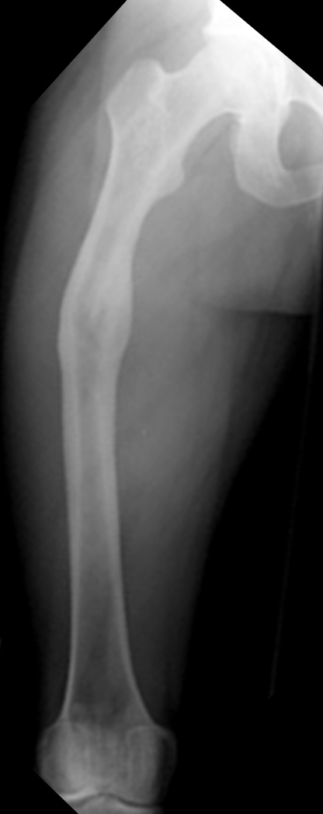
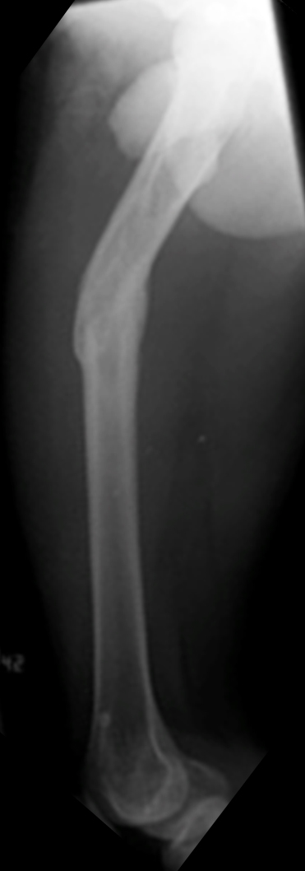
Why fracture reduction? Example 2
Notes:
Why fracture reduction?
This fracture was not treated operatively and has healed with varus, antecurvatum, and shortening malunion.

Slide 7
Aim of reduction
Anatomical reduction
Perfect restoration of bone morphology
Functional reduction
Restoration of anatomical relationships of proximal and distal main fragments:
Length
Alignment
Rotation
Notes:
Some fractures are reduced perfectly to restore the bony anatomy and others to restore the relationship between the proximal and distal main fragments, setting the scene for recovery of the function of the limb.

Slide 8
Choice of reduction method
Depends on the location of the fracture:
Metaphysis and diaphysis:
Functional reduction
Epiphysis (joint):
Anatomical reduction
Notes:
The decision, which reduction method should be used, depends on the location of the fracture:
Meta- and diaphyseal fractures usually need functional reduction.
Joint fractures need anatomical reduction.

Slide 9
Reduction of diaphyseal fractures
Restore functional anatomy:
Length
Alignment
Rotation
Restore axis of the extremity:
Eg, lower limb
Notes:
In diaphyseal fractures:
The functional anatomy is restored (length, alignment, and rotational axis).
The load-bearing axis of the extremity is restored (especially important in the lower limb).

Slide 10
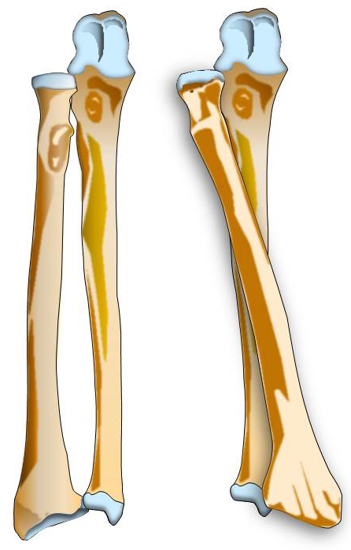
Reduction of diaphyseal fractures
Restore functional anatomy:
Length
Alignment
Rotation
Restore axis of the extremity:
Eg, lower limb
Exception: forearm, which works as a single articular unit
Notes:
An exception is the forearm. The forearm works as a joint (radiohumeral joint, and proximal and distal radio-ulnar joints for pronation and supination).
Image courtesy: Professor Christopher L Colton.

Slide 11
Reduction of articular fractures
Anatomical reduction of the joint surfaces:
Avoid steps
Avoid gaps
Restore axial alignment
Notes:
In articular fractures:
The joint surface is restored anatomically. Gaps and steps in the articular surface must be avoided.
“Steps” means that there is a difference between the levels of two main articular fragments.
“Gaps” means that there is some space between two adjacent main articular fragments.
The axial alignment is restored.

Slide 12
Methods
Direct:
Restore every fragment under direct vision
Indirect:
Blind (not under direct vision) reposition of fragments
Manipulation by traction
Notes:
There are two reduction methods:
Direct reduction where every fragment under direct vision is restored.
Indirect reduction where the direction is done without direct view on the fracture.

Slide 13
Methods of direct reduction
Direct clamp application:
Joint
Shaft
Push-pull technique
Direct application of an implant
“Shoehorn technique”
Notes:
There are different techniques of direct direction.

Slide 14
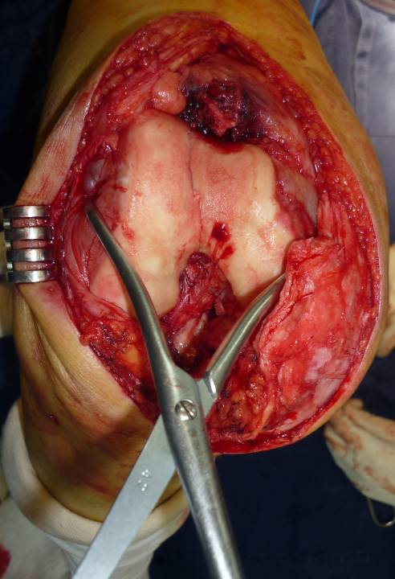
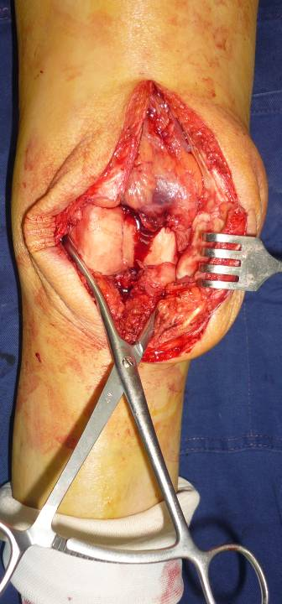
Direct clamp application: joint (example 1 and 2)
Knee
Elbow
Notes:
On this slide you can see how the distal femoral and distal humeral fractures are reduced with a pointed reduction clamp.

Slide 15
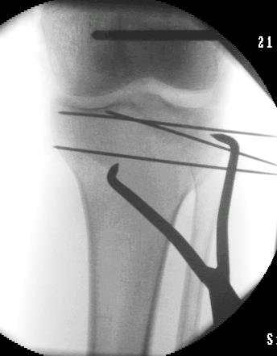
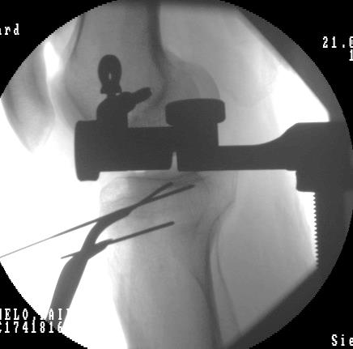
Direct clamp application: joint (example 3)
Notes:
Reduction of proximal tibia/tibia plateau using a distractor in combination with a pointed reduction forceps.

Slide 16
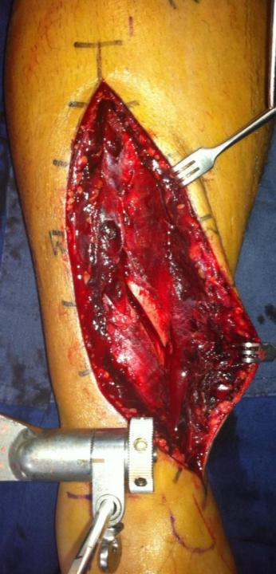
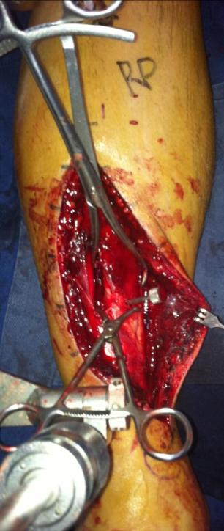
Direct clamp application: shaft (example 4)
Notes:
Also here the distractor is used to gain normal length. The forceps then reduces the main fragments.

Slide 17
Additional Material
The next four slides (slides on reduction tools) are additional to the core knowledge but may be incorporated in any presentation, in which it is required.
Notes:
Information for faculty: All slides on reduction tools can be used and explained. An possible alternative is a discussion of these instruments during hands-on exercises (eg, AO Skills Lab). In that case you may wish not to show these slides.

Slide 18
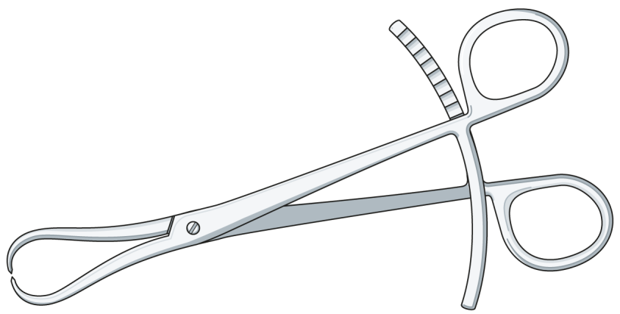
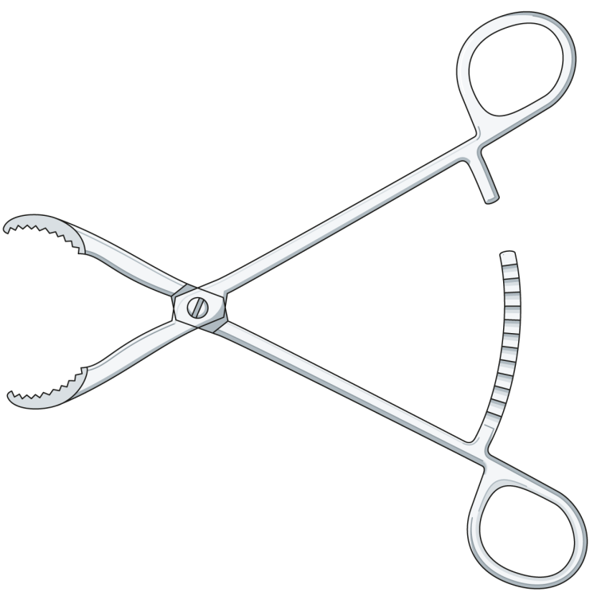
Direct clamp application: reduction tools
Pointed reduction forceps (Weber)
or two-forceps techniques
ReOne-duction in different planes
Toothed reduction forceps
Used for alignment of plate on diaphyseal bone and reduction
Notes:
Information for faculty: All slides on reduction tools can be used and explained. An possible alternative is a discussion of these instruments during hands-on exercises (eg, AO Skills Lab). In that case you may wish not to show these slides.
Commonly used reduction tools are:
Pointed reduction forceps
Toothed reduction forceps

Slide 19
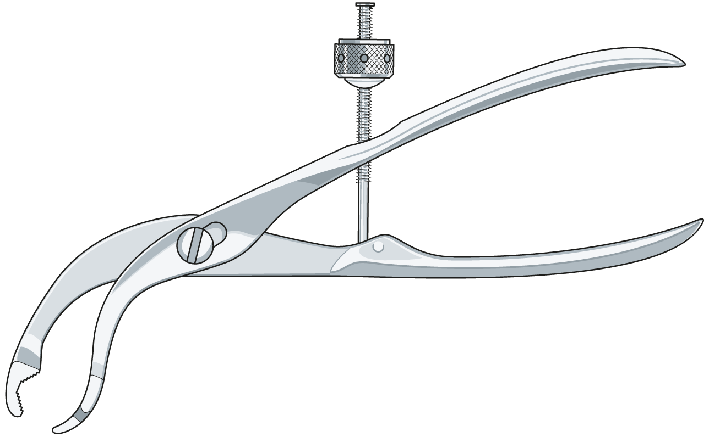
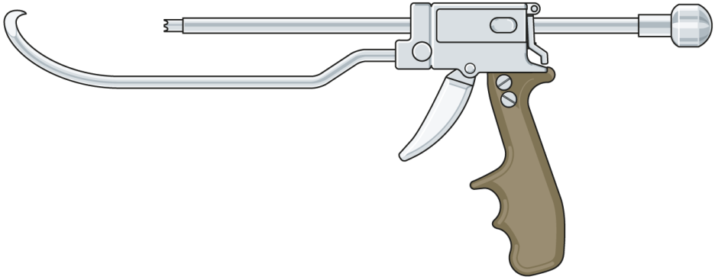
Direct clamp application: reduction tools
Bone holding forceps, self-centering (Verbrugge)
Bone spreader
Distraction
Colinear reduction clamp:
With different attachments, hooks, etc
Compression
Notes:
Information for faculty: All slides on reduction tools can be used and explained. An possible alternative is a discussion of these instruments during hands-on exercises (eg, AO Skills Lab). In that case you may wish not to show these slides.
Commonly used reduction tools are:
Bone-holding forceps, Verbrugge type
Bone spreader
Colinear reduction clamp

Slide 20
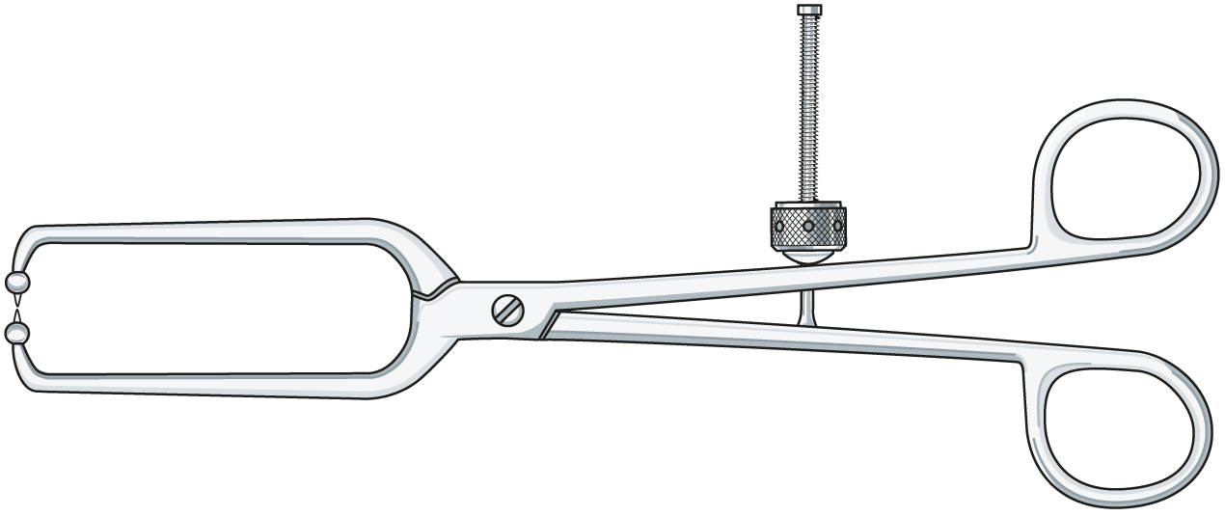
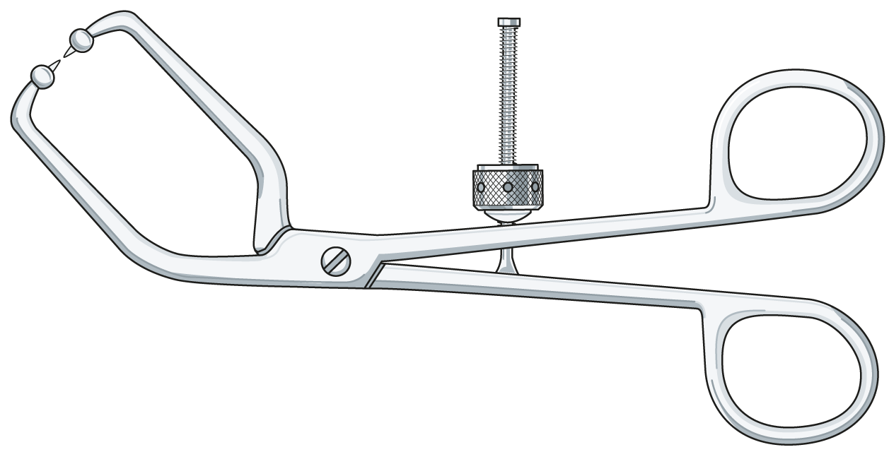
Direct clamp application: reduction tools
Pelvic reduction forceps (King/Queen Tong)
With ballpoints
Angled pelvic reduction forceps (Matta forceps)
Notes:
Information for faculty: All slides on reduction tools can be used and explained. An possible alternative is a discussion of these instruments during hands-on exercises (eg, AO Skills Lab). In that case you may wish not to show these slides.
Reduction tools for oseosynthesis of the pelvis are:
Pelvic reduction forceps
Angled pelvic reduction forceps

Slide 21
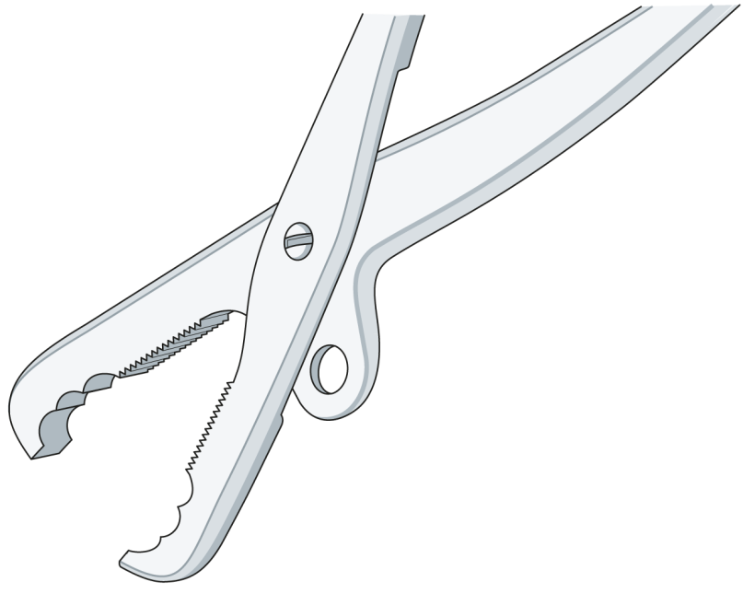
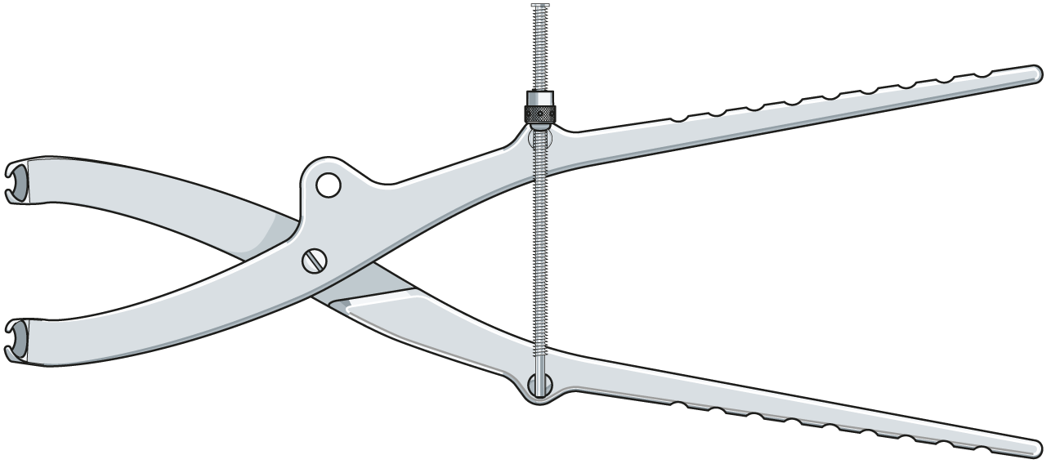
Direct clamp application: reduction tools
Pelvic reduction forceps (Faraboeuf)
Used with 3.5 mm and 4.5 mm screws
Pelvic reduction forceps (Yungbluth)
Used with 3.5 mm and 4.5 mm screws
Notes:
Information for faculty: All slides on reduction tools can be used and explained. An possible alternative is a discussion of these instruments during hands-on exercises (eg, AO Skills Lab). In that case you may wish not to show these slides.
Reduction tools for osteosynthesis of the pelvis are:
Faraboeuf
Yungbluth

Slide 22
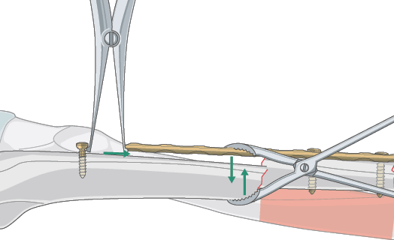
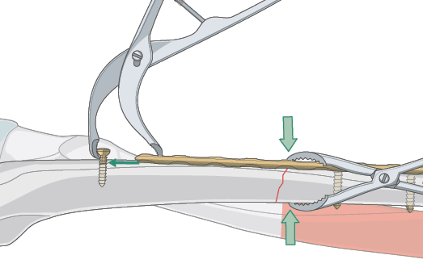
Push–pull technique
Push
Pull
Notes:
In diaphyseal fractures fixed with a plate, the plate is attached to one fragment: then a bone spreader, placed between the end of the plate and an independent screw in one main fragment, can be used to distract the fracture for reduction. A loosely applied reduction forceps helps to maintain the alignment of the main fragment with the plate.
In a next step, in order to maintain the reduction using the same independent screw, preliminary axial compression can then be obtained by pulling the plate end towards the independent screw with a small Verbrugge clamp.

Slide 23
Direct application of an implant (plate)
The articulated tension device (ATD) may also be used for the push-pull technique
Notes:
The articulated tension devide (ATD) can be used to serve the push-pull principle, as illustrated on the previous slide.
The push stage is achieved by reversing the hook on the articulated tension device (see circle and next slide).
Image courtesy: Professor Christopher L Colton.

Slide 24
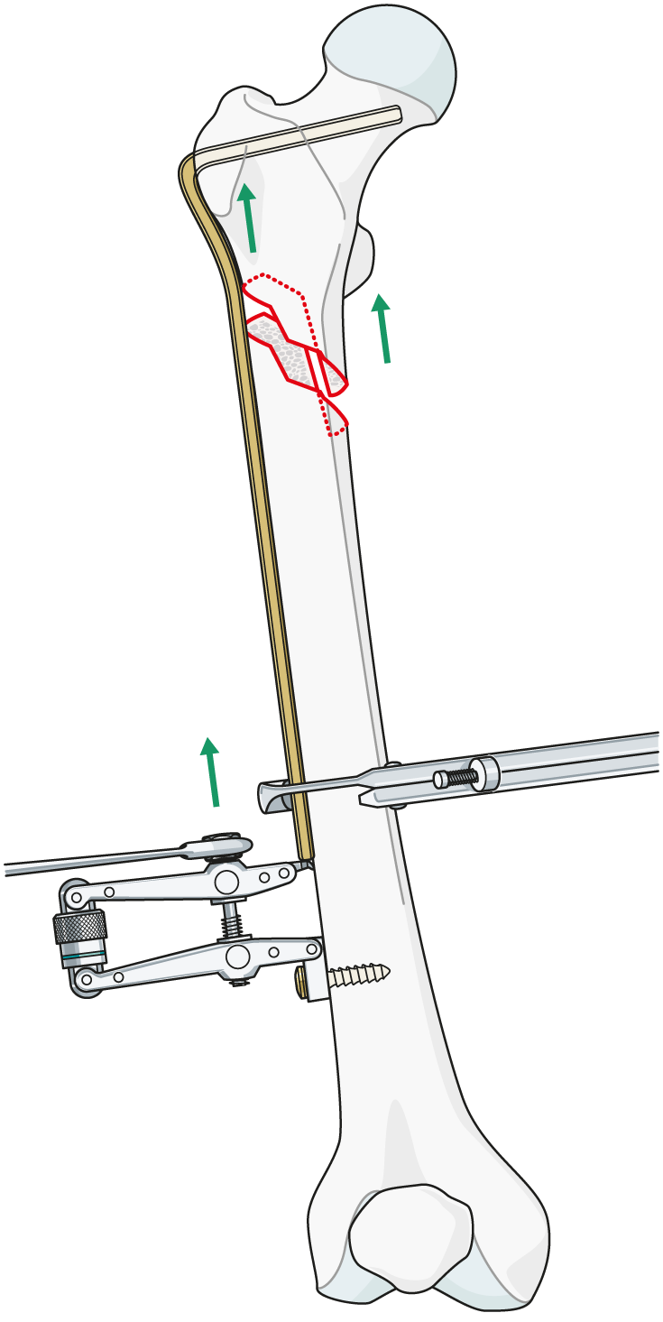
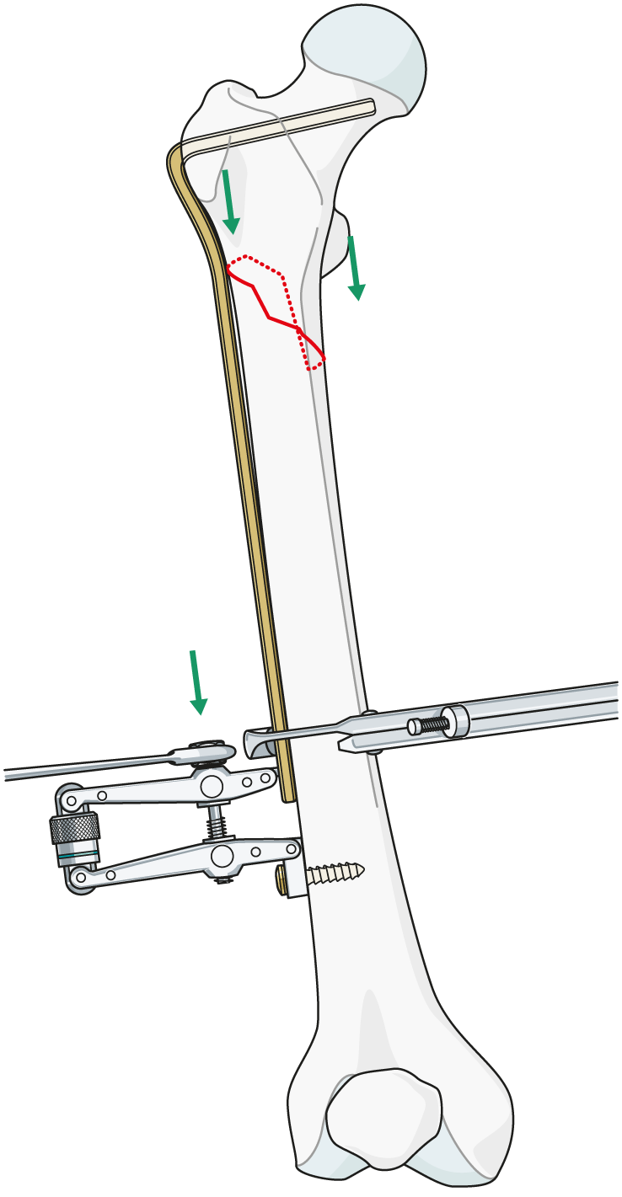
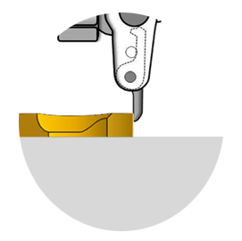
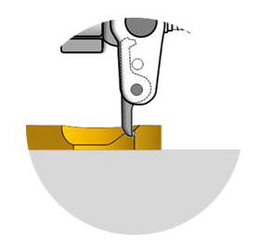
Direct application of an implant (plate)

Slide 25
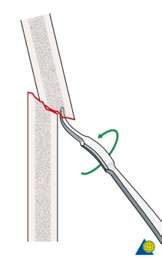
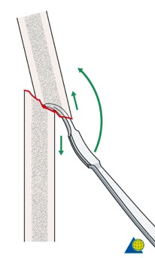
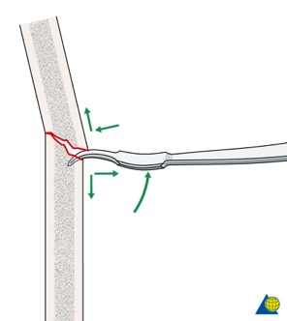
Shoehorn technique
Notes:
The tip of a Hohmann retractor can be used by placing it between the two bone ends of a fracture. By turning the instrument and levering the fragments into position the fracture can be reduced.

Slide 26
Methods of indirect reduction
Traction table with image intensifier
Distractor and joysticks
Frames

Slide 27
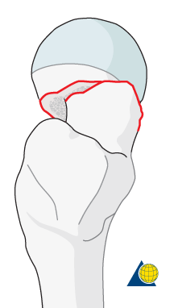
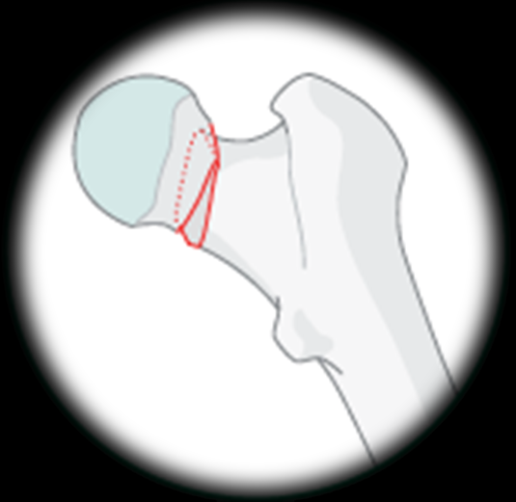
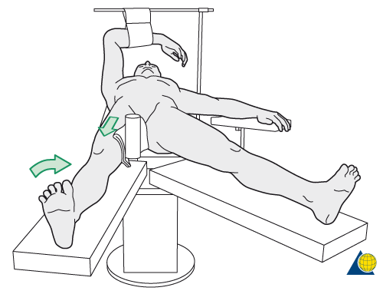
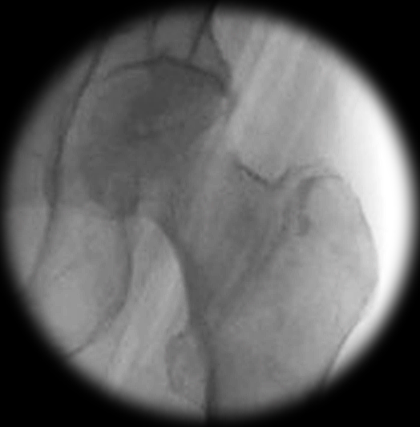
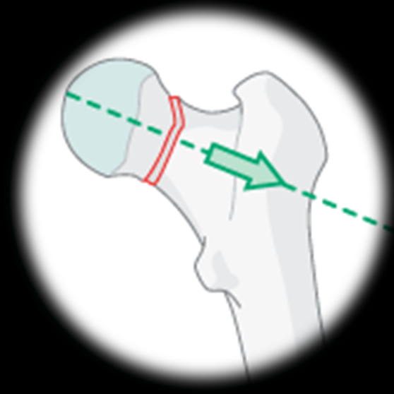
Traction table
Prereduction
Postreduction
Notes:
The fracture table is used to facilitate the reduction of certain fractures. It is commonly used for the reduction and fixation of proximal hip fractures.

Slide 28
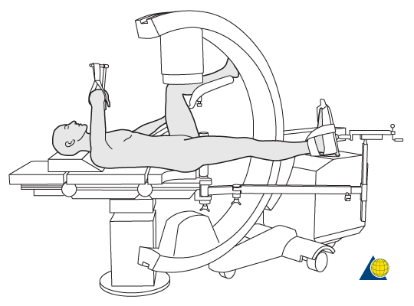
Traction table (with image intensifier)
Notes:
The use of the image intensifier is crucial when performing closed reduction and to guide fixation.
When using the extension table, good access with the image intensifier must be possible in both views, AP and lateral view.

Slide 29
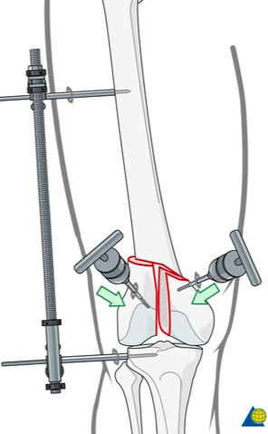
Distractor and joysticks
Notes:
The large distractor is a tool used to distract the fracture. In a next step reduction can be carried out. The distractor can be used with any table, for any type of fracture, and with all kinds of implants, including the intramedullary nail.
In combination with joysticks (Schanz screw with T-handle, placed in each fragment) reduction can more easily be obtained.

Slide 30
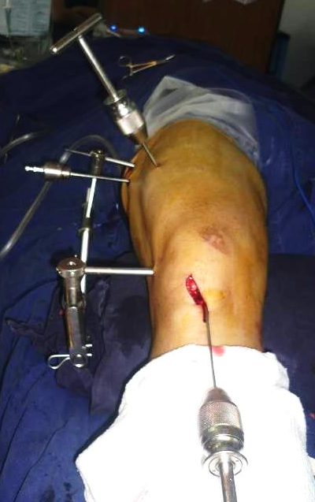
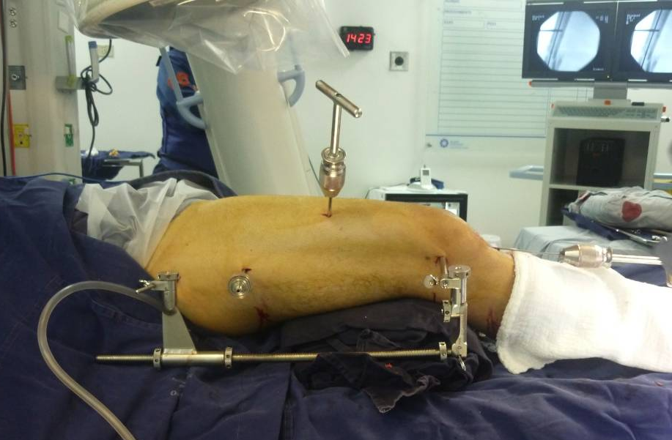
Distractor and joysticks: example

Slide 31
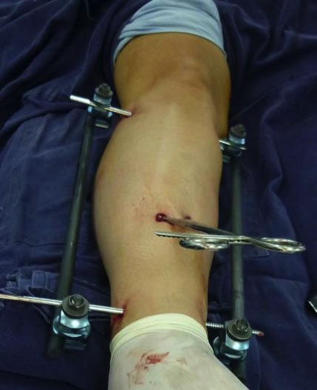
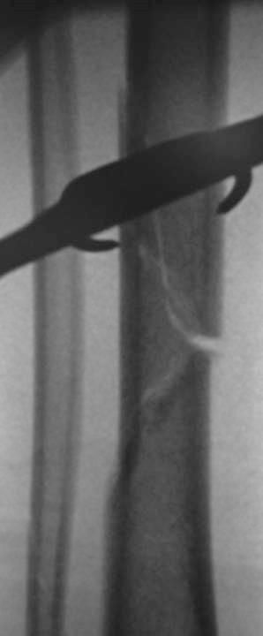
Frames with reduction forceps: example
Notes:
Also the external fixator system with frame distraction can be used to obtain preliminary reduction, particularly in length.

Slide 32
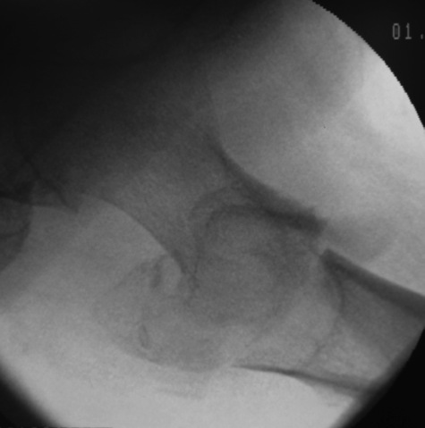
Ball spike

Slide 33
Direct reduction
Advantages:
Easy to see the fracture
Easier to reduce
Disadvantages:
Increases the soft-tissue insult
Notes:
The advantages of direct reduction (from point of view of the surgeon) are that the fracture can easily be seen, which makes it easier to reduce.
The disadvantage is that it is often associated with increased surgical insult to the soft tissue.

Slide 34
Indirect reduction
Advantages:
Preserves soft tissues – biology
Disadvantages:
More difficult to reduce
More difficult to keep it reduced
Increased ionizing radiation
Notes:
The advantage of indirect reduction is that the soft tissues are preserved from additional insult.
Disadvantages are, firstly, the fact that many fractures are more difficult to reduce indirectly and to maintain reduced. Secondly, indirect reduction is also combined with an increased use of the image intensifier, and consequently, a higher exposure of the surgical team to ionizing radiation.

Slide 35
Questions?
Notes:
Optional: Insert questions to check learning outcomes.

Slide 36
The aim of anatomical reduction is
1. Perfect restoration of bone morphology
2. Restoration of anatomical relationships of
proximal and distal main fragments
3. Restoration of length, alignment, and rotation
Notes:
Optional: Insert questions to check learning outcomes.

Slide 37
The aim of anatomical reduction is
1. Perfect restoration of bone morphology
2. Restoration of anatomical relationships of
proximal and distal main fragments
3. Restoration of length, alignment, and rotation
Notes:
Optional: Insert questions to check learning outcomes.

Slide 38
Methods of direct reduction
1. Ball spike
2. Push pull technique and traction table
3. Direct clamp application and shoe horn
technique
Notes:
Optional: Insert questions to check learning outcomes.

Slide 39
Methods of direct reduction
1. Ball spike
2. Push pull technique and traction table
3. Direct clamp application and shoe horn
technique
Notes:
Optional: Insert questions to check learning outcomes.

Slide 40
The colinear reduction clamp is used for
1. Distraction
2. Compression
3. Distraction and compression
Notes:
Optional: Insert questions to check learning outcomes.

Slide 41
The colinear reduction clamp is used for
1. Distraction
2. Compression
3. Distraction and compression
Notes:
Optional: Insert questions to check learning outcomes.

Slide 42
Summary
You should now be able to:
Define reduction and its types
Understand the degrees of displacement of fractures
Describe the reduction methods and the tools used
Notes:
You should now be able to:
Define reduction and its types.
Understand the degrees of displacement of fractures.
Describe the reduction methods and the tools used.

