Slide 1
Perioperative preparation for an osteosynthesis of a proximal femoral fracture
Group discussion
Notes:
Acknowledgements
Contributors
Yarek Brudnicki, Poland
Bernadeta Kaluza, Poland
Review
Emanuel Gautier and Peter Wahl, Switzerland (case)
Thomas Ruedi, Switzerland
Susanne Baeuerle, Switzerland
Isabel Van Rie Richards, Switzerland

Slide 2
How to use this discussion?
Before the course
Go through the presentation and make it your own. Add relevant pictures e.g. of drapes, material if you wish.
Rehearse and make sure that the content is known.
If you are two moderators (ORP and surgeon), decide on who will take the lead for which content.
Some slides contain slide questions (titles).
Other slides contain questions in the notes section which can be used.
The hidden slides can be activated and discussed if wished.
The reference list (slide 3) contains information for further reading.
During the course
Lead the discussion by asking questions.
Do not give another lecture!
Motivate all participants to come up with the content.

Slide 3
Reference list
Topic | Reference
Patient preparation | Orson J, Rusell-Larson D. Patient. In: Porteous M, Bäuerle S, eds. Techniques and Principles for the Operating Room. Stuttgart New York: Thieme; 2010:17–31.
Screw fixation | Saris D. Screw techniques. In: Porteous M, Bäuerle S, eds. Techniques and Principles for the Operating Room. Stuttgart New York: Thieme; 2010:138–144.
Plate functions | Hak D. Plates and plate techniques. In: Porteous M, Bäuerle S, eds. Techniques and Principles for the Operating Room. Stuttgart New York: Thieme; 2010:145–152.
Proximal femoral fractures | Smith M, Porteous M . Proximal femoral fractures. In: Porteous M, Bäuerle S, eds. Techniques and Principles for the Operating Room. Stuttgart New York: Thieme; 2010:440–497.
Diagnostic methods | Guirguis R. Diagnostic methods. In: Porteous M, Bäuerle S, eds. Techniques and Principles for the Operating Room. Stuttgart New York: Thieme; 2010:184–189.
Pre-operative planning | Schelkun S. Preoperative planning for ORP—the team approach. In: Porteous M, Bäuerle S, eds. Techniques and Principles for the Operating Room. Stuttgart New York: Thieme; 2010:190–197.
Reduction techniques | Szypryt P. Reduction techniquesI. In: Porteous M, Bäuerle S, eds. Techniques and Principles for the Operating Room. Stuttgart New York: Thieme; 2010:206–215.
Positioning, approach, reduction and other techniques | Wolinsky P, Stephen D. Femur, shaft. In: Rüedi T, Buckley R, Moran C, eds. AO Principles of Fracture Management, 2nd exp. Edition. Stuttgart New York: Thieme; 2007:767–785
Information WHO Surgical Safety Checklist on | http://www.who.int/patientsafety/safesurgery/ss_checklist/en/

Slide 4
Learning outcomes
At the end of the discussion the participants should be able to:
Describe the fracture briefly
Review the 4 AO principles of fracture fixation
List nursing preparations for internal fixation of a proximal femoral fracture
Notes:
How to use the ppt?
Focus on the 3 learning outcomes.
The participants
Describe briefly the fracture.
Discuss possible treatment(s). In this discussion the treatment with DHS is discussed.
Focus on peri-operative preparations for this particular treatment.
If available, use the workshop instruments to allow hands on individual instruments and to discuss and/or try out functionality of instruments.

Slide 5
Case presentation
65-year-old woman fell from ladder
Left proximal femur fracture
Notes:
Include demention, obesity, diabetes type 2 as possible extra conditions for more advanced course participants. Adapt case and discussions accordingly.
This slide can be printed for the participants in case you wish them to follow the case during the discussion.

Slide 6
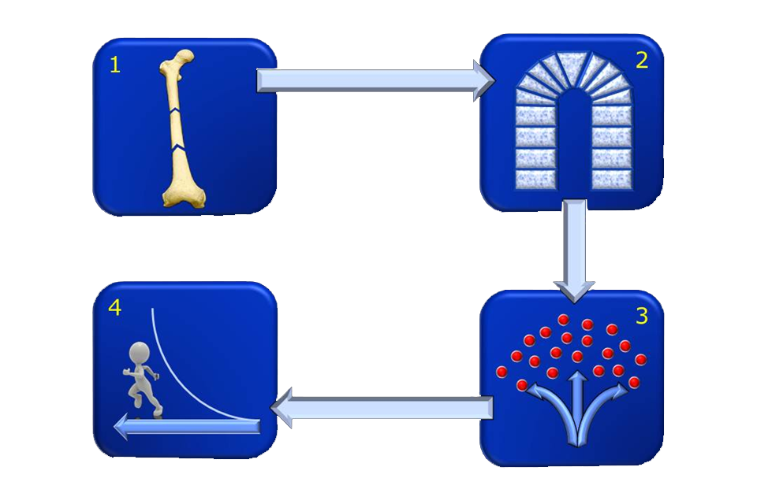
4 Principles of fracture fixation—Review
Notes:
Briefly review the four principles of fracture fixation (if required). The participants have learned about this in a previous lecture. Explain that the entire case including preparation, treatment and after-care is based on these four principles.

Slide 7
Describe the fracture
Bone
Segment
Fracture type
Notes:
Other item(s) which can be discussed here is/are:
What x-rays, images are required? (Both x-ray views (lateral and AP) are needed. Both joints are checked.)
Which bone(s) is(are) broken?
Which segment is broken?
Which fracture type is this?
Is the fracture simple, wedge, or comminuted? What is the pattern of the fracture?
Is this fracture „stable“ or „unstable“?
Does the fracture go into the joint?
Is this an open fracture? (An open fracture is suspected when the bone sticks out, black bubbles are present (which indicates air) and/or dirt is visible (e.g. metal).

Slide 8
Describe the fracture
Femur
Proximal
Trochanteric
Bone
Segment
Fracture type

Slide 9
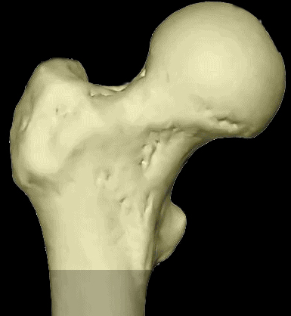
Describe type of proximal femoral fracture
A
Trochanter
B
Neck
C
Head
Extraarticular,
trochanteric
Extraarticular,
neck
Intraarticular,
head
Notes:
This slide can be included if wished.

Slide 10
How would you reduce the fracture? How would you stabilize the fracture?
Notes:
Other items which can be discussed here are:
What type of reduction will be performed? (direct or indirect, open or closed)
What are the principles of stabilization? (absolute or relative stability)
How could the fracture be fixed?
What healing is expected? (direct or indirect bone healing, primary or secondary bone healing)

Slide 11
For this proximal femoral fracture…
…a recommended treatment is
internal fixation with a Dynamic Hip Screw
Notes:
This suggested treatment (see slide) will be discussed further in this discussion.
Other options, eg, PFNA….
Discuss difference between the two devices:
- PFNA load sharing allowing early weight bearing
- DHS load bearing, which usually does permit early weight bearing in an unstable fracture
This is an ideal indication for DHS; with anatomical reduction, correct screw position and good bony support which allows stable construct and immediate weightbearing.
For the stable A1 fractures there is consensus:
Extramedullary fixation: DHS, angle blade plates, etc
- All do very well
- Short surgery
- Little blood loss
- Economic
- Early weight bearing
Intramedullary fixation: PFN, Gamma, etc
- Have no advantages
- More expensive
References:
Curtis MJ, Jinnah RH, Wilson V, et al. Proximal femoral fractures: a biomechanical study to compare intramedullary and extramedullary fixation. Injury. 1994 Mar;25(2):99–104.
Butt MS, Krikler SJ, Nafie S, et al. Comparison of dynamic hip screw and gamma nail: a prospective, randomized, controlled trial. Injury. 1995 Nov;26(9):615–618.
Hoffmann R, Schmidmaier G, Schulz R, et al. [Classic nail versus DHS. A prospective randomised study of fixation of trochanteric femur fractures]. Unfallchirurg. 1999 Mar;102(3):182–190. German

Slide 12
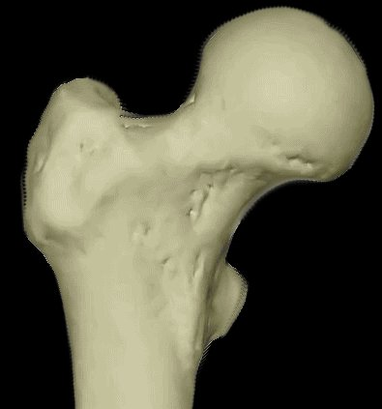
Stable or unstable fracture (1/3)
Notes:
Include this slide if wished
A stable pertrochanteric fracture of the femur allows for an anatomical reduction especially of the medial buttress (calcar). If this has been achieved, the DHS is the ideal implant and allows immediate partial weight bearing. As soon as there is a fragmentation of the medial support, corresponding to an A2/3 type, the DHS risks to break due to fatigue.

Slide 13
Stable or unstable fracture (2/3)
31 A.1
Stable
after reduction
Notes:
Include this slide if wished

Slide 14
Stable or unstable fracture (3/3)
31 A.2/3
Unstable
Notes:
Include this slide if wished

Slide 15
Nursing preparations Pre-, intra and post operative process
Planning
Instrument- and implant check
Procedure
Notes:
Discuss the nursing preparations related to this case.
In the next slides the following will be discussed in more detail:
Planning (including positioning, preparing of equipment etc. and draping)
Instrument- and implant check (including WHO-checklist)
Procedure (including approach and technique)
We use «P.I.P.» to facilitate the three steps (PIP of Planning, Instruments and Procedure).

Slide 16
Nursing preparations Pre-, intra and post operative process
Planning
Instrument- and implant check
Procedure
Notes:
Starting with the planning process….

Slide 17
What do you need to prepare?
Instruments
Implants
Equipment
Notes:
…what do you need to prepare?
Please discuss with your participants the following items. The participants should come up with items for each bullet point. The following slides are some illustrations of what should be prepared.
You are free to include more slides with pictures if deemed required.

Slide 18
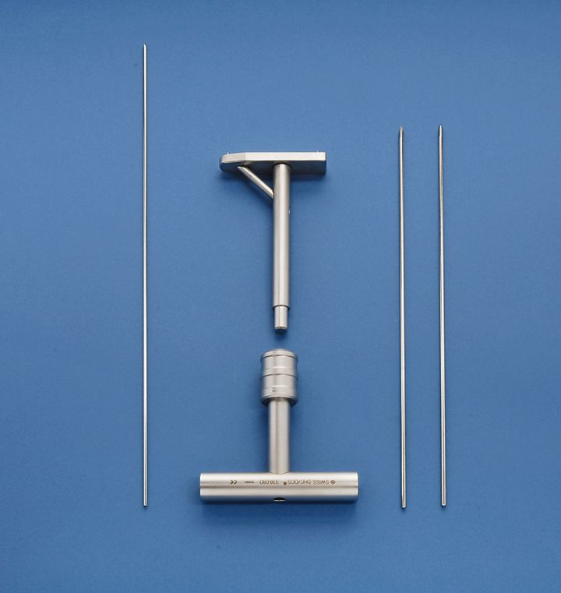
Instruments
Notes:
This slide shows only one set of instruments. The following hidden slides with instruments can be used if wished.
If available, use the workshop instruments to allow hands on individual instruments and to discuss and /or try out functionality of instruments.
Discuss material and equipment necessary for this type of intervention (Image intensifier, etc…).
Discuss specific instruments for fracture fixation with DHS. Note: This picture is not complete. Which instruments are missing?
Discuss plate fixation with corresponding instruments.
Discuss use and intra-operative care and maintenance of specific instruments.

Slide 19
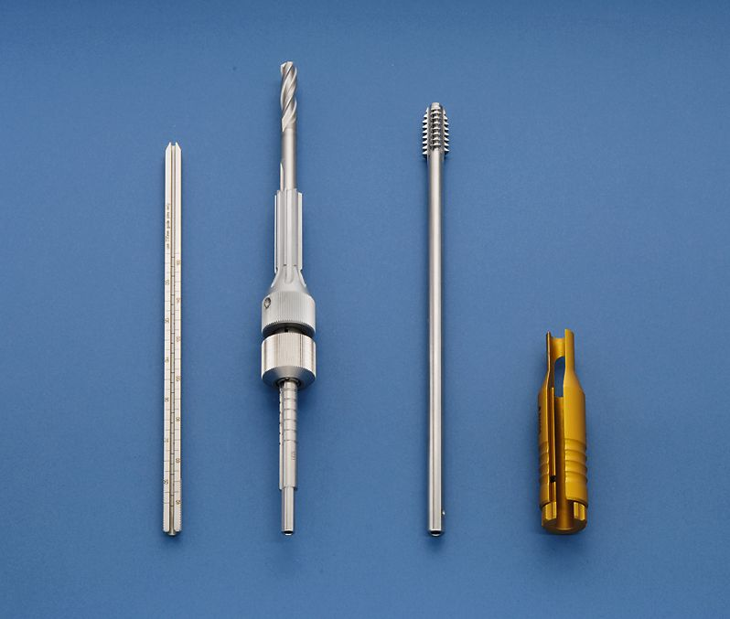
Instruments
Notes:
Use this slide only if wished.

Slide 20
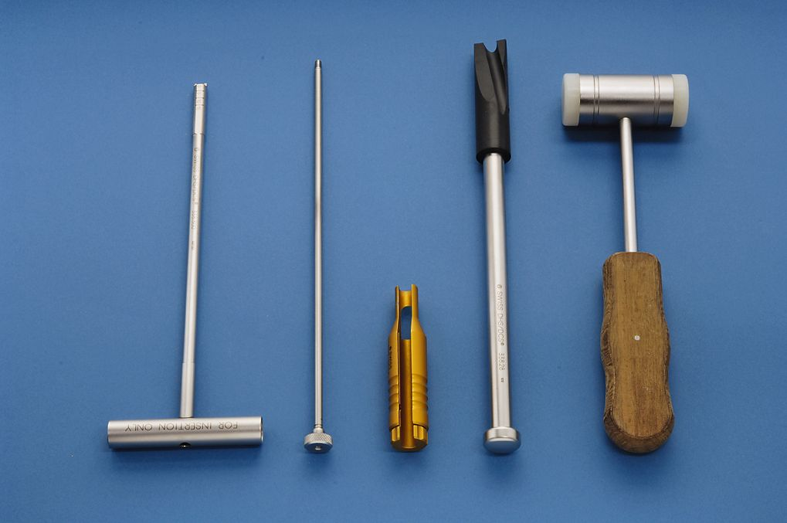
Instruments
Notes:
Use this slide only if wished.

Slide 21
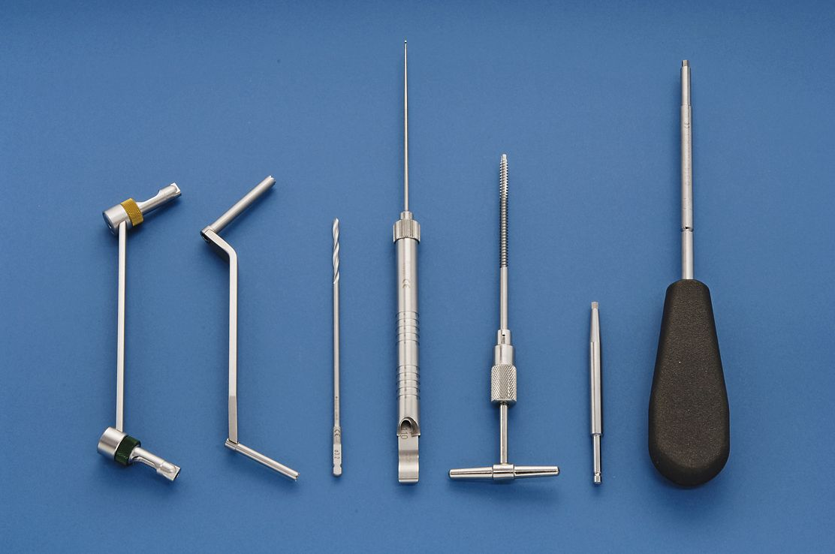
Instruments
Notes:
Use this slide only if wished.

Slide 22
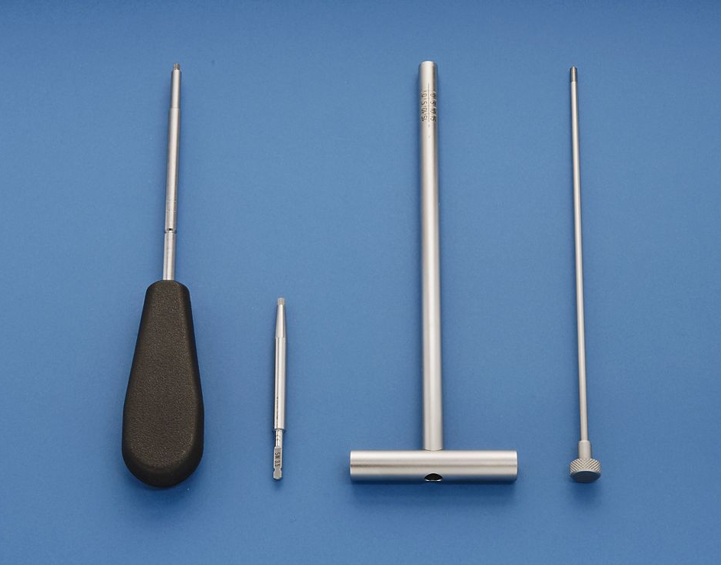
Instruments
Notes:
Use this slide only if wished.

Slide 23
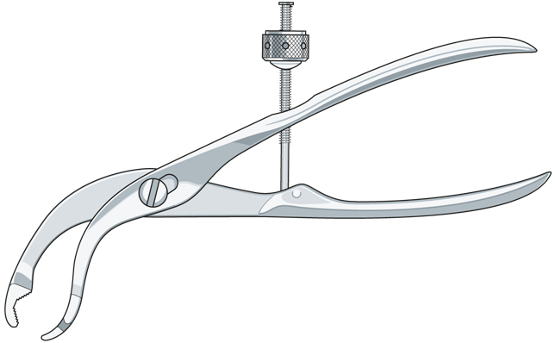
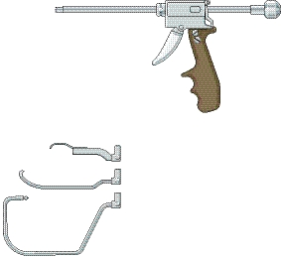
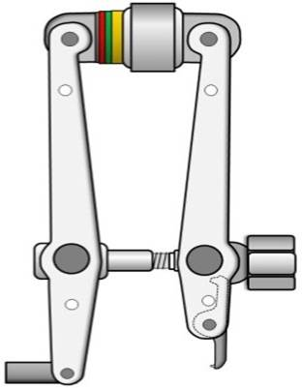
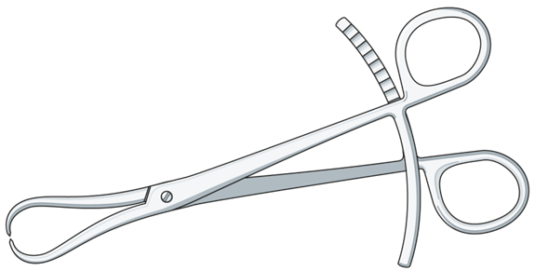
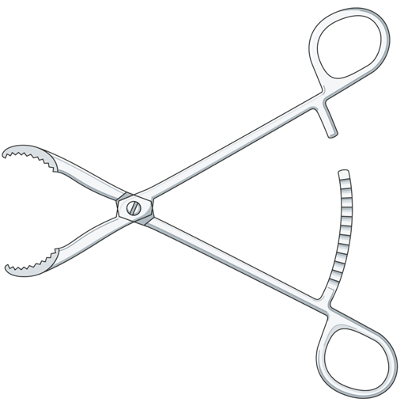
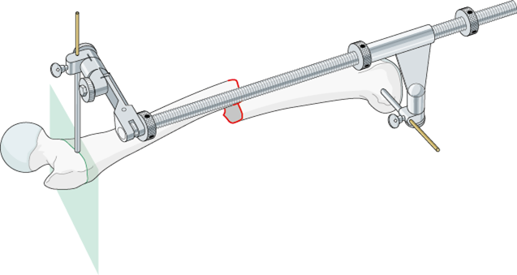
Reduction (distraction) tools

Slide 24
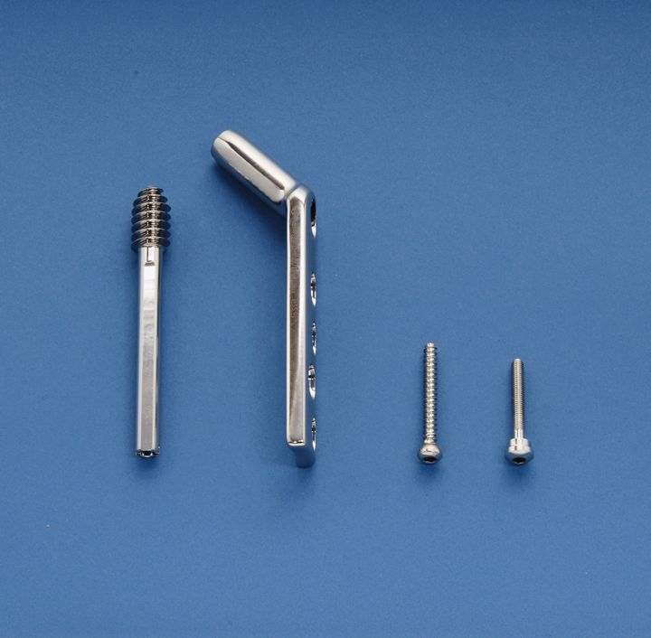
Implants

Slide 25
How would you position the patient?

Slide 26
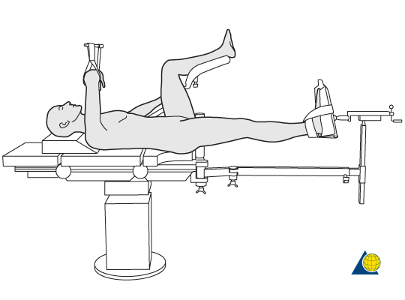
How would you position the patient?
Notes:
Other items which can be discussed here are:
Which possibilities for positioning exist?
Discuss safe positioning for the patient (accessories, OR-table, etc…).
Discuss tips and tricks.
Which complications might occur?
How can these complications be prevented?
Reference: https://www2.aofoundation.org/wps/portal/surgery

Slide 27
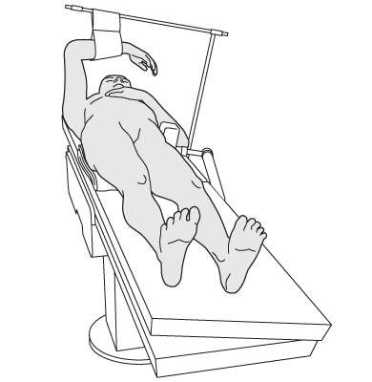
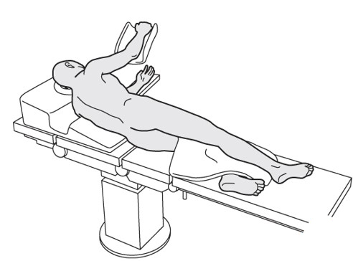
What about these possibilities?
Notes:
Reference: https://www2.aofoundation.org/wps/portal/surgery

Slide 28
How would you drape for this case?

Slide 29
Nursing preparations Pre-, intra and post operative process
Planning
Preparing (Equipment, instruments and implants)
Positioning
Draping
Instrument- and implant check
Procedure
Notes:
Only repeat this if deemed required. This subject is possibly already discussed in the previous discussion.
Questions which can be asked are:
Ask your participants:
What is the final check before skin incision? (refer to Surgical Safety Checklist, see next slides)
Who does this systemically?
What is exactly checked? (availability of instruments and implants or more)
Ask those participants who perform systematically a safety check:
If they use a checklist adapted to their hospital?
If they use a general type of list (see WHO-checklist, AOTrauma checklist)?

Slide 30
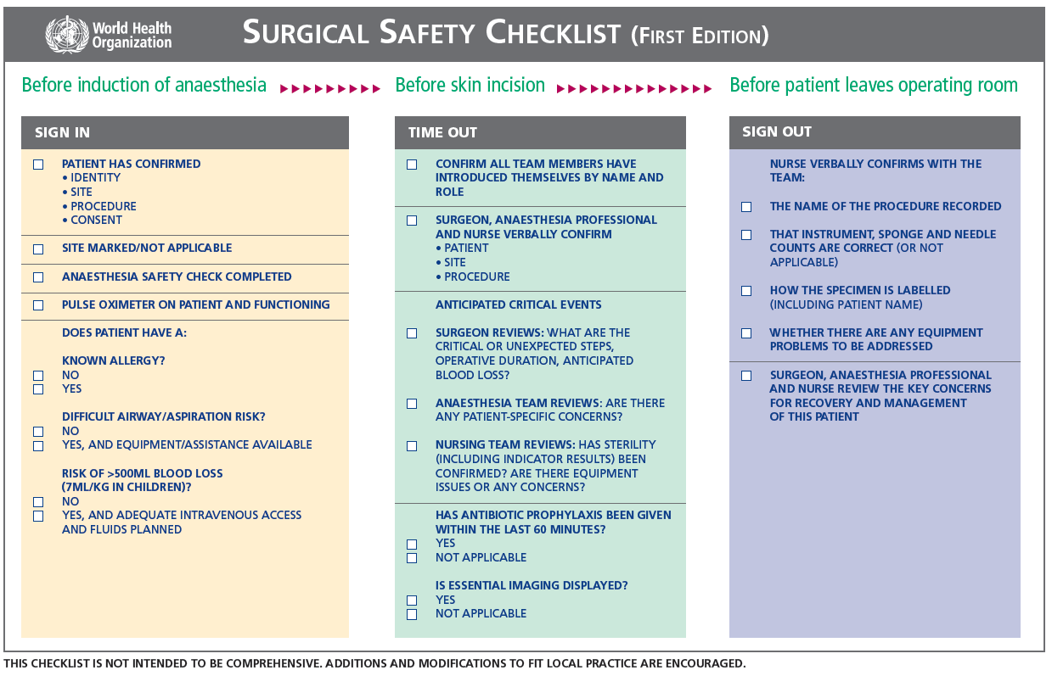
WHO-checklist
Notes:
This is probably discussed in previous discussions. Discuss this slide if wished and required.

Slide 31
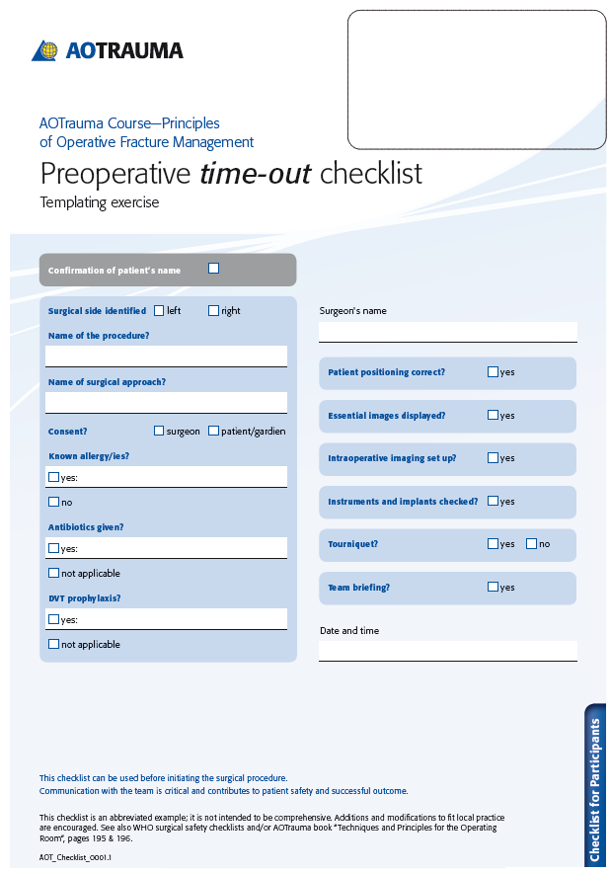
Notes:
This is probably discussed in previous discussions. Discuss this slide if wished and required.
Note that the time-out is only 1 part of the surgical safety checklist.

Slide 32
Nursing preparations Pre-, intra and post operative process
Planning
Positioning
Preparing (Equipment, instruments and implants)
Draping
Instrument- and implant check
WHO-checklist/AOTrauma-checklist
Procedure
Approach
Technique
Notes:
Discuss the procedure step-by-step starting with the approach.

Slide 33
What approach could be done?
Notes:
Other items which can be discussed here are:
Discuss the open, closed and/or minimally invasive approach.
What is the impact regarding the soft tissues?

Slide 34
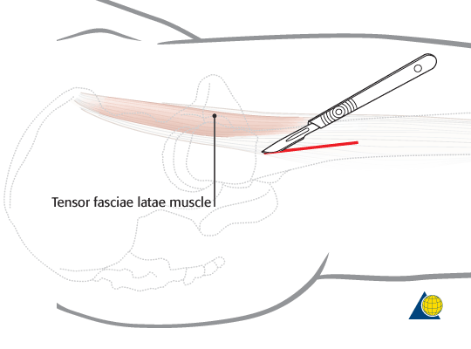
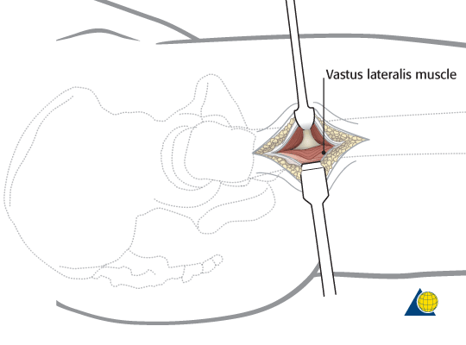
What approach could be done?
Notes:
For insertion of multiple screws, the incision is centered over the femoral neck axis line, and slightly posterior to the palpable mid line of the trochanter. For a sliding hip screw, the plate angle and length will affect the lateral incision. For example, for a two-hole 135º side plate, the incision usually begins a few centimeters beyond the palpable greater trochanter and extends 10 cm further distally, over the femoral shaft. If the soft tissues are thick, the incision may need to be more distal or longer.
Use one or two small elevators to expose the femoral shaft, and place a Hohmann retractor anteriorly. Expose only enough lateral femoral surface for satisfactory hardware placement.
Reference: https://www2.aofoundation.org/wps/portal/surgery

Slide 35
What are the steps of procedure?
Notes:
Participants come up with the steps of procedure. The next slide is a reminder and help which can be used once the participants have given their input.

Slide 36
What are the steps of procedure?
Closed reduction
Insertion of guide wire
Reaming, tapping, and insertion of DHS
Plate fixation
Notes:
Participants come up with the steps of procedure. The next slide is a reminder and help which can be used once the participants have given their input.

Slide 37
What kind of mobilization after surgery is aimed for?
Notes:
Other items which can be discussed here are:
Discuss the mobilization after surgery. (Movements of injured limb, weight bearing, …)
What are available community resources in your country to help mobilize the patient so that they get back home quicker?
How does the diabetes influence the healing process?

Slide 38
Summary—The 4 AO principles
Notes:
Let a participant make a summary on hand of the four AO principles of fracture fixation. Relate/Refer to the case discussed!
Type of reduction (direct or indirect, open or closed)
Principles of stabilization and fixation (absolute or relative stability) with healing expected
Impact of soft tissue (approach)
Expected mobilization after surgery (limb, patient as a whole, weight bearing)

Slide 39
Conclusion
The 65-year-old woman with a proximal femoral fracture is treated with DHS.
Closed reduction is performed on a fracture table
Internal fixation will provide relative stability and secondary bone healing.
The case is prepared following «P.I.P.».

