Slide 1
Fixation principles in osteoporotic bone― the geriatric patient
Emilio Fantin MD
AO Trauma Basic Principles Course
Davos, 2020
Notes:
Published: August 2013
Author: Stephen Kates
Reviewed: Emilio Fantin, 2020

Slide 2
Learning objectives
Differentiate the structure of osteoporotic bone compared to normal bone architecture
Explain why the treatment of patients with fragility fractures goes beyond fracture fixation
Discuss diagnostic and treatment algorithms
List the different options of implants available for fixation
Notes:
→ Teaching points: Focus on general principles of orthogeriatric management and the principles of fixing osteoporotic fractures. With an increasing number of elderly people, it is anticipated that osteoporosis will become an increasing epidemic in the years to come. Bone mineral density (BMD) declines naturally with age in men and women.
The surgical management of fractures in patients with osteoporosis is difficult due to poor bone quality. In particular, fixation of fractures affecting the metaphyseal region of long bones can be associated with an increased rate of complications. For example, there can be implant subsidence or cut-out, failure of fixation, collapse, nonunion, malunion, and the need for reoperations.
After this lecture participants should be able to:
Describe typical structural changes of osteoporotic cortical and cancellous bone
Identify implant characteristics and apply the appropriate implant in response to the bone properties
Apply adapted fixation principles to osteoporotic bone

Slide 3
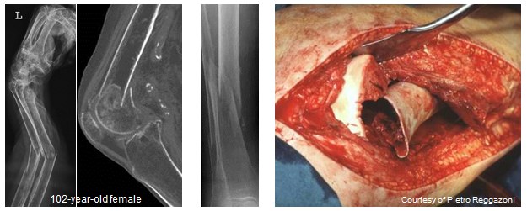
Content
Changes of cortical and cancellous bone and resulting challenges
Implant characteristics in response to reduced bone quality
Applied fixation principles in osteoporotic bone
Notes:
This lecture mainly addresses the typical structural changes in bone and the resulting challenges from a surgeons perspective.
Current implants have not been specifically designed for use in osteoporotic bone although many work well with fragility fractures. In the second part of this lecture we would like to highlight specific characteristics of implants that may be chosen for reduced bone quality to enhance the surgical outcome.
Finally, we would like to show, how these implants should be applied properly in order to achieve constant results. The topic of implant augmentation for improved anchorage is also addressed.

Slide 4
Osteoporosis is…
“...a systemic skeletal disease characterized by low bone mass and microarchitectural deterioration with a consequent increase in bone fragility with susceptibility to fracture...”
- Definition from WHO
Notes:
The World Health Organization (WHO) defines osteoporosis according to measurements of bone mineral density (BMD) using dual-energy x-ray absorptiometry (DEXA).
There are three key elements to be considered when defining osteoporosis:
Bone mass (how much is still left)
Loss of bone mass (how much is lost)
Microstructural changes (how is the bone structured)
The mechanical competence of bone may not be expressed only as a BMD value.

Slide 5
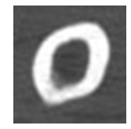
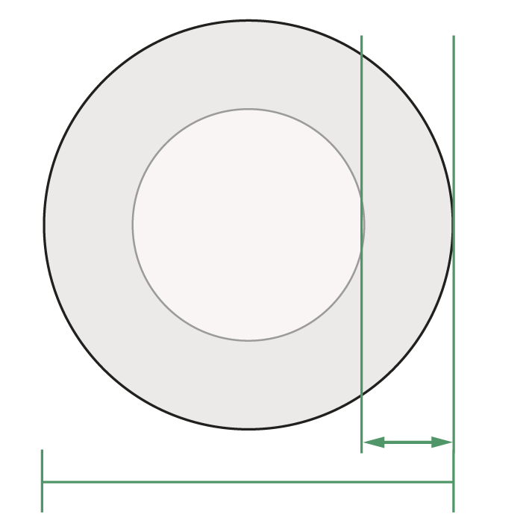
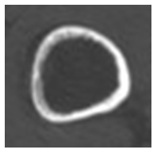
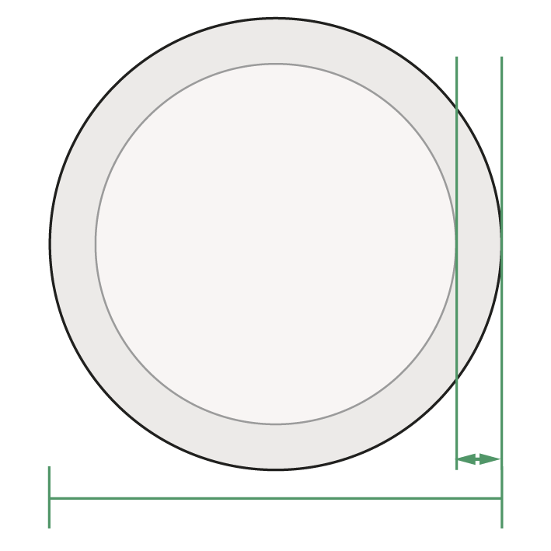
Changes in cortical bone
Decreased thickness
  Increase of bone diameter to maintain bending stiffness
CT cross sections of the femur
Notes:
It is well known and proven that aging humans lose a substantial amount of bone mass compared to the amount present at 25 years of age. It is also well documented that after the age of 40, females lose more bone and at a faster rate than males.
The pattern of age-related cortical bone loss involves thinning long-bone cortices or loss of cortical thickness with concomitant increase in medullary diameter.
Females showed significant (p < .05) decreases in cortical thickness, bone mineral content, and cortical bone density when plotted against age. Males exhibited slight nonsignificant declines for cortical thickness, bone mineral content, and cortical bone density. Both males and females exhibited significant (p < .05) age-related increases in summed haversian canal area values and haversian canal number. Females as a group were found to exhibit significantly (p < .05) larger mean haversian canal area values compared with males, but the male group exhibited more haversian canals per unit area of cortical bone compared with females.
[Thompson DD (1980) Age changes in bone mineralization, cortical thickness, and haversian canal area. Calcif Tissue Int; 31(1):5–11.]
Osteoporosis presents itself with a highly significant loss of cortical thickness throughout the whole spine. This decrease of cortical thickness was more marked in the dorsal shell (p < .05) than in the ventral shell (ventral from C3 to T6 [p < .05] below T6 [p = NS]). We therefore conclude that in osteoporosis the loss of spinal bone mass is not only a loss of trabecular structure but also a loss of cortical thickness.
[Ritzel H, Amling M, Pösl M (1997) The thickness of human vertebral cortical bone and its changes in aging and osteoporosis: a histomorphometric analysis of the complete spinal column from thirty-seven autopsy specimens. J Bone Miner Res; 12(1):89-95.]

Slide 6
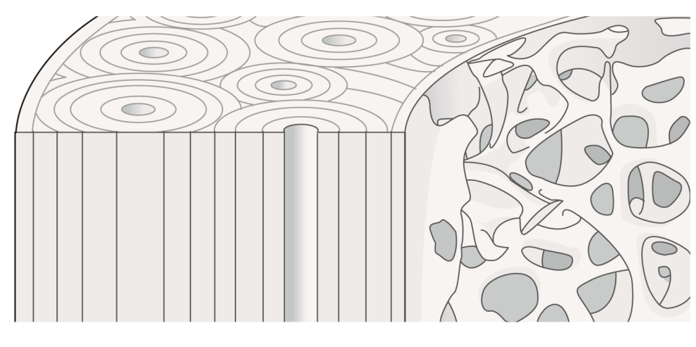
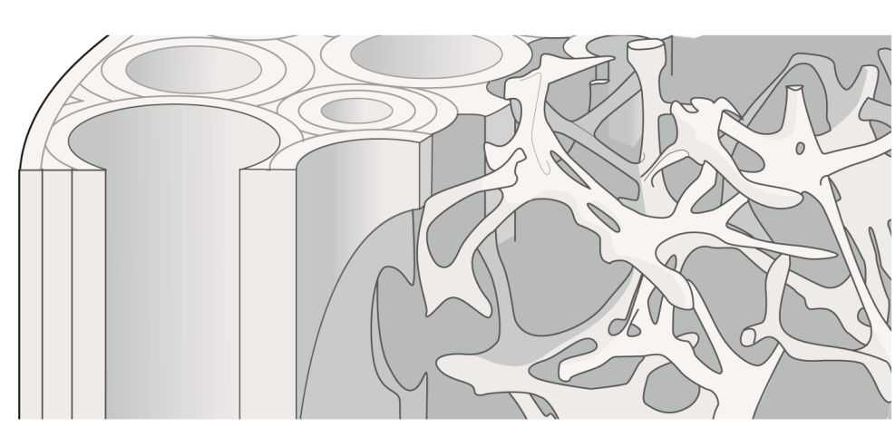
Changes in cortical bone
Increased Haversian canal areas (lacunae formation)
  Increased weakness and predisposition to
  low-energy fractures
Notes:
This diagram of the osteoporotic bone shows a lower bone mass and microarchitectural deterioration of bone tissue; both lead to an increase in bone fragility.
Cortical bone: The thinned cortex has also less quality because of lacunae (haversian canal areas). The more these minute cavities are present, the more porous the bone becomes.
The normal haversian system of bone is dense and compact and is very well organized into a lamellar structure. Normal bone is anisotropic with different properties depending on the direction of load applied in relation to this haversian system’s orientation.
Cancellous bone: The change in bone structure is due to decreasing trabecular thickness, interruption of the trabecular network, reduction of trabecular number, and reduction of trabecular connectivity.
The overall ratio of cancellous bone to cortical bone is increased. The thinner layer of cortex is weaker and is predisposed to low-energy or fragility fractures.

Slide 7
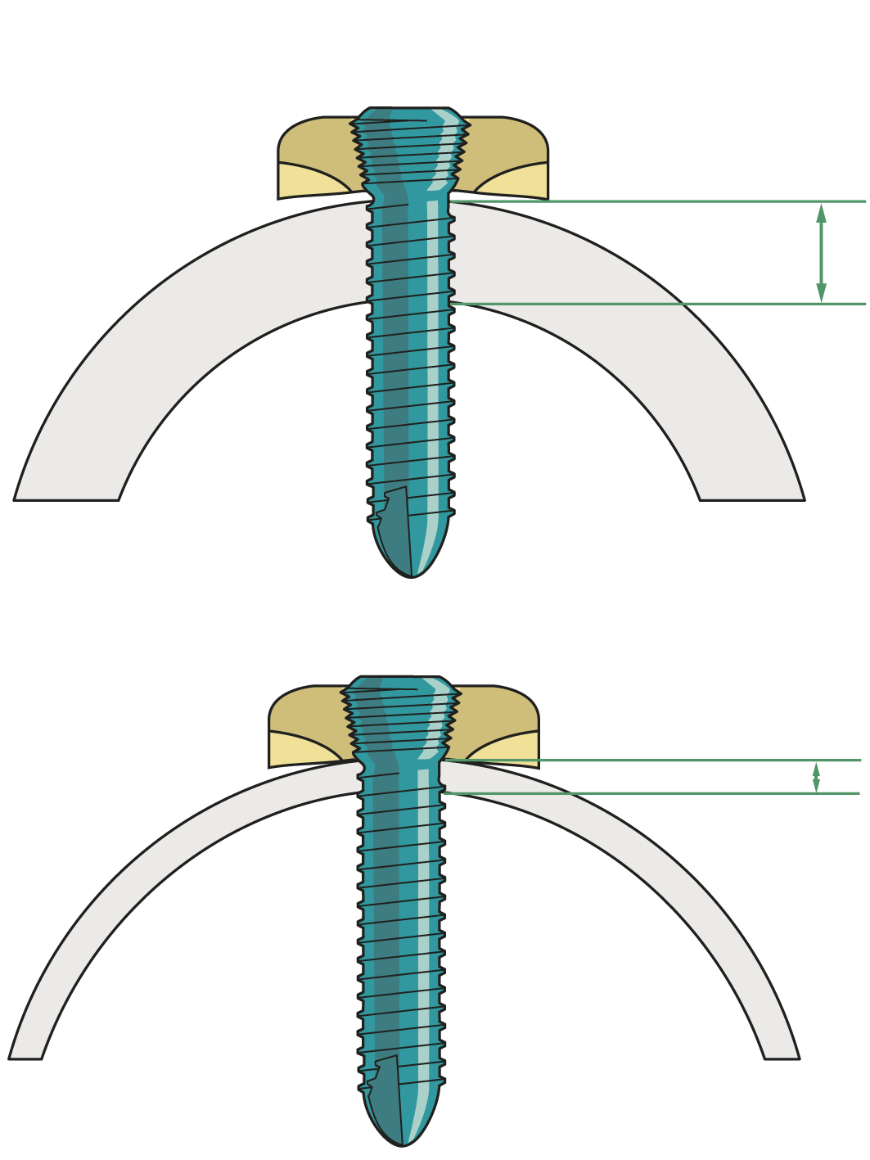
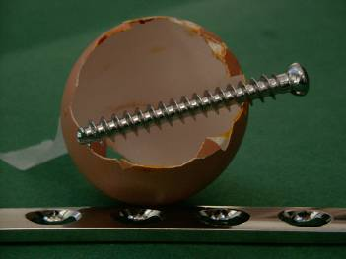
Changes in cortical bone
Decreased thickness
  Less “working length” of implants
Courtesy of Stephan Perren
Notes:
Decreased cortical thickness greatly affects the holding capacity of screws. Osteoporotic cortex could be compared to an egg shell.
The diagrams show the decrease in the so-called working length of the implant (ie, screw) in the osteoporotic bone (decreased thickness of the cortex).

Slide 8
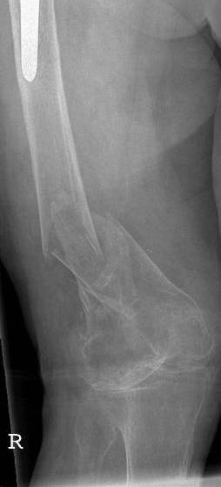
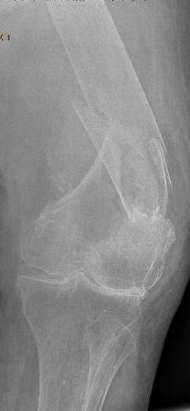
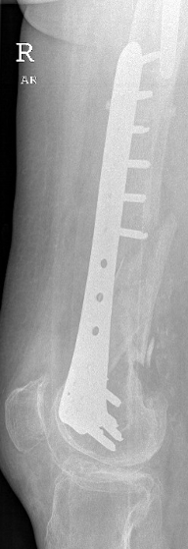
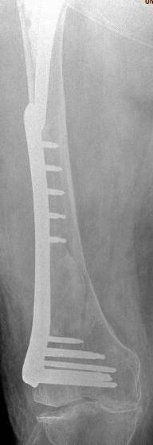
96-year-old woman
Postoperative
Notes:
This is a distal femoral fracture in a 96-year-old female with very thin cortices. Initially, she was treated with a minimally invasive procedure and indirect reduction with a locked plate. For the proximal fixation of the plate only monocortical screws were inserted.
Vancouver type C periprosthetic fracture in very osteoporotic patient is seen here.
This is a typical fracture pattern seen. It is fixed with a LISS plate using all uni-cortical screws.
The fracture has been nicely reduced but only five cortices are engaged proximally in this poor quality bone.
A longer implant could have been used as well to overlap the femoral prosthesis above.

Slide 9
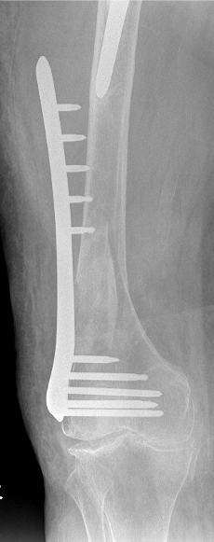
5 days later
Notes:
9
9
Five days later, the plate has pulled off the femoral shaft in a catastrophic failure mode.
The limited cortical engagement of the five unicortical screws is the cause of this problem.
A longer plate and bicortical screws can be used to avoid this type of failure.

Slide 10
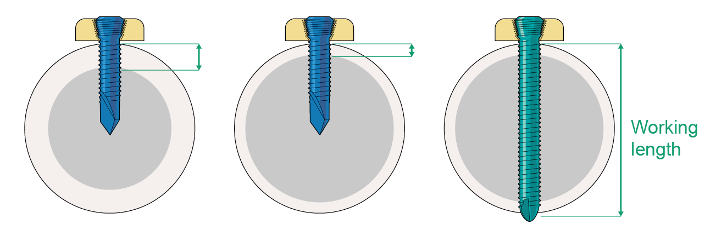
Uni-cortical screws in weak bones are at increased risk of cut out
Better bi-cortical fixation
Long WL
5 days later
Gautier,E and Sommer, Ch. Injury Supp #2, Vol 34, 2003
Notes:
10
10
Five days later, the plate has pulled off the femoral shaft in a catastrophic failure mode.
The limited cortical engagement of the five unicortical screws is the cause of this problem.
A longer plate and bicortical screws can be used to avoid this type of failure.

Slide 11
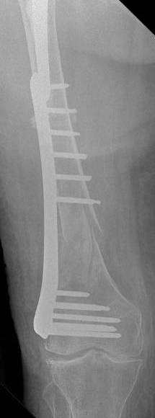
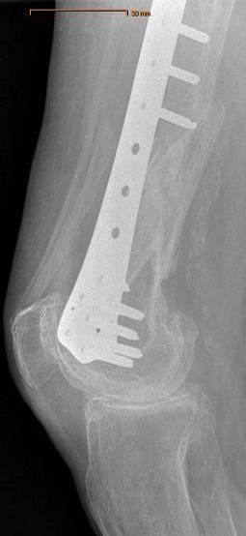
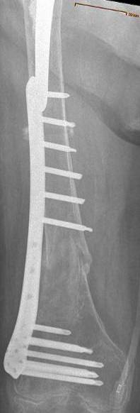
5 days later
postop
10 months postop
Notes:
Only 5 days later and without any violation, the screws have popped out and the plate has pulled off the femoral shaft in a catastrophic failure mode.
The limited cortical engagement of the five only monocortically inserted screws is the cause of this problem.
The problem is resolved by revision surgery applying bicortical screws proximally. The plate has not been changed. A longer plate is a consideration here as well.
More than double the holding force on the plate is now obtained by changing to bicortical screws and 10 cortices are engaged. Uneventful healing of the fracture is demonstrated with an x-ray at 10 months after injury.

Slide 12
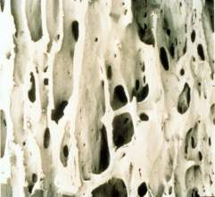
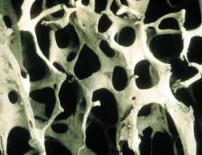
Osteoporotic cancellous bone
Normal
Osteoporotic
Broken cross links
Trabecular thinning
Notes:
The cancellous bone of the metaphyses are greatly effected.
Normal Bone: Has robust trabeculae with multiple strong interconnections. This helps to account for normal bone’s mechanical properties and resiliency.
Alterations in bone metabolism result in thinner cross-link connections in the trabecular bone framework. Many of the interconnections may have become broken with time. The mechanical properties of this bone are considerably weaker as a result.

Slide 13
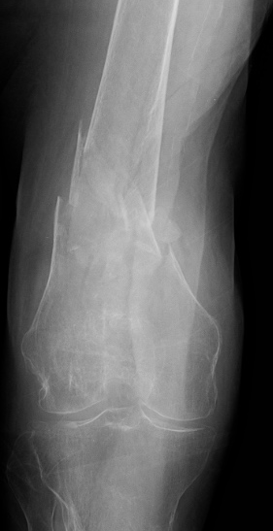
Global demineralization effecting both cortical and metaphyseal bone
Notes:
Direct ramifications on fracture patterns. The thinned, flared metaphysis is completely destroyed and most osteoporotic fractures demonstrate complex fracture patterns with structural compromise through the entire metaphyseal region. The comminution extends distally leaving small epiphyseal segments.
And if we look at the most commonly reported on osteoporotic fractrures we’ll see that they commonly are located at the meta-diaphyseal juntion…..the distal femur,
Complex, metaphyseal fractures are the overwhelming norm in osteoporotic bone
most commonly occurs in the metaphyseal region, with epiphseal extention for sure, but unique in that the metaphyseal injury is most commonly extremely comminuted, comp

Slide 14
Increased outer and inner diameter
Thin, weak cortices
Metaphyseal flaring and loss of trabeculae
77 YO M
Notes:
The radiographs of this 77 YO M, ESRD, CVA fell out of wheel chair demonstrates well these properties
the bone is flared and metaphyseal a greater distance of the extremity….these characteristic have direct ramifications on the way the bone fractures. Complex, metaphyseal fractures are the overwhelming norm in osteoporotic bone
most commonly occurs in the metaphyseal region, with epiphseal extention for sure, but unique in that the metaphyseal injury is most commonly extremely comminuted, comp

Slide 15
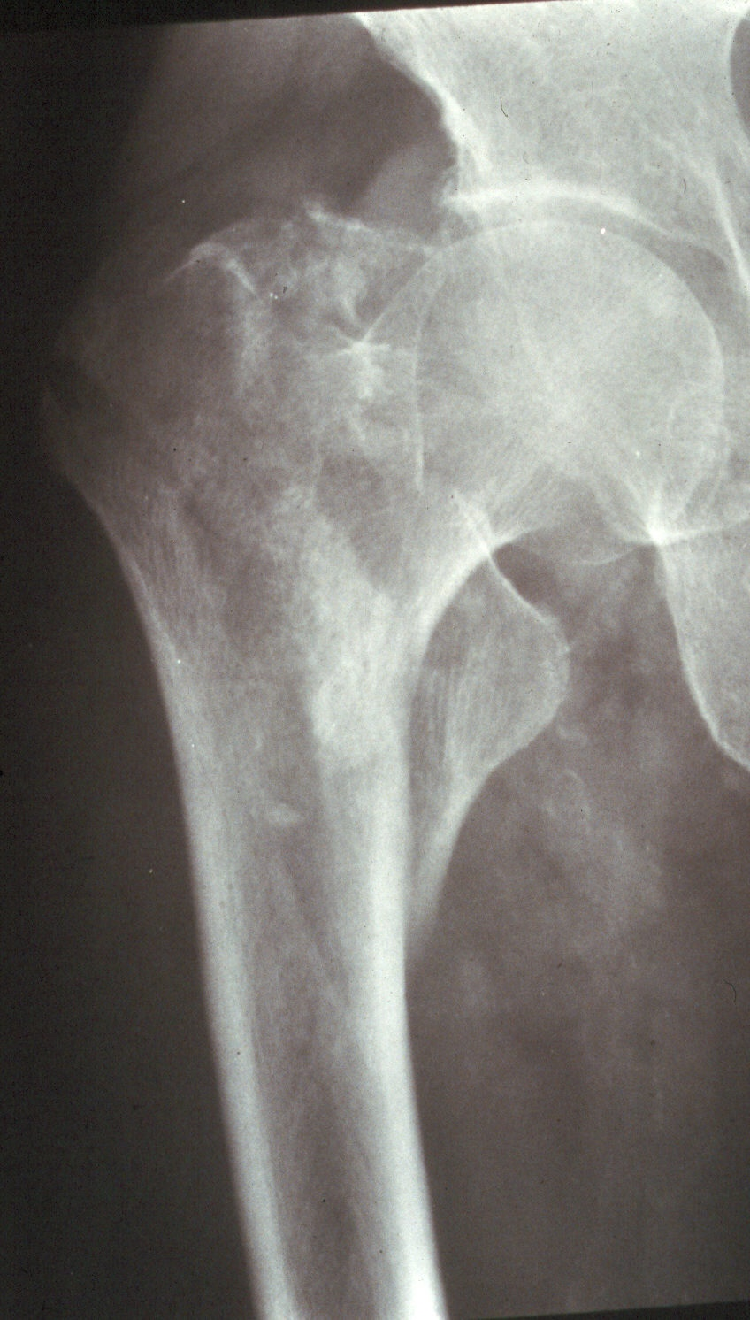
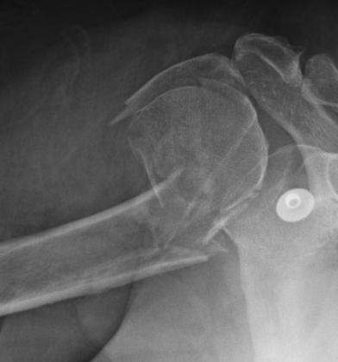
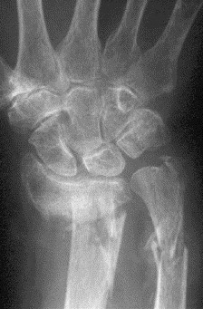
Extensive metaphyseal comminution
Complex small/short articular segments
Notes:
The proximal femur, the proximal humerus, the distal radius…at the flared thinned metaphysis. The comminution is often so extensive as to result in mechanical compromise of both columns not unlike the bone loss cases we saw yesterday with dr. lees 6cm medium defects…..and there is often a complete loss of structural support of load.
So answer 1a towards the question…why do they fail, well, the fracture patterns themselves are challenging and lead to predictable failures.
Yes, epiphyseal extention is common but not distinctly different than the younger patients. But the methaphyseal involvement tends to be complete, anhilating the entire metaphseal region and leaving very small ephiphseal fragments. Simple fractures and diaphyseal fractures are remakedly uncommon. So towards answering the question why are these injuries technically challenging? We the characteristics of osteoporotic bone lead to very difficult fracture patterns to reduce and to stabilize…bringing us to the second problem associated with the weak character of osteoporotic bone

Slide 16
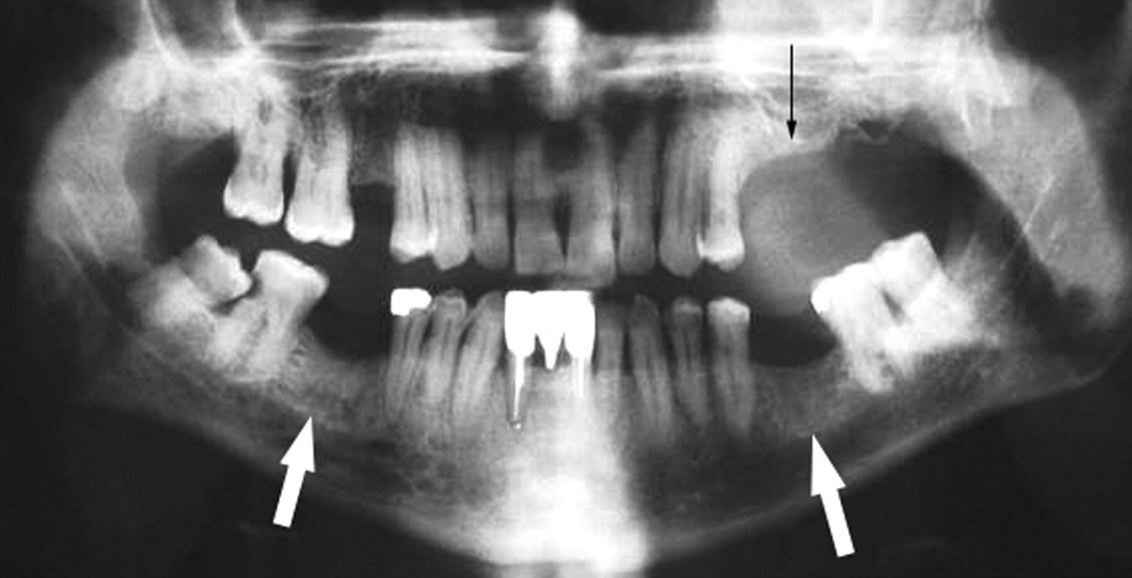
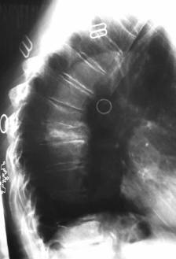
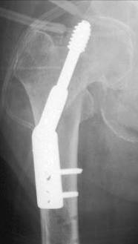
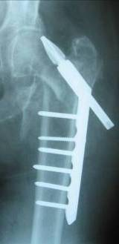
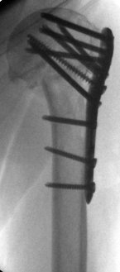
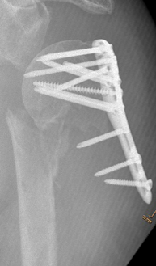
Signs of poor bone quality
Multiple vertebral compression fractures
Previous hip, radial, or shoulder fractures
End-stage renal disease
Steroid or anticonvulsant therapy
Notes:
Not being able to measure local bone quality directly, other signs of poor bone quality may be considered/looked at. For example, poor dentition is a very accurate indicator for bad bone quality, because teeth are formed similar to bone.
A complete history and physical examination can yield important clues that your patient may have extremely poor bone quality. This may alter the surgical plans you make for the fixation in osteoporotic bone. If there is a history of prior fixation failures, consider a completely different tactic to avoid falling into the same trap your colleague encountered before.

Slide 17
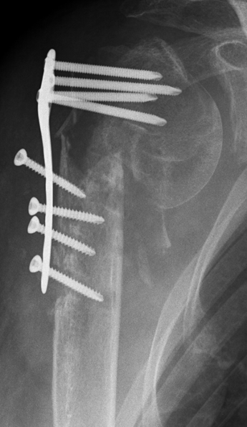
Consequences
More fractures
Operative complications
Failure of fixation
Secondary loss of reduction
Latrogenic fractures
Spontaneous peri-implant
fractures
Notes:
It is difficult to produce secure fixation of the implant to the bone. Bone mineral density correlates linearly with the holding power of screws.
Failure is not uncommon. This may be very frustrating to the surgeon who has tried his best to apply the implants correctly. Often a different approach to this type of bone is required for a successful outcome.
If the load transmitted at the bone-implant interface exceeds the strain tolerance of osteoporotic bone, microfracture, and resorption of bone with loosening of the implant and secondary failure of fixation will occur.
The common mode of failure of internal fixation in osteoporotic bone is bone failure rather than implant breakage. Furthermore, the healing process may be prolonged, because of decreased healing capacity in osteoporosis.
The standard screw uses the tensile forces generated by the screw’s thread to compress the plate to the bone. The plate is stable as long as friction exists between the bone and the implant. When the screw loosens or pulls away from the bone due to poor fixation, this frictional fit with the bone is lost and the construct will rapidly go on to fail.
In the following part of this lecture specific implant characteristics are discussed with the focus on problems/challenges with fixation in osteoporotic bone.

Slide 18
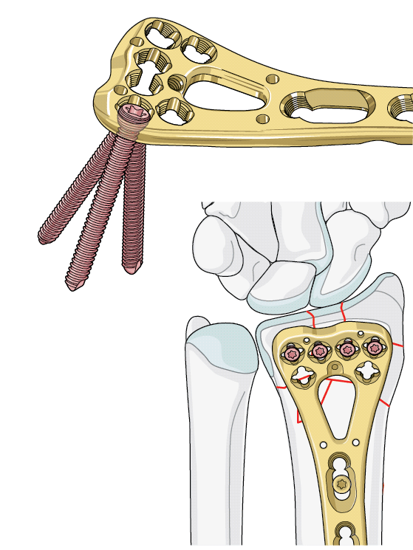
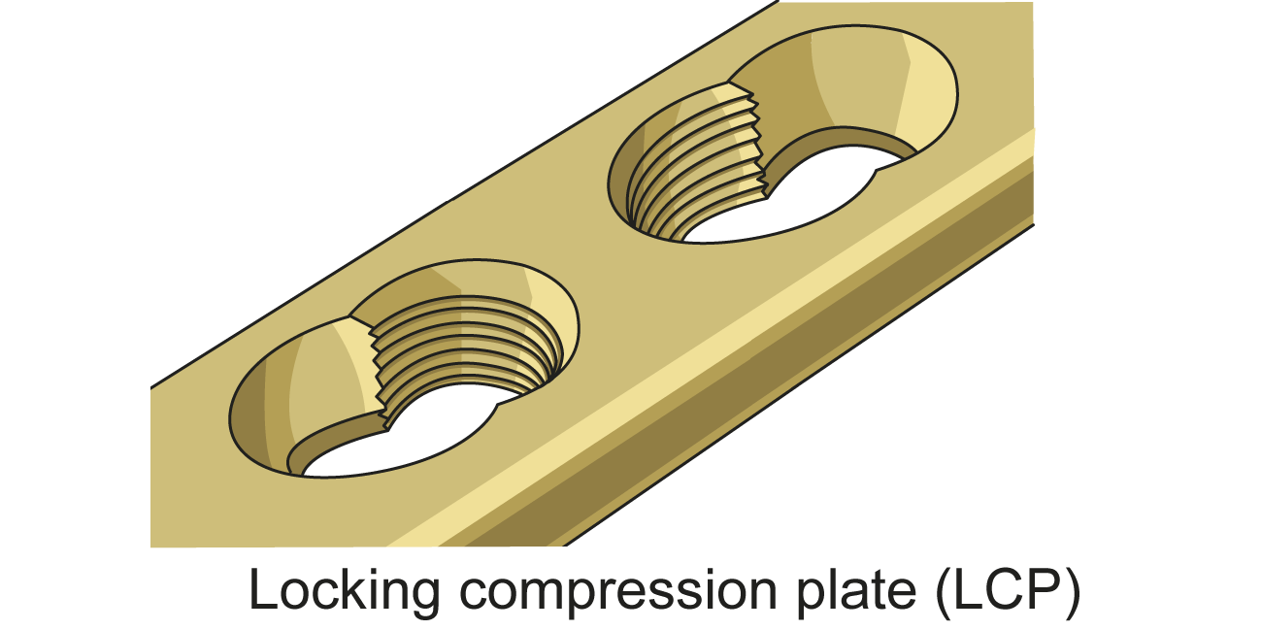
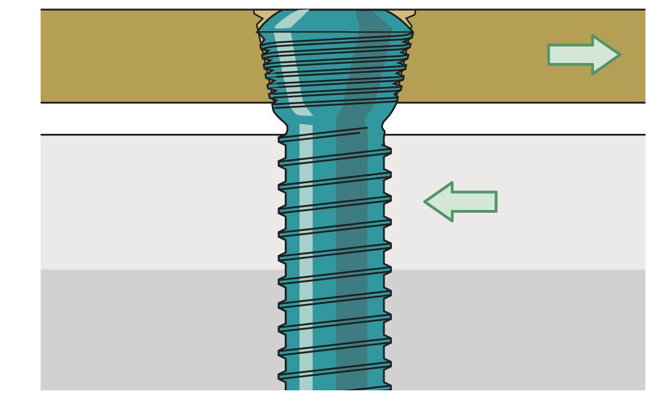
Implant characteristics—angular stability
Locking plates (internal fixator principle)
Angular stable locking screws for nails
Lock Variable Angle Screws
Notes:
The second specific implant feature for osteoporotic bone is angular stability. Angular stability can now be achieved with plates and nails.
Locking compression plate (LCP)
The LCP screw/plate system is a combination of a locked noncontact plate/locked internal fixator and a conventional compression plate. This system allows a fracture specific osteosynthesis—fracture stabilization with different fixation principles and methods.
LCP with combination hole
The LCP combination hole consists of two proven elements:
One half of the hole has the design of the DCP/LC-DCP (dynamic compression unit (DCU) for conventional screws).
One half is conical and threaded to accept the matching thread of the locking head screw providing angular and axial stability. The fixed angle created between the plate and screw is not disturbed by poor bone quality.
The LCP combination hole allows internal fixation to be achieved by inserting either conventional screws (into the unthreaded part of the hole) or locking head screws with angular stability (into the threaded part of the figure-of-eight hole). The locking head screw (LHS) is inserted at a right angle to the plate.
Locking head screws (LHS) provide angular stability and their core diameter is larger; both advantages that provide higher pullout strength and overall strength. This is especially helpful in metaphyseal bone.
Locked screws do not toggle, there is no friction on the bone. The strength is distributed evenly.
LCP can be inserted with minimal exposure of the fracture site.
Angular Stable Locking System (ASLS)
This new system allows for the first time angular stable interlocking of intramedullary nails. Toggling of the screws/bolts is no longer an issue.

Slide 19
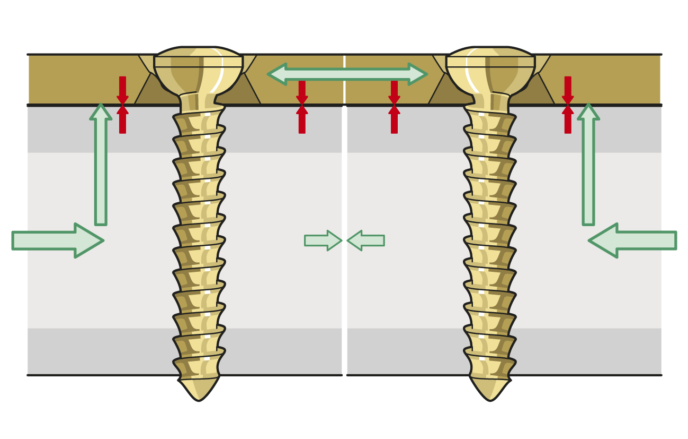
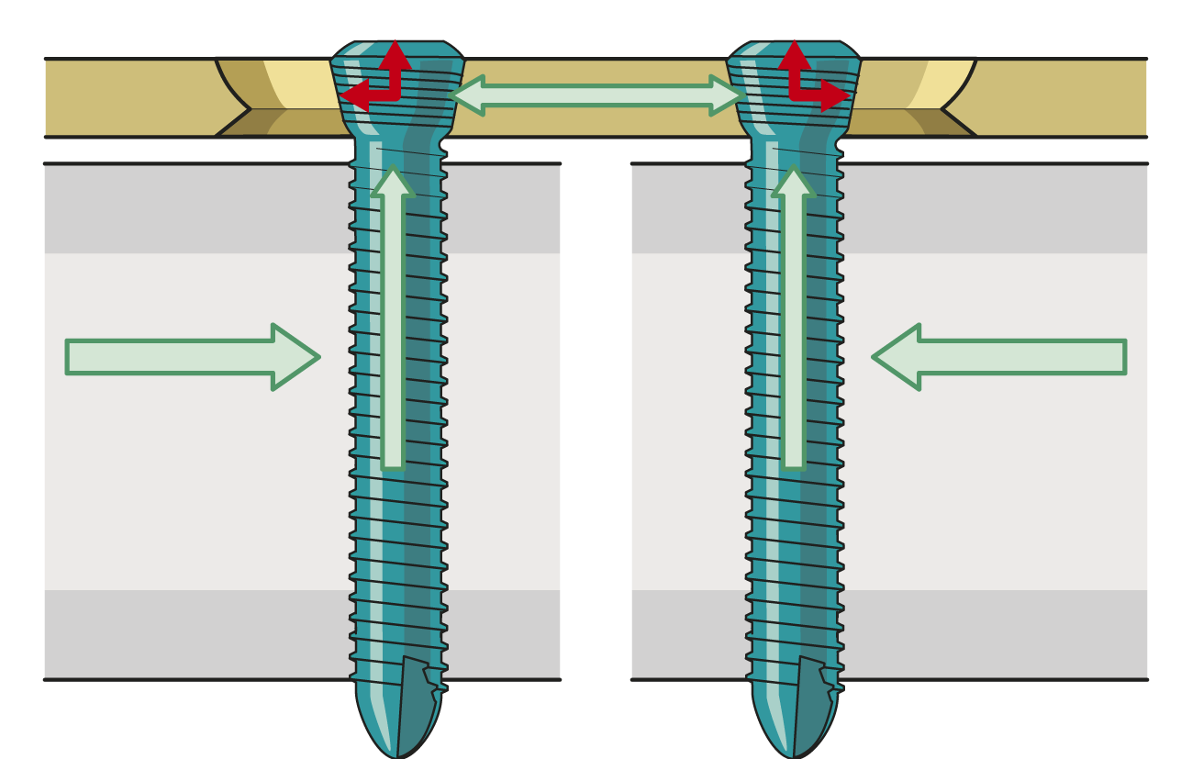
Implant characteristics—biomechanics
Conventional screws
Screws loaded in tension
Plate-bone friction
Compression at fracture site
Locking head screws (LHS)
Screws loaded in shear
No compression of fracture
Notes:
There are fundamental differences between the loading of conventional screws and locking head screws (LHS).
The mechanical principles of fixation required in the decision-making process:
Plate fixation on the bone with conventional screws (compression, friction) or with LHS (noncontact plate).
Interfragmentary compression method to achieve the principle of absolute stability versus locked splinting method to achieve the principle of relative stability.

Slide 20
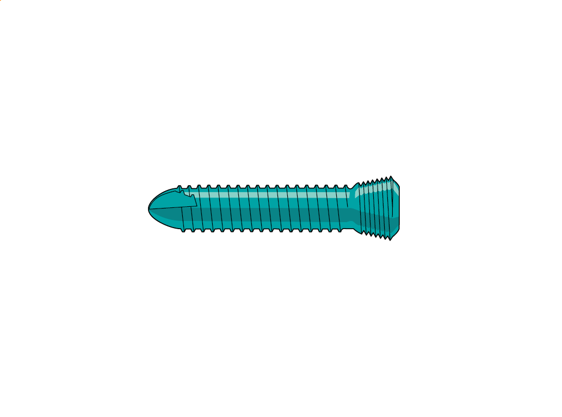
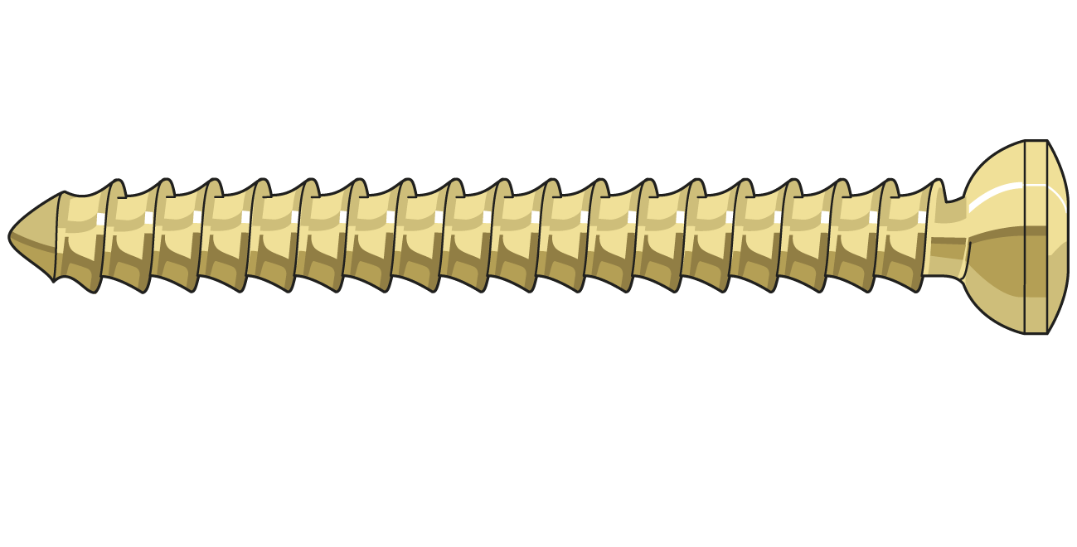
Specific implant characteristics—screw design
Increased bone-implant interface by improved screw designs
Subsidence strongly depends on load-bearing area
Notes:
How can the very limited bone-implant contact area, as shown in the previous slide be increased?
The design of the LHS with dull edges and low thread depth increases the anchorage of the implant in the bone and offers superior subsidence resistance compared to conventional cancellous bone screws.

Slide 21
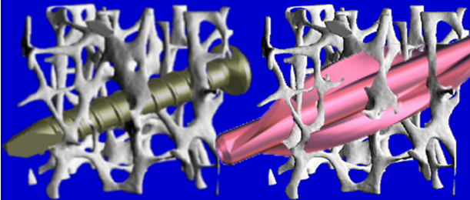
Specific implant characteristics—blades
Increased bone-implant interface by blades instead
of screws—contact area of +53%
Notes:
Blades instead of bolts (in nailing) increase the contact area between the bone and hardware.

Slide 22
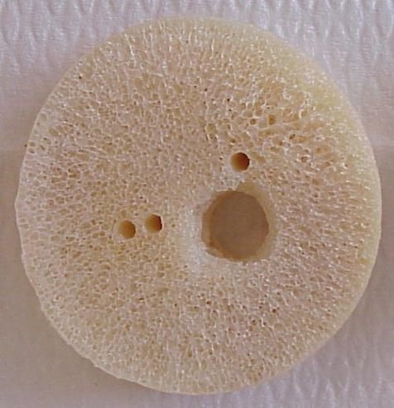
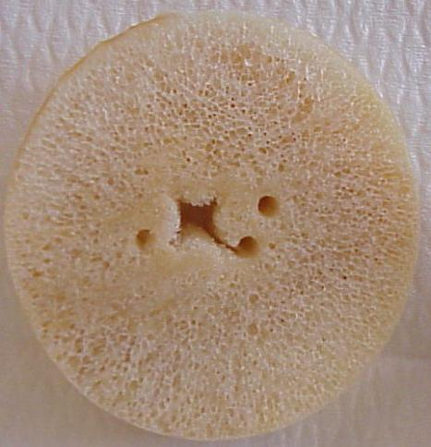
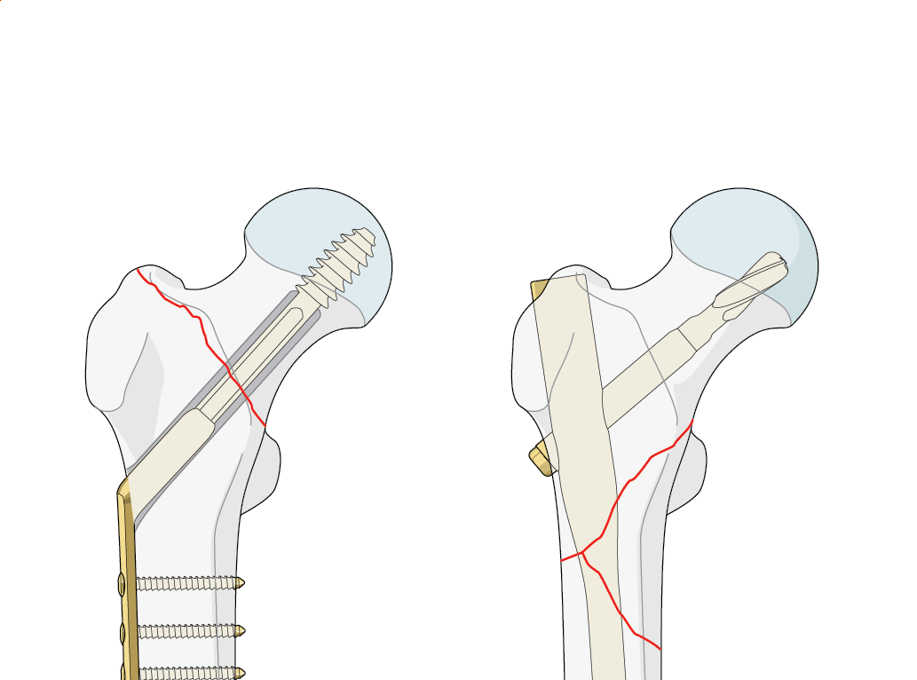
Specific implant characteristics—Helical blades
A = 81.3 mm²
A = 81.3 mm²
A = 26.7 mm²
A = 26.7 mm²
Notes:
Blades instead of bolts (in nailing) increase the contact area between the bone and hardware.

Slide 23
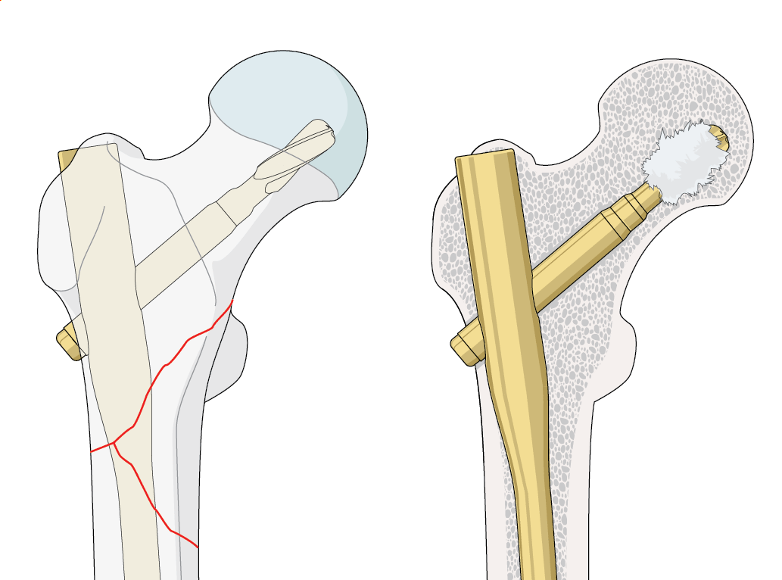
Augmentation

Slide 24
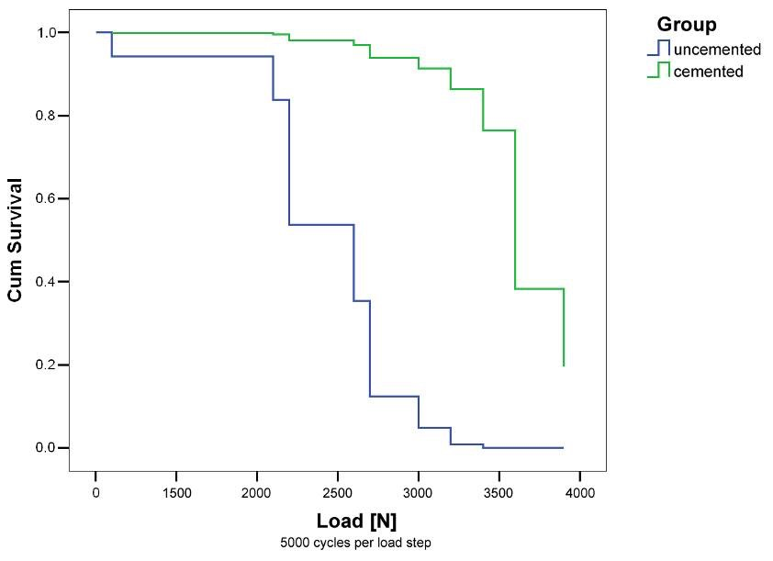
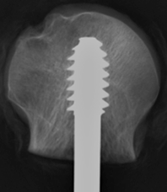
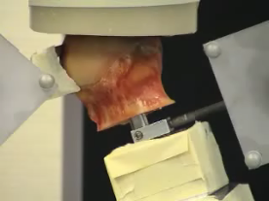
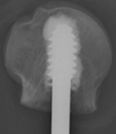
Von der Linden P, Gisep A, Boner V, Windolf M, Appelt A, Suhm N. Biomechanical Evaluation of a New Augmentation Method for Enhanced Screw Fixation in Osteoporotic Proximal Femoral Fractures. J Orthop Res. 2006 Dec;24(12):2230-7.
Notes:
Experimentally, it can be shown that augmentation of dynamic hip screws with only small amounts of cement yielded a significantly better failure mode that screws without augmentation.

Slide 25
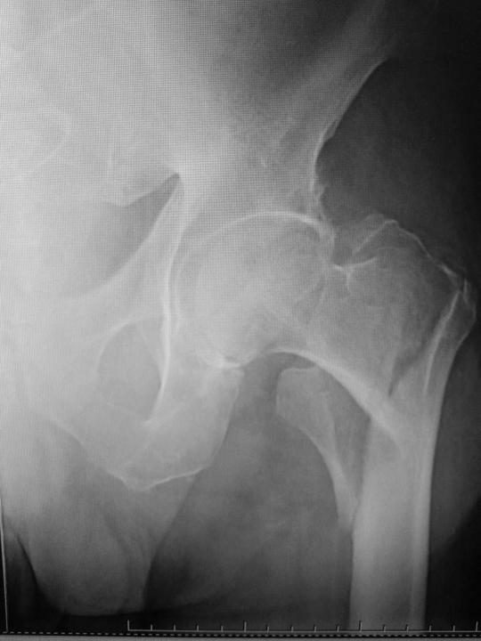
83 YO, F
Fell at home

Slide 26
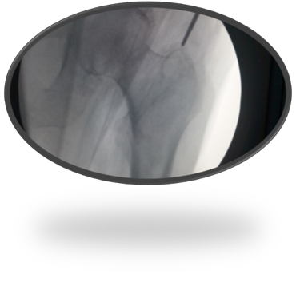
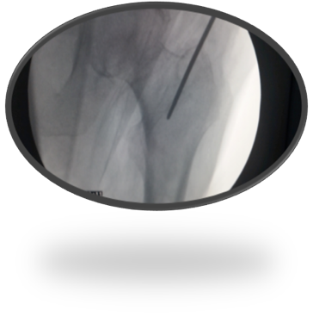







Notes:
The implant-bone interface may also be enlarged by insertion of augmentation material. This technique is probably most often applied in spine surgery not only for vertebroplasty, but also for improving anchorage of transpedicular screws in the bone.

Slide 27

Caso 2

Slide 28
Applied fixation principles in osteoporotic bone
Indirect, functional, not anatomical reduction
Relative instead of absolute stability
Locked splinting with long plates or nails
Load distribution, no peak stresses
No interfragmentary compression
Secondary bone healing with callus formation
No mixture of principles and methods
Notes:
This part of the lecture will address the most important fixation principles applied to clinical examples.
Defined here are the most important rules of fracture fixation in osteoporotic bone: relative rather than absolute stability is usually better in osteoporotic bones.
That implies a couple of consequences that are listed here and demonstrated in the following slides.

Slide 29






Functional reduction
70-year-old woman
Notes:
Periprosthetic distal femoral fracture in a 70-year-old female after a fall at home. Uneventful bone healing after a functional reduction (axes, rotation, length) and locked splinting with a long LISS plate.

Slide 30




Relative instead of absolute stability
79-year-old woman
Notes:
Mix of principles: absolute stability (lag screw, cerclage wires, too many screws in the plate) instead of relative stability.
This fracture of the femoral shaft below a PFN was treated by the surgeon achieving anatomical reduction.
The fracture of the distal femur occurred 2 years after nailing of a proximal femoral fracture (proximal femoral fracture has completely healed).

Slide 31




5 weeks postoperatively
Notes:
Fracture of the plate 5 weeks later.
The problem was resolved with the removal of the “old” proximal nail and insertion of an AFN. Massive callus formation.

Slide 32



Locked splinting with long plates or nails
67 YO F
THA 6 y before
PPF 9 month ago

Slide 33







Slide 34



Splinting with a long plate
Bending forces equally distributed
No peak stresses

Slide 35

85 YO, F
Femoral neck fr 2 y ago
Fell at home
Caso R. Pesantez

Slide 36


Load distribution, no peak stresses

Slide 37





Slide 38



No interfragmentary compression
Secondary bone healing with callus formation

Slide 39
Take-home messages
Age and osteoporosis affect cortical and trabecular bone in different ways
Surface contact area between implant and bone most important for implant anchorage
Diaphyseal fractures:
  Relative stability reduces stress concentration
  Fracture splinting with long locking plates
Metaphyseal fractures:
  Locked plates
  Impaction
  Blades or other higher surface contact area implants are preferred
Notes:
These points represent the essence of this talk.
Cortical bone becomes thinner with a larger diameter. This increases the likelihood of screw pull-out. Cancellous bone trabeculae become thinner, less interconnected and fewer in quantity.
It is usually impossible to achieve traditional compression osteosynthesis in osteoporotic bone.
The surgeon must use all options afforded by new implants with the time honored technique of fracture reduction to achieve success.
Augmentation is another technique that can be used for very poor quality of bone and will certainly be a solution in the future.

