Slide 1
Classification of periprosthetic fractures
Prepared by Bas Masri
Notes:
Author: Bas Masri, MD, FRCSC
Approved by AO Trauma and AO Recon Periprosthetic Fractures Curriculum Taskforce and AO Recon Hip and Knee Curriculum Taskforce (2020)

Slide 2
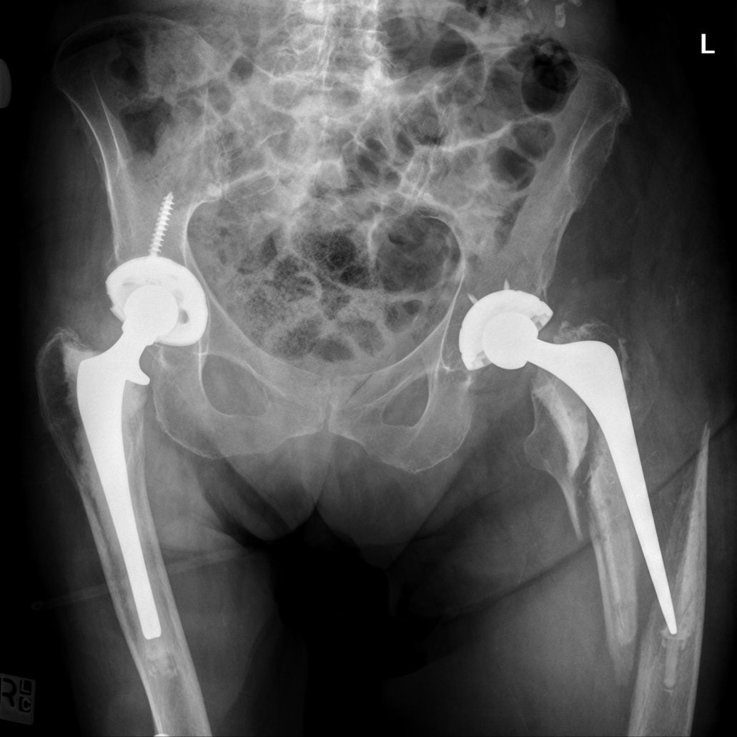
Learning objectives
Apply the Unified Classification System (UCS)
Appreciate the value of a classification system

Slide 3
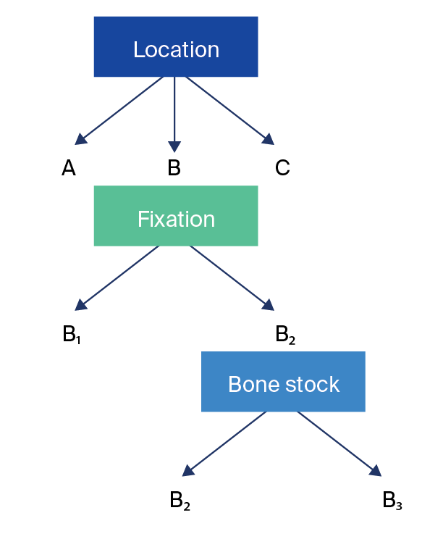
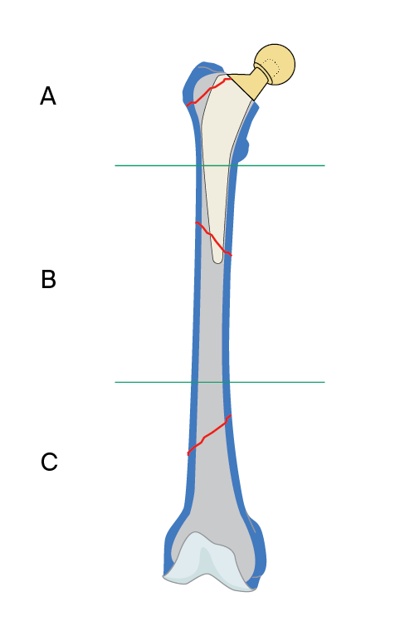
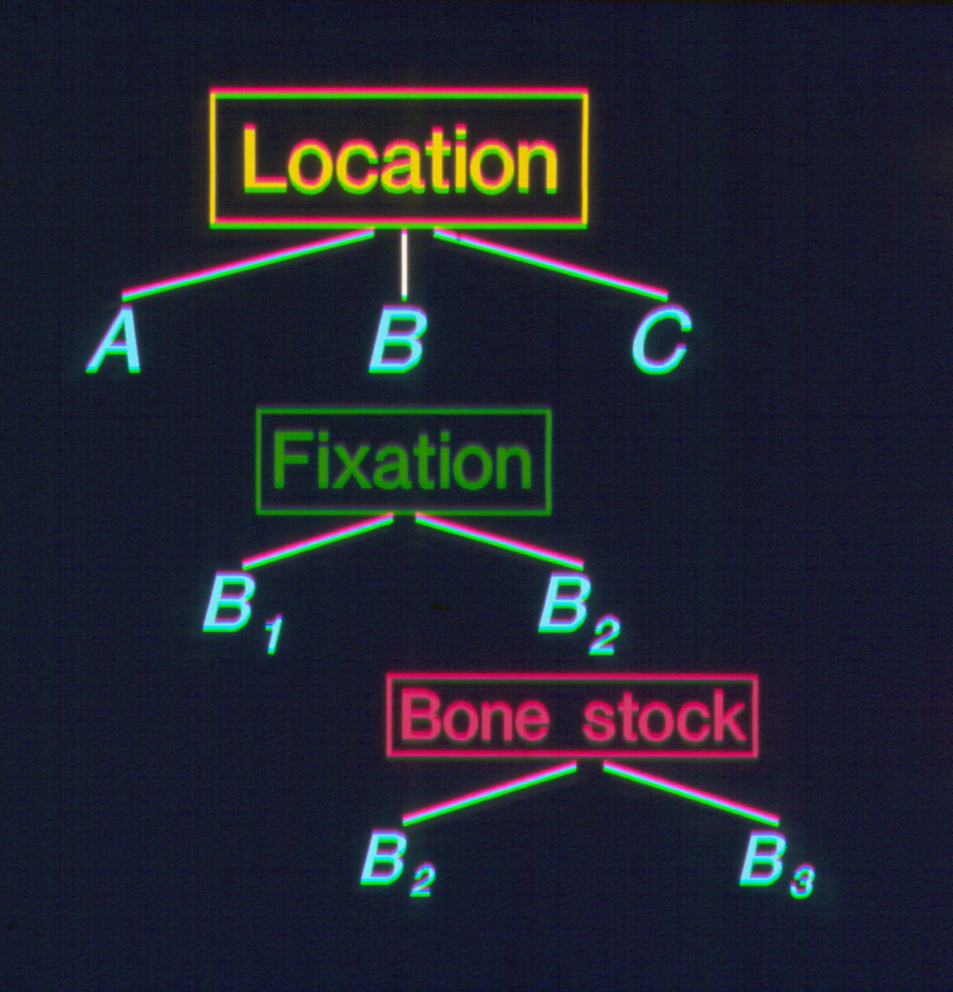
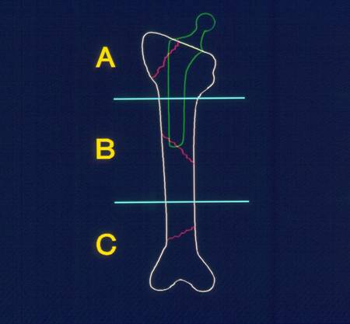
The Vancouver Classification (Duncan & Masri 1995)
4%
9%
16%
39%
32%
Notes:
Reference:
Duncan CP, Masri BA. Fractures of the femur after hip replacement. Instr Course Lect. 1995;44:293–304.

Slide 4
The Unified Classification System
Bringing the Vancouver Classification to other joints and bones

Slide 5
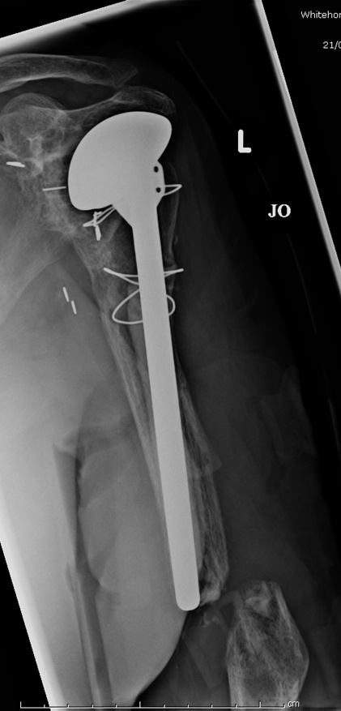
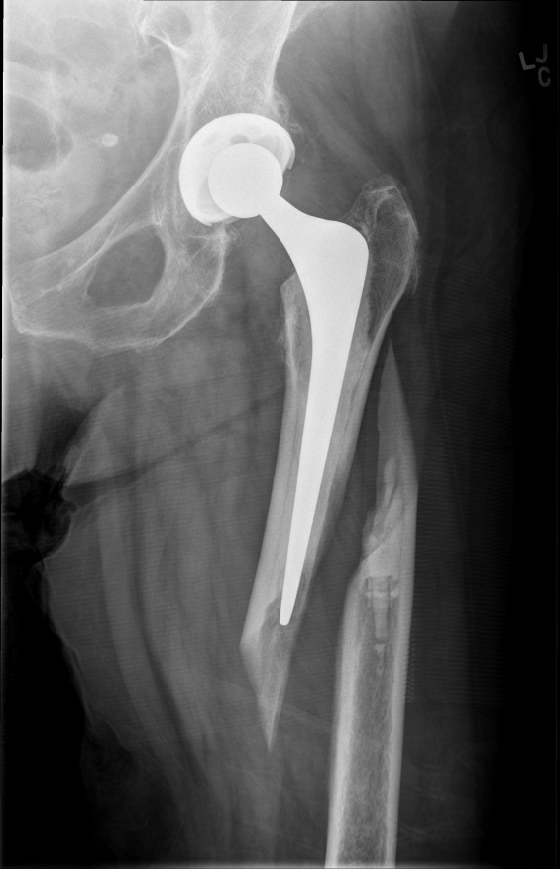
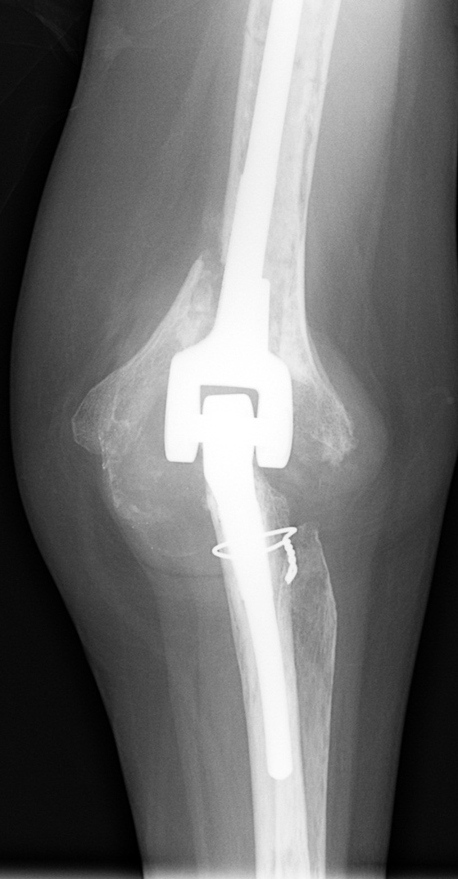
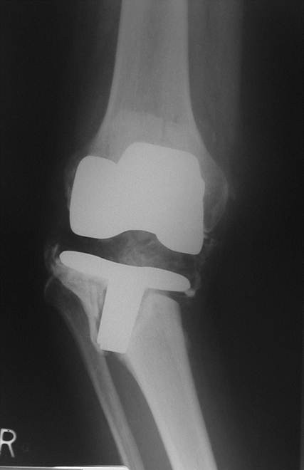
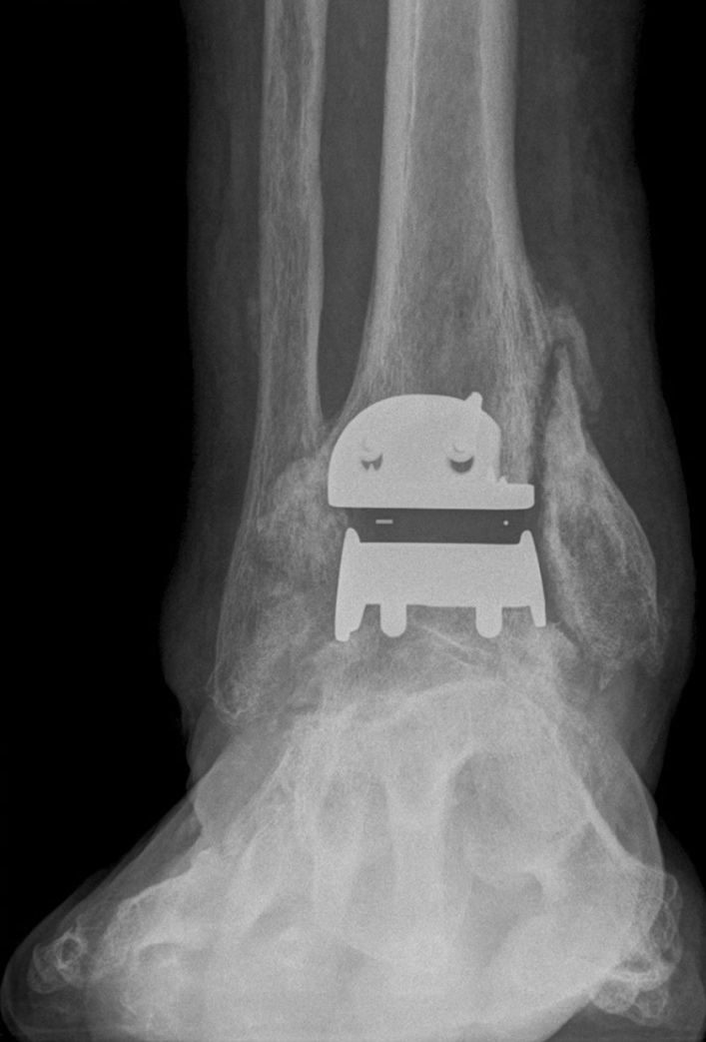
Unified Classification System
Hip
Knee
Shoulder
Elbow
Ankle
Wrist
Pelvis

Slide 6
Unified Classification System—mnemonic
Type A A pophyseal
Type B B ed of implant
Type C C lear of implant
Type D D ividing implants
Type E E ach of two bones
Type F F acing an implant

Slide 7
Type A
Fracture of an Apophysis or protuberance of bone to which a tendon or ligament is attached

Slide 8
Type A
Greater trochanter
Lesser trochanter
Greater tuberosity
Lesser tuberosity
Tibial tuberosity
Coracoid process
Acromion process
Humeral epicondyles
Olecranon process
Coronoid process
… and poles of patella

Slide 9
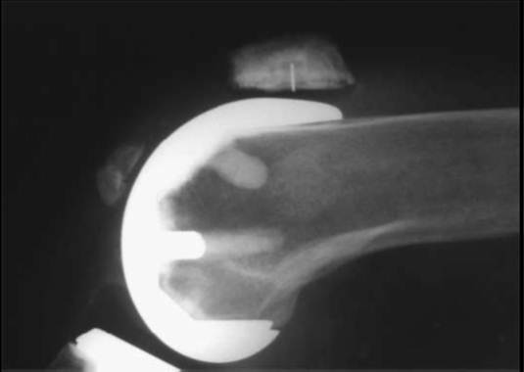
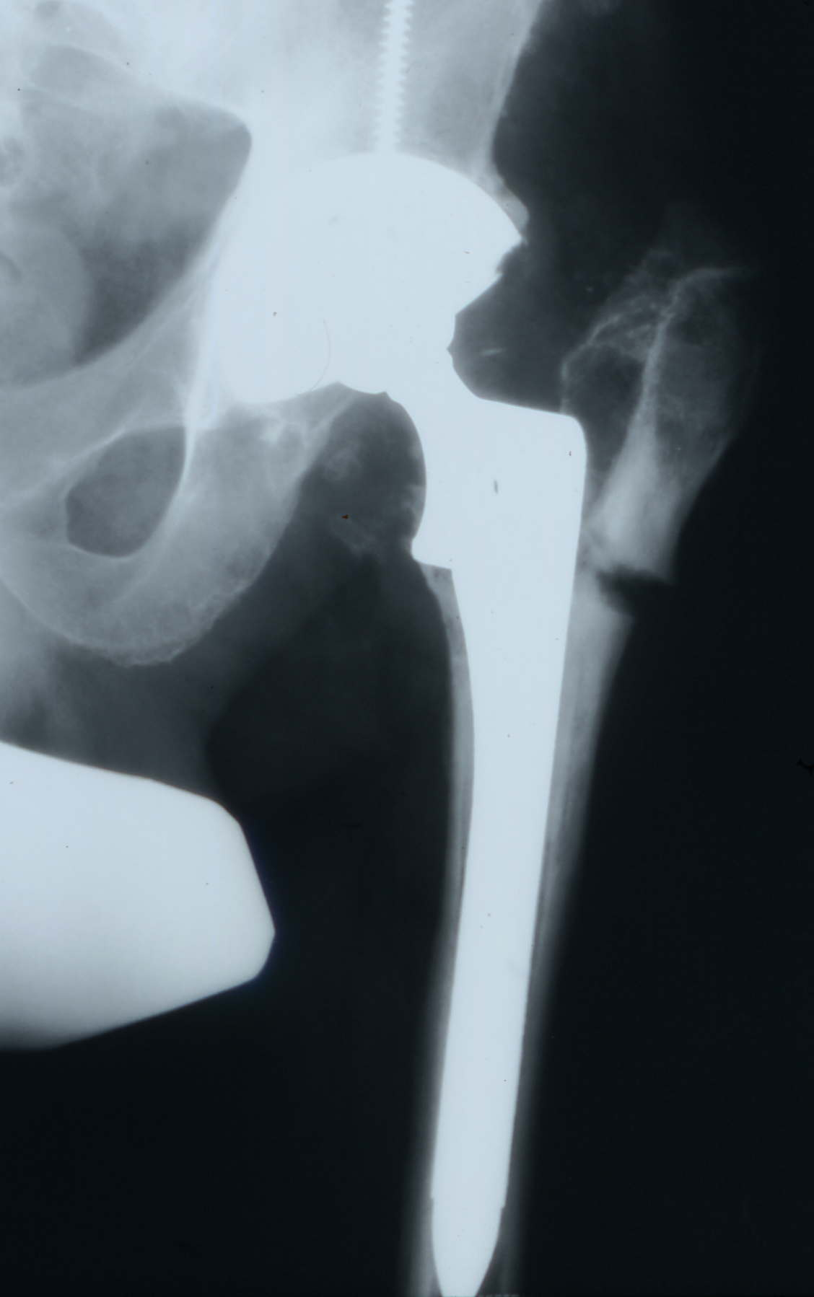
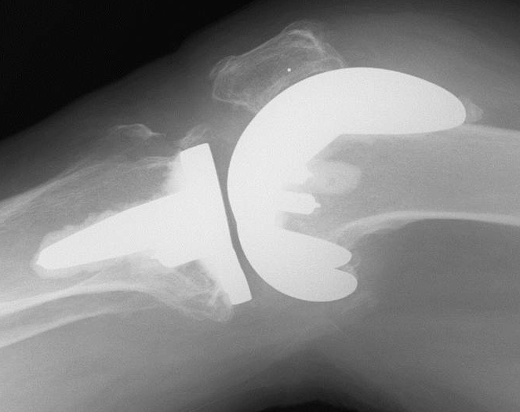
Type A

Slide 10
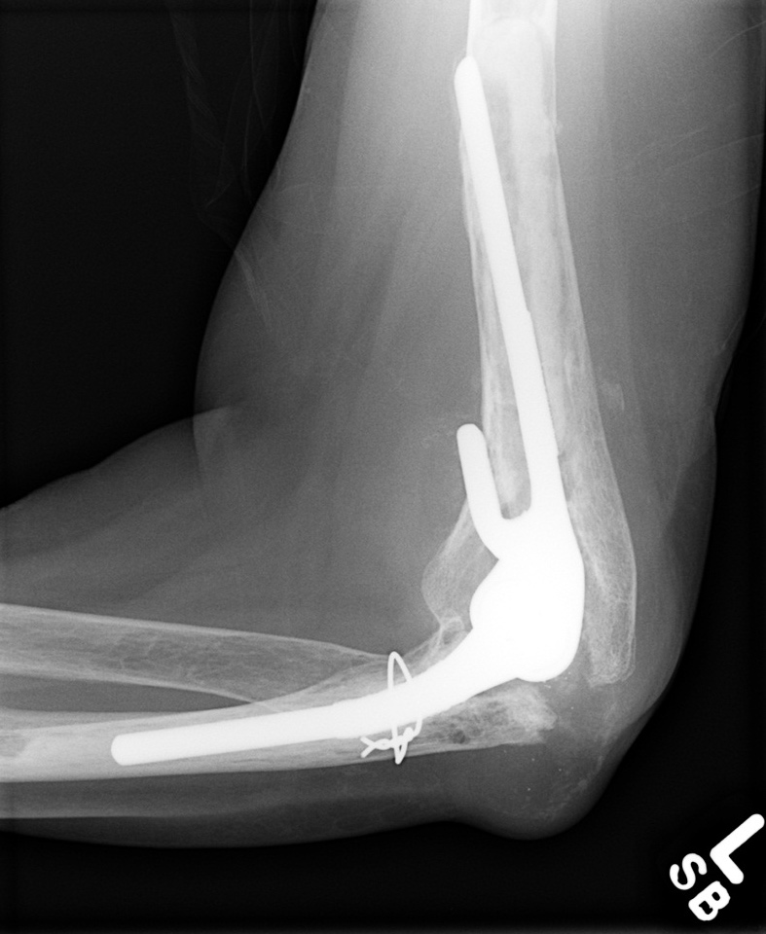
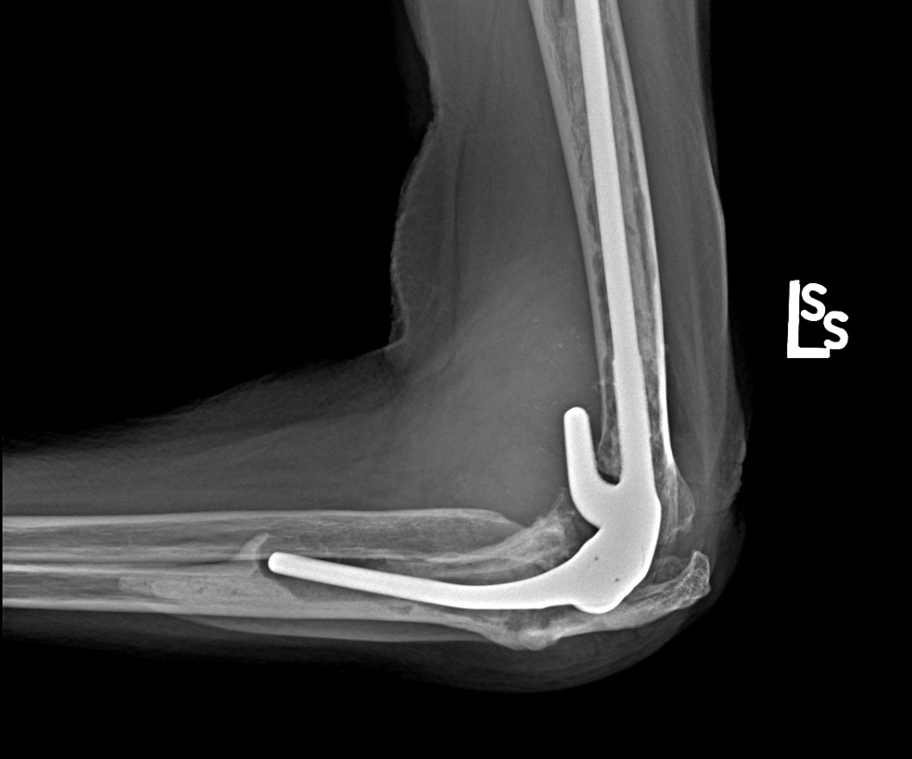
Type B
Fracture involving the Bed supporting the implant

Slide 11
Type B
Needs to be subclassified
B1: Implant well-fixed
B2: Implant loose
B3: Loose and poor bone

Slide 12
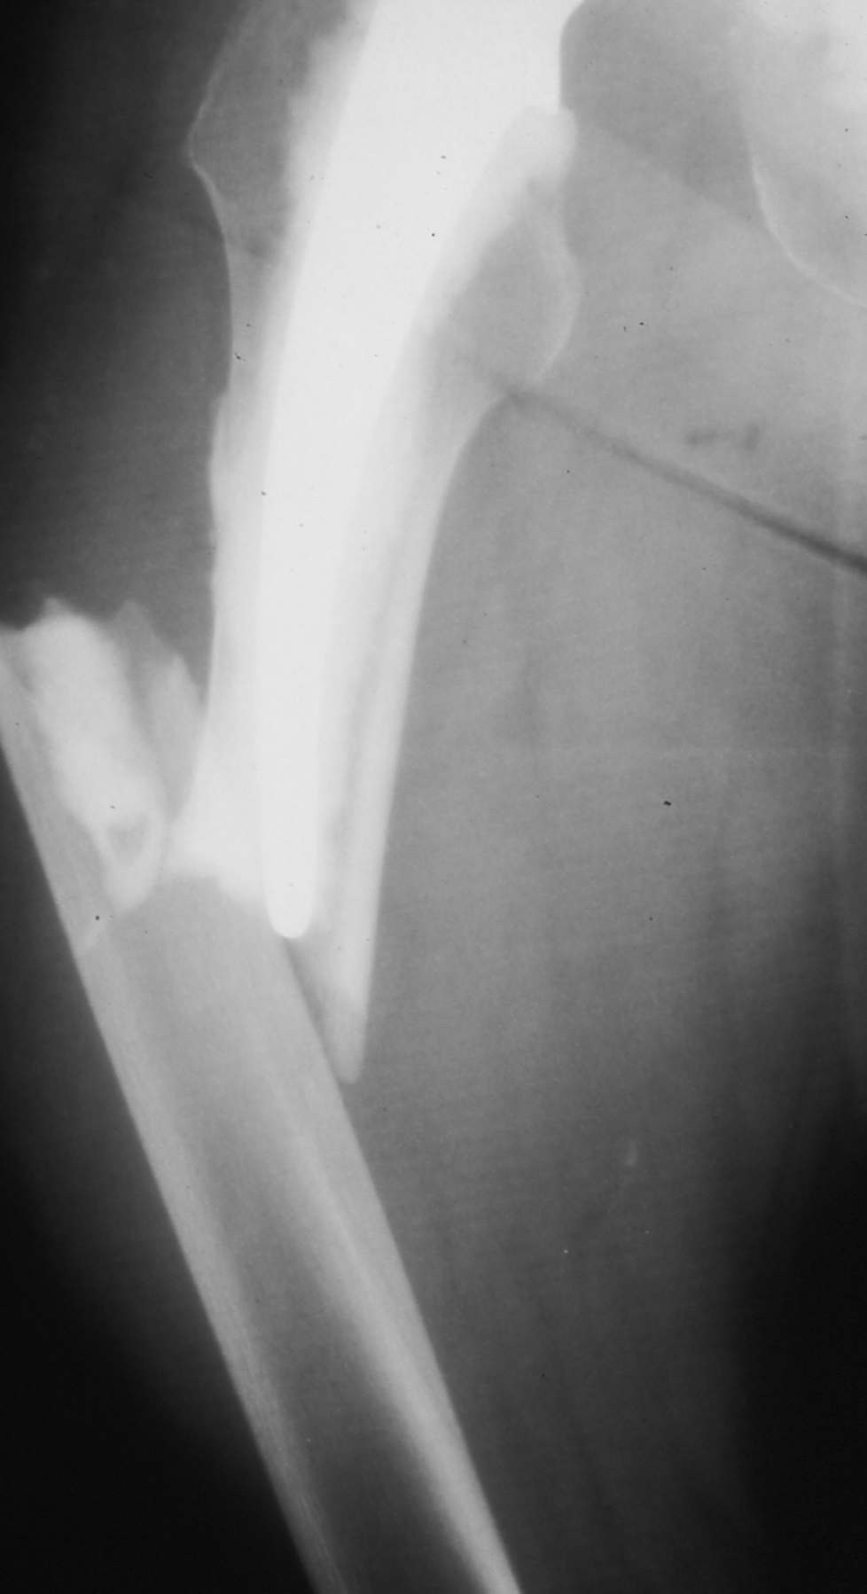
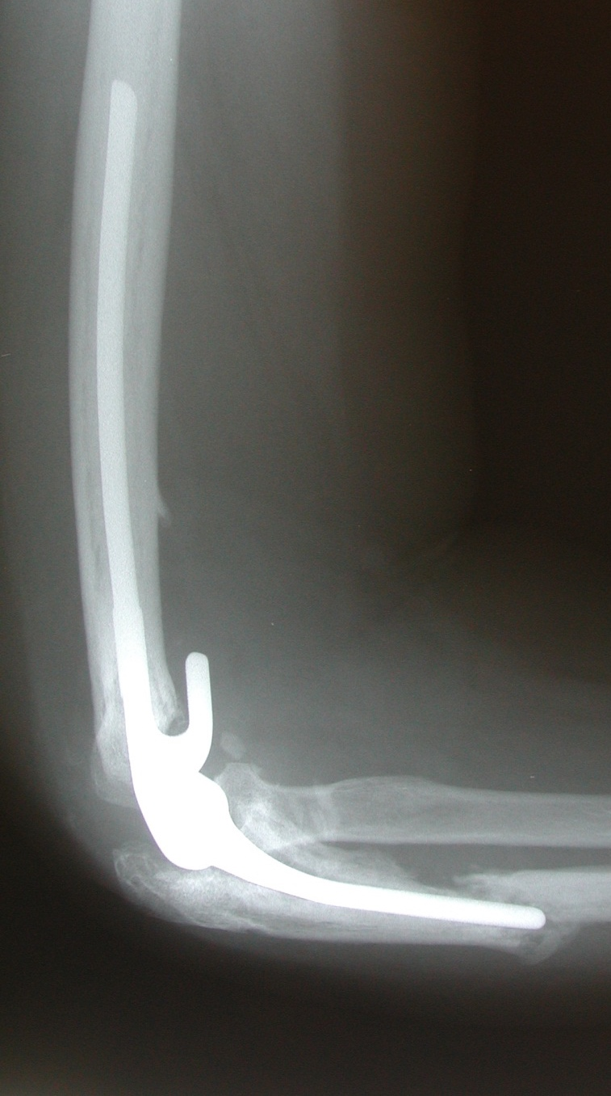
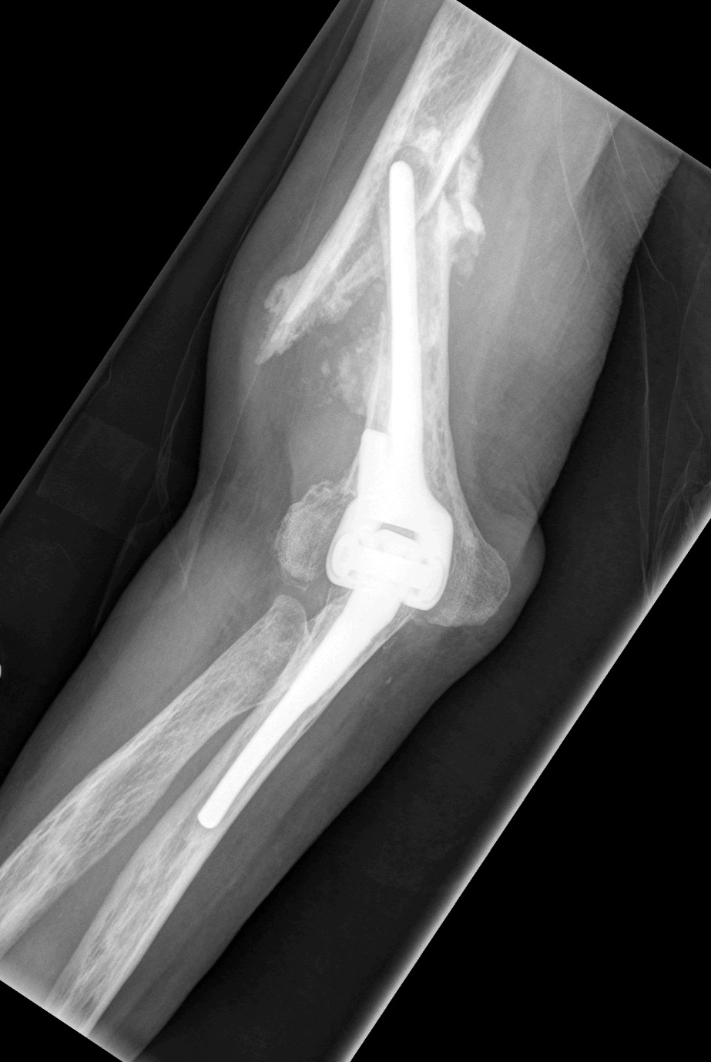
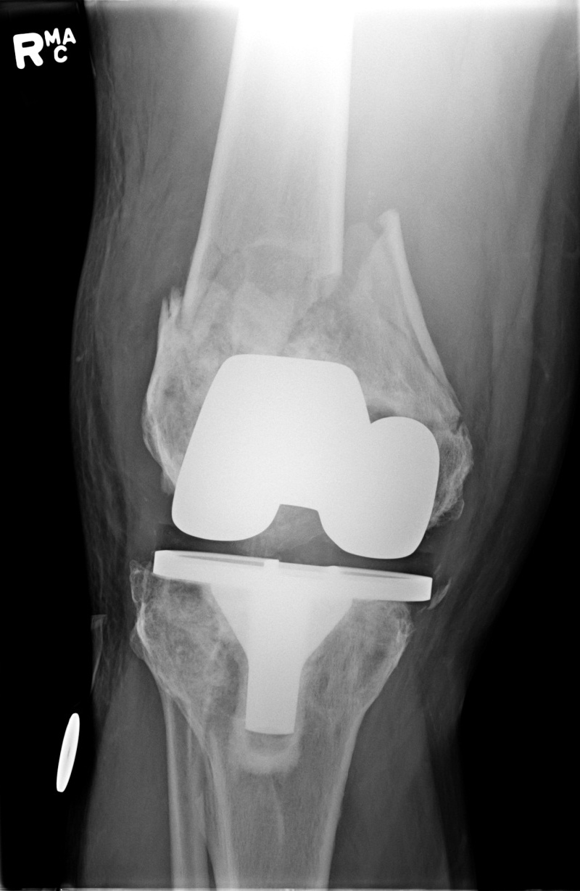
B3
B3
B2
B1

Slide 13
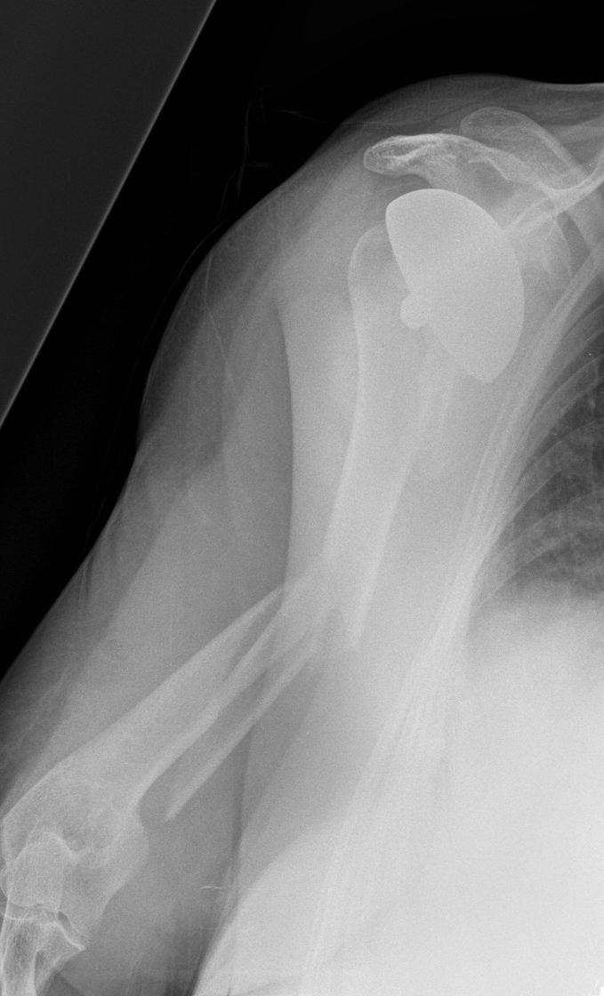
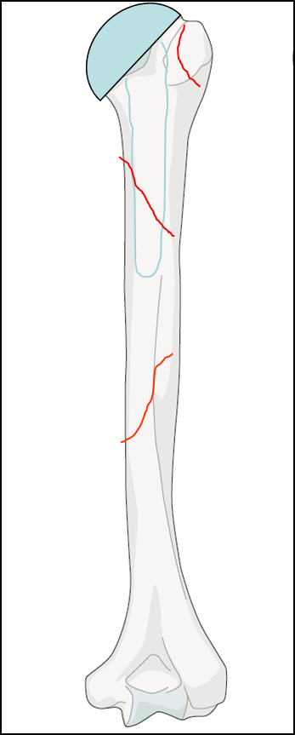
Type C
Well Clear of the implant
Distant enough that the implant can be ignored and the fracture treated independently

Slide 14
Type D
Fracture Dividing one bone supporting two replaced joints:
Femur
Tibia
Humerus
Radius

Slide 15
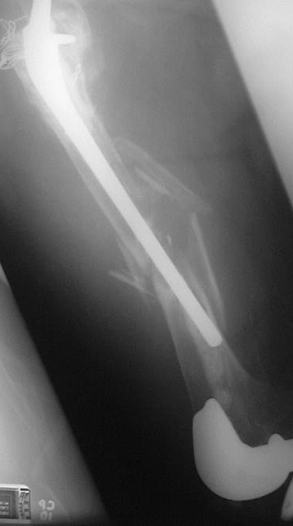
Type D
Fracture between THR and TKR
For management, best to think of it as a hip B3 and ignore knee

Slide 16
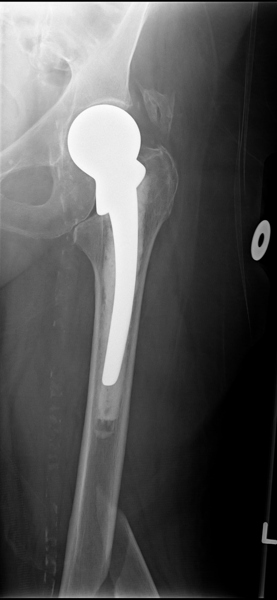
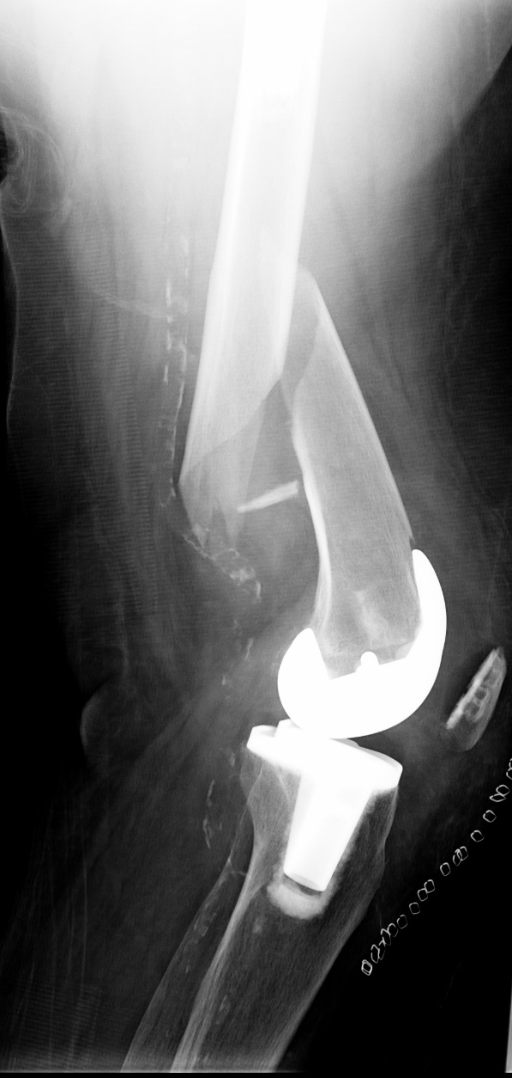
Type C for the hip
Type C for the knee

Slide 17
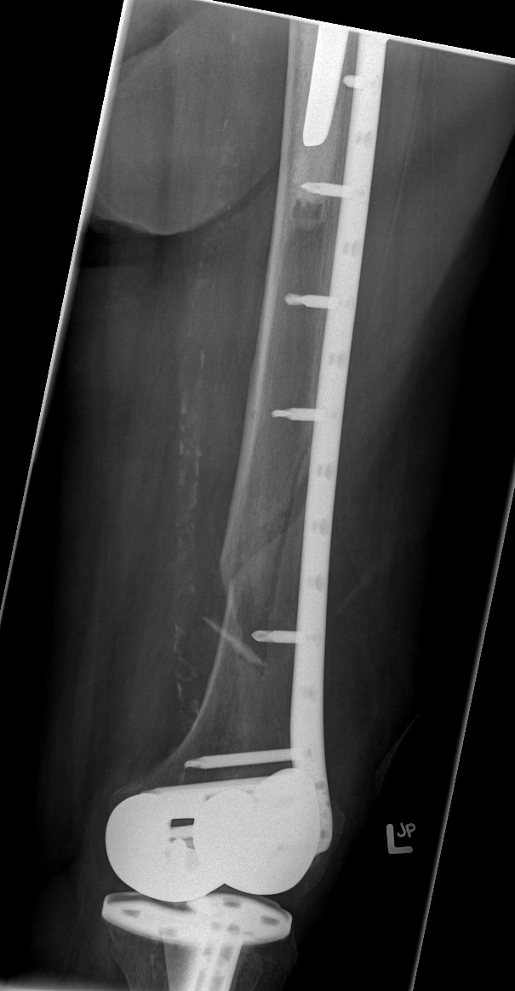
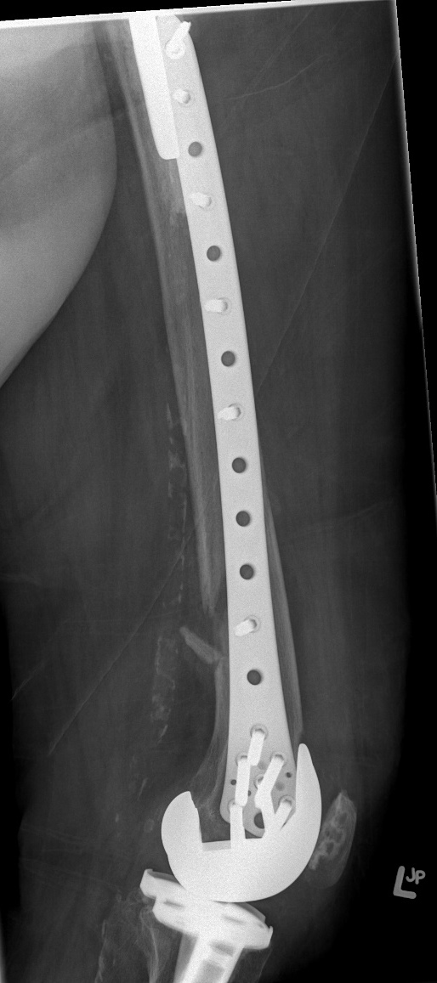

Slide 18
Type D
  Management, need to operate on FEMUR:
    Not for hip nor for knee
  Type of surgery will involve the most affected joint:
    In this case, the hip because the stem will interfere with the plate
    Best to think of type D in terms of most affected joint
  In this case, I would prefer a B1 hip:
    This will dictate treatment
    Improve communication
    Improve reporting of results
Notes:
Clarify what is mean by “Not for hip nor for knee”

Slide 19
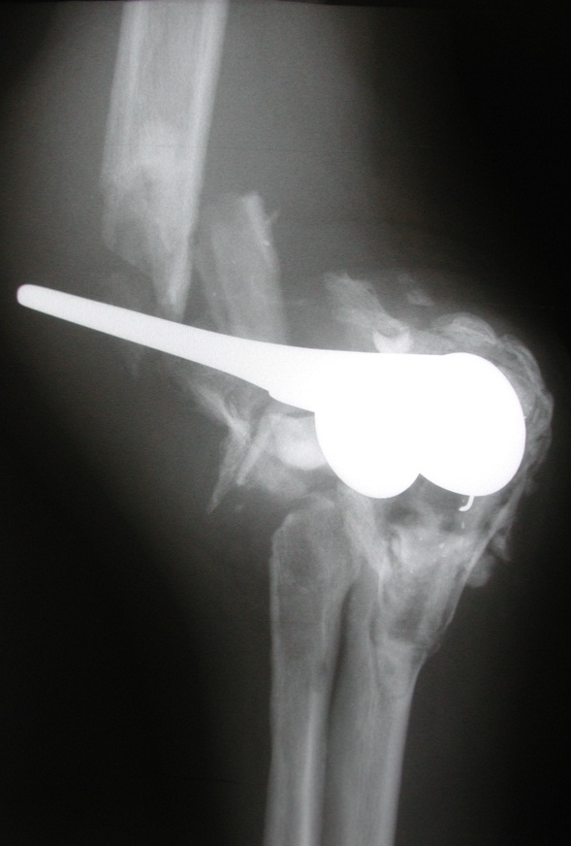
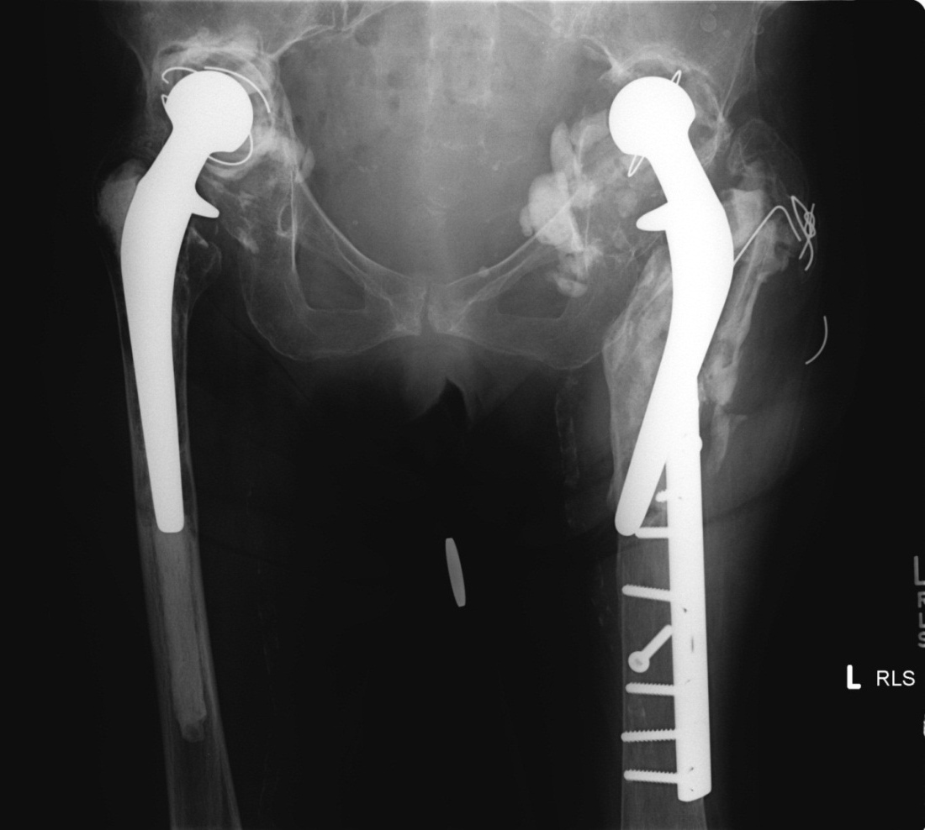
Type E
Each of two bones supporting one arthroplasty

Slide 20
Management
Individualized for each bone containing an implant and managed accordingly
“Block out analysis”

Slide 21
Type E
Each side of the joint is involved

Slide 22
Type E
Type B3 femur

Slide 23
Type E
Type B3 femur
Type B3 pelvis

Slide 24
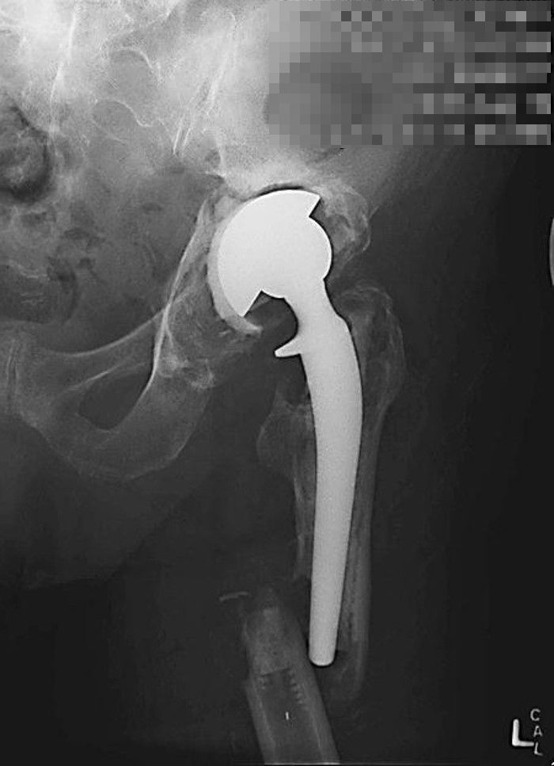
Type E
Fracture involving two bones supporting one arthroplasty
Type B3 for the cup

Slide 25
Type E
Fracture involving two bones supporting one arthroplasty
Type B2 for the stem

Slide 26
Type E
  Need to book surgery for EACH part of the joint:
    Femur and acetabulum in this case
  Designating the fracture as type E will not allow one to determine treatment
  Designating this as B3 pelvis and B2 femur:
    Will allow easier communication
    Will determine treatment
    Will allow reporting of results

Slide 27
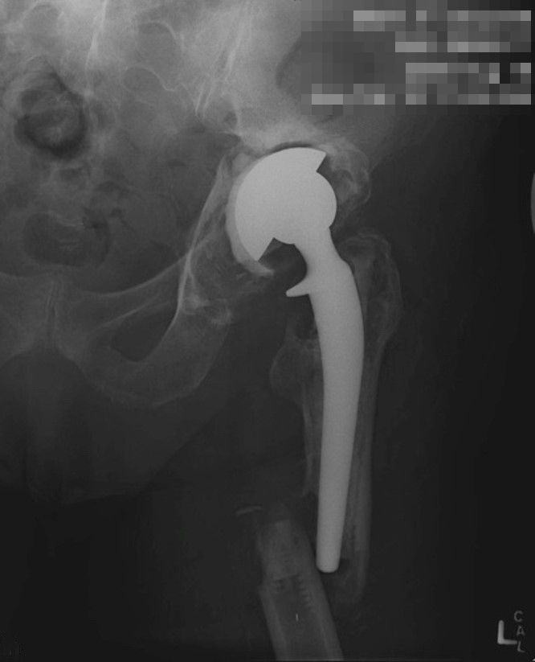
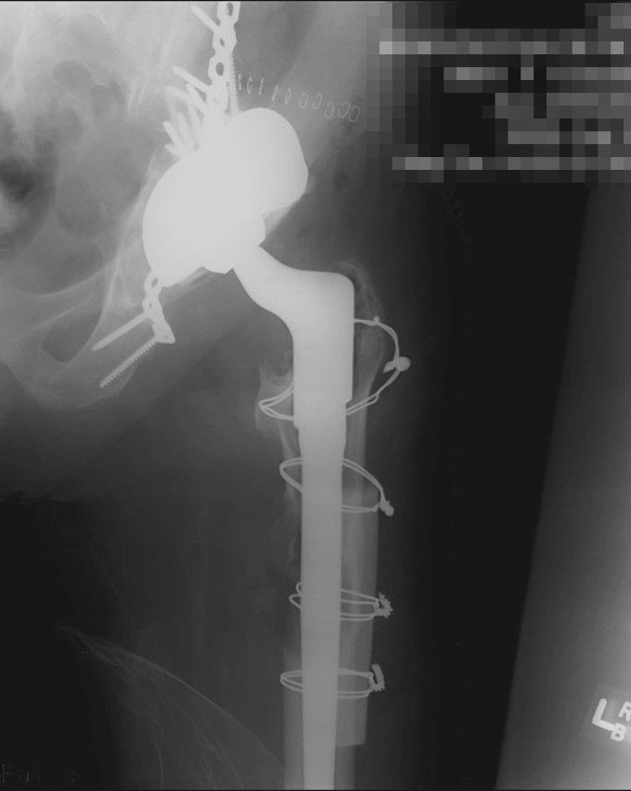
Type E—treated as B3 pelvis and B2 femur
Notes:
27

Slide 28
Unified Classification System—mnemonic
Type A A pophyseal
Type B B ed of implant
Type C C lear of implant
Type D D ividing implants
Type E E ach of two bones
Type F F acing an implant

Slide 29
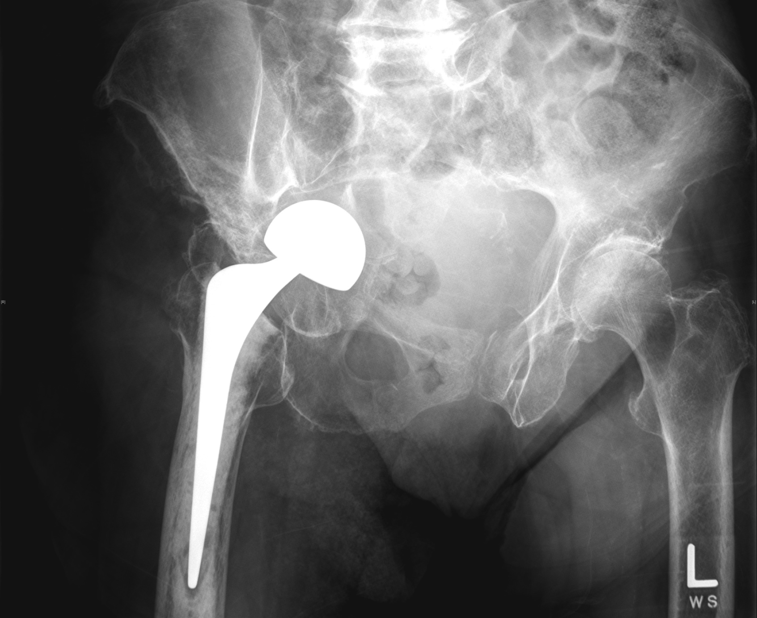

Slide 30
Type F
Management:
Depends on degree of displacement and bone comminution

Slide 31
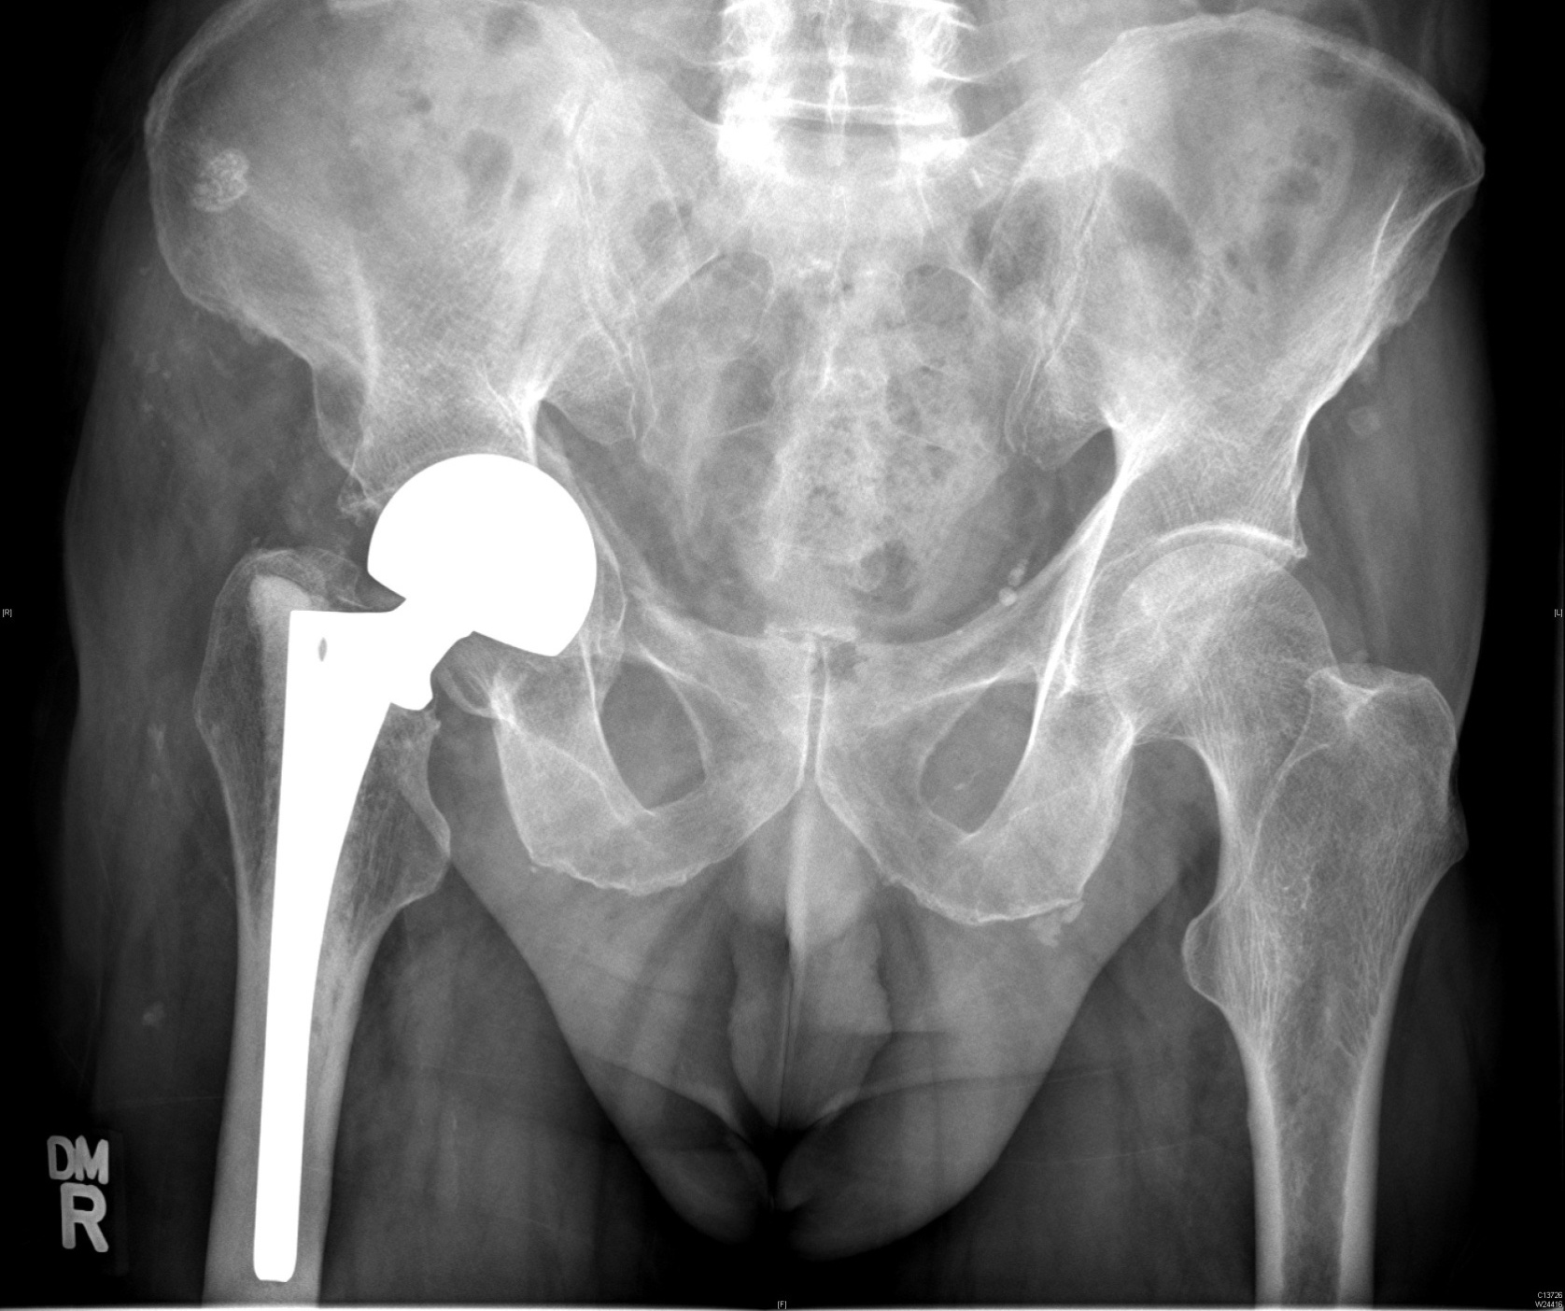
Mildly displaced
Treat as B1

Slide 32
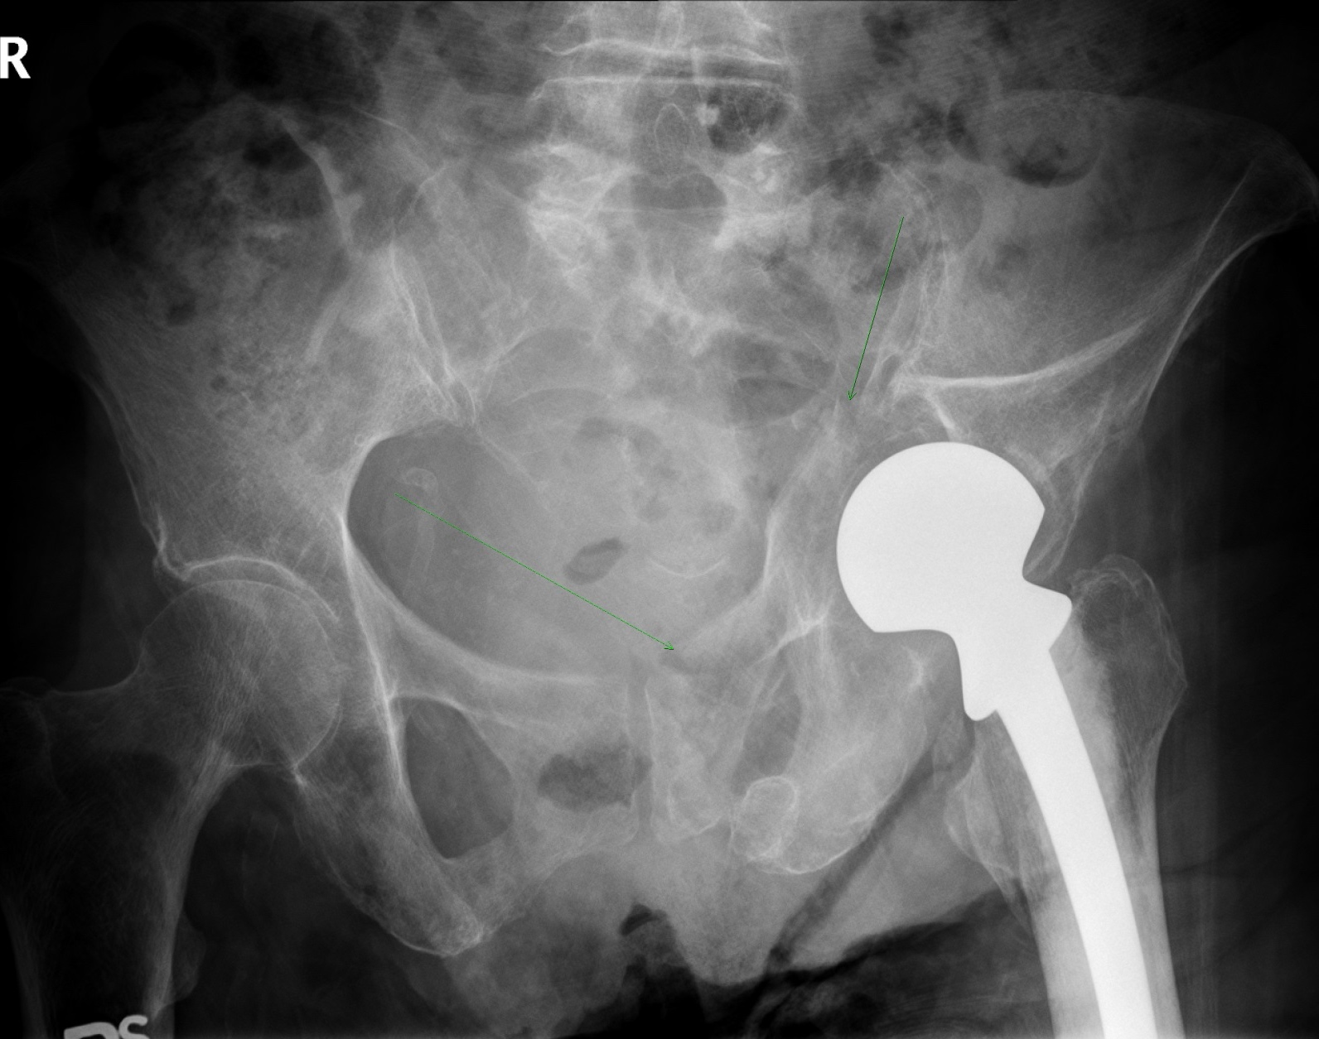
Severely displaced
Treat as B3
Treat as B2

Slide 33
Type F—very rare
Because of adjacent implant, will not treat as native bone
Will have to put in an implant (except in patella)
Best to think of it as a type B fracture
This will dictate appropriate treatment

Slide 34
UCS vs Vancouver classification
  A, B, C exactly the same
  D, E, F:
    Do not indicate treatment
    Still need to think of each bone as A, B, C
Value of UCS is that it brought Vancouver to other joints

Slide 35
Take-home messages
The UCS mnemonic:
Type A, Apophyseal
Type B, Bed of the implant
Type C, Clear of the implant
Type D, Dividing one bone which supports two joint replacements
Type E, Each of two bones supporting one joint replacement
Type F, Facing or articulating with an implant

