Slide 1
Ankle fracture
Case for small group discussion
AO Trauma—Foot & Ankle
Module 1a: Ankle trauma—ankle fractures
Notes:
Michael Swords, US

Slide 2
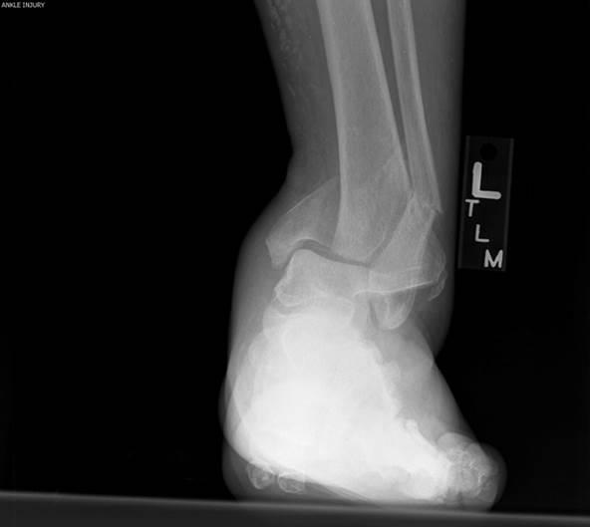
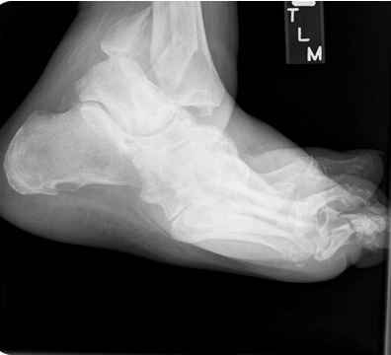
Case description
55-year-old woman, slipped on stair
Poorly controlled diabetic
Closed fracture, moderate swelling, skin in good condition

Slide 3
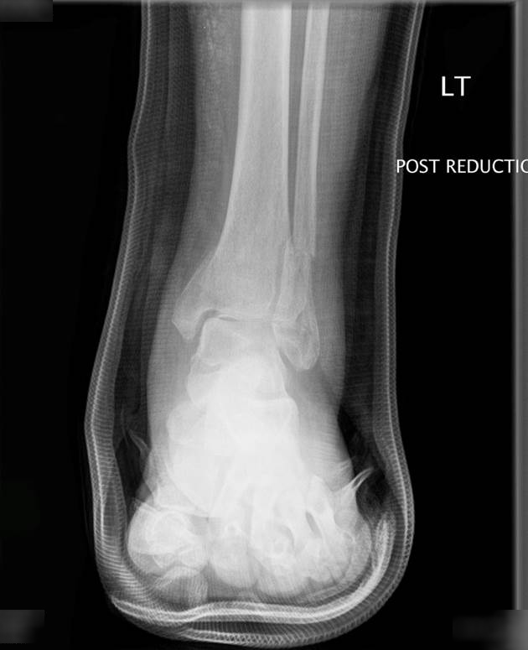
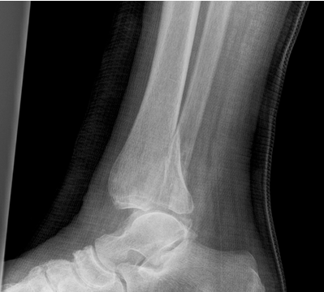
X-rays after closed reduction
CT scan shows no comminution or impaction of posterior malleolus

Slide 4
Discussion points
When do you fix this fracture type?
What various fixation techniques exist?
Treatment alternatives for a poorly controlled diabetic patient?
Notes:
Options of CT scan
Options of fusions or nonoperative treatment

Slide 5
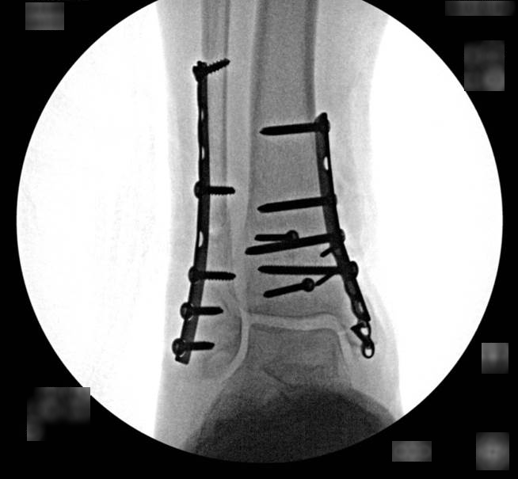
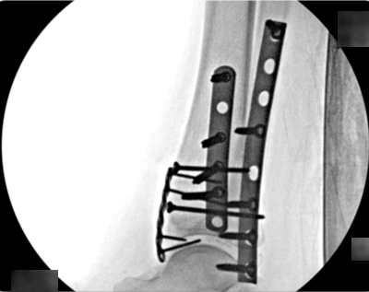
ORIF—intraoperative x-rays

Slide 6
Discussion points
For how long do you administer nonweight bearing treatment?
When do you no longer need to worry about the Charcot?

Slide 7
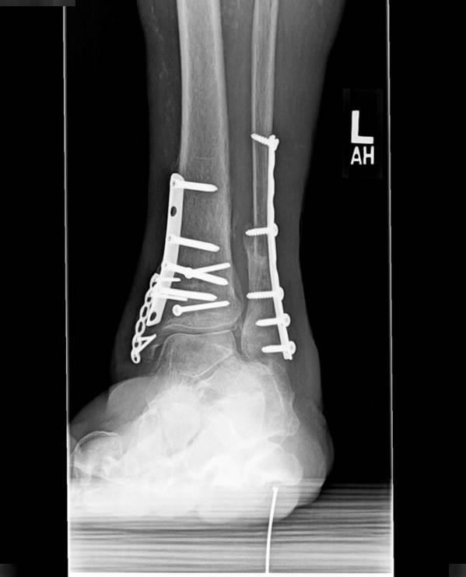
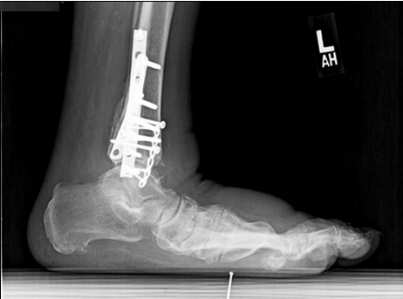
12-month follow-up x-rays

Slide 8
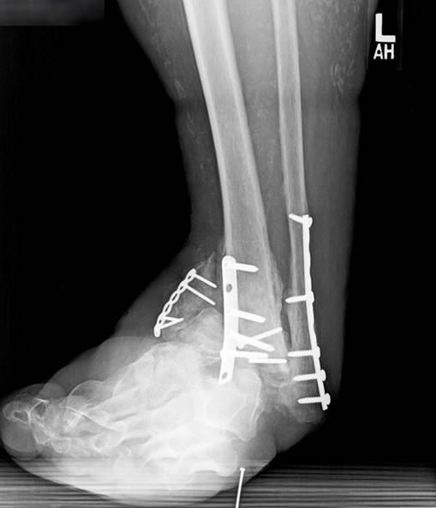
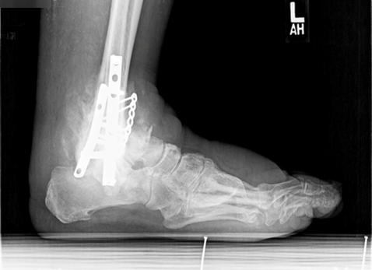
27-month follow-up

Slide 9
Result
Below knee amputation

Slide 10
Take-home messages
Maximum internal fixation necessary in diabetic osteoarthropathy
Prolonged immobilization necessary
Check for foot sensation and overall appearance of the foot in abnormal fracture patterns
Is the mechanism of injury related to the fracture pattern?
Management of diabetes essential

