Slide 1
Ankle fracture
Case for small group discussion
AO Trauma—Foot & Ankle
Module 1a: Ankle trauma—ankle fractures
Notes:
Les Grujic, AU

Slide 2
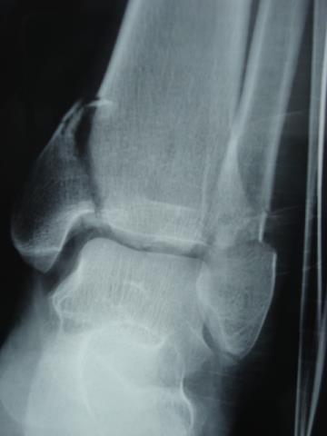
Case description
31-year-old woman
Car accident 3 hours previously
Soft tissues in adequate condition
Closed injury
Is this sufficient information?
Notes:
Points to demonstrate vertical shear (adduction)
Medial impaction
Could be discussed as transition to pilon

Slide 3
Further investigations
CT-scan confirms impaction of the medial plafond
Notes:
Avoid standard screw placement

Slide 4
Which treatment option would you choose?
Options:
Closed reduction and cast
ORIF with cannulated screws for medial malleolus and plate for distal fibula
ORIF both malleoli with antiglide plates
External fixator
Notes:
Avoid standard screw placement

Slide 5
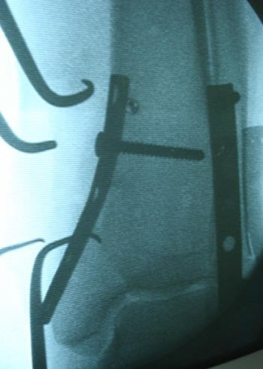
Anatomical ORIF of the distal fibula and antiglide medial plate

Slide 6
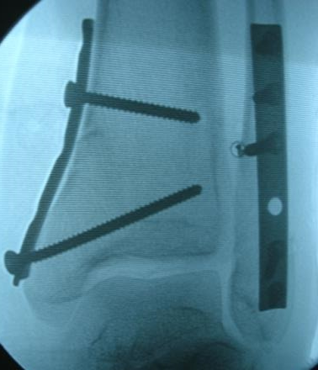
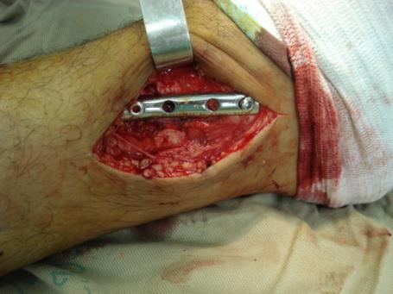
Antiglide plate

Slide 7
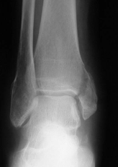
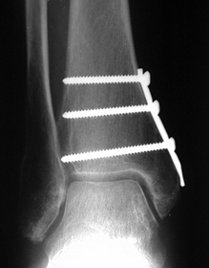
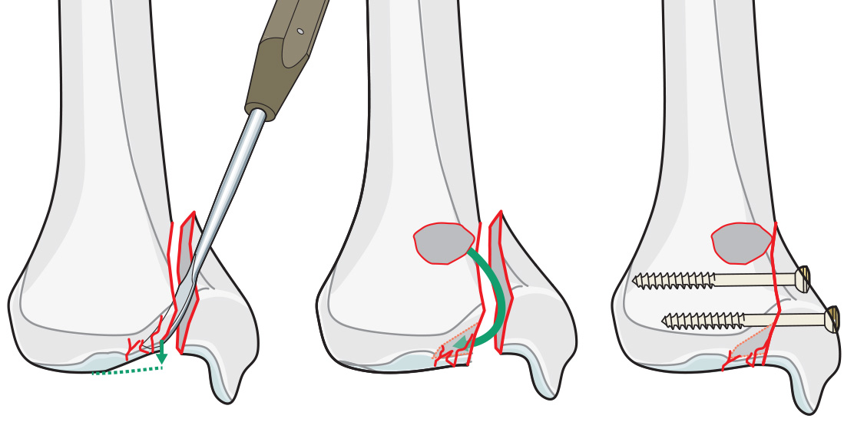
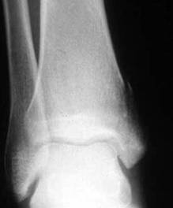
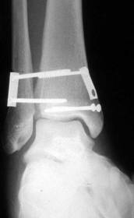
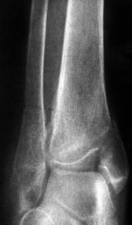
Medial malleolus
Vertically oriented fracture compression and buttress impaction fragment(s)

Slide 8
Take-home messages
Vertical medial malleolar fracture indicates supination-adduction stage 2 fracture
Be aware of medial impaction of the tibial plafond in supination-adduction stage 2 fractures
Buttress plating
Avoid standard oblique medial malleolar screws
Protected weight-bearing due to joint impaction

