Slide 1
Case 3
Periprosthetic total knee replacement
AOTrauma Course
Fragility Fractures and Orthogeriatrics
Notes:
Case 3 learning objectives:
Review the medication list
Discuss anticoagulation and management (indications, inappropriate prescribing)
Discuss the diagnosis of osteoporosis without any treatment/ undertreatment
Discuss the use of MIPO

Slide 2
Case description
79-year-old woman
Stumbled in dizziness at home
Was transferred from a smaller hospital the day after the fall
Charlson Index 2
Heart insufficiency
Osteoporosis
Had cardiac surgery 3 years before (biologic heart valvula)
Has anticoagulation with warfarin

Slide 3
Medication
Cefuroxim 500 mg post operative 1-0-1 for 3 days UTI
Valsartan/HCT 160/12.5 mg 1-0-0
Simvastatin 20 mg 0-0-1
Aspirin 100 mg 0-1-0
Calcium 600 mg 1-0-0
Bormazepam 6 mg 0-0-0-1/4
Oxycodon/naloxon 10/5 1-0-1
Pantoprazol 40 mg 1-0-0
OAC with vitamin K antagonist

Slide 4
Day 1

Slide 5
Current situation
Interprosthetic fracture
Intertrochanteric fracture healed (3 years before)
Femoral component of knee prosthesis seems not to have loosened
Charlson 2, Warfarin
Goal? Bring back home as soon as possible
Bridging therapy and urgent surgery planned
Treatment plan:
Plate fixation
Interlocking and overlapping proximally
Cement fixation of the screws distally
Day 1

Slide 6
Lateral position has a lot of advantages
Day 2

Slide 7
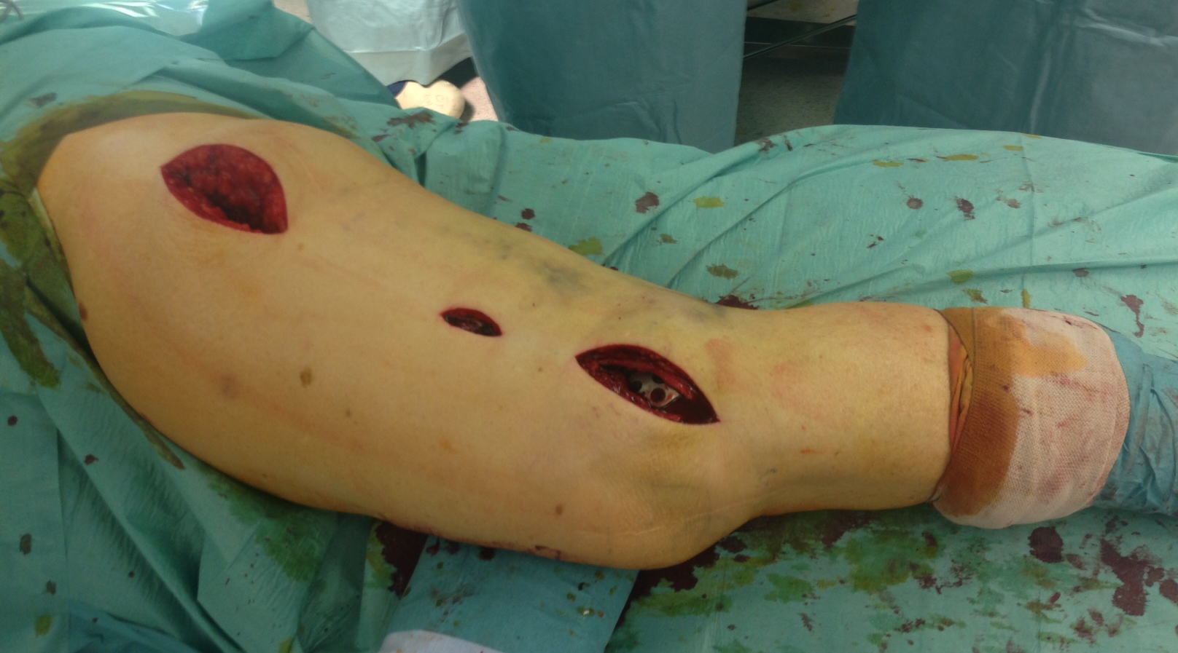
MIPO technique
Day 2

Slide 8
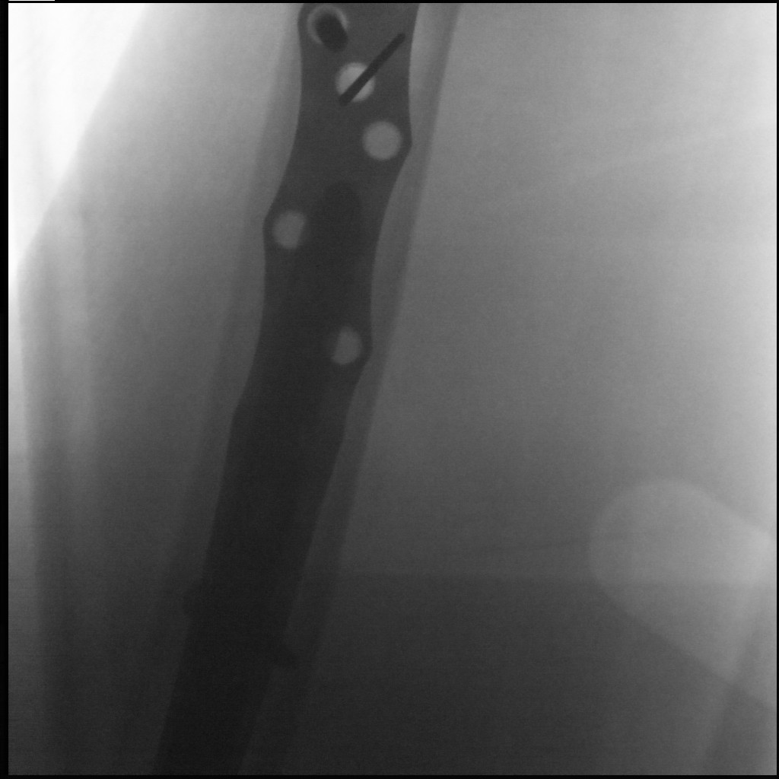
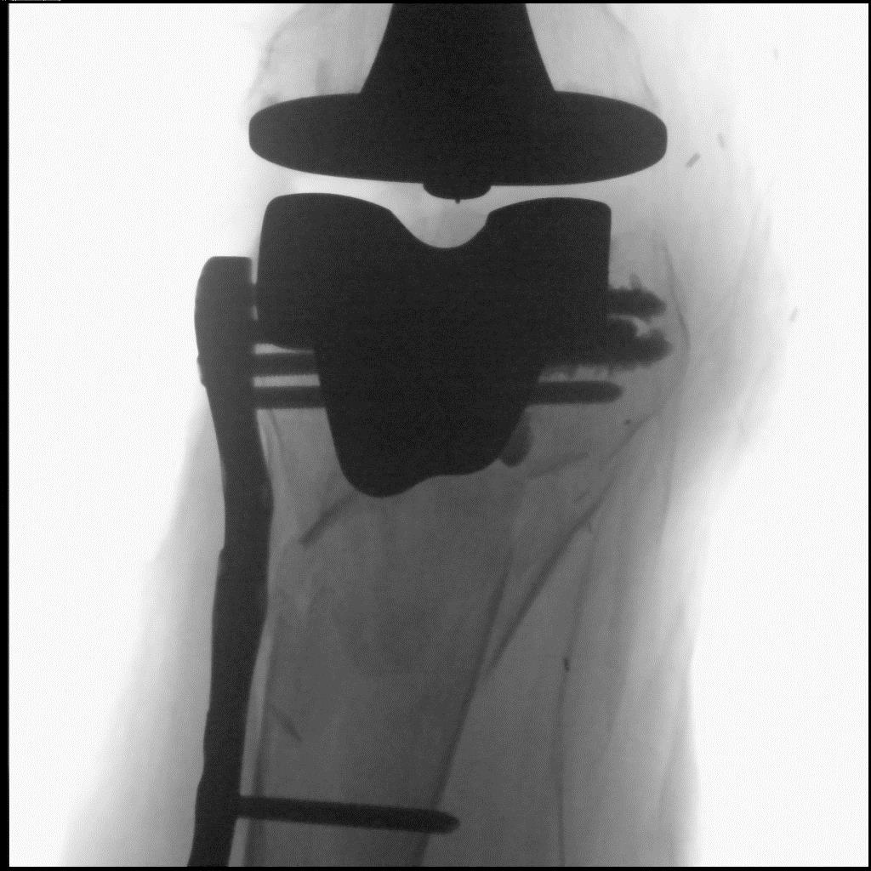
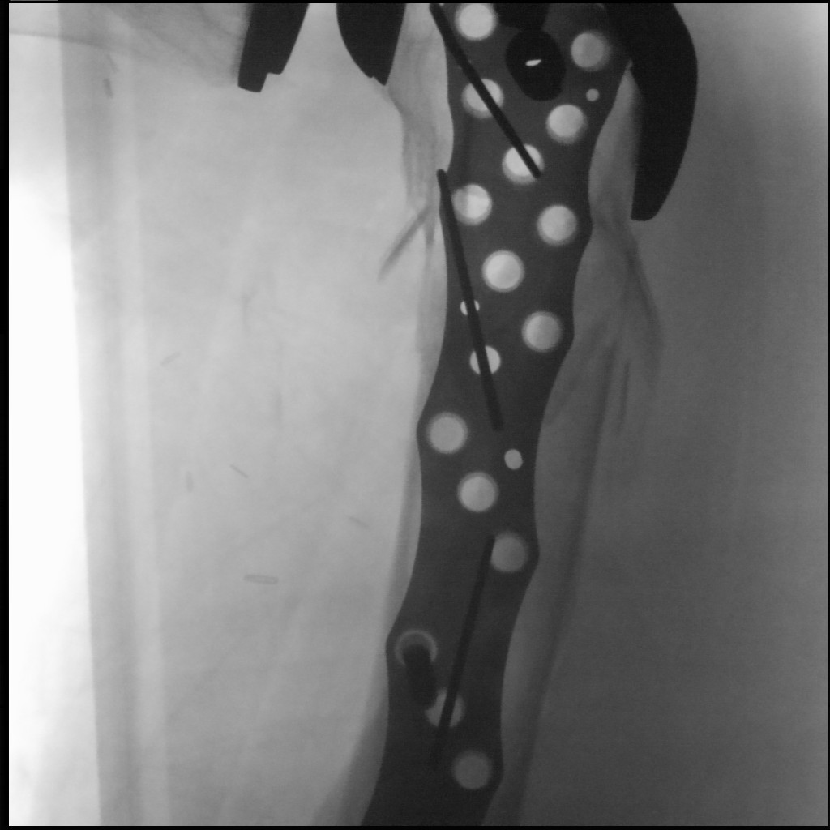
Day 2

Slide 9
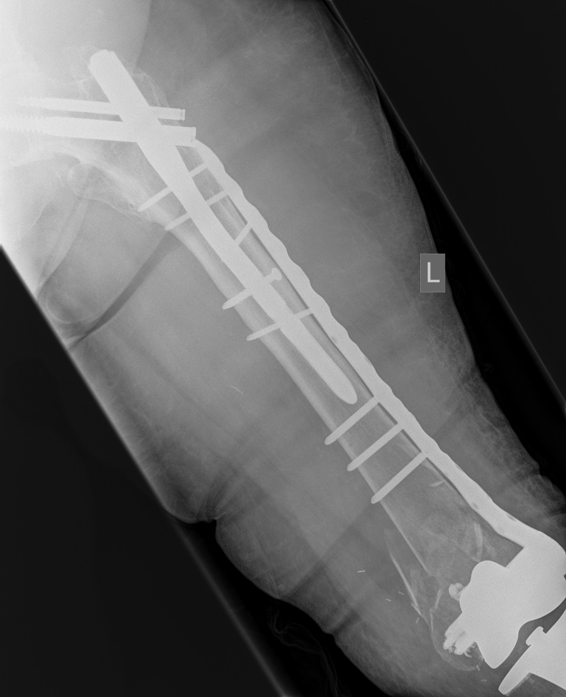
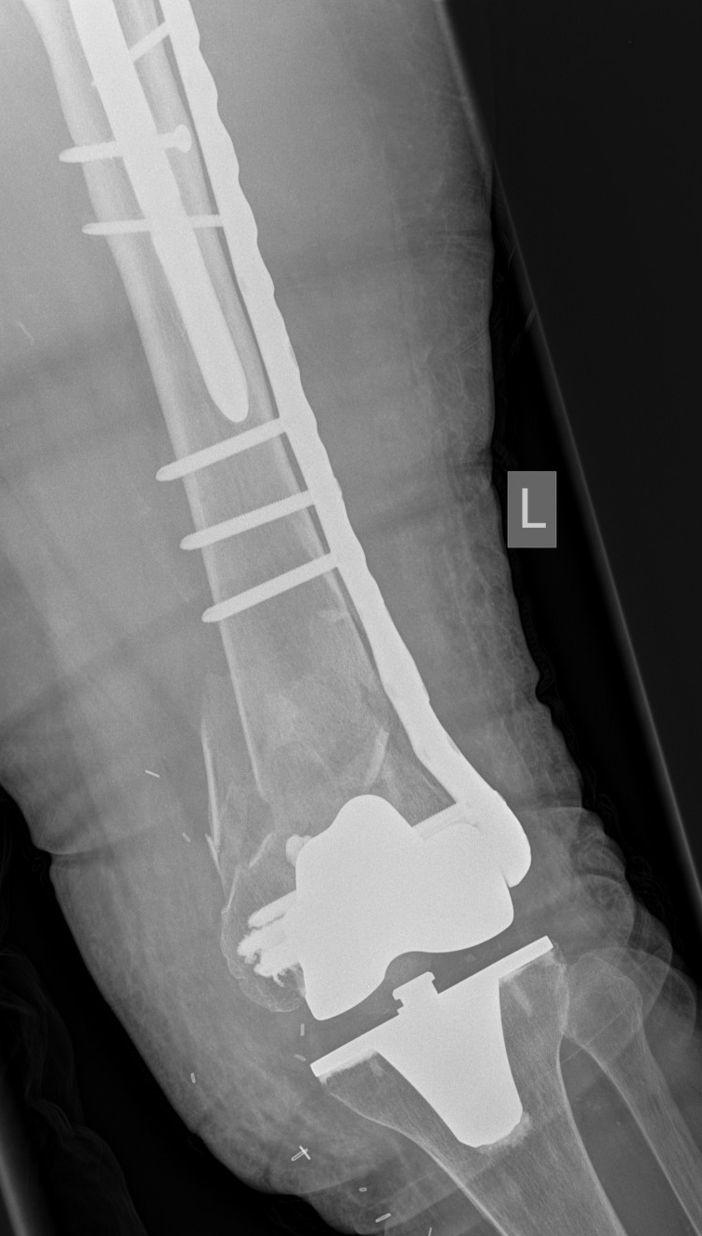
Shortening
Cement use
Day 5

Slide 10
Follow-up
Patient was mobilized with full weight bearing as needed to survive but had problems to mobilize due to fear of falling again
Could not return home again
Went to a nursing home 6 weeks later after geriatric rehabilitation

Slide 11
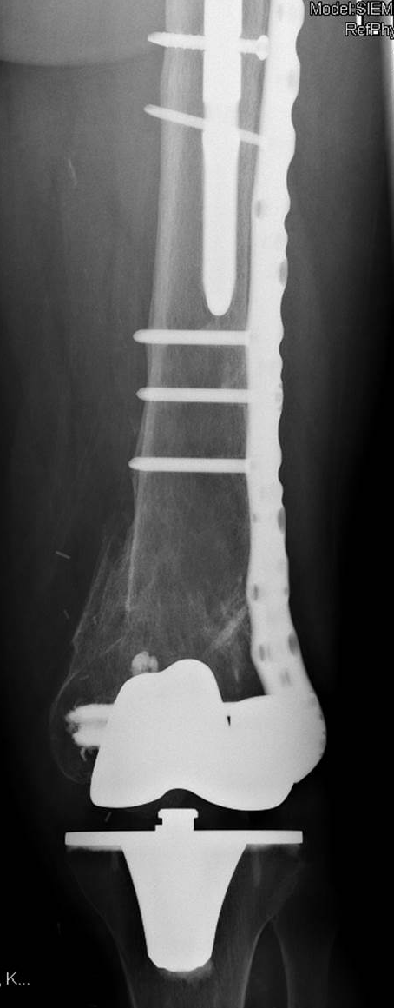
1-year follow-up

Slide 12
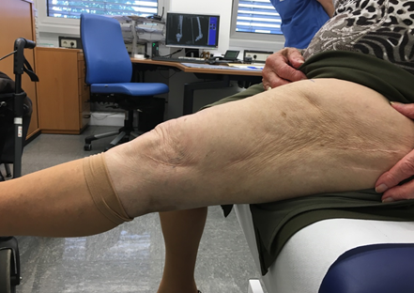
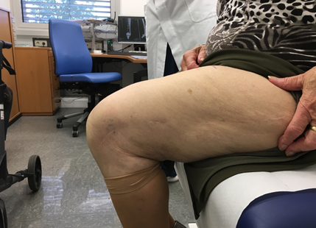
1-year follow-up

Slide 13
Take-home messages
Lateral position, MIPO approach
Cement use in severe osteoporotic cases
Inappropiate prescribing is frequent in older adults, review of medication list is essential (undertreatment regarding osteoporosis, overtreatment regarding cardiac diseases)
Anticoagulation does not result in a delay of more than 24 to 48 hours, if management is appropriate

Slide 14
Thank you
Return to list of cases
Notes:
End of case 3

