Slide 1
Case 10 (a)
Proximal humeral fracture
AOTrauma Course
Fragility Fractures and Orthogeriatrics
Notes:
Case 10 learning objectives:
Discuss operative and nonoperative treatment options
Discuss the impact of further information on the management of complex fragility fracture patients
Discuss the pain treatment
Discuss the risk factors for delirium, the use of restraints, and family support
Discuss the results of lab tests and the indication of antibiotic treatment
Recognize the value and process of shared decision making
Discuss the treatment of delirium

Slide 2
Case description
87-year-old man
Former professor of urology
Sustains a fall in his flat
For many years has suffered dizziness, but no further falls in his history
No known comorbidities, no drug treatment
Complains of massive pain in the right shoulder and some pain in the pelvis

Slide 3
X-rays of left shoulder

Slide 4
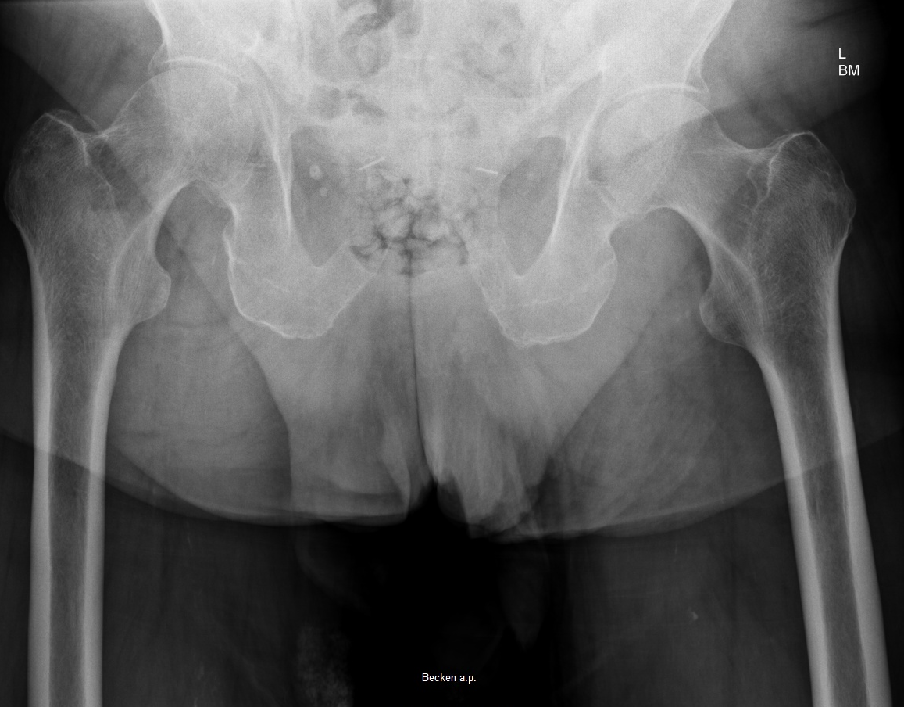
X-rays of pelvis

Slide 5
Patient information
Do you need further information?
Prefacture status: Parker score of 8, ADL 95
He lives independently, together with his wife in their own house in Nuremberg
They receive some support for housework
They have two children, both physicians, daughter is an eye specialist in Switzerland, son is a plastic surgeon in the US
CT scans?
Notes:
Discuss the impact of further information on the management of complex fragility fracture patients.

Slide 6
CT scan of left shoulder

Slide 7
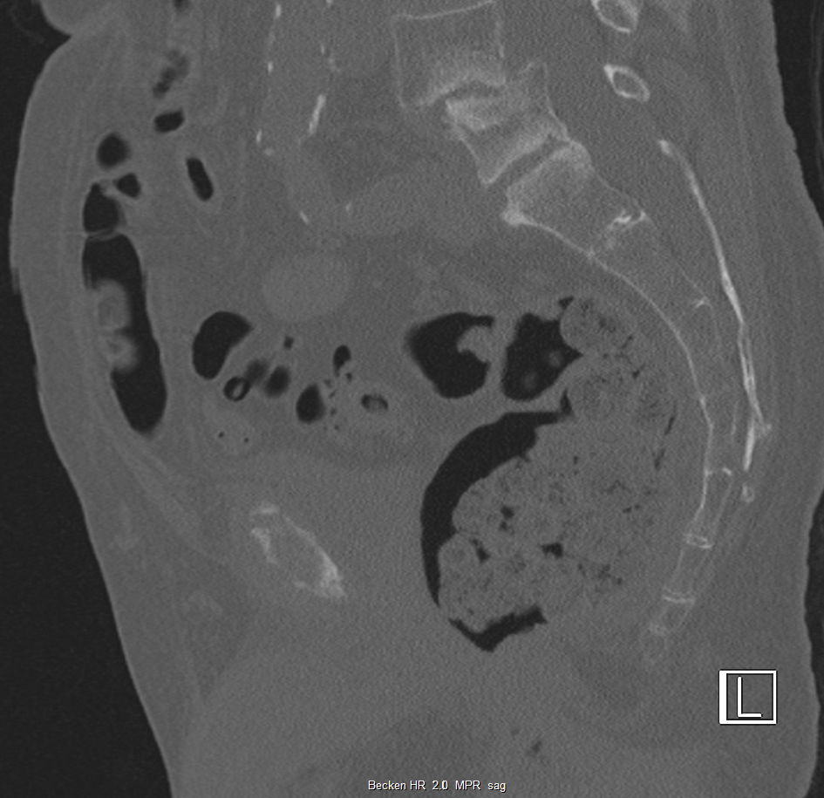
CT scan of pelvis
Surgical treatment?

Slide 8
Geriatric consultation
The patient is confused and agitated
He doesn‘t tolerate nursing
He suffers from urinary incontinence, but refuses a urinary catheter
Pain score 8 (using the VAS)

Slide 9
Medication
Enoxaparin 40 mg sc
Ibuprofen 400 mg 1-1-1
Pantopralol 40 mg 1-0-0
Recommendations:
Hydromorphone ret. 2 mg 1-0-1
Hydromorphone 1.3 mg on demand
Macrogol for prophylaxis of constipation
1000 ml Ringer infusion
Notes:
Discuss the pain treatment.

Slide 10
Daughter demands further investigation
CT of the brain
Neurological examination because of a mild tremor
Consultation by the cardiologist
Consultation by the anesthesiologist

Slide 11
The next night
Patient becomes agitated during the night, he cries, and tries to get out of bed
Nursing was impossible
The staff use restraints and the physician on call prescribes 5 mg haloperidol IM
The following day the patient was transferred to the geriatric ward
The goal was to stabilize the patient regarding the delirium and afterwards go for elective surgery
Results of the CT scan: no bleeding, minimal vascular lesion, older genesis
Notes:
Discuss risk factors for delirium and the use of restraints.

Slide 12
Lab tests
Hb 12.3 g/dl RR 128/68 mmHg
Sodium 132 mmol/l HR 86/min
Calcium 1.98 mmol/l Temp. 37.5°
CRP 8.1 mg/gl ↑ (5.3 two days earlier)
Urine test: no sign of UTI
Chest x-ray: no signs of pneumonia
Infection yes or no?
Antibiotic treatment?
Notes:
Discuss the results of the lab tests and the indication of antibiotic treatment.

Slide 13
Geriatric ward
Patient remains delirious and agitated, he is accompanied by his daughter
He gets a single room with an opportunity for the daughter to sleep in the same room
Antibiotic treatment with cefuroxim 1.5 mg iv and fluid management
No urinary catheter but a urinal is provided
Physiotherapy is provided to mobilize him
Notes:
Discuss the value of family support in such cases.

Slide 14
Updated medication
Paracetamol 500 mg 1-1-1-1
Metamizol 500 mg 1-1-1-1
Vitamin D3 20000 U per day
Quetiapine 25 mg 0-0-0-1 and on demand
Dalteparin 5000 IU sc

Slide 15
Next day
Patient is deeply sedated, so physiotherapy or oral nutrition are not possible
His daughter still demands further investigation
Now what would you do?
Quetiapine medication is stopped and the daughter is informed about the problem of delirium
She is encouraged to become engaged in the care of her father

Slide 16
6 days later
Delirium improves over the days
During day hours the patient is reasonably comfortable but confusion and agitation occur primarily at night
CRP ↓ antibiotic treatment is stopped
Pain is well tolerated

Slide 17
6 days later

Slide 18
Interdisciplinary team meeting
Decision is made for nonoperative treatment, and to continue physiotherapy
Relatives are informed, discussion with them about the pro’s and con’s of surgery
Obtained a consensus with the patient and his family
Notes:
Discuss the process and value of shared decision making.

Slide 19
A further 4 days later

Slide 20
Discharged day 12
Patient still has mild delirium, but urinary incontinence is getting better
He is mobile with some help of one person, ambulatory physiotherapy is recommended
Medication now involves:
Paracetaol 500 mg 1-1-1-1
Vitamin D3 20000 U per week

Slide 21
A further 3 weeks later
3 weeks later, a phone conversation with his son
Situation at home is working, however, clinical situation is still the same

Slide 22
Take-home messages
In older patients, nonoperative treatment of proximal humeral fractures is a good option, even in displaced or fragmented fractures
Delirium is caused multifactorially and not always associated with anesthesia
If possible, nonpharmacological is better than pharmacological treatment
Information and cooperation with family members is extremely important

Slide 23
Thank you
Return to list of cases
Notes:
End of case 10

