Slide 1
Case 11
Periprosthetic acetabular fracture
AOTrauma Course
Fragility Fractures and Orthogeriatrics
Notes:
Case 11 learning objectives:
Consider revision arthroplasty for (periprosthetic) acetabular fractures
Discuss full weight bearing in geriatric fracture treatment
Discuss management of UTI, infection prevention, and antibiotic prophylaxis

Slide 2
Case description
88-year-old woman
Fell in nursing home
Charlson index 2
Heart insufficiency
Hypertension
COPD
Urinary tract infection

Slide 3
Medication
Valsartan/HCT 160/12.5 mg 1-0-0
Aspirin 100 mg 0-1-0
Calcium 600 mg 1-0-0

Slide 4
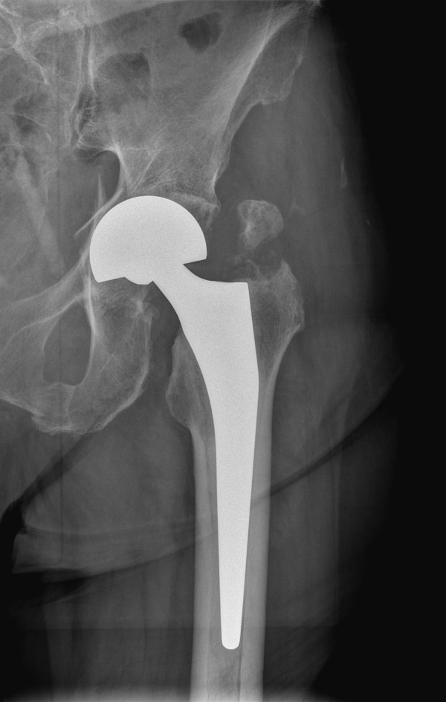
X-rays
Frequent falls
Fracture of greater trochanter
Periprosthetic acetabular fracture

Slide 5
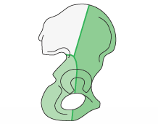
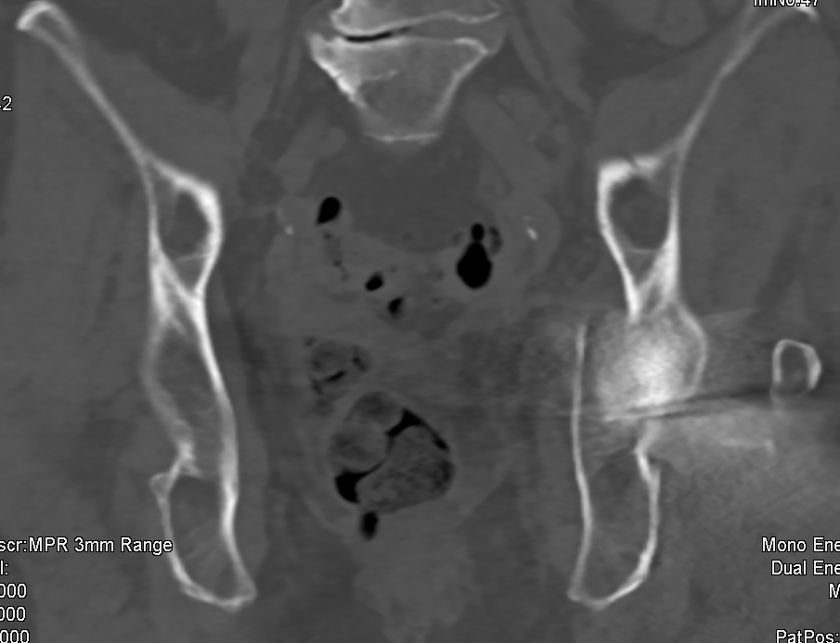
Anterior column fractured

Slide 6
Current situation
Periprosthetic acetabular fracture
Charlson 2, no contraindication for acute surgery
Goal: bring back home ASAP
Options
Plate fixation
Revision arthroplasty
Notes:
Discuss management of UTI, infection prevention, antibiotic prophylaxis

Slide 7
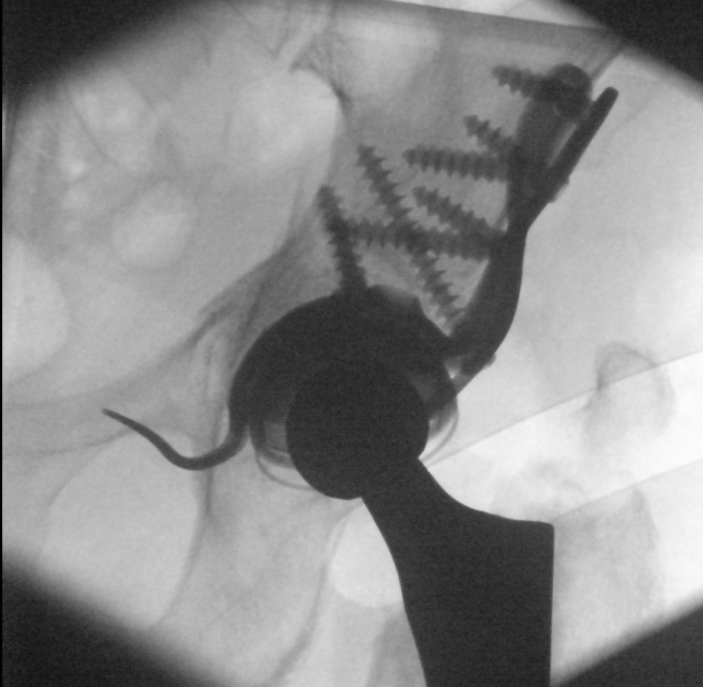
Revision system
Big screws in supraacetablar region with good purchase
Tricalciumphosphate

Slide 8
Tricalciumphosphate

Slide 9
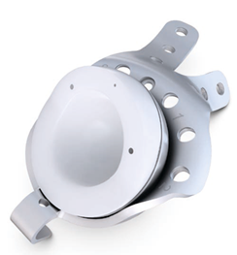
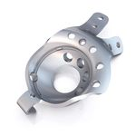
Immediate full weight bearing allowed

Slide 10
Follow-up
Was mobilized with full weight bearing as needed to survive but had problems to mobilize due to fear of falling again
Went back to nursing home
Satisfied at the 1-year follow-up

Slide 11
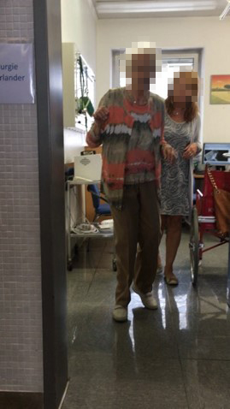
Notes:
In accident surgery, we are increasingly seeing elderly patients, such as this patient, who has contracted injuries to the same localization within the framework of a mundane domestic tumble. However, a completely different surgical strategy is necessary for this patient. The lady had multiple internal medical conditions and must be optimized for the surgery. In addition, we often find two other problems: on the one hand existing implants due to pre-existing injuries, on the other hand a poor bone quality due to a pre-existing osteoporosis. The aim is always to provide as soon as possible operative care and rapid postoperative mobilization.

Slide 12
Take-home messages
Full weight bearing is a must-have in orthogeriatric fracture treatment
Consider revision arthroplasty for (periprosthetic) acetabular fractures

Slide 13
Thank you
Return to list of cases
Notes:
End of case 11

