Slide 1
Cases for Small Group Discussions
AO Trauma Course Fragility Fractures and Orthogeriatrics

Slide 2
List of cases
Contralateral femoral lesion
Periprosthetic total knee prosthesis
Periprosthetic total knee replacement
Unstable pertrochanteric fracture and augmentation
Revision surgery after pertrochanteric fracture
Vertebral fracture
Total hip periprosthetic fracture
Humeral shaft fracture
Distal radial fracture
Proximal humeral fracture
Periprosthetic acetabular fracture
Difficulties in fixation and healing
Elbow fracture
Ankle fracture
Pelvic fracture
Simple two-part proximal humeral fracture

Slide 3
Acknowledgements for all cases
Christian Kammerlander
Emilio Fantin
Markus Gosch
Sergio Fernandez
Roland Biber
Stefaan Nijs
Tobias Roth
Michael Blauth
Peter Brink
Martin Hessmann
Michael Blauth
Stephen Kates
Collaborating authors and reviewers (sorry if we missed anyone)
Return to list of cases

Slide 4
Case 1
Contralateral femoral lesion
AOTrauma Course Fragility Fractures and Orthogeriatrics
Notes:
Case 1 learning objectives:
Discuss the indications for a prophylactic nail or plate on the contralateral side following an atypical fracture
Discuss the pain assessment and medication in the emergency room as well as postoperatively
Discuss anticoagulation treatment with aspirin in terms of a delay of surgery
Discuss treatment of osteoporosis (duration of treatment with alendronate, missing basic treatment with vitamin D and calcium)
Discuss risk of GI bleeding in this setting (indication of PPI in combination with aspirin, in terms of stress ulcer prophylaxis, in terms of side effects of long-term treatment with PPI)
Discuss and select further treatment options for osteoporosis

Slide 5
Case description
65-year-old woman
Right thigh pain after fall from a few steps
Mechanism uncertain, landed on her left thigh
In the emergency department she received 1 g metamizol iv
Notes:
Medical issues:
Discuss the pain medication, in the emergency room as well as postoperatively.

Slide 6
Medical history
Walked unaided
Gastroesophageal reflux disease, Raynaud’s disease
Alendronate for 5 years
Aspirin and proton pump inhibitor
Notes:
Medical issues:
Discuss anticoagulation treatment with aspirin in terms of a delay of surgery.
Discuss treatment of osteoporosis (duration of treatment with alendronate, missing basic treatment with Vitamin D and calcium)
Discuss risk of GI bleeding in this setting (indication of PPI in combination with aspirin, in terms stress ulcer prophylaxis, in terms of side effects of long-term treatment with PPI)

Slide 7
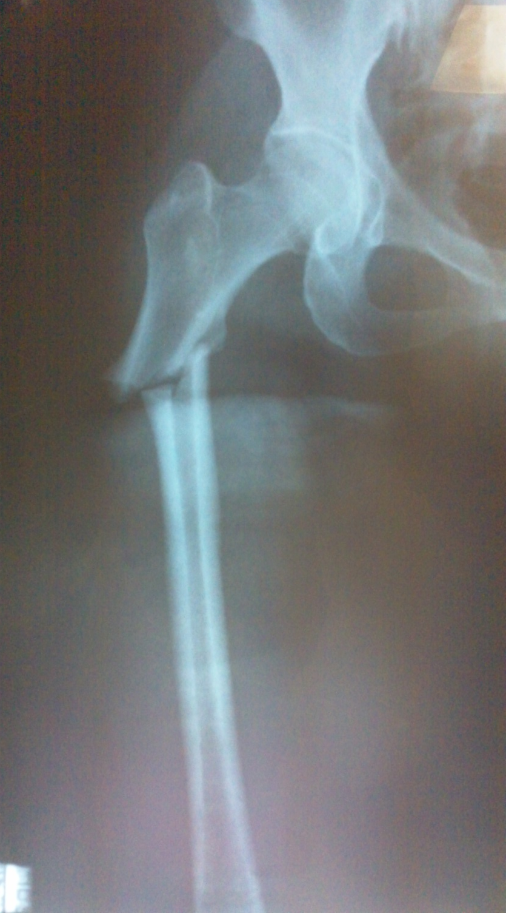
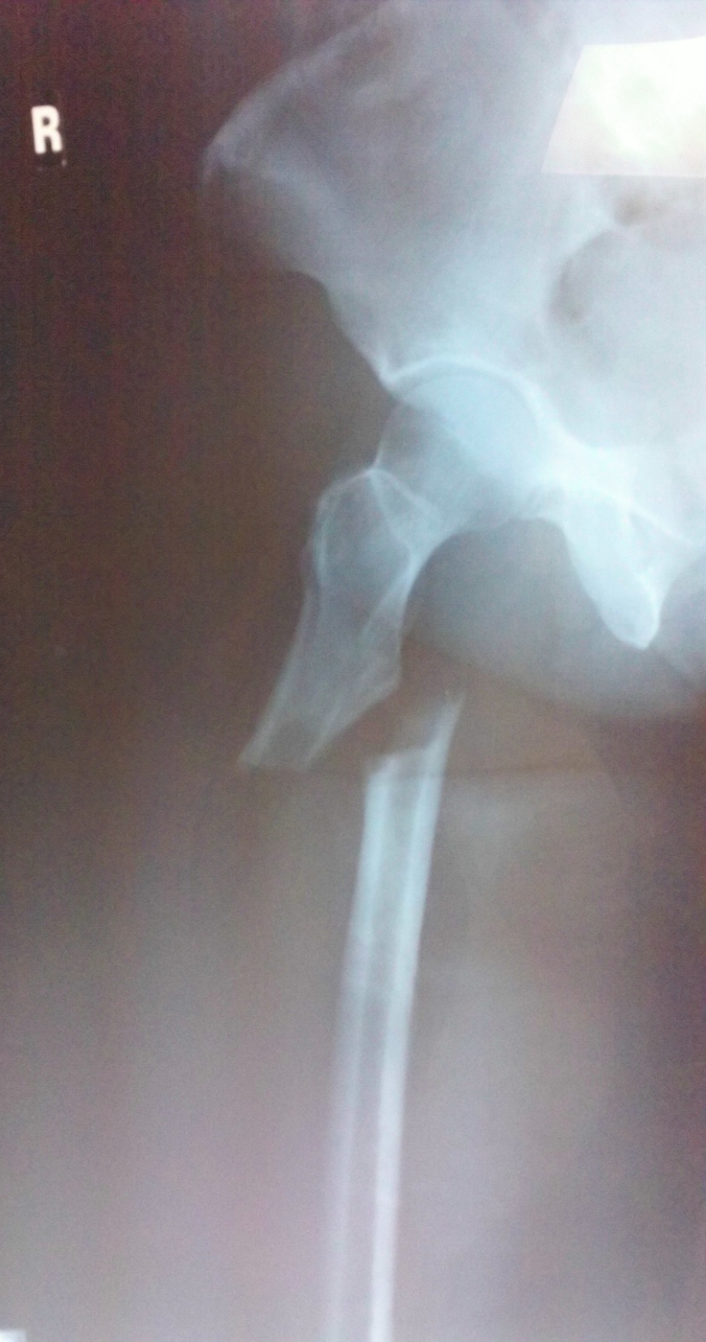

Slide 8
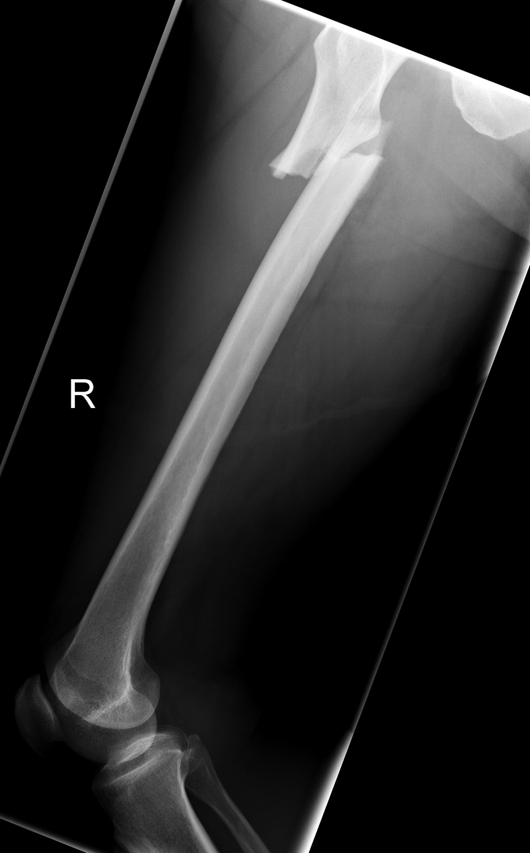

Slide 9
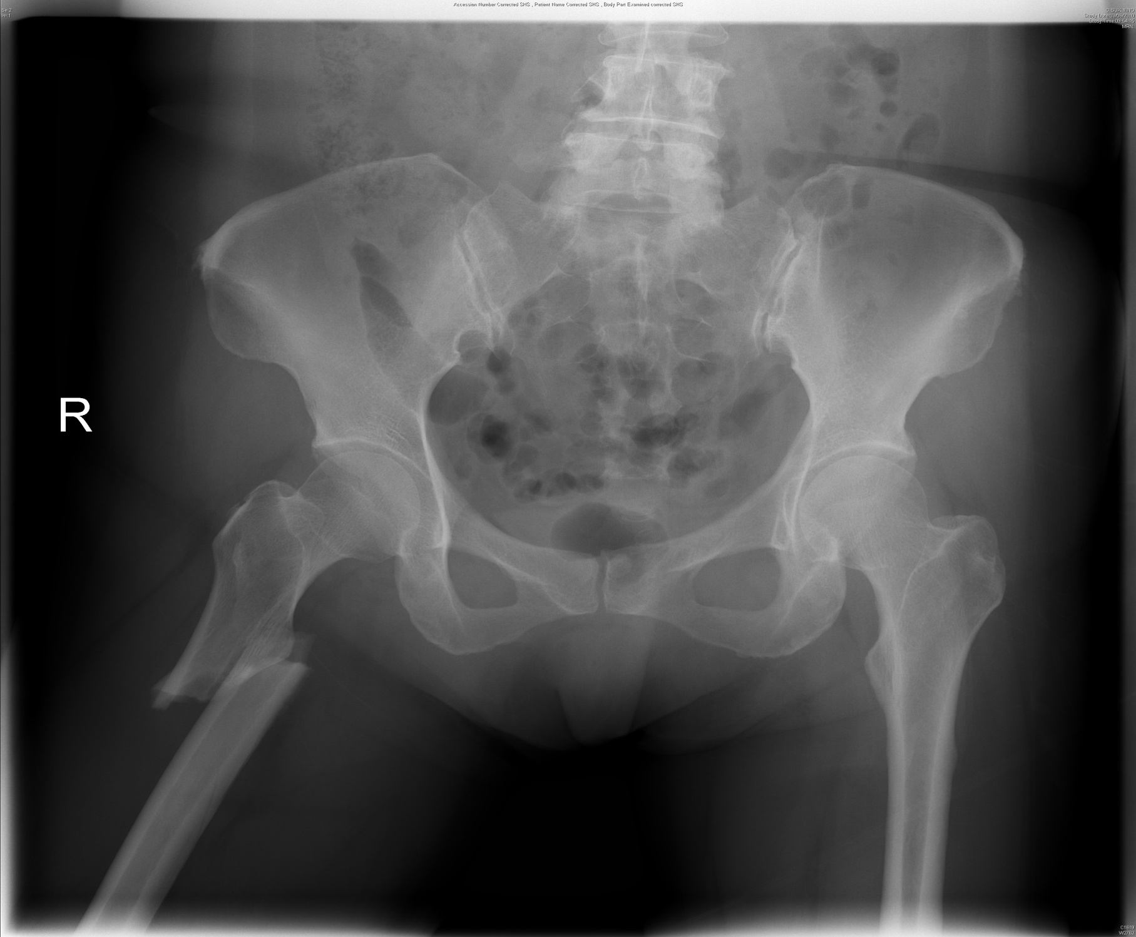

Slide 10
Treatment
Management options

Slide 11
Patient
Right
Left
IM nailing of right femur
Reaming to 11 mm
9 mm X 320 mm A2FN
4.5 mm LCP to left femur
MIPO

Slide 12
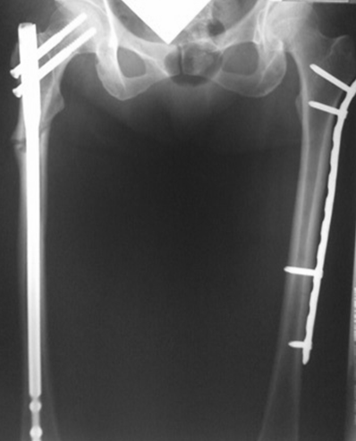
Immediate postoperative

Slide 13
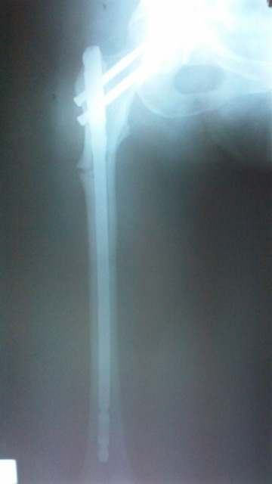
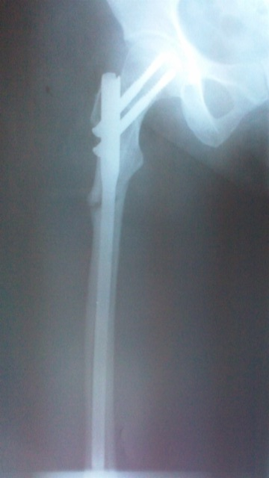
Immediate postoperative
R femur AP
R femur lateral

Slide 14
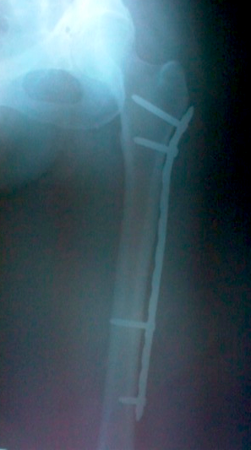
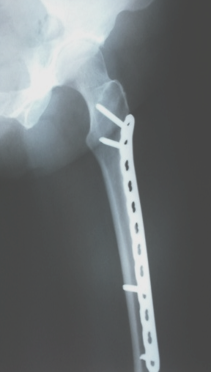
Immediate postoperative
L femur AP
L femur lateral

Slide 15
Postoperative rehabilitation
Immediate postoperative
Full weight bearing on both sides
2 months
Full weight bearing bilaterally with quadripod (walker)
1 year
Walks unaided

Slide 16
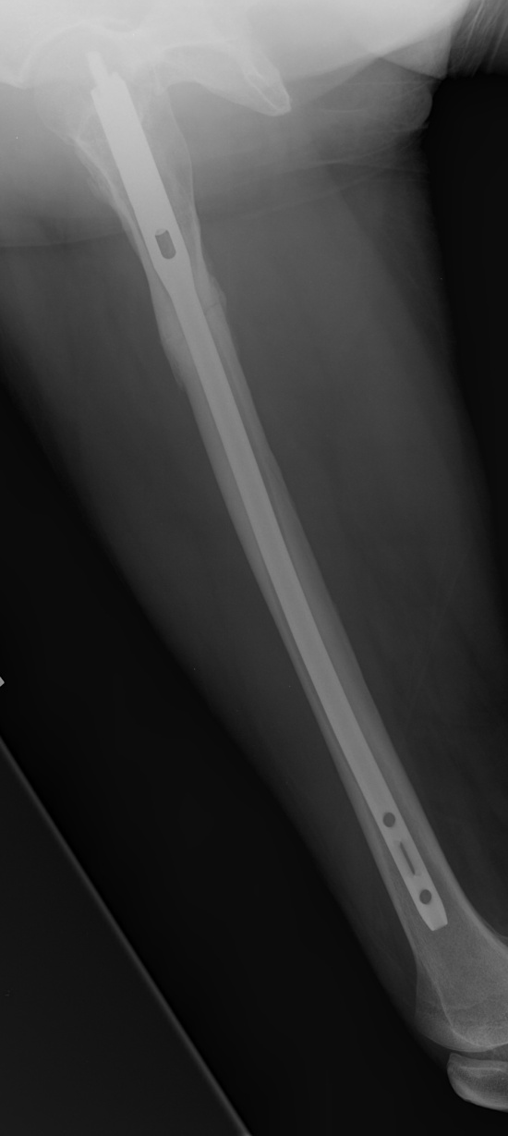
8 months postoperative
R femur AP
R femur lateral

Slide 17
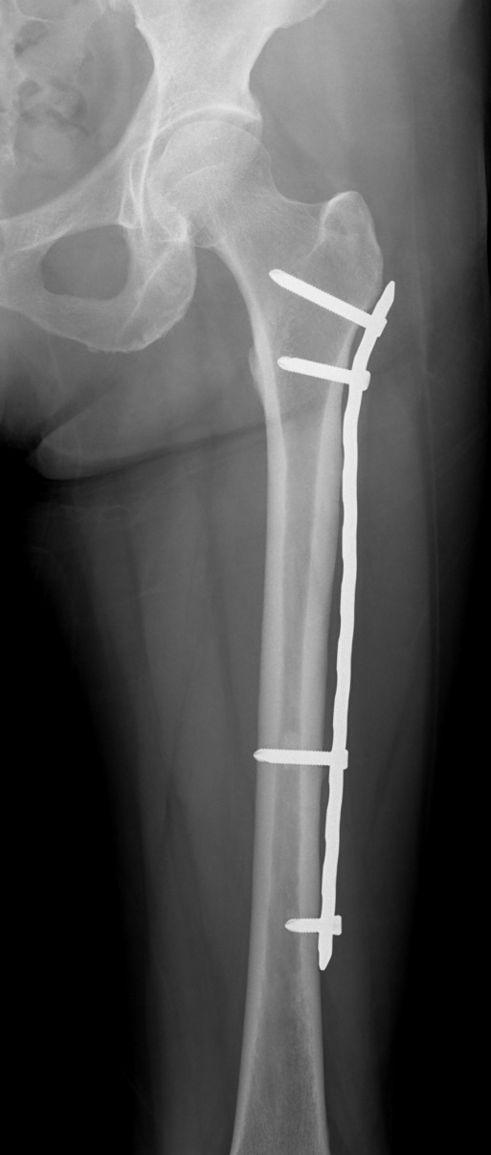
8 months postoperative
L femur AP
L femur lateral
Pain free!

Slide 18
Further osteoporosis treatment
Options?
Notes:
Medical issues:
Discuss and select further treatment options for osteoporosis (stop alendronate, indication for teriparatide, Vitamin D and calcium)

Slide 19
Take-home messages
Check the opposite side in the case of an atypical fracture
Stop bisphosphonate treatment
Discuss osteo-anabolic therapy (teriparatide)
Aspirin is not a reason to delay surgery
Check indication of PPIs
Don’t use NSAIDs as pain medication in the elderly

Slide 20
References
Shane E, Burr D, Abrahamsen B, et al. Atypical subtrochanteric and diaphyseal femoral fractures: Second report of a task force of the American Society for Bone and Mineral Research. JBMR. 2014 Jan; 29(1):1-23.
Tyler W, Bukata S, O'Keefe R. Atypical femur fractures. Clin Geriatr Med. 2014 May; 30(2):349-359.
Notes:
References
Taskforce JBMR 2014
Tyler, Bukata, and O’Keefe

Slide 21
Thank you
Return to list of cases
Notes:
End of case 1

Slide 22
Case 2
Periprosthetic total knee prosthesis
AOTrauma Course Fragility Fractures and Orthogeriatrics
Notes:
Case 2 learning objectives:
Discuss the risk factors of falls and of osteoporosis, including HIV and medications
Classify the periprosthetic fracture
Discuss the revision options and procedure steps

Slide 23
Case description
75-year-old woman
Bilateral OA knees, TKA 13 years ago
Right revision TKR 8 years previous
Known HIV+ for 20 years, on long-term anti-HIV treatment
Walks with a stick
Complained of thigh pain after a fall on level ground
Notes:
Medical issues:
Discuss risk factors for falls and for osteoporosis, including HIV and medication

Slide 24
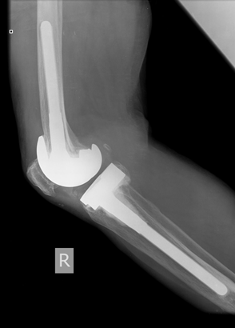
X-rays before injury

Slide 25
X-rays after fall
What is your classification?
Operative options:
Revision arthroplasty vs plating?
What are the difficulties?

Slide 26
Lateral position
Hip
Locking attachment plate system
Knee
Cable system
Cable “eyes”

Slide 27
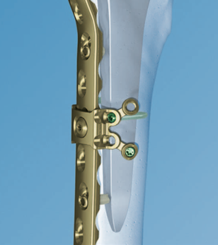
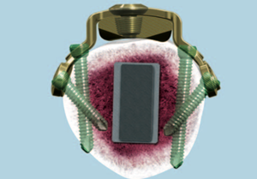
3.5 mm locking screws

Slide 28
Nonvascularized fibula autograft harvested from ipsilateral leg

Slide 29
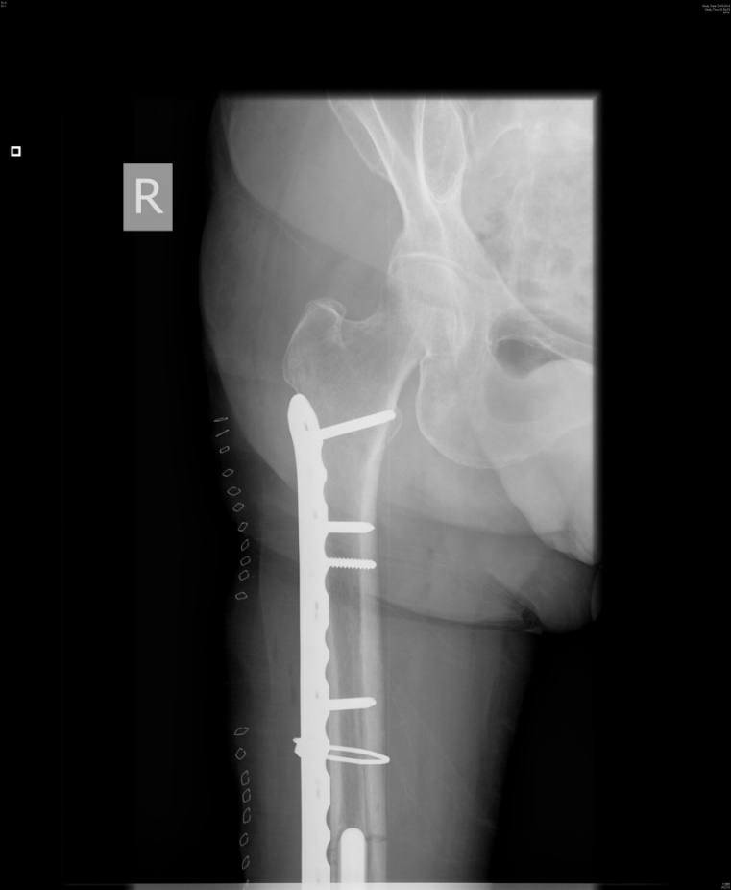
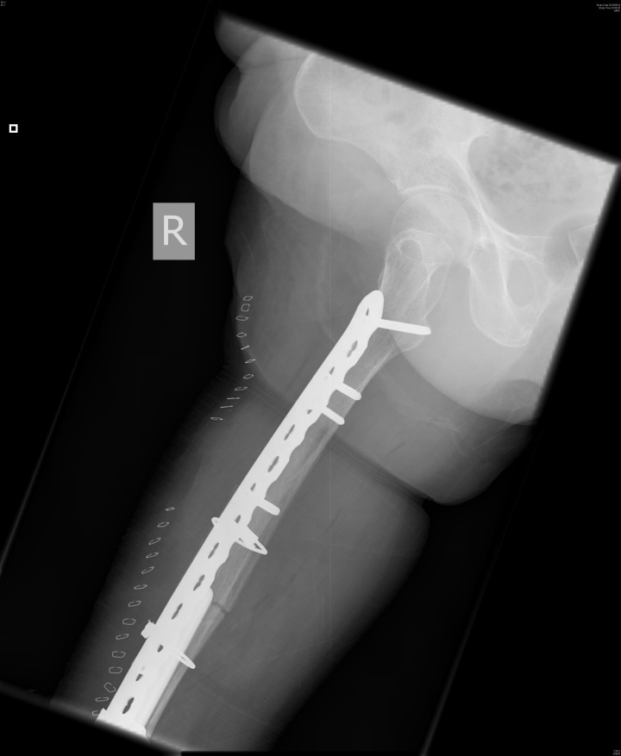
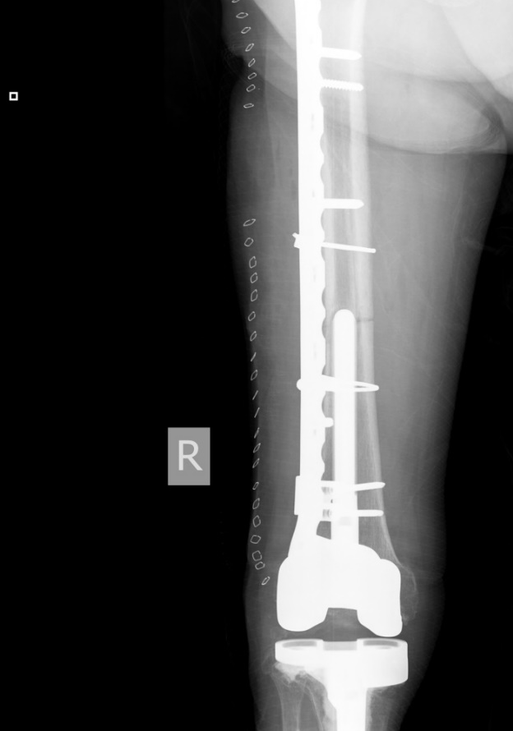
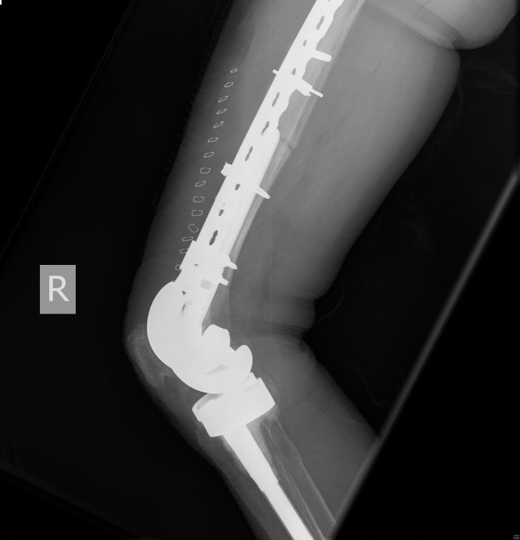
TTD walking

Slide 30
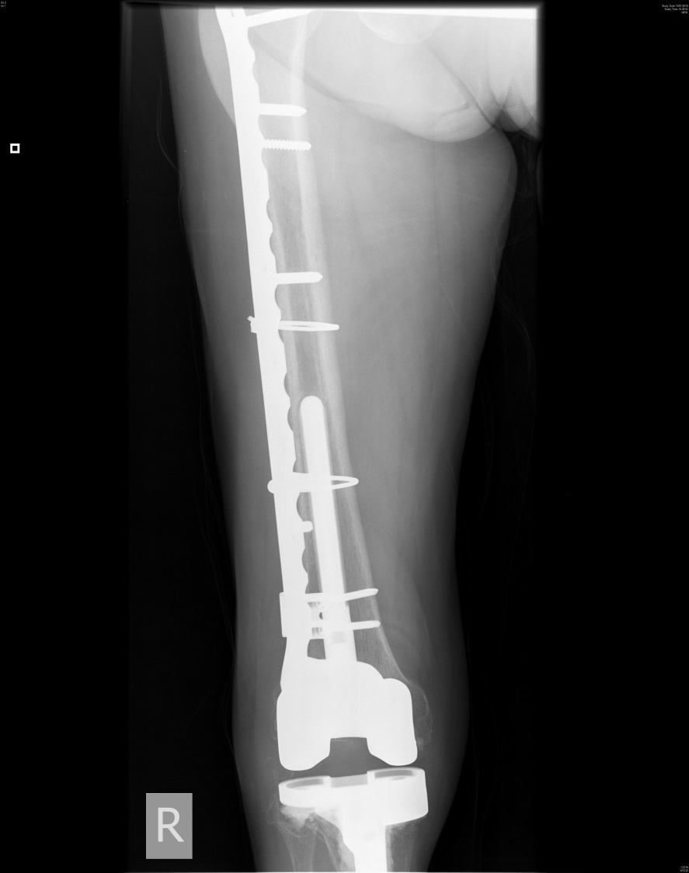
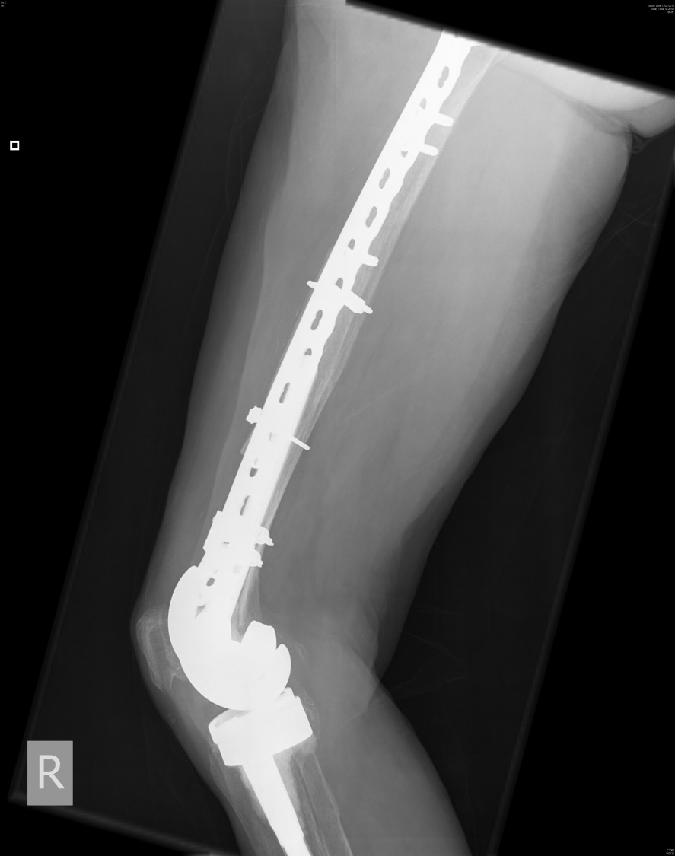
3 months postoperative

Slide 31
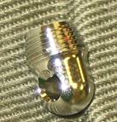
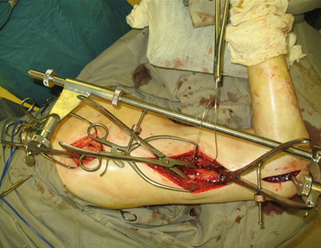
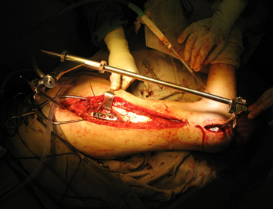
Techniques
Femoral distractor
Cerclage wiring
Lag screws
Locking plate
Cerclage wire reinforcement
Cerclage eye attachment

Slide 32
Take-home messages
Simple fracture needs accurate reduction
Strut graft (allograft or autograph) augmentation can improve both biology and mechanical stability
Plate should span as long as possible
Cerclage wires and locking attachment plates are important in fixing the segment with step
Risk factors for falls and osteoporosis should be addressed and managed, including medication

Slide 33
Thank you
Return to list of cases
Notes:
End of case 2

Slide 34
Case 3
Periprosthetic total knee replacement
AO Trauma Course Fragility Fractures and Orthogeriatrics
Notes:
Case 3 learning objectives:
Review the medication list
Discuss anticoagulation and management (indications, inappropriate prescribing)
Discuss the diagnosis of osteoporosis without any treatment/ undertreatment
Discuss the use of MIPO

Slide 35
Case description
79-year-old woman
Stumbled in dizziness at home
Was transferred from a smaller hospital the day after the fall
Charlson Index 2
Heart insufficiency
Osteoporosis
Had cardiac surgery 3 years before (biologic heart valvula)
Has anticoagulation with warfarin

Slide 36
Medication
Cefuroxim 500 mg post operative 1-0-1 for 3 days UTI
Valsartan/HCT 160/12.5 mg 1-0-0
Simvastatin 20 mg 0-0-1
Aspirin 100 mg 0-1-0
Calcium 600 mg 1-0-0
Bormazepam 6 mg 0-0-0-1/4
Oxycodon/naloxon 10/5 1-0-1
Pantoprazol 40 mg 1-0-0
OAC with vitamin K antagonist

Slide 37
Day 1

Slide 38
Current situation
Interprosthetic fracture
Intertrochanteric fracture healed (3 years before)
Femoral component of knee prosthesis seems not to have loosened
Charlson 2, Warfarin
Goal? Bring back home as soon as possible
Bridging therapy and urgent surgery planned
Treatment plan:
Plate fixation
Interlocking and overlapping proximally
Cement fixation of the screws distally
Day 1

Slide 39
Lateral position has a lot of advantages
Day 2

Slide 40
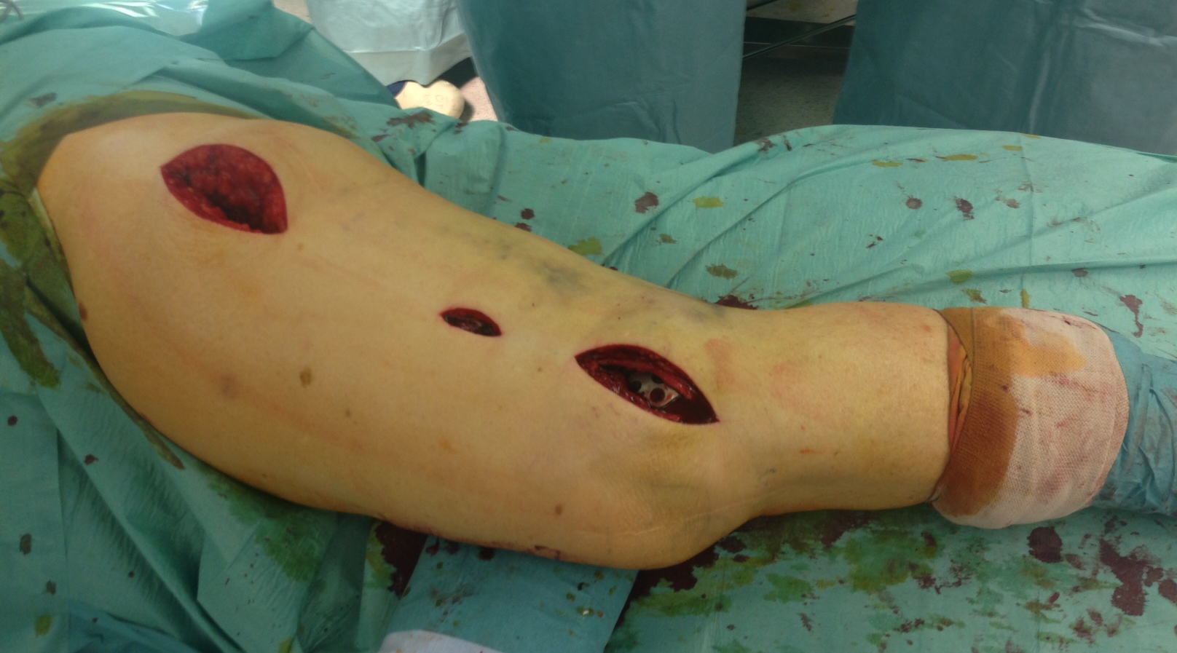
MIPO technique
Day 2

Slide 41
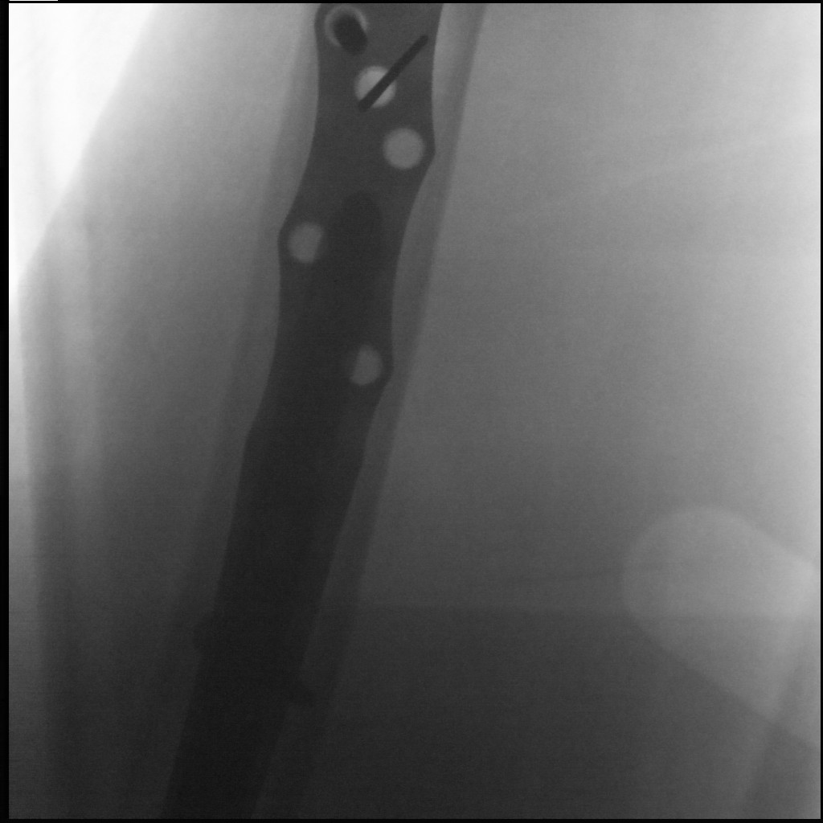
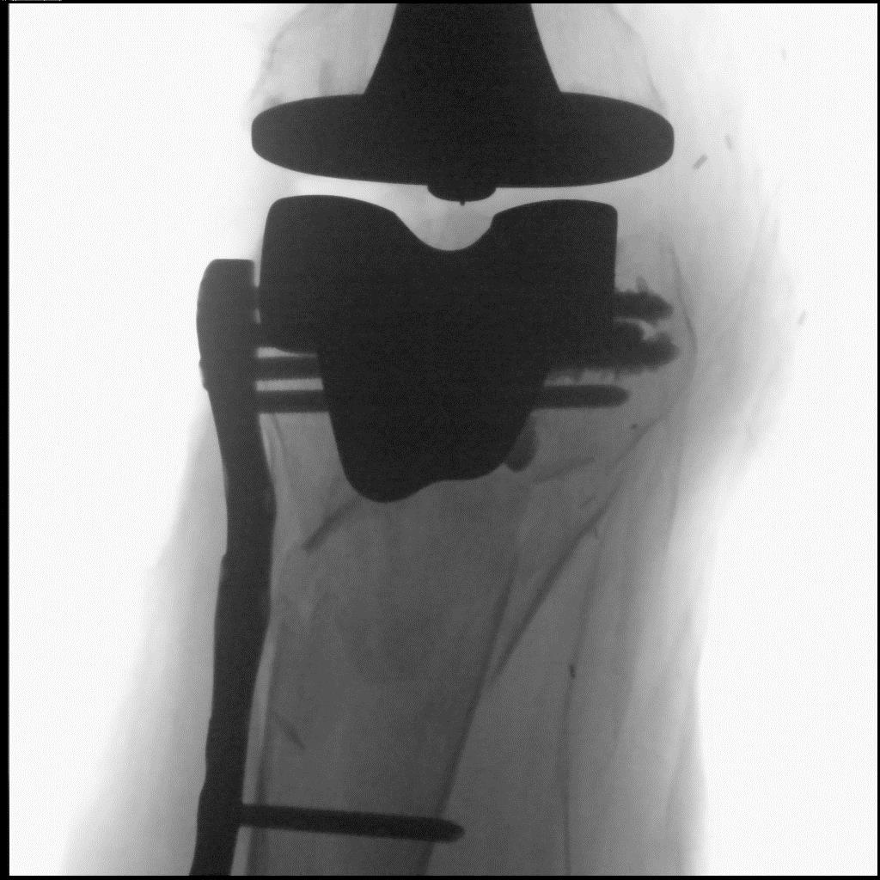
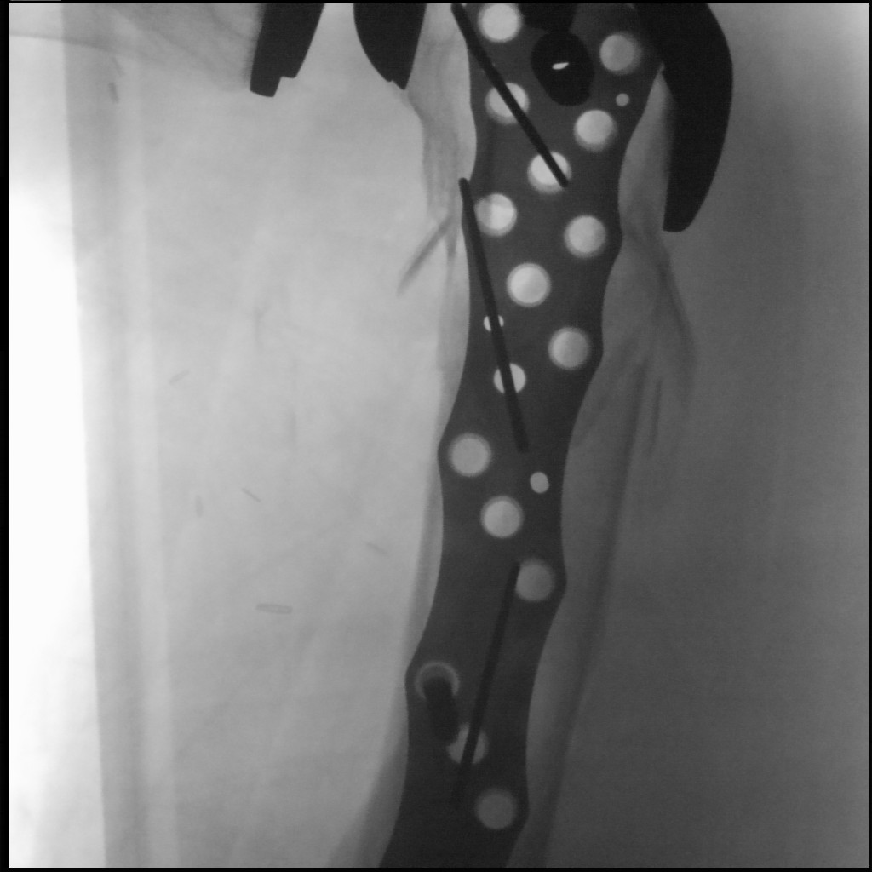
Day 2

Slide 42
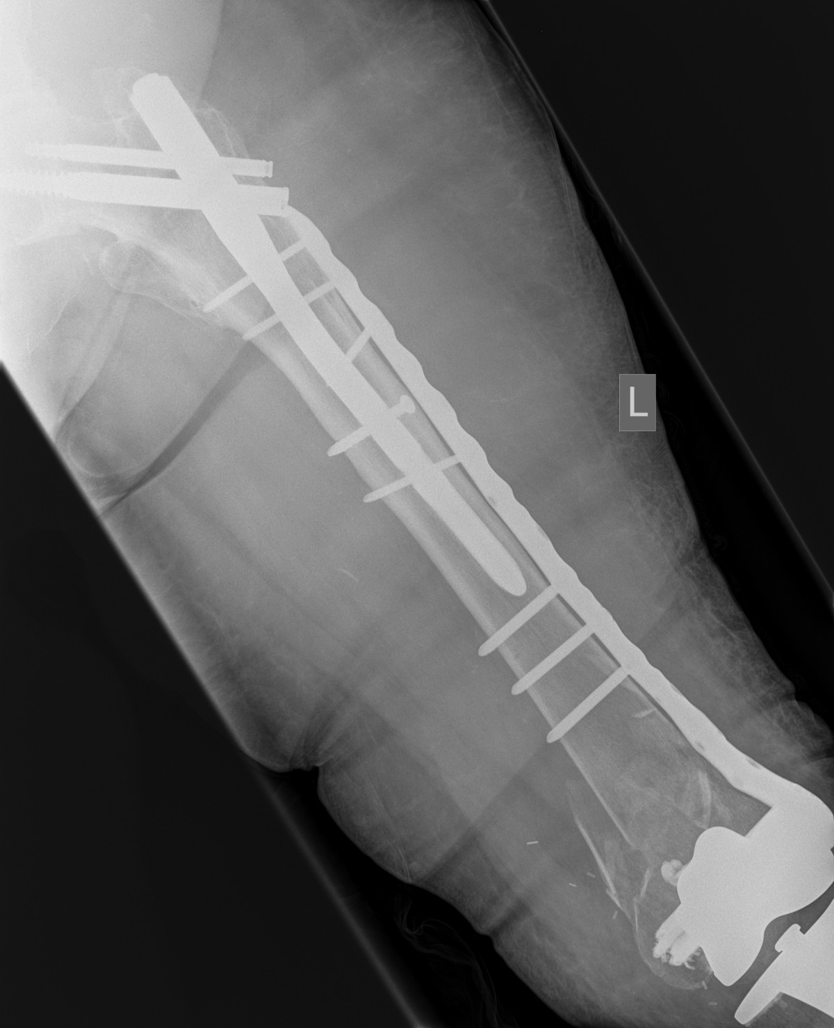
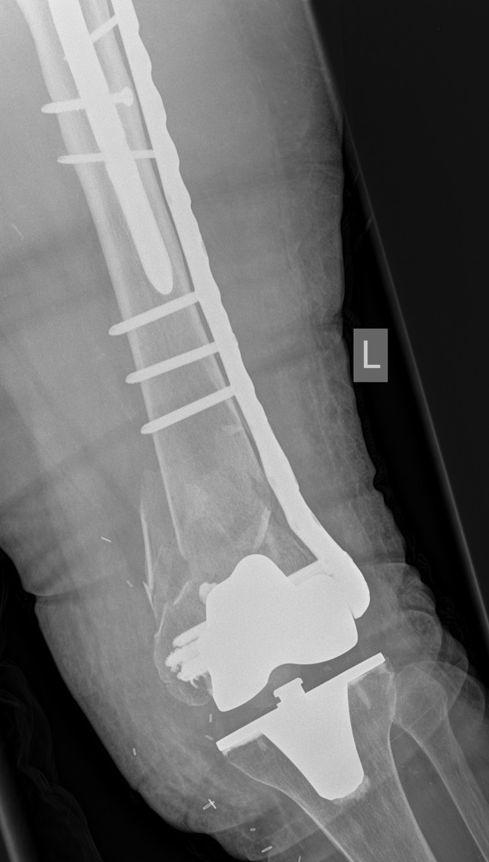
Shortening
Cement use
Day 5

Slide 43
Follow-up
Patient was mobilized with full weight bearing as needed to survive but had problems to mobilize due to fear of falling again
Could not return home again
Went to a nursing home 6 weeks later after geriatric rehabilitation

Slide 44
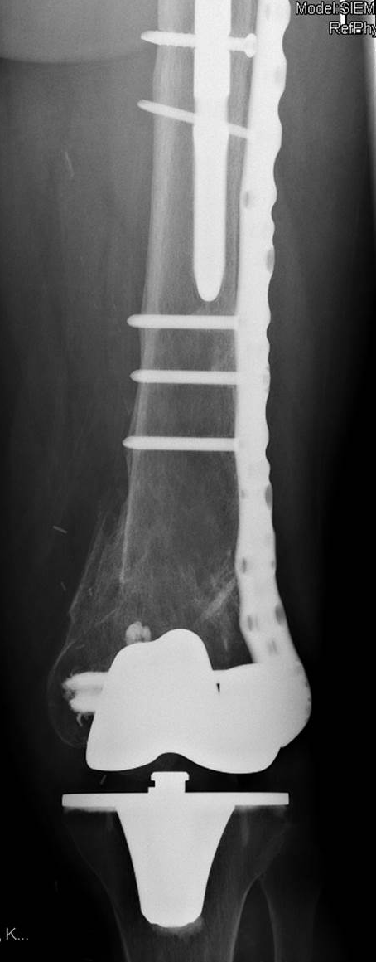
1-year follow-up

Slide 45
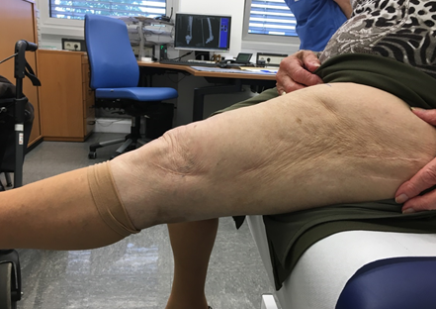
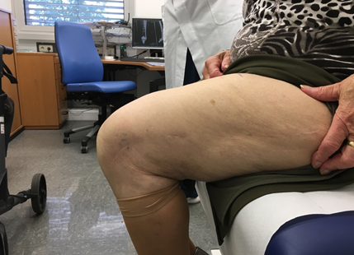
1-year follow-up

Slide 46
Take-home messages
Lateral position, MIPO approach
Cement use in severe osteoporotic cases
Inappropiate prescribing is frequent in older adults, review of medication list is essential (undertreatment regarding osteoporosis, overtreatment regarding cardiac diseases)
Anticoagulation does not result in a delay of more than 24 to 48 hours, if management is appropriate

Slide 47
Thank you
Return to list of cases
Notes:
End of case 3

Slide 48
Case 4
Unstable pertrochanteric fracture and augmentation
AO Trauma Course Fragility Fractures and Orthogeriatrics
Notes:
Case 4 learning objectives:
Discuss comorbidities, risk factors of delirium, and prophylaxis
Discuss the role and usefulness of the various preoperative tests in fragility fracture patients
Discuss cement augmentation

Slide 49
Case description
82-year-old woman
Stumbled on carpet at home
Has lived alone there for 2 months following the death of her husband
Was mobile with walker
Parker-Score of 5, ADL Barthel 75 pts, in an older chart a Mini-Mental-Score of 23 is mentioned
Notes:
Medical Issue:
What is the role of the functional status in older adults?
Discuss appropriate assessment tools for an orthogeriatric unit.
Discuss the role of home environment in secondary fracture prevention.

Slide 50
Medical history
Heart failure
Hypertension
Dementia
Coronary heart disease
Hypoacusis
Macular degeneration
Gastroesophageal reflux
Notes:
50
Medical issues:
Discuss the comorbidities, the use of the Charlson Comorbidity Index.
Discuss risk factors for delirium and prophylaxis.

Slide 51
Medication
Lansoprazol
Lisinopril
Nicorandil
Furosemid
Oxazepam
Aspirin
Potassium chloride
Zolpidem
Mirtazapin
Notes:
51

Slide 52
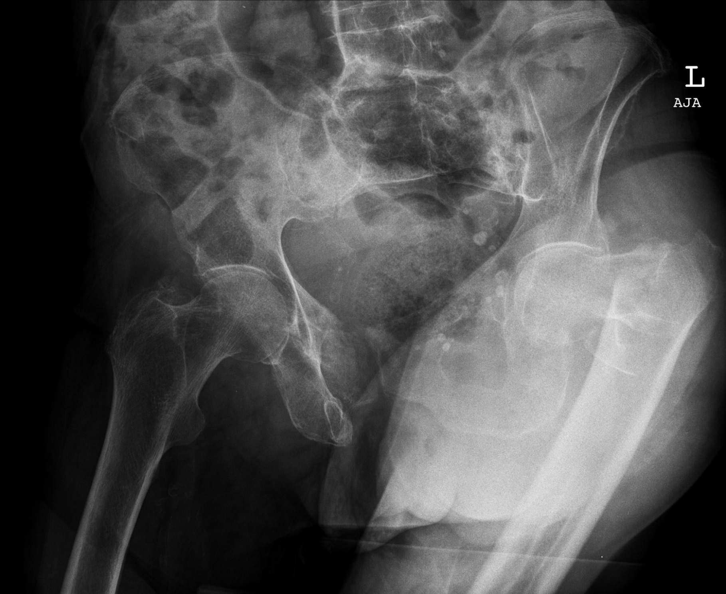
Notes:
52

Slide 53
Preoperative examinations
X-rays
Thoracic X-ray
ECG
Lab
Seen by internal specialist
Intermediate risk
Seen by anesthesiologist
ASA III
Notes:
Medical issues:
Discuss the role and the usefulness of different preoperative tests in fragility fracture patients.

Slide 54
What’s next?
DHS
PFN(a)
Blade plate
... ???
Notes:
54

Slide 55
Treatment
Cleared for surgery within 8 hours
PFNA
General anesthesia
Notes:
55
No general anesthesia due to poor pulmonary and cardiac conditions.
Despite T-AS intake still on the lecture immediate surgery with spinal / plexus anesthesia.
Intraoperatively, the plexus catheter on the shoulder is very poorly sitting, therefore alone ORIF is not conceivable, therefore also additional careful sedation with ketamine.

Slide 56
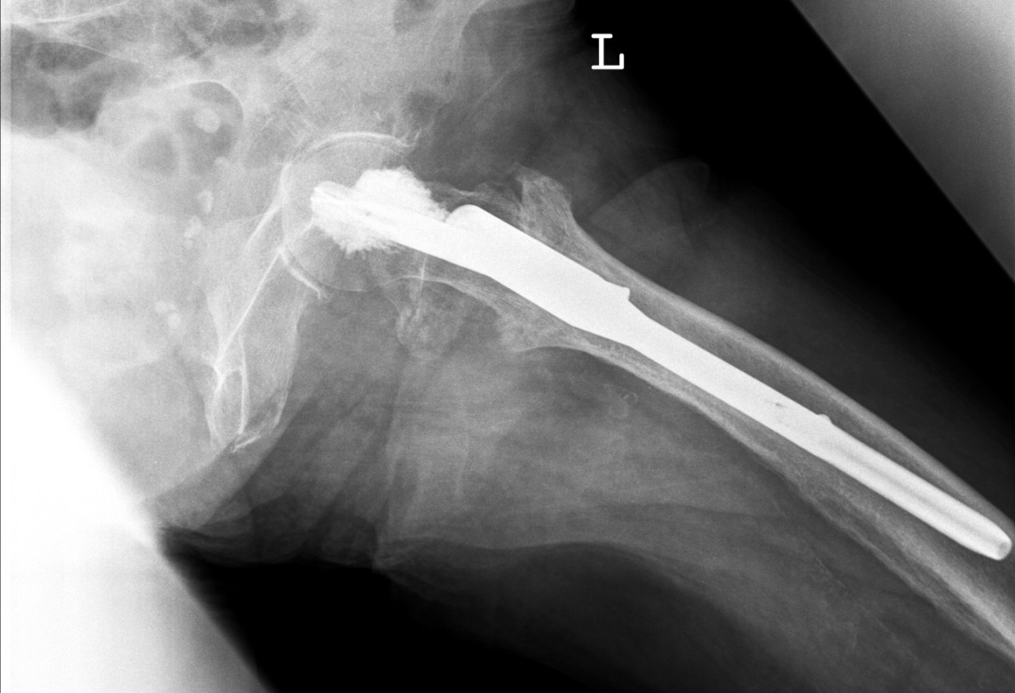
Notes:
56

Slide 57
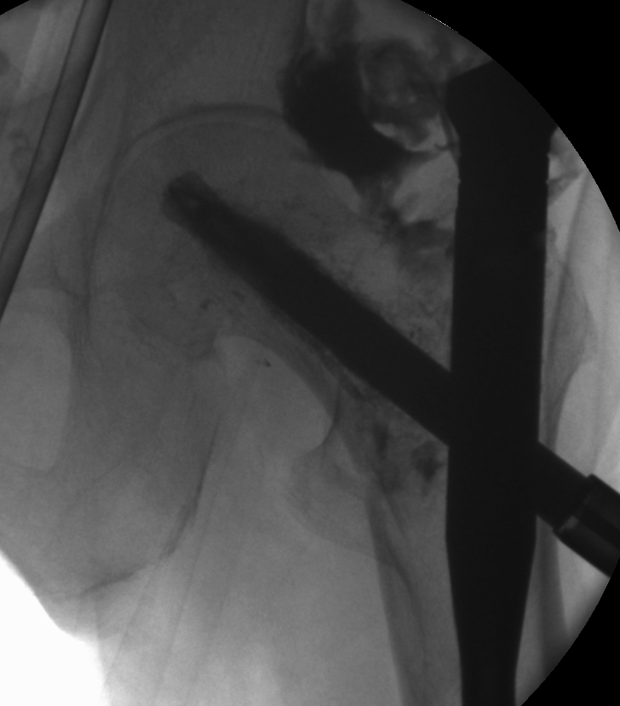
Typical distribution of contrast fluid
Note: no contrast dye within the hip joint

Slide 58
3 months later
Back home after 4 weeks rehabilitation
Mobile with walker alone
Better mood

Slide 59
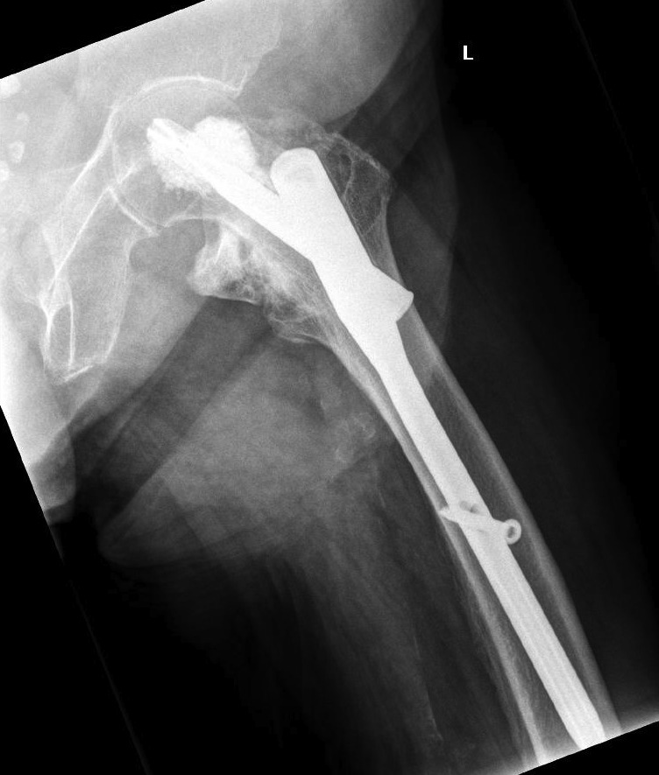
1-year follow-up
Notes:
59

Slide 60
Take-home messages
Standardized augmentation is an option in unstable hip fractures
Comorbidities and assessment of functional status are essential to avoid peri- and postoperative complications (eg, delirium)
Preoperative tests have to be used appropriately and after individual decisions

Slide 61
Thank you
Return to list of cases
Notes:
End of case 4

Slide 62
Case 5
Revision surgery after pertrochanteric fracture
AO Trauma Course Fragility Fractures and Orthogeriatrics
Notes:
Case 5 learning objectives:
Discuss preoperative assessment and optimization, focus on the usefulness of an echo, and in case of a delay of surgery, make a plan and time schedule for the process
Discuss the usefulness of a urinary catheter and the risk in terms of urinary tract infections and delirium
Discuss the management of rivaroxaban and other DOACs
Discuss the need for a DEXA as well as the result in this case
Discuss the anticoagulation management and doses, time of restart?
Discuss the management of cutout

Slide 63
Case description
89-year-old woman
Slipped on a rug and fell when leaving her home to go to the bakery at 07:45
Found by her son 10 minutes later (on his daily visit)
Due to severe pain at the left hip, she could not sit up or stand
Admitted to the ER at 08:20, brought in by ambulance
Clinical examination and x-rays showed a pertrochanteric fracture of the left femur, AO 31-A2
Notes:
Lives alone at home. Is able to manage most of the activities of daily living (ADLs) by herself but gets help from her family if needed

Slide 64
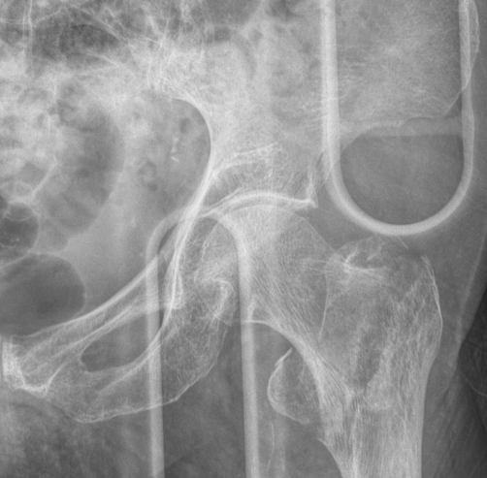
Case description

Slide 65
Medical history
Chronic kidney disease (CKD) stage 2
Paroxysmal atrial fibrillation (AF), takes rivaroxaban 20 mg daily
Aortic insufficiency II°, mitral insufficiency III°, tricuspid insufficiency III°, pulmonary hypertension (PHT)
Heart failure (HF) NYHA III°, arterial hypertension
Recurrent urinary tract infections (UTI), urge incontinence
Notes:
Medical issues:
Discuss preoperative assessment and optimization, focus on the usefulness of an echo and in case you go a delay of surgery, make a plan and time schedule for the further process.
Discuss the usefulness of urinary catheter and the risk in terms of urinary tract infections and delirium
Discuss the management of rivaroxaban and other DOACs.

Slide 66
Operative and postoperative treatment
Optimization of her medication preoperatively by geriatrician; enters OR for surgery 36h post admission
Last intake of rivaroxaban was 12 hours before admission, no bridging therapy was done, postoperatively Enoxaparin 60 mg s.c. twice daily
Closed reduction, PFNa 240/10 mm, 130°
Mobilization on postoperative day 2 with the aid of walking frame, physiotherapy
Transfer to geriatric rehabilitation center on postoperative day 11 for further mobilization and geriatric care
Notes:
Discuss the further anticoagulation management, doses?, time of restart?

Slide 67
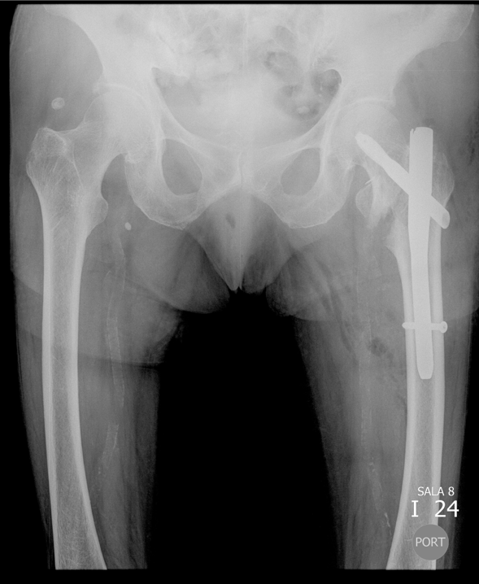
Postoperative x-ray

Slide 68
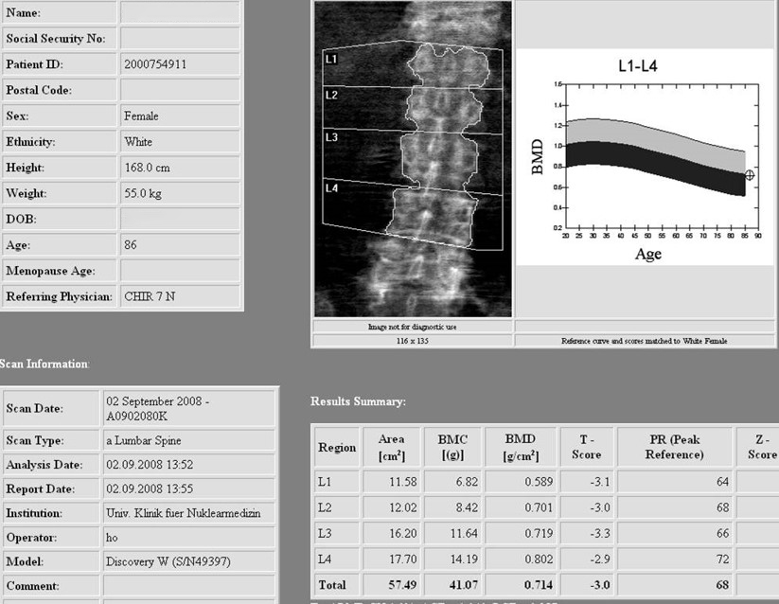
DEXA
Notes:
Medical Issue:
Discuss the need for a DEXA as well as the result in this case.

Slide 69
Geriatric rehabilitation
In spite of her medical problems, the patient mobilized well and was able to walk with the aid of a walking stick and to climb stairs
Discharged back home after 6 weeks of in-hospital stay

Slide 70
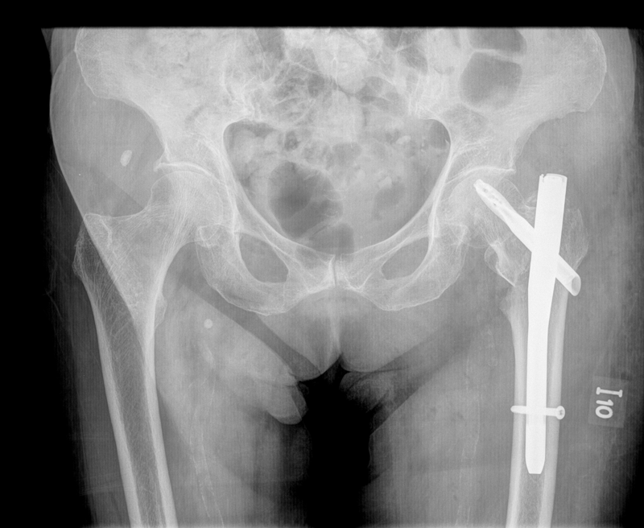
2 weeks later
At the 8-week follow up, the patient complained of progressively worsening pain in the left hip
X-rays show collapse of fracture line

Slide 71
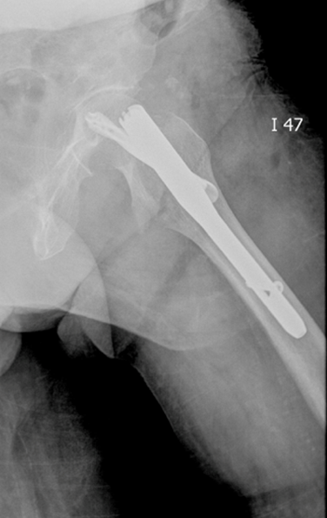

Slide 72
Geriatric rehabilitation center II
Transfer to the geriatric rehabilitation center
After a few weeks, hip pain appeared when turning around on her left leg
No history of fall or trauma

Slide 73
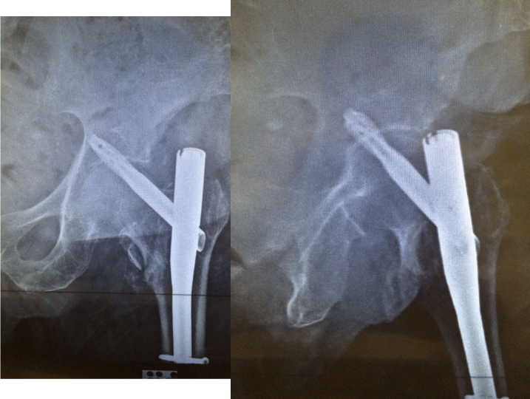

Slide 74
Admission to ER II
Clinical examination and x-rays showed a cut out of TFN
After preoperative optimization, the patient underwent surgery again

Slide 75
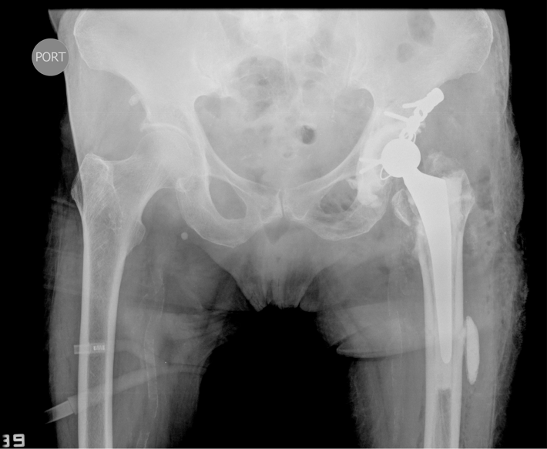

Slide 76
Geriatric rehabilitation center III
Overall hospital stay this time 8 weeks
At discharge, the patient was mobile with a walking frame but lost most of her independence in ADLs

Slide 77
Take-home messages
Optimization may help to improve the outcome, however, it doesn’t guarantee a good outcome
Usually an echocardiogram has no impact on the outcome
DOACs are even easier to manage than vitamin K antagonists
DEXA is not necessary in this case
One complication often provokes others

Slide 78
Thank you
Return to list of cases
Notes:
End of case 5

Slide 79
Case 6
Vertebral fracture
AO Trauma Course Fragility Fractures and Orthogeriatrics
Notes:
Case 6 learning objectives:
Discuss the results of the DEXA
Discuss the indication of vertebroplasty
Discuss the risk of immobilization in terms of sarcopenia
Discuss the assessment and treatment of pain in older adults
Discuss treatment for osteoporosis

Slide 80
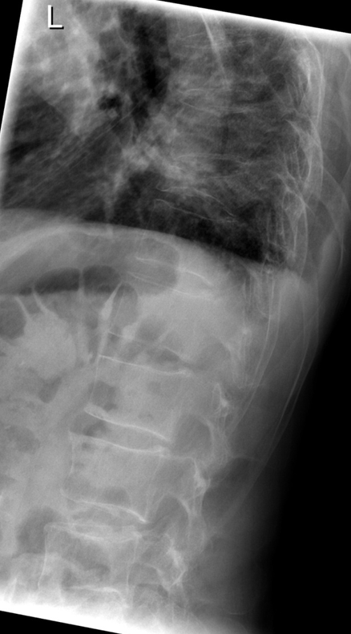
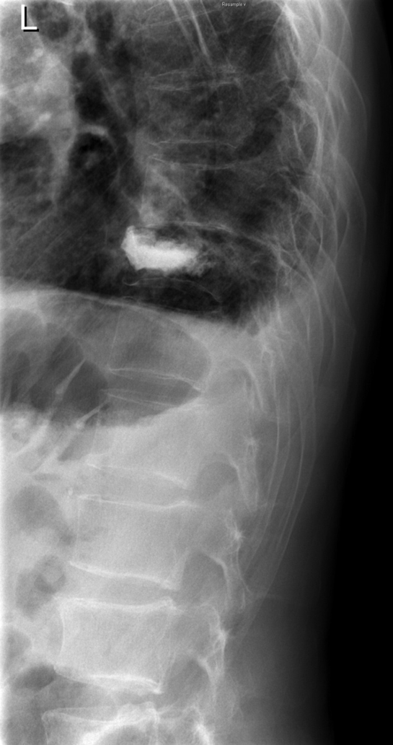
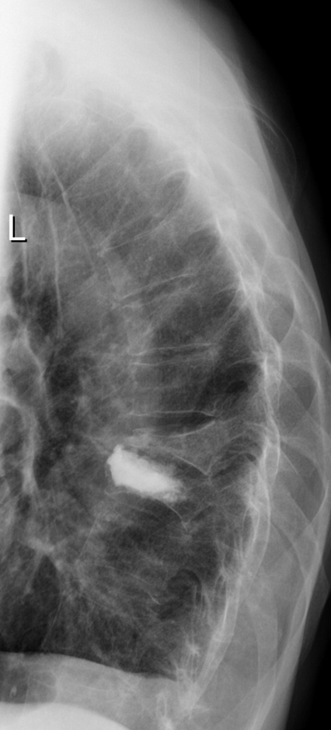
Subsequent vertebral fractures

Slide 81
Medical history
79-year-old man
Low lumbar back pain for 2 weeks: after entering backseat of a car
Previous back pain for 4 weeks: after lifting a heavy weight
In poor health
Mild cognitive impairment

Slide 82
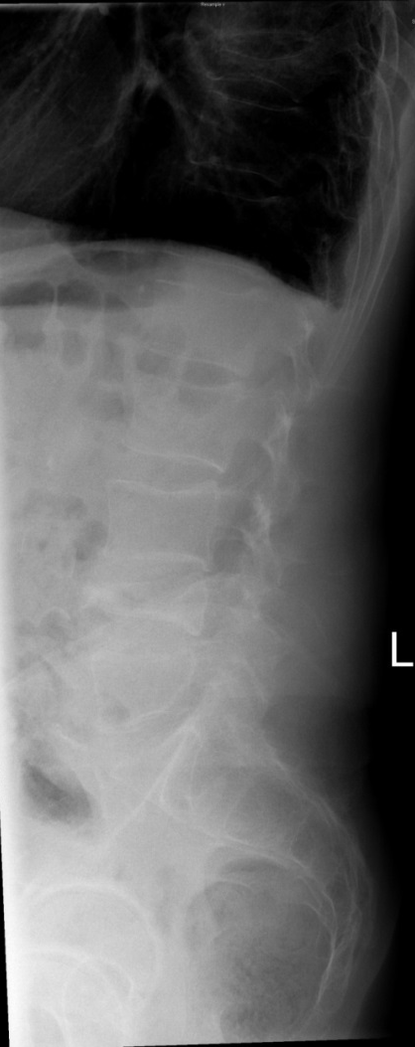
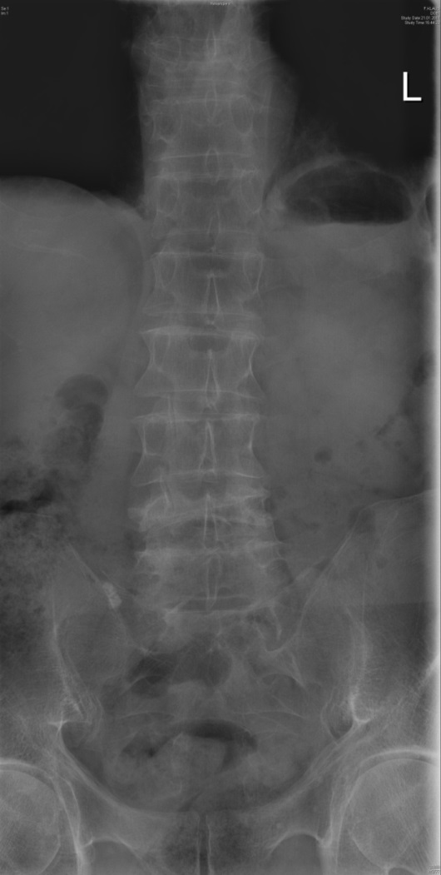
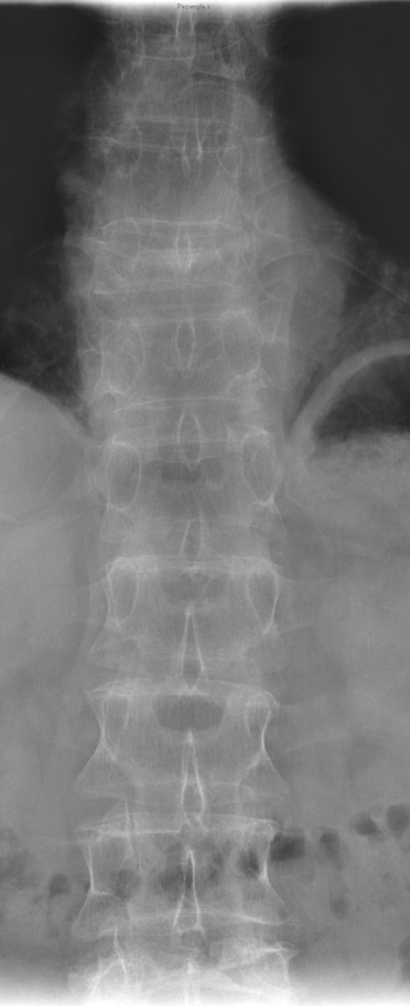
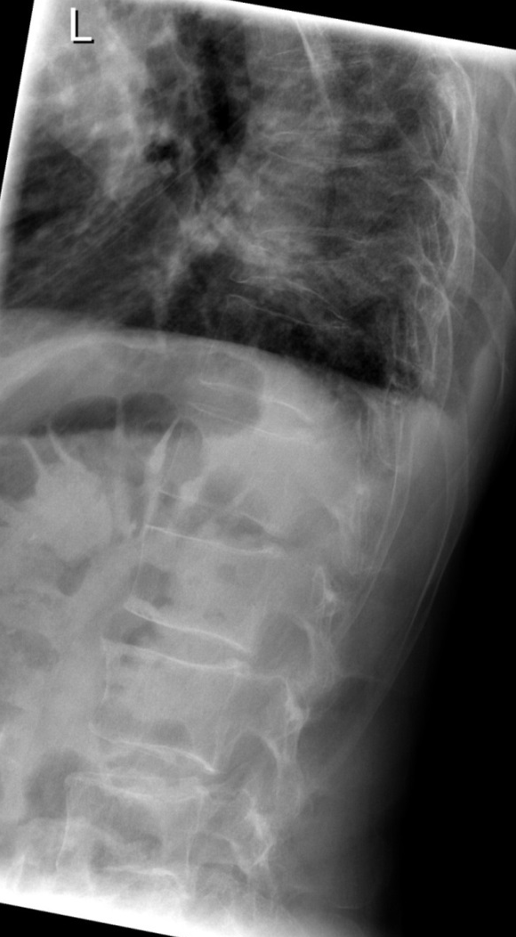
Diagnosis?
Notes:
82

Slide 83
Diagnostics
(Osteoporotic) T10 and L4 fractures
Further diagnostics?
MRI
DEXA
Notes:
83
83

Slide 84
Diagnostics
DEXA: Dual-energy x-ray absorptiometry
Notes:
84
84

Slide 85
Diagnostics
Notes:
85
Diagnostic 21.01.2011
85

Slide 86
Diagnostics
Notes:
86

Slide 87
DEXA on 27 January
Notes:
87
Medical issues:
Discuss the results of the Dexa.
87

Slide 88
DEXA on 27 January
Notes:
88
88

Slide 89
Vertebroplasty 31 January
Notes:
89
Medical Issue:
Discuss the risk of immobilization in terms of sarcopenia.
89

Slide 90
Follow-up x-ray 2 February
Notes:
90
Conventional x-ray on 02/02/2011 of Vertebro
90

Slide 91
Postoperative, VAS 2
Discharge postoperative day 3
Osteoanabolic therapy
3 weeks later: increasing pain
→ T9 compression fracture
Notes:
91
91
Medical issue:
Discuss the assessment and treatment of pain in older adults.
Discuss treatment for osteoporosis.

Slide 92
Follow-up x-ray 1 March
Notes:
92
92

Slide 93
Follow-up x-rays in March
8 March
13 March
Notes:
93
Recordings on 8 March 2011 (left) and 13 March 2011 (right)
93

Slide 94
Follow-up x-rays
26 April
27 September
Notes:
94
94

Slide 95
Take-home messages
The indication for vertebroplasty is pain relief
Subsequent vertebral fractures are an unsolved problem
Treatment of osteoporosis is essential, anabolic drugs (teriparatide are an option)
Immobilization quickly leads to sarcopenia
Sufficient pain assessment and treatment is required to avoid immobilization

Slide 96
Thank you
Return to list of cases
Notes:
End of case 6

Slide 97
Case 7
Total hip periprosthetic fracture
AO Trauma Course Fragility Fractures and Orthogeriatrics
Notes:
Case 7 learning objectives:
Recognize the importance of a multidisciplinary approach in complex situations
Discuss the treatment plan and required tests/examinations of a complex patient, in the emergency room and during care
Discuss early mobilization and physiotherapy so that the patient can resume activities of daily living as soon as possible and to prevent further injuries by making the home environment safer

Slide 98
Case description
84-year-old woman
Stumbled and fell down stairs between 1st and 2nd floor
Possible short loss of consciousness, found by son
Arrived at ER via ambulance at 10 pm, accompanied by her son and daughter-in-law
Pain in right hip
Lived with husband in own apartment in the son’s house
Till this day independently mobile, no help needed

Slide 99
Clinical examination
158 cm, 63 kg
RR 136/77 mmHg, HR ~ 95 bpm, SO2 94%
Conscious, partially disoriented, antero- and retrograde amnesia, appears anxious and unsettled
Neurological exam showed no pathological findings
Slightly bleeding wound in the occipital region (~ 6 cm)
Not able to lift right leg
Scar right hip – previous THA
Notes:
On general examination patient appeared conscious and alert, with no clear evidence of neurological deficit and had various movement in limbs. Vital signs were stable, and there was only evidence of superficial injuries like bruising, contusions, and lacerations on the limbs and head.
History however indicated possible head injury, indicated by amnesia , anxiety and restlessness.

Slide 100
Medical history
Arterial hypertension
Cardiac insufficiency NYHA II (New York Heart Assoc Functional Classification)
Status post necrotizing vasculitis 10 years previous
Status post surgery of cataract and glaucoma on both eyes
Anticoagulation with Warfarin after thrombosis of the left superficial femoral vein 8 years prior after abdominal surgery
Notes:
B-CLL = chronic lymphatic B-cell leukemia
NYHA = New York heart association functional classification: II → Mild symptoms and slight limitation during ordinary activity
Significant past medical history indicates that this patient has completed chemotherapy 8 years ago and is currently stable. With associated cardiovascular disease.
Of significance is that she is on anticoagulation therapy with Acenocumarol, which was prescribed for thrombosis of a superficial vein. The drug in fact was initially indicated only for 6 months but due to failure of communication to the GP it was continued for 9 years.

Slide 101
Medication
Acenocoumarol - sintrom
Digitoxin - digimerck 0.07 mg 1-0-0
Metoprolol - seloken 47.5 mg 1-0-0
Furosemide - lasix 40 mg 1-0-0
Notes:
101
Anticoagulant Acenocoumarol: Vitamin K antagonist
Heart medication:
- Digitoxin: cardiac glycoside
- Metoprolol: selective B1 receptor blocker
- Furosemide: loop diuretic

Slide 102
Examinations
Which examinations would you order?
Notes:
102
Recognize the importance of a multidisciplinary approach in complex situations.
Discuss your treatment plan and required tests/examination in the emergency department.

Slide 103
ER examinations
Craniocerebral and cervical computer tomography (CCT)
X-rays of thorax, pelvis, right lower leg
Routine laboratory tests (slightly elevated liver parameters, normal kidney function, hematocrit 47%, leucocytes (11.2 G/l), thrombocytes (109 G/l), quick (PT) 35%; INR 2.3, normal urine sample
ECG (normal sinus rhythm)
Notes:
103
Investigations ordered:
CT scan - Brain and cervical spine
X-rays – chest x-ray, lumbar spine, pelvis, and right lower limb (because of trauma history – fall down a whole flight of stairs)
Coagulation profile
Routine (preoperative), routine bloods, ECG

Slide 104
CT scan
Traumatic SAB frontoparietal (right side)
Neurosurgical consultation: no indication for surgical intervention, observation recommended, control CT scan in 6 hours
Notes:
104
Multidisciplinary approach to managing this patient, neurosurgeons contacted

Slide 105
X-ray
Notes:
105
Fracture of right femoral neck

Slide 106
Chest x-ray
Notes:
106
Slight signs of heart insufficiency, otherwise normal chest x-ray

Slide 107
ECG
Notes:
107
Electrocardiogram (pre-op) – normal sinus rhythm

Slide 108
Current situation
The 84-year-old female patient is comorbid and osteoporotic
Traumatic subarachnoid hemorrhage on the right frontoparietal region, symptoms of concussion
Periprosthetic fracture in right femur
Occipital wound
Anticoagulation with acenocumarol
It’s 11.30 pm

Slide 109
Treatment
What would you do?
Notes:
Discuss your treatment plan and your next steps

Slide 110
Treatment
Wound treatment of the occipital cut
Immobilization of the right leg in a rubber foam splint
Pain medication with paracetamol (perfalgan)
After interdisciplinary discussion with anesthetist:
Reversion of anticoagulation: vitamin K 10 mg i.v.
Sintrom medication stopped
Observation at ICU, additional administration of prothromplex 2000 IE (human coagulation factors II, VII, IX, X and protein C)
Notes:
In this patient treatment, emphasis is on reversing anticoagulation, mainly due to the intracranial bleeding.
Sintrom was stopped, Vit K was given iv high dose, secondarily after consultation of intensive care anesthesists, also Prothromplex was administered.
Again: multidisciplinary approach

Slide 111
Further treatment
Normal INR (1.0) six hours later
Next day:
GCS 15, retrograde amnesia, no neurological deficit
Intracranial bleeding, no progression on CT scan after 6 hours
Cleared for surgery after interdisciplinary consultation (traumatologist, geriatrician, anesthesiologist)
Underwent surgery 18 hours after admission

Slide 112
Surgical options
Periprosthetic fracture:
Stem revision
ORIF - plating
MIPO - plating
Notes:
In view of the fracture characteristics and the patient’s medical and social history it was decided to proceed with DHS.

Slide 113
Surgical treatment - MIPO
Day 1
Notes:
Under normal INR spinal anesthesia now possible without risk, preferred to general anesthesia in the case of concomitant intracranial bleeding

Slide 114
Surgical treatment - plate
Day 1
Long splinting
Locking attachment plate
Notes:
Under normal INR spinal anesthesia now possible without risk, preferred to general anesthesia in the case of concomitant intracranial bleeding

Slide 115
Postoperative
Day 2-6
Paracetamol (perfalgan) iv and piritramide (dipidolor) sc for pain medication
DVT prophylaxis with enoxaparin (lovenox) 40 mg sc once daily
Pain-dependent full weight-bearing mobilization with walking frame on postoperative day 2
Intracranial bleeding regressed on CT scan by day 5
Daily geriatric and trauma consultation, no complications noted
DEXA scan: osteoporosis
Transferred to geriatric rehabilitation center on postoperative day 6

Slide 116
Postoperative
Day 2-6
Early full weight bearing

Slide 117
Further treatment
Day 7-23
Geriatric assessment: no evidence of cognitive impairment, no signs of depression, slight loss in nutritional status, increased risk of falls, visual impairment on the left side, mixed urinary incontinence; rating: geriatric
Intensive physiotherapy, consultation on preventing injuries
Ophthalmologic consultation: vision could not be improved
Osteoporosis therapy: alendronate (fosamax) and calcium/vit D, additional vit D for 10 weeks
Prophylactic thrombosis prophylaxis for 4 weeks postop, but no longer indication for chronic anticoagulation
Discharged home after 2½ weeks, well mobilized with crutches

Slide 118
3-month follow-up

Slide 119
Take-home messages
Complex situations can be handled better using a multidisciplinary approach
Intracranial bleeding is frequent in anticoagulated geriatric trauma patients
MIPO is an option for periprosthetic fractures with stable stem

Slide 120
Thank you
Return to list of cases
Notes:
End of case 7

Slide 121
Case 8
Humeral shaft fracture
AO Trauma Course Fragility Fractures and Orthogeriatrics
Notes:
Case 8 learning objectives:
Discuss nailing vs plate fixation
Discuss osteoporosis, nutrition, and prevention of falls, especially after a first fracture

Slide 122
Case description
85-year-old woman fell from her nursing home bed
Left arm closed injury
No neurological deficit
Diabetes
Hypertension
Ischemic heart disease
Congestive heart failure
Previous old fracture of right femur, with MIPO

Slide 123
Medication
Aspirin 100 mg 0-1-0
Gliclazid 30 mg 1-0-0
Metoprolol 50 mg ret. 1-0-0
Pantoprazol 20 mg 1-0-0
Perindopril 8 mg 1-0-0
Simvastatin 20 mg 0-0-1
Zolpidem 5 mg 0-0-0-1
Calcium 1500 mg 1-0-0

Slide 124
Fracture of right distal femur 4 years previously

Slide 125
MIPO with DF-LCP

Slide 126
1 year after fixation Screws loosened but fracture heals

Slide 127
X-rays this time

Slide 128
How would you treat it?
Nonoperative
IM nailing
ORIF (plate)
MIPO

Slide 129
Post slab-splint immobilization x-ray
Would you accept this?
Why is the alignment not good?

Slide 130
For MIPO
Comments? Good? Bad?
Would you do the same?
What would be your rehabilitation?

Slide 131
1 month later Allow free mobilization

Slide 132
3 months later Increase in pain
How to manage?
ESR, CRP all normal. No sign of infection. Wound heals well.

Slide 133
3 months later Increase in pain
What went wrong?
Stability?
Biology?
Both?
How to manage?

Slide 134
Revision fixation ORIF with bone substitute
Comment?
Will this heal?
Needs protected movement?
Osteoporosis? Vitamin D deficiency?

Slide 135
1 year post revision fixation Pain free left arm with some shoulder stiffness

Slide 136
Back to the medical aspects
85-year-old woman fell from her nursing home bed
Left arm closed injury
No neurological deficit
Diabetes
Hypertension
Ischemic heart disease
Congestive heart failure
Previous old fracture of right femur, with MIPO
Aspirin 100 mg 0-1-0
Gliclazid 30 mg 1-0-0
Metoprolol 50 mg ret. 1-0-0
Pantoprazol 20 mg 1-0-0
Perindopril 8 mg 1-0-0
Simvastatin 20 mg 0-0-1
Zolpidem 5 mg 0-0-0-1
Calcium 1500 mg 1-0-0
Notes:
Discuss osteoporosis, nutrition, and prevention of falls, especially after a first fracture

Slide 137
Take-home messages
Humeral shaft fracture can usually be treated by nonoperative means but difficulty encountered in:
Transverse fracture pattern
Obese patients (especially ladies)
Very osteoporotic bone
MIPO improves biology but the stability still depends on implant construct and bone quality
Humerus fixation requires a lot of rotational stability
Always exclude secondary cause of osteoporosis and delay bone healing
Secondary fracture prevention (including osteoporosis, nutrition, fall prevention) should be addressed in every patient

Slide 138
Thank you
Return to list of cases
Notes:
End of case 8

Slide 139
Case 9
Distal radial fracture
AO Trauma Course Fragility Fractures and Orthogeriatrics
Notes:
Case 9 learning objectives:
Discuss wrist function as an outcome and operative vs nonoperative care
Recognize and manage a patient with dementia and describe how to get patient consent in this situation
List and recognize the risk factors for delirium

Slide 140
Case description
74-year-old man
Fell in the bathroom during a holiday at a resort with his wife

Slide 141
X-rays

Slide 142
Medical history
Dementia
Risk factors for delirium
Notes:
Discuss the problem of getting consent in patients with dementia and the difference between the wrist fracture and the hip fracture.
Discuss the risk of delirium and options for nonpharmacological and pharmacological prevention.

Slide 143
What is the ideal management?
Surgical fixation of the hip?
What about the distal radius? Nonoperative vs surgical treatment

Slide 145
Post manipulation and reduction
Reconsideration of options?
Nonoperative or surgical?

Slide 146
If surgical option considered
Discuss:
Approach
Implant options
Ulna styloid–does it need fixation?
Carpal tunnel release–is it required?

Slide 147
Intraoperative images

Slide 148
Postoperative images

Slide 149
Take-home messages
Nonoperative managed Colles fractures have high rates of loss of reduction but equal wrist function at 1-year follow-up
In active individuals, fixation is recommended to start early mobilization and weight bearing
In ipsilateral lower limb fractures, upper limb stability with fixation will enhance ambulation with walking aid
Patients with dementia are at high risk for delirium
Nonpharmacological prevention is essential
Getting consent could be very difficult, team responsibility is helpful

Slide 150
Thank you
Return to list of cases
Notes:
End of case 9

Slide 151
Case 10 (a)
Proximal humeral fracture
AO Trauma Course Fragility Fractures and Orthogeriatrics
Notes:
Case 10 learning objectives:
Discuss operative and nonoperative treatment options
Discuss the impact of further information on the management of complex fragility fracture patients
Discuss the pain treatment
Discuss the risk factors for delirium, the use of restraints, and family support
Discuss the results of lab tests and the indication of antibiotic treatment
Recognize the value and process of shared decision making
Discuss the treatment of delirium

Slide 152
Case description
87-year-old man
Former professor of urology
Sustains a fall in his flat
For many years has suffered dizziness, but no further falls in his history
No known comorbidities, no drug treatment
Complains of massive pain in the right shoulder and some pain in the pelvis

Slide 153
X-rays of left shoulder

Slide 154
X-rays of pelvis

Slide 155
Patient information
Do you need further information?
Prefacture status: Parker score of 8, ADL 95
He lives independently, together with his wife in their own house in Nuremberg
They receive some support for housework
They have two children, both physicians, daughter is an eye specialist in Switzerland, son is a plastic surgeon in the US
CT scans?
Notes:
Discuss the impact of further information on the management of complex fragility fracture patients.

Slide 156
CT scan of left shoulder

Slide 157
CT scan of pelvis
Surgical treatment?

Slide 158
Geriatric consultation
The patient is confused and agitated
He doesn‘t tolerate nursing
He suffers from urinary incontinence, but refuses a urinary catheter
Pain score 8 (using the VAS)

Slide 159
Medication
Enoxaparin 40 mg sc
Ibuprofen 400 mg 1-1-1
Pantopralol 40 mg 1-0-0
Recommendations:
Hydromorphone ret. 2 mg 1-0-1
Hydromorphone 1.3 mg on demand
Macrogol for prophylaxis of constipation
1000 ml Ringer infusion
Notes:
Discuss the pain treatment.

Slide 160
Daughter demands further investigation
CT of the brain
Neurological examination because of a mild tremor
Consultation by the cardiologist
Consultation by the anesthesiologist

Slide 161
The next night
Patient becomes agitated during the night, he cries, and tries to get out of bed
Nursing was impossible
The staff use restraints and the physician on call prescribes 5 mg haloperidol IM
The following day the patient was transferred to the geriatric ward
The goal was to stabilize the patient regarding the delirium and afterwards go for elective surgery
Results of the CT scan: no bleeding, minimal vascular lesion, older genesis
Notes:
Discuss risk factors for delirium and the use of restraints.

Slide 162
Lab tests
Hb 12.3 g/dl RR 128/68 mmHg
Sodium 132 mmol/l HR 86/min
Calcium 1.98 mmol/l Temp. 37.5°
CRP 8.1 mg/gl ↑ (5.3 two days earlier)
Urine test: no sign of UTI
Chest x-ray: no signs of pneumonia
Infection yes or no?
Antibiotic treatment?
Notes:
Discuss the results of the lab tests and the indication of antibiotic treatment.

Slide 163
Geriatric ward
Patient remains delirious and agitated, he is accompanied by his daughter
He gets a single room with an opportunity for the daughter to sleep in the same room
Antibiotic treatment with cefuroxim 1.5 mg iv and fluid management
No urinary catheter but a urinal is provided
Physiotherapy is provided to mobilize him
Notes:
Discuss the value of family support in such cases.

Slide 164
Updated medication
Paracetamol 500 mg 1-1-1-1
Metamizol 500 mg 1-1-1-1
Vitamin D3 20000 U per day
Quetiapine 25 mg 0-0-0-1 and on demand
Dalteparin 5000 IU sc

Slide 165
Next day
Patient is deeply sedated, so physiotherapy or oral nutrition are not possible
His daughter still demands further investigation
Now what would you do?
Quetiapine medication is stopped and the daughter is informed about the problem of delirium
She is encouraged to become engaged in the care of her father

Slide 166
6 days later
Delirium improves over the days
During day hours the patient is reasonably comfortable but confusion and agitation occur primarily at night
CRP ↓ antibiotic treatment is stopped
Pain is well tolerated

Slide 167
6 days later

Slide 168
Interdisciplinary team meeting
Decision is made for nonoperative treatment, and to continue physiotherapy
Relatives are informed, discussion with them about the pro’s and con’s of surgery
Obtained a consensus with the patient and his family
Notes:
Discuss the process and value of shared decision making.

Slide 169
A further 4 days later

Slide 170
Discharged day 12
Patient still has mild delirium, but urinary incontinence is getting better
He is mobile with some help of one person, ambulatory physiotherapy is recommended
Medication now involves:
Paracetaol 500 mg 1-1-1-1
Vitamin D3 20000 U per week

Slide 171
A further 3 weeks later
3 weeks later, a phone conversation with his son
Situation at home is working, however, clinical situation is still the same

Slide 172
Take-home messages
In older patients, nonoperative treatment of proximal humeral fractures is a good option, even in displaced or fragmented fractures
Delirium is caused multifactorially and not always associated with anesthesia
If possible, nonpharmacological is better than pharmacological treatment
Information and cooperation with family members is extremely important

Slide 173
Thank you
Return to list of cases
Notes:
End of case 10

Slide 174
Case 10 (b)
Proximal humeral fracture
AO Trauma Course Fragility Fractures and Orthogeriatrics
Notes:
Case 10 learning objectives:
Discuss operative and nonoperative treatment options
Discuss the impact of further information on the management of complex fragility fracture patients
Discuss the pain treatment
Discuss the risk factors for delirium, the use of restraints, and family support
Discuss the results of lab tests and the indication of antibiotic treatment
Recognize the value and process of shared decision making
Discuss the treatment of delirium

Slide 175
Case description
78-year-old woman
Simple fall at home
She complains of massive pain in the left shoulder and some pain in the pelvis
Comorbidities: none mentioned, no drug treatment
Diagnosed with osteoporosis for spine and osteopenia for hip
Notes:
Osteoporosis/osteopenia discovered and treated 6 months before fall

Slide 176
Case description
T score -3,6
T score -2,2
Diagnosed with osteoporosis for spine and osteopenia for hip
Notes:
Osteoporosis/osteopenia discovered and treated 6 months before fall

Slide 177
Simple fall at home
Day 0
Pain left shoulder, neurovascular not compromised, closed injury

Slide 178
Pain is acceptable
Day 5

Slide 179
Moderate function
3 weeks

Slide 180
Radiological outcome
6 months
48⁰
Notes:
Fractures healed in varus and some retroversion.
Less than 55° of retroversion on transscapular view means good functional outcome (see reference).

Slide 181
Clinical outcome
6 months
No complaints
ADL active as before
Notes:
Abduction and endorotation are very acceptable.

Slide 182
Take-home messages
Partially displaced 4-part fractures in older adults can be treated nonoperatively
Amount of retroversion predicts outcome

Slide 183
References
Poeze M, Lenssen AF, Van Empel JM, et al. Conservative management of proximal humeral fractures: can poor functional outcome be related to standard transscapular radiographic evaluation? J Shoulder Elbow Surg. 2010; 19(2):273−281.

Slide 184
Thank you
Return to list of cases
Notes:
End of case 10

Slide 185
Case 11
Periprosthetic acetabular fracture
AO Trauma Course Fragility Fractures and Orthogeriatrics
Notes:
Case 11 learning objectives:
Consider revision arthroplasty for (periprosthetic) acetabular fractures
Discuss full weight bearing in geriatric fracture treatment
Discuss management of UTI, infection prevention, and antibiotic prophylaxis

Slide 186
Case description
88-year-old woman
Fell in nursing home
Charlson index 2
Heart insufficiency
Hypertension
COPD
Urinary tract infection

Slide 187
Medication
Valsartan/HCT 160/12.5 mg 1-0-0
Aspirin 100 mg 0-1-0
Calcium 600 mg 1-0-0

Slide 188
X-rays
Frequent falls
Fracture of greater trochanter
Periprosthetic acetabular fracture

Slide 189
Anterior column fractured

Slide 190
Current situation
Periprosthetic acetabular fracture
Charlson 2, no contraindication for acute surgery
Goal: bring back home ASAP
Options
Plate fixation
Revision arthroplasty
Notes:
Discuss management of UTI, infection prevention, antibiotic prophylaxis

Slide 191
Revision system
Big screws in supraacetablar region with good purchase
Tricalciumphosphate

Slide 192
Tricalciumphosphate

Slide 193
Immediate full weight bearing allowed

Slide 194
Follow-up
Was mobilized with full weight bearing as needed to survive but had problems to mobilize due to fear of falling again
Went back to nursing home
Satisfied at the 1-year follow-up

Slide 195
Notes:
In accident surgery, we are increasingly seeing elderly patients, such as this patient, who has contracted injuries to the same localization within the framework of a mundane domestic tumble. However, a completely different surgical strategy is necessary for this patient. The lady had multiple internal medical conditions and must be optimized for the surgery. In addition, we often find two other problems: on the one hand existing implants due to pre-existing injuries, on the other hand a poor bone quality due to a pre-existing osteoporosis. The aim is always to provide as soon as possible operative care and rapid postoperative mobilization.

Slide 196
Take-home messages
Full weight bearing is a must-have in orthogeriatric fracture treatment
Consider revision arthroplasty for (periprosthetic) acetabular fractures

Slide 197
Thank you
Return to list of cases
Notes:
End of case 11

Slide 198
Case 12
Difficulties in fixation and healing
Difficulties in fixation and healing
AO Trauma Course Fragility Fractures and Orthogeriatrics
Notes:
Case 12 learning objectives:
Discuss the medication list regarding comorbidities, and check the indications and discuss undertreatment
Discuss the recommendation for osteoporosis treatment
Discuss the importance of secondary fracture prevention and reasons for treatment failure of osteoporosis medication
Discuss the indication of teriparatide and the treatment of osteoporosis after two years

Slide 199
Case description
Woman 80+ years old
Height 160 cm, weight 61.8 kg (BMI 24.1)
Former physician
History of falls and fractures:
Fell with vertigo, middle of the night, while on the way to the toilet

Slide 200
Case description
Comorbidities:
Atrial fibrillation
Pulmonary embolism (2004)
Deep vein thrombosis (2011)
Hypertension
Hypercholesterinemia
Chronic renal insufficiency (creatinine 1.01 mg/dl)
Osteoporosis
Gastritis
Bilateral macular degeneration

Slide 201
Case history
Parker Mobility Score: 9/9
Able to walk inside: alone
Able to walk outside: alone
Able to go shopping, to a restaurant or to visit family: alone
Walking aids: none
No obvious signs of dementia or confusion, cooperative
Patient lives alone, wants to stay independent

Slide 202
Medication list
Aspirin | 100 mg 0-1-1 | Antiplatelet – aspirin
Clopidogrel | 75 mg 1-0-0 | Antiplatelet
Enoxaparin | 40 mg SC | Anticoagulant, DVT
Bisoprolol | 5 mg 1-0-0 | Beta-blocker
Lisinopril | 5 mg 1-0-0 | ACE inhibitor, hypertension
Omeprazol | 40 mg 1-0-0 | Protein pump inhibitor
Pravastatin | 80 mg 0-0-1 | Statin, cholesterol
Lorazepam | 1 mg 0-0-0-1 | Benzodiazepine
Notes:
Discuss the medication list regarding the comorbidities. Check the indications and discuss undertreatment.

Slide 203
One year prior to the humerus fracture
An x-ray revealed older serial vertebral fractures
The patient was identified as having osteoporosis but no action was taken with regard to treatment

Slide 204
In 2006 (age 81 years) ‒ unstable, painful, two-part fracture with severe osteoporosis

Slide 207
Pain-adapted mobilization and shoulder sling
Day 1
Day 1
Day 1
Notes:
Speaker notes:
The patient was treated with pain-adapted mobilization and was given a shoulder sling for recovery

Slide 208
Osteoporosis treatment
Ibandronate 3 mg iv every 3 months
Calcium 1000 mg
Vitamin D 400 IU
Copyright. Eli Lilly and Company.
Notes:
Discuss the recommendations for osteoporosis treatment.

Slide 209
Follow-up at 9 weeks

Slide 210
Follow-up at 5 months
Notes:
Speaker notes:
At 5 months, there is varus malalignment

Slide 211
6 months after fracture the patient had only minor complaints
Copyright. Eli Lilly and Company.

Slide 212
4 years later (age 86)
2:51 am: fell on the way to the toilet
Pertrochanteric fracture
Serial rib fractures 4‒6 right, with pneumothorax
Notes:
Discuss the importance of secondary fracture prevention and reasons for treatment failure with osteoporosis medication.

Slide 213
4 years later

Slide 214
Postoperative
Notes:
Speaker notes:
The patient was treated operatively

Slide 215
Lab results
 | Patient result | Recommended range
25-OH-Vitamin D3 | 34 nmol/L | 34‒75 nmol/L
PTH | 60.4 μg/L | 20‒76 μg/L
Ca²⁺ | 2.01 mmol/L | 2.2‒2.55 mmol/L
P1NP (bone formation) | 23 μg/L | 15‒65 μg/L
Beta-crosslaps (bone turnover) | 159 ng/L | <260 ng/L
Copyright. Eli Lilly and Company.
Notes:
Speaker notes:
The patient is 83 years old and still in good health

Slide 216
Further treatment
The patient was given teriparatide
No new fractures
1 year after hip fracture: patient asked for removal of the blade because of pain
Sustained a heart attack perioperatively
2 years later (89 years) still in good general health, living alone
Notes:
Discuss the indication of teriparatide and the treatment of osteoporosis after two years.

Slide 217
Further treatment
Notes:
Discuss the indication of teriparatide and the treatment of osteoporosis after two years.

Slide 218
Take-home messages
To be added

Slide 219
Thank you
Return to list of cases
Notes:
End of case 12

Slide 220
Case 13
Elbow fracture
AO Trauma Course Fragility Fractures and Orthogeriatrics
Notes:
Case 13 learning objectives:
Discuss the definition of fragility fracture and the osteoporosis work-up in that case

Slide 221
Case description
79-year-old man
Accident while riding his bike
Closed injury
Neurovascular intact

Slide 222
X-rays

Slide 223
Intraoperative images
Notes:
Discussion points:
Preliminary fixation with K-wires?
How should the plate be positioned?
Is it necessary to fill metaphyseal defects?

Slide 224
Intraoperative images
Notes:
Radial plate maximal distal without impingement with full extension
Discussion points:
What complications could occur?
Discuss postoperative management
Discuss olecranon osteotomy fixation, options

Slide 225
3 months postoperatively
Extension/flexion 0-10-145°
Free pronation or supination, no pain
Notes:
PDS 1 mm suture tension band has minimal irritation and same construct stability with need for later removal.
Removal is done under local anesthesia and step incision, which is impossible with metal wire.
Discussion points:
What are the rehabilitation protocols?
Is postoperative immobilization needed?

Slide 226
Take-home messages
Traction for primary reduction before x-rays will enhance the understanding of the fracture pattern
Olecranon osteotomy may be a good surgical approach for an intercondylar fracture
Always identify the ulnar nerve
Absolute stability is required for this fracture to enable early range of motion
Notes:
Moderator should ask participants to summarize what else they have learned from this case.

Slide 227
Thank you
Return to list of cases
Notes:
End of case 13

Slide 228
Case 14
Ankle fracture
AO Trauma Course Fragility Fractures and Orthogeriatrics
Notes:
Case 14 learning objectives:
Discuss the risk of wound healing and the problem of fully weight bearing
Discuss the osteoporosis work-up

Slide 229
Case description
70-year-old woman
Diabetes, hypertension
Fall at home
Low energy trauma
No other lesions

Slide 230
Preoperative x-rays

Slide 231
Preoperative x-rays

Slide 232
Postoperative x-rays

Slide 233
3 months postoperative

Slide 234
Take-home messages
Most osteoporotic fractures show complex patterns with structural compromise through the entire metaphyseal region. The comminution extends distally leaving small epiphyseal segments
It is difficult to produce secure fixation of the implant to the bone
Failure is not uncommon
Often a different approach to this type of bone is required for a successful outcome

Slide 235
Thank you
Return to list of cases
Notes:
End of case 14

Slide 236
Case 15
Pelvic fracture
AO Trauma Course Fragility Fractures and Orthogeriatrics
Notes:
Case 15 learning objectives:
Discuss the prognosis of this patient in terms of independency in the future
Discuss the osteoporosis work-up
Discuss fully weight bearing

Slide 237
Case description
73-year-old man
Fall from a one-meter-high ladder
Both hip pain
Patient was independent in his daily activities before injury
Notes:
237

Slide 238
X-rays
Notes:
Discuss the prognosis of this patient in terms of independency in the future.

Slide 239
X-rays

Slide 240
X-rays

Slide 241
X-rays
Notes:
Incidence of elderly patients with acetabular fractures increased by 2.4 times (first half vs second half ).
Anterior column fracture more common in the elderly compared with the younger patients (64% vs 43%).
Common radiological features:
Separate quadrilateral-plate component (50.8%)
Roof impaction (40%)
Comminution (44%)
Marginal impaction (38%)

Slide 244
(Right) Anterior column—post hemitransverse fracture
(Left) Open book sacroiliac joint
Notes:
Acetabular fractures:
Elderly population is growing
Elderly generation is maintaining an active lifestyle
Elderly acetabular fractures are increasing
Often result from simple falls
Ant. column, ant. wall, both column fractures are common

Slide 245
Mio techniques
Day 2

Slide 246
Mio techniques

Slide 253
Postoperative

Slide 254
Postoperative

Slide 255
Postoperative

Slide 256
Postoperative week 5

Slide 257
Notes:
Discuss the osteoporosis work-up.
Discuss fully weight bearing.

Slide 258
Take-home messages
Osteoporotic fractures are associated with high morbidity and mortality
There are multiple strategies to improve fixation in osteoporotic bone. MIO techniques are an excellent choice for fragile fractures
In selected patients with geriatric displaced acetabular fractures, combined ORIF with acute primary THA could allow the patients to regain their ability to walk

Slide 259
References
Ferguson TA, Patel R, Bhandari M, et al. Fractures of the acetabulum in patients aged 60 years and older: an epidemiological and radiological study. J Bone Joint Surg Br. 2010 Feb; 92(2):250-257.
Notes:
(Ferguson, Patel et al. JBJS Br-92, 2010)

Slide 260
Thank you
Return to list of cases
Notes:
End of case 15

Slide 261
Case 16
Simple two-part proximal humeral fracture
AO Trauma Course Fragility Fractures and Orthogeriatrics
Notes:
Case 16 learning objectives:
Discuss pain management
Discuss bone quality and the osteoporosis work-up
Discuss the risk of anaesthesia in terms of mortality and delirium

Slide 262
Case description
72-year-old male patient
Fall from two-meter height (stairs) with a direct impact on the left shoulder
He cannot move the shoulder and is in severe pain
The skin is intact, bruising over the deltoid area and left hemithorax
There are no neurovascular disturbances, especially not concerning the axillary
No clinical indication of other traumatic injuries
Notes:
Discussion points:
Simple two-part fracture
Fixed with either a plate or nail
Well reduced and fixed either through a deltopectoral approach or deltoid split approach

Slide 263
Medical history
06/2007: large cell bladder carcinoma with important post-renal renal failure
01/2008: cystectomy with orthotopic bladder replacement
10/2009: radial head fracture on right elbow
10/2009: scaphoid fracture left wrist

Slide 264
X-ray
Notes:
Discuss pain management.
These x-rays show a two-part surgical neck fracture.
Note the fracture line that extends down metaphysis and requires further imaging of the entire humerus.
One cannot see the lesser tuberosity on these views. Discuss the importance of an axillary view.

Slide 265
X-ray
Notes:
A CT scan can substitute for the axillary view. This confirms the two-part fracture.
The head fragment is large and the bone is solid looking.

Slide 266
Classification
Notes:
Review the classification.

Slide 267
Classification
Is there a fracture between the head and the greater tuberosity?
Is there a fracture between the head and the lesser tuberosity?
Is there a fracture between the greater and the lesser tuberosity?
Is there a fracture between the greater tuberosity and the shaft?
Is there a fracture between the lesser tuberosity and the shaft?
HGLS
Notes:
H-G-L-S classification according to Sukthankar, Leonello, Hertel, Sandow. 2013

Slide 268
Classification
Distraction
Varus
Notes:
Fracture types: importance of varus-valgus and distraction impaction type fractures.
Hardeman Bollars et al.
Hirzinger Tauber et al.

Slide 269
Classification
Posterior tilt
Notes:
Also, the posterior tilt is an important predictor of function according to Poetze.

Slide 270
Defects?
Notes:
Once the fracture has been reduced, you can see whether there is a bone defect.
If so, how important is it and how will it be addressed?

Slide 271
Osteoporosis?
+ 72-year-old man
- Oncological history
Notes:
Discuss the bone quality and the osteoporosis work-up.

Slide 272
Patient and injury related considerations
Functional demands: high
72-year-old but active man
Comorbidities: ASA 2
Oncological history: no active diseases
Vascularization of the head: HGL-S type
Good prognosis
Rotator cuff: no history of shoulder complaints and young patient
Likely to be intact

Slide 273
Treatment options
Nonoperative treatment
Fixation:
Closed nailing
Minimally invasive percutaneous plate osteosynthesis (MIPPO)
Open reduction internal fixation (ORIF)
Notes:
Discuss advantages and disadvantages. Less invasive approaches result in earlier functional recuperation (Südkamp).
Discuss the risk of anaesthesia in terms of mortality and delirium.

Slide 274
Risk factors for failure after ORIF
⬆ Age
Osteoporosis
Nonanatomic reduction
Loss of posteromedial support
Krappinger et al (Injury 2011)
Notes:
The more of these four parameters are present in one patient the higher the failure risk.

Slide 275
Treatment choice
Intramedullary nailing:
Minimally invasive
Closed reduction
Biomechanically superior stability in case of medial defect
Notes:
Biomechanic studies.
Hessmann, Hansen, et al.
Rothstock, Plecko, et al.

Slide 276
Technique
Extend the shoulder
Notes:
Extension of the upper arm is important to deliver the humeral head in front of the acromion and therefore create free access to the right entry point.

Slide 277
Technique
Notes:
The entry point is central in the lateral view and on the apex in the AP view.

Slide 278
Technique
Notes:
Percutaneous hooks can be used to reduce the shaft to the proximal fragment.

Slide 279
Technique

Slide 280
Follow-up x-rays
Week 6
Notes:
Function:
Elevation 120°
Abduction 100°
Exorotation 6/10 (Constant)
Endorotation L3

Slide 281
Follow-up x-rays
Week 52
Notes:
Results:
Full recovery
Symmetric shoulder function.

Slide 282
Take-home messages
Evaluate HGLS and displacement (varus/valgus and posterior tilt)
Consider the aspect of elective surgery regarding risk and benefits
Assess and treat pain as well as osteoporosis
Evaluate biological parameters (patient needs, comorbidities, vascularization of head, rotator cuff)
Importance of anatomical reduction and reconstruction posteromedial support
Exact operative technique, respecting the anatomical key structures
Notes:
For faculty: You should ask the participants what they have learned out of this case as a summary.

Slide 283
References
Rothstock S, Plecko M, Kloub M, et al. Biomechanical evaluation of two intramedullary nailing techniques with different locking options in a three-part fracture proximal humerus model. Clin Biomech (Brstl, Avon). 2012 Aug; 27(7):686–691.
Hardeman F, Bollars P, Donnelly M, et al. Predictive factors for functional outcome and failure in angular stable osteosynthesis of the proximal humerus. Injury. 2012 Feb; 43(2):153–158.
Hirzinger C, Tauber M, Resch H. [Proximal humerus fracture: new aspects in epidemiology, fracture morphology, and diagnostics]. Unfallchirurg. 2011 Dec; 114(12):1051–1058. Germ.
Krappinger D, Bizzotto N, Riedmann S, et al. Predicting failure after surgical fixation of proximal humerus fractures. Injury. 2011 Nov; 42(11):1283–1288.
Hessmann MH, Hansen WS, Krummenauer F, et al. Locked plate fixation and intramedullary nailing for proximal humerus fractures: a biomechanical evaluation. J Trauma. 2005 Jun; 58(6):1194–1201.
Rothstock S, Plecko M, Kloub M, et al. Biomechanical evaluation of two intramedullary nailing techniques with different locking options in a three-part fracture proximal humerus model. Clin Biomech (Brstl, Avon). 2012 Aug; 27(7):686–691.
Sukthankar AV, Leonello DT, Hertel RW, et al. A comprehensive classification of proximal humeral fractures: HGLS system. J Shoulder Elbow Surg. 2013 Jul; 22(7):e1–6.

Slide 284
Thank you
Return to list of cases
Notes:
End of case 16

