Slide 1
Fracture Care in Older Adults
Orthogeriatric Comanagement
Notes:
Updated by Christian Kammerlander and Markus Gosch (January 2018)

Slide 2
Learning objectives
Identify your responsibilities in an extended role within the orthogeriatric management team
Give the reasons why the treatment of patients with fragility fractures goes beyond fracture fixation
Outline how the elements of comanagement will have an impact on the patient’s outcome
Discuss diagnostic and treatment algorithms
Specify how to avoid future fractures
Notes:
“It’s not just about fracture fixation—it’s all about comanagement.” Comanagement makes a
crucial difference in the treatment of comorbid elderly fracture patients.
Many centers worldwide have already successfully implemented an orthogeriatric comanaged
approach. In some areas, there are already fully established Geriatric Fracture Centers
(GFCs).
Please note that the last slide in this PowerPoint presentation outlines the structure of a GFC.

Slide 3
Content
Introduction
  Dimension of the problem
  Challenges
Principles of orthogeriatric comanagement
Preoperative evaluation and optimization
Surgical intervention
Postoperative phase
Prevention

Slide 4
Dimension of the problem
bad outcome (Roche BMJ 2005, Kammerlander AOTS 2011)
  high one-year and short-term mortality
  high rates of internal complications
  bad function (Activities of daily living, self-dependence)
high readmission rates (Fisher AA JOT 2006)
increasing incidence of osteoporotic fractures (Johnell et al OstInt 2006)
high refracture rates (Johnell OstInt 2004)
  2x after hip fracture, 4x after vertebral fracture
  high risk patients

Slide 5
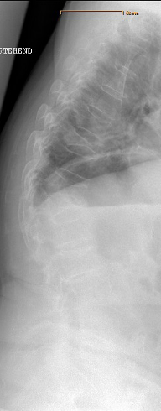
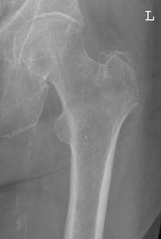
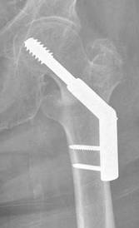
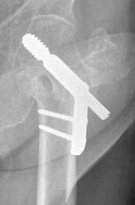
Dimension of the problem—unsatisfactory outcomes
Results that surgeons would never accept in younger patients
High revision and complication rates
Increasing demands of elderly people
Notes:
Results that surgeons would never accept in younger patients are demonstrated in these x-rays: massive shortening of the femoral neck, medialization of the femoral shaft, and severe kyphosis of the spine.
Surgeons should not treat these patients as “second class” patients—although this is very often done, partly because no better treatment methods exist up to now, and partly because the needs of these patients are thought to be low.
To the contrary, the demands of the elderly are raising which refers not only to activities of daily living but also for even more challenging physical activities like golfing or skiing.

Slide 6
Dimension of the problem—unsatisfactory functional outcomes
14.5% of hip fracture patients readmitted within 30 days
40% independent in basic activities of daily living (BADL) 1 year after versus 70% before fracture
14% independent in instrumental activities of daily life (IADL) 1 year after versus 34% before fracture
66.9% 1-year survival rate
20–25% reduction in mobility and related functions
64% nursing home admission within 1 year after hip fracture
Notes:
This slide shows some representative figures with regard to functional outcomes. All statements on this slide are dependent on the respective social welfare system.
BADL: Basic Activities of Daily Living
IADL: Instrumental Activities of Daily Living
References:
Goodman et al. Dartmouth Atlas study, 2011 on Hospital Readmission
Magaziner J, Simonsick EM, Kashner TM, et al. Predictors of functional recovery one year following hospital discharge for hip fracture: a prospective study. J Gerontol. 1990;45(3):M101–107.
Rossell PA, Parker MJ. Functional outcome after hip fracture. A 1-year prospective outcome study of 275 patients. Injury. 2003;34(7):529–532.
Leibson CL, Tosteson AN, Gabriel SE, et al. Mortality, disability, and nursing home use for persons with and without hip fracture: a population-based study. J Am Geriatric Society. 2002;50(10):1644–1650.

Slide 7
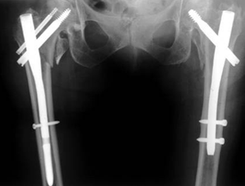
Dimension of the problem—insufficient secondary prophylaxis
Rates of evaluation (8.4%) and treatment (female: 4.6%/male: 2.8%) for osteoporosis after fragility fractures remain low
A fracture on one site
leads to 2–5-fold risk
of future fractures at
any other site
Insufficient knowledge by
the trauma/orthopedic
surgeon
Notes:
The term “tertiary prophylaxis” is reserved for the prophylaxis of future osteoporotic fractures in patients who already have sustained a fragility fracture. This condition applies directly to the vast majority of our patients as trauma and orthopedic surgeons.
The probability of future fractures dramatically increases after the first fragility fracture:
One or more vertebral fracture increases the risk of sustaining a vertebral fracture in one year to 5-fold.
One hip fracture doubles the risk of another fracture.
One fragility fracture leads to 2–3-fold risk of a fracture at any other site.
Many trauma surgeons do not have sufficient knowledge of these coherences.
Primary prophylaxis
Positive screening for osteoporosis with no fragility fracture. Objective of prophylaxis is to prevent osteoporotic fractures. For women who screen positive for osteoporosis, there is good to fair evidence that therapy with alendronate, risedronate, or raloxifene prevents osteoporotic fractures (grade A to B recommendation).
Secondary prophylaxis
Applies to patients with secondary osteoporosis due to, for example, hyperparathyroidism or the long-term intake of steroids. Patients need a different medication to prevent osteoporotic fractures in these particular cases.
Tertiary prophylaxis
Applies to patients having sustained a fragility fracture already.
References:
Feldstein A, Elmer PJ, Orwoll E, et al (2003) Bone mineral density measurement and treatment for osteoporosis in older individuals with fractures: a gap in evidence-based practice guideline implementation. Arch Intern Med; 163(18):2165–2172.
Watts NB, Cooper C, van Staa TP, et al (2004) Relationship between changes in bone mineral density and vertebral fracture risk associated with risedronate: greater increases in bone mineral density do not relate to greater decreases in fracture risk. J Clin Densitom; 7(3):255–261.

Slide 8
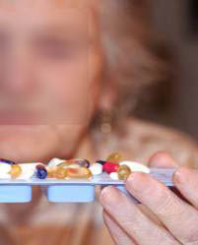
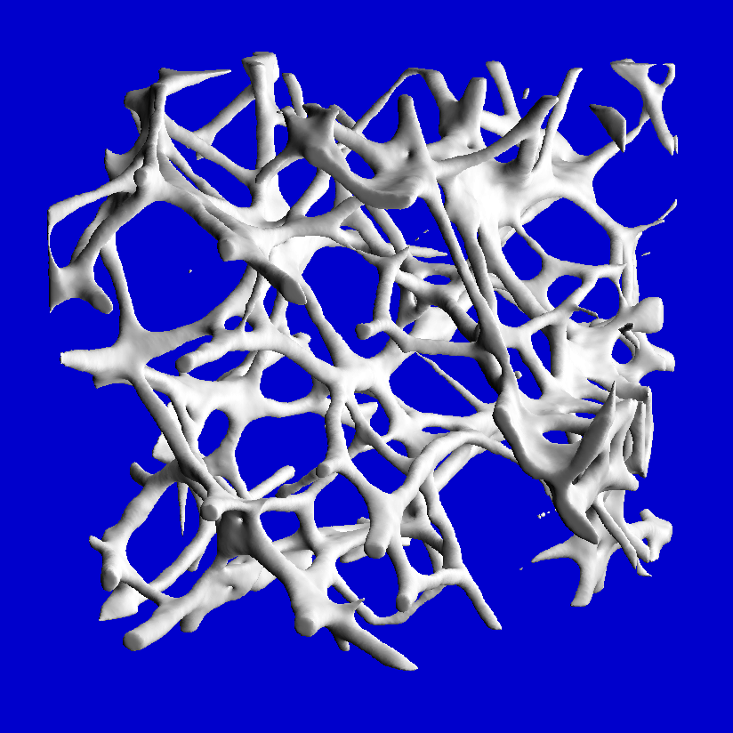
Challenges
Comorbid, medically complex patients
Impaired functional and mental status
Reduced quality of bone
Lumbar spine
Osteoporotic
Notes:
Besides the dimension of the problem, there are challenging circumstances to be considered when treating patients with fragility fractures:
The impaired functional and mental status determines the outcome. The functional status like the instrumental activities of daily living, termed premorbid functional status, makes individual patients different and is therefore even more important than comorbidities. Comorbidities are almost omnipresent and definitely influence postoperative planning. Geriatricians are most familiar with and understand how comorbidities influence the functional status. For example, three or more comorbidities are a strong preoperative risk factor.
These patients are often medically complex; and they have many comorbid conditions that result in failure to compensate and hence frustrate the orthopedic surgeon. Medical assistance is required to help with this. A continuous process involving a geriatrician with comprehensive knowledge is needed, comparable to that of a pediatrician and not simply a one-time consultation with a medical specialist. Also required is rapid optimization and stabilization of the patient’s functional and mental status.
Another challenge for the orthopedic surgeon is the fact of reduced quality of bone.

Slide 9
Why is the trauma surgeon key in this team approach?
Initial patient contact
Initiation of the team approach—nobody else will do it
Responsibility for a
better outcome
Key to the prevention
of future fractures
Notes:
The trauma surgeon has the initial patient contact and identifies the fragility fracture.
Initiation of the team approach—nobody else will do it
This requires an attitude change toward working together with internal medicine or geriatrician colleagues. (Culture change)
Responsibility for a better outcome
It is not good enough to simply fix the fracture properly. The entire patient must be considered for a successful outcome. Patients, families, and society are increasingly holding surgeons accountable for the results.
Key to the prevention of future fractures
The trauma surgeon must accept responsibility for fracture fixation and prevention. We need to embrace a new thought process—manager and organizer.

Slide 10
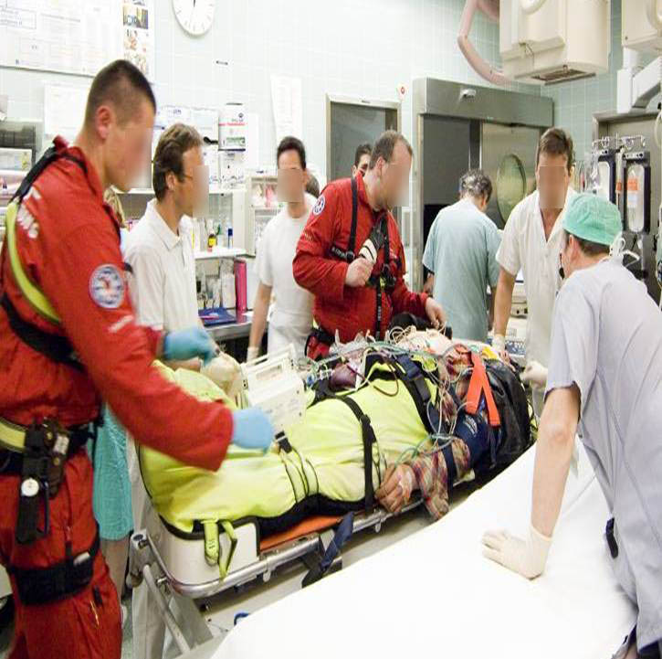
Comanaged care
Emergency physician
Trauma surgeons
Anesthesiologist
Radiologist
Nurses
Total quality management
Notes:
Comanagement of patients with fragility fractures is the most important feature of a Geriatric Fracture Center. These elderly patients are often very difficult to treat, and therefore comanagement makes the decisive difference to any other treatment modalities.
It may be compared to the comanagement of polytraumatized patients by trauma surgeons, anesthesiologists, radiologists, and others which ensures optimal, comprehensive treatment and care. Faced with multiple problems in polytraumatized patients, comanagement has been the standard procedure for many years. In such situations, cooperation is vital.
These same elements and principles are needed for the treatment of elderly fracture patients.
Total quality management is a manufacturing concept that has been introduced many years ago. This allows one to look at each individual step in a process and look for ways to improve that step, thereby improving the whole process.

Slide 11
Orthogeriatric comanagement—principles
Team approach from admission until completion
of rehabilitation
  Interdisciplinary care
  Co-ownership
  Protocol driven care
Prioritization of patients
Notes:
Comanagement is the most important part of interdisciplinary care of frail elderly patients from admission to completion of rehabilitation. With interdisciplinary care, we take advantage of the expertise of other specialists that the orthopedic surgeon may lack.
Co-ownership or shared ownership means that all team members share the responsibility for the care of patients and rely upon the performance of one another for a successful outcome.
Seen daily by the orthopedist
Seen daily by the internist (geriatrician)
Daily communication
Equal responsibilities
Interdisciplinary care by the team members will benefit the patient. Cooperation allows for a collegial environment in which to provide care for patients, and this helps to avoid errors. The patient and their families sense this close cooperation and find it comforting.
Protocols are co-developed. Local “best practices” are to be taken into consideration, sensitivity should be paid to reasonable preferences. Protocols are preapproved by all team members, so that all agree upon local best practices and meet hospital policies. Protocols help avoid inappropriate variation and errors. They reduce the hassle factor so common today in medical care. Well-designed protocols make it easier for physicians to follow the correct pathway.
Like children, old patients need prioritization because they do not have reserves in many senses.

Slide 12
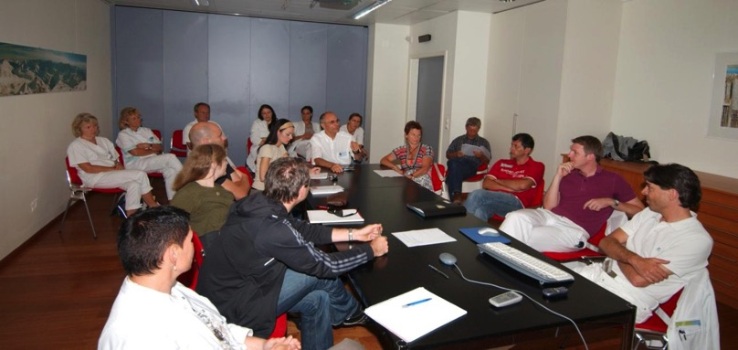
Team members
Trauma surgeons
Geriatricians
Anaesthetists
Nurses
Social workers
Rehabilitation team
frequent
communication
Notes:
geriatricians – one full time geriatrician out of a pool of 5 geriatricians from a nearby acute geriatric clinic

Slide 13
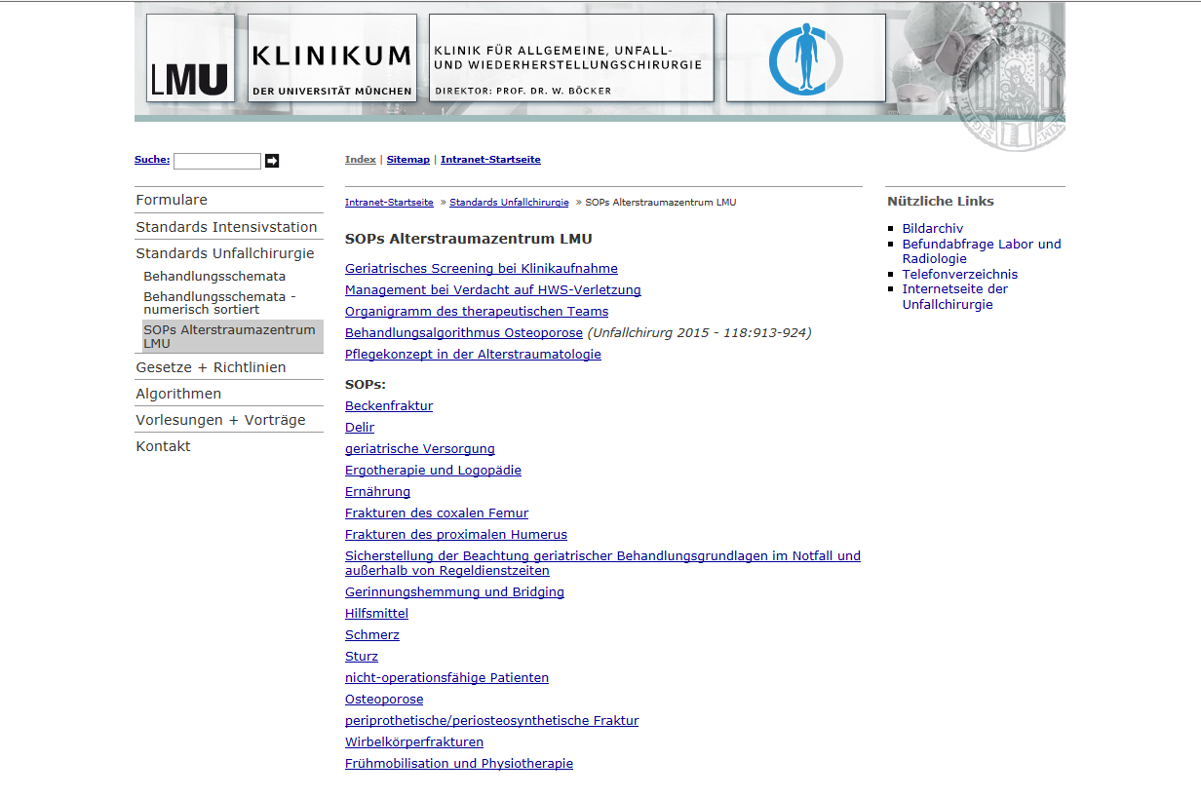
Protocols, SOP
Notes:
No was, to accomplish this task alone
Comanagement is the most important part of interdisciplinary care of frail elderly patients from admission to completion of rehabilitation. With interdisciplinary care, we take advantage of the expertise of other specialists that the orthopedic surgeon may lack.
Coownership or shared ownership means that all team members share the responsibility for the care of patients and rely upon the performance of one another for a successful outcome.
Seen daily by the orthopedist
Seen daily by the internist (geriatrician)
Daily communication
Equal responsibilities
Interdisciplinary care by the team members will benefit the patient. Cooperation allows for a collegial environment in which to provide care for patients, and this helps to avoid errors. The patient and their families sense this close cooperation and find it comforting.
Protocols are codeveloped. Local “best practices” are to be taken into consideration, sensitivity should be paid to reasonable preferences. Protocols are preapproved to by all team members, so that all agree upon local best practices and meet hospital policies. Protocols help avoid inappropriate variation and errors. They reduce the hassle factor so common today in medical care. Well-designed protocols make it easier for physicians to follow the correct pathway.
Like children, old patients need prioritization because they do not have reserves in many senses.

Slide 14
Orthogeriatric comanagement—potential for improvement
Shorter length of hospital stay
Lower complication rates
Lower readmission rates
Better restoration of quality of life
Cost reductions
Notes:
There is much room for improved outcomes in geriatric fracture patients. Goals should include:
Shorter length of stay in the hospital
Total quality management with low readmission rates, low complication rates, and restoration of quality of life
The potential for improvement depends largely on the local conditions in a very broad sense.
It may be influenced by:
The health care system
Availability of nursing homes and rehabilitation beds
The immediate availability of implants
Operating room availability and postoperative care capacity
And so on…

Slide 15
Orthogeriatric comanagement—evidence
10% shorter length of stay and lower readmission rates
Lower costs: 61% of US average
Low rates of major morbidity and mortality and acceptable functional outcomes
Significant reductions in morbidity and mortality
Decrease from 28% to 7.6% in readmission rate
Reduced costs
Notes:
Why are we confident in telling you that comanagement is successful in treating these special patients? There is evidence to support this—some excerpts are shown on this slide.
References:
Friedman SM, Mendelson DA, Kates SL, et al. Geriatric Co-Management of Proximal Femur Fractures: Total Quality Management and Protocol-Driven Care Result in Better Outcomes for a Frail Patient Population. J Am Geriatr Soc. 2008 Jul;56(7):1349–1356.
Adunsky A, Arad M, Levi R, et al. Five-year experience with the 'Sheba' model of comprehensive orthogeriatric care for elderly hip fracture patients. Disabil Rehabil. 2005;27(18–19):1123–1127.
Fisher AA, Davis MW, Rubenach SE, et al. Outcomes for older patients with hip fractures: the impact of orthopedic and geriatric medicine cocare. J Orthop Trauma. 2006 Mar;20(3):172–178; discussion 179–180.
Kates SL, Mendelson DA, Friedman SM. The value of an organized fracture program for the elderly: early results. J Orthop Trauma. 2011 Apr;25(4):233–237.
Kates SL, Blake D, Bingham KW, et al. Comparison of an organized geriatric fracture program to United States government data. Geriatr Orthop Surg Rehabil. 2010 Sep;1(1):15–21.

Slide 16
Cost effectiveness

Slide 17
Phases
preoperative
  inclusion criteria (>80 bzw. >70 multimorbid)
  fast track in emergency room, optimization
operation
  Single-shot-Surgery, fixation pinciples adapted to osteoporotic bone
  adapted anaesthesia
postoperative
  Comanagement on the ward, SOP, avoid complications
  discharge management, social workers, physiotherapy
recovery
  geriatric rehabilitation
  no weight bearing restrictions
prevention
  osteoporosis diagnosis and treatment, falls prevention
  traumatologic aftercare

Slide 18


Preoperative evaluation and optimization—why is it so important?
Fast-track preoperative evaluation and optimization of the patient for surgery plays a vital role
Requires a
comanaged approach
Notes:
The overall goal is to shorten the stay in the emergency department to 2 hours.
This allows for a much more humane experience for the elderly. The most appropriate way to
achieve this is through the application of protocols. Previous agreement with the emergency
department is needed to handle patients according to defined and standardized protocols.
In general, the time spent in the emergency department is a good measure of how well the
system works!
One main goal during this stage is to promptly diagnose the fracture and then ensure and restore the medical stability of the
patient to make him/her fit for surgery. This is done by the geriatrician.
The following slides will explain preoperative evaluation and optimization within orthogeriatric
comanagement—what it is, and what does it include?
Preoperative evaluation and optimization:
Pain control
Fluids and electrolyte management
Coagulation management
Timing of surgery
Surgical intervention, and postoperative phase/prevention:
Delirium
Diagnostics
Basic and specific therapy
Medication
Falls prevention

Slide 19
Preoperative evaluation and optimization—pain control
Cognitively intact patients with undertreated pain
  Nine times more likely to develop delirium
Advanced dementia patients
  Received only 1/3 the amount of opioid analgesia compared to cognitively intact patients of whom 40% reported severe pain postoperatively
Comorbidities must be considered (liver, kidney, dementia) when administering basic pain medication
Notes:
This slide shows, why sufficient pain treatment immediately following admission is so important. The elderly often have difficulties reporting or conveying their pain and the improvement after treatment. Discomfort and pain may be confused or mixed up.
The Visual Analog Scale (VAS) usually used in standard evaluation of pain, is of limited use when evaluating pain in the elderly. This is because even cognitive intact elderly patients often need a lot of assistance or are unable to make their choice on this scale. Therefore, an important part to pain evaluation is additional observation by others (third-party observation or external observation).
References:
Morrison RS, Magaziner J, McLaughlin MA, et al. The impact of postoperative pain on outcomes following hip fracture. Pain. 2003;103(3):303–11.
Morrison RS, Siu AL. A comparison of pain and its treatment in advanced dementia and cognitively intact patients with hip fracture. J Pain Symptom Manage. 2000;19(4):240–248.

Slide 20
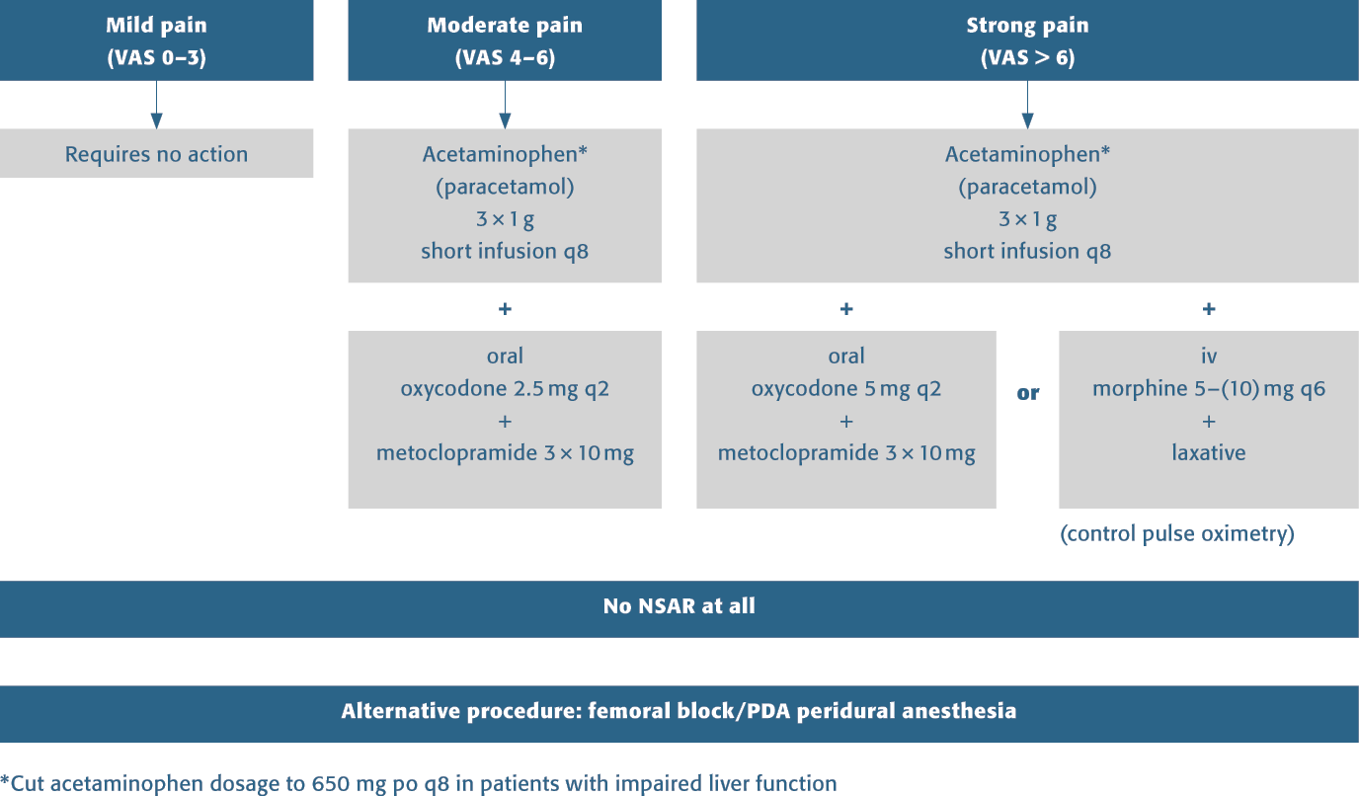
Pain management algorithm
Notes:
This algorithm gives a good and straight-forward overview for pain management.
Early pain control managed by/together with the anesthesiologist helps lessen delirium.
No meperidine!

Slide 21
Preoperative evaluation and optimization—fluid and electrolyte management
Preoperative evaluation
  Physical examination: exsiccosis? hypothermia?
  Laboratory testing
Therapy
  Infusion therapy
  Substitution
  Warming
Control parameters
  Blood count, temperature, central venous catheter
  Urine > 100/h
Notes:
The critical factors that have to be medically stable are related mainly to the vital signs: blood pressure, heart rate, temperature—a very sensitive indication that is often neglected—respiratory rate, and pain control which may be seen as the fifth vital sign.
Fluid and electrolyte management: Hydration is usually required (most hip fracture patients are dehydrated) and initiated in the emergency department. Transfusions are ordered if required.
Furthermore, any medication must be well managed. Is the medication regimen appropriate to the patient‘s current medical condition?
All bad medication should be stopped and the regimen corrected for the present condition of the patient. All unnecessary medication is stopped as well; only the essential should be continued.
Trigger medication that harms the patient should be immediately stopped. Drugs like Darvon, Demerol, Benadryl (Diphenhydramine), and anticholinergic medication may cause delirium because they have psychoactive effects. Most physicians are wary of halting medication, which may result in harm to the patient.
It is recommended to evaluate calcium level and vitamin D status.

Slide 22
Preoperative evaluation and optimization—coagulation management
Acetylsalicylacid
  Immediate surgery possible
  Thrombocyte tests if spinal anesthesia considered
Cumarine/warfarin
  Immediate surgery if prothrombin > 60–70%
  INR < 1.5 for small to medium surgery
  INR < 1.3 for more involved procedures
  Immediate surgery with prothrombin and fresh frozen plasma 10/20 ml/kg body weight possible
  Reversing 12–24h: vitamin K, 5–10 mg orally
Notes:
INR = international normalized ratio

Slide 23
Preoperative evaluation and optimization—coagulation management
Clopidogrel bisulfate (Plavix)
  No consensus for immediate surgery
  Immediate surgery possible with thrombocyte
  concentrate to hand
  Recommendation: proceed with surgery
  Preoperative thrombocyte tests if spinal anesthesia
  is considered
  Elective surgery: wait for 7 days
  Do not delay urgent surgeries such as hip fracture repair

Slide 24
Preoperative evaluation and optimization—coagulation management
Rivaroxiban and dibigatrin
  Delay 24–36 hours
  No antidote
  42 hours if spinal anesthesia is considered
  Elective surgery: wait for 2 days

Slide 25
Preoperative evaluation and optimization—timing of surgery
Medically stable patient
Delay of > 48 hours for hip fracture surgery means significant increase in short-term and 1-year mortality
Delay of > 48 hours for hip fracture surgery increases 30-day all-cause mortality by 41% and 1-year all-cause mortality by 32%
Frail elderly should be treated as a priority but not as an emergency within 24–48 hours (urgent but not emergent)
Notes:
The 30-day mortality following surgery for a hip fracture was 9%. Patients with medical comorbidities that delayed surgery had 2.5 times the risk of death within 30 days after the surgery compared with patients without comorbidities that delayed surgery.
Mortality was not increased when the surgery was delayed up to 4 days for patients who were otherwise fit for hip fracture surgery. However, a delay of more than 4 days significantly increased mortality.
References:
Moran CG, Wenn RT, Sikand M, et al (2005) Early mortality after hip fracture: is delay before surgery important? J Bone Joint Surg Am; 87(3):483–489
Novack V, Jotkowitz A, Etzion O, et al (2007) Does delay in surgery after hip fracture lead to worse outcomes? A multicenter survey. Int J Qual Health Care; 19(3):170–176.
Shiga T, Wajima Z, Ohe Y (2008) Is operative delay associated with increased mortality of hip fracture patients? Systematic review, meta-analysis, and meta-regression. Can J Anaesth; 55(3):146–154.
Orosz GM, Magaziner J, Hannan EL, et al (2004) Association of timing of surgery for hip fracture and patient outcomes. JAMA; 291(14):1738–1743.

Slide 26
Preoperative evaluation and optimization—timing of surgery
Medically unstable patient
Timing of surgery in the medically unstable patient is controversial
Medically unstable conditions that have to be improved first include:
  Acute renal insufficiency
  Acute cardiac decompensation, especially aortic stenosis
  Pneumonia, asthma
Stabilization of patients, surgery when medically optimized, or palliative care if appropriate
Notes:
No fixed parameters are defined for the “medically unstable patient” in the literature.
Outlined are three typical examples of situations where general agreement exists that such patients should not go for immediate surgery, but rather first be improved. It depends on local agreements and protocols as to which medical conditions are defined as unstable and thus should be improved prior to surgery.

Slide 27
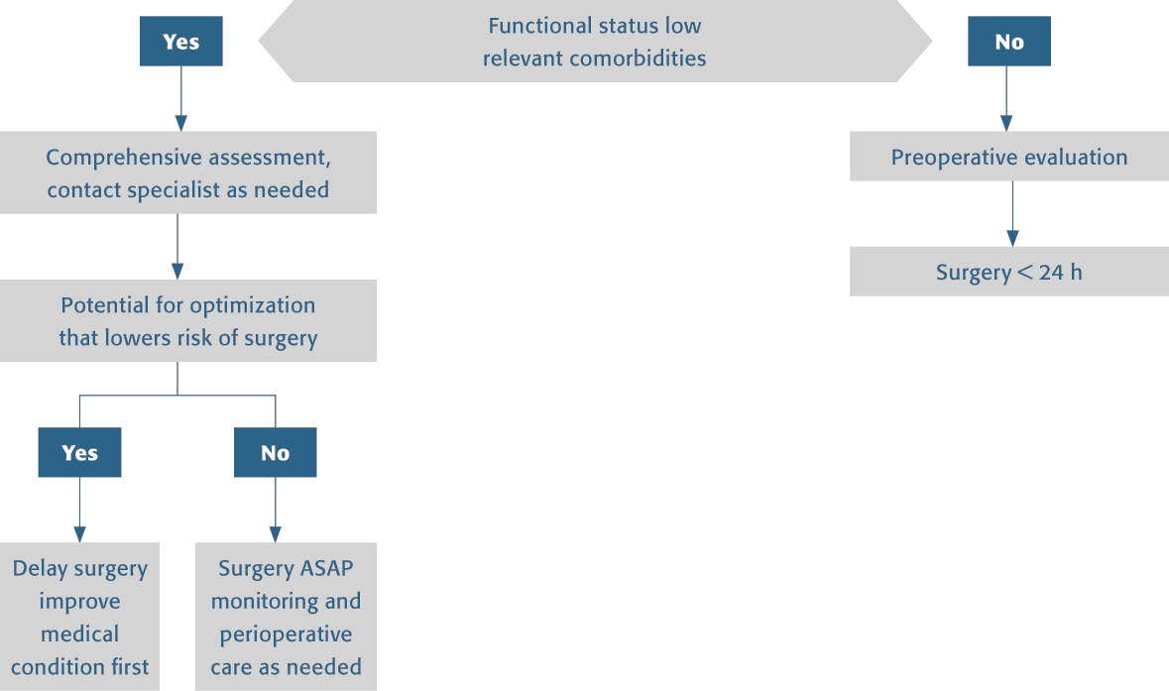
Timing of surgery
Notes:
Algorithm explanation
Note:
1) Preoperative evaluation can be done by the anesthesiologist. Focus on activities of daily life may help to estimate the individual risk and subsequently the need of intensive care treatment.
2) Early surgery should be attempted if the patient is in a medically stable condition.
3) If there is potential for improvement of the patient’s condition, surgery should be postponed.
4) If the patient‘s condition cannot be optimized, surgery should be performed as early as possible, but advanced intra- and postoperative care is mandatory.

Slide 28
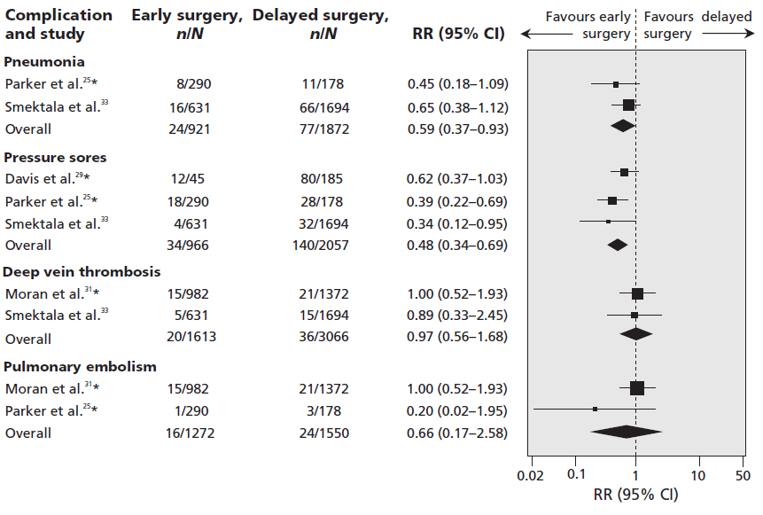
Time to surgery - complications
Simunovic N et al. Effect of early surgery after hip fracture on mortality and complications; systematic review and meta-analysis. CMAJ, Oct. 19, 2010

Slide 29
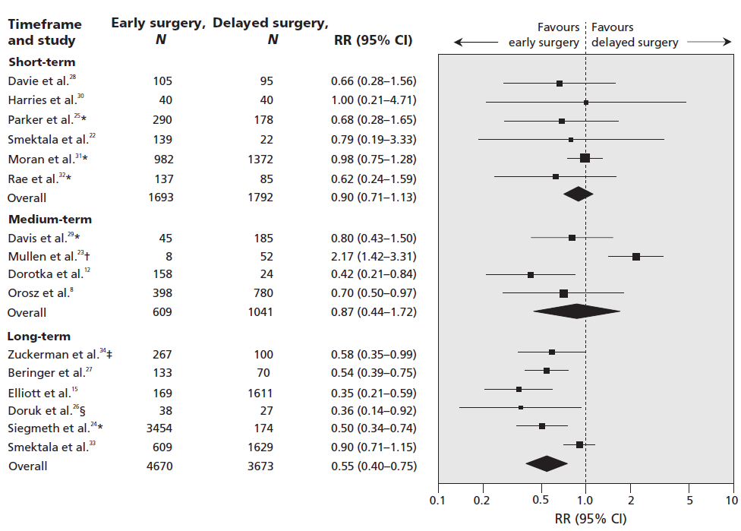
Time to surgery - mortality
Simunovic N et al. Effect of early surgery after hip fracture on mortality and complications; systematic review and meta-analysis. CMAJ, Oct. 19, 2010

Slide 30
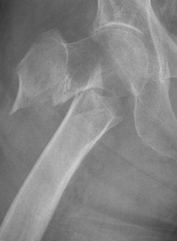
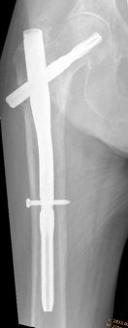
Surgical intervention
As early as possible
Adapted anesthesia
Adapted surgical
procedures
  “Single-shot surgery”
  Minimally invasive
  surgery
  Optimal implants
  for osteoporotic
  bone and immediate
  weight bearing
Notes:
The most important thing in these patients is to stabilize the fracture. Treatment should allow for early mobilization with full weight bearing.
Once the fracture is stabilized, it is the comorbidities that become the real challenge when treating these patients.

Slide 31
Postoperative phase—general recommendations
Regular orthogeriatric rounds
Wards may need to be adapted to the elderly
Codeveloped order sets and nursing care plans
Prevention of complications:
  Urinary tract infection
  Pressure sores
  Chest infection
  Thromboembolism
  Sepsis, etc
Notes:
The members of the team coordinate daily rounds and visits of the patients—daily communication improves patient care.
The standardized order set comprises of:
Pain control
DVT prophylaxis
Beta blockers
Acetaminophen (paracetamol) around the clock
Limitations, for example, are: Removal of the Foley catheter on postoperative day 1, avoiding troublesome medications like nonsteroidal antiinflammatory drugs because of renal function, and peptic ulcer disease. Narcotics (opioids) break through pain.
Weight-bearing status: weight bearing as tolerated is preferred to facilitate better outcomes.
A standardized nursing care plan or map is coordinated with the surgeons and geriatricians to make sure that a coordinated team approach to care occurs. Thus, goals are set and will likely be met by the team.

Slide 32
Postoperative phase
procedure acc. to our guidelines
Geriatrician uses green pen for writing in medical records
Statement of each day

Slide 33
Postoperative phase—delirium
Delirium in patients > 65 years old is frequent
15–53% postoperatively versus 14–24% on admission
Multiple causes like pain, hypoxia, depression
Associated with poor functional recovery
30–50% reduction in delirium through geriatrician consultation
Notes:
Avoiding opioids or using very low doses of opioids increased the risk of delirium. Cognitively intact patients with undertreated pain were nine times more likely to develop delirium than patients whose pain was adequately treated. Undertreated pain and inadequate analgesia appear to be risk factors for delirium in frail older adults.
[Morrison RS, Magaziner J, Gilbert M, et al. Relationship between pain and opioid analgesics on the development of delirium following hip fracture. J Gerontol A Biol Sci Med Sci. 2003;58(1):76–-81.]
Of the total amount of medication ordered that was received, the mean percentage was 27.67%. Individuals admitted with a risk factor of hearing loss received significantly less amount of pain medication than those with other risk factors (P = .023). Nurses should carefully assess pain management in their older patients. If using a PCA pump, the older patient's ability to manage the pump should be reassessed often. If a patient is admitted with risk factors for development of delirium, unmanaged pain might be the additional factor that precipitates delirium.
[Robinson S, Vollmer C, Jirka H, et al. Aging and delirium: too much or too little pain medication? Pain Manag Nurs. 2008;9(2):66–72.]
Delirium at admission (ie, prior to surgery) was associated with poorer functioning in physical, cognitive, and affective domains at 6 months postfracture and slower rates of recovery. Impairment and delays in recovery may be further exacerbated by increased depressive symptoms in confused patients over time.
[Gruber-Baldini AL, Dolan MM, Hawkes W, et al. Cognitive impairment in hip fracture patients: timing of detection and longitudinal follow-up. J Am Geriatr Soc. 2003;51(9):1227–1236.]
References:
Marcantonio ER, Flacker JM, Wright RJ, et al. Reducing delirium after hip fracture: a randomized trial. Am Geriatr Soc. 2001;49(5):516–522

Slide 34
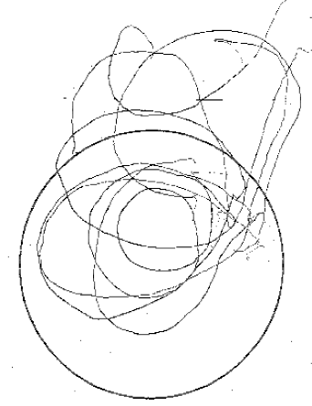
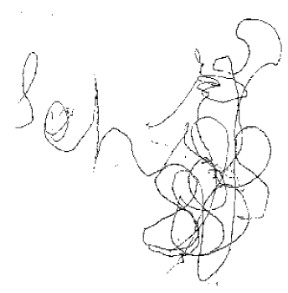
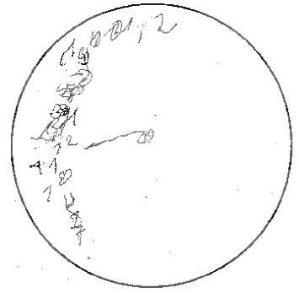
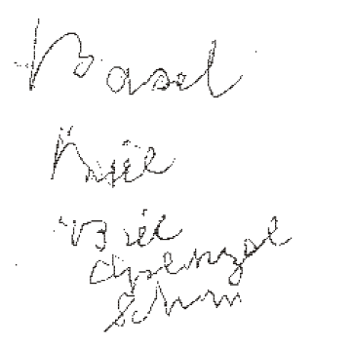
Delirious patient—clock-drawing test and MMS: write a sentence
1 day
postoperatively
4 days
postoperatively
82-year-old male patient after femoral fracture
Notes:
As it is important to differentiate delirium from dementia, several tests are performed. The clock-drawing test is one of these. This test is not used to diagnose dementia but to assess dementia as one of the major risk factors that the patient may suffer from postoperative delirium.
The clock-drawing test is a brief cognitive assessment tool. The patient is asked to draw a clock face including the numbers. The number twelve must appear at the top and there must be twelve numbers present. He/she is then asked to draw two distinguishable hands showing the time. The time must be identified correctly.
MMS = mini mental status
Part of this test is asking the patients to write a sentence. As shown on this slide, this is still not possible on the 4th day postoperatively but the words are more readable than before.
Having diagnosed cognitive decline, it is still not possible to define whether the decline is due to delirium, dementia, or acute delirium based on preexisting dementia.

Slide 35
Postoperative phase—delirium
Monitor closely to prevent delirium
Therapy
  Eliminate the cause, eg, pain, infection, tethers
  Antipsychotic drugs: haloperidol 0.5–1 mg
  Low dose of risperidone

Slide 36
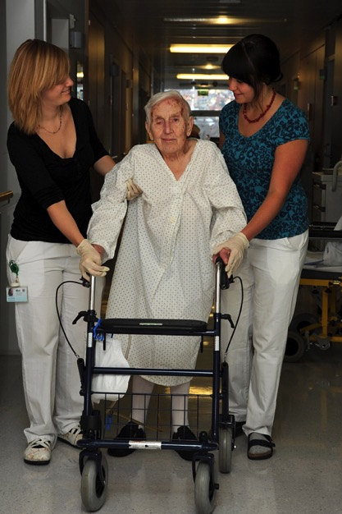
Postoperative Phase - Mobilisation
Patientenbild
Fastest possible mobilisation with allowed full weight bearing
Weight bearing
restrictions lead
to immobilisation
TILAK
Notes:
Nach dem Motto: auch wenn es nicht zur katastrophic failure kommt …

Slide 37
Is full weight bearing necessary?
sign. better mortiality rates !
Langenhan R, Trobisch P, Ricart P, Probst A. J Orthop Trauma. 2012 Feb;26(2):80-5 Aggressive surgical treatment of periprosthetic femur fractures can reduce mortality: comparison of open reduction and internal fixation versus a modular prosthesis nail.

Slide 38
Management of discharge
Individually developed decision for each patient
Contact
  Relatives, Nursing care homes, Physician,
  Social worker
Discharge Package
  standardized
    Medical report incl. medication and recommendation for further treatment
    Follow-up dates arr. by Study Nurse
    Geriatric recommendation
    Traumatologic recommendation

Slide 39
Prevention to avoid subsequent fractures

Slide 40
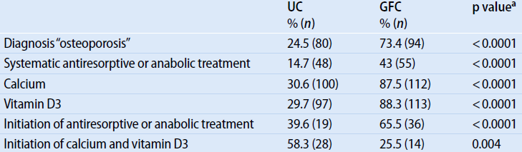
Bone therapy in a Geriatric fracture center
Gosch M., Kammerlander C. et al Treatment of osteoporosis in postmenopausal hip fracture patients after geriatric rehabilitation: changes over the last decade. Z Gerontol Geriatr. 2011 Dec;44(6):381-6.

Slide 41
Prevention—basic and specific osteoporosis medication
For all patients over 65 years old with typical fragility fractures (caused by a fall from standing height)

Slide 42
Prevention—minimal diagnostics for patients with fragility fracture
Serum/plasma
  ESR, CRP, blood count, calcium, phosphate, creatinine, alkaline phosphatase, γGT, electrophoresis, TSH*
  25-OH vitamin D, PTH
24-hour urine test: calcium/creatinine ratio
Dual energy x-ray absorptiometry (DEXA) bone densitometry (lumbar spine, femur, possibly distal radius)
Vertebral fracture assessment (VFA)
* Leitlinien von DVO/“Initiative Arznei und Vernunft”, Guidelines from DVO/“Initiative Medicines and Reason, Austria”
Notes:
Diagnostics to screen for secondary osteoporosis
Blood tests:
ESR, CRP, blood count, electrophoresis tests to screen out, eg, carcinoma/multiple myeloma, PCP, autoimmune diseases.
Calcium, phosphate, creatinine, alkaline phosphatase, γGT, PTH tests to screen out renal/liver dysfunction, hyperparathyroidism.
TSH to screen out hyperthyroidism.
25-OH vitamin D tests since most geriatric patients have vitamin D deficiency.
24-hour urine test to screen out hypercalciuria.
DEXA scanning is the current standard for evaluation of bone mineral density. It does not assess the bone micro–architecture, which is also important for fracture risk.
DEXA exposes the patient to minimal doses of radiation and is safe and repeatable. When repeating the DEXA scan, it is preferable to use the same machine and reader to avoid being misled. DEXA scanning should not be done more often than every two years. It is hard to assess the changes with therapy in shorter intervals.
VFA: anamnestic evidence for former, maybe clinically silent vertebral fractures?
*DVO Dachverband Osteologie. DVO is the umbrella association for osteology in German-speaking countries; “Initiative Arznei und Vernunft”–expert medical therapy recommendations for Austria.

Slide 43


Prevention—basic therapy
Vitamin D insufficiency present in 96% of women with hip fractures (38% had extremely low levels)
Recommendations
  Vitamin D loading dose 180.000 IU and up to 2000 IU daily
  Calcium 1500 mg/day
  vitamin D 800–1000 IU daily
  Nutrition and lifestyle advice
  Mini nutritional assessment
  Protein/supplementary drinks
Notes:
Vitamin D deficiency defined as a 25(OH)D <32 g/mL was present in 96% of women with hip fractures, of which 38% had extremely low levels <9 ng/mL.
Milk products provide calcium and protein needed for bone and muscle: 1 glass of milk = 300 mg; 1 slice of hard cheese = 300 mg; mineral water, some contain 500 mg/l. Calcium supplements alone may not reduce nonvertebral fractures or hip fractures. Vitamin D supplements increase calcium absorption but Vitamin D alone has no antifracture effect. Vitamin D can be produced in the skin via UVB-irradiation. Risk: winter sun is insufficient in Europe, sun screen, age. Nutritional sources are rare (ie, daily fatty fish).
Recommendations for Vitamin D and Calcium—ensure vitamin D supplementation first: 800–1000 IU vitamin D in all individuals with a fracture, aged 60+, and postmenopausal women. Optimal 25-hydroxivitamin D level: 75–100 nmol/l (30–40 ng/ml)—most older individuals are deficient, thus 25-hydroxyvitamin D assessment is optional. Patients with severe deficiency will need more than 800-1000 IU vitamin D. 25-hydroxyvitamin D levels should be measured after 4-6 weeks for treatment adjustment. 400 IU will increase 25-hydroxyvitamin D by about 10 nmol/l. Encourage calcium intake from natural sources: target 700–800 mg/day in combination with a daily vitamin D supplement of no less than 800 IU/day. If adherence is low, give weekly 5600 IU vitamin D; intramuscular vitamin D is not well absorbed.
Patients and family often ask about nutrition/lifestyle advice in order to participate in their own care. Vitamin D3 (1200 mg/day) plus calcium (1550mg /d in 3 divided doses) for the average nondeficient patient is the accepted regimen (varies in different countries). If the patient is vitamin D3 deficient, 50,000 units of D3 per week for 12 weeks should start to replete this vitamin. Rechecking the patient’s 1,25 OH vitamin D level after 12 weeks is prudent to make sure they are being adequately replenished. Smoking/alcohol counseling are important and treatment options must match the patient’s personal requirements. For the bed-bound dementia patient, calcium and vitamin D may be enough. For active elderly, a more aggressive approach to their condition is suggested to lessen the likelihood of future fractures.
References:
Leboff MS, Hawkes WG, Glowacki J, et al (2008) Vitamin D-deficiency and post-fracture changes in lower extremity function and falls in women with hip fractures. Osteoporosis Int
2007 Meta-analysis of RCTs; Bischoff-Ferrari HA et al. AJCN 2007)

Slide 44
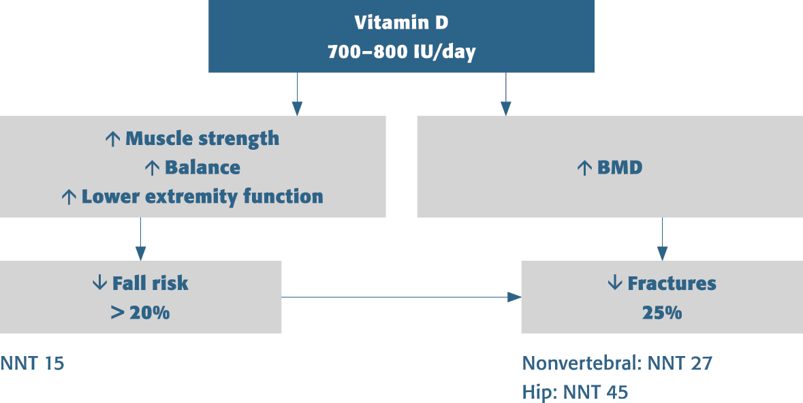
Prevention—dual benefit of vitamin D
Notes:
44
Rationale for vitamin D supplementation in orthopedic patients based on evidence from high-quality RCTs:
Improve bone health (first fracture, refracture; implant survival)
700–800 IU vitamin D per day reduces hip and nonvertebral fractures by 25%
[Bischoff-Ferrari HA, et al (2005) JAMA; update in press Archives of Int. Med.]
Reduce risk of falls and improve muscle strength and balance
700–800 IU vitamin D per day reduces falls by 35–65%
[Bischoff-Ferrari HA et al (2004) JAMA; Bischoff-Ferrari HA et al (2006) Archives of Internal Medicine; Broe KE (2007) JAGS]
Potential benefits on general health
The VDR is present on all organ systems and all cells of the immune system
Higher 25-hydroxyvitamin D levels were associated with a lower risk of hypertension, MI, diabetes, cancer, and mortality

Slide 45
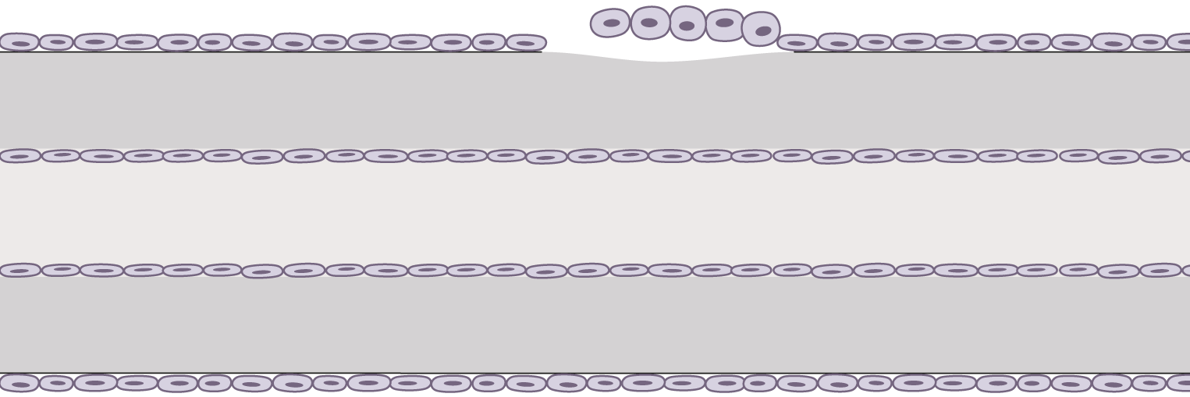
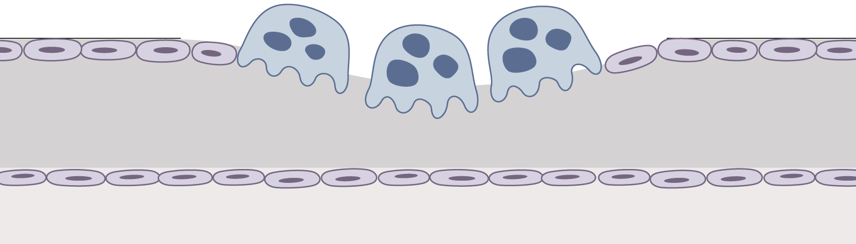
Prevention—specific medication therapy
Osteoblasts
+
Bone forming drugs
  PTH
Antiresorptive drugs
  Bisphosphonates
  Strontium
  SERM
Osteoclasts
—
Notes:
Specific medication therapy may be divided into bone forming and antiresorptive drugs (inhibition of bone resorption and stimulation of bone formation).
PTH: for example Forteo (teriparatide)
Selective estrogene receptor modulators (SERM)
How is osteoporosis categorized?
Diagnosis and graduation is based on the difference between the measured value and mean value of healthy young adult controls and that of healthy age-matched adults. These differences are expressed in the number of standard deviations of the reference population. The difference from young adults gives the T-score, the difference from age-matched controls gives the Z-score.

Slide 46
Prevention—specific medication therapy in the yet untreated patient
Oral bisphosphonate
  Risedronate 35 mg or alendronate 70 mg once a week
  Special intake guidelines are to be considered
Strontium ranelate IV every day
  Good study results in the subgroup of > 80-year olds
  Vitamin D repletion necessary
Ibandronate IV every third month
  No proof of effectiveness on nonvertebral fractures
Notes:
References:
Seeman E, Vellas B, Benhamou C, et al. Strontium ranelate reduces the risk of vertebral and nonvertebral fractures in women eighty years of age and older. J Bone Miner Res. 2006;21(7):1113–1120.
Chesnut CH 3rd, McClung MR, Wasnich RD, et al. Oral daily ibandronate prevents bone loss in early postmenopausal women without osteoporosis. J Bone Miner Res. 2004;19(1):11–18.

Slide 47
Prevention—specific medication therapy in the yet untreated patient
Zoledronic acid IV once a year
  Good results in vertebral, nonvertebral, and hip fractures
  Convincing results for secondary prevention of clinical fractures after hip fracture and a reduced mortality rate
  “Flu-like syndrome” in about 35% after first infusion
  Paracetamol or NSAID prophylaxis within the first 3 days is recommended
  Initial infusion 2 or more weeks after fracture repair
Notes:
Zoledronic acid is the only approved bisphosphonate in patients with a low trauma hip fractures and in male osteoporosis patients (so far in Europe only).
References:
Bruyere O, Brandi M, Burlet N, et al. Post-fracture management of patients with hip fracture: a perspective. Curr Med Res Opin. 2008;24(10):2841–2851.
Black DM, Delmas PD, Eastell R, et al. Once-yearly zoledronic acid for treatment of postmenopausal osteoporosis. N Engl J Med. 2007;356(18):1809–1822.
Lyles KW, Colón-Emeric CS, Magaziner JS, et al. Zoledronic Acid in Reducing Clinical Fracture and Mortality after Hip Fracture. N Engl J Med. 2007;357:nihpa40967.

Slide 48
Prevention—specific medication therapy in patients previously treated with antiresorptive drugs, with extremely bad BMD, or multiple fractures
Parathyroid hormone, anabolic therapy
  Teriparatide 20 µg daily sc: no data regarding hip fractures
  rhPTH(1-84) 100 µg daily sc: no data regarding hip and other nonvertebral fractures
  Therapy limited to 18 months, following that period antiresorptive therapy needed
  Control of calcium in serum and urine
Notes:
Teriparatide (PTH 1-34) has so far shown to be effective in vertebral fractures and nonvertebral sites, however, it still lacks the indications for the hip. This is being actively examined.
As per reimbursement code, administration of parathyroid hormone, anabolic therapy only if vertebral fracture occurred during previous antiresorptive therapy for at least 2 years.
References:
Neer RM, Arnaud CD, Zanchetta JR, et al (2001) Effect of parathyroid hormone (1-34) on fractures and bone mineral density in postmenopausal women with osteoporosis. N Engl J Med; 344(19):1434–1441.
Greenspan SL, Bone HG, Ettinger MP, et al (2007) Effect of recombinant human parathyroid (1-84) on vertebral fracture and bone mineral density in postmenopausal women with osteoporosis: a randomized trial. Ann Intern Med; 146(5):326–339

Slide 49
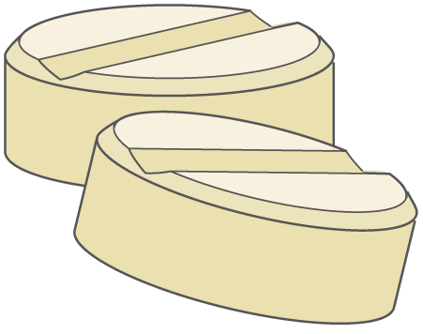
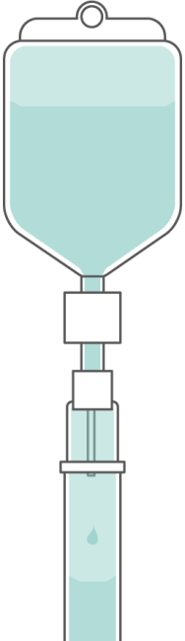
Administration of bisphosphonates
Oral bisphosphonates: compliance < 50% at 6 months
Daily
Weekly
Immediately start with therapy
during first hospital stay
Intravenous bisphosphonates
ibandronate, pamidronate
Every 3 months
Yearly
zoledronate
Notes:
Studies of oral bisphosphonates have shown approximately 25% of patients not in a company-sponsored study will comply with their medication regimen.
50% of patients participating in pharmaceutical company-sponsored studies on bisphosphonates show compliance at 6 months.
On the other hand, intravenous bisphosphonates have very high compliance and are tolerated much better in the elderly population. Ibandronate and pamidronate last approximately 3 to 4 months between doses.
Zoledronate has a yearly dosing interval.

Slide 50
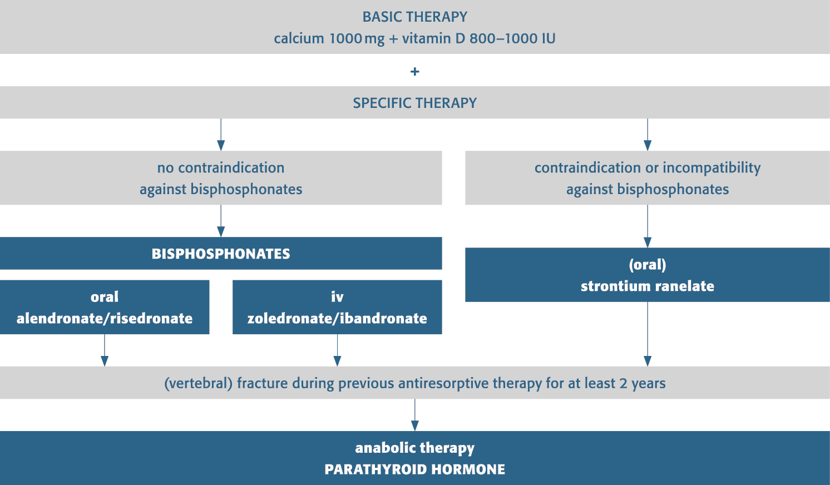
Basic and specific therapy

Slide 51
Prevention—preventing falls
Correct polypharmacy
Improve physical status
  Balance, strength, and mobility
  Gait analysis and training
  Visual or hearing aids
  Mental status
Vertigo
Assess home environment
Notes:
Assess home environment—a visiting nurse or a service can inspect the home to check for hazards that may contribute to falls.

Slide 52

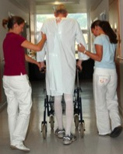
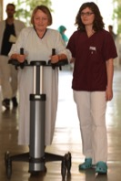
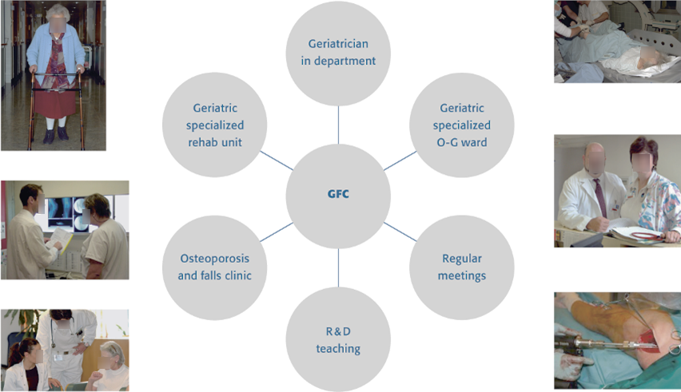
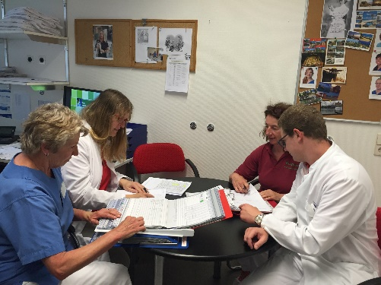
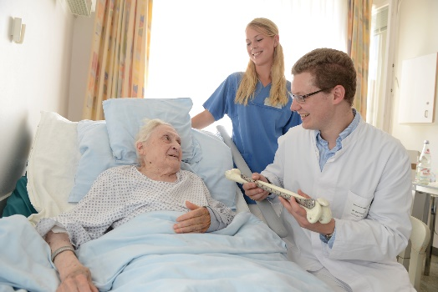

Geriatric Fracture Center
Notes:
This last slide is optional for faculty who would like to show the setup of a functional geriatric fracture center. Worldwide, several centers have already successfully implemented a comanaged approach.
Geriatrician with responsibility for the GFC only. The geriatrician is responsible for constantly taking care of comorbidities and optimization.
A GFC acts in:
Patient care
Pathways
Comanagement
Research
Continuous improvement by quality management
Evaluation of new protocols, implants, etc.
Education and training
Courses
Fellowships
Student lectures
A list of orthogeriatric units with successful models (however, others are possible):
Nurse-based liaison service; 15 units in Newcastle upon Tyne, UK.
Multidisciplinary liaison service (weekly ward round); 16 units in London, UK.
Assign a geriatrician to provide daily care in the orthopedic ward; 17 units in Rome, Italy; and 4 units in Surrey, UK.
Clinical pathway/multidisciplinary care; 37 units in Melbourne, Australia; and 20 units in Sydney, Australia.
Interdisciplinary intervention in the hospital and community by allied health professionals; 21 units in Gold Coast, Australia
Orthogeriatric unit (ward); 22 units in Tel Aviv, Israel.
Transfer to the geriatric ward after surgery; 23 units in Kinkomaa, Finland.
Geriatric orthopedic rehabilitation; 8 units in New York City, USA.
Hospital at home 24 units in Nedlands, Australia, WA; 25 units in Cambridge, UK.
Medical management by hospitalist service in a surgical ward; 26 units in Rochester, USA.

Slide 53

Orthogeriatrics App—AOTrauma

Slide 54
Take-home messages
Orthogeriatric comanaged approach can better address the scope of the problem
Prevention of future fractures through appropriate medication and actions is vital
Comprehensive patient evaluation including geriatric assessment have an impact on improved patient outcome
Notes:
Although improvements in surgical technique will help, it is in the arrangements for holistic medical care of these elderly patients that the biggest gains can be made!
Comanagement and an interdisciplinary team approach are essential for any Geriatric Fracture Center. The application of such a program is possible with a dedicated orthopedist, geriatrician or hospitalist, anesthesiologist, and administrative support. Such a program will have the immediate effect of improving the quality of care delivered to the elderly.
An important take-home message is that the role of the trauma surgeon involves the well being of the entire patient, not just the fractured bone. Comanagement leads to a collegial medical care environment in the hospital. Protocol-driven care reduces errors. A proactive approach to care reduces readmissions and complications experienced by geriatric fracture patients. The comanaged care approach also reduces costs with minimal investment from the hospital. The surgeon’s attitude is key to the implementation of such changes.

