Slide 1
Small group discussion A
Case 2
Midface fractures
Notes:
Zygomaticomaxillary complex (ZMC) fractures without orbital floor repair
Note: It is important to know that the small group discussions are not about any individual case (these discussions often use a mixture of patient cases and images)

Slide 2
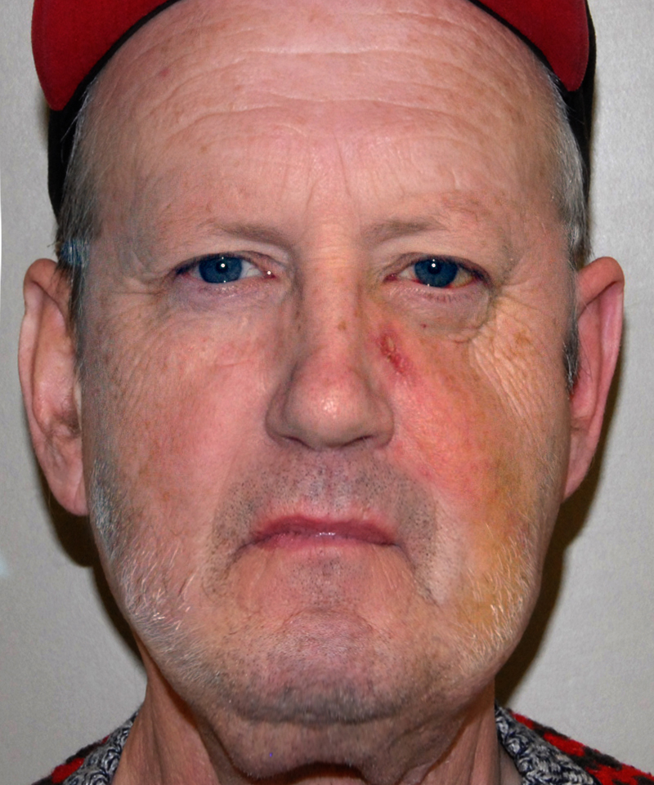
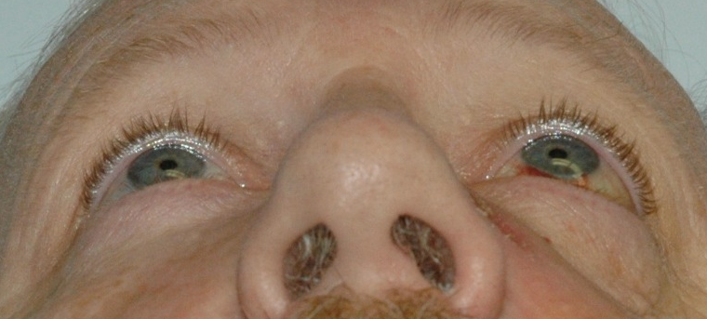
Notes:
Introduce case history
Man who had a cycling crash: No diplopia
Describe the clinical findings
Malar flattening, decreased facial projection
Globe position unaffected
What area of hypoesthesia might be present?
Numbness on the left side involving upper teeth and gums, cheek, and left nasal side wall
Make a presumptive diagnosis and how would you confirm that?
ZMC fracture and needs CT scan of the face

Slide 3
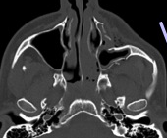
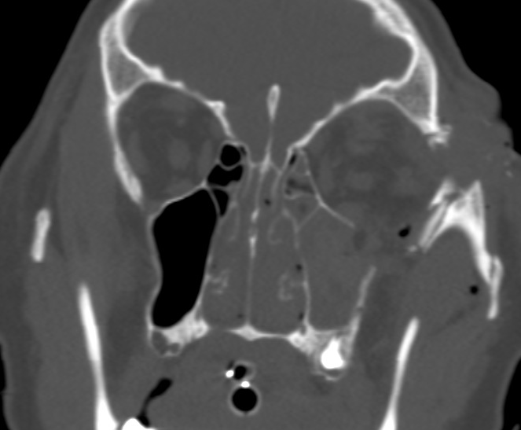
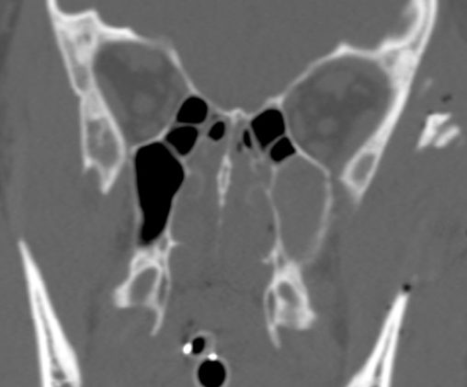
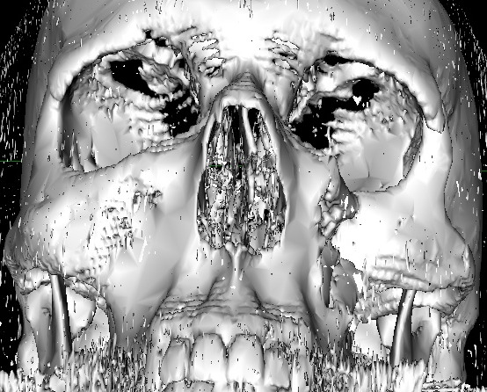
Notes:
Describe the CT scan, highlighting the condition of the orbital floor
Note that floor fracture is lateral to the infraorbital nerve, also no floor fracture is seen posteriorly
How will you approach these fractures?
This will depend on what needs to be fixated, the lower eyelid incision carries the greatest complication profile so it may be better to avoid it if possible
Will definitely need vestibular incision due to comminution and one other at least, either upper eyelid or lower eyelid
Can discuss the need for a third incision
How many points of fixation are enough in this case?
This is controversial
This patient has some displacement of the lateral wall (on coronal cut and on 3D CT) and a non-comminuted infraorbital rim (axial cut and 3D CT) with a comminuted lateral buttress (3D CT) so some surgeons would consider fixating the ZF suture and the lateral buttress only and can look at the rim after reduction from the vestibular incision. If reduced, then you could leave it; if not reduced or still mobile, you may then consider a lower lid incision
Discuss indications for orbital floor repair in zygomatico-orbito-maxillary complex (ZOMC) treatment
Generally lateral fractures without herniation do not need exploration
Need to explore floor if fractures extend medial to nerve into medial floor and medial wall and if there is orbital fat herniation
May need to explore if patient already needs a lower lid incision for some other reason

Slide 4
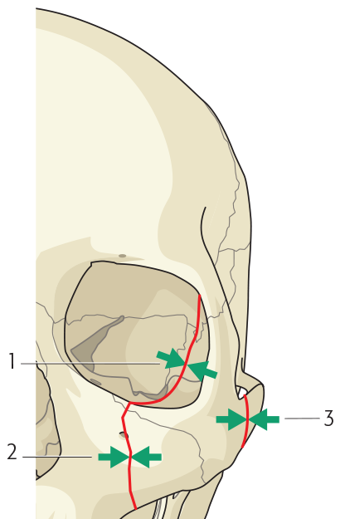
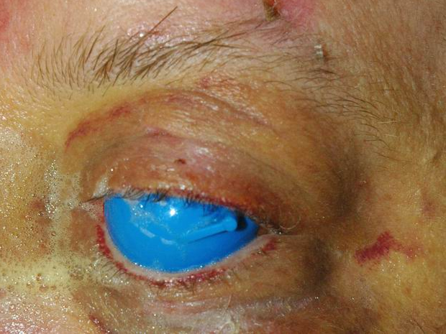
Notes:
Discuss the best approaches to the ZF suture, and why
Upper eyelid crease or blepharoplasty approach well hidden in crease
If you are limited to one ZMC approach in this case, which would it be? If limited to two?
If one, then vestibular due to comminution of bone
If two, then upper lid and vestibular, avoids lower lid incision and can see infraorbital rim from vestibular approach, also rim appears noncomminuted
Comment on the landmarks that are most reliable for ZMC accurate reduction and how do you achieve reduction
Very important point, need to highlight importance of sphenozygomatic suture and lateral orbital wall
Lateral orbital wall is a complex curve and anatomical reduction here suggests 3D anatomical reduction for the entire ZMC
Describe the order in which fracture lines would be reduced and fixated
Generally reduce the least comminuted and displaced fractures first
Also surgeons tend to start at the ZF as this allows stable to unstable reduction to occur and can look at the lateral wall as well

Slide 5
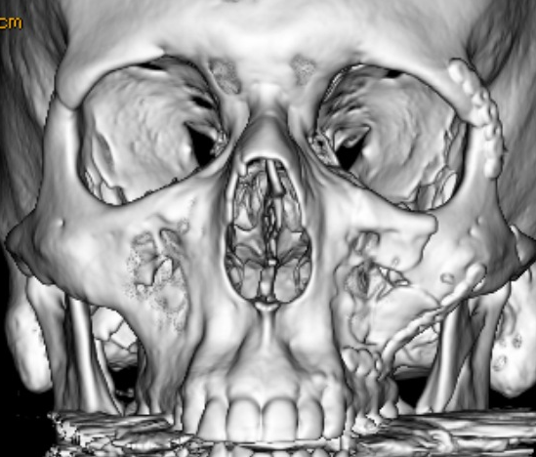
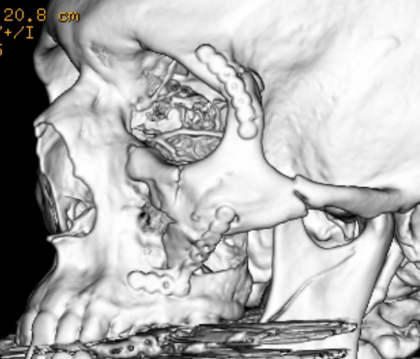
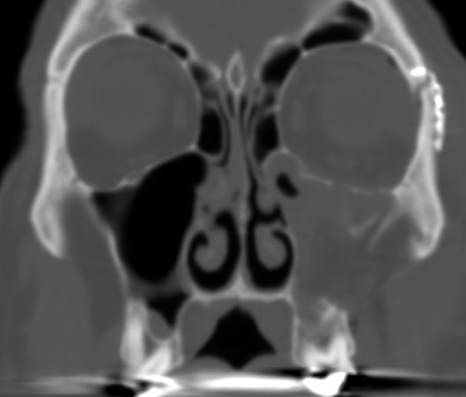
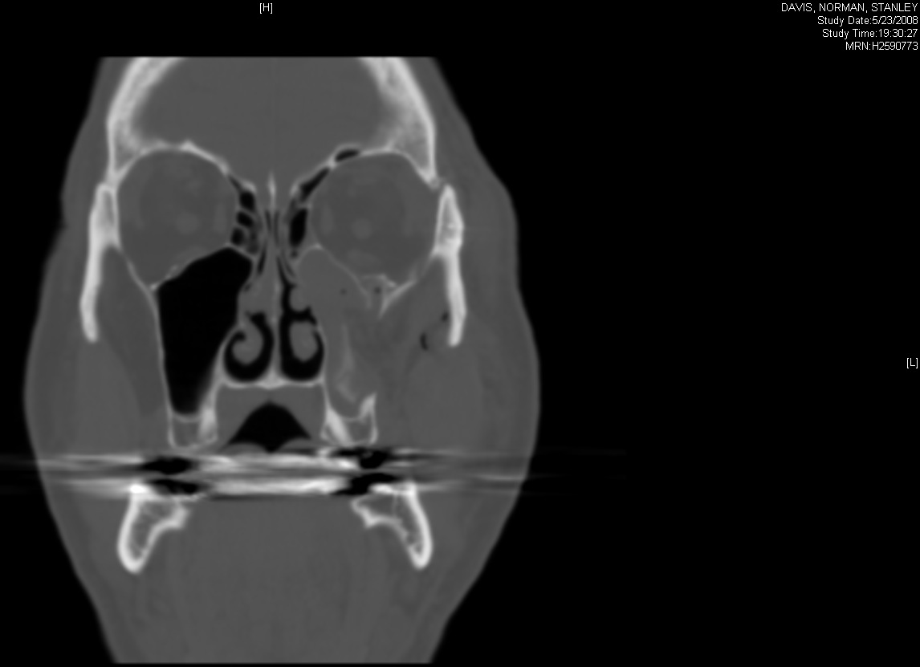
Notes:
No approach or repair to the orbital floor was made. Comment on this outcome.
Small defect persists in bony floor, no orbital fat herniation seen
If an approach to the orbital floor had been made, how would you decide to graft it or not?
Size of defect….large vs small
Evidence of periorbita (periosteum) disruption with herniation increases risk of late enophthalmos as does a large floor defect
Comment on the number of plates and their position. Is two-point fixation of this ZMC fracture adequate?
Anatomical reduction has been achieved

Slide 6
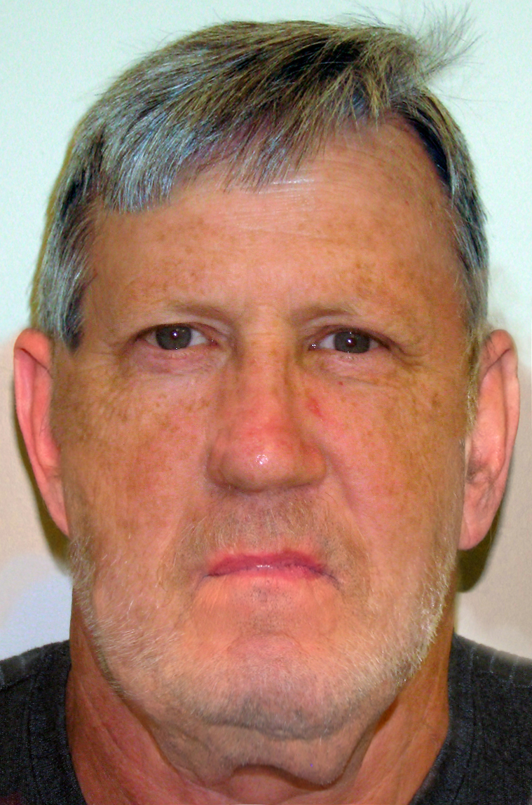
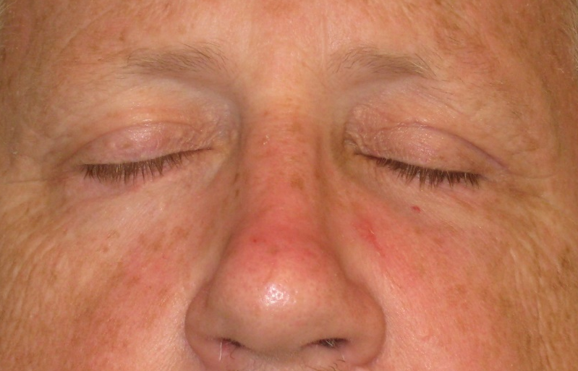
4 weeks postop
6 weeks postoperative
Notes:
Critique the clinical outcome/appearance, highlighting upper bleph scar
What parameters of appearance and function are assessed in the postoperative ZMC patient
Malar projection and esthetics of facial proportion
Globe position and presence of enophthalmos or dystopia
Mouth opening
Cheek sensation
Discuss indications for, and techniques of, soft-tissue resuspension after ZMC open reduction and internal fixation
Not needed in this patient as no lower lid incision was made and the periosteum is likely intact still at rim apex
At ZF it is beneficial to reapproximate or tighten periosteal sleeve which keeps lateral canthus in position, as well as reapproximating orbicularis fibers to some degree

