Slide 1

Reverse shoulder arthroplasty
AO Recon Course―Comprehensive Shoulder Arthroplasty
Notes:
Author: Chunyan Jiang
Shoulder Service, Beijing Jishuitan Hospital
School of Medicine, Peking University
Date: June, 2020

Slide 2
Learning objectives
Recognize the indications and contraindications for reverse shoulder arthroplasty
Address glenoid fixation and proper implant version
Plan for the procedure

Slide 3
Rotator cuff deficient shoulder
Force imbalance
Superior migration of the humeral head
Deltoid retraction
Nonfunctional joint (unstable center of rotation)

Slide 4
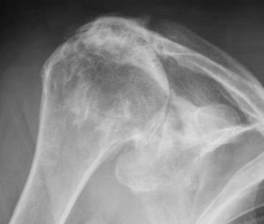
Cuff tear arthropathy (CTA)
Increased force on remaining cuff and superior migration = eccentric glenoid loading
Subsequent cuff tear arthropathy

Slide 5
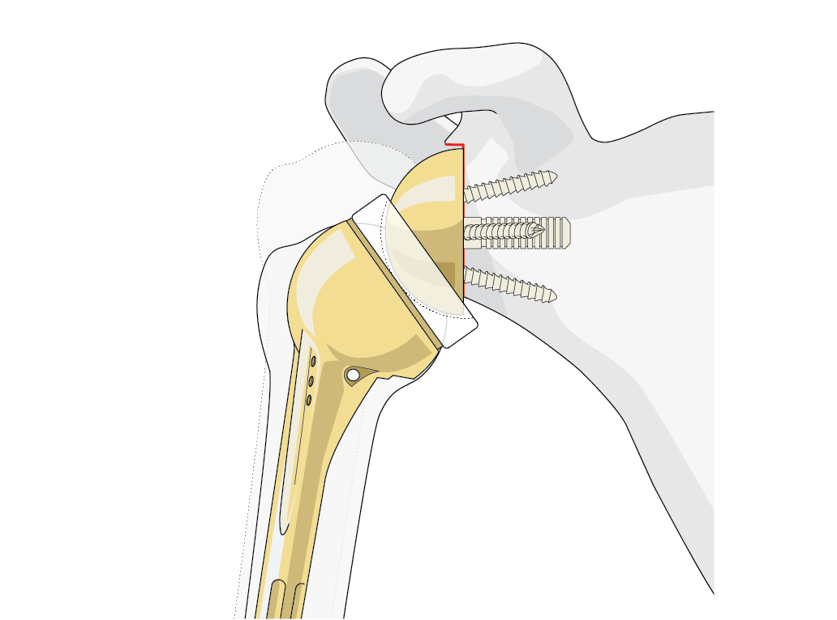
The reversed prosthesis
The idea: a reversed ball and socket prosthesis which relies solely on the deltoid for both movement and stability
Theory:
Stabilizes center of rotation
Increases deltoid lever arm
Restores active elevation

Slide 6
The principles
Fixed center of rotation with congruent joint surfaces
  Compensates for the deficient cuff muscles
  Increases stability
Medialized center of rotation
  Reduces torque on the glenoid component
Lowered humerus relative to the glenoid
  Restores deltoid tension

Slide 7
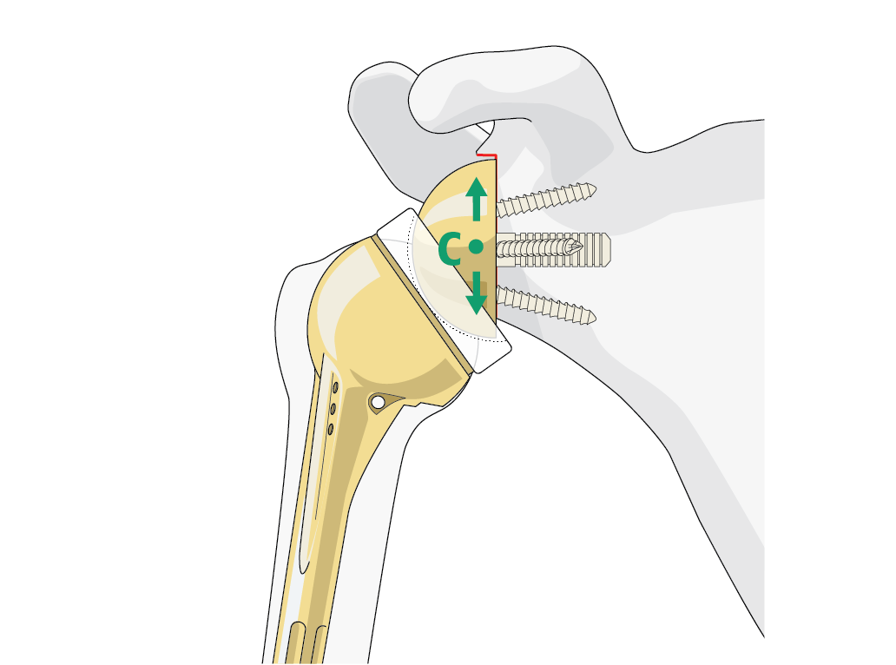
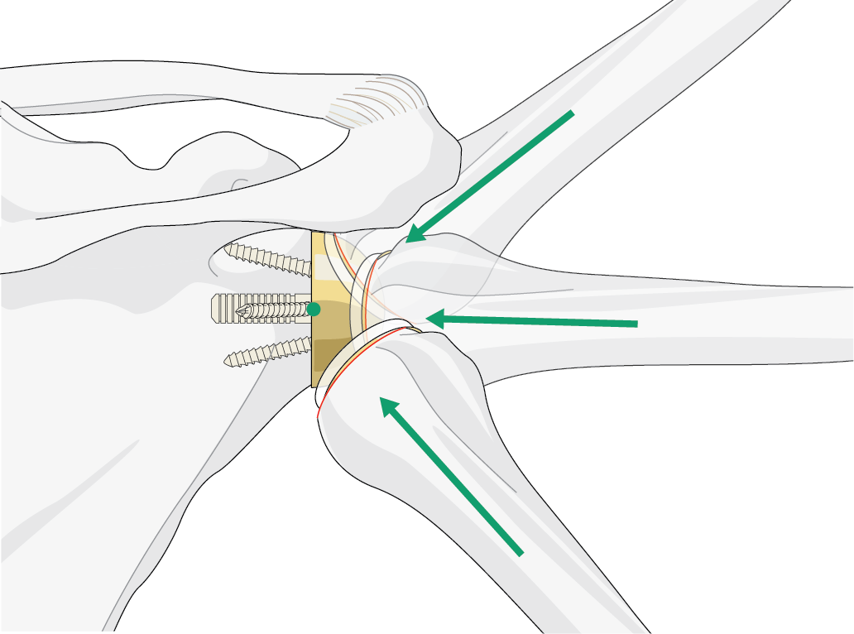
Reduced torque on the glenoid
No lever arm on glenoid anchorage
Compressive forces >> shear forces

Slide 8
Designed to function only with the deltoid

Slide 9
Reverse shoulder arthroplasty—indications
Cuff-deficient arthritis: CTA, OA, RA
Cuff-deficient fractures and very comminuted osteoporotic GT
Revisions (failed humeral head replacement / total shoulder replacement, fracture sequelae, infection)

Slide 10
Reverse shoulder arthroplasty—key issues
Indication control: hard to bailout if failed!
Baseplate fixation: preoperative evaluation critical
Stability: proper tension and version
Avoid complications

Slide 11
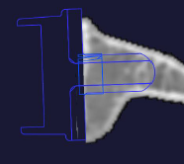
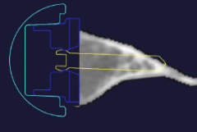
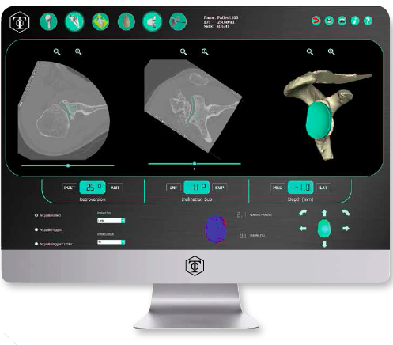
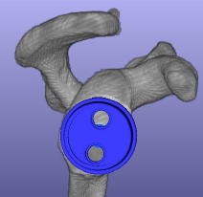
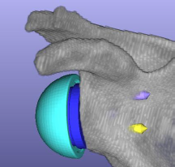
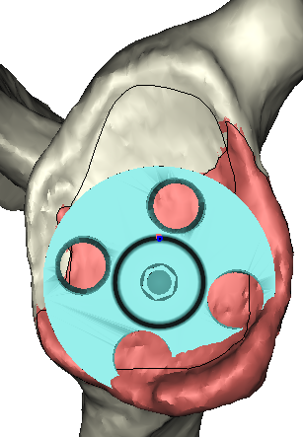
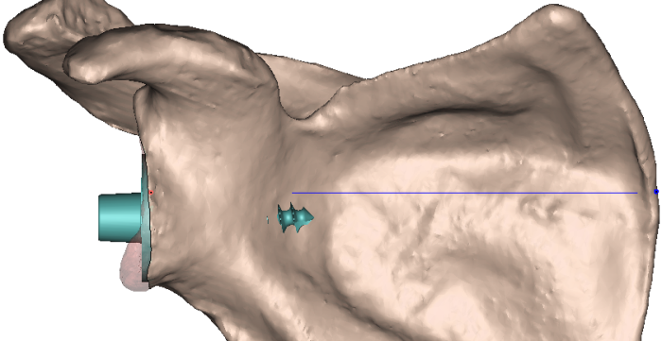
Preoperative planning and patient specific instrumentation (PSI)
Notes:
Today I believe that you have to have a 3-D planning software if you are going to treat a difficult glenoid.
It is a must have and you will be surprised what you will learn from it if you compare it to standard imaging.

Slide 12
Maintain stability in reverse shoulder arthroplasty
Proper tension (distalization and lateralization)
Inferior tilt
Glenosphere enlargement

Slide 13
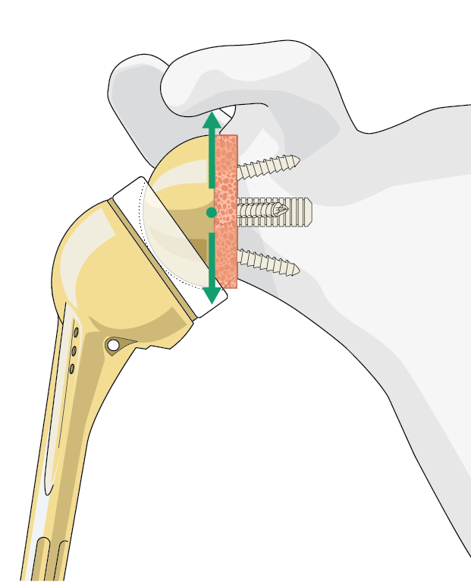
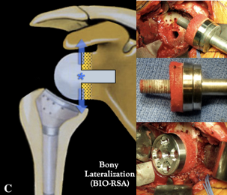
Lateralization
Increase lateral offset with bone graft

Slide 14
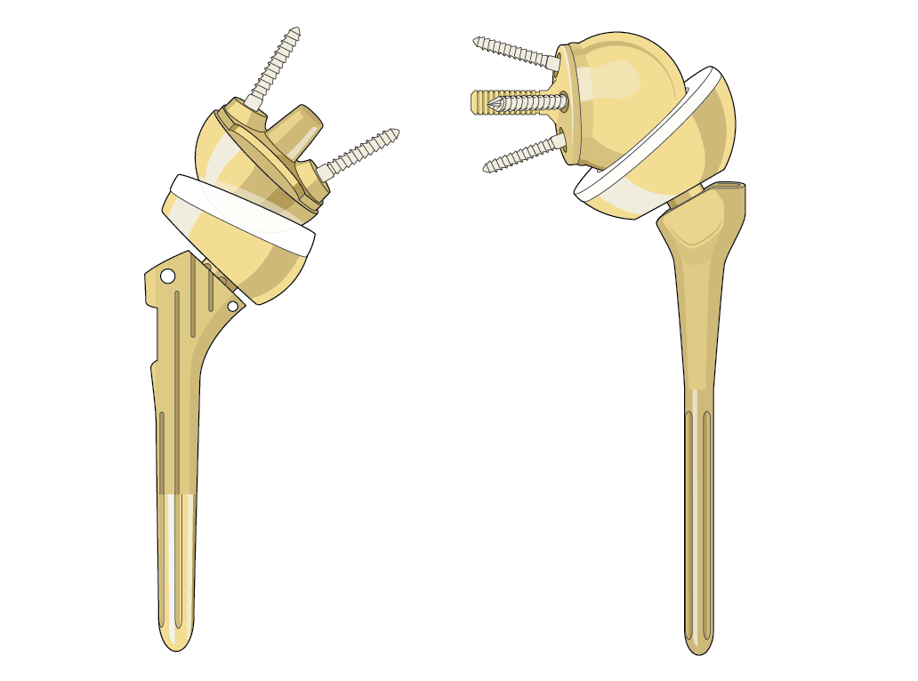
Lateralization
Increase lateral offset with metal
  Glenosphere offset
  Humeral offset

Slide 15
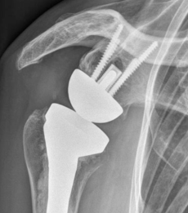
Maintain stability in reverse shoulder arthroplasty
Proper tension (distalization and lateralization)
Inferior tilt
Glenosphere enlargement

Slide 16
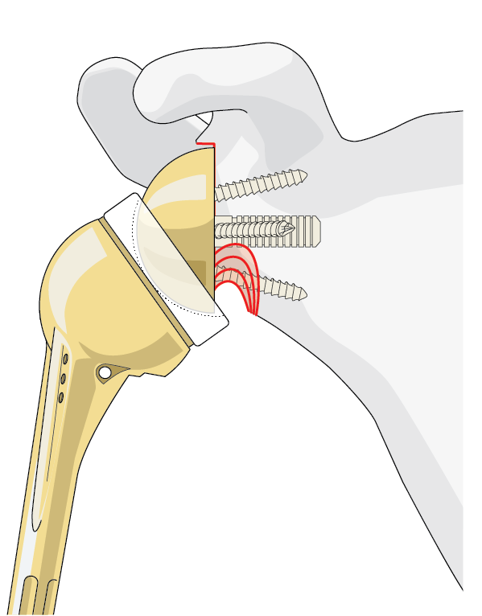
Medialize CR—drawbacks
Mechanical impingements and notching

Slide 17
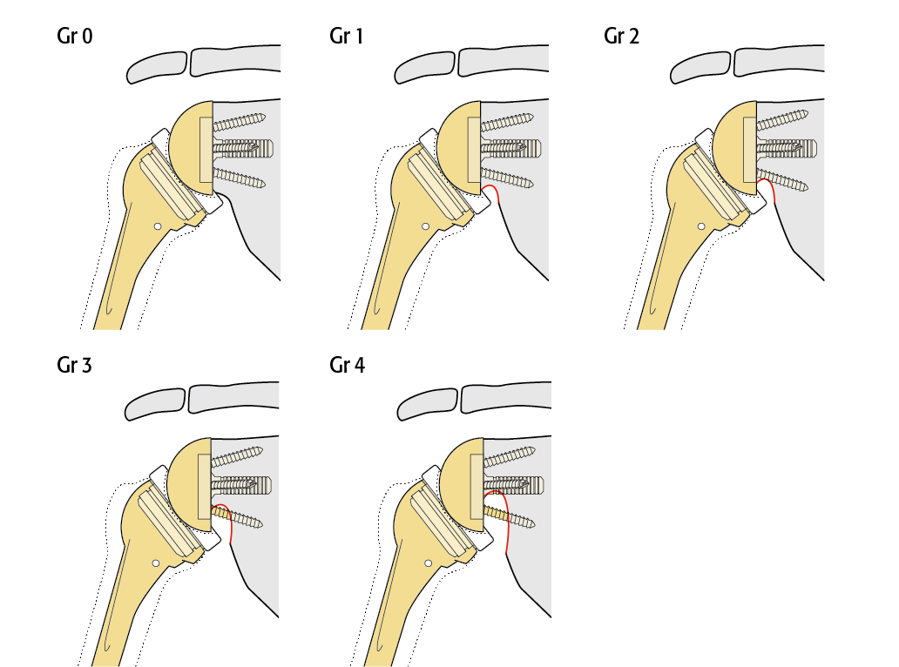
Glenoid notching
Notes:
The was 88% of notch without any influence on the Constant score.

Slide 18
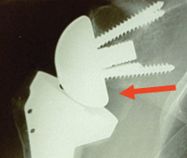


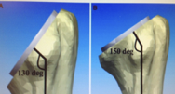
Avoid notching
Inferior overhang
Lateral offset
Steeper humeral cut

Slide 19
Reverse shoulder arthroplasty—key issues
Indication control: hard to bailout if failed!
Baseplate fixation: preoperative evaluation critical
Stability: proper tension and version
Avoid complications: hematoma, infection, stress fracture, etc

Slide 20
Take-home messages
Reverse arthroplasty: indication control
CTA most appropriate indication for reverse shoulder arthroplasty
Key issues: glenoid fixation and proper implant version
3-D preoperative planning and PSI are the future

