Slide 1
Radiographic assessment and classification
X-ray and computed tomography
Dr. Javier del Rio
AO Trauma Online Course—Pelvic and Acetabular Fracture Management
Mutual de Seguridad
Santiago, Chile
Davos, December 4–6, 2020

Slide 2
Declaration conflicts of interest
I have no financial relationships with commercial entities that produce healthcare related products.
Notes:
Declaration options (choose 1, 2 or 3):
I have no financial relationships with commercial entities that produce healthcare related products.
The commercial entities with which I have a financial relationship do not produce healthcare related products or services relevant to the content of my presentation.
I disclose the following financial relationships with commercial entities that produce healthcare related products or services:
Consultant for:
Advisory Board for:
Board member of:
Employee of:
Grant/Research support from:
Honoraria from:
Stockholder in:
Speaker/teacher for:
Royalties from:
Intellectual property rights for:

Slide 3
Learning objectives
After this learning experience, you will be able to:
Describe pelvic x-ray views (AP, inlet, and outlet)
Identify structures at risk and fracture patterns in a CT scan
Classify a pelvic fracture
Notes:
Learning objectives should be: Specific, Measurable, Achievable, Relevant, Time-bound (SMART)
DO NOT use the verbs: understand and know (they are not measurable)
USE the sentence: After this learning experience, learner will be able to:
USE these verbs for KNOWLEDGE (mostly for lectures): define, describe, identify, list, outline, recall, reproduce, show, etc.
USE these verbs for SKILLS (mostly for practicals): apply, operate, measure, assemble, construct, design, demonstrate, examine, execute, fix, etc.
USE these verbs for ATTITUDE (mostly for small groups and practicals): accept, appreciate, embrace, relate, resolve, value, etc.
Example lecture: Preoperative planning
Highlight the importance of preoperative planning
Describe various techniques for preoperative planning
Formulate and draw an operative plan
Describe a surgical tactic step by step p (eg, positioning, choice of surgical approach, instruments, reduction technique, implants)
Incorporate patient safety protocols (mark site, time-out check list) in the preoperative plan

Slide 4
Pelvic x-ray
General information on pelvic anatomy
3 views: AP, inlet, and outlet
Useful: x-rays during surgery

Slide 5
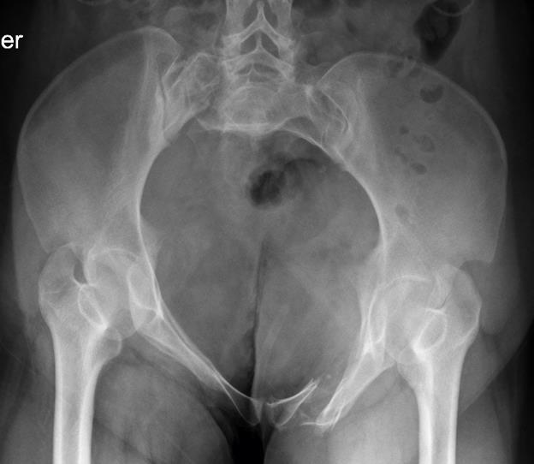
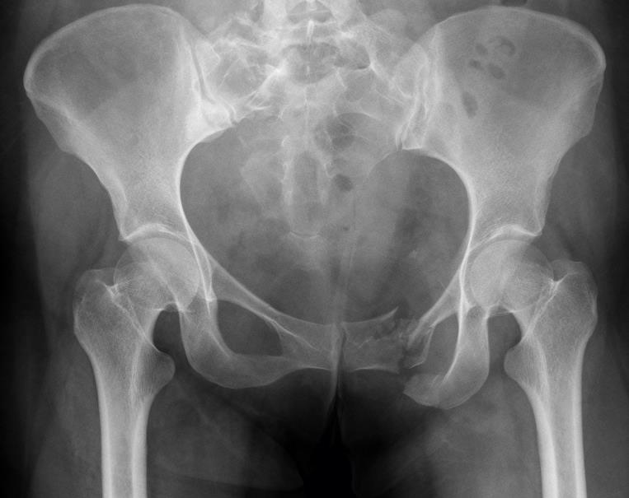
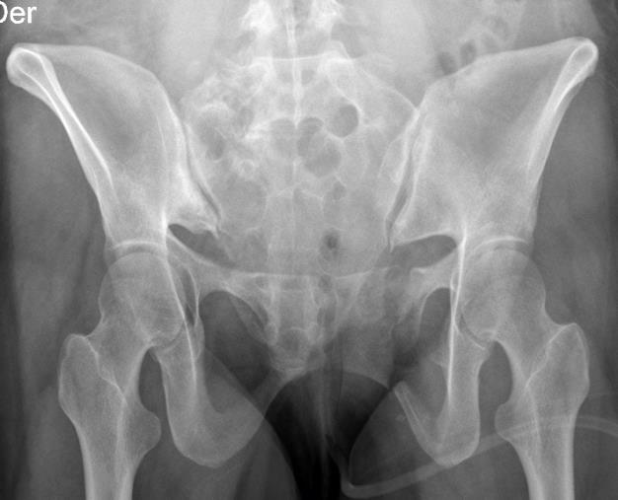


Pelvic x-ray
Inlet
Outlet
AP

Slide 6
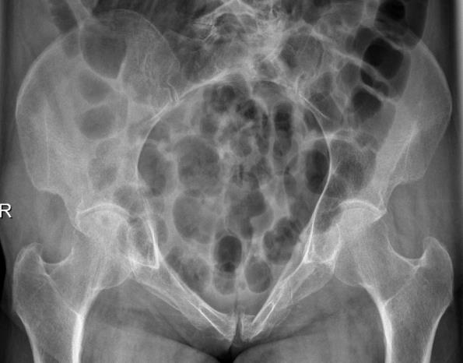
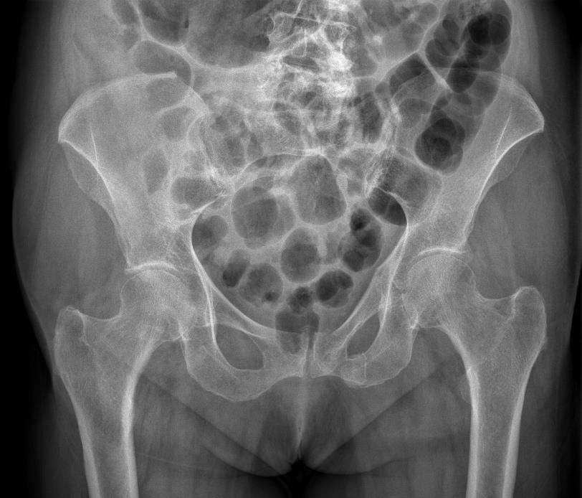
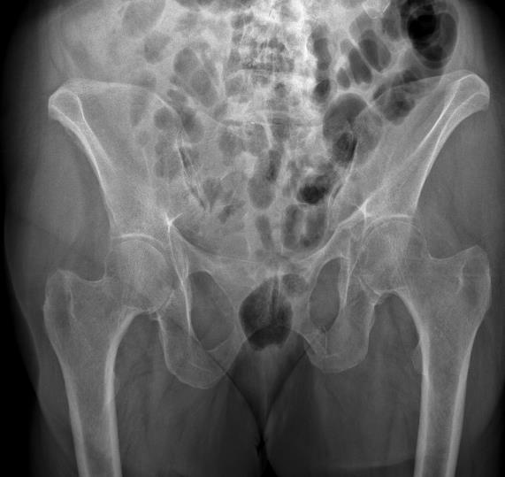
87-year-old woman
Fell from her own height
Lumbosacral pain

Slide 7
Pelvic x-ray
General information on pelvic anatomy
3 views: AP, inlet, and outlet
Useful: x-rays during surgery
Some polytrauma patients don’t have an x-ray
Difficult to evaluate posterior pelvis

Slide 8
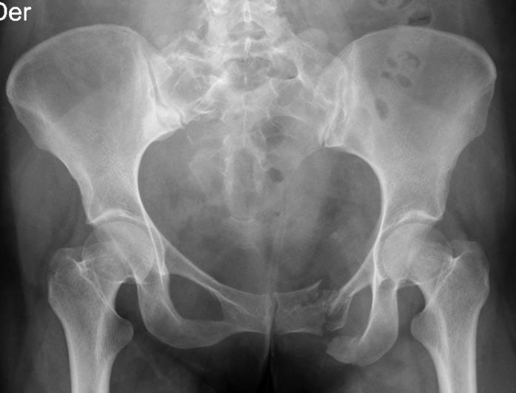
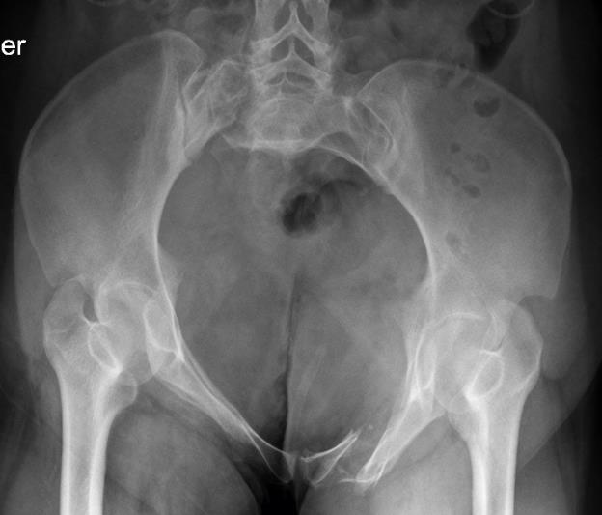


Slide 9
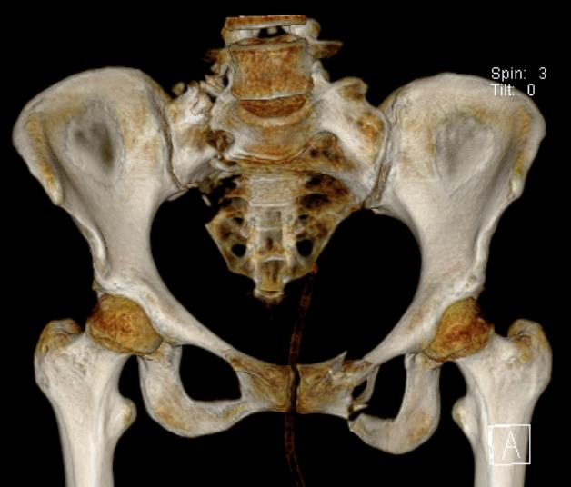
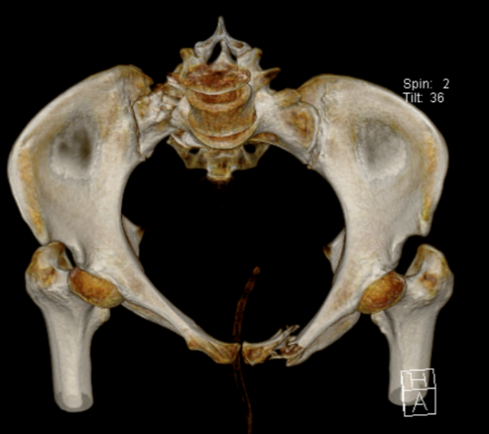
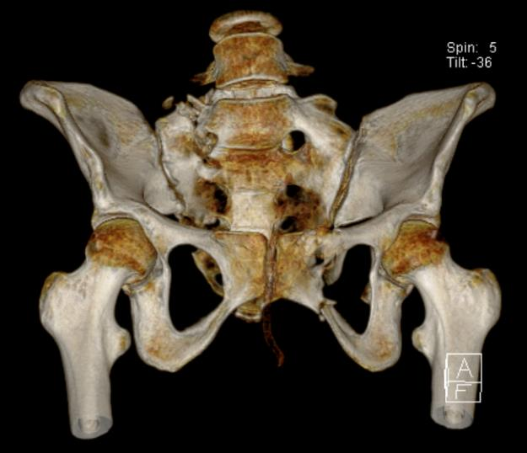

Slide 10
CT scan
Study of choice
Every pelvic fracture should have a CT scan/Pan scan
Contrast is useful in diagnosing some lesions
3D reconstructions help in understanding complex fracture patterns

Slide 11

CT scan: always follow a sequence
Soft tissues: obesity, Morel-Lavallee
Blood vessels: active bleeding, absence
Hematomas: retzius, retroperitoneal
Organs: bladder, rectum, uterus, testicles
Fracture: anatomy, size, fragments, pattern

Slide 12
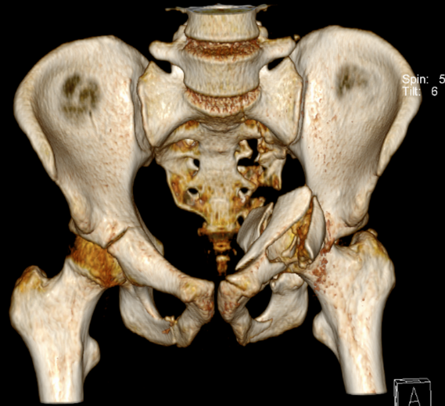
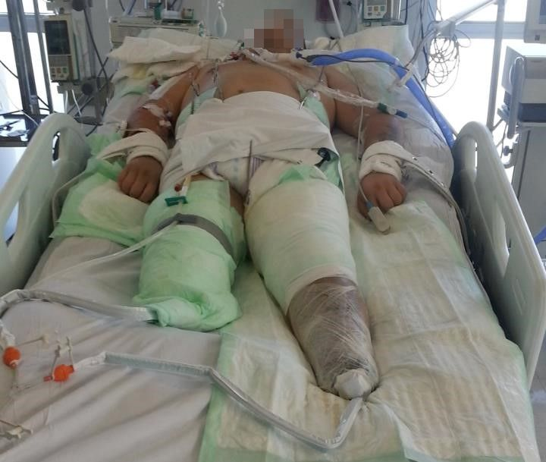
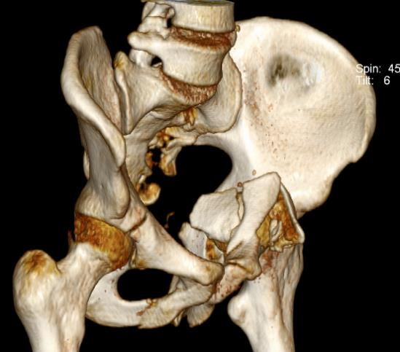
Clinical case
30-year-old man
Motor vehicle collision
Bilateral lower extremities amputated
Pelvis + left T-type acetabular fracture

Slide 13

Our plan:
Percutaneous pelvic fixation
ORIF of acetabular fracture

Slide 14
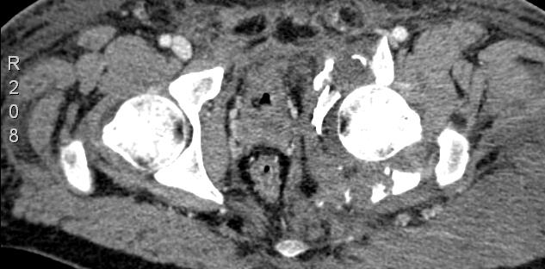
Our plan:
Percutaneous pelvic fixation
ORIF of acetabular fracture
CT scan: soft-tissue window

Slide 15
Other examples

Slide 16
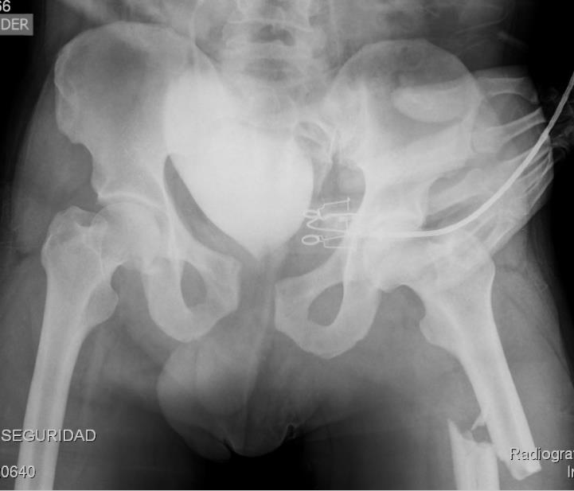
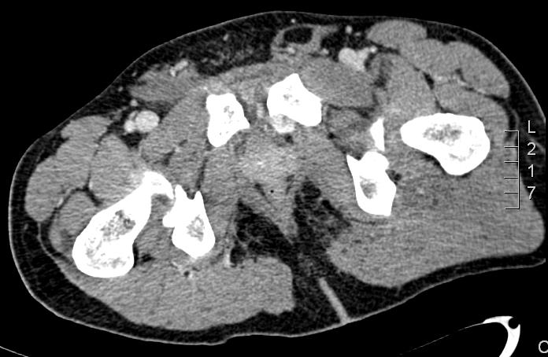
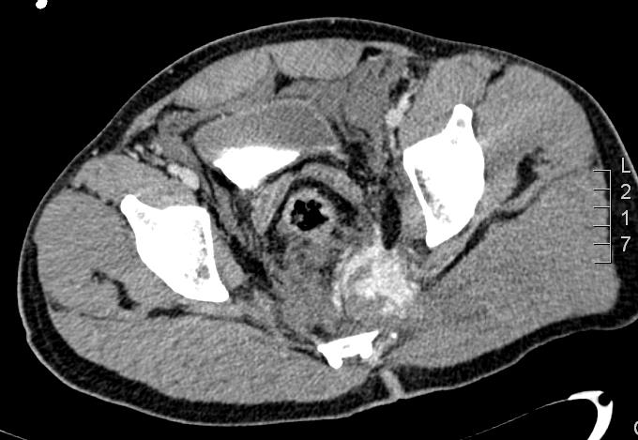
46-year-old man
Motorcycle vs truck
BP 90/50 mm Hg
HR 130x

Slide 17
46-year-old man
Motorcycle vs truck
BP 90/50 mm Hg
HR 130x

Slide 18
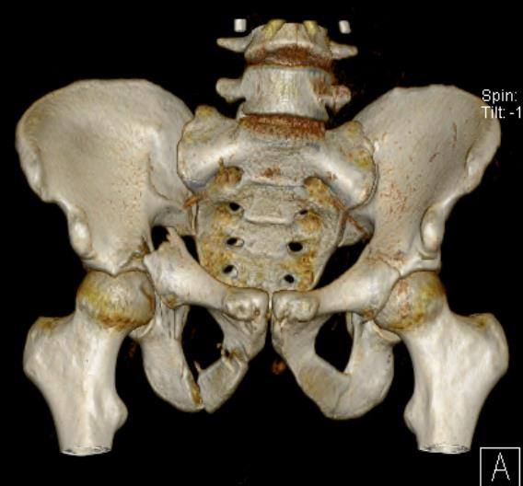
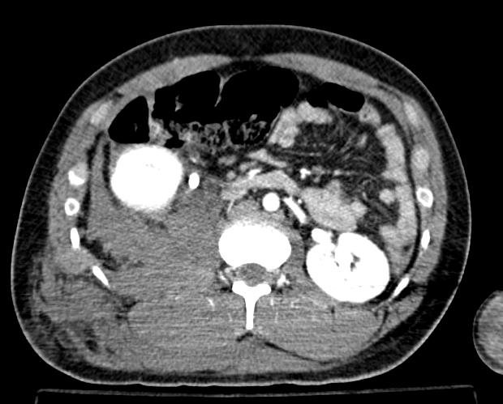
21-year-old man
Run over by a car
BP 100/70 mm Hg
Hematocrit 21% (2 units of blood)

Slide 19
21-year-old man
Run over by a car
BP 100/70 mm Hg
Hematocrit 21% (2 units of blood)

Slide 20
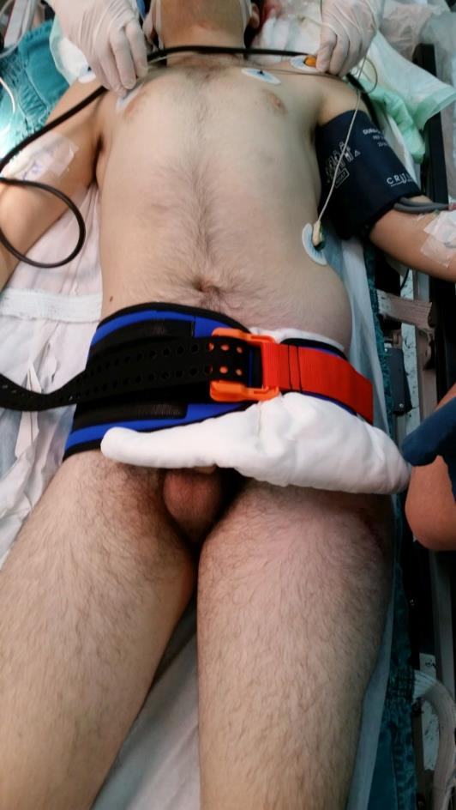
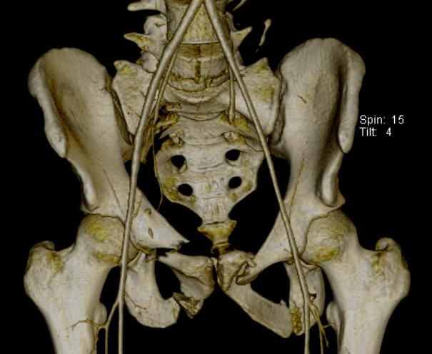
18-year-old man
Run over by a car
HDN unstable

Slide 21
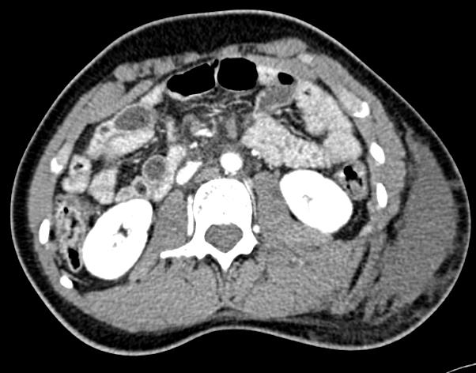
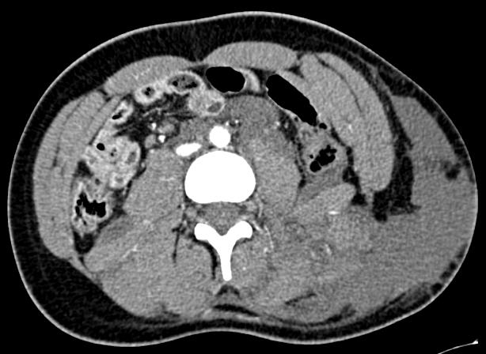

Slide 22
7% Hematocrit

Slide 23
7% Hematocrit

Slide 24
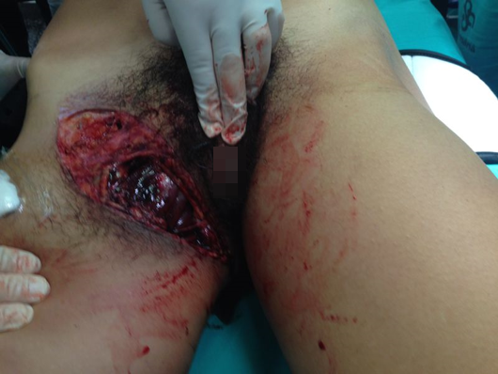
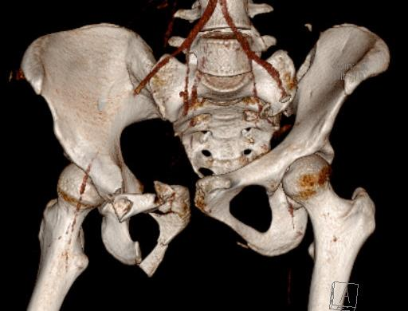
17-year-old woman
Run over by a bus
HDN unstable

Slide 25
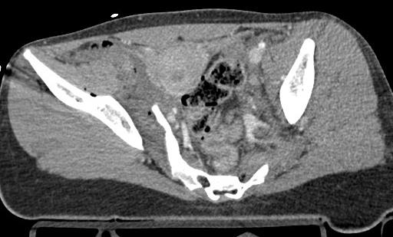
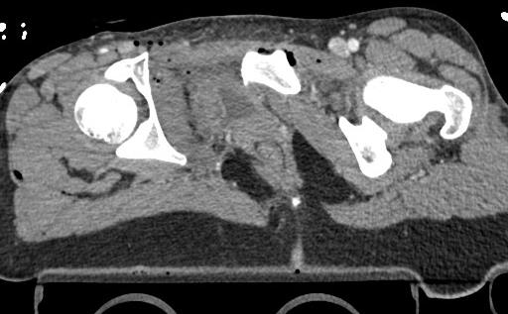

Slide 26
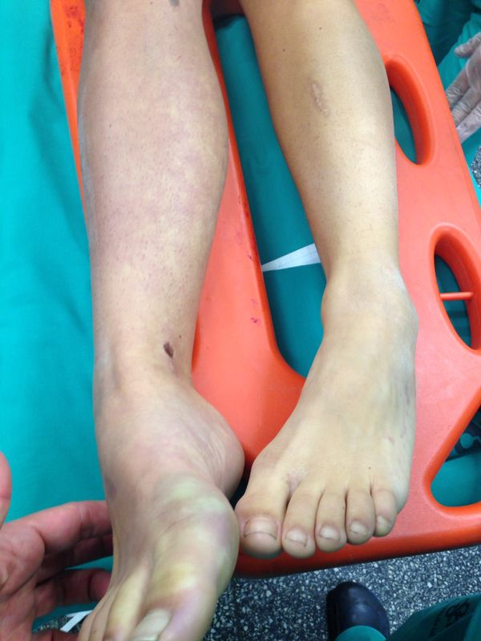

Slide 27
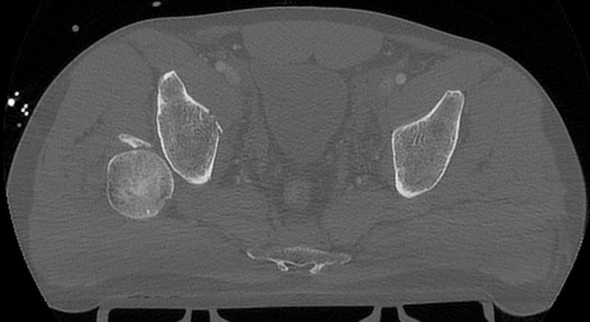
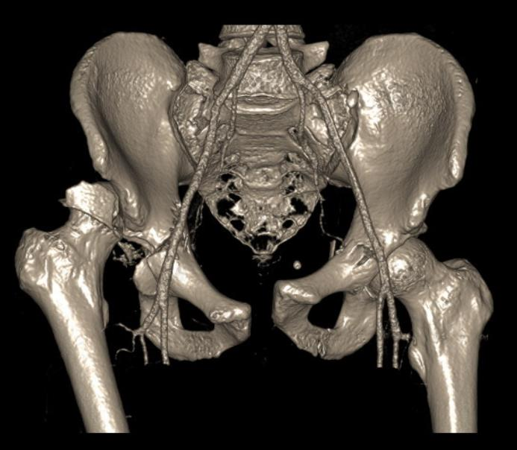
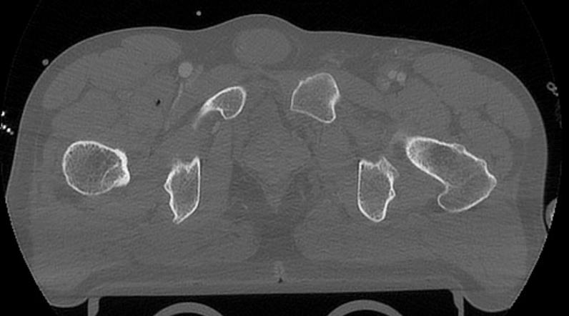
52-year-old man
Motorcycle vs car
Intubated

Slide 28
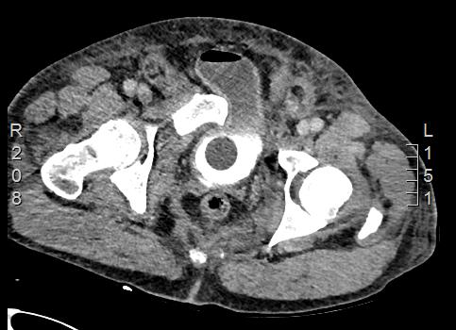
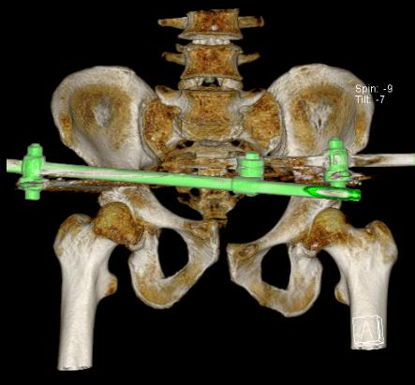
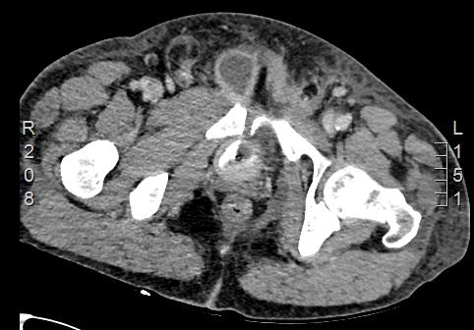
45-year-old man
Transferred with a pelvic external fixator

Slide 29
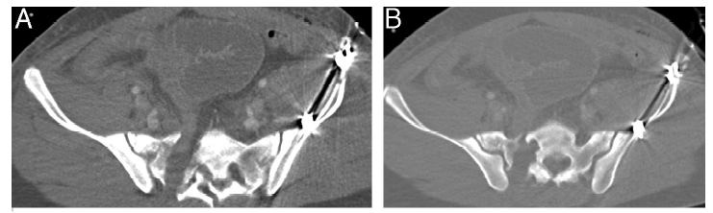

Slide 30
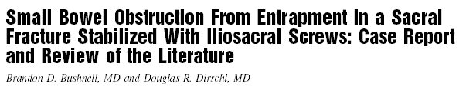
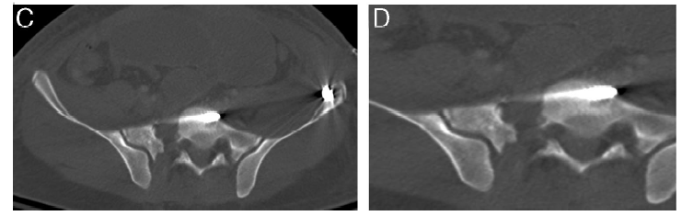

Slide 31
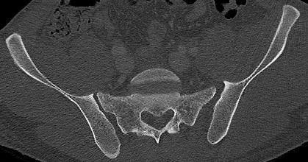
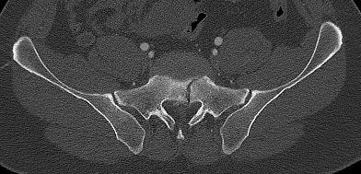
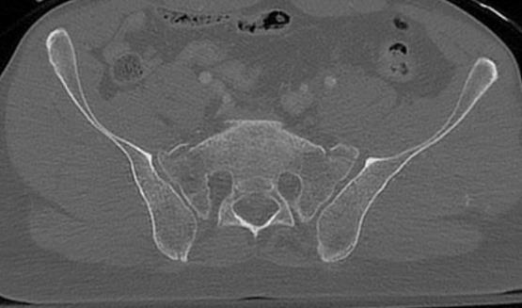
And the fracture?
3D reconstruction: complex fracture patterns
Axial cuts must be analyzed
Different anatomies: customized fixation strategies
Different sizes of patients

Slide 32
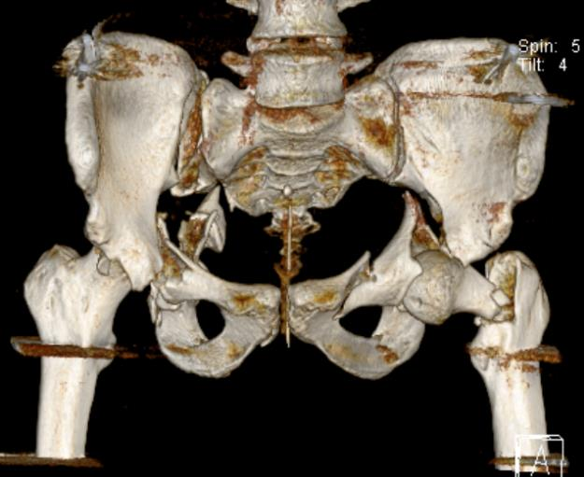
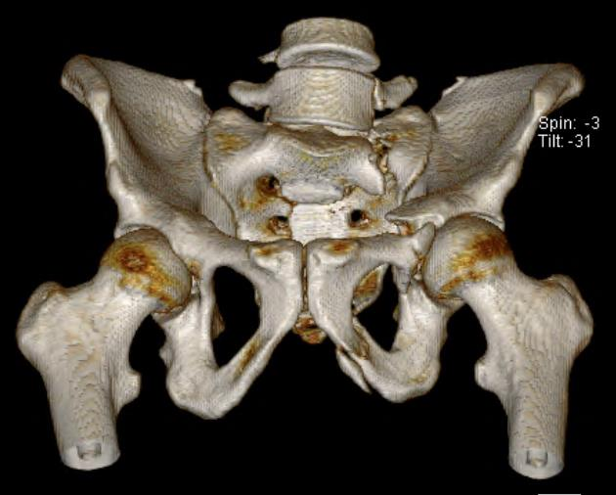
Understand fracture pattern(s) Identify anatomical variations
3D reconstruction

Slide 33
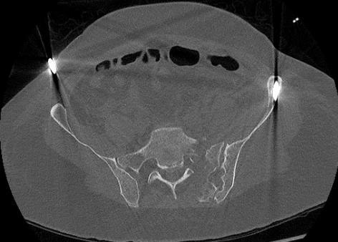
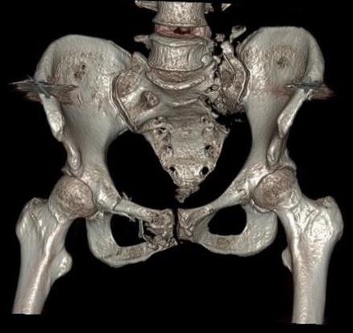
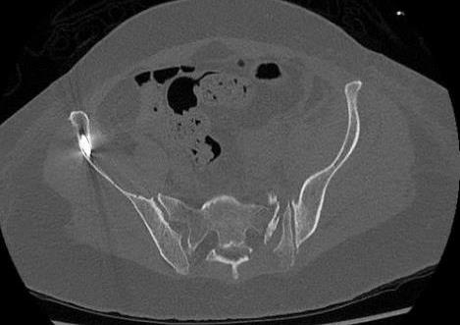
Always look at the axial images

Slide 34
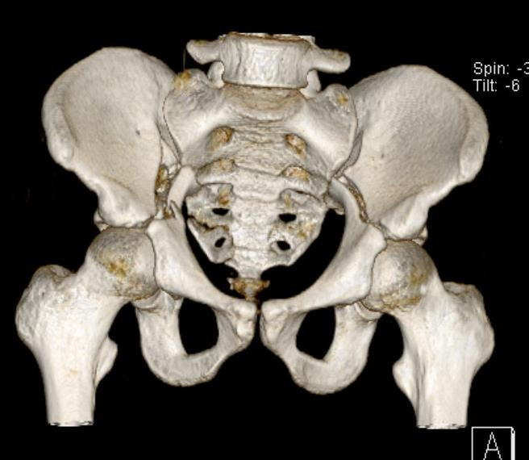
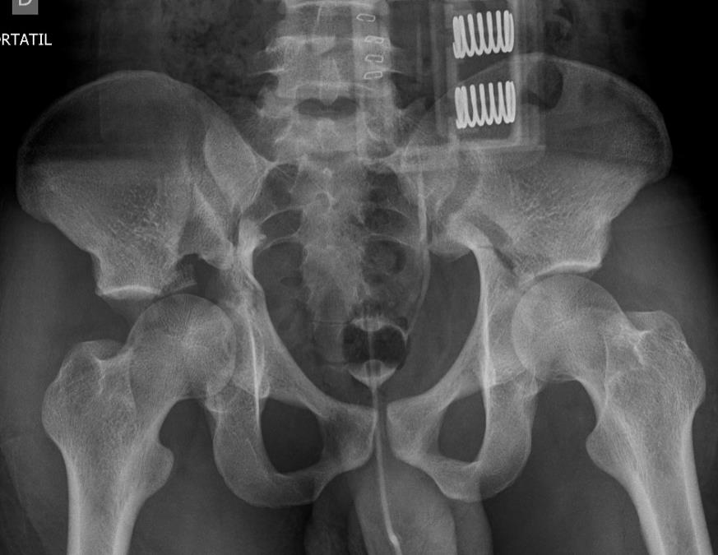
Underestimation of instability
18-year-old patient
Motor vehicle collision
HDN unstable

Slide 35
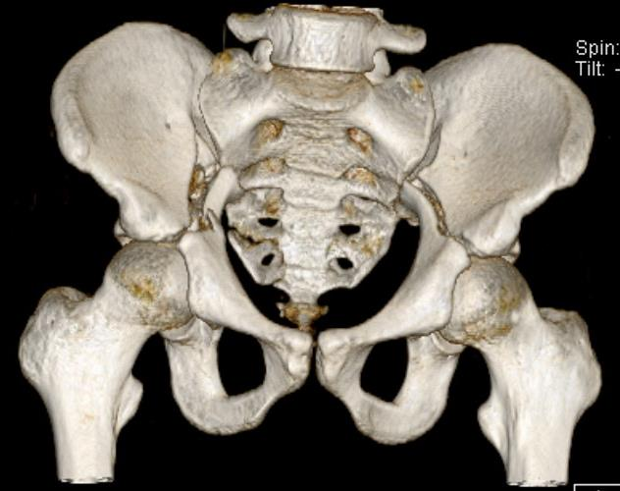

VS

Slide 36
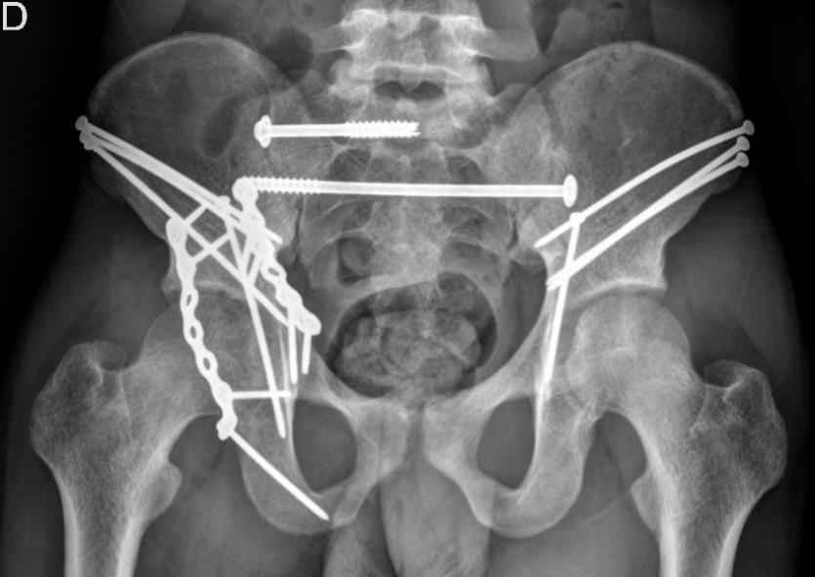
VS

Slide 37



30-year-old woman
Run over by a truck
Severe facial injury

Slide 38

Underestimation of instability

Slide 39

Underestimation of instability

Slide 40


AO pelvic fracture classification

Slide 41


Slide 42




Slide 43




Slide 44
Take-home messages
Proper analysis of images is mandatory (x-rays and CT scans)
Huge amount of information can be obtained (vital)
Hidden instability should be suspected
Pelvic fractures can be classified as
Intact posterior arch
Incomplete disruption posterior arch
Complete disruption posterior arch
Notes:
Your take-home messages should
Match with your learning objectives
Summarize three to maximum five important points
Be your last slide (this is what your learners will remember and that will stay until the next speaker is up)
Your take-home message can
Be a powerful graphic or picture that is related to the topic
Not be something that has nothing to do with the topic (eg, a picture of your hospital or family or a “thank you” slide)
Example: Preoperative planning
Formulate a preoperative plan
Identify and assess benefits of preoperative planning
Develop a surgical tactic
Describe steps involved

