Slide 1
Small group discussion C Case 2 Mandibular fractures
Notes:
Mandibular body and condylar fracture—load sharing, fixation OPTION 2

Slide 2
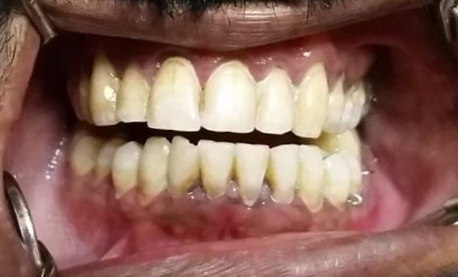
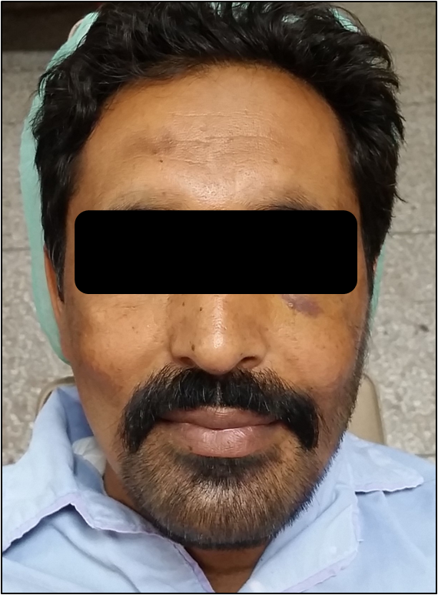
Notes:
Introduce case history
34-year-old man
2 days after altercation
Pain in lower jaw left side and right preauricular region
Clinical findings?
What radiographs?

Slide 3
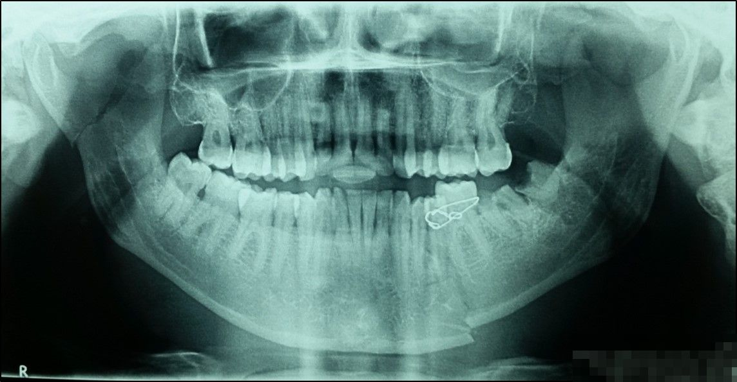
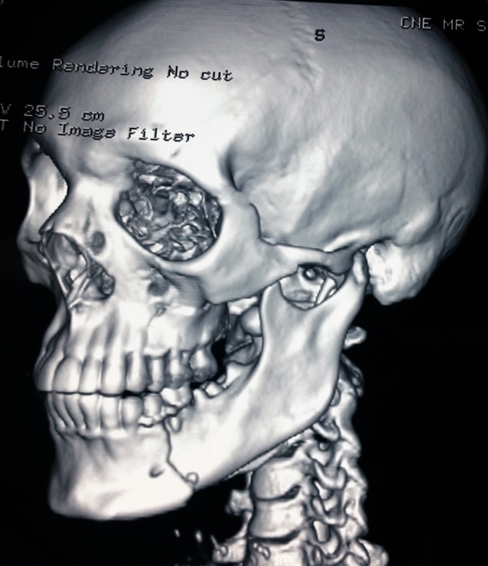
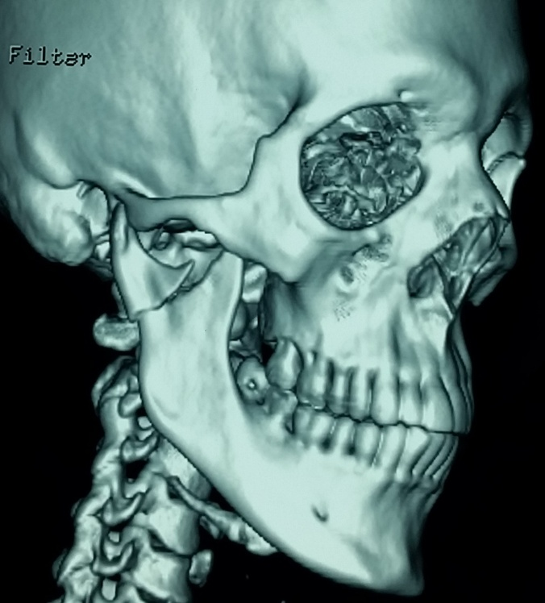
Notes:
Ask about the radiographic findings
Right condylar and left body fractures. Body fracture temporarily treated with dental wiring
Role of this dental wiring:
Control bleeding from inferior alveolar vessels
Relieves pain and discomfort
What surgical approaches?
What type of fixation required?
Two load-sharing miniplates at body fracture and two miniplates or one thicker plate at condyle

Slide 4
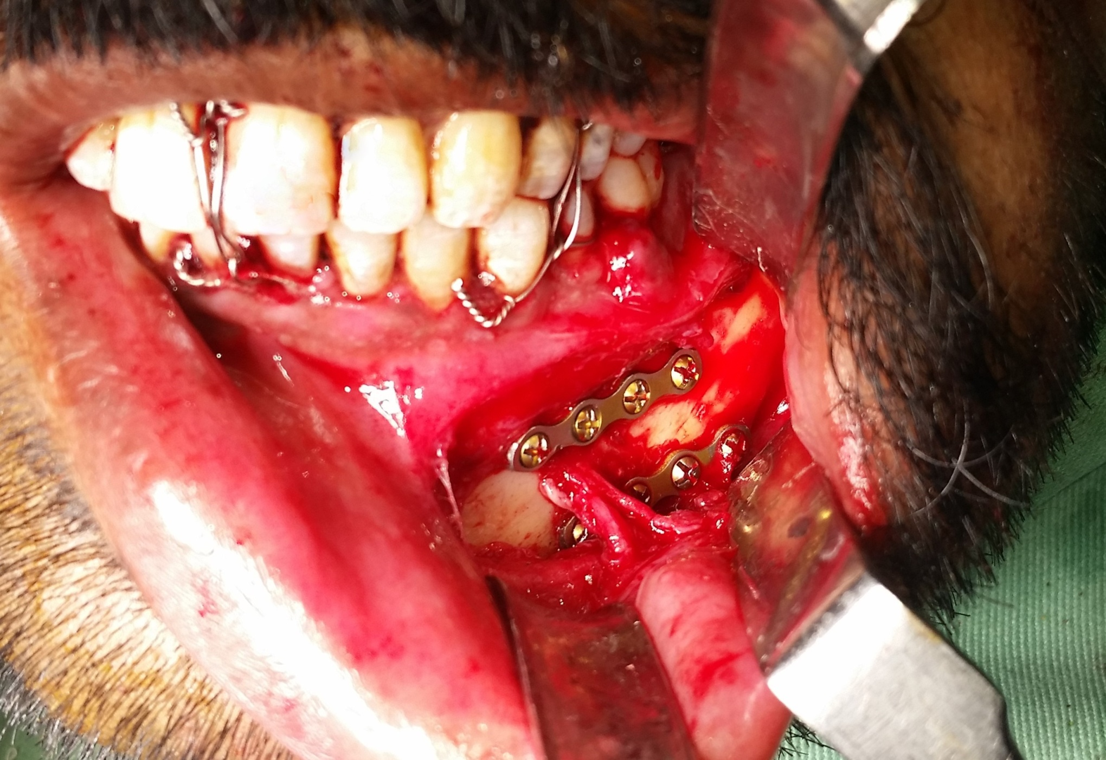
Notes:
Transoral incision, nerve release
Plate positioning?
Lower border (bellow IA nerve) and one above the IA nerve (bellow root apices)

Slide 5
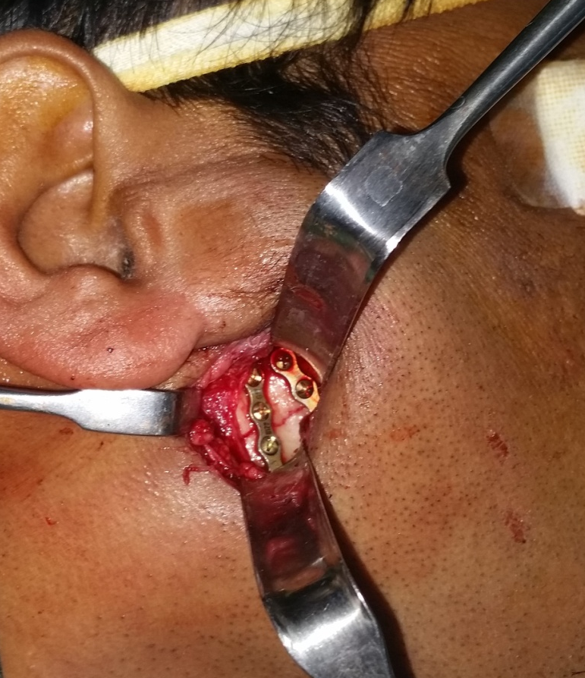
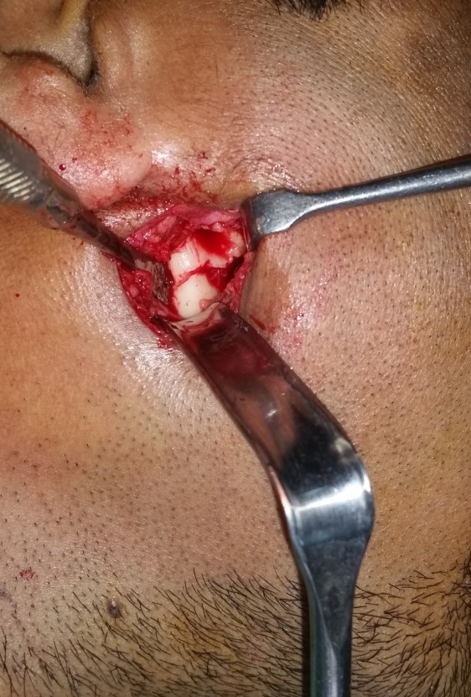
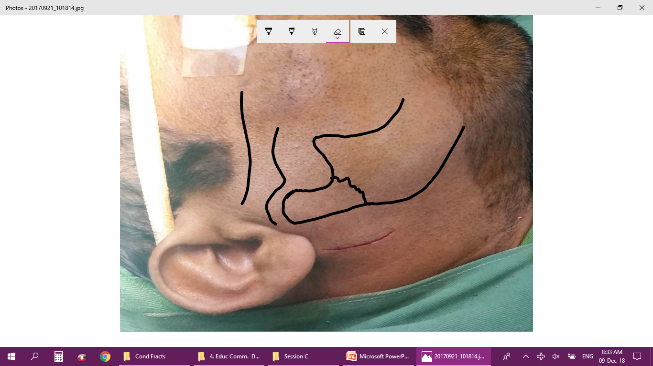
Notes:
Surgical approaches for condyle?
Transparotid / retromandibular / preauricular
Technique of transparotid approach?
Risks?
Facial nerve injury (prevention: avoid local anesthetic for hemostasis and electrical nerve stimulator)
Parotid fistula (prevention: water tight closure of parotid capsule)

Slide 6

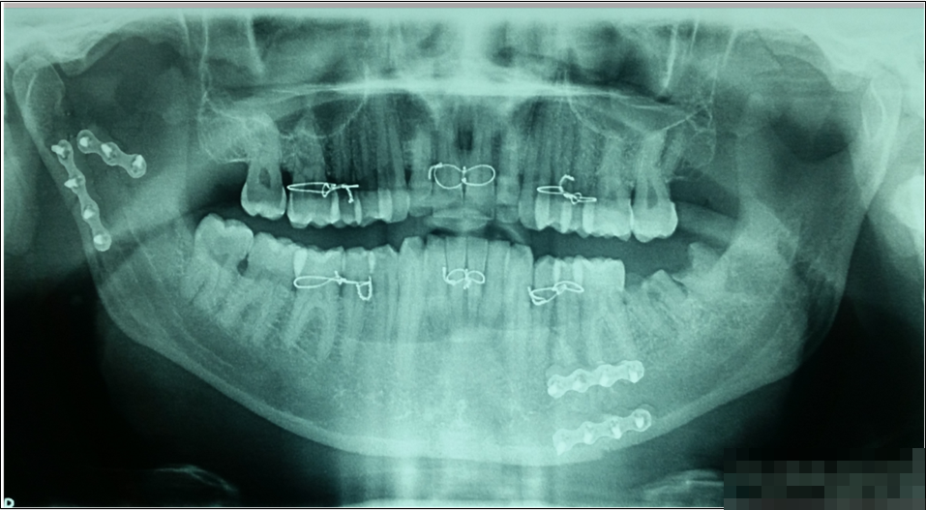
Pre- and post operative
Notes:
Condylar fixation: number and types of plates?
Sequence of fixation?
Discuss removal of dental wiring after stable internal fixation

Slide 7
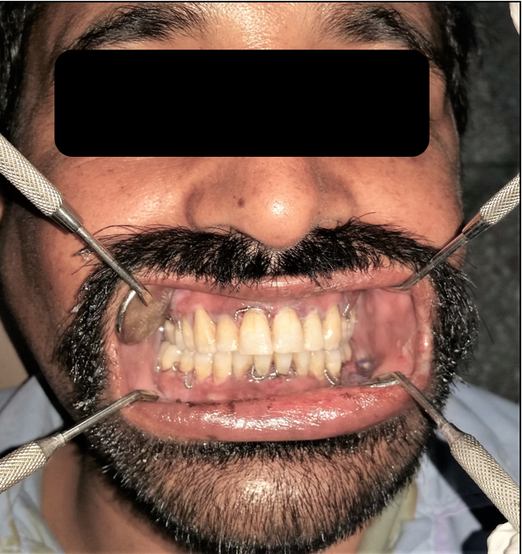
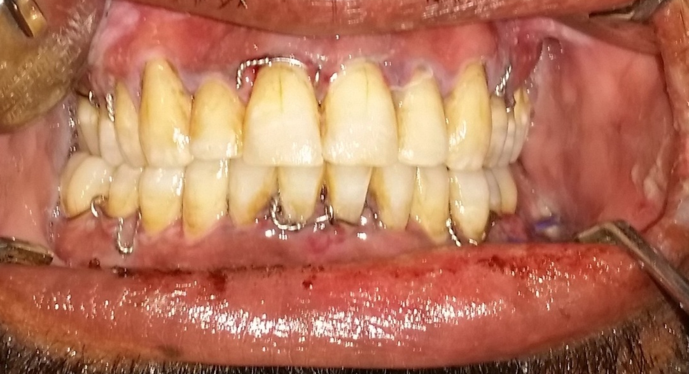
Postoperative occlusion

Slide 8
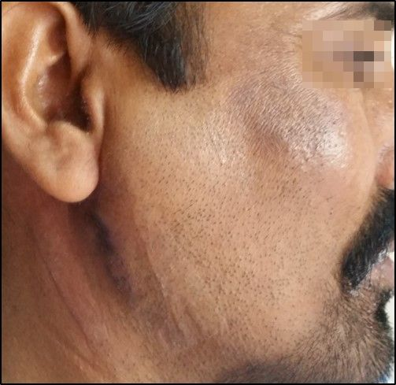
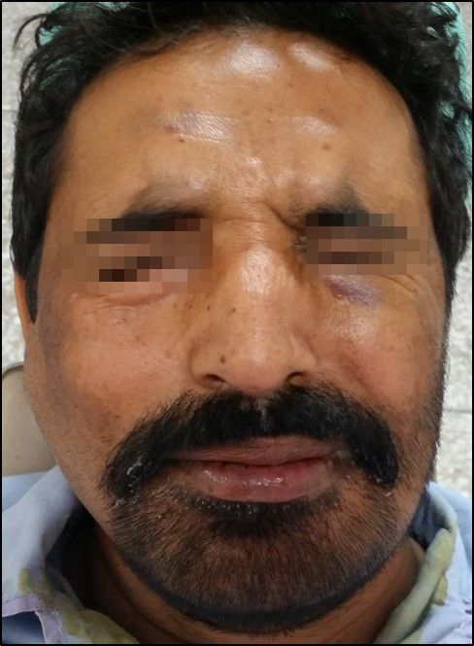
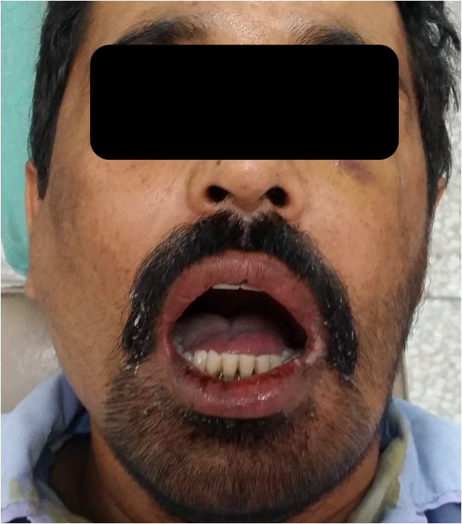
Postoperative healing and function

