Slide 1
Decision-making indications and timing for operative treatment
Mark C Reilly, MD
AO Trauma Online Course—Pelvic and Acetabular Fracture Management
Professor, Rutgers-New Jersey Medical School
Davos, December 4–6, 2020

Slide 2
Disclosure: potential or actual conflicts of interest
Faculty: Mark C Reilly
Relationships with commercial interests Speakers Bureau, Consulting Fees: Stryker Orthopaedics All potential conflicts of interest have been resolved prior to this event.
Notes:
Declaration options (choose 1, 2 or 3):
I have no financial relationships with commercial entities that produce healthcare related products.
The commercial entities with which I have a financial relationship do not produce healthcare related products or services relevant to the content of my presentation.
I disclose the following financial relationships with commercial entities that produce healthcare related products or services:
Consultant for:
Advisory Board for:
Board member of:
Employee of:
Grant/Research support from:
Honoraria from:
Stockholder in:
Speaker/teacher for:
Royalties from:
Intellectual property rights for:

Slide 3
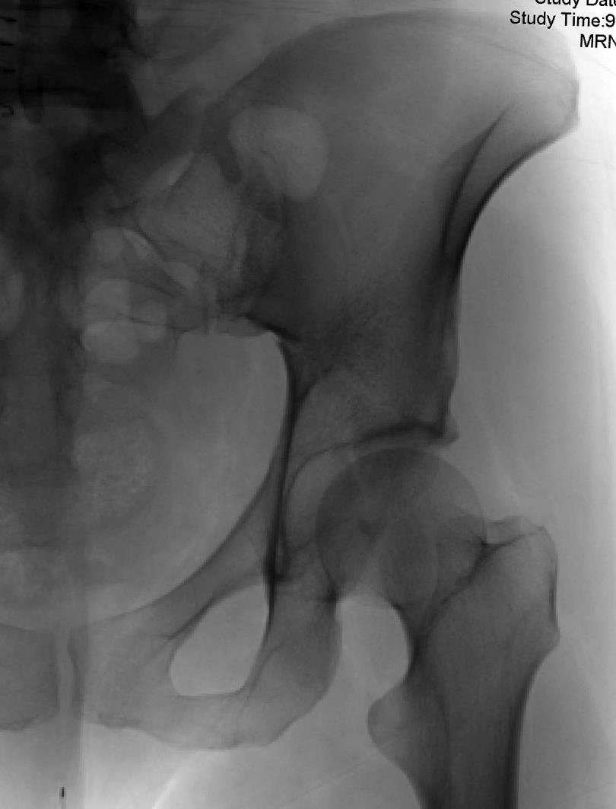
Decision making
Is this an emergency?
Does this need surgery?
If so, what surgical approach?

Slide 4
Learning objectives
Understand the acute management of acetabular fractures
Recognize the importance of hip dislocation/subluxation
Understand the indications for surgical treatment of acetabular fractures
Understand the factors important in choosing a surgical approach for acetabular fractures

Slide 5
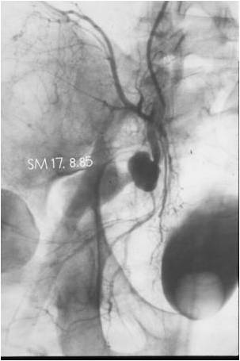
Emergent care
Unlike pelvic fractures, acetabular fractures rarely are associated with persistent hypotension
Emergent definitive care is rare
What are the emergent considerations for patients with acetabular fractures?

Slide 6
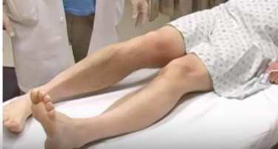
Femoral head dislocation
Occurs in 10–32% of acetabular fractures
Most commonly posterior
Time to relocation may be associated with avascular necrosis, continued mechanical cartilage wear
Not necessarily poorer outcomes
Bhandari, Dreinhofer

Slide 7
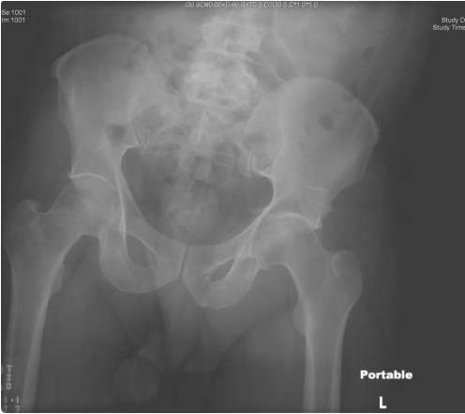
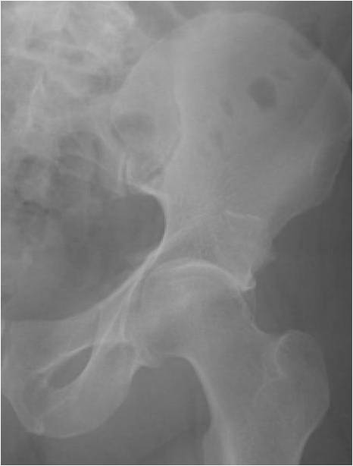

Slide 8
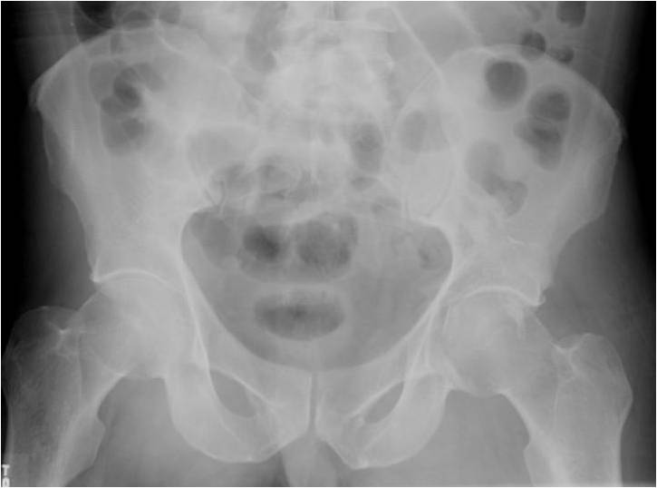
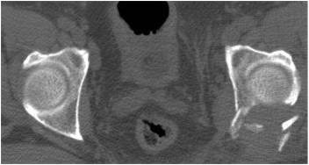

Slide 9
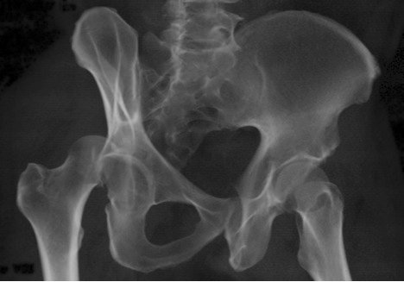
Reduction of dislocation
As early as possible
Atraumatic
Appropriate sedation
General anesthesia
Avoid multiple attempts

Slide 10
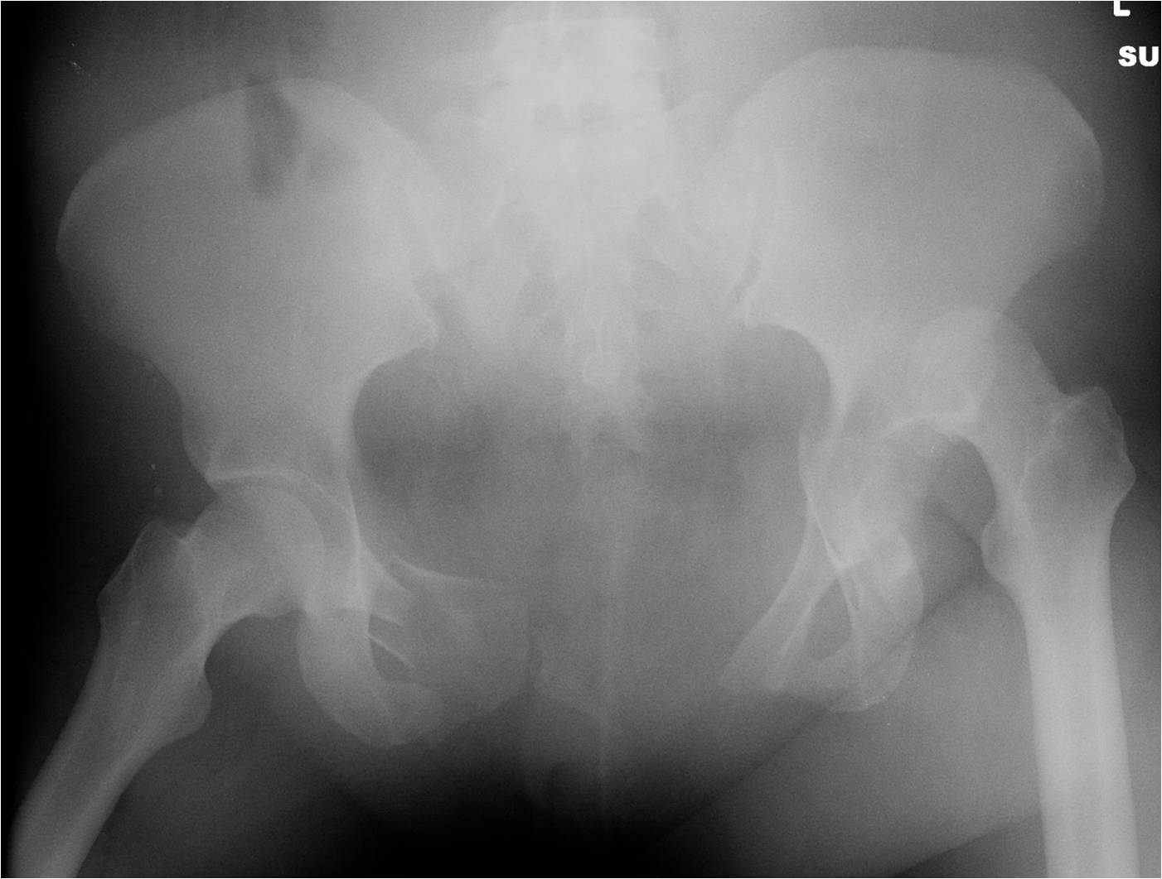

Slide 11
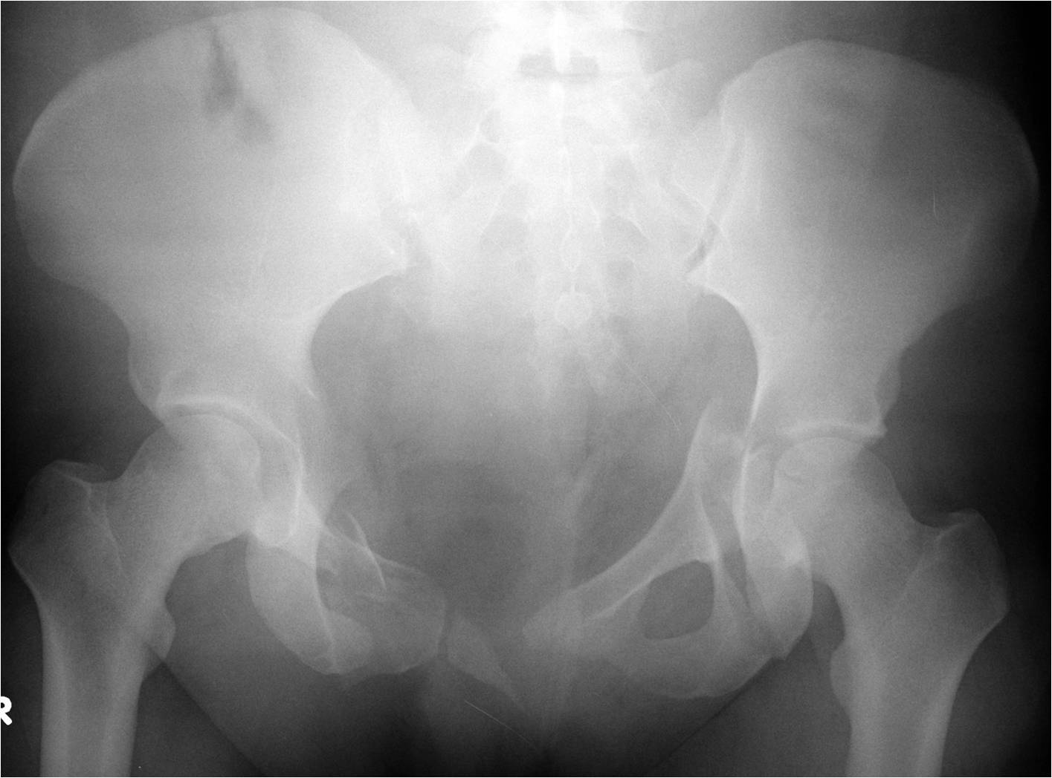

Slide 12
Role for traction?
Concern for mechanical wear
Persistent hip subluxation
Concern for hip instability
Incarcerated fragments
Minimize deformity pending operative treatment

Slide 13
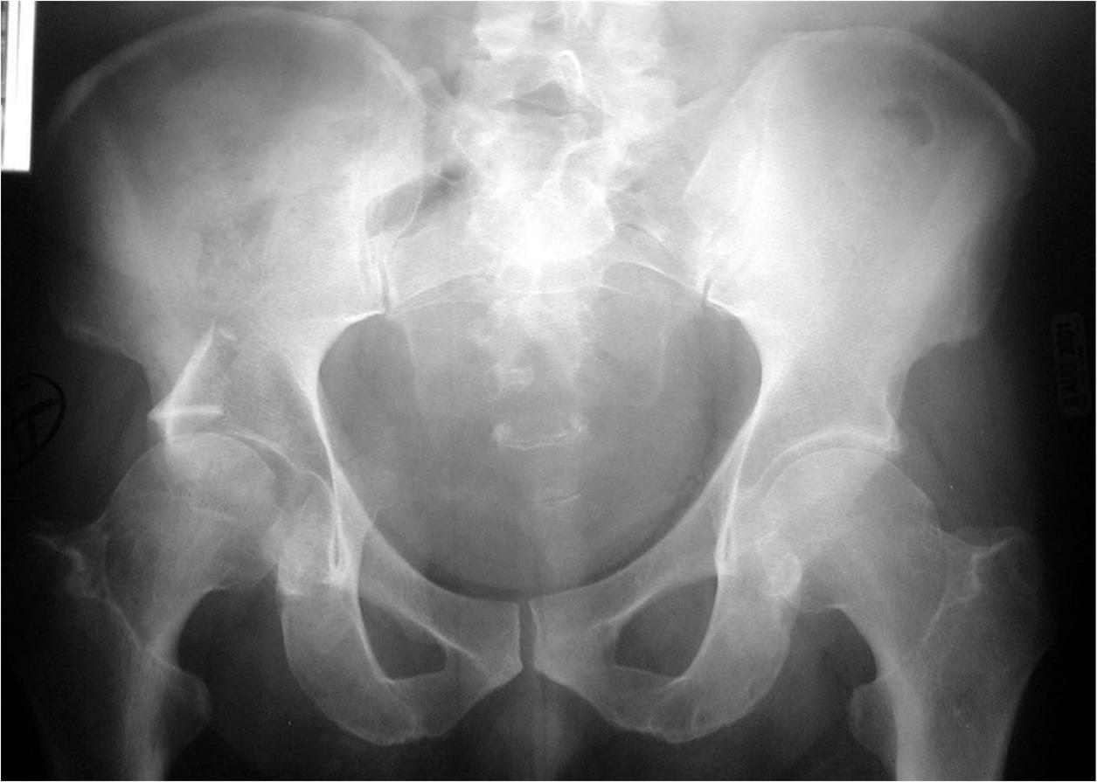
Large posterosuperior wall fracture

Slide 14
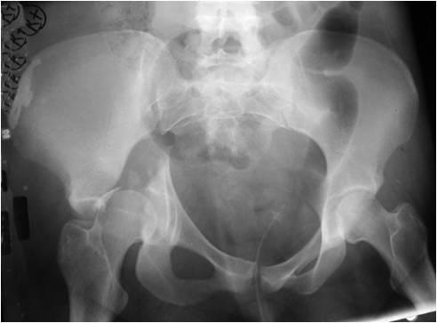
Medial subluxation (common with trans-tectal, transverse, and T-shaped fractures)

Slide 15
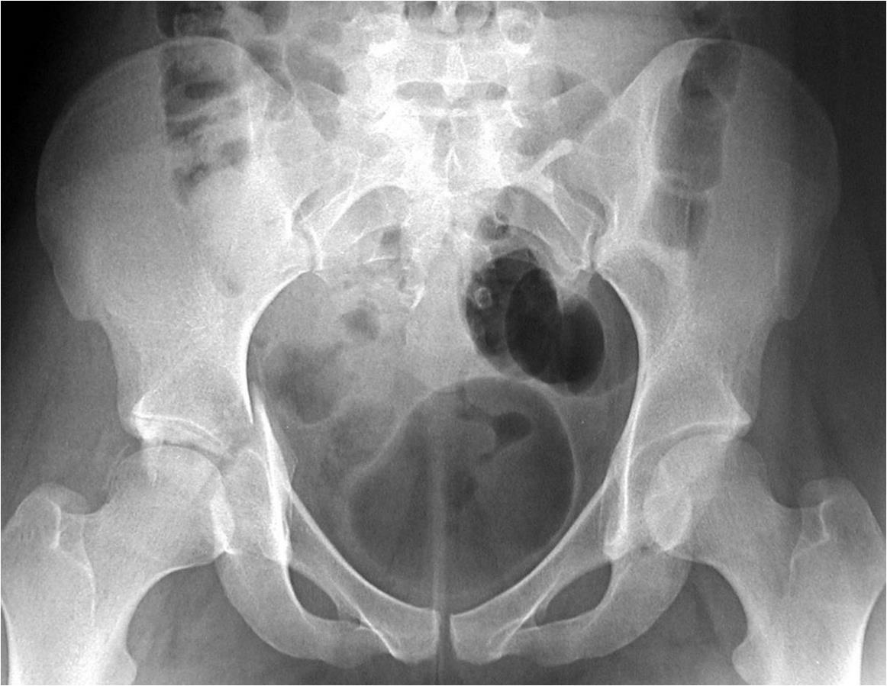
Incarcerated fragments

Slide 16
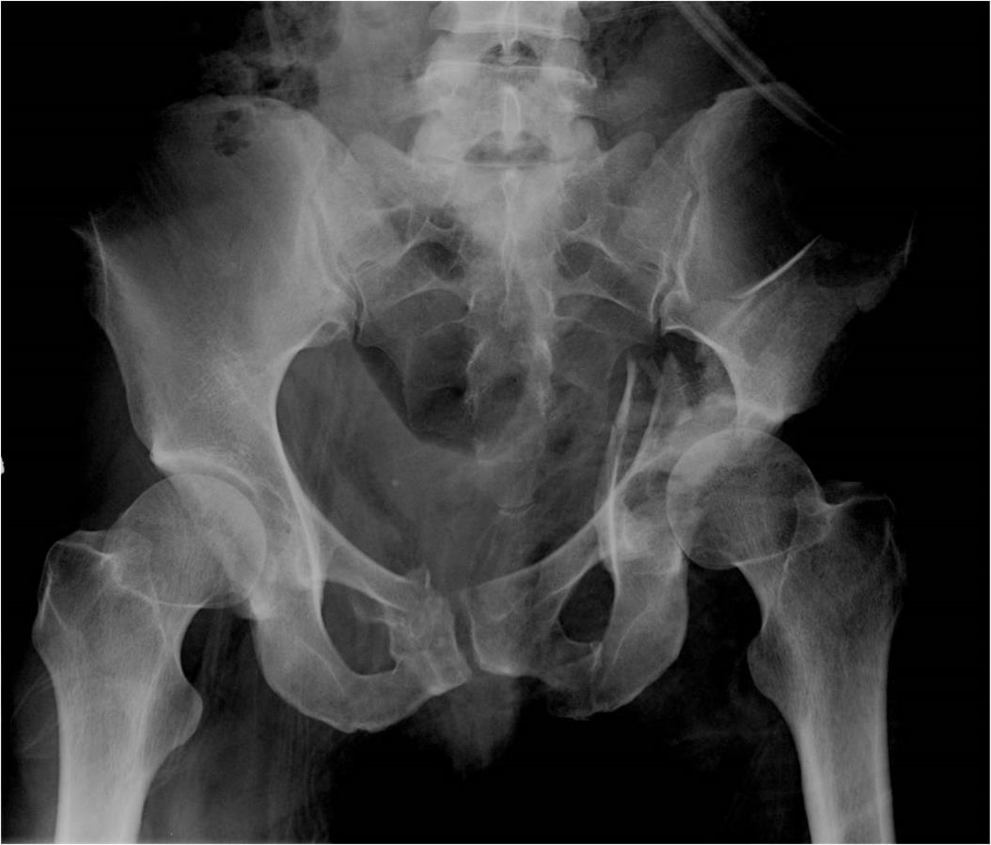
Minimize deformity while awaiting definitive surgery

Slide 17
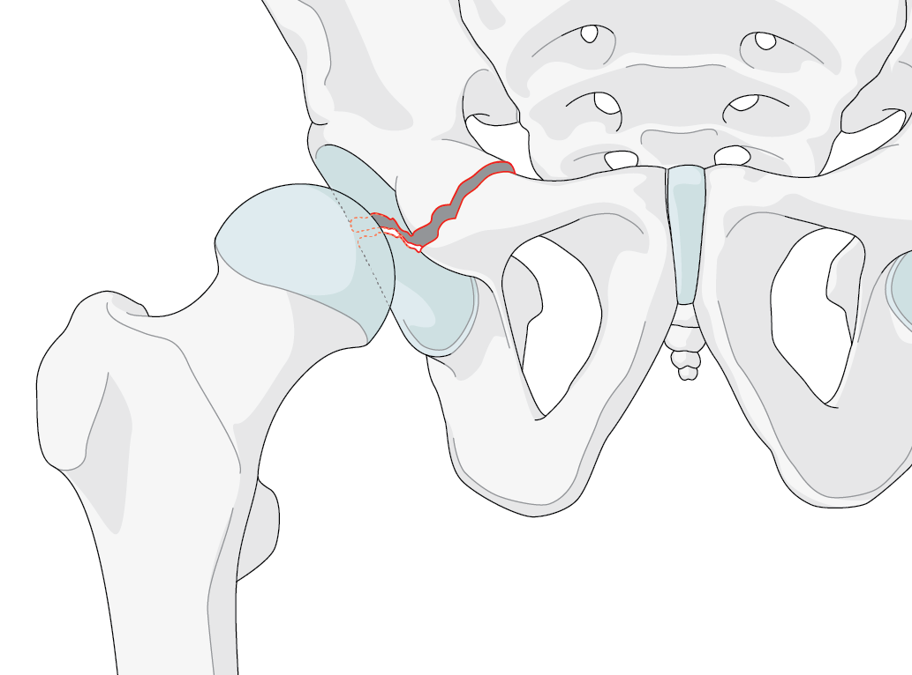
Who needs surgery?
Most displaced fractures will do better with operative treatment
More important to identify which patients and which fractures may be amenable to nonoperative management

Slide 18
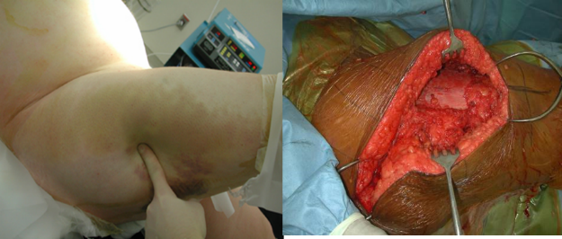
Determining factors
Patient
Age
Functional activity level
Bone quality
Medical comorbidities
Soft-tissue considerations

Slide 19
Determining factors
Fracture
Location (weight bearing dome)
Displacement (articular)
Fragment size (posterior wall)
Stability and congruence of the hip joint

Slide 20
Fracture evaluation
Complete set of x-rays
AP, 45° obliques (Judet)
Inlet, outlet
Initial views out of traction
Computer tomography

Slide 21
Stability
Congruence (joint symmetry)
Loss of congruence detrimental to joint outcome (nonoperative treatment)
Rowe 1961 Stewart 1954
Subluxation of the femoral head is an indication for surgery
Static vs dynamic
Initial vs eventual

Slide 22
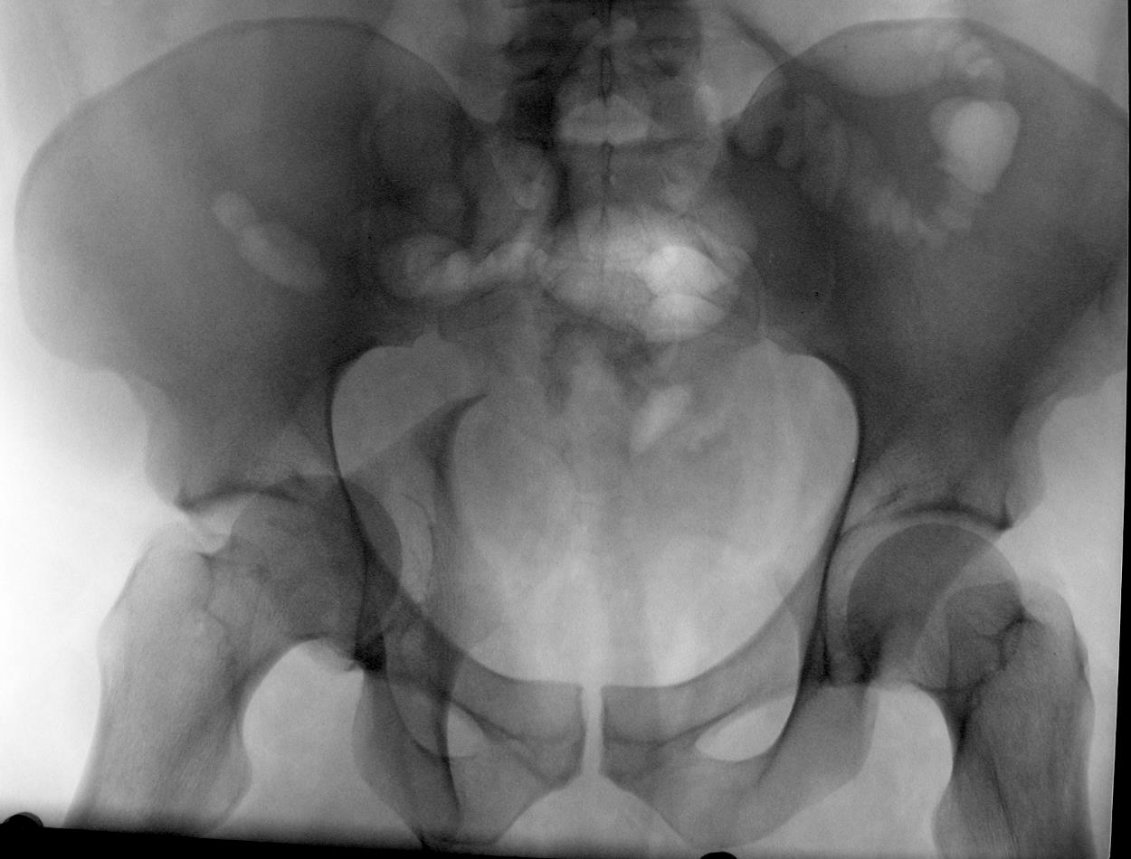
Congruence and stability—static evaluation

Slide 23
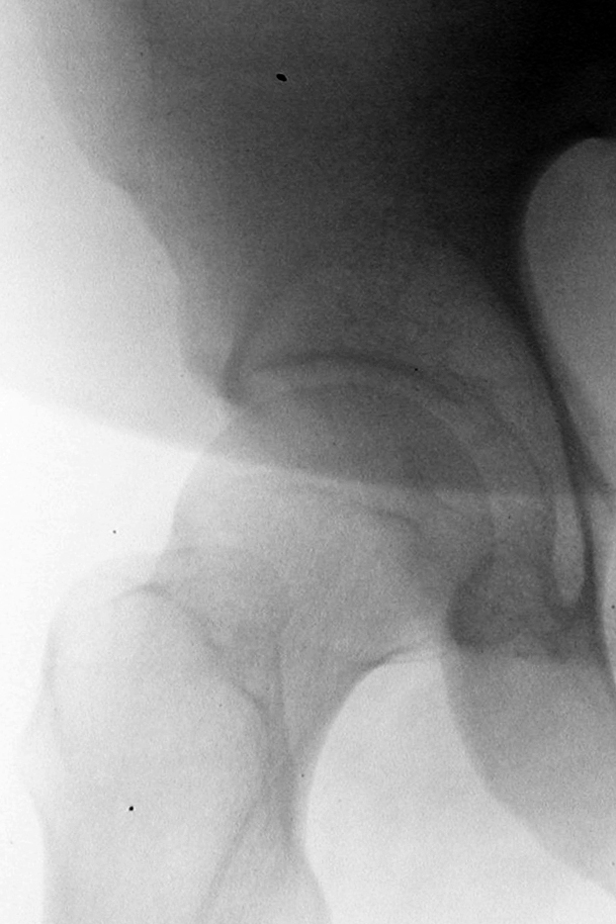
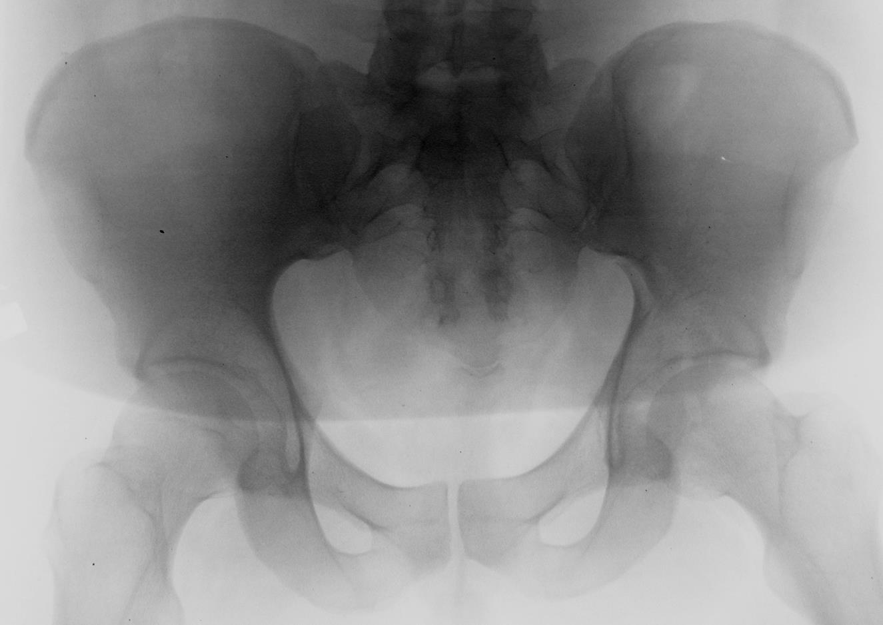
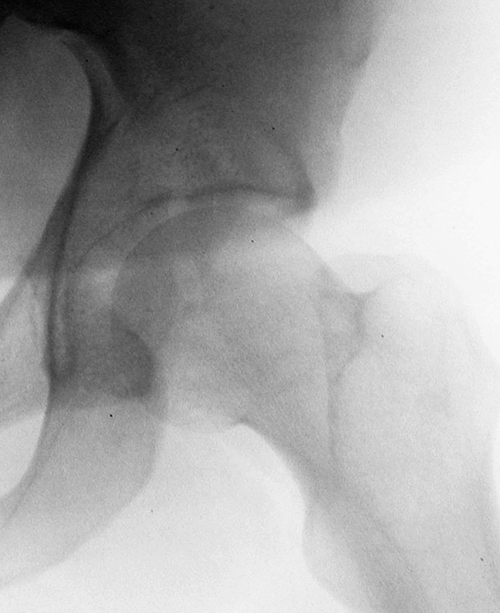
Congruence and stability—static evaluation

Slide 24
Congruence and stability—static evaluation

Slide 25
Congruence and stability—static evaluation

Slide 26
Congruence and stability—static evaluation

Slide 27
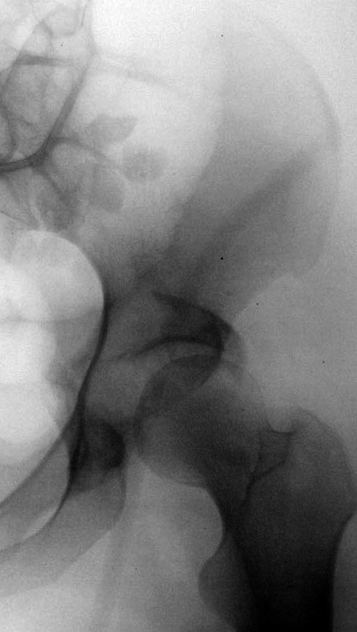
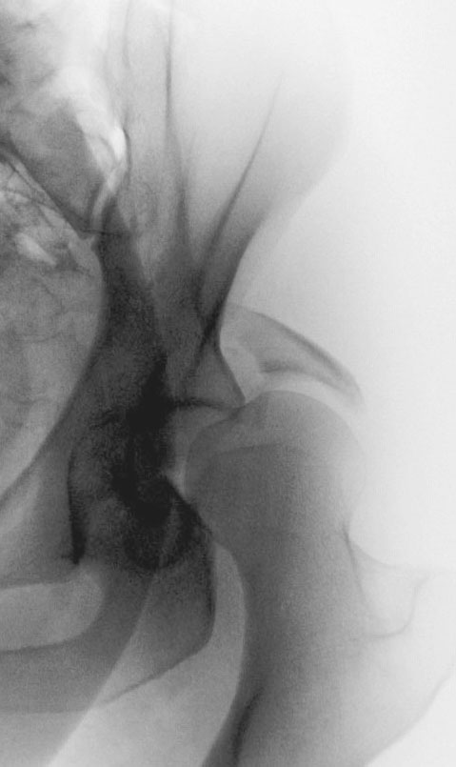
Congruence and stability—dynamic evaluation
Posterior wall
Static hip stability
Dynamic hip stability through physiological range of motion

Slide 28
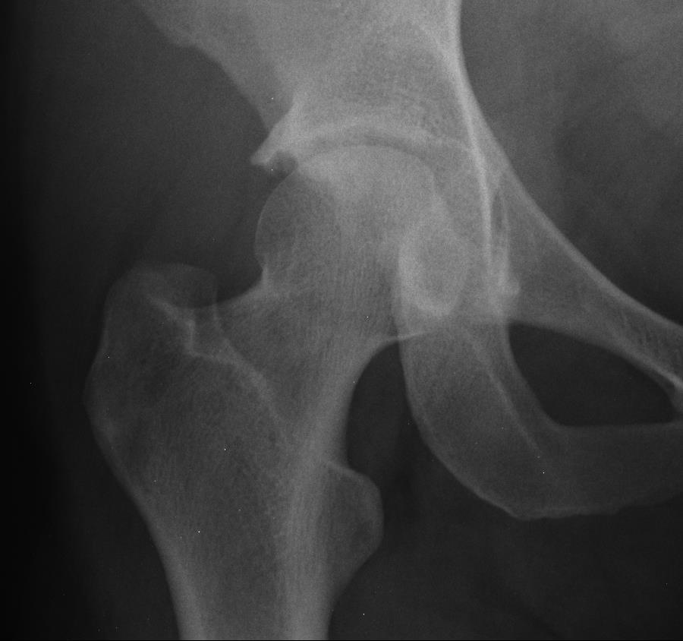
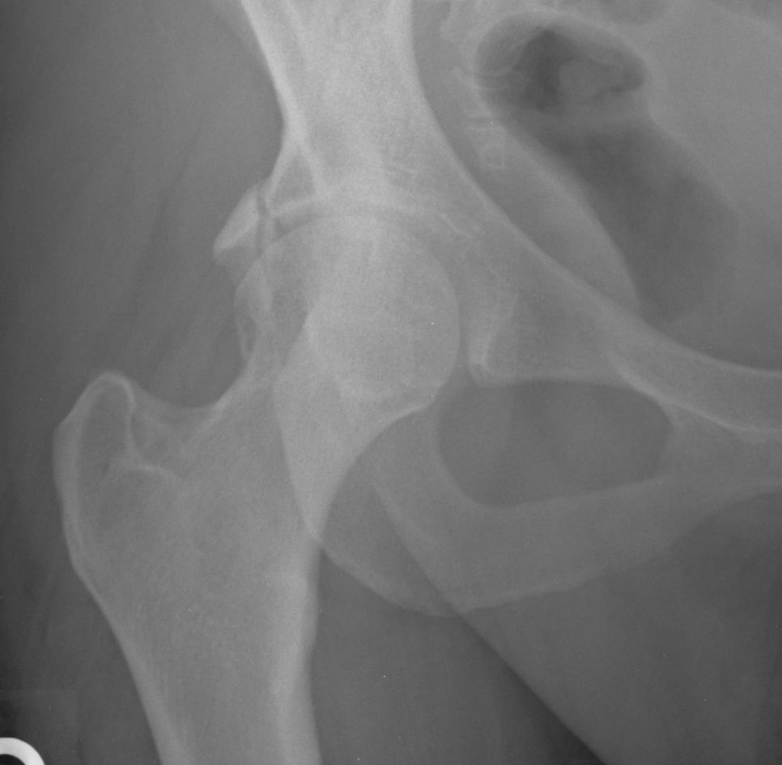

Slide 29
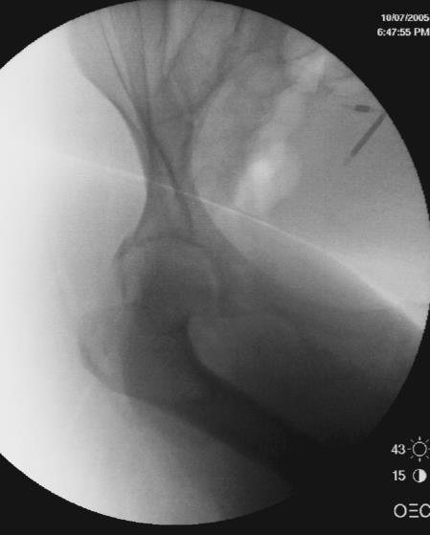
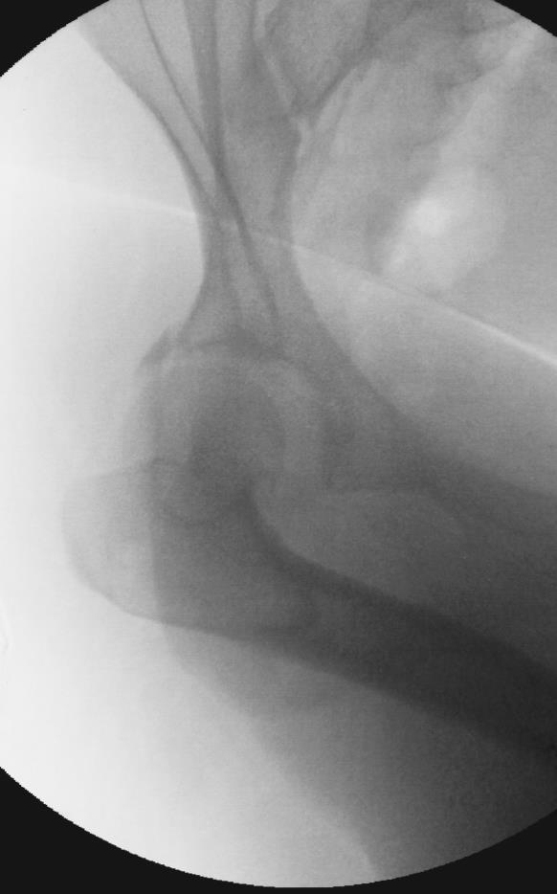

Slide 30
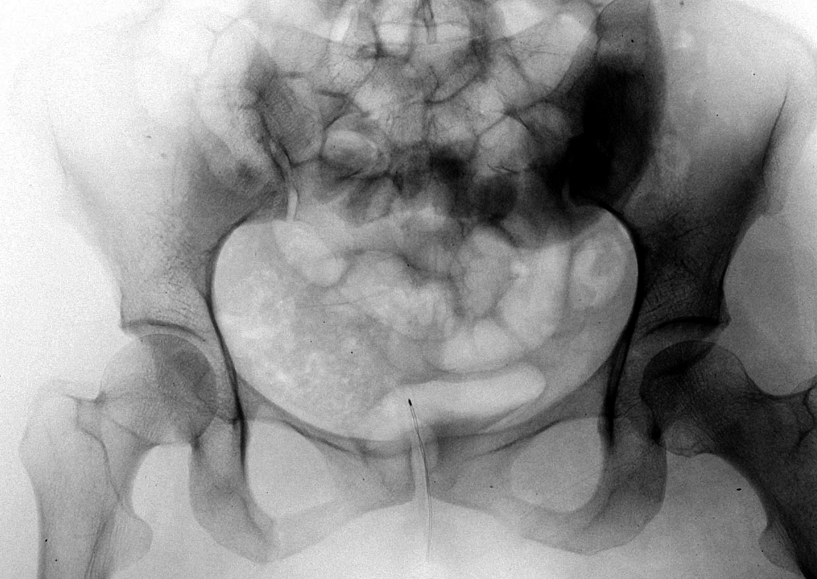
Congruence and stability—incarcerated fragments

Slide 31
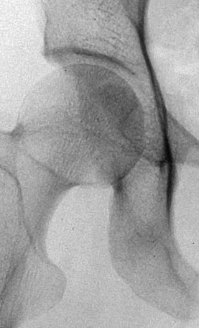
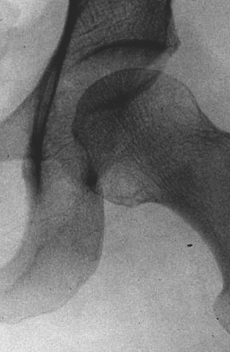
Congruence and stability—incarcerated fragments

Slide 32
Congruence and stability—incarcerated fragments

Slide 33
Congruence and stability—incarcerated fragments

Slide 34
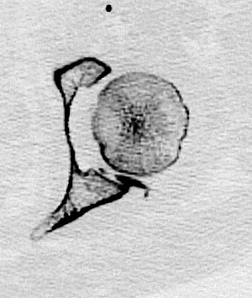
Congruence and stability—incarcerated fragments

Slide 35
Fracture location
Displaced fractures in the “weight bearing dome” (WBD) negatively effect joint outcome
Letournel 1964
Matta 1986-7, Heeg 87

Slide 36
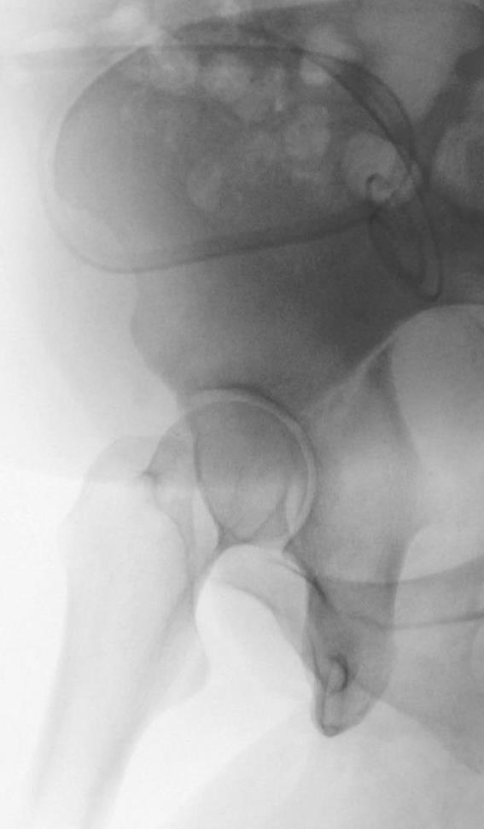
Weight bearing dome
“Roof arc (RA) angle”
Attempt to identify important area of acetabulum through which the majority of the joint reactive force is transmitted (Matta 1986)
45º defined WBD
Three standard views
Could be used as indication for nonoperative management
Not necessary if subluxation seen
Not applicable for PW or ABC patterns
Notes:
In order to better understand surgical indications, an understanding of the superior articular surface or weight bearing portion of the acetabulum has been attempted. This is been defined traditionally by the roof arch angle as described by Matta.

Slide 37
CT subchondral arc (Olson 1993)
Top 10 mm = 45° RA
From subchondral condensation
Notes:
Olson attempted to better define this superior roof by using computerized tomography. Mathematically the superior articular surface or the 45 degree roof arch angle was shown to be equivalent to the top 10 millimeters of the acetabulum evaluated from the subchondral condensation of the superior acetabulum. A fracture which entered this top 10 millimeters was felt to involve the superior articular surface.

Slide 38
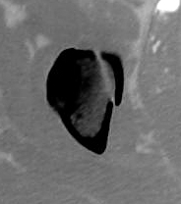
CT subchondral arc (Olson 1993)
Top 10 mm = 45° RA
From subchondral condensation

Slide 39
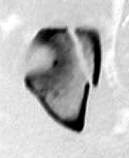
CT subchondral arc (Olson 1993)
Top 10 mm = 45° RA
From subchondral condensation

Slide 40
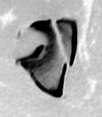
CT subchondral arc (Olson 1993)
Top 10 mm = 45° RA
From subchondral condensation

Slide 41
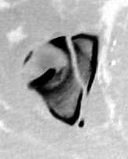
CT subchondral arc (Olson 1993)
Top 10 mm = 45° RA
From subchondral condensation

Slide 42
CT subchondral arc (Olson 1993)
Top 10 mm = 45° RA
From subchondral condensation

Slide 43
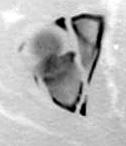
CT subchondral arc (Olson 1993)
Top 10 mm = 45° RA
From subchondral condensation

Slide 44
Weight bearing dome—stability
Vrahas et al JBJS 1999. Static mechanical loading:
AC, PC, Tr fracture model
Anterior RA 25°
Measured on obturator oblique
Posterior RA 70°
On iliac oblique
Above the ischial spine
Medial RA 45°
*Not validated clinically

Slide 45
Displacement
Degree of displacement
> 2 mm poorly tolerated s/p open reduction and internal fixation
Highly constrained joint
Dependent on location in joint
Dependent on joint stability
Affects joint congruence in all but the associated both-column fractures

Slide 46
Surgical indications
Any subluxation/loss of congruence
Displacement > 2 mm within WBD
Posterior wall fracture with hip joint instability
Retained intraarticular fragment
Notes:
The surgical indications for fractures of the acetabulum are loss of joint congruence or joint symmetry on any of the three radiographic views. This represents joint instability and therefore is an indication for surgery. A fracture which is displaced ≥ 2mm within the superior articular surface. A fracture of the posterior wall that consists of > 20-30% of the posterior articular surface as determined by CT, or any fracture or dislocation with retained intraarticular fracture fragments.

Slide 47
Most acetabular fractures will require operative management
Define indications for nonoperative management

Slide 48
Nonoperative indications
Congruent on all three views out of traction
Fractures displaced > 2 mm
Congruent, RA > 45°
Displacement < 2 mm in superior articular surface (RA ≤ 45°)
Maintained until union
Notes:
Nonoperative treatment is therefore indicated if the femoral head remains congruent to the acetabulum on all three views, a fracture within the superior articular surface is displaced < 2mm or a fracture displaced greater than this with roof arc angles > 45°on all three views.

Slide 49
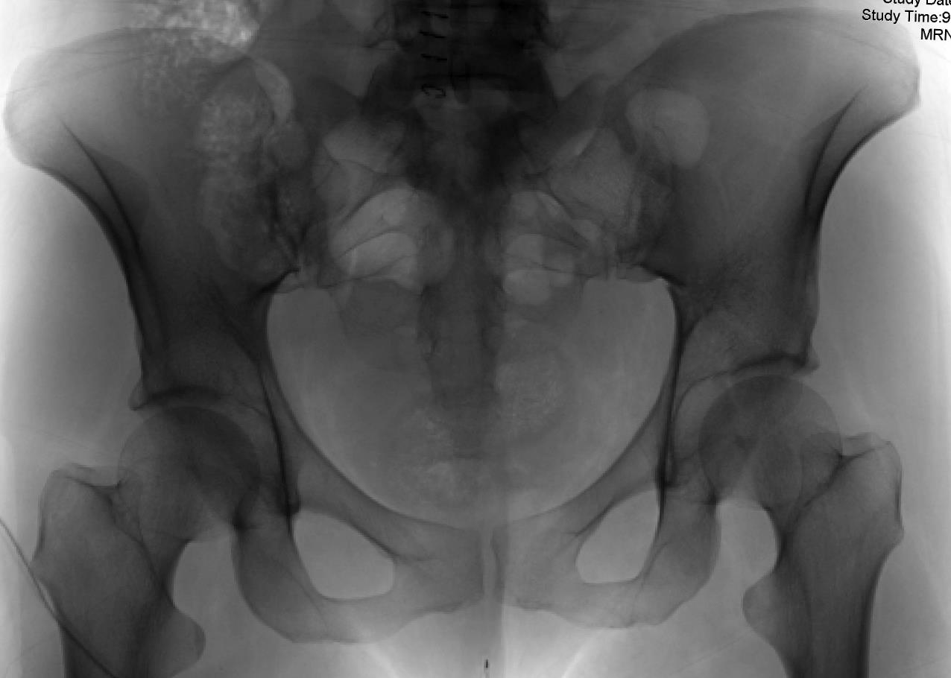

Slide 50
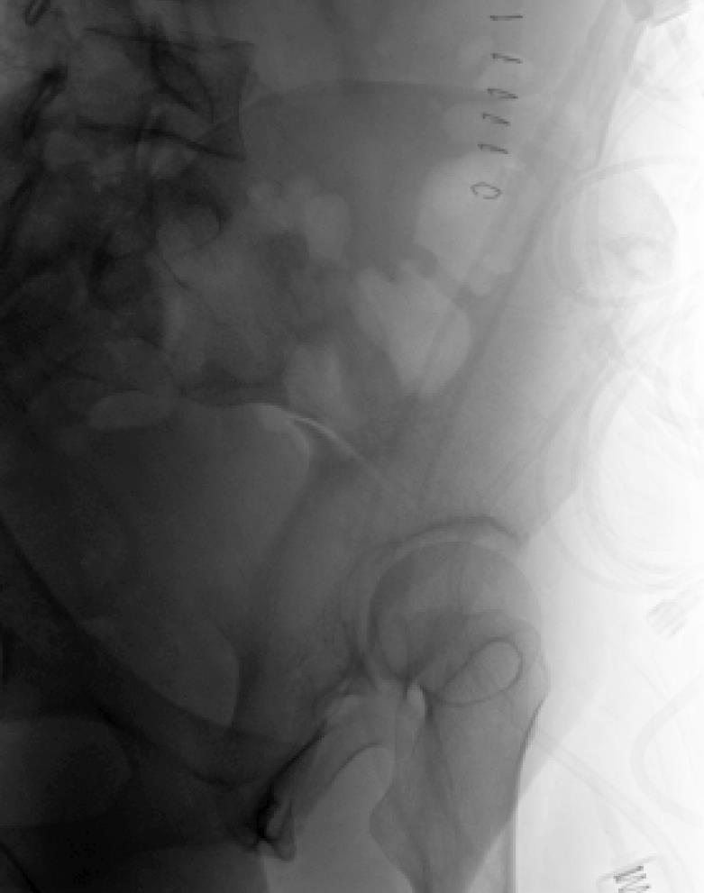
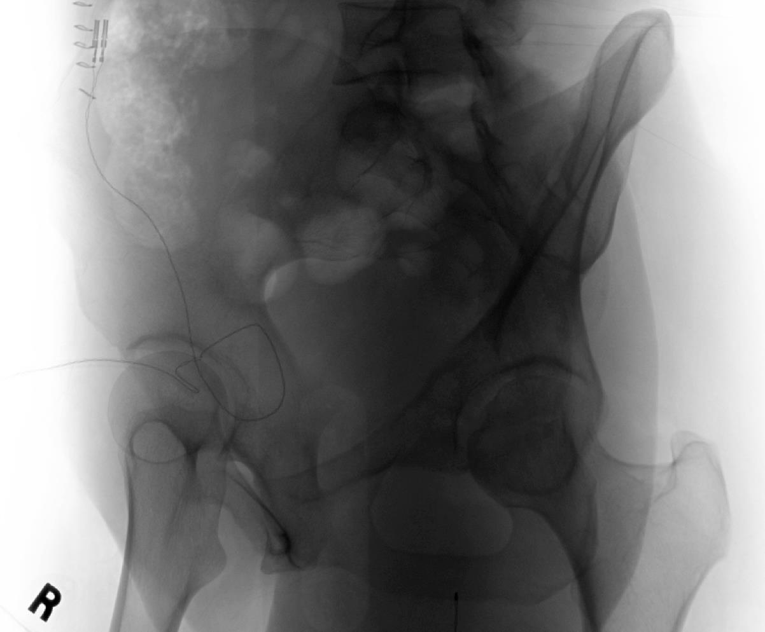

Slide 51
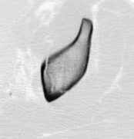
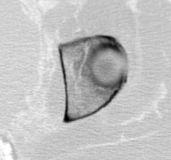

Slide 52
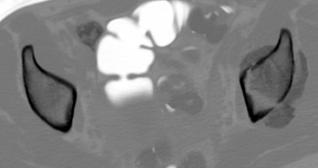
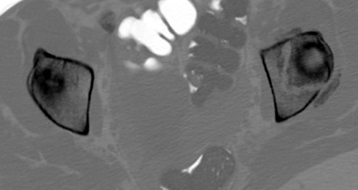
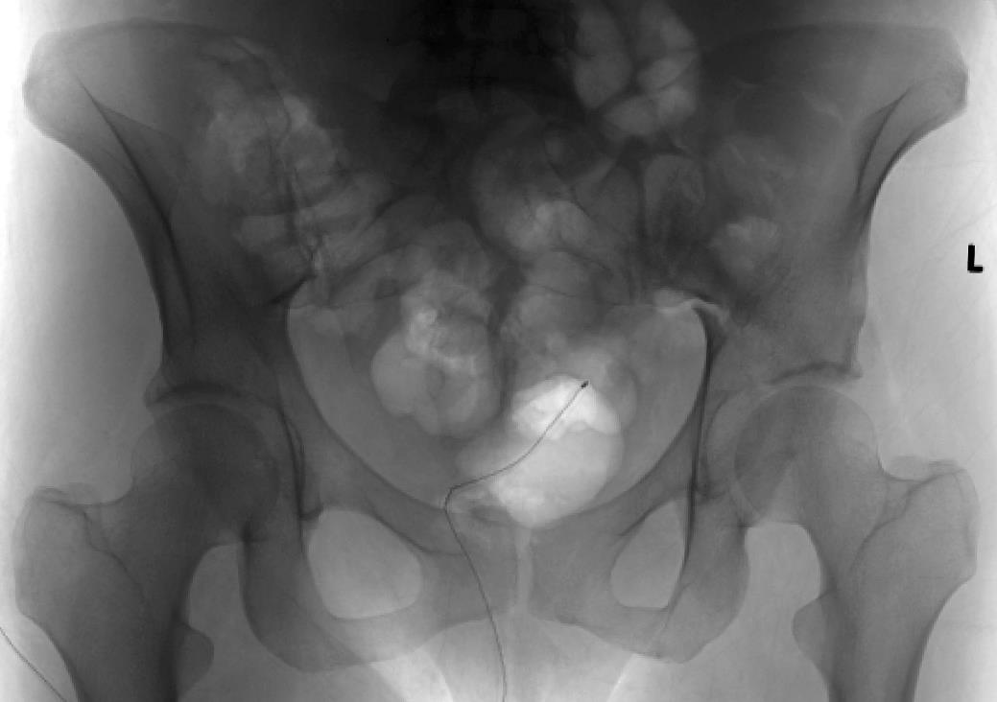

Slide 53
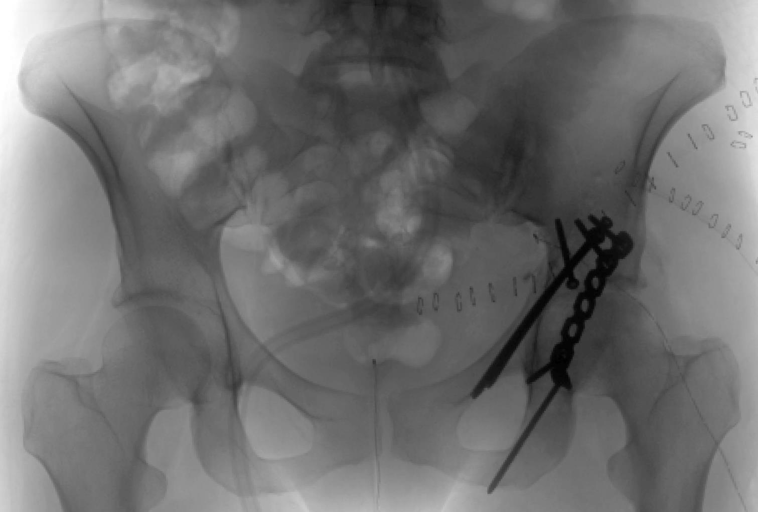

Slide 54
Nonoperative treatment
Traditionally bedrest or traction
Letournel
Early mobilization associated with low risk of displacement (Stover, Tornetta)
Frequent radiographic evaluation
Identify displacements early
Intraoperative stress x-rays useful
Notes:
Non operativer treatment has traditionally included bed rest for five to eight weeks with or without traction. We have shown that early mobilization of patients who meet non operative criteria with fractures displaced less than 2 mm did not lead to further displacement. Tornetta has also described the use of interoperative stress radiographs to determine if occult instability exists. Using this as an additional determination of non-operative treatment he showed that 91 percent of these patients went on to get excellent results in three years. Interestingly both studies identified that fractures associated with additional pelvic ring pathology were unstable or more likely to displace.

Slide 55
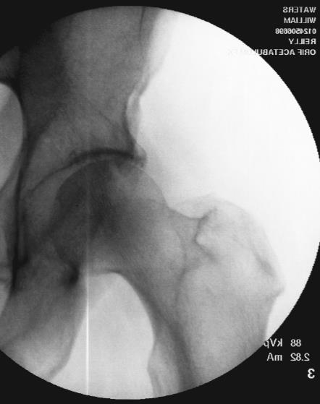
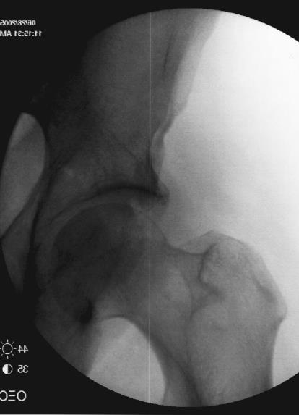

Slide 56
Choice of surgical approach
Proper interpretation of x-rays allows for classification
Fracture displacement, location, and hip stability determine need for surgery
Fracture pattern determines surgical approach
Single approach preferred
Kocher Langenbeck
Ilioinguinal
Extended iliofemoral

Slide 57
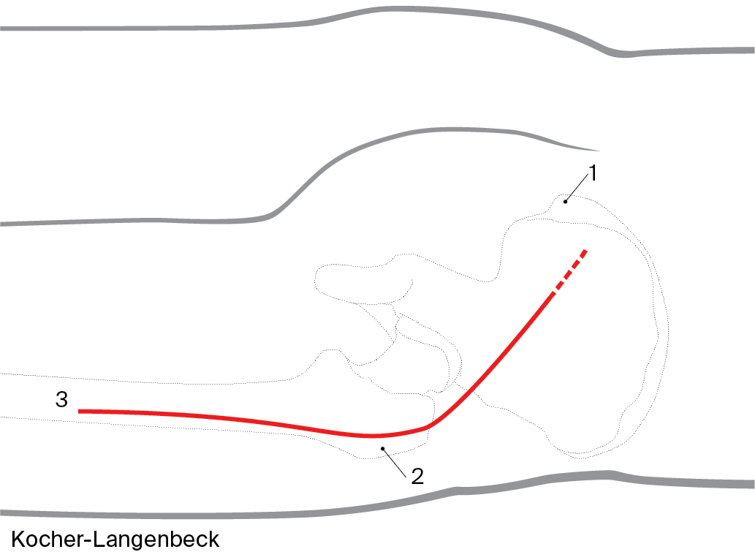
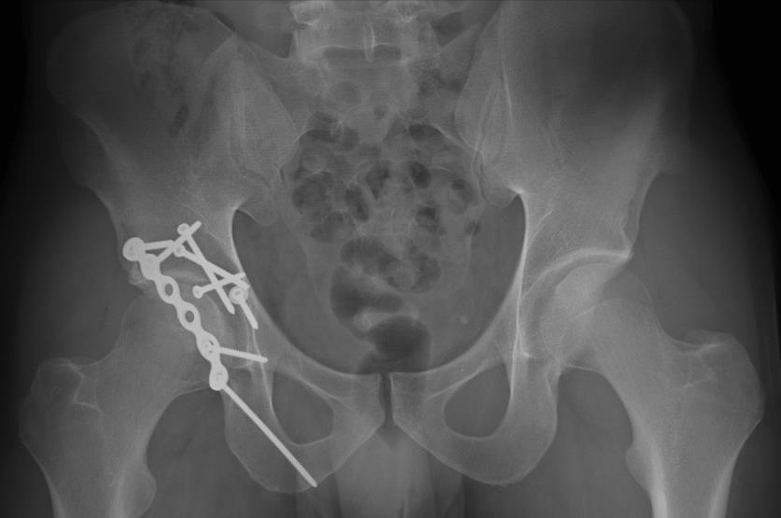
Kocher-Langenbeck approach
Approach to posterior column and posterior articular surface
Posterior wall
Posterior column
PC + PW
Most transverse, Tr + PW
Some T-shaped

Slide 58
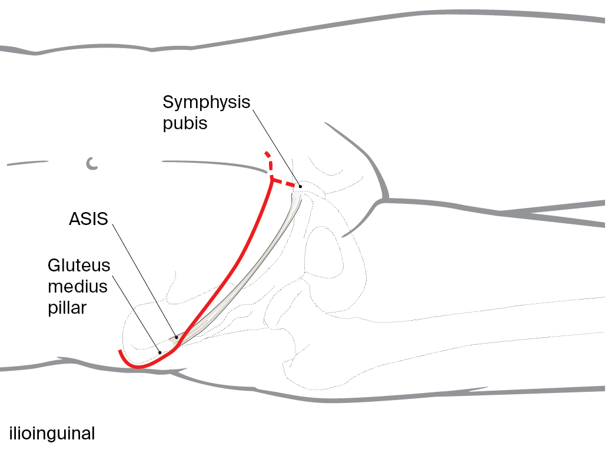
Ilioinguinal approach
Approach to the anterior column and anterior articular surface
Anterior wall
Anterior column
Most anterior + PHT
Most ABC

Slide 59
Extended iliofemoral approach
Extensile approach
Maximal simultaneous access to both columns of the acetabulum
Certain transverse + PW, T-shaped, ABC
Associated fracture patterns > 21 days

Slide 60
Take-home message
Dislocation of the hip requires urgent reduction and consideration for traction
Most displaced acetabular fractures will require reduction and fixation
Subluxation/hip stability main indication for open reduction and internal fixation
Location and displacement also considerations
Fracture pattern determines approach

