Slide 1
Ankle fusion malunion
Case for small group discussion
AOTrauma—Foot & Ankle
Module 7: Ankle arthritis
Notes:
Ankle fusion malunion
Author: Michael Clare, US

Slide 2
Case description
49-year-old man
6’3” (1.90 m) / 275 lbs (125 kg) / 1+ packages per day smoker
10 years status post ankle arthrodesis
Motor vehicle accident/talar neck fracture in mid-1990s
Wears custom shoe

Slide 3
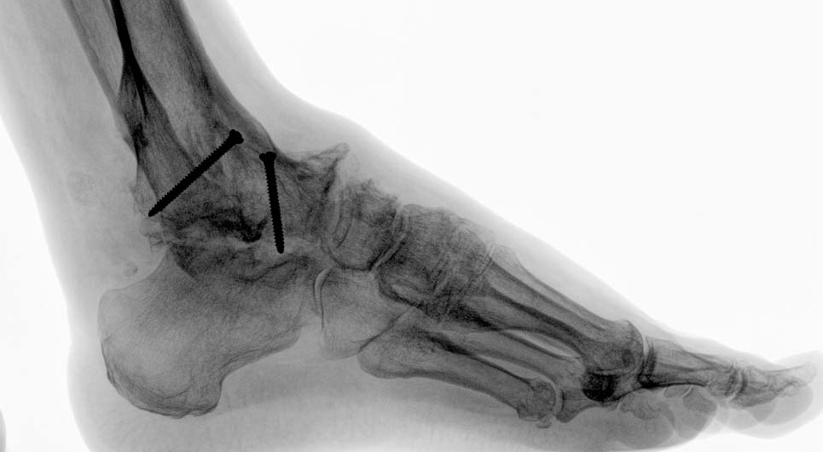
Examination
Equinus deformity through ankle
< 5° dorsiflexion-plantarflexion motion arc
Tender sinus tarsi
Calluses at metatarsal heads

Slide 4
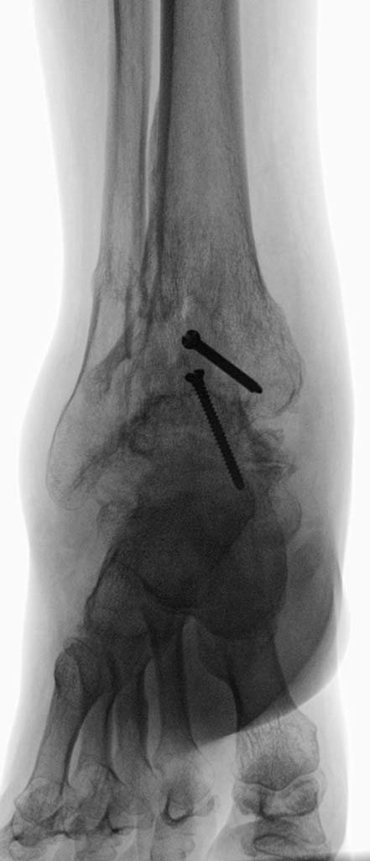
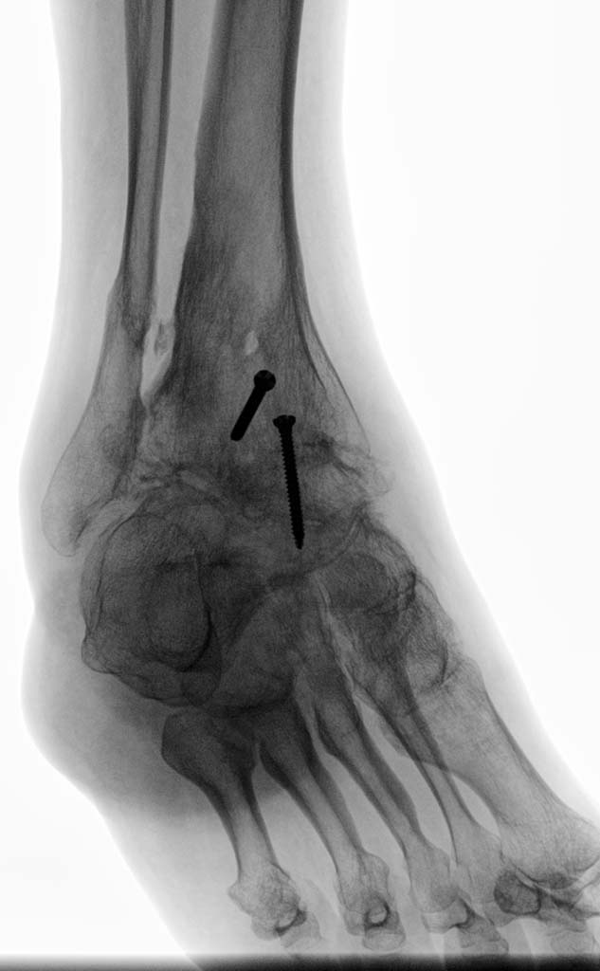

Slide 5
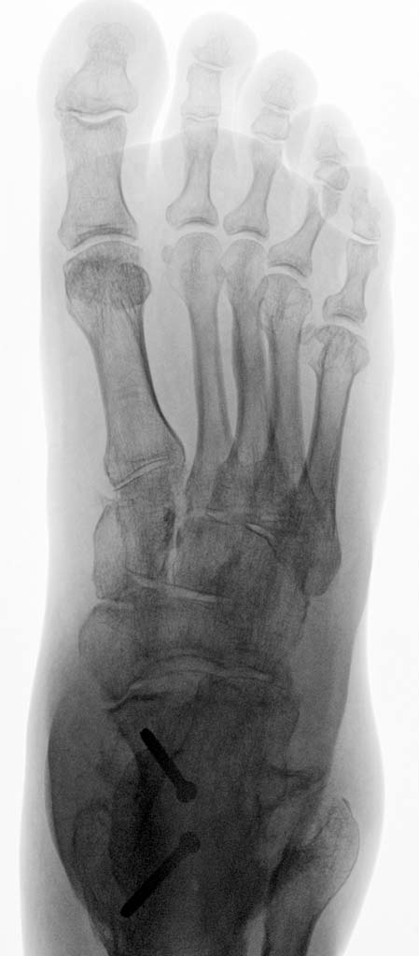
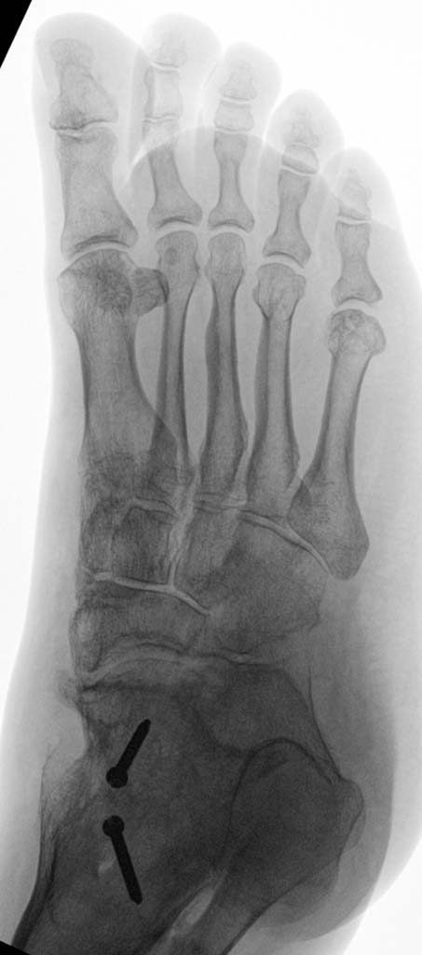

Slide 6
Diagnosis?

Slide 7
Discussion
Which treatment option would you choose?
  Dorsiflexion osteotomy through ankle fusion mass
  Shortening fibular osteotomy
  Subtalar arthrodesis
  Talonavicular ostectomy
Notes:
Diagnoses:
Equinus ankle—arthrodesis malunion
Adjacent subtalar arthritis
Talonavicular exostosis

Slide 8
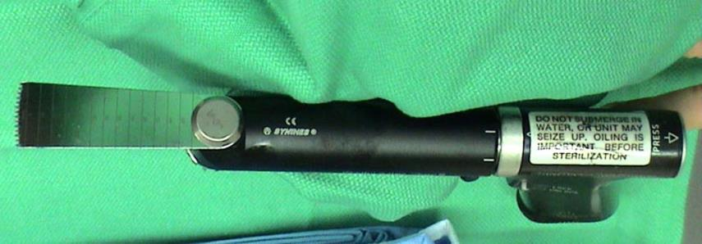
Dorsiflexion osteotomy
Anterior approach
Additional posteromedial approach—retract posterior tibial tendon/neurovascular bundle
Notes:
Nv:neurovarscular

Slide 9
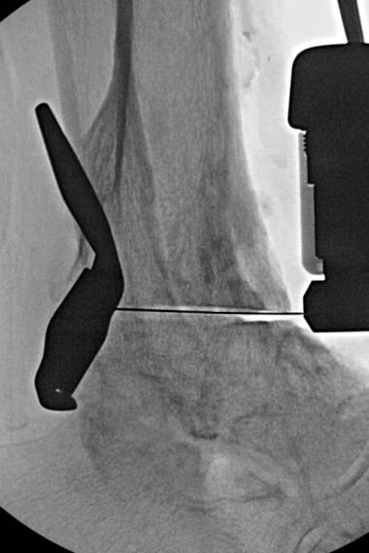
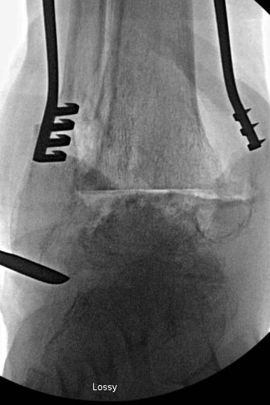

Slide 10
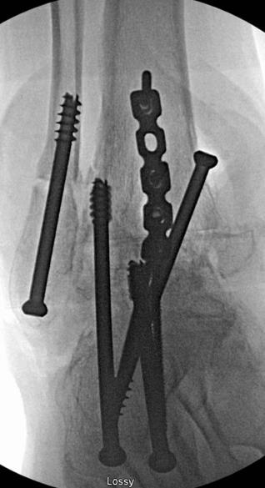
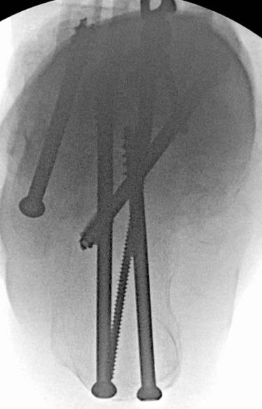

Slide 11
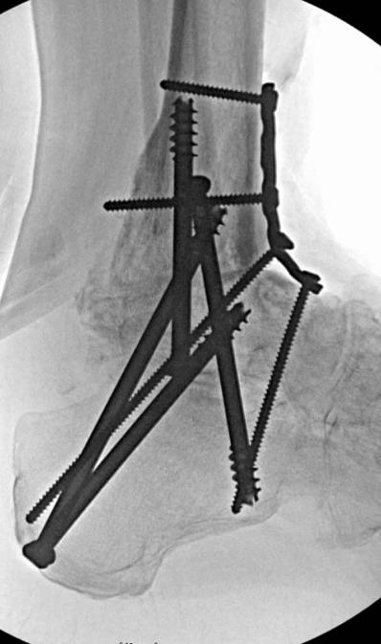

Slide 12
Postoperative protocol
Splint/cast immobilization
Nonweight bearing for 10 weeks
Boot/progress weight bearing
Transition to regular shoe

Slide 13
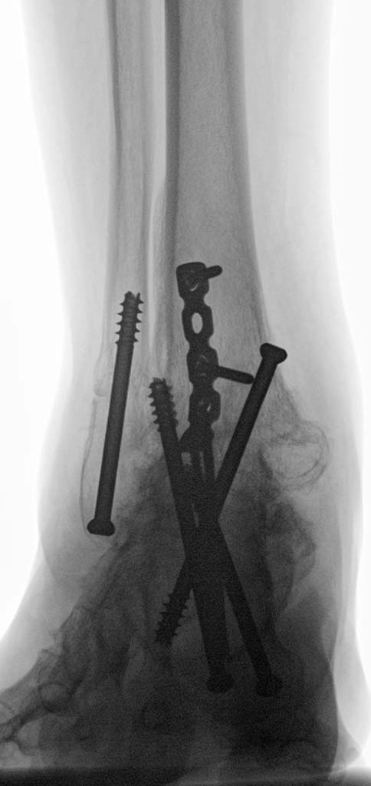
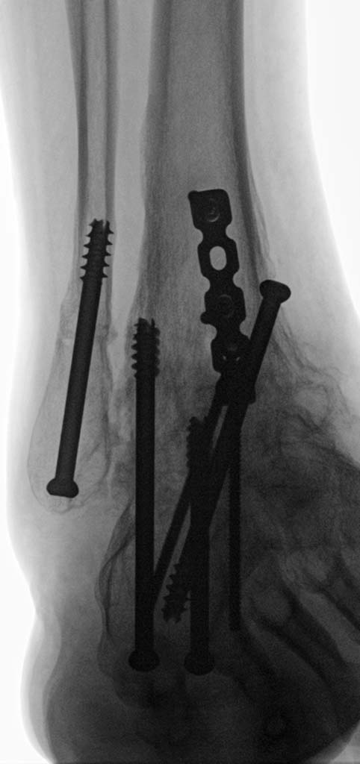
Follow-up and final result

Slide 14
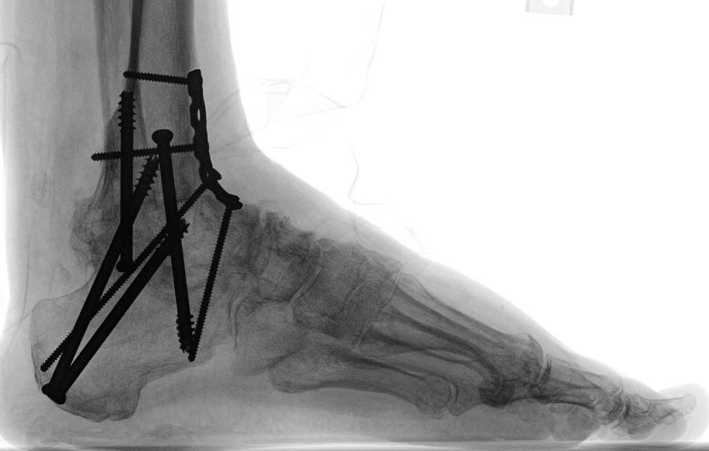
Follow-up and final result

Slide 15
Take-home messages
Ankle arthrodesis
Need to (re-)establish neutral-neutral tibial hindfoot axis
Adjacent joint arthritis
Inevitable with arthrodesis of any essential joint
Accelerated with malaligned ankle arthrodesis

