Slide 1
Ankle arthritis
Case for small group discussion
AOTrauma—Foot & Ankle
Module 7: Ankle arthritis
Notes:
Author: Stefan Rammelt, DE

Slide 2
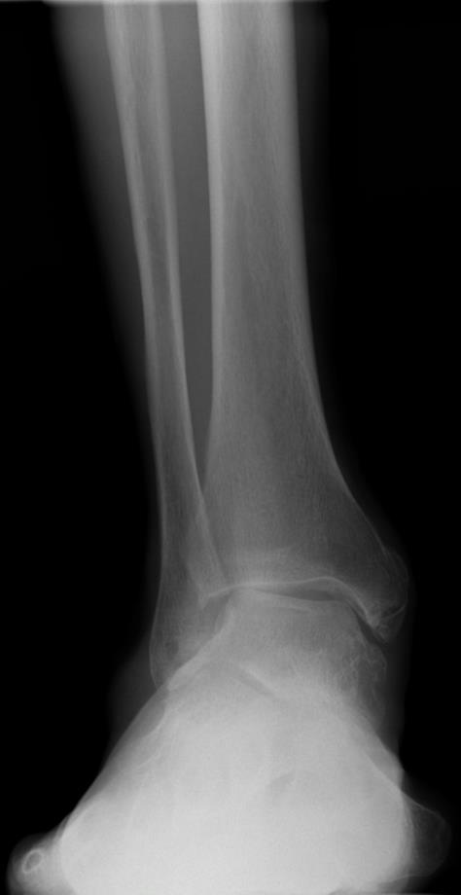
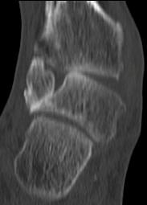
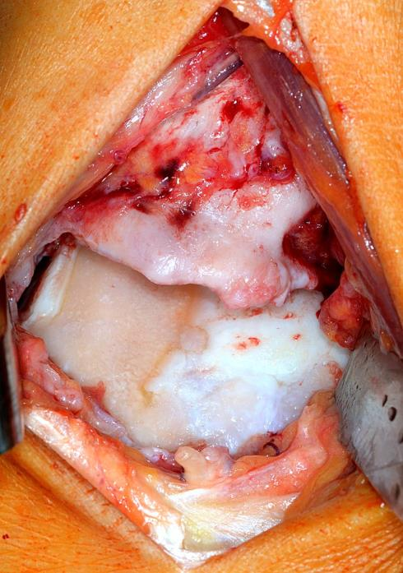
Ankle arthritis and instability
48-year-old active man
Increasing pain and deformity
No trauma history except for “sprains”

Slide 3
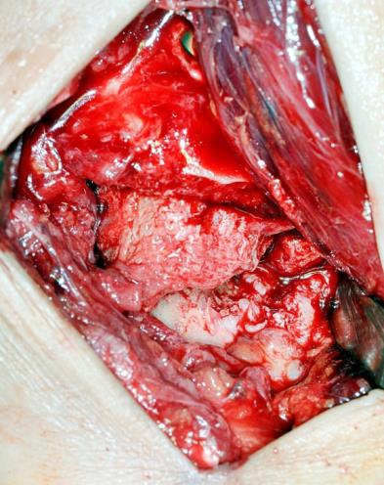
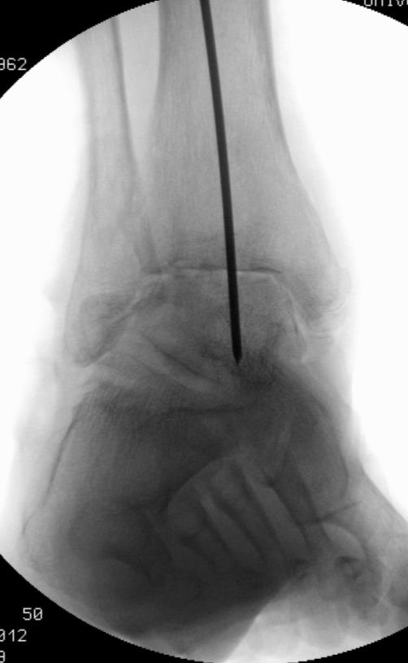
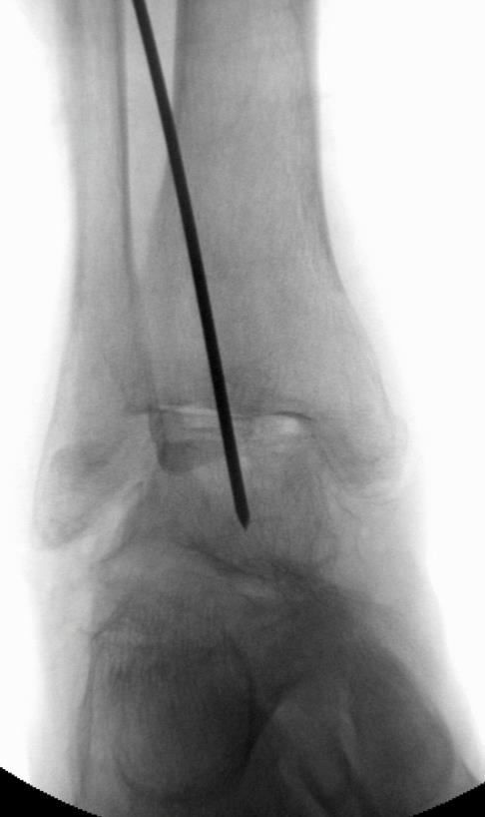
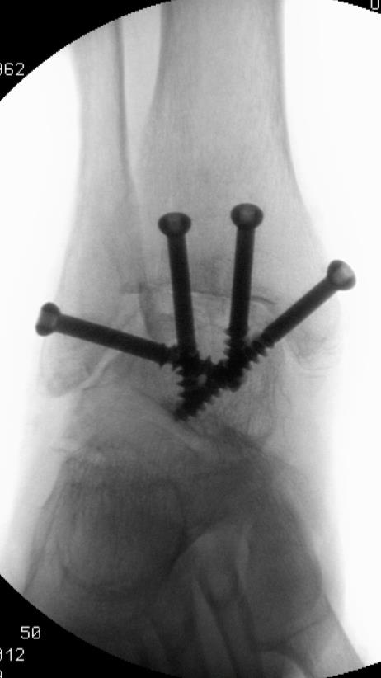
Correction

Slide 4
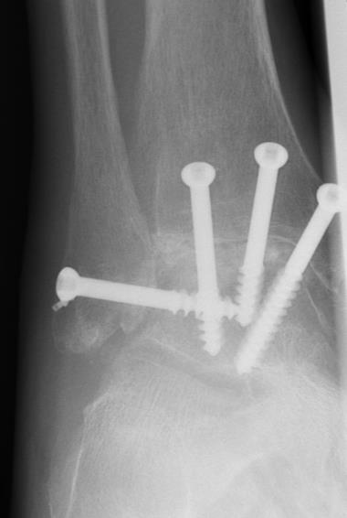
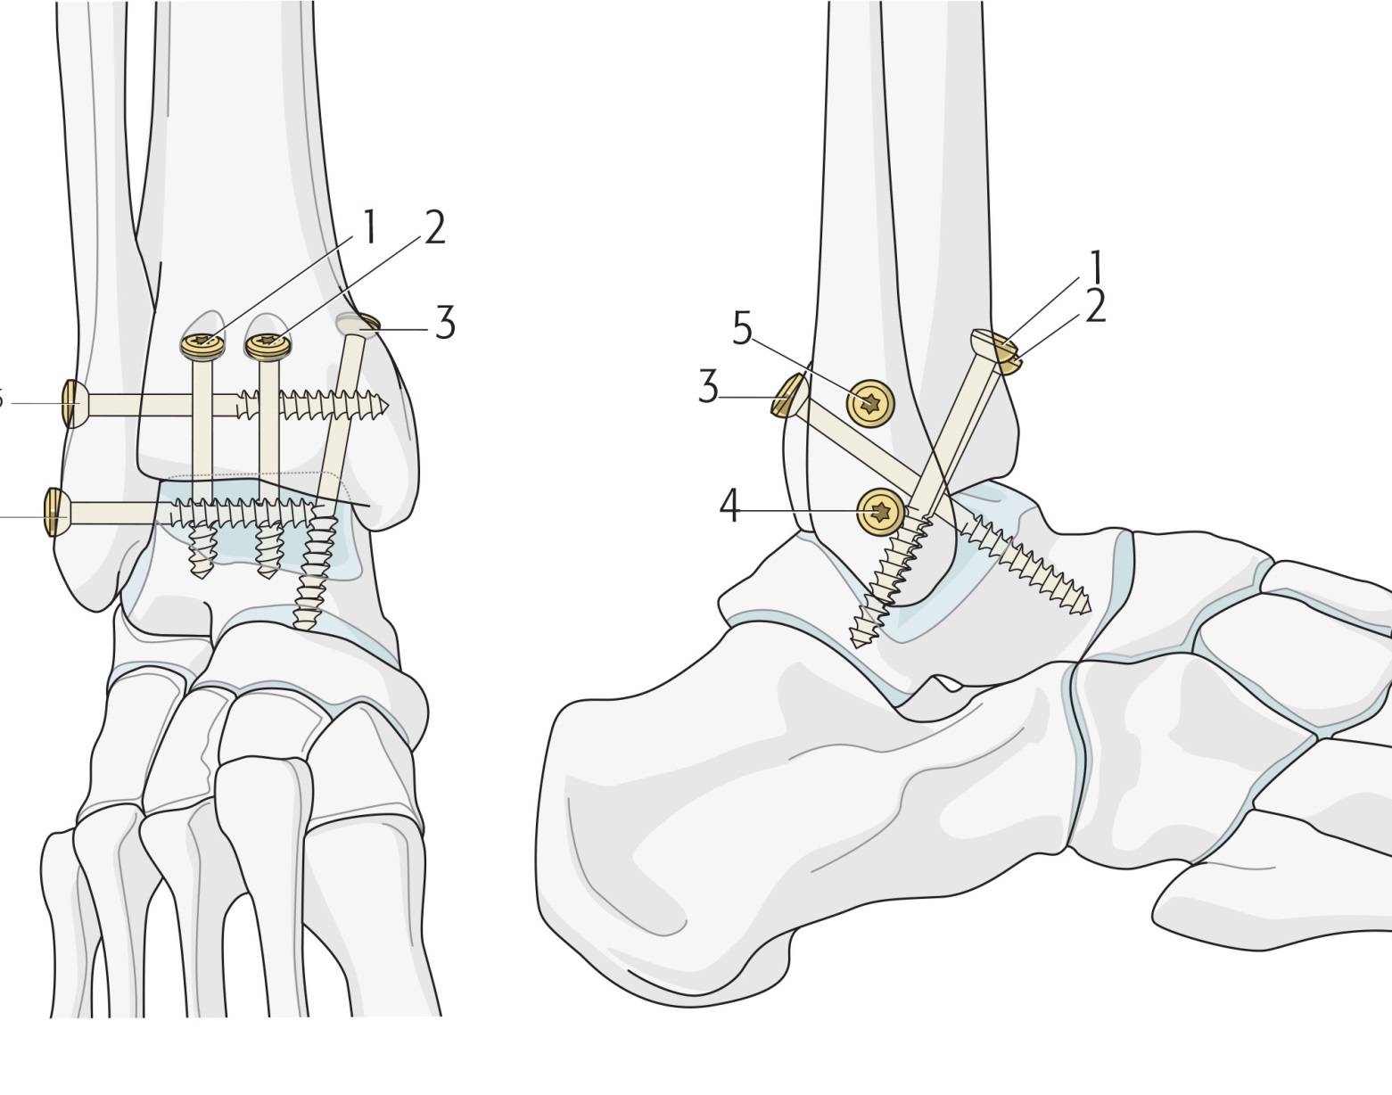
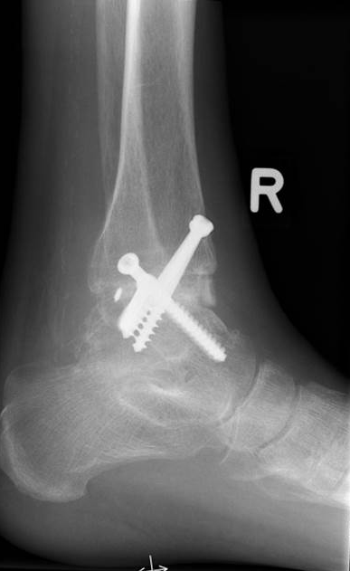
Stable fixation with 4 (–5) screws
Notes:
References:
Zwipp H, Rammelt S, Endres T, et al. High union rates and function scores at midterm followup with ankle arthrodesis using a four screw technique. Clin Orthop Relat Res. 2010 Apr;468(4):958–968.

Slide 5
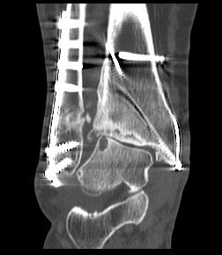
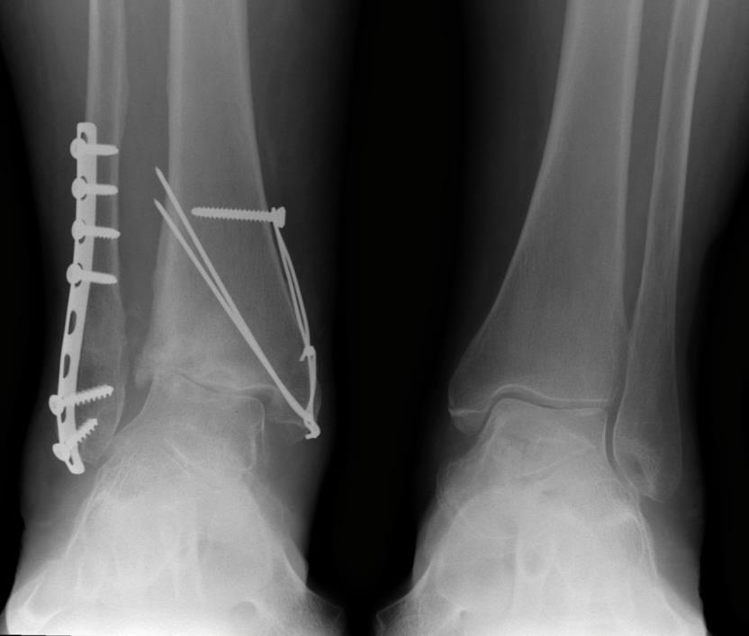
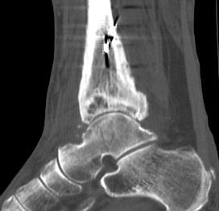
Another approach
75-year-old woman
Posttraumatic arthritis
Avascular necrosis of lateral tibial plafond

Slide 6
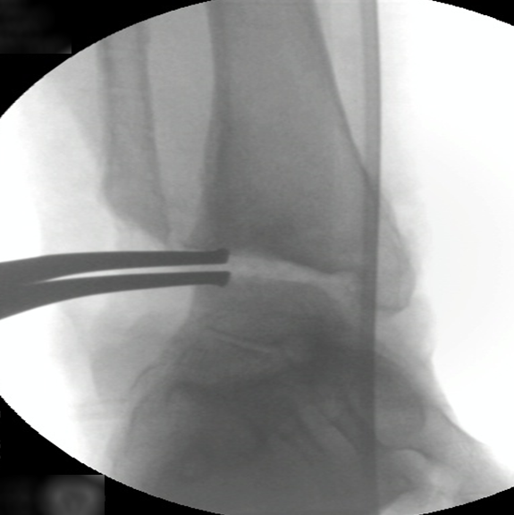
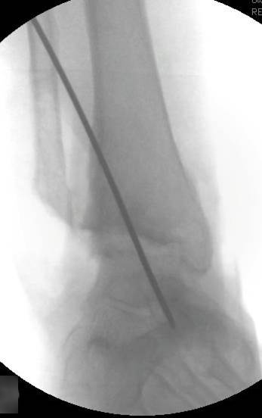
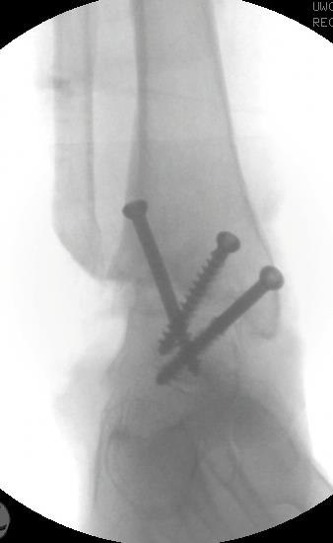
Transfibular approach
Fibula used as bone graft

Slide 7
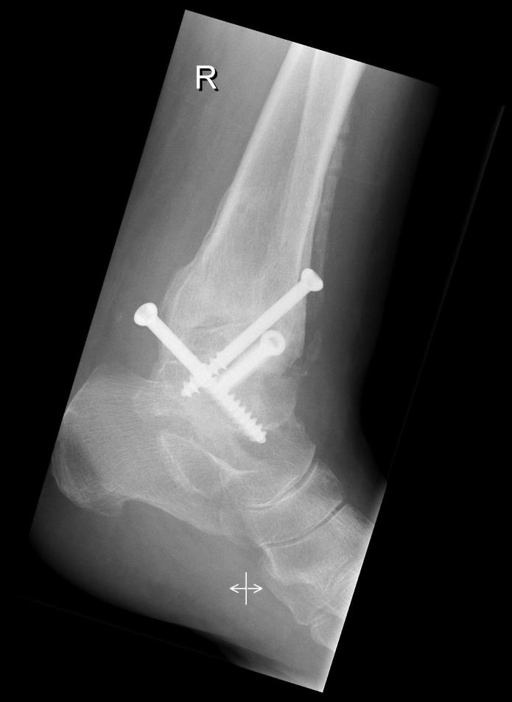
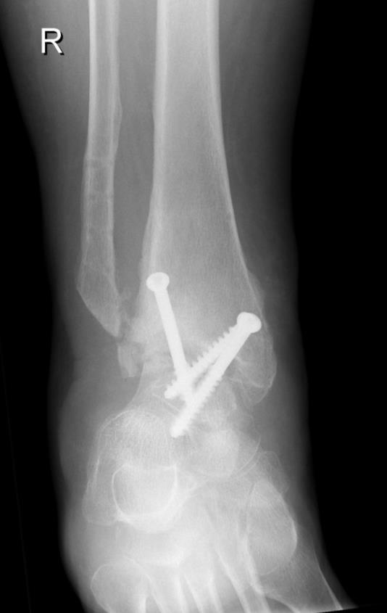
Transfibular approach
Fibula used as bone graft

Slide 8
Why fusion?
Good correction of deformities
Salvage after avascular necrosis, infection
Stable solution for active patients
Compensatory motion and few cases with relevant arthritis at adjacent joints
Reliable pain reduction
Less revisions than with total ankle replacement

Slide 9
Take-home messages
Most important—realignment
Stable internal fixation with screws
Good long-term results
Lower incidence of adjacent joint arthrosis with correct technique
Zwipp et al. Clin Orthop Relat Res. 2010;468:958–968
Notes:
References:
Zwipp H, Rammelt S, Endres T, et al. High union rates and function scores at midterm followup with ankle arthrodesis using a four screw technique. Clin Orthop Relat Res. 2010 Apr;468(4):958–968.

